Slide 1
ReBCO – BNL Status Report
Ramesh Gupta
USMDP General Meeting
July 6, 2022

Slide 2
HTS Coil Tests at various stages (all funded) at the BNL Rapid-turn-around, Low-cost, R&D 10 T Dipole Test Facility
CORC coil quench studies (MDP) – Coil wound and tested at 77 K at ACT, to arrive at BNL soon for testing with the 10 T Nb₃Sn common coil dipole
CORC coil 13-14 T HTS/LTS hybrid dipole (STTR) – Coils to be wound soon and tested at 77 K; once delivered in support structure will try to meet extended (2+2) 8/22 deadline
PSI Nb₃Sn coil and BNL HTS coil for HTS/LTS hybrid test at high field (hopefully >12.3 T) - Both coils wound and are at BNL in their respective support structure
VIPER cable in U-shape (arpa-e fusion) – Cable available, working on the details
Magnum-NX coil test with SMS (fusion) – Waiting for the coil to be wound
CORC cable-in-conduit test with General Atomics (fusion) – Test article ready at GA, waiting for administrative/legal work to be completed
HTS coils with ceramic insulation (US-Japan) – likely in FY 2023
  Significant investment from BNL for higher current (20 kA with power supply, and 50 kA with SC transformer) and higher temperature testing (20K, 4-40K)

Slide 3
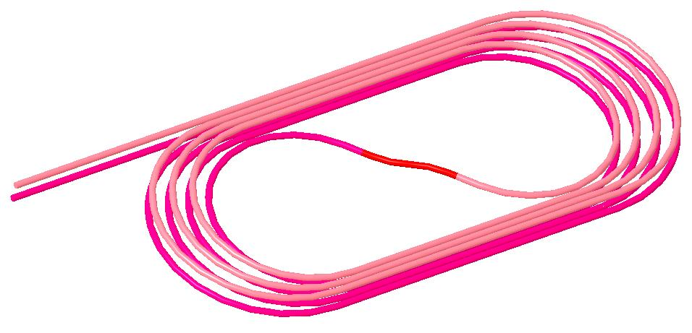
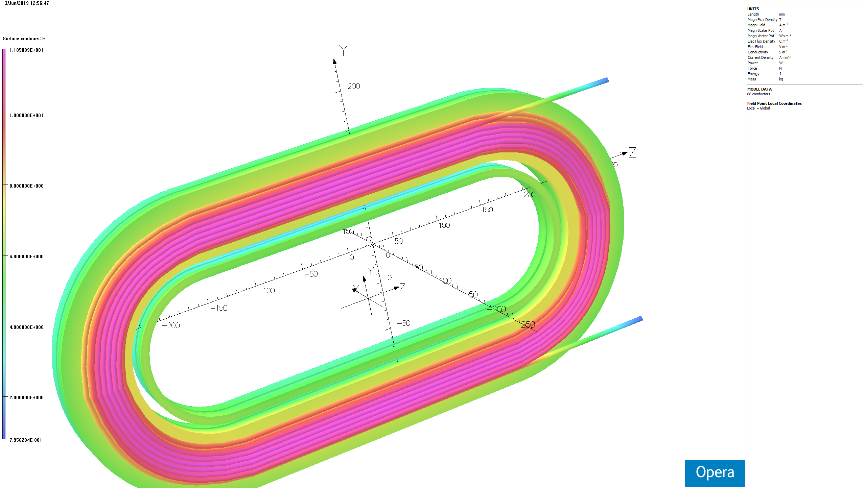
High Level Goals/Plans/Tasks
Two Related R&D programs. Magnet Design Program (MDP) and Small Business Technology Transfer (STTR)
MDP: “In-field quench studies of a long CORC cable” in the background field of common coil dipole via one 8-turn HTS coil (S-turn in to flip the polarity)
STTR: “Demonstration of a high field HTS/LTS hybrid dipole” with two sets of double pancake coils made with 6+8 turns (total 28 turns) of CORC cable
MDP:
Quench studies & technology demo
(10.7 T with
10 T from LTS)
STTR:
High field Demo
(13-14 T with
10 T from LTS)

Slide 4
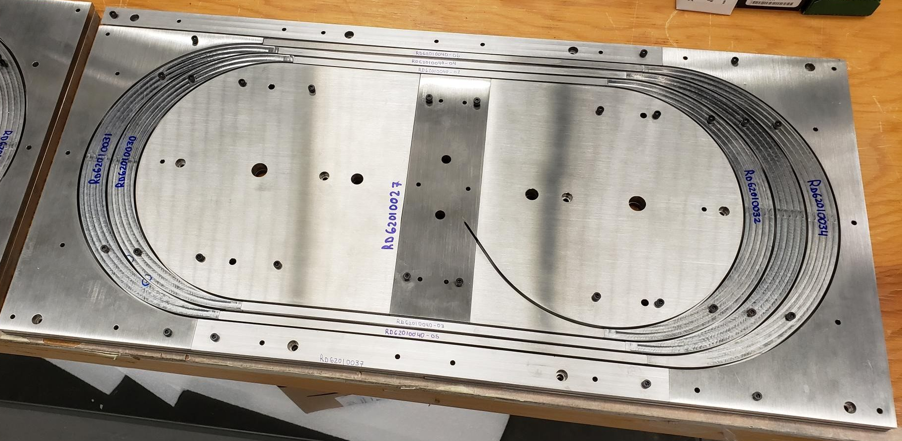
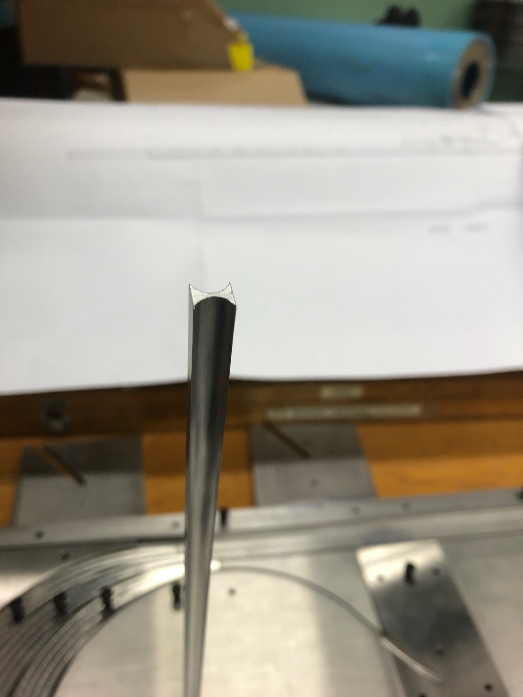
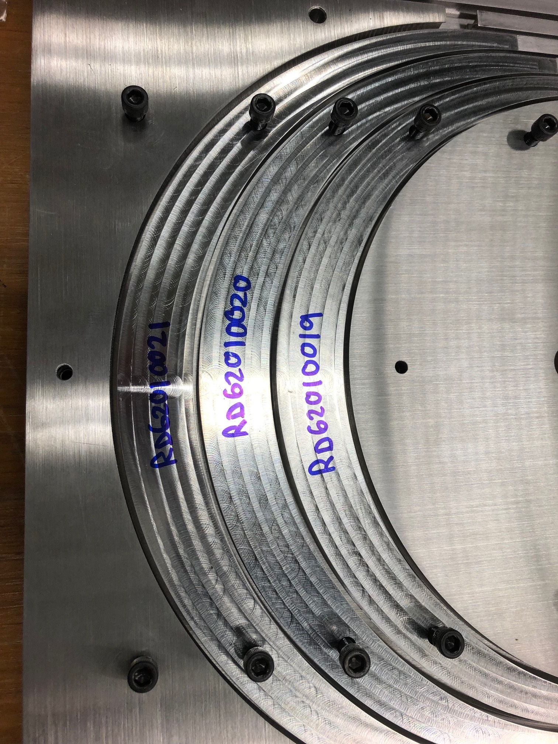
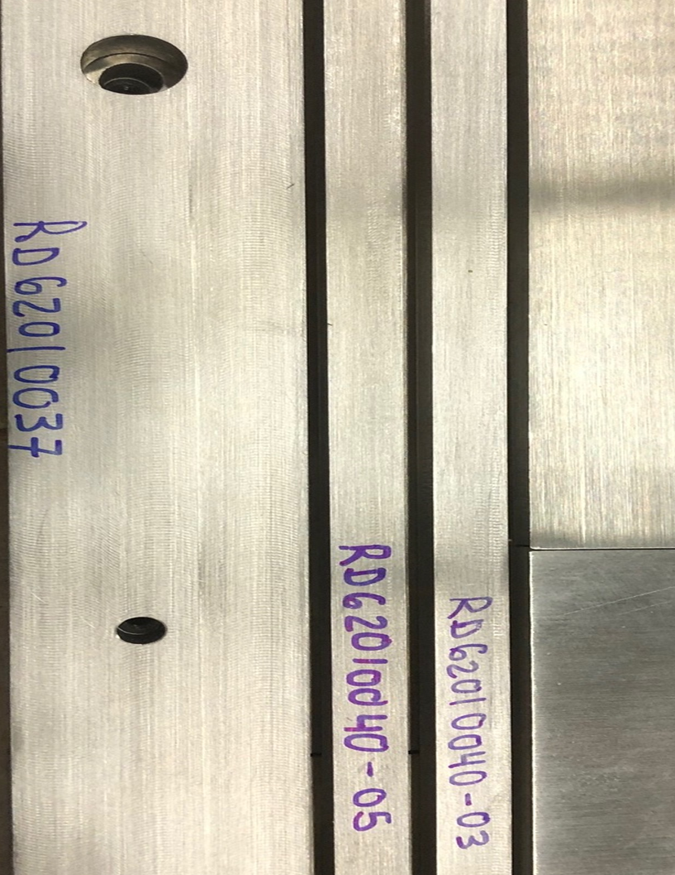
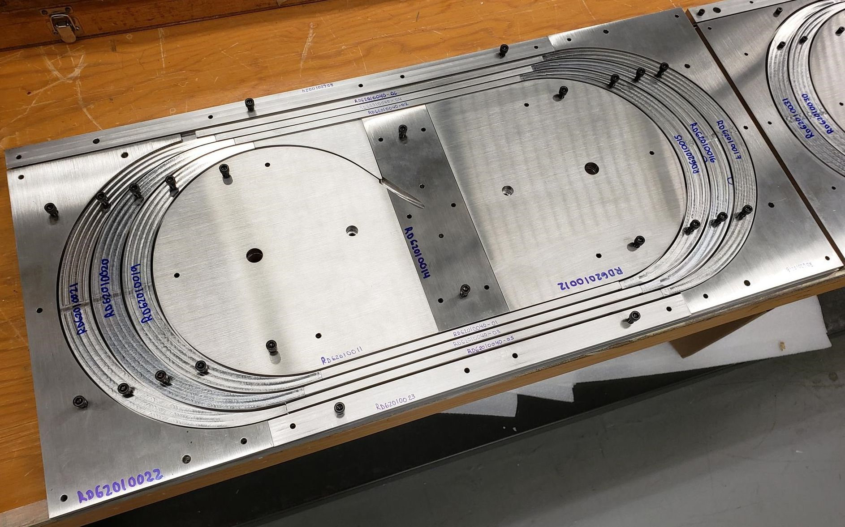
A Few Coil Structure Parts Shown Below
(all parts for MDP coil test obtained)

Slide 5
ACT proposed an alternate design and requested to wind the MDP coil as a practice winding for the STTR CORC coil

Slide 6
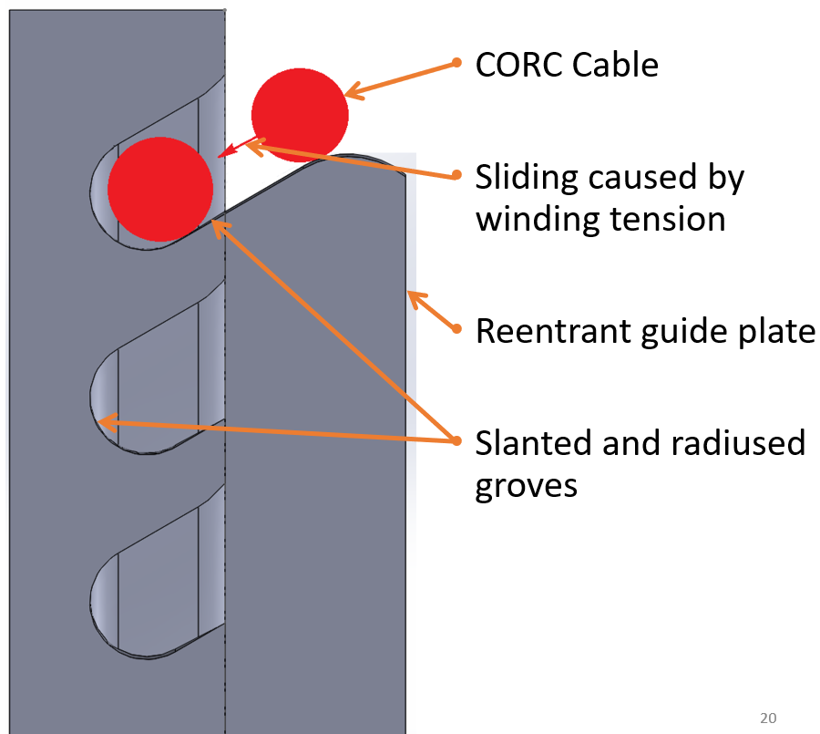
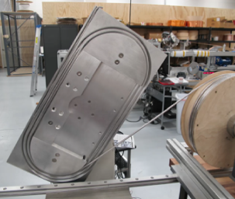
New Design from ACT
All pics: Courtesy ACT
Courtesy: Jeremy Weiss, Zack Johnson, Kyle Radcliff, Danko van der Laan, ACT

Slide 7
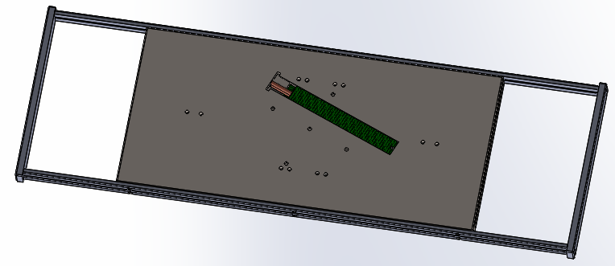
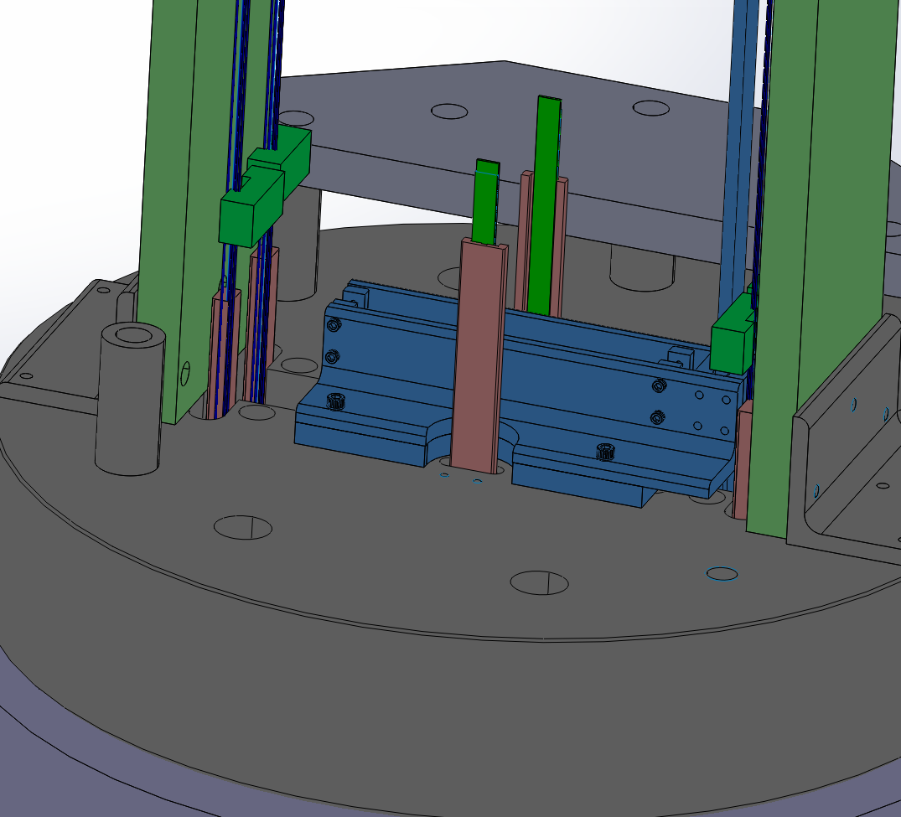
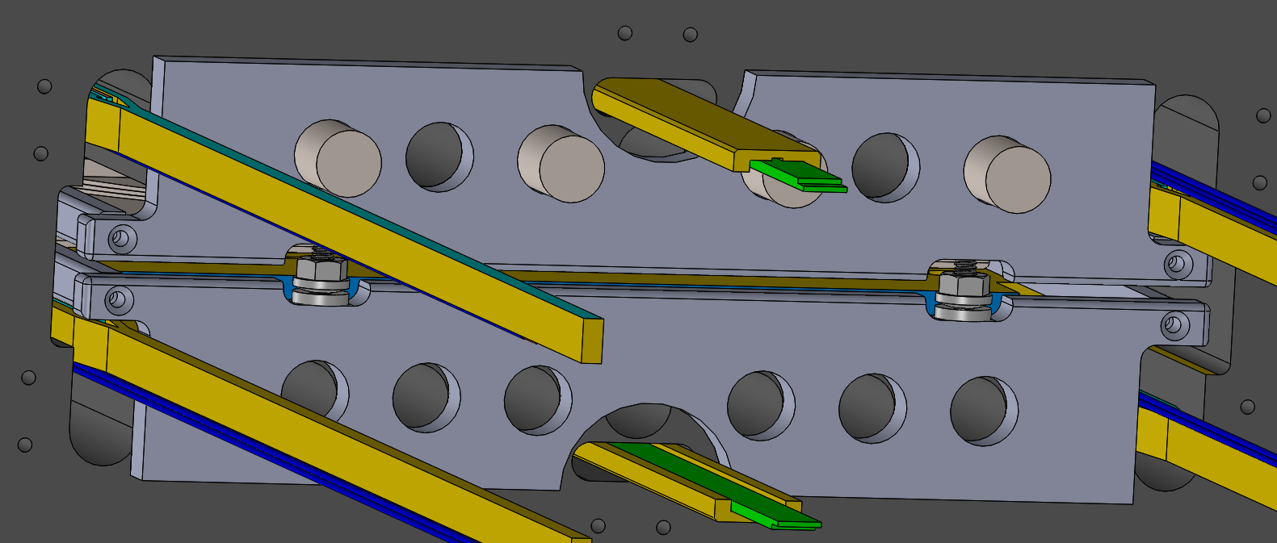
MDP CORC COIL INSERT in DCC017
Coil in a frame
MDP CORC Coil installed in DCC017
All pics: Courtesy ACT
Mounting design

Slide 8
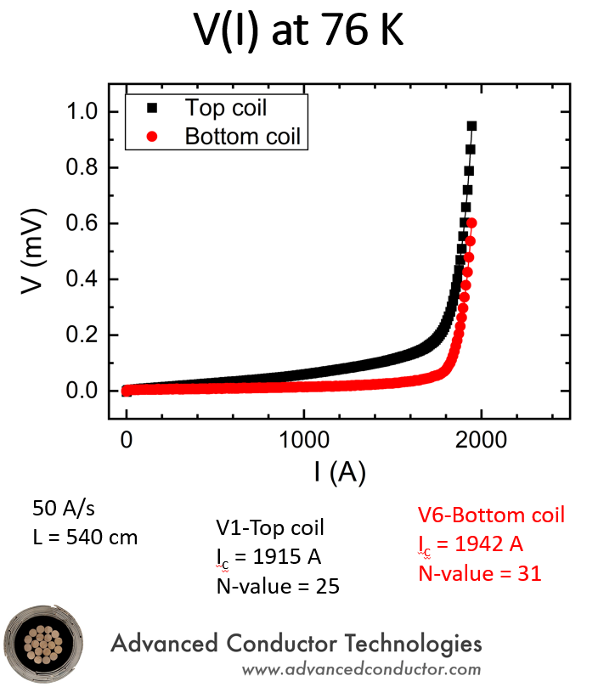
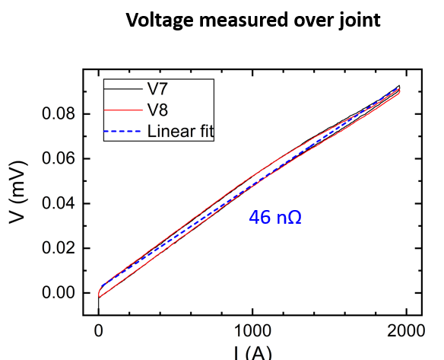
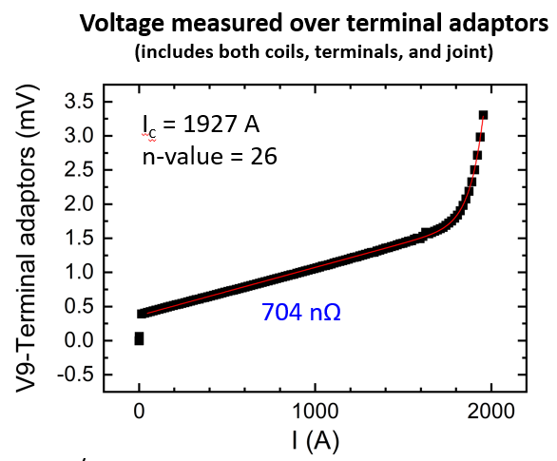
Pre-test in Liquid Nitrogen at ACT
Will request ACT to make full presentation in our subgroup meeting
Joint resistances at 76 K
BNL to receive the coil soon for 4K testing with DCC017

Slide 9
HTS/LTS Hybrid Dipole STTR with CORC coil

Slide 10
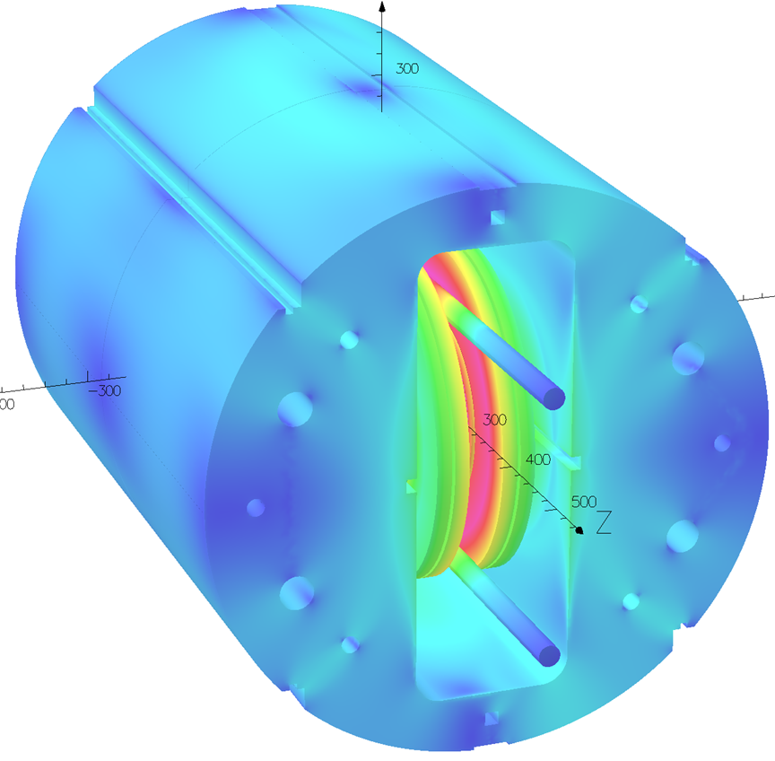
Recap: CORC Coils with the Common Coil Dipole
STTR Coils two sets:
Each with 6 and 8 turns
STTR: High field Demo
(13-14 T with 10 T from LTS)
MDP: Quench studies and technology demo
(10.7 T with 10 T from LTS)
MDP Coil
4+4 turns
with an S-turn
CORC® coils will run in series with the Nb₃Sn coils

Slide 11
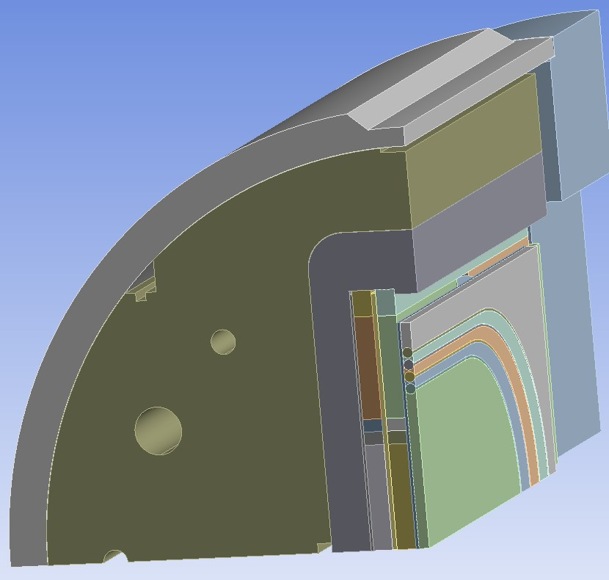
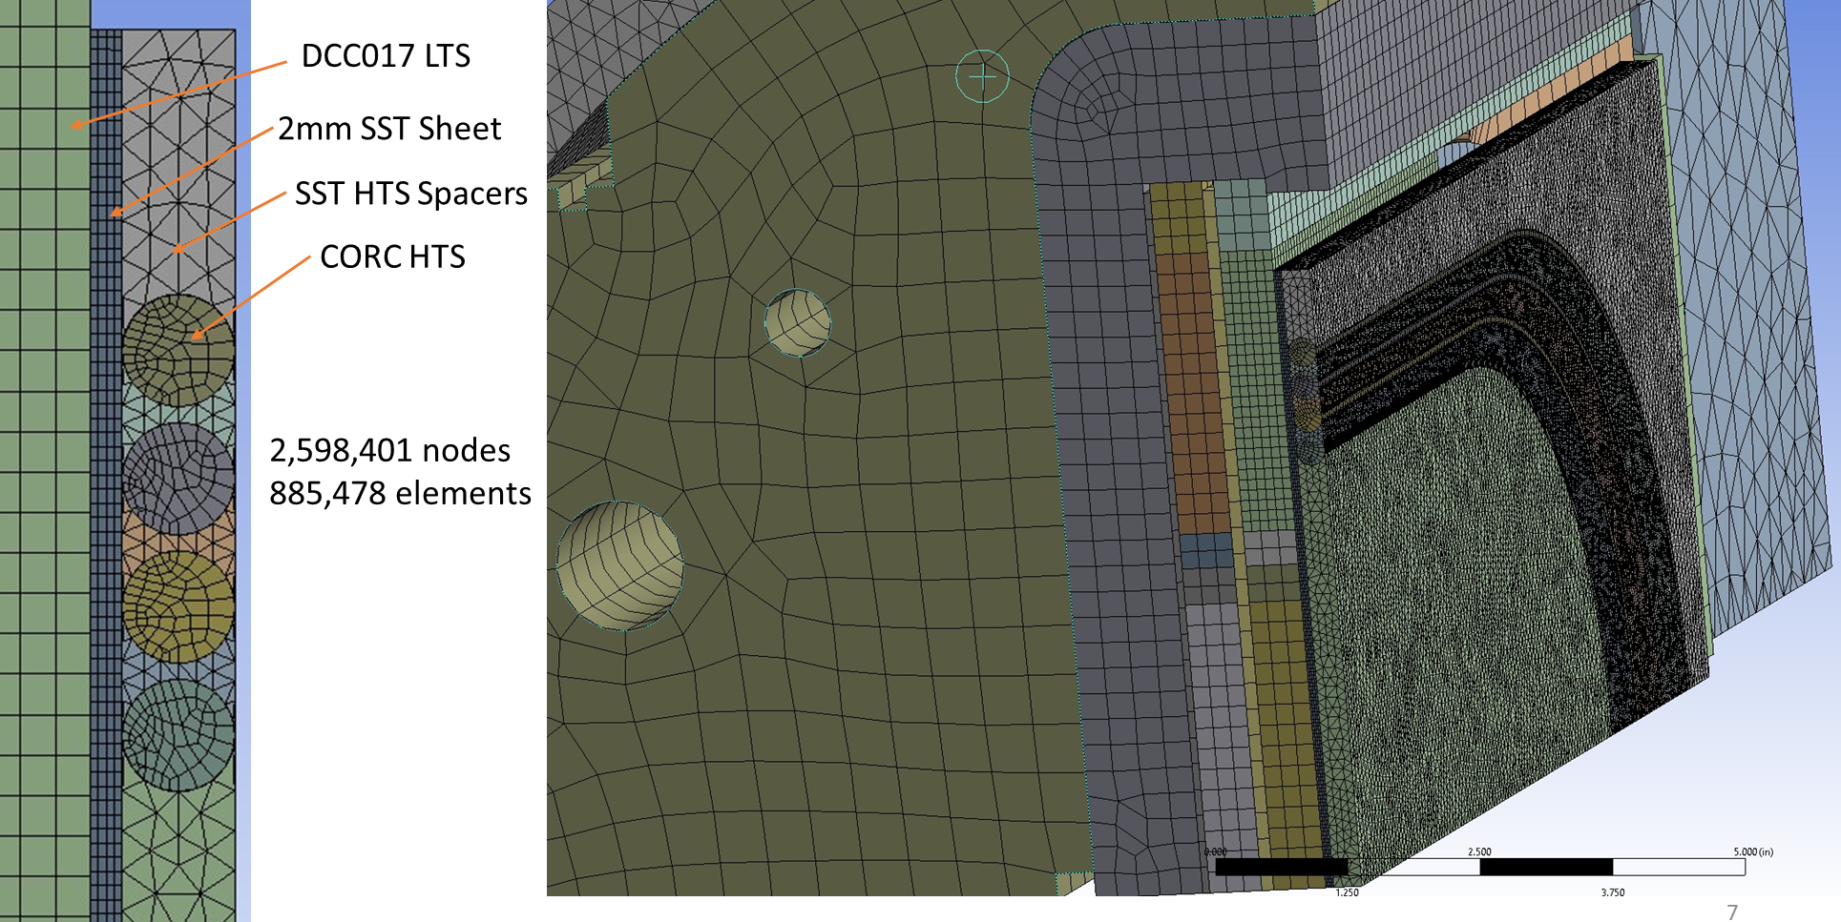
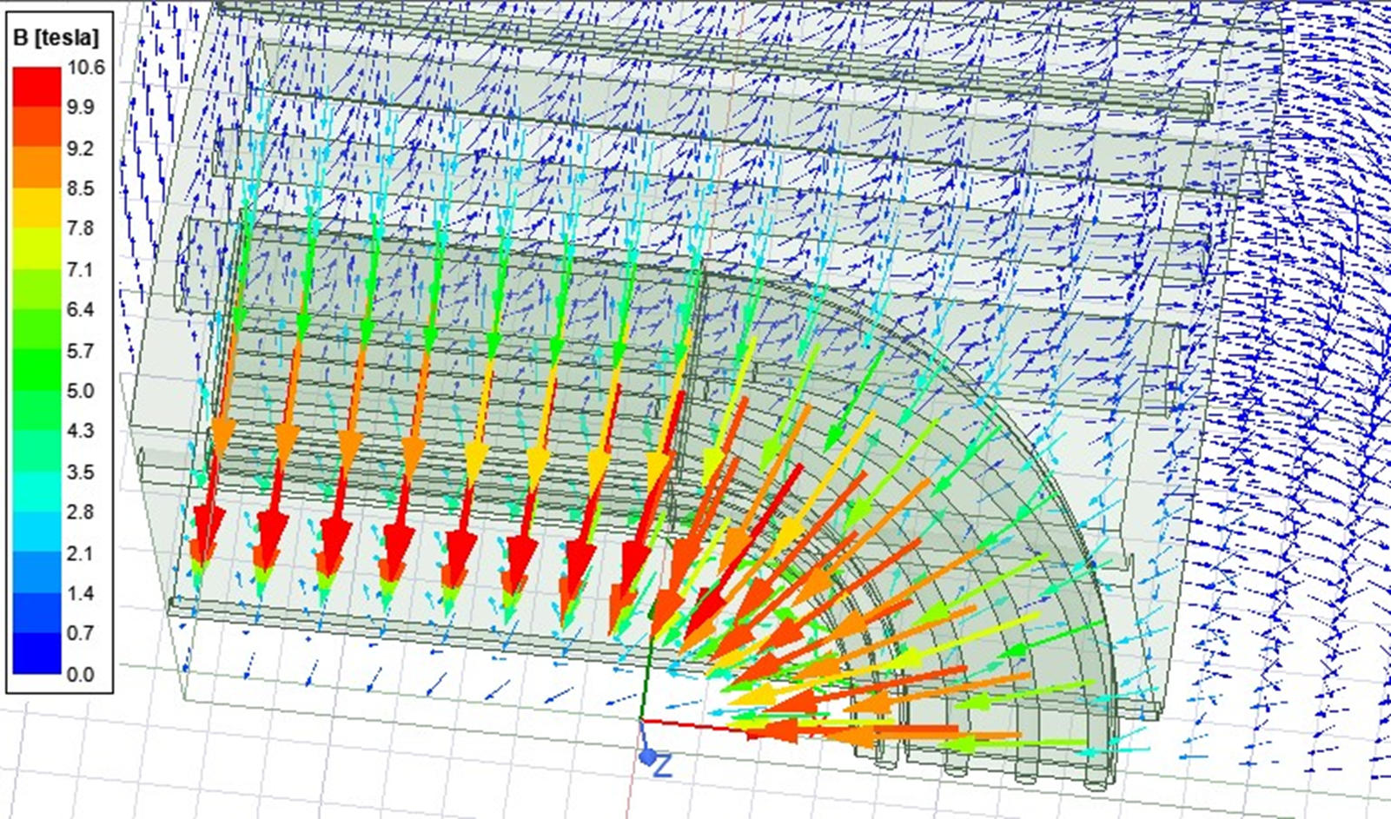
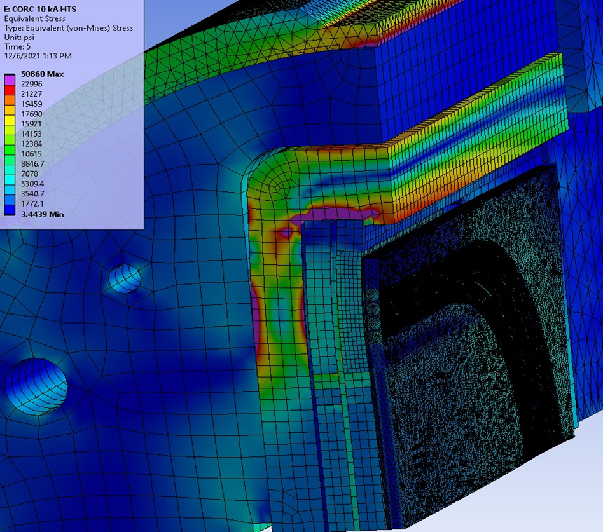
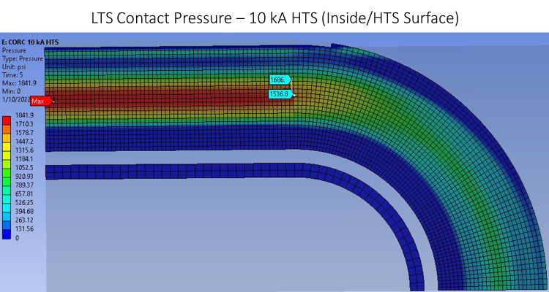
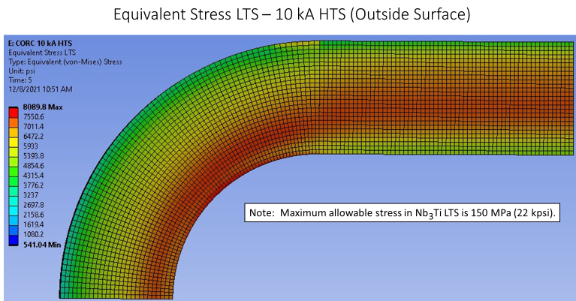
Finite element analysis performed for the CORC coil in a structure @10 kA inside BNL common coil dipole @10 T
Equivalent Stress

Slide 12
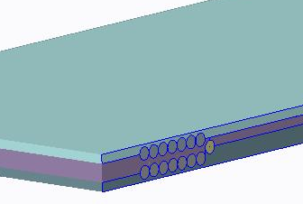
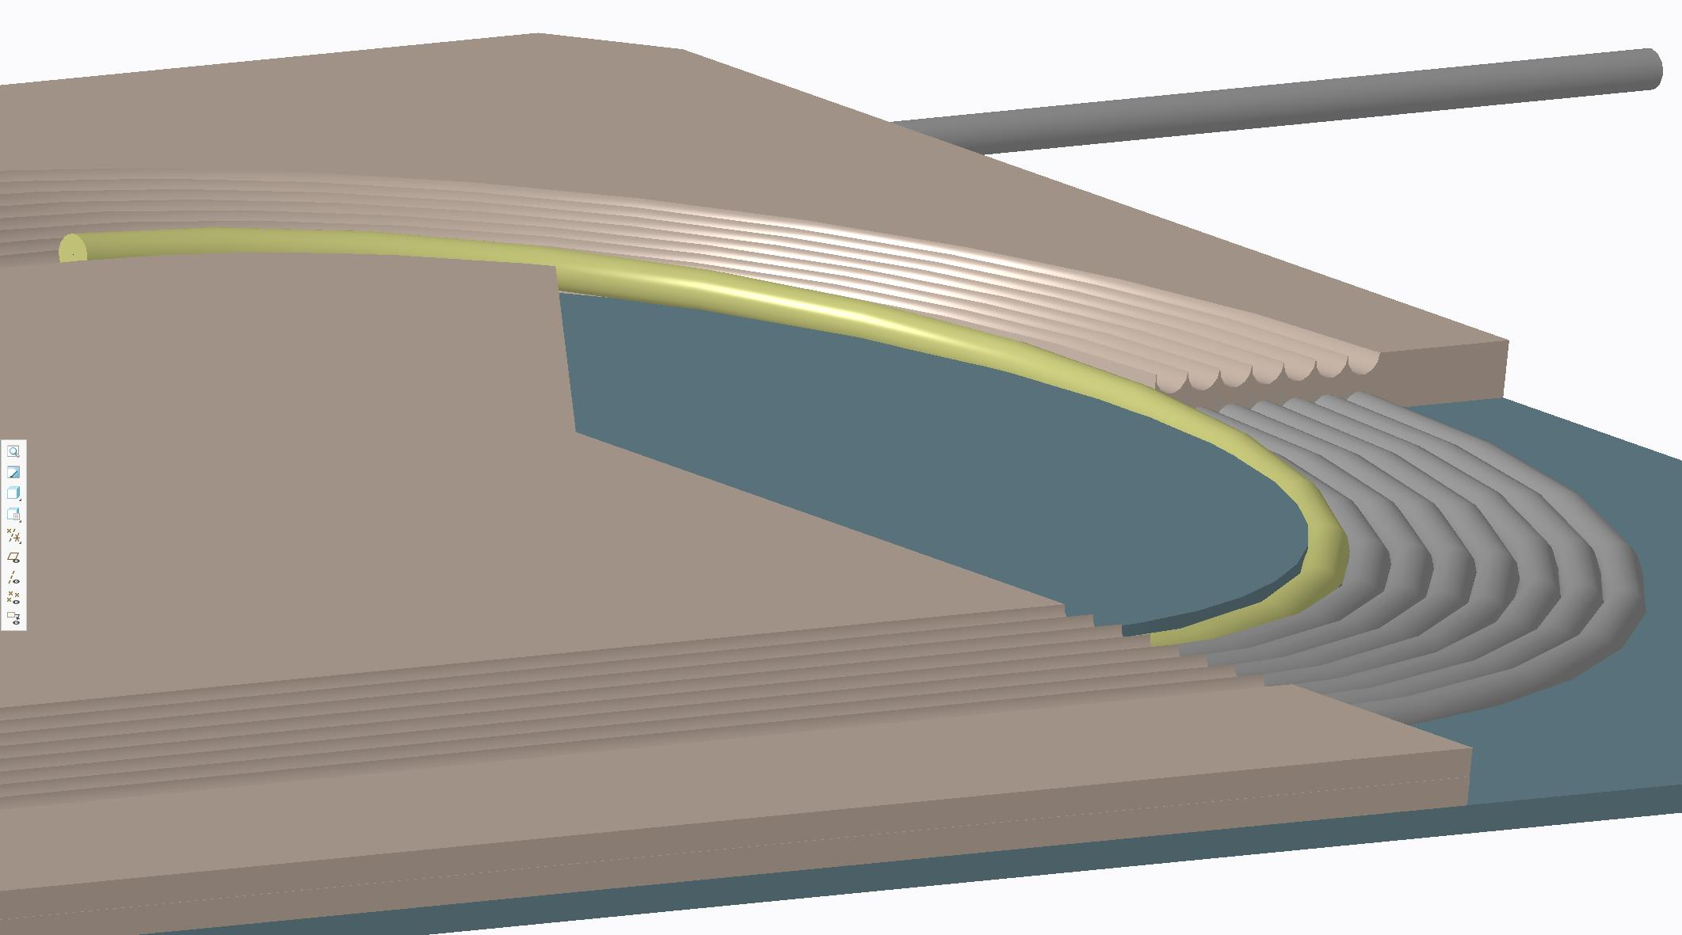
Early Design Work at BNL
Conductor fully supported
But cable was difficult to put in place

Slide 13
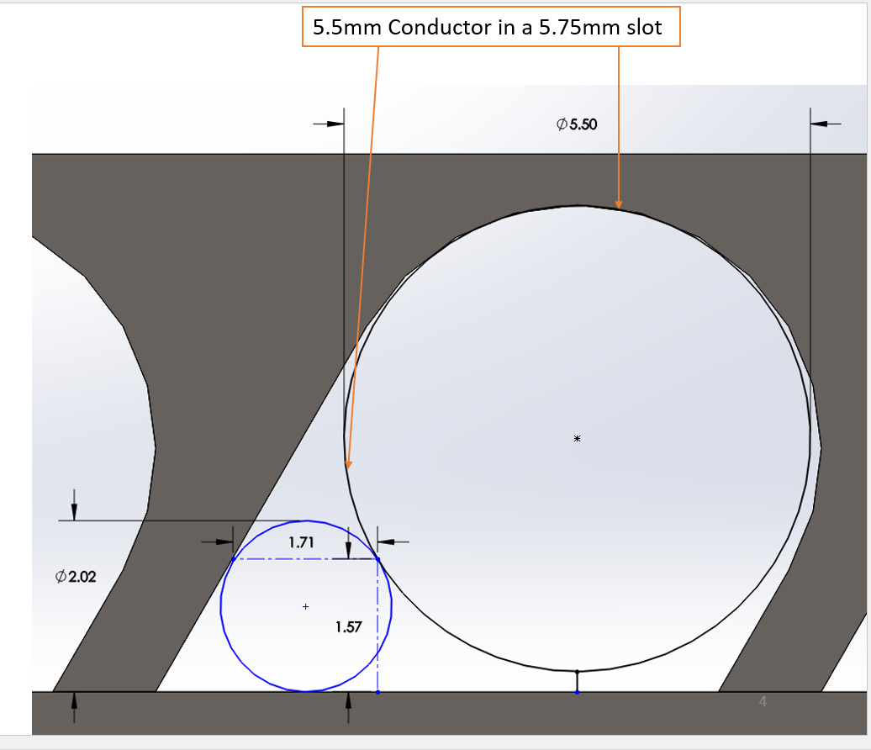
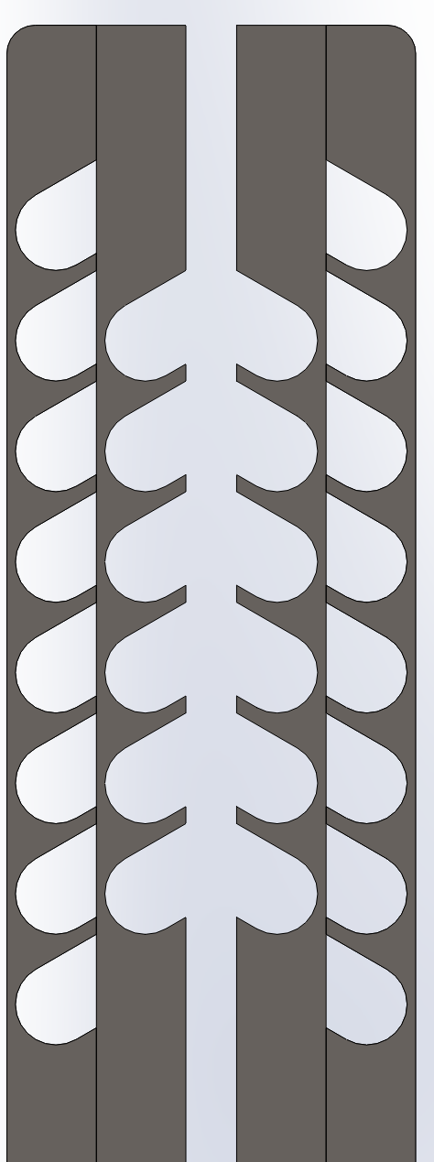
Work Performed at ACT
4 Plate Coil
Outer plates have 8 turns
Inner plates have 6 turns
Coils centered at ± 118mm
The left-hand and right-hand coils are mirrors of each other

Slide 14
Status of STTR
e-mail from Danko (this morning):
Zack, who made the model of the STTR coil is on vacation this week, but I’ll have someone else prepare a STEP file of the STTR coil.
The current connectors are the same as four the MDP coil. We’ve sent an overview last week, which is attached. The only difference between the STTR and MDP coils is that the lead position may have shifted by no more than an inch. The STEP file should clarify this. I assume that the lead connectors will interface with flexible Rutherford cables so this should be no problem and the current lead interface blocks could be machined.
The cable for the STTR coil will be finished this week, while all remaining parts for the coil should arrive next week. The STTR coil will be wound the week of July 18th, tested in liquid nitrogen the week of July 25th, and shipped top BNL before the end of that week. Assuming shipping freight takes one week, the coil should arrive at BNL before August 5th. There is a likelihood that we might speed things up and deliver sooner, but I’ll keep you updated.

Slide 15
Ongoing Discussion within MDP Collaborators
Discussion on the detail instrumentation
Discussion on the detail test plan
Both will be formalized soon.

Slide 16
PSI Nb₃Sn coil Test and HTS/LTS High Field Hybrid Dipole Test

Slide 17

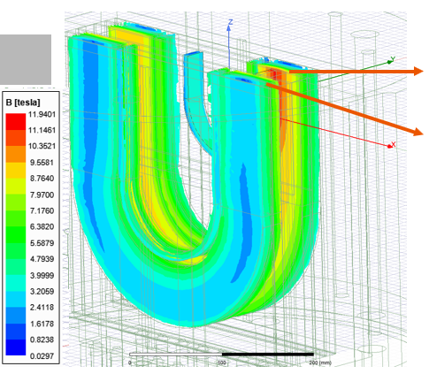
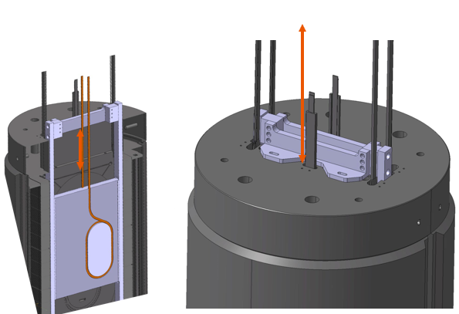

MDP BigBoX Test Nb₃Sn Coil Test with PSI
Coil in support structure received
Suggest a separate presentation from PSI
As such one aperture is available, use this
Taking advantage and testing an HTS coil

Slide 18
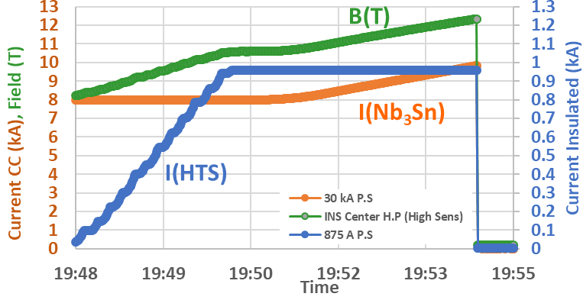
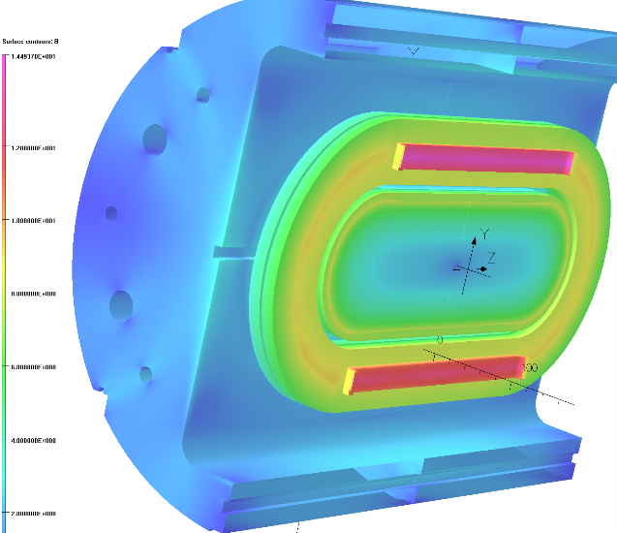
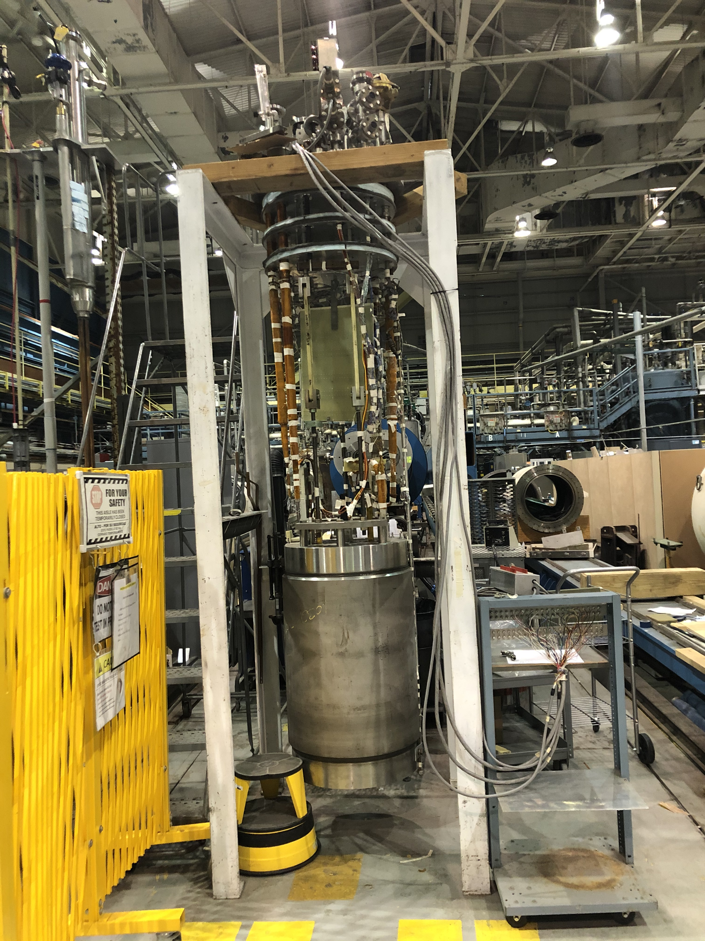
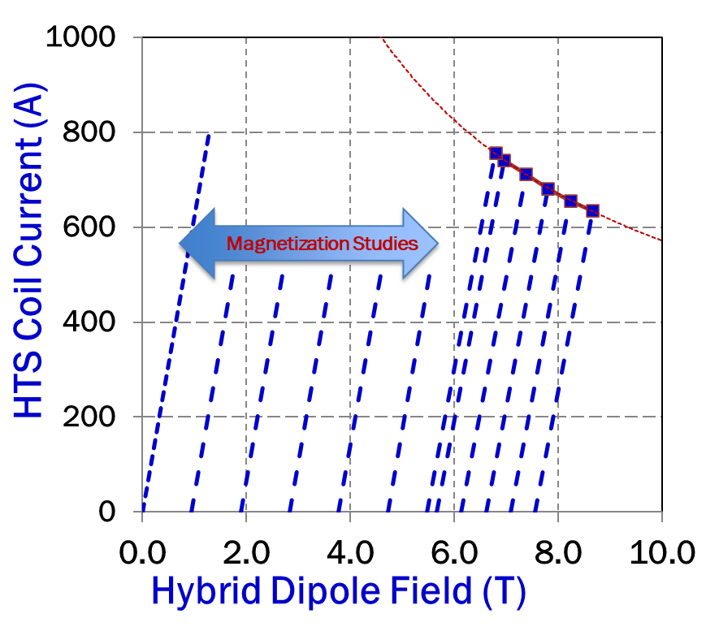
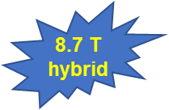
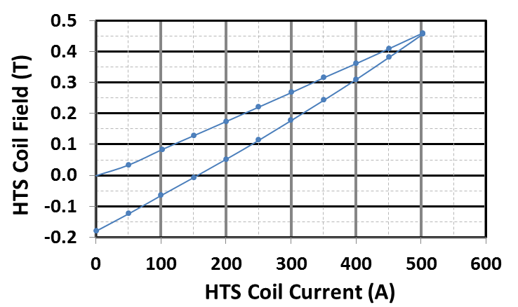
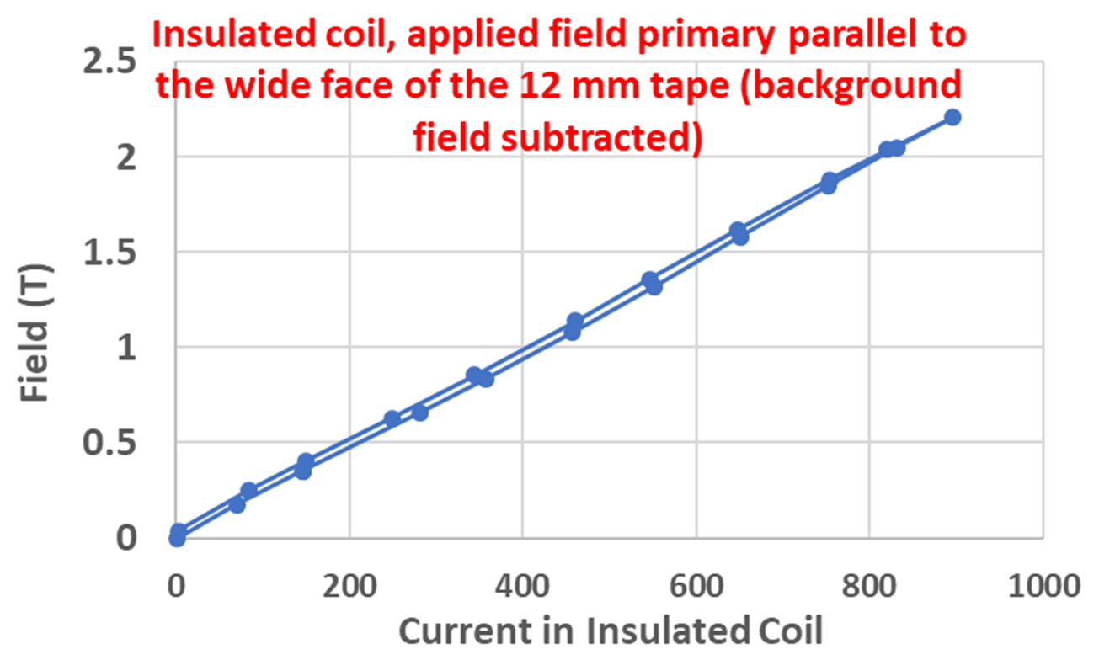
Room for Improvement in Previous MDP Test of 12.3 T HTS/LTS Dipole
MDP 2020
USMDP “Record” HTS/LTS 12.3 T Hybrid Dipole (2020)
HTS Coil#1
Quench Studies
HTS Coil#2
PBL/BNL STTR
Maximum field was not limited by HTS coil. It was by LTS coil.
Theory: HTS coil was pinching on the Nb₃Sn making it quench
NEXT: Intermediate structure
2016
Magnetization Studies
2016
SBIR: Field
Perpendicular
MDP: Field
Parallel
MDP 2020
Also, to find why coils got damaged

Slide 19
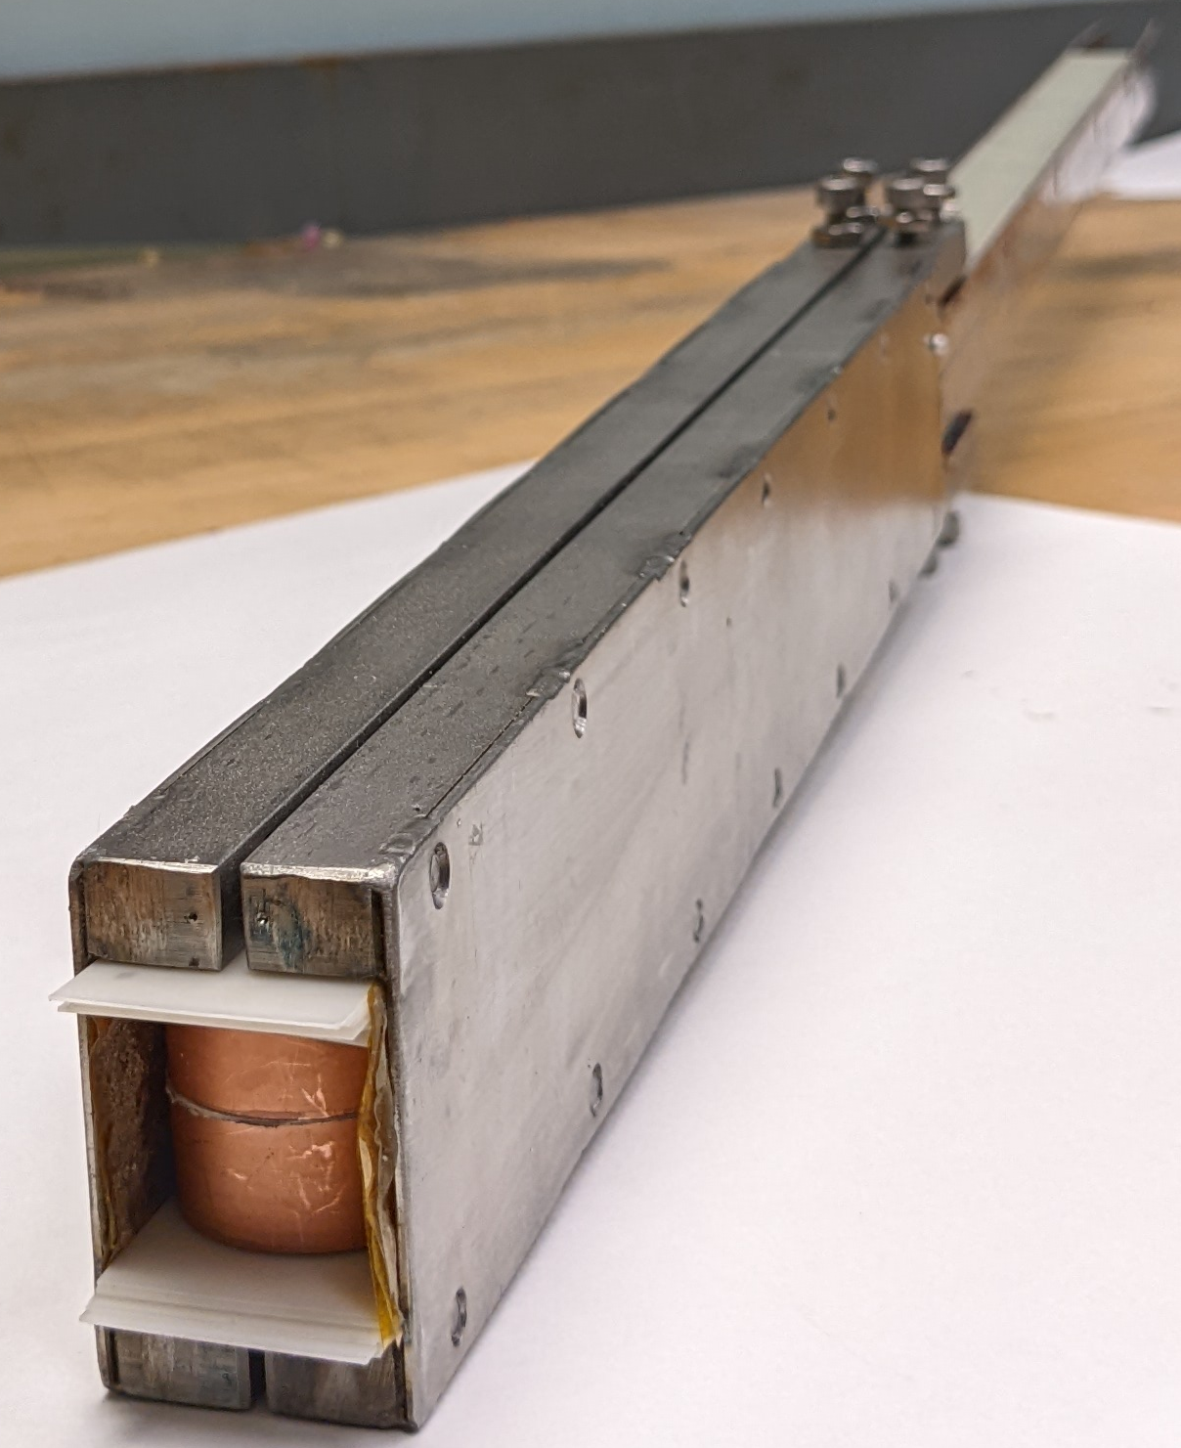
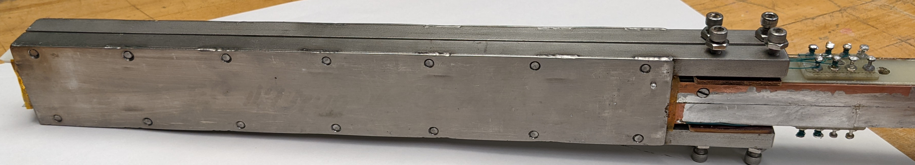
New MDP HTS Coil in a Support Structure
Question: Can a higher hybrid field be reached with some intermediate structure on HTS coil (stress management) ?
77 K Test Results
A simple, low-cost, versatile structure made
Recently wound coil with leftover conductor tested at 77 K in the structure

Slide 20
Future Possibilities
We need high current cables with many wires/tapes- for accelerator magnets
  Insert coil made with high current STAR cable (request to MDP made)
    This is high current cable different from the cable limited by bend radius restriction
  Insert coil made with VIPER cable (in discussion with CFS)
  Insert coil made with Magnum (Alex Otto) Cable
Conductor friendly designs offer many benefits, such as they allow wide range of cables to their potential

Slide 21
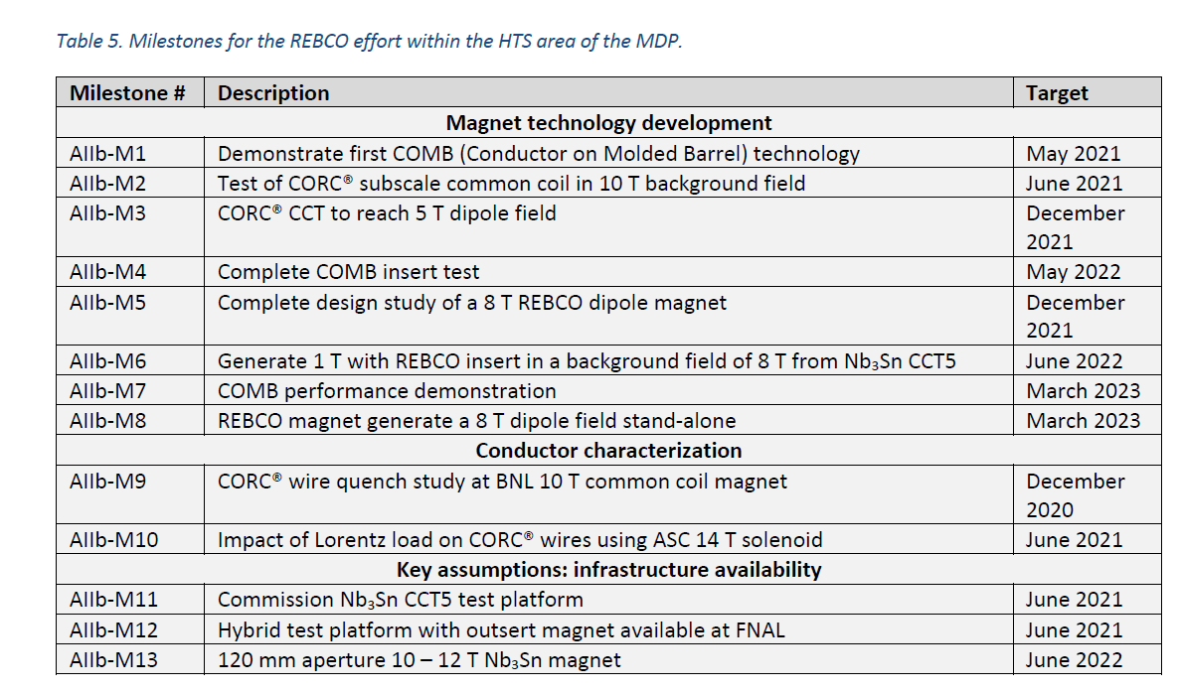
BNL Milestones
ACT/BNL
STTR
08/22
Completion date depends on the delivery of the coils (if STTR coil doesn’t arrive in time, then MDP coil can be tested sooner)
BNL/LBL
MDP
12/22

Slide 22
Acknowledgement
This presentation benefited from the discussions with and direct contributions from the following colleagues:
ACT: Danko van der Laan, Jeremy Weiss, Zachary Johnson
BNL: Anis Ben Yahia, Michael Anerella, Jesse Schmalzle, Piyush Joshi, Mithlesh Kumar,…
FNAL: Vadim Kashikhin, Vito Lomardo
LBNL: Xiaorong Wang, Maxim Martchevsky, Reed Teyber,…
… and more

Slide 23
Summary
HTS/LTS program at BNL is primarily based on a Common coil dipole with a large opening which provides a rapid-turn-around and low-cost R&D option for developing and testing technologies and instrumentation and for addressing specific questions - one at a time.
This is alternate and complimentary to developing and demonstrating technology by building magnets which takes much longer time and uses much larger budget.
Several tests with several collaborators (domestic and international; research institutions and industries) are planned within MDP and with others (SBIR, fusion, international, etc.) to develop and tests various aspects of designs and technologies at ~10 T or above.
Specific questions to be addressed: HTS/LTS hybrid magnets, quench, magnetization, high current HTS cables, joints, high ramp rates, insulation, instrumentation, etc..
More synergistic programs are invited. Please evaluate and see what and how to do it.

