Slide 1


20 T – Cos(𝛳) Designs
G. Vallone, P. Ferracin, V. Marinozzi
12-July-2022
LBNL, FNAL

Slide 2
Index
Introduction
Magnetic Solution
Mechanical model results
  Rigid structures and stress management
  Thick intercoil study
  SMCT Study
Conclusion

Slide 3
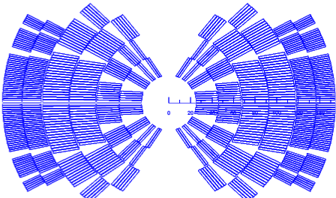
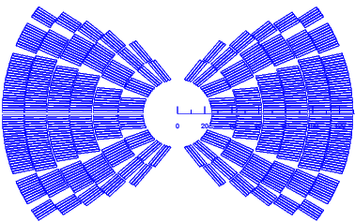
Introduction
CT I
CT II
We explore the mechanical stresses for 20T cos(ϑ) design
  CT I: 4 Bi2212 layers
  CT II: 2 Bi2212 layers
We select CT II as best ($) design

Slide 4
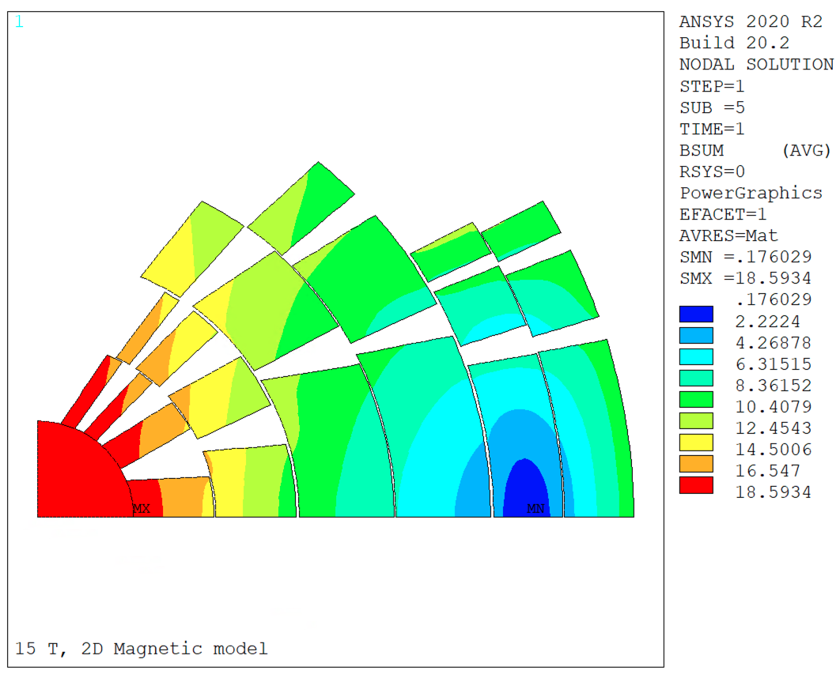
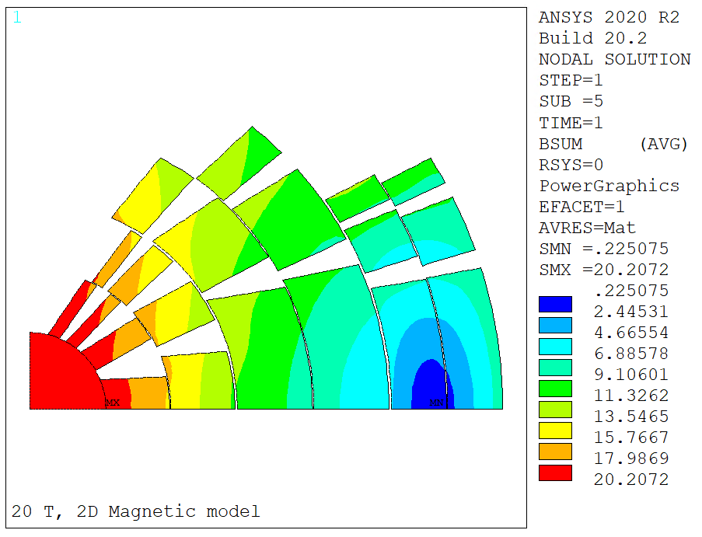
Magnetic Field
B, T
No Iron
B, T
With Iron
Mechanical analysis with forces from magnetic field with yoke
  20 T central field in Roxie, 19.94 T in ANSYS

Slide 5
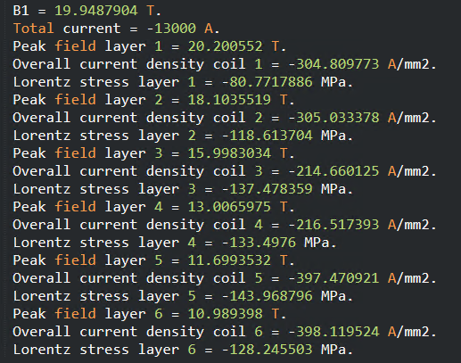
Magnetic Model Results
Lorentz stress very reasonable in all layers

Slide 6
Index
Introduction
Magnetic Solution
Mechanical model results
  Rigid structures and stress management
  Thick intercoil study
  SMCT Study
Conclusion

Slide 7
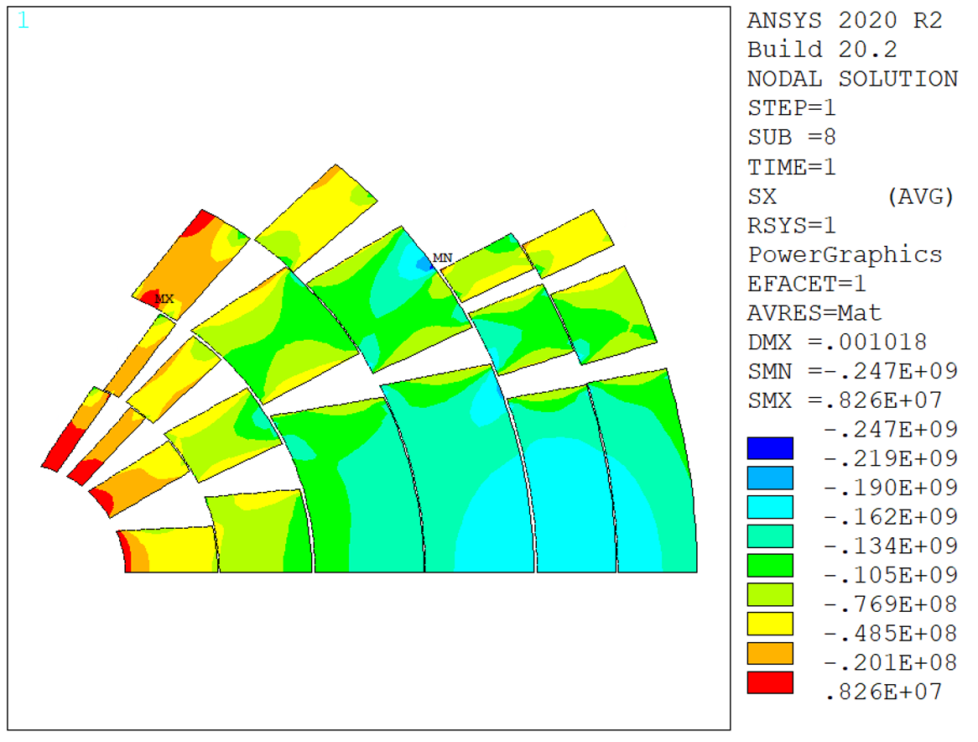
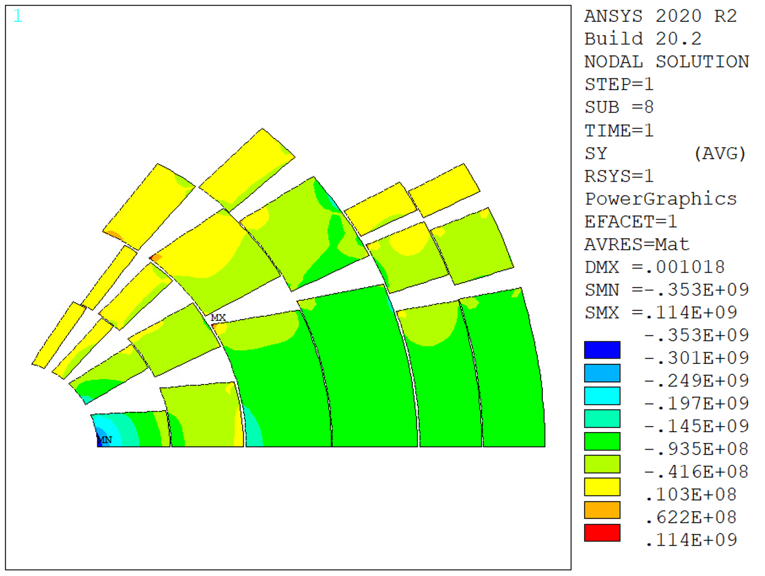
Rigid Structure
Radial
Stress
Azimuthal
Stress
Assumptions:
  Rigid structure around the last coil
  Coil modelled as linear elastic, E = 20 GPa
  Frictionless contact on the intercoil insulation
  Glued contact on the interlayers
Max stress, mid plane:
  Radial: 183 MPa, Azimuthal: 353 MPa
  Inner radius stress due to coil deformability
Lorentz stress on layer 1 was only 80 MPa, but bending…

Slide 8
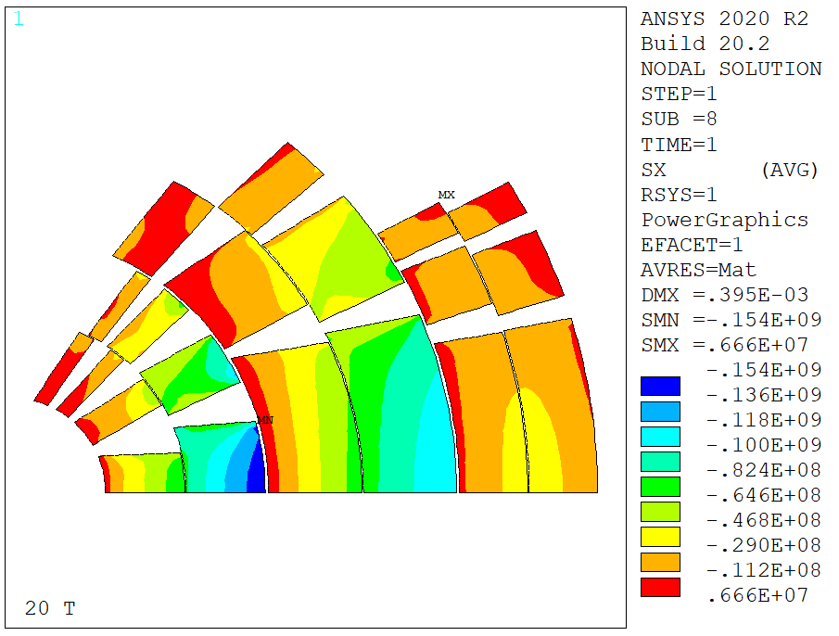
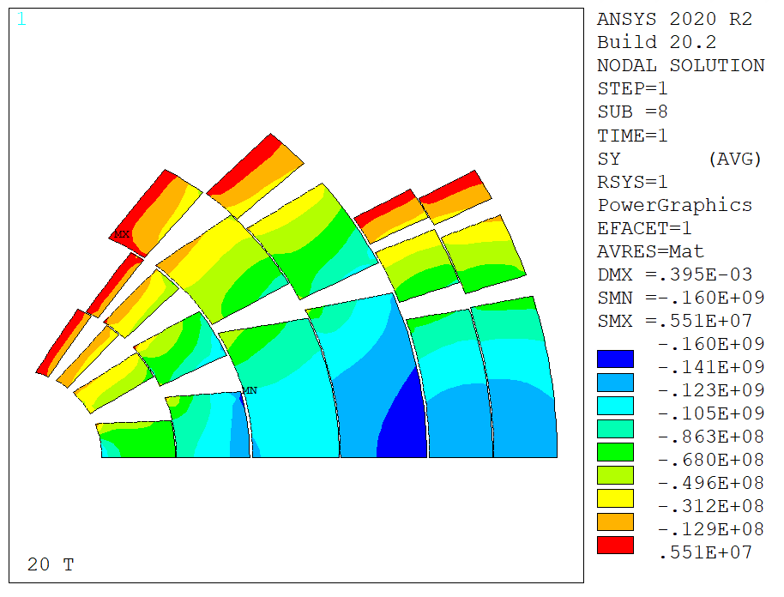
Rigid Structure, Intercepting (Fixed intercoil)
Radial
Stress
Azimuthal
Stress
Intercepting structure - intercoil fixed (u=0)
  Removes bending and accumulation of radial forces
140 MPa radial, 155 MPa azimuthal
With perfect interception between coils, layer 2 has to be stress managed
  Radial+azimuthal stresses exceed limits

Slide 9
Rigid Structure, Intercepting (Fixed intercoil+interlayer)
Radial
Stress
Azimuthal
Stress
Intercepting structure – intercoil and interlayers fixed (u=0)
Even with perfect interception between layers, layer 2 has to be stress managed
101 MPa radial, 147 MPa azimuthal

Slide 10
Result Summary - Intercepting
In red stresses that are over our limits
Rigid intercoil + interlayer close to Lorentz stress

Slide 11
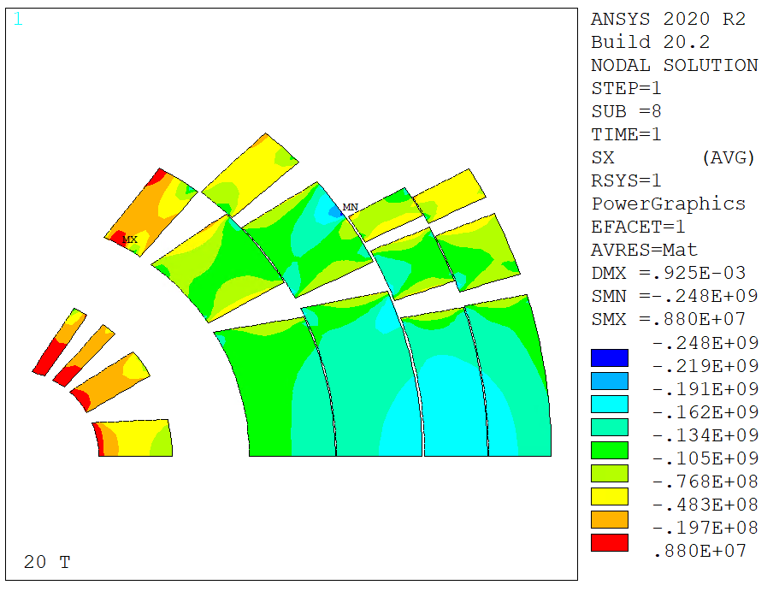
Rigid Structure, Layer 2 Stress Managed
Radial
Stress
Azimuthal
Stress
If we stress manage L2, do we need to do the same on L1?
  Is the additional stiffness from stress management enough to remove the stress peaks in L1?
  Model with L2 in stainless steel (coil and spacers)
179 MPa radial, 302 MPa azimuthal
Layer 1 has to be stress managed
  Azimuthal stresses exceed limits

Slide 12
Result Summary – Stress Management
We can repeat the exercise ‘stress-managing’ only some layers (x means stress managed)
Stress managed solutions show that in reality we might be able to stress manage only layer 1, 2, but layer 3 is very close to the limit
  Field is low, but stress might become higher when outer structure and stress management are not ‘ideal’
  On the other hand, coil 3 can work with no stress management

Slide 13
Index
Introduction
Magnetic Solution
Mechanical model results
  Rigid structures and stress management
  Thick intercoil study
  SMCT Study
Conclusion

Slide 14
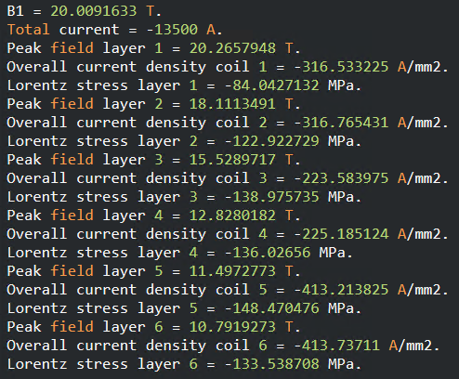
Steel Intercoil – Magnetic Field
Old
New
5 mm thick stainless steel intercoil shim/structure
Current ramped up to get back to 20 T
  From 13 kA to 13.45 kA

Slide 15
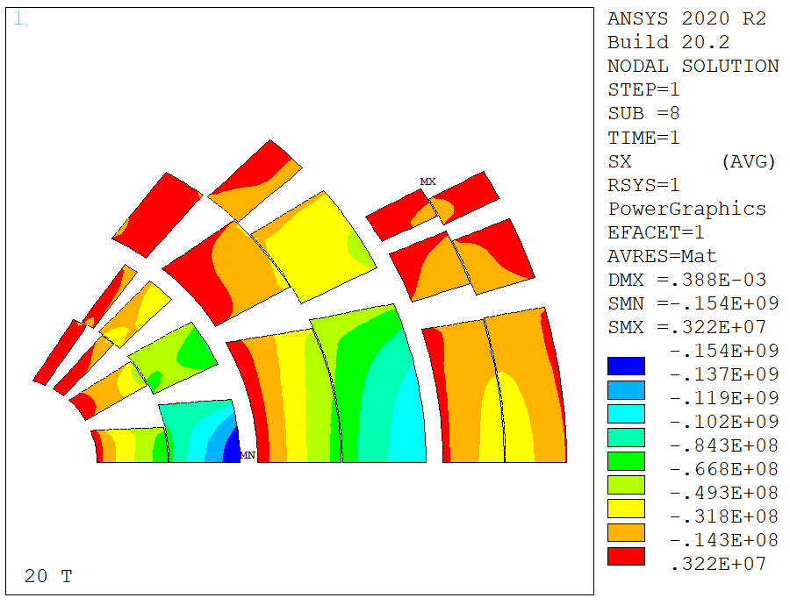
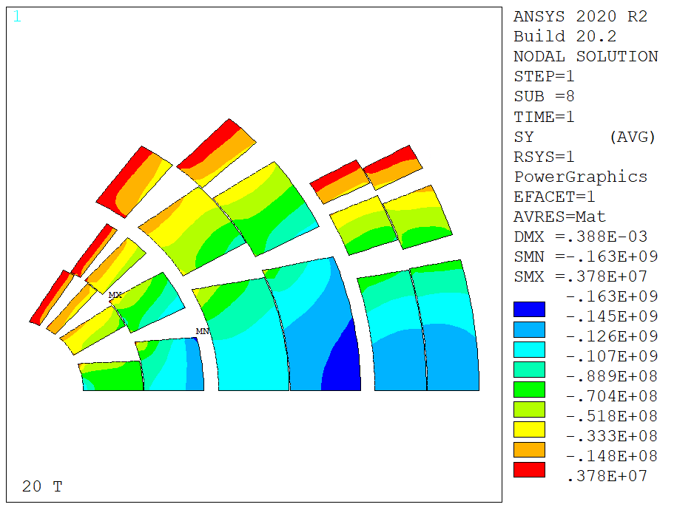
Case 0 – Rigid Intercoil
Rigid intercoil shells (locked on x=0)
Azimuthal: 163 MPa, Radial: 154 MPa
Not super promising – reality will be worse

Slide 16
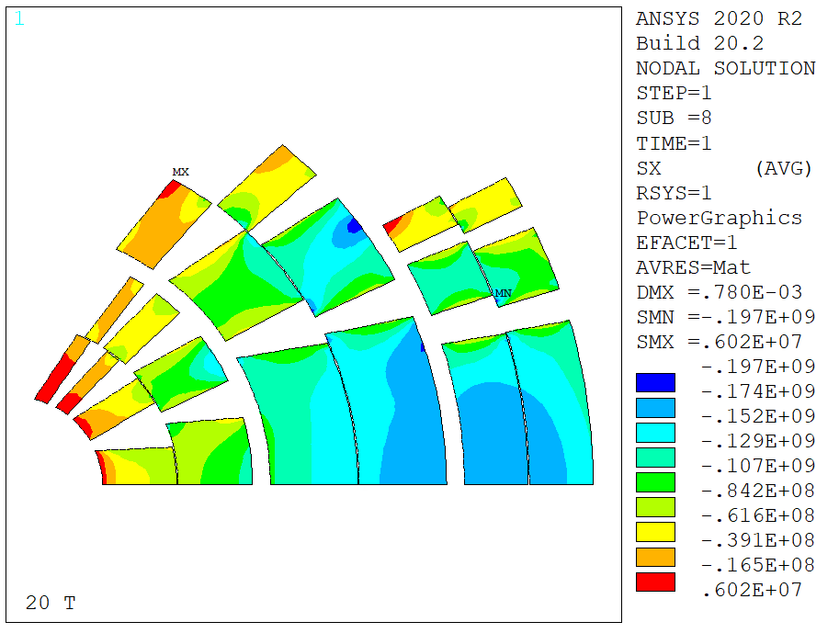
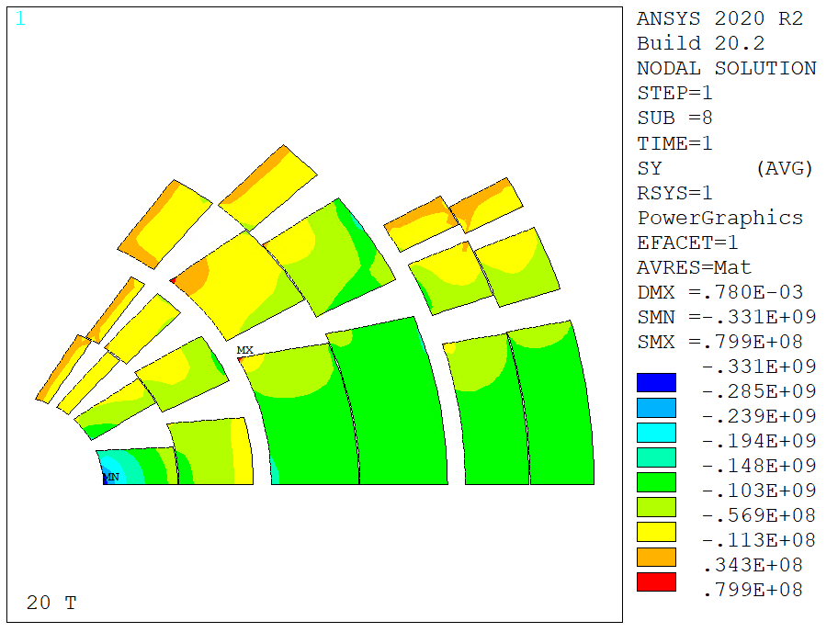
Case A – Steel ‘Open Rings’
Intercoil shims open at 90°
Azimuthal: 331 MPa, Radial: 173 MPa
  Does not solve the bending problem on the first layer

Slide 17
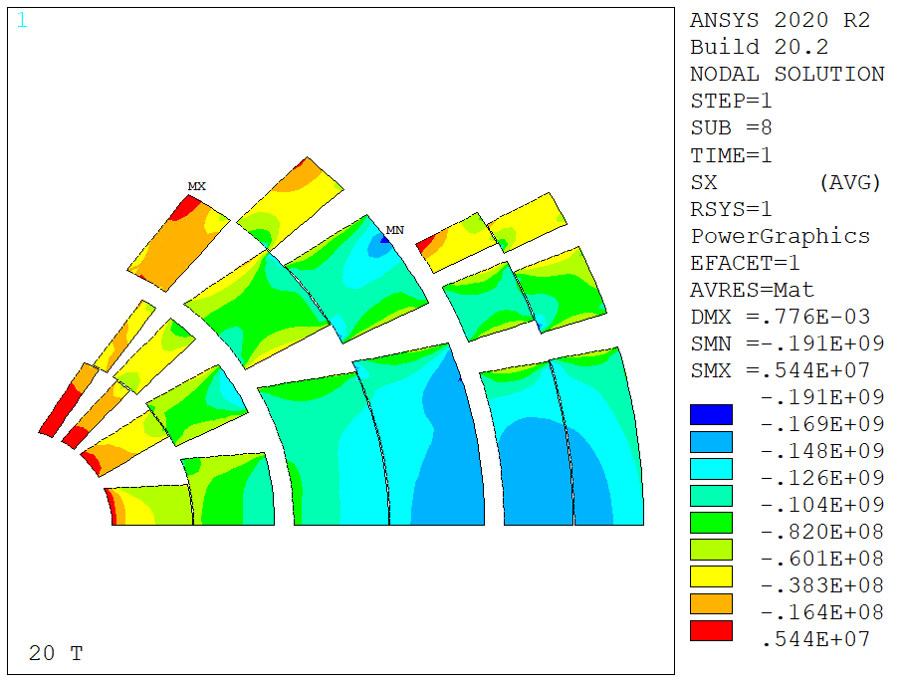
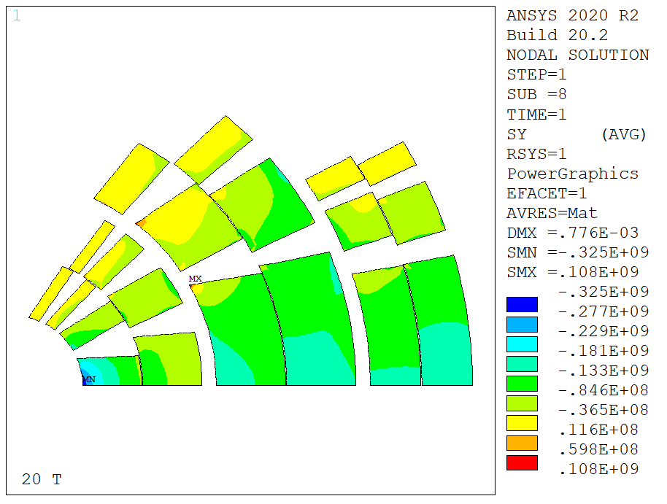
Case B – Steel Shells
Intercoil shims closed at 90° (shell design)
Azimuthal: 325 MPa, Radial: 167 MPa
  Similar to open rings and more complicated to assembly / not worth considering

Slide 18
Index
Introduction
Magnetic Solution
Mechanical model results
  Rigid structures and stress management
  Thick intercoil study
  SMCT Study
Conclusion

Slide 19
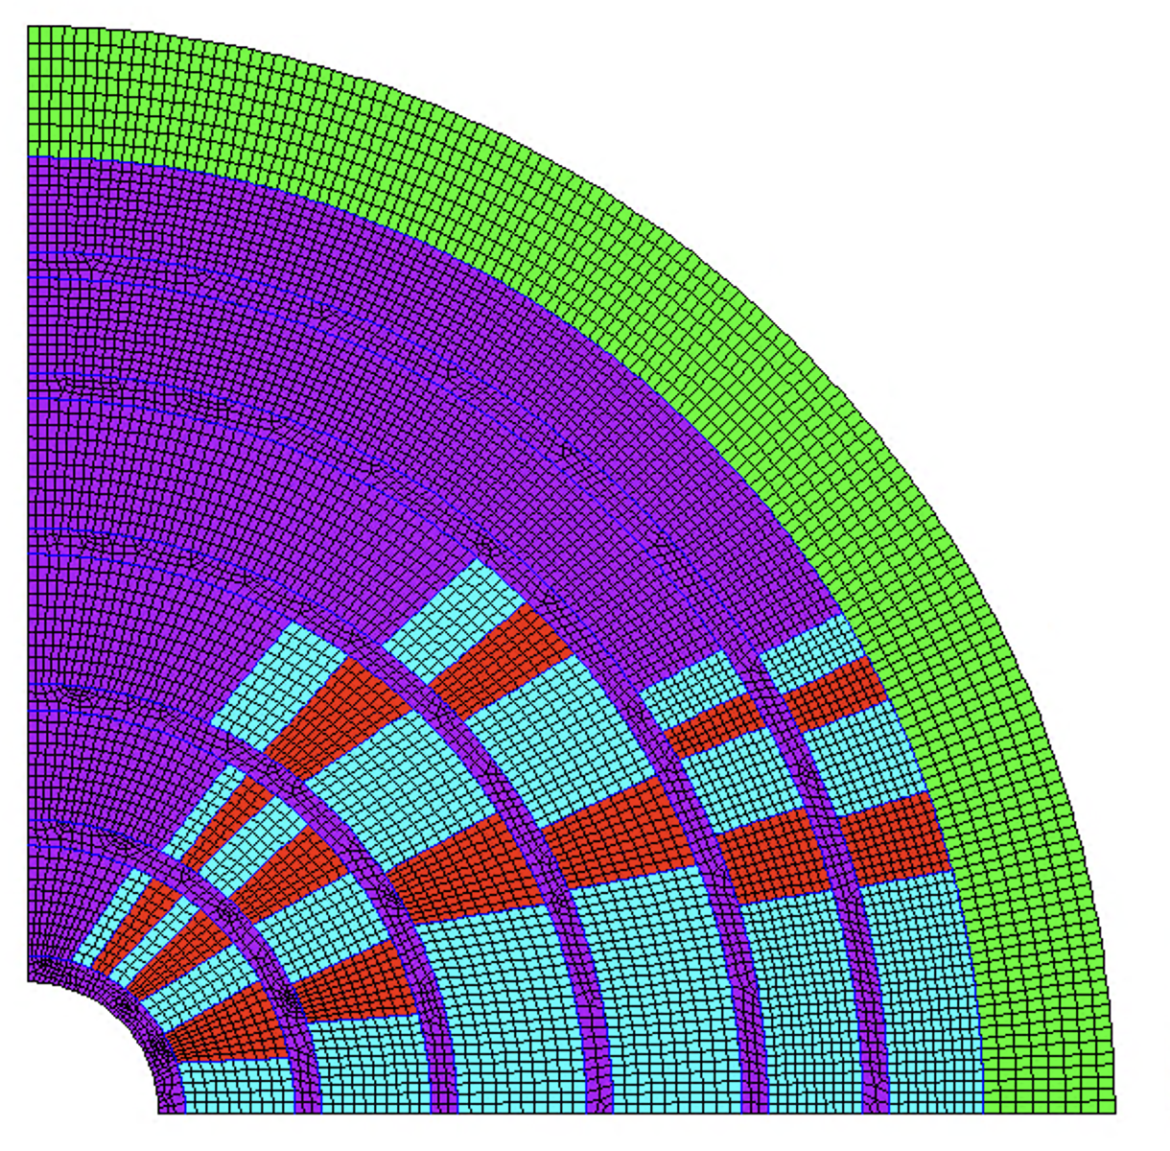
A test with an SMCT ‘Design’
2D model with mandrel + coil
  Preliminary geometry for test purposes: 5 mm thick stainless steel mandrel added to previous design
  All ‘open’ contacts between coil and mandrels (and mandrel/mandrel)

Slide 20
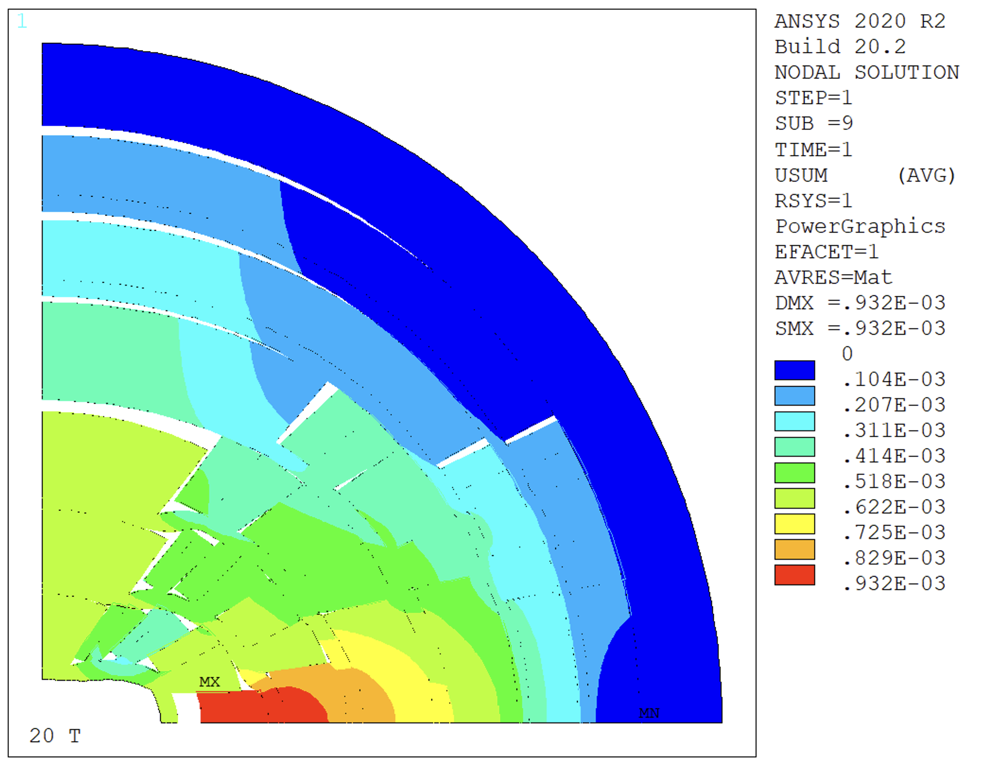
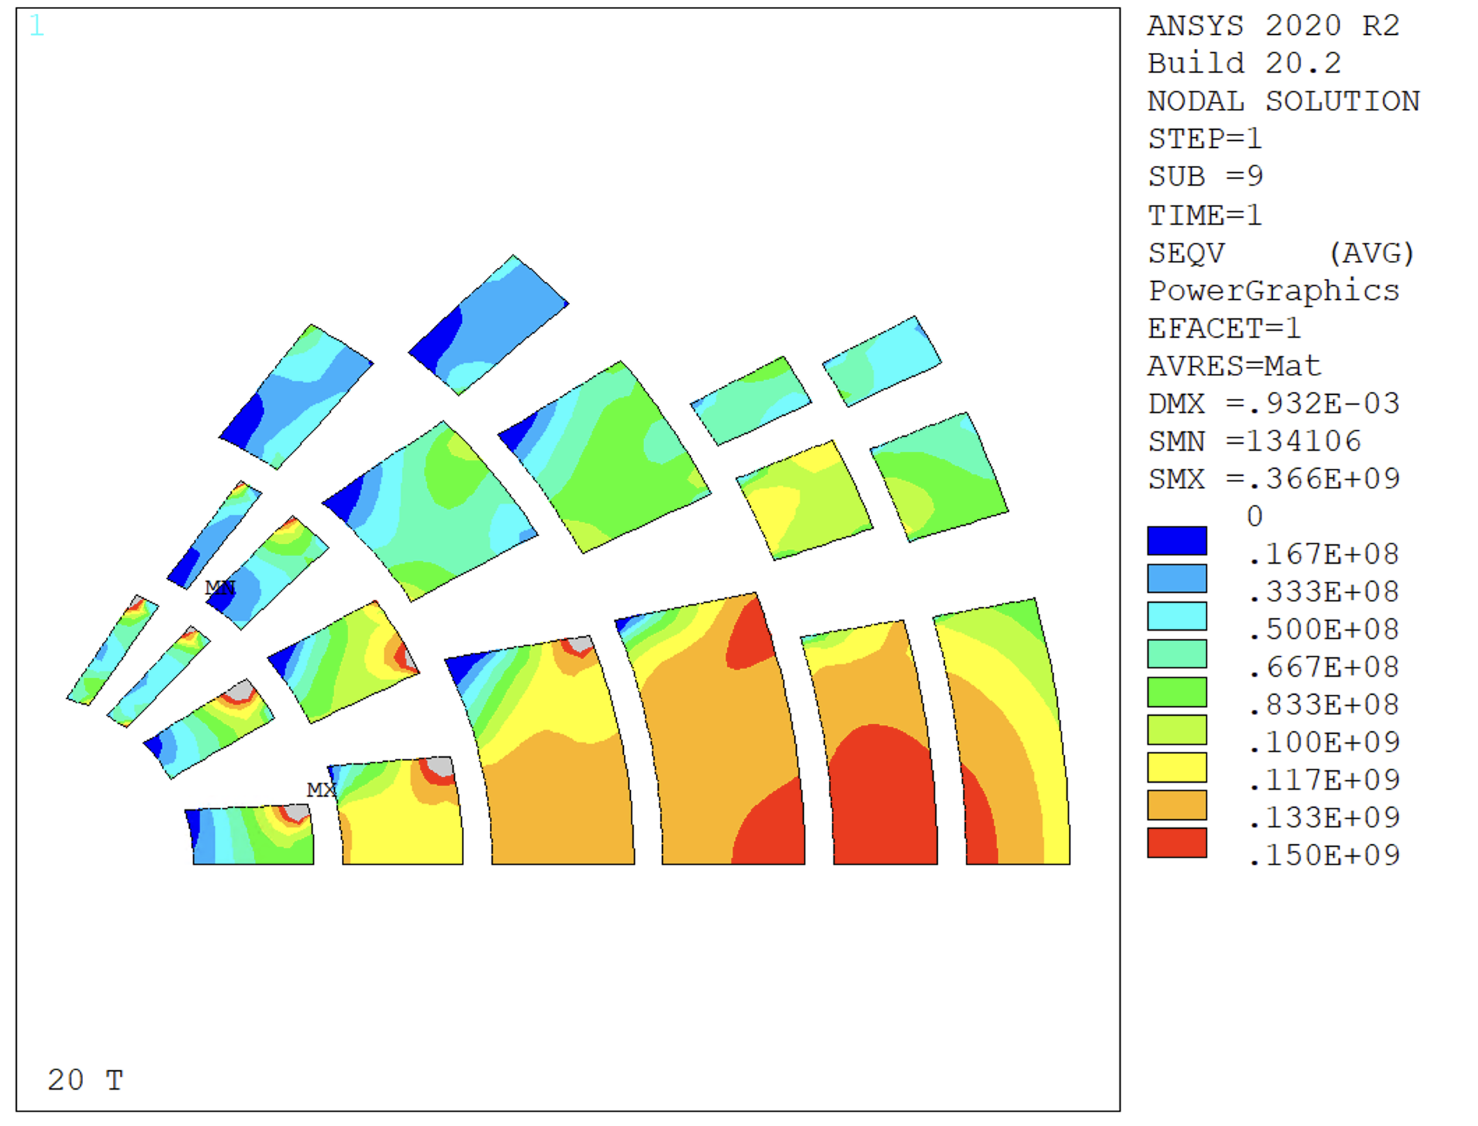
A test with an SMCT ‘Design’
Test with new model with coil non-bonded
Significant stress spike on the inner layer mid-plane block

Slide 21
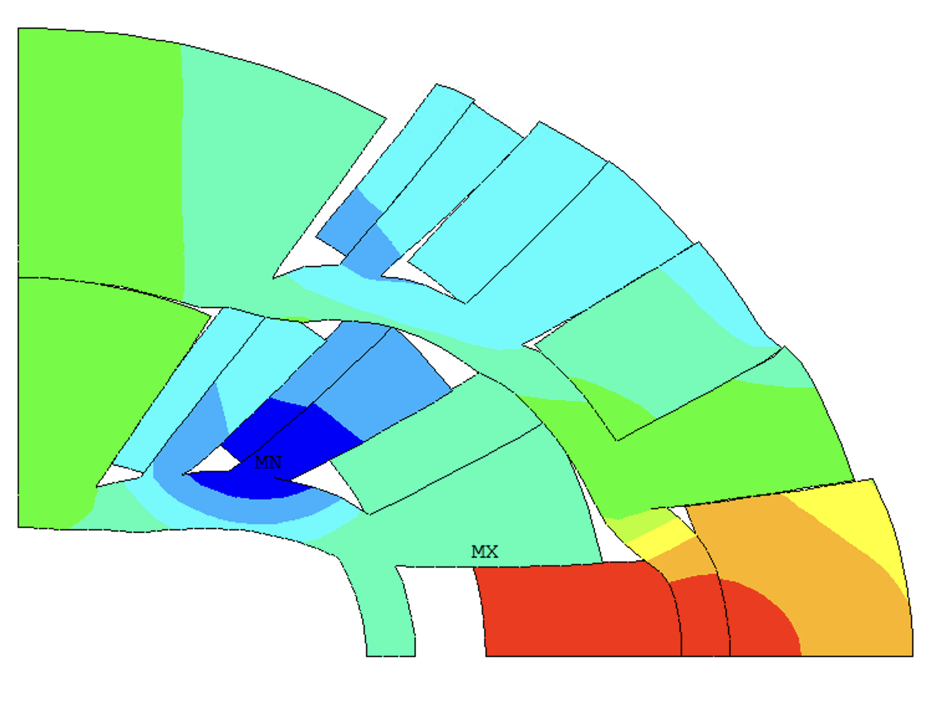
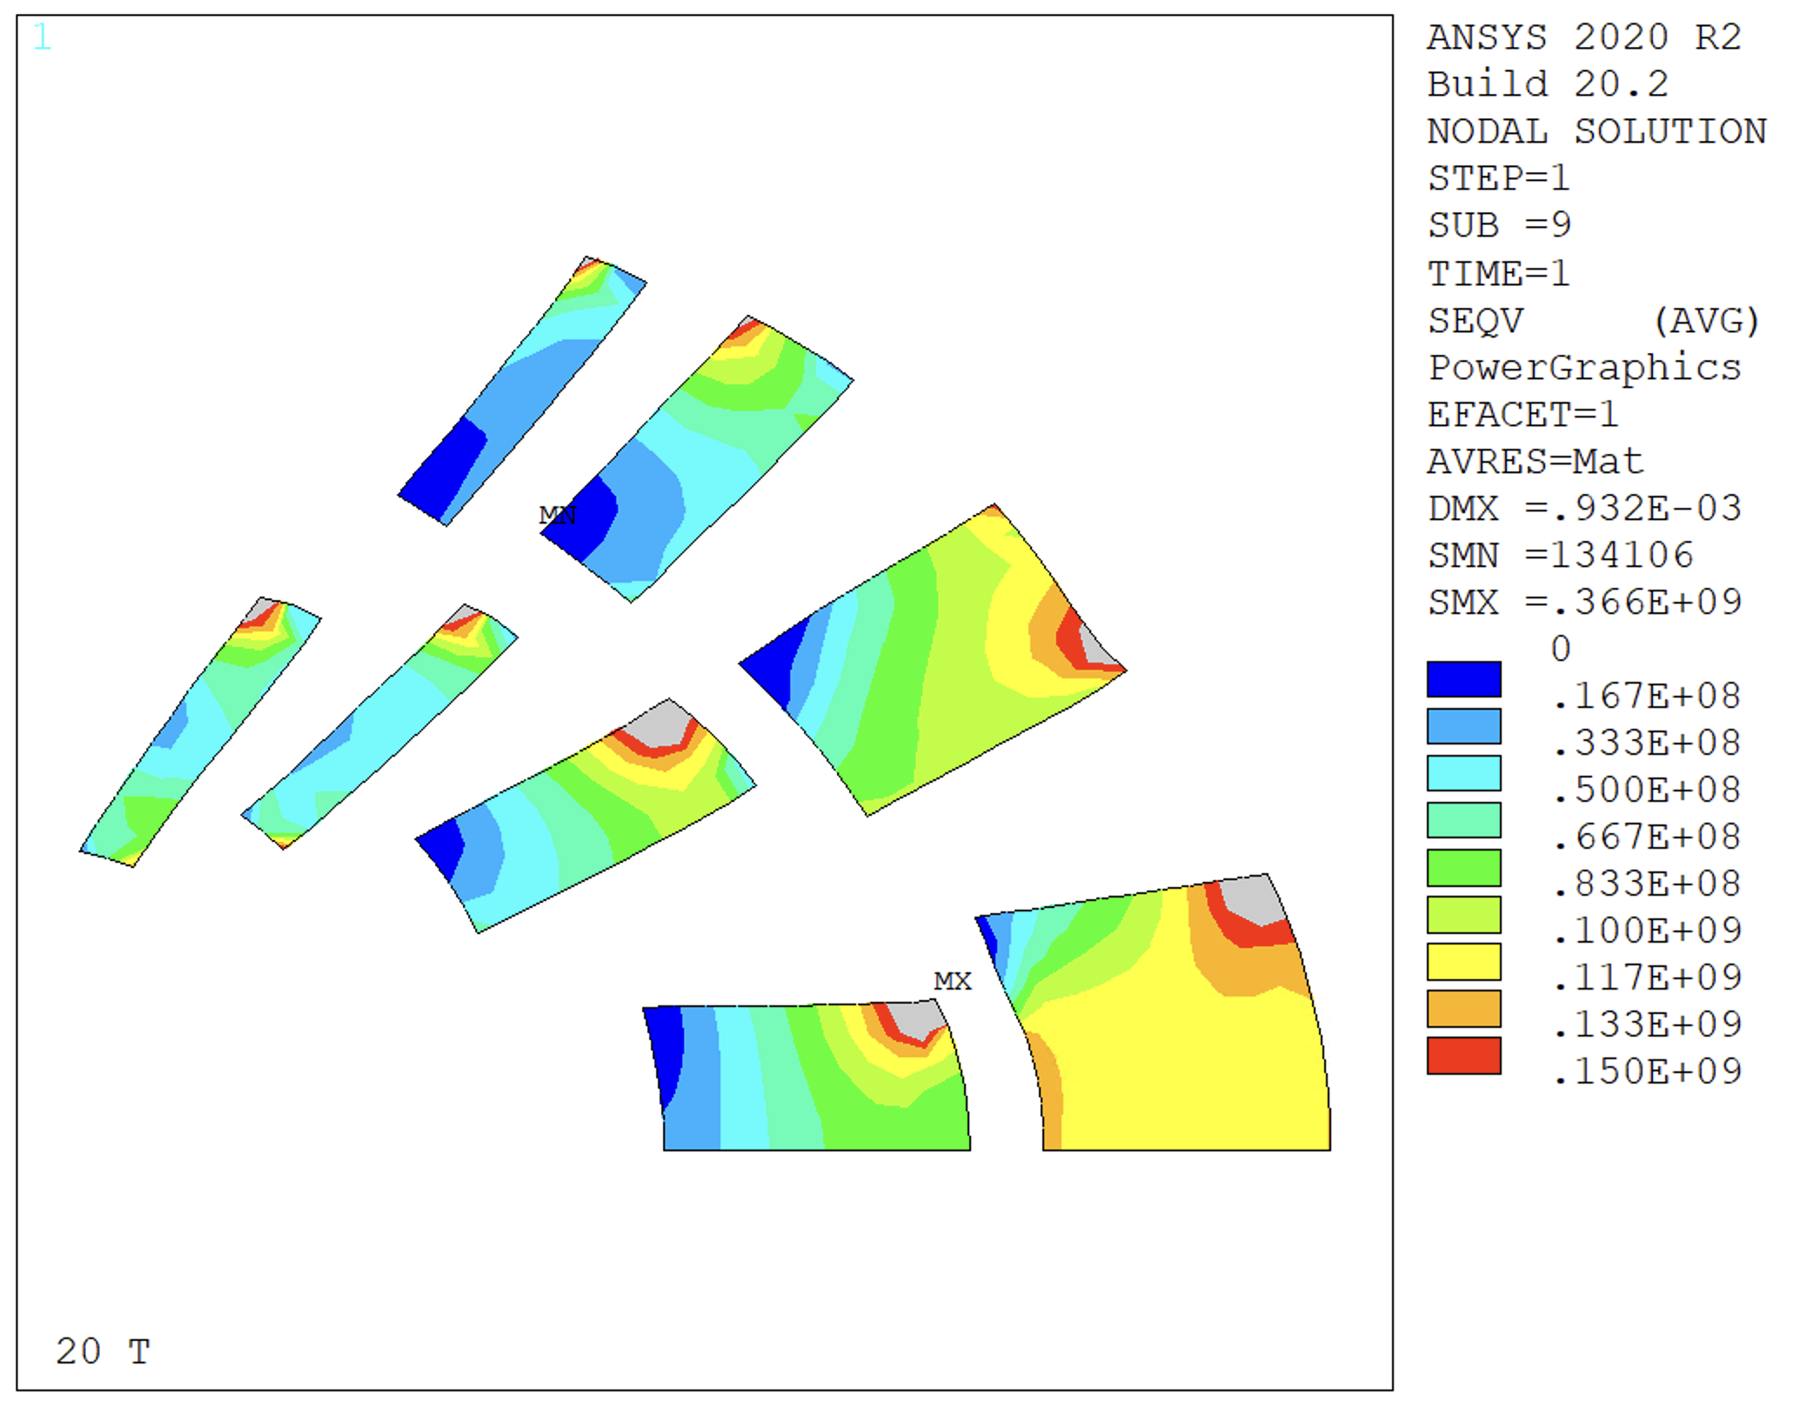
A test with an SMCT ‘Design’
This spike is due to radial forces and contact with the second layer spar
This result suggests that we need more radial support

Slide 22
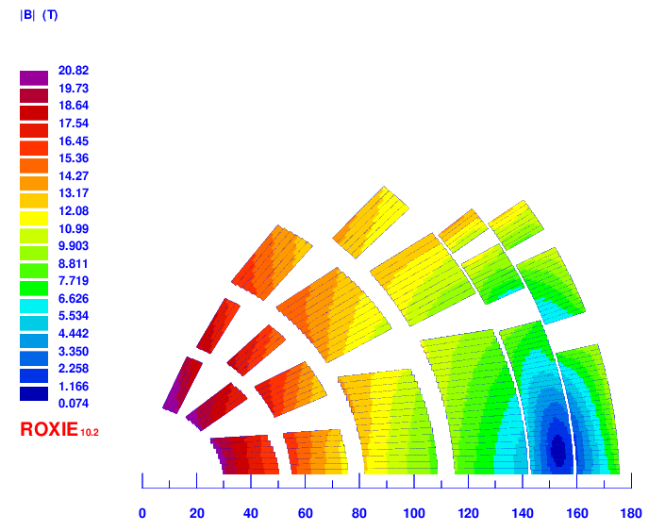
SMCT-CT hybrid: v17
2 layer HTS, 4 layer LTS
Strands: 0.9 – 1.1 – 0.8 mm, 40 – 44 – 35
Cable width: 20.65 – 26.82– 15.51 mm
Stabilizer/Superconductor: 3 – 1 – 1.2
Coil width: 158 mm
Current: 14200 A
Peak field: 20.8 – 16.26 – 13.36 T
Margin: 84.4 – 85.3 – 85.6 %
J_{cu} on LTS: 1479 A/mm²

Slide 23
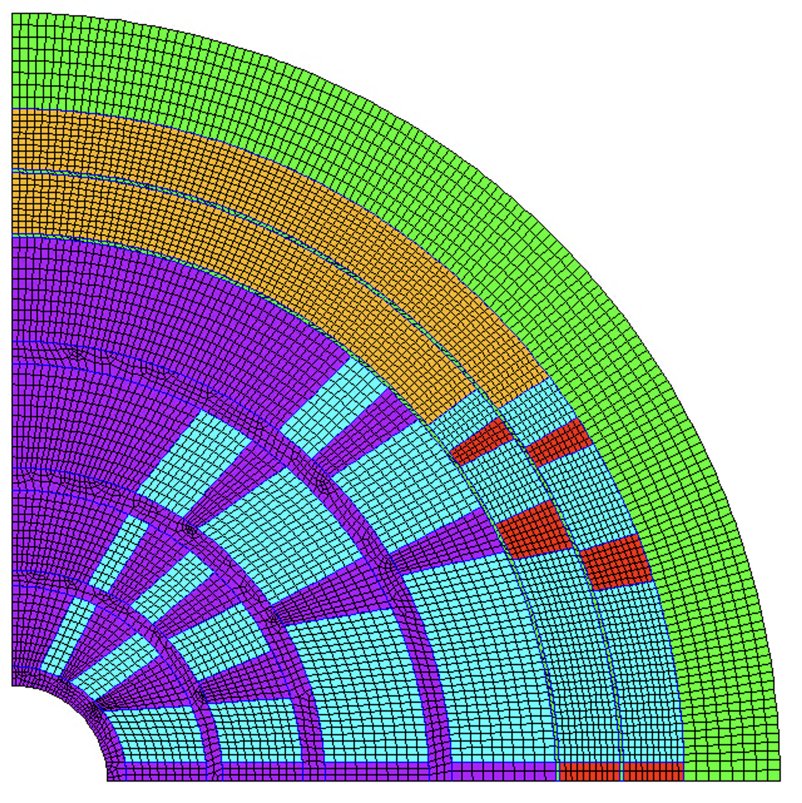
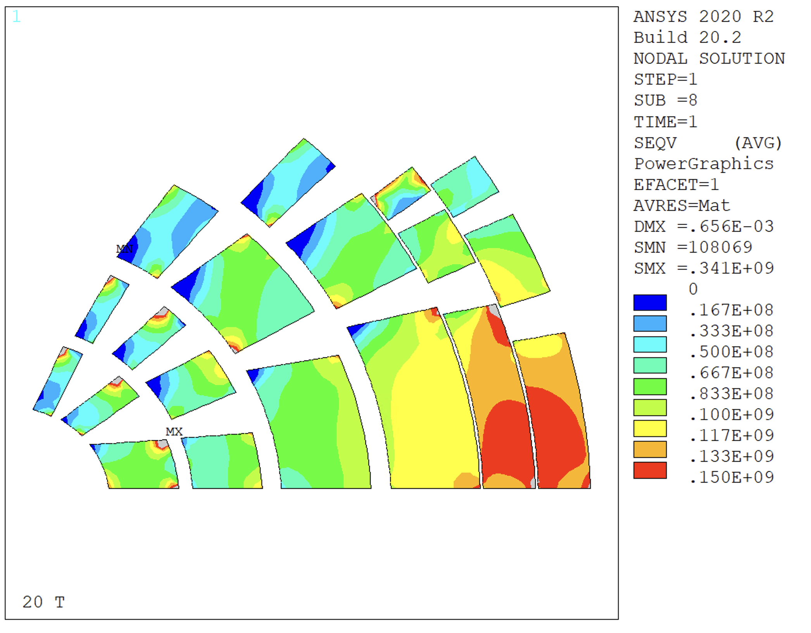
SMCT Design – v17
Adding a mid-plane ‘shim’
Layers 1-4 stress managed
Layers 5-6 with ‘standard’ wedges, impregnated

Slide 24
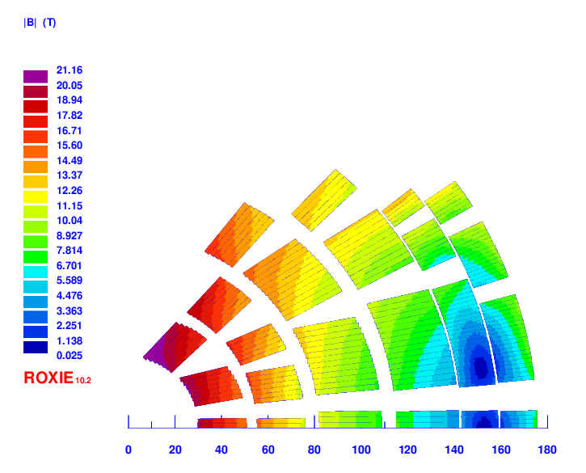
SMCT-CT hybrid: v18
2 layer HTS, 4 layer LTS
Strands: 0.9 – 1.1 – 0.8 mm, 40 – 44 – 35
Cable width: 20.65 – 26.82– 15.51 mm
Stabilizer/Superconductor: 3 – 1 – 1.2
Coil width: 158 mm
Current: 14200 A
Peak field: 21.2 – 16.23 – 13.09 T
Margin: 84.9 – 85.2 – 84.3 %
J_{cu} on LTS: 1479 A/mm²

Slide 25
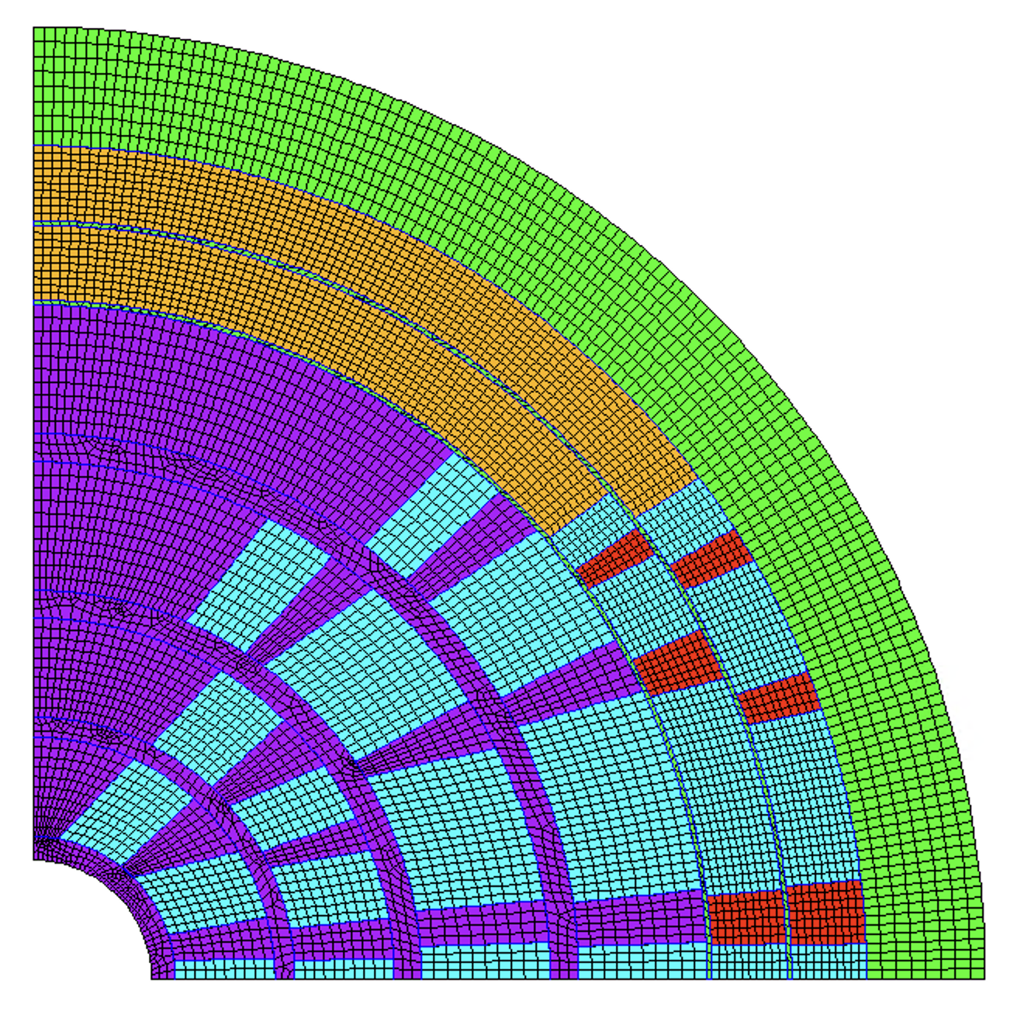
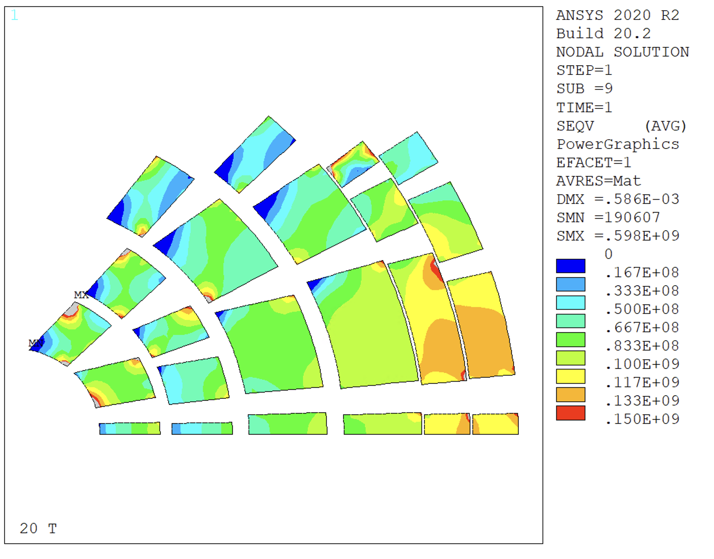
SMCT Design – v18
Aligned wedges, no thick mid-plane shim
Further improvement
  A magneto/mechanical optimization might help

Slide 26
Comparison
v0
v1
v2
Suggestions?

Slide 27
Index
Introduction
Magnetic Solution
Mechanical model results
  Rigid structures and stress management
  Thick intercoil study
  SMCT Study
Conclusion

Slide 28
Conclusion
Solution with rigid intercoil shims shows that layer 2 requires stress management (both radial and azimuthal)
Solution with ‘stress-managed’ layer 2 shows that also layer 1 needs stress management
  Layer 1 sees high azimuthal stresses even when introducing thick intercoil shims
  Layer 3 is very close to the stress limits, might also need stress management
  Other layers seem feasible also with no stress management (with a rigid structure around)
Thick steel intercoils do not provide enough stiffness to reduce the stresses in a CT design

Slide 29
Action Items
SMCT/CCT for inner coil (coil debonded from wedges), 5 mm spar on both layers, coil 2, 3 standard cos(ϑ)

Slide 30
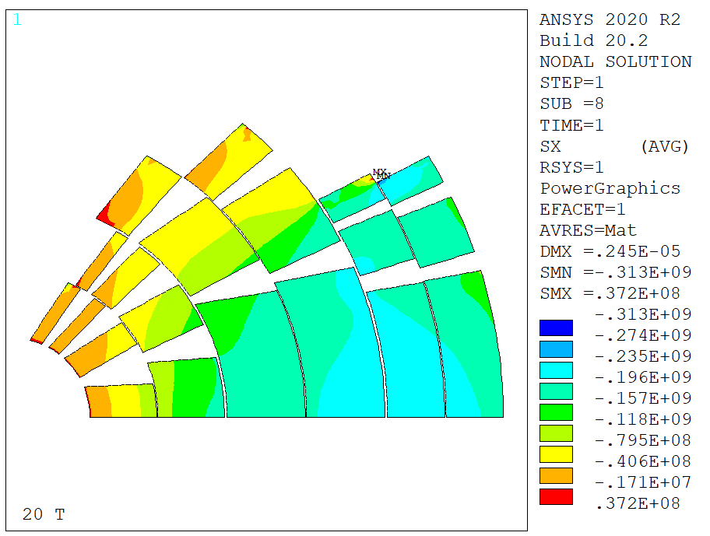
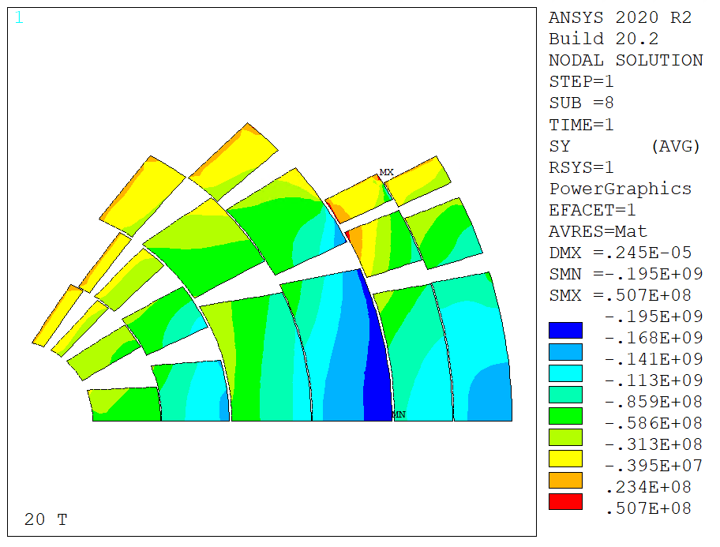
Rigid Structure and Coil
Radial
Stress
Azimuthal
Stress
Coil modelled as linear elastic, E = 1e4 GPa
  ~226 MPa radial, 195 MPa azimuthal
  REMOVE

Slide 31
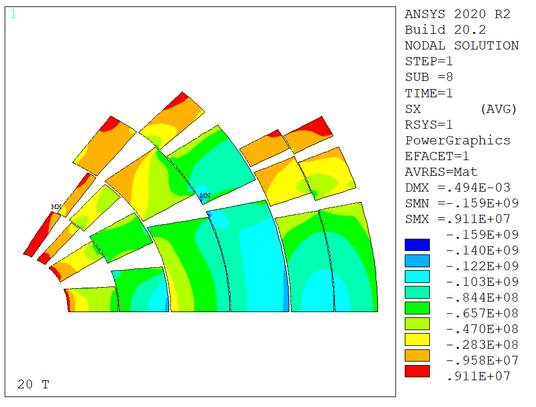
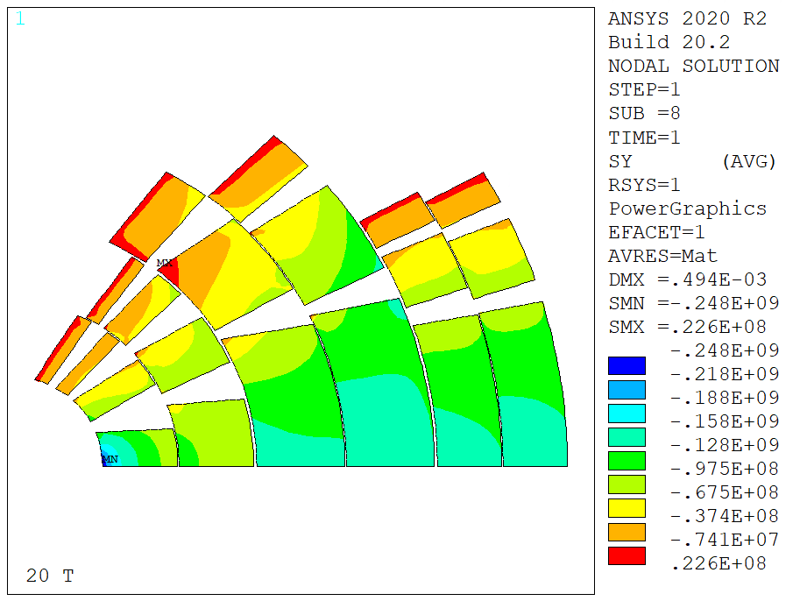
Rigid Structure, Intercepting (Rigid intercoil)
Coil modelled as linear elastic, E = 20 GPa
Intercepting structure, rigid intercoil (E=1e7 GPa)
~127 MPa radial, 248 MPa azimuthal
Should try with thicker intercoil
IN EXTRA / Non funziona il modello (contatti?)

Slide 32
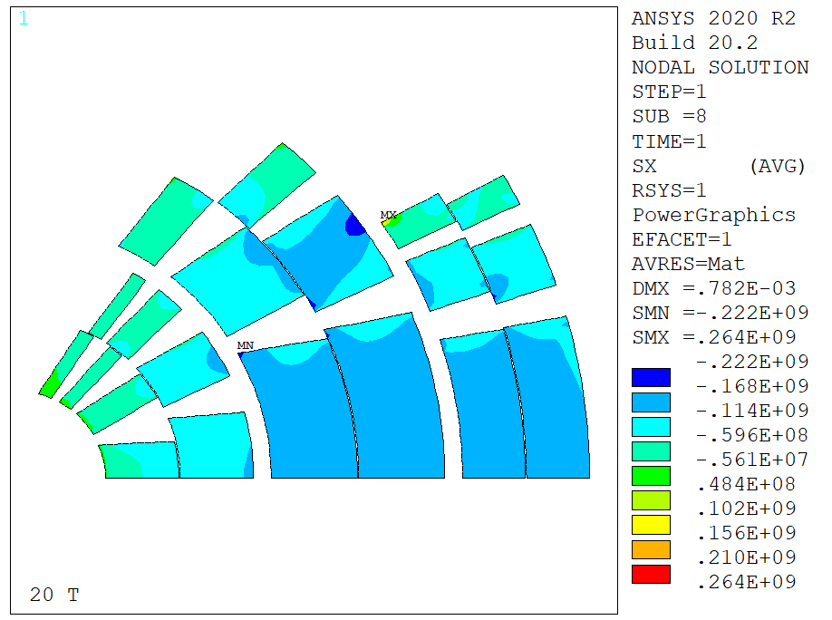
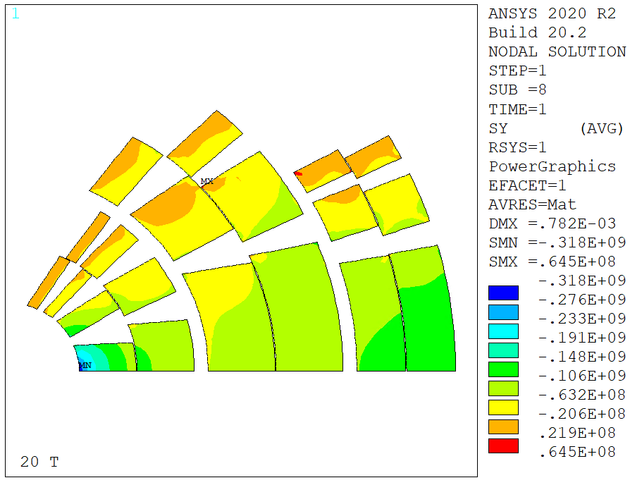
Case C – Steel Collars – Coil Impregnated
Intercoil shims closed at 90° (shell design)
Coils impregnated together
Still does not work

