Slide 1
20T Common Coil Design Status
Ramesh Gupta, BNL
MDP General Meeting
August 3rd, 2022

Slide 2
Overview
Onward from what was presented at the annual meeting
Question: Do the advantages of common coil design still hold after a more detailed analysis? Review them one by one for 20 T hybrid
Progress made since the annual meeting
Question: Are the design requirements met when the same (not similar) design is used for the magnetic and mechanical analysis?
Future plans (including a proof-of-principle demo magnet)
Question: Apart from developing the design of 20 T dipole, can an accelerator type common coil dipole be demonstrated within MDP?
Summary

Slide 3
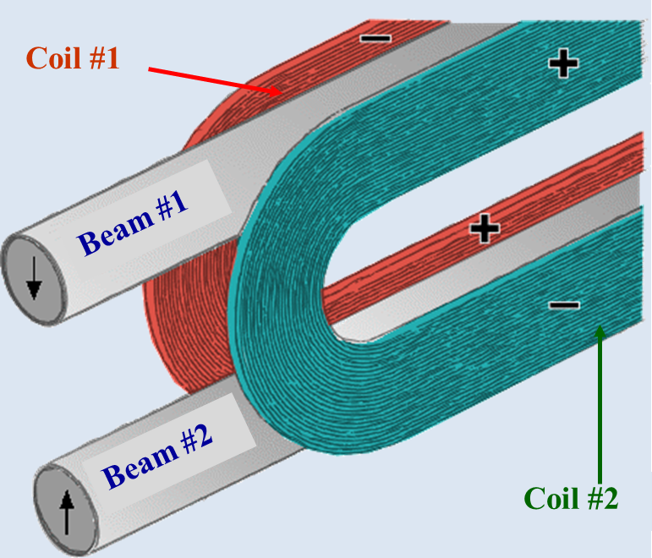
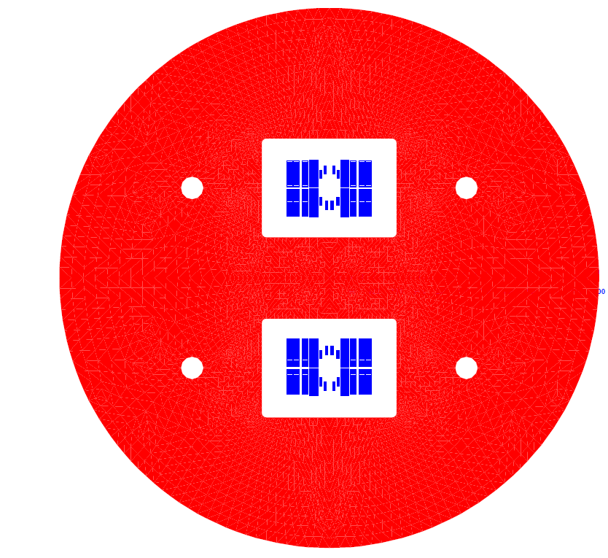
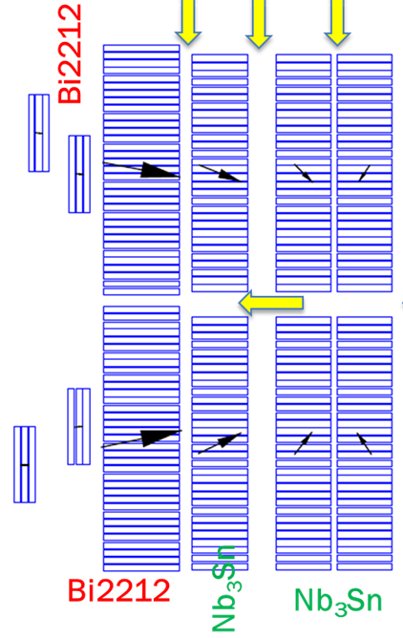
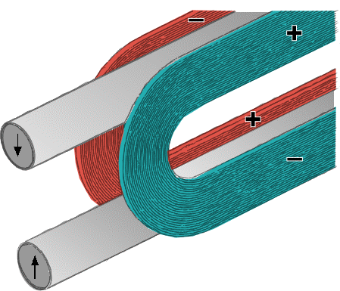
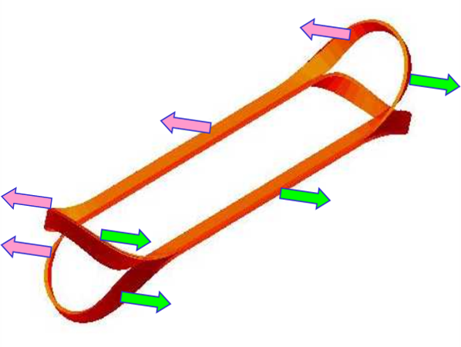
Common Coil Geometry for High Field HTS/LTS Hybrid Collider Dipole
6
7
10
12
1
3
4
5
7
9
11
2
Common coil design
Inherent benefits/limitation of the geometry
Significantly lower conductor usage over other designs at high fields
Easier and efficient segmentation between HTS and LTS coils
All LTS coils identical – significant savings, particularly in R&D
Good field quality and required 15% operating margin over 20 T
Unique geometry for managing large Lorentz forces at high fields
CT/CCT and block designs

Slide 4
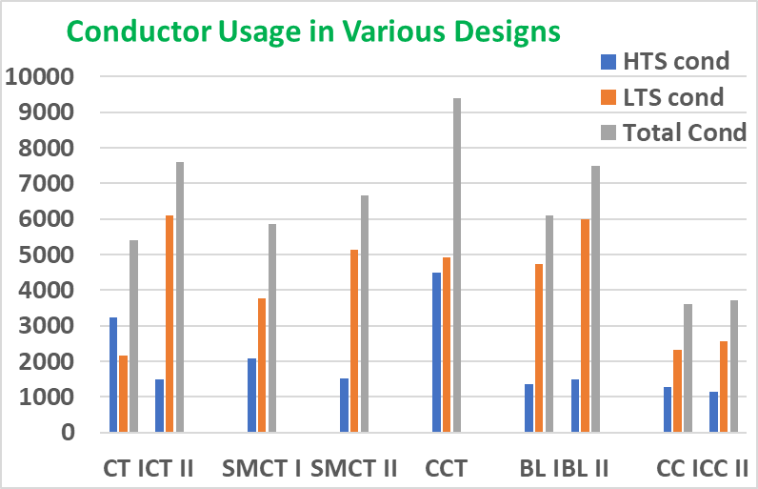
Common Coil Design Uses Less Conductor for Very High Field Dipole
Stress Managed Cosϑ
Block coil
(BL)
Cosϑ
(CT)
(SMTC)
Common Coil (CC)
Canted Cosine Theta
(CCT)
Common Coil
1
2
3
4
5
1
2
3
4
5
Comparative studies of 20 T designs (as presented at MT) revealed that the common coil design uses significantly less conductor (including less HTS) than the other designs. This was a surprise initially; now understood and validated.
Question: Is that still valid after a more detailed analysis? YES

Slide 5
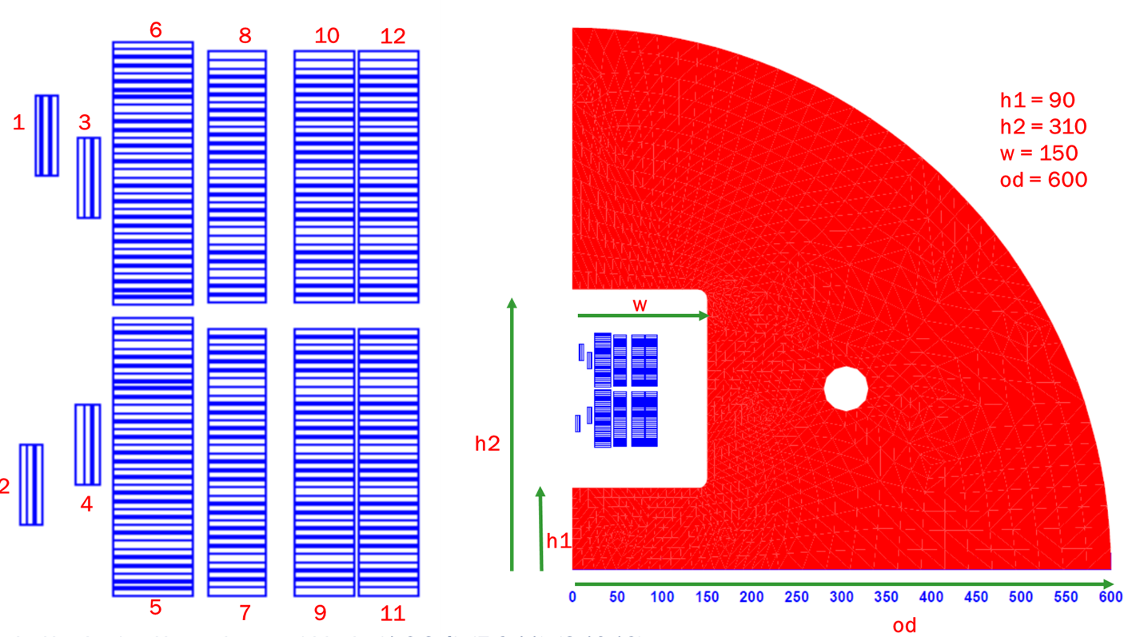
Efficient Segmentation between HTS and LTS Coils; + Identical Nb₃Sn Coils
Nb₃Sn coils
(identical)
Efficient segmentation between HTS and LTS coils; only HTS coil for the main coil (plus small pole coils)
All Nb₃Sn coils can be made identical. Meaning only one set for winding, reaction and impregnation tooling with a simple racetrack coil geometry.
Need less practice & spare coils; can sort/switch coils between layers. These two offer significant savings.
Question: Is that still valid after a more detailed analysis? YES
Such prospects can't be imagined in the CT/SMCT or CCT designs
Bi2212
Bi2212

Slide 6
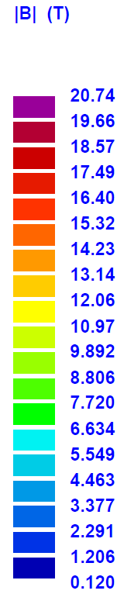
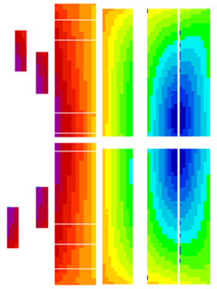
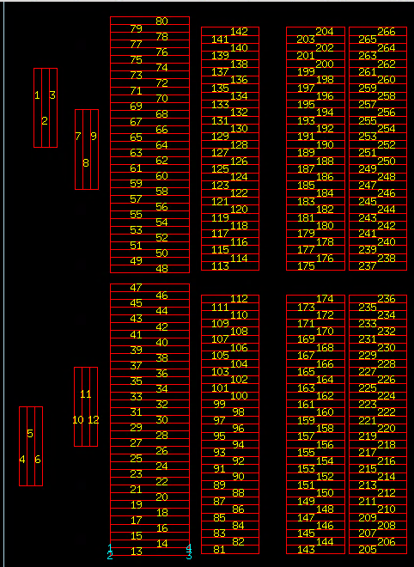
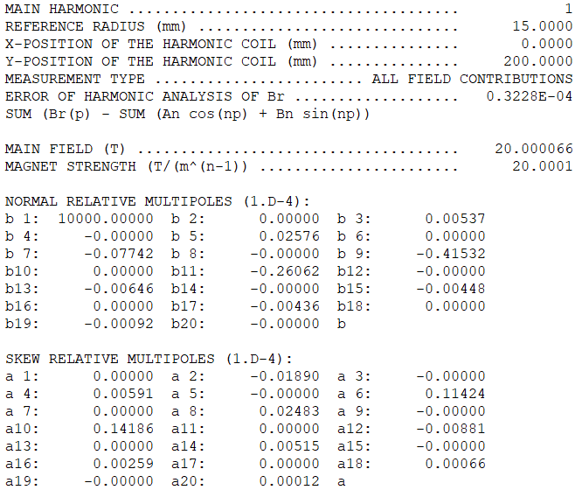
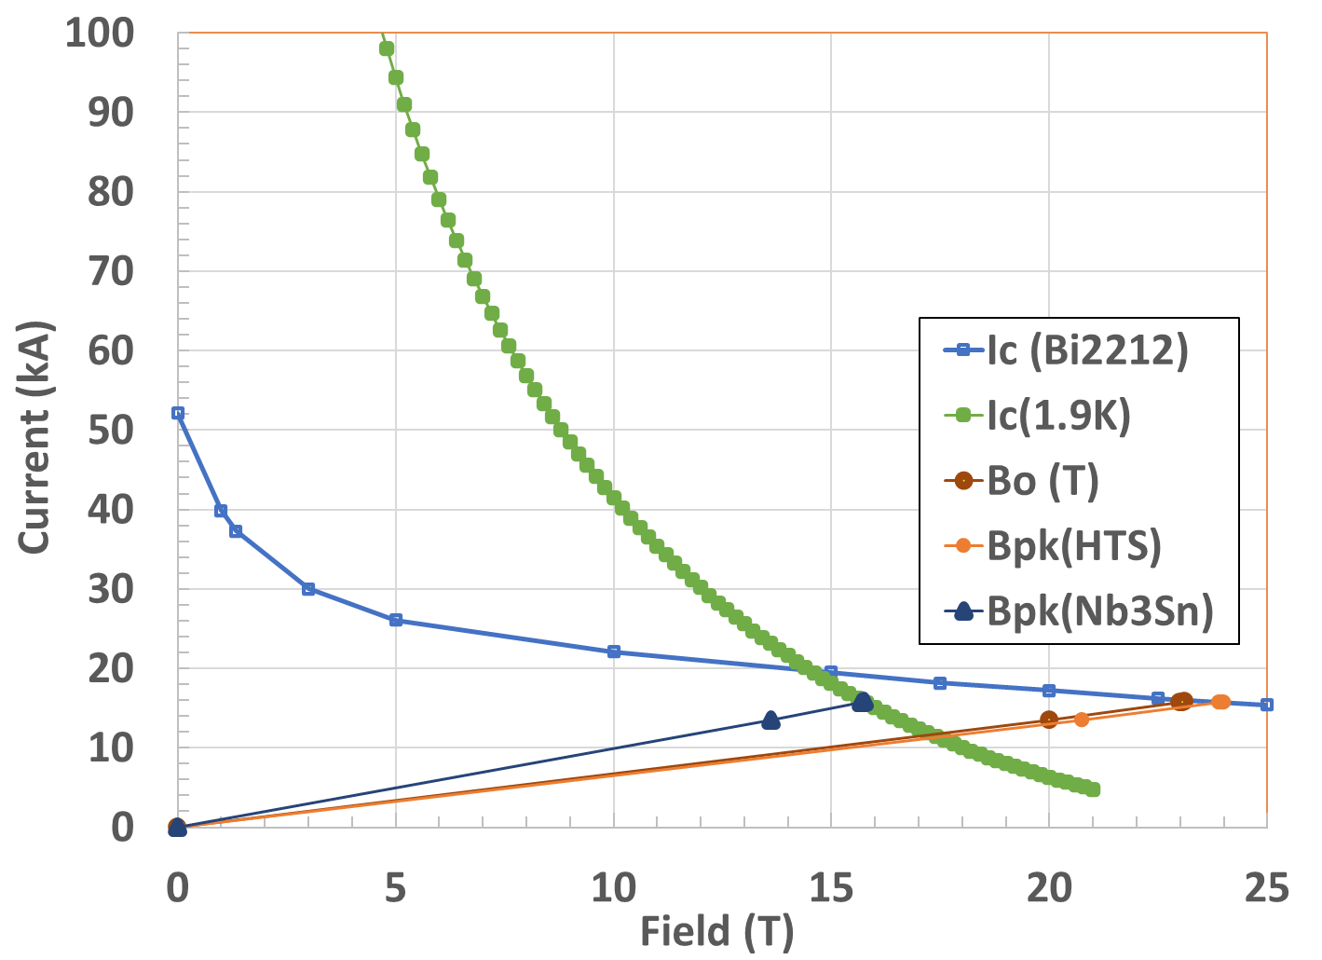
Design Meets the Field Quality and Operating Margin Requirements
Question: Is that still valid after a more detailed analysis? YES
No. of Turns
(½ bore)
HTS: 80
LTS: 186
Total: 266
Geometric harmonics < 0.5 10⁻⁴

Slide 7
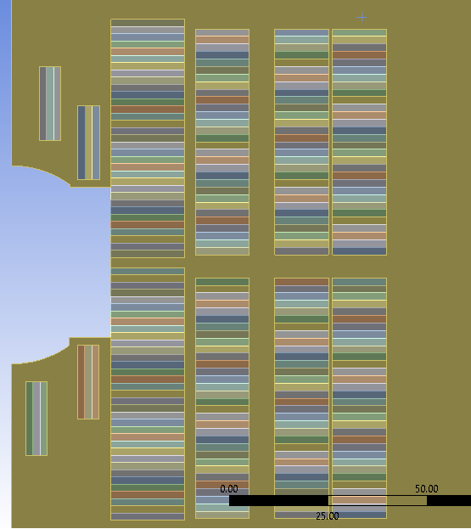
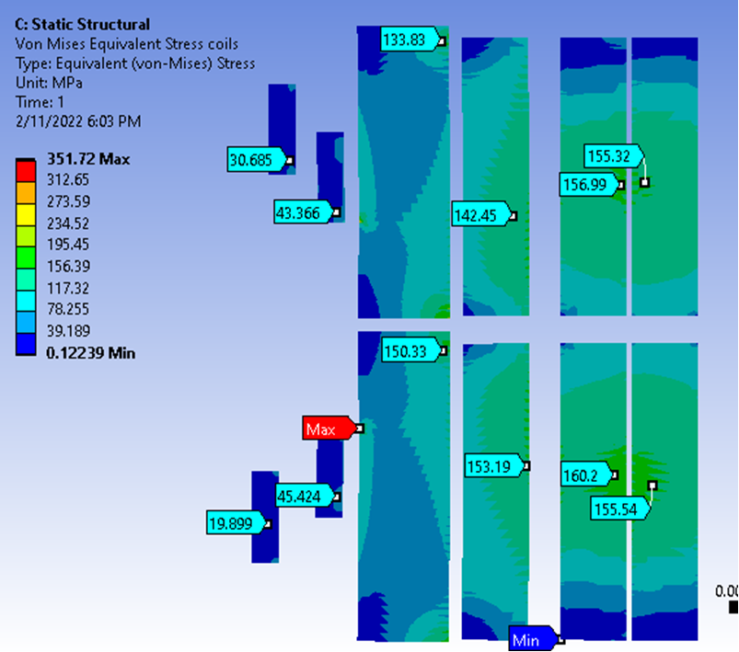
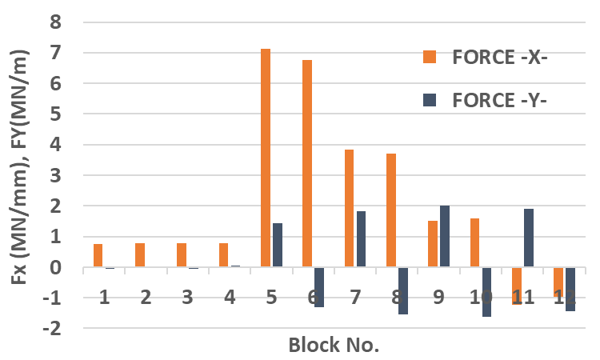
Initial Mechanical Analysis of the
20 T Hybrid Common Coil Design
Horizontal forces much larger than vertical (vertical is 1/3 of horizontal)
Large horizontal deflection can be tolerated since coils move as a unit - without causing much internal strain in the ends or transition regions
Chris Runyan
John Cozzolino
Mike Anerella
Von Mises in coil
Different models showed that the stresses in coils can be kept below the maximum specified. However, it was not demonstrated in the same geometry and not exactly the geometry that was used in the magnetic design.
Now we are using the same geometry for all analysis to find a self-consistent solution. Good progress.

Slide 8
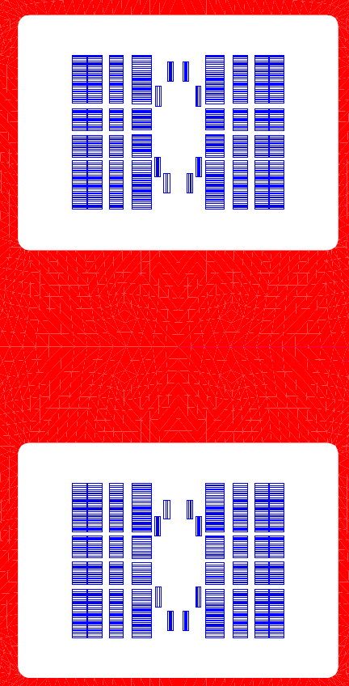
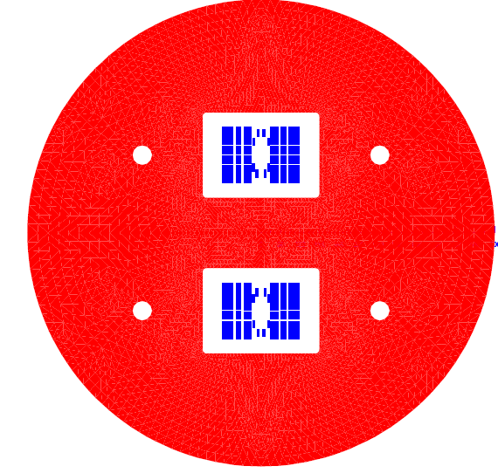
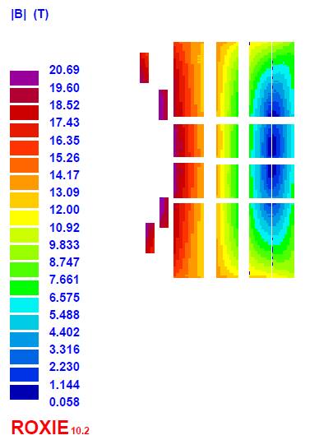
New 20 T HTS/LTS Hybrid Design (May 2022) (spacers in magnetic design takes input from mechanical)
Low Peak Field Enhancement (<3.5%) means more margin
25 mm clear bore + sufficient structure

Slide 9

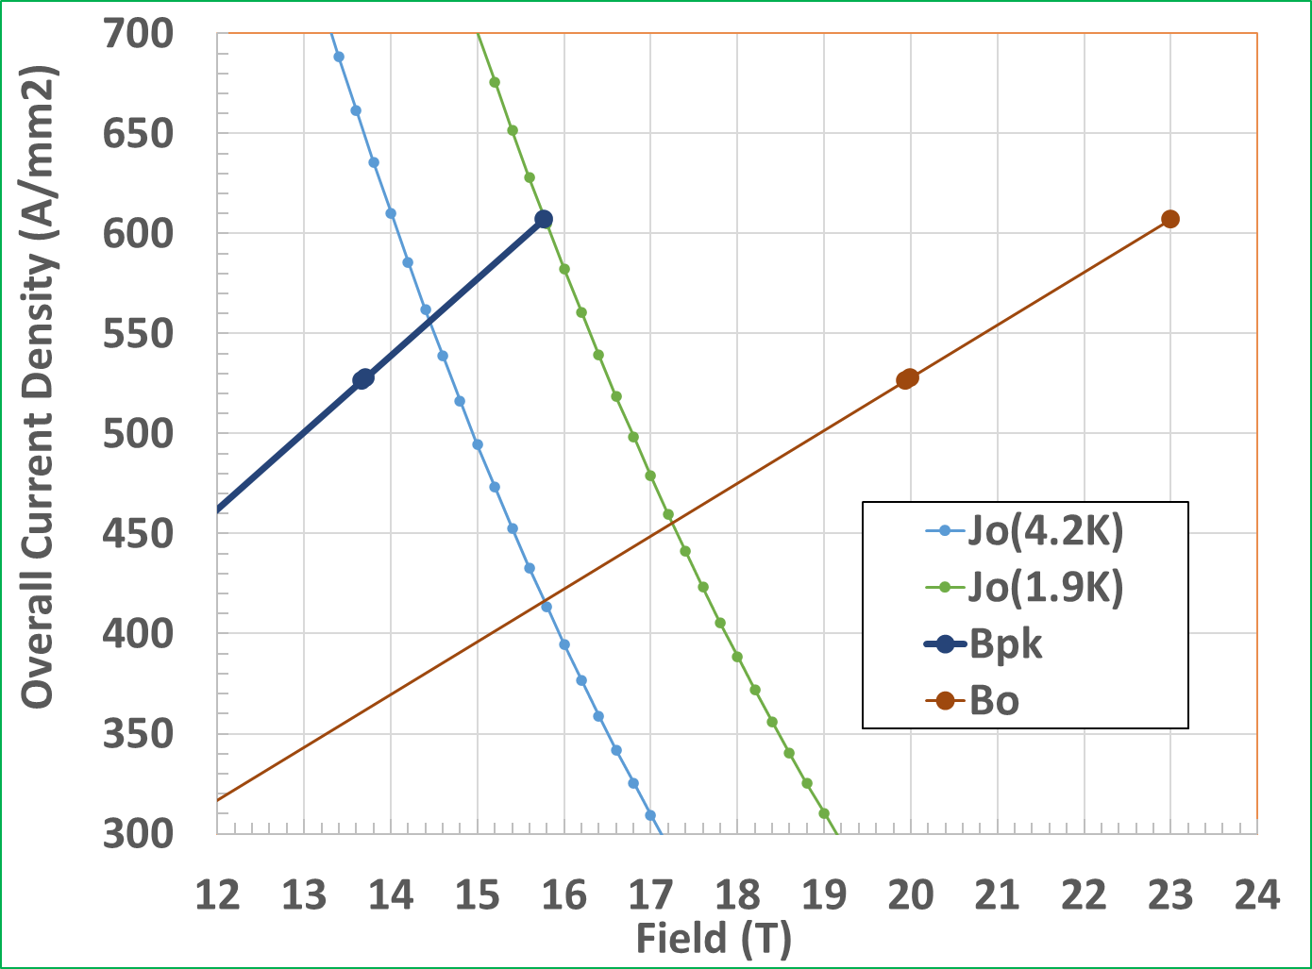
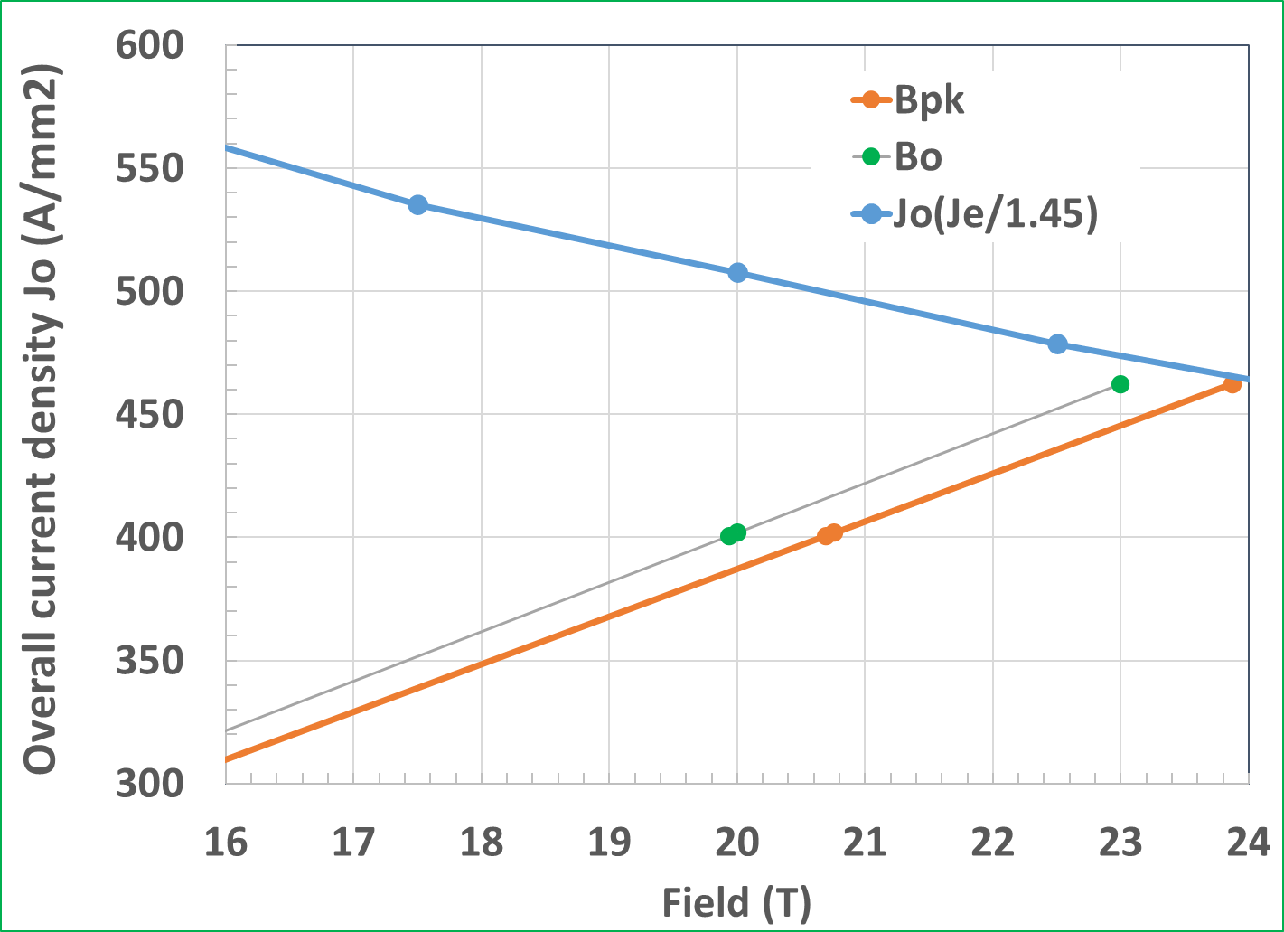
Magnetic Design (May 2022) with 15% Margin
LTS
Peak Field (Bpk)
Nb₃Sn (2K)
Central Field (Bo)
HTS
Central Field (Bo)
Peak Field (Bpk)
Nb₃Sn (4.2K)

Slide 10
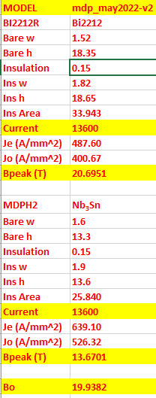
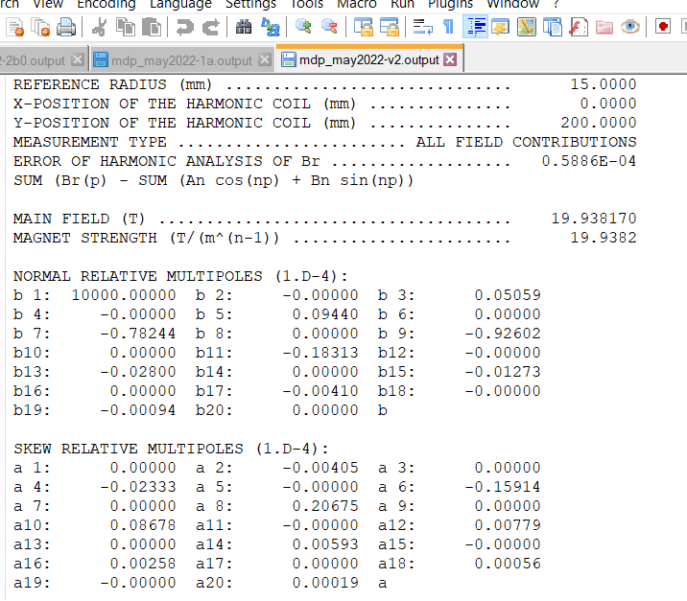
Magnetic Design (May 2022) Good Field Quality
All harmonics <1 unit

Slide 11
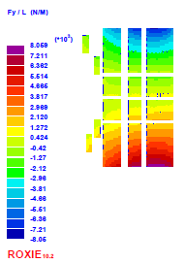
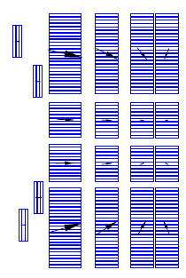
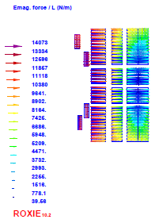
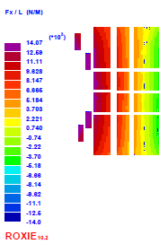
Strategy Behind the Mechanical Structure (take advantage of the force distribution)
New Design: Forces @20 T (Mostly horizontal, particularly on HTS coils)
Key Components of Structure: Vertical Plates, Horizontal Spacers, Collars, Yoke, Shell + ???
Horizontal
Vertical
Advantage Common Coil: Forces can be easily managed

Slide 12
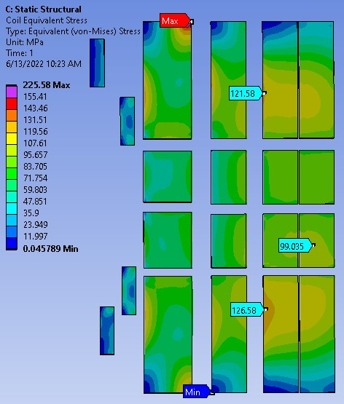
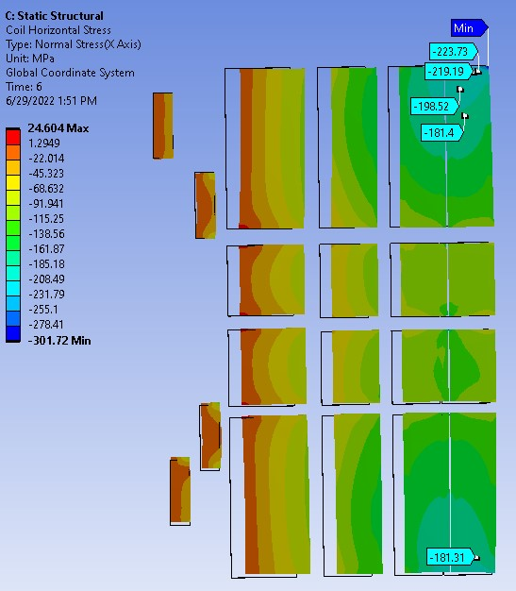
Developing Mechanical Structure
Original Case
(vertical spacers bonded to the collar)
SST vertical separators are allowed to slide relative to the collar
Pole
Stresses and Strain are within acceptable limits at most places See John Cozzolino’s presentation
However, at pole the exceed the limit either in HTS or in LTS, depending on the contact (bonded or sliding)
Attempt to make things better increased the local peak
This is because of the bending of the coil layer. The two cases show that it can be balanced out
Next slide for some possibilities
Pole
Midplane
Midplane
Pole
Pole

Slide 13
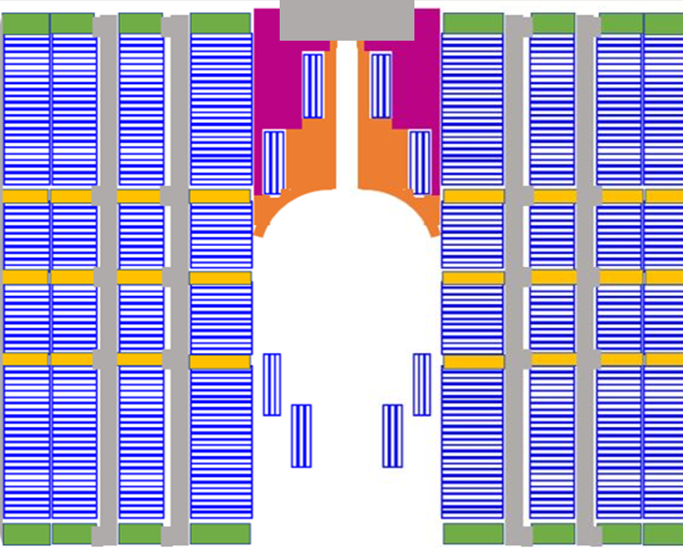
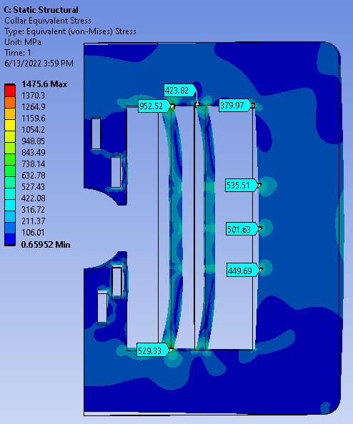
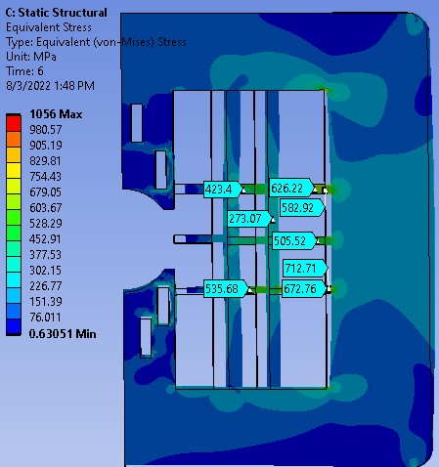
Balancing the stresses HTS Vs LTS & Midplane Vs Pole
Concept to reduce the bending stress at the top and bottom of the coils:
(a) Weaken collars near the pole region to allow more deflection at the top and bottom
(b) Use spring or softer material or gaps to allow some limited deflection to transfer the stress
Holes in the collar to control deflection (to make them uniform), like the holes in the iron to control saturation
Softer material
Or Gap
Or Spring

Slide 14
Next Step
Tasks after completing the iterations of the mechanical structure:
Perform quench protection analysis.
Develop concepts for assembling the magnet.
Perform 3-d magnetic and 3-d mechanical analysis for a 20 T design.
Perform refined mechanical analysis for practical 3-d structures.
Several common coil dipoles with main coils have been built and tested; however, none with the pole coils necessary for the field quality. Build pole coils and demonstrate them in a proof-of-principle magnet (e.g. in DCC017).
Perform cost estimates of R&D dipoles and for large scale series production.
As a part of “comparative” task force, compare the complete package with other designs (including unique advantages and disadvantages)

Slide 15
What is the most critical thing that must be proven for the common coil design?
Although several common coil designs have been designed with a variety of conductor (NbTi, Nb₃Sn, Bi2212, Bi2223, ReBCO), all have been made with the main coil only
The most efficient design to obtain good field is the one with the pole coils
We need to demonstrate a proof-of-principle design for pole coils that clear the bore tube. Many geometry considered but none demonstrated.
Pole coils can be built, integrated and tested with the main coils in the BNL common coil dipole DCC017. Attempt to do that demo took off three times with SBIR Phase I (see next slide). However, none could be carried out as no Phase II was funded despite the productive work in Phase I.
Proof-of-principle demo of the pole coils should be a priority for MDP. It can be done in a short period at a low cost for insert coil made anywhere

Slide 16
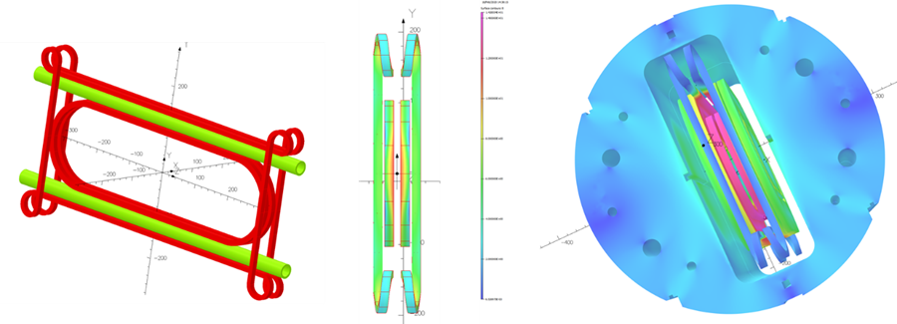
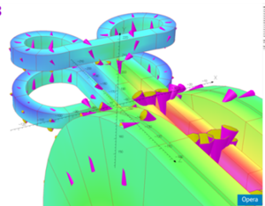
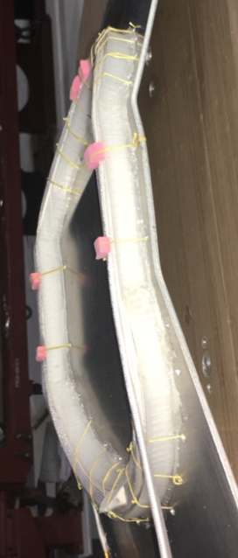
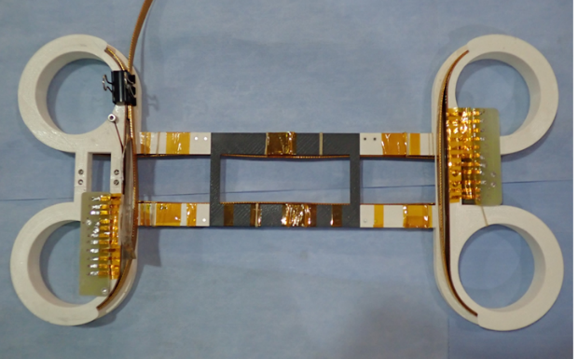
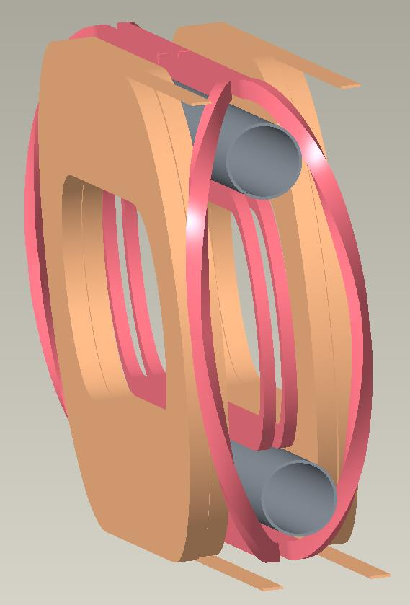
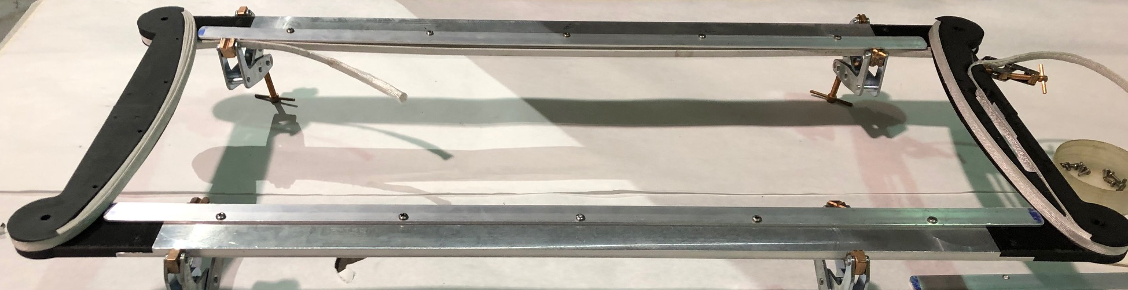
A Few Possible Layouts of Pole Coils Clearing the Bore (other geometries discussed elsewhere)
Overpass/underpass (cloverleaf) design
Practice pole coil windings and preliminary designs performed under “three” Phase I SBIR/STTR.
A part of MDP can be a Proof-of-Principle demo of an accelerator type common coil dipole at 10+ T
CERN is also working on this design
HTS Coil
Nb₃Sn Coil
Insert coils pole coils will be wound & tested with DCC017

Slide 17
Summary
MDP comparative study revealed that for very high field dipoles (20 T), common coil design uses significantly less conductor than that used in other designs. The analysis presented here explains why?
Common coil offers several advantages, some outlined in this presentation.
A focused effort should now be made across the labs to develop this design in more detail (including 3-d design, quench protection, assembly, R&D plan, etc.).
This is a different design and provides new opportunity. A good opportunity for new scientists and engineers (who come with less to NO pre-conceived notions and biases) for doing pioneering work.
Suggest that we to do a full comparative study of all options in the next annual meeting and see if an update in direction is warranted.

