Slide 1
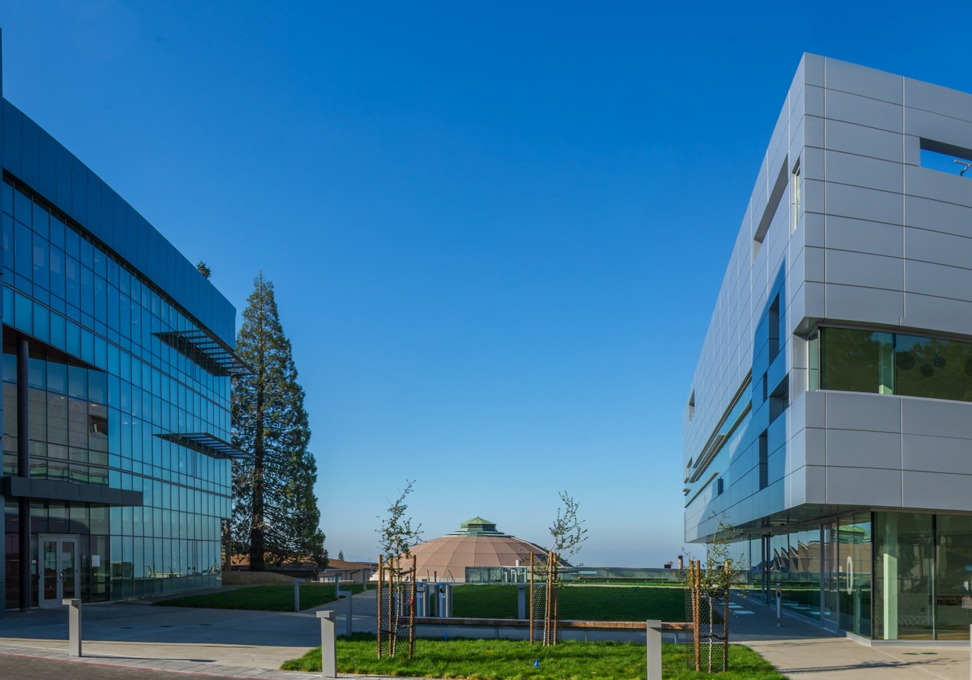
Review of EOC feedback and project actions
External Advisory Committee
Soren Prestemon
Director, US Magnet Development Program
Director, Berkeley Center for Magnet Technology
Lawrence Berkeley National Laboratory
MRCH 20, 2024
LBNL, Berkeley, CA

Slide 2
EOC - Charge
  Joe Minervini (Chair)
  Steve Gourlay (Co-chair / Backup)
  Luca Bottura
  Luisa Chiesa
  Danko van der Laan
  Ruben Carcagno
  Nicolai Martovetsky
Charge
1. 1. Comment on the project status, in particular technical advances on the magnet and on the facility preparations.
2. Is the project taking appropriate steps to address community needs and to manage expectations for the facility?
3. Are project risks reasonably documented and understood by the project team? Are there additional risks that the project should consider?
4. What are the long-term considerations that we should be acting on now?
5. Have we reasonably addressed feedback from the last EOC meeting?
Role of the Oversight Committee (OC):
  Represent user interests in facility plans
  Provide guidance and oversight for the overall facility development
  Provide feedback on performance goals, overall design, and its implementation
  Provide advice to the project management in terms of:
                - Responsiveness to community needs
    - Coordination and integration of efforts magnet/facility
    - Balance of project risk and cost & schedule
  Provide guidance on:
    - Facility operational structure and user needs
    - Collaboration and coordination with other laboratories
  Provide feedback to sponsors on project team performance

Slide 3
Our organizational structure is stable and proving to be effective
The current organization is shown to the right.
  Note that resources (people) are managed by SP and GV within the two organizations (not the PM’s).
At LBNL, PF has close oversight of Magnet Program staff (including engineers, designers, and technicians)
  Over last ~year, significant staffing improvements:
    New designers (Anjana and Ryan; 20% of Serenity) and technicians brought on board

Slide 4

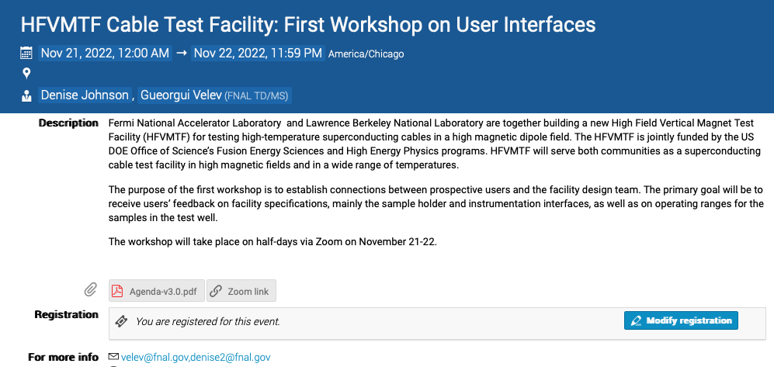
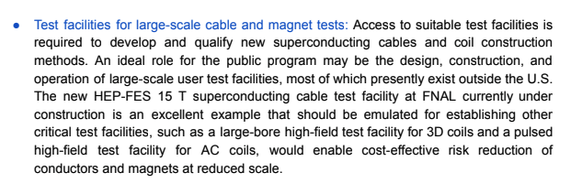
Significant community outreach underway
We had a very productive first meeting with the user community
It is time to organize a second meeting to further clarify and prioritize sample testing capabilities
Workshop website link
From summary report:

Slide 5
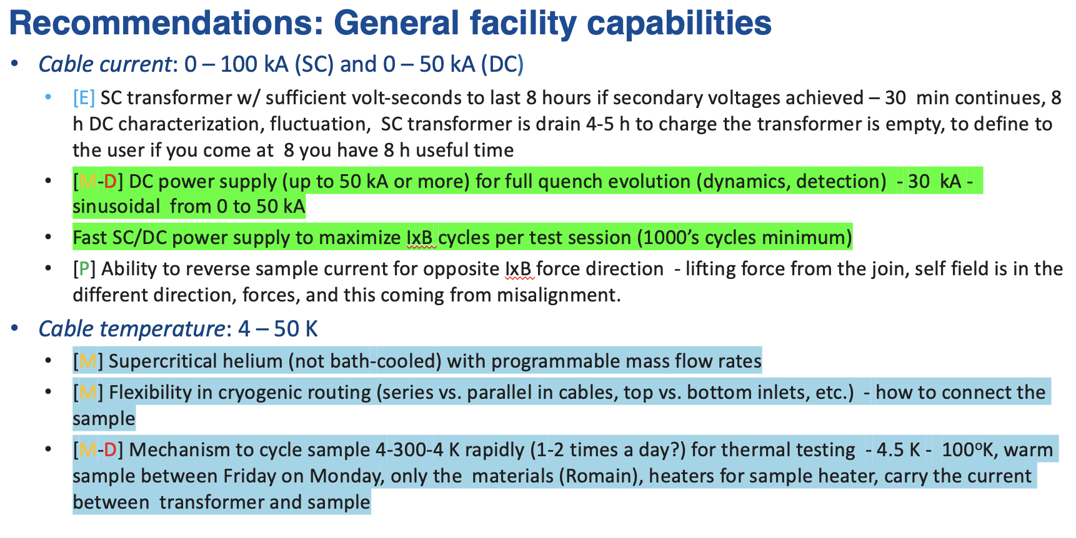
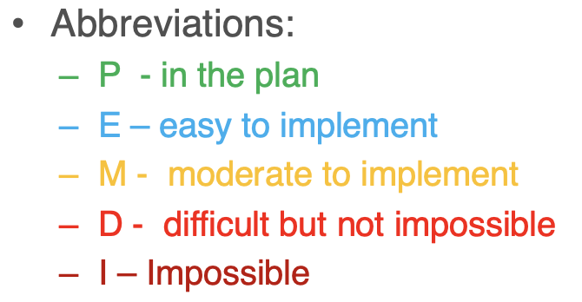
First Workshop on User Interfaces provided important guidance
A suite of recommendations were distilled
  First of six pages of wish-list and recommendations:

Slide 6
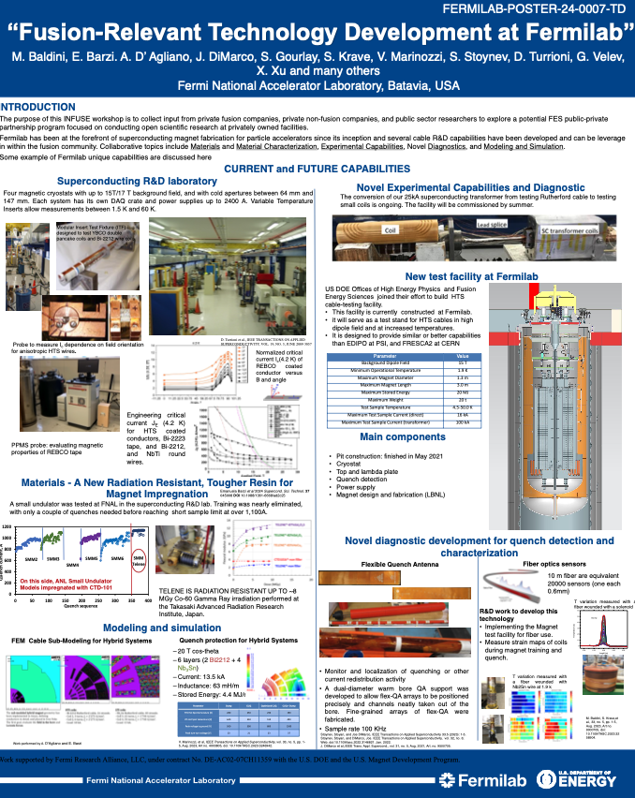
Examples of presentations and publications to the community
Conference/workshop oral presentations:
  ASC 2022, Honolulu
  MT-28 (2!), Sept. 2023,Aix-en-Provence, France
  Superconducting Magnet Test Facility Workshop, April, 2023, Salerno, Italy
Also communicated at the recent INFUSE workshop, PPPL
Publications:
  G. V. Velev et al., "Design and Construction of a High Field Cable Test Facility at Fermilab," in IEEE Transactions on Applied Superconductivity, vol. 31, no. 5, pp. 1-4, Aug. 2021G. Vallone et al., "Magnetic and Mechanical Analysis of a Large Aperture 15 T Cable Test Facility Dipole Magnet," in IEEE Transactions on Applied Superconductivity, vol. 31, no. 5, pp. 1-6, Aug. 2021, Art no. 9500406,
  J. L. R. Fernández et al., "Engineering Design of a Large Aperture 15 T Cable Test Facility Dipole Magnet," in IEEE Transactions on Applied Superconductivity, vol. 32, no. 6, pp. 1-5, Sept. 2022
  G. Vallone et al., "Computation of the Strain Induced Critical Current Reduction in the 16 T Nb3Sn Test Facility Dipole," in IEEE Transactions on Applied Superconductivity, vol. 33, no. 5, pp. 1-5, Aug. 2023
  G. Vallone, E. Ravaioli, E. Anderssen, D. Arbelaez, J. R. Fernandez and G. Sabbi, "Simulation of Thermo-Mechanical Stresses After a Quench in the 15 T Test Facility Dipole Magnet," in IEEE Transactions on Applied Superconductivity, vol. 34, no. 5, pp. 1-6, Aug. 2024
  G. V. Velev et al., "Status of the High Field Cable Test Facility at Fermilab," in IEEE Transactions on Applied Superconductivity, vol. 33, no. 5, pp. 1-6, Aug. 2023, Art no. 9500306, doi: 10.1109/TASC.2023.3242853
  Nikolic, V., Velev, G., Bruce, R., Tope, T., Orris, D., Yuan, X., and Kifarkis, M. Status of the Top Plate and Anticryostat for High Field Cable Test Facility at Fermilab. United States: N. p., 2023. Web. doi:10.2172/2005211.

Slide 7
EOC Feedback is highly valued
The detailed comments from the EOC are all considered
  Many have been, or are being, addressed – see detailed examples in the following presentations
    Example: “The committee recommends starting the process of interacting with the potential user community to define the facility specifications as soon as reasonably possible.”
  Some will be tracked and addressed at the appropriate time in the future
    Example: “Specification for the test samples design and interface should be developed considering input from the potential user community"

Slide 8
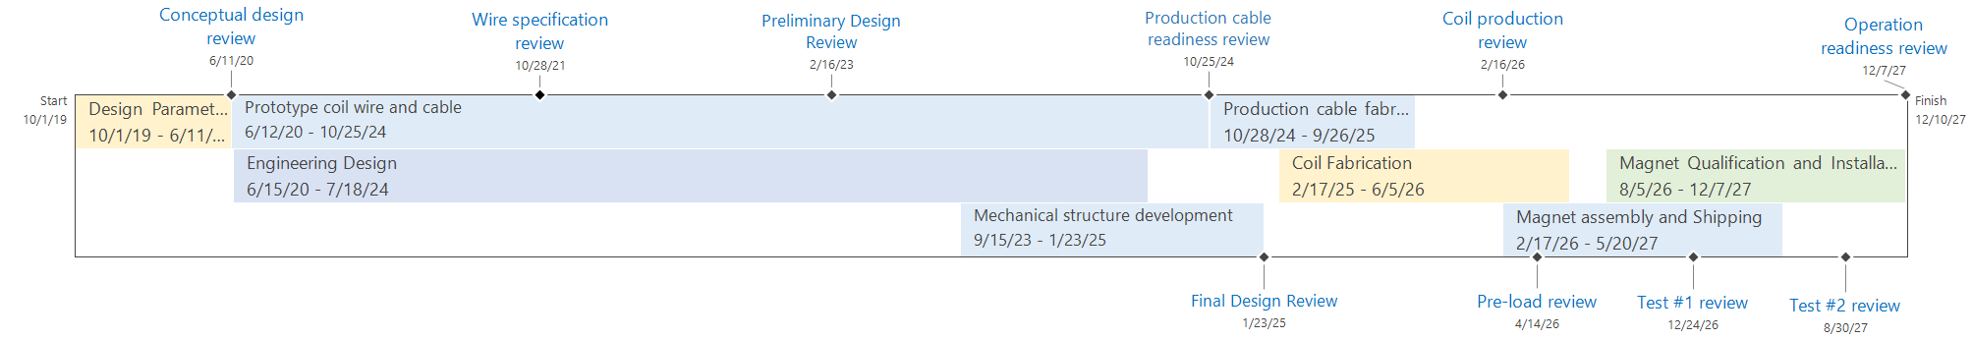
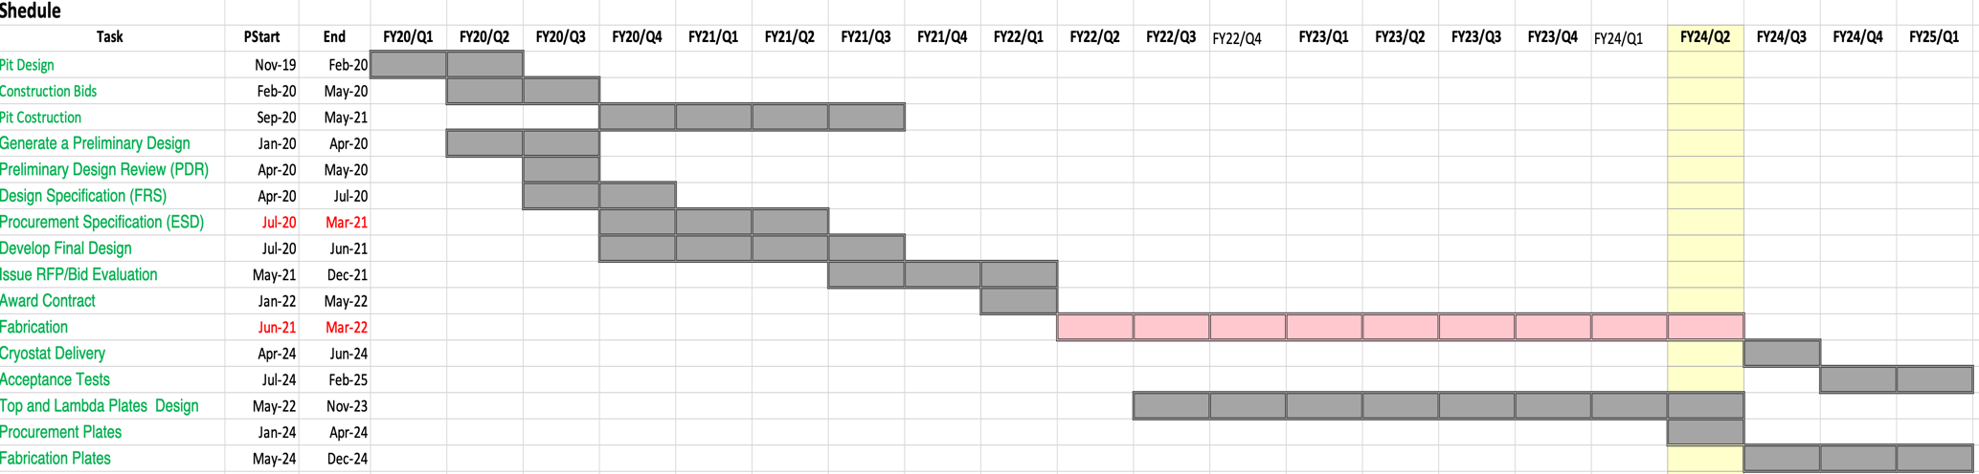
First look at schedule – details in later talks

Slide 9
How the meeting is organized
A detailed status update of the Test Facility Dipole
  Magnet Design and Procurement – Giorgio Vallone
    Giorgio is the primary analyst for the AUP Magnet Structures, and is taking on Lead Coordinator role for the Modeling Area in the MDP
  Manufacturing and Infrastructure Status – Jose Luis Rudeiros
    Significant experience in magnet assembly, processes, tooling (CERN, LBNL)
  Conductor and Cable – Ian Pong (presentation via pre-recorded video)
    Significant experience from ITER, CERN, and at LBNL (AUP, MDP)
A detailed update of the FNAL Facility Preparations
  Test Facility Preparations – George Velev

