Slide 1



UNIVERSITY OF
CALIFORNIA

Slide 2
Test Facility Dipole
Analysis Updates
G. Vallone, D. Arbelaez, N. Cheggour, P. Ferracin, A. Hafalia, P. Mallon, JL. Rudeiros Fernandez, GL. Sabbi, D. Turrioni
EOC Meeting
19 August 2022

Slide 3
Outline
Timeline
Design overview
Engineering developments
Next steps and conclusion

Slide 4
Timeline
Design started from work performed on HEPDipo, presented at MT26, 2019:
    https://ieeexplore.ieee.org/document/8982034
Conceptual design presented at the CDR on 06/11/2020:
    https://conferences.lbl.gov/event/359/
  Magnetic and mechanical analysis presented at ASC2020:
    https://ieeexplore.ieee.org/abstract/document/9376992
  Initial developments on engineering design presented at MT27, 2021:
    https://ieeexplore.ieee.org/abstract/document/9733270
  Strain effects on the magnet critical surface were evaluated including reversible and irreversible effects. Presented at the Wire Specification Review (10/28/2021):
    https://conferences.lbl.gov/event/759/
Now we are trying to get from a conceptual design to a ‘manufacturable’ design, with engineering considerations

Slide 5
Outline
Timeline
Design overview
Engineering developments
Next steps and conclusion

Slide 6
Our Design Criteria
  Requirements:
    Material limits:
      Based on the MQXF design criteria
      Consider fragile fracture for materials with KI<100 MPa m^{1/2}
      Material properties available in the back-up slides
    Prestress:
      20 MPa max. tension (bonded model)
        Failure criteria for the epoxy bonding
        Neglect the ‘corner spikes’ (~1 contact element, 1 mm)
  Design ‘performance’:
    Load line margin
    Coil stress (high/low field)
    Field quality for consistent comparison of different solutions

Slide 7
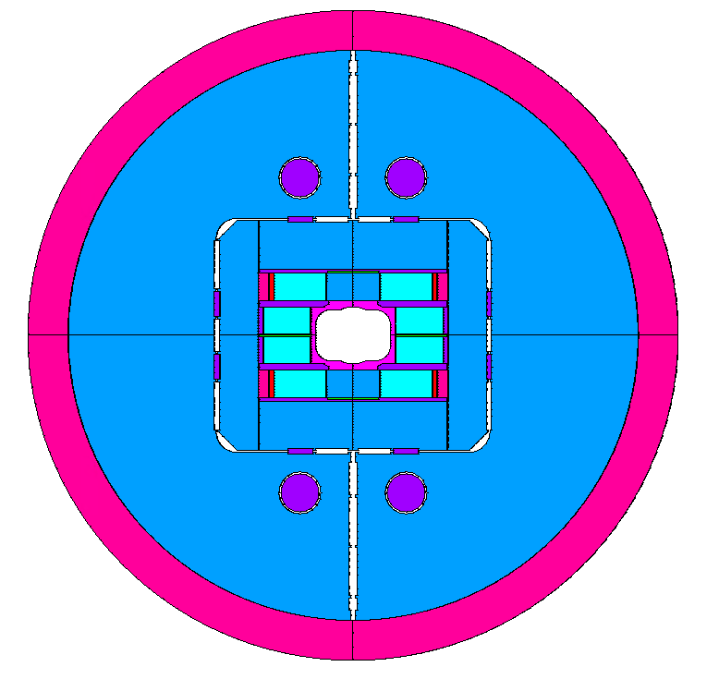
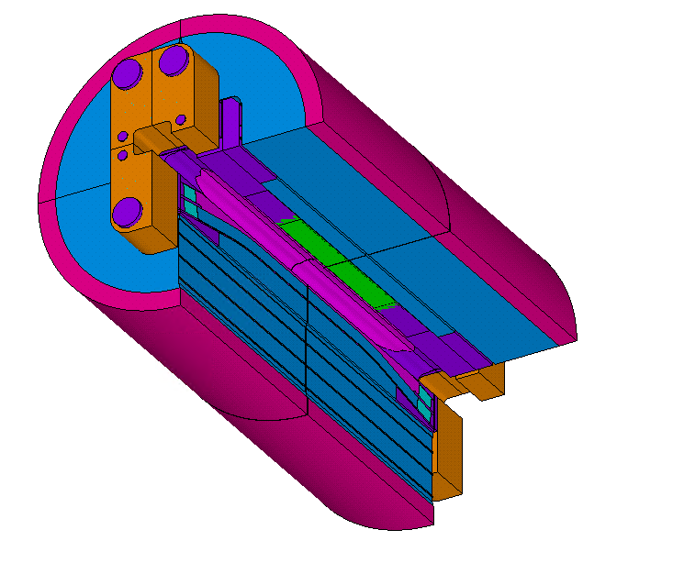
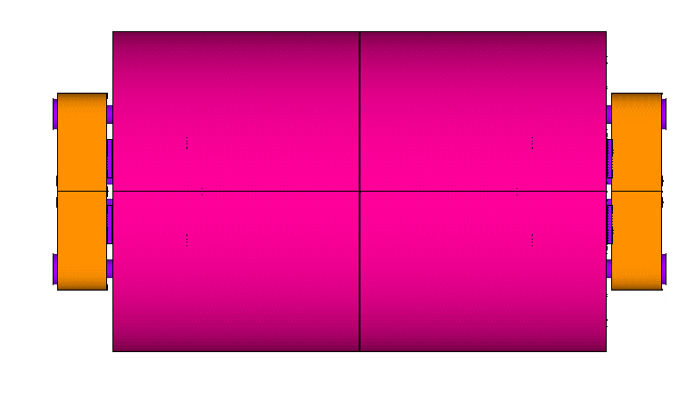
TFD Design Overview (1)
L_{y} = 2.0 m
Φ = 1.3 m
L = 2.49 m

Slide 8
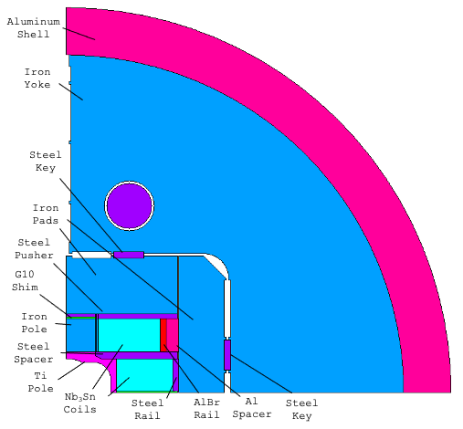
TFD Design Overview (2)
Highlights:
    ‘LD01’ coil configuration
    G10 shim in the boat
      Reduces stress in the pole
      Limits the pole bending, reducing the tension ‘spikes’ at the pole/coil interface
    Key position defined to limit the max. tension at the pole/coil interface
    Aluminum bronze rail with Al shim
      A ‘soft’ layer between the coil and the horizontal pad allows to remove local high stress zones in the coil
    Different shimming for inner and outer coil
    Yoke bladder loading
      Limits the coil peak stress at room temperature

Slide 9
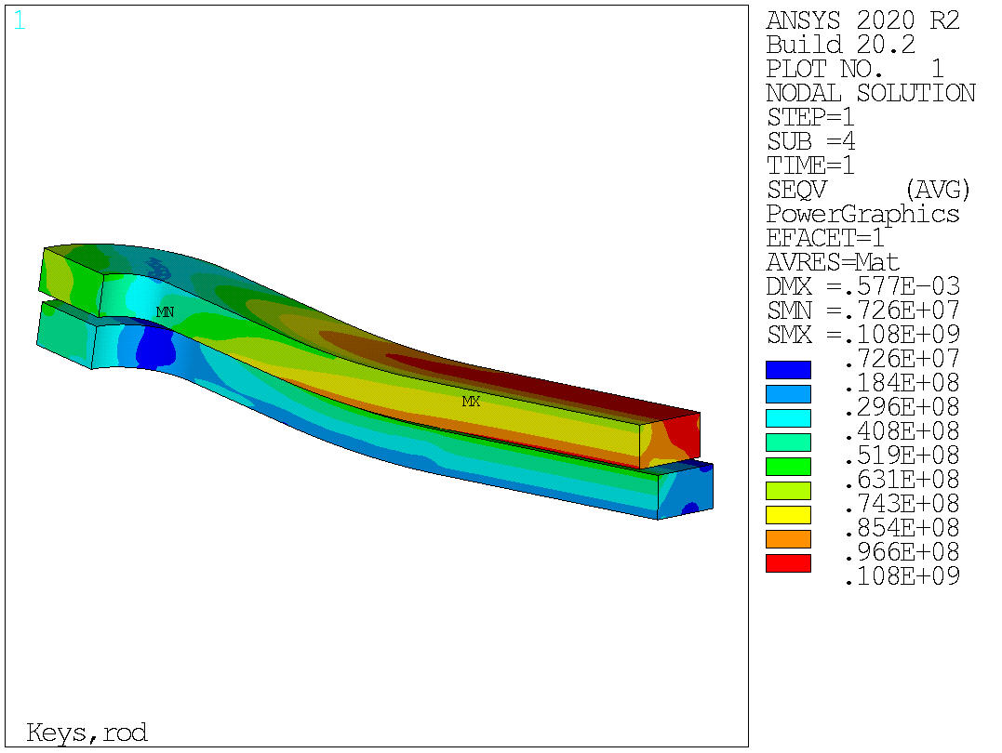
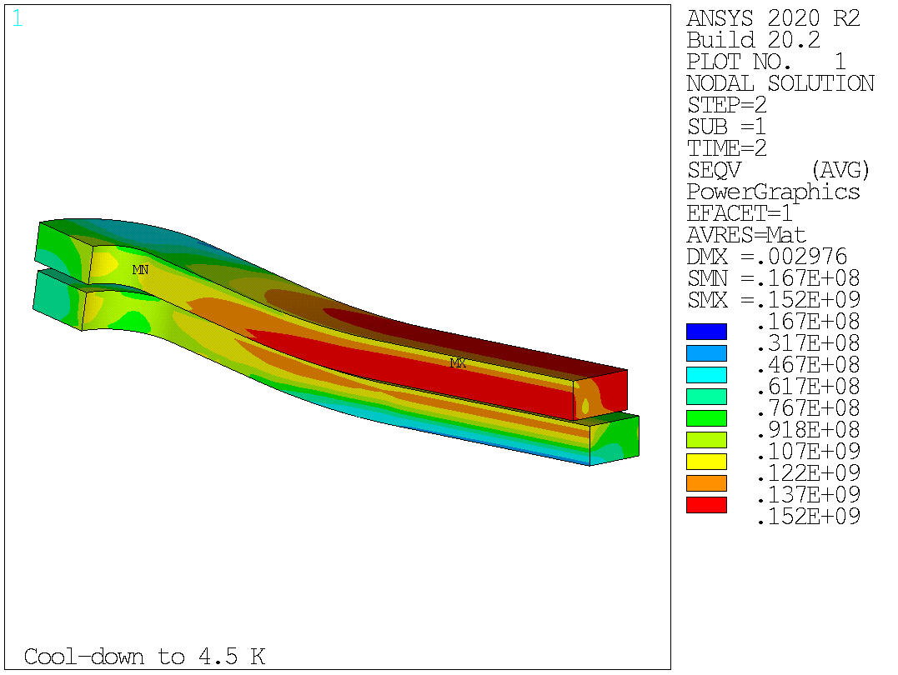
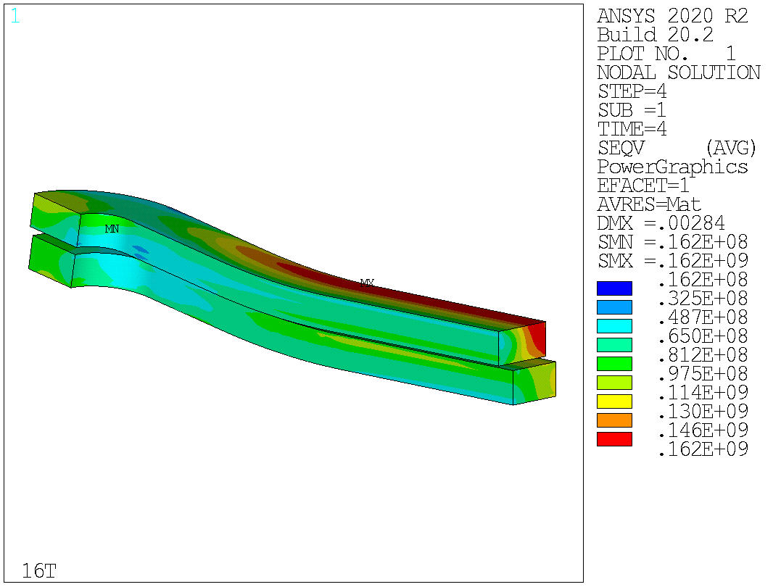
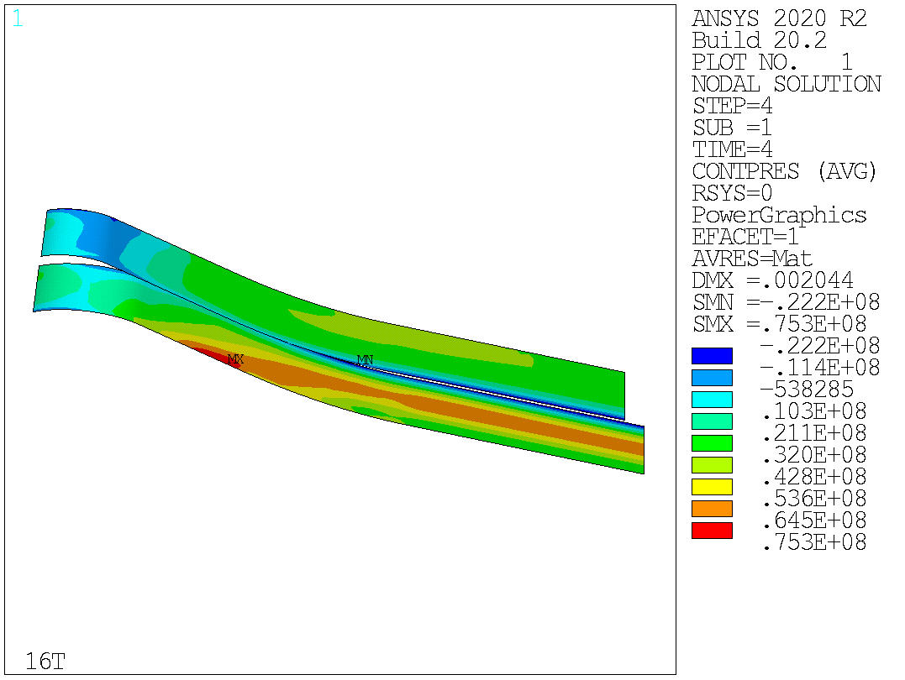
Current Design Results - Mechanics
Current design satisfies the mechanical constraints on the coil limits
With full prestress for 16 T operation:
      Peak stress below 110 MPa at room temperature
      152 MPa on the high field region after cooldown
      162 MPa in the low region at 16 T

Slide 10
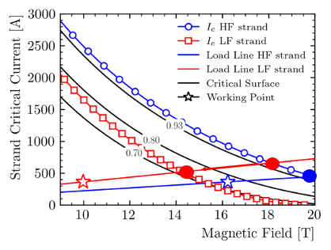
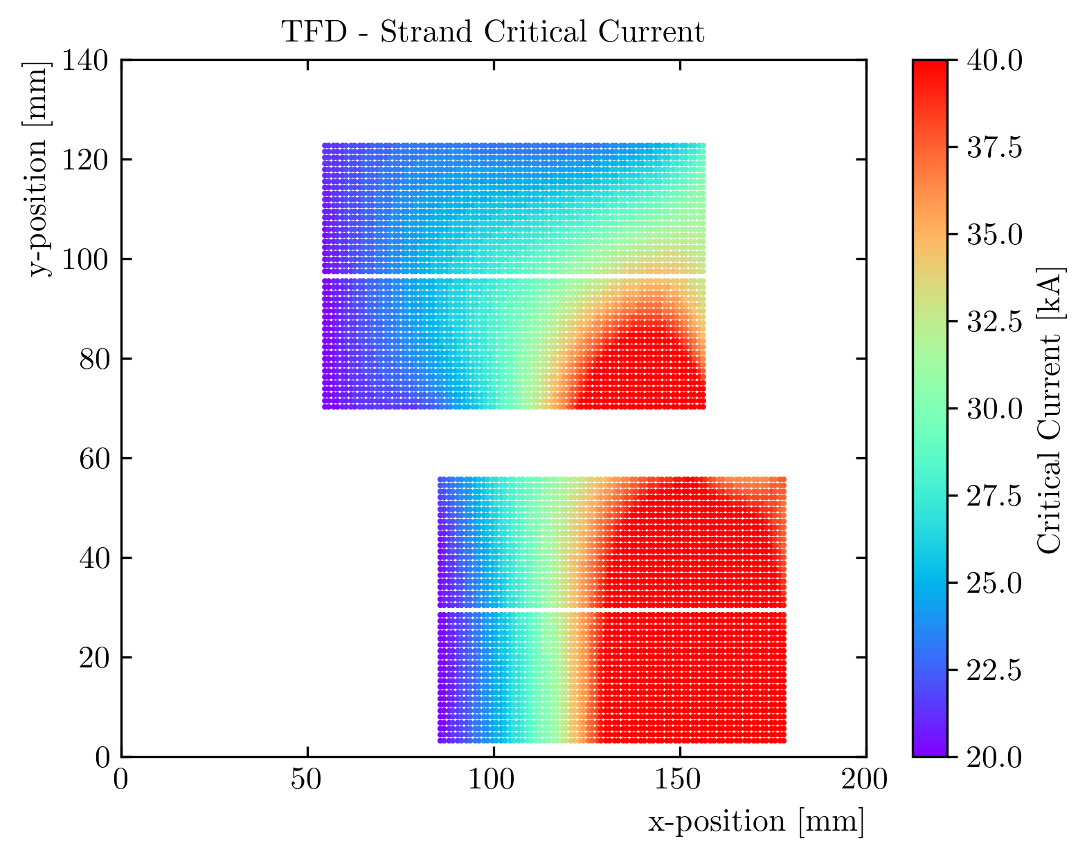
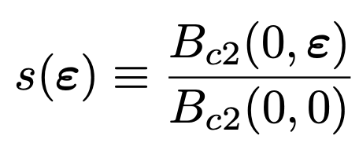
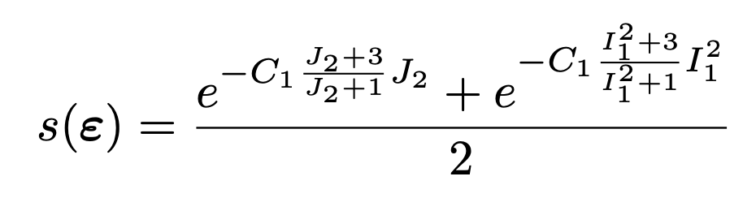
Load Line Margin
Low field
High stress
High field
Low stress
We compute the short sample limit for each strand, as a function of field and strain
    Detailed ‘strand’ model of the magnet (2D)
    Critical surface parametrization from strand measurements
    80% in the high field / low stress region
    68% in the low field / high stress region.
      This would be 56% with no strain effects
Notes:
TFD_contour_seps_cd.png

Slide 11
Outline
Timeline
Design overview
Engineering developments
Next steps and conclusion

Slide 12
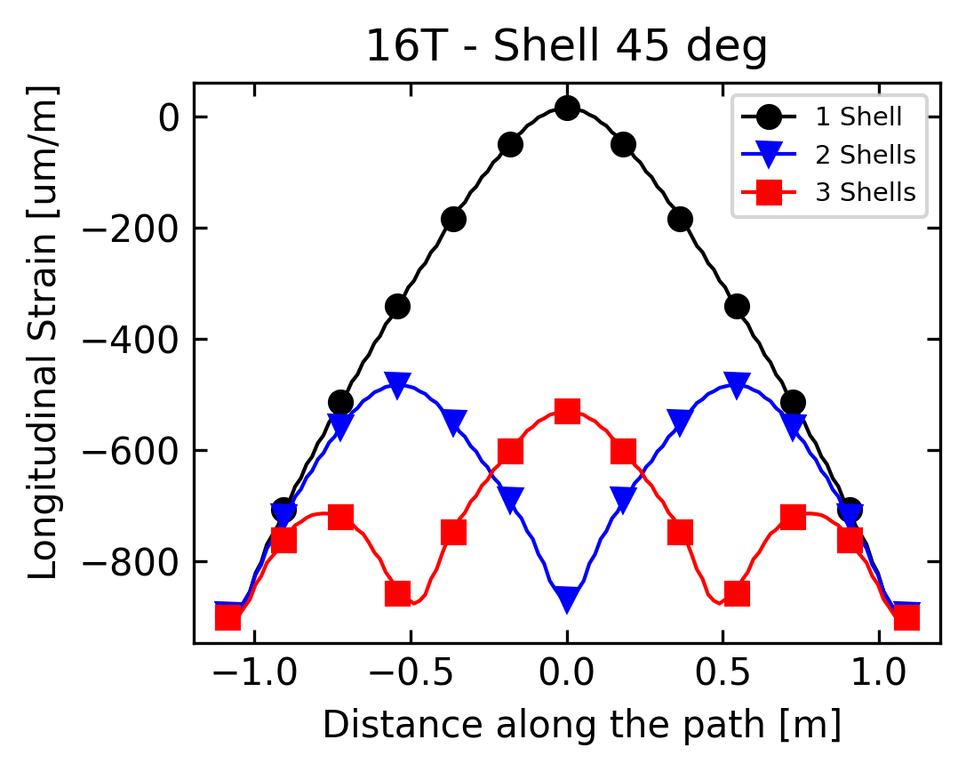
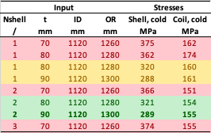
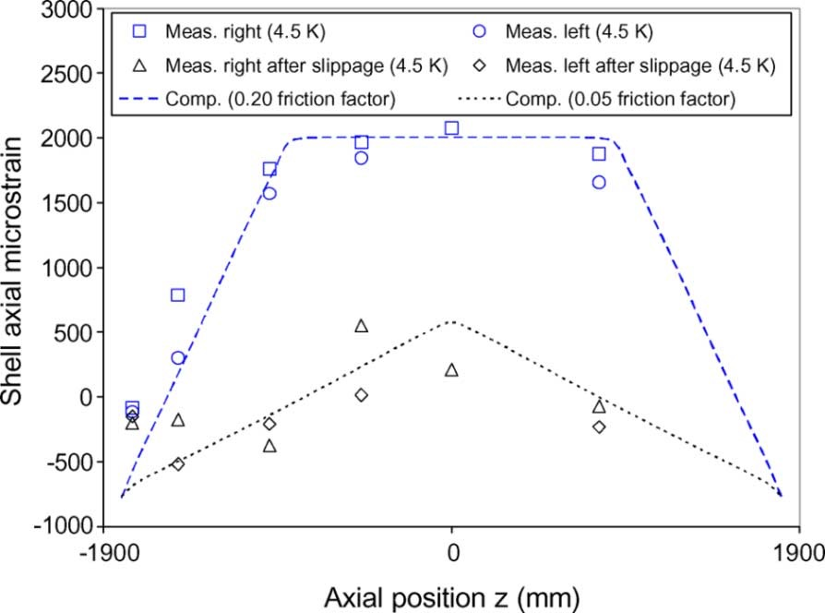
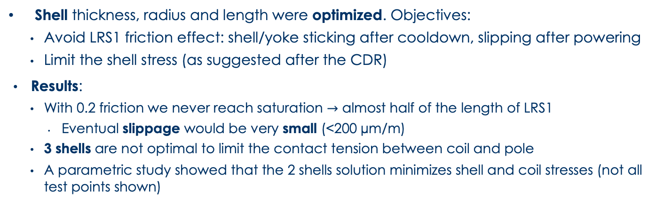
Shell Design
Shell thickness, radius and length were optimized. Objectives:
    Avoid LRS1 friction effect: shell/yoke sticking after cooldown, slipping after powering
    Limit the shell stress (as suggested after the CDR)
  Results:
    With 0.2 friction we never reach saturation $→$ almost half of the length of LRS1
      Eventual slippage would be very small (<200 µm/m)
    3 shells are not optimal to limit the contact tension between coil and pole
    A parametric study showed that the 2 shells solution minimizes shell and coil stresses (not all test points shown)

Slide 13
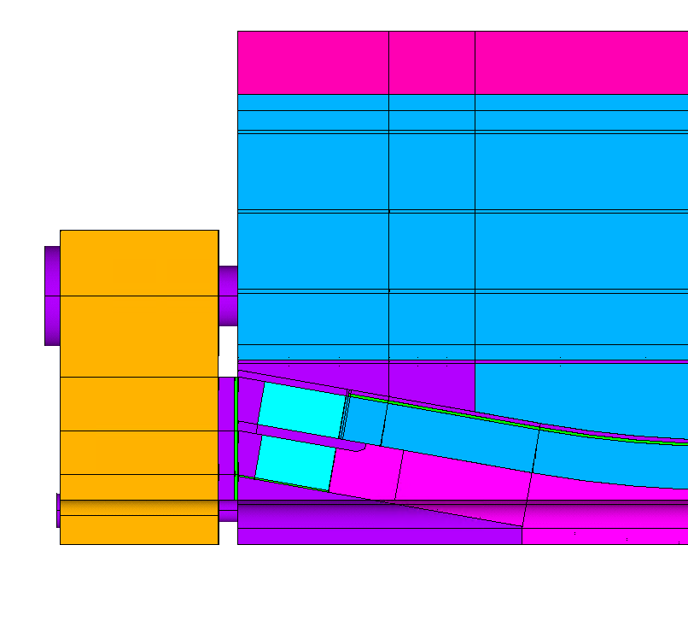
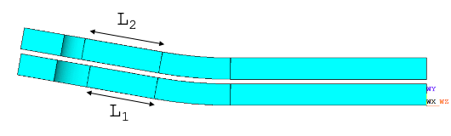
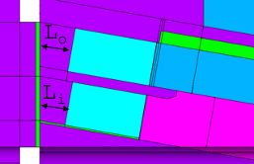
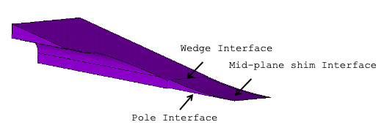
End Region Optimization
Coil ramp length
Iron pads
length
Longitudinal load system
End spacer thickness
Several solutions for the end-region optimized to minimize coil stress, avoid coil/pole debonding, and maximize the straight section length…
…respecting fabrication/manufacturability constraints
Wedge design

Slide 14
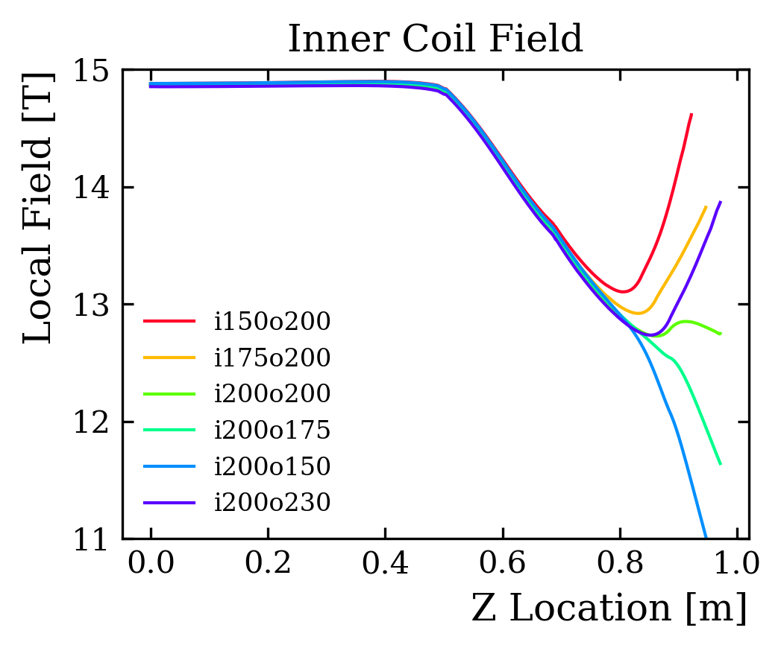
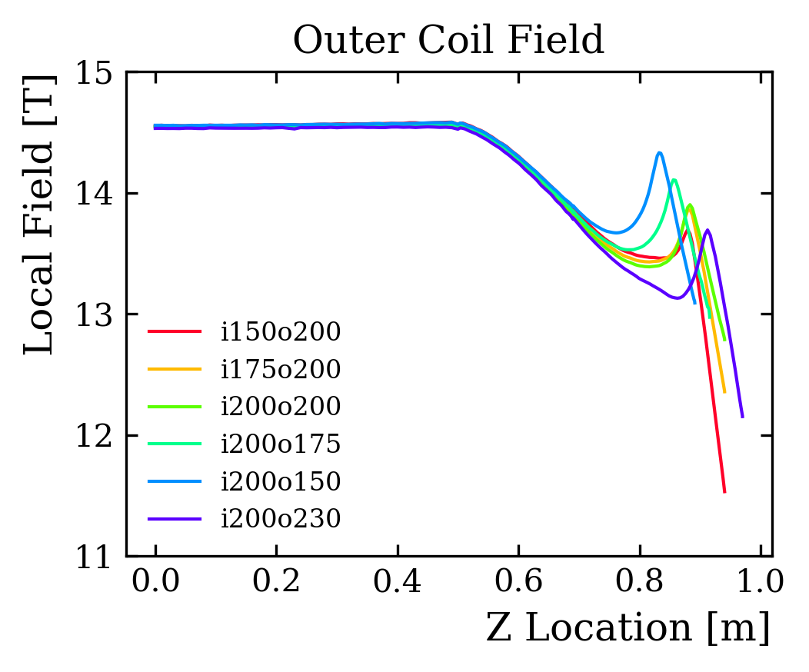
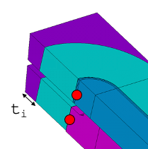
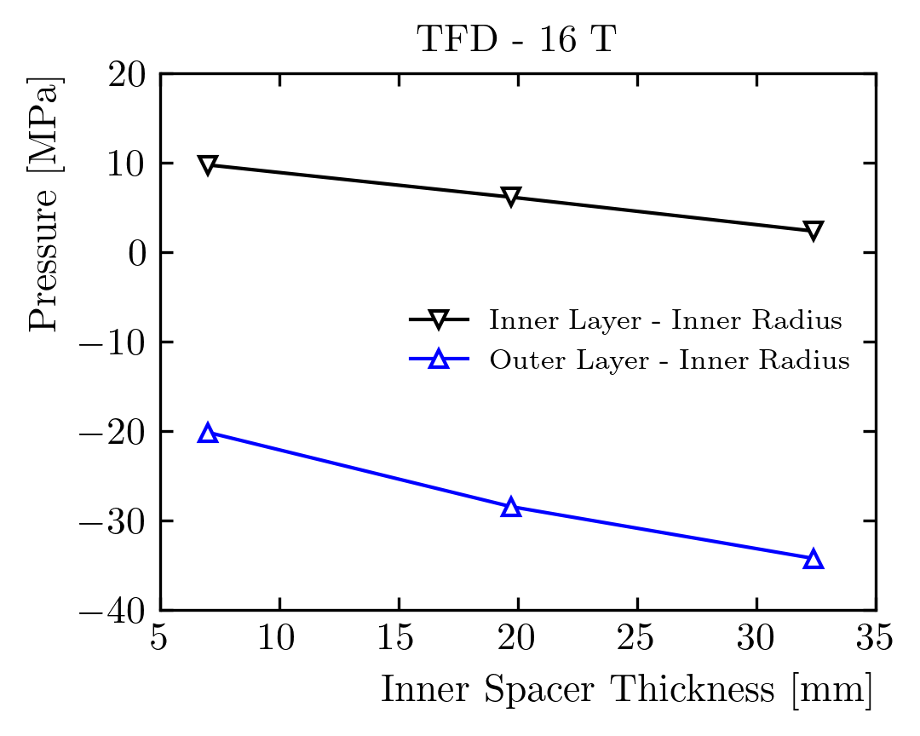
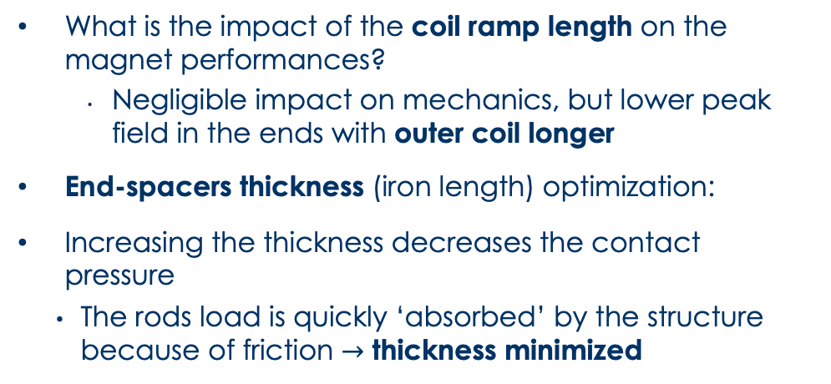
Coil Ends Design
What is the impact of the coil ramp length on the magnet performances?
      Negligible impact on mechanics, but lower peak field in the ends with outer coil longer
End-spacers thickness (iron length) optimization:
Increasing the thickness decreases the contact pressure
    The rods load is quickly ‘absorbed’ by the structure because of friction $→$ thickness minimized

Slide 15
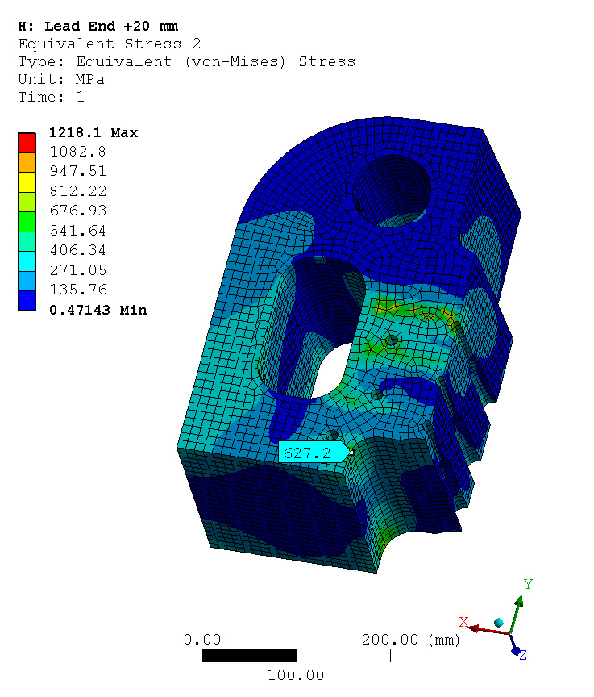
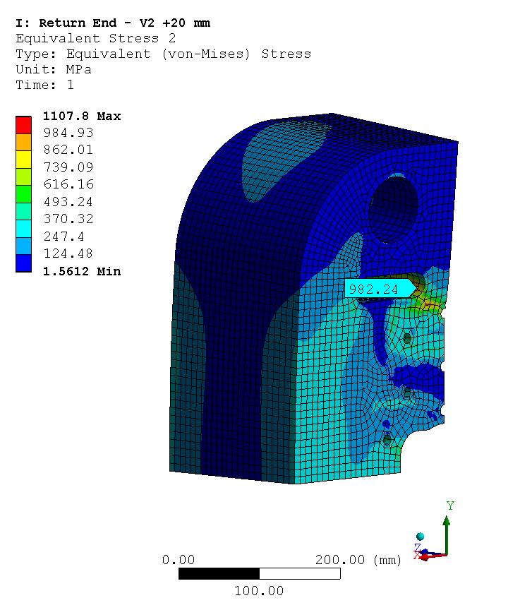
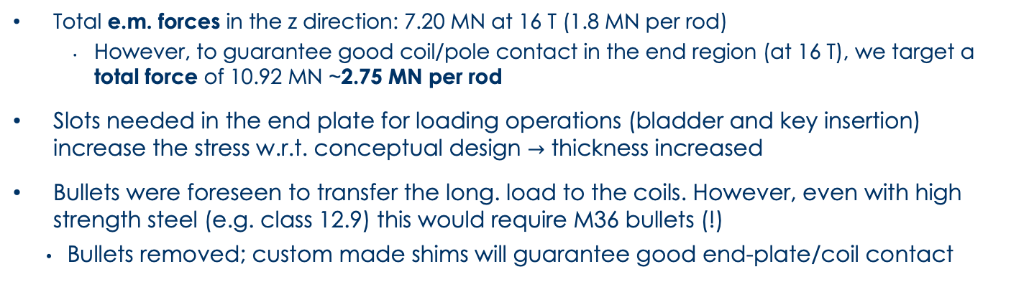
Longitudinal Prestress System
Step | Fz [MN]
Loading | 9.05
Cold | 10.62
15 T | 10.89
16 T | 10.92
Radius | Stress | Safety Fact.
mm | MPa | /
6 | 8135 | 0.14
8 | 4576 | 0.24
10 | 2928 | 0.38
12 | 2034 | 0.54
14 | 1494 | 0.74
16 | 1144 | 0.96
18 | 904 | 1.22
20 | 732 | 1.50
Lead End
Return End
Bullet Sizing
Total e.m. forces in the z direction: 7.20 MN at 16 T (1.8 MN per rod)
      However, to guarantee good coil/pole contact in the end region (at 16 T), we target a total force of 10.92 MN ~2.75 MN per rod
Slots needed in the end plate for loading operations (bladder and key insertion) increase the stress w.r.t. conceptual design $→$ thickness increased
Bullets were foreseen to transfer the long. load to the coils. However, even with high strength steel (e.g. class 12.9) this would require M36 bullets (!)
    Bullets removed; custom made shims will guarantee good end-plate/coil contact

Slide 16
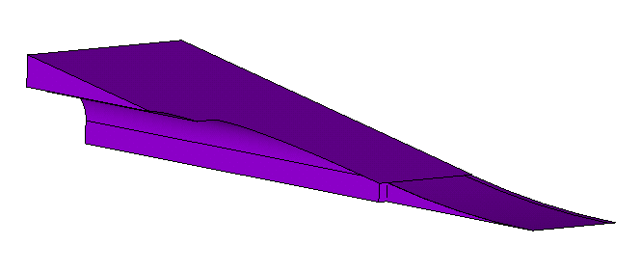
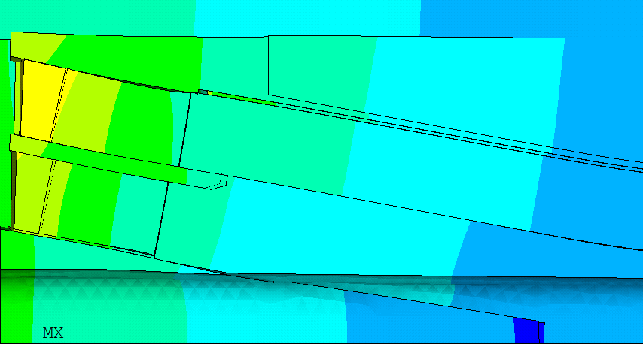
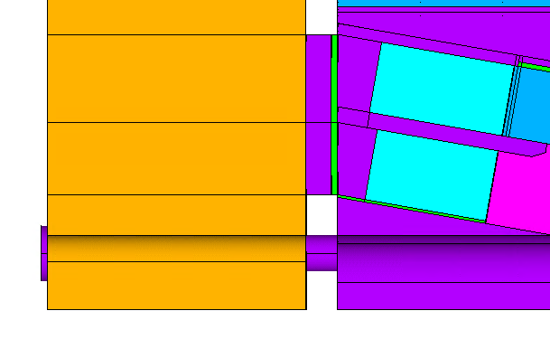
Wedge Optimization
Wedge
Wedge
Interface
Mid-plane shim
Interface
Triangle
Pole Interface
Wedge/Pole Gap
Options considered for wedge design:
    Triangle and wedge in one steel piece, non-bonded
    Triangle in GFRP, bonded
    Triangle in GFRP, as additional component
    Option II discarded because computations show that the triangle would debond during loading
    Option III discarded as a gap between the wedge/triangle would open during operation
Non impregnated wedge is kept in place by ‘soft’ bullets:
    Bullet size/material was optimized minimizing the wedge/pole gap, and limiting the impact on coil prestress
Wedge
bullet

Slide 17
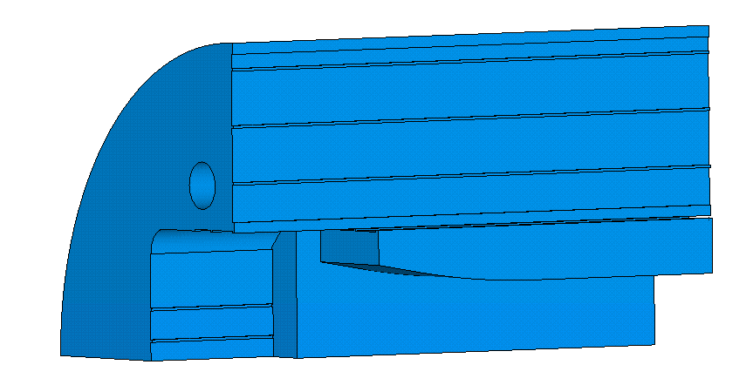
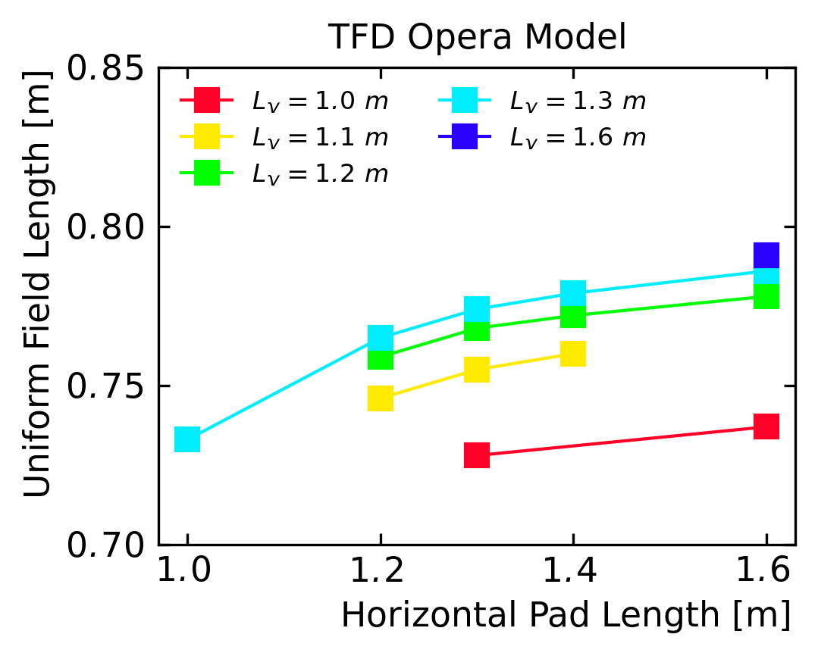
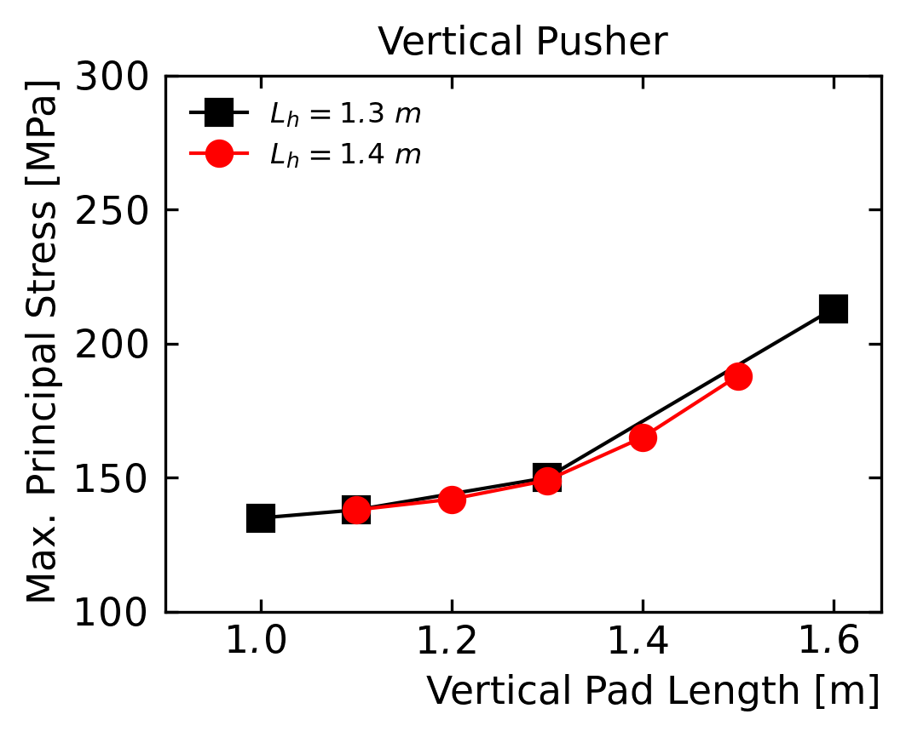
Iron - Vertical and Horizontal Pad
L_{v}
L_{h}
Parametric study of the iron length of the pads
      Maximize uniform field length (> 0.75 m
      Minimize iron stress
  Vertical pusher impact saturates at around 1.3 m
Max. principal stress on pads independent
    Horizontal pad stress ‘knee’ at 1.4 m (not shown)
    Vertical pad stress ‘knee’ at 1.3 m

Slide 18
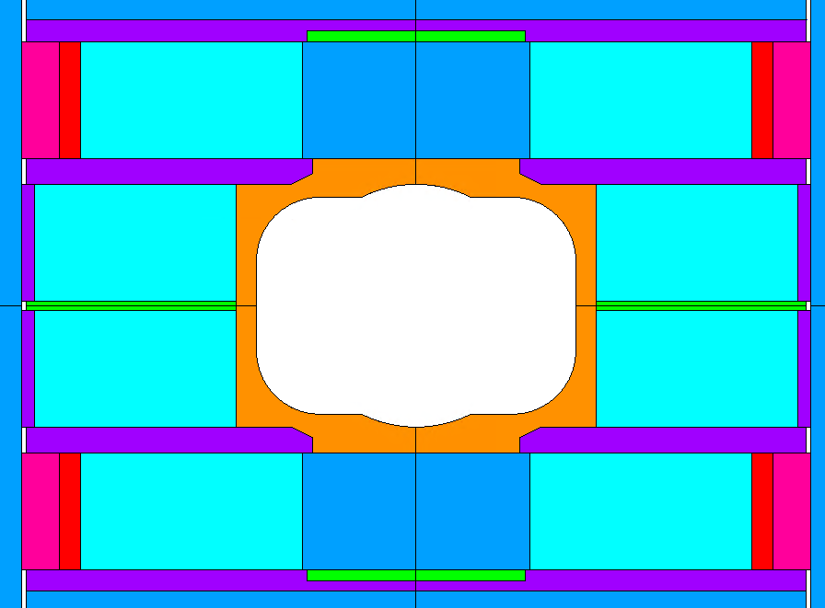
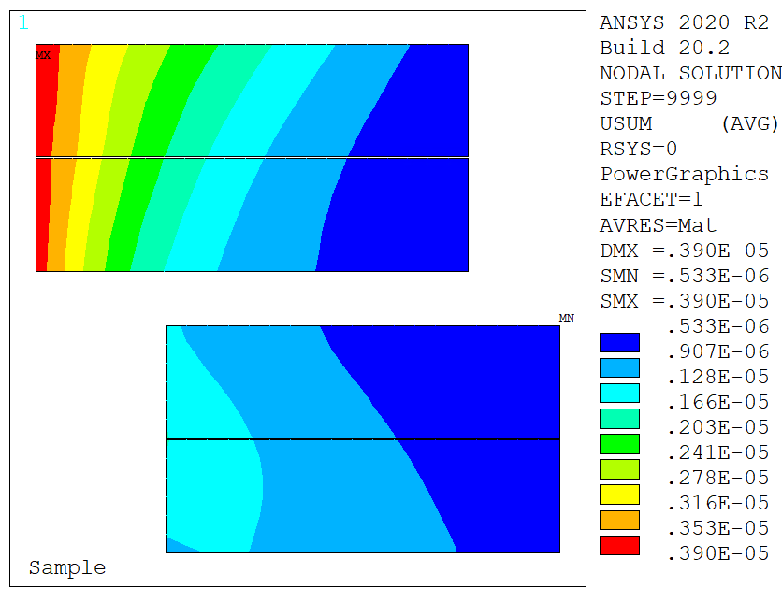
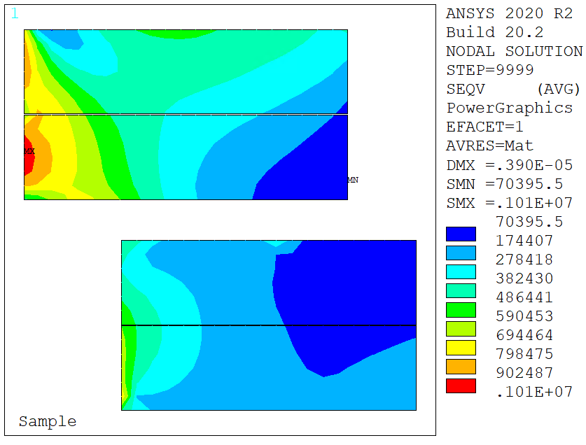
Sample Holder Load Cases
F_{s}
F_{s}
Displacements
Design was created assuming no mechanical interaction between the magnet and the test well
    At the moment, it is not clear if this will be the case
We investigated potential usage scenarios:
    E.g. non-centered fusion cables: 200 kN symmetric load. Only quadrant model available but should be as conservative as possible
    Negligible impact: displacements < 4; stresses < 1 MPa
Stresses

Slide 19
Outline
Timeline
Design overview
Engineering developments
Next steps and conclusion

Slide 20
Conclusion and Next Steps
We have shown examples of how we are moving from the conceptual design to an ‘engineering’ design:
    Many details were defined evaluating their impact on magnetic and mechanical performances :
      Coil design: ramp length, spacer thickness
      Longitudinal loading system: end-plate sizing, load transfer to coil and wedge
      Wedge design
      Iron pad length
  Next steps:
    We are investigating potential interactions with sample holders during operation
    Detail the plan for measurements during loading
      Important to control the prestress application

Slide 21
Extra

Slide 22
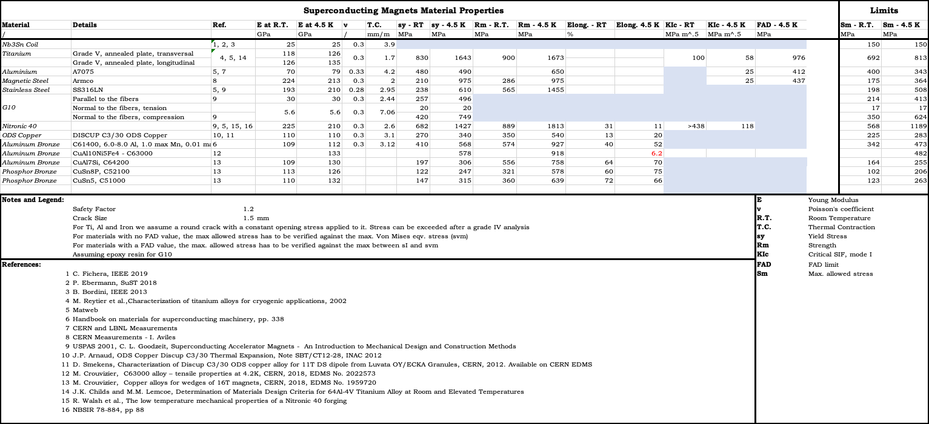
Material Properties
Von Mises eqv. stress used for non-fragile material
Higher between Von Mises and S1 for the fragile materials (very conservative)
Coil limits at cold: Von Mises < 150/180 MPa (low field/ high field regions)

Slide 23
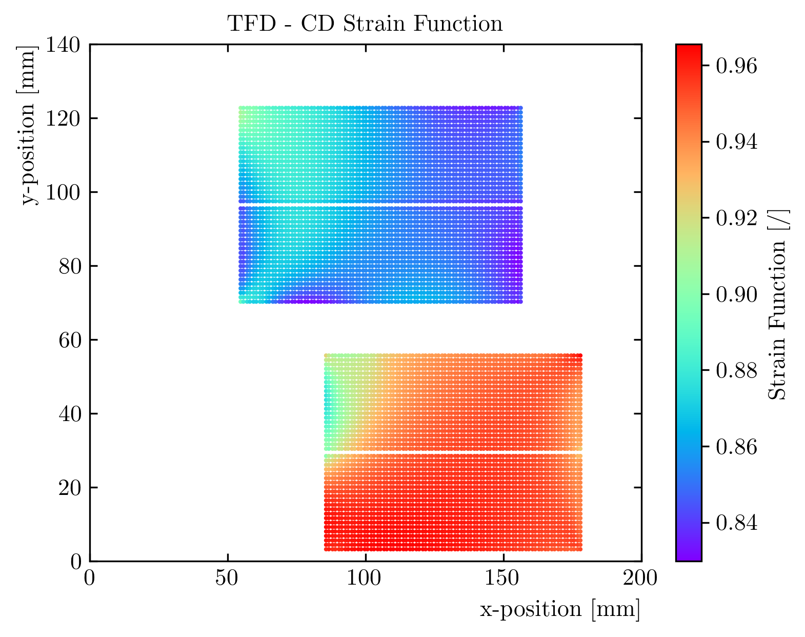
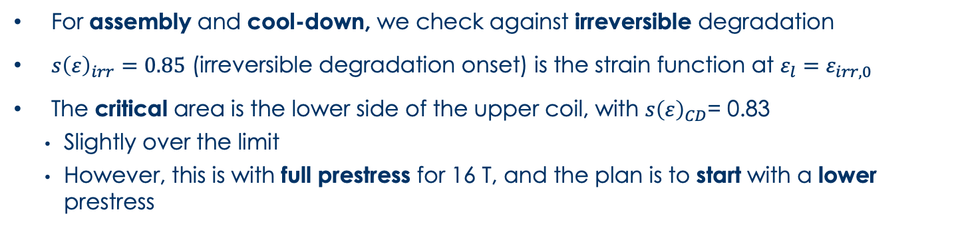
Irreversible Degradation
Critical
area
For assembly and cool-down, we check against irreversible degradation
$s{\left(ε\right)}_{irr}=0.85$ (irreversible degradation onset) is the strain function at $ε_{l}=ε_{irr,0}$
The critical area is the lower side of the upper coil, with $s{\left(ε\right)}_{CD}$= 0.83
    Slightly over the limit
    However, this is with full prestress for 16 T, and the plan is to start with a lower prestress
Notes:
TFD_contour_seps_cd.png

