Slide 1
HTS Cable Test Facility - Project Technical Updates
G. Velev

Slide 2
Outline
Short Overview
STEP 1: Test Pit construction and cryostat (GPP at Fermilab)
  Current Status
  Plans
STEP 2: Quench Protection and Monitoring systems (QP/QM), Power Supplies, and test insert (cable holder)
  Current Status
  Plans
STEP 3: Test Facility integration
Schedule
Anti-cryostat design
Summary
Notes:
General Plant Project
Purple

Slide 3
Overview of the Test Facility
The test facility is constructed in Industrial Building 1, APS-TD, Fermilab. The proposed place was selected based on the proximity to the needed base infrastructure, including cryogenic, power, water and cranes.
Minimum operating temperature of the facility is 1.9K for the magnet providing the background field and with min 4.2-4.5 K for the test samples, variable to ~50 K.
The test pit cryostat should accommodate a dipole (cold mass) with maximum dimensions of 1.3 m and length of < 3 m
The maximum energy in the test field dipole should be < 20 MJ
The maximum weight of the dipole cold mass should not exceed 20 ton
The test facility should be efficient and safe, minimizing the time for experiment preparation and no helium losses.
Operational lifetime of the facility at least 20 years.

Slide 4
Operational Modes
TWO OPERATIONAL MODES
Fusion mode (FES) - cable test
  15 T@1.9K ( ~15 kA) main dipole with diameter 1.3 m
  Anti-cryostat with sample holder for cable test
  Variable temperature for the cable 4.2 –to 50 K
  SC transformer to provide 100kA
  Full diagnostic and protection
  Dedicated top&lambda plate
Magnet R&D mode (MDP)
  Large aperture/large diameter magnets LTS at 1.9 K (current facility can test ~ 0.8 m magnets at 4.5K) powered up to 24 kA
  Hybrid magnet tests (LTS + HTS) at 1.9 K powered with 24 kA and 16 kA PSs
  Full diagnostic and protection
  Dedicated top&lambda plate

Slide 5
Project structure – Fermilab
Project Director
G. Velev
Project Manager
V. Nikolic
Mechanical
V. Nikolic
Cryostat
R.Bruce
QP/QC system
C. Arcola
Power Supplies
X. Yuan
Integration
G. Velev (interim)
Magnet and Cryo
Sectors Personnel

Slide 6
Test Pit and Cryostat – Status
This part of the project includes only the civil (pit) construction, the magnet cryostat and top&lambda plates
It was classified as GPP by Fermilab DOE site office
  Pit design was finalized - Feb 2020
  Bidding process – May 2020
  Construction Contract was awarded in Sep 2020
  Pit construction - started in October 2020 –finished April 2021
Project Execution plan

Slide 7
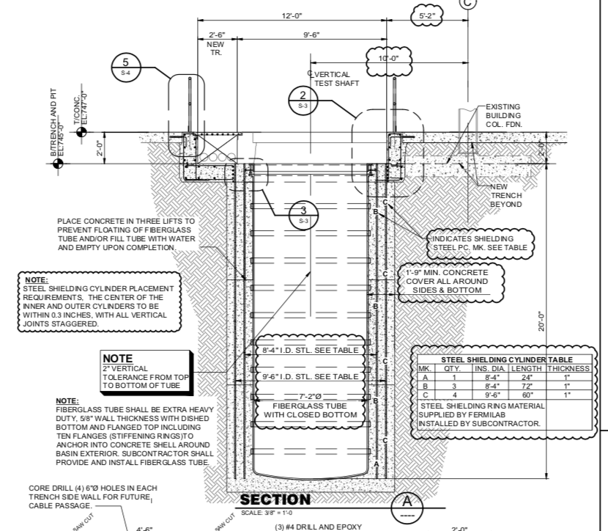
What was changed in the design and execution?
We added two cylindrical steel shields to contain the fringe magnetic field.
  Thickness of the shields is 2’’
  Distance between inner and outer is 5’’
These shields protect the nearby vertical SRF test stands which are very sensitive to any external fields
The shielding was not included in the original bidding package for the construction, this increased the original cost

Slide 8
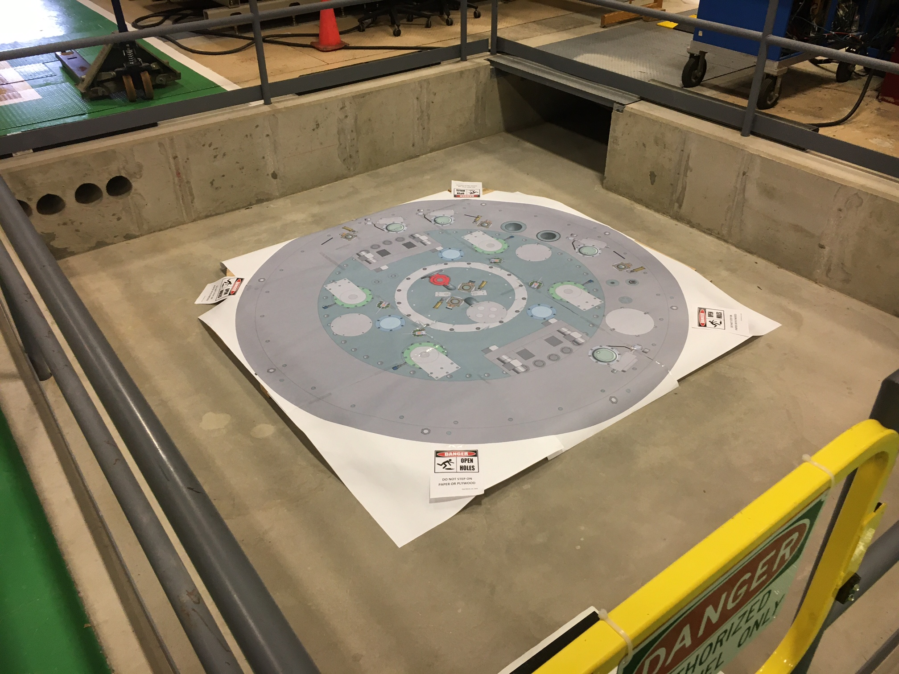
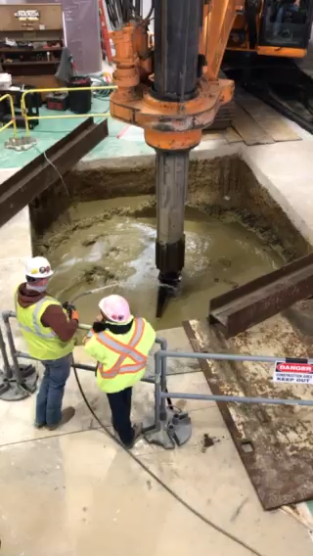
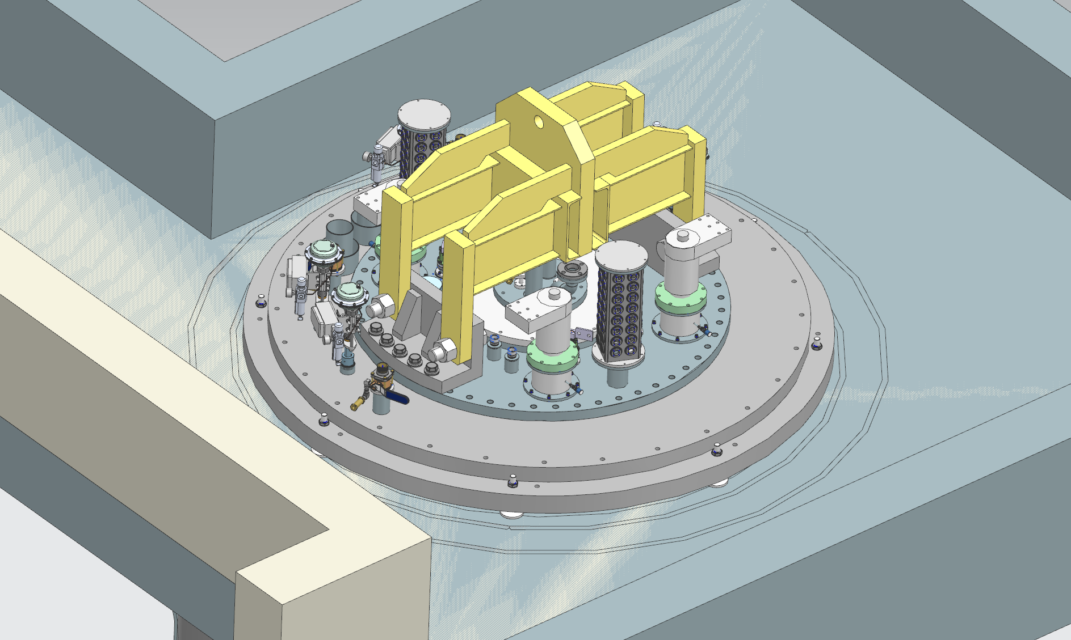
Current status - pit is done
HFVMTF pit
There were some scary moments
  At ~ 5 m the well walls started to collapse
  Concern that building column support was possibly compromised
  Additional concrete was injected
  Column survey before an after construction was showing no significant change of the tilt or position of the column
  Pit is done, it is dry even during strong Midwest rains
6 m deep pit for the cryostat

Slide 9
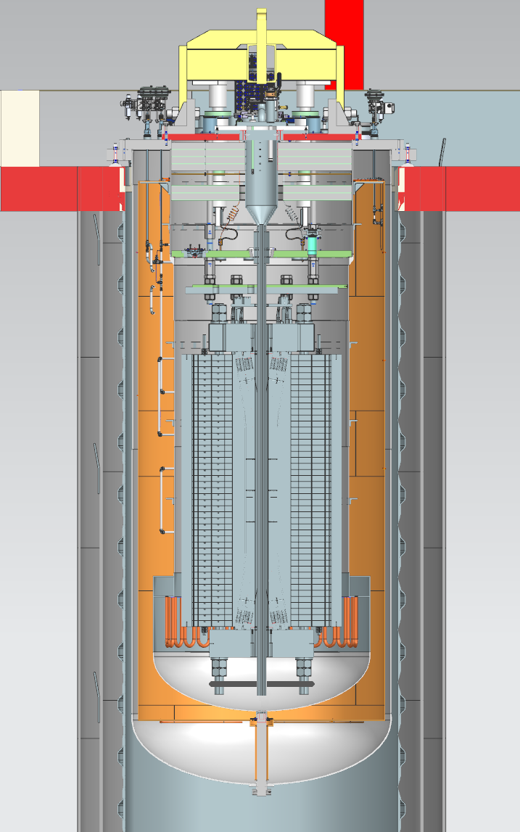
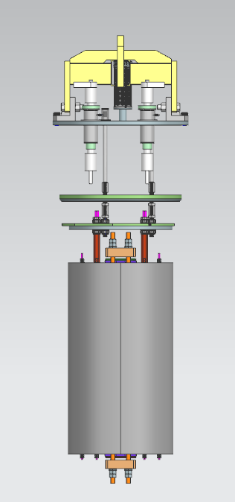
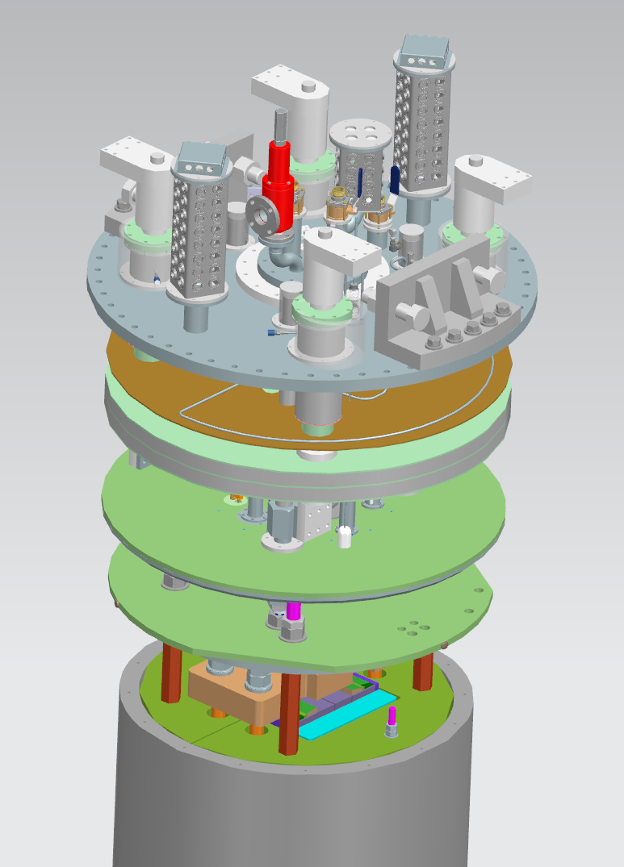
Cryostat and top&lambda plates
Preliminary cryostat design is finalized
Vendor is selected
  Meeting with the vendor every week
  Final design review is expected in October
  Expected delivery June 2023
Top and lambda plate design is in progress
The goal is to deliver the top and lambda plate in the Jan/Feb 2023 to start cold commissioning of the cryostat
Top
Lambda
Top
Lambda

Slide 10

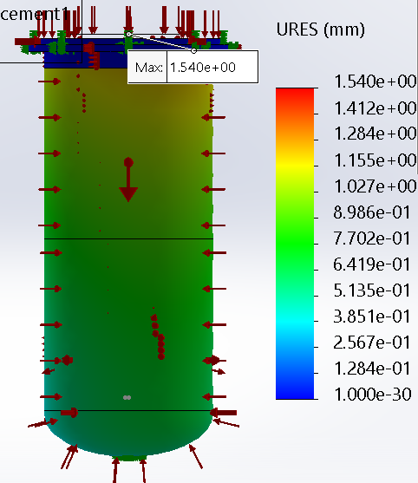
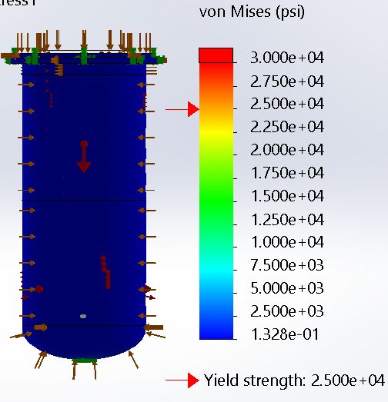
FEA Model Vertical
Model Inputs:
Gravity along center axis
Internal Pressure of 30 psid
15 psig placed on vacuum shell
No pressure load on shield
Large Displacement on top plate
5

Slide 11
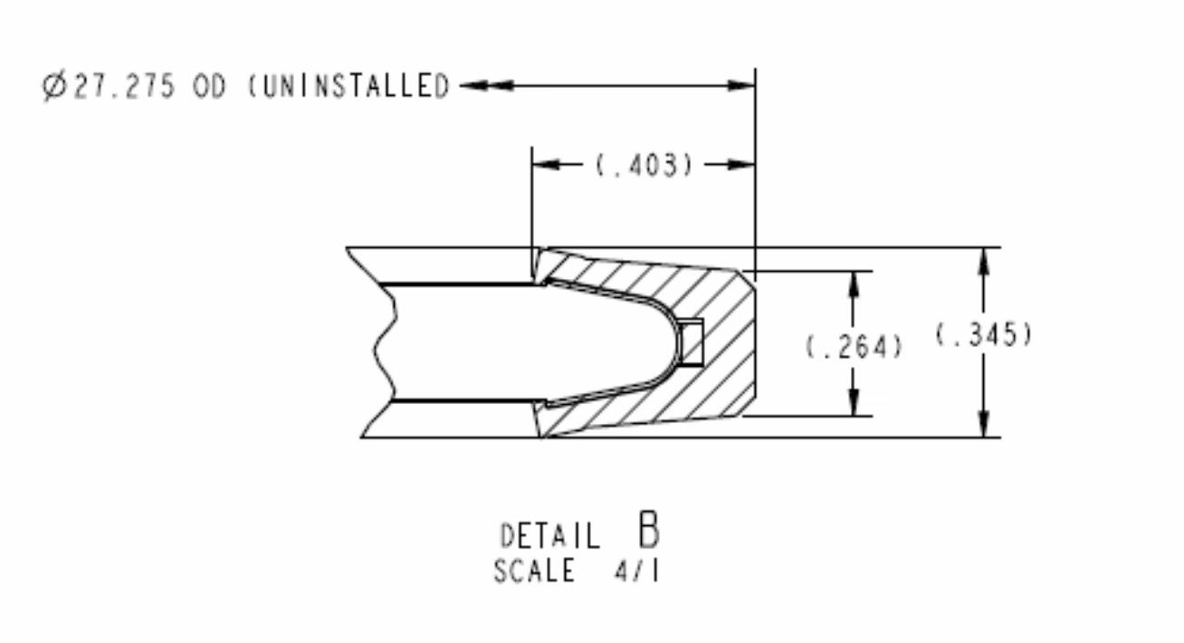
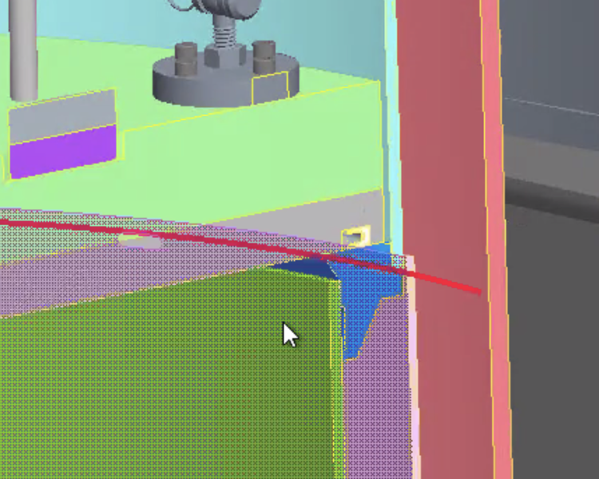
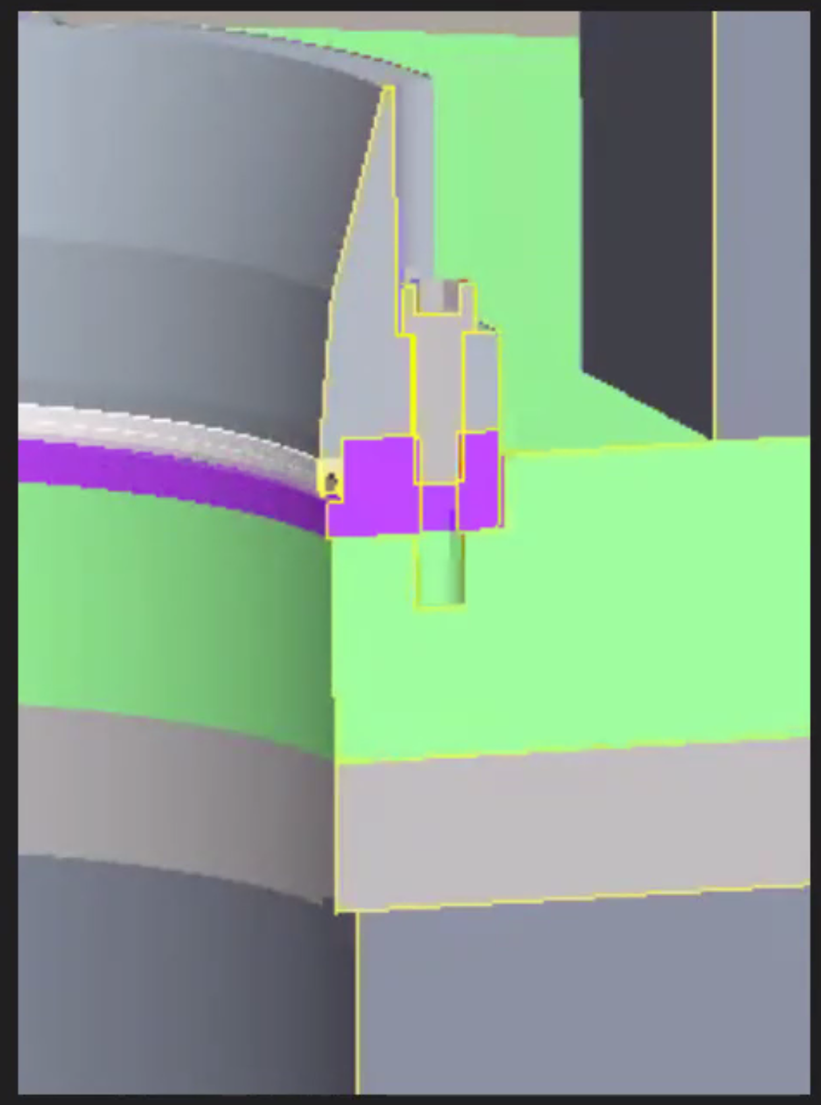
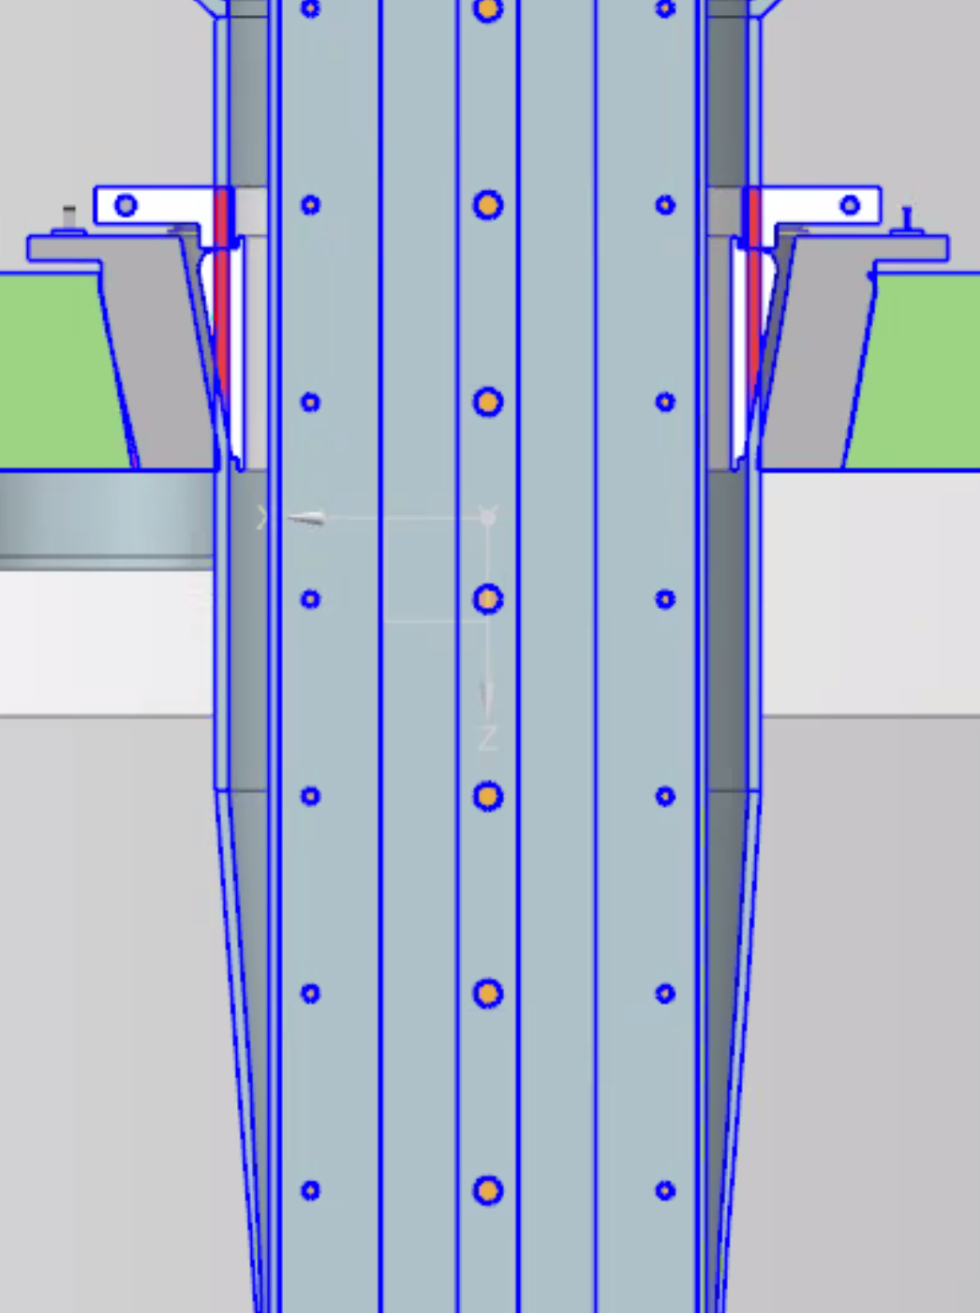
Lambda plate seal
We entertained 3 different options for lambda plate sealing - decided on the BNL seal following one of the EOC recommendations
After several meetings with BNL and evaluating our options, we decided to used BNL Lambda plate seal
For the anti-cryostat seal we are still looking at two options BNL and Fermilab

Slide 12
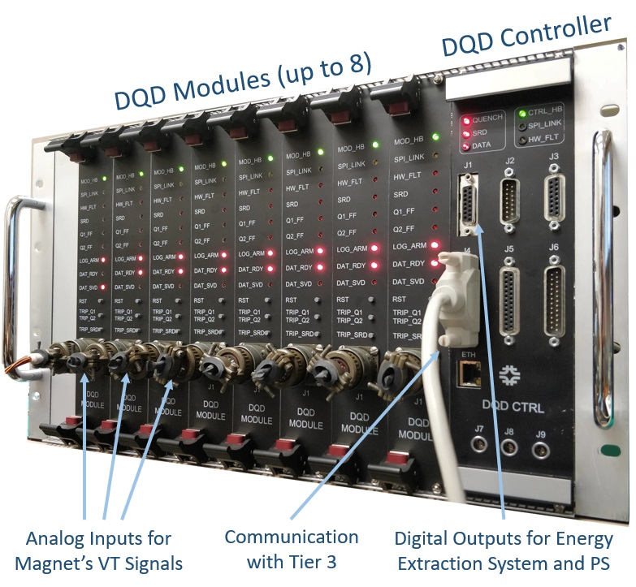
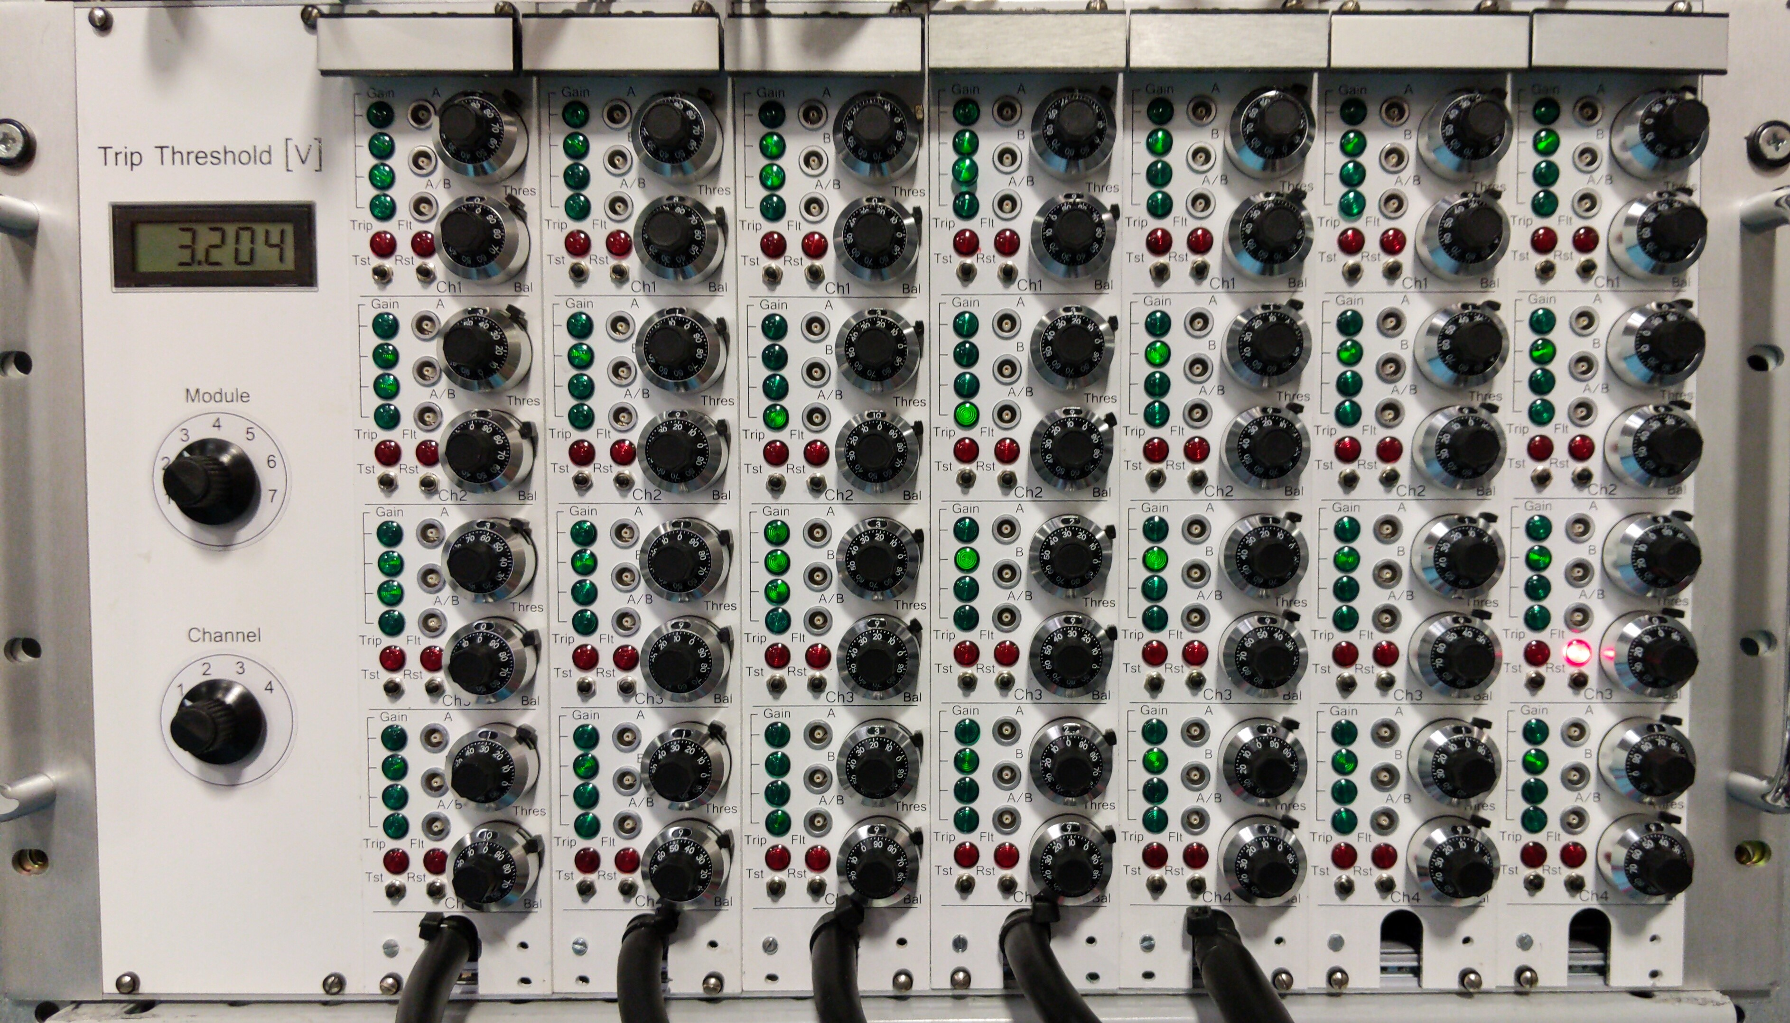
Quench Protection and Quench Monitoring (QP/QM)
Benefiting from the projects, LHC-AUP and mostly Mu2e
Production/Operational grade QM/Qm - design is done, some modifications are in progress
AQD system

Slide 13
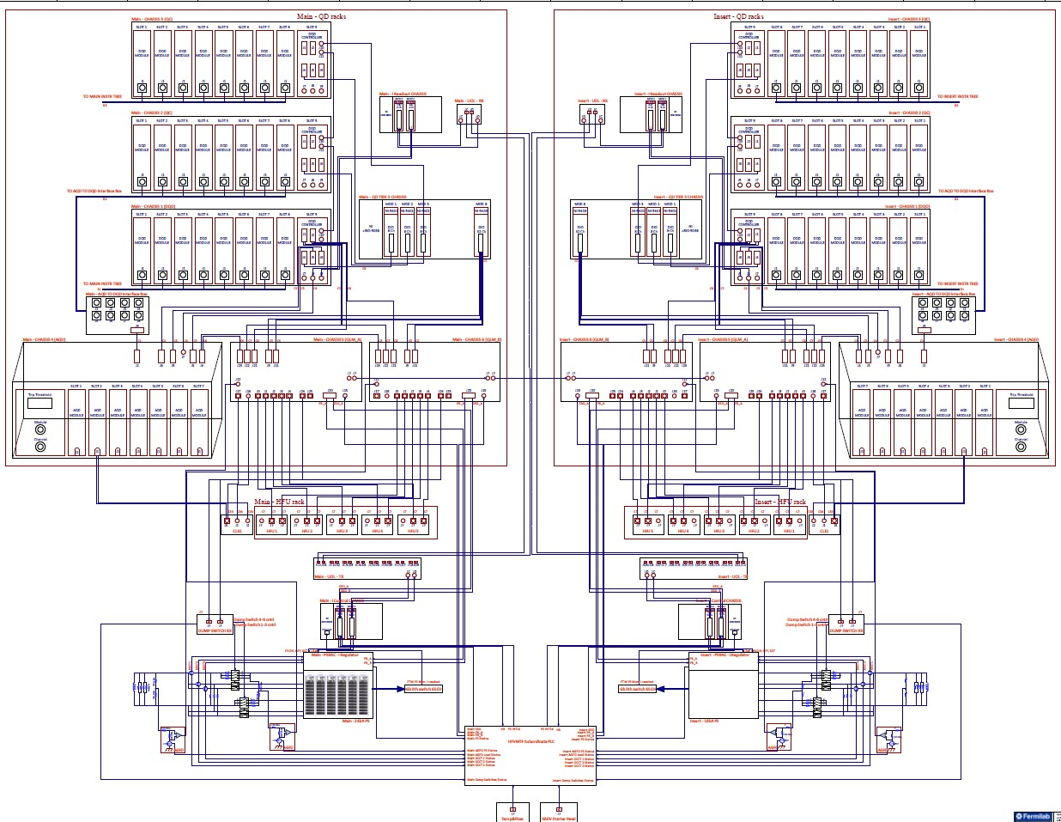
HFVMTF QPM Architecture
Branch 1
Branch 2
Quench Detection & Management
Quench Logic &Protection
PS Cntrl and Monitoring
HFVMTF

Slide 14
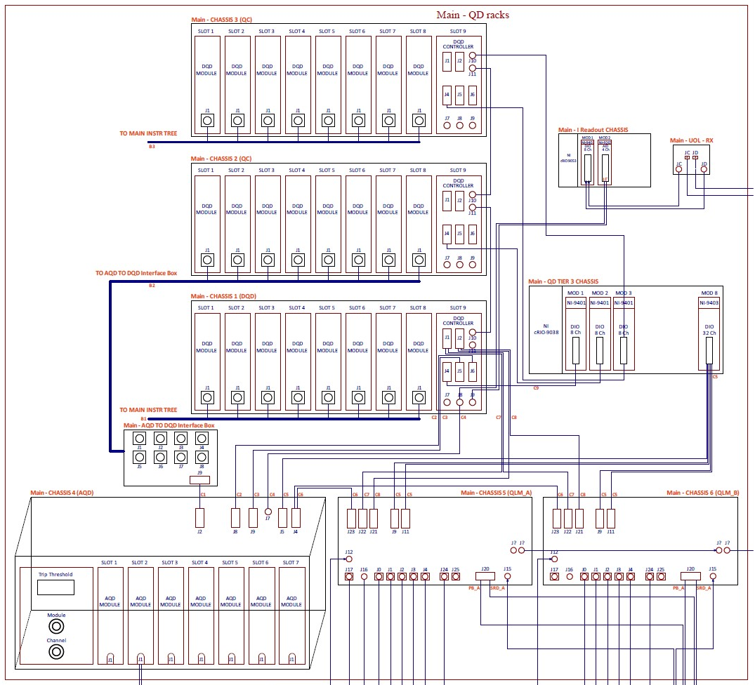
HFVMTF QPM Details – Quench Detectors & Management
The HFVMTF QPM system is based on a QD system developed for the Mu2e experiment.
Primary Custom Digital Quench Detection System (DQD)
Redundant Custom Analog Quench Detection System (AQD)
Quench management system, based on National Instruments C-RIO (Tier III ). Provides quench configuration, control and monitoring, and quench data management.

Slide 15
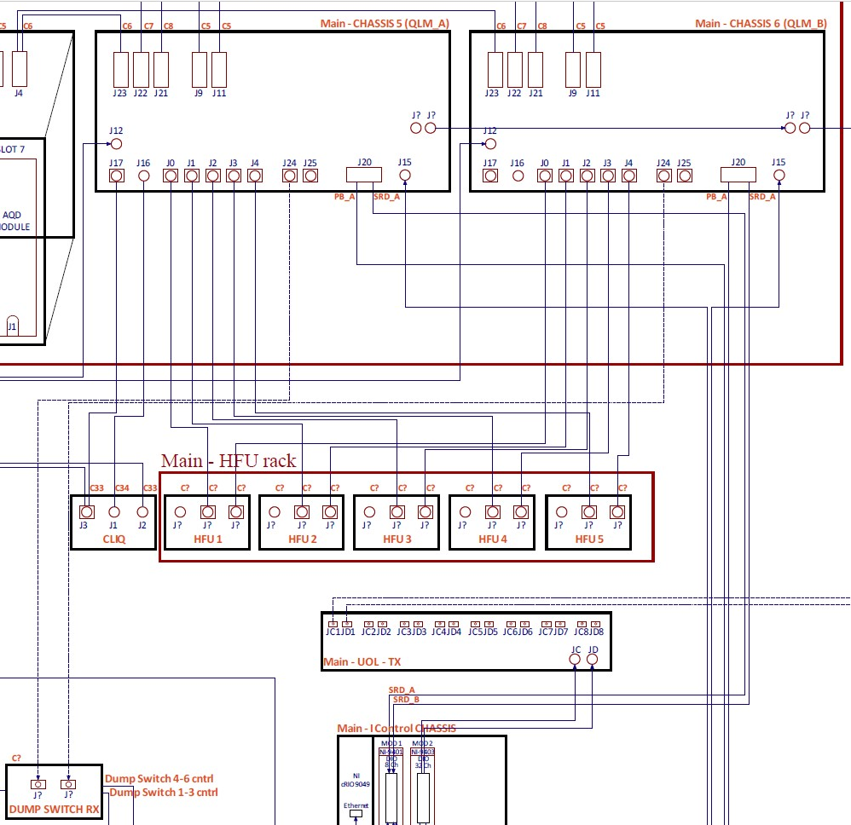
HFVMTF QPM Details – Quench Logic & Protection
A set of two custom Quench Logic Modules (QLMs) carry out the critical hardware-based quench logic, such as:
- Heater control logic
- CLIQ control logic
- Energy extraction system enable and discharge control
- Power system Enable, Phase Back, and Slow Ramp Down.
HFVMTF

Slide 16
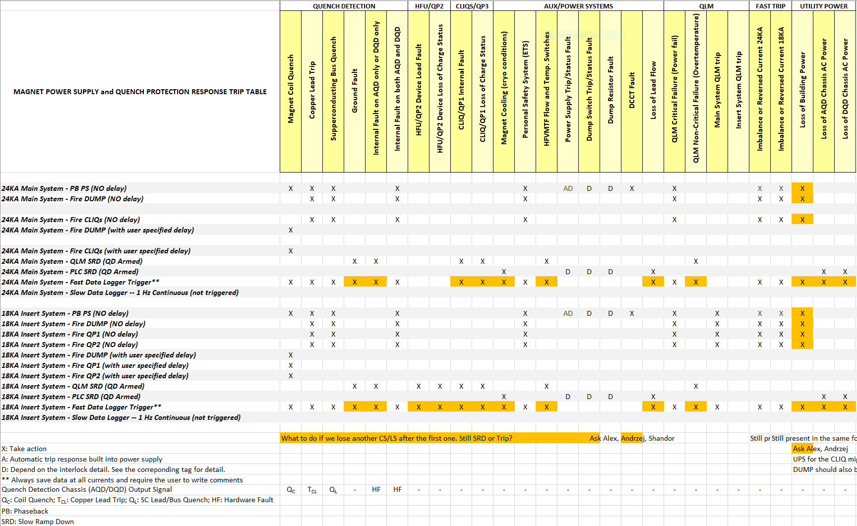
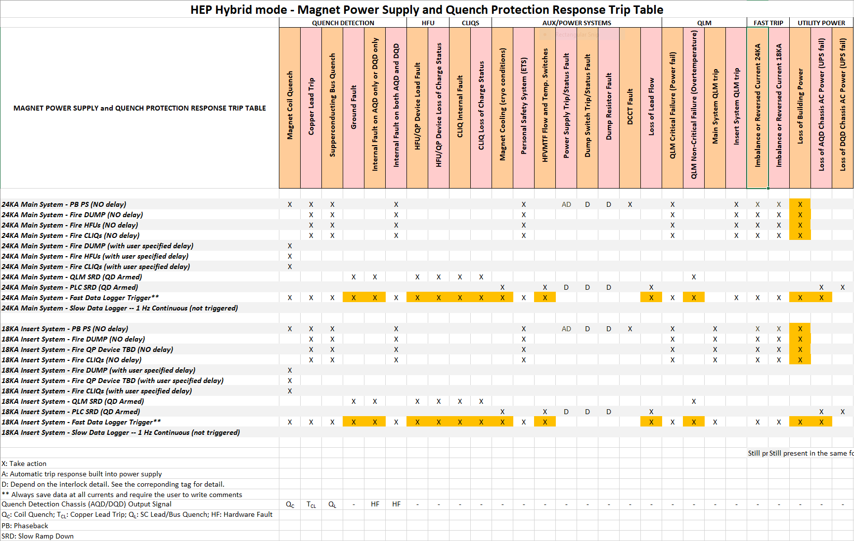
HFVMTF Trip Matrix – FES/HEP

Slide 17
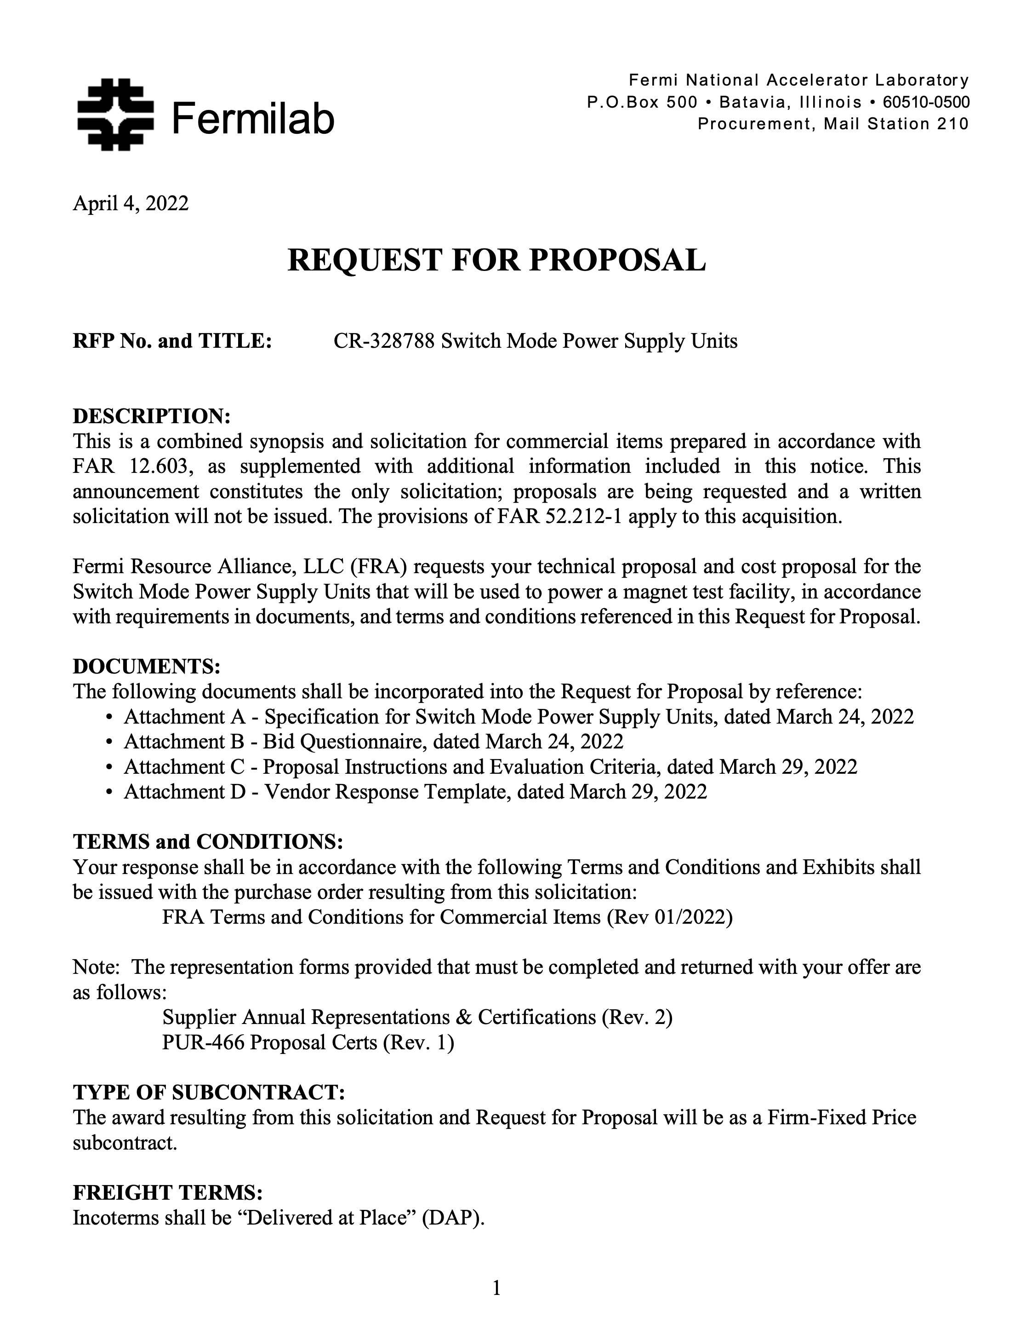
Power Supplies
Power Supply cost is $/per Watt
Looking for possible optimization and cost cut, e.g. 20 V units, switch-mode power supply
Procurement process started – bids are in progress
We are procuring two sets of PSs:
  Min 20 V @24 kA to power the main field magnet (LTS in case of hybrid test)
  Min 20 V @16 kA to power the sample (HTS in case of Hybrid test).
First RFP was sent in April. We had 3 bids - none of them were satisfying the specs.
Rebid process was started at the end of June: on Aug 18 we received, 4 bids from 3 USA and 1 European companies. We are starting the evaluation.

Slide 18
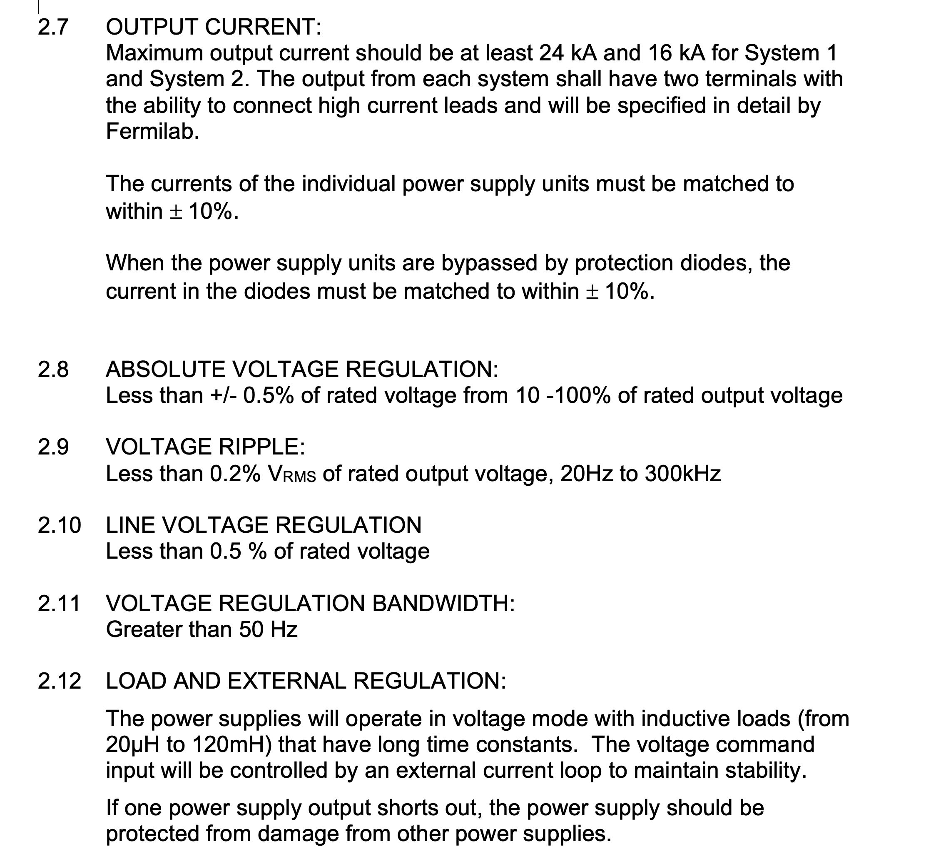
PS specifications
Specifications are finalized
We are asking for modular system of switch-mode power supply
PSs should be on the same technology – interchangeable.
Evaluation expert groups is formed, 5 people, 2 from the Fermilab’s Acc. Division PS
For the current controller we are utilizing the Acc. Division development for mu2e project

Slide 19
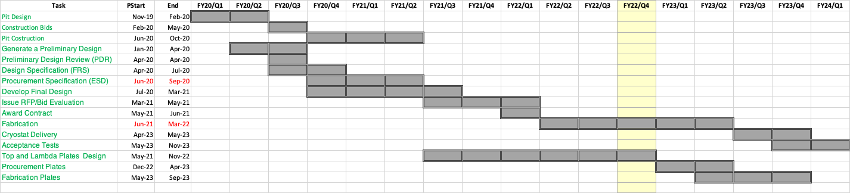
Schedule
Two major known-unknowns
  PS delivery – June 2023?
  QP/QM system chip delivery – end of 2022 or later.
Best estimation of the test facility completion - End 2023

Slide 20
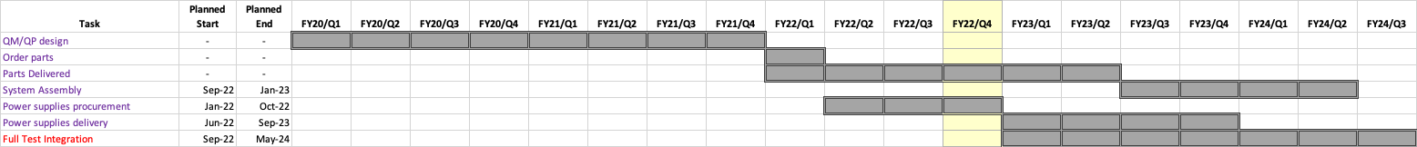
Schedule Update –QP/PS/Integration
The QP/QM schedule is updated
  It incorporates that the system is designed and article (version) 3 is tested
  Indirectly it was affected from the COVID projects delays.
  It incorporates the COVID component delay (electronics)
Final integration schedule is 8 months which is reasonable
The goal is in Jan-May 2024 to test the a MDP magnet in the pit as final integration

Slide 21
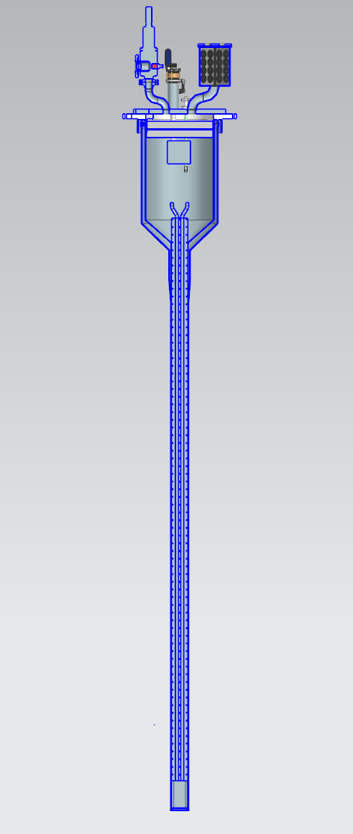
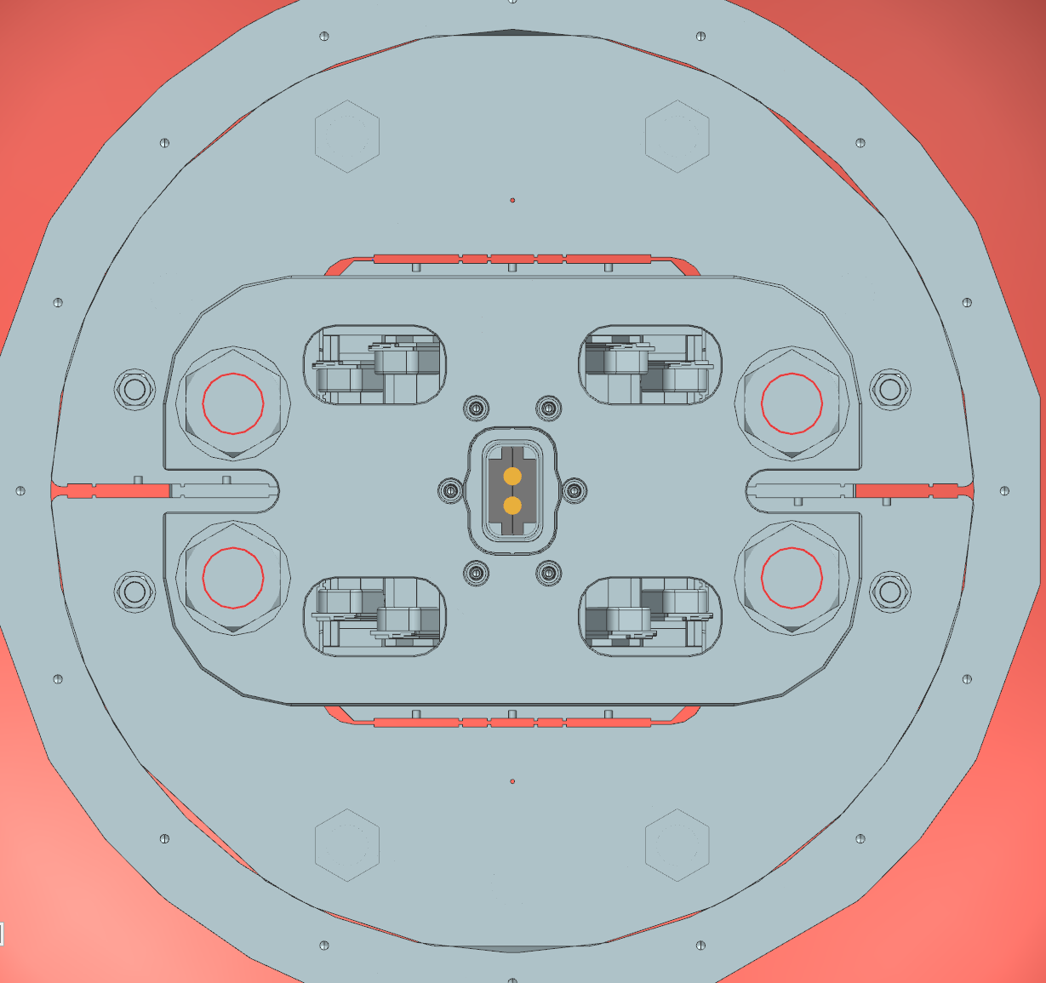
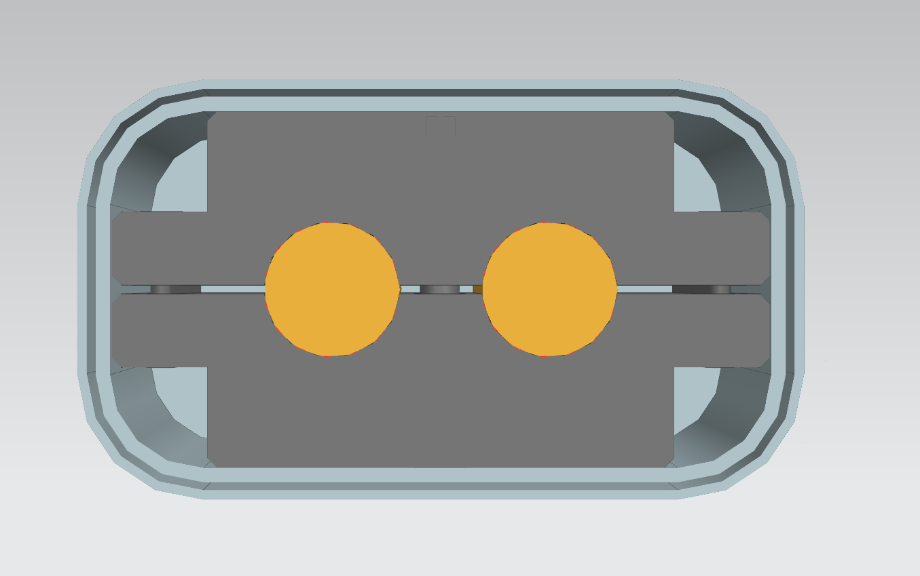
Anti-cryostat and sample holder - design
We have a preliminary design of the anti-cryostat
It follows the EDIPO sample holder
Field should be Perpendicular to the field
We prefer the force to face in not out, some R&D and desing is needed.
B=15 T
F=1.5MN/m
I_{max}=100 kA

Slide 22
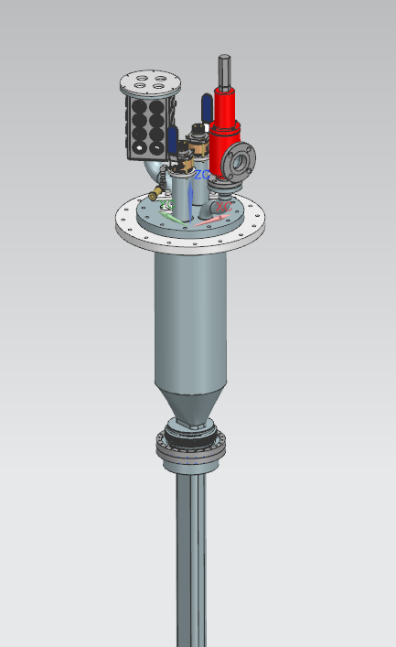
Open questions
There are several questions connected mostly with SC test sample anti-cryostat and test sample well for FES
  Assuming EDIPO type sample cryostat, is this what we need?
  What are sample dimensions? Constant?
  Any limitations on temperature gradient within the sample during testing?
  Sample orientation to the field?
  Are there any requirements for warmup/cooldown?
  SC transformer, what design we should use? Is 100kA what we need?
  Can be CICC be direct cooled (LHe bath) or LHe flow in the cooling channels? Does this matter for the test?
We need input from users community

Slide 23
Summary
The HFVMTF test pit construction is done
Procurement is finalized. The final cryostat design is in progress with the company – cryostat is expected not early than May 2023
The QP/QM system is a close copy of the mu2e/AUP production systems
  Small modifications are needed
  Main electronic parts are ordered in Nov 2022 –Jan 2023 (Covid delays)
Power supplies second bids are received. Expecting to have a contact in December.
Integration of the stand needs additional cryo effort – expect to get resources after first AUP cryomodule test, October 2022.
Risks are identified.
As today, the current estimation of the stand completion is May 2024.
The anticryostat needs better specs from community.

Slide 24
Backup Slides

Slide 25
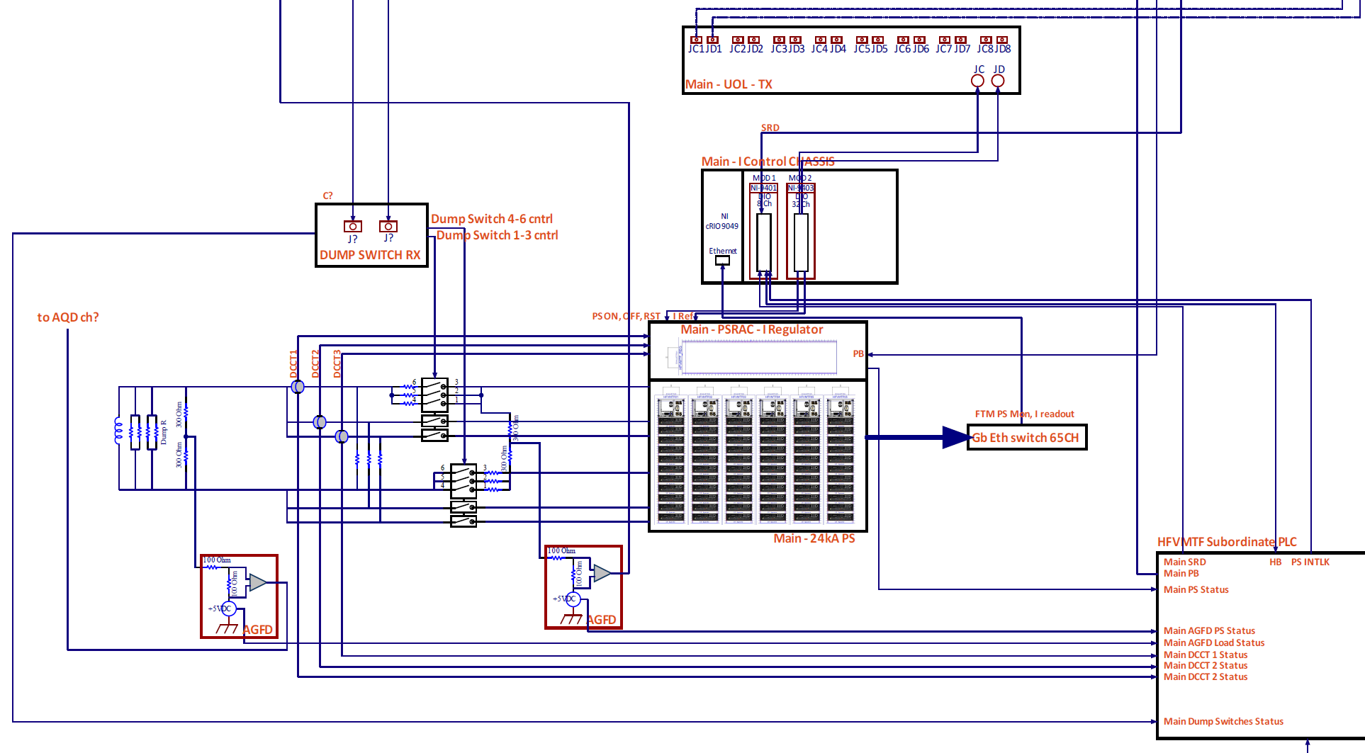
HFVMTF QPM Details – PS Control and Monitoring
Subordinate PLC to monitor temp, water pressure, DCCTs and Dump Switches status
2x Active Ground Fault Detectors
PS consists of Switching Power Supply modules and I-regulator
NI c-RIO based I-control produces open loop Current set-point (Custom profile or periodic waves)
PS Ethernet monitoring for Fast Trip Module and Imbalanced Current protection
Current readout and optical fiber-based distribution for the Current dependent threshold on QDs

Slide 26
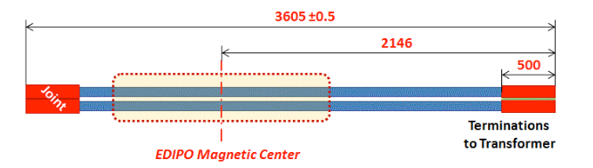
Backup pictures

Slide 27
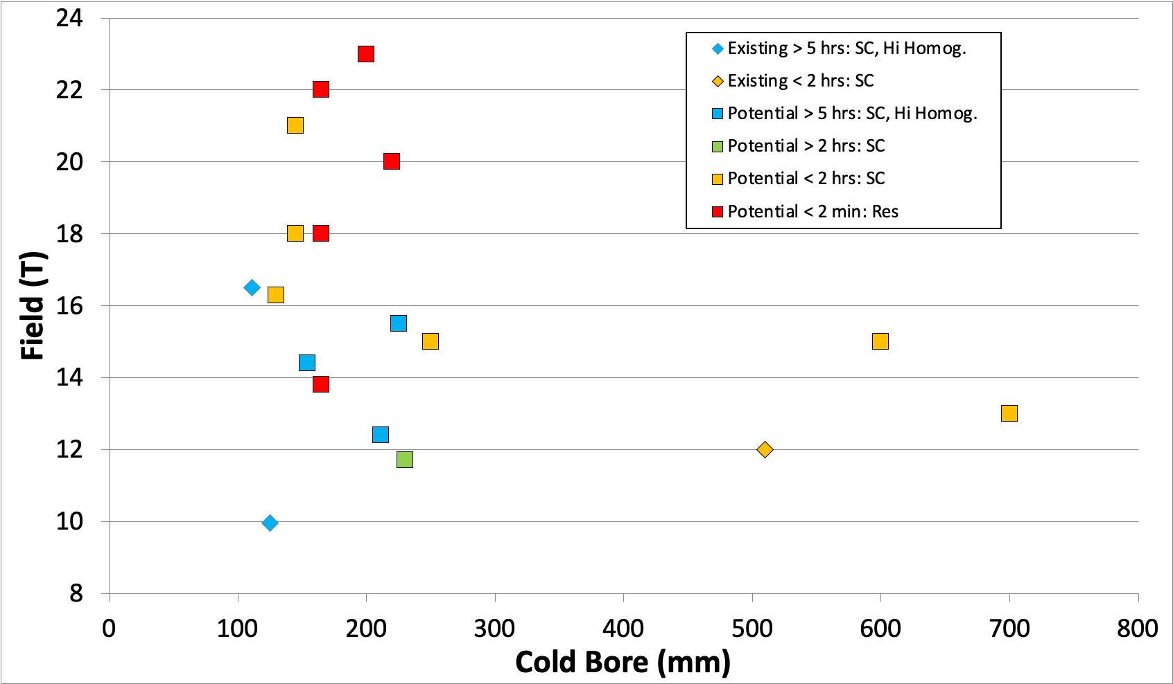
Test Facilities - M. Bird

Slide 28
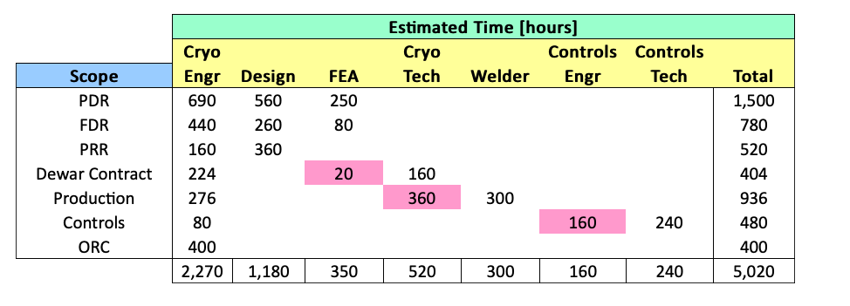
Integration
Documentation for the integration of the pit was started this summer – based on the AUP stand 4 experience
A cryo engineer left the division - the process was delayed
A discussion with the cryo sector for optimization of the project resources (mu2e, AUP, PIP II) is in progress. Need funding in FY23 to get engineering support
Aug 2021
3520 h

Slide 29
Funding Status
This project has very low or no contingency (10% were used in GPP estimation and some other task)
 | Funds Planned/Received/Pending
Cost Estimate (k$) | Step 1 | Step 2 | Step 3 | TPC | Comments
k$ | $1,549.0 | $1,612.5 | $563.5 | $3,725.0 | Total Cost
Year received | FES | HEP | FY total | Steps
FY19 received (GPP-test pit) | $1,299.0 | $250.0 | $1,549.0 | Step 1 | Received in August 2019, $500k is for the civil construction and $1000k for cryostat
FY20 Received (QP/QM) | $0.0 | $650.0 | $650.0 | Step 2 | Received in May 2020, for QP/QM electronics
FY21 Received (Power Supplies) | $0.0 | $962.5 | $962.5 | Step 2 | Received in April 2021, for PSs and supporting electronics
FY22 (Integration) | $563.5 | $0.0 | $563.5 | Step 3 | Needed for Integration (not received)
Total | $1,862.5 | $1,862.5 | $3,725.0

Slide 30
Funding: Step 1 - details
FY19 received (GPP-test pit) | $1,299.0 | $250.0 | $1,549.0 | Step 1 | Received in August 2019, $500k is for the civil construction and $1000k for cryostat
The funding for the test pit was $500k
  Test pit actual cost is $584k - overrun is due to
    adding the steel shielding
    several change request during the construction
The funding for the cryostat and Top&Lambda plates is $1,049k
  the cryostat design is $438k – we planned $473k
  The cryostats manufacturing:
    Planned cost: $428k
    Bids are vendor 1 - $749; Vendor 2 – $936.3k
The top&lambda plates in design process: going RFQ in a 2 months

Slide 31
Funding: Step 1 – Summary
 | STEP 1 - Test Pit, Cryostat, Top&Lambda Plates
Cost Estimate (k$) | Planned | Actual Cost Vendor 1 | Actual Cost Vendor2 | Diff. Vendor 1 | Diff. Vendor 2 | Comments
Test Pit construction | $499 | $584 |  | -$85 | -$85 | Construction is done
Cryostat Design | $473 | $438 |  | $35 | $35 | It is finished
Cryostat procurement | $428 | $749 | $936 | -$321 | -$508 | Bids are in
Top&Lamba plates | $149 | $149 |  | $0 | $0 | Not ordered yet
Summary | $1,549 | $1,920 | $2,107 | -$371 | -$558
As yesterday, Vendor 1 is selected (Ability Technology Inc. in IL)

Slide 32
Step 2 - details
For quench Protection and quench monitoring systems we received $650k. The work is in progress. We ordered the log-lead time components (chips) – delivery time 8 months
Power supplies procurement process will start after New Year. For PSs we have received $963k.
 | STEP 2 - QP/QM systems and PSs
Cost Estimate (k$) | Planned | Costed | Balance | Comments
Quench Protection/Monitoring | $650 | $136 | $514 | Work is in progress
Power Supplies | $963 | $15 | $948 | Specifications are in progress
Summary | $1,613 | $151 | $1,462

Slide 33
Step 3 – details
We have planned 3520 h for integration + appropriate M&S
We need to receive $563.5k to start the system integration. We need to have funds to secure resources from cryo-sector
This might be not enough, but I do not have better estimation – need to work on it
 | STEP 3 - System integration
Cost Estimate (k$) | Planned | Costed | Balance | Comments
Integration | $564 | $0 | $564 | Design just started; manpower limited
Summary | $564 | $0 | $564

Slide 34
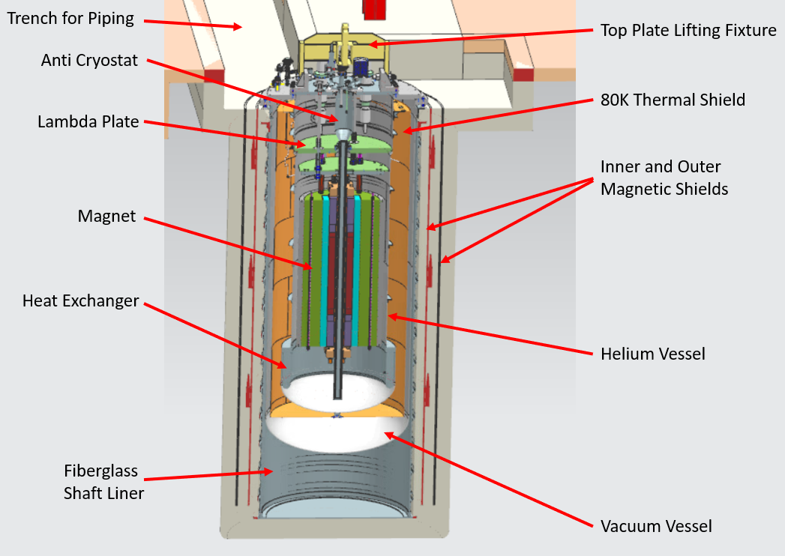
Civil Construction Design
Current VMTF
HFVMTF

Slide 35
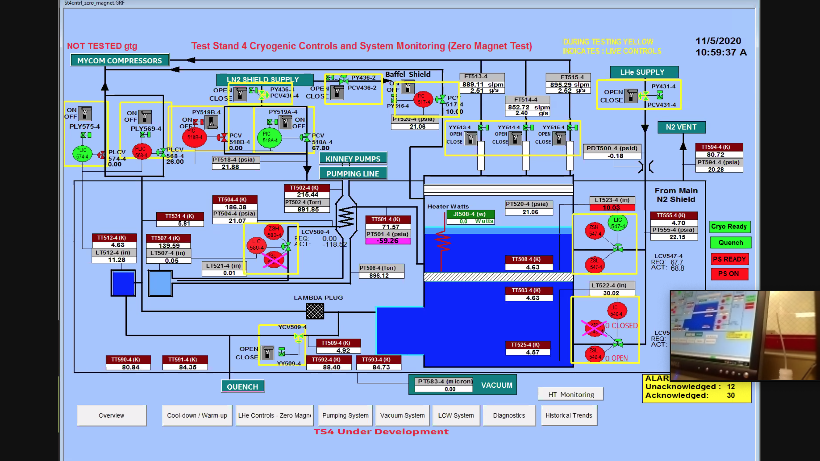
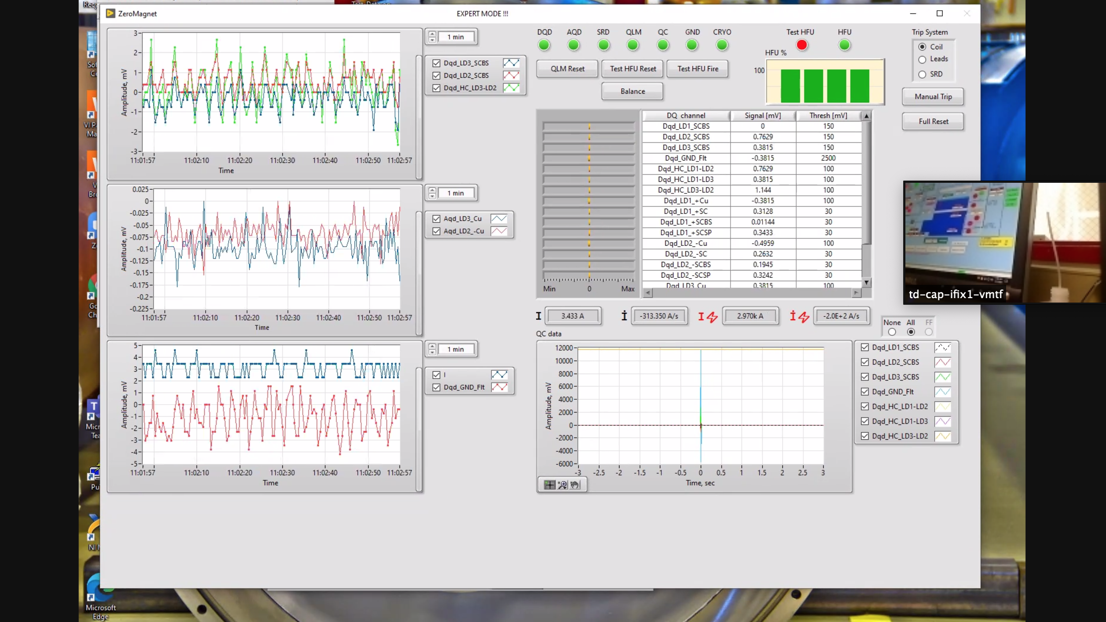
Mu2e 1st Article Quench Protection
Hi-Lumi ZMT Cold Test
ZOOM Power Test side note:
The test was carried out in the control room, which has a limited capacity due to COVID-19
Zoom meetings were set up so all the subject matter experts could participate
The relevant test GUIs were shared with audio – worked great!
Darryl Orris

