Slide 1
20T hybrid block-coil
V5.5
E. Rochepault
22/08/2022

Slide 2
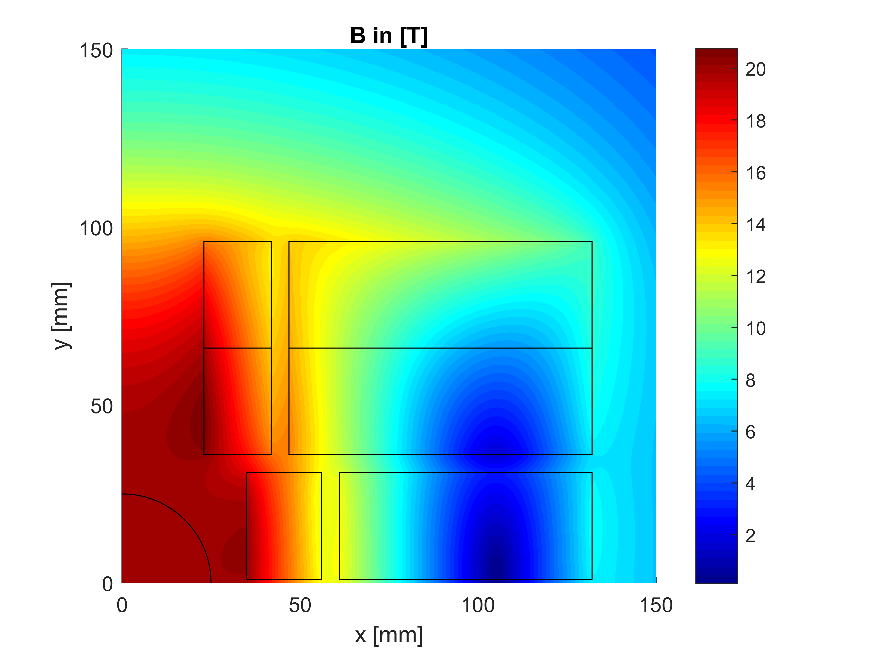
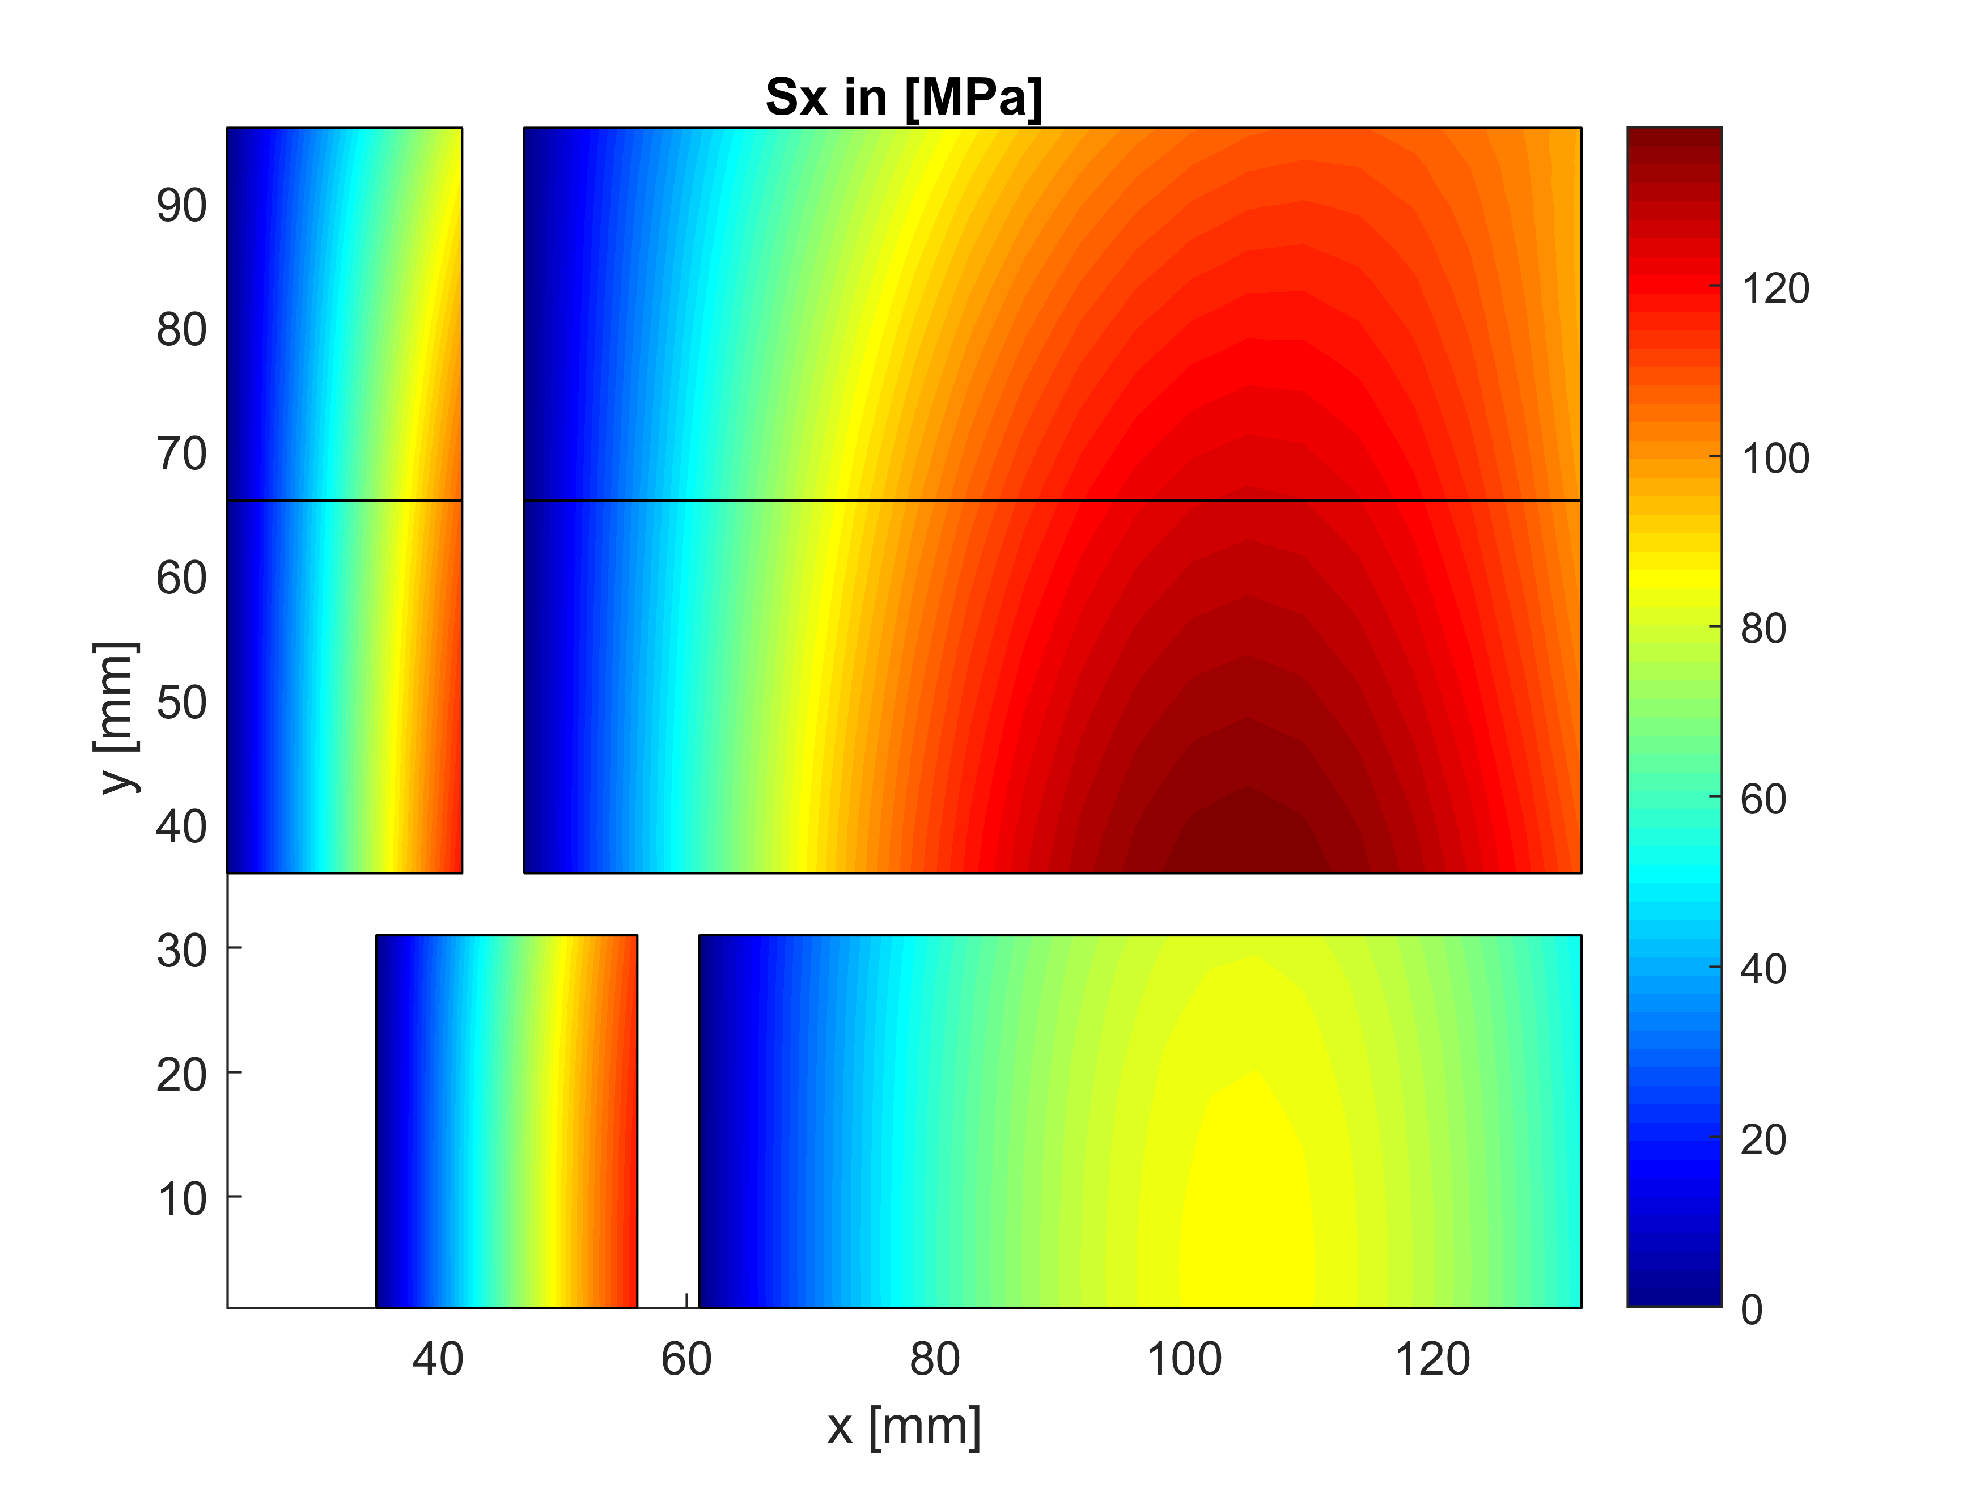
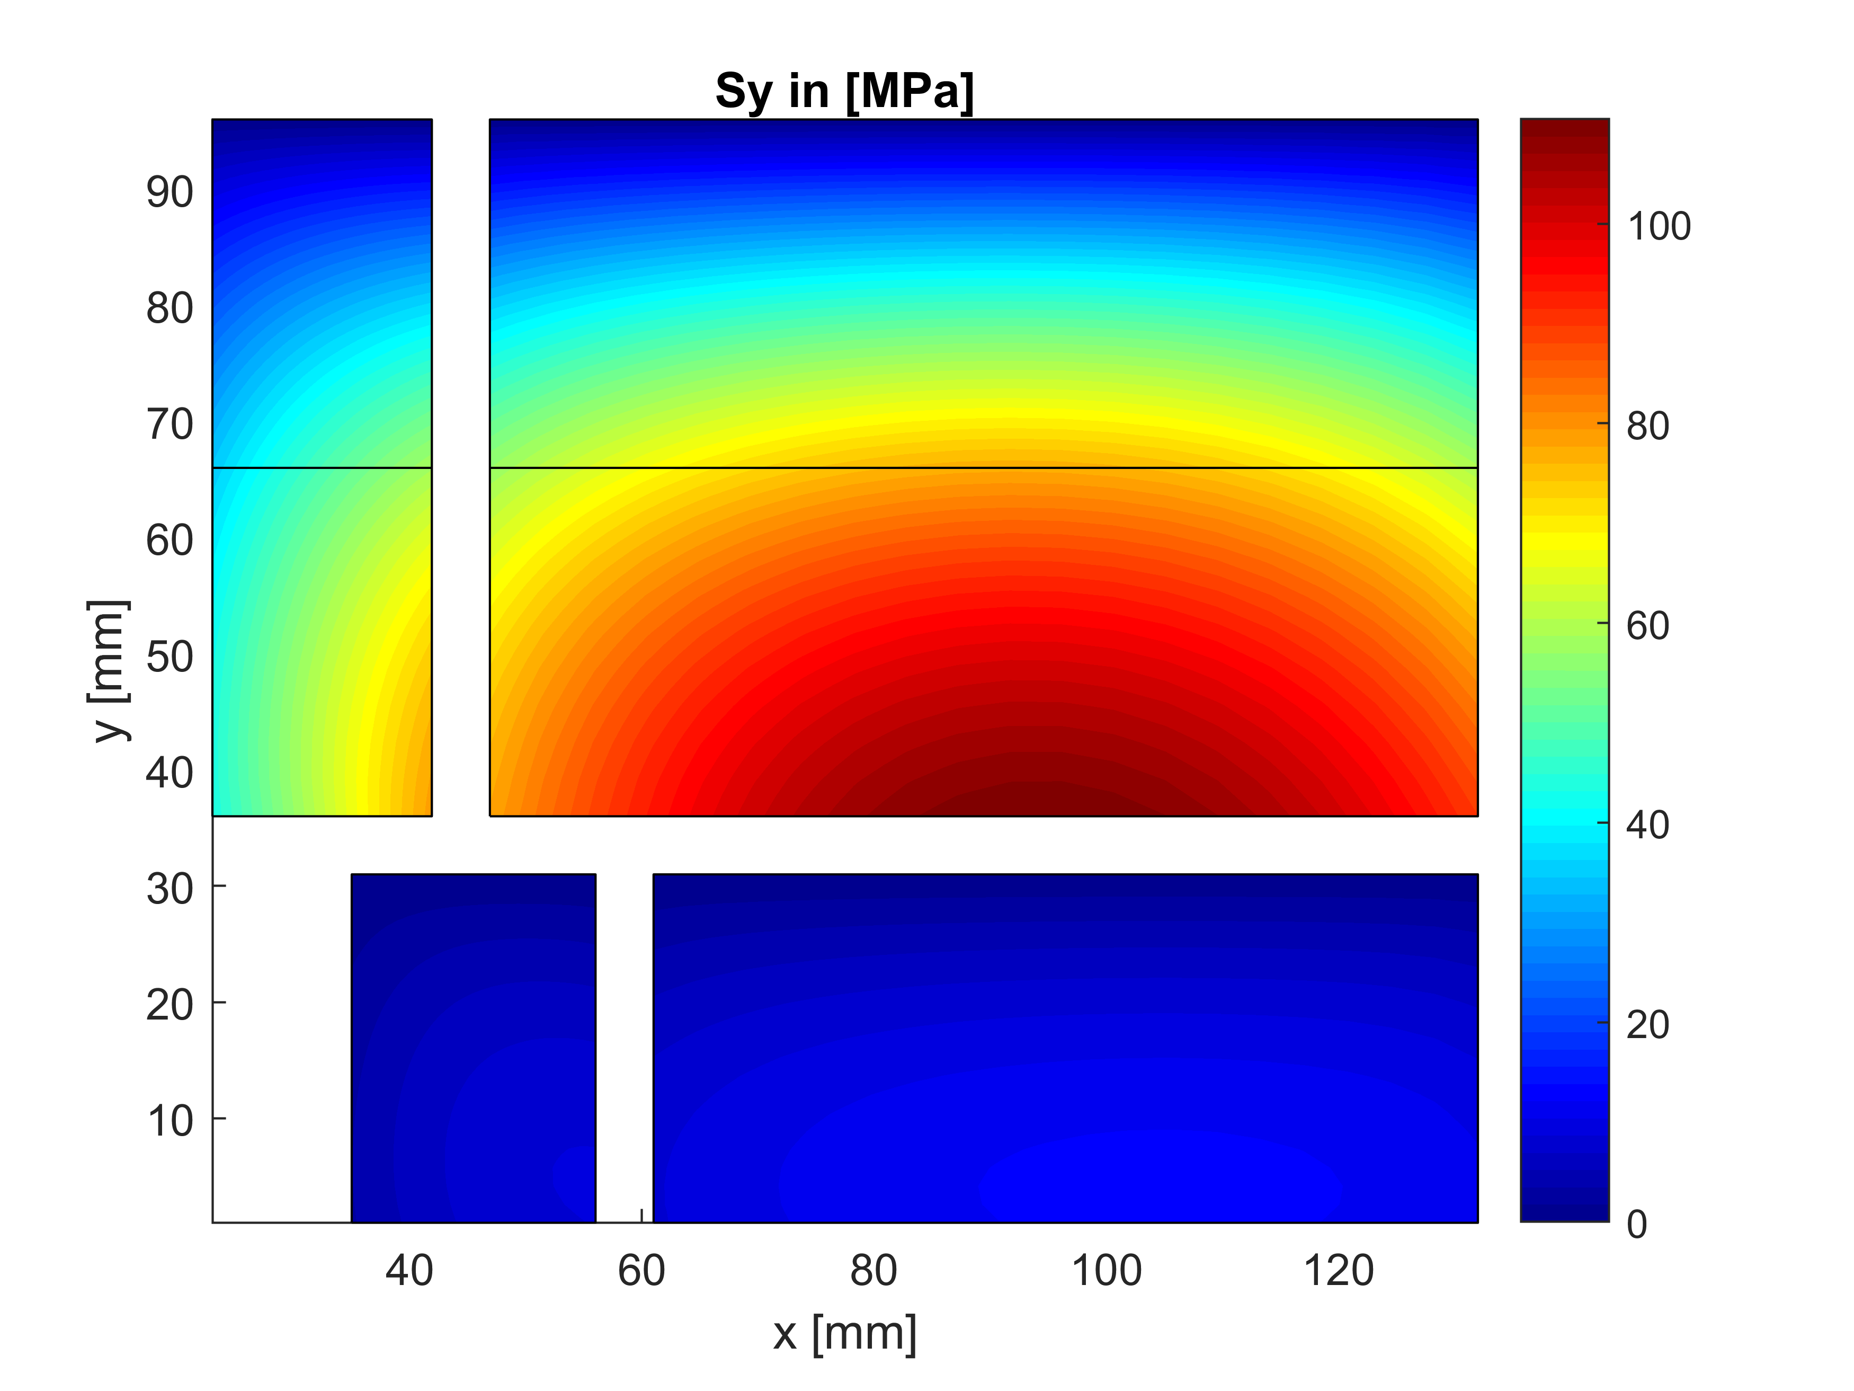


Best case with field quality – 5.5
b_{n} [unit] | Matlab Analytical | Ansys No iron | Ansys iron
b3 | -6.27 | -6.33 | -0.55
b5 | -3.18 | -3.12 | -2.99
b7 | -0.131 | -0.088 | -0.065
b9 | 0.113 | 0.100 | 0.085
@ 20 T in the bore
No iron
Grading factor = 0.9
Quadrant area = 9000 mm²
110 MPa
Without iron:
118 MPa
138 MPa

Slide 3
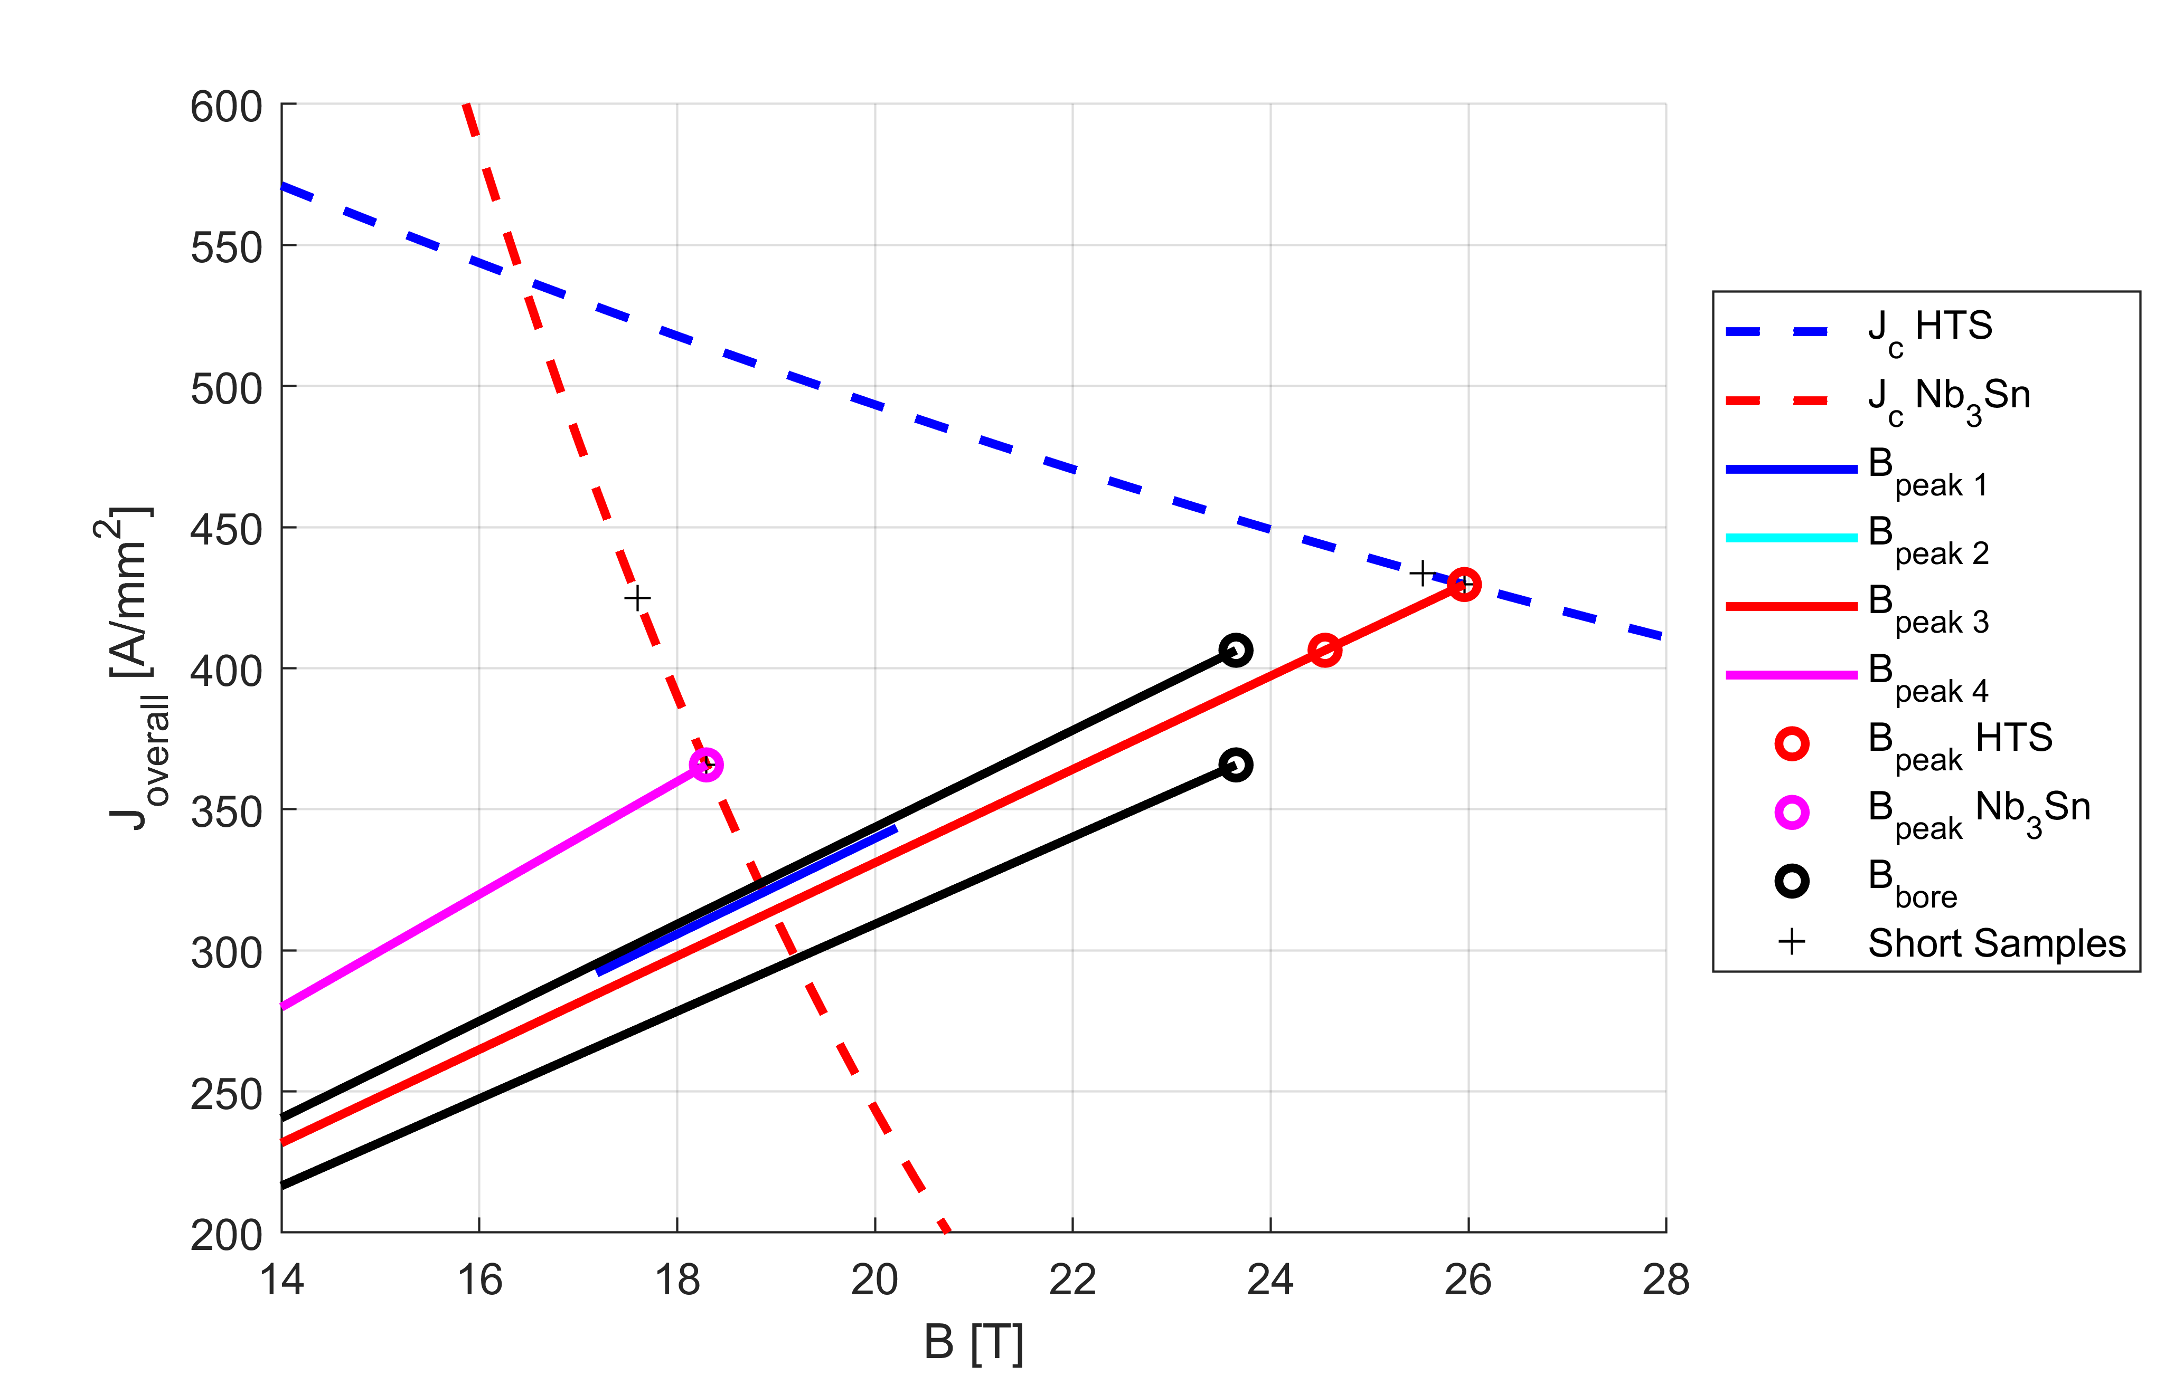
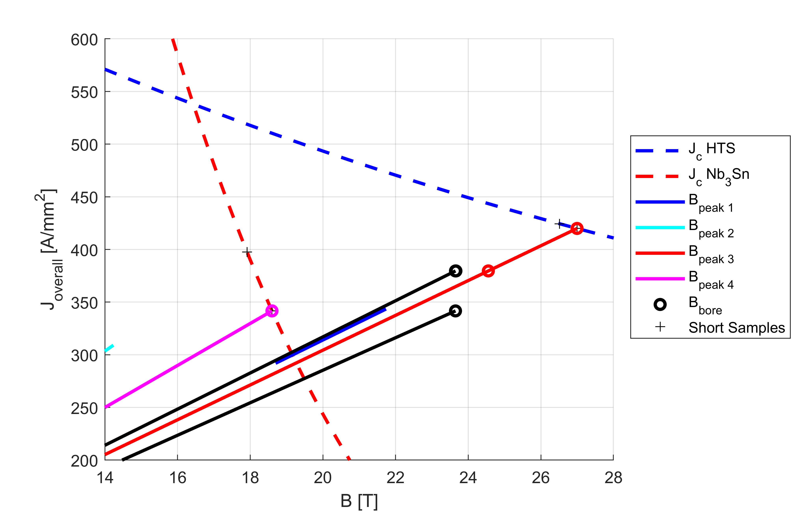
Operating Points – 5.5
 |  | Matlab | Ansys | Ansys
 |  | No iron | No iron | iron
20 T
J_{HF} | A/mm2 | 343.4 | 343.7 | 317.0
J_{LF} | A/mm2 | 309.1 | 309.3 | 285.3
B₀ | T | 19.99 | 20.00 | 20.00
B_{peak,HF} | T | 20.75 | 20.76 | 20.76
B_{peak,LF} | T | 15.46 | 15.47 | 15.77
Margin | % | 15.5 | 15.4 | 16.5
Sx peak LF | MPa | 118.4 | 117.3 | 109.7
Sx peak HF | MPa | 138.6 | 140.3 | 142.0
Sy peak | MPa | 110.5 | 110.6 | 89.6
Short sample
J_{HF,SS} | A/mm2 | 406.1 | 406.4 | 379.6
J_{LF,SS} | A/mm2 | 365.5 | 365.7 | 341.6
B_{0,SS} | T | 23.65 | 23.65 | 23.66
B_{SS,HF} | T | 24.54 | 24.55 | 24.55
B_{SS,LF} | T | 18.3 | 18.30 | 18.60
Sx peak LF | MPa | 165.5 | 164.1 | 155.0
Sx peak HF | MPa | 193.7 | 196.2 | 201.2
Sy peak | MPa | 154.4 | 154.7 | 126.6
Without iron
With iron

Slide 4
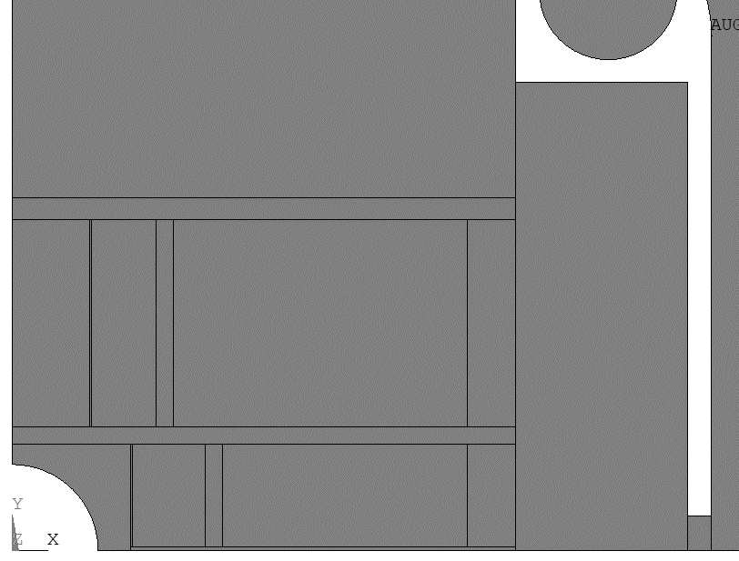
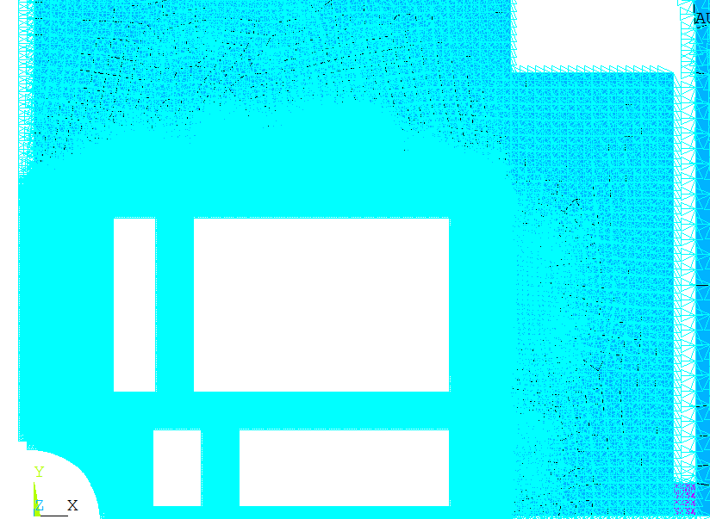
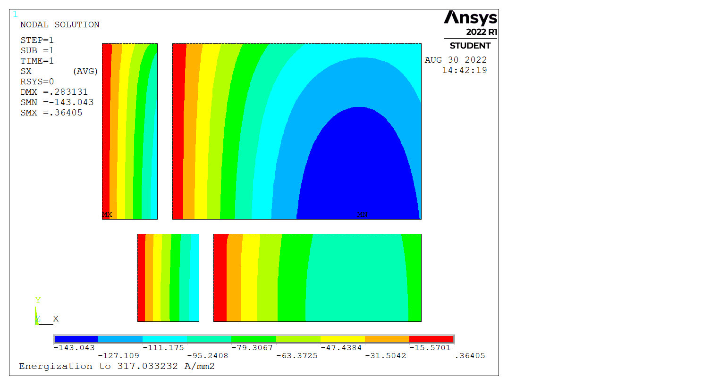
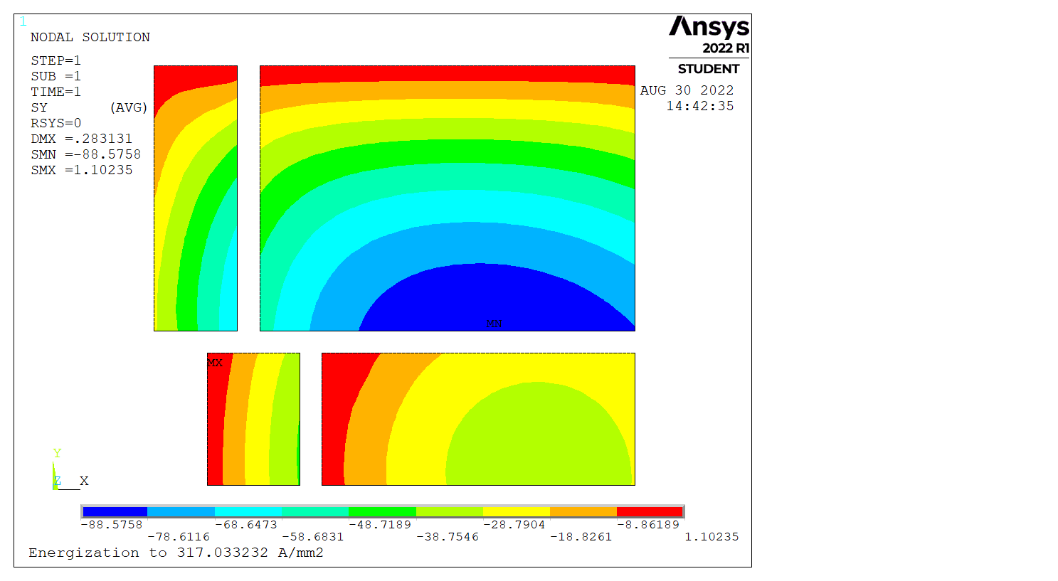
Rigid boundaries
Fixed nodes everywhere but the coil blocks
Lorentz forces only
With iron
→ Same as analytical model
Sx
Sy
143 MPa
108 MPa
86 MPa

Slide 5
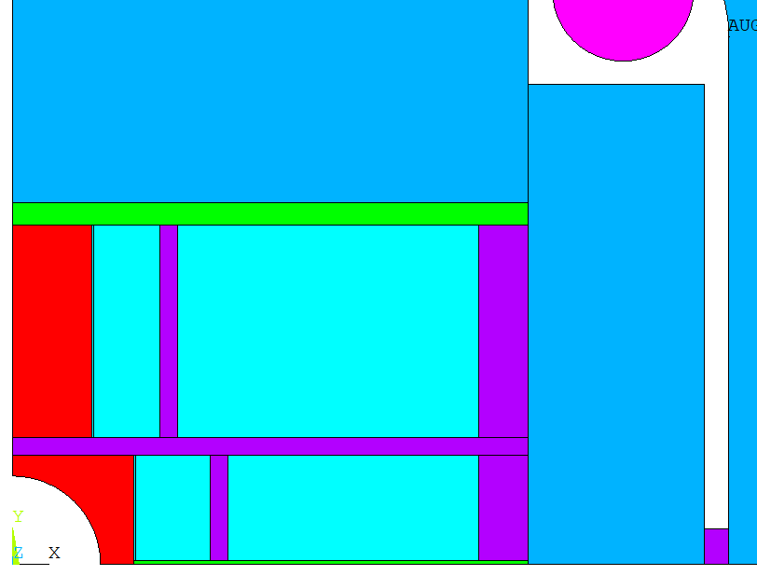
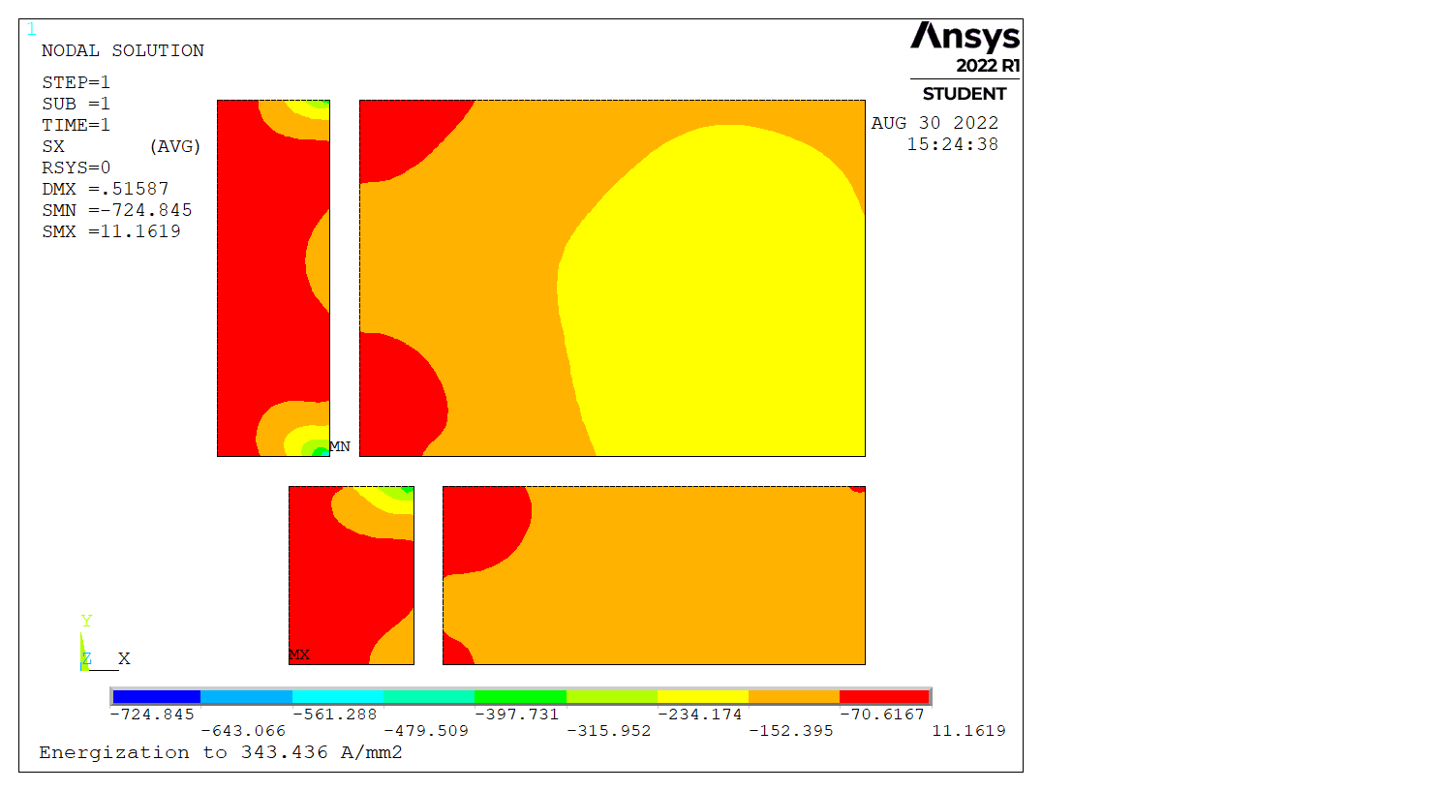
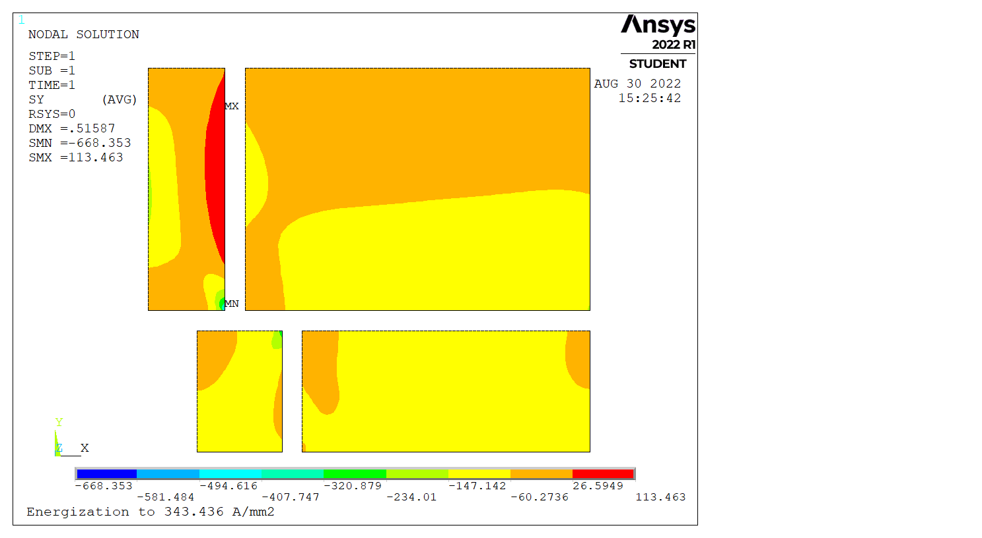
Bonded components
All surrounding components bonded
→ High peak stresses in corners
Sx
Sy
179 MPa
228 MPa
725 MPa
668 MPa

Slide 6
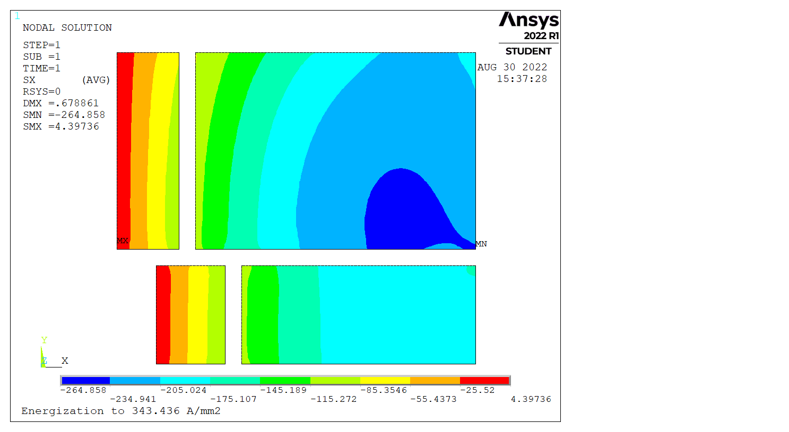
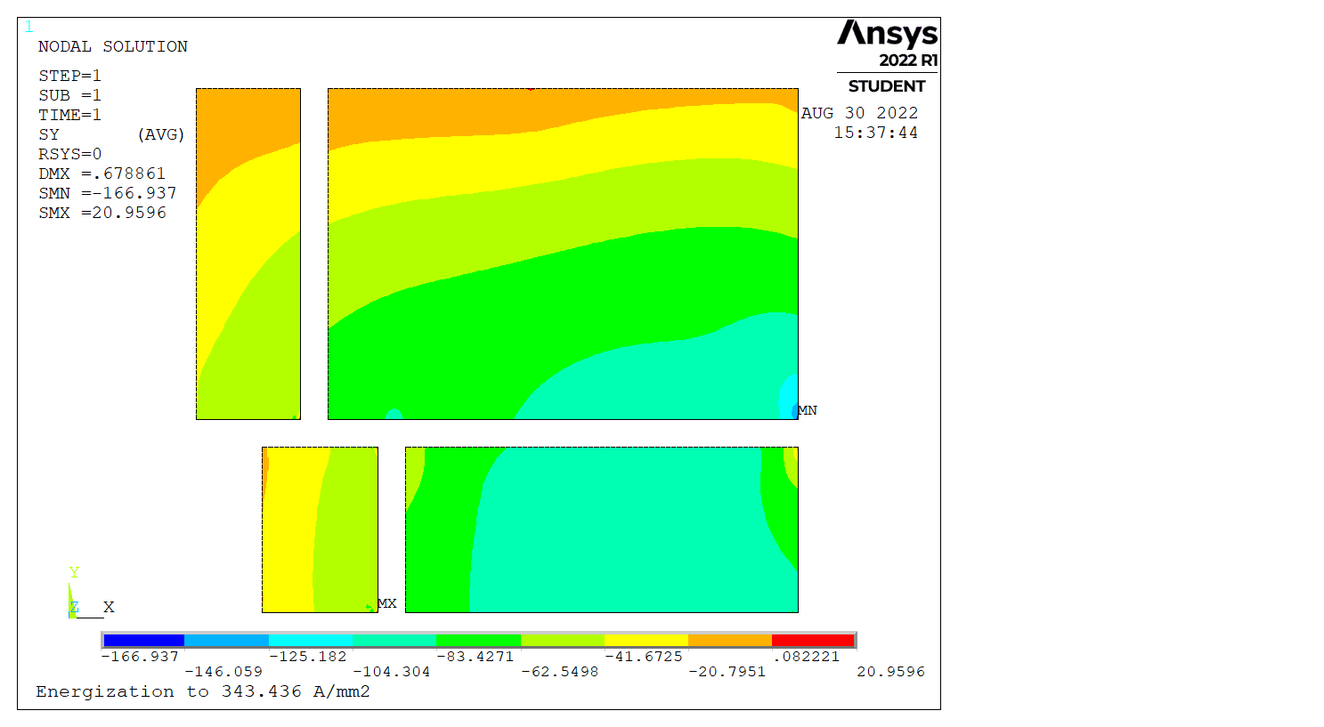
Free components
All surrounding components free (separation + sliding)
→ No stress decoupling, peak in corner
Sx
Sy
167 MPa
265 MPa
116 MPa

Slide 7
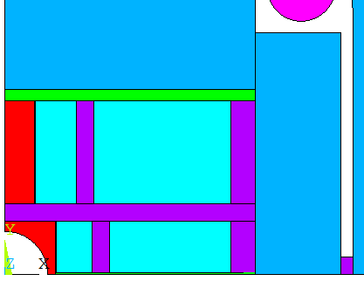
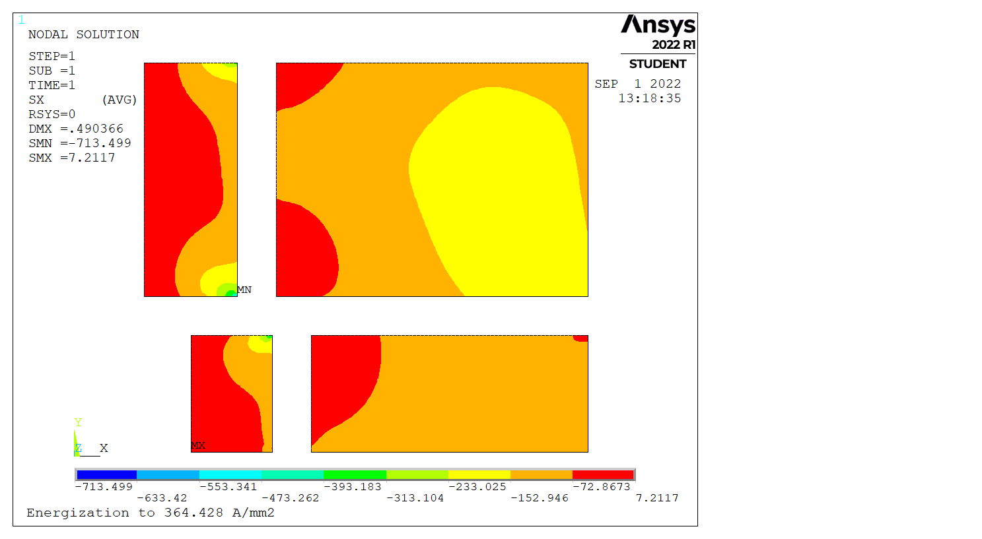
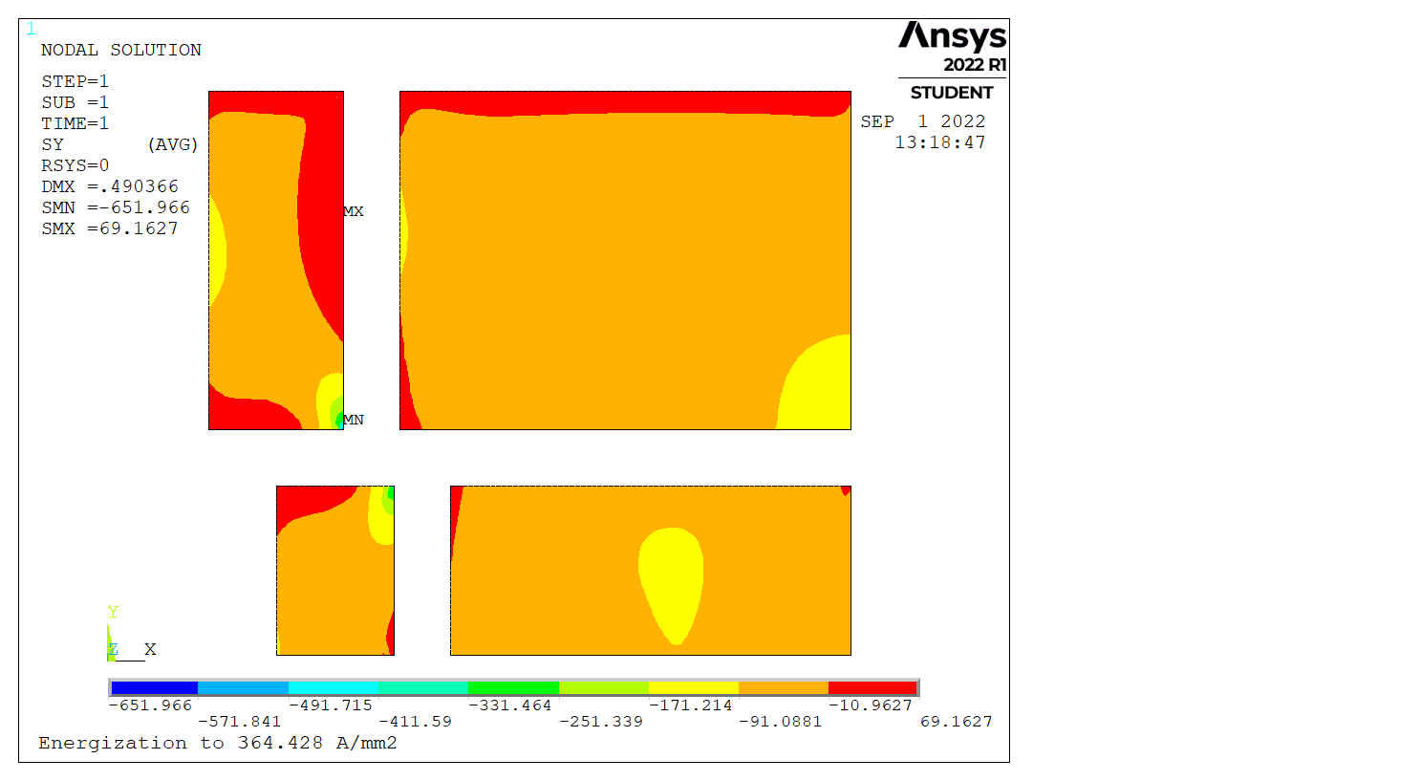
Bonded components – 10 mm structure
Ribs and plate 10 mm thick
Current calculated to generate the same peak stress
→ No significant improvement
Sx
Sy
~170 MPa
~230 MPa
713 MPa
652 MPa

Slide 8
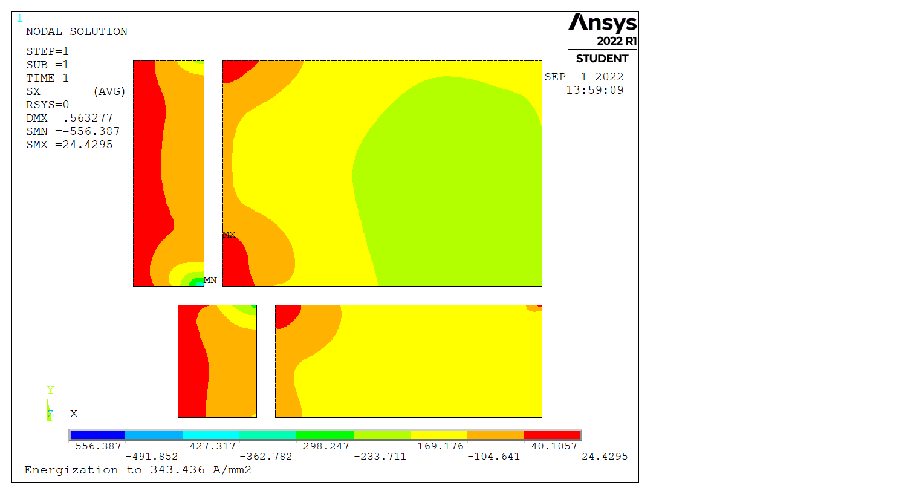
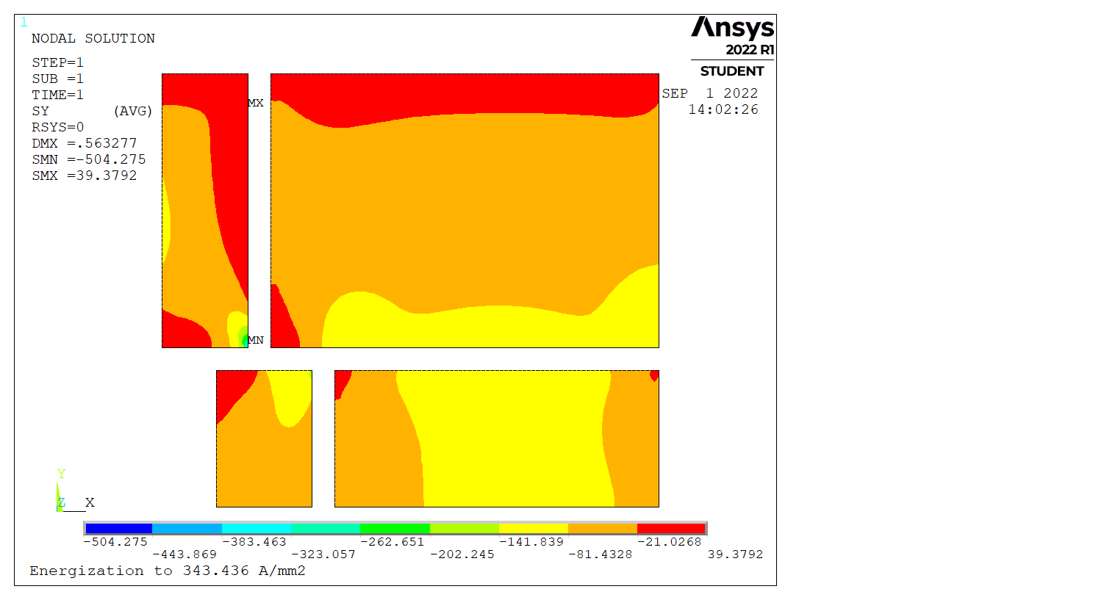
Sliding cage
Vertical plates free to slide
BC u_{x}=0 realeased
→ Slight decrease of peak stresses
Sx
Sy
~140 MPa
~230 MPa
556 MPa
504 MPa

Slide 9
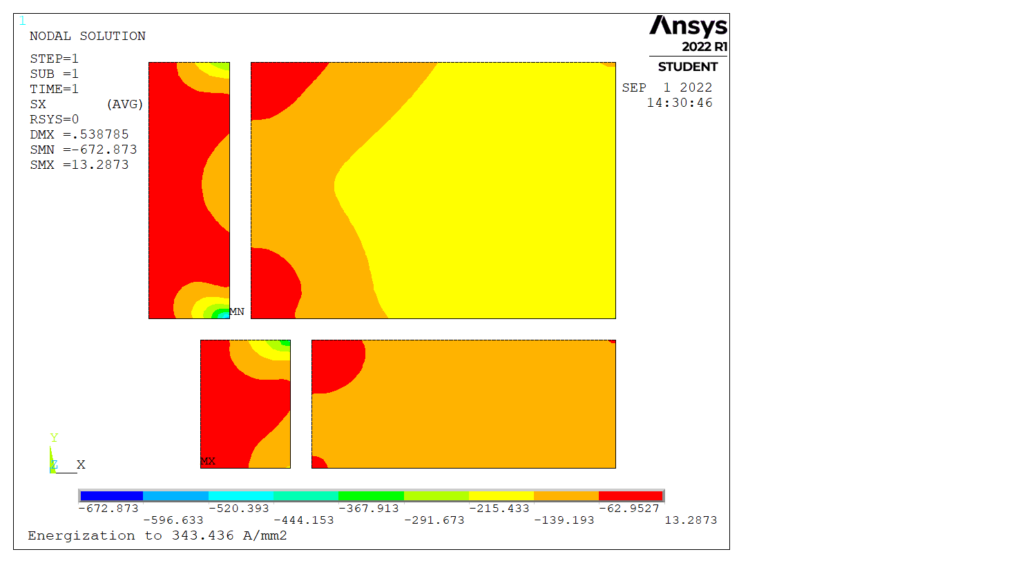
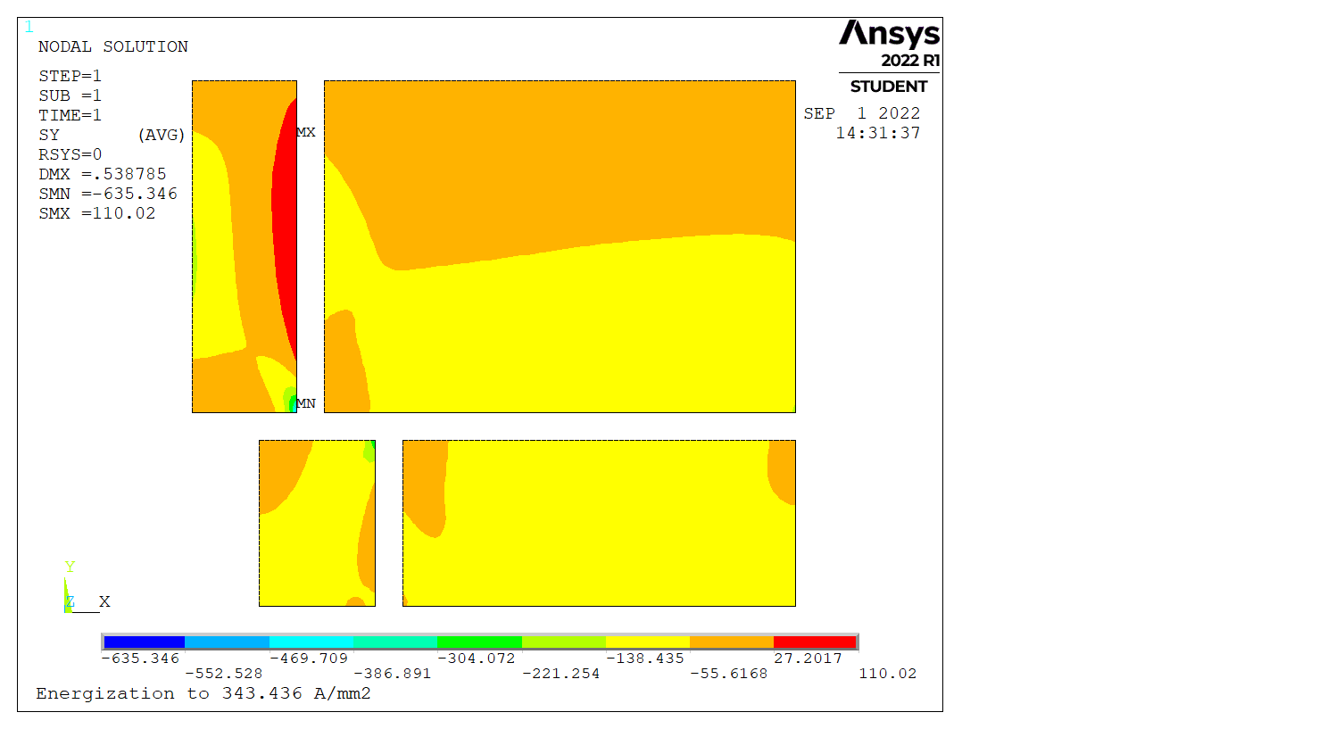
Detached ribs
Ribs in ‘rough’ contact
= separation but no sliding
→ Slight decrease of peak stresses
Sx
Sy
~140 MPa
~210 MPa
673 MPa
635 MPa

Slide 10
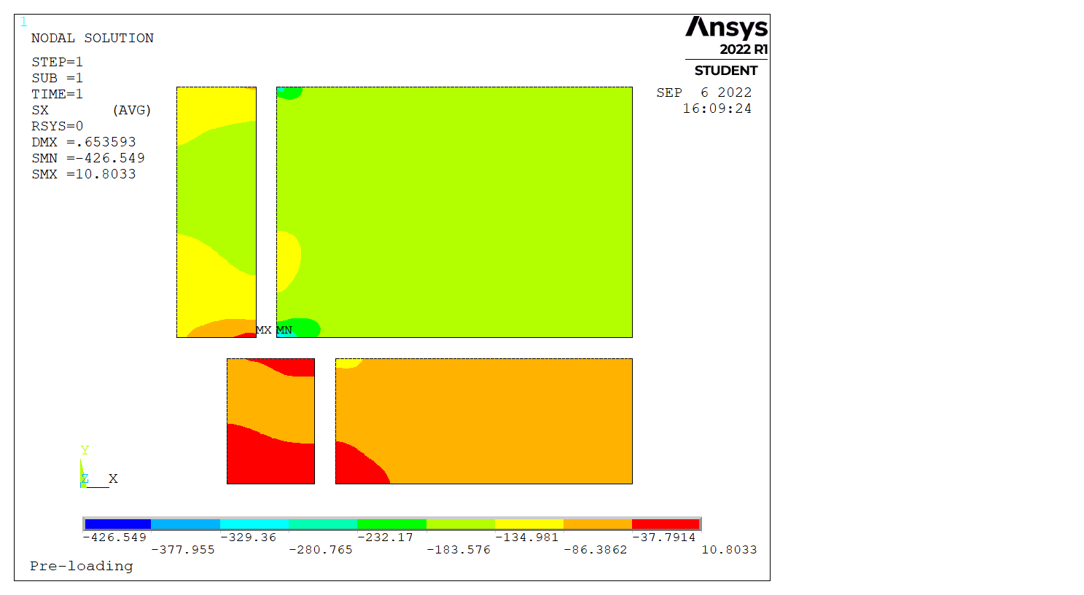
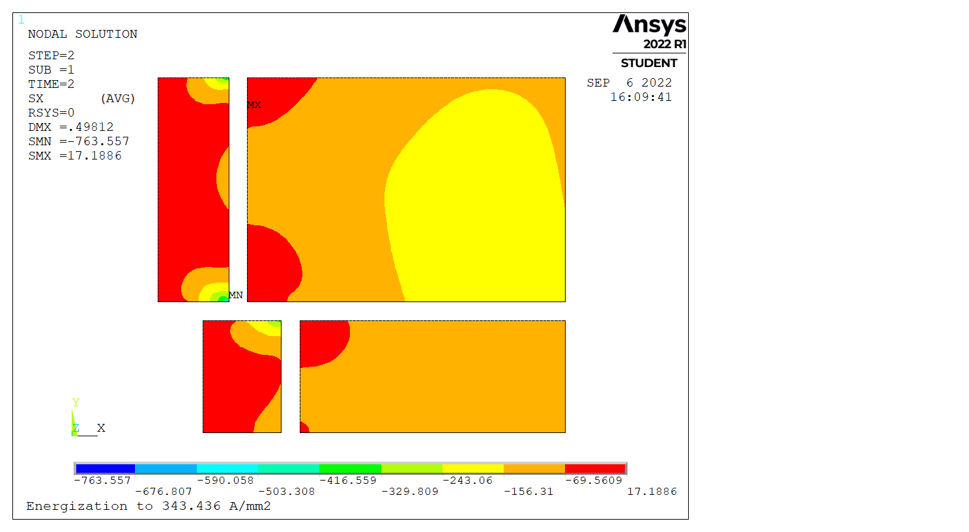
Preload
“Conceptual preload” = External pressure on the rails to “counter-bend” the ribs
→ No significant improvement
150 MPa
75 MPa
Sx at preload
Sx at nominal
140 MPa
219 MPa
764 MPa
427 MPa

Slide 11
Soft insulation – to be calculated
Coil blocks surrounded by a soft layer of insulation
→ Likely to decrease locally the peak stresses
Sx
Sy

Slide 12
Taking into account plasticization – to be calculated
Bi-linear model for coil blocks Taking into account plasticization
→ Likely to decrease locally the peak stresses, but non predictable effect of a higher deformation

Slide 13
Taking into account plasticization – to be calculated
Bi-linear model for coil blocks Taking into account plasticization
→ Likely to decrease locally the peak stresses, but non predictable effect of a higher deformation

Slide 14
Adding stress-release in components
Adding notches or springs in components to absorb deformation
→ Likely to decrease locally the peak stresses, but requires a more advanced engineering design

