Slide 1
Training reduction milestones status I
MDP Meeting
September 14, 2022
Emanuela Barzi
Fermi National Accelerator Laboratory
US Magnet Development Program

Slide 2
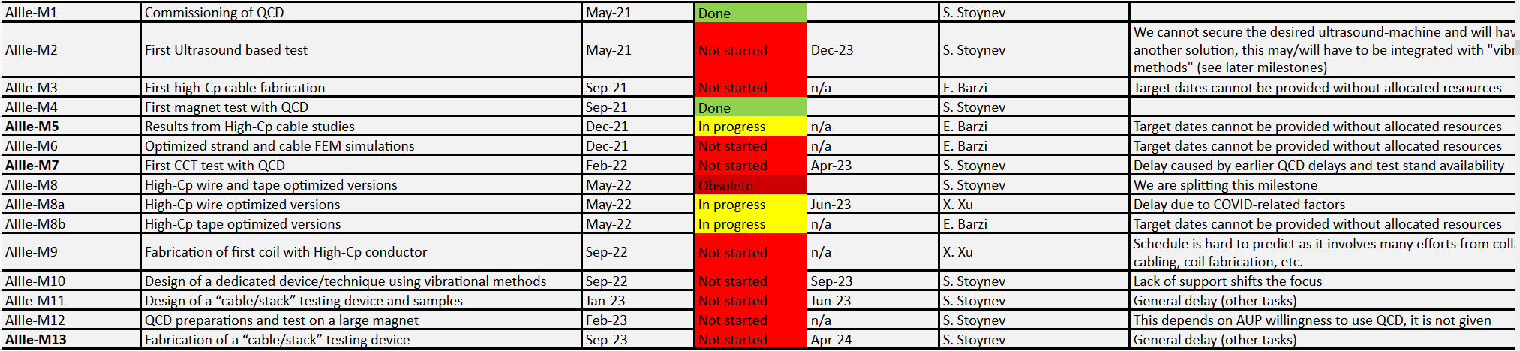
Updated milestones
NO NEW DATA SINCE NOVEMBER 10, 2021 - 0.055 μm thick tape of Cu-Gd₂O₂S powder – 16 m $3k
Was split from wire
Was split from wire

Slide 3
Resources – Requested vs. Received
Requested resources for High-C_{p} Tape & Cable Development FY22
0.14 FTE
The SC R&D LAB is presently operating with 1.5 Tech FTE whereas 4.4 FTE would be needed for current projects.
Total requested resources for FY22 US-MDP – 2.9 Tech FTE
All tasks Magnet: 1.6 Tech FTE
All tasks Conductor and materials: 1.3 Tech FTE

Slide 4
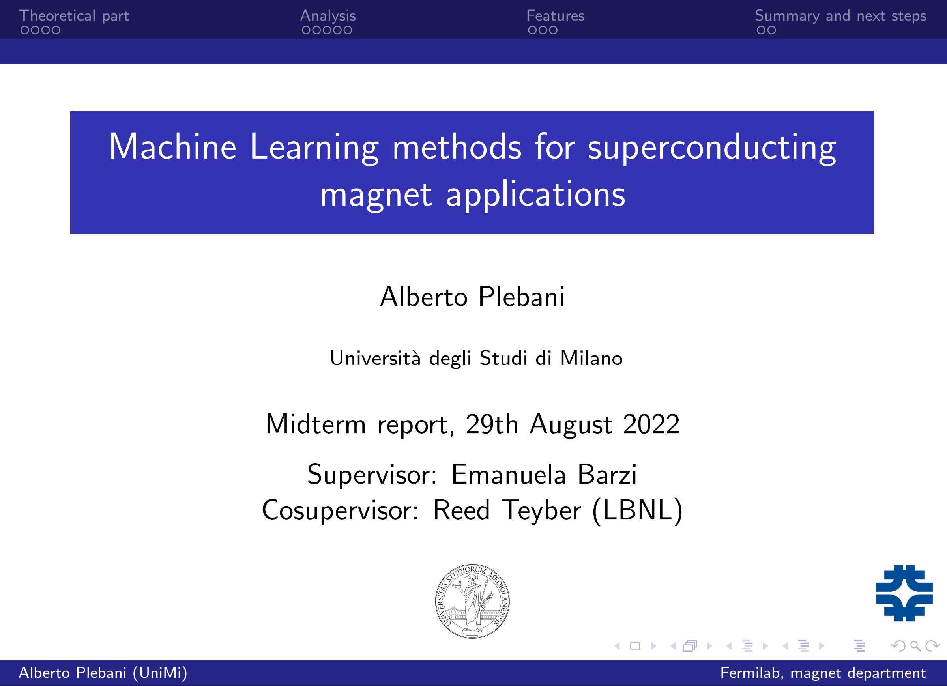
Graduate Student from the reopened FNAL Italian/European Student Program
Looking for quench precursors in LBL quench antennae data during magnet ramps.

Slide 5

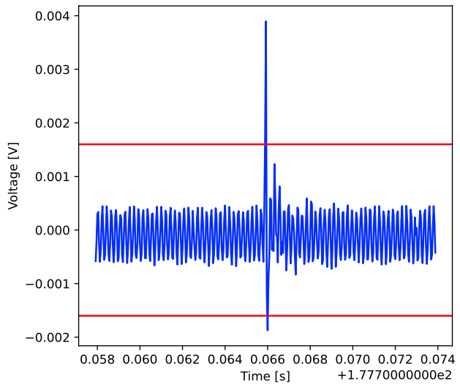
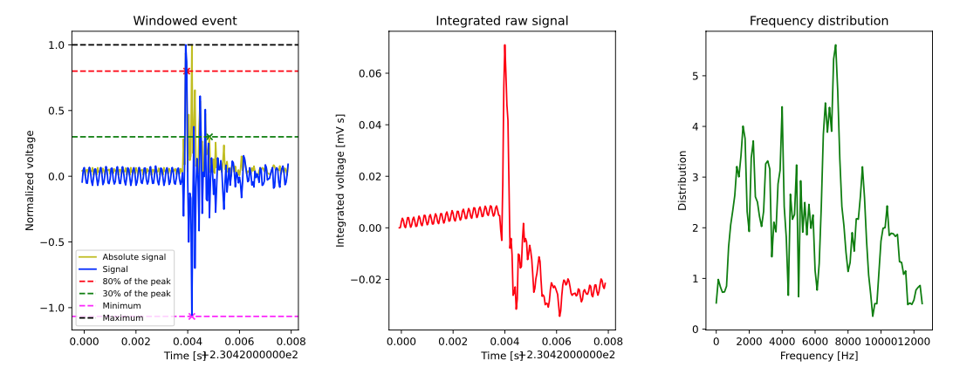
Machine learning methods for superconducting magnet applications - Alberto Plebani
Goal: apply machine learning methods to identify and learn about the disturbances in high field superconducting accelerators magnets
Course of work:
  Analysis of voltage along the ramp prior to the quench, looking for spikes in the voltage (identified as events)
  Creation of windows around each event
  Extraction of features from the windowed events, regarding the shape of the event and its frequency distribution, obtained through FFT
  Features will then be fed to an unsupervised Machine Learning algorithm in order to cluster the events generated by the same phenomena, such as magnet vibration and coil displacement
  Once the events are clustered, it will be possible to state which phenomena generated the events
  This will be useful for quench prediction and identification
Example of a windowed event
Example of features extracted from the windowed event

