Slide 1
The TREND update and Nuclear Data Needs for BNL
Presenter: Dmitri G. Medvedev
Date: March 1, 2023

Slide 2
TREND: TRi-lab Effort on Nuclear Data
Co-authors and collaborators
Brookhaven National Laboratory (BNL):
Michael Skulski (postdoctoral), Cathy S. Cutler
Los Alamos National Laboratory (LANL):
Ellen O’Brien, Christiaan E. Vermeulen, Eva Birnbaum (alumni), Jonathan Morrell (postdoctoral), Francois M. Nortier (alumni, retired)
Lawrence Berkeley National Laboratory (LBNL)/UC Berkeley:
Catherine Apgar (graduate student), Morgan Fox (alumni), Andrew Voyles, Lee A. Bernstein

Slide 3
Rationale
Knowledge energy dependent cross section is critical for:
Accurate prediction of the yield of the isotope of interest
Accurate prediction of radioisotopic impurities
Defining the energy windows for optimum, cost-effective production of isotopes
It facilitates:
Production planning
Defining shielding requirements
Transportation and shipment constraints
Bonus: comprehensive cross section data sets help constrain nuclear reaction models

Slide 4
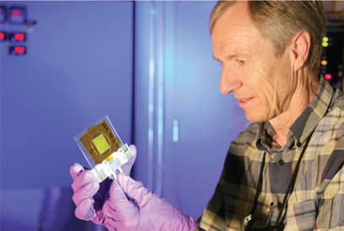
Current state of the field
Most of the data sets are limited to proton energy range up to 30 MeV
A few more data sets are available up to 160 MeV
Limited number of data sets are available up to 200 MeV
Approach
A tri-lab collaboration was formed to address the needs and cover proton energy range up to 200 MeV
LBNL/UC Berkeley – 0 - 55 MeV
LANL – 55 - 100 MeV
BNL – 100 - 200 MeV
Seeks to measure nuclear reaction cross sections for production of medically relevant (and other) isotopes and for beam monitor reactions
A comprehensive list of reactions was captured by Dr. François M. Nortier (Meiring) in 2017

Slide 5
Data sets of the primary focus
Priority | Isotope | Target | Incident particle | Measurement focus | Energy range | Years
1 | ⁷²Se, ⁶⁸Ge | ⁷⁵As | p | Primary: ⁷²Se, ⁶⁸Ge Impurities: ^{70,71,73,75}Se, ^{66,67,69,71}Ge | Up to 200 MeV | 2019
2 | ¹¹⁹Te, ^{117m}Sn | ^{nat}Sb | p | Primary: ^{119m,119g}Te, ^{117m}Sn Impurities: ^{116,117,118,121m,121g,123m}Te, ^{113,119m,121m,121g}Sn | Up to 200 MeV | 2020-21
3 | ²⁰²Pb | ^{nat}Tl | p | Primary: ^{202m,202g}Pb Impurities: ^{198,199,200,201,203,204,205}Pb | Up to 200 MeV | 2022
4 | ¹³⁴Ce | ^{nat}La | p | Primary: ¹³⁴Ce Impurities: ^{132,133,133,137,139}Ce | 50-200 MeV | 2023

Slide 6
Experimental: stacked foil technique
Irradiate array of target and monitor foils with known thickness/areal density intermixed with degraders
Very low current 100-200 nA
Use gamma spectroscopy to count each foil individually
Multiple spectra collection allows for accurate error characterization
Determine activity of all produced radionuclides
Use activation equation to solve for $σ$ for each individual foil
Degraders
Dr. Jonathan Morrell developed Python based code (Curie)* which performs gamma spectra fitting and decay routine that is used for data analysis
*J. T. Morrell, Curie: Python Toolkit for Experimental Nuclear Data (2020).

Slide 7
Facilities
LBNL operates 88-inch cyclotron
Both light- and heavy-ion capabilities.
Protons and other light-ions are available at intensities (10-20 pA)
Maximum energies of 60 MeV (protons), 65 MeV (deuterons), 170 MeV (³He), and 130 MeV (⁴He).
BLIP (BNL) and IPF (LANL) share conceptually similar design
Operate of LINACs
IPF max accepted proton energy 100 MeV, max current 350 µA
BLIP max energy 200 MeV, incrementally tunable, max current 200 µA
Designed for large scale isotope production

Slide 8
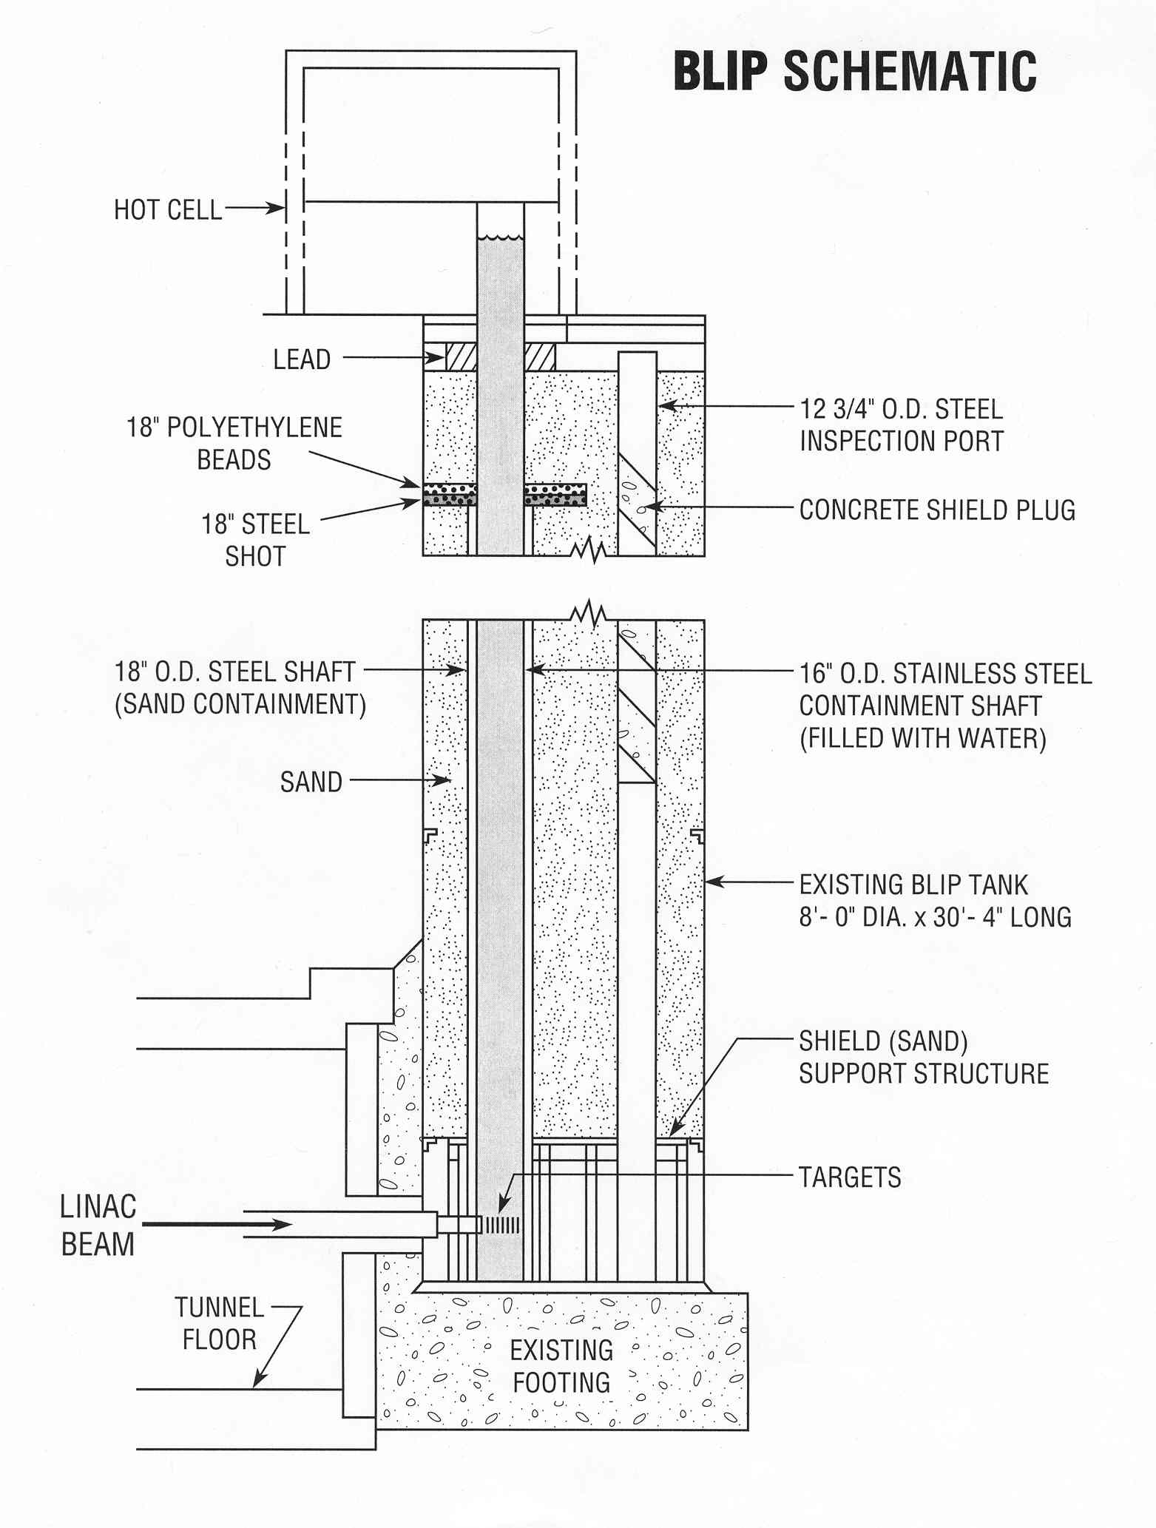
Brookhaven Linac Isotope Producer (BLIP) target station
Ground level
Located 30 feet below ground level to the bottom of the water shaft
Targets delivered to and retrieved from the beamline using chain drive system
About 6 inches (152.4 mm) of space available along the beam pass for target positioning
Incrementally tunable LINAC energy: 200, 180, 160, 140, 117, 66 MeV
Rastered and focused beam pattern
Multiple targets arranger stacked one after another

Slide 9
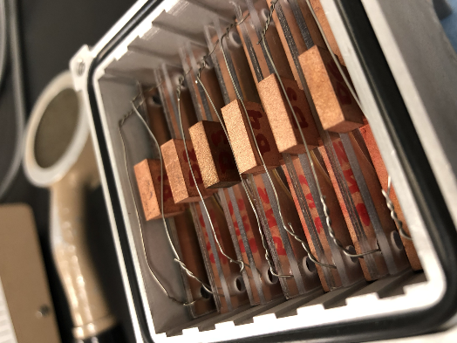
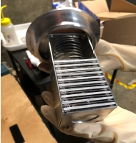
Experimental: stacked foils for irradiation
IPF
BLIP
LBNL

Slide 10
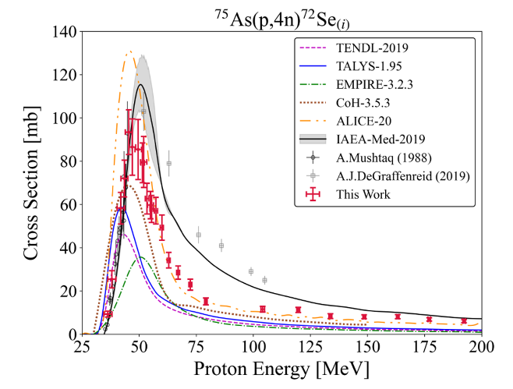
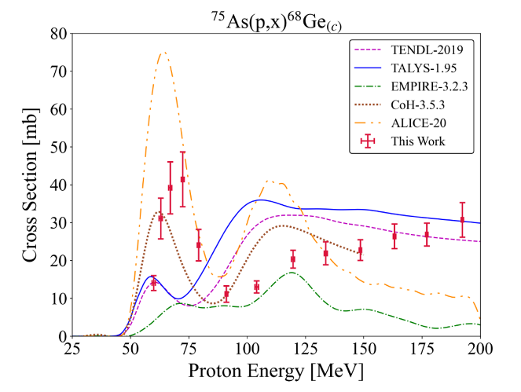
Morgan Fox LBNL

Slide 11
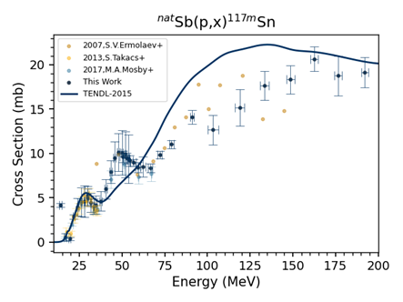
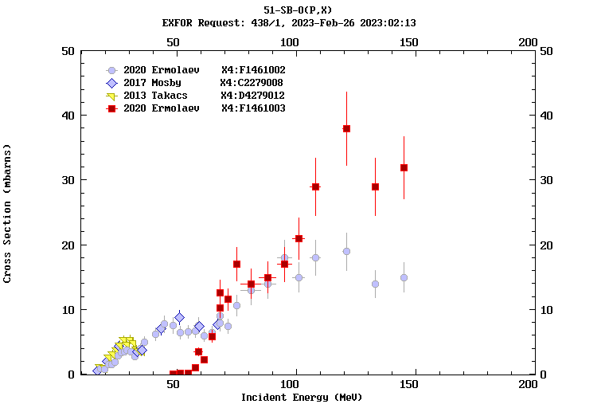
Catherine Apgar LBNL

Slide 12
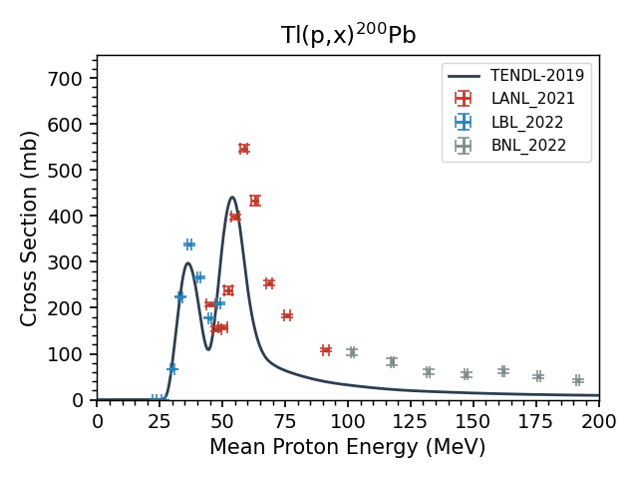
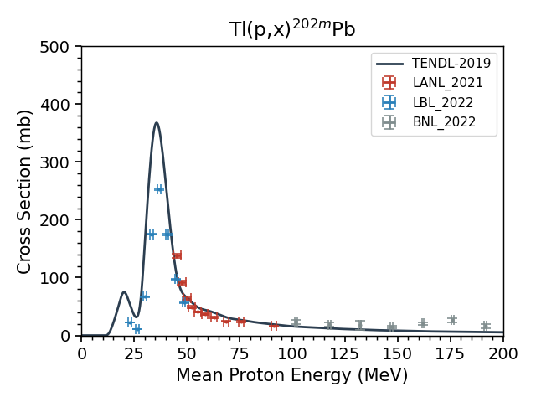
Michael Skulski BNL

Slide 13
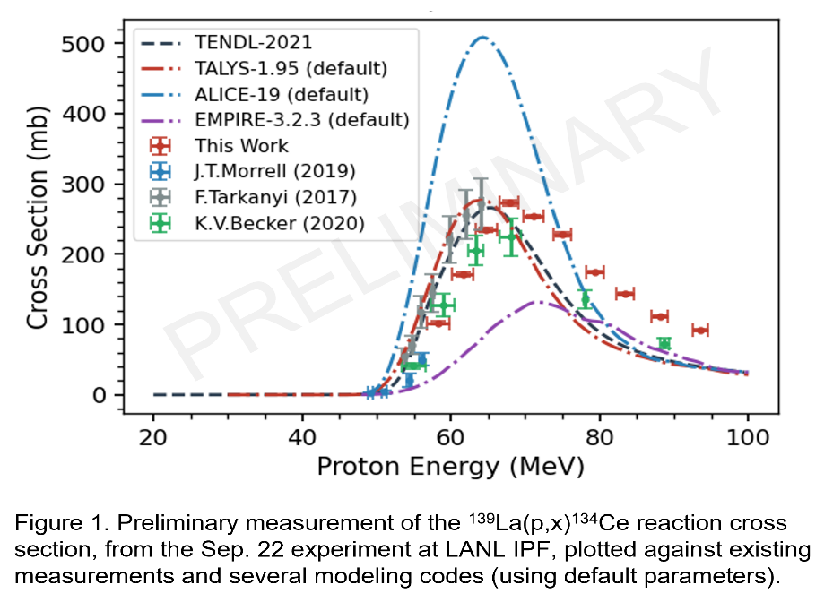
Jonathan Morrell
LBNL→LANL

Slide 14
Implications for isotope production
Reactions on arsenic: first data set for ^{nat}As(p,x) ⁶⁸Ge reaction up to 200 MeV revealed opportunities for Ge-68 production with medium to high energy protons
Lower thermal load on the target at higher energy
No interference with medium energy production targets at BLIP
Reactions on antimony:
Control of co-production of long-lived Sn-113 impurity
Better understanding of energy resolution for Te-118 and Te-119

Slide 15
Implications for isotope production
Reactions of thallium: comprehensive data sets on thallium will constrain Talys prediction of difficult to measure Pb-202 and Pb-205
Reactions on lanthanum: control of the impurities in production of Ce-134

Slide 16
BLIP nuclear data needs
BLIP receives 200 MeV protons: this energy has to be absorbed either by degraders or production targets
Cross section data sets with improved uncertainties are necessary for design of both targets and degraders
Data sets for production for energies from 100-200 MeV are of particular importance at BLIP to improve economics of production
Cross section data sets for fast neutrons are of importance due to substantial flux of secondary neutrons

Slide 17
Acknowledgement
US Department of Energy Isotope Program for funding
Whole-hearted acknowledgement goes to all support personnel of LINAC, Health Physics, engineers, designers
BNL is managed by Brookhaven Science Associates operated by Battelle Memorial Institute (Battelle) and Stony Brook University for US DOE Office of Science.
LANL is managed by Triad LLC, a partnership between Battelle, the Texas A&M University System, and the Regents of the University of California (UC) for the Department of Energy’s National Nuclear Security Administration.
LBNL is managed by University of California for US DOE Office of Science

Slide 18
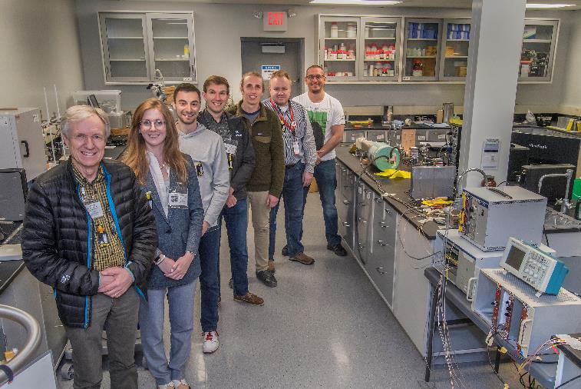
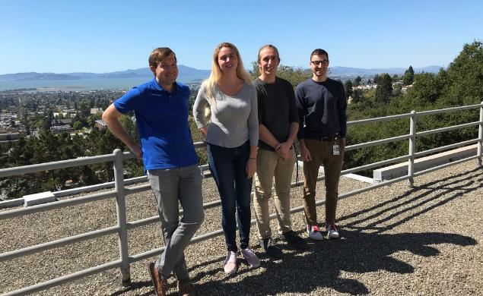
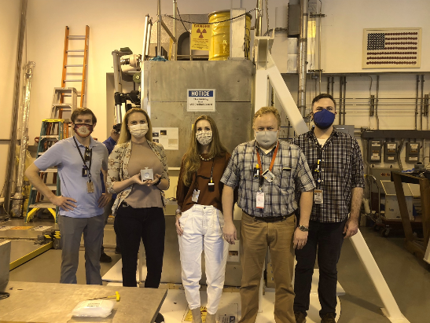
The Tri-lab Nuclear Data Collaboration
Andrew Voyles (UCB)
Dmitri Medvedev (BNL)
Not Pictured:
Lee Bernstein (LBNL)
Eva Birnbaum (LANL)
Cathy Cutler (BNL)
Ellen O’Brien (LANL)
Morgan Fox (UCB)
Meiring Nortier (LANL)
Etienne Vermeulen (LANL)
Jon Morrell (UCB)
Catherine Apgar
Berkeley Nuclear Data Team
Jon Morrell
Morgan Fox
Andrew Voyles
Michael Skulski (BNL)

