Slide 1

IAEA Technical Report:
Auger electron-emitters for radiopharmaceutical developments
Data Needs & Capabilities for Auger Electron Emitters
Roger W. Howell
Department of Radiology
Division of Radiation Research
Rutgers New Jersey Medical School

Slide 2
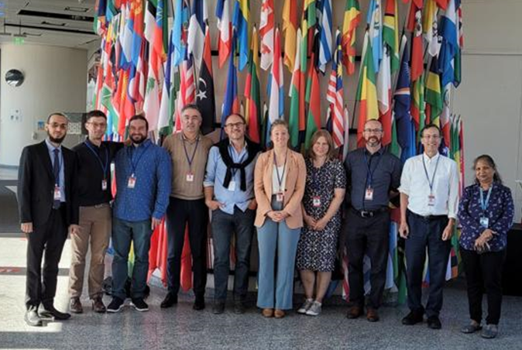
IAEA
Report Committee
Julie Bolcaen
  NRF iThemba LABS, Cape Town, South-Africa
Bart Cornelissen
  University of Groningen, Groningen, The Netherlands
Jonathan Engle
  University of Wisconsin, Madison, Wisconsin, USA
Mohammed Gizawy
  Egyptian Atomic Energy Authority, Cairo, Egypt
Roger W Howell
  Rutgers University, Newark, NJ USA
Aruna Korde
  International Atomic Energy Agency, Vienna, Austria
António Paulo
  Universidade de Lisboa, Bobadela LRS, Portugal
Jean-Pierre Pouget
  INSERM, Montpellier, France
Valery Radchenko
  TRIUMF, Vancouver, BC, Canada
  University of British Columbia, Vancouver, BC, Canada
Samantha YA Terry
  King's College London, London, UK
R. No. C0237
Vienna International Centre
Vienna
Austria
5 to 9 September 2022
Ref. No.: EVT 2103627

Slide 3
Introduction
Auger electron emitting radionuclides
Radiobiology of Auger emitters
AE radiopharmaceutical therapy
IAEA criteria for radionuclide selection
Suggestions for roles of DOE in Auger electron radiopharmaceutical therapy

Slide 4
Auger Electron Emitting Radionuclides

Slide 5
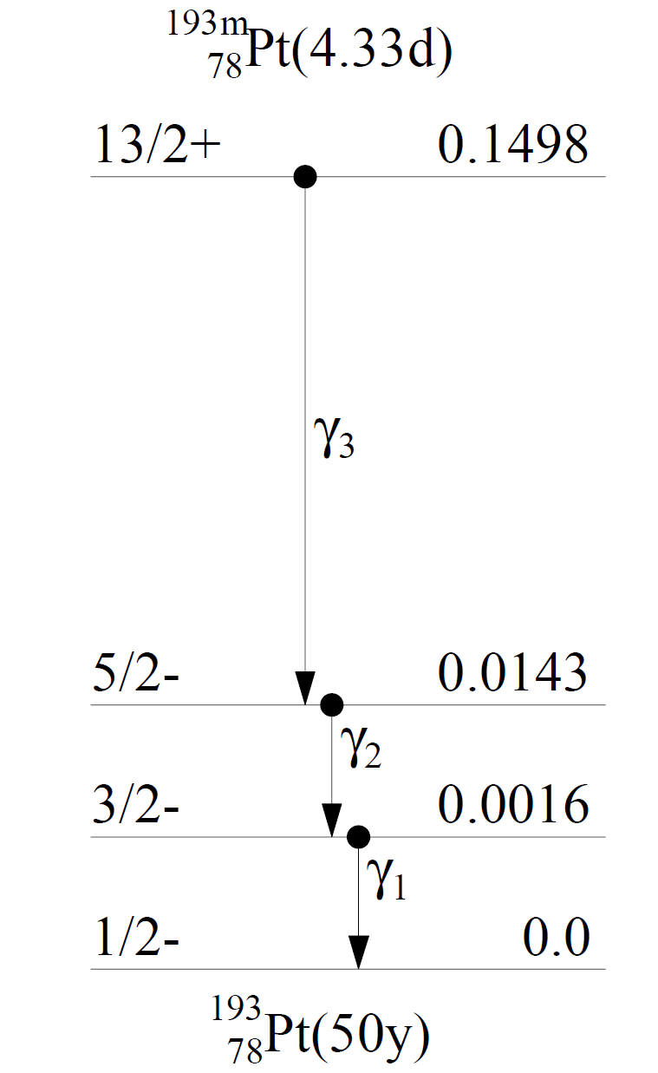
Decay Schemes - Auger Electron Emitters
(IC)
(IC)
(IC)

Slide 6
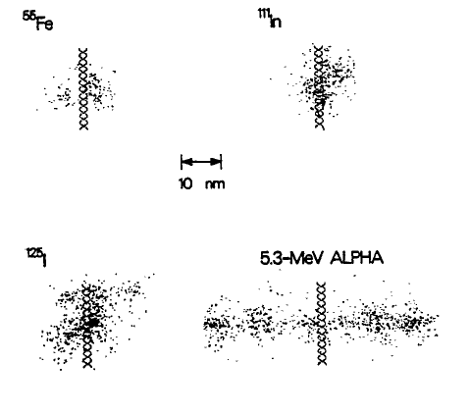
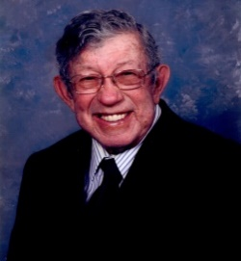
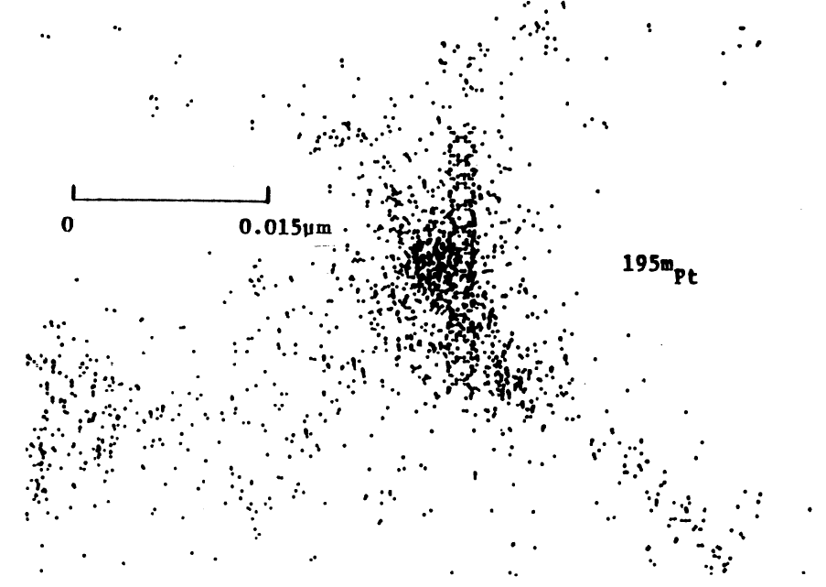
Densely Ionizing High Linear Energy Transfer (LET)
Alpha-particles and Auger-electrons
⁵⁵Fe
¹¹¹In
ORNL’s Harvel Wright
¹²⁵I
5.3 MeV α-particle
^{195m}Pt
Howell et al. Radiat Res 140, 55-62 (1994)
Wright et al. Radiat. Prot. Dosim. 31, 59-62 (1990).

Slide 7
Average Auger electrons/decay
Radionuclide | Physical half-life (d) | Average Auger electrons/decay
Tc-99m | 6 hours | 4
Ge-71 | 11.4 days | 5
Pd-103 | 16 days | 8
In-111 | 2.8 days | 15
Sn-117m | 13.6 days | 14
I-123 | 13.2 hours | 15
Tl-201 | 3 days | 21
Hg-197m | 23.8 hours | 23
Sb-119 | 1.6 days | 24
I-125 | 60 days | 25
Pt-193m | 4.3 days | 26
Pt-195m | 4 days | 33

Slide 8
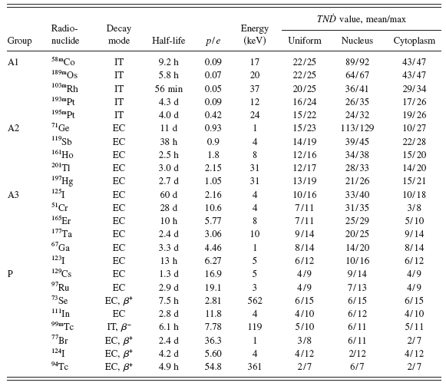
Auger Electron Emitters
Photon/Electron Ratios (avoid many photons)
Ra-223 and Y-90 microspheres have been readily accepted in medical practice, in part, because they emit very few photons and therefore considered “safe”.
Uusijärvi et al. Medical Physics 33, 3260-3269 (2006)

Slide 9
Radiobiology of Auger electron emitters

Slide 10
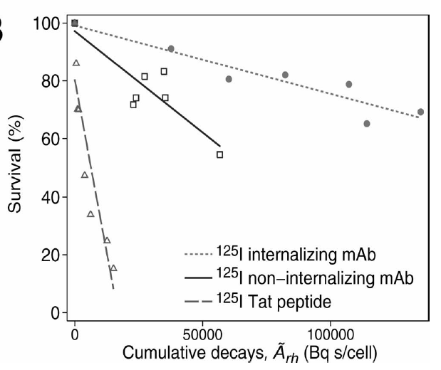

¹²⁵I decays on cell membrane are more effective than decays in cytoplasm
But……
Several logs of kill will require >>100,000 decays
cytoplasm
cell membrane
nucleus
$$∴high molar activity$$
Pouget et al. Radiat Res 170, 192–200 (2008)

Slide 11
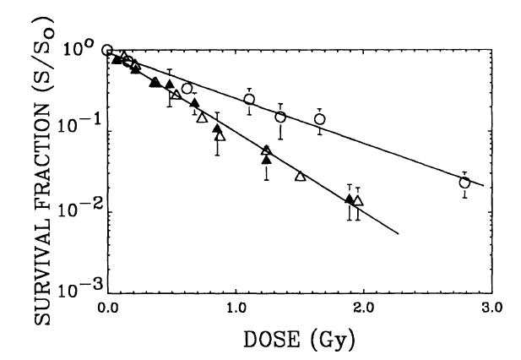
DNA-Incorporated Auger Electron Emitters are more Radiotoxic than Alpha Particles
9 decays for Po-210
37% survival
²¹⁰Po-citrate
5.3 MeV α
66 decays
for I-125
¹²⁵IdU, ¹²⁵IdC
ABSORBED DOSE TO CELL NUCLEUS (Gy)
Howell et al. Radiat. Res. 128, 282-292 (1991)

Slide 12
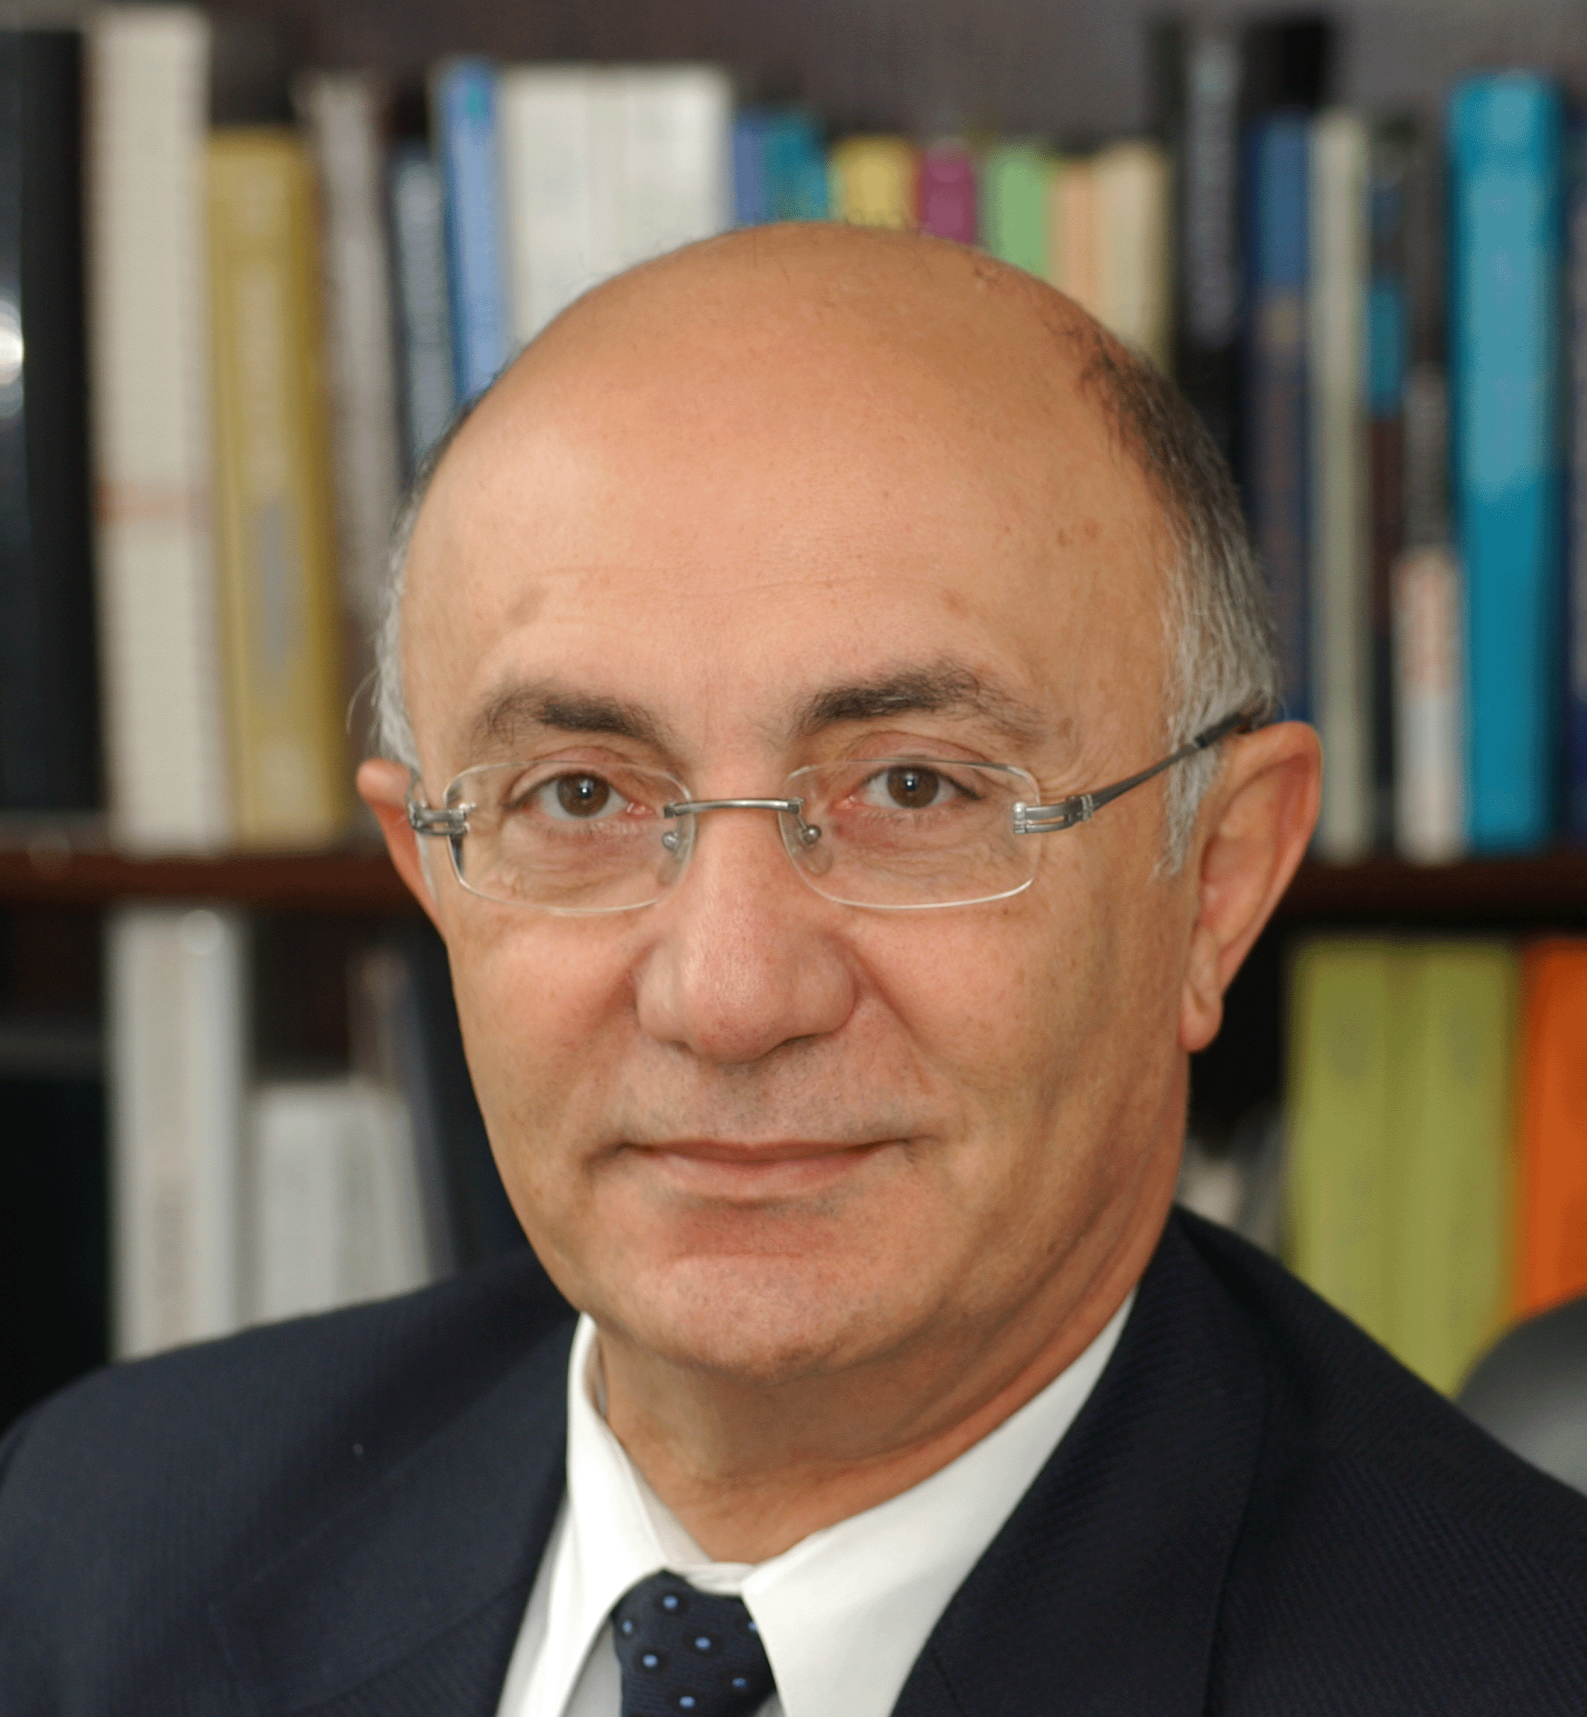
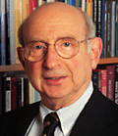
Weak Auger Emitters Require More Decays

Slide 13
The Path to
AE Radiopharmaceutical Therapy

Slide 14
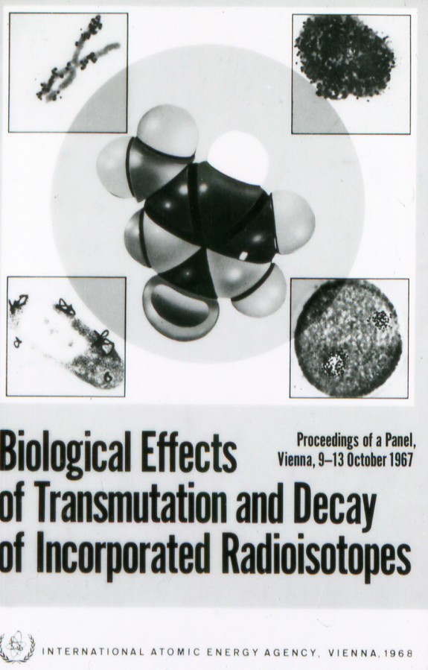
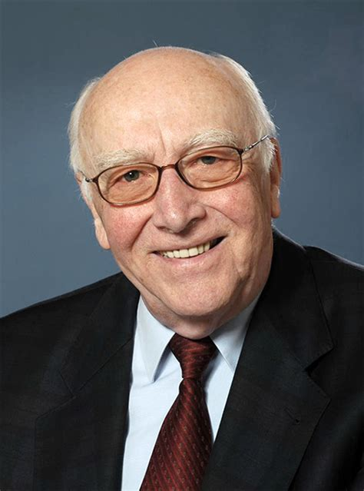
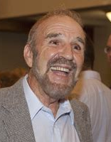
Awakening of Auger Electrons for Therapy
Ludwig Feinendegen
Jim Adelstein
Kurt Hofer (1939-2015)
56 years………

Slide 15
Circle Back to Key Points
Auger Electron Emitters for Therapy
High-LET type radiotoxicity and no dose rate effect
Radiochemistry is “easier” than with alpha emitters
Protectable – primarily classical indirect effects
  implies safety factor relative to alpha particles
Many decays needed to sterilize tumor cells
  use as few decays as possible:
  use radiopharm cocktails to minimize injected activity
    minimizes photons
    minimizes normal tissue toxicity
  prolific Auger electron emitters are preferred

Slide 16
IAEA Committee Criteria for
Prioritizing Radionuclides
Number of Auger electrons per decay
Photon/electron ratio (low photon yield)
Co-emission of conversion electrons and/or beta particles
Normal tissue toxicity (ion should not concentrate in organs)
Physical half-life (preferably 3-20 days)
Targetry and production
  (p,n), (p,xn) most widely available
  d, α, ³He … lesser availability
  Neutron (reactor) low molar activity
  Enriched targets high cost and unreliable supply
Separation chemistry
  Require high chemical and radiochemical purity
  n,y products which decay via β-decay to the desired radionuclide
Vector chemistry
  Chelators
  Require extremely high molar activity due to large number of decays needed

Slide 17
IAEA Criteria for Selection
Bad
Good
Better
Best
#AE/decay | 0-4 | 5-10 | 11-20 | >20
#CE/decay | 0 | 0-1 | 1-2 | >2
%β decay (E) | Present |  |  | None
γ toxicity risk for patient and handlers | High |  |  | None
Imageable (theranostic)* | None | <5% intensity 60-300 keV gammas | 5-50% 60-300 keV gammas | >50% 60-300+ keV gammas or 511 keV PET
Stable daughter (SD) | No | / | / | Yes
Half-life | 12 h < T < 20 d | < 24 hrs | 1-2 days | 3-20 days
Current worldwide availability (WWA) | Not | Limited | In some locations | Widely
Target availability (TA) for radionuclide production | Unavailable or extremely limited | Limited or insufficient enrichment, exorbitant cost | Available but requires enriched or expensive | Widely available and inexpensive
Radiochemistry and separation (RC) | Not currently reported | Challenging | Feasible | Optimized
Chelator availability (CA) | None | Complex radiolabelling | Most likely available | Routine
Molar activity (MA) | Not available without carrier or < 1 GBq/µmol | 1 - 10 GBq/µmol of ligand | 10 - 100 GBq/µmol of ligand | >100 GBq/ µmol of ligand
Vector availability (VA) | No vectors studied |  |  | Considerable number studied
Cellular dosimetry: Self-dose/Total dose ratio (SD/TD) to be defined

Slide 18
DOE Driven Solutions to IAEA Criteria
Bad
Good
Better
Best
DOE driven
solutions to increase variety and amount of supply
#AE/decay | 0-4 | 5-10 | 11-20 | >20
#CE/decay | 0 | 0-1 | 1-2 | >2
%β decay (E) | Present |  |  | None
γ toxicity risk for patient and handlers | High |  |  | None
Imageable (theranostic)* | None | <5% intensity 60-300 keV gammas | 5-50% 60-300 keV gammas | >50% 60-300+ keV gammas or 511 keV PET
Stable daughter (SD) | No | / | / | Yes
Half-life | 12 h < T < 20 d | < 24 hrs | 1-2 days | 3-20 days
Current worldwide availability (WWA) | Not | Limited | In some locations | Widely
Target availability (TA) for radionuclide production | Unavailable or extremely limited | Limited or insufficient enrichment, exorbitant cost | Available but requires enriched or expensive | Widely available and inexpensive
Radiochemistry and separation (RC) | Not currently reported | Challenging | Feasible | Optimized
Chelator availability (CA) | None | Complex radiolabelling | Most likely available | Routine
Molar activity (MA) | Not available without carrier or < 1 GBq/µmol | 1 - 10 GBq/µmol of ligand | 10 - 100 GBq/µmol of ligand | >100 GBq/ µmol of ligand
Vector availability (VA) | No vectors studied |  |  | Considerable number studied
Cellular dosimetry: Self-dose/Total dose ratio (SD/TD) to be defined
4
1
2
3

Slide 19
IAEA Committee
Preliminary List of Radionuclides
Considered for Scoring
^{58m}Co ⁶⁴Cu ⁶⁷Ga ⁷¹Ge ⁷⁷Br
^{99m}Tc ¹⁰³Pd ^{103m}Rh ¹⁰⁷Cd ¹¹¹In
¹¹⁹Sb ¹²³I ¹²⁵I ^{125m}Te ¹³⁵La
¹⁵⁵Tb ¹⁶¹Tb ¹⁶⁵Er ¹⁸⁰Ta ^{189m}Os
^{191m}Os ^{193m}Pt ^{193m}Ir ^{195m}Pt ^{197m}Hg
²⁰¹Tl ²³¹Th ²³⁷U ²³⁹Np
Review article on criteria in preparation.
Julie Bolcaen^{1#}, Mohammed Gizawy², Samantha YA Terry³, António Paulo⁴, Bart Cornelissen⁵, Aruna Korde⁶, Jonathan Engle⁷, Valery Radchenko^{8*}, Roger W. Howell⁹

Slide 20
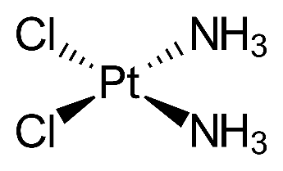
Data Needed to Select and Optimize Radionuclide Production
^{193m}Pt (example)
  ¹⁹²Pt (n,γ) ^{193m}Pt (σ = 2 b)
    Low specific activity due to cold Pt
  ¹⁹²Os (α,3n) ^{193m}Pt (next slide)
    Alpha particle energy important for yield and to minimize contaminants
    High specific activity needed to maximize radiation absorbed dose and reduce chemotoxicity of cisplatin

Slide 21
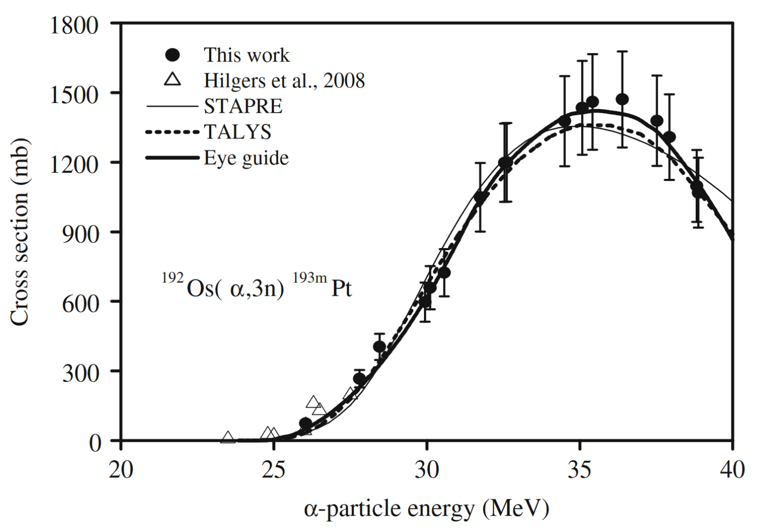
¹⁹²Os (α,3n) ^{193m}Pt Cross Section vs E
Uddin et al. Appl Radiat Isotop 68: 2001–2006, 2010

Slide 22
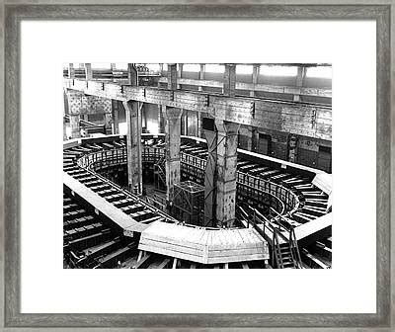
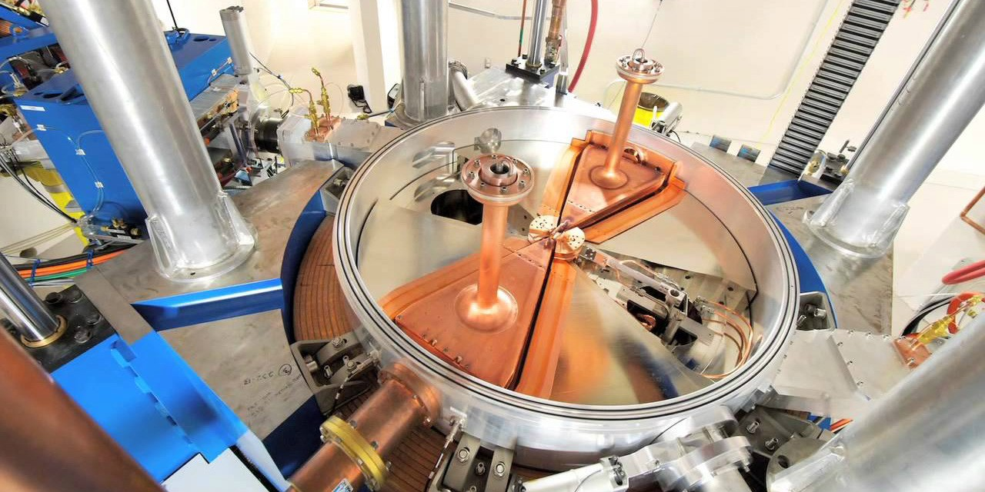
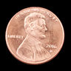
Suggested Roles of DOE in Auger Electron Radiopharmaceutical Therapy
Explore alternate production pathways
  expand target enrichment capabilities
  calculate/measure cross sections of reaction products
  calculate/measure Auger + ICD electron yields
Increase radionuclide availability to promote research
  expand production capacity
  no cost for funded DOE/NIH research (like beam time)
  low cost for wide distribution
Invest in radiochemistry
  separation chemistry (extract desired radionuclide)
  chelation chemistry
  radiopharmaceutical chemistry

Slide 23
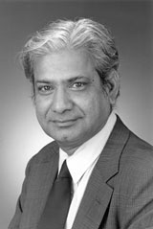
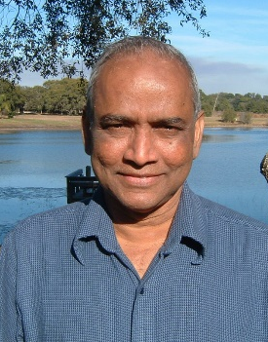
Acknowledgments to Auger Mentors
Fellows
Venkat Narra
Murty Goddu
Ravi Harapanhalli
Mike Azure
De-Yan Hou
Marek Lenarczyk
Anupam Bishayee
Bogdan Gerashchenko
Massimo Pinto
Prasad Neti
John Akudugu
Sumudu Katugampola
Students
Behrooz Vaziri
Jordan Pasternack
Han Wu
Jianchao Wang
Kandula Sastry
(1935-2001)
Dandamudi Rao
Amin Kassis
Jim Adelstein

Slide 24
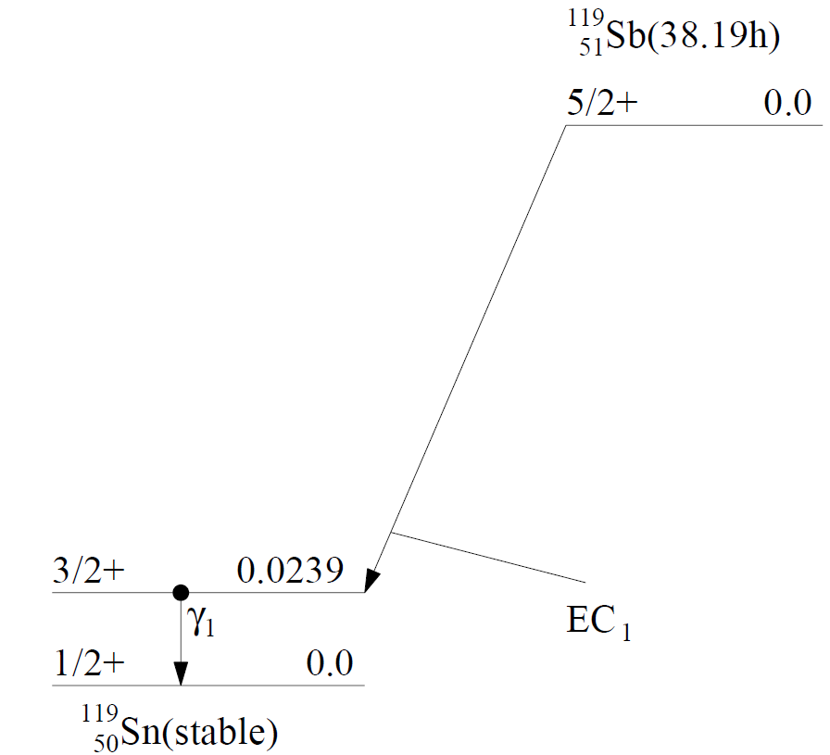
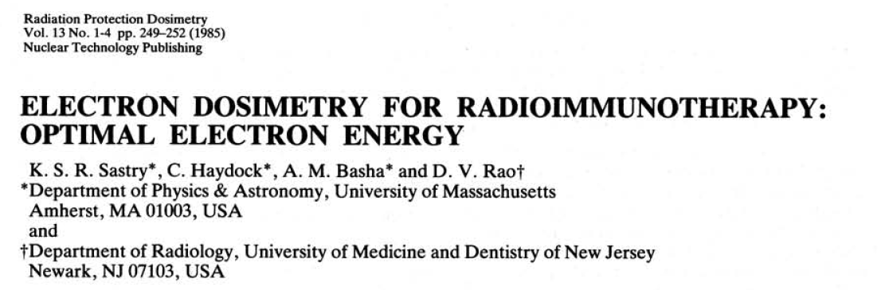
¹¹⁹Sb = Sastry’s pick for Auger therapy
      Top-rated by
Filosovov …Radchenko https://doi.org/10.1016/j.nucmedbio.2020.12.001
24 Auger electrons / decay
Theranostics? Unfortunately, no photons useful for imaging.

Slide 25
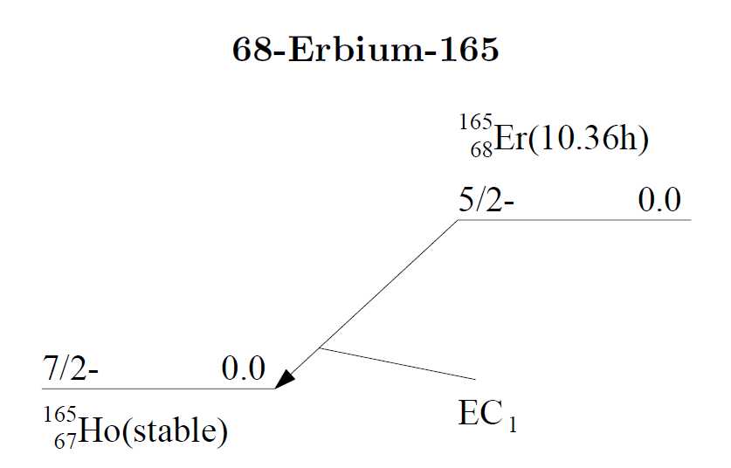
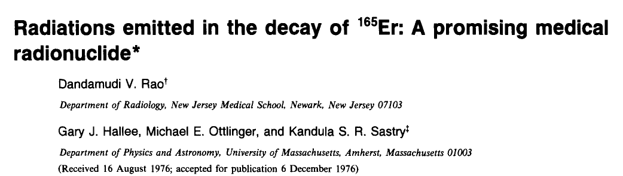
¹⁶⁵Er = Rao’s Auger emitter
Rao et al. Med Phys 4, 177-186 (1977)

Slide 26
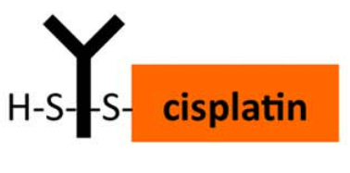
Rationale for ^{193m}Pt
High radiochemical purity of ^{193m}Pt
  ¹⁹²Os (36 MeV α,3n : σ = 1.5 b) ^{193m}Pt
  0.6% ^{195m}Pt (similar characteristics as ^{193m}Pt)
No-carrier added
~ 30 Auger electrons per decay
~ 4 day physical half-life
Well studied chemistry (chemotherapy)
Cold platinum available for chemistry development
Potential theranostics imaging (0.11%, 135.5 keV)
Antibody-cis-^{193m}Pt ? : Cytometry A. 2016 89(3)292-300.
Howell et al. 4th Int Radiopharm Dosim Symp. pp. 493-513, 1986
Azure et al. https://njms.rutgers.edu/departments/division_radiation/documents/Azure1992_001.pdf
Uddin et al. Appl Radiat Isotop 68: 2001–2006, 2010

