Slide 1
Overview of LWR and Advanced Reactor Fuel Forms
02/28/2022
Sebastian Schunert
Idaho National Laboratory – Reactor Physics Methods and Analysis

Slide 2
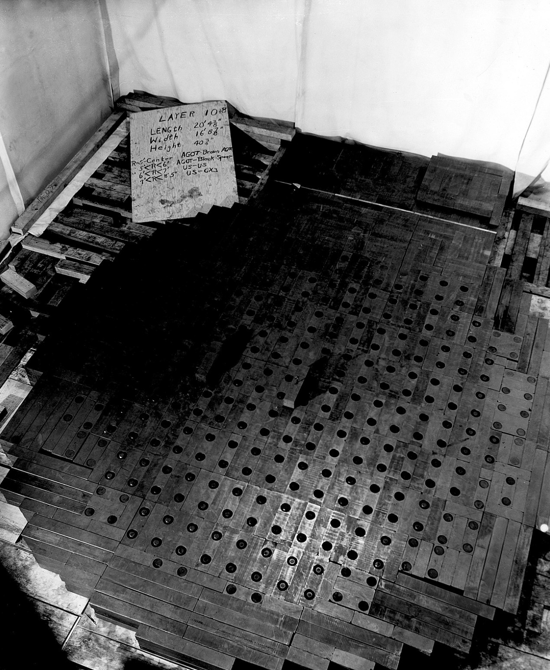
Requirements for Nuclear Fuel for Power Production
Neutronics: Critical under operating conditions with margin for burnup & power level changes
(excess reactivity $ρ_{ex}$* for PWRs 0.3 dk/k, 30,000 pcm)
Thermal-hydraulics: fuel must be coolable
Fuel performance: withstand harsh reactor conditions for reasonable duration & retain fission products
Chemistry: Chemical compatibility with moderator, coolant, structural materials
Chicago pile 10th layer [1]
Does CP1 make the cut?
*$ρ=\frac{k−1}{k}$

Slide 3
Fuel – Moderator – Coolant: Mix & Match
Thermal reactors
Fast reactors
Geometry: homogeneous, dissolved, dispersed, plate, rods, pebbles
Fuels
U, Pu, Th
Enrichment
Metal, Ceramic, Dissolved, TRISO
Moderator
Graphite, Beryllium,
H₂0, D₂0, Hydrites (ZrH), Flibe
Coolant
Liquid metals, Molten salts, Water, Gas, Heat pipes
Fluoride salt-cooled high-temperature reactor (FHR)
TRISO fuel in pebbles HALEU (<20% enriched)
Molten salt coolant (Flibe)
Graphite moderator [some moderation from Flibe]
Light water reactor
5% enriched UO₂ rods
H₂0 coolant & Moderator
Fast Molten Salt Reactor (MSFR)
U-Pu-Th dissolved in molten LiF:
LiF-(U,Pu)F₃-ThF₄

Slide 4
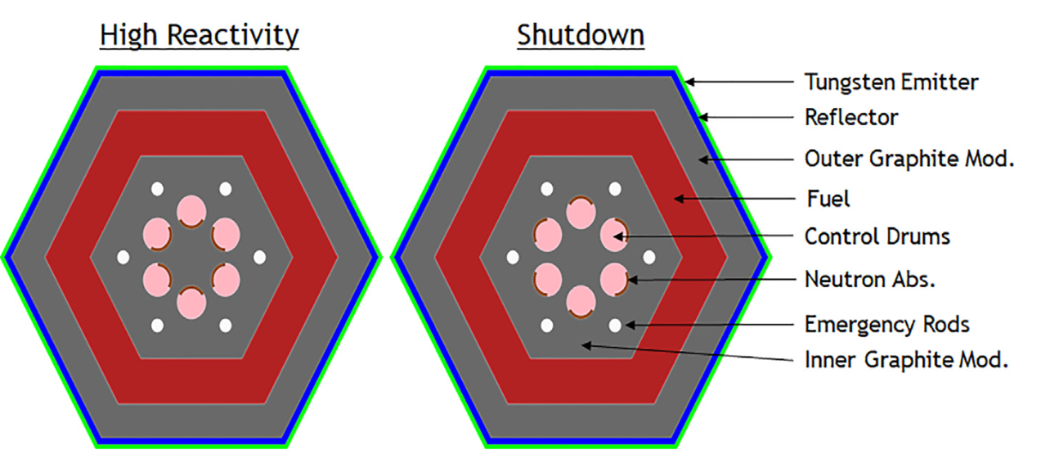
Mix & Match
RBMK (graphite moderated BWRs)
1.8% enriched UO₂
Graphite moderated
H₂0 cooled
Metal fuel in Light water reactor
Metallic U
H₂0 cooled & moderated
Positive power coefficients of reactivity
Water oxidizes metallic fuel
Cladding failure is severe!
Power reactor without coolant?
Ultrasmall high-temperature
UC or UN CERMET fuel
Graphite moderated
Conduction + radiation + PV
Ref [2]

Slide 5
Genealogy of Nuclear Reactors
Not an exhaustive list!
Thermal
Fast
Spectrum
H₂0
D₂0
Graphite
Moderator
Gas
He, H₂
Molten salt
Coolant
Sodium
Lead
Salt
UO₂ 5%
pins
U₃O₈ 94% in Al plates
UO₂ 0.7%
pins
HALEU TRISO in pebbles
HALEU TRISO in cylinders
HALEU TRISO in pebbles
Dissolved
U Metal
Fuel
form
UO₂**
Dissolved
PWR
BWR
VVER
ATR*
CANDU
PHWR
Sodium fast reactor
(EBR-II)
Lead cooled fast reactor
Fast pool-type MSRs
Pebble Bed Reactors
Prismatic
Gas-cooled
Reactors
FHR
MSRE
*Advanced Test Reactor
**UN [Westinghouse design], MOX or metallic fuels possible

Slide 6
Why so many reactor concepts?
Reactor types have advantages and disadvantages and no one reactor is perfect for every need!
PWR
High power density, relatively low fuel enrichment, economy of scale, water is not toxic, transparent, liquid at room temperature & pressure
Require active safety systems, pressurized, low outlet temperatures (330ºC), difficult fuel reprocessing, relatively small discharge burnup, small margin to boiling, generates H₂ from cladding
Gas cooled pebble bed reactors
Passively safe, deployable at moderate powers (100 MW), high outlet temperatures (750ºC), high discharge burnup, continuous refueling and low excess reactivity
HALEU is required, Low power density, pressurized, no fuel reprocessing, create dust during operation
Sodium fast reactors
Passively safe, supports fuel reprocessing, decent outlet temperature (550ºC), atmospheric or near atmospheric pressure, high discharge burnup, high power density
HALEU is required, sodium reacts with air & water, metal fuel poses fuel performance issues

Slide 7
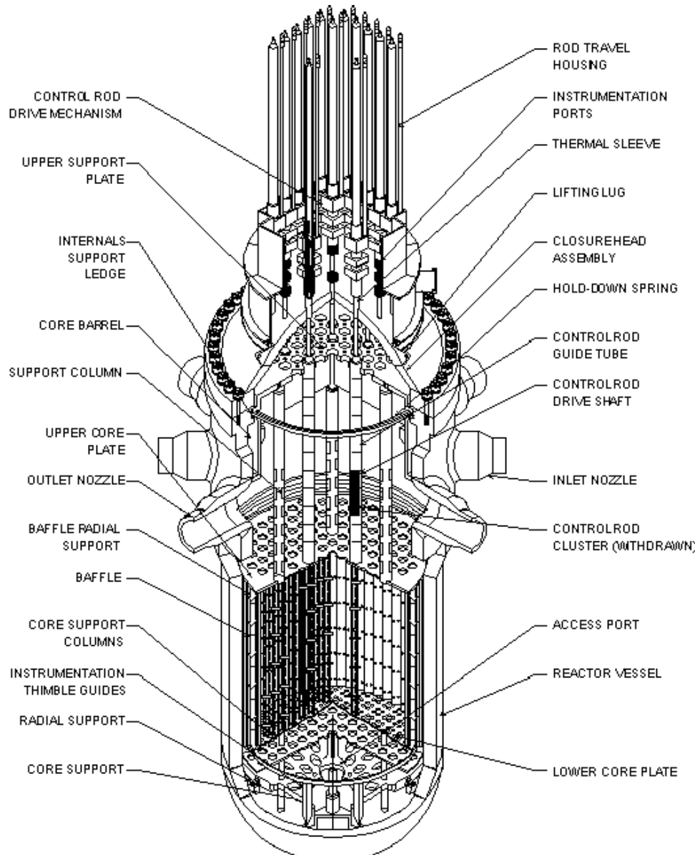
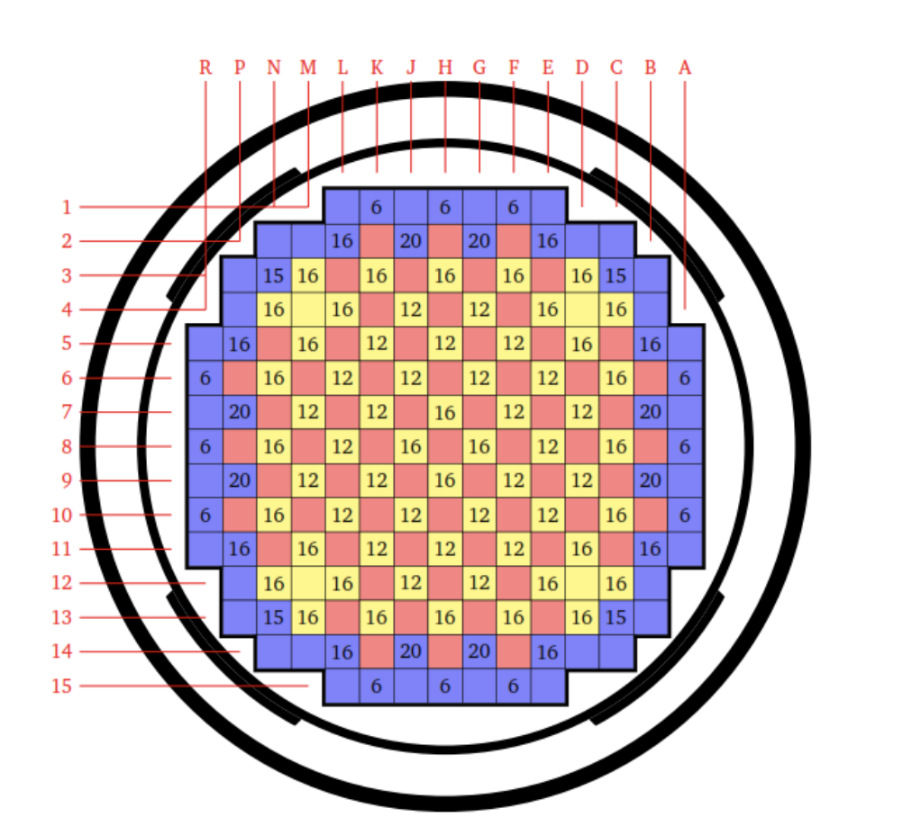
Example 1: Pressurized water reactor (Gen II)
Quantity | Value
Spectrum | Thermal
Power | ~3,000 MWth
Average core power density | ~100 MW/m3
Maximum burnup | 62.5 MWd/kg
Fuel | 5% enriched UO₂
Ceramic UO₂ fueled, light water moderated
Square assemblies (20 cm across), 17x17 pins (D = 0.94 cm)
High pressure (15.5 MPa) keeps most water from boiling (yet some channels boil!)
LWRs are mostly used for grid scale electricity production with once-through fuel cycles
x-y view of the core
20 cm
Ref [5]
4 m
Ref [3]
Ref [4]

Slide 8
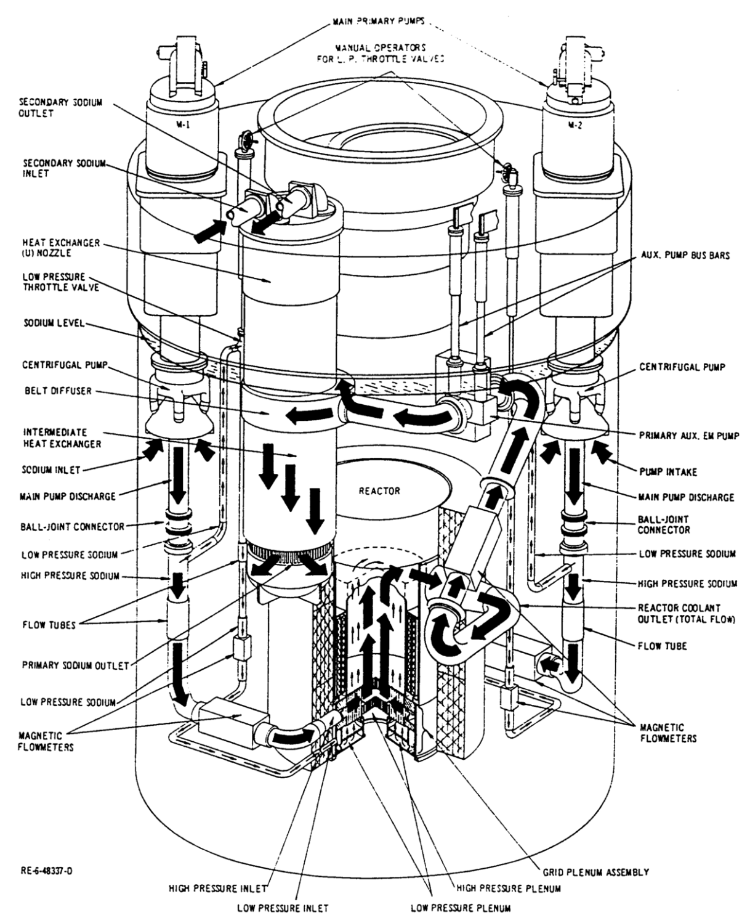
Example 2: Sodium Cooled Fast Reactor – EBR-II
Quantity | Value
Spectrum | Fast
Power | ~60 MWth
Driver fuel power density | ~400 MW/m3
Typical burnup | 100 MWd/kg
Driver fuel | 95 wt% U (62.5% enriched) + 5% Fissium*
Metal fuel – sodium cooled breeder reactor
Integral (no direct pipes out of vessel) pool type concept
Hexagonal assemblies (6 cm across), fuel pins (D = 0.37 cm)
Phase 1: technological demonstration of complete breeder power plant + reprocessing of metallic fuel
Phase 2: demonstrate the integral fast reactor with a focus on material’s testing & safety transients
x-y view of the core + blanket
axial view of driver
assembly
Ref [7]
x-y view of driver
assembly
Core, ~ 1ft
Ref [7]
3m
30 cm
6 cm
Ref [7]
Ref [6]
* Fissium: metal fuel + small amount of fission products

Slide 9
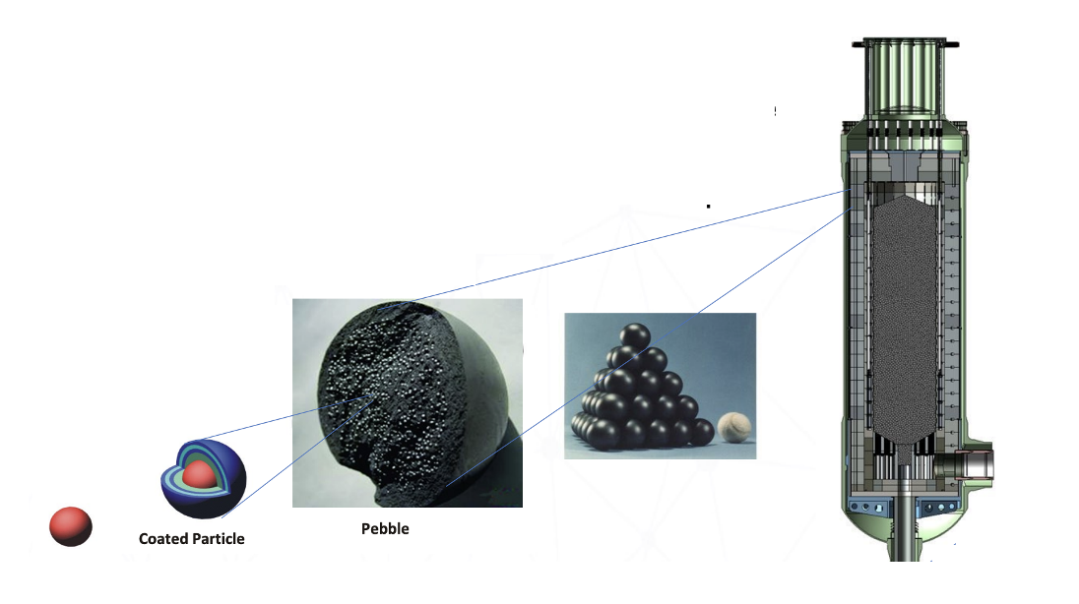
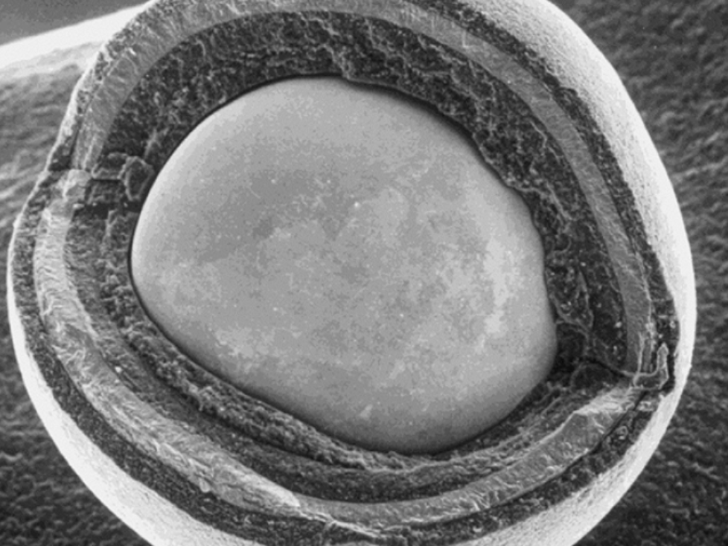
Example 3: Pebble Bed Reactor – XE-100
XE-100 is X-energies ARDP design
200 MWth Helium cooled pebble bed reactor
Special feature of PBRs is online refueling, pebbles move through the core while being irradiated
Fuel:
Several 100,000 pebbles in the core
Pebble contains thousands of tristructural
isotropic particles (TRISO)
TRISOs are extremely robust:
retain fission products for longer than
300 h at 1800C
Quantity | Value
Spectrum | Thermal
Power | ~200 MWth
Average core power density | ~4 MW/m3
Typical burnup | 160 MWd/kg
Fuel | 15.5% enriched UCO TRISO in graphite pebbles
Ref [9]
Buffer
Fuel
~0.8 mm
4m
IPyC
SiC
OPyC
*Note: fuel enrichment and fuel type (UO2 vs. UCO) varies between designs and operational phase
Ref [8]

Slide 10
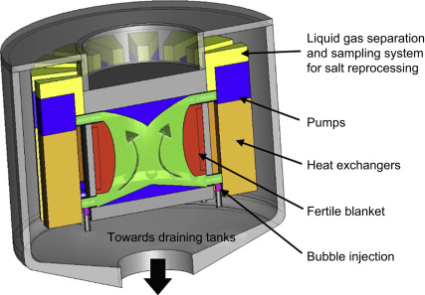
Example 4: Pool-type Fast Molten Salt Reactor
Quantity | Value
Spectrum | Fast
Power | ~3,000 MWth
Average core power density (per salt volume) | ~350 MW/m3 (167 MW/m3)
Typical burnup | Very high
Fuel | LiF-ThF₄-(²³³U or ^{enr}U)F₄ or LiF-ThF₄-(Pu-MA)F₃ with 77.5 mol% LiF
Design based on the molten salt fast reactor (MSFR) concept initially developed at CNRS (European conceptual design)
MSFR is a very big machine compared to other MSRs
Very simple design:
Pool of molten salt with dissolved fuel
Molten salt flows into reactor cavity most of the power is created
16 pump & heat exchanger legs around the core
Online reprocessing of fission products
Fast pool-type MSRs can be designed as breeders (Th and U) or for burning transuranics
Salt can be fluoride or chloride based
LiF: fluoride is chemically reactive, Li creates Tritium
UCl₃ – NaCl, Cl is a neutron absorber
Big R&D need: Corrosion & material compatibility!
2.5m
Pictures are all from Ref [13]

Slide 11
Where do fission products matter for reactor engineering?
Example 1: Reactivity effects when reactor power changes - Xenon pit
Example 2: Fission products’ chemical interaction with the clad after going into contact (fuel-cladding-chemical-interaction, FCCI)
Example 3: Source term in TRISO fuel – diffusion of fission products through TRISO layers
Honorable mention: Decay heat (important but unfortunately not enough time)

Slide 12
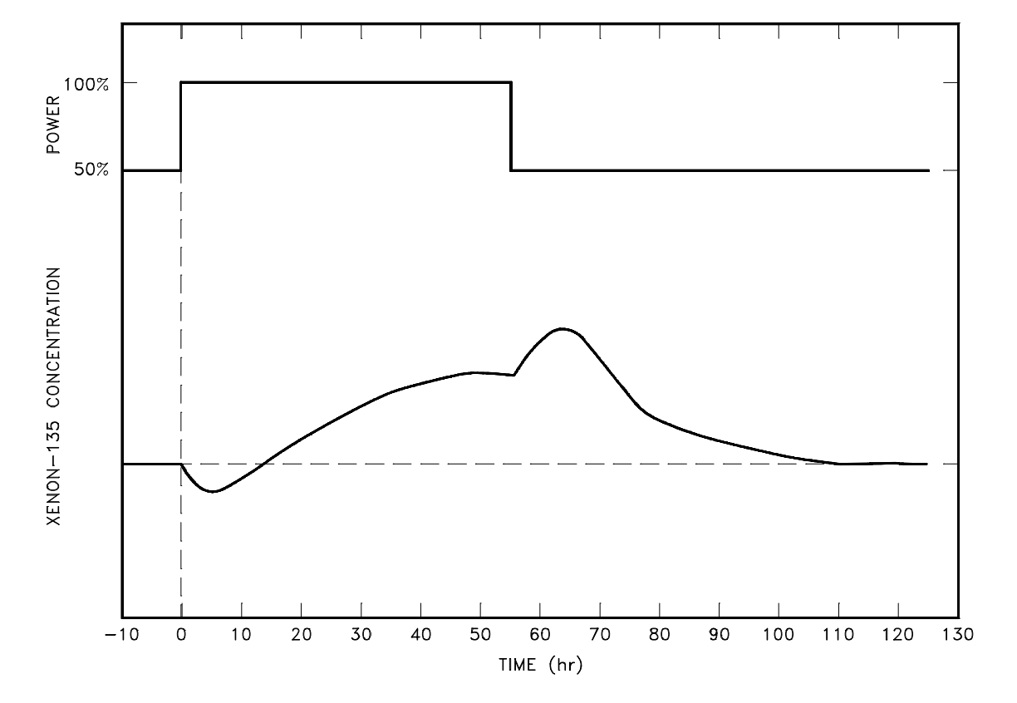
Fission Product Impact 1: Xenon pit
Fission
$$γI$$
$$γX$$
$$λI$$
$$λX$$
Xenon-135 is a strong neutron absorber
It is created by fission & decay from I-135
During reactor steady-state its level remains constant
What happens when power/flux levels change (say drop)?
If power drops, both direct creation and destruction reduce, but indirect reduction reduces slower
Initial buildup and then slump of Xe-135
This has significant reactivity consequences
Xe pit occurred before Chernobyl accident and led the operator to remove all control rods
Relevant during power changes in reactors – not important for base load but very important for load following
Issue for all thermal reactors
¹³⁵I
¹³⁵Xe
¹³⁵Cs
$$σ_{a}φ$$
Simplified Xe decay scheme
Ref [14]

Slide 13
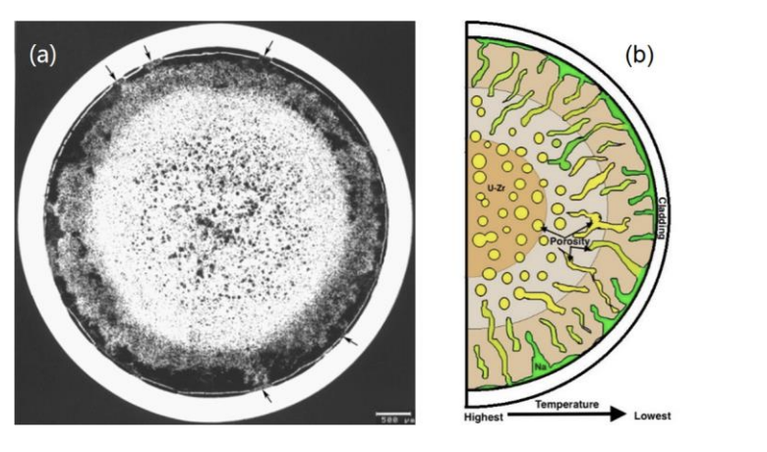
Fission Product Impact 2: Fuel-Cladding-Chemical-Interaction
SFR fuel: Metallic U-Fis with stainless-steel cladding & sodium bond
Metallic fuel swells significantly under irradiation => cladding failure if fuel contacts clad before fission gas release (FCMI)
Reduce smear density to release fission gases before cladding contact
This creates Lanthanide fission product pathways
Lanthanides form low melting eutectics at the pellet cladding interface => cladding failure
Fuel
Smear density = $\frac{\text{Fuel}\text{+}\text{Sodium} \text{Bond} }{\text{Fuel}}$
Sodium
Cladding
Gas bubbles
Cracks
Cladding
FCMI
Fission gas release
FCCI
Lanthanide migration paths
Ref [10]
Contact + Stress

Slide 14
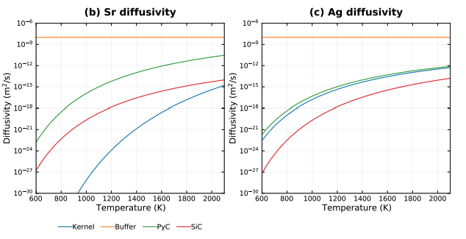
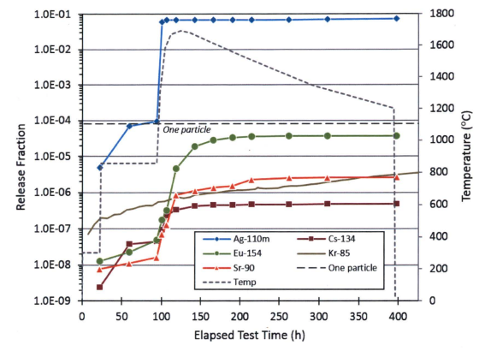
Fission Product Impact 3: TRISO Fission Product Retention
Fuel
Buf
PyC
SiC
PyC
Nuclear fuel should retain fission products from entering the coolant as much as possible
Traditionally, fuel matrix + cladding serve that purpose
For TRISO fuel, the TRISO layers provide that function
Fission products: Sr-90, Ag-110, Cs-137 & 134
How well do TRISOs retain fission products?
AGR-1 reported 0 TRISO failures out of 300,000 TRISOs
FP
T>1600C!!
Large Ag release
Everything else is retained
Ref [12]
Sr is retained by SiC & Kernel but Ag is only retained by the SiC => need to avoid SiC failure!
Ref [11]

Slide 15
Summary and Conclusion
Power reactors come in a variety of shapes and sizes because no single concept fits all needs
A variety of fuel forms is used: ceramic, metallic, TRISO, dissolved in molten salts
With different fuel forms come different challenges to handle fission products – think FCCI in metallic fuel & retention in TRISOs
Some challenges stemming from fission products are common to many reactors: Xenon pit is an example for all thermal reactors
Data needs in the future will not just require fission product yields but also uncertainties as we include uncertainties in our designs

Slide 17
References
[1] https://en.wikipedia.org/wiki/Chicago_Pile-1, ENERGY.GOV, Public domain, via Wikimedia Commons
[2] Naiki Kaffezakis et al., High temperature ultra-small modular reactor: Pre-conceptual design, Annals of Nuclear Energy 141, https://doi.org/10.1016/j.anucene.2020.107311
[3] Public Domain, https://commons.wikimedia.org/w/index.php?curid=475349
[4] Forget, Benoit, Smith, Kord, Kumar, Shikhar, Rathbun, Miriam, and Liang, Jingang. Integral Full Core Multi-Physics PWR Benchmark with Measured Data. United States: N. p., 2018. Web. doi:10.2172/1432668, https://www.osti.gov/servlets/purl/1432668
[5] https://commons.wikimedia.org/wiki/File:Nuclear_fuel_element.jpg#/media/File:Nuclear_fuel_element.jpg
[6] By Federal Government of the United States - Shutdown and closure of the experimental breeder reactor - II, Argonne National Laboratory, ANL/ENT/CP-106386, Public Domain, https://commons.wikimedia.org/w/index.php?curid=16917477
[7] T. Fei at al.. “Neutronics Benchmark Specifications for EBR-II Shutdown Heat Removal Test SHRT-45R – Revision 1”, https://publications.anl.gov/anlpubs/2018/05/143362.pdf
[8] Hans Gougar, “High Temperature Gascooled Reactor - History, Physics, Design Features”, INL/MIS-19-52882-Revision-0 https://inldigitallibrary.inl.gov/sites/sti/sti/Sort_24839.pdf
[9] https://www.energy.gov/ne/articles/triso-particles-most-robust-nuclear-fuel-earth
[10] Yi Xie, “Lanthanide Migration and Immobilization in Metallic Fuel ”, INL/JOU-18-51305-Revision-0, https://inldigitallibrary.inl.gov/sites/sti/sti/Sort_7248.pdf
[11] Dave Petti, “A Summary of the Results from the DOE Advanced Gas Reactor (AGR) Fuel Development and Qualification Program”, INL/EXT-16-40784 https://inldigitallibrary.inl.gov/sites/sti/sti/7323666.pdf
[12] J. Hales, “Modeling fission product diffusion in TRISO fuel particles with BISON”, https://www.osti.gov/biblio/1829987, https://www.osti.gov/servlets/purl/1829987
[13] M. Allibert et al., “Molten salt fast reactors”, Handbook of Generation IV Nuclear Reactors, https://doi.org/10.1016/B978-0-08-100149-3.00007-0
[14] DOE-HDBK-1019/2-93, DOE Fundamentals Handbook, Nuclear Physics and Reactor Theory, Volume 2 of 2, https://www.standards.doe.gov/standards-documents/1000/1019-bhdbk-1993-v2

