Slide 1




















IAEA activities on Fission Yields
R. Capote on behalf of the IAEA FY CRP participants
Deputy Section Head, IAEA NAPC-Nuclear Data Section

Slide 2
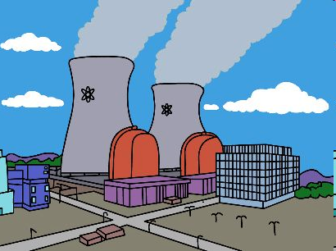
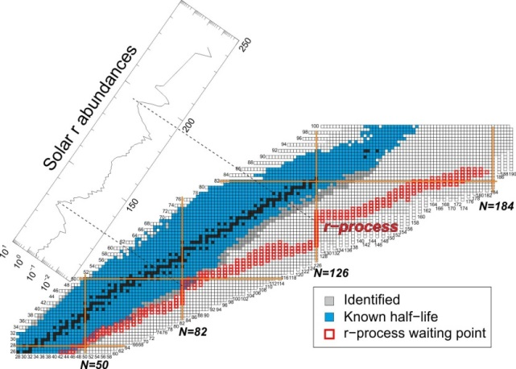
Fission Product Yields
Reactor applications:
  Fuel inventory (PIE)
  Burn-up calculations (based on burn-up indicators)
  Decay heat & Dose calculations with uncertainties
  Spent fuel storage and transport (Criticality-safety)
  Dose calculations with uncertainties
  Full core analysis with uncertainties
Safeguards:
  Non-invasive reactor monitoring: knowledge and quantification
  of the antineutrino spectra produced as a result of beta-decaying
  fission products from a reactor inventory
  Evaluated high quality and complete decay data and
  fission yield data libraries are essential.
  IAEA started a Coordinated Research Project (CRP)
  On Fission Yields in 2020.
  1st meeting held in December 2020, second in December 2022

Slide 3
IAEA CRP on Evaluation of Fission Yields of major actinides
Main scope: Cf-252(sf); n + U-235,238; n + Pu-239,241 (incl. energy dependence)
Compilation of experimental data: all experimental data on independent (IFY), cumulative FYs (CFY) and FY(En) to be incorporated in EXFOR (incl. expt. covariances)
Evaluation: new evaluations at different En (thermal, fast, 14 MeV + more) with associated uncertainties (evaluation methodology, evaluation of FYs, uncertainties and correlations, covariances, formats) -> This is a critical outcome for the CRP success
Theory: improve models and systematics based on new experimental data (include all-in approaches that consider E-dependence, TKE, ν multiplicities, etc)
IFY vs CFY (consistency, propagation of uncertainties, updated decay data libraries)
Validation: test new FY data against integral data, i.e. nubars, anti-neutrino spectra, decay heat, delayed-neutron yield, high burn-up, etc
Dissemination – data retrieval – visualization

Slide 4
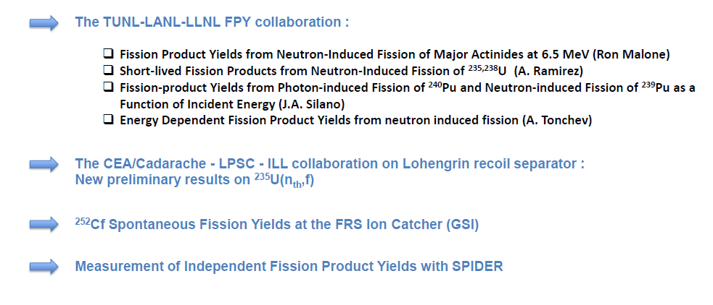
Summary of FPY new experiments

Slide 5
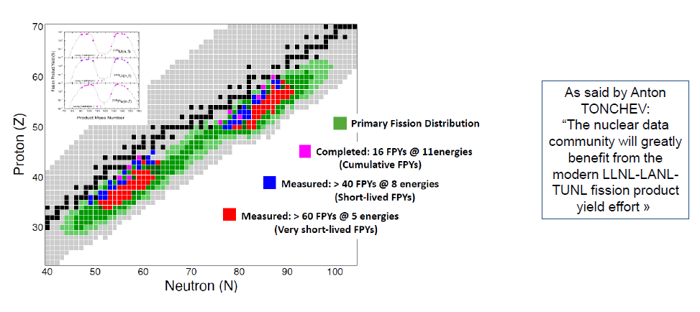

TUNL-LLNL-LANL FPY collaboration
@ND2022

Slide 6
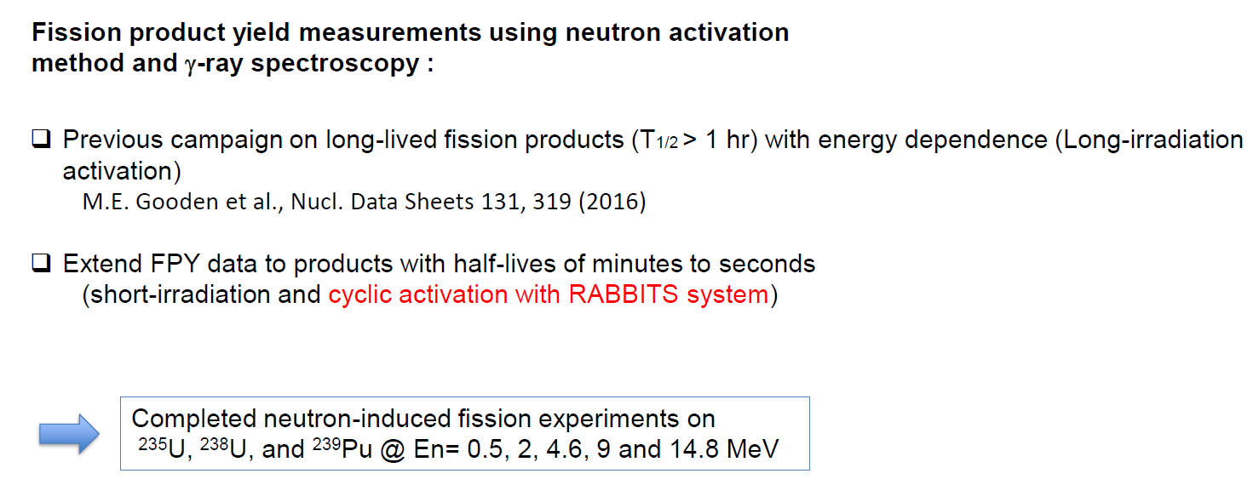
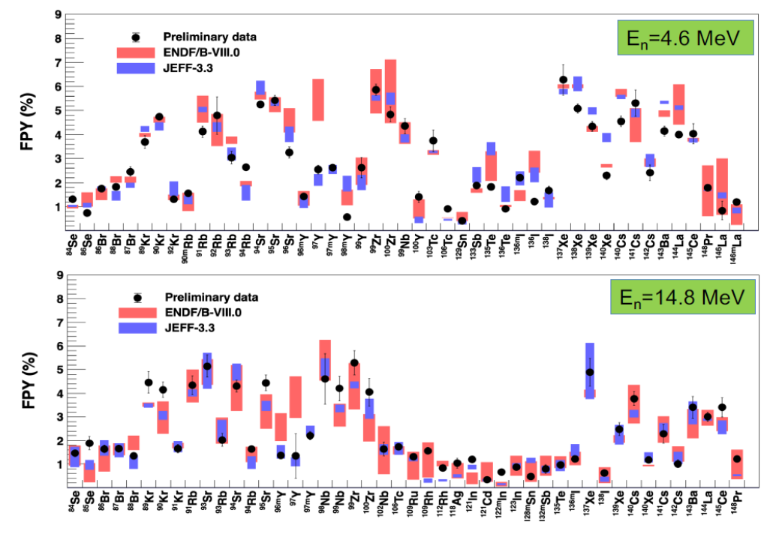
TUNL-LLNL-LANL FPY collaboration
@ND2022

Slide 7
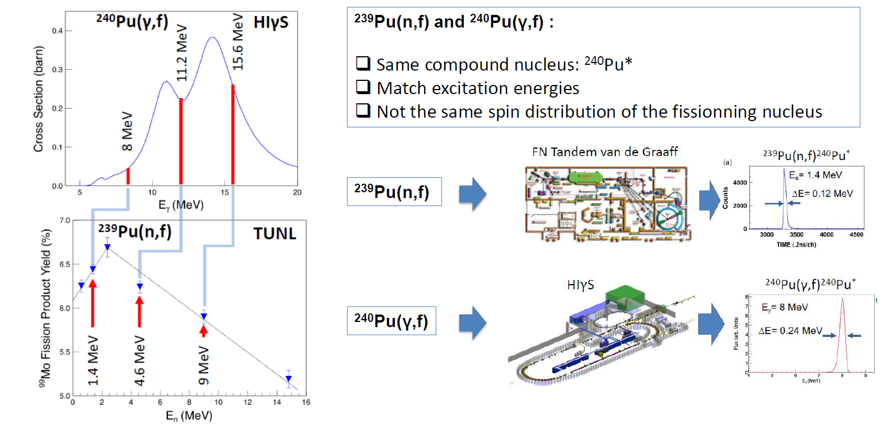
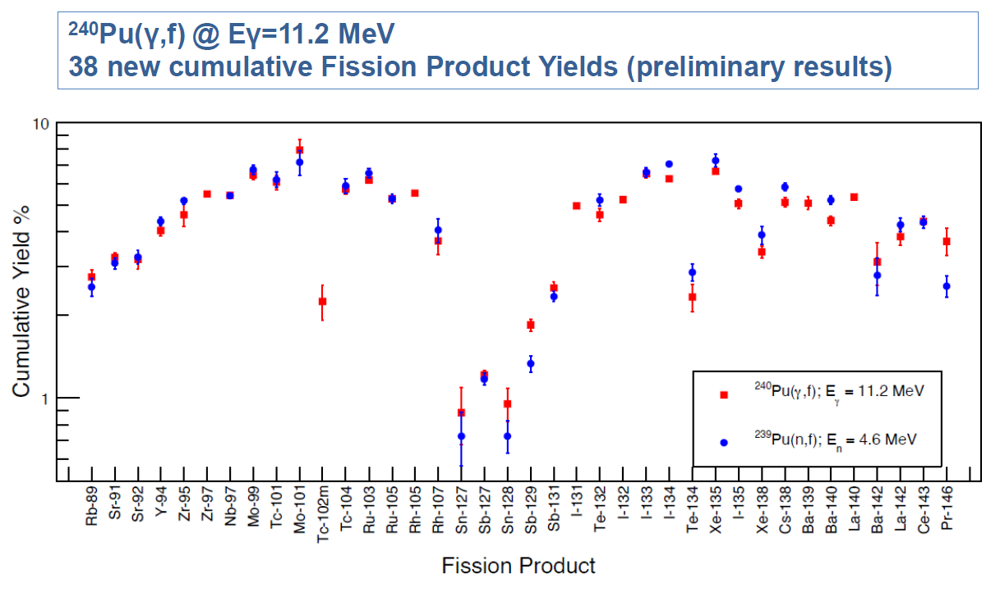
TUNL-LLNL-LANL FPY collaboration
@ND2022

Slide 8

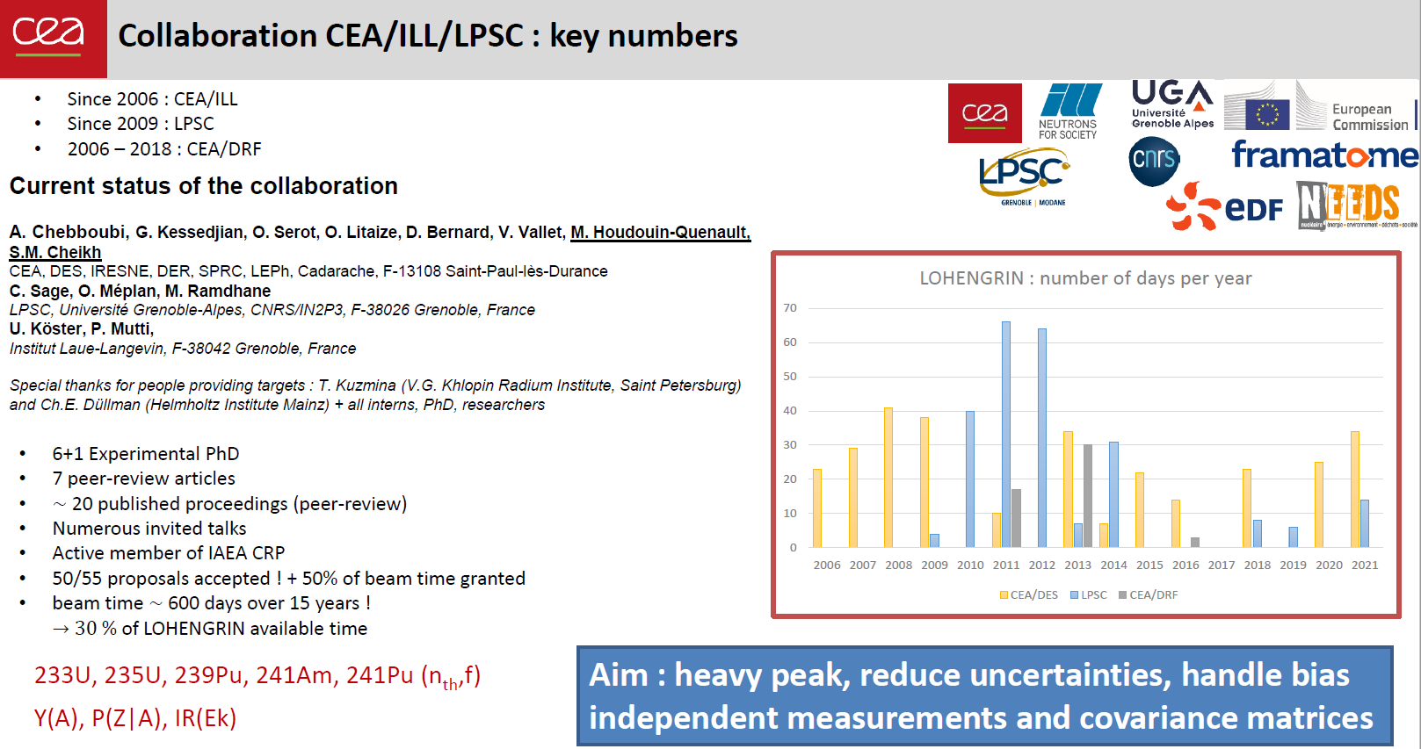
600 days over 15 years

Slide 9
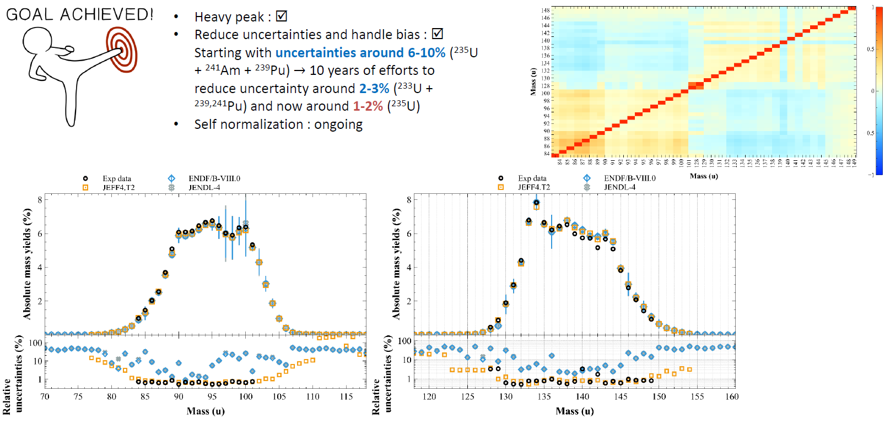

Slide 10
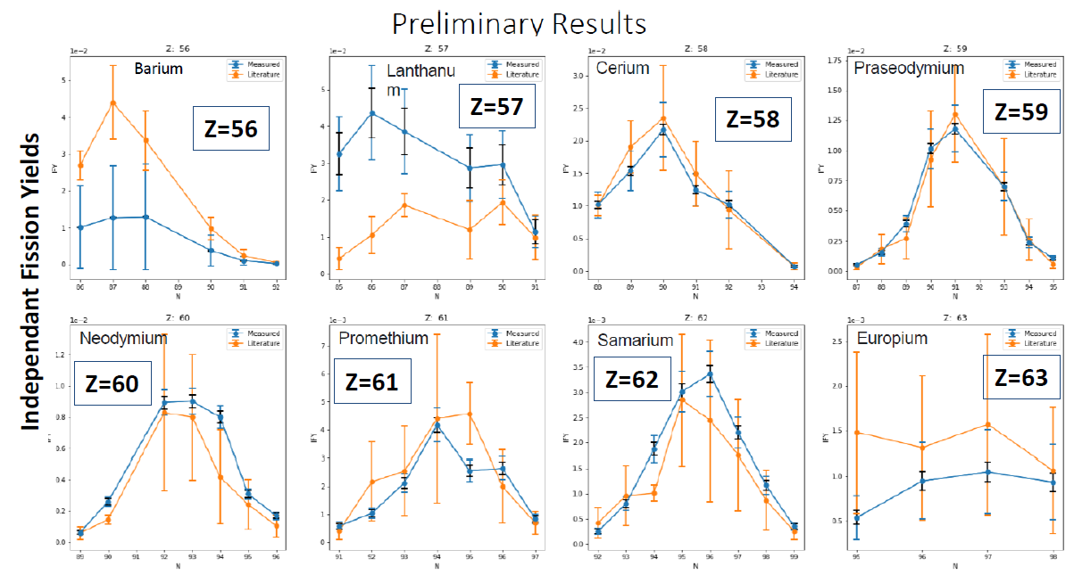
²⁵²Cf SFY at the FRS Ion Catcher
@ND2022

Slide 11
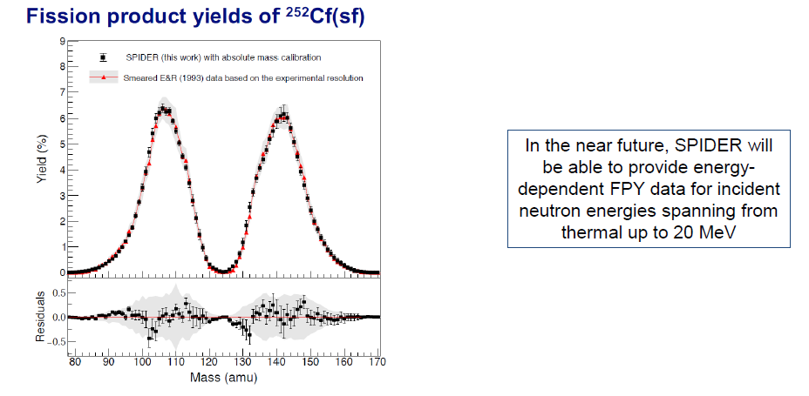
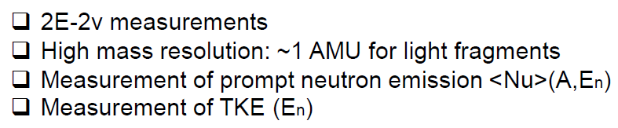
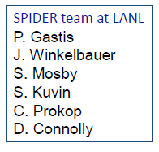
²⁵²Cf SFY measured with SPIDER
@ND2022

Slide 12
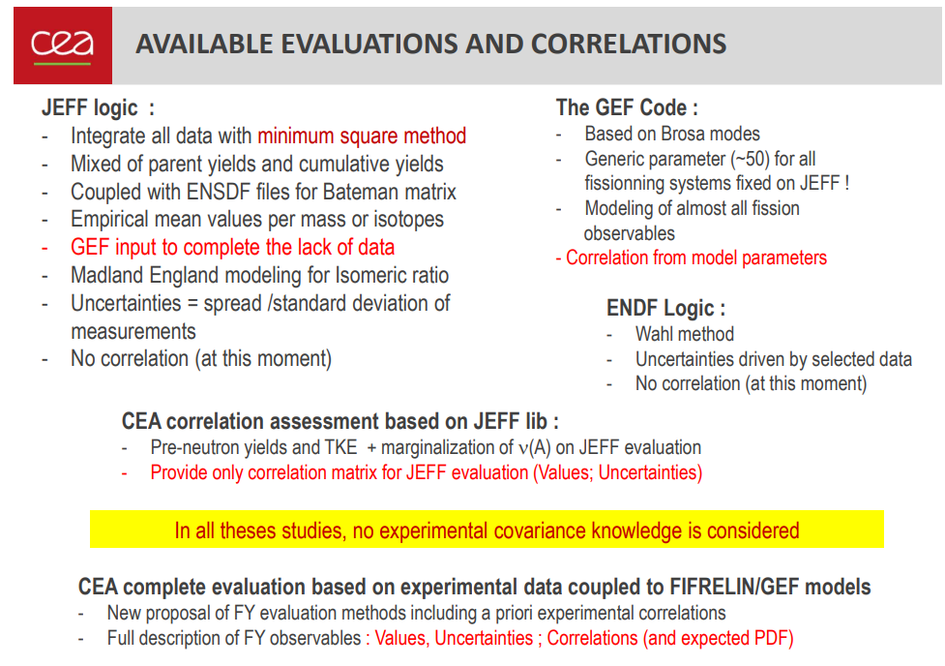
CEA/NNL new evaluation – JEFF-4

Slide 13
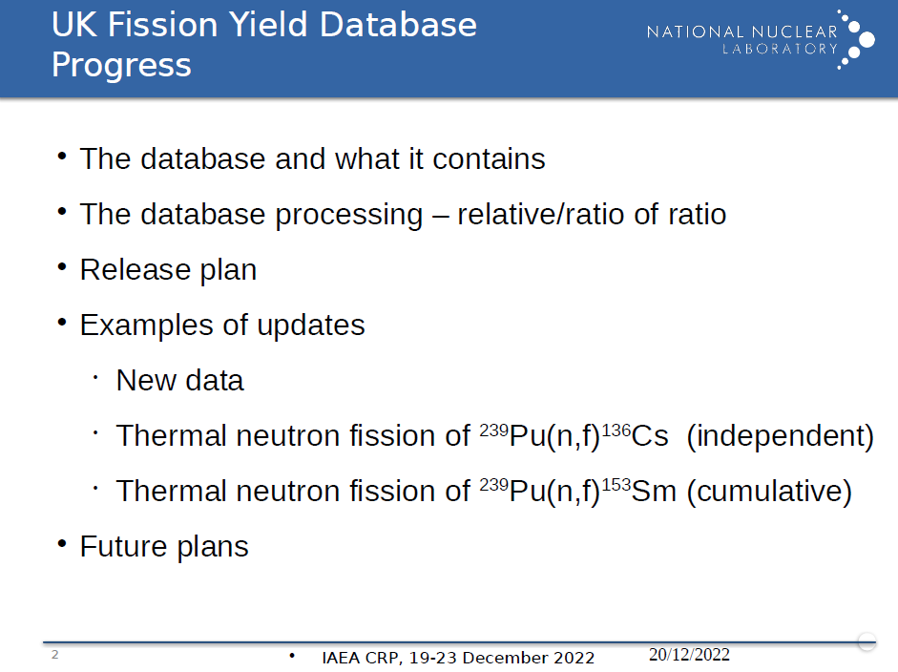


Slide 14
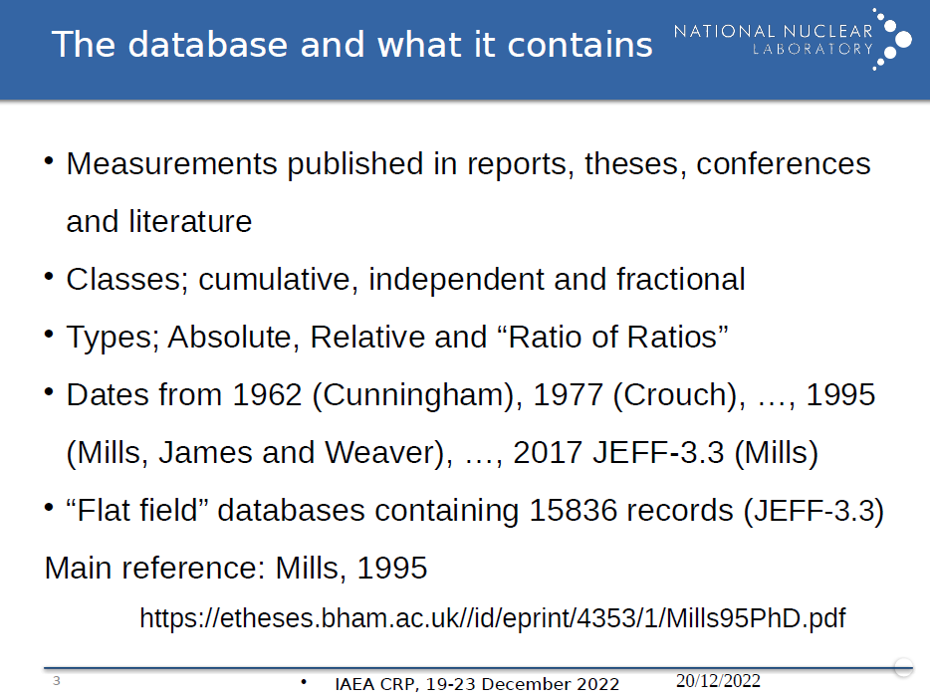

Slide 15
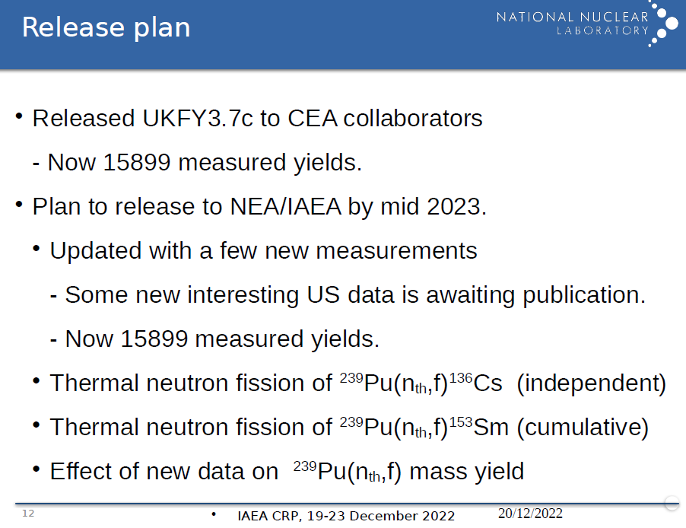

Slide 16
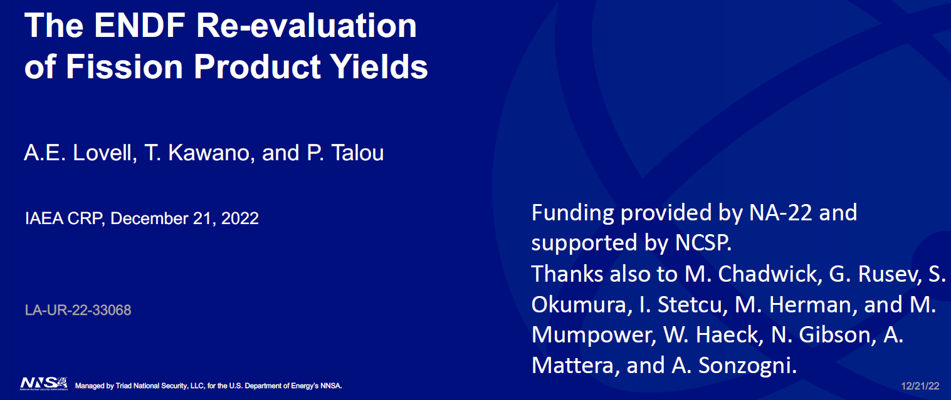
ENDF re-evaluation of FPY

Slide 17
ENDF re-evaluation of FPY

Slide 18
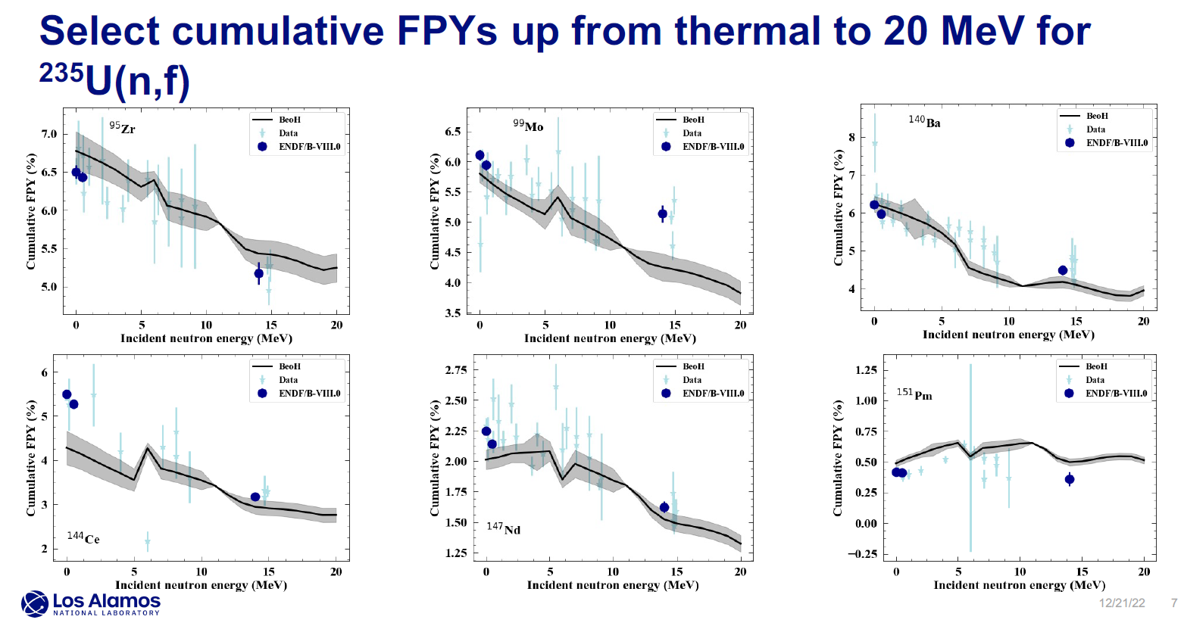
ENDF re-evaluation of FPY

Slide 19
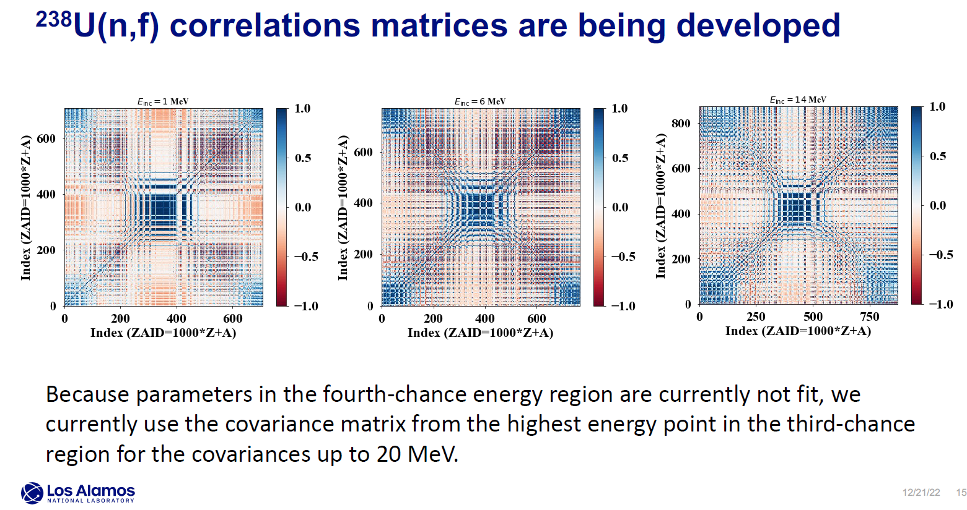
ENDF re-evaluation of FPY

Slide 20
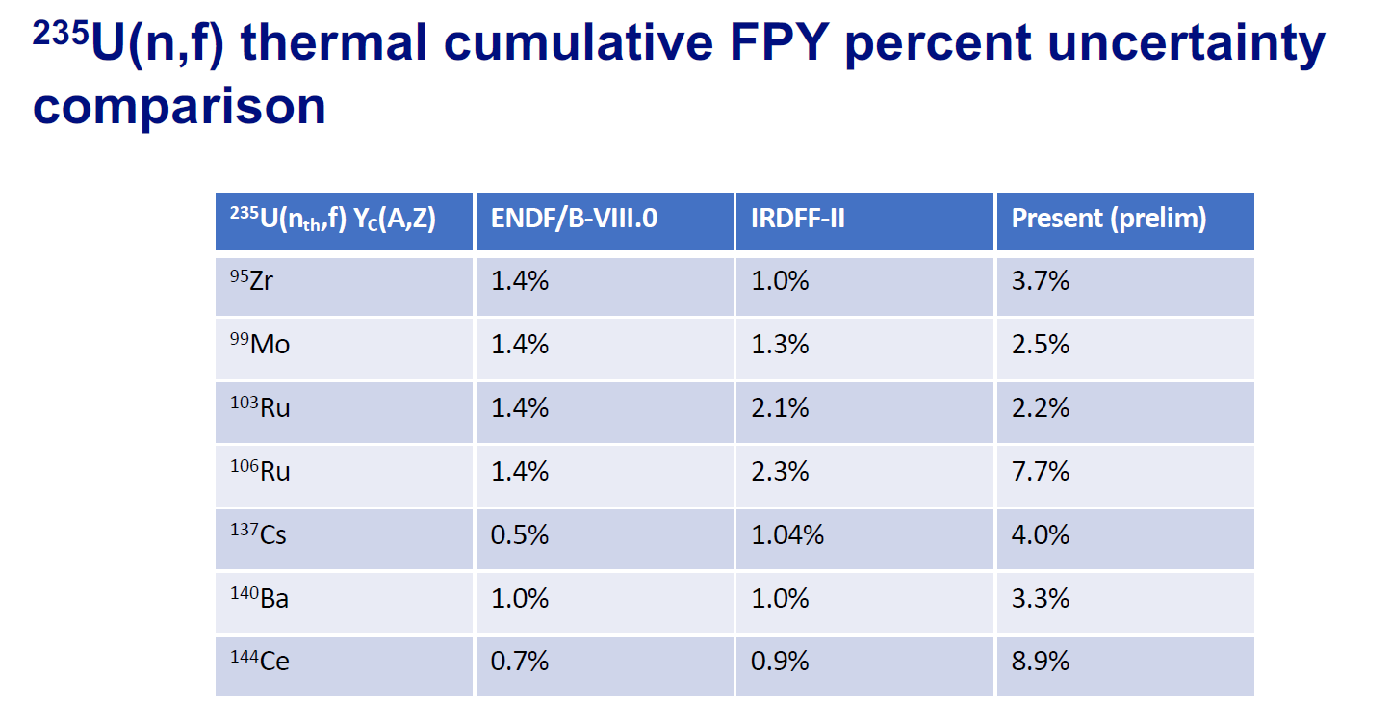
ENDF re-evaluation of FPY

Slide 21
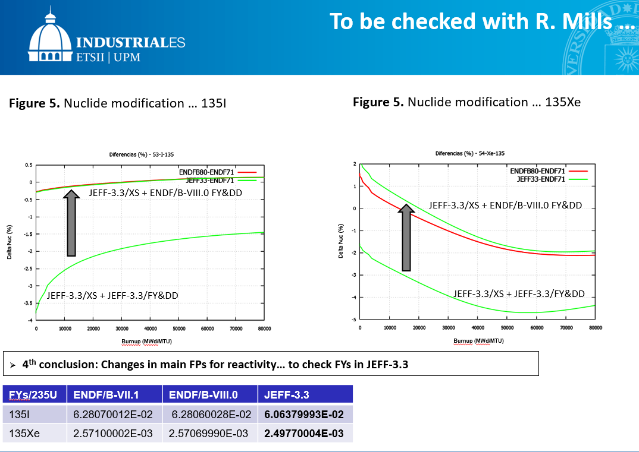


Slide 22
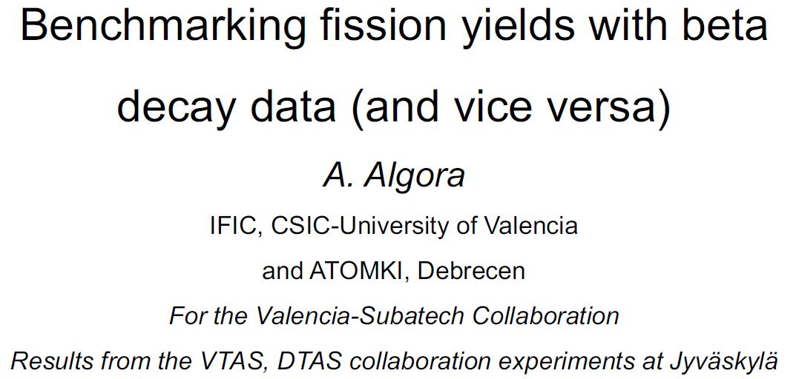

Slide 23
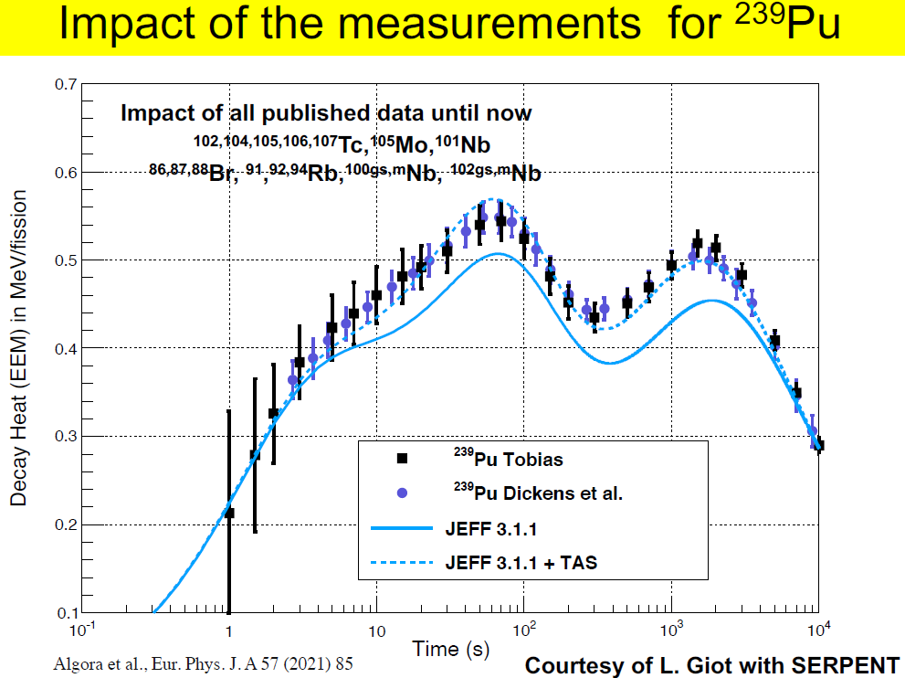

Slide 24
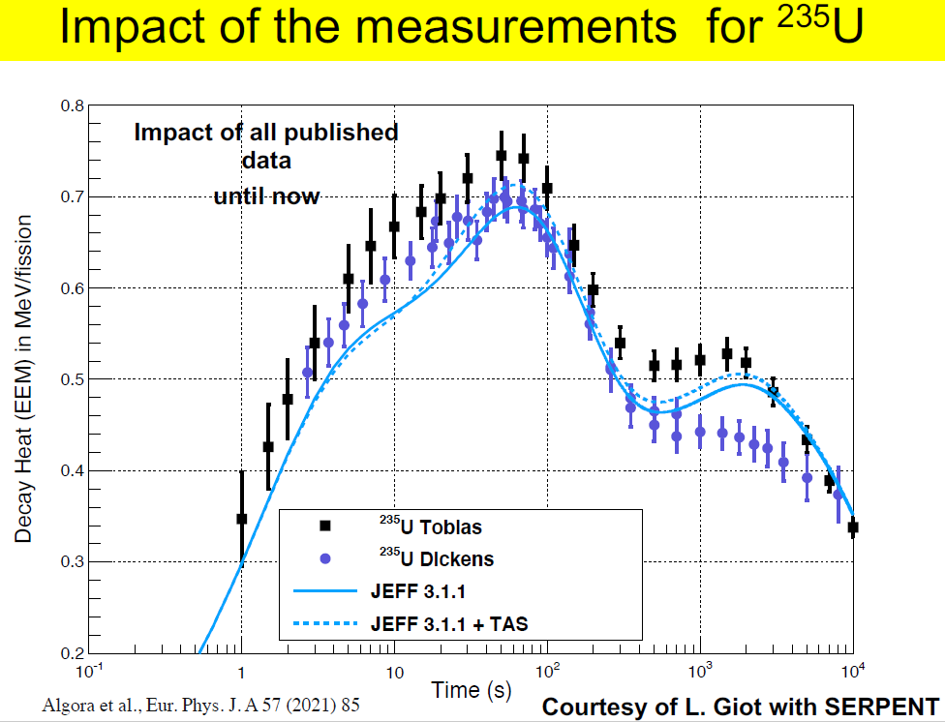

Slide 25
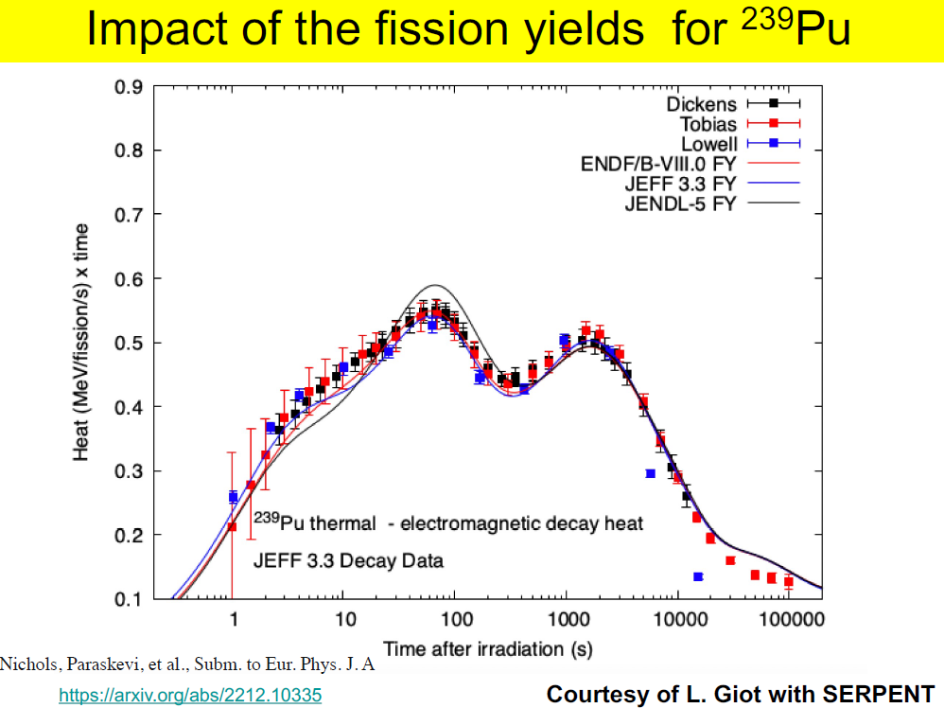

Slide 26
IAEA CRP on Evaluation of FPYs: summary
Main scope: Cf-252(sf); n + U-235,238; n + Pu-239 (incl. energy dependence)
A large international effort to measure new FPYs using updated techniques led to a significant update of the available database -> Lohengrin and TUNL-LLNL-LANL data
Comprehensive compilation of experimental data undertaken: all experimental data on independent (IFY), cumulative FYs (CFY) and FY(En) incorporated in EXFOR (incl. expt. covariances) -> IAEA & BNL coordination (all E&R data plus new data + comprehensive retrieval of older data)
New evaluations at different En (thermal, fast, 14 MeV + more) with associated uncertainties (evaluation methodology, evaluation of FYs, uncertainties and correlations, covariances, formats) -> ENDF evaluation (LANL), CEA/NNL (JEFF)
Importance of decay data highlighted (e.g., TAS)
Validation: Sensitivity of burn-up, decay heat and anti-neutrino spectra to FPYs are shown

