Slide 1
Accident Source Terms
David L. Luxat

Slide 2
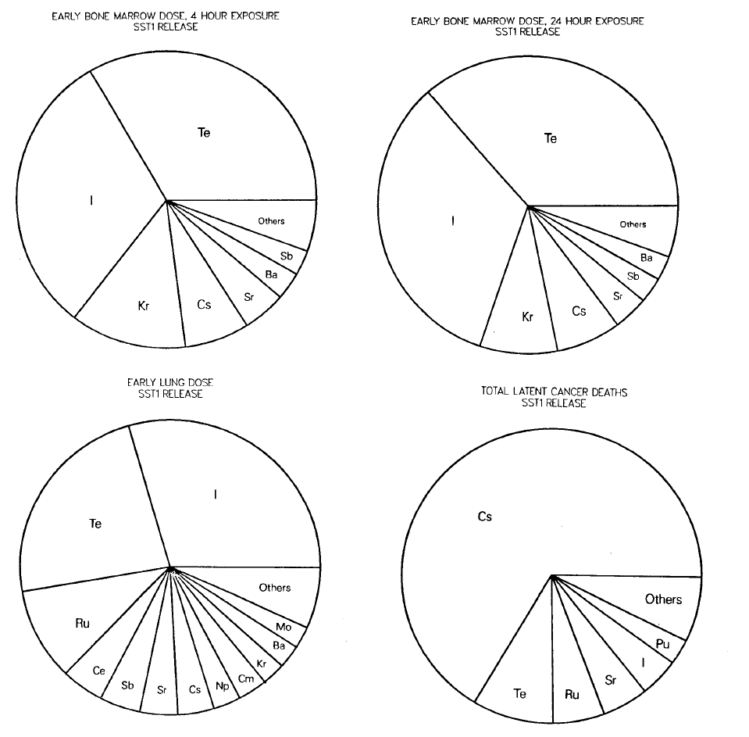
Radiological Release – Health Effects
Importance of radionuclide to off-site health effects influenced by
Fraction of inventory released to environment
Abundance in reactor inventory
Radioactive half-life
Radiobiological importance of radionuclide and daughter radionuclides
Importance characterized in early study NUREG/CR-4467 (SAND85-2575)
Relative Importance of Individual Elements to Reactor Accident Consequences Assuming Equal Release Fractions

Slide 3
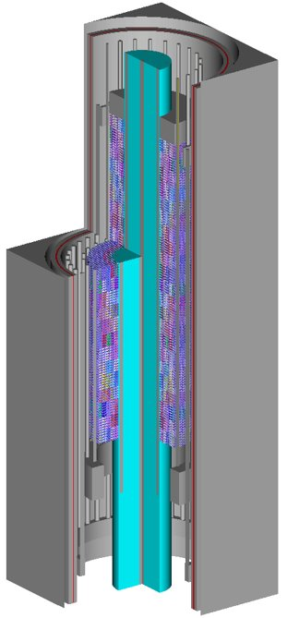
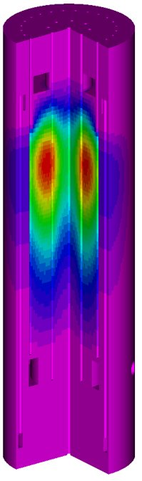
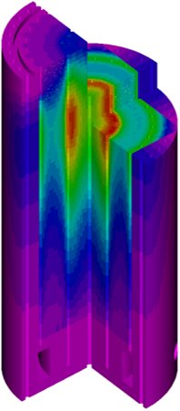
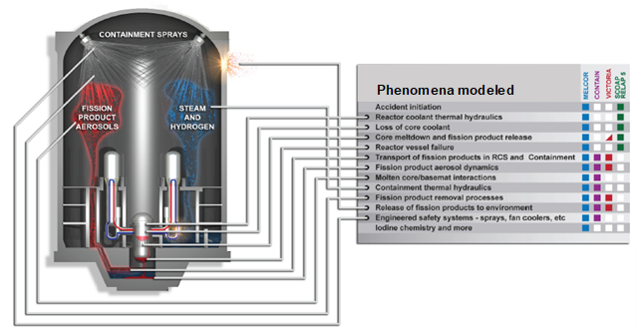
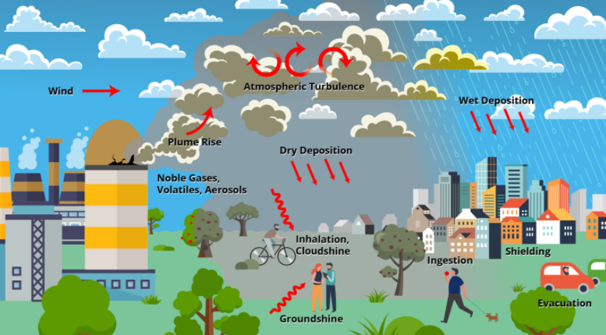
Regulatory Mechanistic Source Term Development
MACCS (SNL)
Radiological Consequences
Near- and far-field atmospheric transport and deposition
Assessment of health and economic impacts
MELCOR (SNL)
Integrated Severe Accident Progression
Hydrodynamics for range of working fluids
Fission product transport
Accident response of plant structures, systems and components
SCALE (ORNL)
Neutronics
Criticality
Shielding
Radionuclide inventory
Burnup credit
Decay heat
Nuclear Reactor System Applications
Non-Reactor Applications
Safety/Risk Assessment
Technology-neutral
Accident forensics (Fukushima, TMI)
Probabilistic risk assessment
Regulatory
License amendments
Risk-informed regulation
Design certification (e.g., NuScale)
Vulnerability studies
Design/Operational Support
Design analysis scoping calculations
Training simulators
Experimental
Naval
Advanced LWRs
Advanced Non-LWRs
Fusion
Spent Fuel
Neutron beam injectors
Facility Safety
Risk studies
Leak path factor calculations
Li loop LOFA transient analysis
ITER cryostat modeling
He-cooled pebble test blanket (H³)
Multi-unit accidents
Dry storage
DOE safety toolbox codes
DOE nuclear facilities (Pantex, Hanford, Los Alamos, Savannah River Site)
Emergency Planning Zone Analysis
Emergency preparedness
Spent fuel transport/package applications

Slide 4
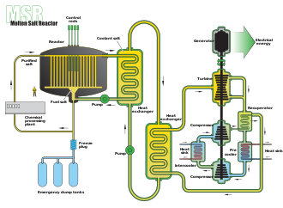
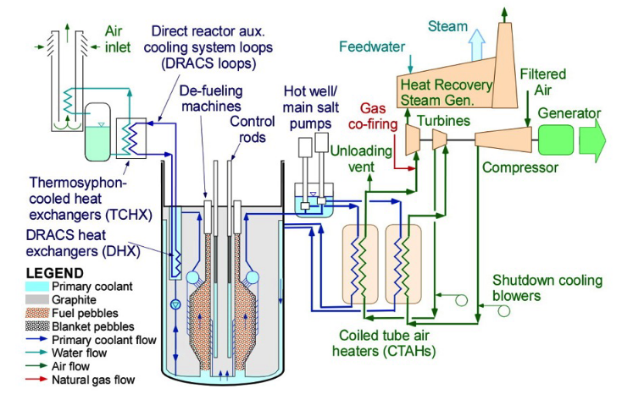
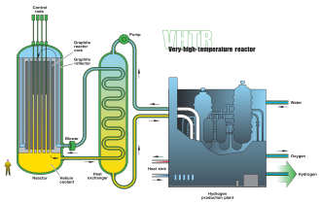
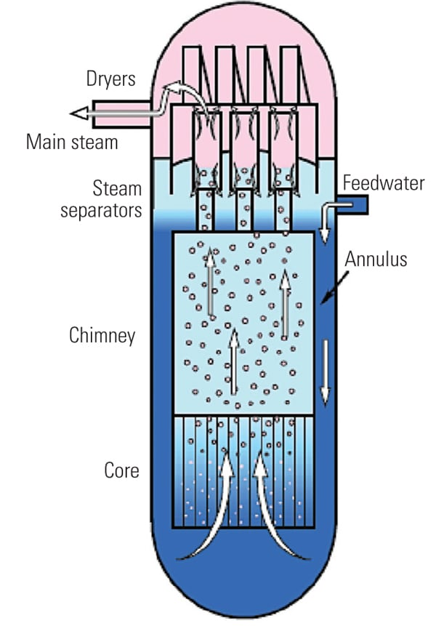
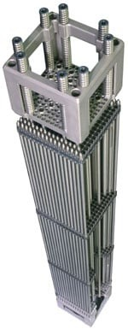



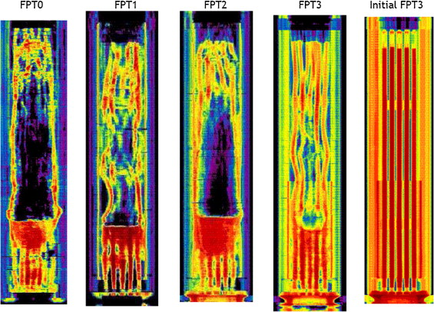
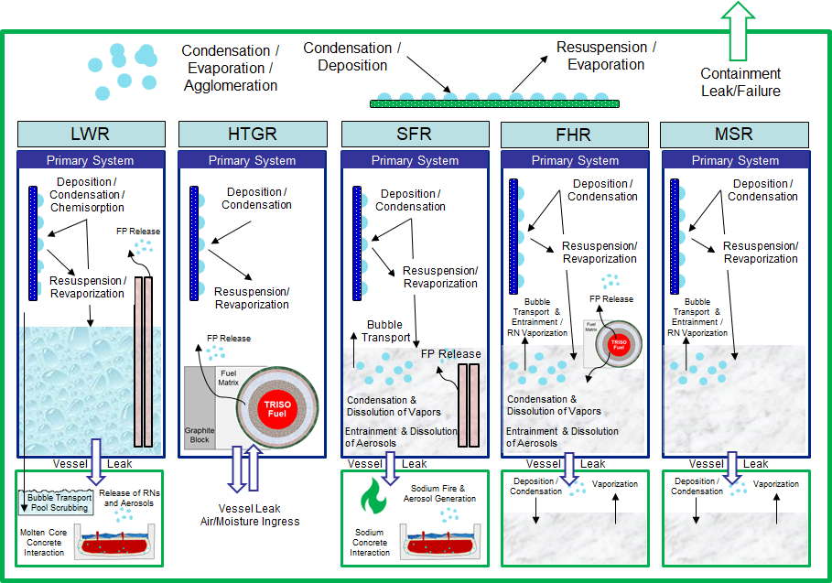
Integral Safety Analysis – What a Code Like MELCOR Does
Thermal hydraulics
Fuel thermal-mechanical response
Ex-vessel damage progression
Neutronics
Core degradation
Fission product release and transport
SCALE (ORNL)
T. Haste, et al., “A comparison of core degradation phenomena in the CORA, QUENCH, Phébus SFD, and Phébus FP experiments,” Nuclear Engineering and Design, vol. 283, pp. 8-20, 2015.
Office of Nuclear Regulatory Research, “Three Mile Island Accident of 1979 Knowledge Management Digest,” Nuclear Regulatory Commission, Washington, D.C. 2012
4

Slide 5
LWR Accident Modeling

Slide 6
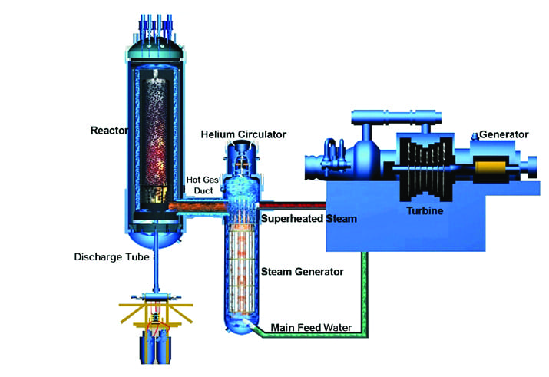
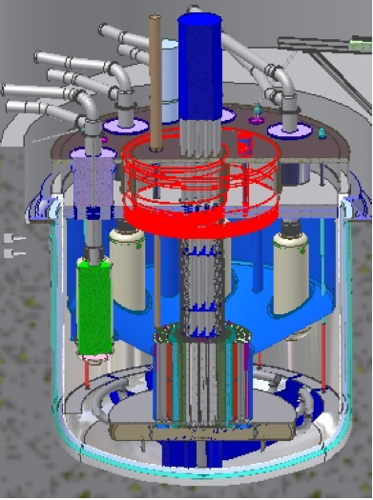
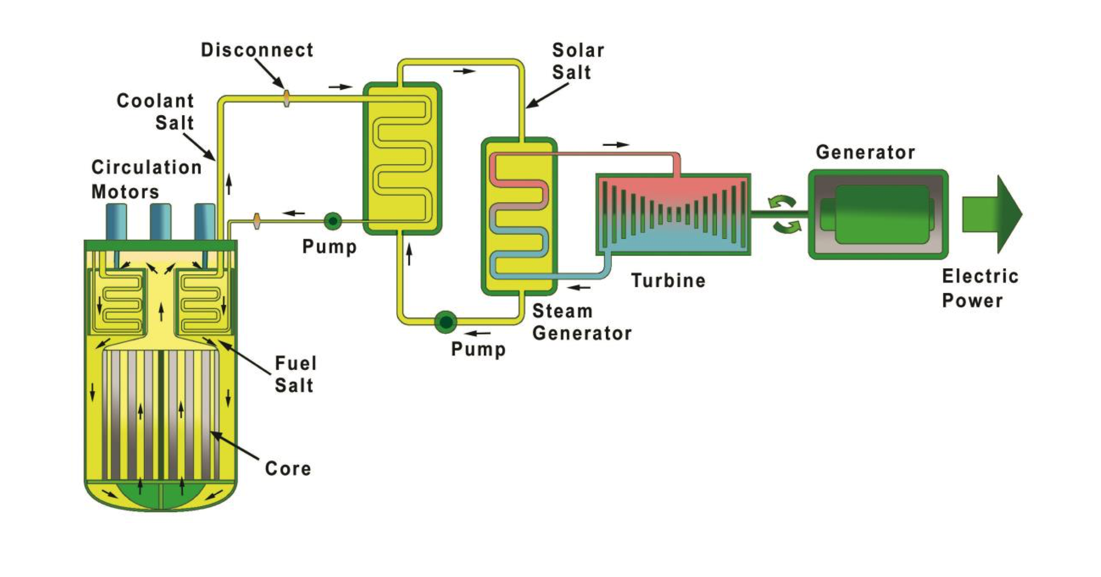
Non-LWR Accident Modeling
Hydrodynamic modeling
Generalized working fluid treatment
Conduction heat transfer within working fluids
Generalized convection and flow models to capture flow through new core geometries (e.g., pebble beds)
Core models
TRISO pebble and compact core components
Heat pipe reactor core component
Graphite oxidation
Intercell and intracell conduction
Fast reactor core degradation
Fission product release
Generalized release modeling for metallic fuels
Radionuclide transport and release from TRISO particles, pebbles and compacts
Generalized Radionuclide Transport and Retention (GRTR) model
Simplified neutronic modeling
Solid fuel core point kinetics
Fluid point kinetics (liquid-fueled molten salt reactors)

Slide 7



Generalized Radionuclide Transport and Retention (GRTR)
Track where fission products are and how much is released from liquid to atmosphere
Determine mobility of fission products to identify if they can reach environment
Characterizes evolution of fission products between different physico-chemical forms
Fission product evolution from a liquid pool to an atmosphere
  Influenced by solubility and vapor pressure
Insoluble fission product deposition on structures
GRTR mass transport modeling characterizes
Concentration of radionuclide forms
Concentration gradients between radionuclide forms
Resistance to mass transfer between radionuclide forms using standard correlation-based interfacial mass transport theory
$$x_{i}^{atm}$$
$$x_{i,liq}^{sat}$$

Slide 8
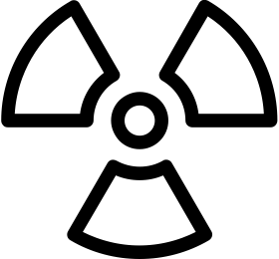


Nuclear Facility Source Term Evaluations and Integral Accident Analysis
Source term and leak path factor analysis (aerosol physics, vapor physics, speciation, chemistry, etc.)
Broad accident sequence spectrum (multi-room fire, explosions, spills, etc.)
Complex facility modeling (connectivity, interlocks, multi-zone ventilation and filtration, etc.)

