Slide 1
Overview of US Data Preservation (Open Data in Low Energy Nuclear Physics)
"Open access to the data will, in the long term, allow the maximum realization of their scientific potential." --CMS Collaboration
Jin Wu
National Nuclear Data Center
Workshop for Applied Nuclear Data Activities (WANDA) – 3/1/23

Slide 2
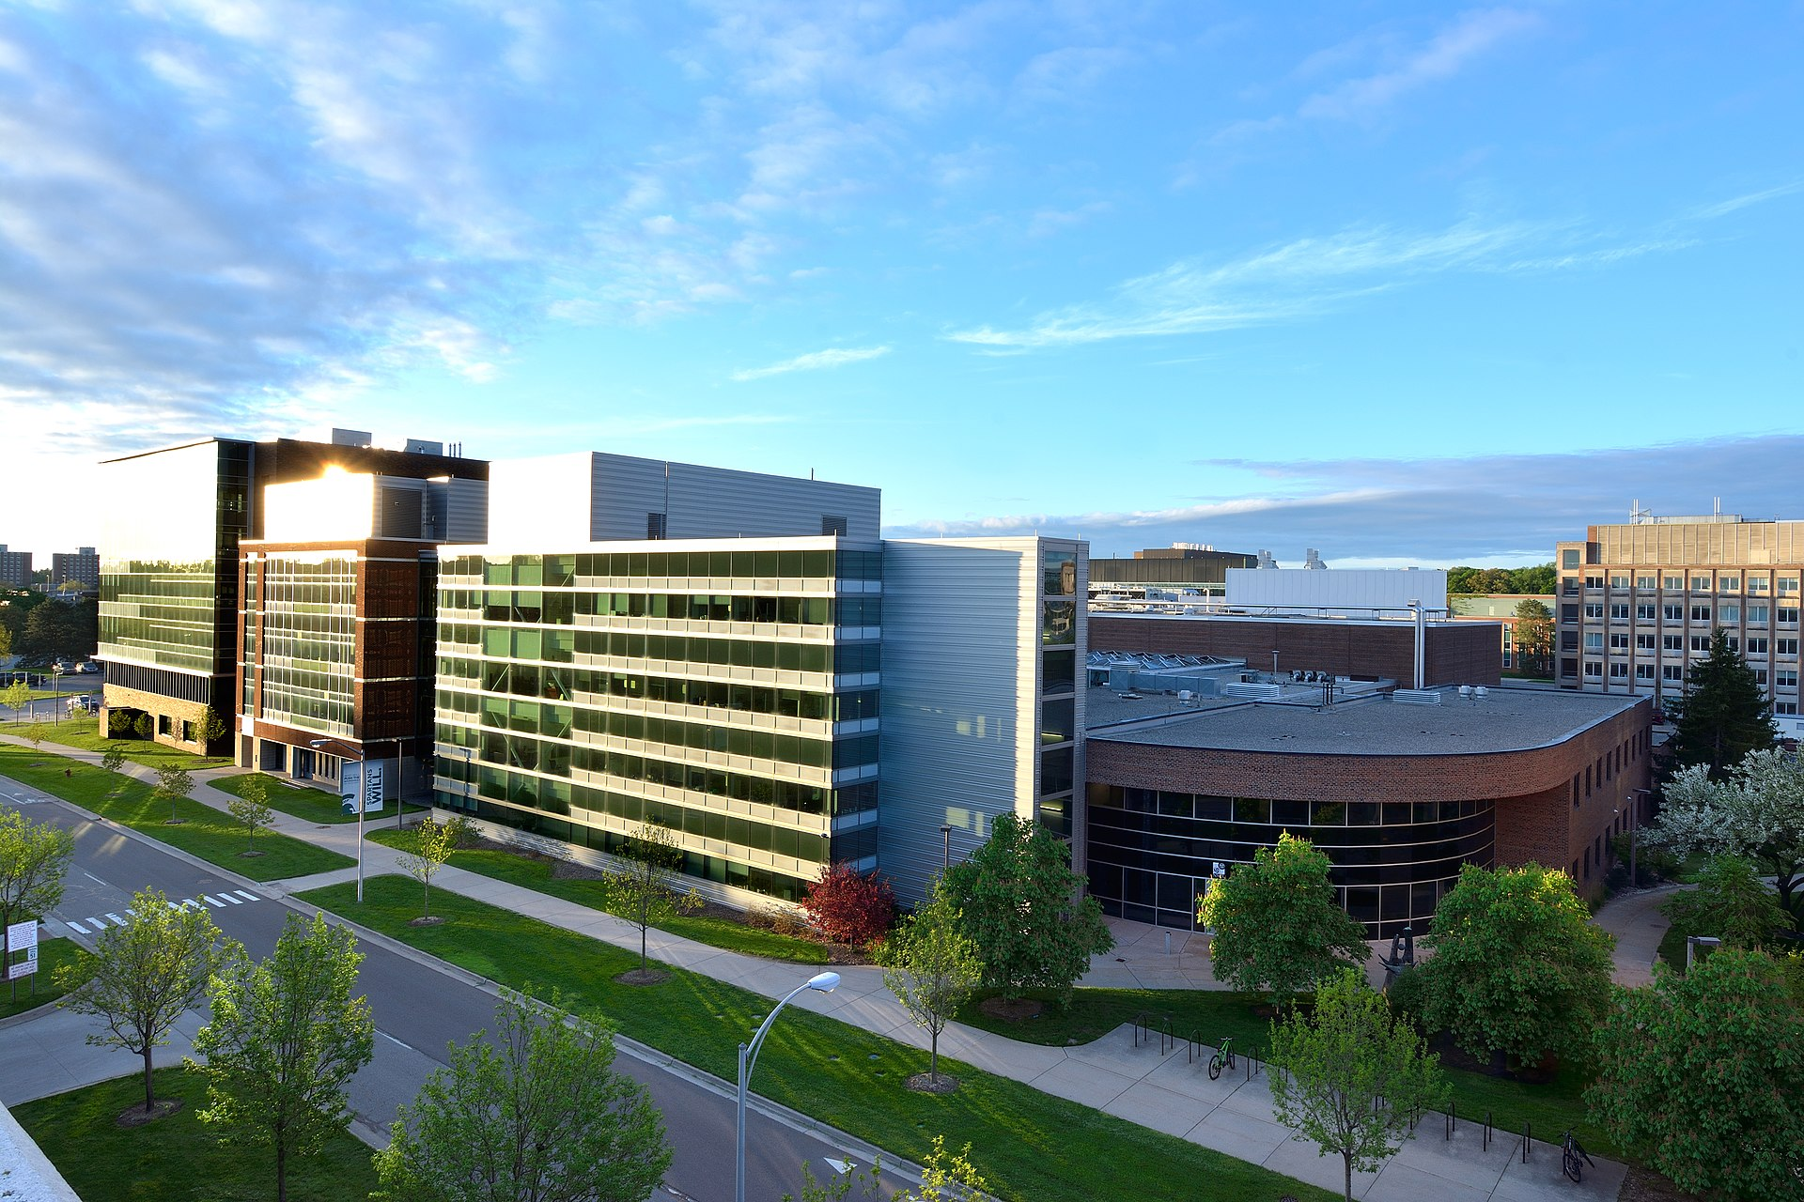
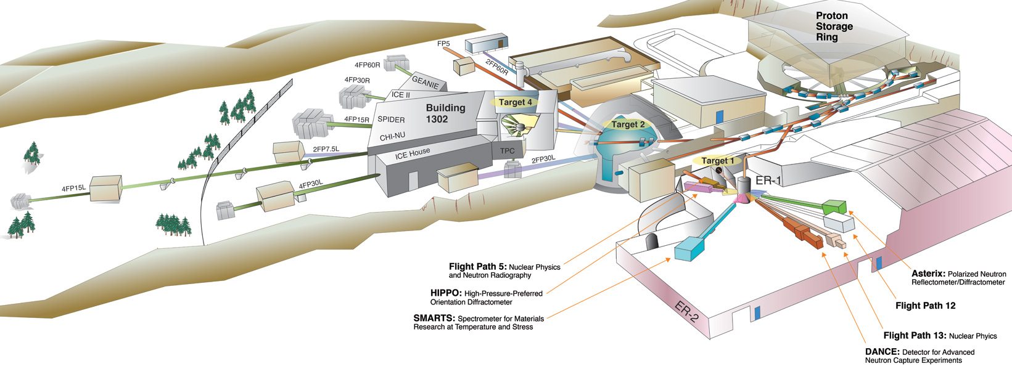
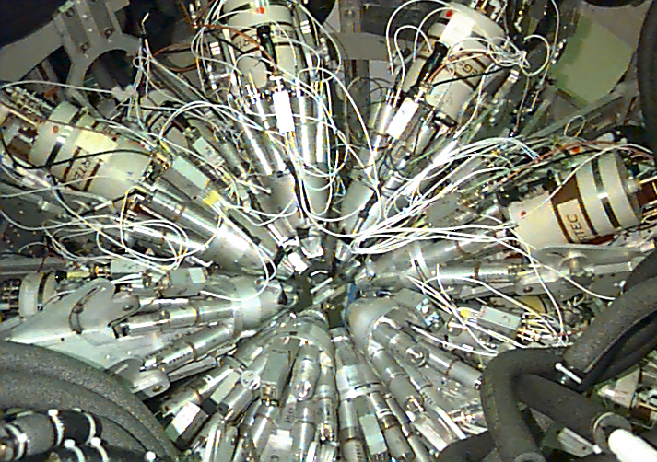
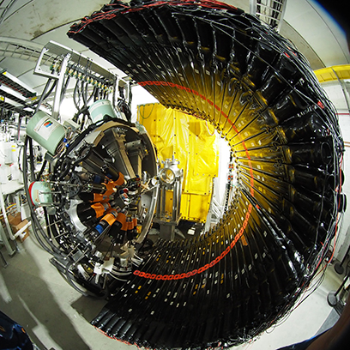
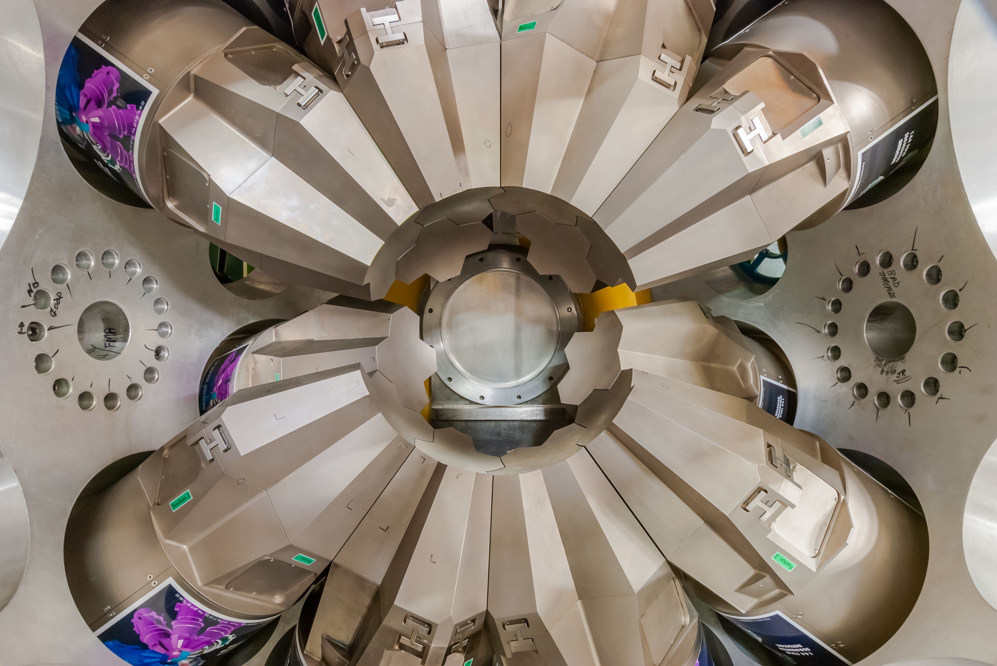
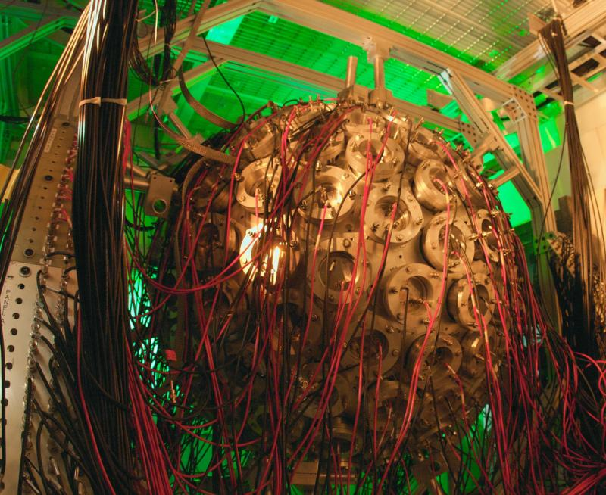
Where are we?
GEANIE
DANCE
FDS
GRETA
Large amounts of experimental data will be produced attributing to the powerful accelerators and complex detection systems.
This “self-curation” by individual research groups lacks uniformity and results in a situation where data discovery and reuse are often difficult or impossible.

Slide 3
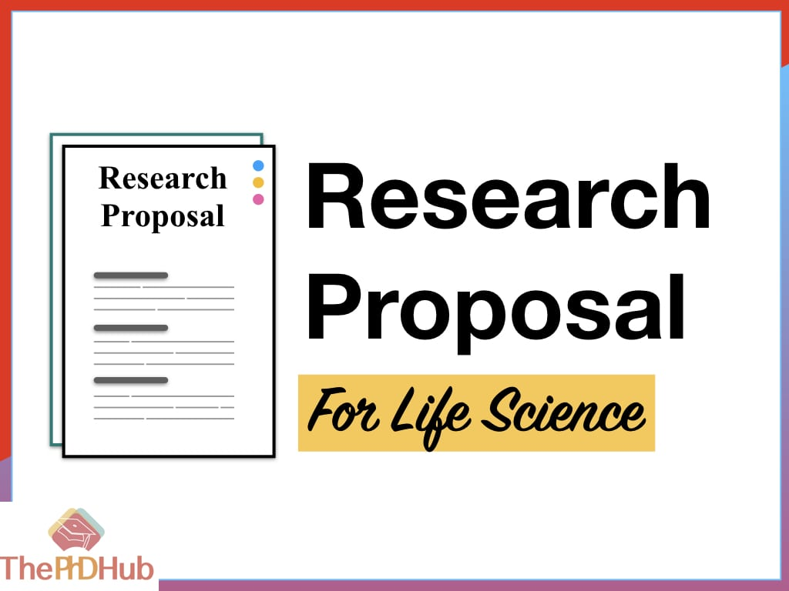
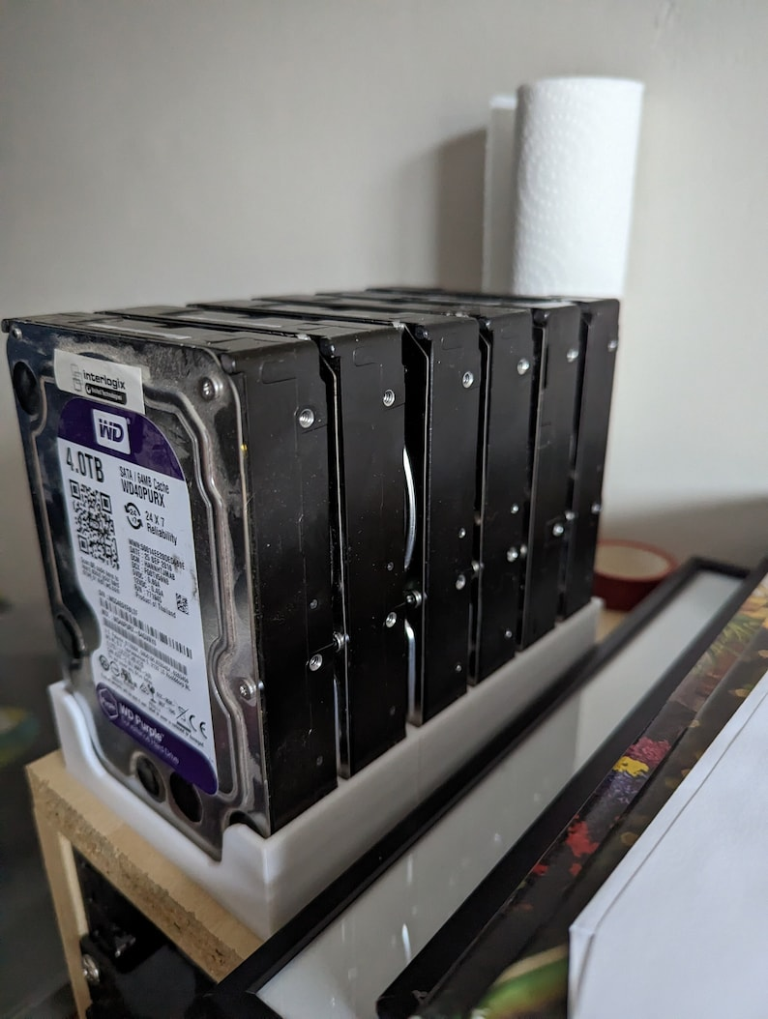
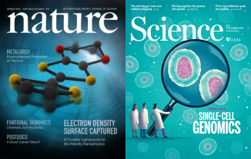
Many scientists could do ...

Slide 4
MEMORANDUM from White House (issued on 8/25/2022)
See presentation “Public Access Policy and Data Management Plans” by Dr. Michael Cooke

Slide 5
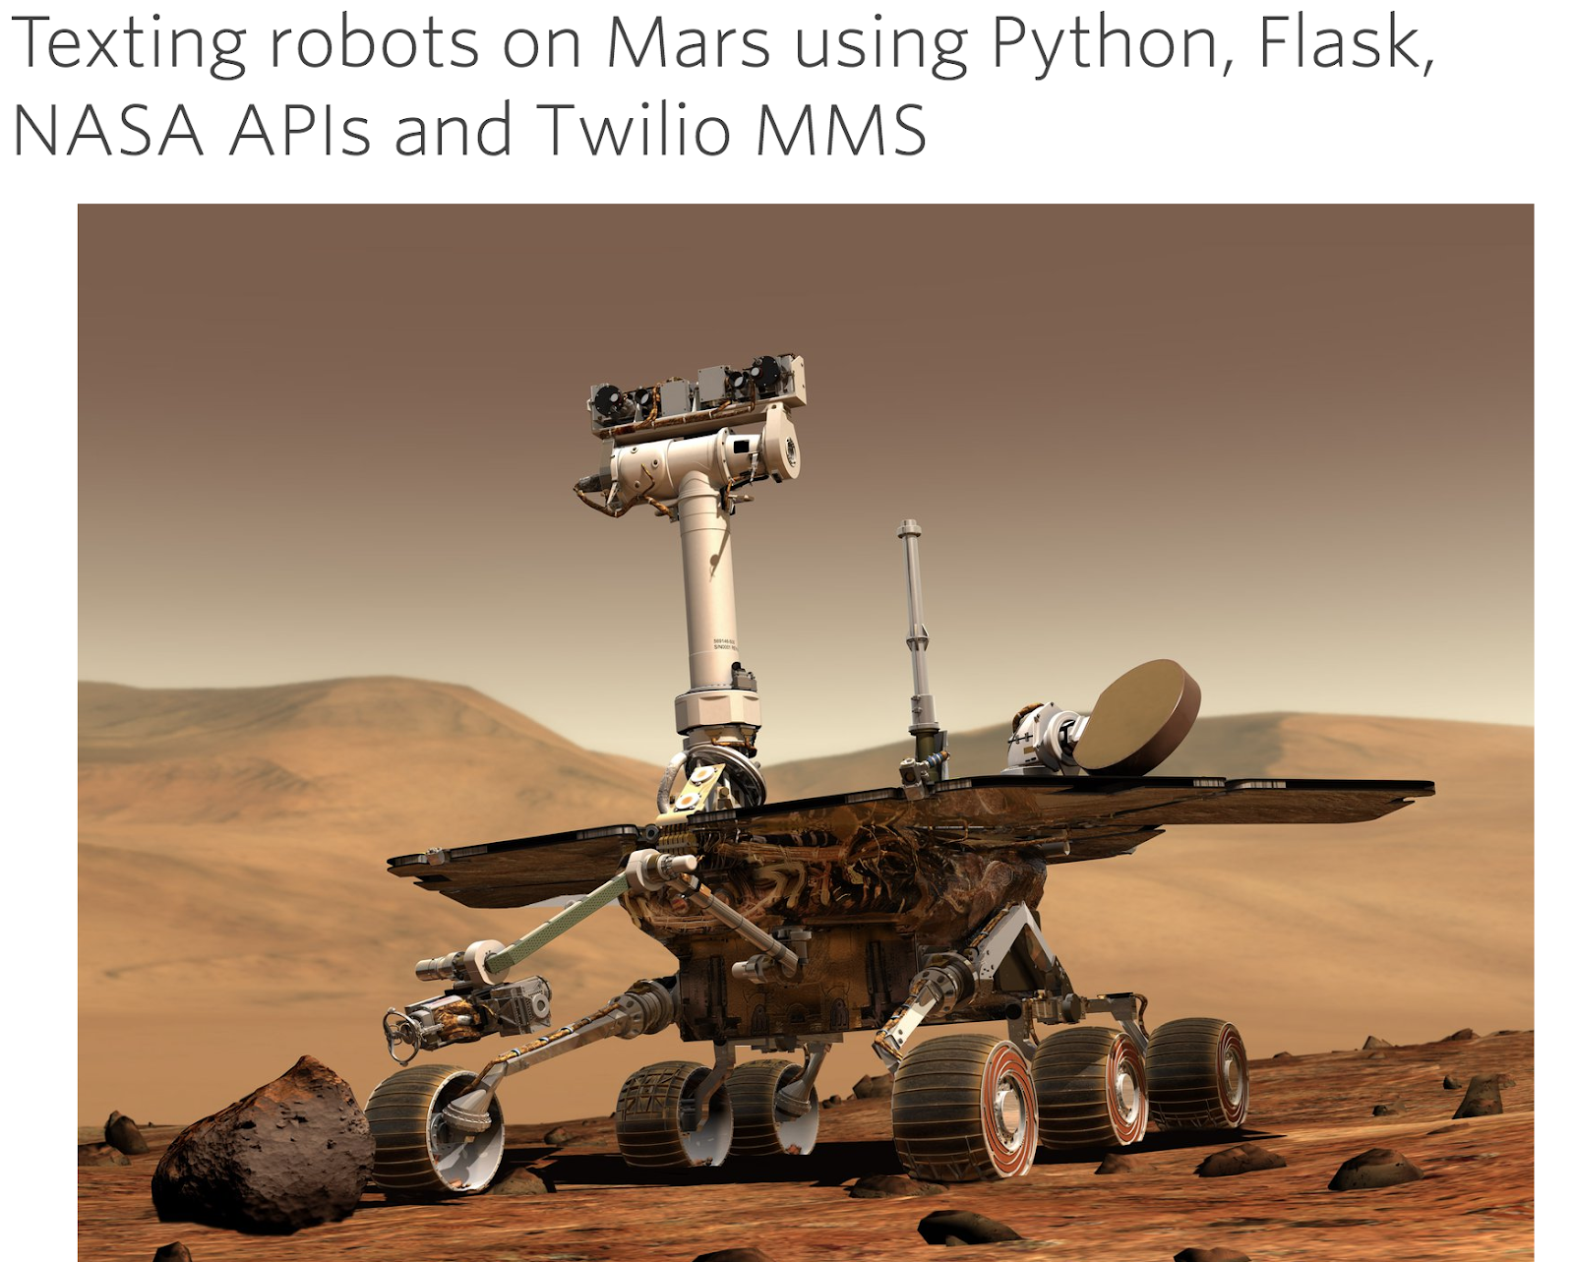
NASA Open Data
Data.nasa.gov
Code.nasa.gov
API.nasa.gov
Started in July 2014
20K unique users
40K active datasets

Slide 6
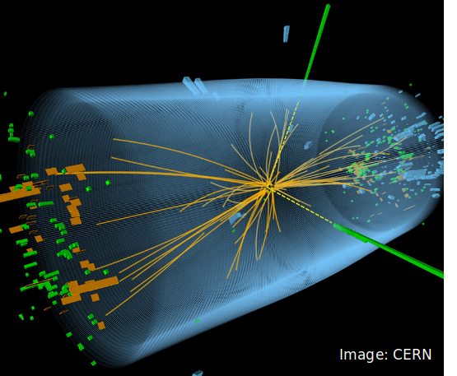
CERN Open Data
>2 petabytes of data available to the public LHC, ATLAS, CMS, ALICE, etc.
Preprocessed data
Example source code

Slide 7
European Open Data in Nuclear Physics
See Presentation "openNP" by Dr Adrien Matta (Ganil)

Slide 8
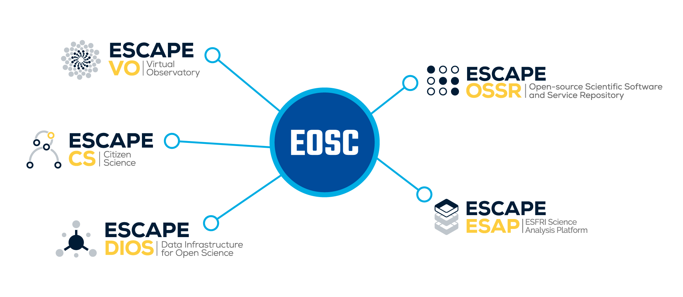
European Open Science Cloud (EOSC) – ESCAPE Program
Brings together the astronomy, astro-particle and particle physics communities, aiming to produce versatile solutions for the open data management, cross-border and multi-disciplinary open environment.
Composed by 31 European organizations with wealth expertise and experience on various of research fields, which are committed to contribute to the construction of the data research open environment

Slide 9
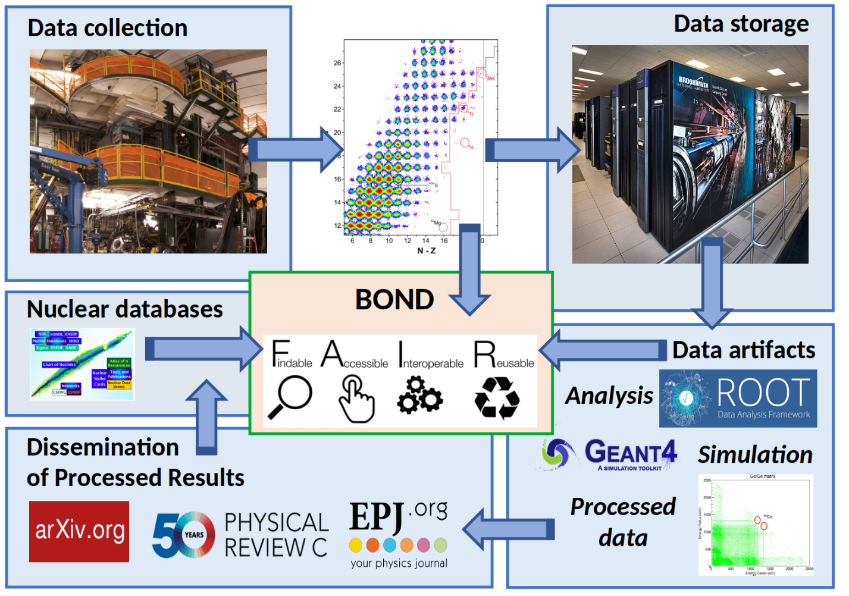
Modern database technology: curating open data
Open Data curation
Acceptance of Proposal
During Experiment
Acceptance of publication
The end of embargo period
Credit: Adam Hayes

Slide 10
The "FAIR" data principle
Findable with a globally-unique identifier and rich metadata
Accessible through a free and standard protocol
Interoperable with as much standardization as possible
Reusable with accurate and rich provenance metadata
Findable
Metadata
Persistent Identifiers (e.g. DOI)
Accessible
Web portal
Data embargo
Interoperable
Workflow starting from acceptance of proposal
Data Management Plan
APIs
Expansionable and Reusable
Policy
Expansionable
Infrastructure

Slide 11
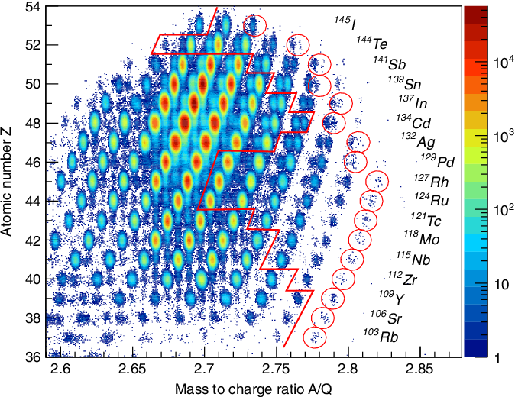
What we get from Open Data
110 Isotopes
G. Lorusso et al, PRL 114, 192501 (2015)
Validation of results
Rescue / improve / repurpose existing data
Byproducts – time and grants saving (e.g. fission, fragmentation, deep-inelastic, etc)
Education
Dataset citation
Future experiment guidance
Implemented ML/AL: Experiment optimization, and data analysis, data management.
Measured: β-T_{1/2}, P_{n}, β-𝜸, Isomers, ICe
Published:
β-T_{1/2} (110 Isotopes)
¹²⁶Pd, ¹²⁸Pd Isomers
¹²⁶Pd, β- 𝜸
¹²³Ag, ¹²⁵Ag: β- 𝜸
¹²⁵Pd, ¹²⁷Pd: isomers
Large amounts of byproducts are unanalyzed!

Slide 12
Future Perspective
Developing & maintaining Open Data website
Organizing Community workshops
Developing Data/Metadata, Persistent Identifiers system
Recruiting future contributors
Jin Wu
jwu2@bnl.gov
Elizabeth McCutchan
mccutchan@bnl.gov
David Brown
dbrown@bnl.gov

Slide 13
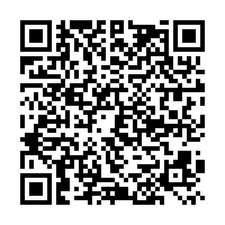
Data Preservation Survey
https://docs.google.com/forms/d/e/1FAIpQLSeyhMTibWwfqbcXa4r8nYE9NFS_dLgTNVpx2ZTUEjiwky_3fg/viewform?usp=sf_link

Slide 14
Thank you!

