Slide 1

The case for an evaluated database of statistical nuclear quantities
Lee Bernstein
Department of Nuclear Engineering
UC-Berkeley
Nuclear Science Division
Lawrence Berkeley National Laboratory
WANDA 2023
Crystal City, VA
February 27, 2023

Slide 2
What are statistical (Quasicontinuum) nuclear data
The Evaluated Nuclear Structure Data File (ENSDF) has information about discrete, particle-bound nuclear states and the decays connecting them.

Slide 3
What are statistical (Quasicontinuum) nuclear data
The Evaluated Nuclear Structure Data File (ENSDF) has information about discrete, particle-bound nuclear states and the decays connecting them.
States with E_{x} > a few MeV, particularly those with high-values of E_{x}/J, are unknown and both their E_{x}-J distribution and the probability that they will decay via emission of a γ-ray of a given energy are statistically distributed using continuous functions:
  Nuclear Level Density = ρ(E_{x},J^{π})
  Photon Strength Function = F(E_{γ})
QC
States

Slide 4
What are statistical (Quasicontinuum) nuclear data
The Evaluated Nuclear Structure Data File (ENSDF) has information about discrete, particle-bound nuclear states and the decays connecting them.
States with E_{x} > a few MeV, particularly those with high-values of E_{x}/J, are unknown and both their E_{x}-J distribution and the probability that they will decay via emission of a γ-ray of a given energy are statistically distributed using continuous functions:
  Nuclear Level Density = ρ(E_{x},J^{π})
  Photon Strength Function = F(E_{γ})
These Quasicontinuum (QC) states are the ones most likely to connect to states populated in neutron capture, making ρ(E_{x},J^{π}) and F(E_{γ}) critical to accurate nuclear reaction modeling
Neutron Capture
S_{n}
QC
States

Slide 5




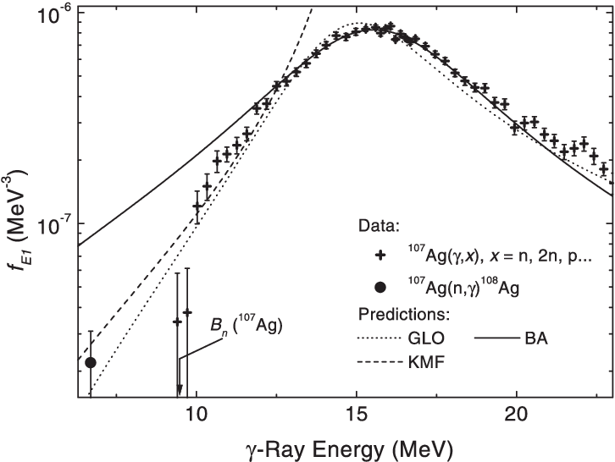
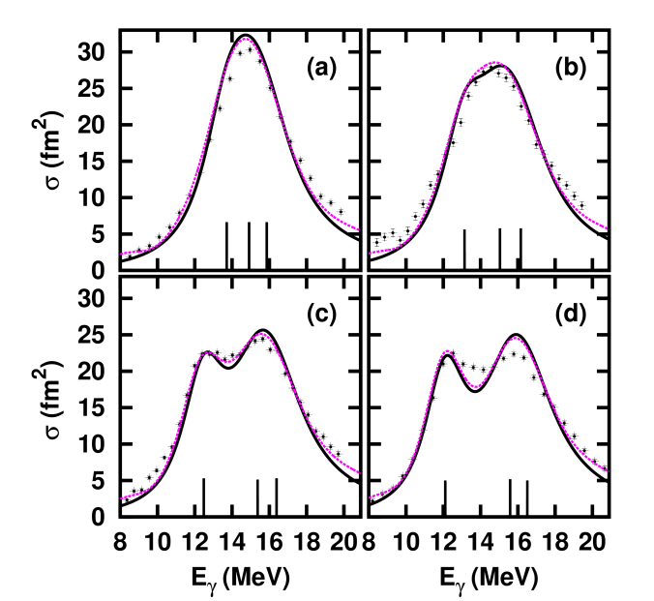
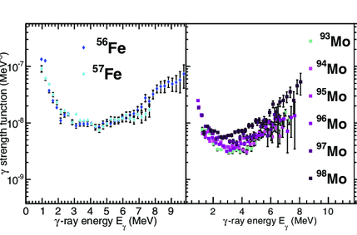
What are statistical nuclear data
  Nuclear Level Density = ρ(E_{x},J^{π})
Neutron Capture
S_{n}
Fermi Gas Model
Constant Temperature Model
QC
States
Plus many, many more…
  Photon Strength Function = F(E_{γ})
Plus many, many more…
How do these data effect the reaction rates needed for applications?

Slide 6
What are statistical nuclear data
  Nuclear Level Density = ρ(E_{x},J^{π})
Neutron Capture
S_{n}
Fermi Gas Model
Constant Temperature Model
QC
States
Plus many, many more…

Slide 7
What are statistical nuclear data
  Nuclear Level Density = ρ(E_{x},J^{π})
Neutron Capture
S_{n}
Fermi Gas Model
Constant Temperature Model
QC
States
Plus many, many more…
  Photon Strength Function = F(E_{γ})
Plus many, many more…

Slide 8
What are statistical nuclear data
  Nuclear Level Density = ρ(E_{x},J^{π})
Neutron Capture
S_{n}
Fermi Gas Model
Constant Temperature Model
QC
States
Plus many, many more…
  Photon Strength Function = F(E_{γ})
Plus many, many more…
How do these data effect the reaction rates needed for applications?

Slide 9
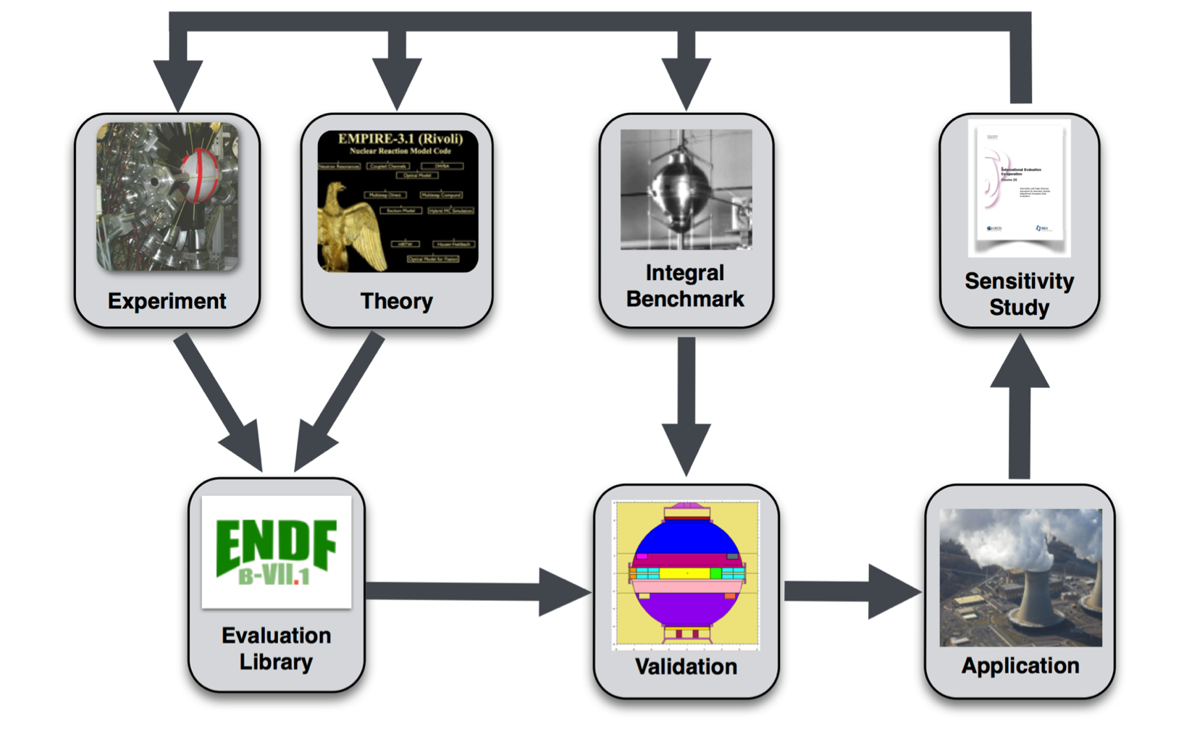
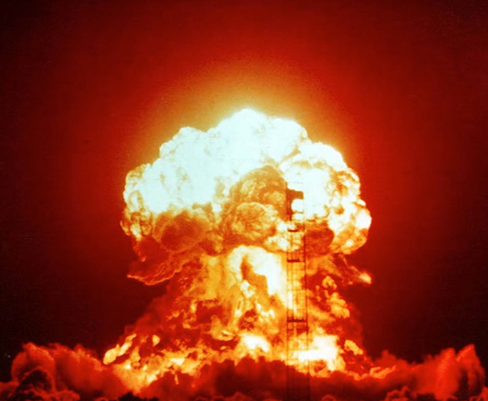
Where Statistical Data Enters Reaction Evaluation
Reaction models are “tuned” by varying underlying physics knobs, such as QC properties and OM parameters, by evaluators to reproduce measured angle- and energy-differential cross section data (since we can’t measure everything needed).
Models of “integral benchmarks” (e.g., systems that depend on multiple nuclear data inputs) are compared to the “real deal” to validate the underlying nuclear data
Integral Benchmark
BUT QC properties such as Nuclear Level Density (ρ(E_{x},J,π)) and Gamma Strength Functions (Γ(E_{γ})) are now being measured regularly and their values should not be adjusted “at will” by evaluators
e.g., QC properties are another “trash can” (to quote Dave)
Thanks to Dave Brown (BNL/NNDC)

Slide 10
Example: ²³⁹Pu(n,x) in Jezebel modeled using cross sections from two different nuclear data libraries
k_{eff}
²³⁹Pu
el -500
n,n’ +704
ENDF/B-VIII.0
vs. JEFF-3.3
QC measurements of could help address compensating uncertainties
*L.A.B. et al., Annu. Rev. Nucl. Part. Sci. 2019.69:109-136.

Slide 11
Let’s consider an example from Medical Applications
Production of ^{134,139}Ce for medical imaging using high energy protons

Slide 12
The Effect on the Ground-to-Isomer Ratio is greater
Production of ⁸⁶Y for medical imaging
Level Density
J-Distribution
Default
σ_{cutoff} / 2
σ_{cutoff} x 1.5

Slide 13
How about an example from NA-11’s perspective
^{89g,m}Zr as a radiochemical diagnostic
Level Density
J-Distribution
Default
σ_{cutoff} / 2
σ_{cutoff} x 1.5

Slide 14
How about a broadly important reaction?
Dependence of ²³⁵U(n,γ) at Fast Fission Energies on ρ(J)
Default
σ_{cutoff} x 0.66
σ_{cutoff} x 1.5
What about the dependence on F(E_{γ})?

Slide 15
How about a broadly important reaction?
Dependence of ²³⁵U(n,γ) at Fast Fission Energies on F(E_{γ})
We can ignore this, but we do so at our peril

Slide 16
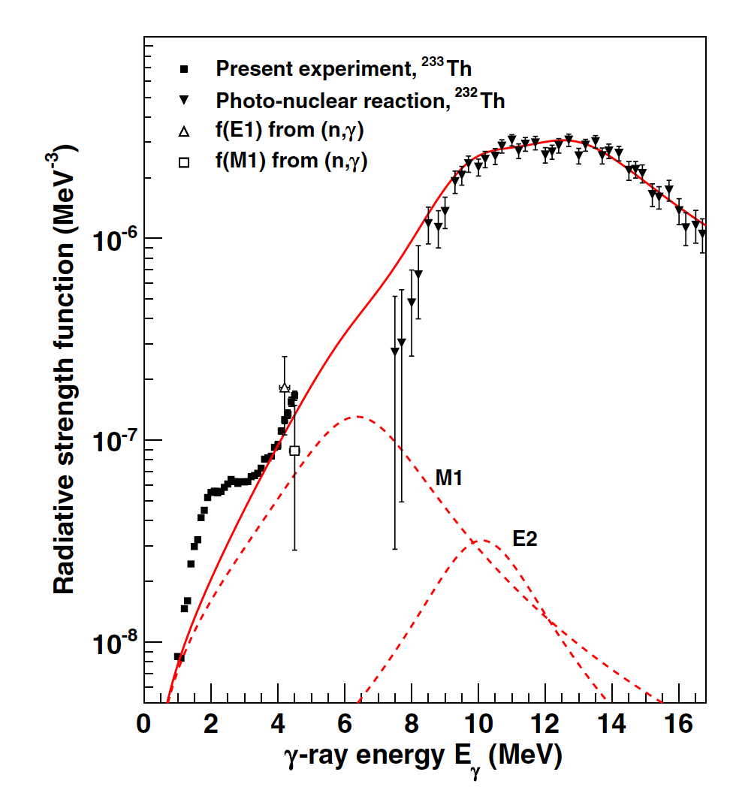
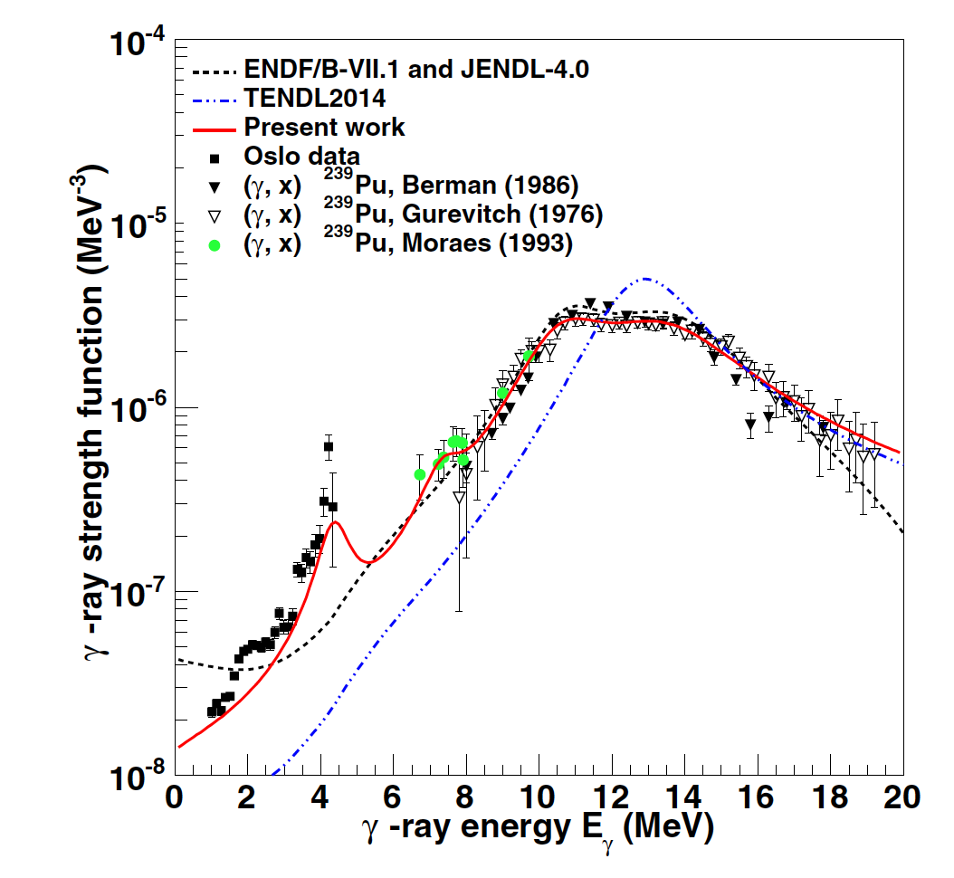
Examples of recent F(E_{γ}) data in Actinide nuclei
A great deal of data is showing that there’s significant strength at low E_{γ}

Slide 17
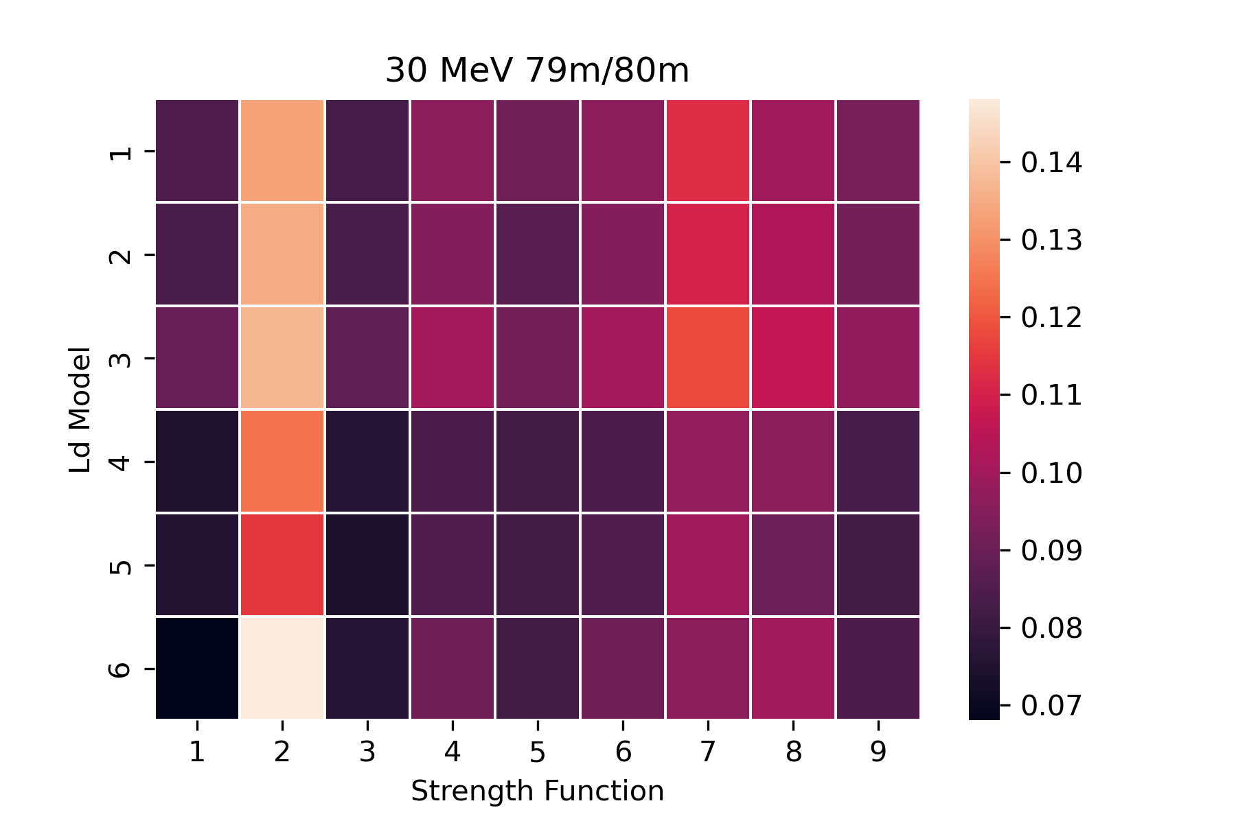
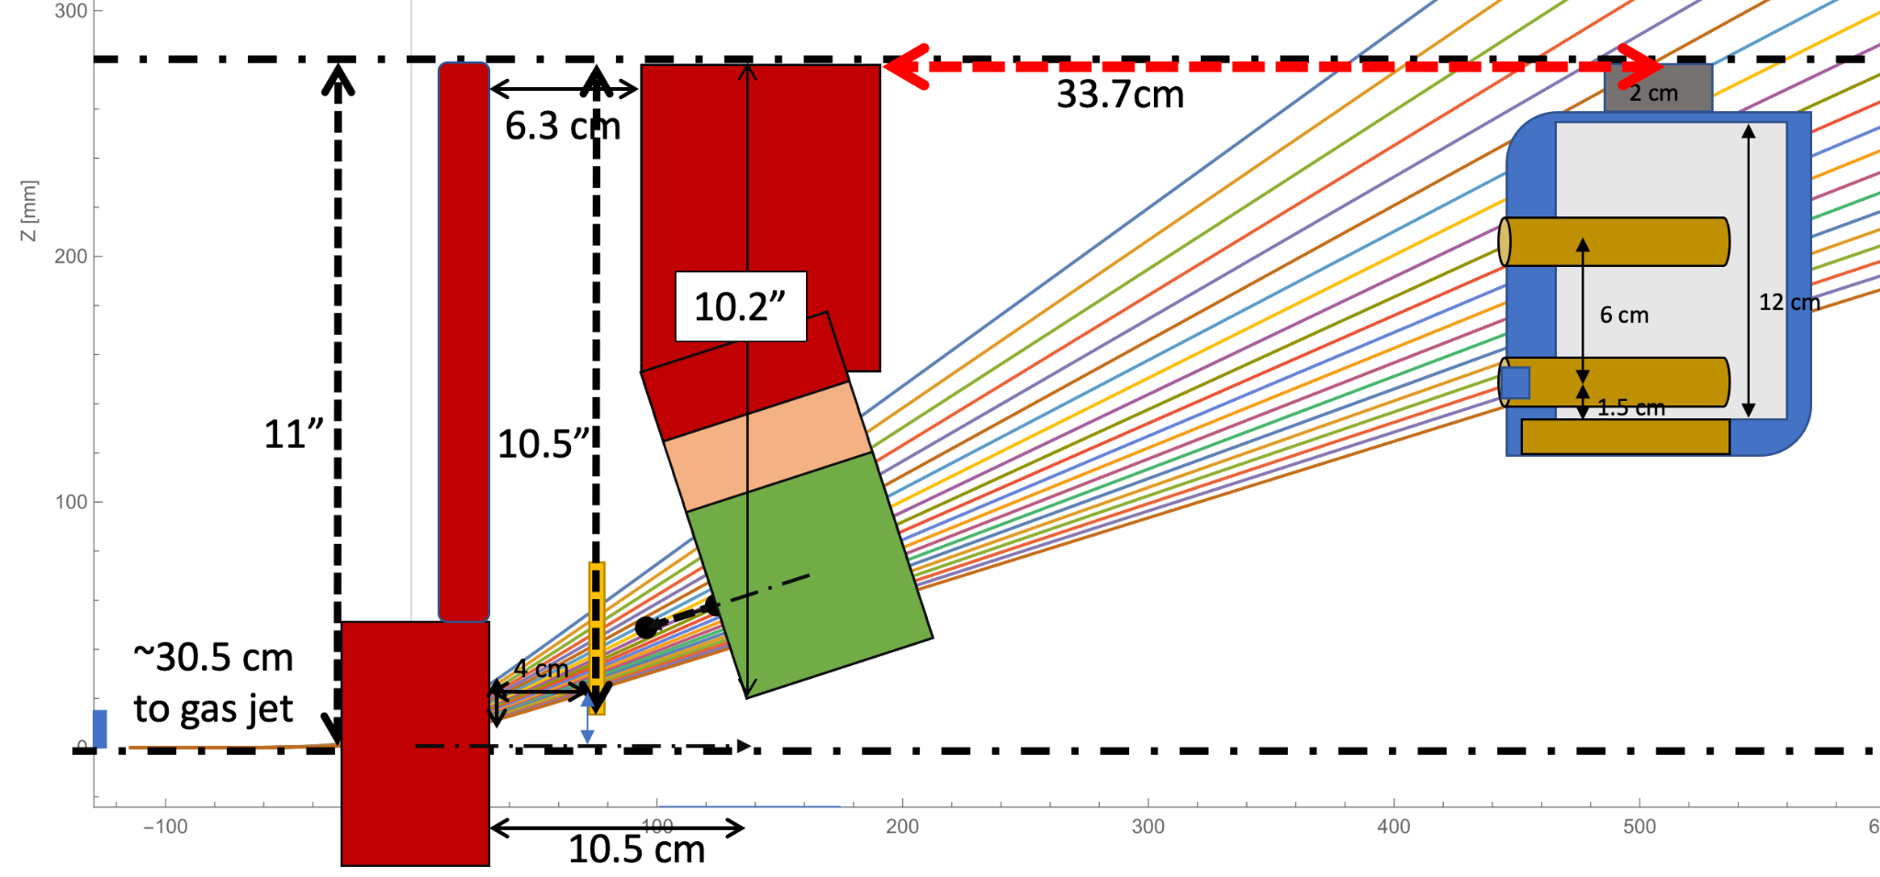
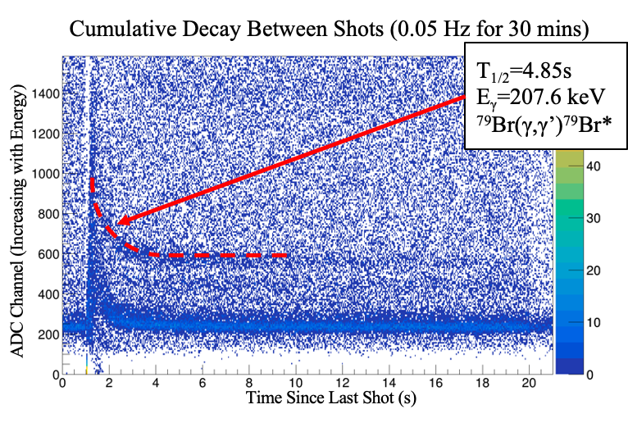
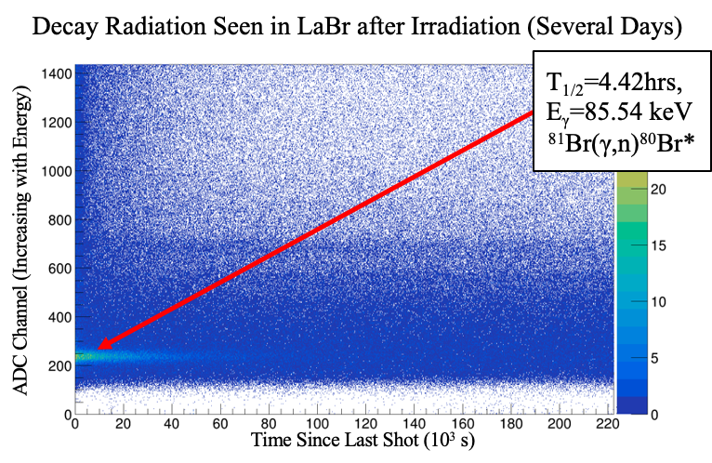
Photoexcitation of Br using the BELLA short-pulse laser facility
(supported by Google)
⁸⁰Br/ ^{79m}Br ratio
Activation Ratio: Brem. Photons Br79m/Br80m
NLD models
LaBr active target
RSF models
⁷⁹Br(γ,γ’)^{79m}Br
⁸¹Br(γ,n)⁸⁰Br
Irradiation Cases | Population Ratios (#/Shot)
Brem. Photons 79/80 | 0.023±0.0024
Electrons 79/80 | 0.033±0.0015
Brem. 79/Electrons 79 | 0.503±0.0515
Brem. 80/Electrons 80 | 0.719±0.0326

Slide 18
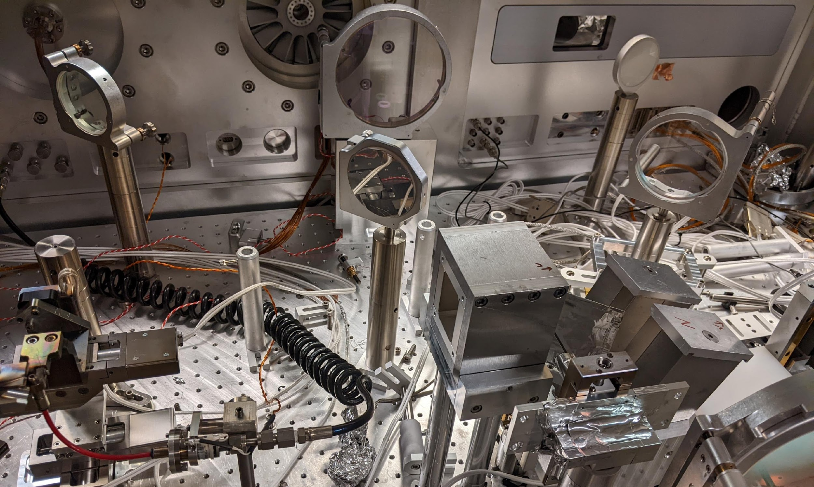
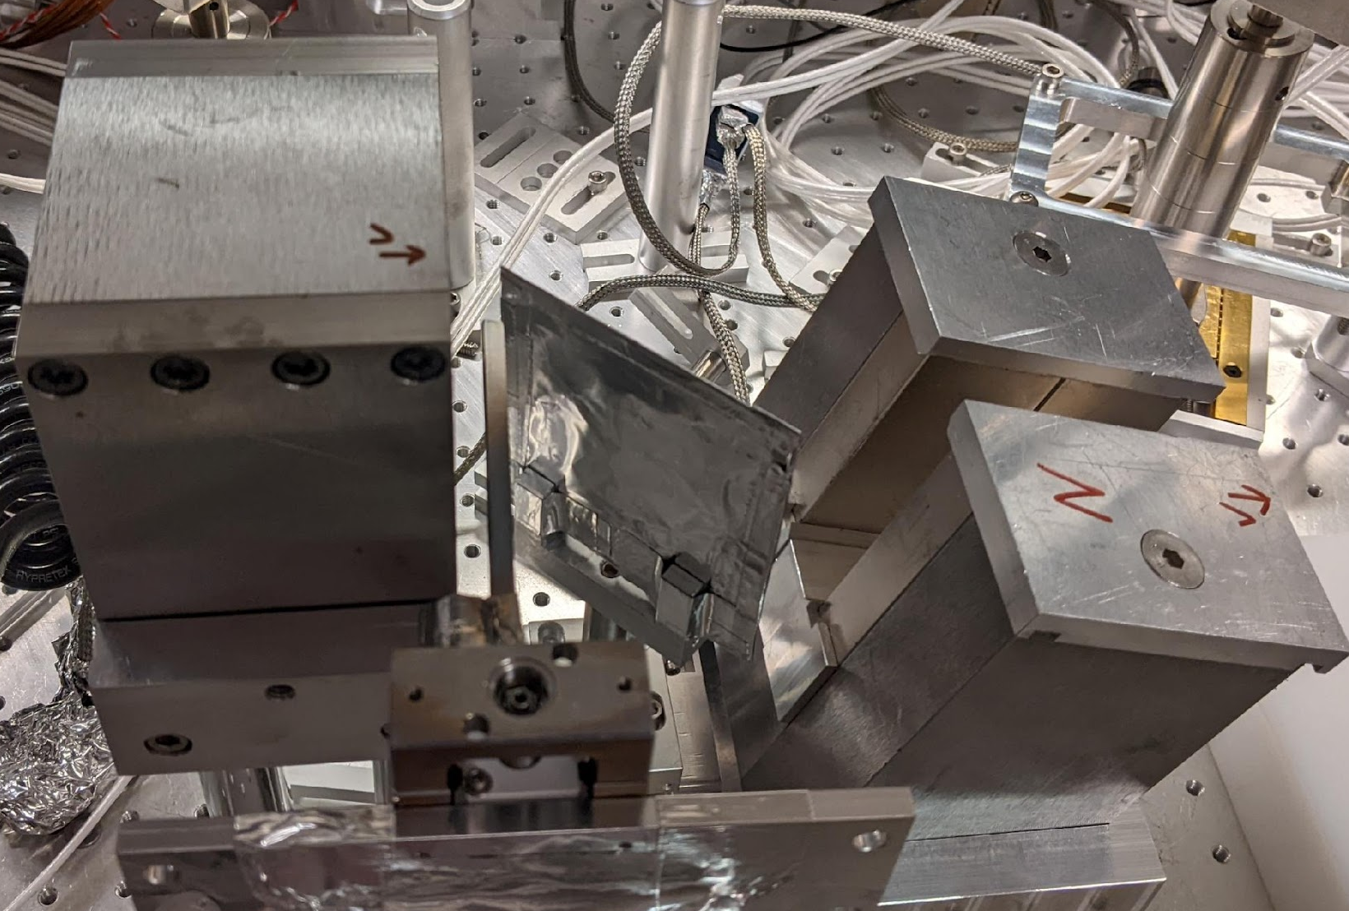
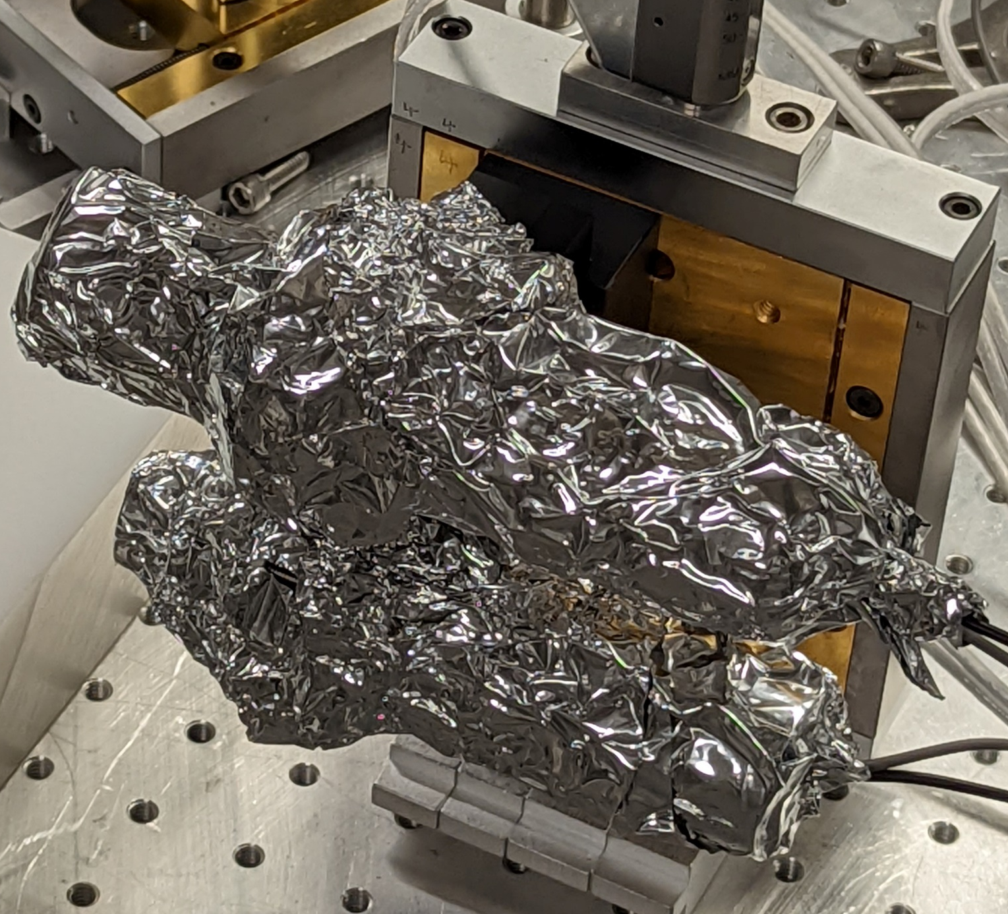
Experimental setup at BELLA HTT
Imaging Camera
LANEX
Dispersion Magnet
LANEX
Brem. converter
Electrons
Clean-up Magnet
Gas Jet (accelerator)
Brem. converter
Active Targets

Slide 19
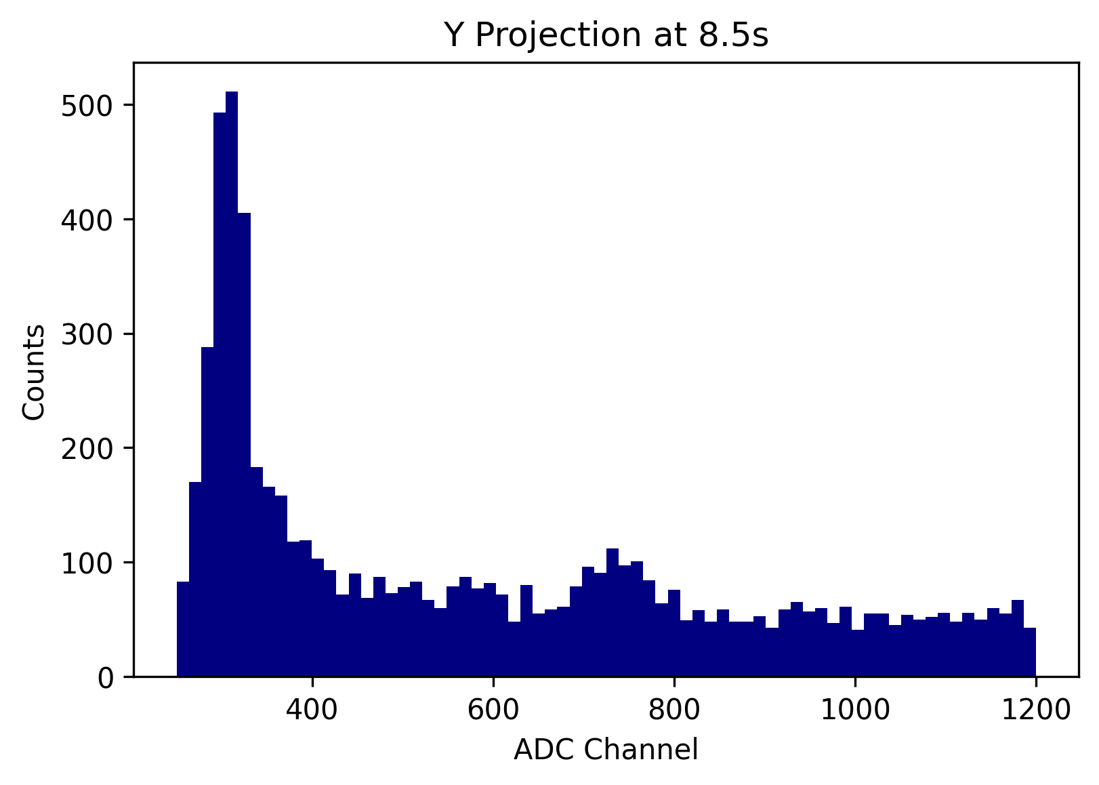
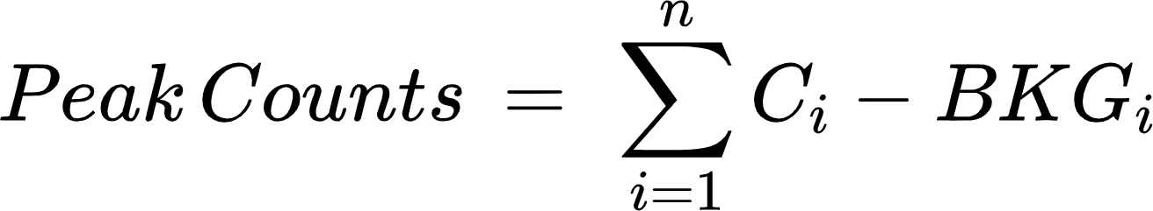
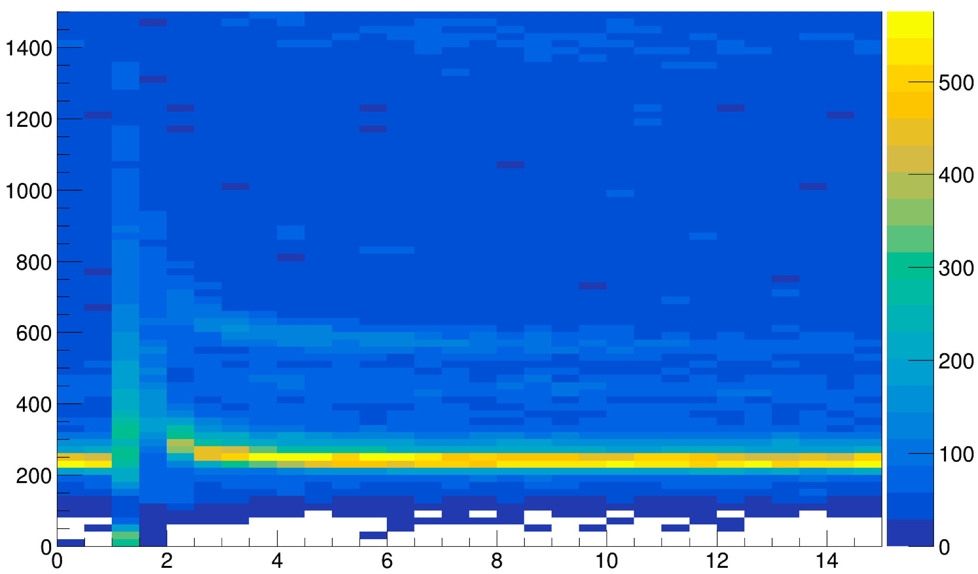
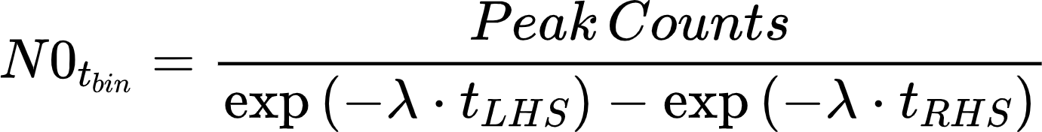
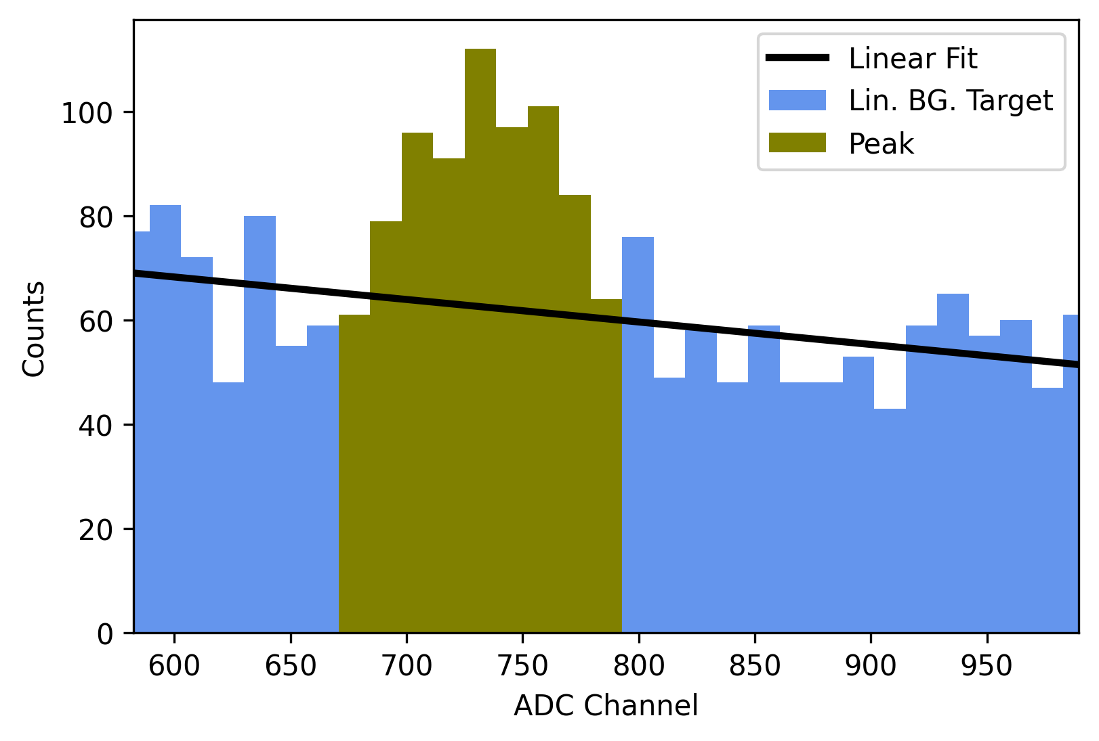
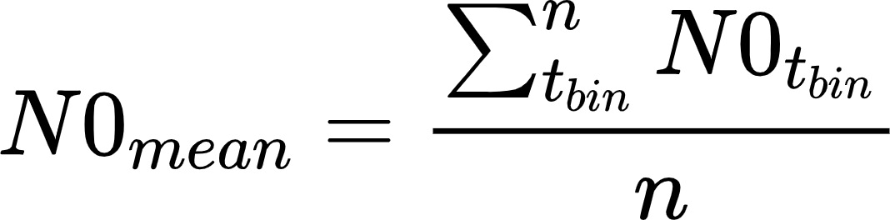
Analysis: Calculating population levels
2D Histogram, Time Integrated
ADC Channel
Counts
Time (s)
t_{LHS}
t_{RHS}
t_{bin}
Notes:
In the case of the Br80 isomer peak, decay correction was necessary to account for the production/decay during extended runs, due to the long half-life of the isomer state (4.42 hours)

Slide 20
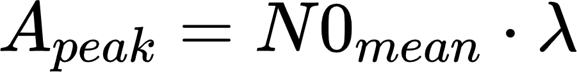
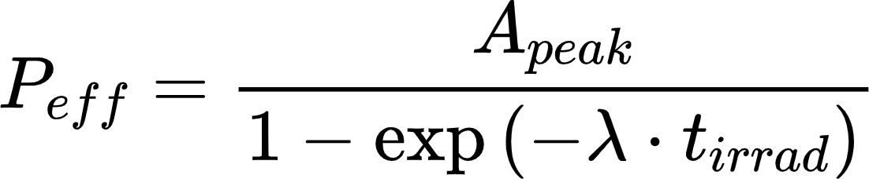
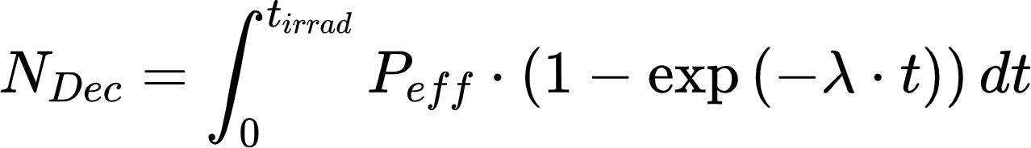
Analysis: Considerations for long-lived states
Br80 isomer requires production/decay correction due to long lifetime (4.42 hrs)

Slide 21
Results: Population ratios can provide insight into unclear physics
Population ratios provide insight into which models are more physically representative
Ratio “heat maps” show which combinations of nuclear level densities and 𝜸-strength functions approach observed results
Activation Ratio: Brem. Photons Br79m/Br80m
Irradiation Cases | Population Ratios (#/Shot)
Brem. Photons 79/80 | 0.023±0.0024
Electrons 79/80 | 0.033±0.0015
Brem. 79/Electrons 79 | 0.503±0.0515
Brem. 80/Electrons 80 | 0.719±0.0326
Notes:
Briefly discuss the different LD and SF models, especially take note of the LDs 4,5,6 and SFs 1,3
Additionally talk about angular momentum tables
-

Slide 22
The publication rate of QC Data is on the rise
This probably a radical underestimation the actual number of articles since QC properties are often not indexed properly in NSR!
Side note: We need Natural Language Processing to compile all of the available data!

Slide 23
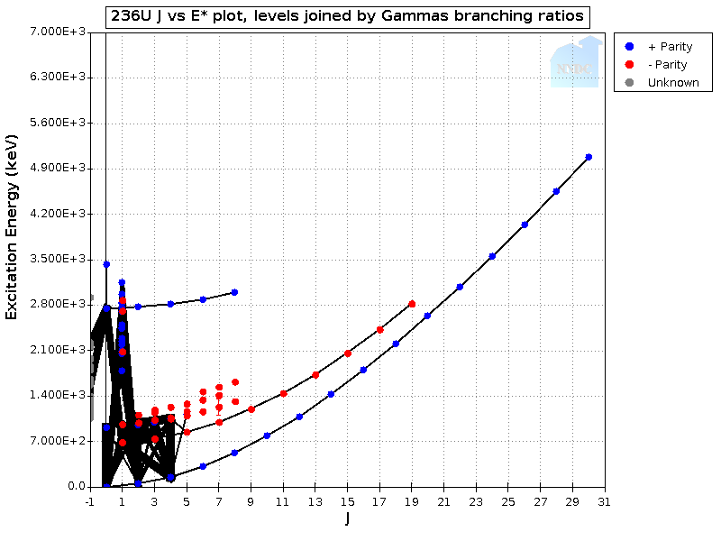
There are a wealth of source of experimental data on QC properties
Energy-Indexing approaches:
  Direct Reaction + γ-ray coincidence: Uses outgoing particle energy to iteratively obtain a Level Density and Photon strength from a “1st Generation γ-ray spectrum” (Γ_{i}(E_{γ})) for an E slice i :
  Γ_{i}(E_{γ}) = F(E_{γ})ρ(E_{x} - E_{γ})
Direct Reaction
²³⁶U J vs. E* plot (NNDC)

Slide 24
There are a wealth of source of experimental data on QC properties
Energy-Indexing approaches:
  Direct Reaction + γ-ray coincidence: Uses outgoing particle energy to iteratively obtain a Level Density and Photon strength from a “1st Generation γ-ray spectrum” (Γ_{i}(E_{γ})) for an E slice i :
  Γ_{i}(E_{γ}) = F(E_{γ})ρ(E_{x} - E_{γ})
  High Q-value β-decay using a segmented Total Absorption Spectrometer (TAS). Already used with CARIBU. FRIB will provide data on nuclei far from stability.
“Pandemonium” β-decay
feeding
Log(f_{t})
²³⁶U J vs. E* plot (NNDC)

Slide 25
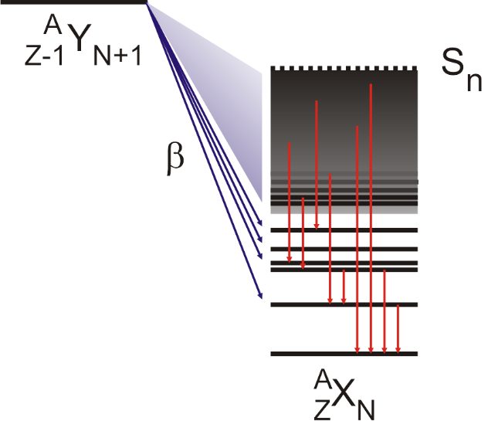
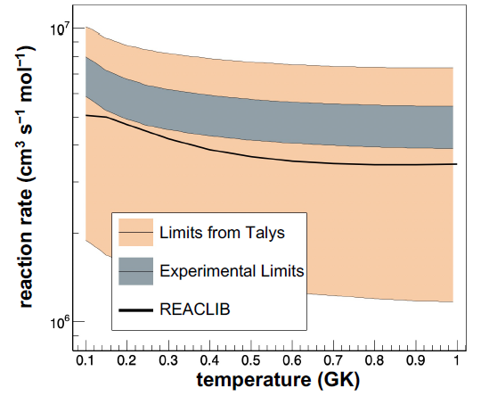
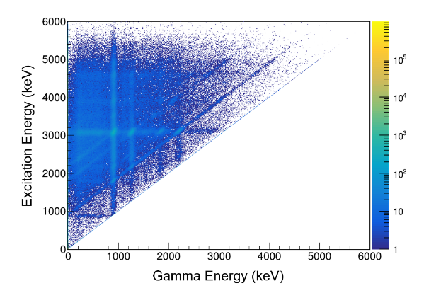
Using beta decay and total absorption spectroscopy to infer critical nuclear data (Thanks to S. Liddick & A. Spyrou!)
Measure beta decay of nucleus using TAS.
Extract critical QC structure, astrophysics, and stockpile stewardship
  I_{β}
  avg. e⁻/γ energy
  n/γ competition
  nuclear level density, γ-ray strength,
  Tests F(E_{γ}) independence of J^{π} (Brink-Axel Hypothesis)
  neutron capture cross section
SuN
1⁺
243
93%
3⁻
101
52%
6⁻
0
100%
⁷⁰Cu
See the talk by Sean Liddick!
¹³⁹Ba(n,γ)¹⁴⁰Ba submitted
A.C.Larsen, A.Spyrou, S.N.Liddick, M.Guttormsen, Prog.Part.Nucl.Phys. 107, 69 (2019)
S.N.Liddick, A. Spyrou et. al., PRL, 116, 242502 (2016)
A. Spyrou, S.N.Liddick et al., PRL 117, 142701 (2016)
A.C.Larsen etl al., PRC 97, 054329 (2018)

Slide 26
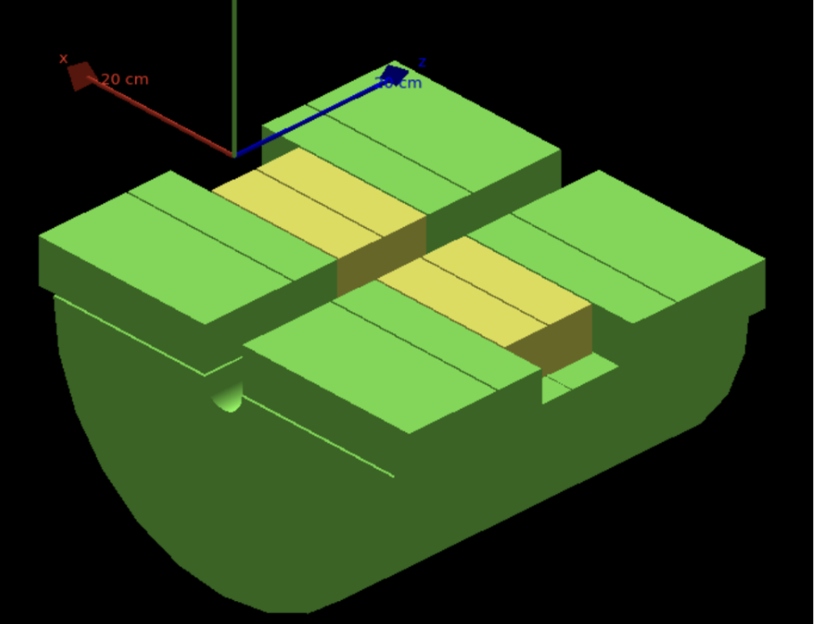
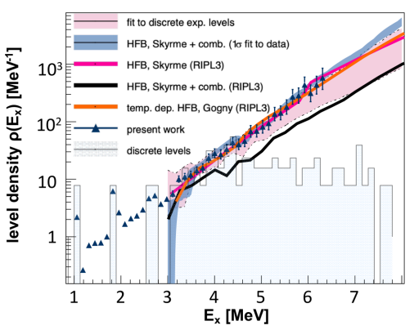
Continual improvement in hardware and software technique to advance the state-of-the-art (Thanks to S. Liddick & A. Spyrou!)
SuN++ currently under development ( new 12 NaI and 8 CeBr₃).
Smaller segments help to identify the direction of the electron and reduce electron background
Better energy resolution with CeBr₃ segments to identify low-lying discrete levels
CeBr₃
NaI(Tl)
Application of shape method with β−Oslo.
Provides a model independent nuclear level density for populated states in nuclei far from stability.
Constrained NLD leads to a reduction in predicted neutron capture cross section uncertainty of an order of magnitude
⁸⁸Kr
D.Mucher et al., PRC 107, L011602 (2023)

Slide 27
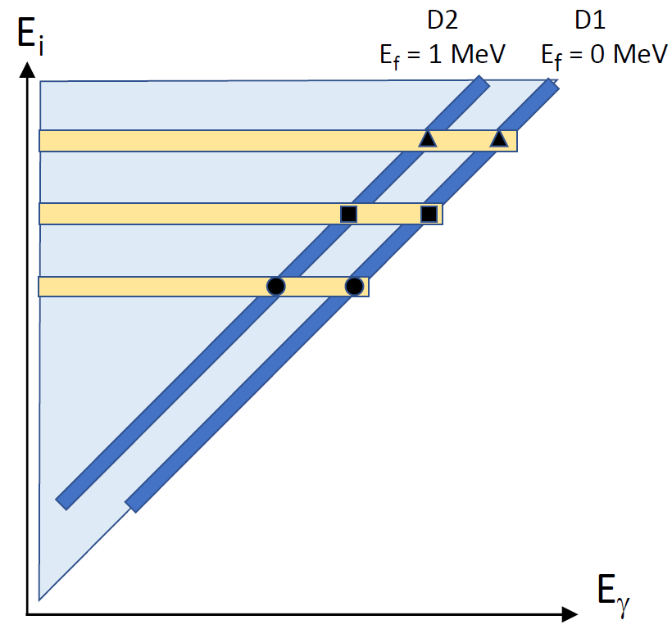
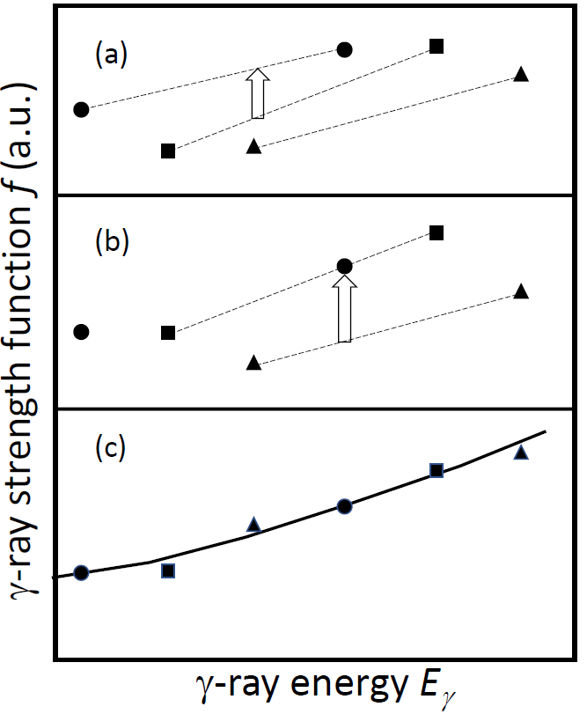



Combining the Shape and β-Oslo Methods at FRIB offers a chance to address improve reaction rate calculations for unstable nuclei
Primaries from intercepts of diagonals with E_{x}.
E_{i}
Pair of data points internally normalized and proportional to PSF.
0⁺ 1MeV
0⁺ g.s.
Thanks to Mathis Wiedeking iThemba Labs!
Independent normalization for γ-ray strength functions: The shape method, M. Wiedeking, M. Guttormsen, A. C. Larsen, F. Zeiser, A. Görgen, S. N. Liddick, D. Mücher, S. Siem, and A. Spyrou Phys. Rev. C 104, 014311 – Published 12 July 2021

Slide 28
Combining the Shape and β-Oslo Methods at FRIB offers a chance to address improve reaction rate calculations for unstable nuclei
Primaries from intercepts of diagonals with E_{x}.
E_{i}
Pair of data points internally normalized and proportional to PSF.
0⁺ 1MeV
0⁺ g.s.
Thanks to Mathis Wiedeking iThemba Labs!
Independent normalization for γ-ray strength functions: The shape method, M. Wiedeking, M. Guttormsen, A. C. Larsen, F. Zeiser, A. Görgen, S. N. Liddick, D. Mücher, S. Siem, and A. Spyrou Phys. Rev. C 104, 014311 – Published 12 July 2021

Slide 29
Combining the Shape and β-Oslo Methods at FRIB offers a chance to address improve reaction rate calculations for unstable nuclei
Primaries from intercepts of diagonals with E_{x}.
E_{i}
Pair of data points internally normalized and proportional to PSF.
0⁺ 1MeV
0⁺ g.s.
Thanks to Mathis Wiedeking iThemba Labs!
Independent normalization for γ-ray strength functions: The shape method, M. Wiedeking, M. Guttormsen, A. C. Larsen, F. Zeiser, A. Görgen, S. N. Liddick, D. Mücher, S. Siem, and A. Spyrou Phys. Rev. C 104, 014311 – Published 12 July 2021

Slide 30
Combining the Shape and β-Oslo Methods at FRIB offers a chance to address improve reaction rate calculations for unstable nuclei
Primaries from intercepts of diagonals with E_{x}.
E_{i}
0⁺ 1MeV
0⁺ g.s.
Thanks to Mathis Wiedeking iThemba Labs!
Independent normalization for γ-ray strength functions: The shape method, M. Wiedeking, M. Guttormsen, A. C. Larsen, F. Zeiser, A. Görgen, S. N. Liddick, D. Mücher, S. Siem, and A. Spyrou Phys. Rev. C 104, 014311 – Published 12 July 2021

Slide 31
There are also a wealth of source of experimental data on QC properties
Energy-Indexing approaches (Oslo, β-Oslo):
  Direct Reaction + γ-ray coincidence: Uses outgoing particle energy to iteratively obtain a Level Density and Photon strength from a “1st Generation γ-ray spectrum” (Γ_{i}(E_{γ})) for an E slice i :
  Γ_{i}(E_{γ}) = F(E_{γ})ρ(E_{x} - E_{γ})
  High Q-value β-decay using a segmented Total Absorption Spectrometer (TAS). Already used with CARIBU. FRIB will provide data on nuclei far from stability.
Photo-absorption (HIγS, Brehmsstrahlung)
  Measures F(E_{γ}) from ground to 1⁻ states.
²³⁶U J vs. E* plot (NNDC)

Slide 32
There are a wealth of source of experimental data on QC properties
S_{n} + E_{n}
Energy-Indexing approaches (Oslo, β-Oslo):
  Direct Reaction + γ-ray coincidence: Uses outgoing particle energy to iteratively obtain a Level Density and Photon strength from a “1st Generation γ-ray spectrum” (Γ_{i}(E_{γ})) for an E slice i :
  Γ_{i}(E_{γ}) = F(E_{γ})ρ(E_{x} - E_{γ})
  High Q-value β-decay using a segmented Total Absorption Spectrometer (TAS). Already used with CARIBU. FRIB will provide data on nuclei far from stability.
Photo-absorption (HIγS, Brehmsstrahlung)
  Measures F(E_{γ}) from ground to 1⁻ states.
High-resolution (n,γ) (DANCE etc.)
  Forward fit through response function to obtain F(E_{γ}) and ρ(E_{x}) simultaneously
S_{n}
²³⁶U J vs. E* plot (NNDC)

Slide 33
There are a wealth of source of experimental data on QC properties
E_{x}
Energy-Indexing approaches (Oslo, β-Oslo):
  Direct Reaction + γ-ray coincidence: Uses outgoing particle energy to iteratively obtain a Level Density and Photon strength from a “1st Generation γ-ray spectrum” (Γ_{i}(E_{γ})) for an E slice i :
  Γ_{i}(E_{γ}) = F(E_{γ})ρ(E_{x} - E_{γ})
  High Q-value β-decay using a segmented Total Absorption Spectrometer (TAS). Already used with CARIBU. FRIB will provide data on nuclei far from stability.
Photo-absorption (HIγS, Brehmsstrahlung)
  Measures F(E_{γ}) from ground to 1⁻ states.
High-resolution (n,γ) (DANCE etc.)
  Forward fit through response function to obtain F(E_{γ}) and ρ(E_{x}) simultaneously
(n,n’γ) & Neutron evaporation spectra
  Measures ρ(E_{x}) by determining kT_{nuclear}
S_{n}
See the talk by Alexander Voinov!
²³⁶U J vs. E* plot (NNDC)

Slide 34
Summary
Nuclear Level Densities and Gamma Strength functions are key inputs for reaction modeling needed for applied and basic nuclear science.
There is a wealth of new data being generated using both stable and radioactive ion beam facilities
A new evaluation effort is needed the couples structure and reaction data to provide nominal values and uncertainties for NLD and RSF.
Thanks for your attention!

