Slide 1
Continuing Investments in Nuclear Data
Dr. Timothy J. Hallman
Associate Director, Office of Science for Nuclear Physics
Office of Science (SC) U.S. Department of Energy (DOE)

Slide 2
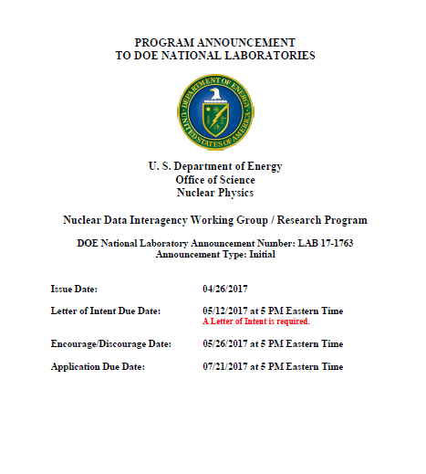
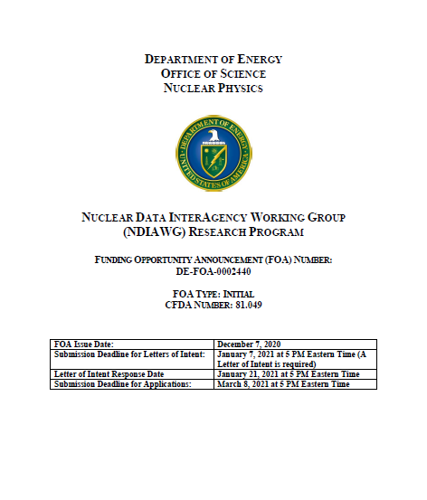
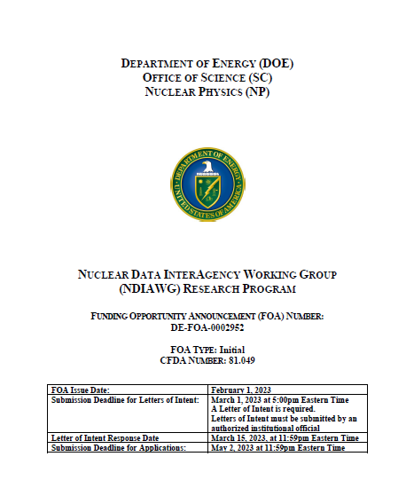
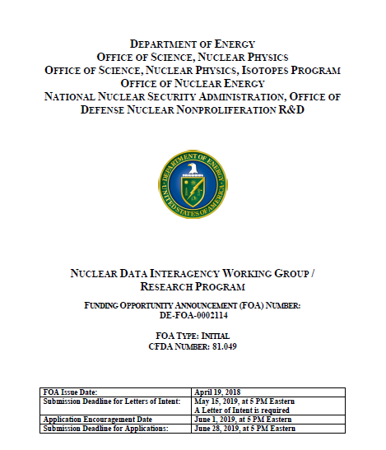
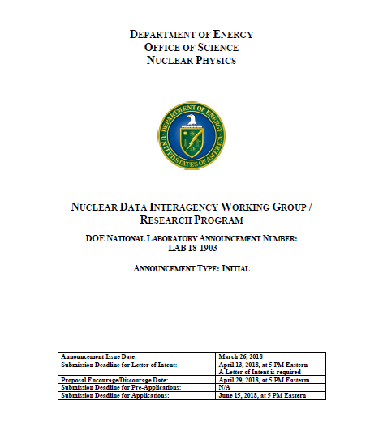
Funding Opportunities for Nuclear Data Continue
FY17
FY18
FY23
FY19
FY21

Slide 3
NDIAWG Funded Efforts Since 2016
Total Investment $49,773,881.00
23 individual projects
8 different lead organizations
6 DOE sites (ANL, BNL, LANL, LBNL, LLNL, ORNL)
2 universities (Duke, US Naval Academy)
14 collaborating orgs
6 DOE sites (BNL, LANL, LBNL, LLNL, PNNL, NNSS)
8 universities (Duke, Notre Dame, Univ. of Dallas, Mississippi State, Kentucky, NC
State, TUNL)

Slide 4
NSAC Nuclear Data Charge
U.S. Department of Energy and the
National Science Foundation
April 13, 2022
Professor Gail Dodge
Chair, DOE/NSF Nuclear Science Advisory Committee College of Sciences
Old Dominion University 4600 Elkhorn Avenue
Norfolk, Virginia 23529
Dear Professor Dodge:
This letter is to request that the Nuclear Science Advisory Committee (NSAC) establish an NSAC Sub-Committee to assess challenges, opportunities, and priorities for effective stewardship of nuclear data.

Slide 5
NSAC Nuclear Data Charge
“Nuclear data” is data derived from observed properties of nuclei, their decays and decay products, and the interactions of both nuclei and their decay products with other nuclei, subatomic particles or in bulk matter. Data from theoretical models created for comparison with experimental nuclear data may also be considered for inclusion under this definition.
Increasingly, access to accurate, reliable nuclear data plays an essential role in the success of Federal missions such as non-proliferation, nuclear forensics, homeland security, national defense, space exploration, clean energy generation, and scientific research. Data access is also key to innovative commercial developments such as new medicines, automated industrial controls, energy exploration, energy security, nuclear reactor design, and isotope production. The mission of the United States Nuclear Data Program (USNDP) …. is to provide current, accurate, authoritative data for workers in pure and applied areas of nuclear science and engineering. This is accomplished primarily through the compilation, evaluation, dissemination, and archiving of extensive nuclear datasets. USNDP also addresses gaps in nuclear data, through targeted experimental studies and the use of theoretical models. A keystone of USNDP stewardship of nuclear data is the activity of the National Nuclear Data Center (NNDC) hosted at Brookhaven National Laboratory.

Slide 6
NSAC Nuclear Data Charge
NSAC is requested to develop a strategic plan with prioritized recommendations to guide federal investment in the U.S. Nuclear Data Program (USNDP). This will consist of two separate steps and corresponding reports that will serve as a basis to inform the strategic plan:
Assess USNDP Status, which would include the following actions:
Assess and document recent achievements in nuclear data and their impact.
Survey current and future federal and non-federal needs for reliable, accurate, secure, accessible nuclear data.
Assess the role, competitiveness, and importance of the USNDP in an international context.
Based on the USNDP Status Report above, provide recommendations for maintaining effective stewardship of nuclear data, which includes the following actions:
Identify challenges for nuclear data stewardship in the future, including identifying and prioritizing the most compelling opportunities to enhance and advance NP stewardship of nuclear data and the impact if those opportunities can be realized.
Describe possible ways the Nuclear Data (ND) community can work to train and retain a diverse, equitable, and inclusive workforce capable of sustaining the U.S. ND enterprise.
Identify access needs for facilities and instrumentation, crosscutting opportunities with other federal programs, and potentially mutually beneficial interactions with other domestic and international stakeholders.

Slide 7
NSAC Nuclear Data Charge
We request that you submit an interim report on the outcome of the first step (USNDP Status Report) by September 15, 2022, with the second and final report submitted by January 30, 2023. We appreciate NSAC’s willingness to take on this important task and look forward to receiving its report.
J. Stephen Binkley Sean Jones
Acting Director Assistant Director
Office of Science Directorate for Mathematical
U.S. Department of Energy and Physical Sciences National Science Foundation
'
Sincerely,
J. Stephen Binkley
Sean L Jones

Slide 8
The dependence of the application areas on the nuclear data thrust areas and initiative can be expressed in a table
}
Existing USNDP Efforts
}
New USNDP Initiatives
}
Enabling
USNDP
initiatives

Slide 9
SC Diversity, Equity, and Inclusion Initiatives
Advancing DEI at the DOE National Labs
Promoting DEI in SC’s business practices
SC’s statement of commitment & PIER
Increasing SC engagement and participation
DOE & interagency coordination
Establishment of the SC SW-DEI Office
9

Slide 10
PIER Plans
Promoting Inclusive and Equitable Research (PIER) Plans
Beginning in FY 2023, all Department of Energy (DOE) Office of Science Funding Opportunity Announcements (FOAs) and DOE National Lab Announcements and other funding solicitations will require applicants to submit a Promoting Inclusive and Equitable Research (PIER) Plan as an appendix to their proposal narrative. PIER Plans should describe the activities and strategies applicants will incorporate to promote diversity, equity, inclusion, and accessibility in their research projects. PIER Plans will be evaluated as part of the merit review process and will be used to inform funding decisions.
FAQ at: https://science.osti.gov/grants/Applicant-and-Awardee-Resources/PIER-Plans/Q-and-As

Slide 11
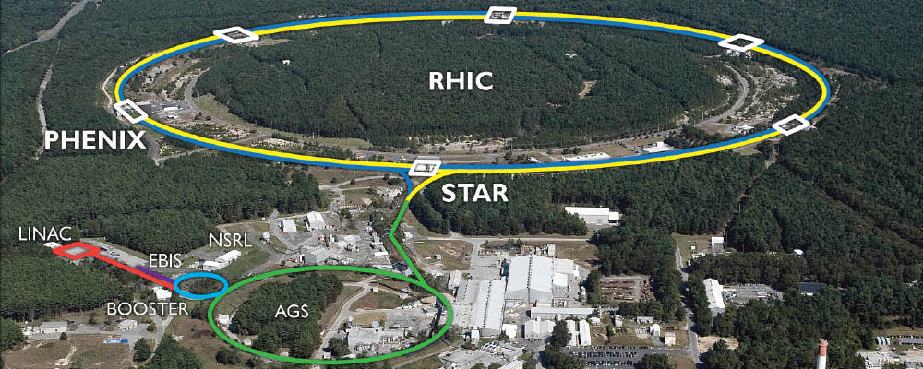
One Non-Conventional Source of Nuclear Data?
High Energy Heavy Ion Fragmentation Data Needed by NASA to benchmark codes

Slide 12
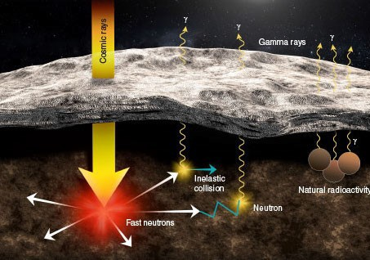
Potential Benefits of Nuclear Data: The Sky is Not Even the Limit
Most planetary nuclear spectroscopy experiments rely on galactic cosmic rays to stimulate neutron and gamma-ray emission from planetary surfaces, as shown in Fig. 4.6. In this scenario, high-energy primary cosmic-ray particles (>30 MeV), primarily protons, initiate nuclear spallation reactions to depths of a few meters in the surface. Spallation neutrons can escape the surface and the energy-dependent shape of the neutron spectrum provides constraints on the bulk composition and hydrogen content of the
surface. Moreover, the neutrons interact with subsurface materials and stimulate gamma-ray emission via inelastic scattering and neutron radiative capture reactions. The resulting gamma rays provide
element-diagnostic measurements of the surface composition to depths of tens of centimeters. NASA’s upcoming Dragonfly mission to Titan will use a D-T neutron generator to stimulate gamma-ray emission from the surface. However, the underlying nuclear reactions of interest are neutron inelastic scattering and radiative capture.
Figure 4.6: Schematic of cosmic ray interactions with planetary surfaces. Rendering by V. Chen [Cas19].
https://science.osti.gov/np/nsac/Reports

