Slide 1
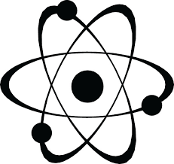
Nuclear Data Working Group (NDWG) WANDA2023 Catherine Romano Chair, NDWG Todd Bredeweg Vice Chair, NDWG Stephanie Lyons Director of Communications, NDWG
February 27-March 2, 2023
Crystal City, VA

Slide 2
The Nuclear Data Working group (NDWG)
MISSION STATEMENT
The goal of the Nuclear Data Working Group (NDWG) is to facilitate communication, collaboration, coordination, and prioritization of nuclear data efforts across multiple program offices, the national laboratories, universities, and industry.
Established 2015
NDWG website: https://www.nndc.bnl.gov/ndwg/

Slide 3
NDWG Roster as of January 2022
49 Members
17 programs
11 national laboratories
PARTNERS | NDWG Member | Organization
DOE/SC/Nuclear Physics | Lee Bernstein Catherine Romano | LBNL Aerospace Corp
NNSA/DNN R&D/PD/NA-22 | Fredrik Tovesson | ANL
NNSA/DNN R&D/Forensics | Todd Bredeweg Jason Burke | LANL LLNL
NNSA/DNN R&D/SNDD | Ron Soltz David Gerts | LLNL LANL
NNSA/NCSP/NA-511 | Mike Zerkle Marco Pigni | NNL ORNL
NNSA/NR/NA-30 | Mike Zerkle | NNL
NNSA/Defense Prog./NA-113 | Jo Ressler Shea Mosby | LLNL LANL
NNSA/Defense Prog./NA-114 | Nathan Gibson Robert Casperson | LANL LLNL
DOE/Nuclear Energy | Matthew Jesse Javier Ortensi | ORNL INL
NRC | Will Wieselquist Jesse Brown | ORNL
NNSA/Office of Nuclear Forensics/NA-83 | Corey Keith Chris Krenn | LANL LLNL
DOE/SC/Isotope Office | Etienne Vermeulen | LANL
NNSA/Emergency Response/NA-82 | John Koglin Pete Jaegers | LLNL LANL
NIST | Brian Zimmerman | NIST
US Nuclear Data Program | Dave Brown | BNL
NNSA/Nuclear Safeguards and Security/NA-24 | Young Ham | Tech Advisor
Missile Defense Agency/Rad Hardness | Courtney Matzkind | MDA
LAB | NDWG Member
ANL | Filip Kondev
ANL | Guy Savard
BNL | Alejandro Sonzogni
INL | Sebastian Schunert
JLAB | Mike Dion
LANL | Mark Chadwick
LANL | Robert Little
LBNL | Brian Quiter
LBNL | Bethany Goldblum
LLNL | Teresa Bailey
LLNL | Tim Rose
ORNL | TBD
PNNL | Stephanie Lyons
PNNL | Bruce Pierson
SNL | Pat Griffin
SNL | Phil Dreike
SRNL | Kalee Fenker
SRNL | Chris McGrath
AT LARGE MEMBERS | Bruce Pierson
Jim Koster | LANL
Patrick Talou | LANL
John Engle | Univ. WISC
Teresa Bailey | LLNL
Morgan White | LANL

Slide 4
Nuclear Data Interagency Working Group (NDIAWG)
Led by:
Tim Hallman, Associate Director for Nuclear Physics of the Office of Science
Keith Jankowski, Program Manager for Nuclear Data
Funds nuclear data efforts through an annual collaborative NDIWG Funding Opportunity Announcement
Meets quarterly for information exchange, identification of mutual nuclear data needs and coordination of nuclear data efforts.
Most recent invite list included 60 federal program managers across a variety of federal agencies covering basic science, energy, national security, defense, space applications, and isotope production.
Most recent outreach is to fusion applications.
NDIAWG FOA just released
Planning FOA for new evaluators

Slide 5
NDWG/NDIAWG Timeline
Nuclear Data Working Group Formed
(11/15)
NDIWG FOA Released
NP, NE, IP, DNN R&D, DNDO (4/17)
NDIWG FOA Released
NP, NE, IP DNN R&D (3/19)
RNDWA
(10/22)
Workshop on Nuclear Data for Reactor Antineutrino Measurements (WoNDRAM) (06/21)
USNDP Review (7/14)
Nuclear Data Interagency Working Group (PMs) (6,/16)
NDIWG FOA Released
NP, ASCR, NE, DNN R&D, DP (3/18)
NDIWG FOA Released
NP, IP DNN R&D (12/20)
Uncertainty Quantification for Nuclear Data Workshop
(10/22)
NDIWG FOA Released
NP, IP DNN R&D (3/23)
2014
2015
2016
2017
2018
2019
2020
2021
2022
2023
Nuclear Data Needs and Capabilities for Applications (NDNCA) Workshop (05/15)
WANDA2020 (03/20)
WANDA2022 (02/22)
NSAC-ND report on nuclear data (03/22)
DNN R&D Nuclear Data Roadmapping Workshop (NDREW) (01/18)
Nuclear Data Exchange Meeting (04/16)
WANDA2021 (01/21)
WANDA2023 (03/23)
WANDA2019 (01/19)
Notes:
This is in your handout

Slide 6
NDWG 2022 Accomplishments
WANDA2022
Nuclear Data for High Energy Ion Interactions and Secondary Particle Production
Neutrons as Secondary Particles and Their Interactions with Matter
Stopping powers, energy deposition and dose
Reactions on Unstable Nuclei
Photon Reactions and Transport
Nuclear Data adjustments and Impact on Applications
Business meeting, August 2022 at LLNL
Stephanie Lyons elected Director of Communications
Newsletter in progress
UQ workshop, Chaired by Denise Neudecker, October 2022
Restricted Nuclear Data Workshop for Applications, October 2022
Linkedin page, Mike Dion
Jefferson Lab is a new participant

Slide 7
Organizations Represented at NDWG Workshops
Universities | National Laboratories | Federal Agencies
Air Force Institute of Technology | Argonne National Laboratory | DOE
Boston University | Brookhaven National Laboratory | Office of Science, Office of Nuclear Physics
Central Michigan University | Idaho National Laboratory | Office of Science, Fusion Energy Sciences
 | Jefferson Laboratory
Colorado School of Mines | Lawrence Berkeley National Laboratory | Office of Science, Office of High Energy Physics
George Washington University | Lawrence Livermore National Laboratory | Office of Science, Adv. Scientific Computing Research
Illinois Institute of Technology | Los Alamos National Laboratory | Office of Science, Isotope Program
Johns Hopkins University | National Institute of Standards and Technology | Office of Nuclear Energy
Michigan State University | National Superconducting Cyclotron Laboratory | ARPA-E
North Carolina State University | Naval Nuclear Laboratory | NNSA
Ohio University | Oak Ridge National Laboratory | Defense Programs, NA-11
Oregon State University | Pacific Northwest National Laboratory | Defense Nuclear Nonproliferation, NA-20
Rensselaer Polytechnic Institute | Sandia National Laboratories | Naval Reactors, NA-30
Texas A&M University | Savannah River National Laboratory | Infrastructure & Environment, NA-50
Triangle Universities Nuclear Laboratory | SLAC National Accelerator Laboratory, Stanford University | Defense Nuclear Security, NA-80
United States Naval Academy | JPL - Jet Propulsion Laboratory | DOD
Univerisity of Tennessee | Johns Hopkins Applied Physics Laboratory | Defense Threat Reduction Agency
Univeristy of Wisconsin | Thomas Jefferson National Accelerator Facility | MDA - Missle Defense Agency
University of California, Berkeley | Industry | AFTAC - Air Force Technical Applications Center
University of Massachusetts | ARA | Other
University of Michigan | Schlumberger | NRC - Nuclear Regulatory Commission
University of Notre Dame | Studsvik, Scandpower | NASA - National Aeronautics and Space Administration
University of Tennessee, Knoxville | Westinghouse | NIH - National Institute of Health, National Cancer Inst.
University of Washington | X-energy | DHS - Countering Weapons of Mass Destruction
University of California, Davis | The Aerospace Corporation
Missouri State University | Mayo Clinic
Carnegie Mellon University | KBR Wyle/ SSAI
Univeristy of Nevada, Las Vegas | International Agencies
Vanderbilt University | European Commission, Joint Research Centre
East Carolina University | International Atomic Energy Agency
Kansas State University | Japan Atomic Energy Agency
Western Norway Univ. of Applied Sciences | National Institute for Nuclear Physics (INFN)
North Carolina Central University | UK Ministry of Defence
Duke University | European Space Agency
Technical University of Darmstadt | CERN
Lancaster University | Institute of Astronomy and Space Physics (IAFE)
Massachusetts Institute of Technology

Slide 8
Wanda Topics that have Been Funded
 | NDNCA (2015) Cross-cutting recommendations |  |  | WANDA2019 Topics |  |  | WANDA2022 Topics
 | Dosimetry Standards |  |  | Nuclear Data for Isotope Production | x |  | Reactions on Unstable Nuclei
 | Fission | x |  | Safeguards | x |  | High Energy Ion Interactions and Secondary Particles
 | Decay Data and g-Branching Ratios | x |  | Materials Damage |  |  | Neutrons as Secondary Particles and Interactions | x
 | Neutron Transport Covariance Reduction |  |  | Nuclear Data for Nuclear Energy | x |  | Photon Reactions and Transport
 | Expanded Integral Validation |  |  | (n,x) Reactions | x |  | Stopping Powers, Energy Depostion and Dose
 | Antineutrinos from Reactors | x |  | Atomic Data, NRF Data |  |  | Nuclear Data Adjustments and Impact on Applications
 | NDEM (2016) Cross-cutting recommendataions |  |  | WANDA2020 Topics
 | Improving the Pipeline infrastructure | x |  | Covariance/Uncertainty/Sensitivity/Validation
 | Improved Covariance Data |  |  | Nuclear Data for Isotope Production and Targetry Needs | x
 | Inelastic Scattering on actinides | x |  | Machine Learning/AI
 | Capture gamma spectra | x |  | Detector Models, Atomic Data and Stopping Powers
 | Improved Fission yields | x |  | Scattering, Transport and Shielding | x
 | Target Production to Support Nuclear Data Experiments | x |  | Neutron induced gammas and gamma decay | x
 | NDREW (2018) Topics |  |  | WANDA2021 Topics
 | Uncertainty, Sensitivity, and Covariance |  |  | Advanced Computing for Nuclear Data
 | Neutron Capture and Associated Spectra | x |  | Predictive Codes for Isotope Production
 | Fission I, Independent and Cumulative Yields | x |  | Expanded Benchmarks and Validation for Nuclear Data
 | Gamma-Induced Reactions | x |  | Nuclear Data for Space Applications
 | Inelastic Neutron Scattering and Associated Spectra | x |  | Nuclear Data for Advanced Reactors and Security
 | Fission II, Prompt Gammas and Neutrons | x |  | The Human Pipeline for Nuclear Data
 | (α,n) Reactions | x
 | Targets, Facilities and Detector Systems | x |  | WoNDRAM Topics
 | Fission III, Decay Data | x |  | Reactor Antineutrino Source Term | x
 | Development of Benchmark Exercises |  |  | Antinneutrino Spectrum Calculations | x
 | Data Processing & Transport Code Needs |  |  | Detector Response
 | Actinide Cross Sections | x

Slide 9
$50 Million NDIAWG FOA Funded Projects Since 2018
FY start | Title | Lead | PI
FY18 | Novel Approach for Improving Antineutrino Spectra Predictions for Nonproliferation Applications | ANL | Kondev, Filip
FY18 | Improving the Nuclear Data on Fission Product Decays at CARIBU | ANL | Savard, Guy
FY19 | Independent Fission Product Yields from 0.5 to 20 MeV | LANL | Winkelbauer, Jack
FY19 | Energy Dependent Fission Product Yields | LLNL | Tonchev, Anton
FY19 | Measurements of Independent Fission Product Yields | LANL | Duke, Dana
FY19 | Beta-strength function, reactor decay heat, and anti-neutrino properties from total absorption spectroscopy of fission fragments | ORNL | Rykaczewski, Krzysztof
FY19 | Integral Measurements of Independent and Cumulative Fission Product Yields Supporting Nuclear Forensics and Other Applications | LANL | Bredeweg, Todd
FY19 | Evaluation of Energy Dependent Fission Product Yields | LANL | Kawano, Toshihiko
FY19 | Improving the double-differential 238U(n,n’g) cross section using neutron-gamma coincidences | LBNL | Bernstein, Lee
FY20 | Scoping Study of the Impact of (alpha,n) Reactions and Yields of Nonproliferation Applications | ORNL | Romano, Catherine
FY20 | Assessment of Nuclear Data Needs for Neutron Active Interrogation | ORNL | McConchie, Seth
FY20 | Fission product yield measurements using 252Cf spontaneous fission and neutron-induced fission on actinide targets at CARIBU | ANL | Savard, Guy
FY20 | Modernization and Optimization of the Evaluated Nuclear Structure Data File | BNL | McCutchan, Elizabeth
FY20 | 238U(p,xn) and 235U(d,xn) 235-237Np Nuclear Reaction Cross Sections Relevant to the Production of 236gNp | LBNL | Bernstein, Lee
FY21 | Neutron Scattering Cross Sections: (n,n'), (n,n'g), and (n,g) Measurements | USNA | Vanhoy, Jeff
FY19 | State-of-the-art Gamma-ray Spectroscopy to Enhance the ENSDF | BNL | McCutchan, Elizabeth
FY22 | Gamma Rays Induced by Neutrons | BNL | Brown, Dave
FY22 | White-source neutron-gamma coincidence measurements of gamma production cross sections at LANSCE | LANL | Kelly, Keegan
FY22 | Evaluation of Gamma-ray Production | LANL | Kawano, Toshihiko
FY22 | ß-energy spectral shapes in fission products affecting reactor decay heat and anti-neutrino flux | ORNL | Charlie Rasco
FY22 | Two and Three-body Photodisintegration of the Triton at Energies Below 30 MeV | Duke Univ | Calvin Howell
FY22 | Designing Nuclear-data Measurements that Resolve Discrepancies in Existing Data | LANL | Denise Neudecker
FY22 | Modern Structure-based Nuclear Data Evaluations for Basic Science, Nuclear Safety & Security | LANL | Mark Paris

Slide 10
The NDWG Has Facilitated Communications through Workshops Across Communities and Programs
Many nuclear data users do not realize the uncertainties can be quite large.
Many nuclear data “needs” documents are written, but programs often do not know where to begin to meet those needs.
Nuclear data producers can benefit in understanding user needs.
The scope of nuclear data is large collaboration is critical.
Universities stay informed on program priorities.
USERS
Needs and
Impact
EVALUATORS/
PROCESSORS
Evaluation Code
Capabilities/Needs
EXPERIMENTALISTS
PROGRAM MANAGERS
Experimental
Capabilities/Needs
MISSION PRIORITIES
UNIVERSITIES
INTERNATIONAL
COLLABORATORS
Collaboration Opportunities
Coordinate efforts

Slide 11
Increased integration of Basic Science community
Nuclear Data for High Energy Ion Interactions and Secondary Particle Production
Stopping Powers, Energy Deposition and Dose
Reactions on Unstable Nuclei Gamma Strength Functions and Level Densities
Workshop on Nuclear Data for Reactor Antineutrino Measurements
Outreach to Fusion
APPLICATIONS/
USERS
EVALUATORS/
PROCESSORS
EXPERIMENTALISTS
Basic Science
Astrophysics
High energy physics
Theory
PROGRAM MANAGERS
UNIVERSITIES
INTERNATIONAL
COLLABORATORS

Slide 12
WANDA2022 Outcomes
Nuclear Data Needs

Slide 13
The goals of our discussions during WANDA2023
Identify nuclear data needs
Identify cross-cutting programs
Examine the current state of the data
Recommend solutions
Look at ALL tasks required to provide nuclear data to the user
Don’t be afraid to think big
What is the total solution
Describe next steps
Charge to Participants
Participate!
Ask Questions

Slide 14
Thank you!

Slide 15
Why Do We Care About Nuclear Data?
“There is a need to be able to model systems from first principals where reality is not known.”
Nuclear Data Pipeline Talk: Teresa Bailey, NDREW, 2018
In many cases, nuclear data drive the uncertainties in those models

Slide 16
Past Session Topic Suggestions
S/U Sessions
Sensitivity studies
“Truth in Covariances” and S/U analysis
Methods for propagating uncertainties
Covariances and errors in benchmark and data tuning
UQ/S capabilities development and methods
Benchmark/validation/propagation of uncertainties
Benchmarks and metadata
Uncertainty Quantification in Nuclear Data
Pipeline Sessions
Methods for cross section data library tuning
Turning ND pipeline into a Bayesian network
Future of nuclear data pipeline
Methods to speed up pipeline using (or not) advanced computing
Best practices/SQA
Ensure Utilization of new data in Application Code
What ND measurements, modelling, evaluation, compilation and other horizontal methods should look like in say 2040
Program Based Sessions
A focused topic for NE
FRIB needs
NRC could use more discussion
Space, medical and fusion applications
Versatile Test Reactor (VTR)
Nuclear data for decommissioning
Medical isotope nuclear data library
Other Sessions
Structural materials
Thermal scattering
Processing codes and formatting
Disentangling Multiphysics models/data
Shielding - Elastic and inelastic scattering as it pertains to shielding - Validation for shielding
Scattering: elastic and inelastic
Theory
Materials and targetry
Follow-up of Atomic Data session
Processing big data sets
Gaps in facilities and infrastructure
Code development: processing, evaluation, transport
The production of a charged-particle reaction library to 200+ MeV/amu and how to validate
Direct measurements of radioisotope targets
Gamma production
The transition from resonant to continuous treatments of nuclear data
Data needs synergies
ENDF 9.0
Catch-all/Miscellaneous/Stand-alone talks

Slide 17
Session Topic Suggestions from WANDA2022
more on space applications
short-lived isotopes
Nuclear data for radiation damage metrics
Importance and treatment of cross-reaction channel correlations
Derivation of uncertainty in experimental data measurements
Determination of uncertainty in calculated cross sections
Nuclear data needs to enable new neutron detection capabilities/systems
New nuclear data opportunities and needs arising from FRIB coming online
Nuclear decay data continues to be a point of concern for Nuclear Forensics
Spontaneous fission yields (SFY), including data for Pu240 and Cm isotopes.
The integration of fission yield inventories calculations for SFY into SCALE/ORIGEN.
Fusion
Walkthrough of past workshop recommendations and assessment of progress (this might require more homework ahead of WANDA - but workshop attendees could discuss what still needs to be done to close or if open recs are still needed)
Maybe something more in depth on medical (how to ""do"" nuclear data with biology - cancer treatments, etc). A lot of good discussions during WANDA22 during stopping power session and presentation from NIH"
neutron capture
Nuclear data for medical applications (production, dosimetry, etc.). Focus on alpha emitters.
FRIB needs,
Uncertainty Quantification
Recent data updates and the downstream effect on applications
Data of importance for safeguards measurements
"The Future of Nuclear Data Processing" would make a great session and is long overdue.

Slide 18
Past Workshop Slides

Slide 19
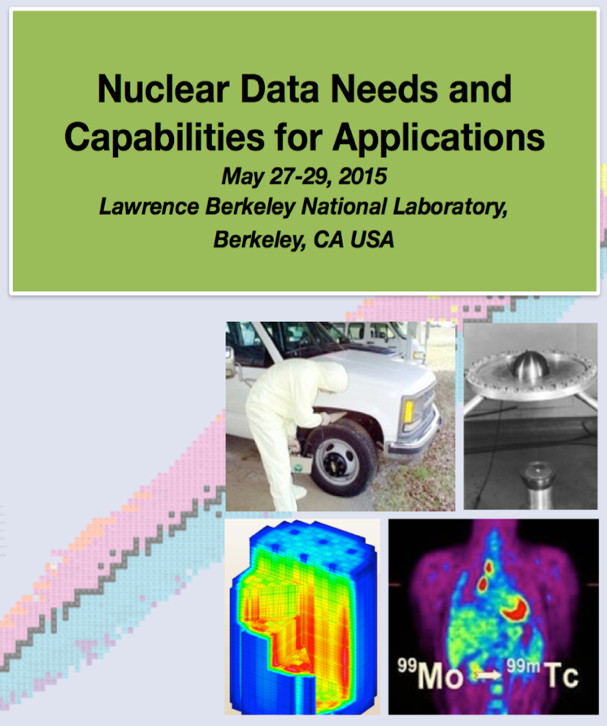
Nuclear Data Needs and Capabilities for Applications
May 2015
Lawrence Berkeley National Laboratory
76 Participants
Workshop Participants Identified High-Priority Cross-Cutting Needs
Dosimetry Standards
A Better Understanding of Fission
Decay Data and g-Branching Ratios
Neutron Transport Covariance Reduction
Expanded Integral Validation
Antineutrinos from Reactors
Topics in red have led to funded projects

Slide 20
Nuclear Data Exchange Meeting: 5-year, plan to address high-priority cross-cutting nuclear data needs
Presented by the NDWG to 25 Federal Program Managers from DOE, NNSA, DoD and DHS
April 2016
Washington, DC
Priorities:
Revitalize the Nuclear Data Pipeline
Expand Covariance Data and Its Use
Improve Inelastic Scattering Data for Neutron Transport
Upgrade Capture Gamma-ray Data in ENDF
Improve Theory, Modeling, Data and Evaluation of Fission Fragment Yields
Reestablishment of Actinide Target Production Capabilities
Topics in red have led to funded projects

Slide 21
Nuclear Data Roadmapping and Enhancement Workshop (NDREW)
January 2018
Washington, DC
110 Participants
Nonproliferation Focus
Uncertainty, Sensitivity, and Covariance
Neutron Capture and Associated Spectra
Fission I, Independent and Cumulative Yields
Fission II, Prompt Gammas and Neutrons
Fission III, Decay Data
Inelastic Neutron Scattering and Associated Spectra
(α,n) Reactions
Targets, Facilities and Detector System
Development of Benchmark Exercises
Data Processing & Transport Code Needs
Actinide Cross Sections
Gamma-Induced Reactions
Topics in red have led to funded projects

Slide 22
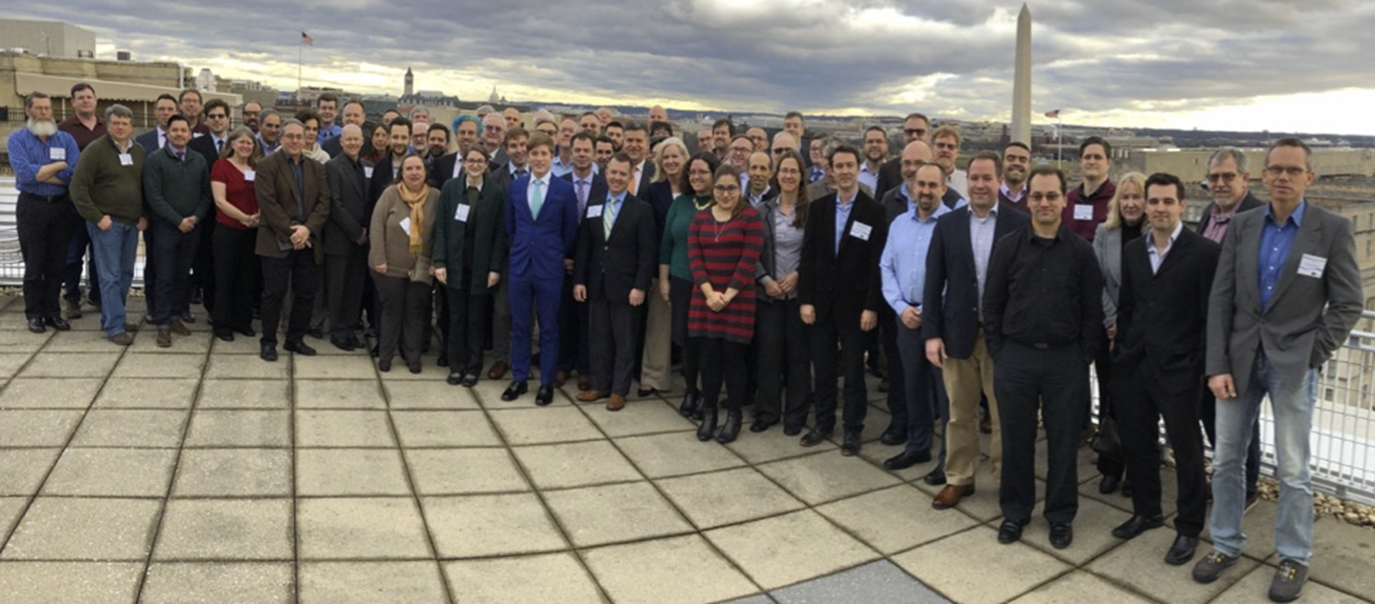
Workshop for Applied Nuclear Data Activities WANDA2019
January 2019
Washington, DC
Over 125 Participants
Topics
Nuclear Data for Nuclear Energy
Materials Damage
Nuclear Data for Isotope Production
Atomic Data and NRF Data
Nuclear Data for Safeguards
(n,x) reactions
Topics in red have led to funded projects

Slide 23
Workshop for Applied Nuclear Data Activities: WANDA2020
March 2020
Washington, DC
Over 160 Participants
Topics:
Covariance/Uncertainty/Sensitivity/Validation
Nuclear Data for Isotope Production and Targetry Needs
Machine Learning/AI
Detector Models, Atomic Data and Stopping Powers
Scattering, Transport and Shielding
Neutron Induced Gammas and Gamma Decay
Topics in red have led to funded projects

Slide 24
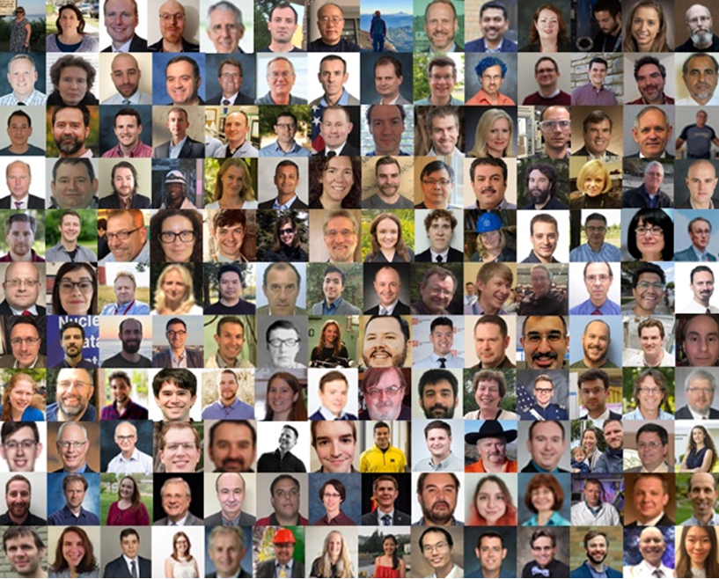
Workshop for Applied Nuclear Data Activities: WANDA2021
Jan-Feb 2021
Virtual
Over 350 Participants
Topics:
Advanced Computing for Nuclear Data
Predictive Codes for Isotope Production
Expanded Benchmarks and Validation for Nuclear Data
Nuclear Data for Space Applications
Nuclear Data for Advanced Reactors and Security
The Human Pipeline for Nuclear Data
Topics in red have led to funded projects

Slide 25
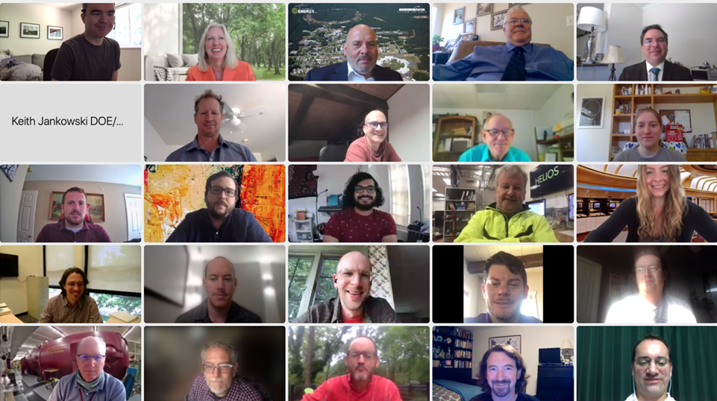
Workshop on Nuclear Data for Reactor Antineutrino Measurements: WoNDRAM
June 2021
Virtual
Over 180 Participants
Topics:
Reactor Antineutrino Source Term
Antineutrino Spectrum Calculations
Nuclear Data for Detector Response
Topics in red have led to funded projects

Slide 26
Workshop for Applied Nuclear Data Activities: WANDA2022
Feb-Mar 2022
Virtual
Over 300 Participants
Topics:
Reactions on Unstable Nuclei
High Energy Ion Interactions and Secondary Particles
Neutrons as Secondary Particles and Interactions
Photon Reactions and Transport
Stopping Powers, Energy Deposition and Dose
Nuclear Data Adjustments and Impact on Applications
Topics in red have led to funded projects

