Slide 1

Nuclear Data Pipeline
David Brown
WANDA 2023, Crowne Plaza Crystal City
27 February 2023

Slide 2




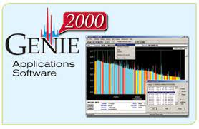


Many software packages use embedded ENDF/B data
Reactor design, simulation and licensing codes.
Nuclear waste and repositories.
Radiation spectroscopy, dose, detectors and shielding.
Defense and CTBTO.

Slide 3
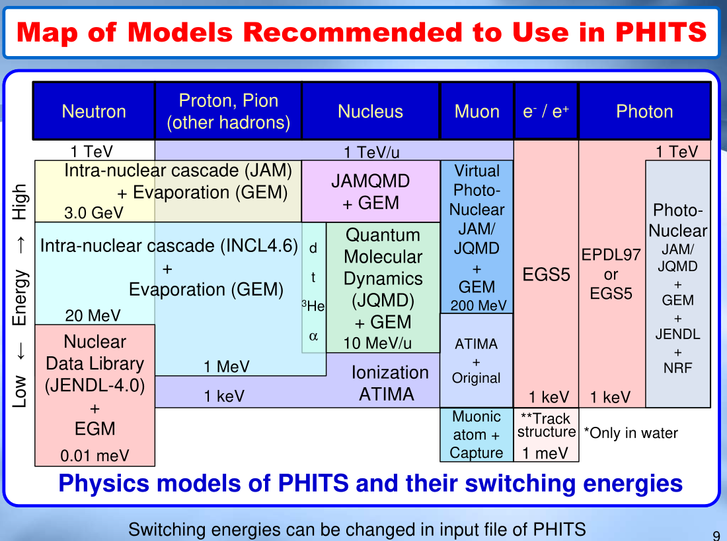
https://phits.jaea.go.jp/lec/phits-introduction-en.pdf

Slide 4
(ENDF) data tables
https://phits.jaea.go.jp/lec/phits-introduction-en.pdf
Stopping Powers

Slide 5
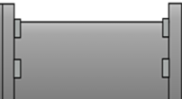
The Nuclear Data Pipeline
Our goal is to get the highest quality data to users
Theory & Experiment
Data Processing
Transport Codes
Verification & Validation
Evaluation
User

Slide 6
But wait…

Slide 7
The Nuclear Data Pipeline
With uncertainties, the users now have the tools to inform priorities
Sensitivity (/Uncertainty) Study
Theory & Evaluation
Data Processing
Transport Codes
Experiment
Benchmarking
User

Slide 8
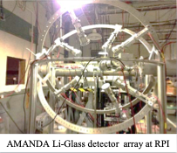
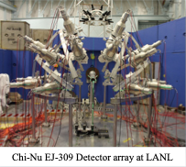
Why do we need experiment?
We do not fully understand the physics
We can not theoretically calculate Nuclear Data with sufficient accuracy required by applications
  Experiments constrain the uncertainty of evaluated data
  Test the accuracy of evaluated files and codes physics
Sensitivity (/Uncertainty) Study
Theory & Evaluation
Data Processing
Transport Codes
Benchmarking
Experiment
User
Slide based on Y. Danon’s WANDA 2020 Pipeline Talk

Slide 9
Why do we need experiment?
Differential experiments, examples:
Neutron cross section as a function of neutron energy
Neutron capture cascades gamma spectrum
Fission fragment yields
Quasi-differential experiments
Validation experiments, examples:
Criticality experiments (benchmarks)
Integral shielding measurements
Quasi-differential experiments
We do not fully understand the physics
We can not theoretically calculate Nuclear Data with sufficient accuracy required by applications
  Experiments constrain the uncertainty of evaluated data files
  Test the accuracy of evaluated files and transport codes physics
Facilities at many National Labs and universities
Sensitivity (/Uncertainty) Study
Theory & Evaluation
Data Processing
Transport Codes
Benchmarking
Experiment
User
Slide based on Y. Danon’s WANDA 2020 Pipeline Talk

Slide 10
Theory + Experiment + Statistics = Evaluation
Experiments rarely cover all that users want
Nuclear Theory is needed!
  - Complete data files for users
  - Make predictions/extrapolate (beyond calibration)
    - Provide estimates of uncertainties & correlations
    Statistics provide the glue
- “To the best of our knowledge...”
(given time, location, resources)
- Bayesian statistics / Uncertainty Quantification
Sensitivity (/Uncertainty) Study
Theory & Evaluation
Data Processing
Transport Codes
Benchmarking
Experiment
User
Slide based on P. Talou’s WANDA 2020 Pipeline Talk

Slide 11
Theory + Experiment + Statistics = Evaluation
Experiments rarely cover the full space of what users need
Nuclear Theory is crucial for the nuclear data evaluation process
  - Need for complete data files for users
  - Theory is needed for predictions (beyond calibration)
    - Provide estimates of uncertainties & correlations
    Statistics provide the glue
- “To the best of our knowledge...”
(given time, location, resources)
- Bayesian statistics / Uncertainty Quantification
The appropriate theory is problem dependent:
R-matrix for resonance region
Optical Model + Hauser-Feshbach for higher energies
Curve fitting when there is good data
…
HPC needed in many cases:
Density functional theory (fission)
Ab-initio methods
Uncertainty quantification
AI/ML increasing integrated into evaluation process
Sensitivity (/Uncertainty) Study
Theory & Evaluation
Data Processing
Transport Codes
Benchmarking
Experiment
User
Slide based on P. Talou’s WANDA 2020 Pipeline Talk

Slide 12
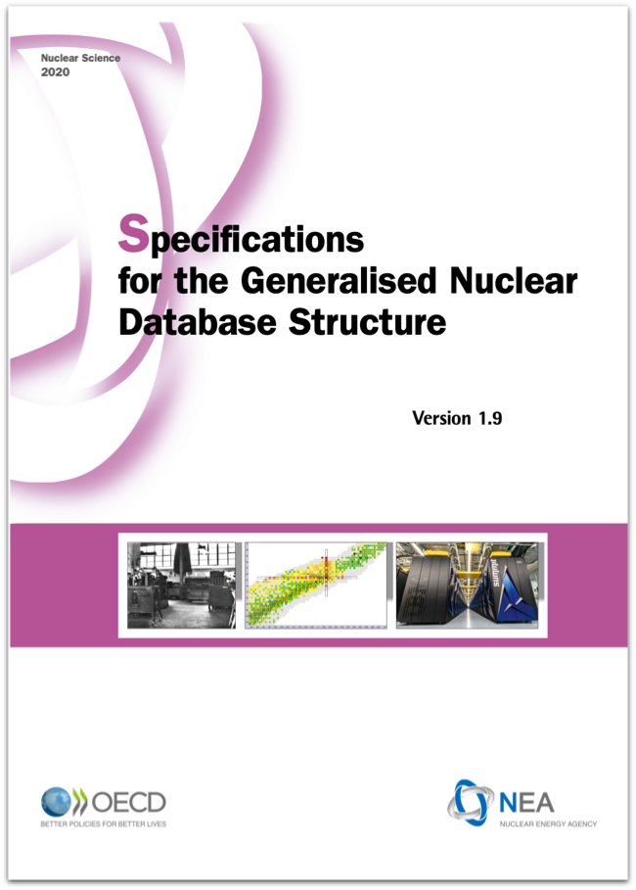

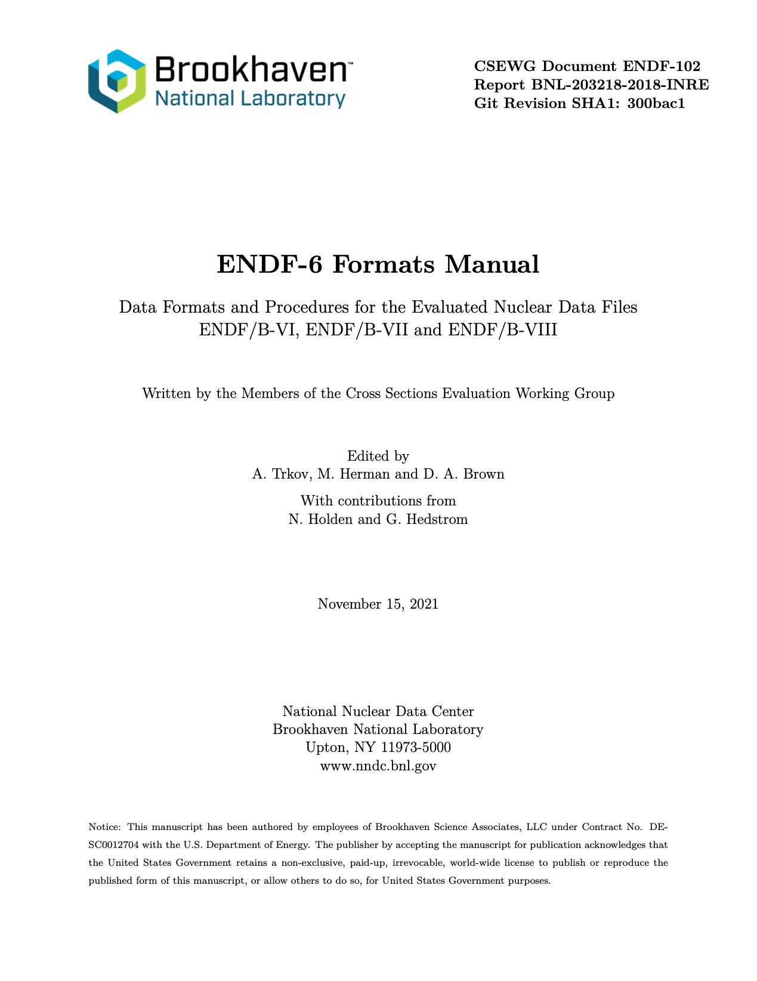
Data Processing (and formats!)
ENDF (and soon GNDS) is only an agreed upon intermediate format
  - Evaluations must be translated into a form digestible
  by downstream codes
- Requires deep understanding of physics in evaluations
and physics as implemented in downstream codes
Data needed by user may not have a “spot” in existing evaluations or downstream codes
Underappreciated potential bottleneck
Codes such as NJOY, FUDGE and AMPX do this step
Sensitivity (/Uncertainty) Study
Theory & Evaluation
Data Processing
Transport Codes
Benchmarking
Experiment
User
Slide based on J. Conlin’s WANDA 2020 Pipeline Talk

Slide 13
Transport codes
Transport codes:
- Numerically solve the linear Boltzmann Transport Eq.
- Deterministic (S_{N},P_{N}) & Stochastic (Monte Carlo)
Calculations tend to be relatively
expensive, driving codes to HPC
and emerging architectures
Transport code developers:
- Often the first customer of nuclear data
- Often develop a strong interest in nuclear data
  - Develop a deep understanding about need for
  high quality data
Sensitivity (/Uncertainty) Study
Theory & Evaluation
Data Processing
Transport Codes
Benchmarking
Experiment
User
Slide based on T. Bailey’s WANDA 2020 Pipeline Talk

Slide 14
Benchmarking
Do you trust this Byzantine process?
You shouldn’t!
Validation that analytical method adequately represents reality for a given application.
Integrated test of
  Evaluated nuclear data
  Nuclear data processing codes
  Transport codes
Sensitivity (/Uncertainty) Study
Theory & Evaluation
Data Processing
Transport Codes
Benchmarking
Experiment
User
Slide based on M. Zerkle’s WANDA 2020 Pipeline Talk

Slide 15
Benchmarking
Basic data for benchmark development
Critical assemblies
Subcritical assemblies
Engineering mockup critical assemblies
Reactor startup exp.
Reactor operation data
Shielding experiments
Well characterized experiments in
established handbooks:
ICSBEP (criticality safety)
IRPhEP (reactor physics)
SINBAD (shielding)
Do you trust this Byzantine process?
You shouldn’t!
Validation that analytical method adequately represents reality for a given application.
Integrated test of
  Evaluated nuclear data
  Nuclear data processing codes
  Transport codes
Sensitivity (/Uncertainty) Study
Theory & Evaluation
Data Processing
Transport Codes
Benchmarking
Experiment
User
Slide based on M. Zerkle’s WANDA 2020 Pipeline Talk

Slide 16

Uncertainty Quantification/Sensitivities
Uncertainty Quantification helps inform decision makers, and identifies sources of uncertainty that could be reduced.
Sensitivity (/Uncertainty) Study
Theory & Evaluation
Data Processing
Transport Codes
Benchmarking
Experiment
User
Slide based on R. Casperson’s WANDA 2020 Pipeline Talk

Slide 17
Uncertainty Quantification/Sensitivities
Forms of Uncertainty Propagation
UQ involves propagation of uncertainties through models of interest, and analysis of output distributions.
Sensitivity studies useful as an intermediate step.
Inverse UQ using experimental output data is
relevant to some applications, and can produce
constrained input distributions.
Uncertainty Quantification helps inform decision makers, and identifies sources of uncertainty that could be reduced.
Sensitivity (/Uncertainty) Study
Theory & Evaluation
Data Processing
Transport Codes
Benchmarking
Experiment
User
Slide based on R. Casperson’s WANDA 2020 Pipeline Talk

Slide 18
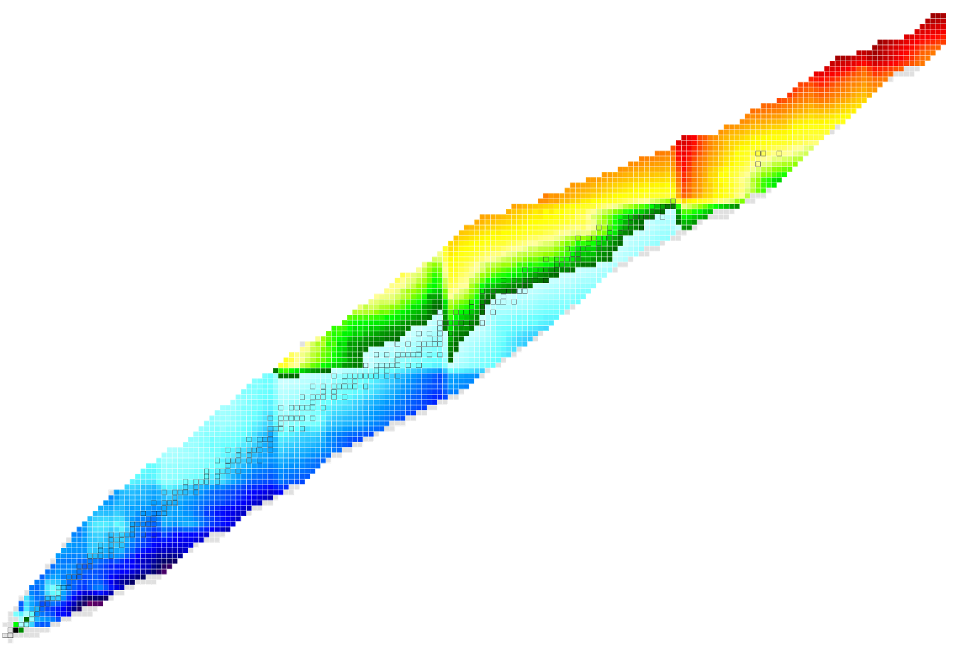
US Nuclear Data Program is the custodian of most nuclear data needed for applications
Nuclear Science References (NSR)
Nuclear physics articles indexed according to content
EXFOR
Compiled nuclear reaction data
XUNDL
Compiled nuclear structure and decay data
ENSDF
Recommended nuclear structure and
decay data
ENDF
Recommended particle transport and
decay data, with a strong emphasis on
neutron-induced reaction data
FIXME
NNDC website:
www.nndc.bnl.gov

Slide 19

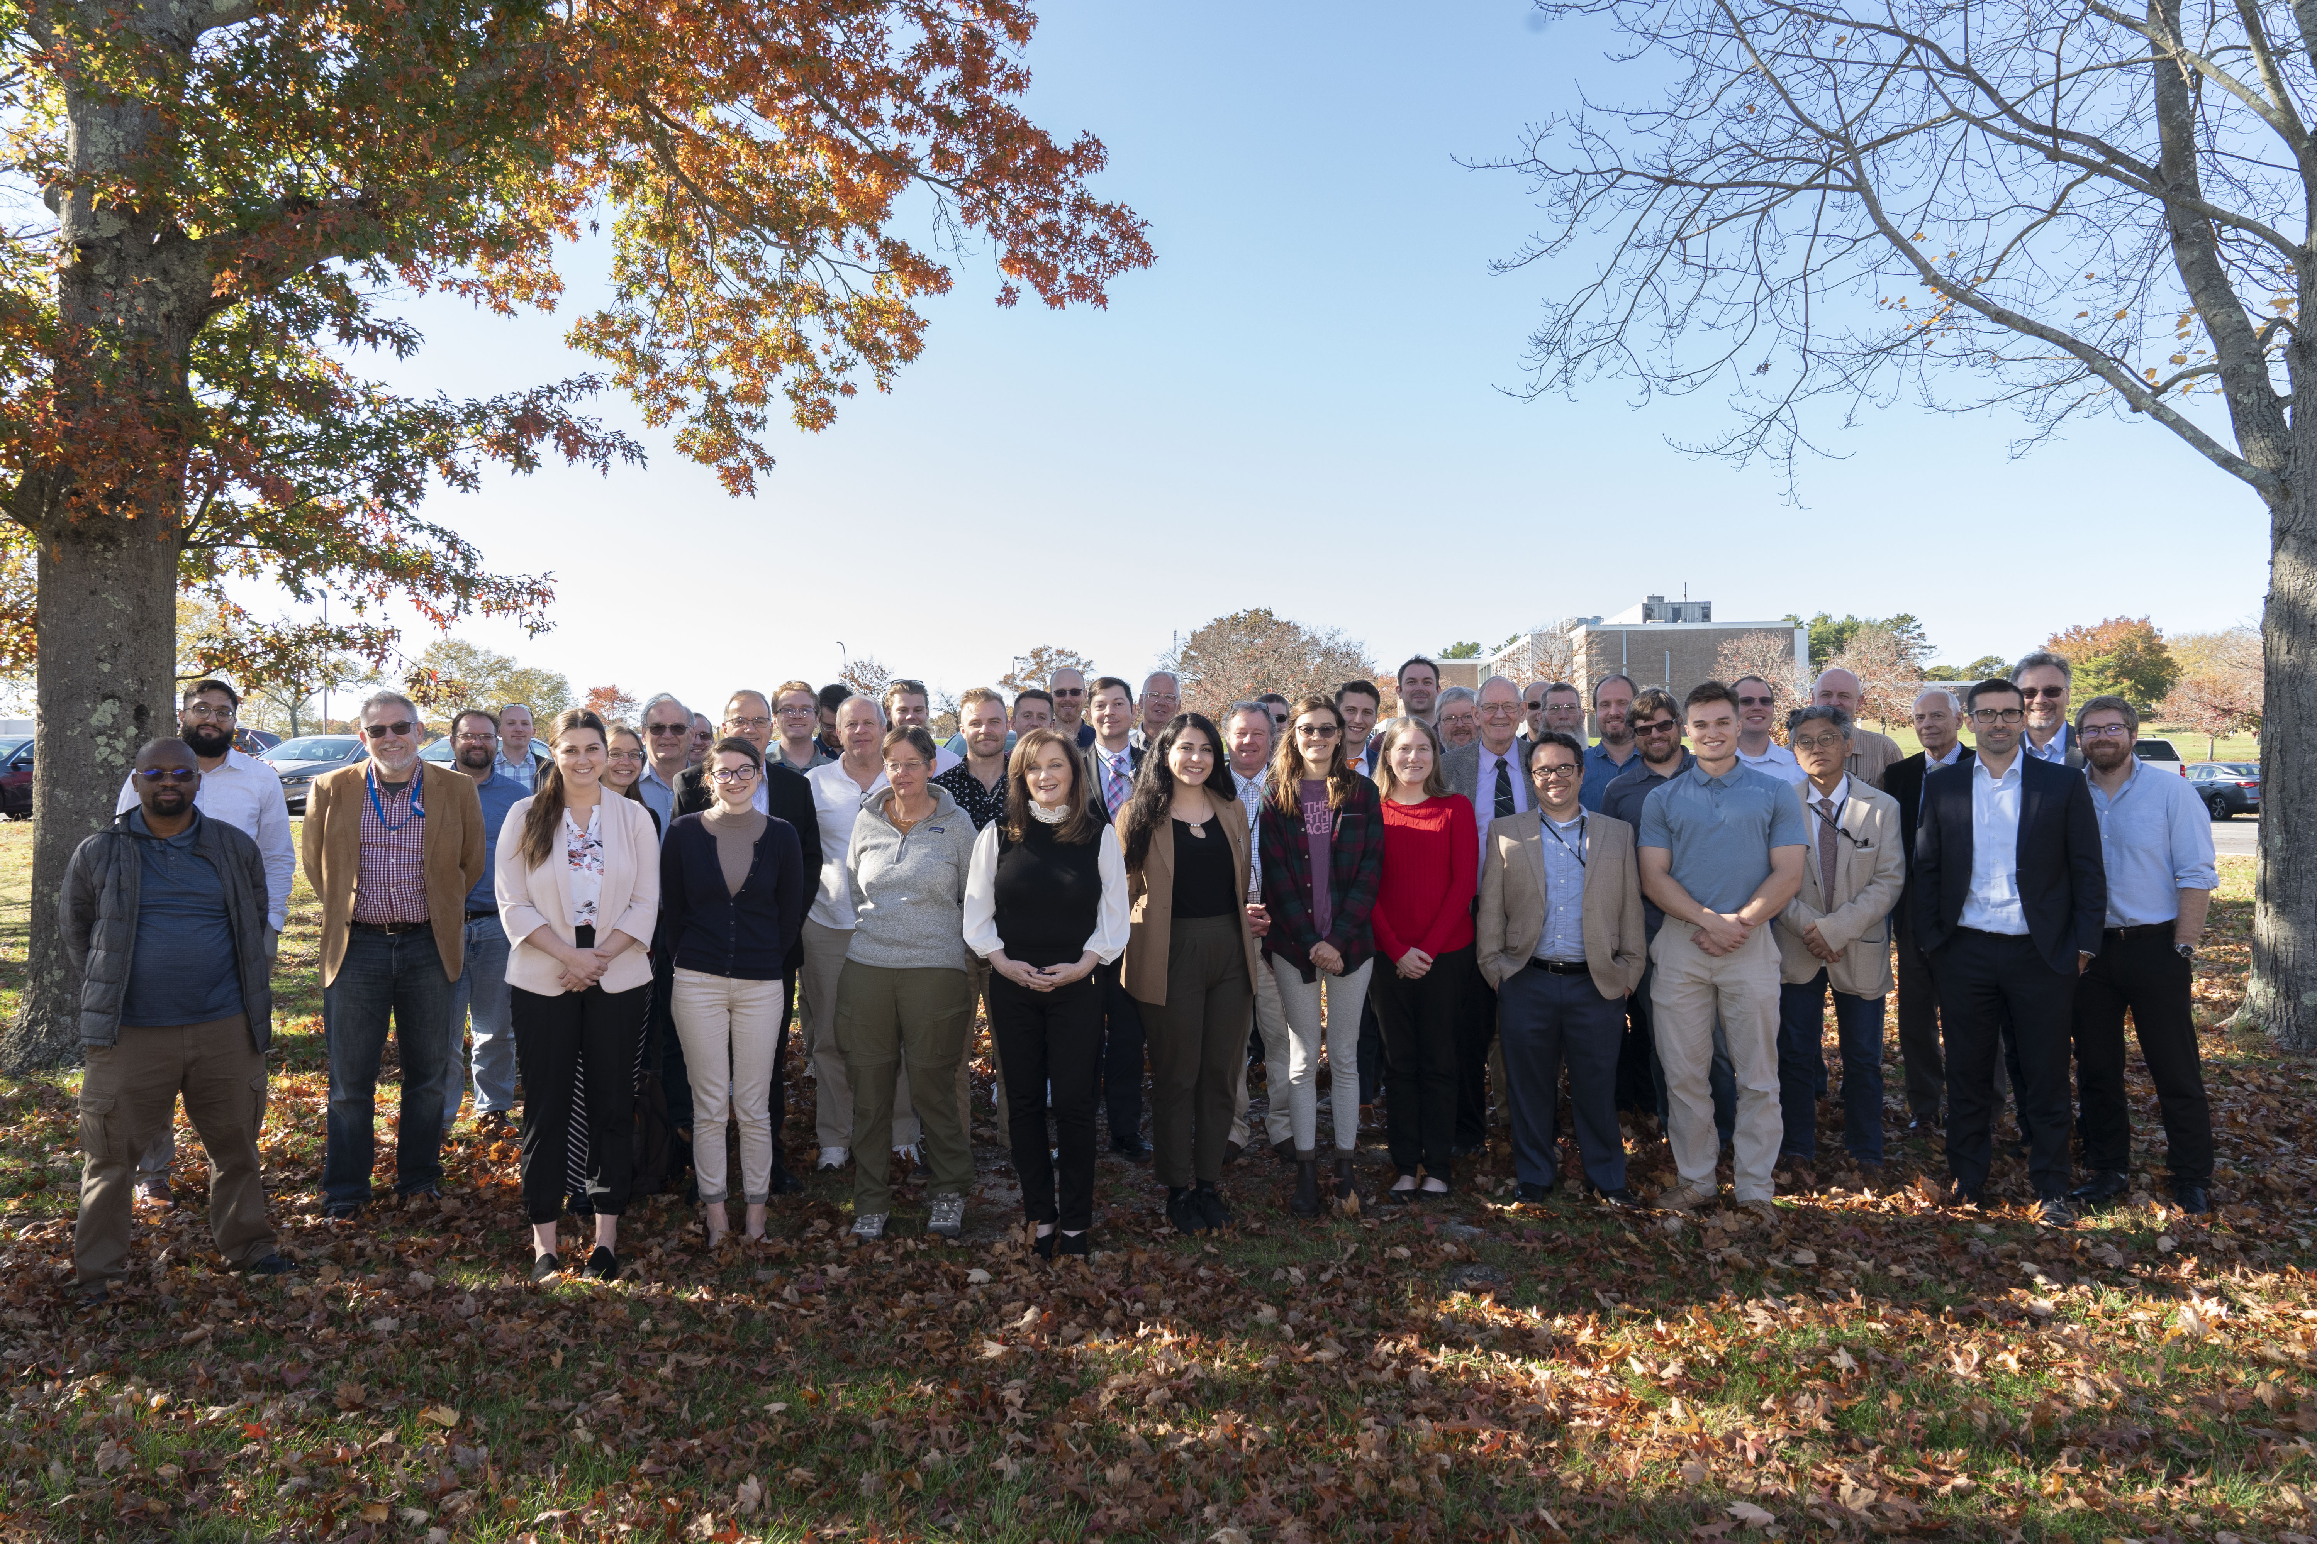
The Cross Section Evaluation Working Group produces ENDF/B library
Formed 1966 & Chaired by BNL
Currently ~200 members of the collaboration from 25 institutions
  US programs, industry and international partners
  If you see something in the library, at some point a sponsor somewhere wanted it
All steps of nuclear data pipeline coordinated through CSEWG
Depending on what needs done, getting required data in library can be major effort
CSEWG collaboration meeting in November 2022: our first in-person meeting since the pandemic started!
We are always open to new users and collaborators

Slide 20
All steps of nuclear data pipeline are coordinated through CSEWG
Covariances
Chair: Denise Neudecker (LANL)
Chair:
David Brown (BNL)
dbrown@bnl.gov
Library Manager:
Gustavo Nobre (BNL)
gnobre@bnl.gov
Sensitivity (/Uncertainty) Study
Experiment
Theory & Evaluation
Data Processing
Transport Codes
Benchmarking
User
Measurements
Chair: Yaron Danon (RPI)
Formats & Processing
Co-chair: Mike Dunn (Spectra Tech Inc.)
Co-chair: Doro Wiarda (ORNL)
Users
All of us!
Evaluation
Transport and Neutrons: chair Mark Chadwick (LANL)
FPY and Decay: chair Toshihiko Kawano (LANL)
TSL: chair Ayman Hawari (NCSU)
Charged Particles: chair Marco Pigni (ORNL)
Validation
Chair: Mike Zerkle (NNL)

Slide 21
  Final comments
CSEWG and ENDF:
  Welcomes collaboration in and out of US (but inside is easier)
  Long tradition of quality/continuous improvement
  Conservative, driven by experiment when possible
  Golden Rule (whoever has the gold makes the rules)
USNDP and NNDC are a resource for many other data product
Data is (when complete) OPEN

Slide 22
Backup slides

Slide 23

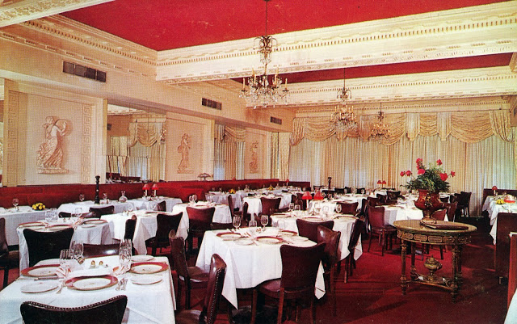
Before ENDF
By 1960, there were many data efforts worldwide
  different formats
  often hard-coded libraries
  proprietary data
  Notable efforts: UKNDL (AWE, UK),
  NDA library (US), ENDL (LRL, US)
~1962 H. Honeck (BNL), A. Henry (Westinghouse), G. Joanou (GA) met at Colony Restaurant in DC decided on action
  requested Reactor Mathematics and Computation Division of ANS to sponsor 2 meetings to link databases
http://www.streetsofwashington.com/2013/10/fine-dining-in-washington-dc-in-1950s.html

Slide 24
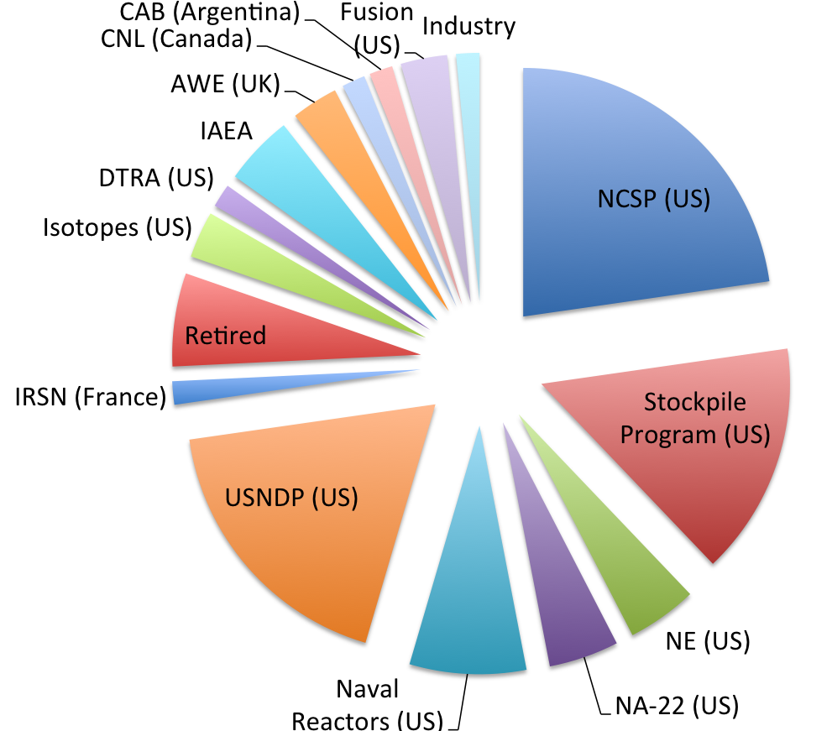
CSEWG is a long standing collaboration between the data users who are also the biggest content providers
Fraction of evaluations provided for ENDF/B-VIII.0

Slide 25
By sharing through CSEWG many sponsors reap the benefit of collaboration
Program | Measurement | Theory | Compilation | Evaluation | QA (V&V, IE) | Infrastructure (gitlab, etc.)
DTRA | ✓
International (IAEA,NEA,…) | ✓ | ✓ | ✓ | ✓ | ✓ | ✓
NA-22 | ✓ | ✓ |  | ✓
Naval Reactors | ✓ |  |  | ✓ | ✓
NCSP | ✓ | ✓ |  | ✓ | ✓ | ✓
Nuclear Energy |  |  |  |  | ✓
Other (IP, Fusion, …) | ✓ | ✓
Defense Programs | ✓ | ✓ |  | ✓ | ✓ | ✓
USNDP | ✓ | ✓ | ✓ | ✓ | ✓ | ✓

Slide 26
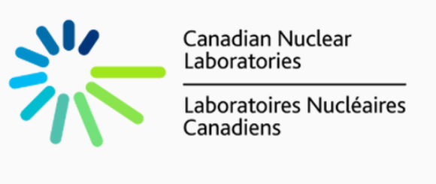




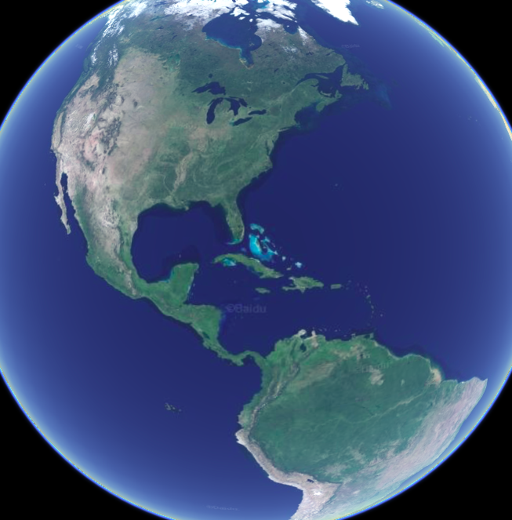










Slide 27


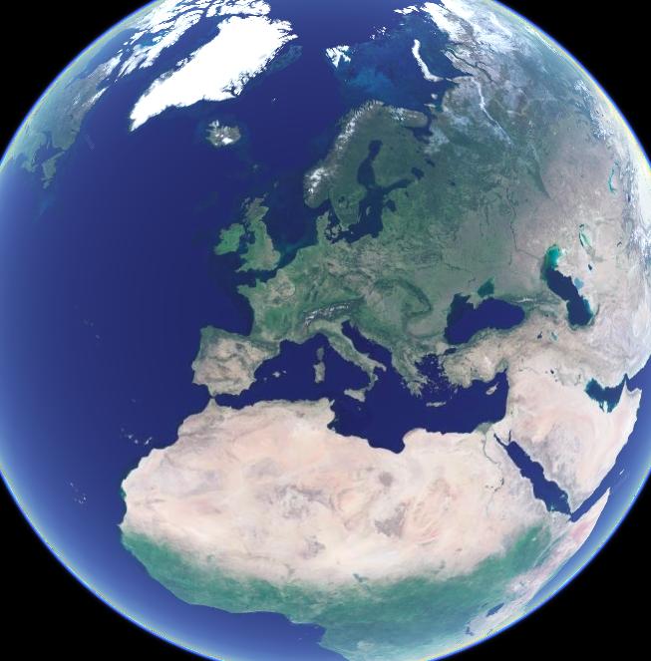
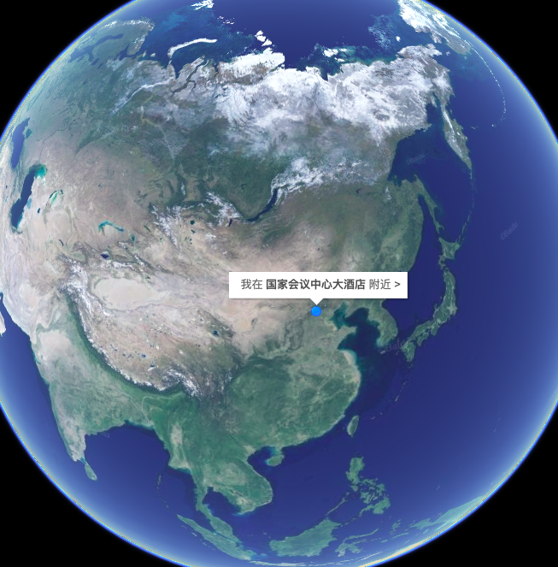



CSEWG is not limited to the Americas

