Slide 1
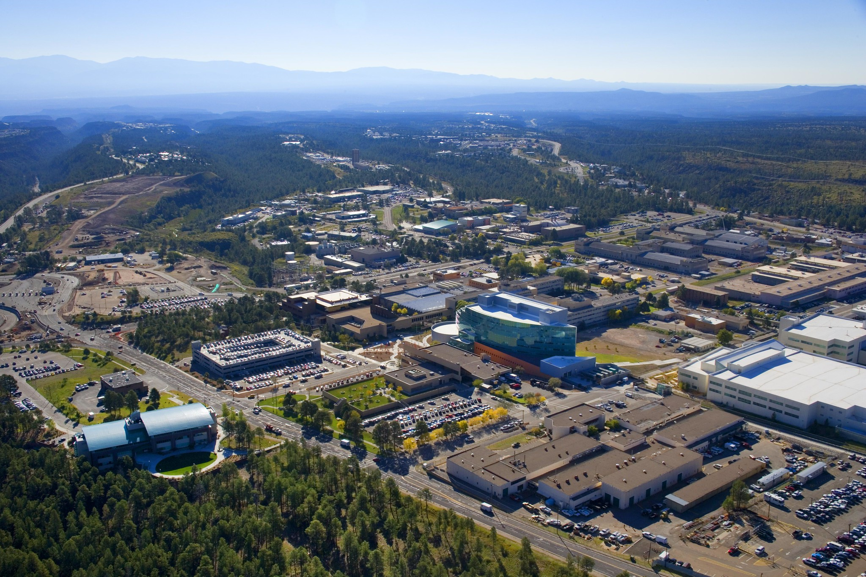

Slide 2
Short-Lived Fission Product Yield Measurements at TUNL
Dr. Matthew E. Gooden
03/02/2023
LA-UR-#######

Slide 3
OUTLINE
Short-Lived Fission Yields

Slide 4
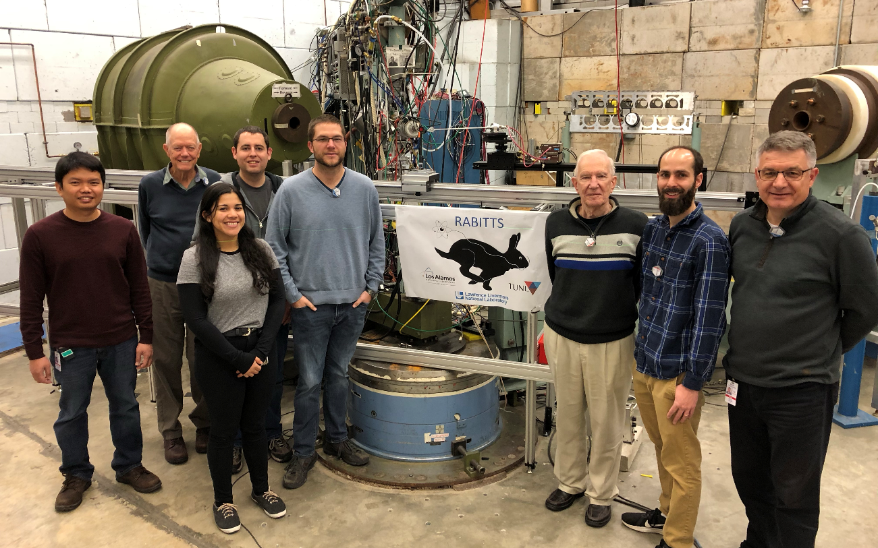
Collaboration
LANL
Matthew E. Gooden
Todd A. Bredeweg
Evelyn Bond
David Vieira
Jerry Wilhelmy
Vanessa Linero
Joint collaboration between LANL, LLNL and TUNL:
LLNL
Ron Malone
Anthony Ramirez
Jack Silano
Mark Stoyer
Anton Tonchev
TUNL
Sean Finch
Calvin Howell
Werner Tornow

Slide 5
MOTIVATION
Continuing our collaborations efforts to measure fission yield energy dependence:
  Have produced extension collection for energy dep. of late time fission products
    Can we get more from early time?
  Additional data needed for evaluation efforts and understanding other issues: reactor anti-neutrino anomaly
Funded under NDIAWG FOA 2019 to measure the energy dependence of short-lived fission product yield at TUNL

Slide 6
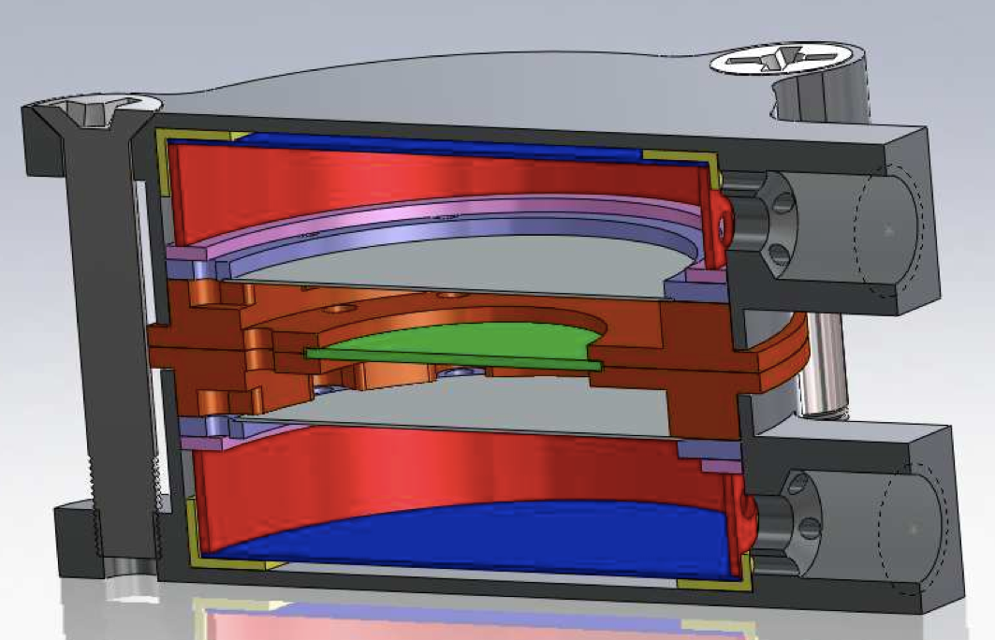
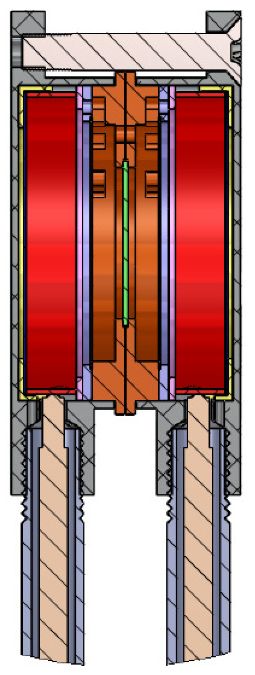
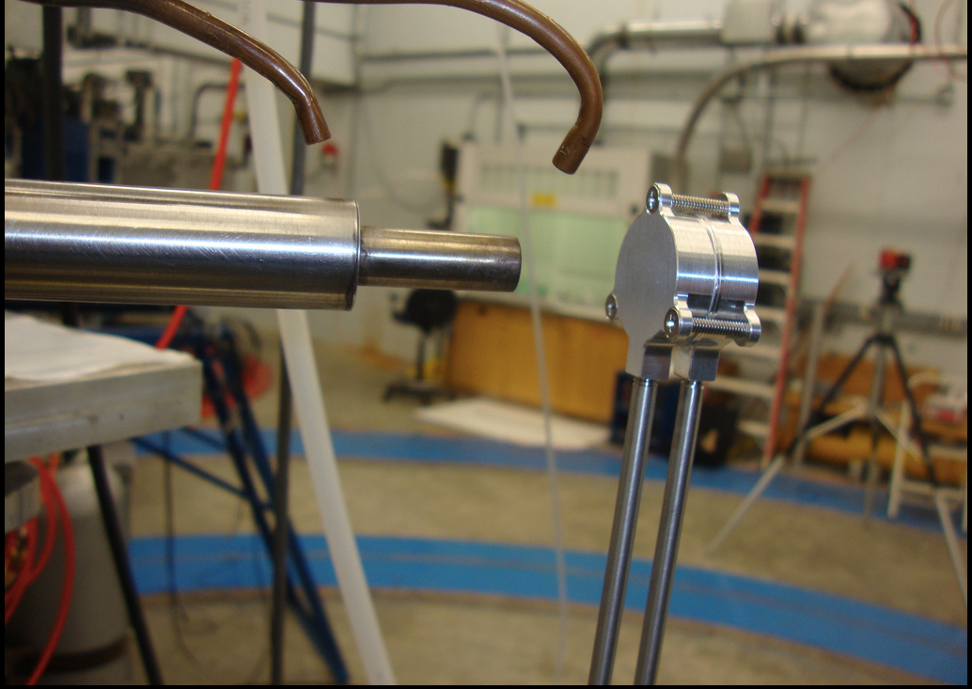
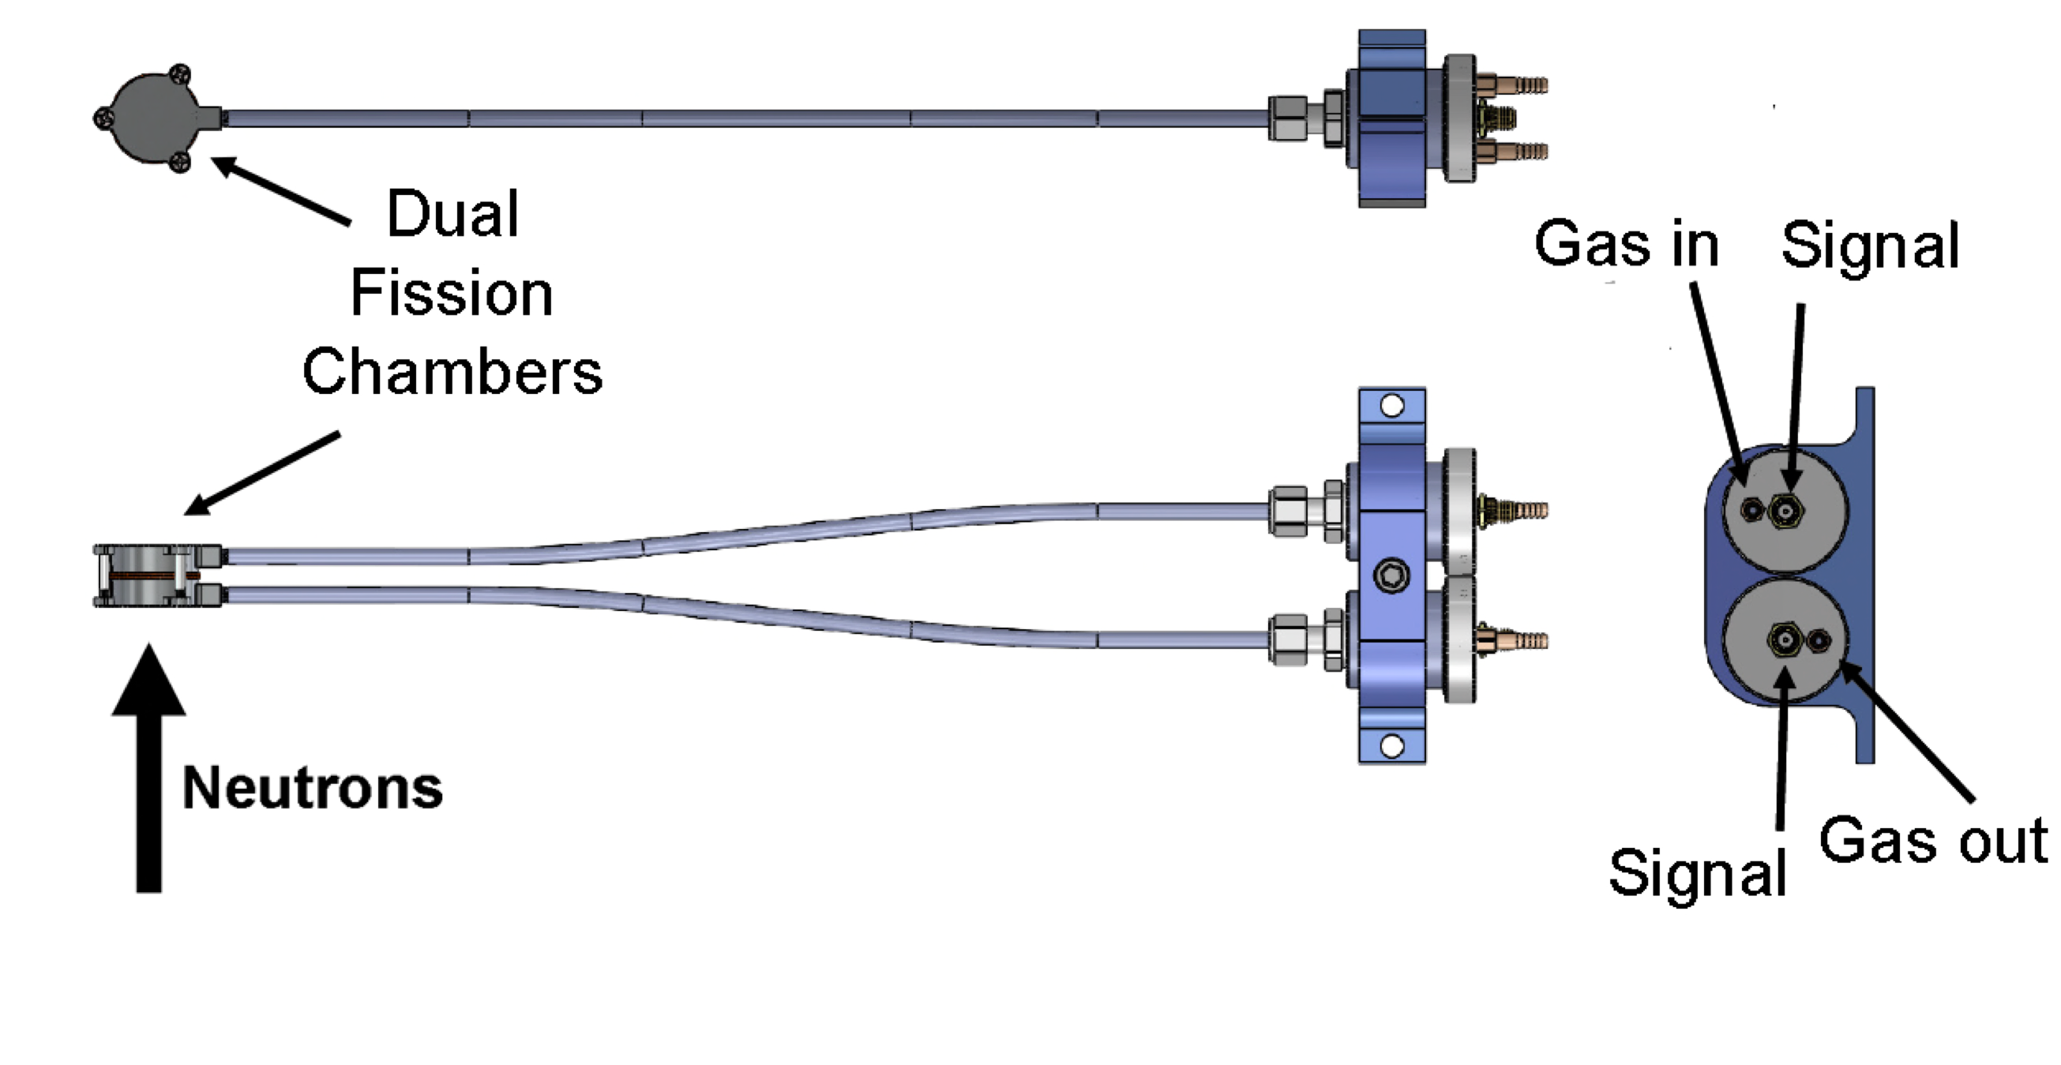
Fission Chambers
1.727 cm
To measure the fission yield, we need to know how many fissions happened Fission Chambers
3 Chambers were constructed: 1 for each target isotope
  ²³⁵U: ~ 100 μg/cm² ref. / 200 mg/cm² target
  ²³⁸U: ~ 100 μg/cm² ref. / 400 mg/cm² target
  ²³⁹Pu: ~ 10 μg/cm² ref. / 200 mg/cm² target
2.267 cm
The number of fissions in the target is determined by scaling
  Total Fissions = Counts * M_{T}/M_{R}
  No fission cross section needed!
Los Alamos National Laboratory
2/26/23 | 6

Slide 7
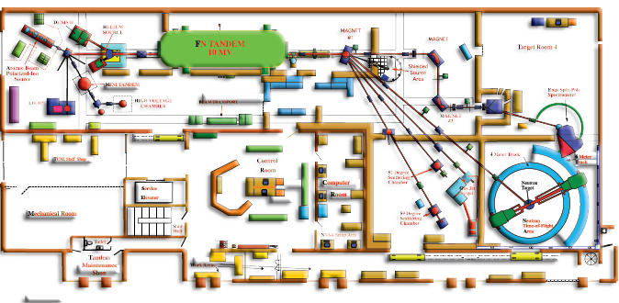
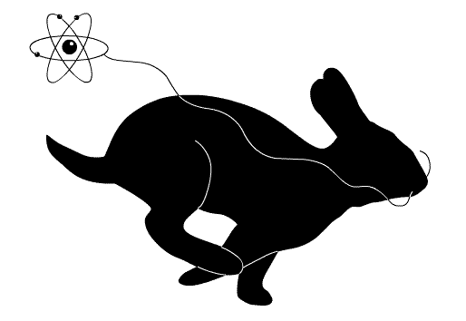
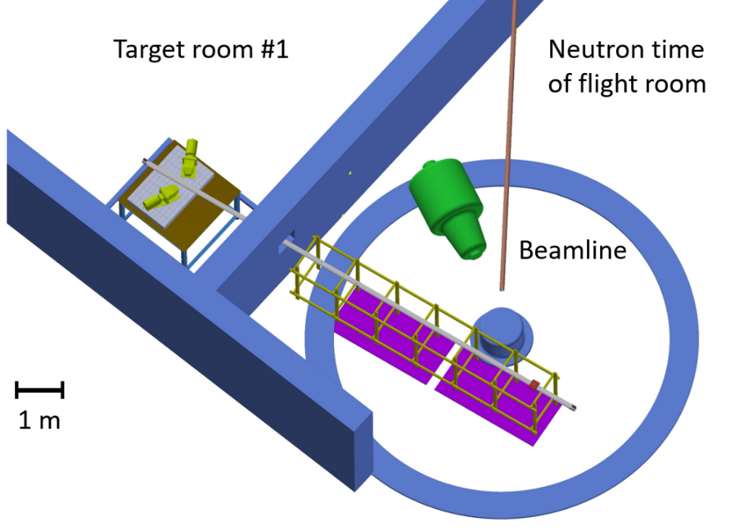
DENIS source
FN TANDEM 10MV
RABITTS
RApid
Belt-driven
Irradiated
Target
Transfer
System
Fully automated system moves target between irradiation and counting positions
7 m travel distance with 1.05 s transit time
Max speed 10 m/s (22.3 mph)
Beam pulsed to coincide with counting cycles
Beam deflected during counting cycles; i.e. no neutrons
S. Finch, et al., “Development of a rapid-transit system for precision nuclear physics measurements,” Nuclear Instrumentation and Methods A 1025, 166127 (2022).

Slide 8
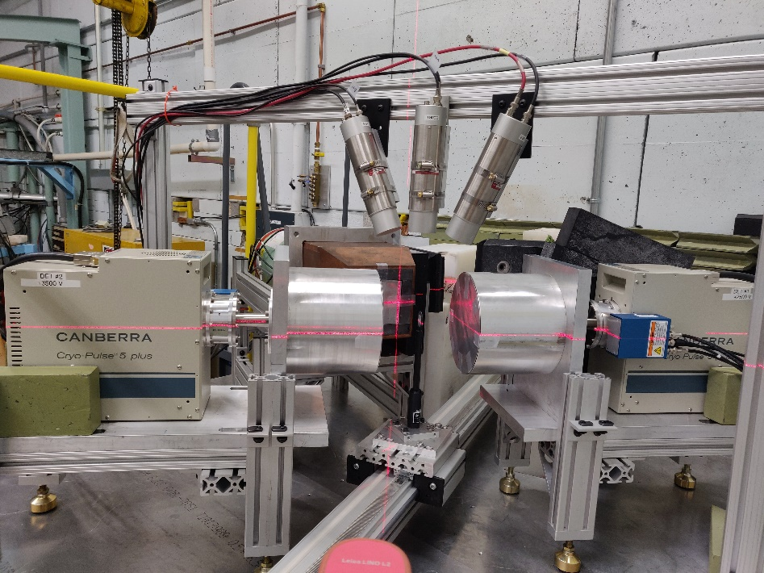
RABITTS
RApid
Belt-driven
Irradiated
Target
Transfer
System
Cyclic activation with varying cycles of irradiation and counting in different target rooms
Gamma-ray spectroscopy performed with two Canberra 60% efficient BEGe detectors with electric cooling
  Other detectors sometimes used: Canberra Clover, CeBr
Digital daq using Mesytec MDPP-16 digitizers
Sample held outside the fission chamber (cannot run in normal operation)
  MCNP used to take chamber results to target position
  92Sr fission yield from previous work used as additional normalization
S. Finch, et al., “Development of a rapid-transit system for precision nuclear physics measurements,” Nuclear Instrumentation and Methods A 1025, 166127 (2022).

Slide 9
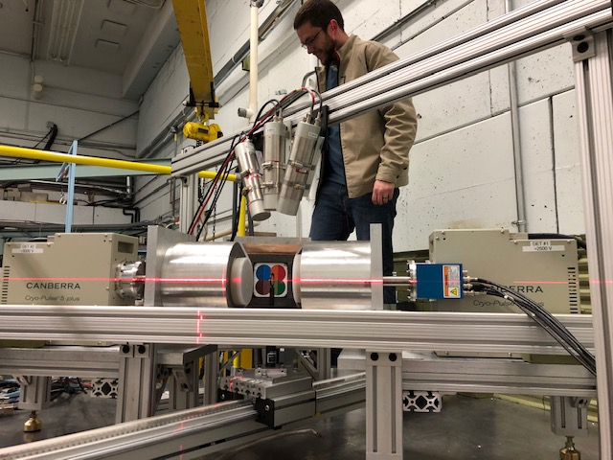
Experiment Summary:
RABITTS
Target
BEGe
10 m
Irradiation & Counting Cycles
Target Position Reproducibility | 42 µm
Transit Time | 1 s
4 s
20 s
x 5000 times
10 s
60 s
x 2000 times
60 s
300 s
x 400 times

Slide 10
RESULTS

Slide 11
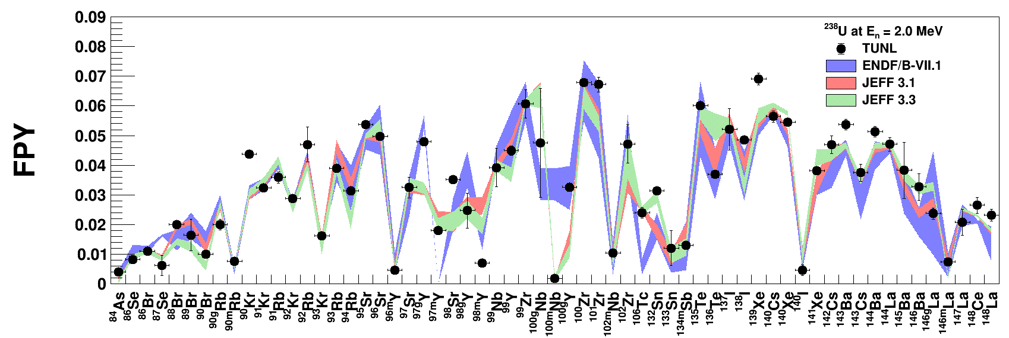
Results: ²³⁸U at 2.0 MeV
Observed over 300 γ-rays resulting from fission
60 Preliminary FPYs for ²³⁸U(n,f) at E_{n} = 2.0 MeV
Only statistical uncertainties are shown (uncertainties on γ-ray intensity are not included)

Slide 12
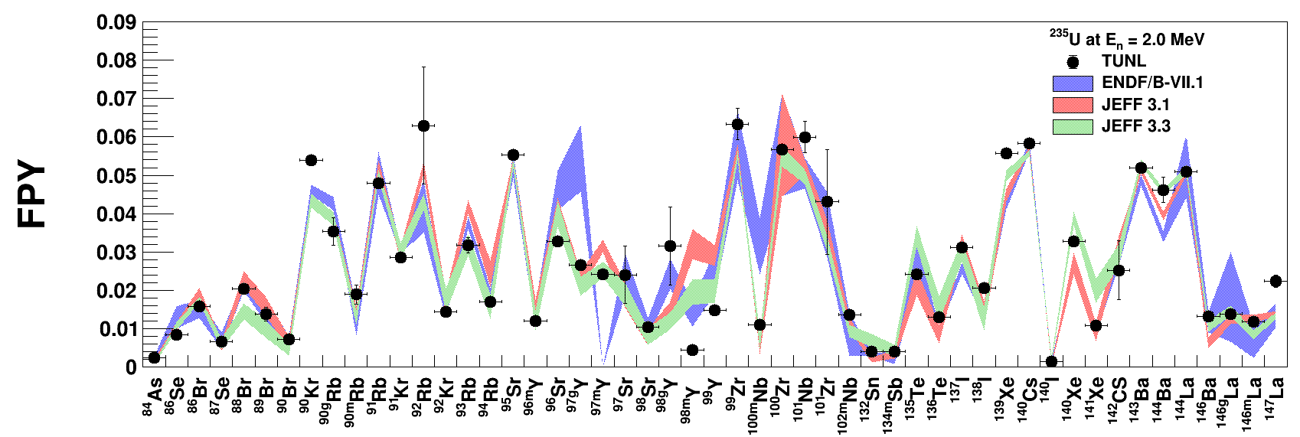
Results: ²³⁵U at 2.0 MeV

Slide 13
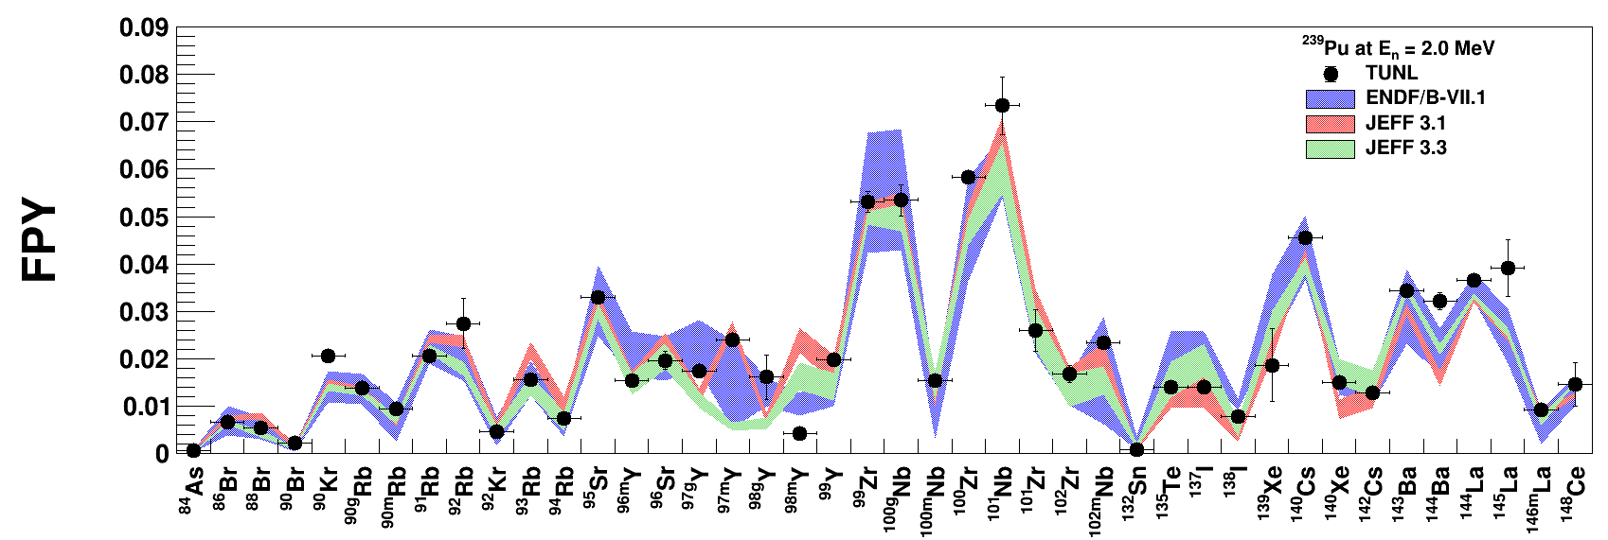
Results: ²³⁹Pu at 2.0 MeV

Slide 14
Summary: Our Coverage on the Nuclear Chart
Completed: Long Irradiation
16 FPYs @ 11 energies
Measured: jackRabbit
46 FPYs @ 6 energies
Measured: RABITTS
60 FPYs @ 5 energies

Slide 15
THANK YOU

