Slide 1
Session I: Gamma Strength Function & Level Density
Applications
Theory
Theory
Applications
γ-ray strength functions (gSF)
nuclear level densities (NLD)
γ-ray intensities
cross sections
Experiment
Experiment

Slide 2
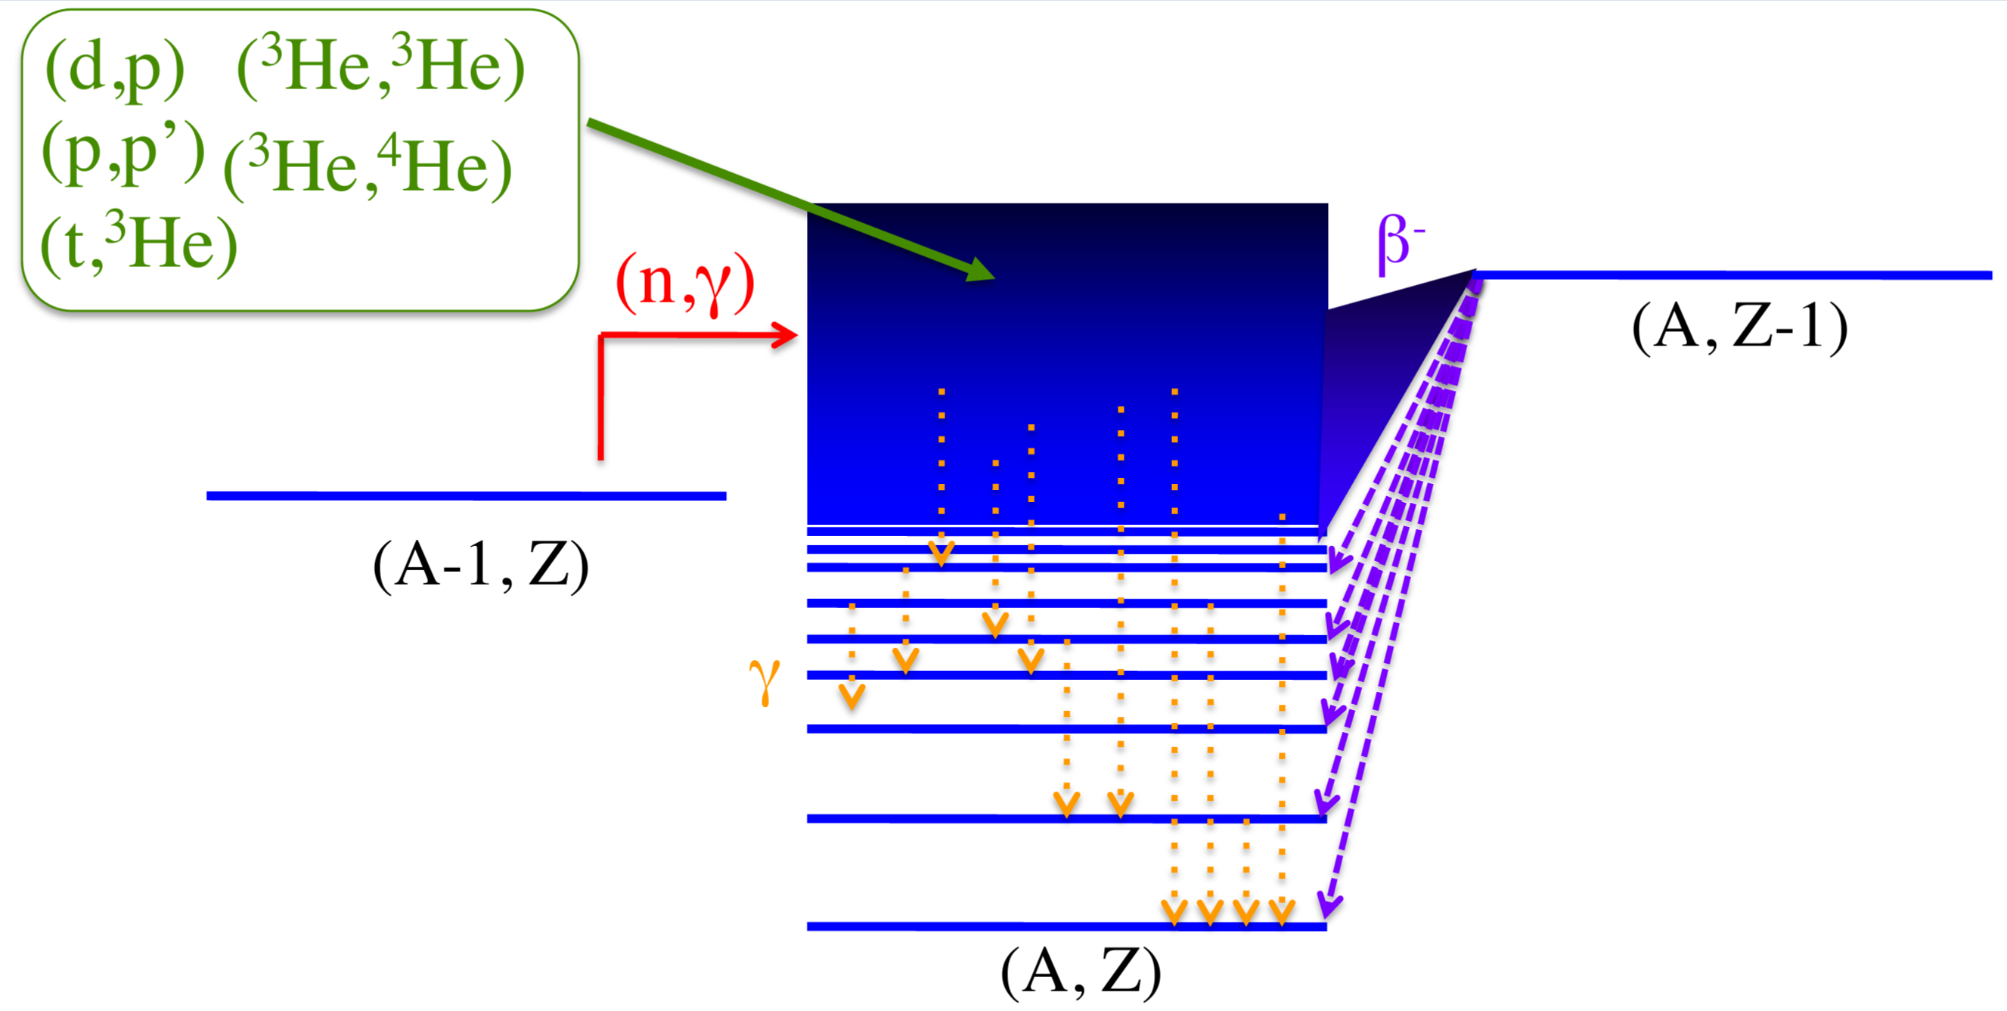
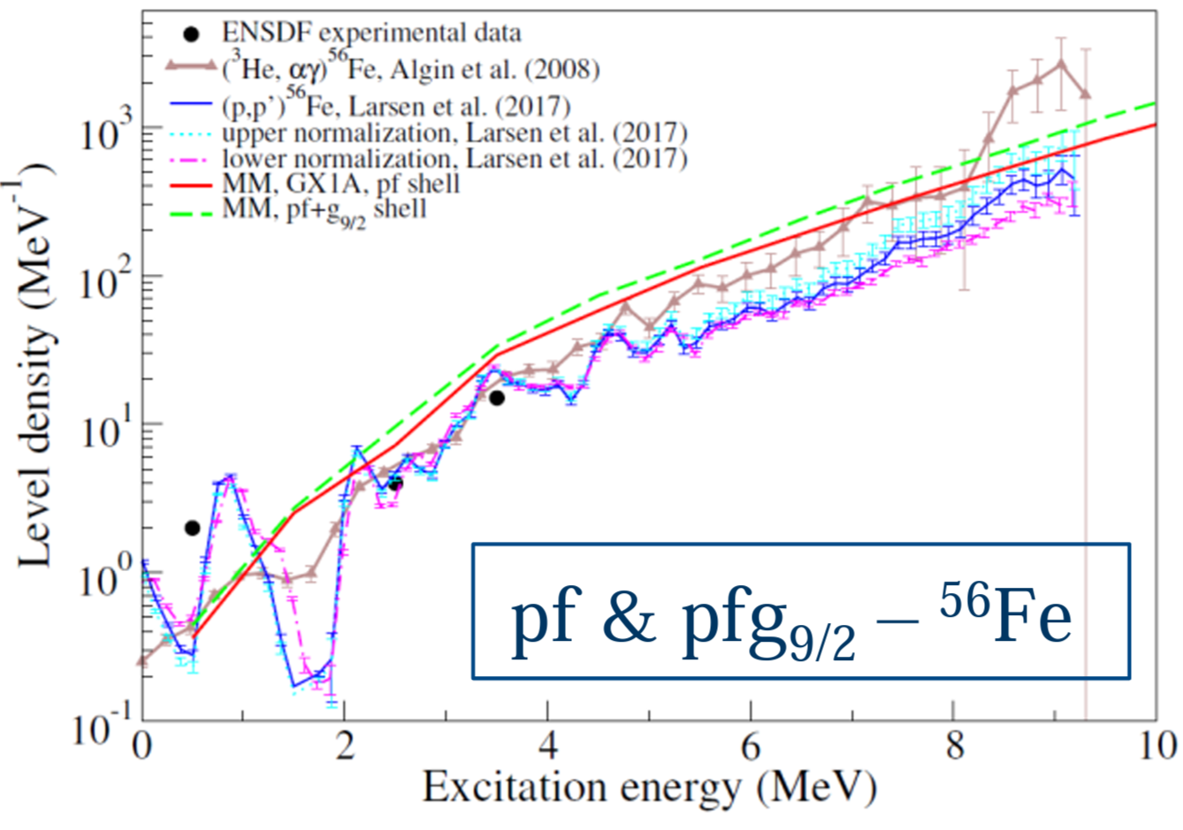
10 Talks from leaders in NLD/gSF experimental and theory work
Experiment
Lee Bernstein Introduction/summary
Paul Koehler Neutron resonance parameters to improve gSF
Sean Liddick b-Oslo method to extract NLD/gSF from rare isotopes
Alexander Voinov Particle evaporation technique for determining NLD
Andrea Richard Indirect (n,g) measurement techniques
Theory
Jutta Escher TLC: Targeted Experiments, Lots of Theory, Considered Experiments
Matt Mumpower Uncertainties in capture rate calculations due to NLD and gSF
Sofia Karampagia Modern NLD calculations using microscopic nuclear theory
Nicolas Schunck Modern gSF from extended QRPA and FAM
Amanda Lewis The case for an evaluated NLD/gSF database

Slide 3
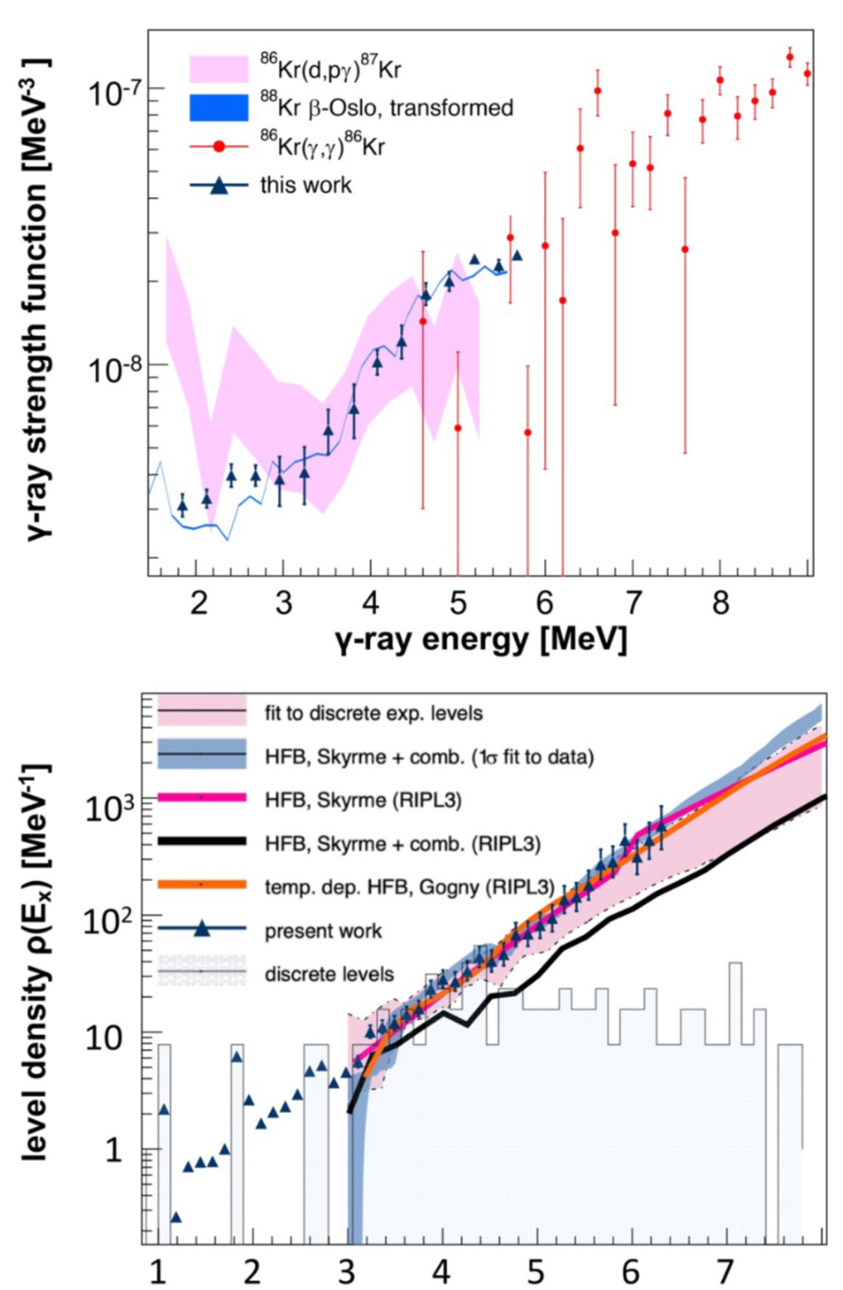
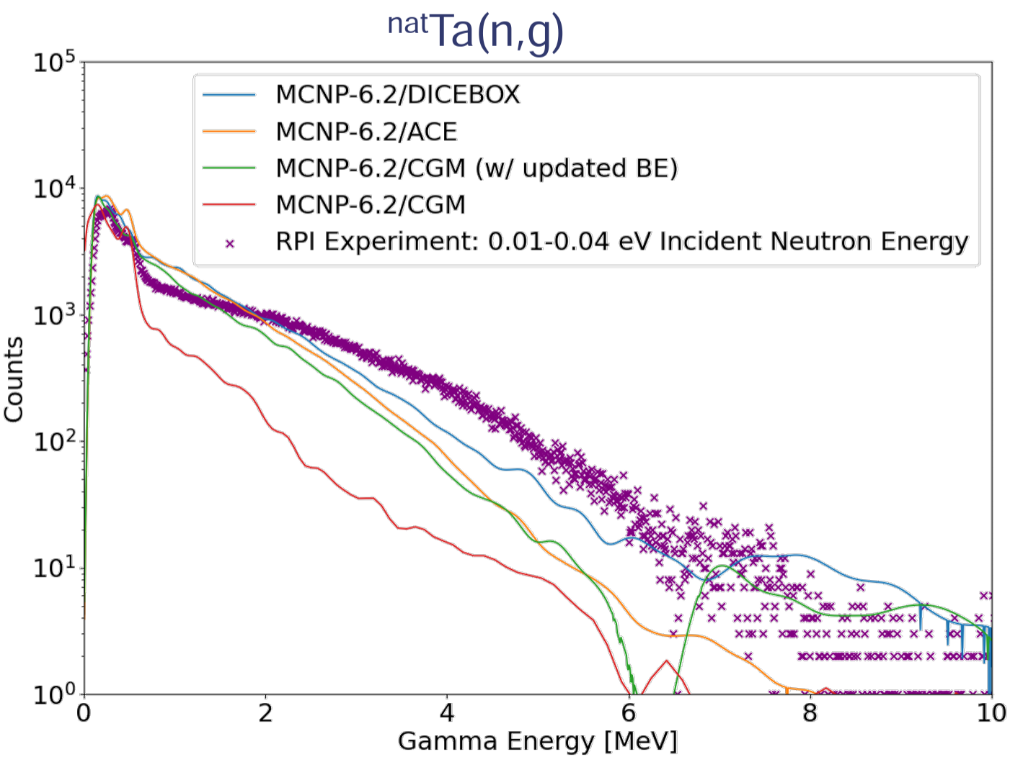
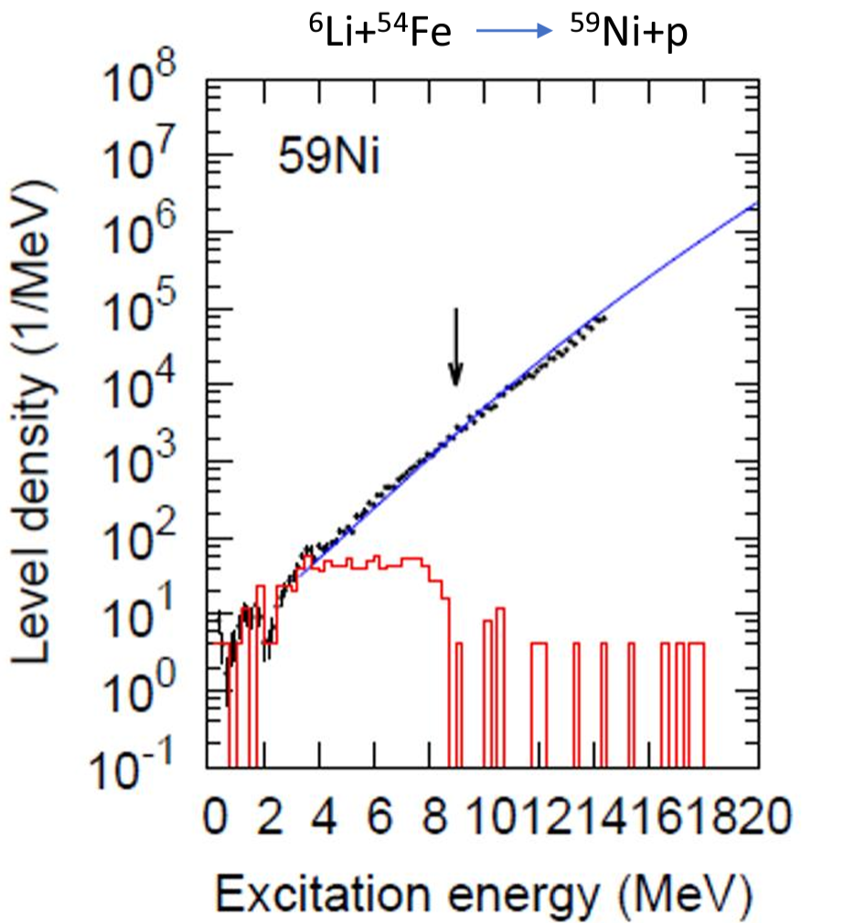
Experimental techniques for determining QC properties
Energy indexing approaches
Reaction-based (Surrogate, particle scattering, particle evaporation)
Oslo methods (beta-Oslo, Shape method analysis)
Photo-absorption
High resolution (n,g)
(n,n’g) and neutron evaporation spectra
Particle evaporation to determine NLD (A. Voinov)
RPI Gamma Multiplicity Counter Data against several gamma-cascade models (A. Lewis)
Shape-method results to eliminate theoretical normalizations for Olso method. (A. Richard)

Slide 4
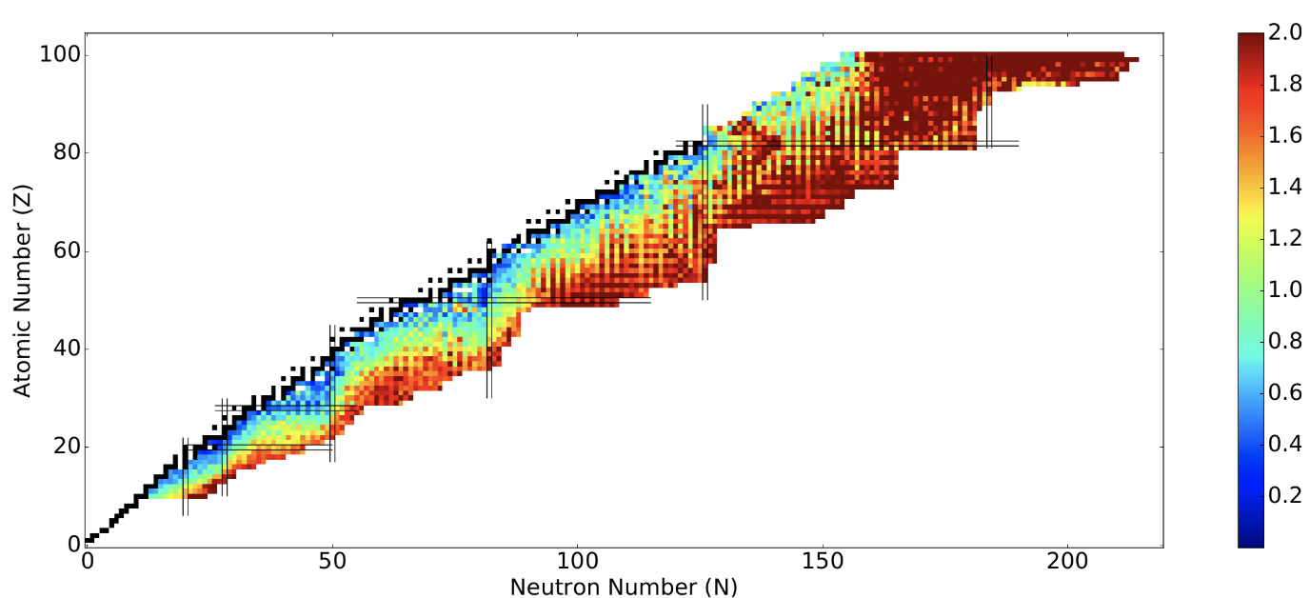
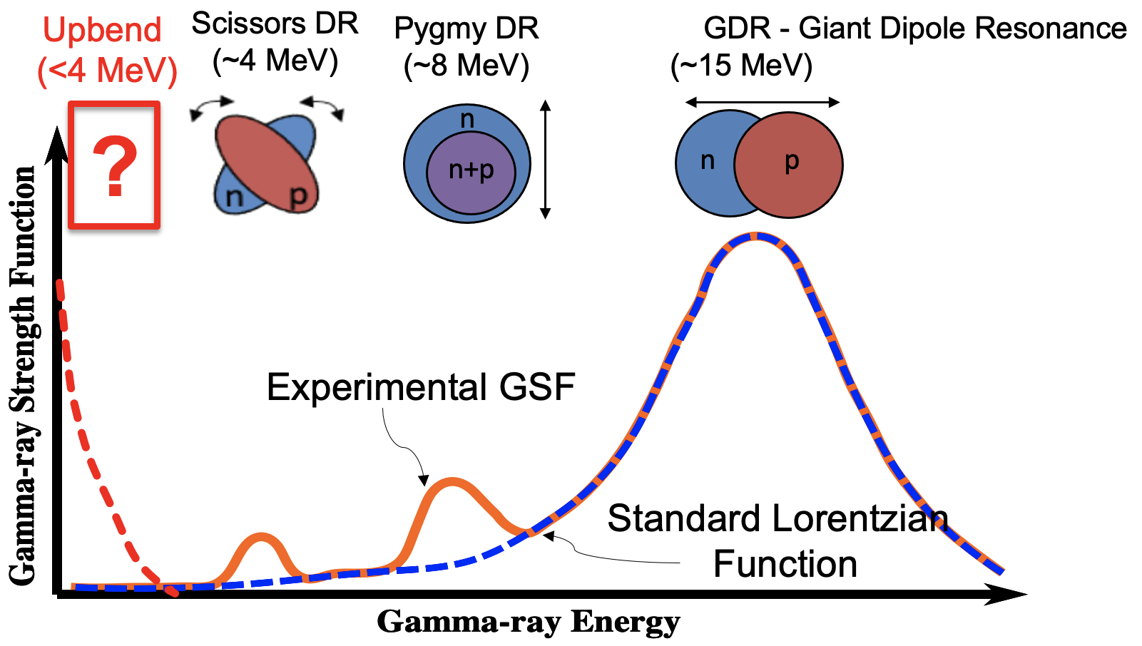
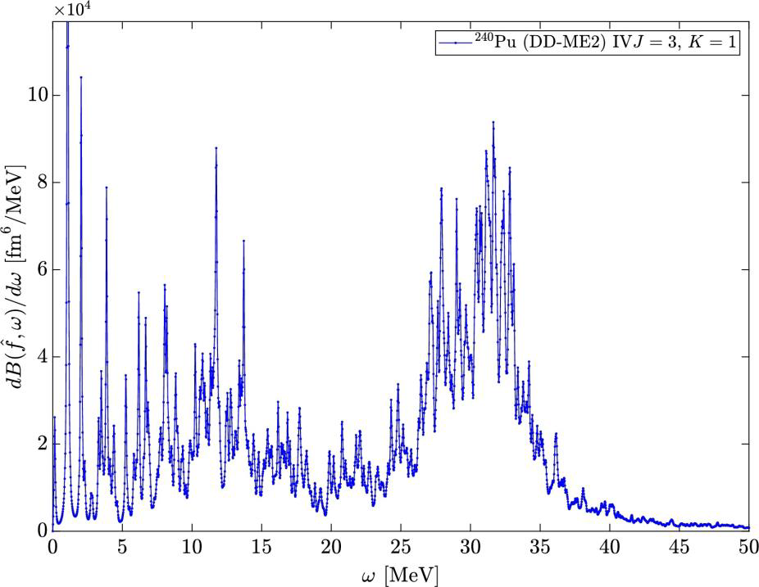
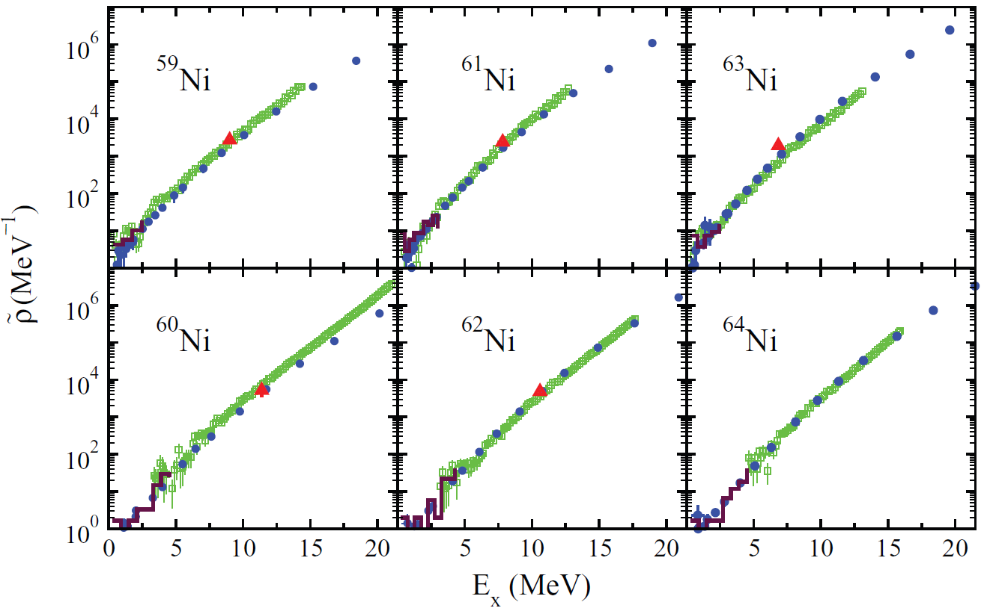
Theory
A. Richards and M. Mumpower: γSF uncertainties lead to large (n,γ) uncertainties
J. Escher: Deeper understanding of the underlying nucl. structure
γ-ray strength from QRPA calculations N. Schunck
Level densities from shell-model calculations by S. Karampagia

Slide 5
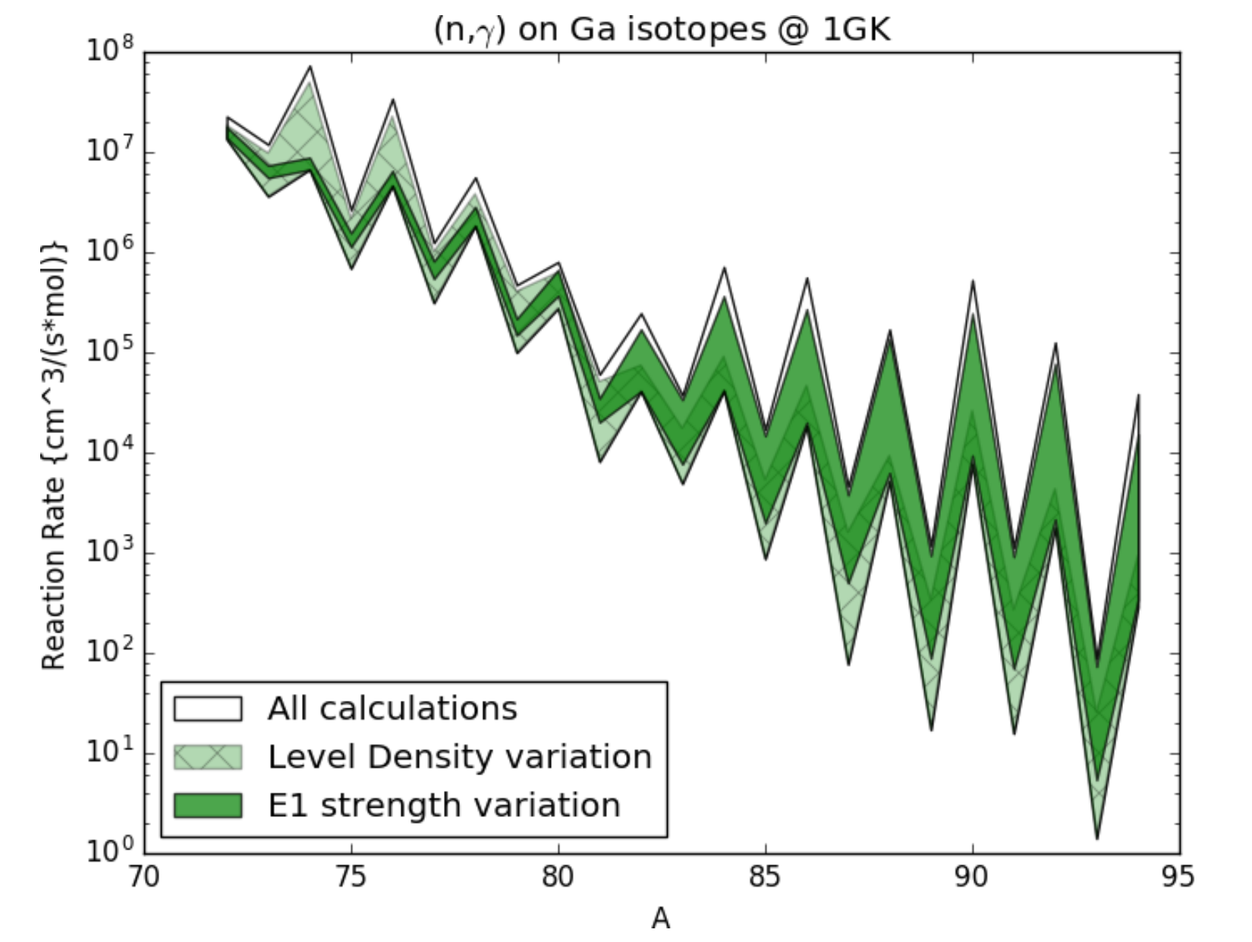
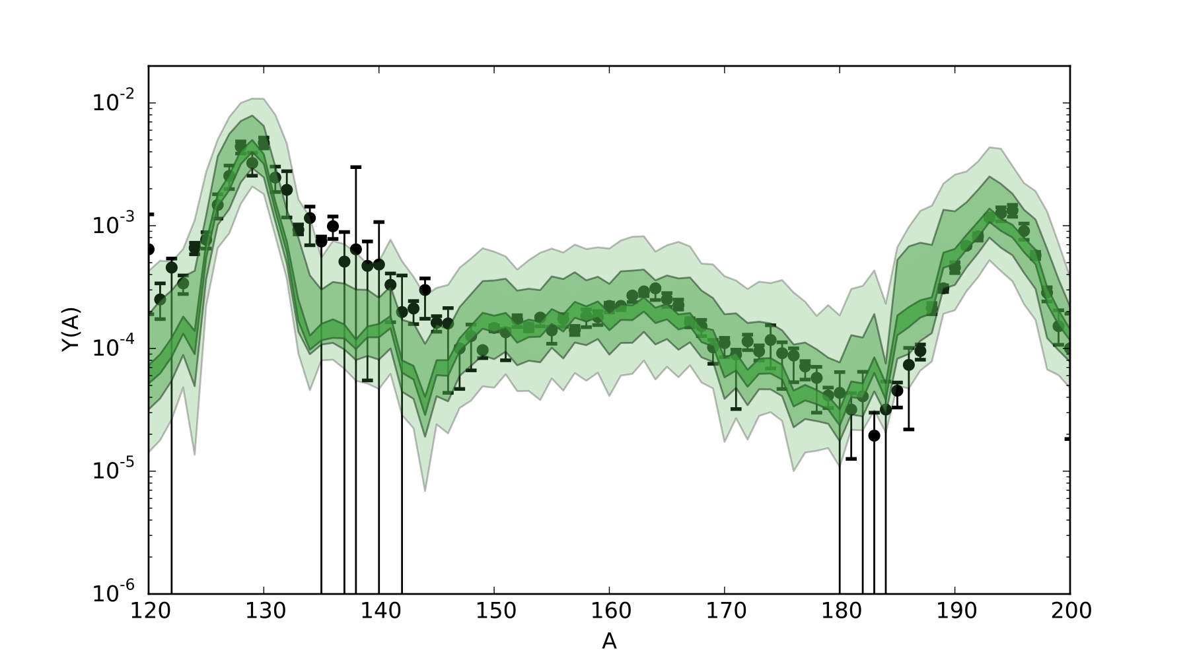
Challenges
Relevance and uncertainties
S. Liddick
M. Mumpower

Slide 6
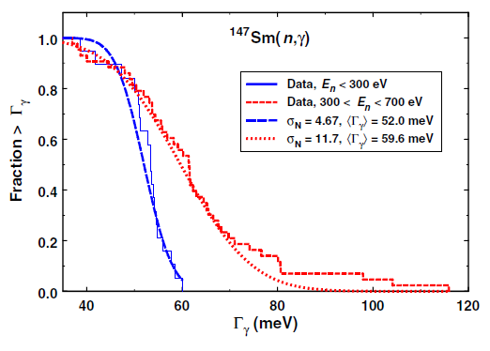
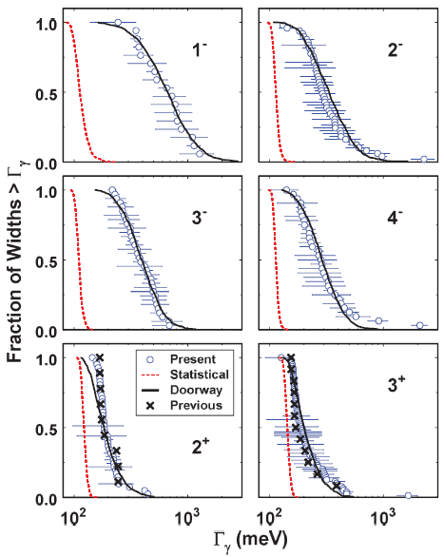
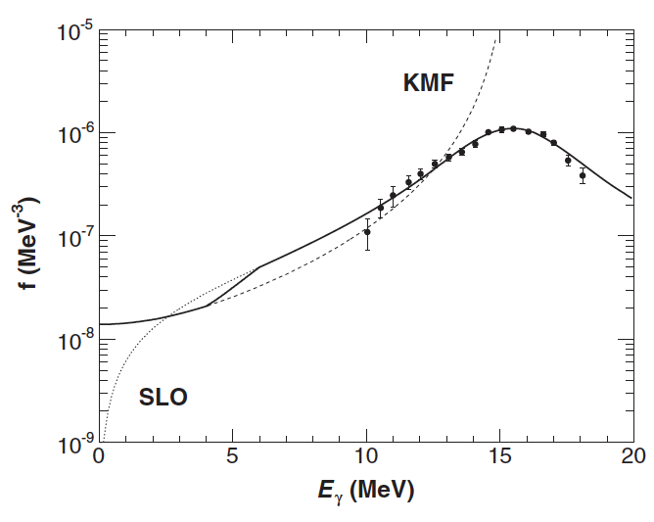
Challenges
Theory development is needed
Using two γ-ray strength functions within the same nucleus.
^{112,114}Sn
⁹⁶Mo
Statistical behavior
P. Koehler
γ-ray cascades to the ground state are described by SLO, while γ-ray cascades to the first 2+ state are described by SLO+KMF.
Nonstatistical behavior

Slide 7
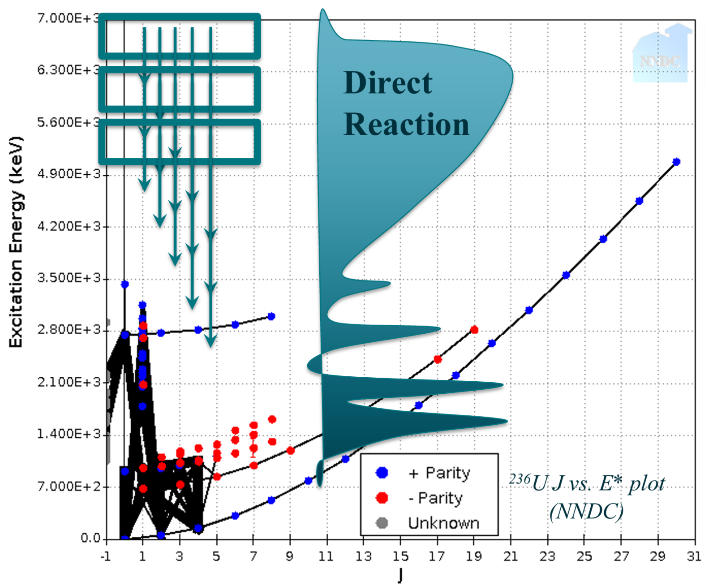
Recommendations for future work:
Development of Evaluated QC properties library
→ Preferred gSF/NLD models for reactions
Targeted experiments to push theory forward
→Identify needs and create experiment to target resolving specific questions/challenges
gSF: Microscopic explanation of features? Dependence on deformation, mass, N? Limits of Brink-Axel assumption(s)?
NLD: Correlations in LDs? Impact of deformation, spin-dependencies, non-equal parities?
Experimental neutron-rich anchor points to benchmark theoretical developments
→ Complete spectroscopy experimentation
β-decay feeding
Complete spectroscopy may be necessary to enable a full description of gamma emission from neutron capture. Encompassing both discrete level information and QC information.

