Slide 1
Oak Ridge National Laboratory Experimental Nuclear Data Capabilities and Needs for Isotope Production
Justin Griswold

Slide 2
High Flux Isotope Reactor (HFIR) and Radiochemical Engineering Development Center enable heavy element production at Oak Ridge National Laboratory
HFIR and REDC began operation in 1965 and 1966, respectively
HFIR operation is expected to continue at least until 2040
High-end aspects of isotope production (heavy actinides, specialty medical isotopes), neutron scattering, and materials irradiation
Unique capabilities for radioisotope separations (>400 isotope shipments annually to universities, hospitals, industry, and other research institutions)

Slide 3
HFIR: Unique capabilities
Highest thermal flux in Western world
2.1 × 10¹⁵ n/cm²-s thermal
1 × 10¹⁴ n/cm²-s epithermal (< 1 MeV)
4.7 × 10¹⁴ n/cm²-s fast (> 1 MeV)
Brightest cold neutron source in world
Delivers 6–7 cycles per year
Missions:
Neutron scattering research
Isotope production
Material irradiation
Neutron activation analyses
HFIR operations are supported by the Office of Basic Energy Sciences in DOE’s Office of Science

Slide 4
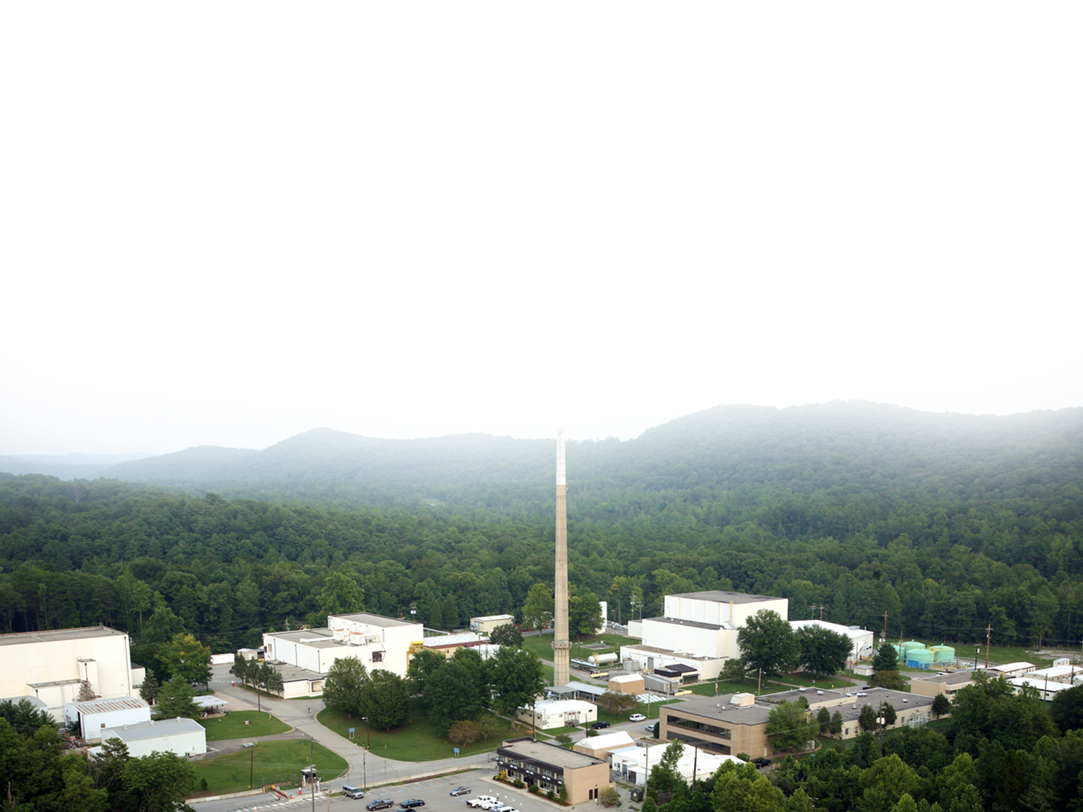
Current and emerging radioisotope production at ORNL
²²⁸Th
²⁴⁹Bk
²⁵⁷Fm
⁸⁹Sr
^{254/253}Es
^{117m}Sn*
³³P*
⁹⁰Sr†
¹⁵³Gd*†
²²⁷Ac*
²⁵²Cf
²²⁵Ac(A/D)*
¹³³Ba
⁶³Ni
⁷⁵Se
²²⁴Ra/²¹²Pb*
¹⁸⁸W/¹⁸⁸Re*
^{166m}Ho*
²²³Ra/²²⁷Th
¹⁷⁰Tm*
²²⁹Th*
¹⁴⁷Pm
²³⁸Pu
¹⁹¹Os*†
¹⁹²Ir*†
⁶⁰Co†
¹⁷⁷Lu(direct) *†
⁶⁰Co(crystals)†
^{195m}Pt*
²²⁹Th*
¹⁴⁷Pm*
¹⁴C*
²¹⁰Pb*†
¹²⁵I †
¹²⁹I †
²³⁰Th†
¹⁰⁹Cd*†
¹⁷⁷Lu(indirect)*†
ORNL also dispenses high purity ^{238,239,240,242,244}Pu, ²³⁷Np, ²⁴³Am, ⁹⁹Tc, ²⁰⁹Po, ^{233,234,235,238}U, and ^{244,248}Cm from inventory
In production
Production ready
Proposed / Under development
Emerging
* Limited Production / facilities needed
† ‪‪‪ Cost proposal submitted / in preparation
A/D Accelerator or Decay produced
The production of these radioisotopes is made possible because of the High Flux Isotope Reactor and hot cell processing capabilities at ORNL
Notes:
34 isotopes produced/dispensed for DOE IP plus Pu238 for NASA= 35 isotopes

Slide 5
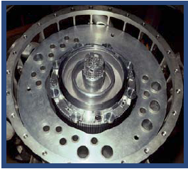
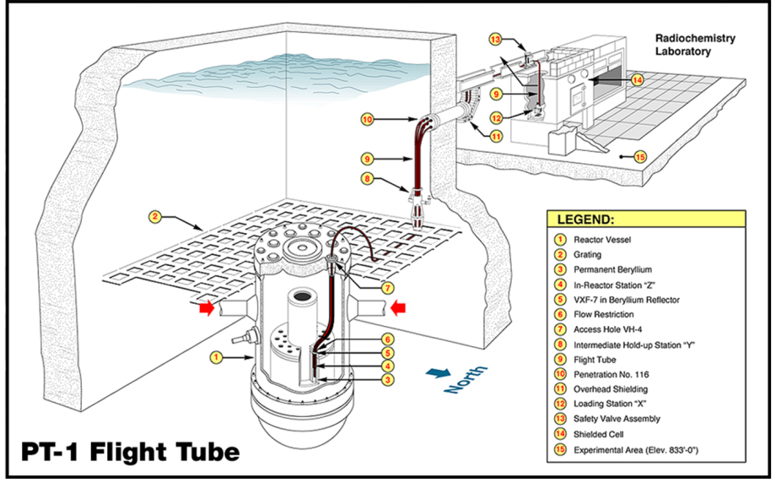
Neutron Activation Analysis (NAA) Facility
Top Side of Reactor and Beryllium Reflector
Contains two pneumatic tube facilities
PT-1 Thermal Flux 4 x 10¹⁴ n cm⁻² s⁻¹
PT-2 Thermal Flux 4 x 10¹³ n cm⁻² s⁻¹
Post-irradiation, PT-1 samples are delivered to a lightly shielded hot cell and PT-2 samples are delivered to a fume hood
Location of NAA PT-1
Unique set-up for nuclear data experiments involving short-lived radionuclides
Various HPGe detectors are available in the NAA lab for post-irradiation sample analysis
Several are optimized for loss-free counting of short-lived radionuclides

Slide 6
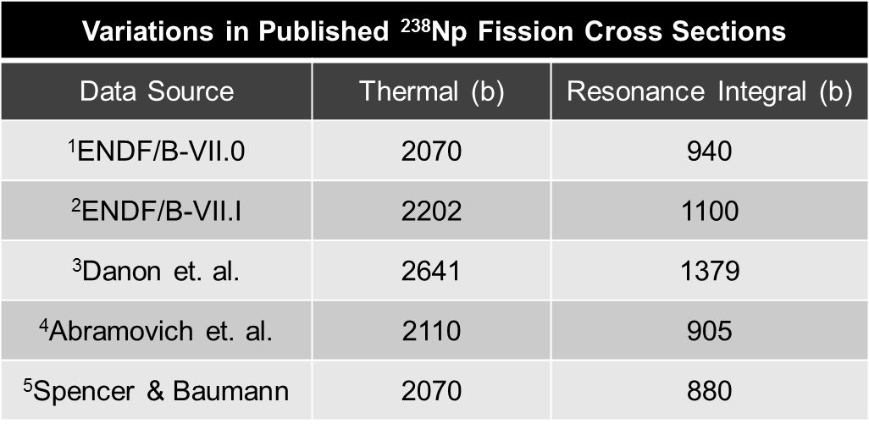
Np-238 Fission Cross Section
Largest source of heat generation in ²³⁷NpO₂/Al cermet pellets irradiated in HFIR to produce ²³⁸Pu
Short half-life (2.117d), makes experimental measurements difficult
Series of experiments led by C. Romano and D. Glasgow performed at NAA facility (PT-1) to measure ²³⁷Np(n,γ)²³⁸Np and ²³⁸Np(n,f) effective reaction cross sections
¹M. B. Chadwick, et. al., ENDF/B-VII.0: Next Generation Evaluated Nuclear Data Library for Nuclear Science and Technology, Nuclear Data Sheets, 107, pp. 2931-3060, 2006.
²M. B. Chadwick, et al., ENDF/B-VII.1 Nuclear Data for Science and Technology: Cross Sections, Covariances, Fission Product Yields and Decay Data, Nuclear Data Sheets, 112, pp. 2887-2996, 2011
3DANON, Y., MOORE, M.S., KOEHLER, P.E., et al., Nucl. Sci. Eng., 1996, V. 124,p. 482.
⁴ABRAMOVICH, S.A., ANDREEV, M., BOL'SHAKOV, Yu., et al., Proc. of the XIII Meeting on Physics of Nuclear Fission in the Memory of SMIRENKIN, G.M. (Prof.), Obninsk, 1995, p. 303.
⁵J. D. SPENCER and N. P. BAUMANN, "Measurement of Integral Fission Cross Sections for 238Np," Trans. Am. Nucl. Soc., 12, 284 (1969).2

Slide 7
Np-238 Fission Cross Section (Cont.)
Effective two-group cross section for ²³⁷Np(n,γ)²³⁸Np as measured in NAA is close to previously measured experimental data and evaluated data¹
Flux for PT-1 closely monitored with monitor foils before and after irradiation
ORIGEN depletion used as comparison to experimental data
²³⁸Np experimental recovery agreed, ²³⁹Np experimental recovery was 30-60% lower²
Supplementary data also needed for fission product harvesting (¹⁴⁷Pm, ⁸⁵Kr, ⁹⁰Sr etc.)
¹Catherine Romano, Ram Venkataraman, David Glasgow & Ben Roach (2022) Measurement of the Effective Capture Cross Section of ²³⁸Np in the High Flux Isotope Reactor, Nuclear Technology, 208:11, 1696-1703, DOI: 10.1080/00295450.2022.2070353
²Riley Hunley, Justin Knowles, & David Glasgow (2015), Verification of the ²³⁸Np Fission Cross Section for HFIR ²³⁸Pu Production. ANS Winter Meeting, Washington D.C.

Slide 8
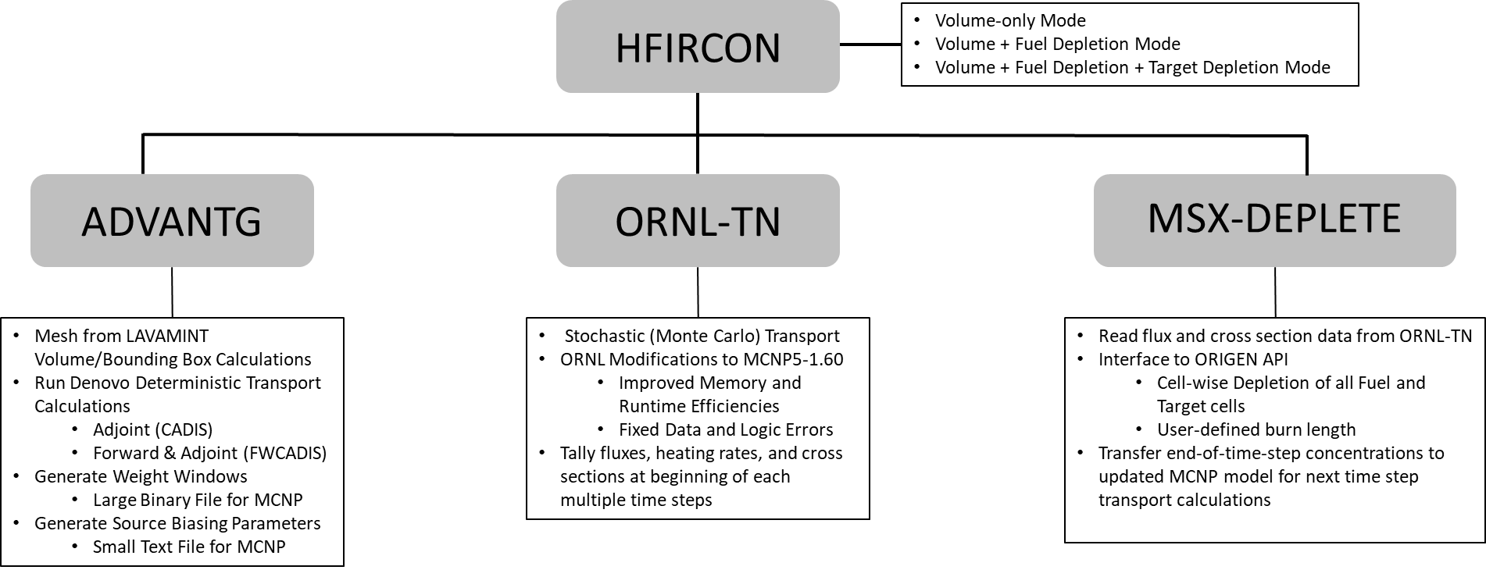
How we use nuclear data - HFIRCON
Toolkit to Automate Many HFIR Transport Calculations
Initial Development to Support ²³⁸Pu Production
Extends many code improvements initially developed for large ITER analyses
Final Product Intended to Support Numerous Other Analyses
Materials Testing, Isotope Production, Target and/or Core Design
Heat generation rates
Cycle length calculations
Supports HFIR target safety bases
S. C. Wilson et al., HFIRCON Version 1.0.5 User Guide, ORNL/TM-2020/1742 (2020).

Slide 9
HFIRCON Nuclear Data Needs
Reaction Cross Sections for New Isotope Production Campaigns (recently added (n,g) xs for ¹⁸⁷W/¹⁸⁸W and ²²⁸Ra)
Reaction cross sections for ORIGEN depletion
Full evaluation with scattering and secondary particle production not needed for ORIGEN
Best Available Gamma Production Data (GPD)
Local heat generation rates can be off significantly in isotope production or materials testing targets
With no GPD, photon energy from (n,X) reactions remains local to the target
For light elements much (95+ % in some cases) of the gamma energy is absorbed outside of the region of interest
Even for heavier elements (e.g., tungsten) roughly half of the gamma energy may be transported out of region of interest
For a portion of the HFIR control elements, local heating rate calculations were conservative by roughly 5x due to missing GPD

Slide 10
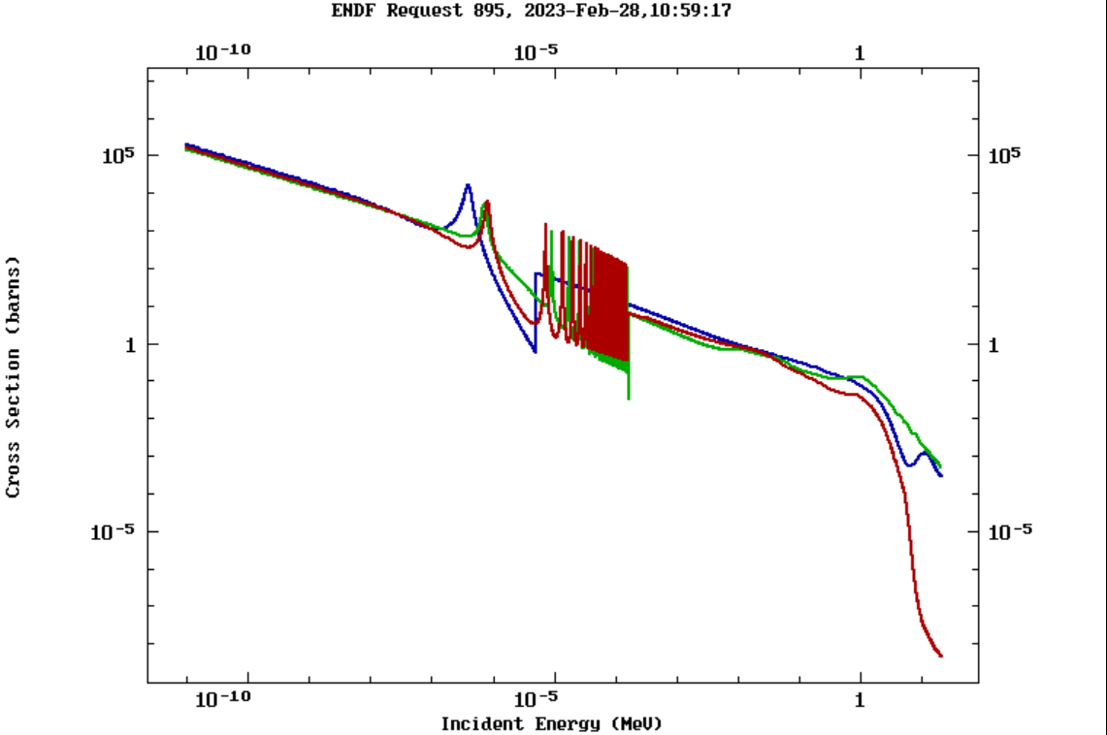
Heavy Actinide Nuclear Data Needs
²³⁹Pu
²⁴⁰Pu
²⁴¹Pu
²⁴²Pu
²⁴³Pu
²⁴³Am
²⁴⁴Am
²⁴⁴Cm
²⁴⁵Cm
²⁴⁶Cm
²⁴⁷Cm
²⁴⁸Cm
²⁴⁹Cm
²⁴⁹Bk
²⁵⁰Bk
²⁵⁰Cf
²⁵¹Cf
²⁵²Cf
1.5%
0.3%
10%
8.5%
36%
0.4%
Fission
products
26%
0.8%
Fission
products
Fission
products
64%
Fission
products
~5-10% uncertainty in absorption cross sections of most Cm-Cf isotopes
Uncertain resonance energies
Critical to production of Bk, Es, Fm isotopes used in superheavy element synthesis
Fission products
D.E. Ferguson, A. Chetham-Strode, and J. R. McWerter, ORNL-TM-165, P. 13 (1962).
²⁵¹Cf Absorption Cross Section
Blue: ENDF/B-VIII.0
Green: JEFF-3.3
Red: ROSFOND-2010

Slide 11
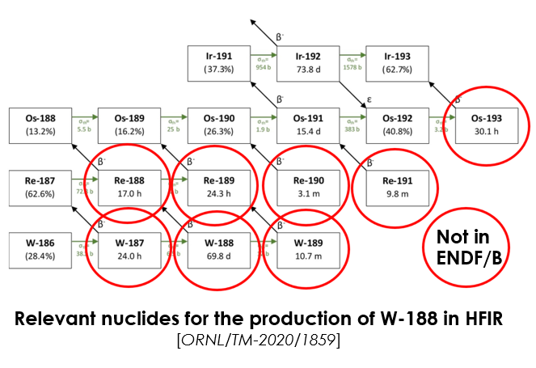
Additional Needs
Inelastic neutron scattering data for ¹¹⁷Sn(n,n’)^{117m}Sn and ¹⁹⁵Pt(n,n’)^{195m}Pt reaction cross sections
Confirmation of ²²⁹Th fission cross section
Largest component of heat generation for HFIR production of ²²⁷Ac and ²²⁹Th through irradiation of ²²⁶RaCO₃/Al cermet pellets
W and Os cross sections related to ¹⁸⁸W production in HFIR through the irradiation of enriched ¹⁸⁶W rings
Gaps in available nuclear data are routinely discovered as new isotope production campaigns begin

Slide 12
How can we help the nuclear data community?
Focus is on isotope production
Data is generated as a coproduced byproduct of isotope production campaigns
Geometry is not ideal for nuclear data experiments
Self-shielding, flux depression etc.
In-situ flux monitoring is not common
Database of experimental data with corresponding theoretical models with accurate experimental geometry?

Slide 13
Acknowledgements
Mitch Allmond
Rike Bostelmann
Chris Bryan
David Chandler
Roy Copping
Charles Daily
David Glasgow
Julie Ezold
Susan Hogle
Riley Hunley
Ben Roach
Cathy Romano
Ram Venkataraman
This research is supported by the U.S. Department of Energy Isotope Program, managed by the Office of Science for Isotope R&D and Production.

Slide 14
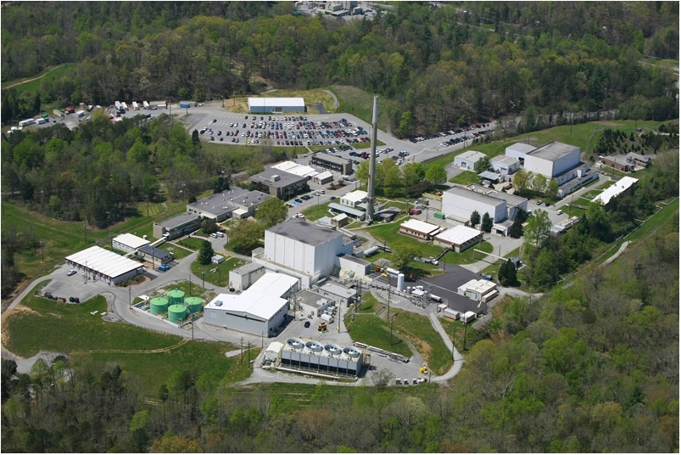
Thank You!

Slide 15
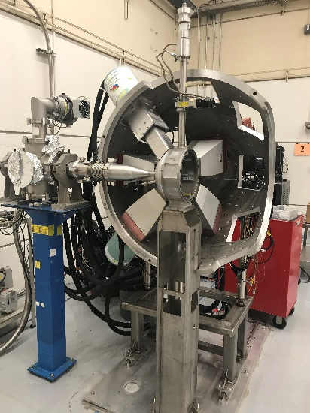
CLARION Detector System
Compton suppressed HPGe detectors
Useful for detecting low-intensity gamma ray emissions within high background
Can perform γ-γ coincidence measurements
Used recently in detection of ²²⁹Pa(t_{1/2} = 1.5 d) from ²³²Th(p,4n)²²⁹Pa reaction
²²⁹Pa decays to valuable medical radionuclide ²²⁹Th
Experiment performed at 88-inch cyclotron at LBL
Precursor to FSDi detection system being installed at FRIB

