Slide 1
WANDA Presentation
27 February - 3 March 2023
Presenter: Tod Caldwell
Program: Office of Experimental Science

Slide 2
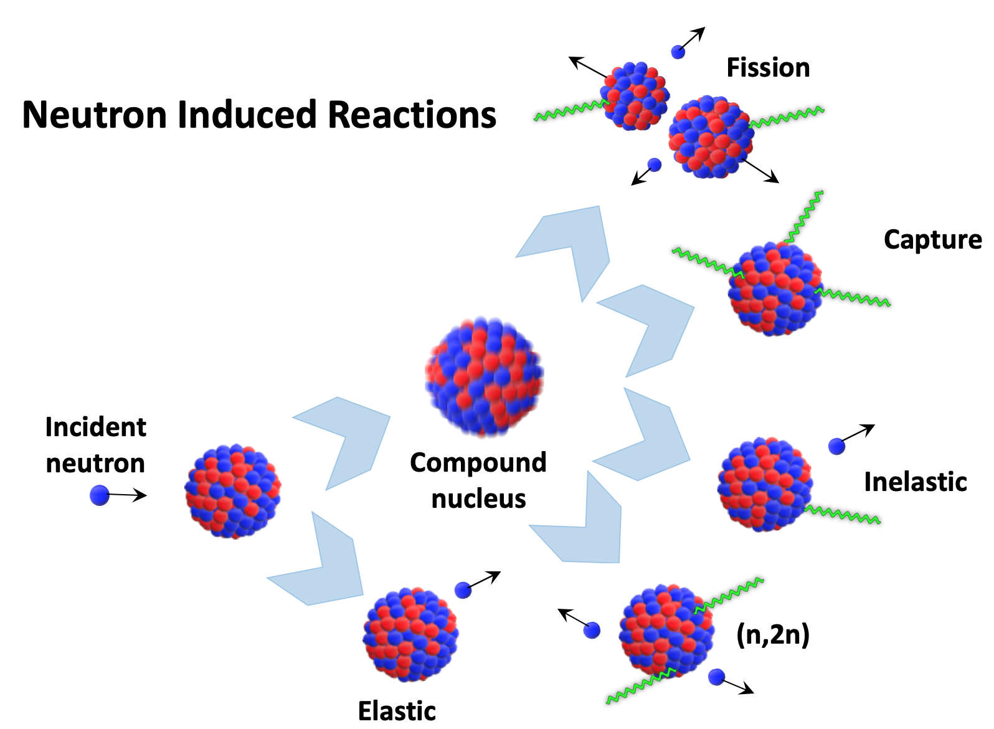
Nuclear science experiments are critical to predictive capabilities
OES supports experimental nuclear science measurements improving our predictive capabilities
  Limited first-principle theory for nuclear physics – experimental measurements are needed
Complex experiments are designed, fielded, analyzed and shared with the nuclear data community
  Efforts benefit applications, but also broader foundational science understanding
Teamwork is a core value
  Partnerships between national laboratories and universities
  Members span a range of experiences, educational levels, and skills
  NNSA also supports connections between national laboratories and universities through SSAA, SSGF, and other programs
OES currently supports measurements in:
Fission properties
Fission product yields
Reactions on unstable isotopes
Neutron scatter

Slide 3
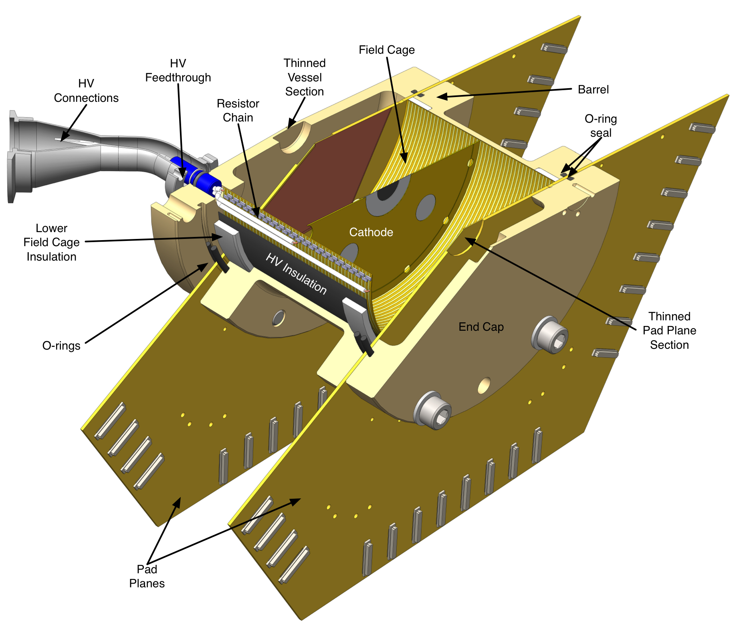
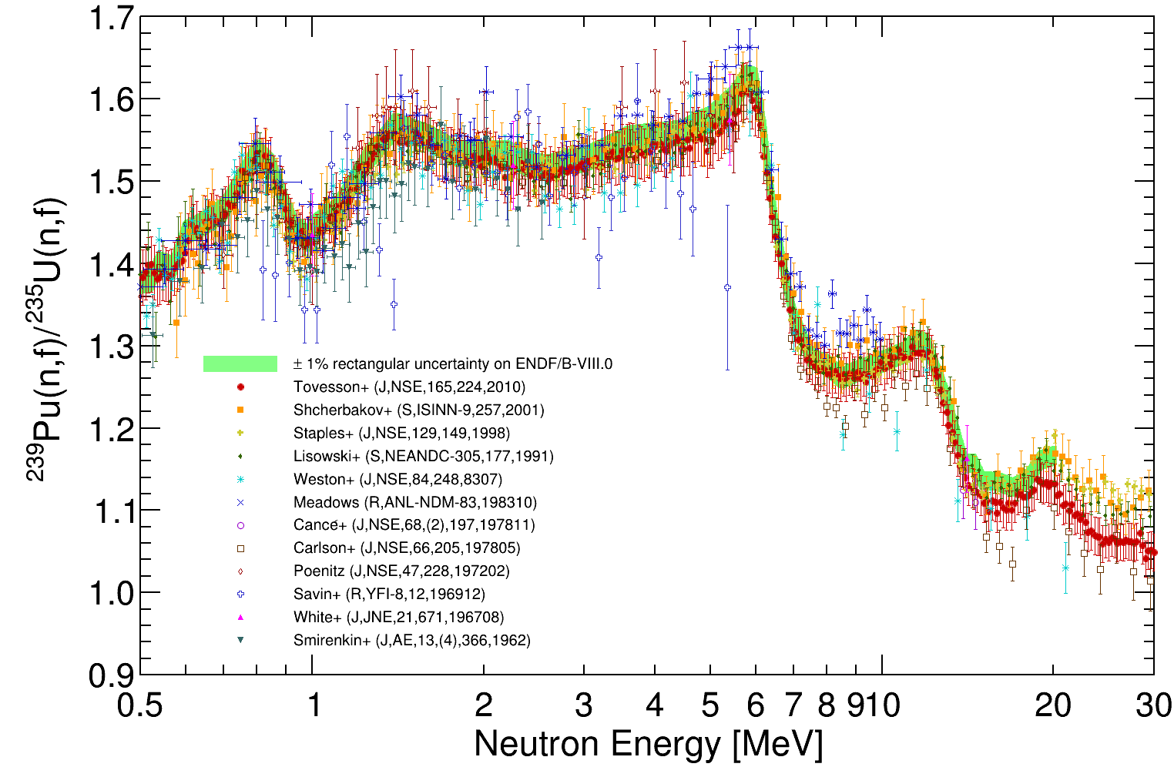
High-precision fission data collected with sophisticated detection systems at LANSCE facility
Fission Time Projection Chamber (fissionTPC) was developed for precision cross-section measurements
  Data for ²³⁵U, ²³⁸U, and ²³⁹Pu neutron-induced fission with unprecedented uncertainty analysis (ENDF/B-VIII)
  NIFFTE collaboration includes LLNL, LANL, Oregon State U., Colorado Sch. Mines, Abilene Christian U., Cal Poly
Chi-Nu was developed to reduce uncertainties of prompt neutron emission spectrum following fission
  Data for ²³⁵U, ²³⁸U, and ²³⁹Pu fission neutrons
  Collaboration includes LANL, LLNL
These efforts were long-term investments that provided excellent data and were achieved through a collaboration between LLNL, LANL, and multiple universities

Slide 4
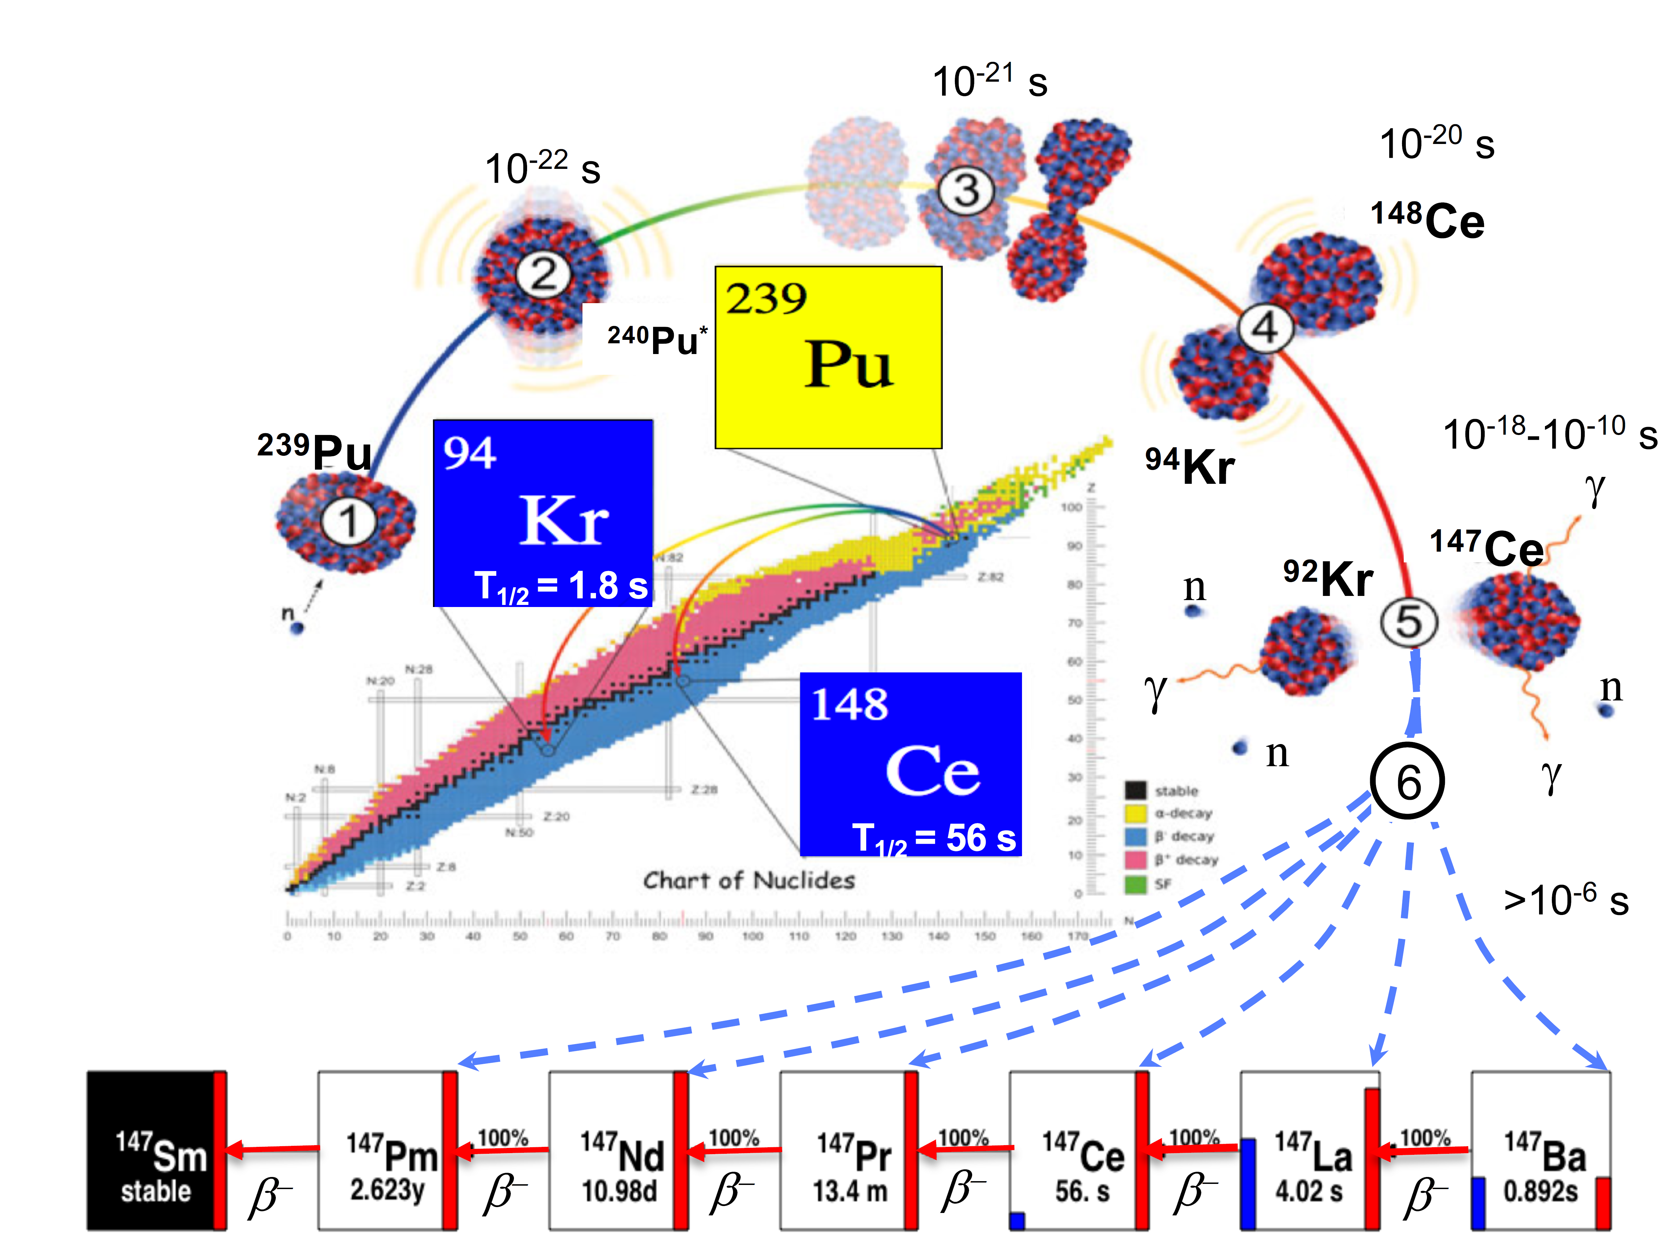
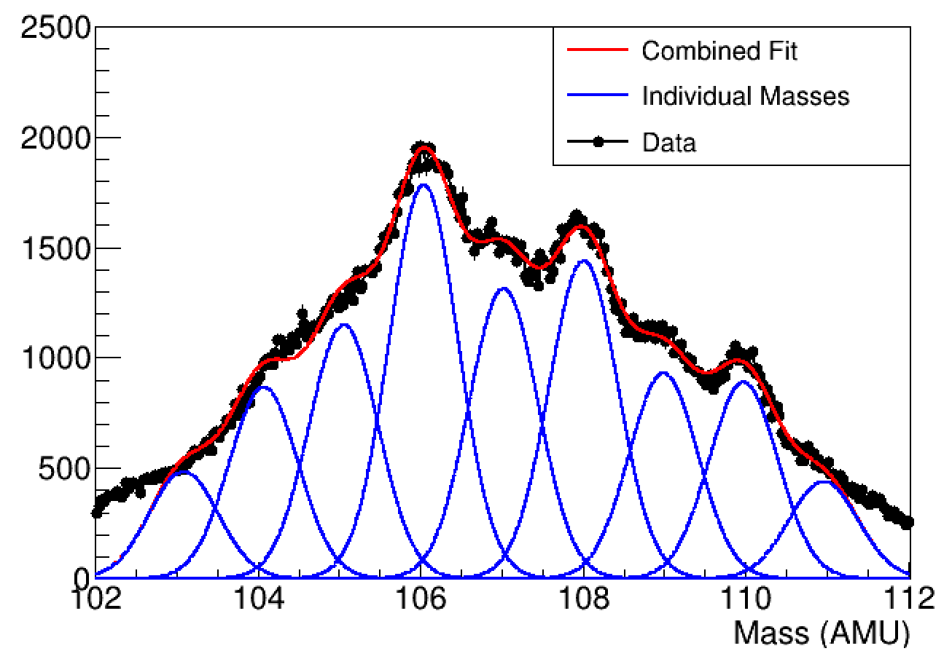
Fission products also provide important attributes of the fission process
Cumulative (long-lived) yields define how many fissions occurred; independent (short-lived) yields help improve fission theory developments
LLNL-LANL-TUNL collaboration developed absolute experimental technique to measure fission products from neutron-induced fission on ²³⁵U, ²³⁸U, and ²³⁹Pu
LLNL-ANL-TAMU collaboration measures branching ratios needed to determine yields
LANL SPIDER effort at LANSCE working toward defining covariances between fission products
Prof. Tornow and LLNL physicist Silano at TUNL
Detectors at TAMU for branching ratios
Mass measurements with SPIDER at LANSCE

Slide 5
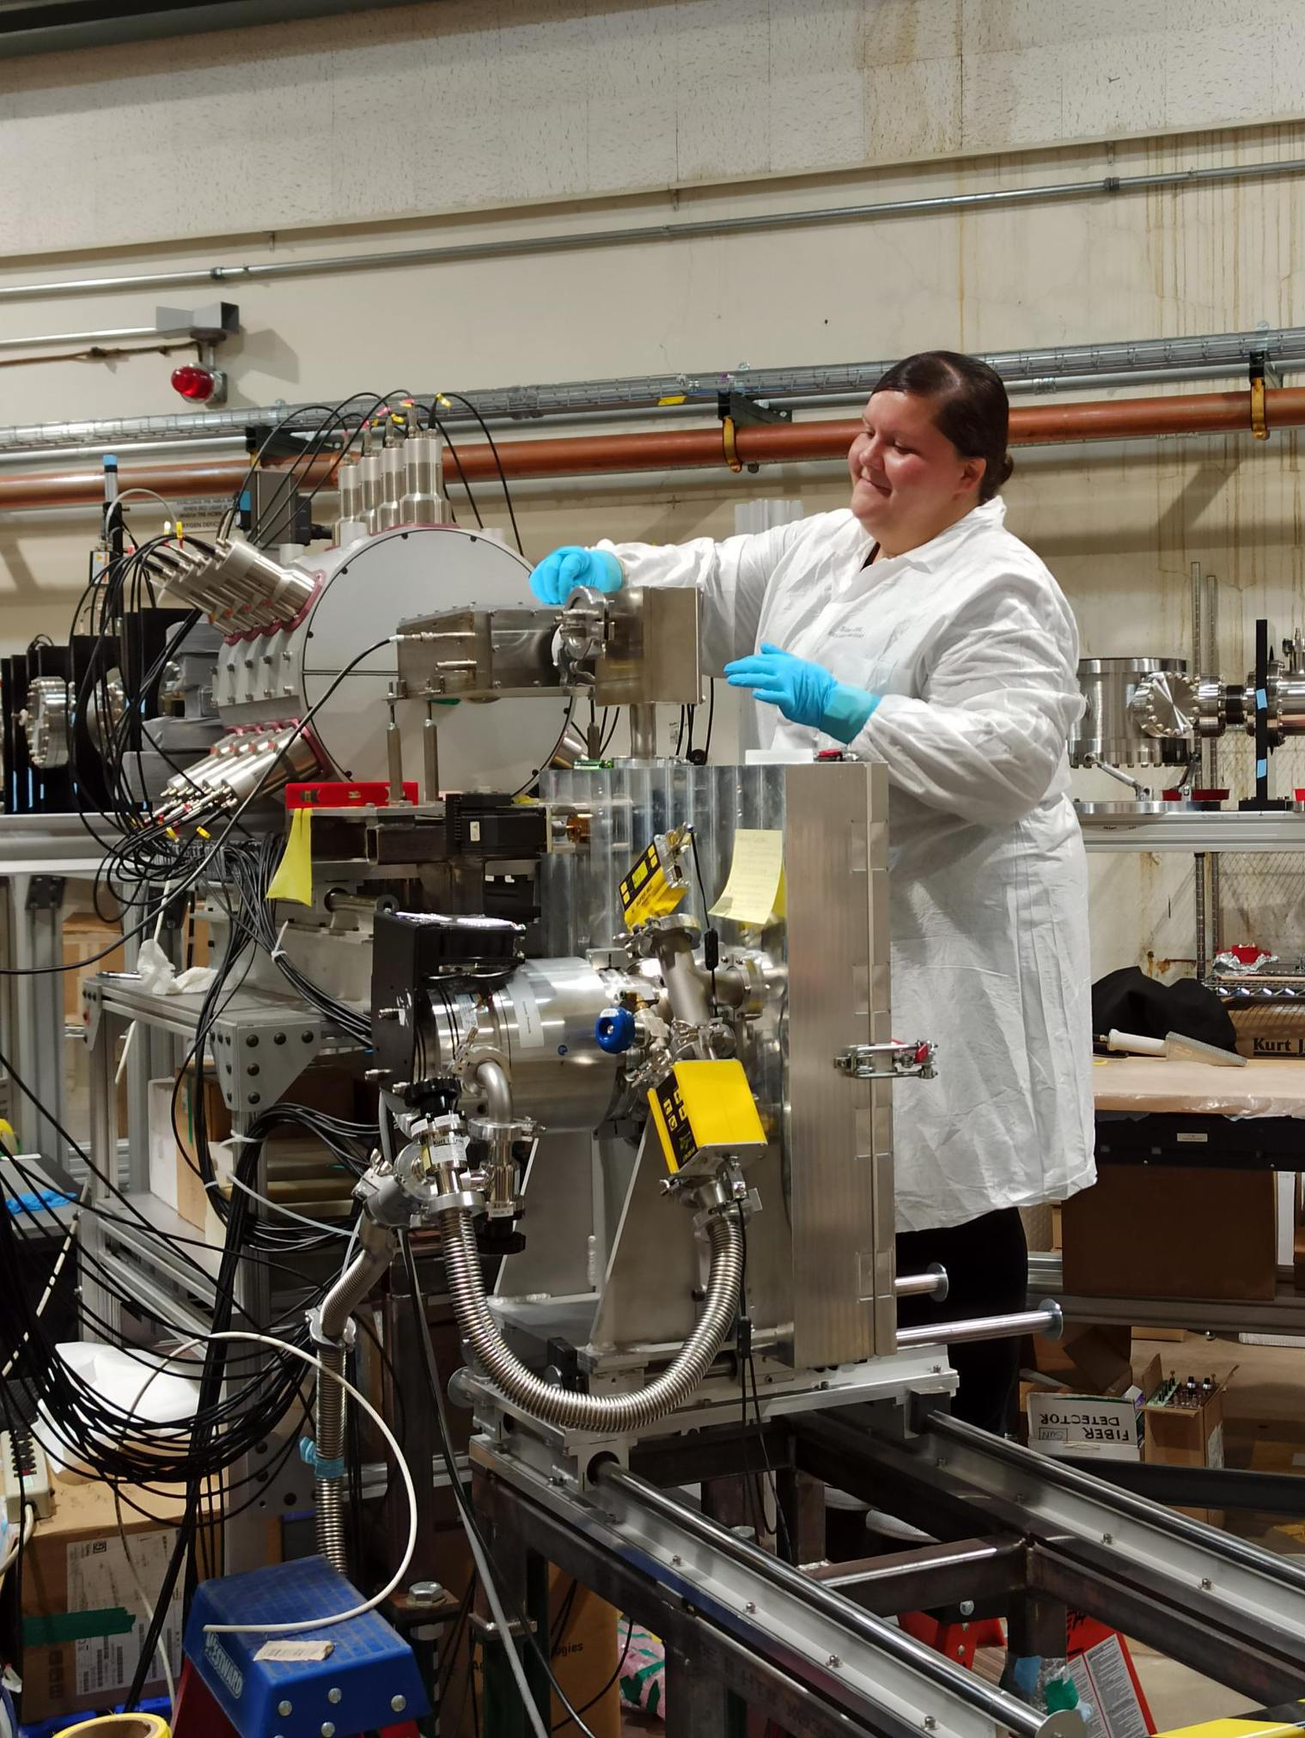
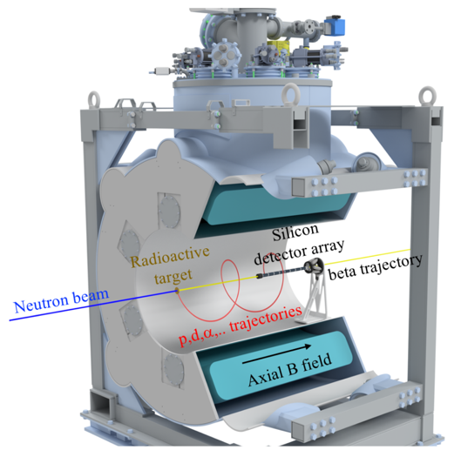
Reaction measurements on unstable isotopes are important, and challenging
Reactions on fission products
  Can affect cumulative yields for isobars
Radiochemical diagnostics
Challenging measurements
  Indirect techniques with LLNL at ANL, MSU, and TAMU
  Direct techniques at NIF and LANSCE
LLNL post-doc Richard with the SuN detector at ANL, indirect neutron capture measurements on A=95 fission products
88
(n,2n)
89
(n,2n)
90
83.4 d
78.4 hr
51%
(n,γ)
(n,γ)
Concept for solenoidal spectrometer targeting (n,p) measurements on radioactive isotopes
Example: simplified Zr reaction network, where many reactions are on unstable nuclei (few to no measurements)

Slide 6
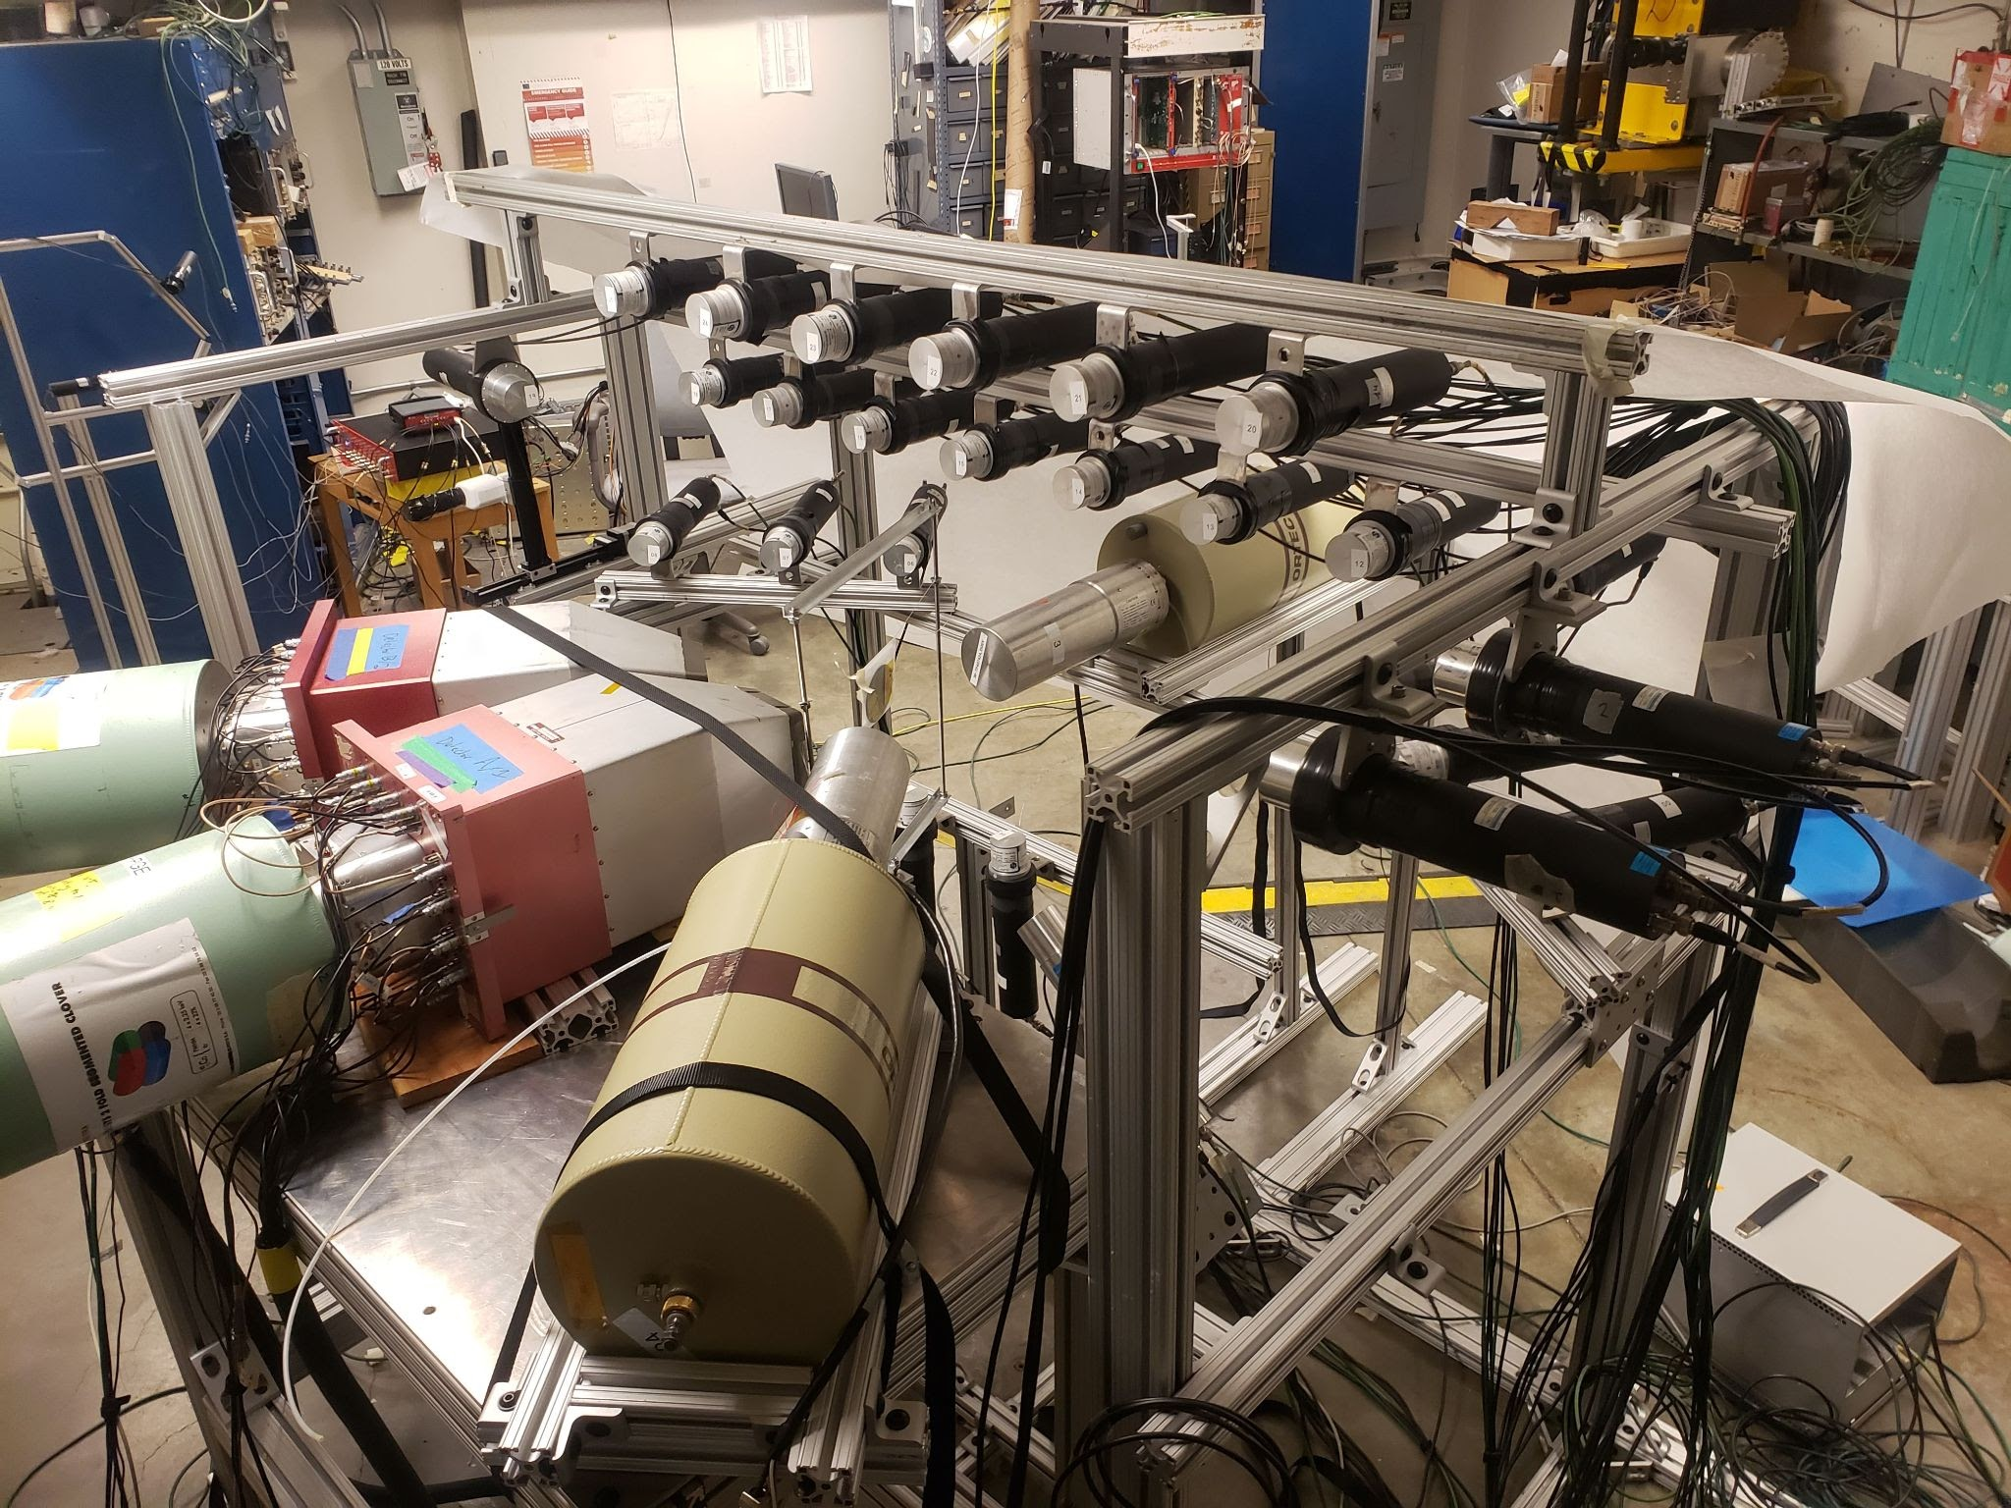
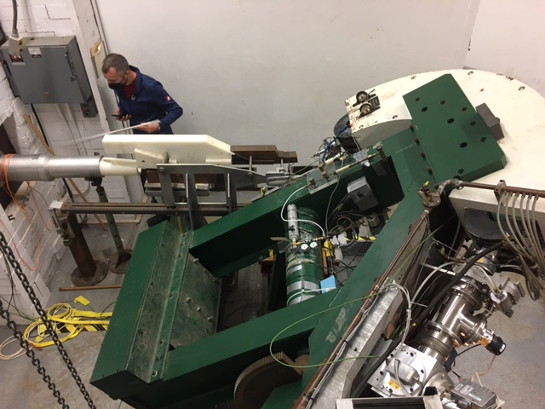
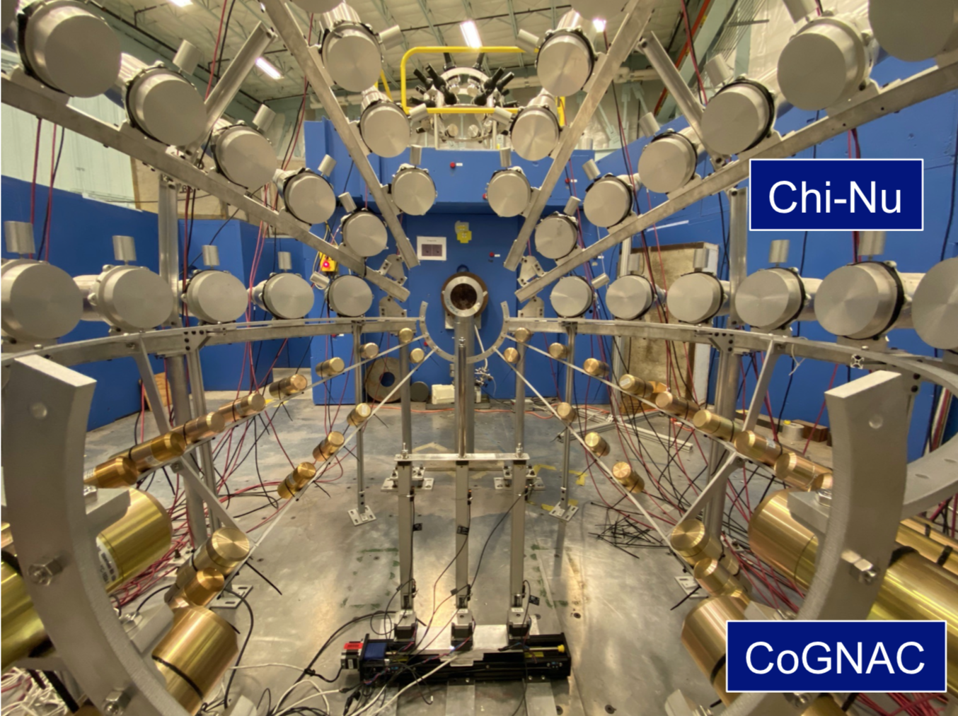
Difficult neutron scatter measurements are also being tackled
Scattering a difficult neutron reaction channel to measure and poorly constrained
  Limited reaction observables: neutrons, γ rays
  Neutrons are very hard (but necessary) to measure, generally rely on time-of-flight for energy measurement (>>10 ns flightpath)
Actinides present more obstacles:
  Significant neutron background from fission
  Low γ−ray energies/intensities in actinides make neutrons the only reliable probe
  Actinide material difficult to work with
Active efforts underway to collect these important data
Light elements, narrow energy neutrons, LLNL with UC Berkeley and LBNL:
GENESIS, large array for γ- and neutron detection at LBNL
Actinide elements, pseudo-monoenergetic neutrons, LLNL with Ohio U. and TUNL:
Swinger magnet and LLNL post-doc Kisyov at Ohio
Light and actinide elements, broad-energy neutron source: LANL at LANSCE with CoGNAC

Slide 7
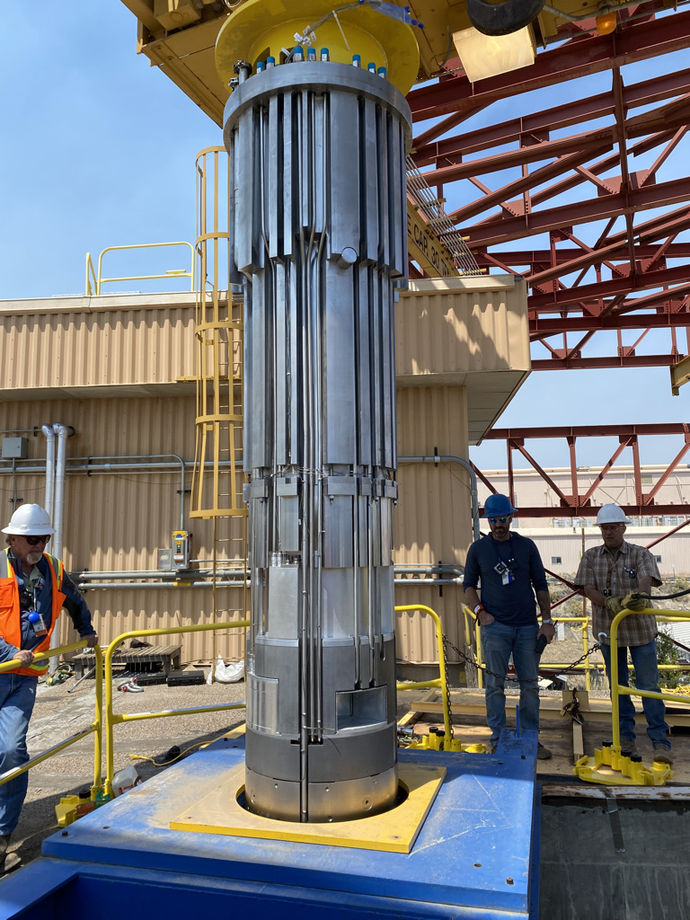
LANSCE’s Lujan Center has seen first neutrons from the newly installed Mk-IV spallation target
  Mk-IV offers higher fast neutron flux and better resolution for nuclear physics measurements.
  Installation was performed during the 2022 LANSCE maintenance cycle, commissioning continued into the 2022 run cycle.
  The DICER instrument successfully performed neutron transmission on a 1 micro-gram sample of radioactive ⁸⁸Zr produced at LANSCE’s Isotope Production Facility.
  The Detector for Advanced Neutron Capture Experiments (DANCE) took initial data which will guide flight path and instrument optimizations needed to exploit MkIV’s capabilities.
MkIV assembly prepared for installation
Schematic of DICER instrument and photograph of radioactive ⁸⁸Zr target

Slide 8
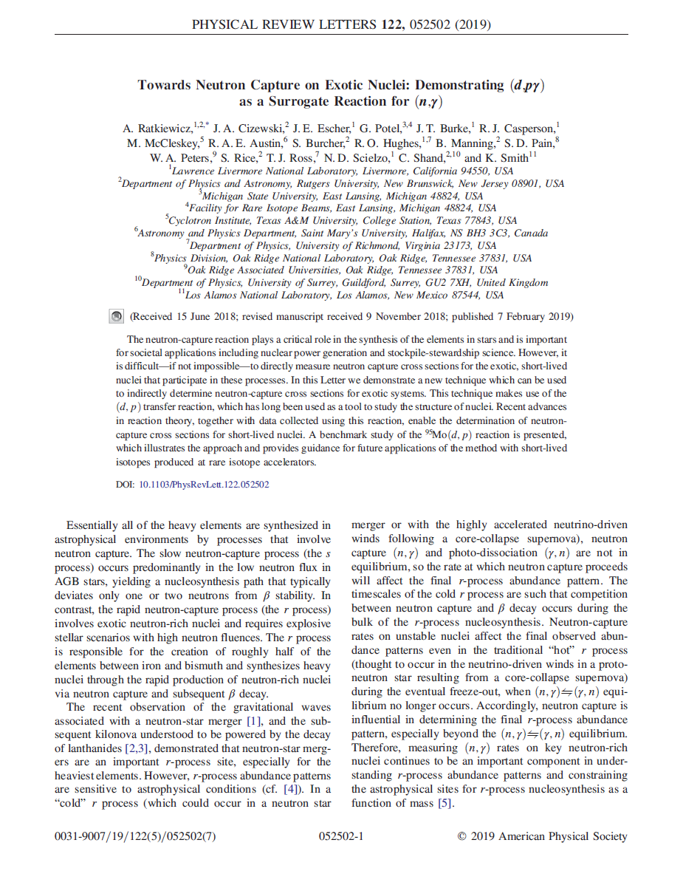
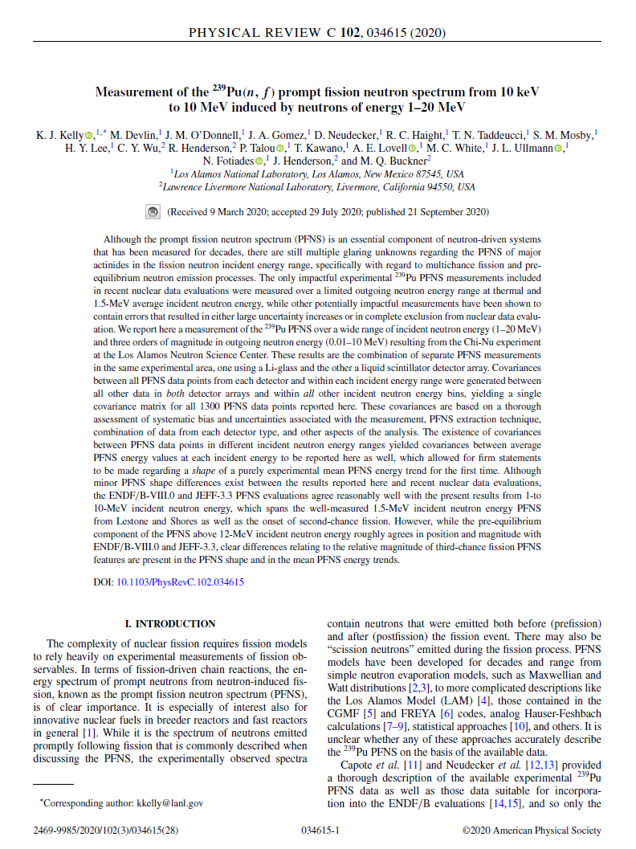
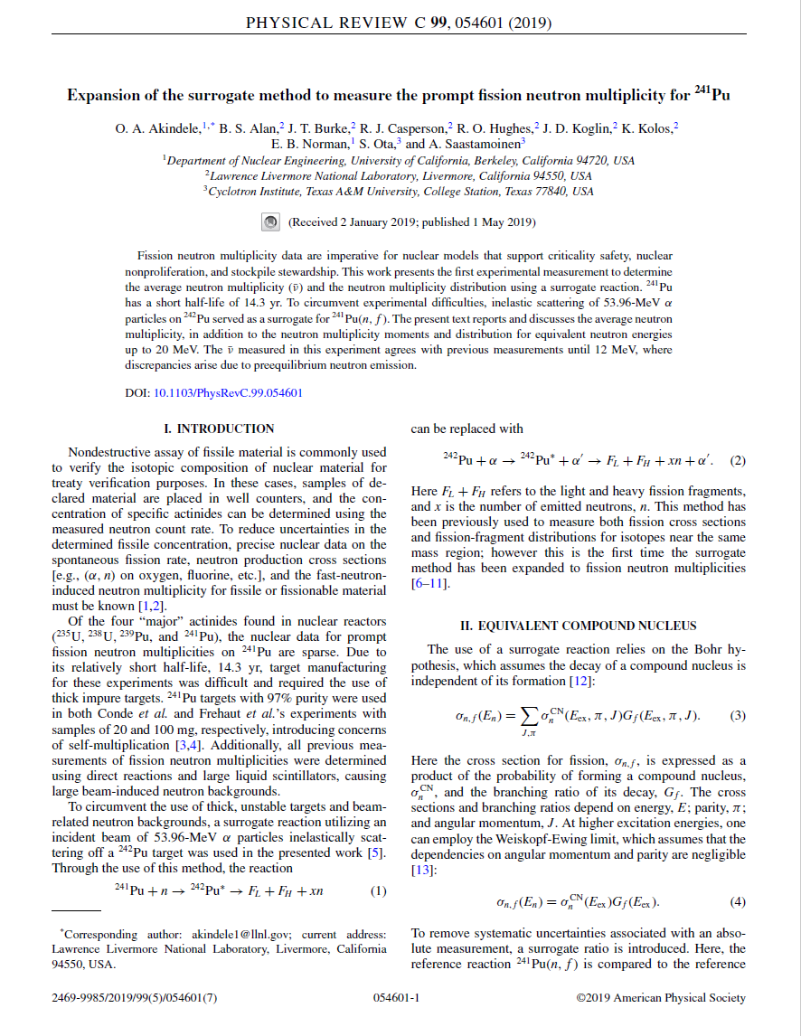
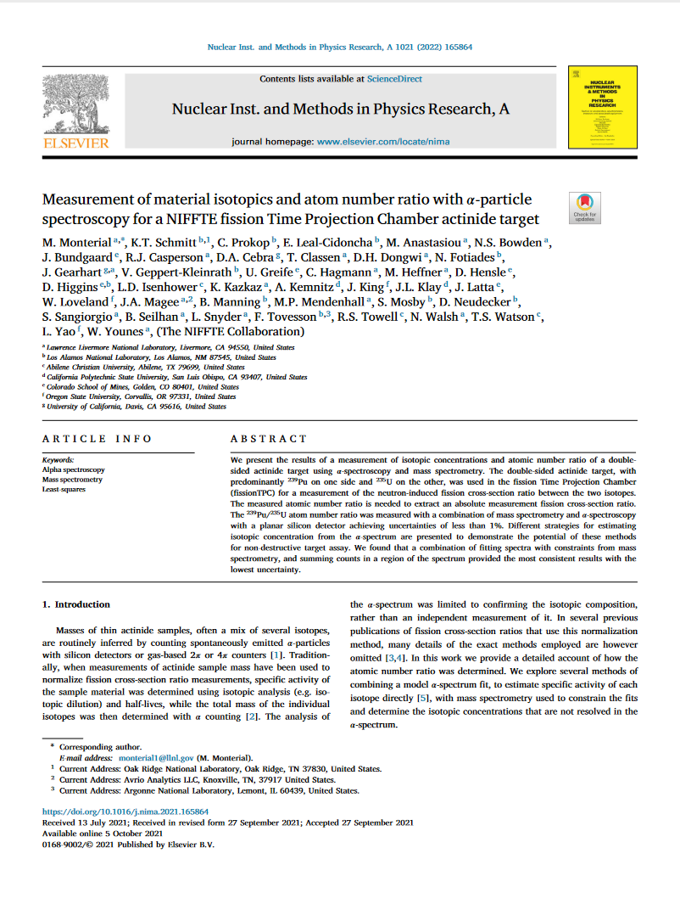

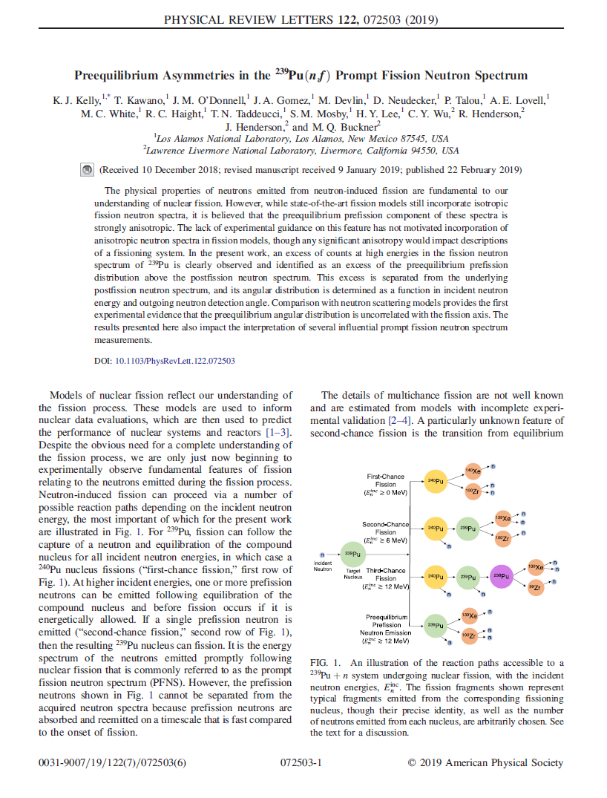
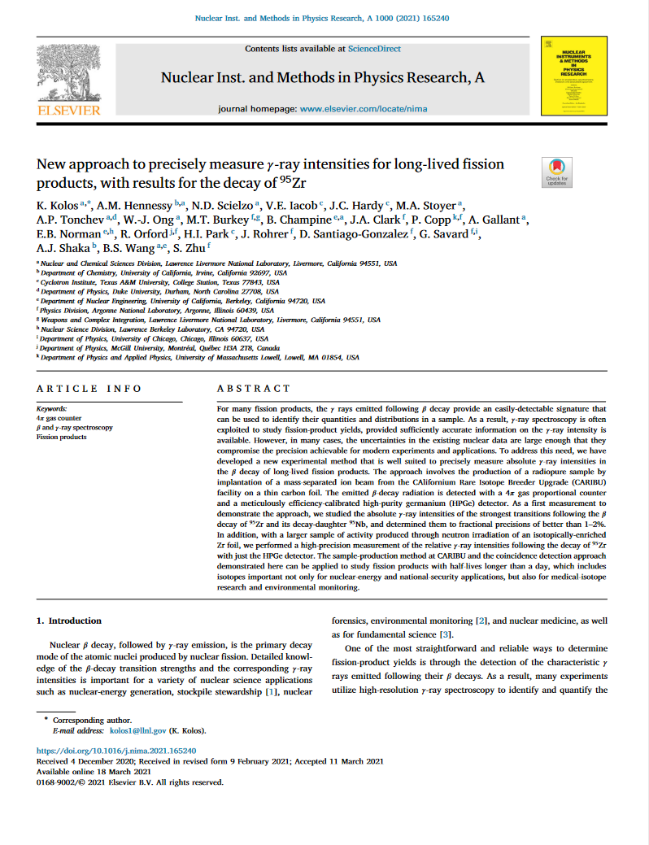
OES supports multiple experimental efforts driven by applications needs
Data needs identified through sensitivity studies and connections across NNSA offices
Challenging measurements taken on by diverse teams
Delivering on fission data
  Fission cross sections, fissionTPC
  Prompt fission neutron spectra, Chi-Nu
  Fission product yields
Expanding capabilities for reactions on unstable nuclei
Developing methods for neutron scatter measurements
Data are shared with the broader community – improves foundational science understanding
Applications
Needs
Delivery
Nuclear Data
Library
Foundational Data
Experiment/Theory
Evaluation
Reaction Theory

Slide 9
LANSCE slides

Slide 10
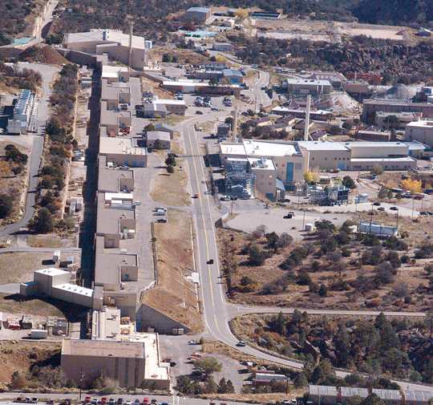
LANSCE’s unique flexibility serves a variety of missions
Proton Radiography (pRad Facility)
Dynamic radiography for defense programs and counterproliferation
Lujan Neutron Scattering Center (Lujan Center)
Neutron scattering and imaging for defense programs and nuclear energy
Nuclear physics for defense programs
Weapons Neutron Research Facility (WNR)
Nuclear physics for defense programs, counterproliferation, and criticality safety
Electronics testing for industry and global security
Isotope Production Facility (IPF)
Medical and other isotopes for the isotope program
Short-lived isotopes for defense programs, non-/counterproliferation, and criticality safety
Ultra-Cold Neutron Facility (UCN)
Unique probe for nuclear physics and NSF, possible future defense program uses
Area A
Future experimental possibilities
UCN
Lujan Center
Area A
pRad Facility
WNR
Accelerator
IPF
  100-800 MeV proton energies
  six target stations (three neutron spallation targets)
  sixteen beam lines

Slide 11
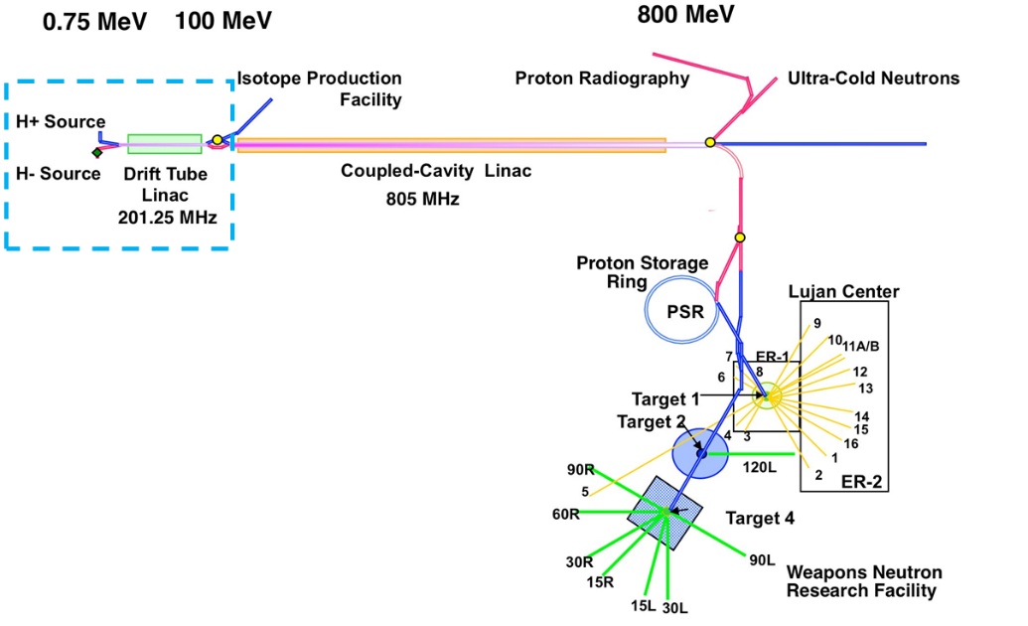
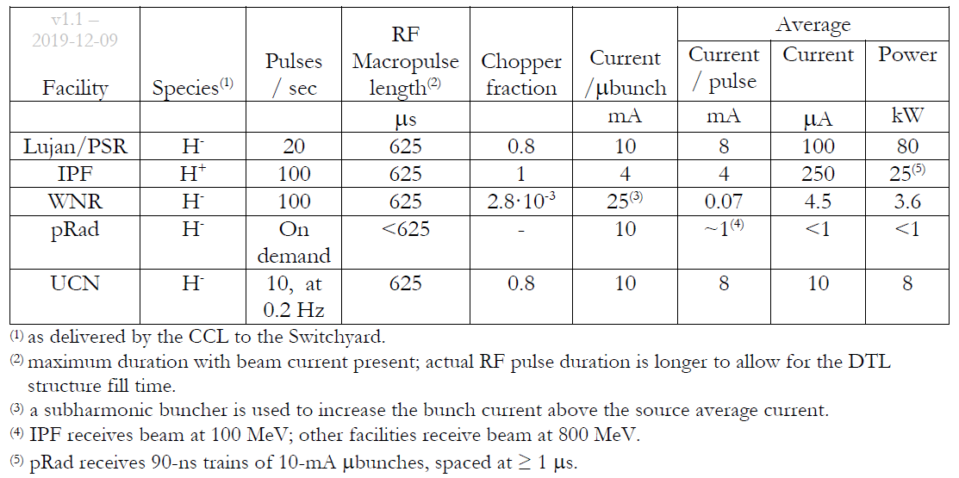
LANSCE delivers diverse research beams supporting multiple missions
PSR: Proton Storage Ring
IPF: Isotope Production Faciltiy
WNR: Weapon Neutron Research
pRad: Proton Radiography
UCN: Ultra-Cold Neutrons

Slide 12
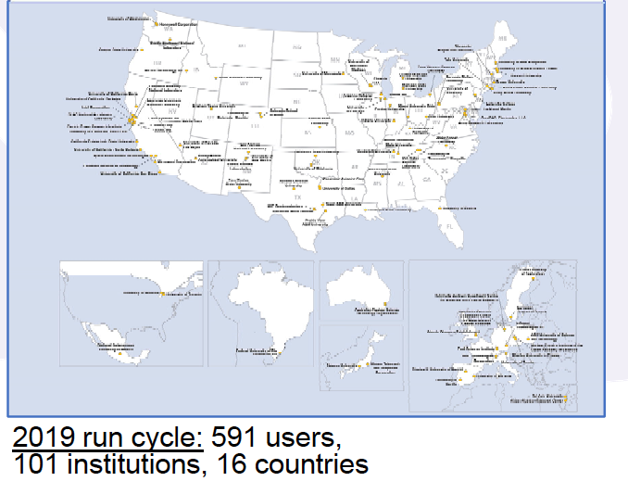
pRad, Lujan, and WNR constitute the NNSA LANSCE User Facility
Proposal process:
Proposals are solicited in January
Each is reviewed for feasibility
Feasible proposals go to review committees in February/March. Each proposal is evaluated for technical merit, relevance, and resource usage
The committees send recommendations to the program in April. The program selects the final plan, with concurrence from line management and the LANSCE user facility director
Experimental reviews before execution ensure safety, security, regulatory, and technical readiness
During June-December run cycle, programs adjust schedules to account for changes in beam delivery, sample availability, programmatic relevance, etc.
As a rule, ~80-85% of the experiments/beam time support NNSA mission deliverables and ~15-20% are reserved for experimental research and development.
All experimental areas are ~2x oversubscribed

