Slide 1
Progress on Nb₃Sn APC Wires
JF. Croteau¹, A. Baskys¹, I. Pong¹, F. Wan², X. Xu²
¹LBNL and ²FNAL (jcroteau@lbl.gov)

Slide 2
Outline
Nanoprecipitate dimensions: APS feasibility study
Investigation of Hf-rich phase
Oxygen content and distribution

Slide 3
Main Objectives
The main (or practical) objective of the ongoing research is to better understand the heat treatment of Nb₃Sn superconducting wires with artificial pinning centers (ZrO₂ and HfO₂) to optimize the heat treatments and produce wires with higher superconducting properties (J_{c} and H_{c2}) for particle accelerator magnets.
This will be accomplished by:
Studying the size and density evolution of nanoprecipitates at different stages and dwell times of a heat treatment
Studying the formation of intermediate phases in the sub-elements at different stages and dwell times of a heat treatment
Modelling the growth of the nanoprecipitates for different heat treatment conditions
1. APS study
3. Oxygen content
2. Hf-rich phase

Slide 4
Nanoprecipitate Dimensions: APS Feasibility Study

Slide 5
Current State of the Research
Nanoprecipitates were characterized using TEM for different temperatures and dwell time at TU Vienna by Alice Moros (previously at LBNL) and colleagues
TEM is limited in the volume of material analyzed
Only few regions in a sub-element were analyzed for each HT condition
We need more data to have a better understanding of nanoprecipitate size from different heat treatments
We want a model to predict/estimate their size for given conditions

Slide 6
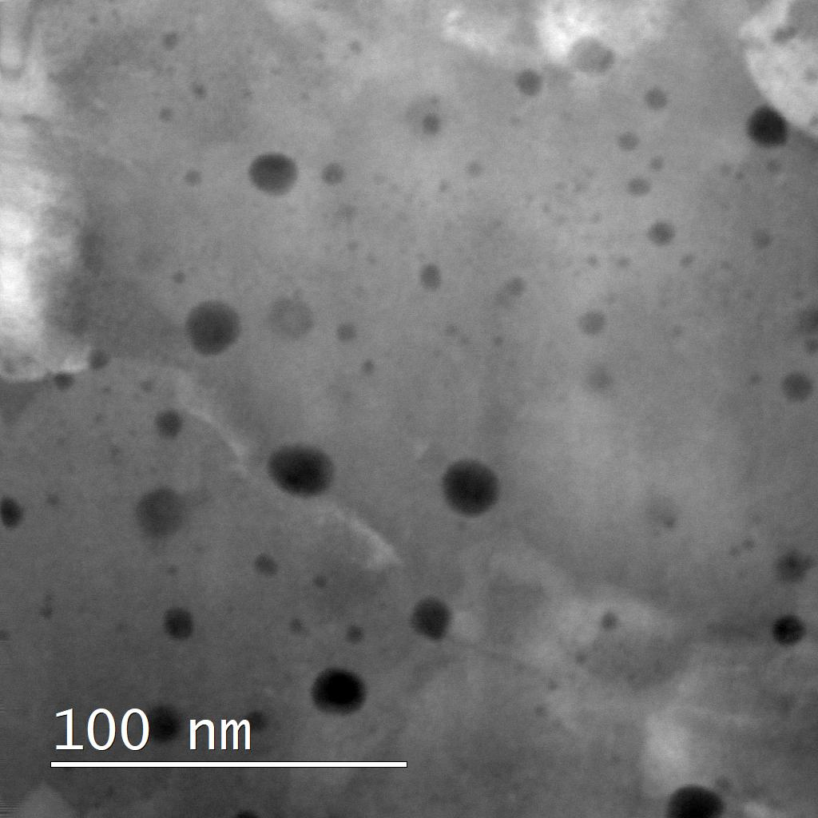
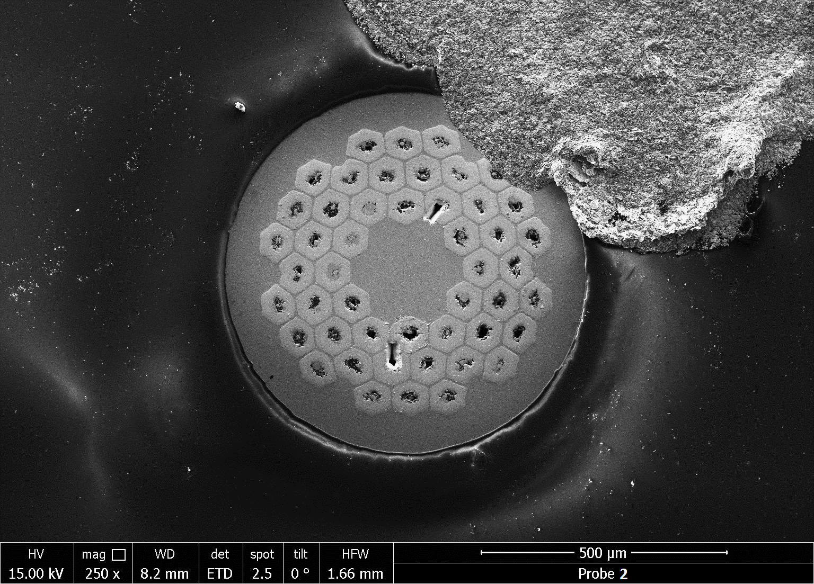
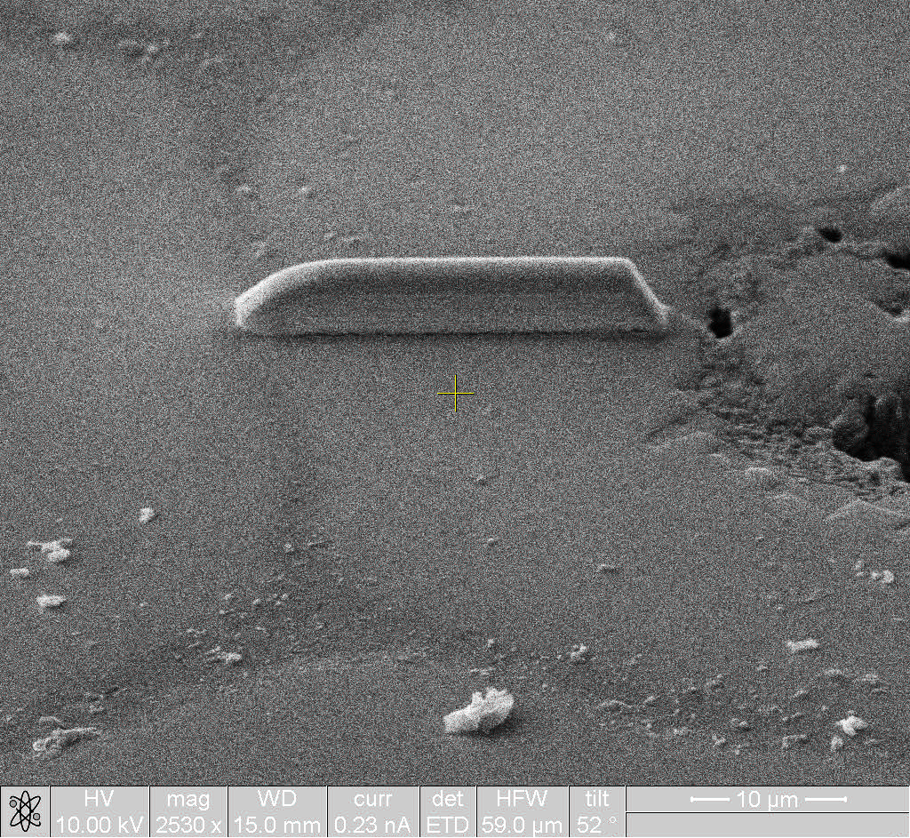
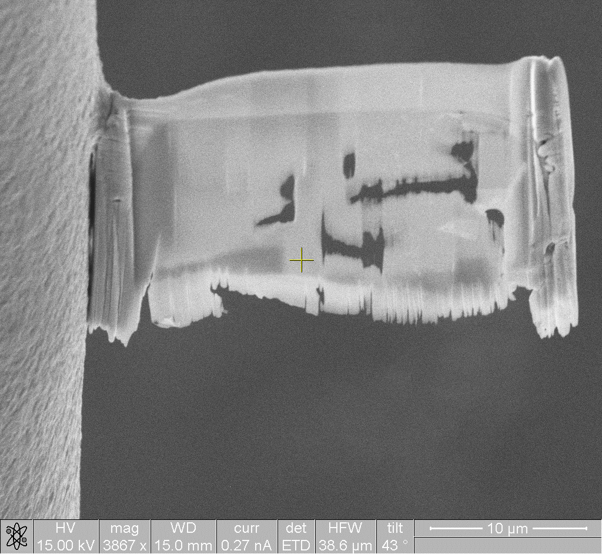
Limited Volume and Statistics from TEM Studies
Current approach with TEM
48 sub-elements/wire → analyzing ~ 700 x 700 x 100 nm³ per lamella
18.15 mm
Cross-section of a 40-strand Rutherford cable
Lamella extracted with a FIB
Sub-element
TEM region
Pt
Pt
SEM and TEM images from A. Moros’s PhD

Slide 7
Nanoprecipitate Characterization
Largest precipitates appear to be for samples heat treated at the highest temperature (700–720°C) for a short dwell time (45–69 h)
Large variation between samples heat treated in the same conditions
Large standard deviation in precipitate size for the same sample
Need (1) more data and (2) a more systematic approach to understand growth and coarsening of the nanoprecipitates
Heat treatment conditions previously studied
stdv
T (°C)
Approx. precipitate diameter
ø 5 nm 10 nm
720 °C
Hf
Zr
700 °C
685 °C
675 °C
…
…
0
100
200
300
400
t (h)
Precipitate size data from A. Moros (CERN, previously at LBNL)

Slide 8
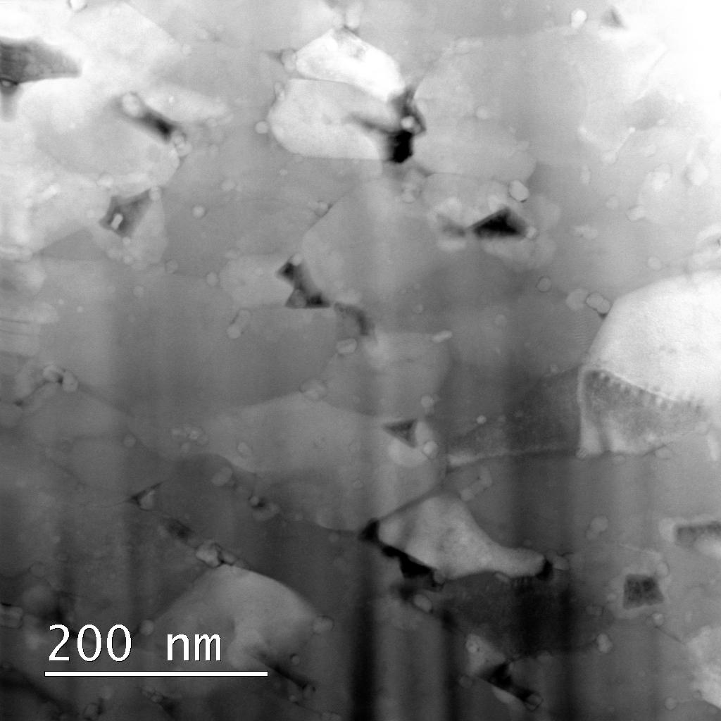
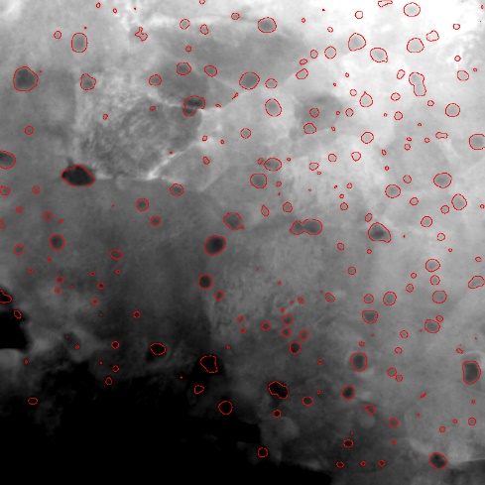
1. Machine Learning to Analyze TEM Images
See A. Baskys’s talk
Machine learning for image analysis of superconducting materials
More data and systematic study: Nanoprecipitate identification from all available TEM images
HfO₂ precipitates*
Labeling
*Z-contrast is similar for HfO₂ and Nb₃Sn matrix Z_{eff}: Nb₃Sn = 43.25, HfO₂ = 29.33, ZrO₂ = 18.67
Nanoprecipitate identification
TEM image and labelled data from A. Moros (CERN, previously at LBNL)

Slide 9
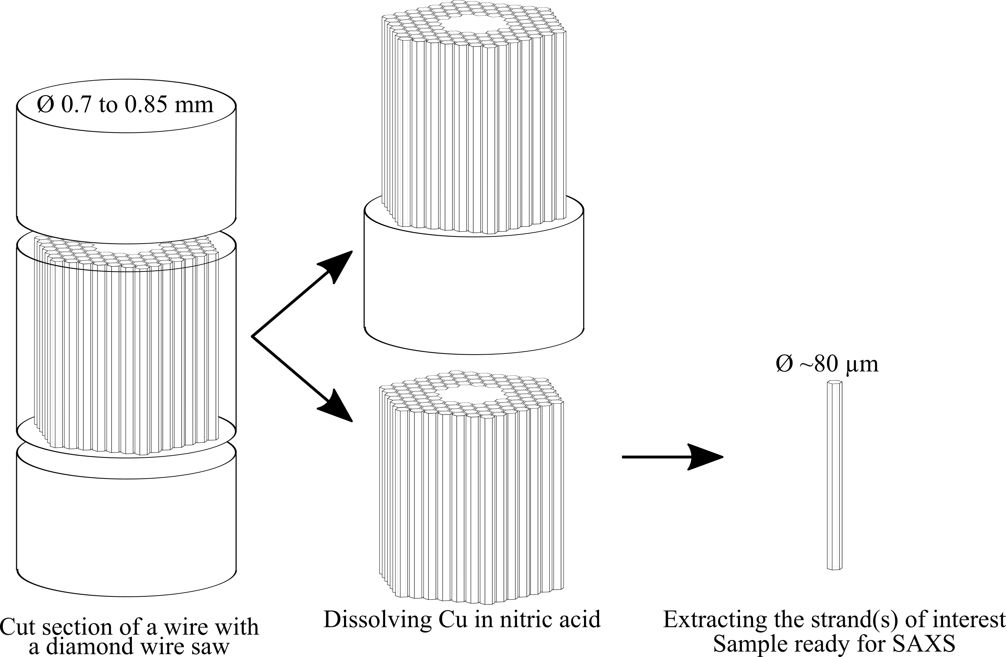
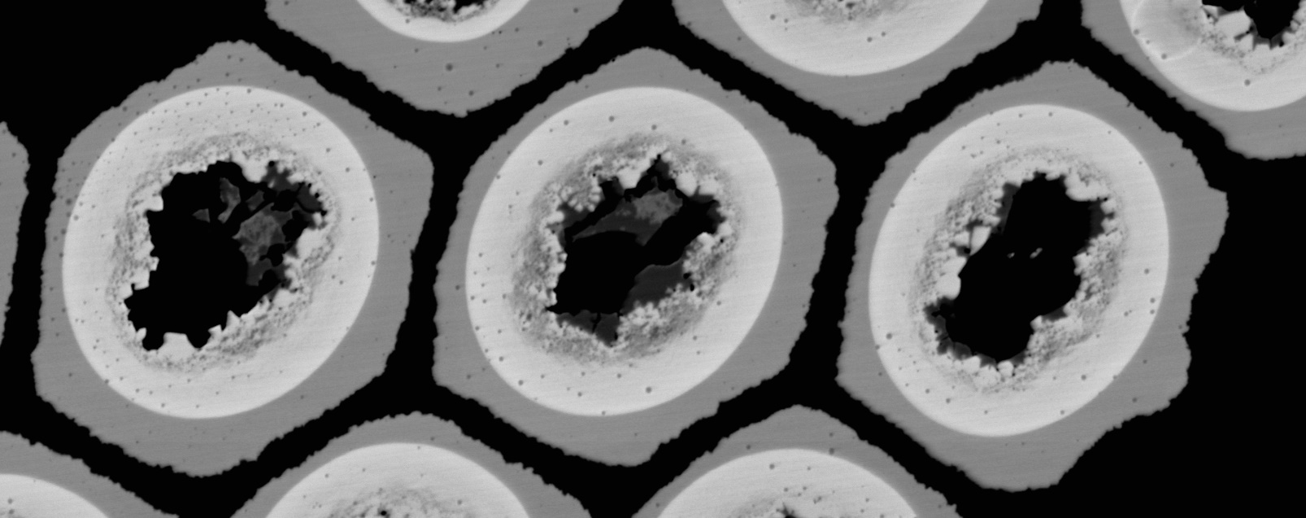
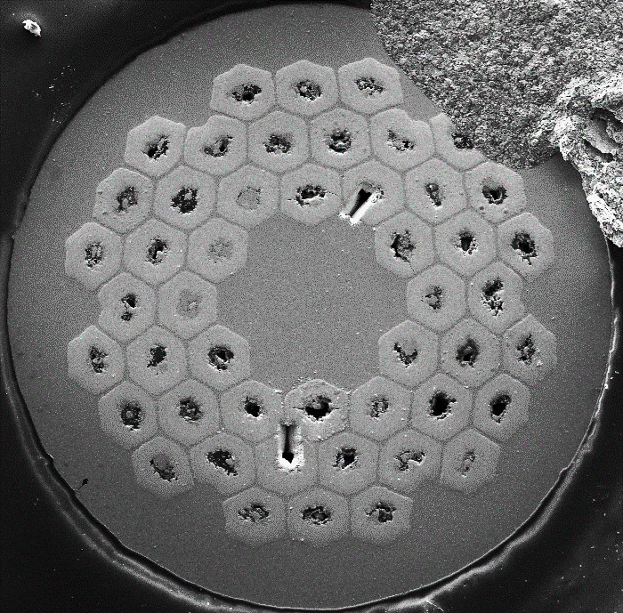
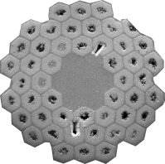
2. Synchrotron High Energy X-Rays
Cu
Nb
x-ray
Nb₃Sn
SAXS detector
Precipitate size
Precipitate density
Cu + Voids
WAXS detector
Phase identification (“similar” to XRD)
Cu
Cu
Nb₃Sn, ZrO₂ or HfO₂, Kirkdendall voids, Nb
*if the wires are twisted, the extracted sub-elements will be spirals
Top view/cross-section

Slide 10
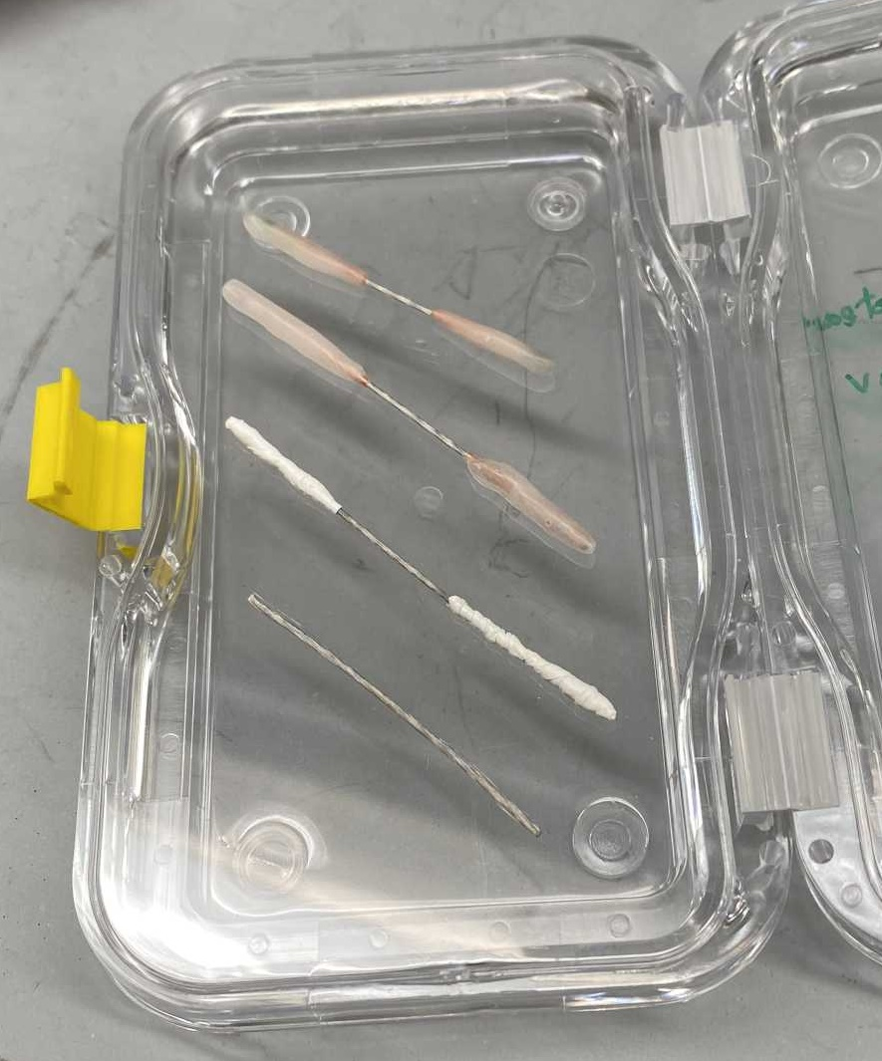
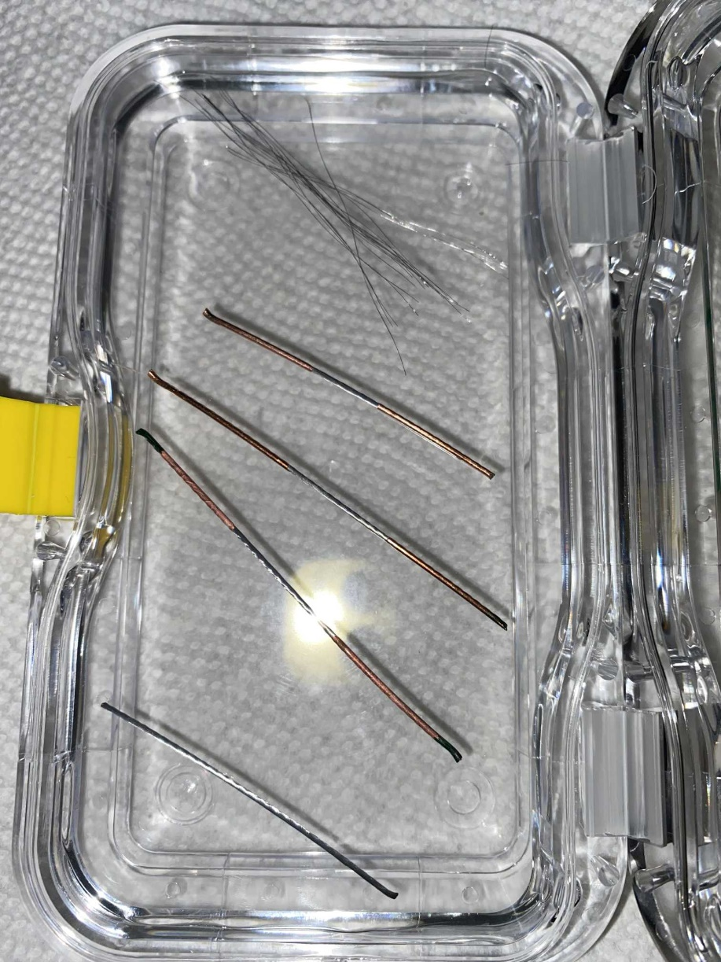
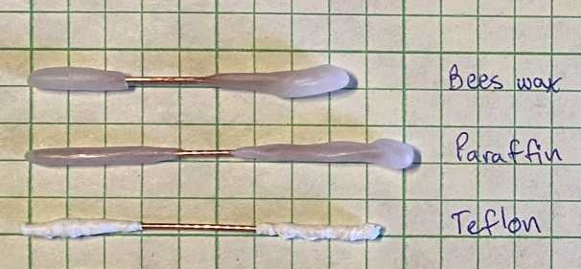
Sample Preparation: Masking and Etching
Masking with Teflon tape works well (enough) for our purpose
Paraffin wax and beeswax were also tried. They are better at masking, but more complicated to completely remove after etching (essential for the heat treatment)
Masked AUP Wires
Masked wires after etching and after removing the masks

Slide 11
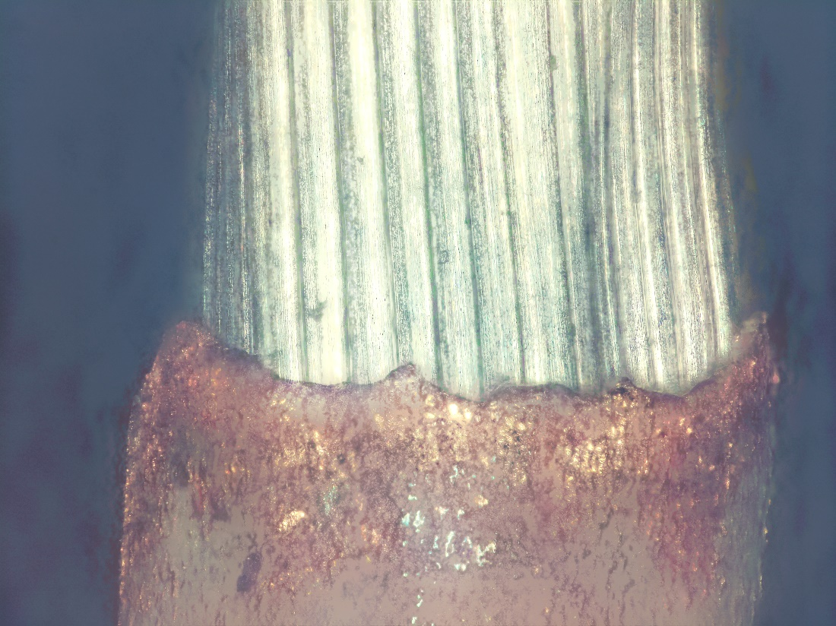
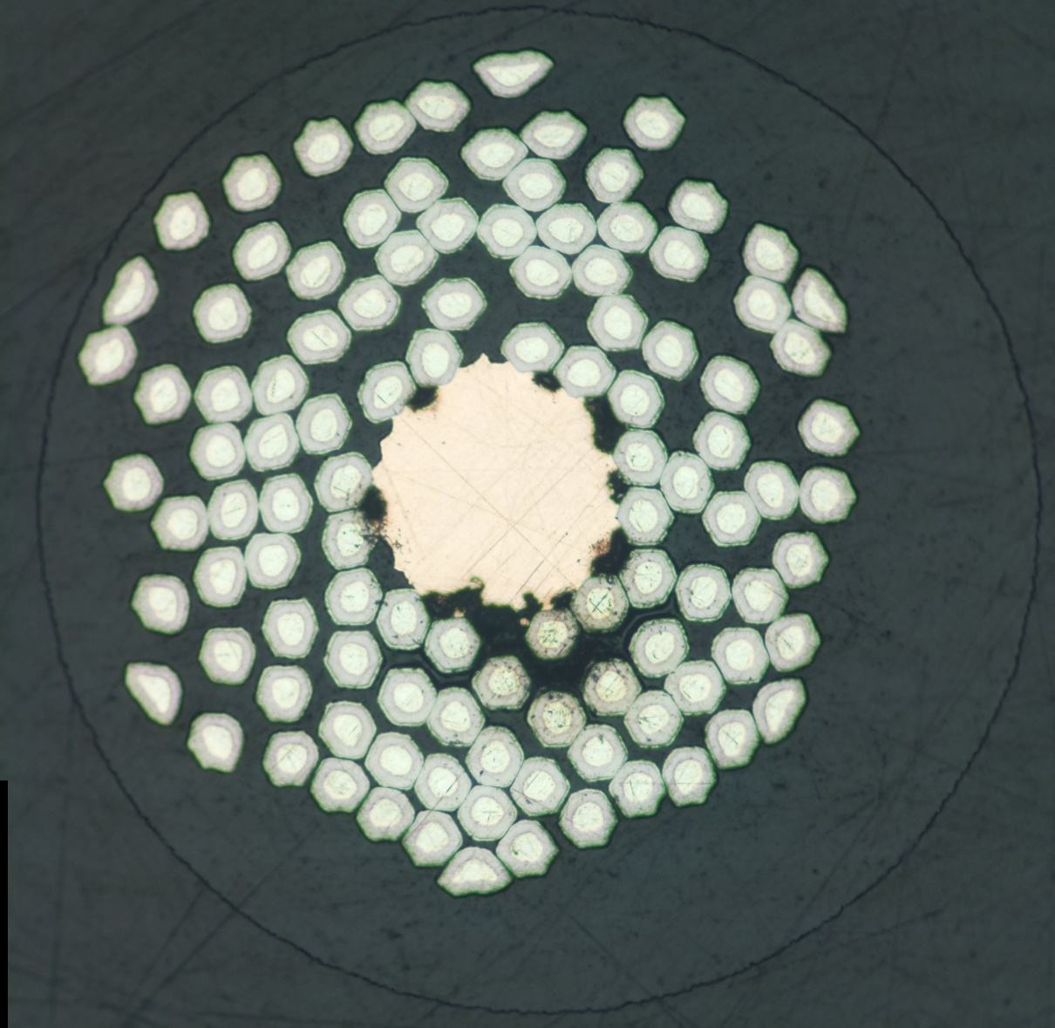
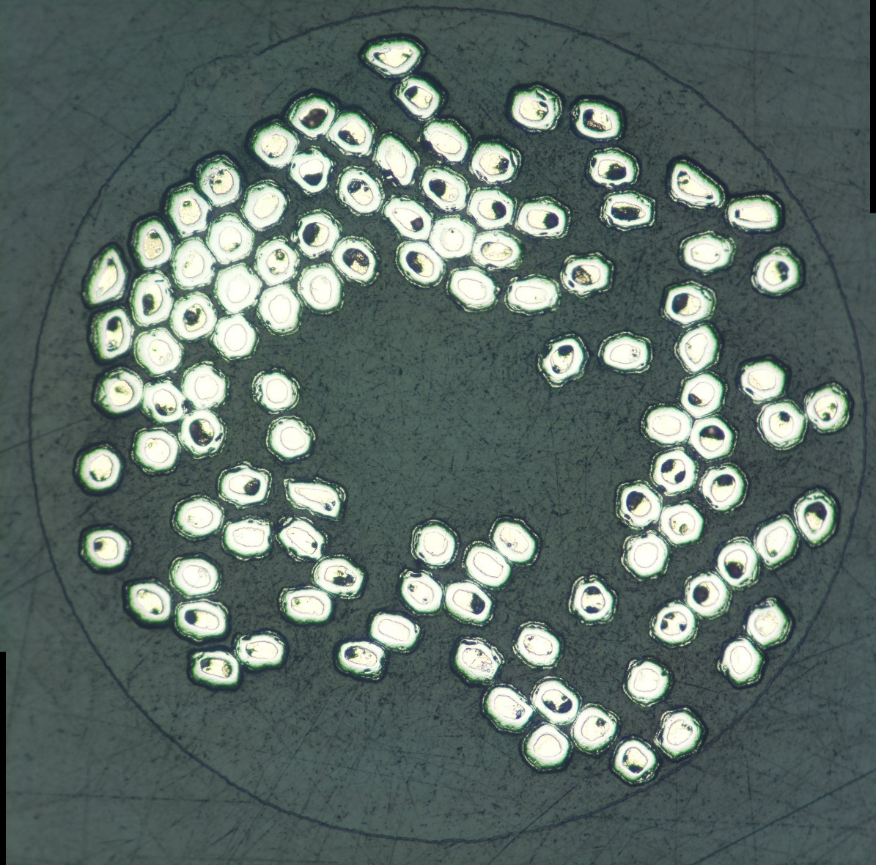
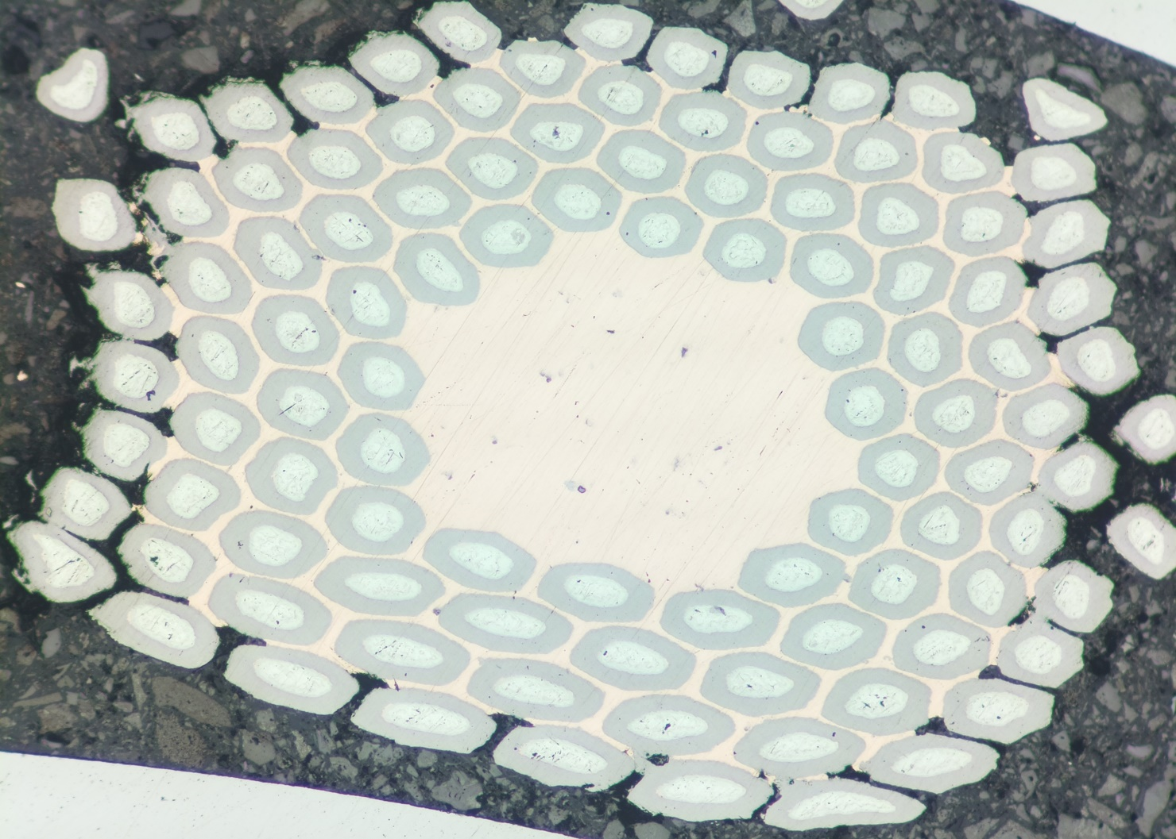
Masking and Etching
Trials with RRP (AUP) wires showed that 20 min etches the Cu around the 1st layer of sub-elements and 5 h leaves only the core Cu. The Nb barriers are not reacting with HNO₃
Cross-section of etched wires
Edge of the masked region
Unreacted
Reacted
20min etch
5h etch

Slide 12
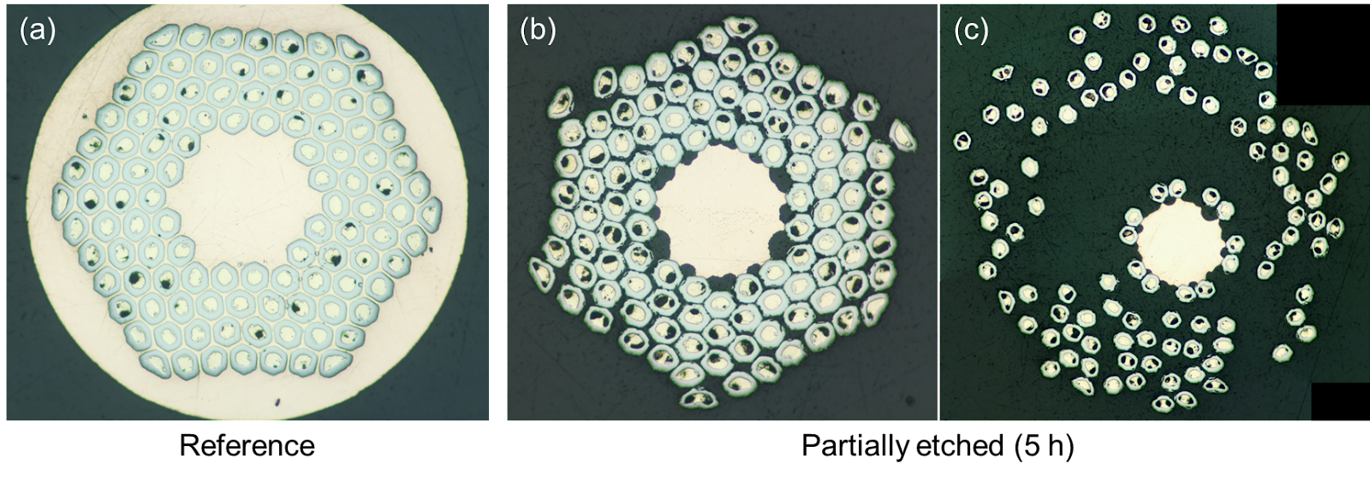
Heat Treatment of Etched Wires
Heat treatment of AUP wire etched for 5h: no apparent Sn leak or other issues
(a)
(a) Reference wire for comparison
Promising for in-situ study
(b) Partially etched (5h) AUP wire
(b)

Slide 13
Feasibility Study Wires
Heat treatment conditions
Wires with ZrO₂ at 700°C for 0h, 2h, 9.7h, and 30h
Wires with HfO₂ at 700°C for 9.7h
Wires with Hf, but no internal oxidation at 700°C for 2h
Sample preparation conditions
With copper matrix (not etched)
Without copper matrix (etched for 0.5h and 5.5h)
Extracted sub-elements (1 sub-element and a bunch of 3 sub-elements)
Wire and sub-elements in quartz tubes (for future in-situ study)

Slide 14
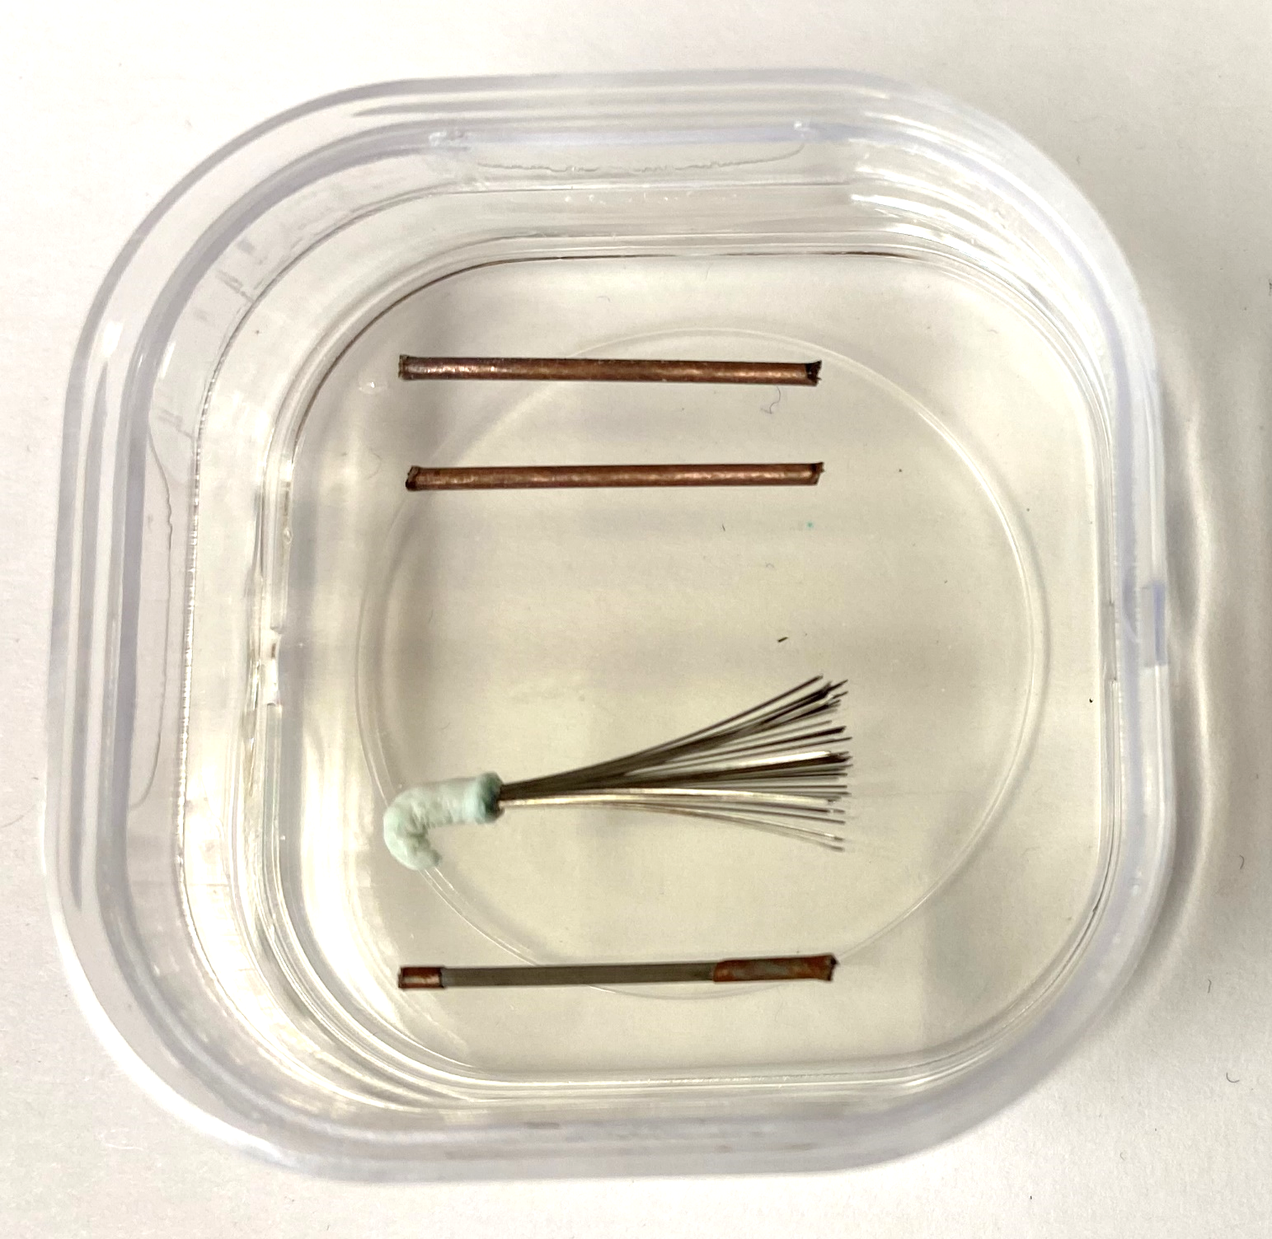
Feasibility Study: Sample Preparation
Masking with Teflon tape worked
Samples etched in nitric acid
Wire cutting and masking
Not masked
Nitric acid etching and unmasking
1 end masked
2 ends masked

Slide 15
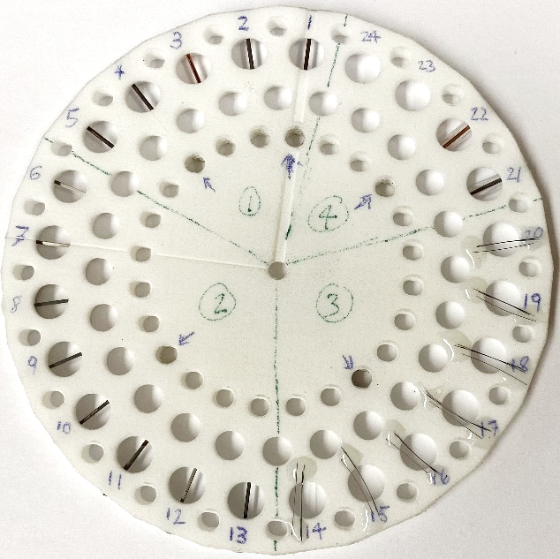
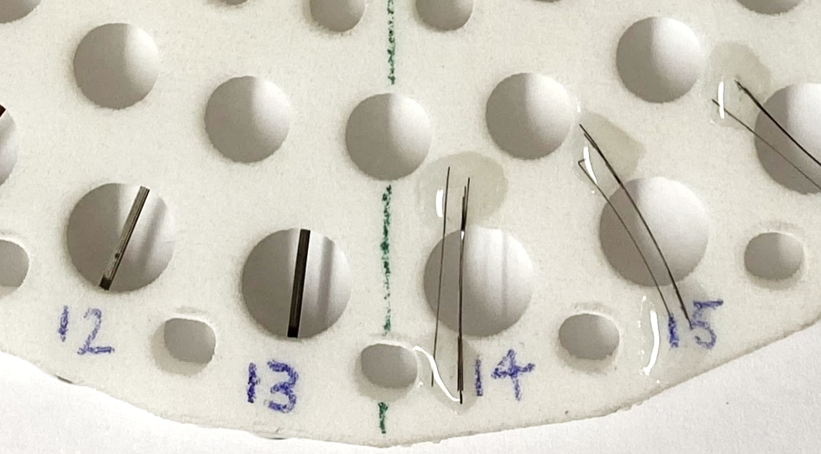
Feasibility Study: Sample Preparation
Analysis of the same wire at different stages of a heat treatment for different sample preparation conditions (total of 22 samples)
Quartz tubes
Exposed sub-elements
1 and 3 sub-elements

Slide 16
Project Timeline
Rapid access proposal was approved for a feasibility study on October 14 and 15
Aiming to conduct an in-situ study during cycle run 2023-1
Feasibility study (10/14 – 10/15)
Rapid access proposal
Oct 28
First calls with beamline scientists
shutdown APS-U*
Cycle run 2023-1
June
July
August
September
October
November
December
January
February
March
April
May
2022
2023
*https://www.aps.anl.gov/APS-Upgrade
https://www.aps.anl.gov/Users-Information/About-Proposals/Proposal-Deadlines-and-Meetings

Slide 17
Conclusions and Next Steps
Conclusions
We need more data on nanoprecipitate size and density to have a better understanding of their formation and growth during heat treatment
Next Steps
Feasibility study will take place at the APS in 2 weeks
New proposal for an in-situ study in 2023

Slide 18
Investigation of Hf-Rich Phase

Slide 19
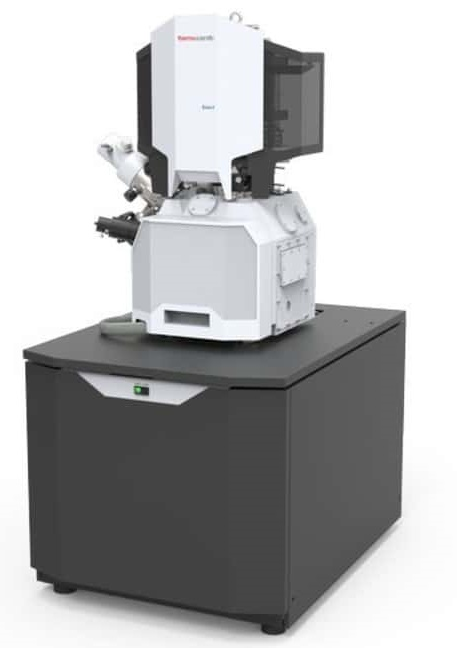
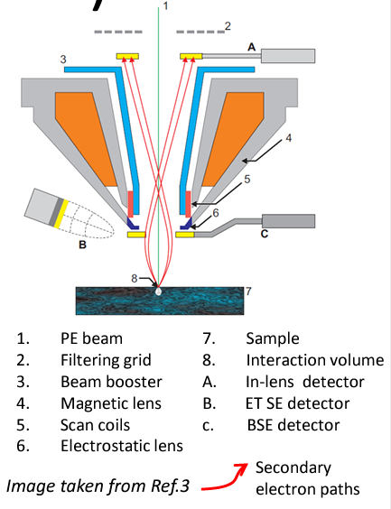
Scios 2 DualBeam SEM from ThermoFischer
We have access to a state-of-the-art dual beam SEM at UC Berkeley’s Nuclear Engineering department
SEM and FIB (Ga+ ions)
Detectors
SE
BSE
Combined in-column SE+BSE
EDS
EBSD
STEM (BF, DF, HAADF)
https://www.iitk.ac.in/meesa/SEM/tutorial/SEM_TGP.pdf

Slide 20
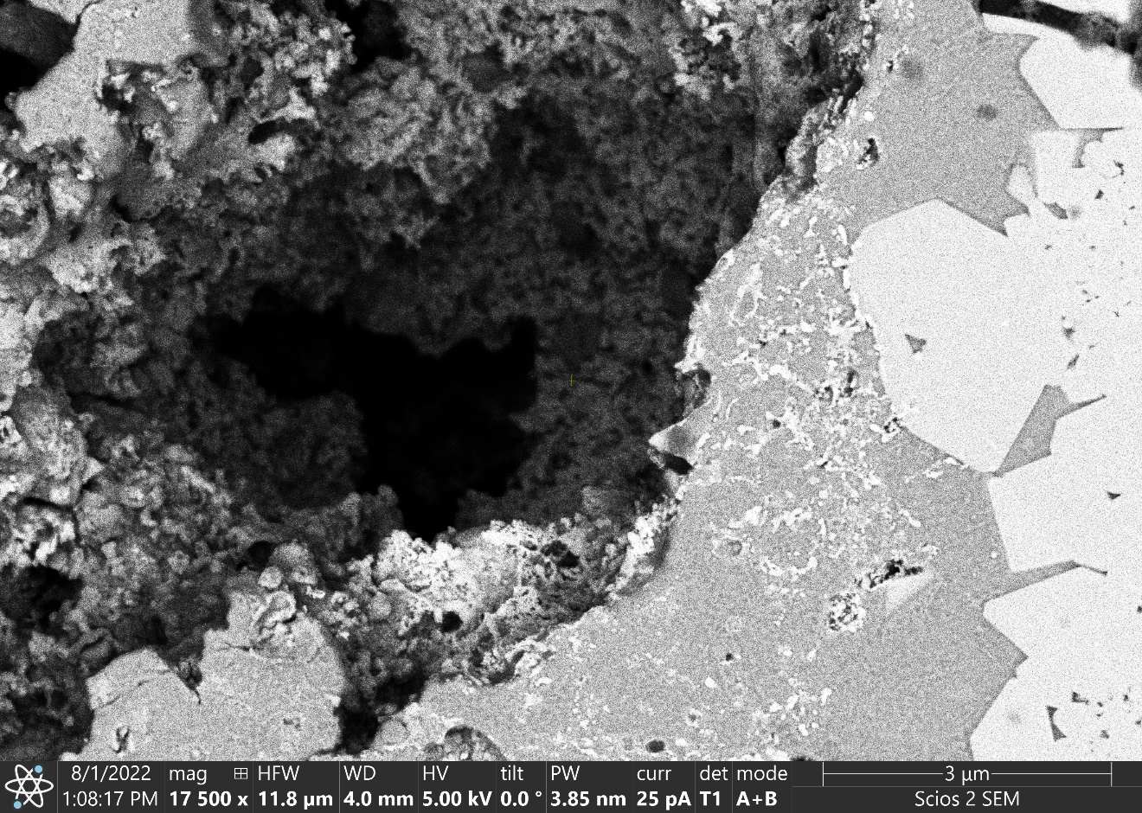
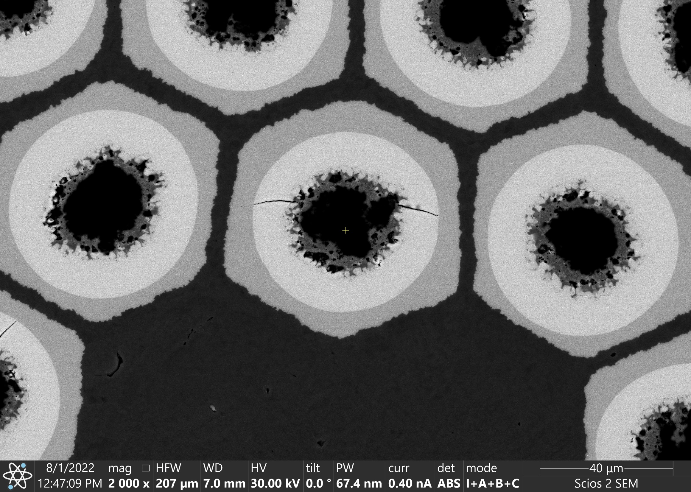
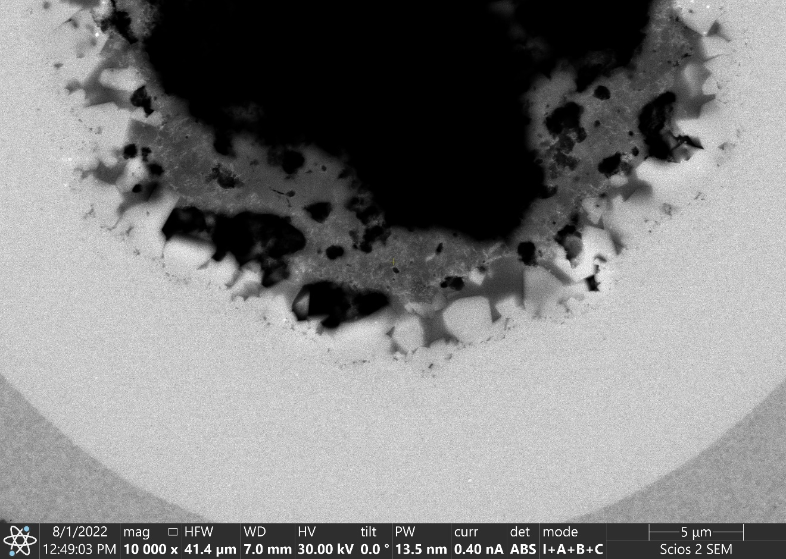
SEM Capabilities
In-column combined SE and BSE detectors
BSE

Slide 21
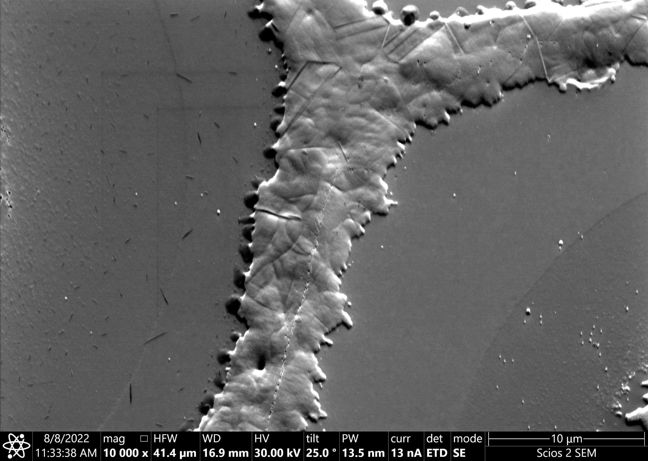
SE Detector: High Resolution at High Magnification
Image enhanced to show features
Twin
GB
Grain and twin boundaries in copper (“hexagons cut by parallel lines”)
Crack/line between cladded and stacked sub-elements visible
Crack/line
Nb/Nb₃Sn boundary

Slide 22
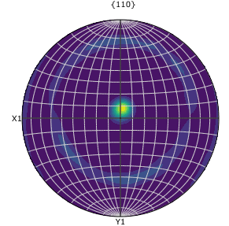
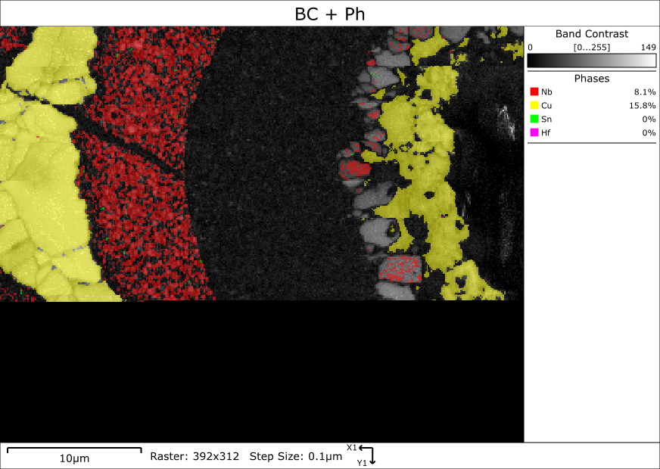
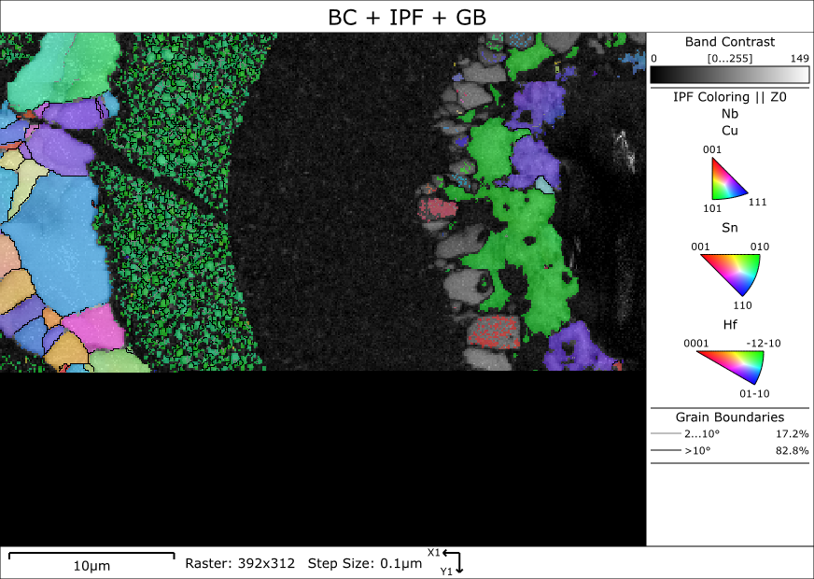
EBSD – Phases and Grain Orientations
Not indexing the Nb₃Sn phase and the NbSn₂ and/or Nausite
Nb has a 110 fiber texture (expected for BCC metal deformed in tension)

Slide 23
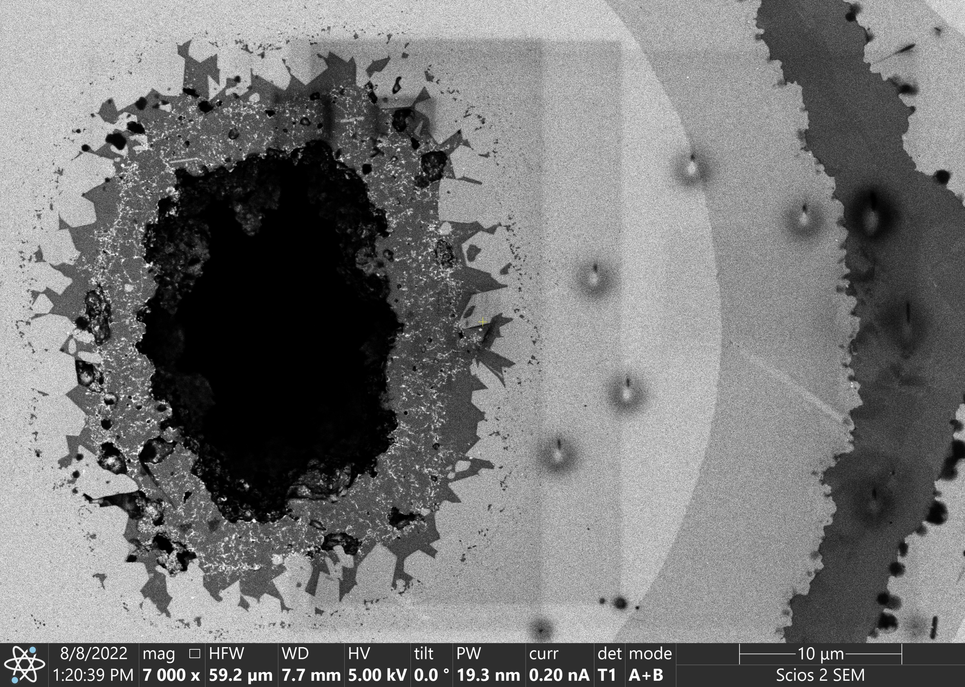
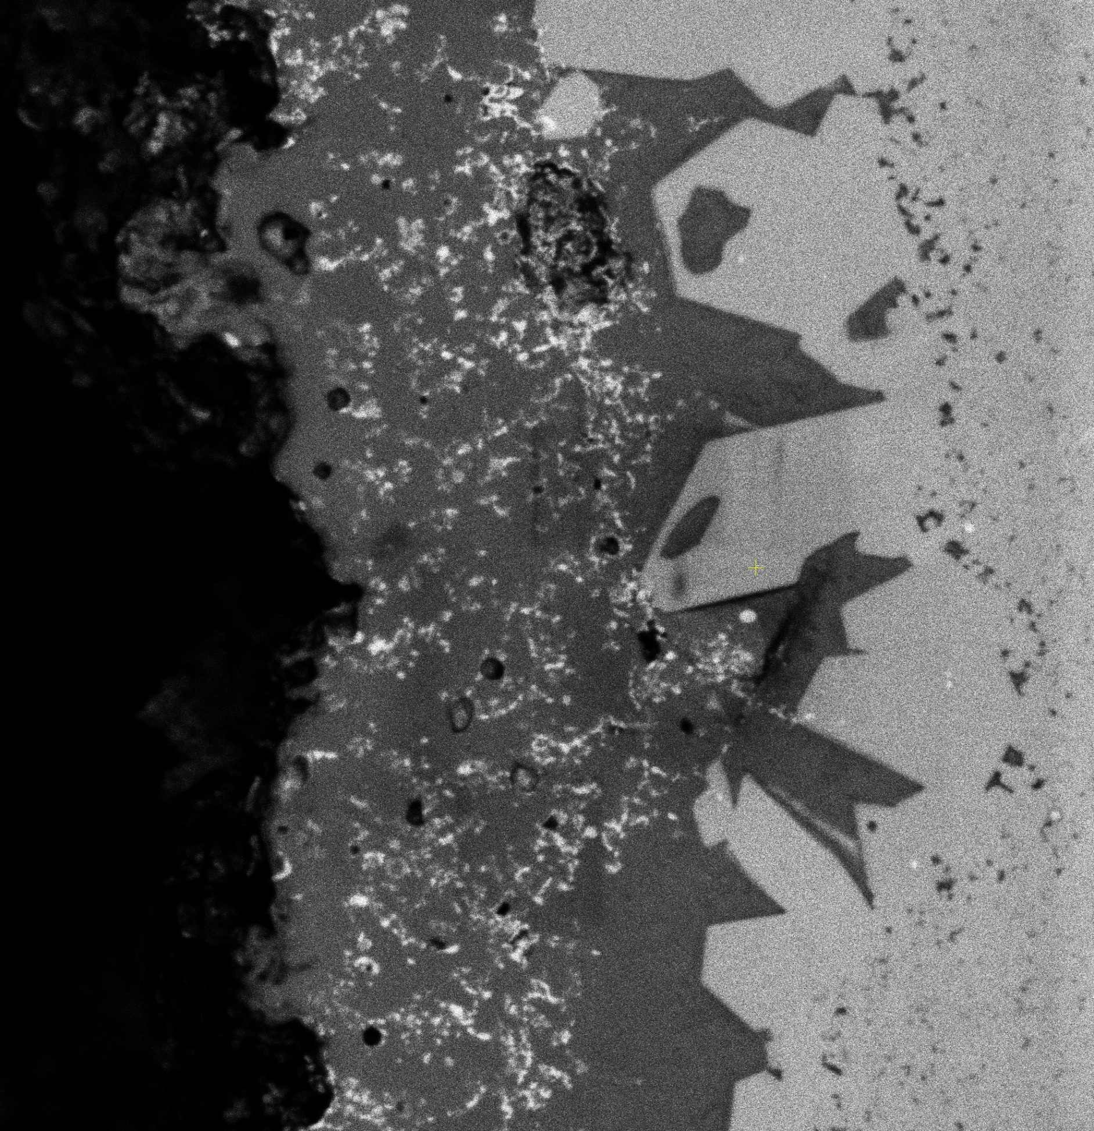
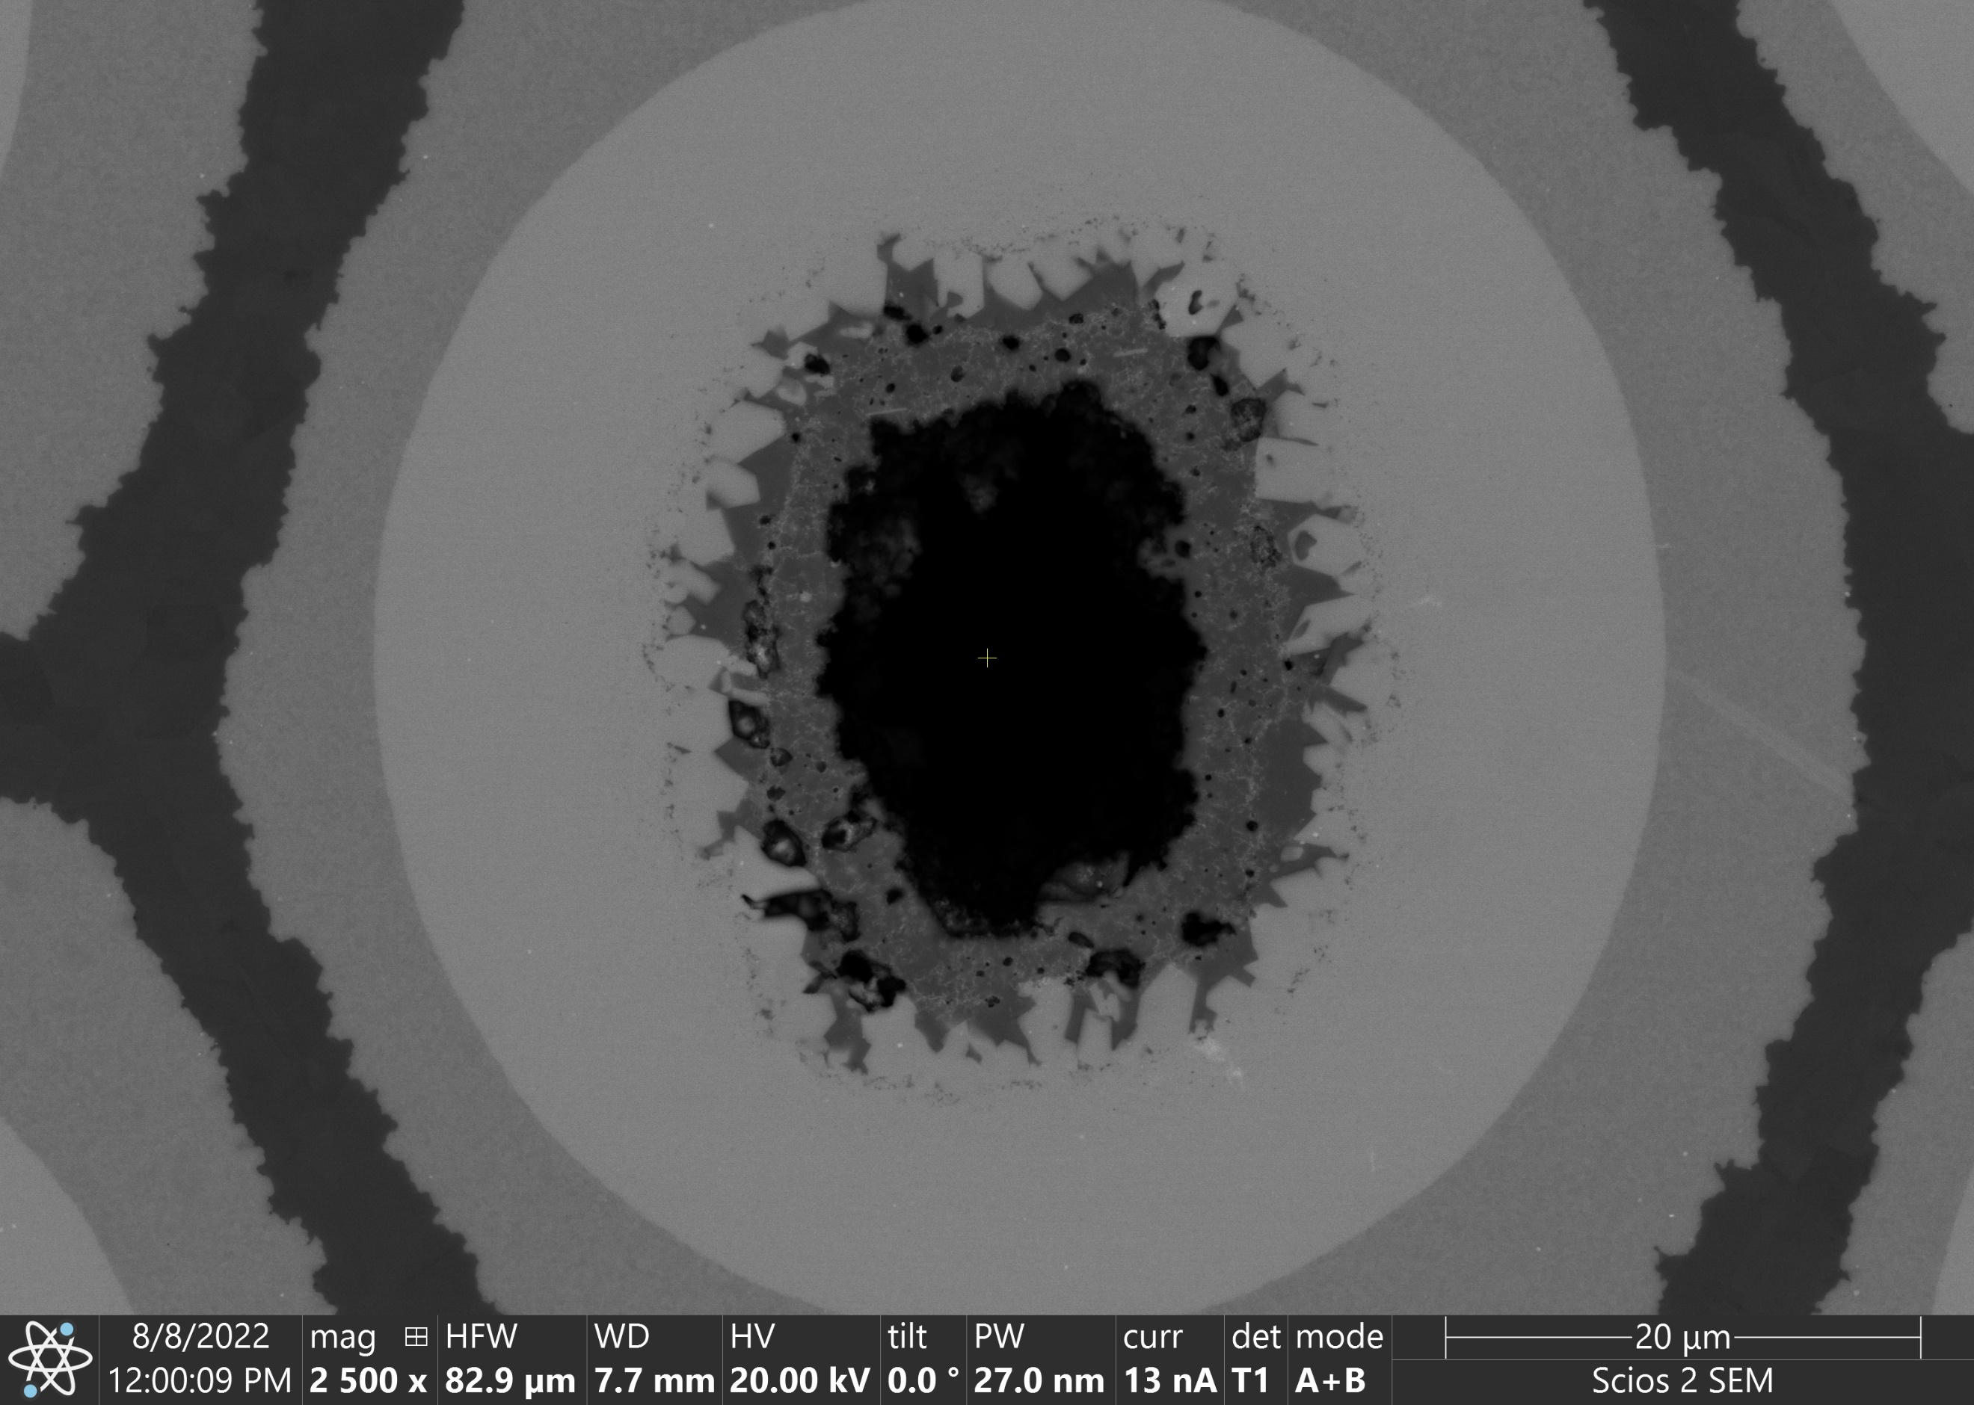
BSE and SE Images – Hf- and/or Ta-Rich Phase
NbSn₂ and/or Nausite
C-contamination
Hf-/Ta-rich
Nb₃Sn
Nb barrier
Cu
2.5 µm
Cu-rich

Slide 24
Conclusions and Next Steps
Conclusions
Access to well equipped and relatively new SEM at UC Berkeley
We’ve observed an intermediate phase that was not previously known to form in Nb₃Sn wires with Hf (might have been observed in casted Cu-Hf alloys)
Next Steps
Analysis of reacted wires with internal oxidation to see if the phase is also present
Analysis of WAXS data to see if we can detect it

Slide 25
Oxygen content and distribution

Slide 26
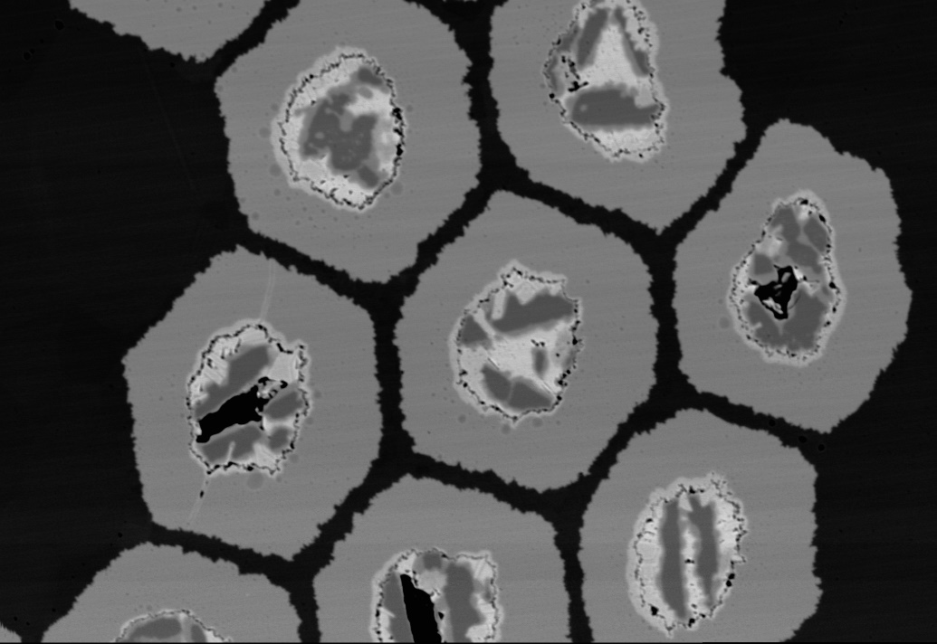
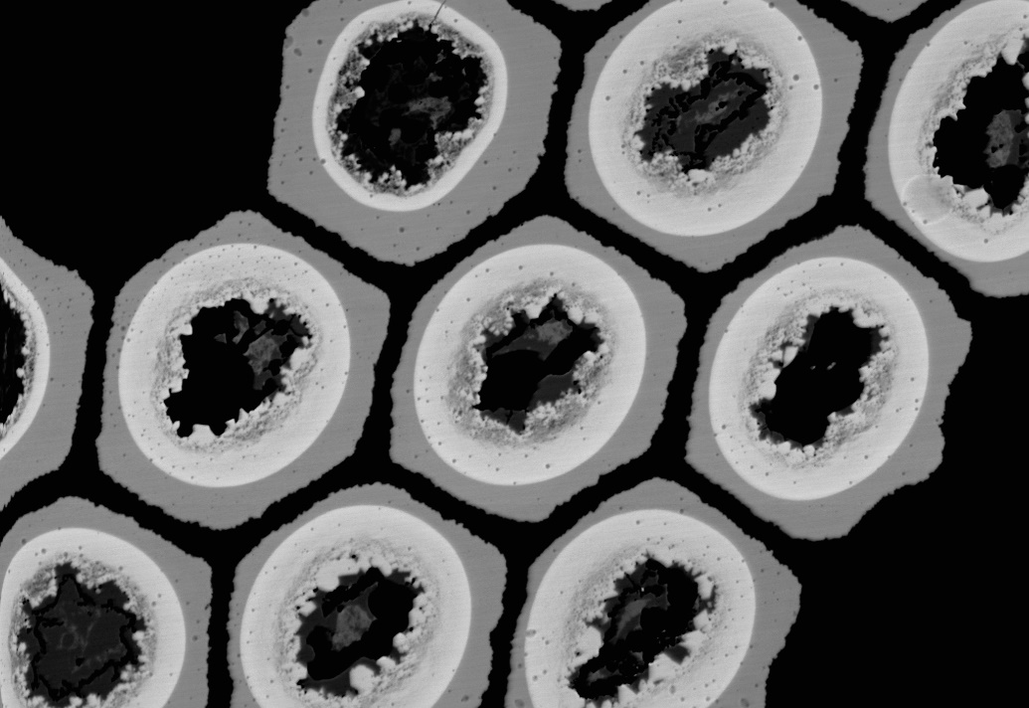
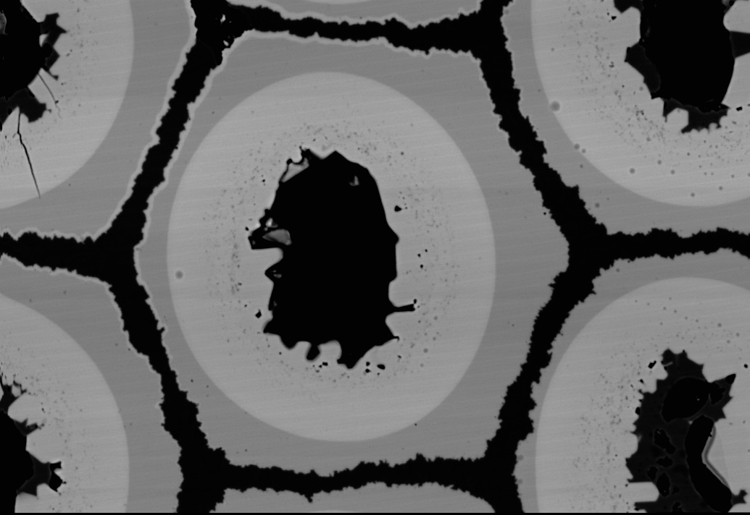
Summary of Ongoing Research
Unpublished results – Please do not use
The expulsion of O from the core (SnO₂ powder) and the formation of the oxide nanoprecipitates is not well understood
Oxygen content between different HT conditions was not accurately measured using EDX
Tried using EDX with image analysis methods for radial distribution in unreacted Nb and in entire sub-elements
Cu
Nb₃Sn
Sn-leak (over reacted)
Nb
Upon reaching 700°C
700°C–2 h
700°C–8 h
700°C–60 h
Backscattered electron images from LBNL, wires from FNAL and Hyper Tech Research Inc.

Slide 27
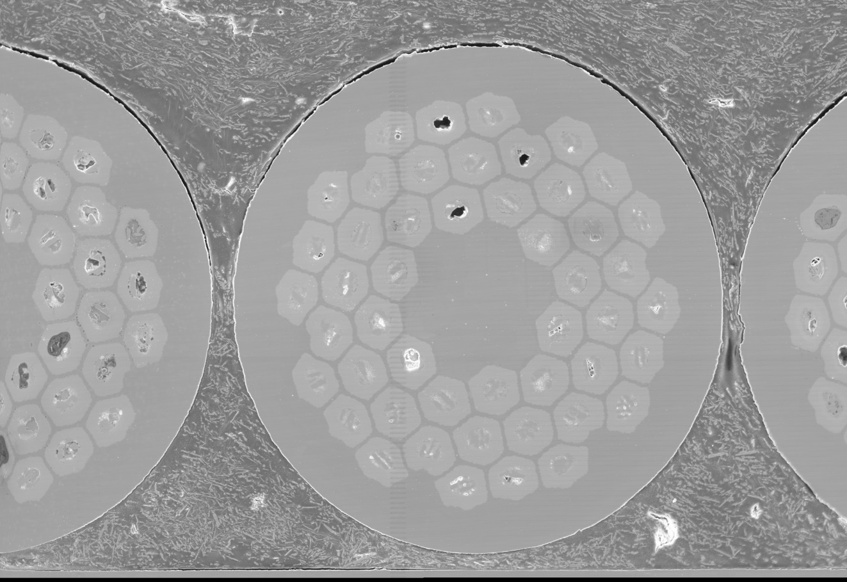
Method – Image Analysis and Radial O Content
SE
Cu
Nb
Sn
O
Zr
Ta
BSE
EDX composition maps

Slide 28
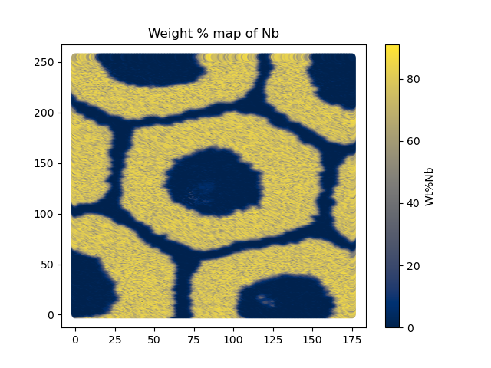
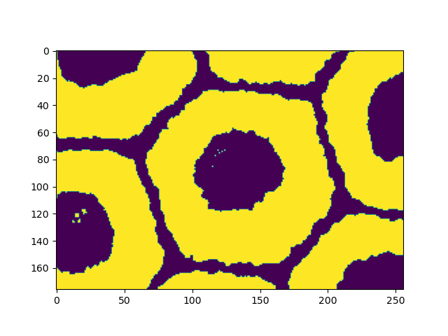
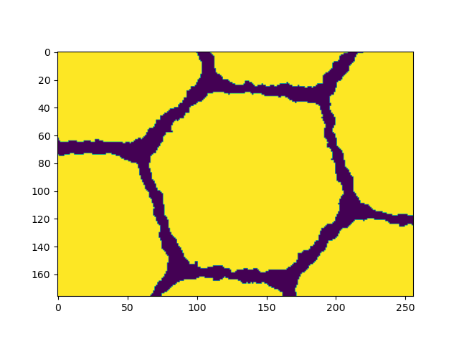
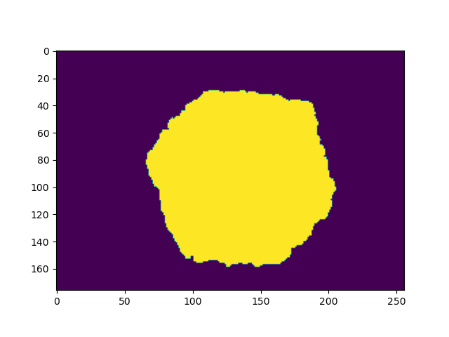
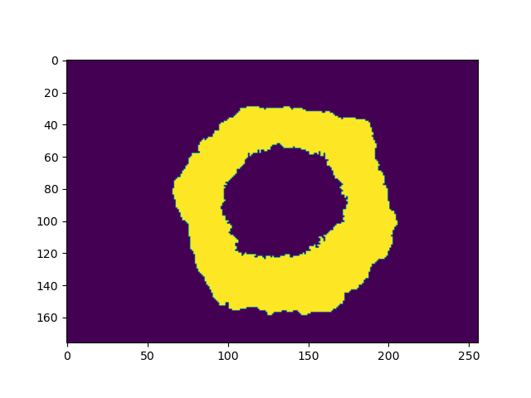
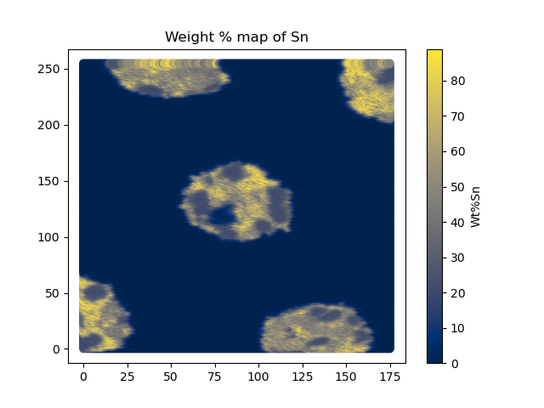
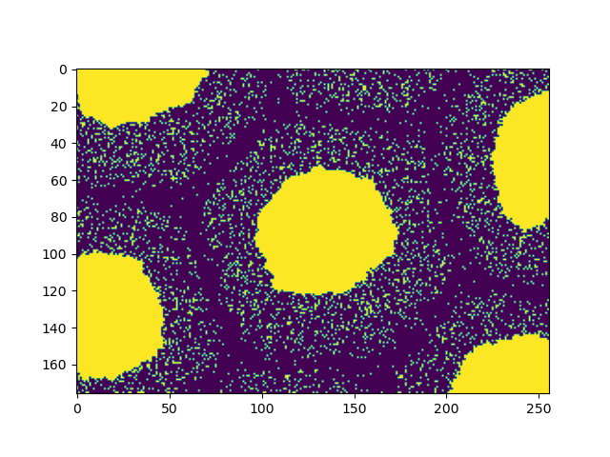
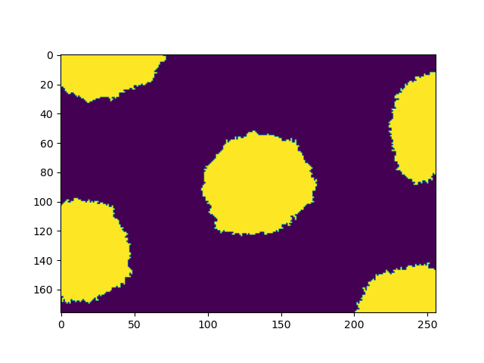
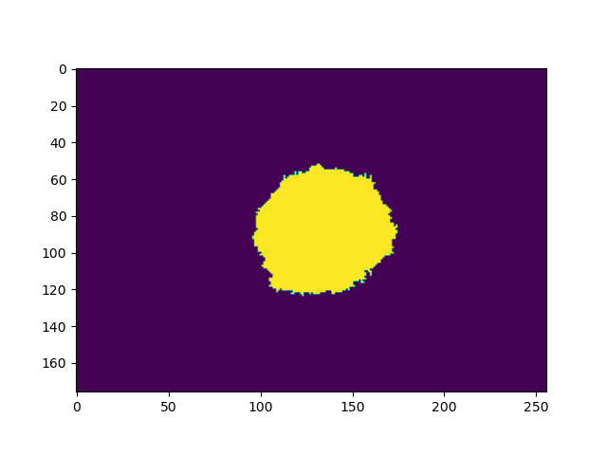
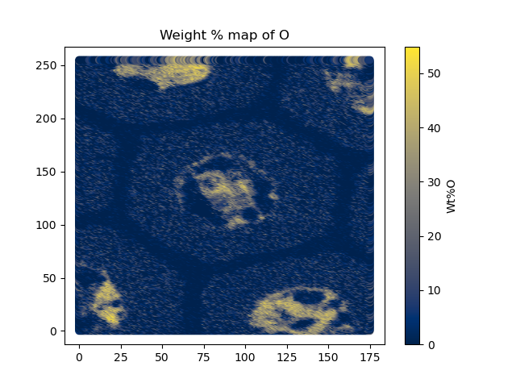
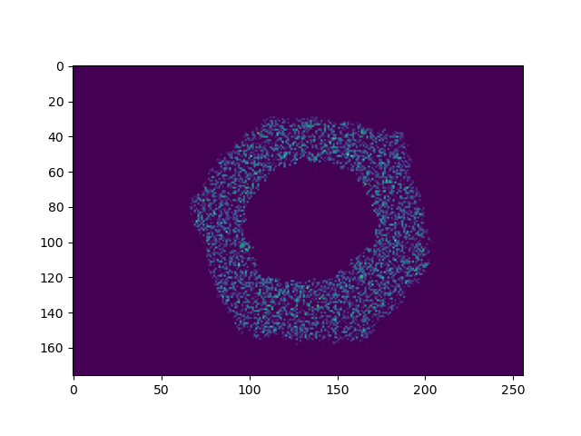
Method – Image Analysis and Radial O Content
Nb
Unreacted Nb
–
Sn
O
Python library used for image analysis: https://scikit-image.org/
O in unreacted Nb
*atomic % maps were used, this illustration is an example of the method used

Slide 29
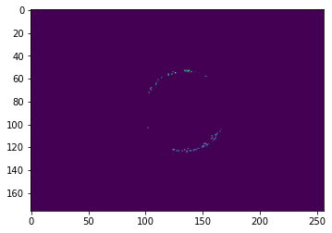
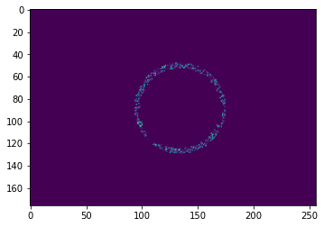
Method – Image Analysis and Radial O Content
1-Nb₃Sn/Nb
2
3
mean O at% avg. radius
r = 0
Analysis for different radii
4
5
6
7
8
9-Nb/Cu
O in unreacted Nb
r = 1

Slide 30
Nanoindentation
Cu
~13 µm
Objective: indent unreacted Nb barrier
Number of specimens (wires): 4
Heat treatment temperature: 700°C
Dwell times: 0, 2, 8, 60h
Samples were vibratory polished
Samples are hot mounted in a “puck”
Nb₃Sn
~6.7 µm
~4 µm
Nb
Cu
Cu
50 µm
4. 700°C–0 h
5. 700°C–2 h
6. 700°C–8 h
7. 700°C–60 h

Slide 31
Conclusions and Next Steps
Conclusions
Oxygen was not accurately measured using EDX
Next Steps
Nanoindentation of Nb-barrier of wires heat treated at different dwell times planned
Attempt to indirectly measure different oxygen content by measuring changes in mechanical properties (expecting higher hardness for higher O-content)

Slide 32
Conclusions
Nanoprecipitate Dimensions
APS feasibility study mid-October
Proposal for in-situ study in 2023
Hf-rich Phase
Investigation of non-reference wires
Oxygen Content
Nanoindentation measurements planned at UC Berkeley

Slide 33
Thank you!
JF. Croteau¹, A. Baskys¹, I. Pong¹, F. Wan², X. Xu²
¹LBNL and ²FNAL (jcroteau@lbl.gov)

Slide 34
Backup Slides

Slide 35
Ostwald Ripening – Lifshitz-Slyozov-Wagner Theory
Hafnium
$B=O$ is the rate controlling species
$β=2$
S.K. Bhattacharyya and K.C. Russell, 1976, Coarsening Kinetics of Silica in Copper, Metallurgical Transactions A, V7A, pp. 453-462 ..\..\..\..\..\My Drive\References\Papers\bhattacharyya1976.pdf
Compound $A_{α}B_{β}→ZrO_{2} or HfO_{2}$
$M$ the metal. We will assume that the matrix is pure niobium (Nb) for the purpose of finding parameters in the literature, but it should be Nb₃Sn
coarsening rate
Plots of r³ vs time for SiO₂ in Cu for different temperatures (Bhattacharyya and Russell 1976)
$${\overline{r}}^{3}={\overline{r}}_{0}^{3}+\frac{8D_{B}C_{B}σV^{2}}{9RTβ^{2}}t$$
simplification to a linear equation:
$${\overline{r}}^{3}={\overline{r}}_{0}^{3}+m t$$
slope could be experimentally determined for different temperatures
$${\overline{r}}^{3}$$
$${\overline{r}}_{0}^{3}$$
$$t$$

Slide 36
Ostwald Ripening – Lifshitz-Slyozov-Wagner Theory
Hafnium
$${\overline{r}}^{3}={\overline{r}}_{0}^{3}+\frac{8D_{B}C_{B}σV^{2}}{9RTβ^{2}}t$$
720 °C
slope could be experimentally determined for different temperatures
700 °C
685 °C
675 °C
$${\overline{r}}^{3}$$
$${\overline{r}}_{0}^{3}$$
This should be linear for “diffusion-controlled coarsening”
$$t$$
A dependence with ${\overline{r}}^{2}$ (or something else) would indicate different governing processes, such as “interface kinetics”
Are we still in the formation phase and not the coarsening (growth) phase?

