Slide 1
Machine Learning for Nb₃Sn wire image analysis
Algirdas Baskys, Kevin Gillespie, Jean-Francois Croteau, Ian Pong
(abaskys@lbl.gov)
Lawrence Berkeley National Laboratory

Slide 2
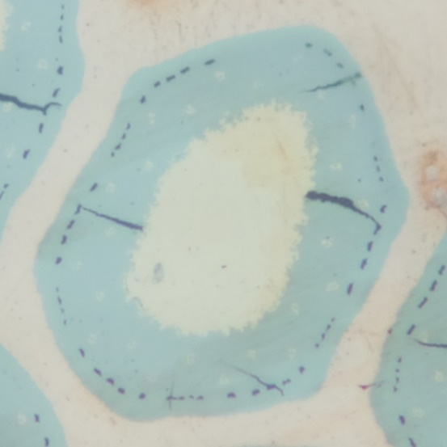
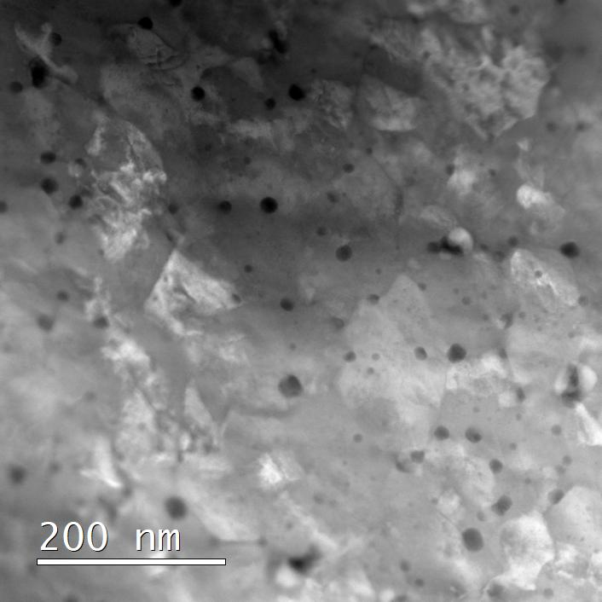

Problems to tackle using ML
Image analysis (IA) in a commonly used tool in many sciences (software tools available)
Some problems are not easily tractable using conventional IA techniques:
  Where color/brightness/edges do not encode all necessary information
  Where morphology of the region plays a large role in pixel classification
Grain size from fracture surfaces
Nanoprecipitates
in Nb₃Sn
Fractured subelements

Slide 3
Outline
01
Nanoprecipitate characterization in Nb₃Sn
02
Fractography for grain size determination
03
Crack counting in coil sections for destructive testing

Slide 4
Nb₃Sn with artificial pinning centers (APC)
The sample preparation and analysis workflow
is typically:
Polishing the sample
Extracting a thin lamella using FIB
Imaging using TEM/STEM
Manual precipitate labeling
Analysis of the B/W image for determining the size/density distribution
Both sample preparation and analysis is time-consuming.
Analysis can potentially be sped up using ML
Sample preparation and workflow for nanoprecipitate analysis in APC Nb₃Sn wires. A thin lamella is extracted from a polished wire cross-section (circled in red) a), the thinned lamellas are images using a transmission electron microscope. The nanoprecipitates are identified and manually masked c), the masked image can be used to obtain nanoprecipitate statistics. Sample preparation and imaging by A. Moros, CERN.
Notes:
Methods for getting relevant data:
Atom probe tomography
TEM
Small angle X-Ray Scattering

Slide 5
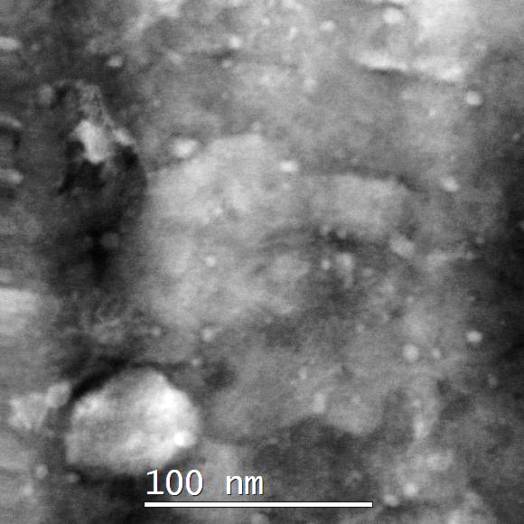
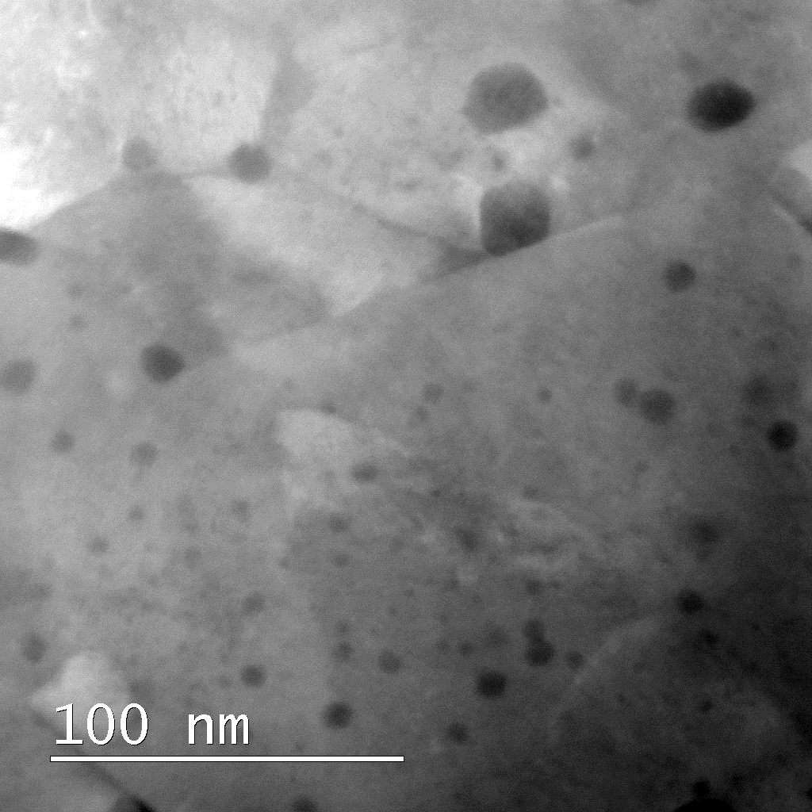
Nb₃Sn with artificial pinning centers (APC)
HfO₂ precipitates
ZrO₂ precipitates
Grain boundary
HfO₂ precipitates
ZrO₂ precipitates
Images courtesy of A. Moros, CERN
Notes:
Methods for getting relevant data:
Atom probe tomography
TEM
Small angle X-Ray Scattering

Slide 6
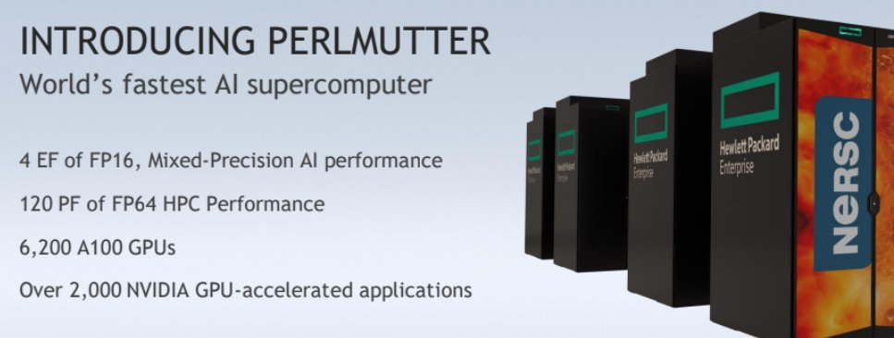
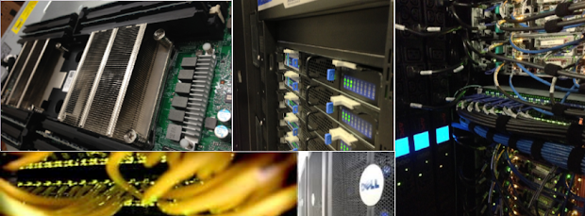
Machine learning approach
The National Energy Research Scientific Computing Center (NERSC) is the primary scientific computing facility for the Office of Science in the U.S. Department of Energy and it is located at LBNL.
We were awarded an exploratory grant to use Perlmutter supercomputer for analysis of Nb₃Sn wires using machine learning.
CPU Node Hours Award: 500 h
GPU Node Hours Award: 100 h
Archive Storage Award (TB): 1 TB
Project CFS Award (TB): 20 TB
Other computing facilities available at LBNL:
Lawrencium cluster
Einsteinium cluster (with GPU nodes)
Access to AWS and GCP
Having the software stack in a container (Docker) can help with portability and encapsulation of development environments.

Slide 7
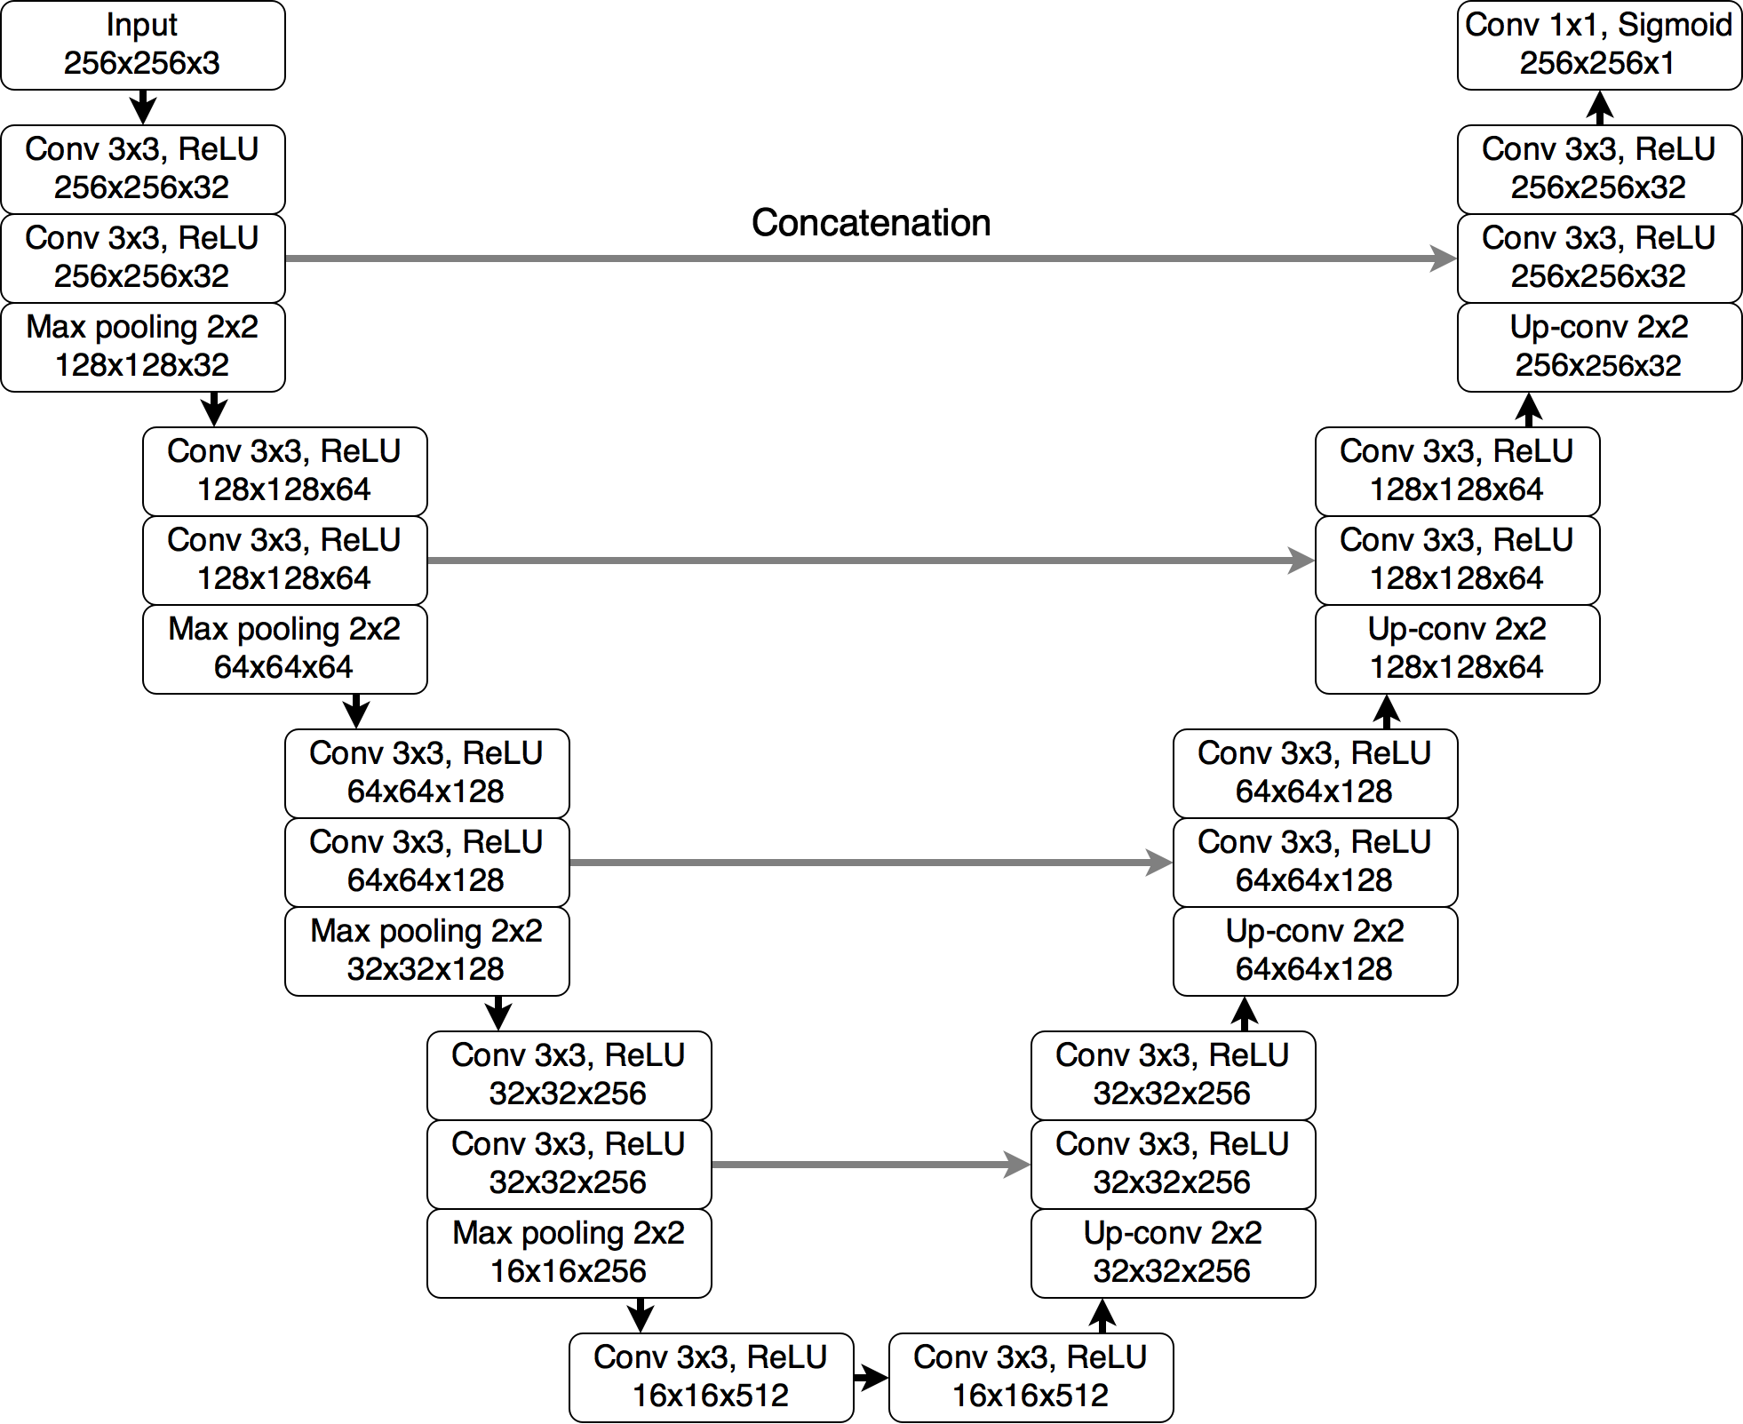
Nb₃Sn with artificial pinning centers (APC)
U-NET
We are developing NN based on U-NET [1] architecture:
Often used for bio-medical image segmentation
PyTorch (python) implementations widely available as starting point
Once the datasets are no longer the limiting aspect, other neural network architectures such as fully convolutional networks [1] and deepLabv3 [2] will be evaluated.
Convolutional neural network used U-Net. Figure from https://pytorch.org/hub/mateuszbuda_brain-segmentation-pytorch_unet/
[1] http://arxiv.org/abs/1505.04597
[2] doi: 10.1109/TPAMI.2016.2572683
[3] http://arxiv.org/abs/1706.05587
Notes:
U-Net good starting point for semantic segmentation problems

Slide 8
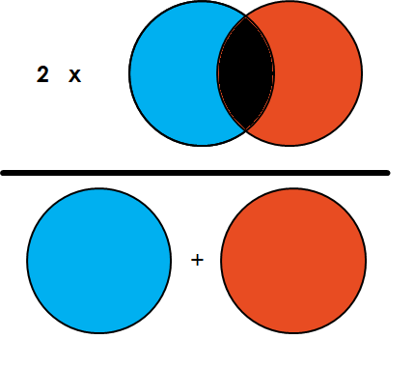
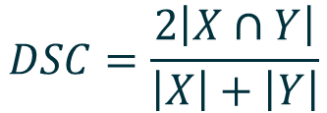
Nb₃Sn with artificial pinning centers (APC)
With ~75 images labeled, we can start with training… however:
Need a training set (for model training)
Need a validation set (for tweaking hyperparameters)
Need a test set (for evaluating the model)
This considerably shrinks our training dataset, to at least alleviate the problem, we can consider:
Image augmentation (image rotation, flipping, distortion, ...)
Synthetic data
Training using training dataset
Evaluation of the model using validation dataset
Tune model according to results on validation dataset
Model performing best on validation data
Confirm performance on test dataset
$$DSC=\frac{2\left|X∩Y\right|}{\left|X\right|+\left|Y\right|}$$
Before evaluation, need to decide on the metrics. Sørensen–Dice coefficient (DSC) is commonly used for semantic segmentation problems, but others may be used as well.
Notes:
Methods for getting relevant data:
Atom probe tomography
TEM
Small angle X-Ray Scattering

Slide 9
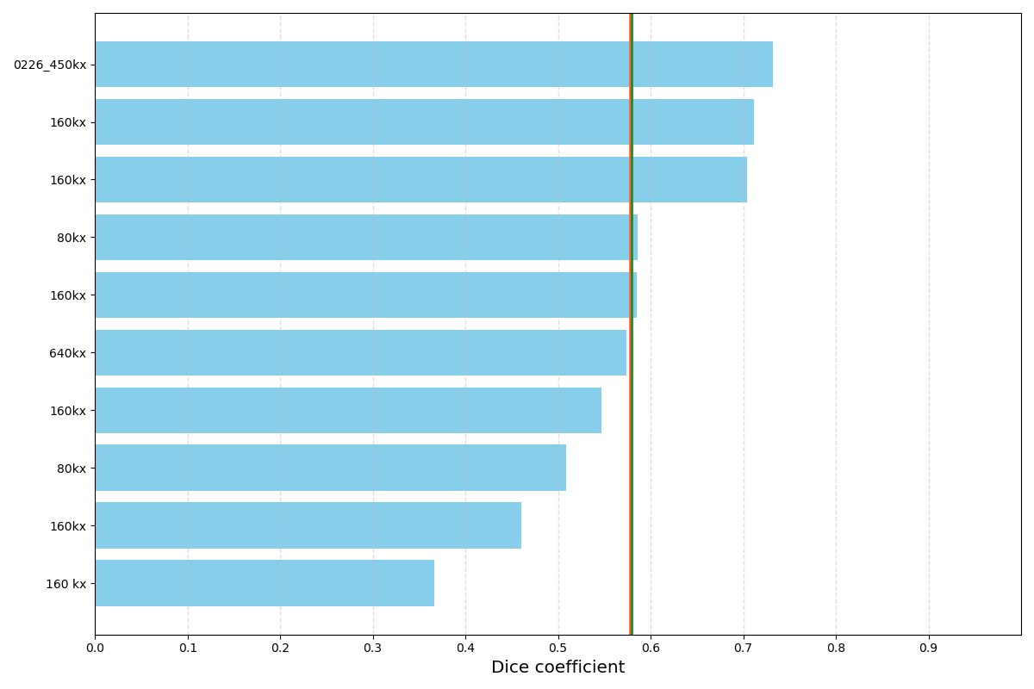
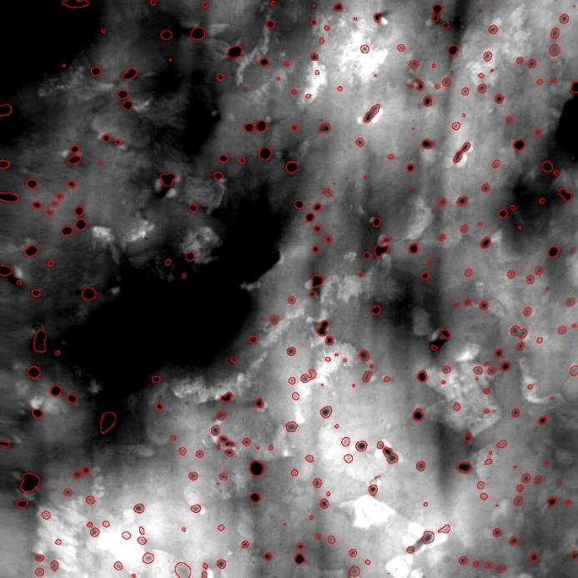
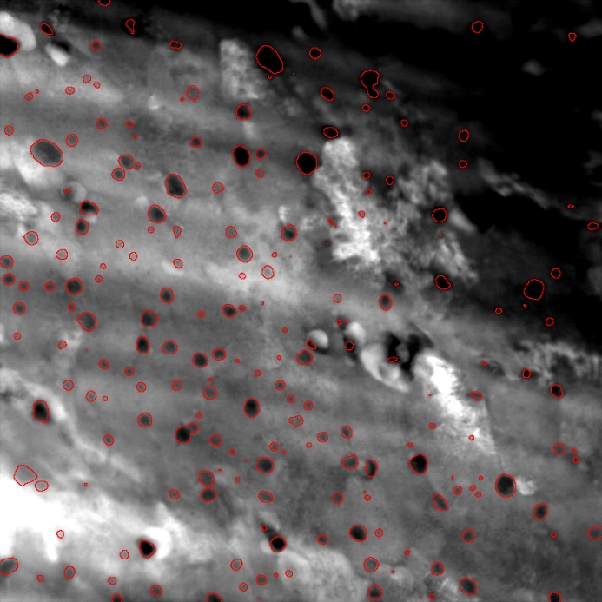
Nb₃Sn with artificial pinning centers (APC)
Initial results with no model “tuning”
Model seems to capture most features of interest
DSC in the range of 0.37-0.72
There is some ambiguity in the data labels with makes the evaluation difficult.
Samples
Other parameters to check:
Identification of PPTs regardless of their size
Size comparison of correctly identified PPTs

Slide 10
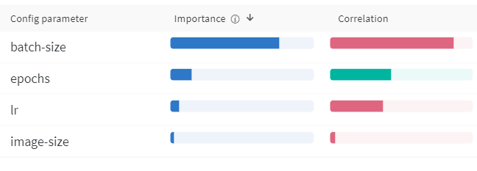
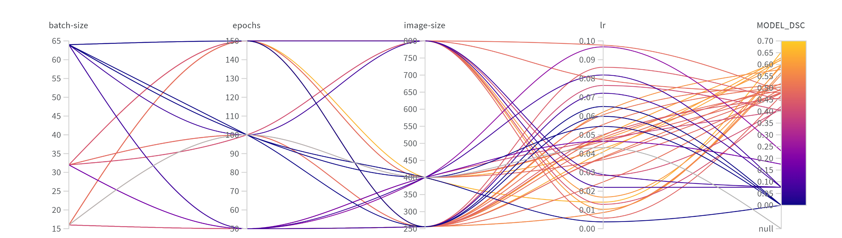
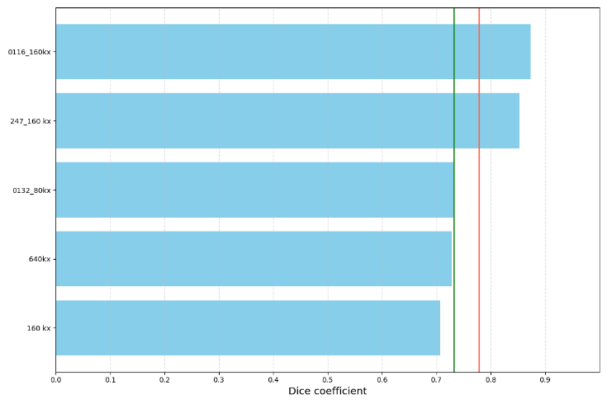
Nb₃Sn with artificial pinning centers (APC)
Hyperparameter sweeps can be useful to determine optimal parameters
Grid search of Bayesian methods are often used
Directs to what parameters are most important
Increased the mean DSC from 0.58 to 0.76 using same dataset
Lack of data is the primary difficulty
Notes:
Check DSC in the test dataset

Slide 11
Outline
01
Nanoprecipitate characterization in Nb₃Sn
02
Fractography for grain size determination
03
Crack counting in coil sections for destructive testing

Slide 12
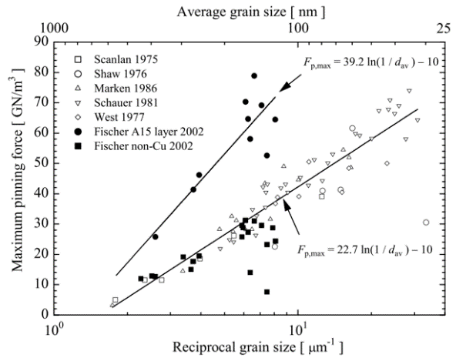
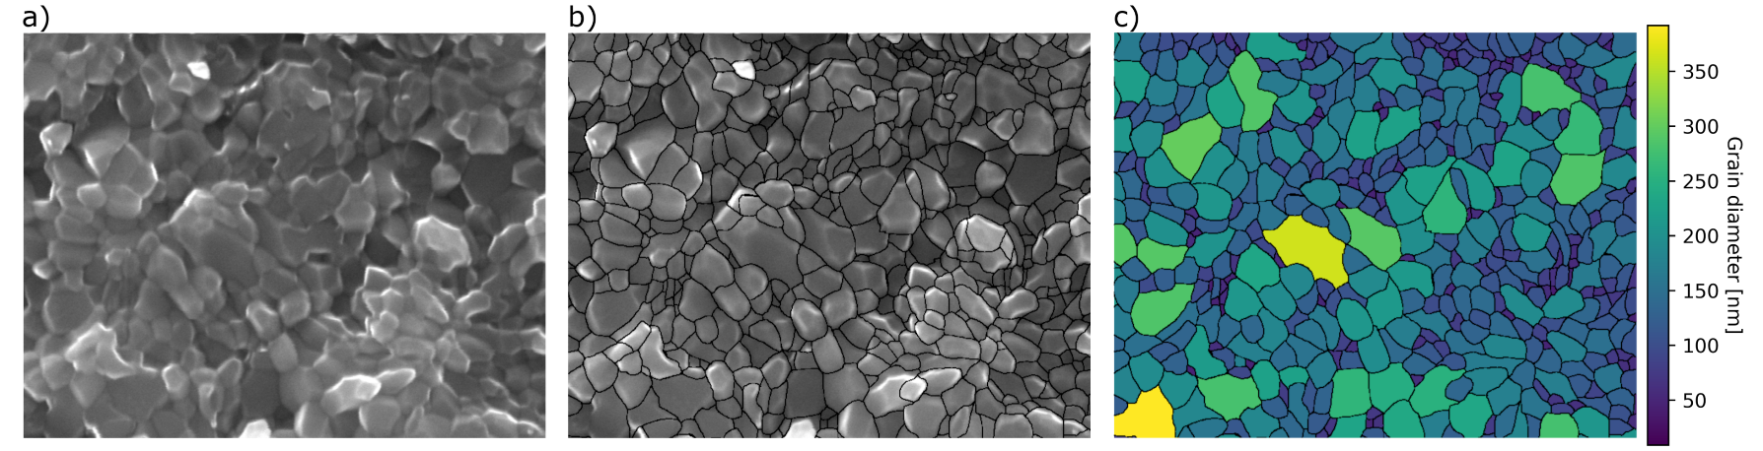
Fractography
Grain size is one of the more important characteristics of Nb₃Sn as grain boundaries act as magnetic flux pinning centers inhibiting energy dissipation as current flows though the superconductor.
Typical grain sizes range from ~20 to 200 nm depending on the heat-treatment schedule and wire architecture.
Given their small size, determination of grain size is not trivial.
Although not the only available method, analysis of wire fracture surfaces is by far the most common method for determining Nb₃Sn grain size
  Nb₃Sn exhibits intergranular fracture
  Easy sample preparation
  Imaging requires an SEM
  Analysis is labor intensive
Maximum pinning force as a function of grain size at 4.2 K in Nb₃Sn wires with no artificial pinning centers [1]
Analysis would benefit from automation using ML
Workflow for manually grain size analysis. Individual grains in an Nb₃Sn fractograph a) as imaged, b) after manual contour tracing; c) with an overlay of the image analysis results.
[1] A. Godeke, “Performance Boundaries in Nb₃Sn”, PhD thesis, June. 2005

Slide 13
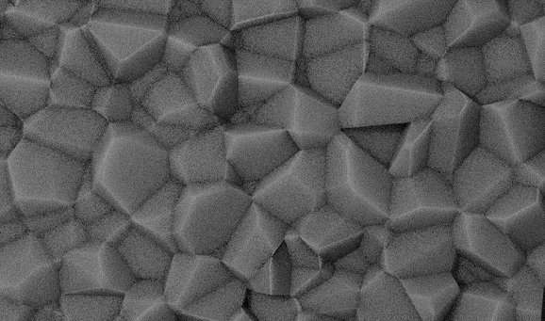
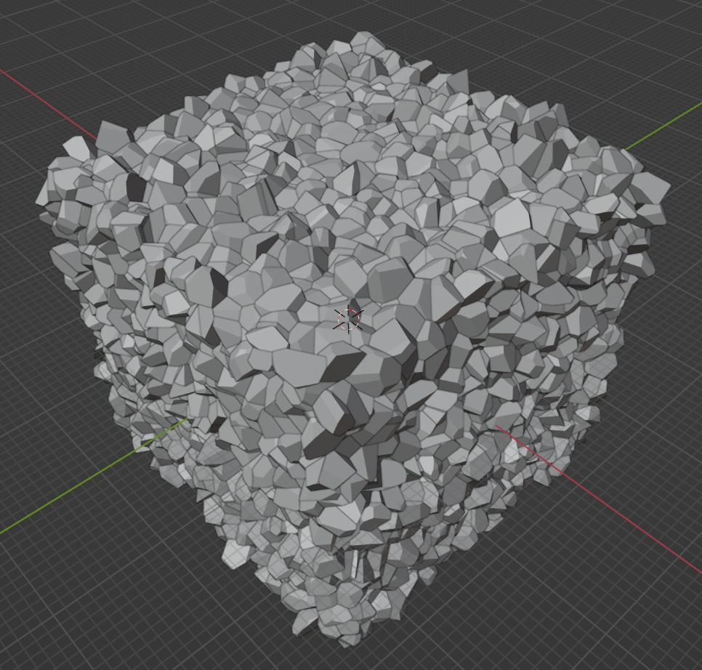
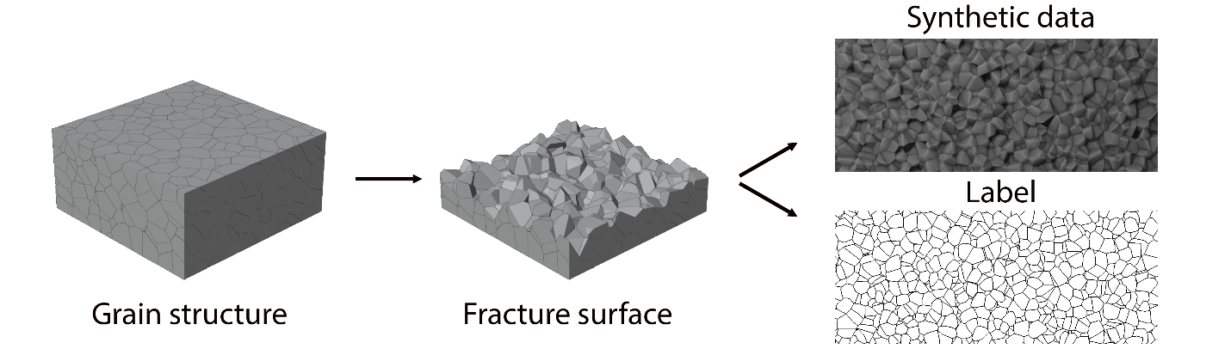
Fractography
A rule of thumb for training ML models, 10³ of labeled images are required.
  Prohibitively extensive endeavor for this problem
Pursuing to augment hand-labeled data with synthetic data
A 3D grain structure in generated using Voronoi construction from randomly distributed points (equiaxed grains)
A section of grains is removed to show a “fracture” surface
The grains are textured and lit as to resemble an SEM SE image
A true ground truth!
Workflow developed for generating synthetic fractography images and associated labels. Grain structure analog is created using a 3D Voronoi construction. Portion of the grains removed to reveal "an intergranular fracture surface". The grains are then textured and lit to imitate a secondary electron contrast image taken using an SEM. Visible grain interfaces are rendered as well to create the label image.

Slide 14
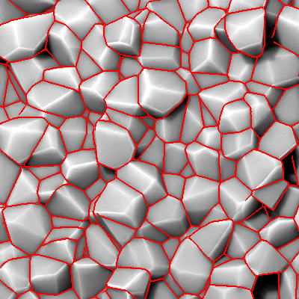
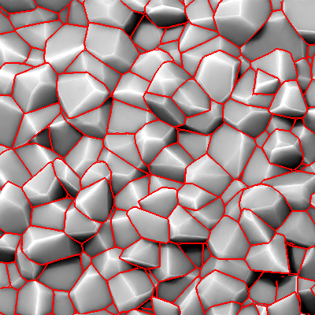
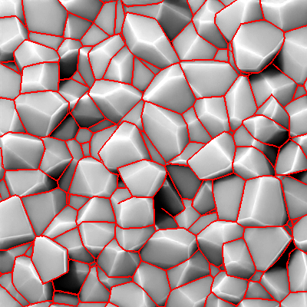
Fractography
  We are just about done with generating the synthetic data
  Initial results of labeling synthetic data very promising with accuracy of > 90%
  Next steps include integration with hand labeled data, image augmentation and model/hyperparameter tuning

Slide 15
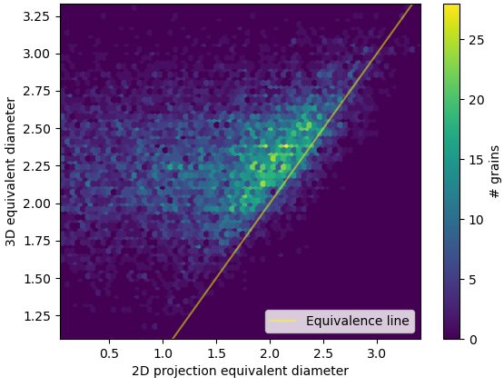
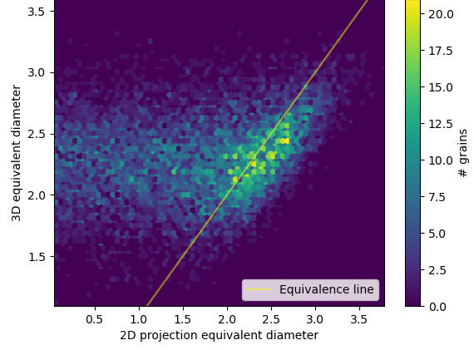
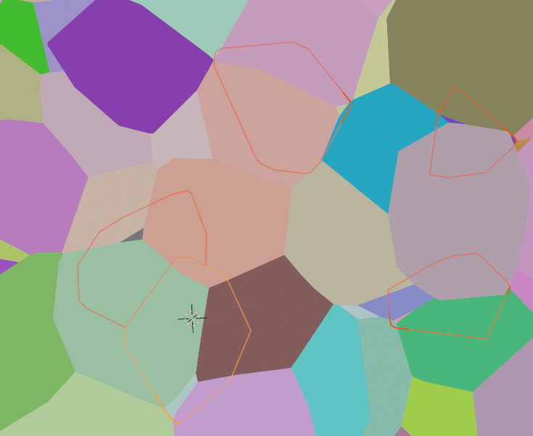
Fractography
Offshoot of the synthetic data generation work:
Kevin Gillespie was investigating how the grain sizes determined by different methods relate to the true – volume based – value and to each other.
  Fractography (area)
  “Flat polish” (area)
  “Flat polish” (line intercept) [1]
Information on the topic is somewhat limited as although standards exist (ASTM E112) [1], they are based on analytical formulae with many assumptions
Full control on the grain structure:
  Various size distributions
  Columnar grains
a)
Flat polish
b)
Fractography
Flat polish observation
Hidden grain shape
Grain diameter based on volume vs. grain size based on a) 2D projection are of a fractography; b) 2D projection of a polished specimen. Figures based on a grain structure generated using Voronoi construction. (Kevin Gillespie).
[1] “Standard Test Methods for Determining Average Grain Size“, ASTM E112-13(2021), DOI: 10.1520/E0112-13R21
Notes:
Put labels on

Slide 16
Outline
01
Nanoprecipitate characterization in Nb₃Sn
02
Fractography for grain size determination
03
Crack counting in coil sections for destructive testing

Slide 17
Cracked Nb₃Sn Subelement Identification
Nb₃Sn dipole magnets present a challenge in their mechanical design as the brittle Nb₃Sn subelements are susceptible to damage by cracking if stresses are not managed carefully. Even a small number of cracks can significantly reduce strand performance.
A single coil cross-section may have on the order of ~500,000 individual subelements that need to be investigated for potential cracks – an effort that would require one month at a rate of one second per subelement!
A cross-section of a Nb₃Sn cosine theta dipole accelerator magnet. An enlarged image of a Rutherford cable from the coil cross-section is shown in green, image of a wire from the cable cross-section is shown in blue box. An individual subelement from a wire is shown in a red box.

Slide 18

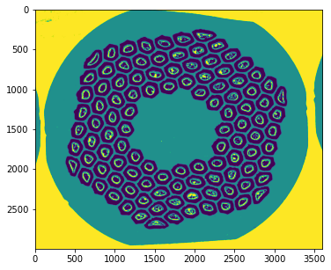
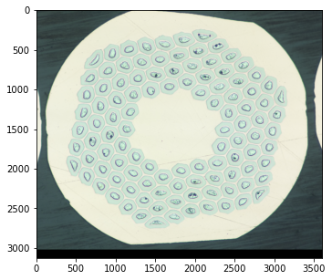
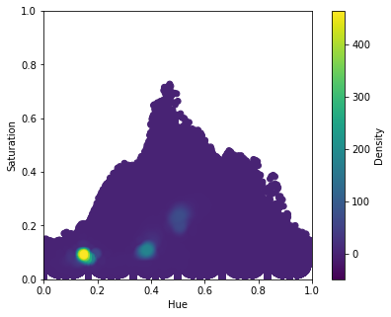
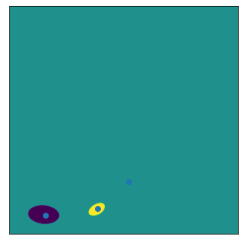
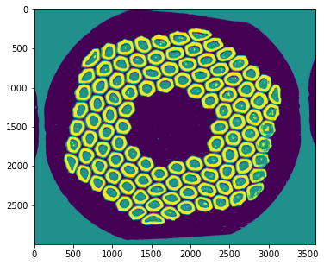
Cracked Nb₃Sn Subelement Identification
Unsupervised learning – feature clustering
K-Means decision boundary
Segmented image
Histogram of 2 properties of pixels in the image
Image to be segmented
Gaussian Mixtures decision boundary
Segmented image

Slide 19
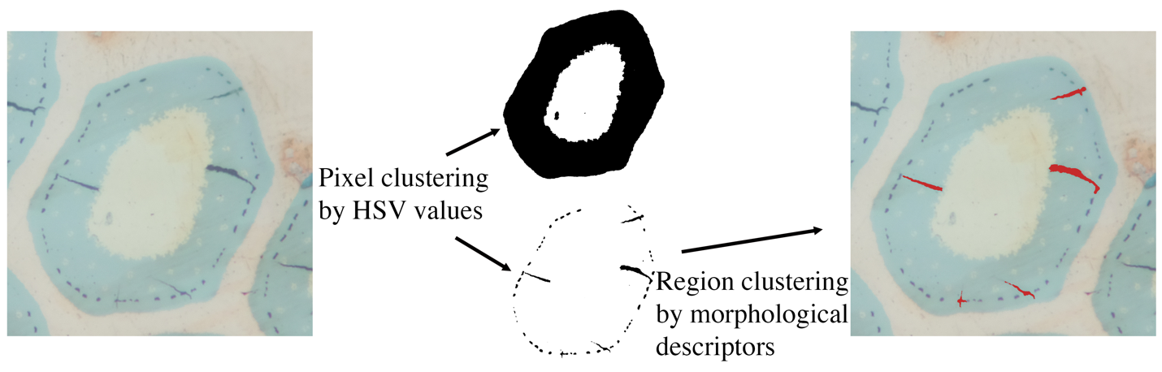
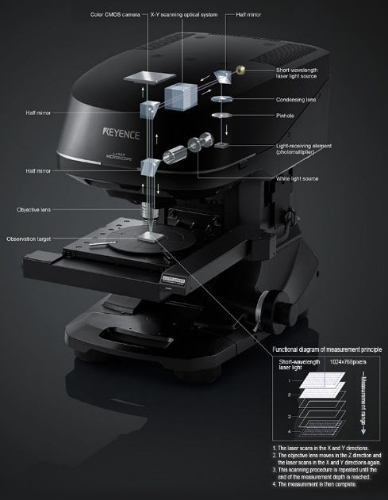
Cracked Nb₃Sn Subelement Identification
Similar approach can be used for segmentation of cracked subelements:
Isolate subelements and darker features within subelement via clustering based on color
Isolate cracks from porosity/voids using
morphological features (size, aspect ratio, etc)
Once the cracks are segmented, parameters of interest can be calculated trivially (density of cracks and their orientation) that can be used to determine their origin.
Size of the dataset is the largest challenge:
High magnification required
Large area
Automated stage and autofocusing required
Stitching of images on-demand
Keyence confocal microscope

Slide 20
Conclusions and next steps
Some problems necessitate ML approaches
  Non-supervised ML is now commonplace in IA
  Use of supervised machine learning (CNNs) in literature is increasing
Initial results promising but dataset size requirements are an issue
Synthetic data and data augmentation can help
Ground truth in some cases in not easily attainable making model evaluation difficult
Next steps include obtaining more labeled data
Synthetic data generation and evaluation of its effectiveness
Model architecture/training parameter refinement

Slide 21
Thank you! Questions?
Machine Learning for Nb₃Sn wire image analysis
Algirdas Baskys, Kevin Gillespie, Jean-Francois Croteau, Ian Pong
(abaskys@lbl.gov)
Lawrence Berkeley National Laboratory

Slide 22
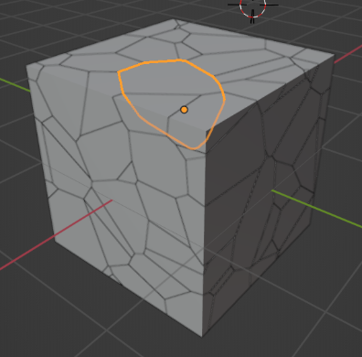
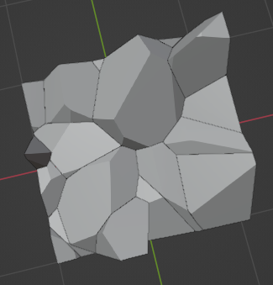
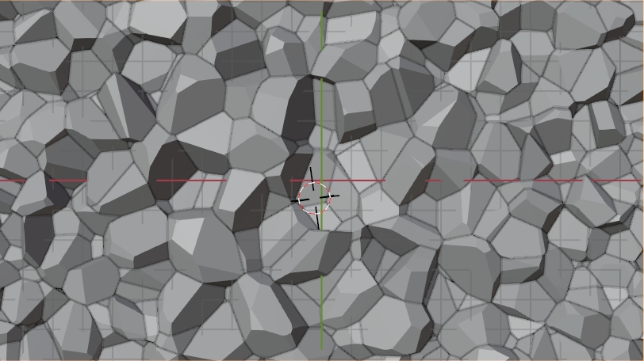

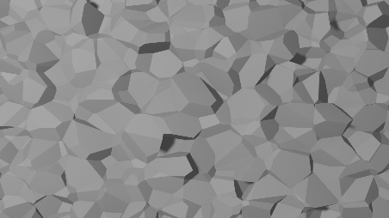

Synthetic data
To minimize the need for real data, we create our own:
“Data” and label created together
Straight forward to automate to create large dataset for training
The pre-trained model is likely to need less real data to achieve good performance
Only read data would be used for validation
Notes:
The 3D models will also help to investigate how the grain size determined by fractography relates to actual grain size/diameter

Slide 23
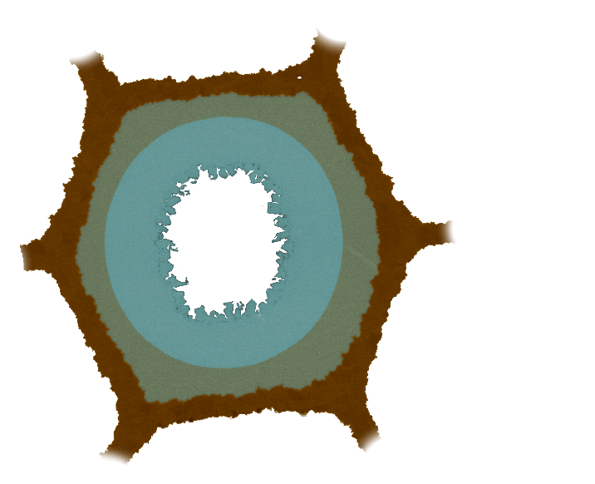
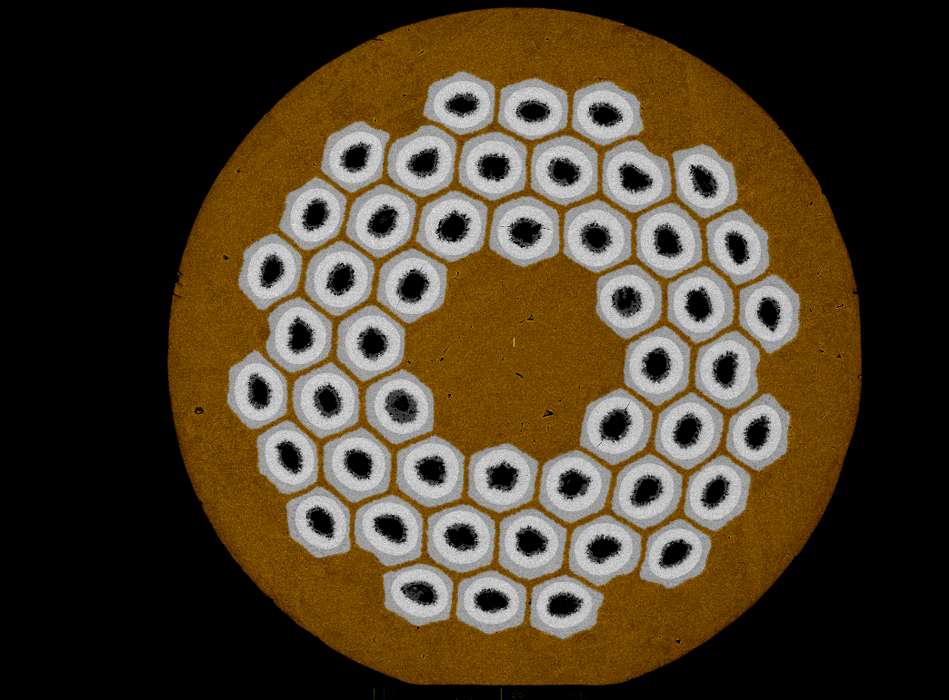
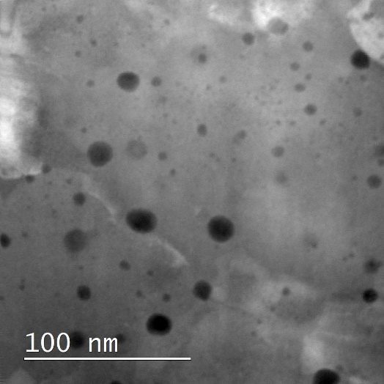
Nb₃Sn with artificial pinning centers (APC)
a)
APC wires developed at Fermilab (X. Xu) and Hypertech Inc. The first Nb₃Sn wire measured in transport to meet the FCC specification in terms of critical current.
APCs contribute to:
  Additional point pinning
  Reduction in grain coarsening during HT
To optimize heat-treatment of APC wires it is of interest to determine:
  Precipitates size,
  Density
  Growth rate
Multiple samples need to be analyzed, but both sample preparation and analysis are very time consuming
The images are not suitable for analysis via conventional IA techniques
b)
TEM images by Alice Moros, CERN
a) Internally oxidized wire performances compared with state-of-the-art PIT and RRP wires, and CERN’s FCC’s specifications [1]; b) Grain boundary (APC GB) and point pinning due to nanoprecipitates (APC PP) contributions to the pining force in APC wires as well as data from powder in tube (PIT) Nb₃Sn wires for reference [2].
[1] X. Xu et. al., doi: 10.1016/j.scriptamat.2020.05.043
[2] J. Rochester et. al., doi: 10.1109/TASC.2021.3057560
Notes:
Potentially remove as JF will be covering the material

