Slide 1
Update on Costheta cross section
V. Marinozzi
07/13/2021

Slide 2
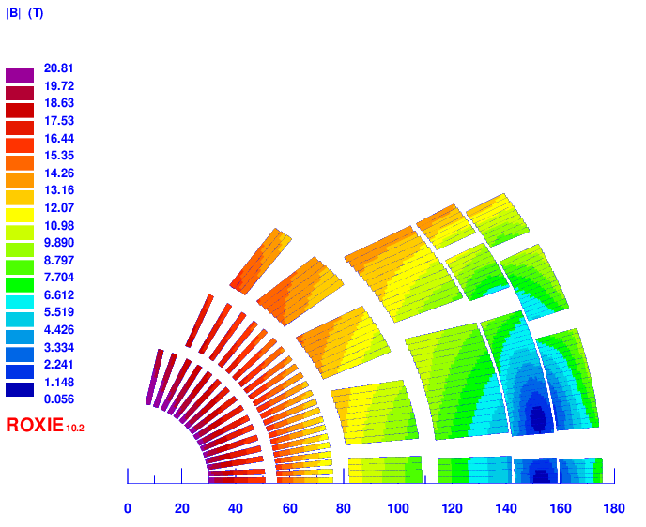
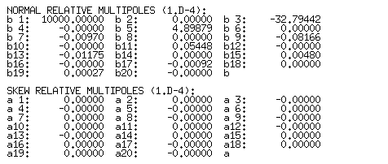
v23
2 layer HTS, 4 layer LTS
Strands: 0.9 – 1.1 – 0.8 mm, 40 – 44 – 35
Cable width: 20.65 – 26.82 – 15.51 mm
Stabilizer/Superconductor: 3 – 1 – 1.2
Coil width: 145 mm
Current: 14100
Peak field: 20.55 – 15.59 – 13.98 T
Margin: 82.5 – 81 – 87 %
J_{cu} on LTS: 1469 A/mm²

Slide 3
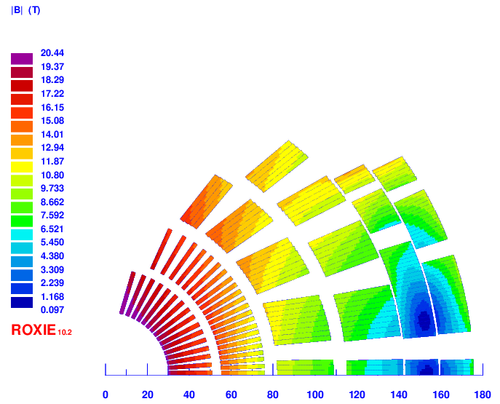
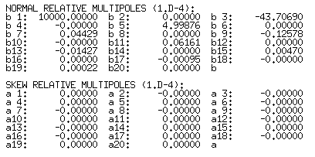
v24
2 layer HTS, 4 layer LTS
Strands: 0.9 – 1.1 – 0.8 mm, 40 – 44 – 35
Cable width: 20.65 – 26.82 – 15.51 mm
Stabilizer/Superconductor: 3 – 1 – 1.2
Coil width: 145 mm
Current: 14500
Peak field: 20.44 – 15.56 – 12.96 T
Margin: 85 – 82 – 85 %
J_{cu} on LTS: 1511 A/mm²

Slide 4
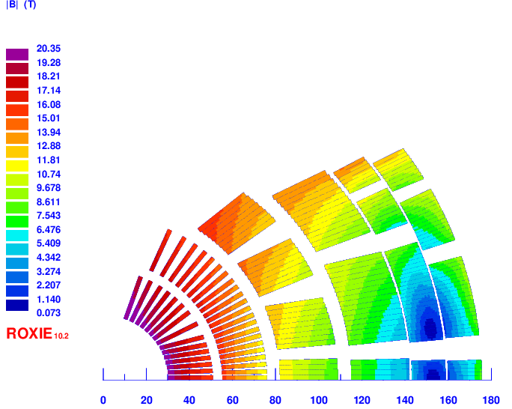
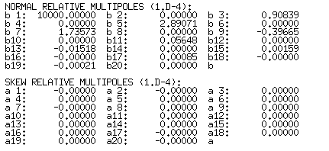
v23b
2 layer HTS, 4 layer LTS
Strands: 0.9 – 1.1 – 0.8 mm, 40 – 44 – 35
Cable width: 20.65 – 26.82 – 15.51 mm
Stabilizer/Superconductor: 3 – 1 – 1.2
Coil width: 145 mm
Current: 14100
Peak field: 20.35 – 15.73 – 13.95 T
Margin: 83 – 83 – 88 %
J_{cu} on LTS: 1469 A/mm²

