Slide 1
20T hybrid block-coil
V5.8
E. Rochepault
14/09/2022

Slide 2
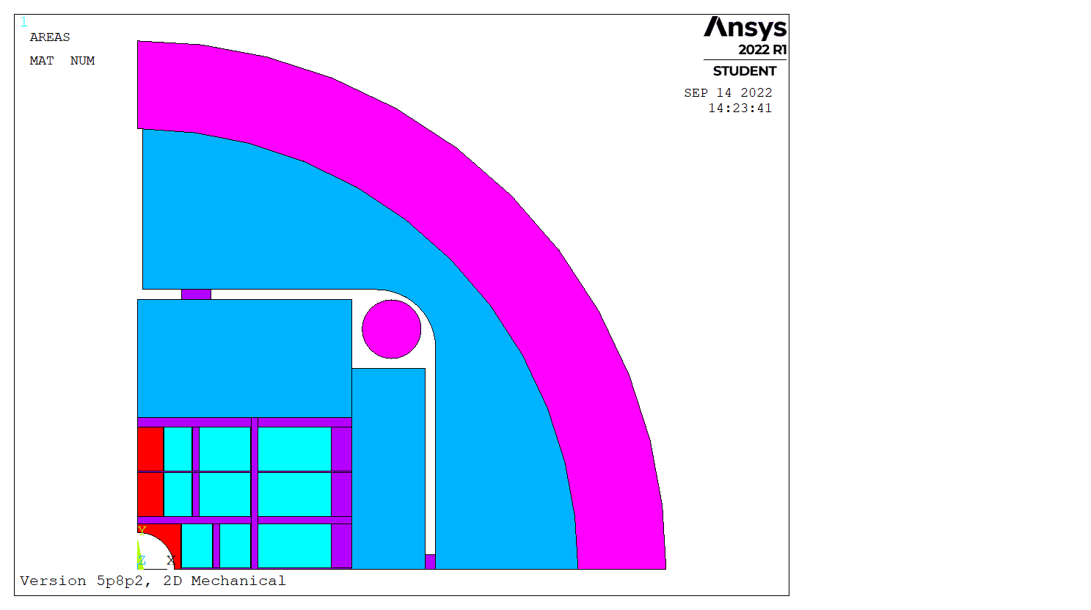
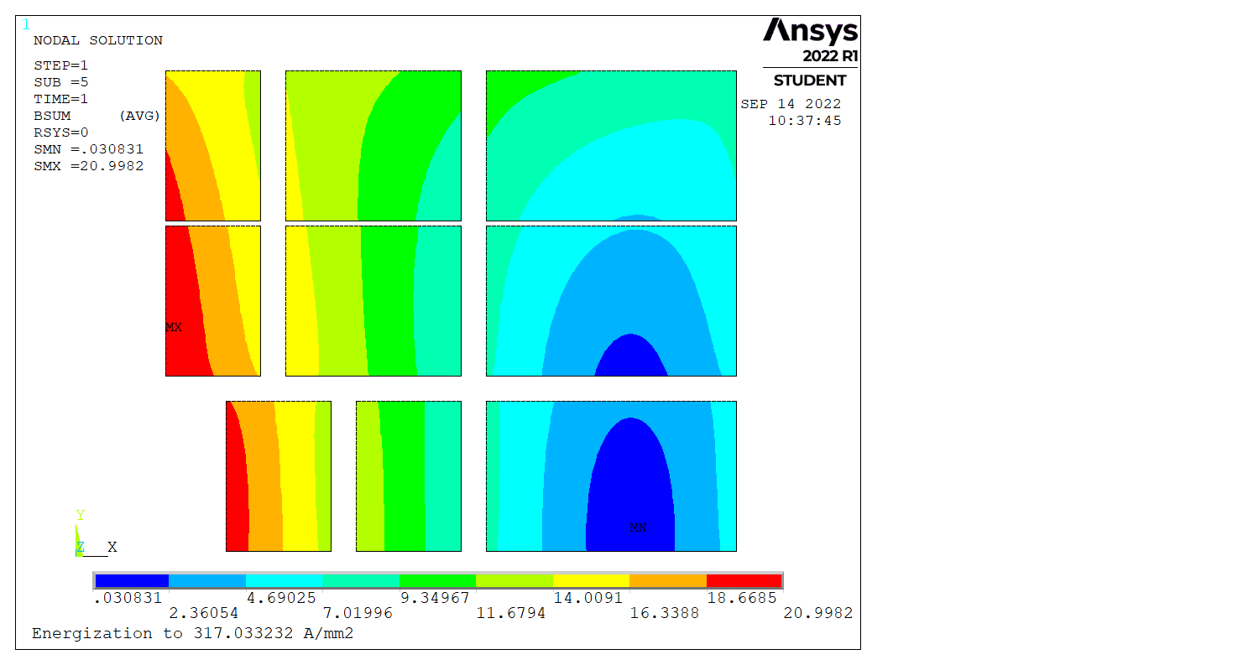


Magnetic model – 5.8.2
Magnetic layout modified to:
  split the Nb3Sn blocks in 2
  incorporate ribs in between
  (no magnetic optimization)
With iron:
  20.2 T in the bore
  21.0 T peak field

Slide 3
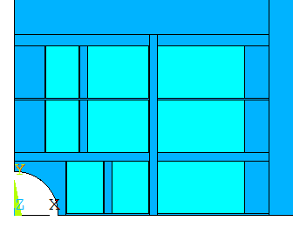
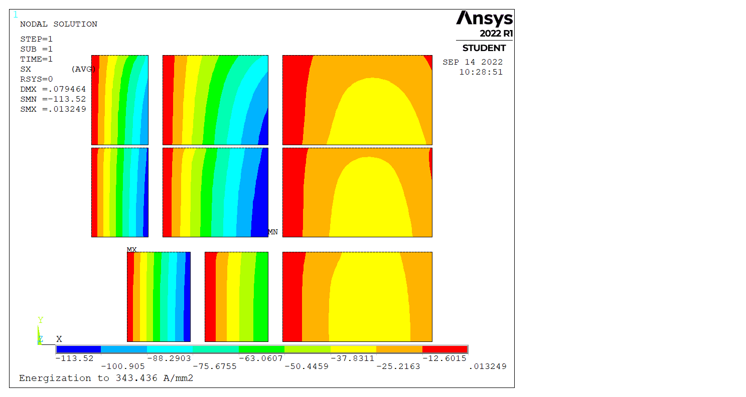
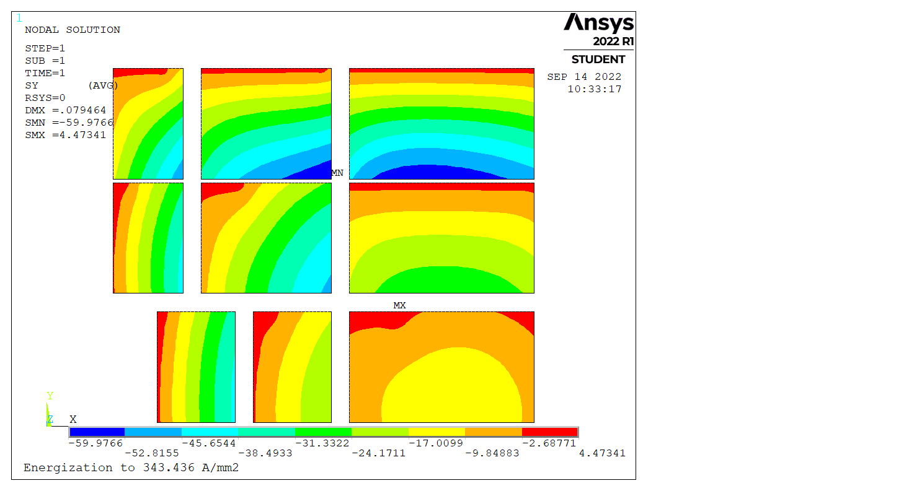
Rigid boundaries
Fixed nodes (= infinitely rigid) everywhere but the coil blocks
Lorentz forces only
With iron
Sx
Sy
60 MPa
113 MPa

Slide 4
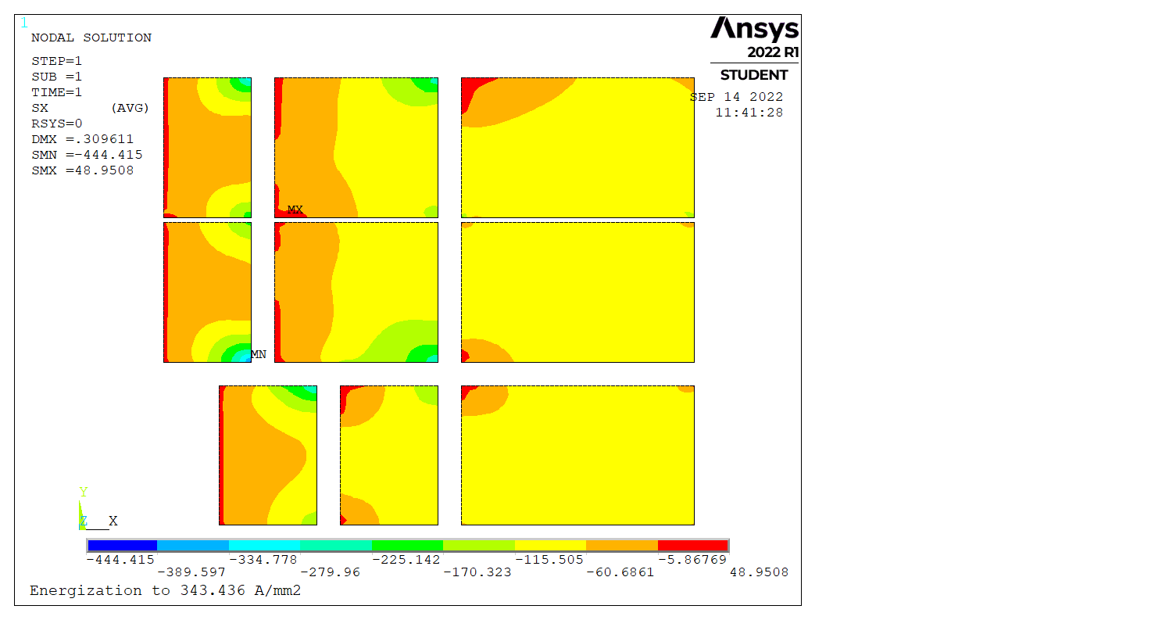
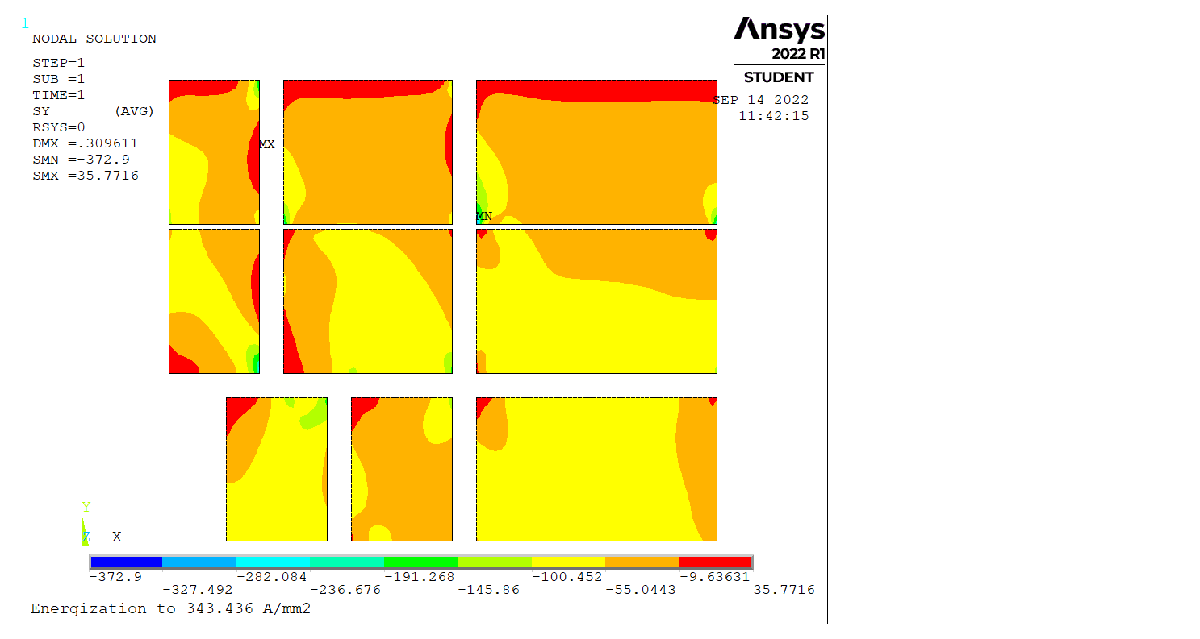
All components bonded, coil sliding
All surrounding components bonded
Coil shims bonded to coils
Coil blocks sliding
Rigid structure
→ Peak stresses in corners
Sx
Sy
373 MPa
444 MPa

Slide 5
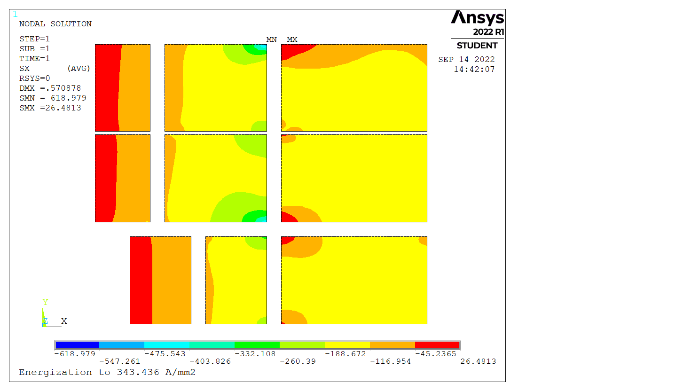
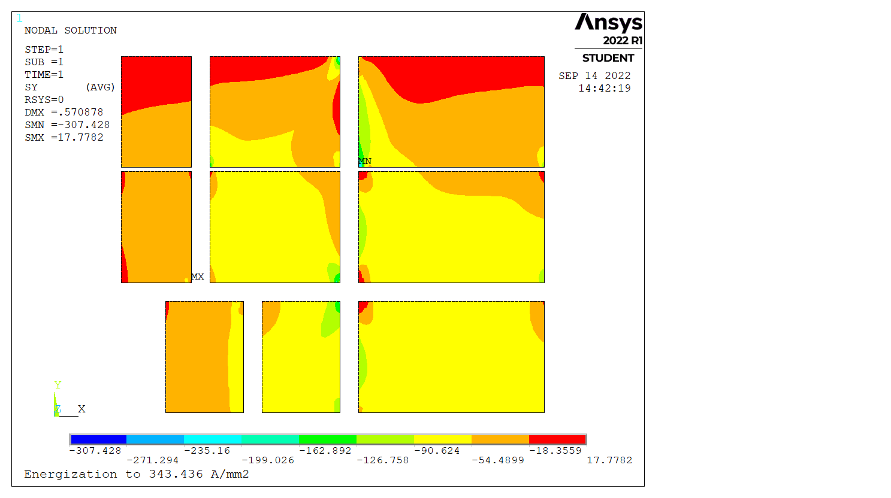
Components sliding and separating
All surrounding components bonded
Coil blocks sliding and separating
Main rib bonded to YPad
Some coil blocks sliding with no separation to improve convergence
→ High bending of main rib
Sx
Sy
307 MPa
619 MPa

