Slide 1
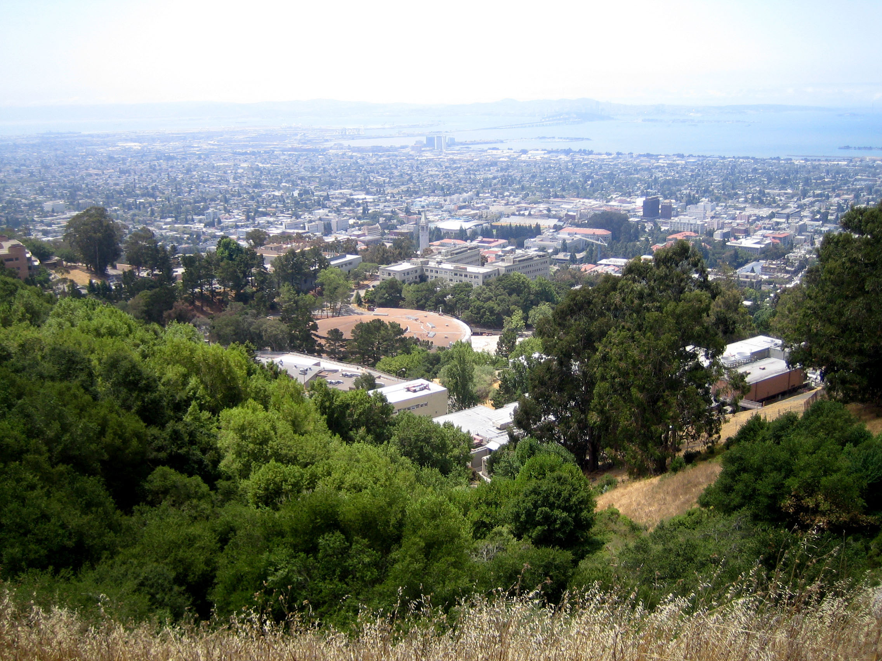
Thinking of Colliding Nuclei as a Thermalized System
Gary D. Westfall
Michigan State University, Emeritus
Symposium on Collective Flow in Nuclear matter: a Celebration of Art Poskanzer’s Life and Career
Lawrence Berkeley National Laboratory
December 9, 2022

Slide 2
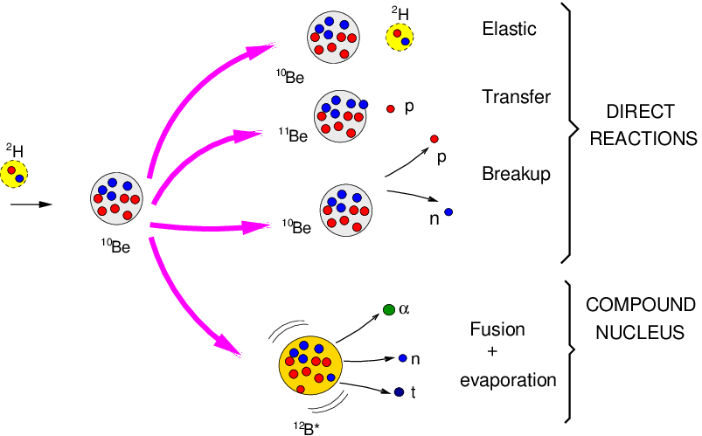
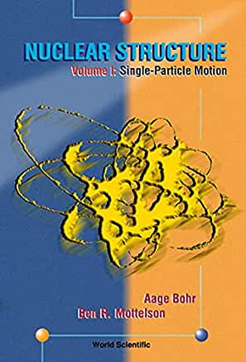
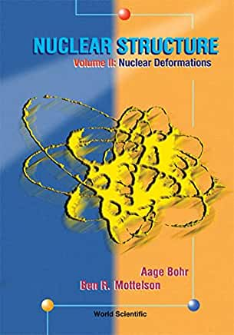
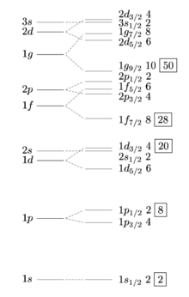
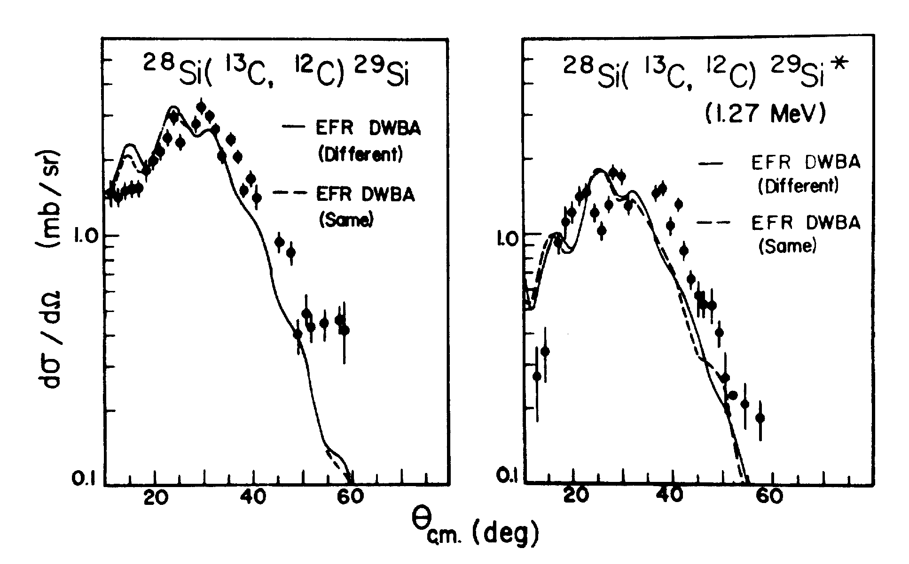
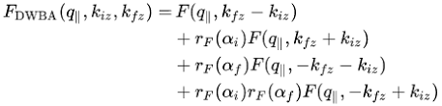
Nuclear Physics Before the Bevalac
Shell model
Compound nucleus
DWBA
Group Theory
Angular momentum algebra

Slide 3
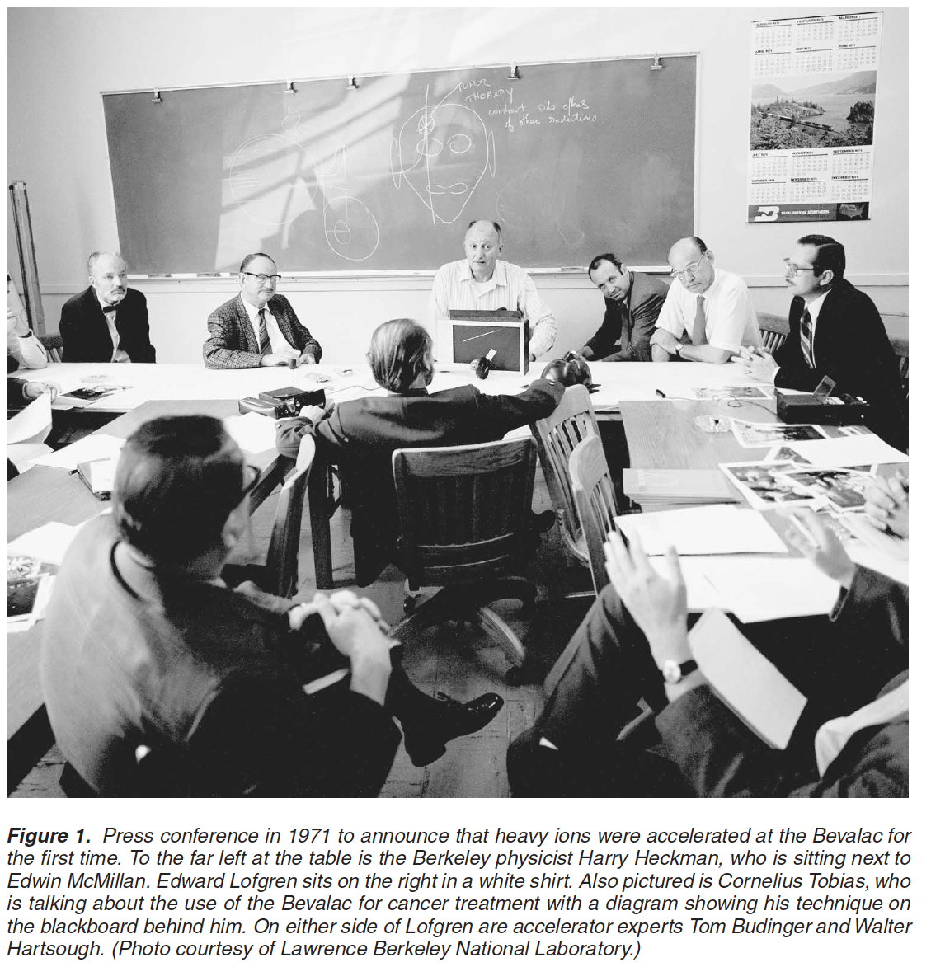
Birth of the Bevalac
Bevalac was proposed by Al Ghiorso
Photo shows press conference in 1971 announcing acceleration of heavy ions at the Bevatron using a local ion source to produce ¹⁴N beams at
2 AGeV by Hermann Grunder and his team
First Bevalac heavy ion beams were produced using the SuperHILAC and the Bevatron August 1, 1974.
Soon followed by Ne and Ar beams by the end of the year
Catherine Westfall
“Rethinking Big Science
Modest, Mezzo, Grand Science and the
and the Development of the Bevalac, 1971 – 1994”
Isis, 2003, 94:30-56

Slide 4
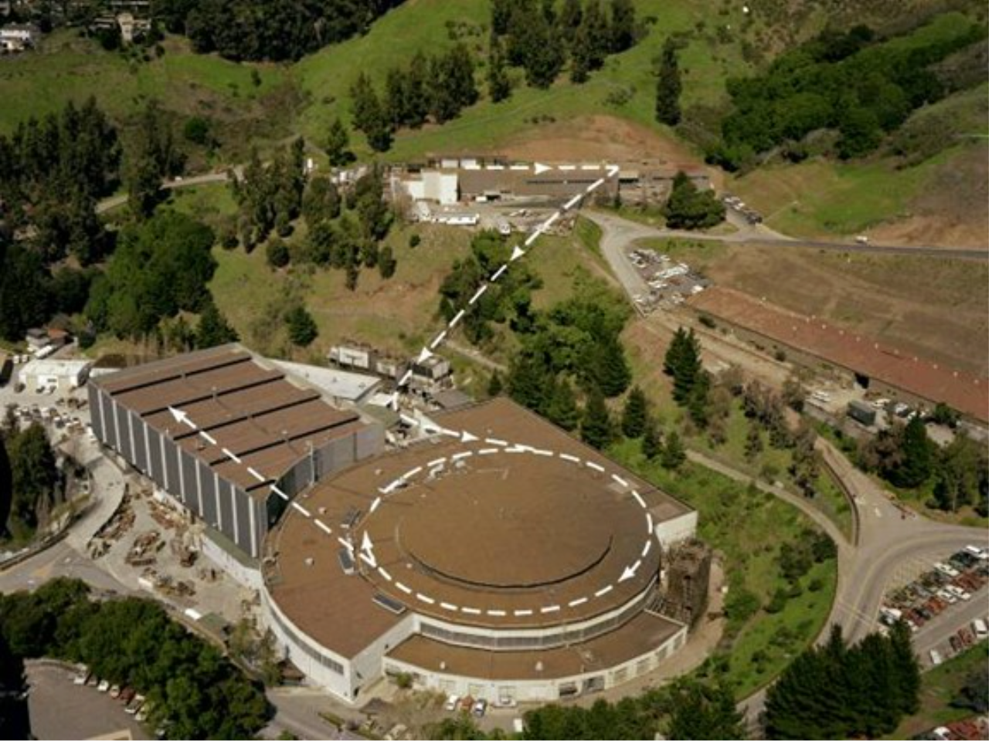
SuperHILAC
Transfer Line
Bevatron

Slide 5
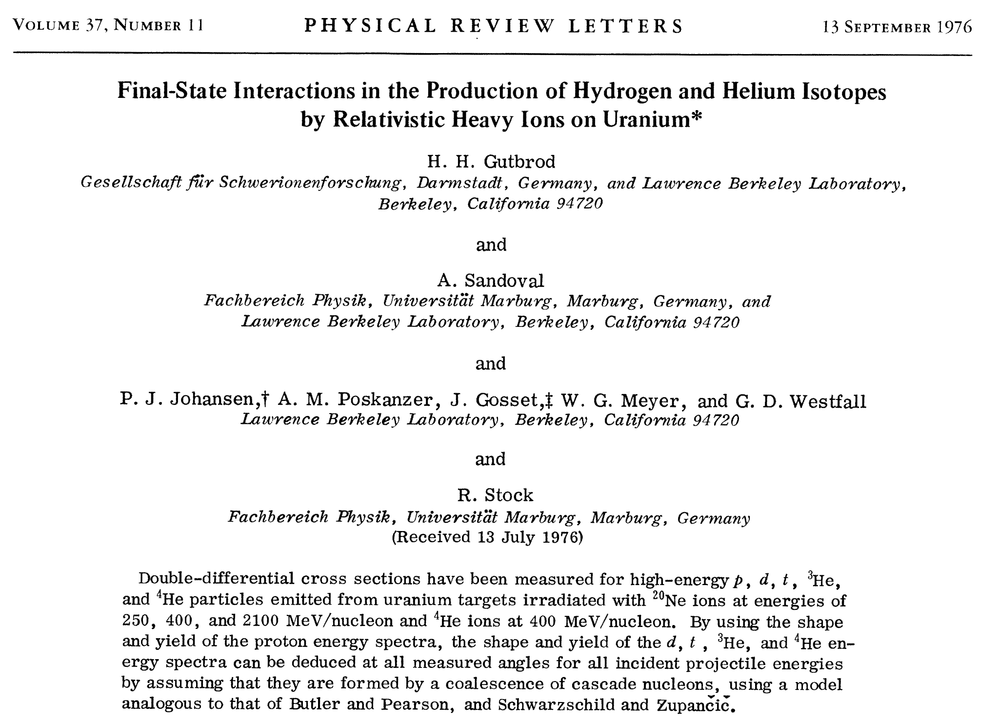

Slide 6
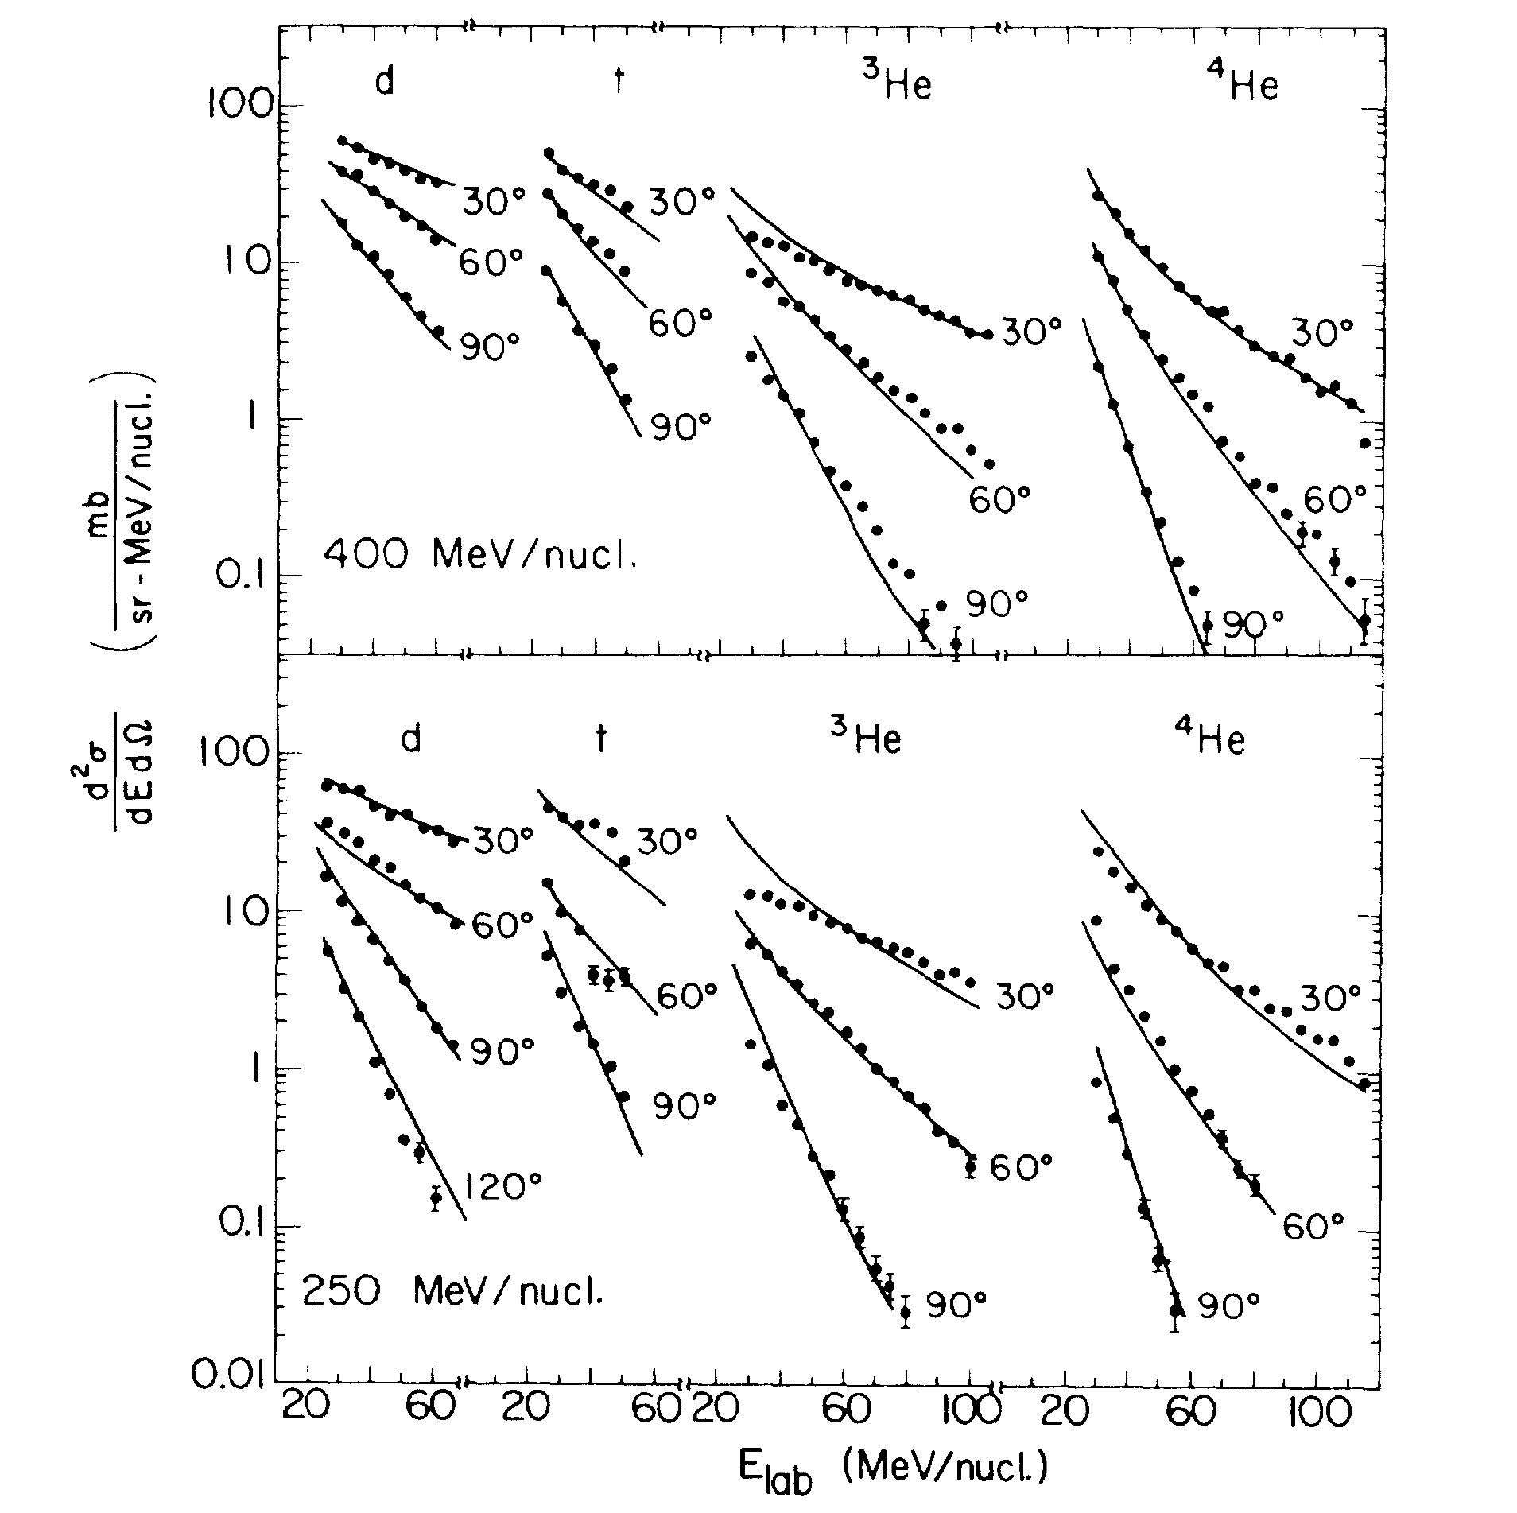
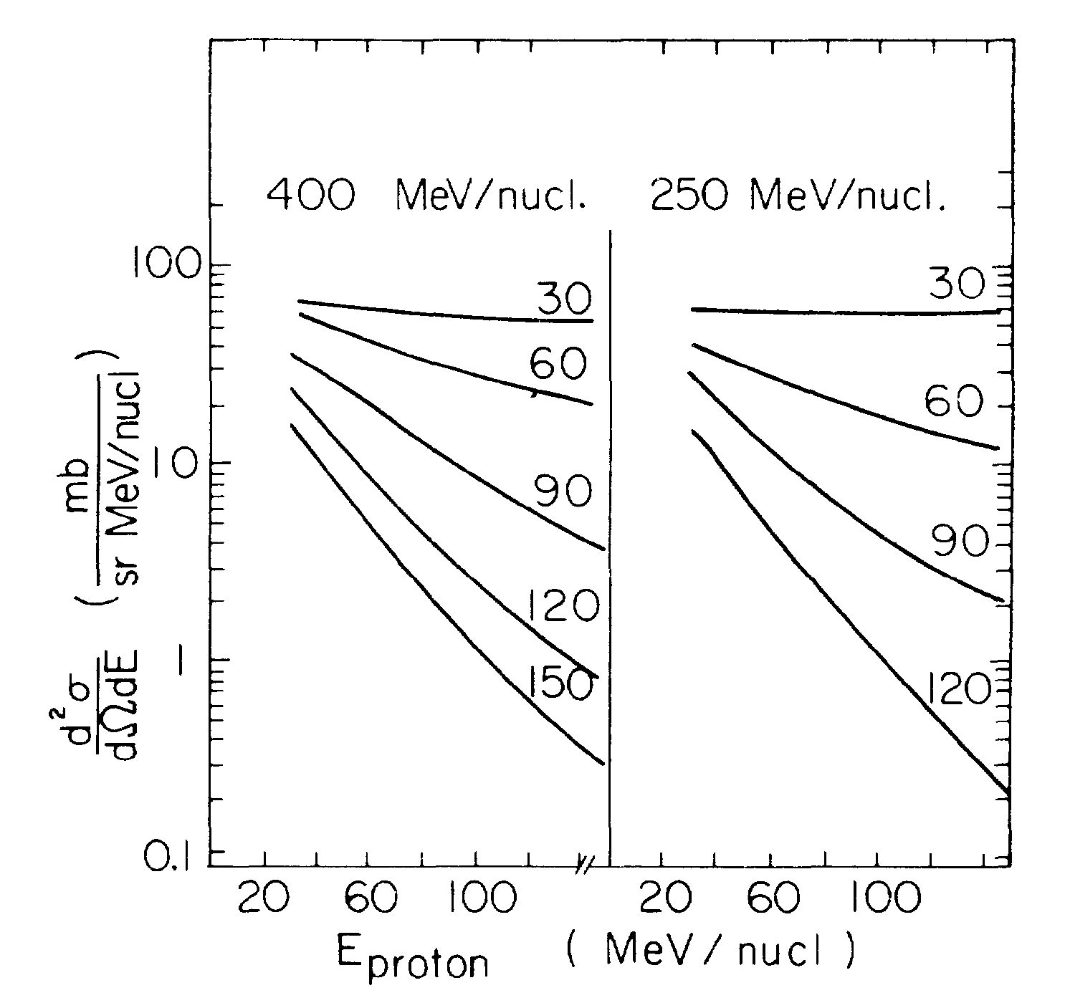
The Coalescence Model

Slide 7
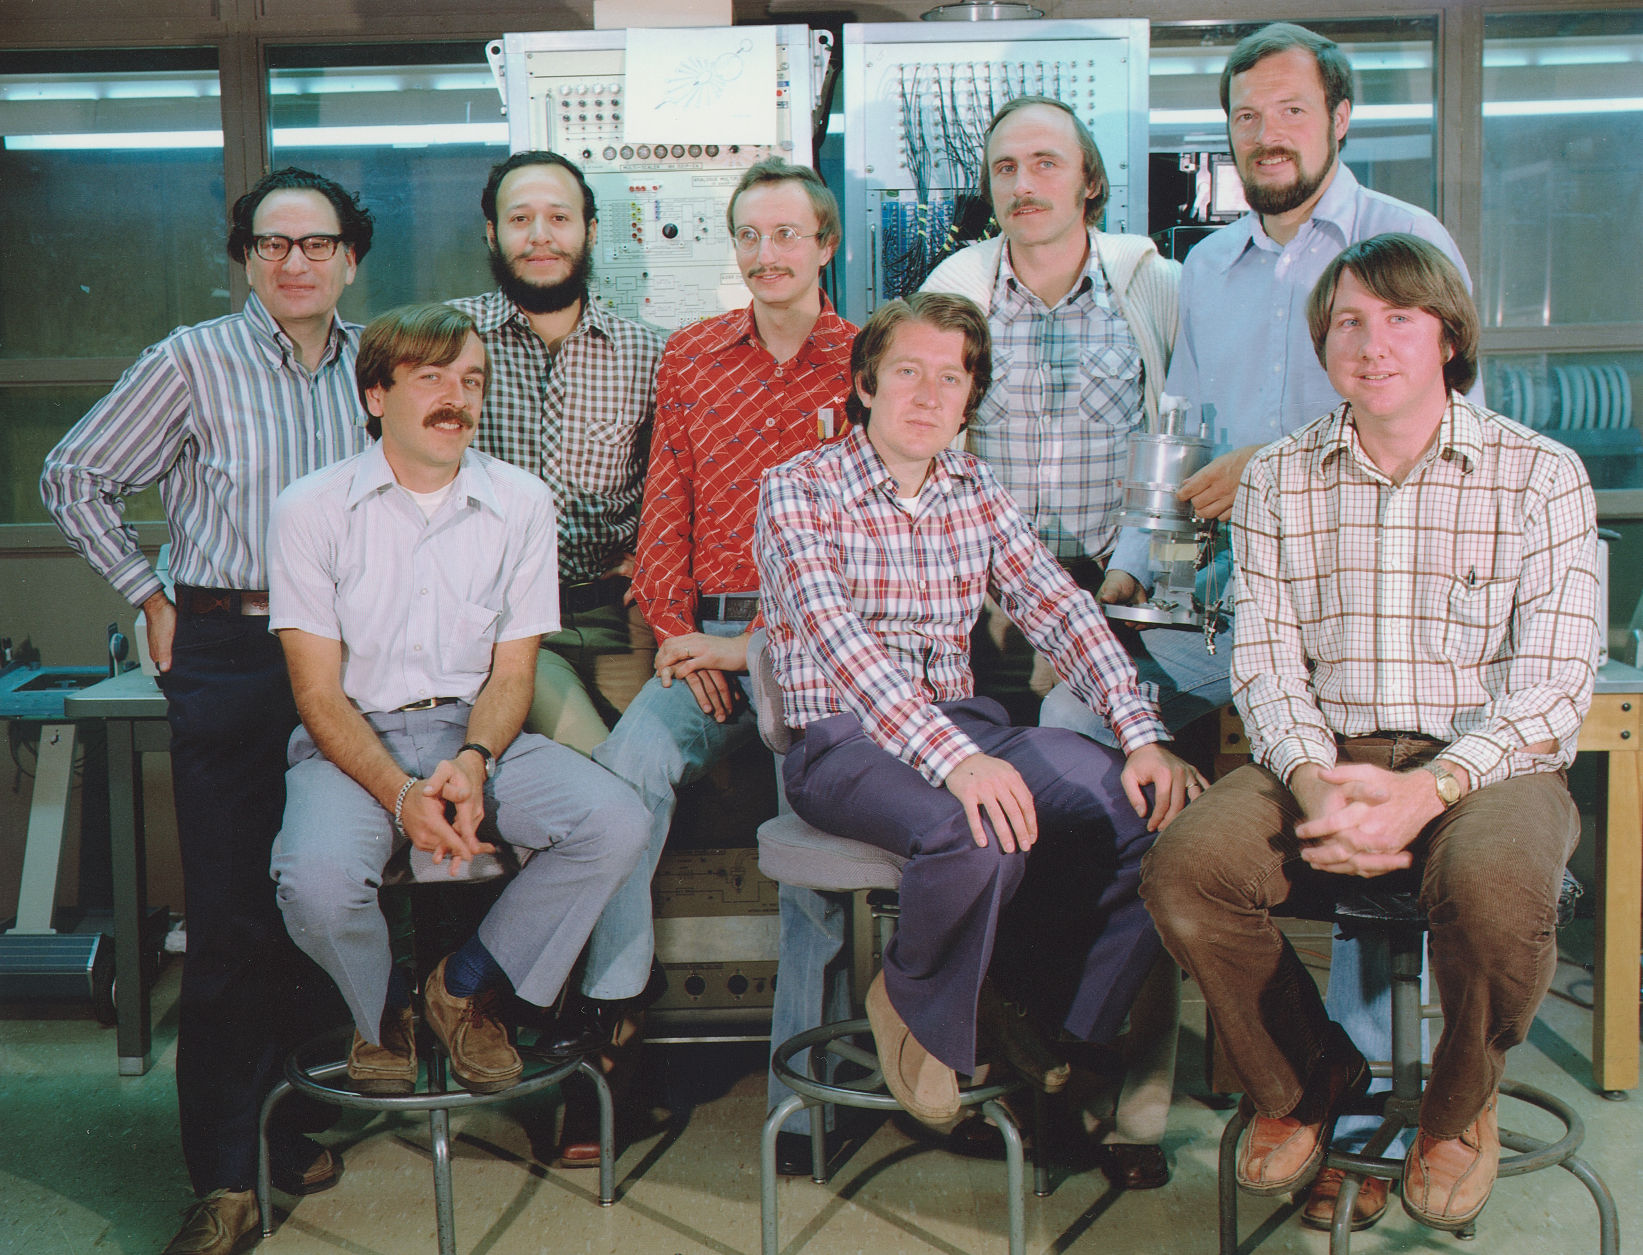

Slide 8
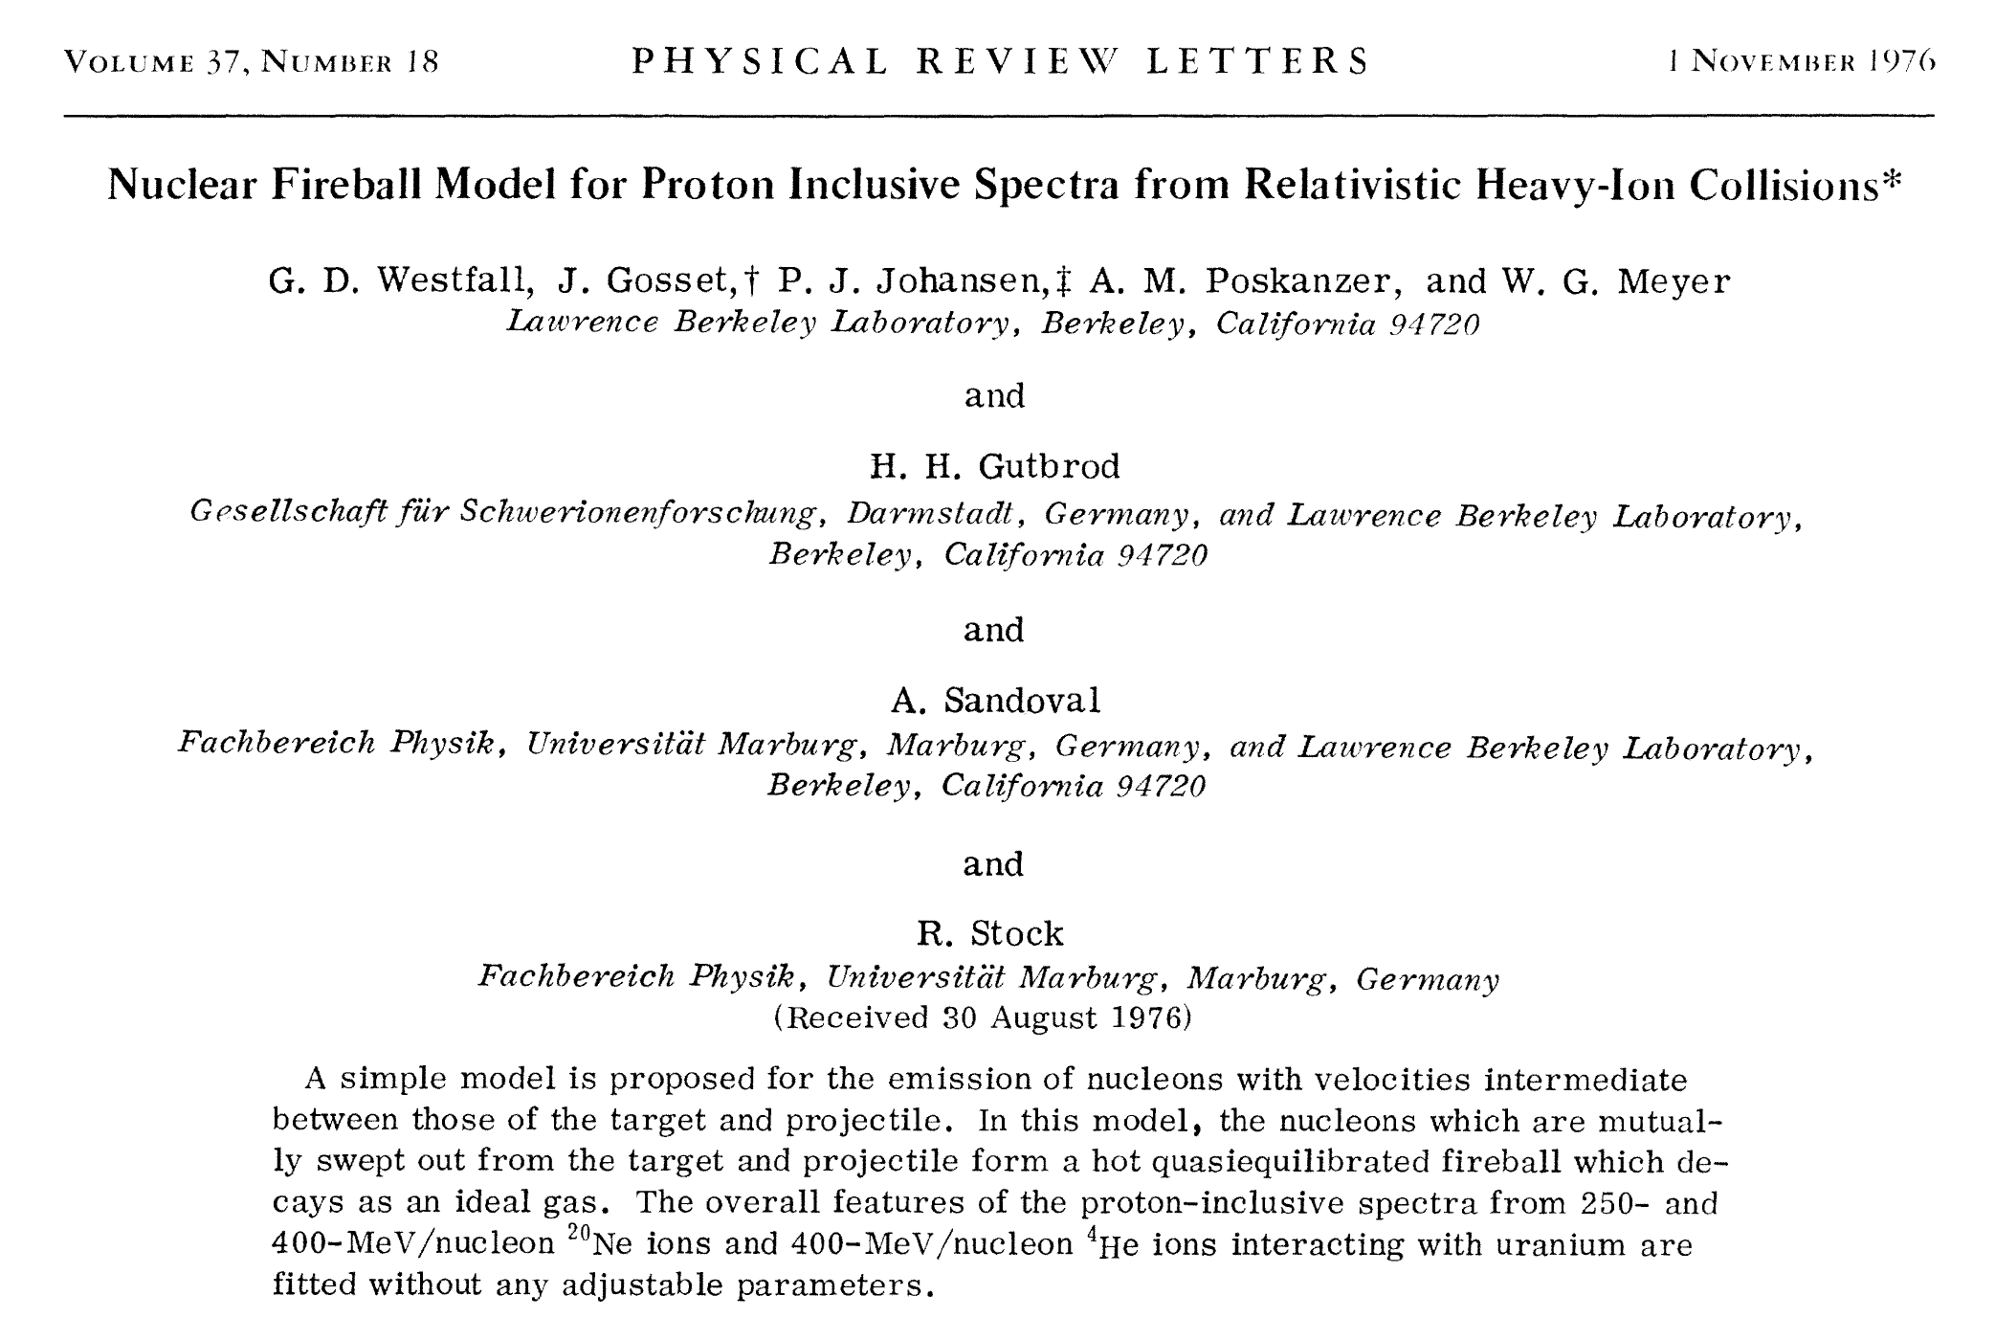
The fireball model successfully reproduced particle production data from the Bevalac and showed that we can think of nuclear physics in terms of thermodynamics.

Slide 9
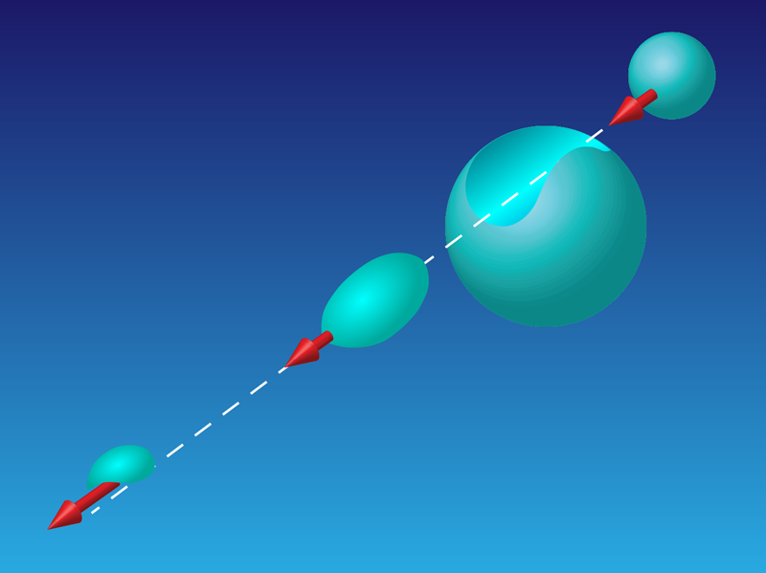
The Nuclear Fireball Model
50 Years of Physical Review C: Probing the Secrets of Nuclei
October 28, 2020• Physics 13, 168

Slide 10
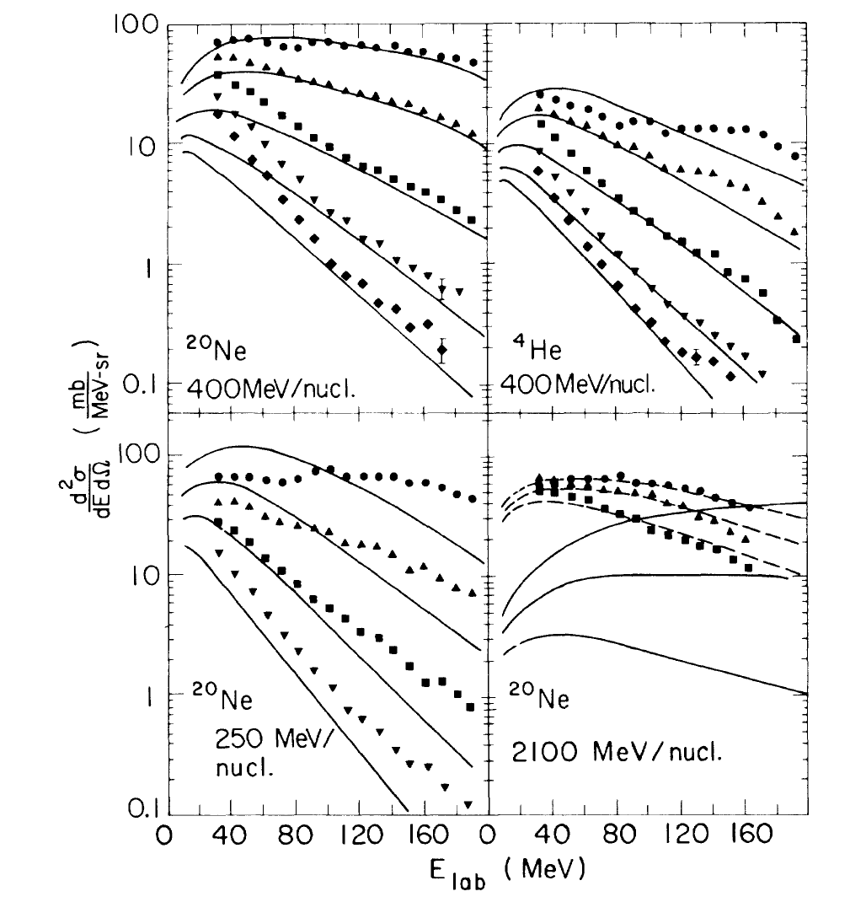
Fireball Model

Slide 11
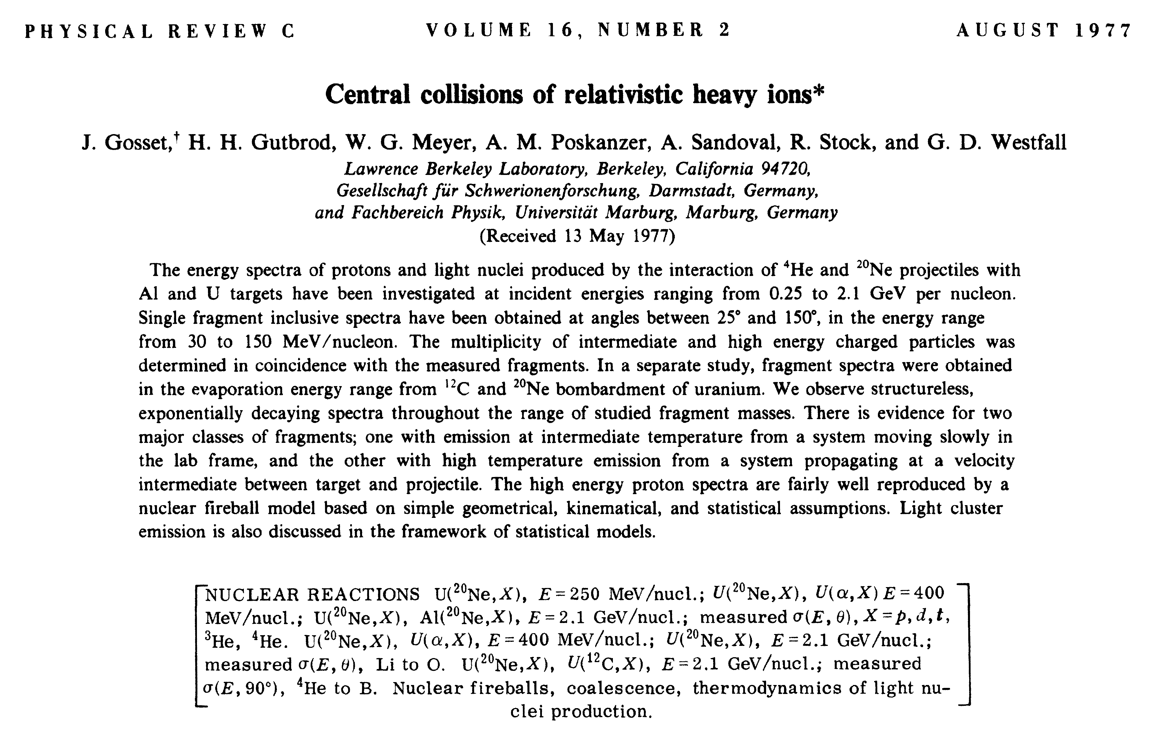

Slide 12
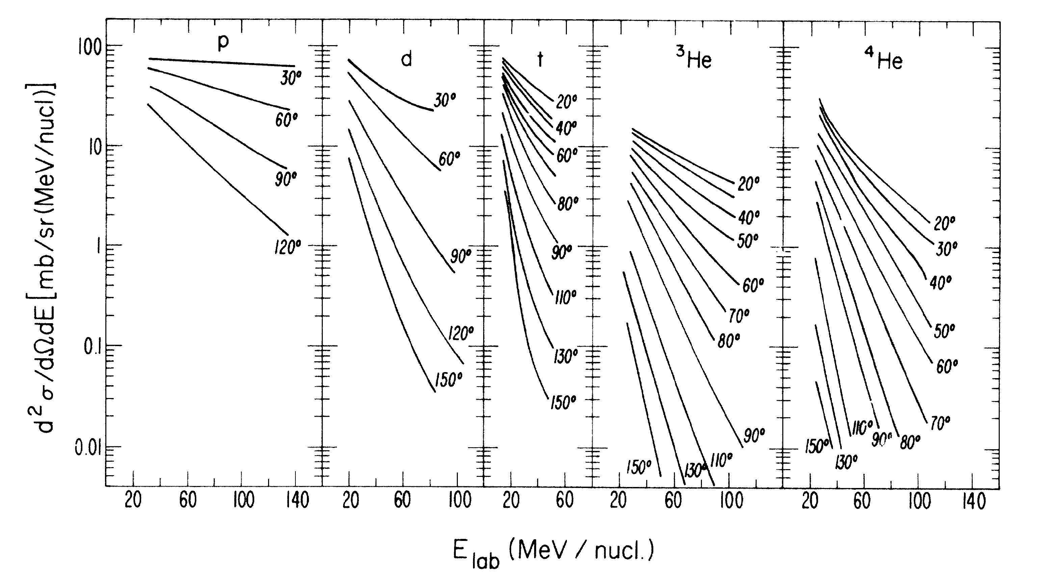
Milestone
“This was the first significant experimental paper in the field of relativistic
heavy-ion collisions.” - Physical Review C 50th Anniversary Milestones, 2020
Ne+U 400 AMeV

Slide 14
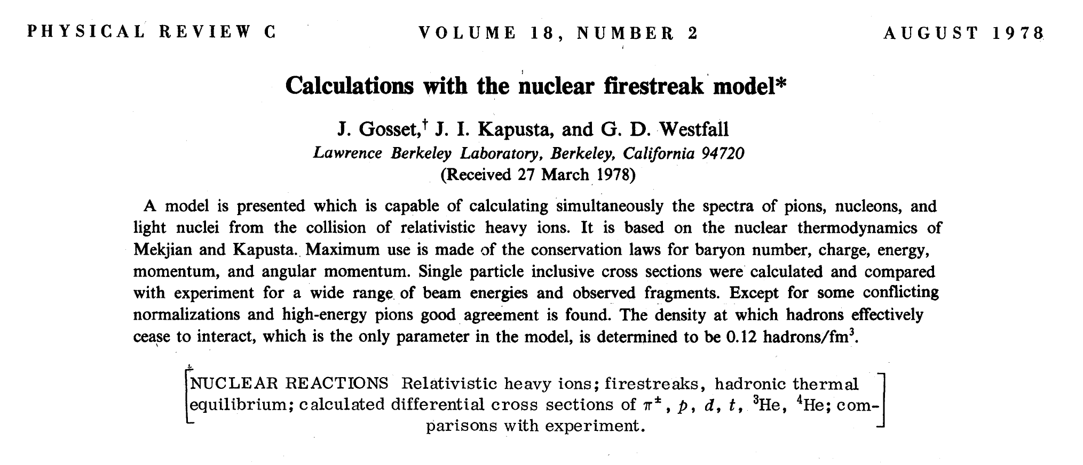

Slide 15
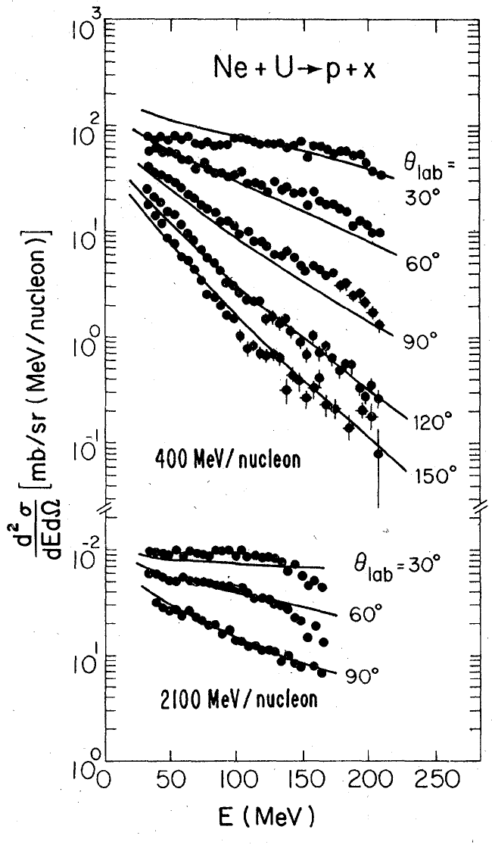
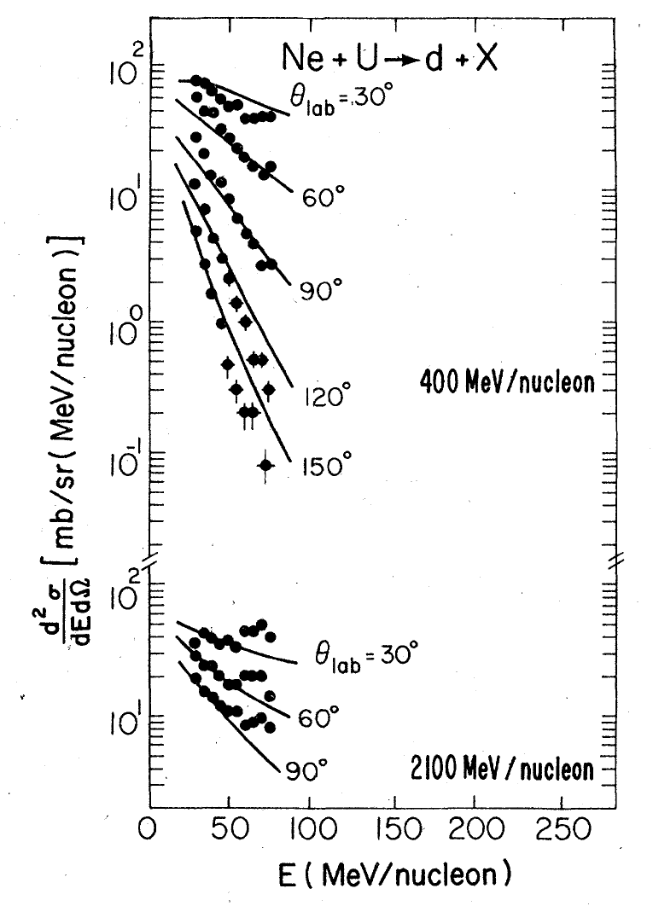
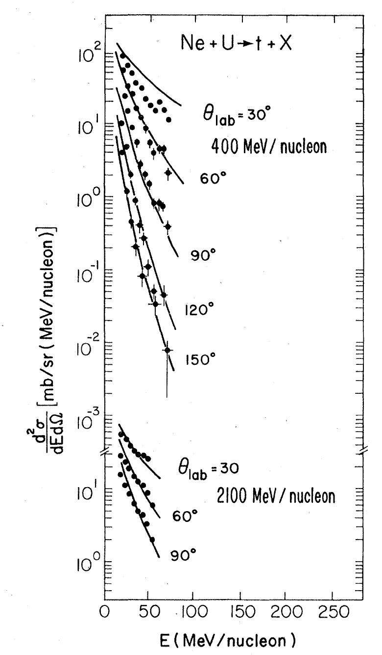
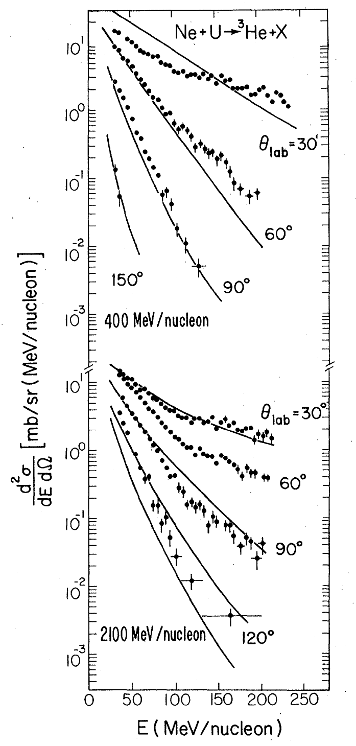
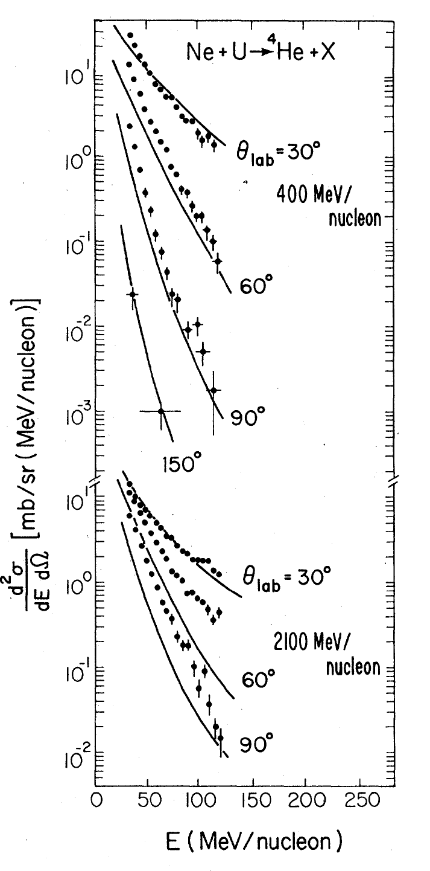
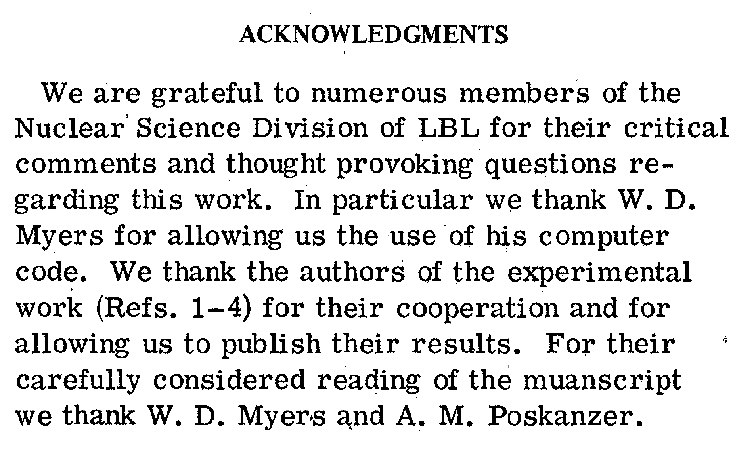
FireStreak Model

Slide 16
Why Thermalization – Nuclear Transport Models?
Interplay of nucleon-nucleon collisions and collective mean field effects
Rise of nuclear transport models (VUU, BUU, QMD, …)
Ideas later extended to ultra-relativistic collisions (Parton Cascade, RQMD, UrQMD, …)
Explains how collective flow effects arise
Explains particle production (pions, kaons, photons, …)
Explains how colliding heavy ion systems approach thermalization

Slide 17
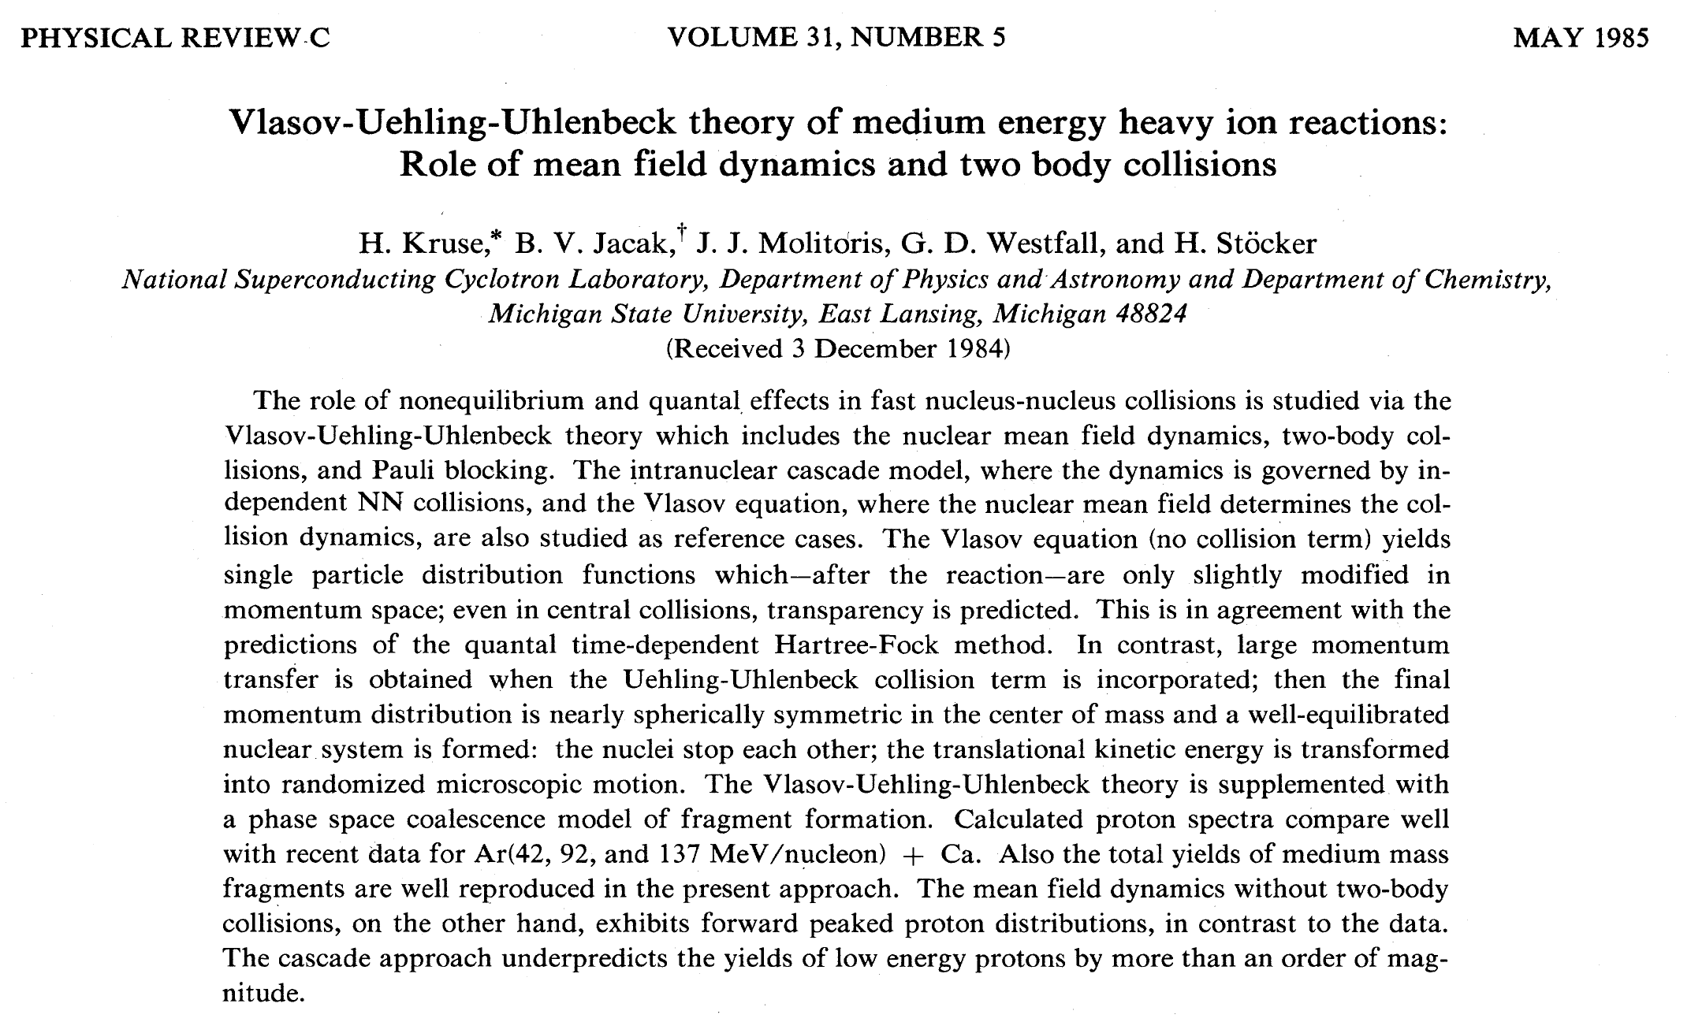
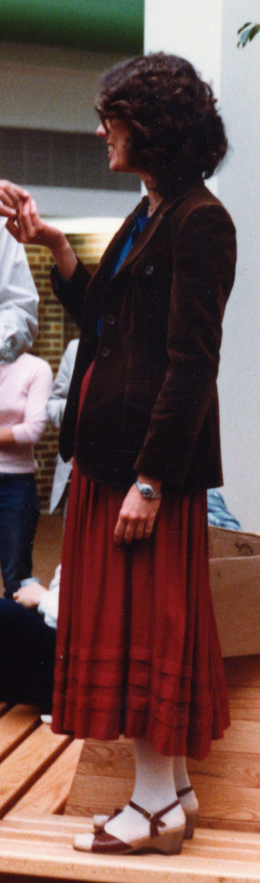

Slide 18
Years go by….

Slide 19
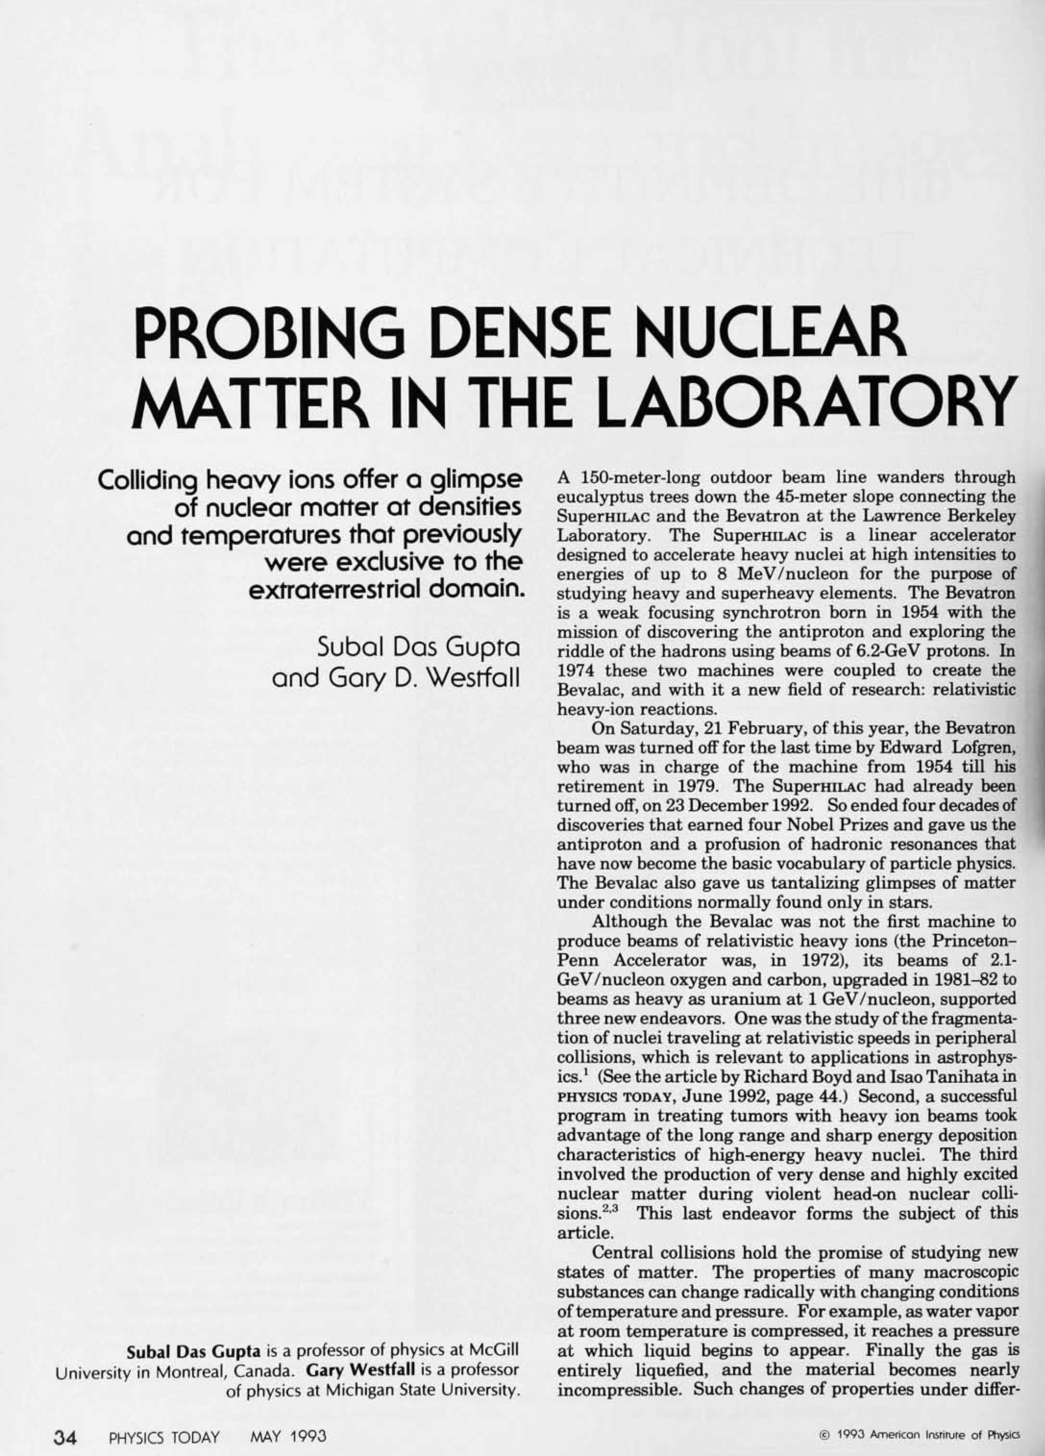
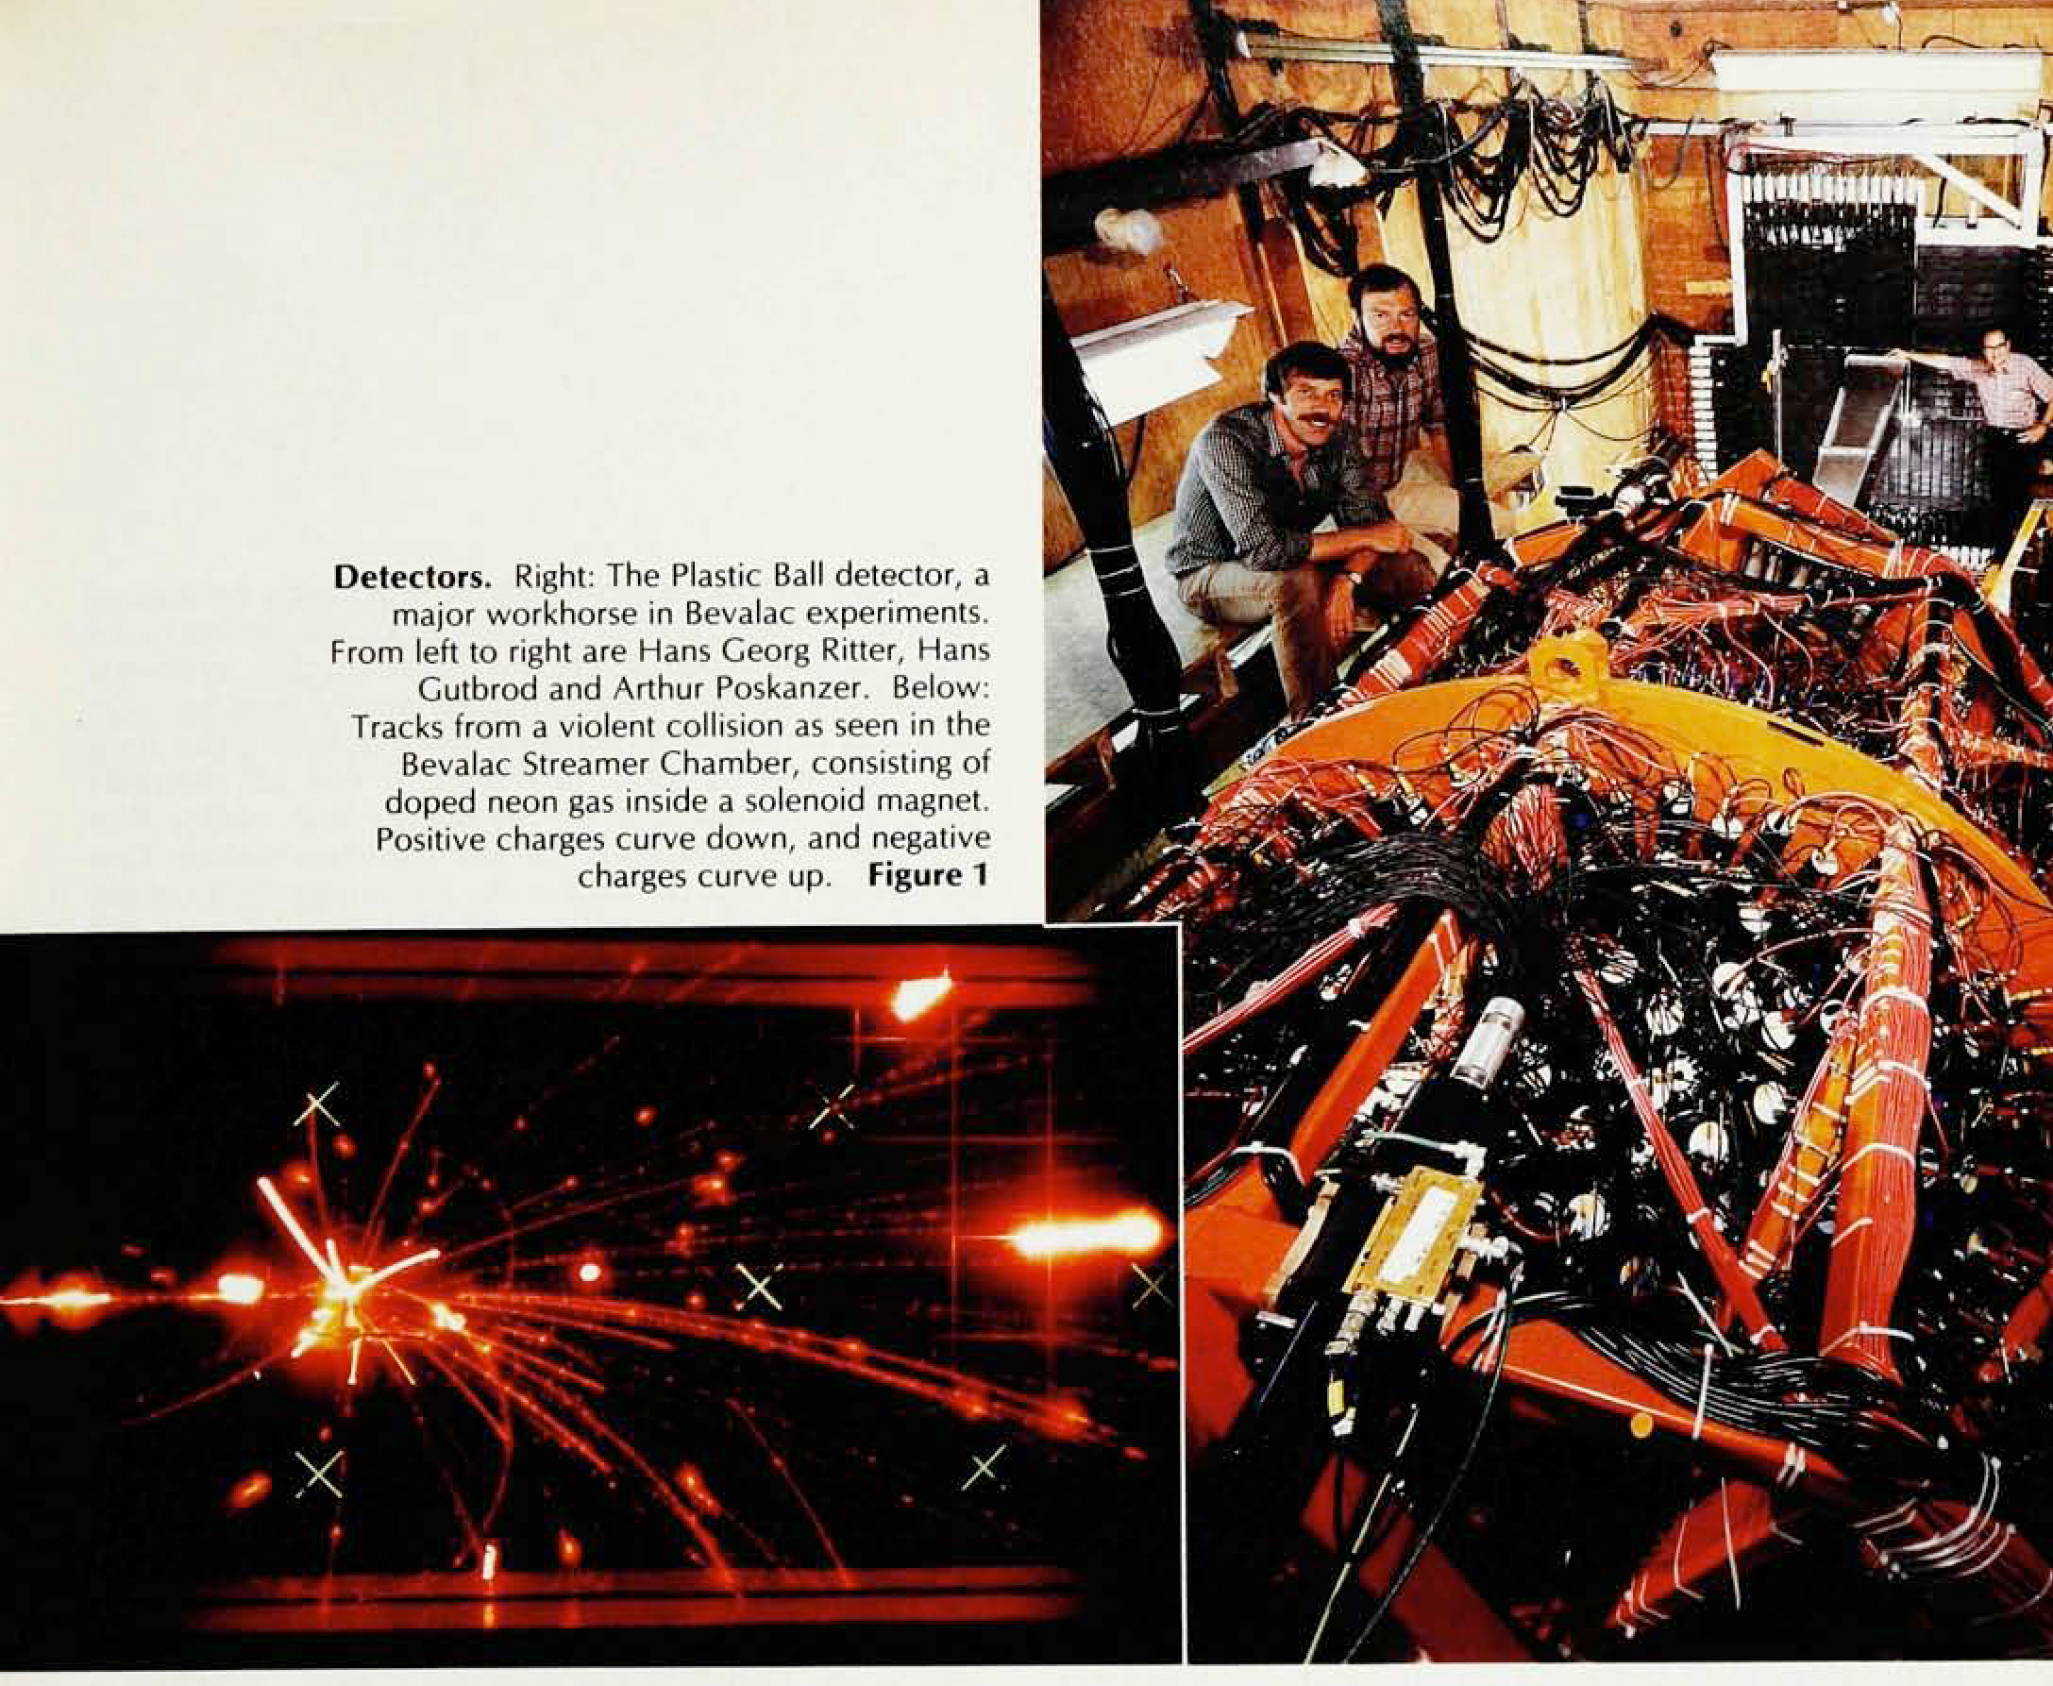

Slide 20
More years go by…

Slide 21
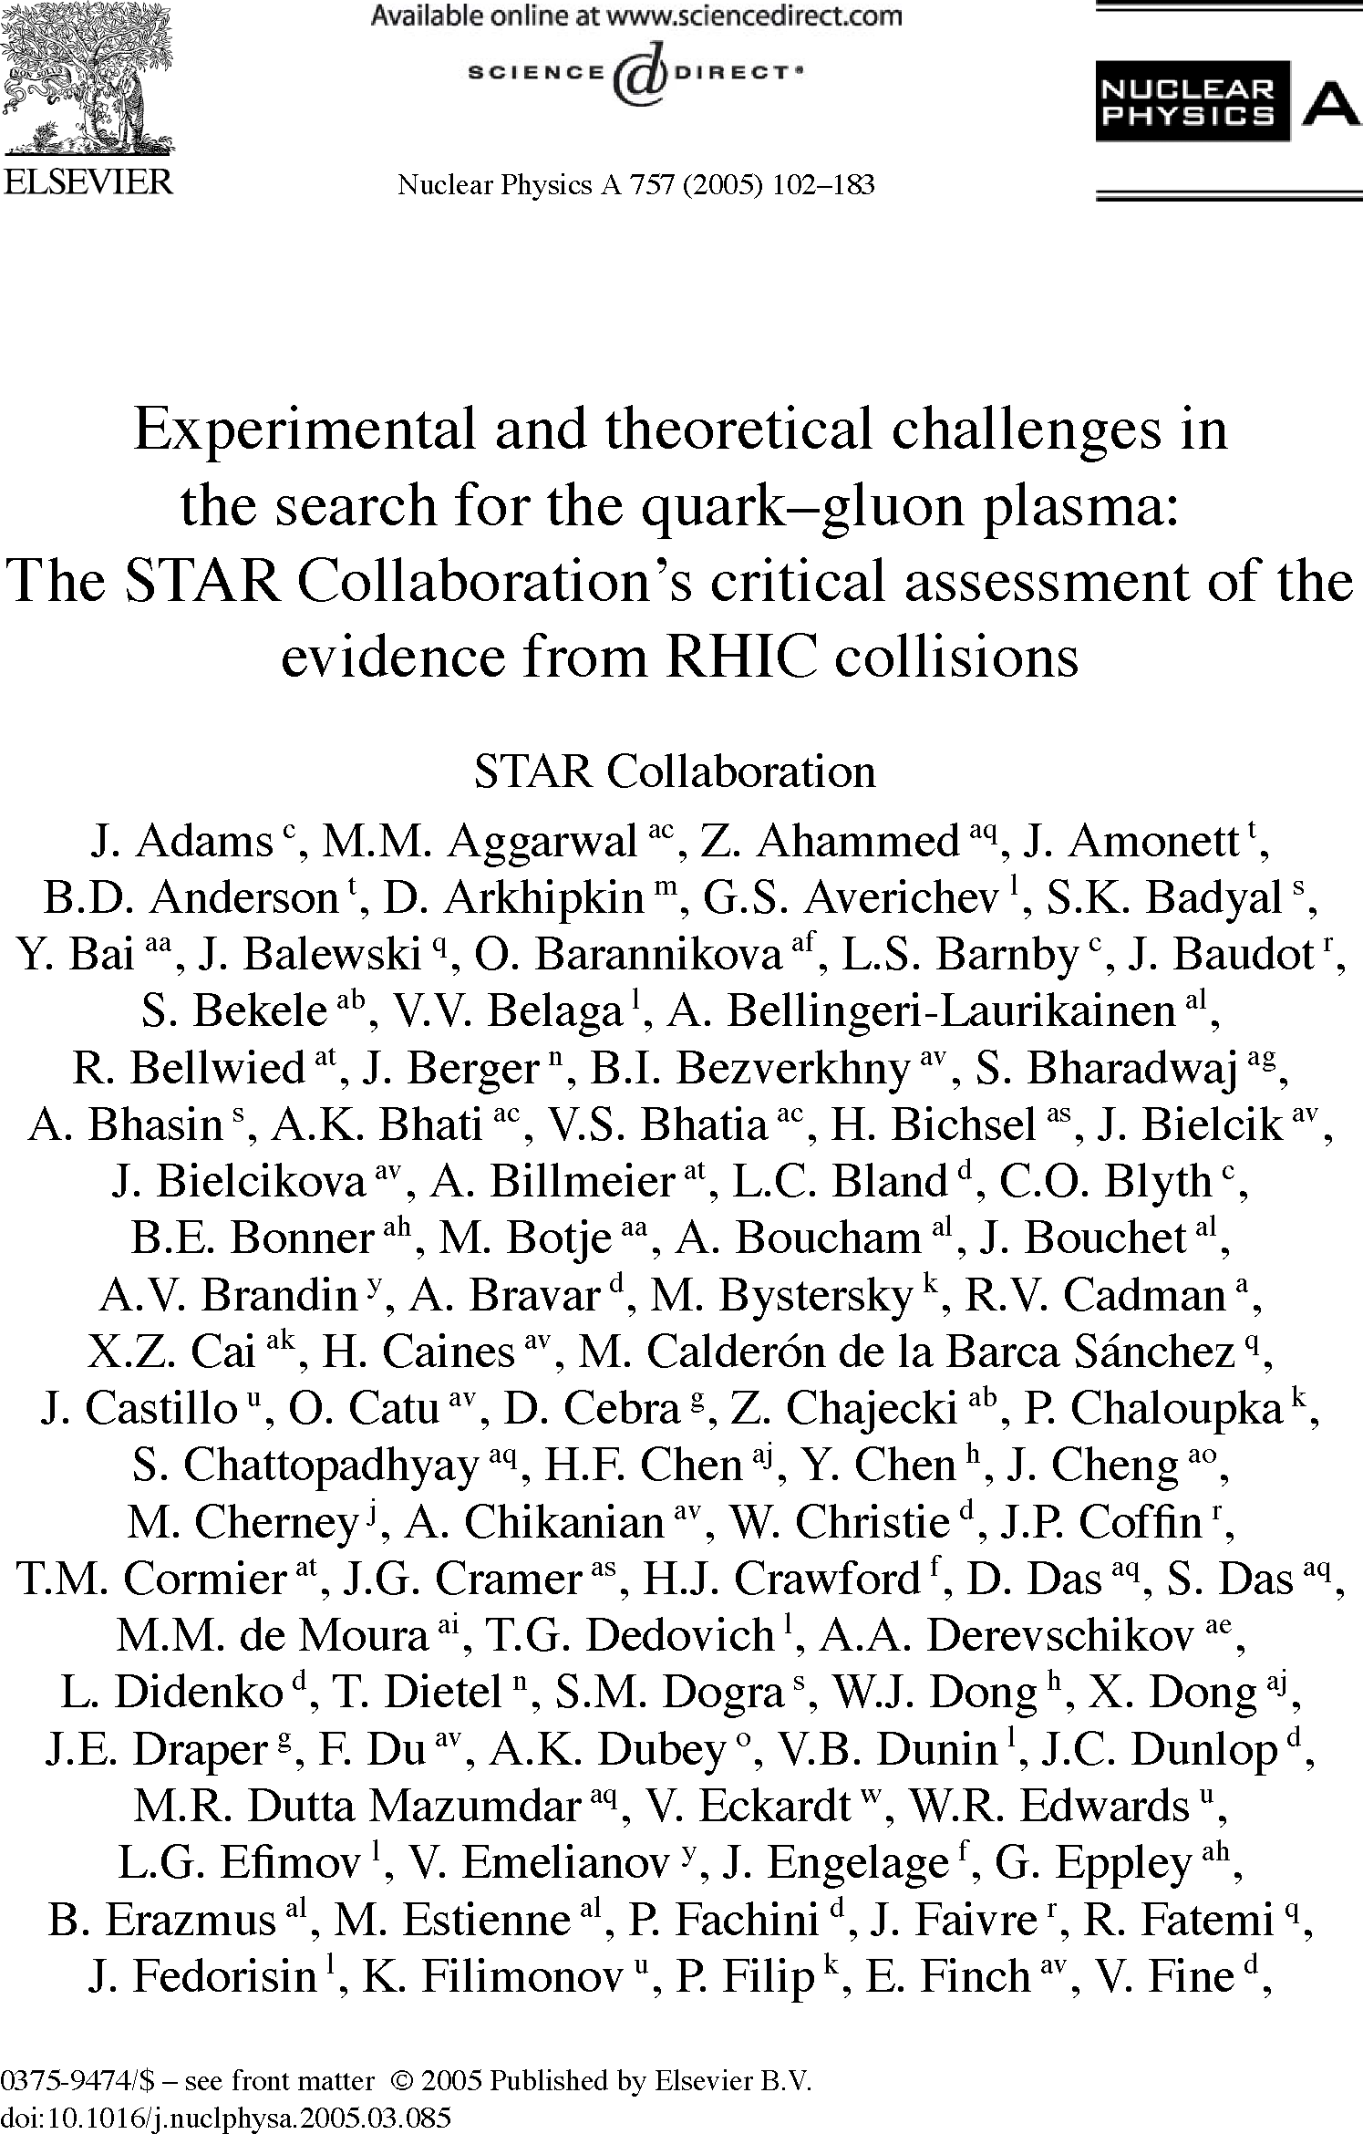
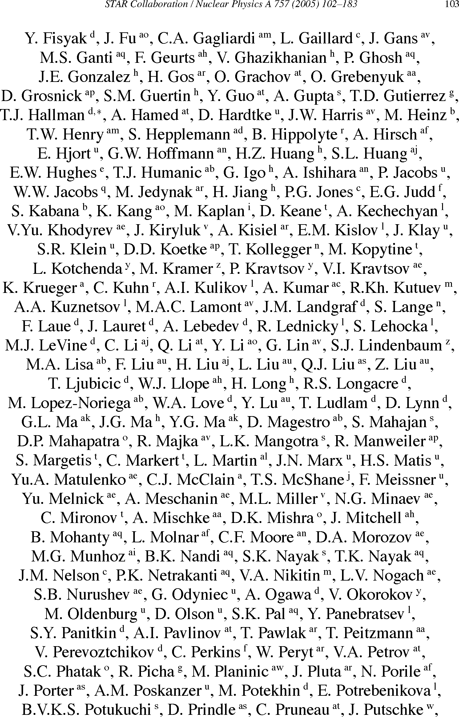
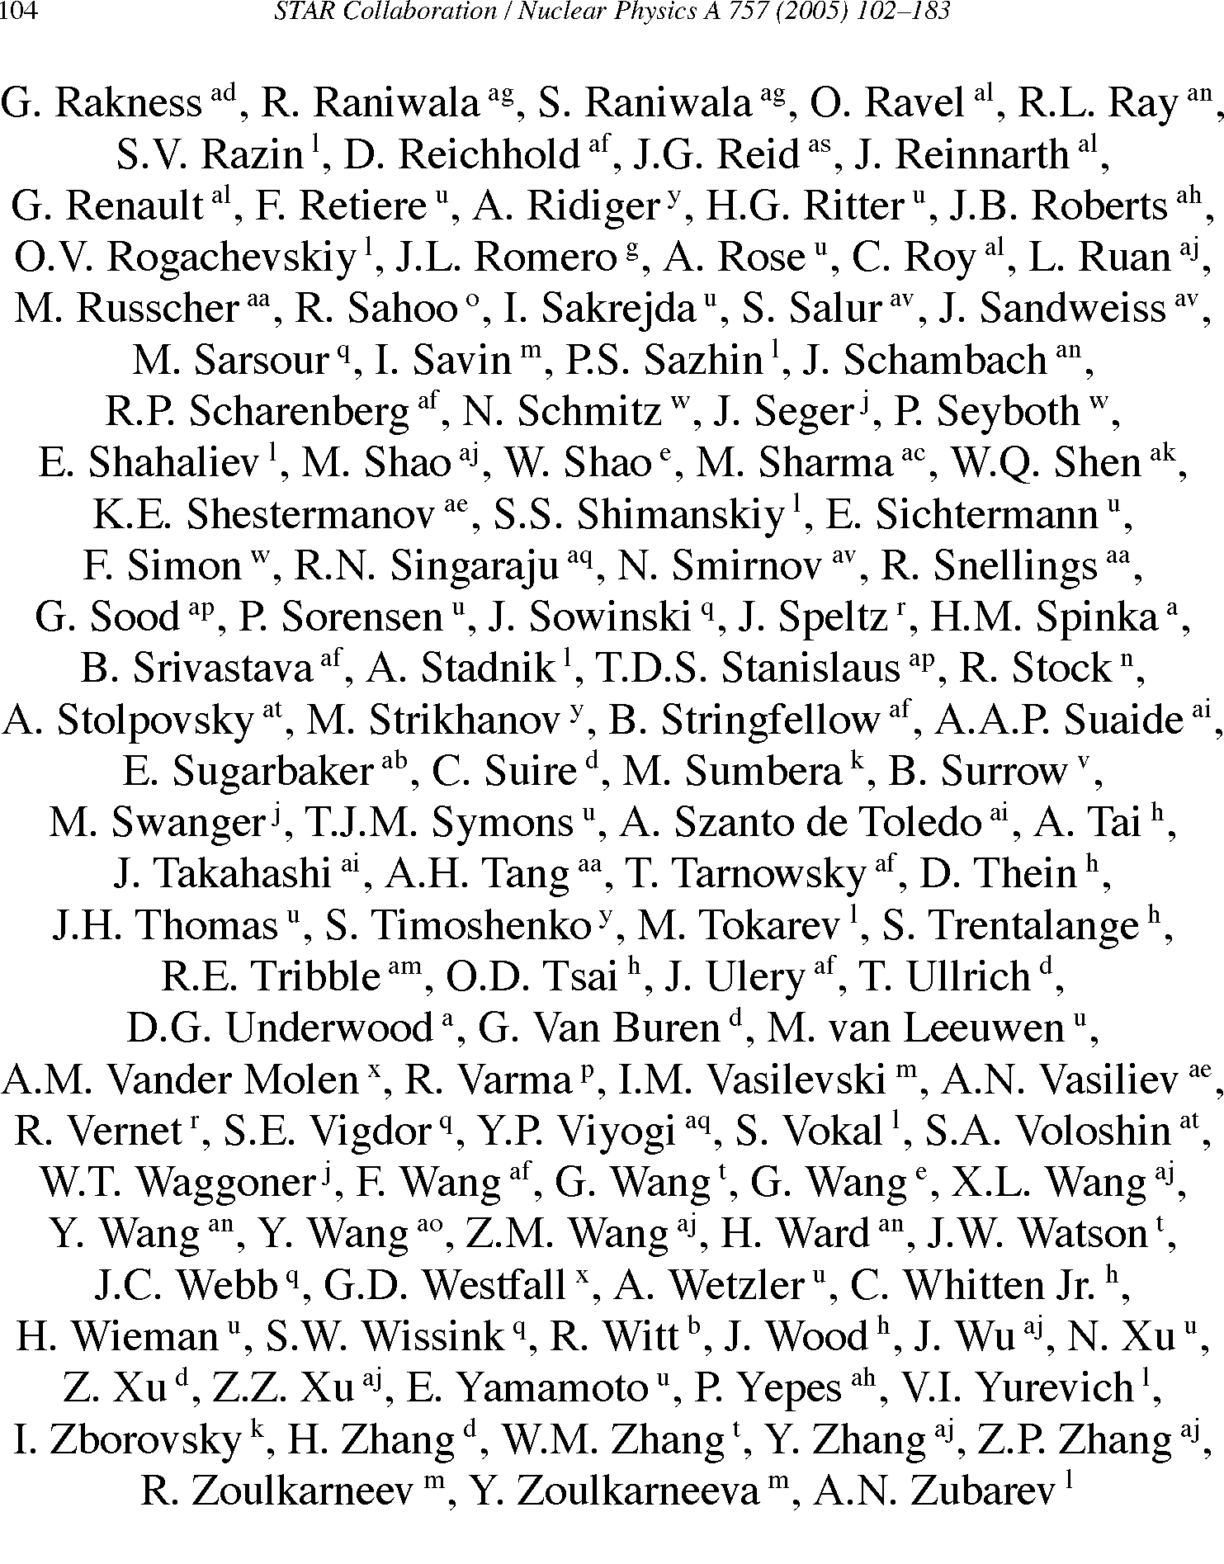

Slide 22
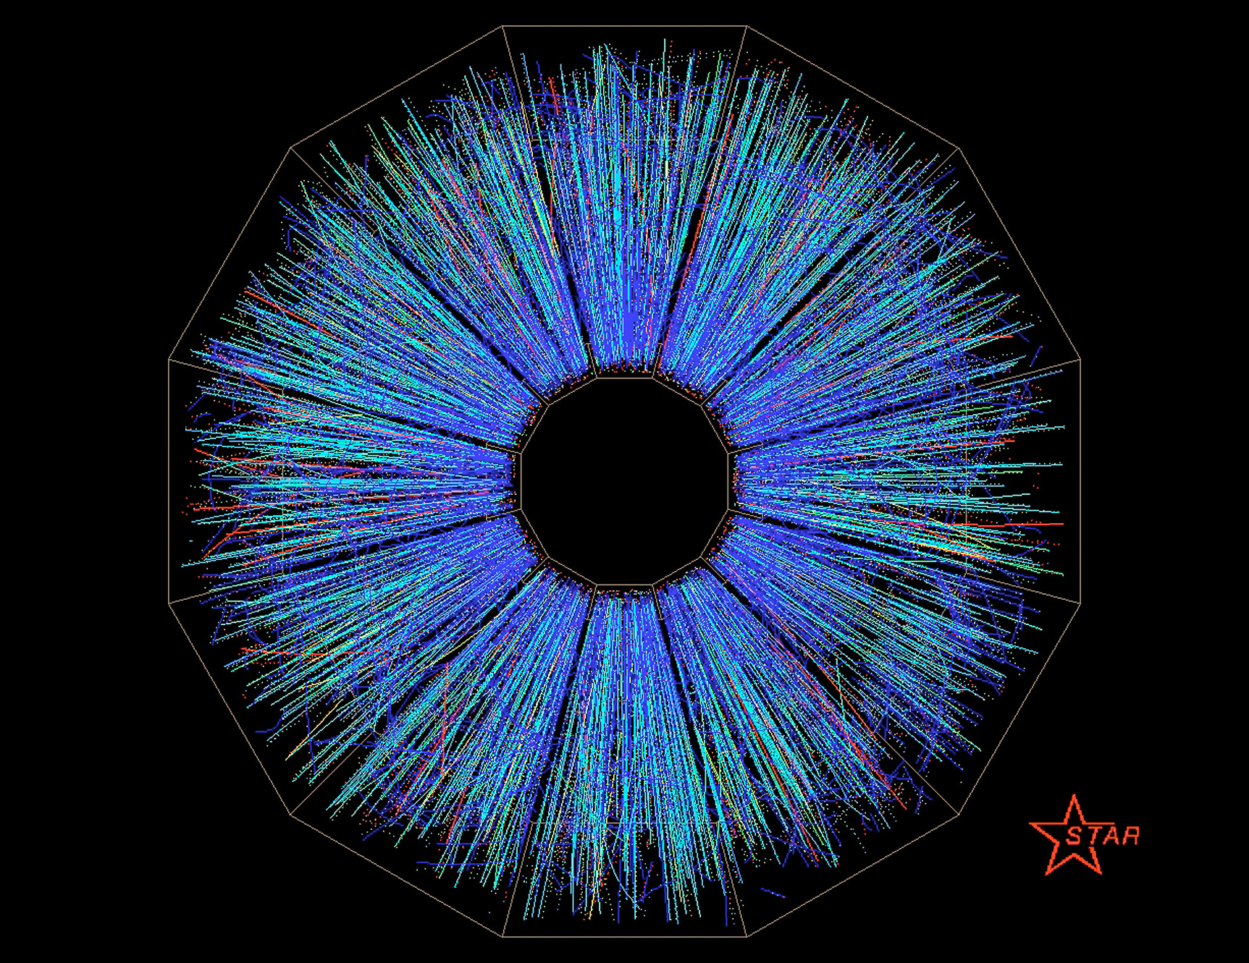
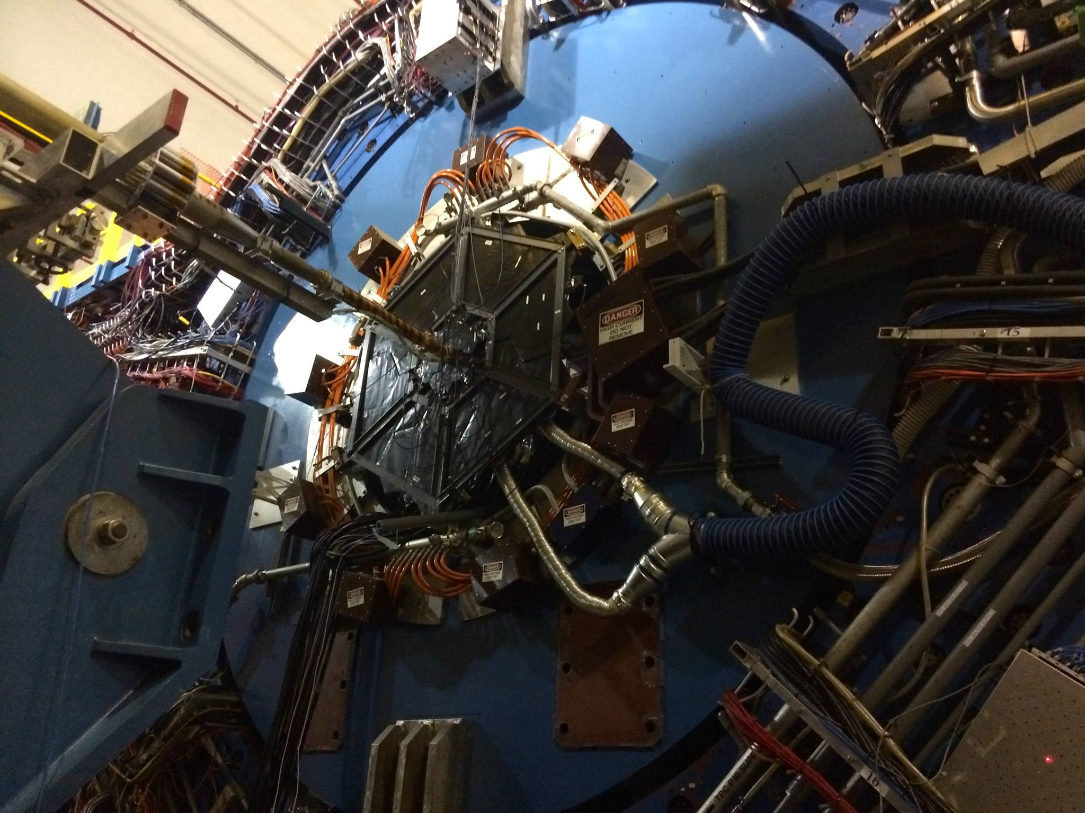
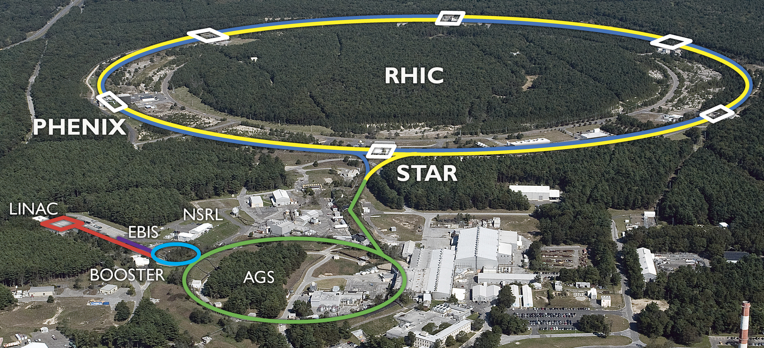

Slide 23
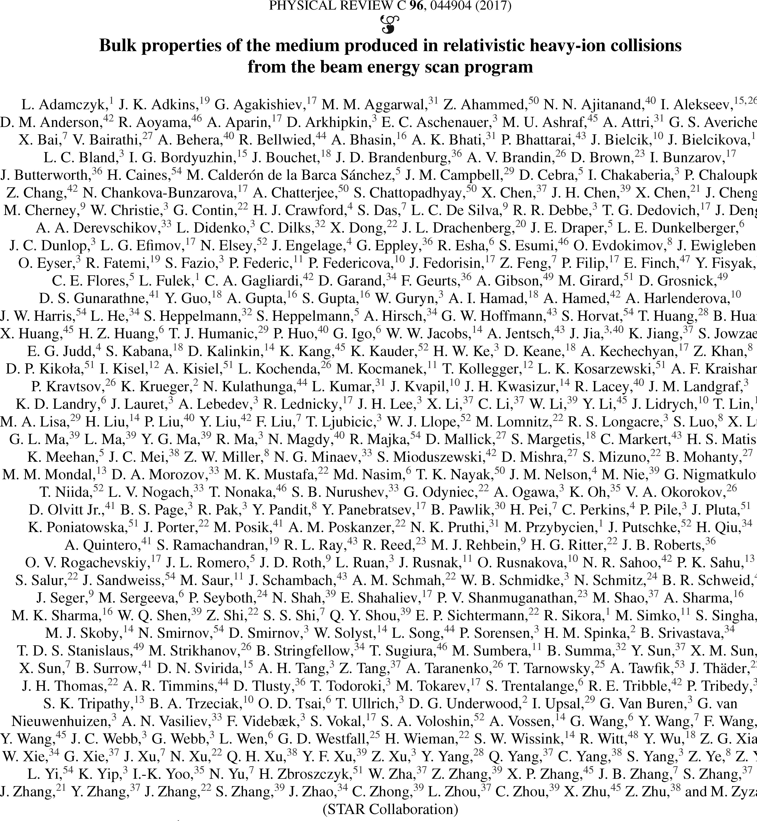

Slide 24
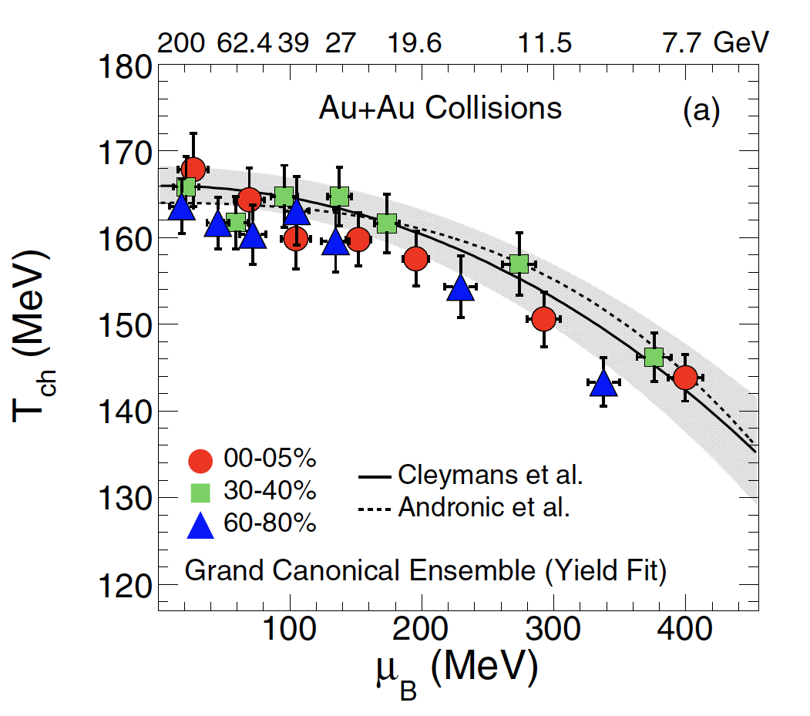
Global Thermodynamic Fits

Slide 25
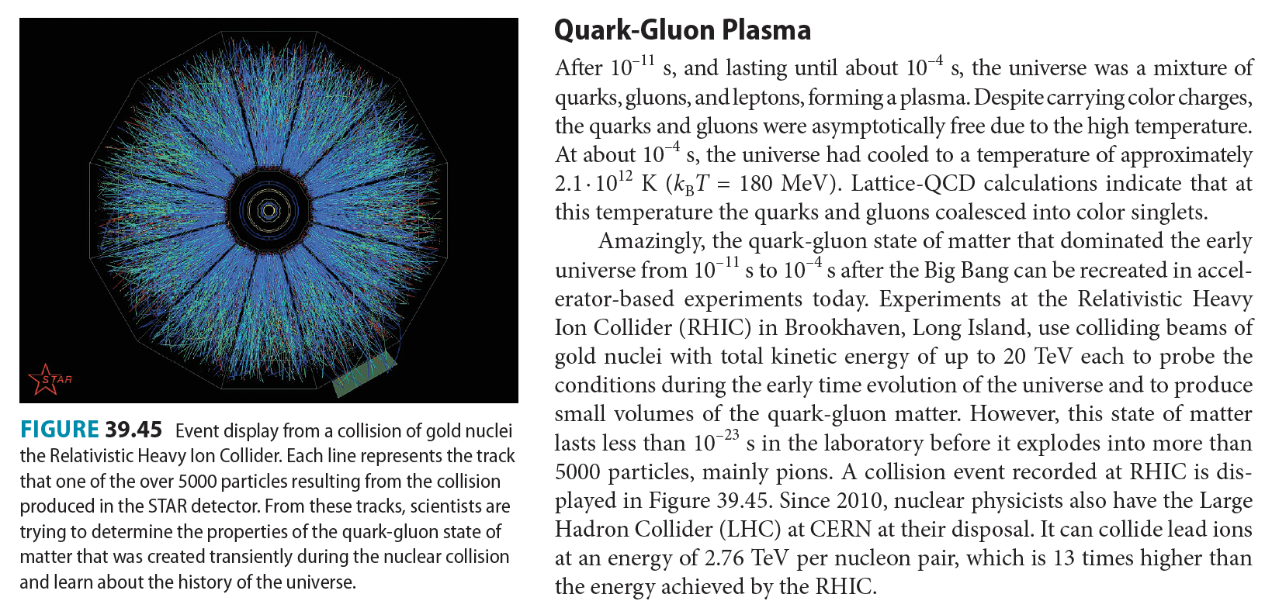
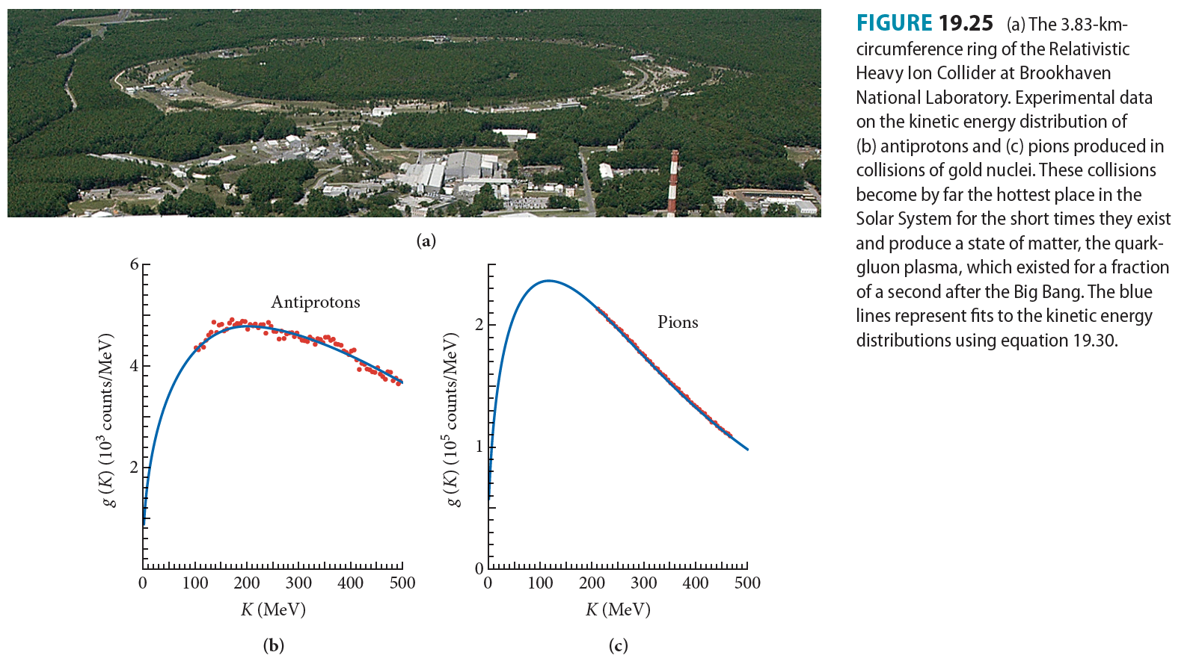
This All Becomes Textbook Physics

Slide 26
Bevalac Legacy
The machine that changed nuclear physics
Bridge between nuclear and particle physics
  Relativistic heavy ion collisions
Thermalization
Collective Flow Effects
Connections to Astrophysics
Opened an entire new universe of research opportunities that all of us have enjoyed exploring for the last 5 decades … with no end in sight.

Slide 27
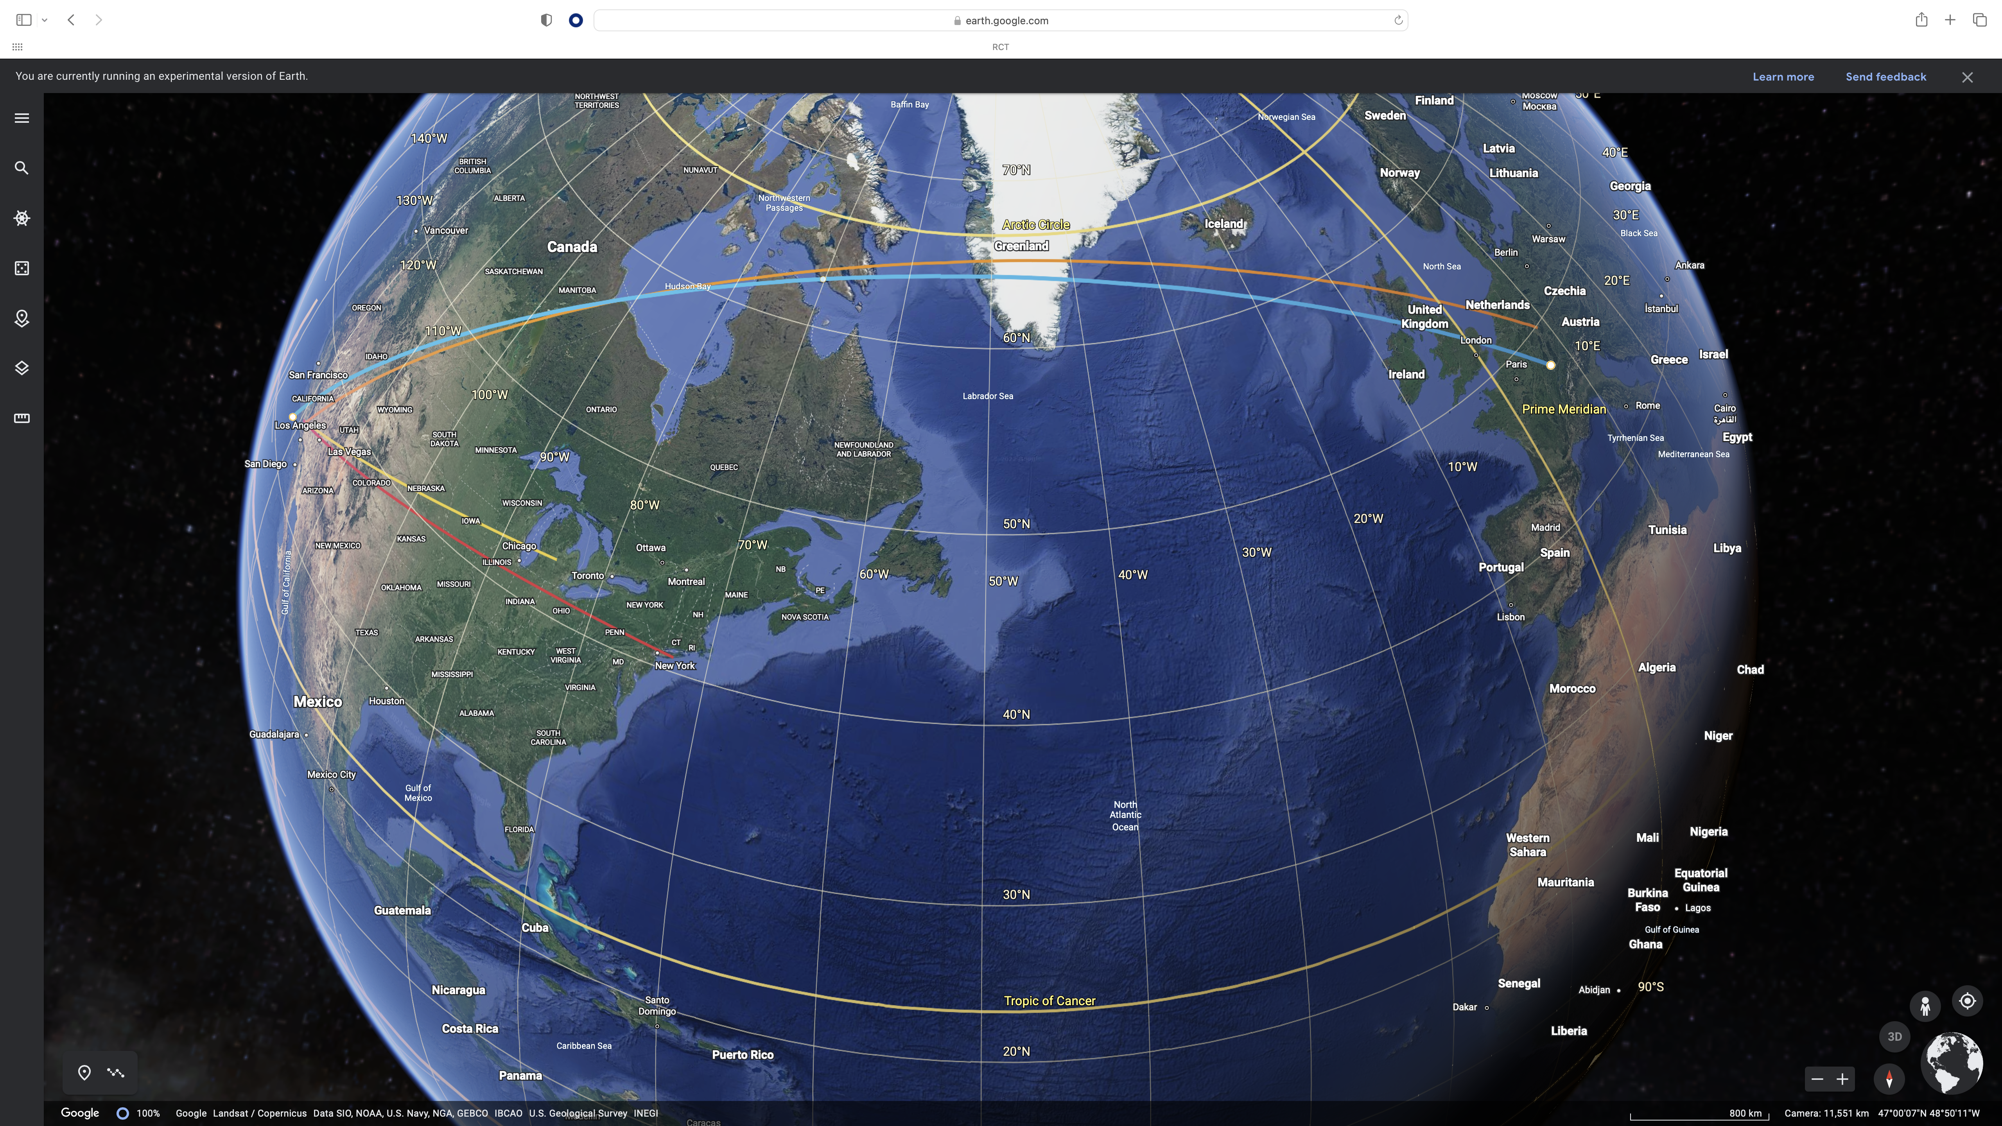
GSI SIS
CERN SPS/LHC
LBNL
Bevalac
MSU NSCL
BNL AGS/RHIC

