Slide 1
CCT6 Update
Lucas Brouwer, Mariusz Juchno, Diego Arbelaez, Reed Teyber, Paolo Ferracin, and Giorgio Vallone (for the CCT Team)
11/09/2022

Slide 2
Outline
updates on CCT6 design (new cross-section)
seven turn winding mandrel fabricated out of bronze
initial winding + reaction tests with the seven turn mandrel

Slide 3
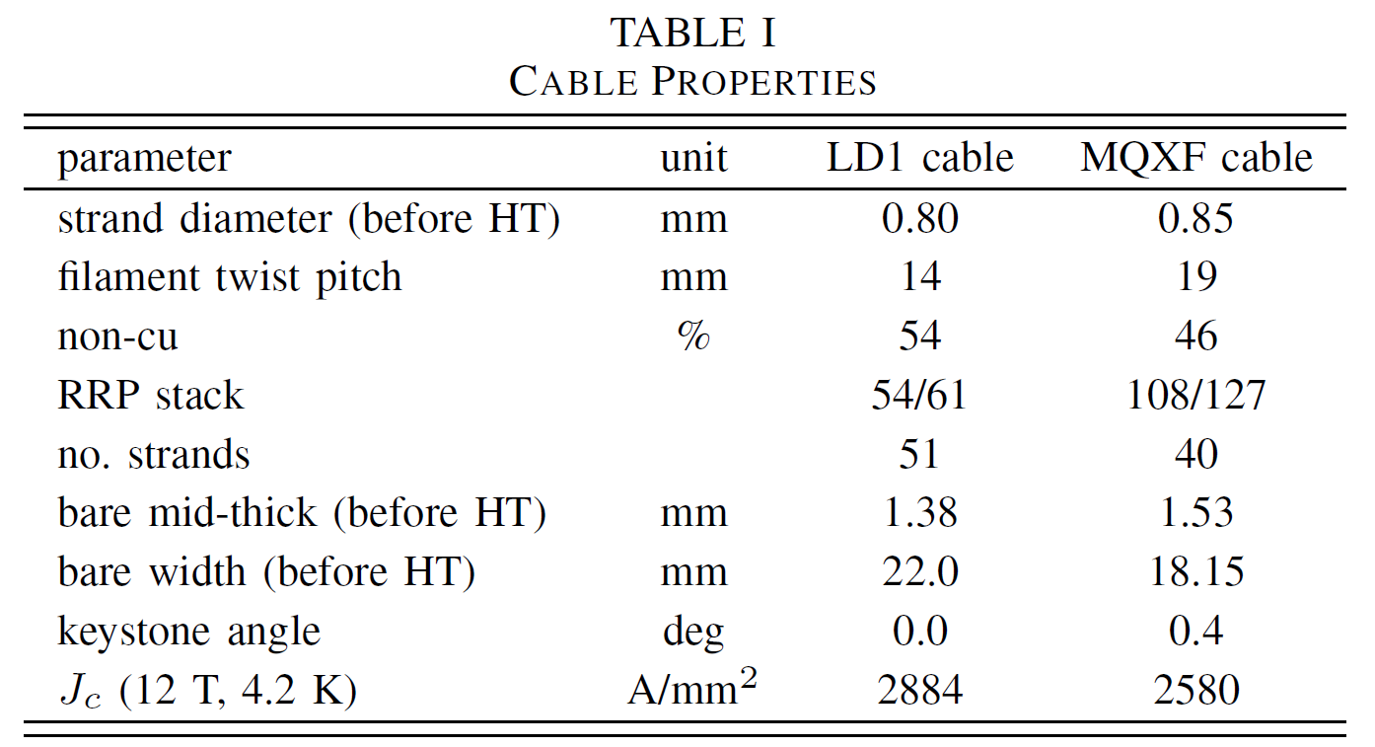
Reminder: CCT6 is a 4-layer, graded design based on existing cables
Targets from MDP program plan
120 mm clear bore diameter
four layers
12 T at 4.2 K, 13 T at 1.9 K
CCT6 graded cross-section
MQXF cable for outer layers (needs sourcing)
LD1 cable for inner layers (in-hand)
Assumptions for insulation and channel design is based on CCT5 experience
cable
ins. + gap of 300 μ per side

Slide 4
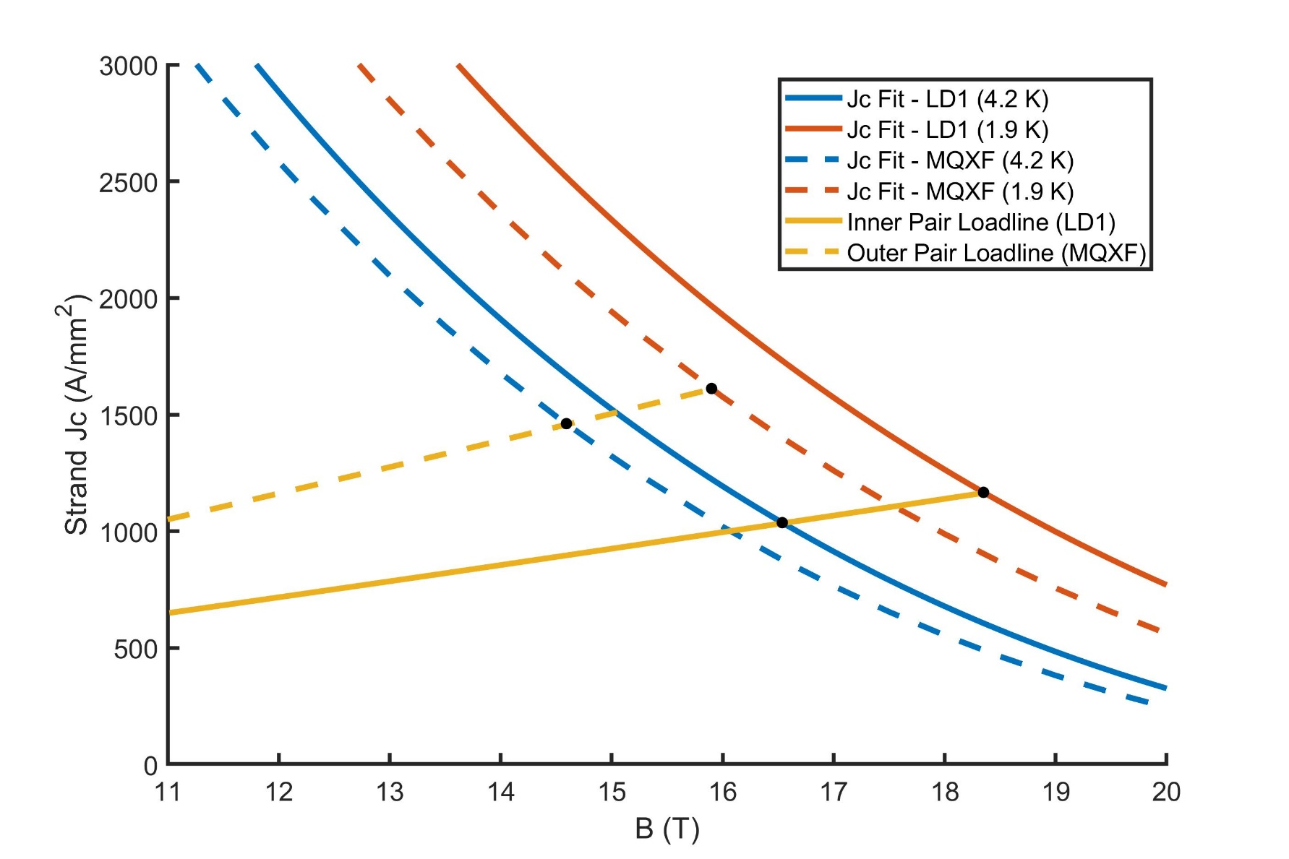
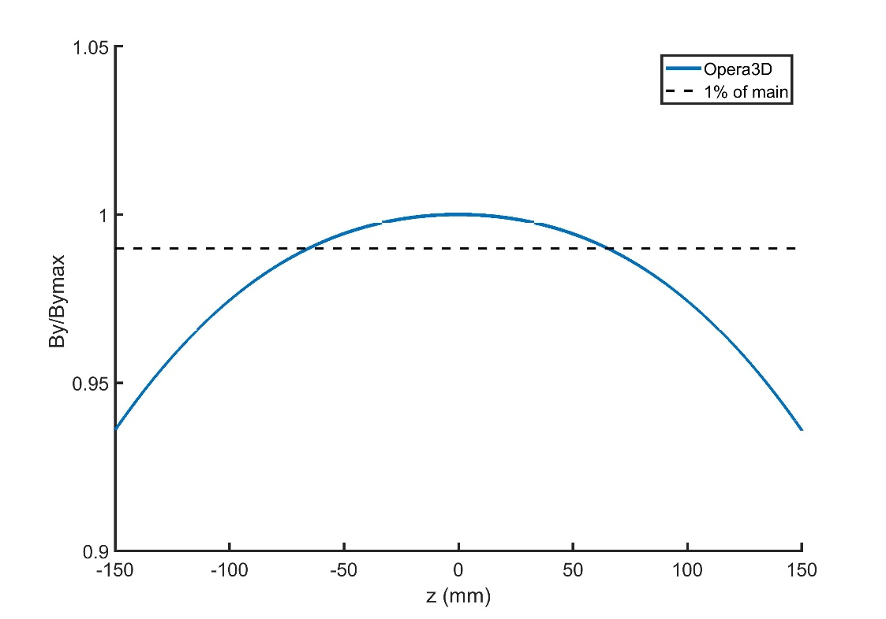
30% operational margin at the MDP targets
Straight-section length of 130 mm based on 1% criteria
1-2% rise of field at conductor

Slide 5
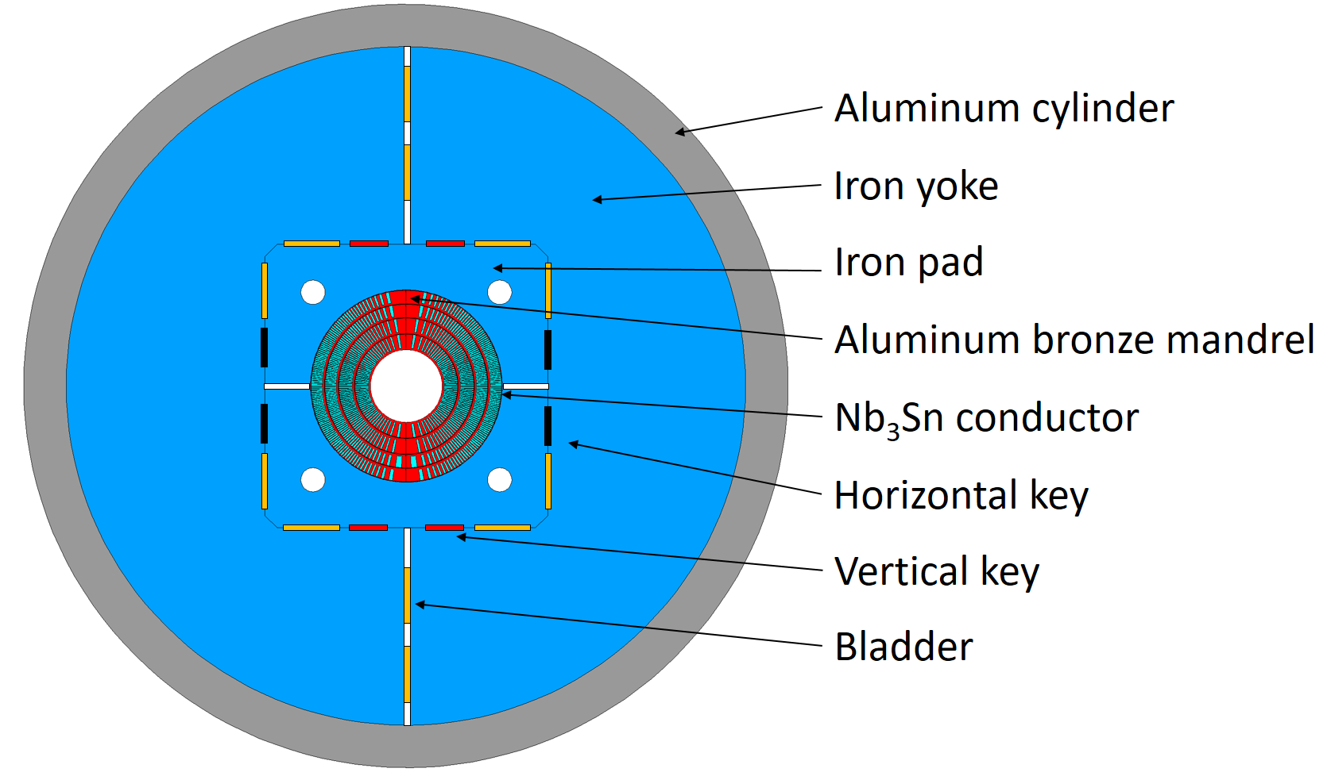
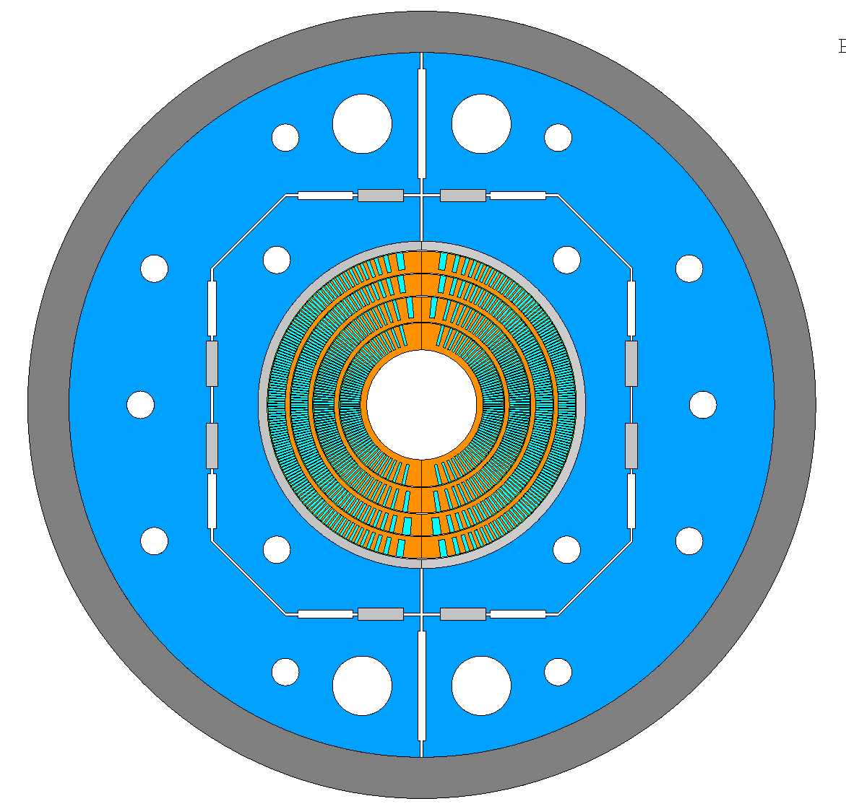
Updated structural cross section is optimized to fit in LBNL cryostat (Mariusz Juchno)
Original structure made use of existing LD1 shell (presented at MT27)
Conductor stress results from the new 2D cross section
Cooldown
13 T
1260 mm OD
Sθ (MPa)
Cooldown
13 T
von Mises (MPa)
von Mises (MPa)
860 mm OD
New structure reduces the OD by 400 mm to be compatible with testing at LBNL

Slide 6
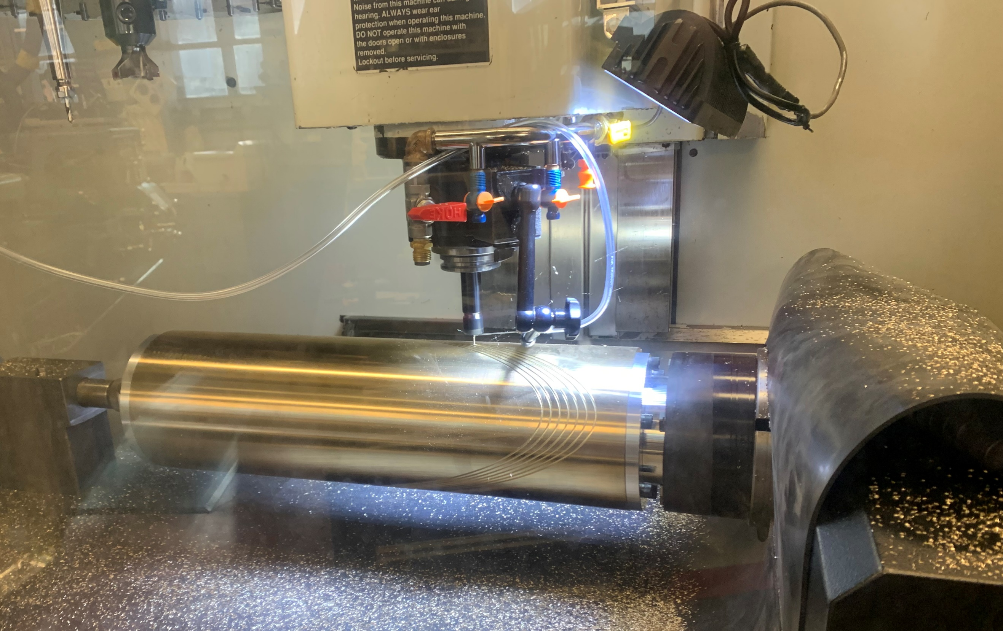
The feasibility of mandrel fabrication and coil winding with such a large cable is unknown (new regime compared to CCT5)
CCT6 channel to relative scale
22.6 mm
Deep, thin grooves present challenges for CNC machining of the channel
CCT5 channel
11 mm
2.1 mm
2.0 mm

Slide 7
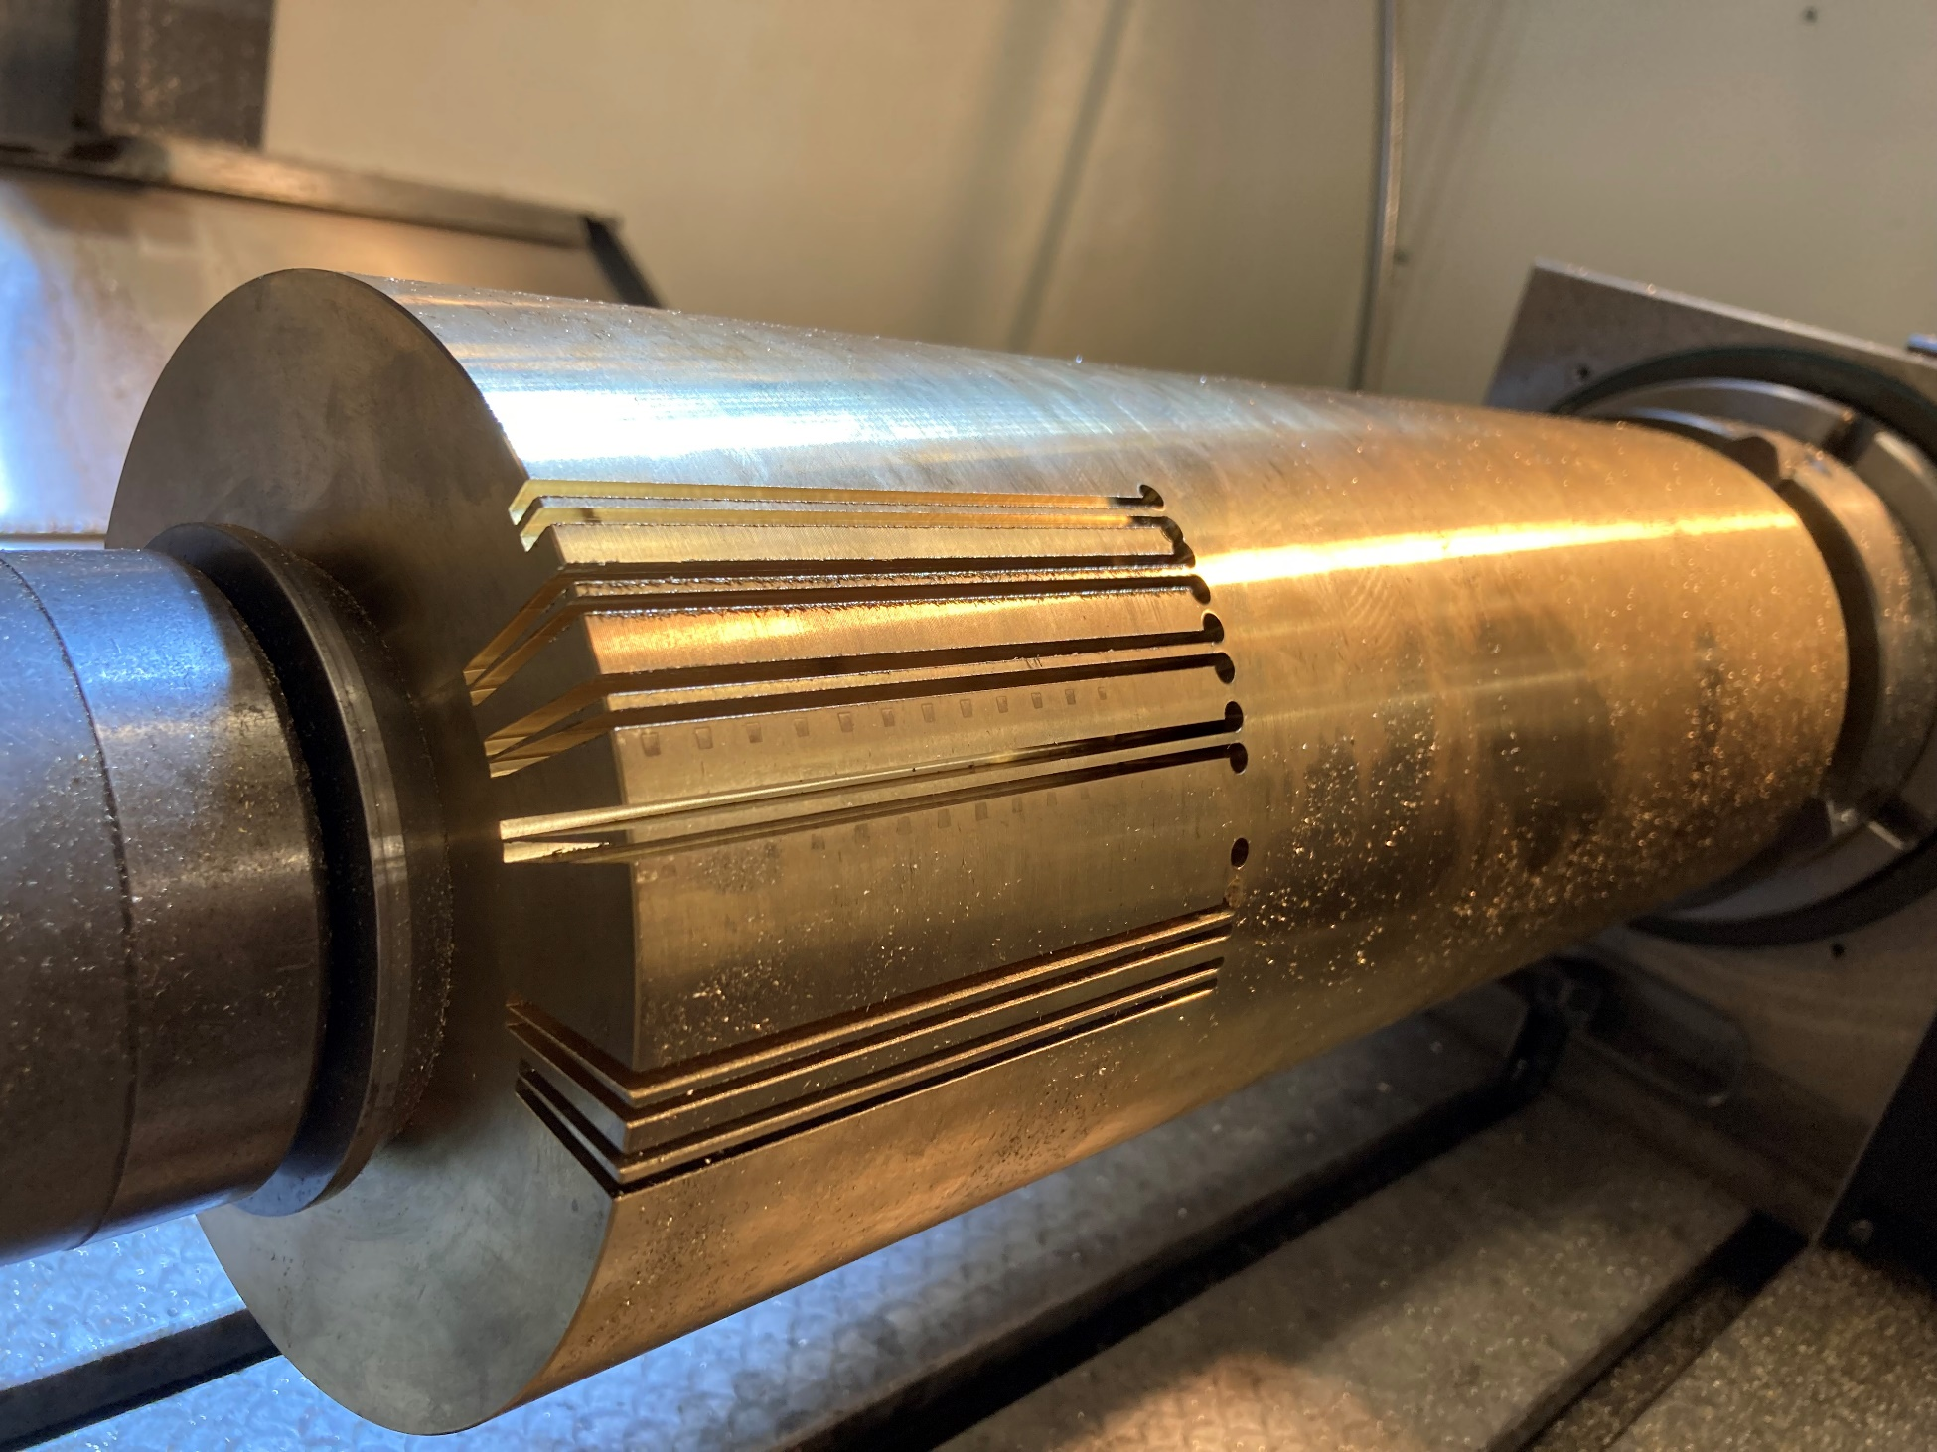
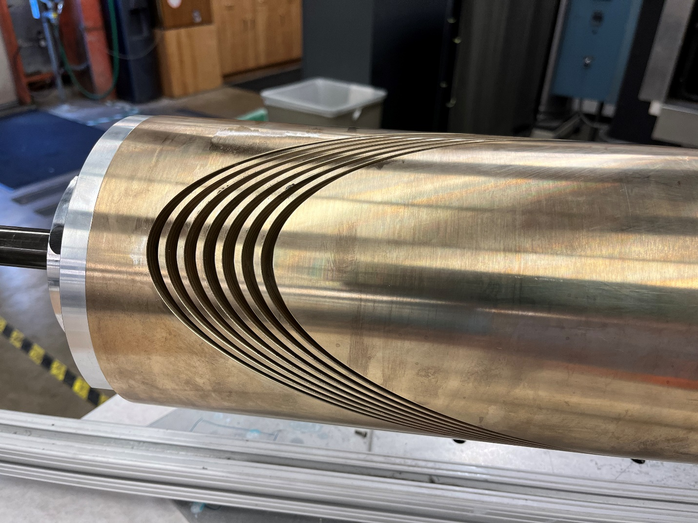
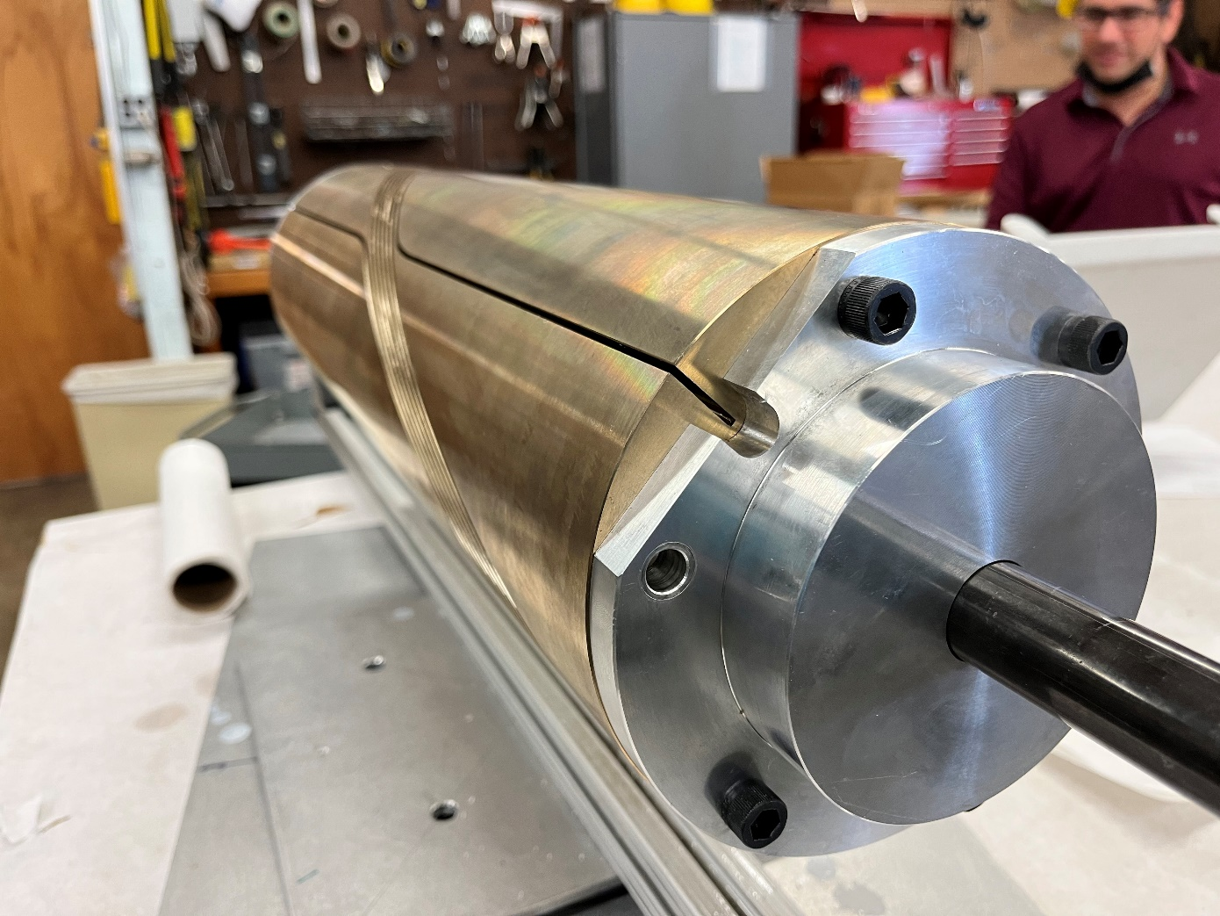
A seven-test mandrel to demonstrate feasibility of machining and winding, and to measure reaction gaps of conductor
Seven-turn mandrel matching the inner layer of CCT6 (22.6x2 mm grooves)
Initial, straight groove machining tests showed promise and allowed for trying different cutting tools and speeds
Oversized at pole to measure length change during reaction
Machining performed by M. Maruszewski

Slide 8
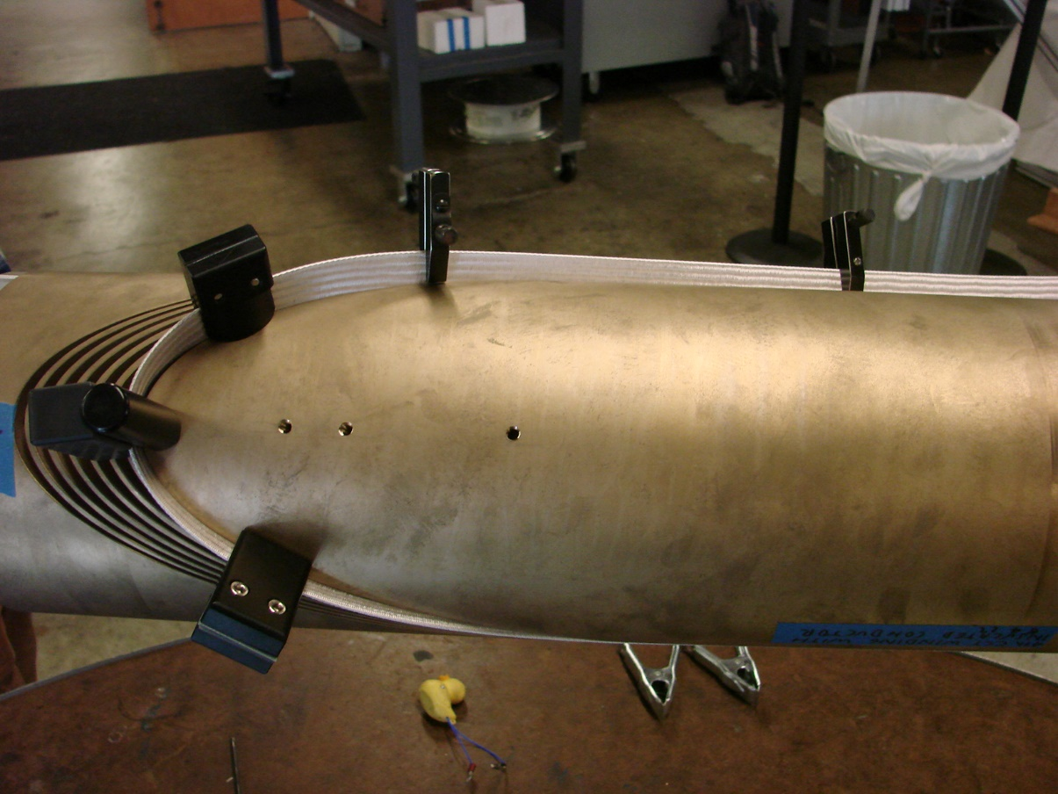
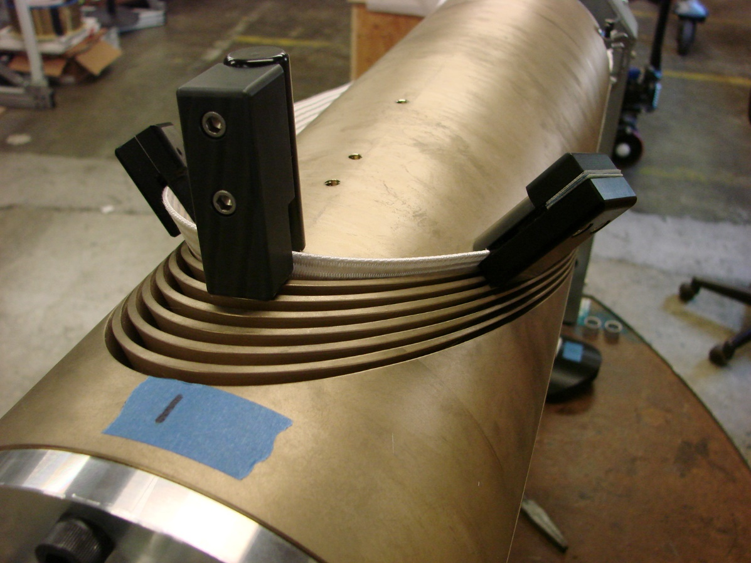
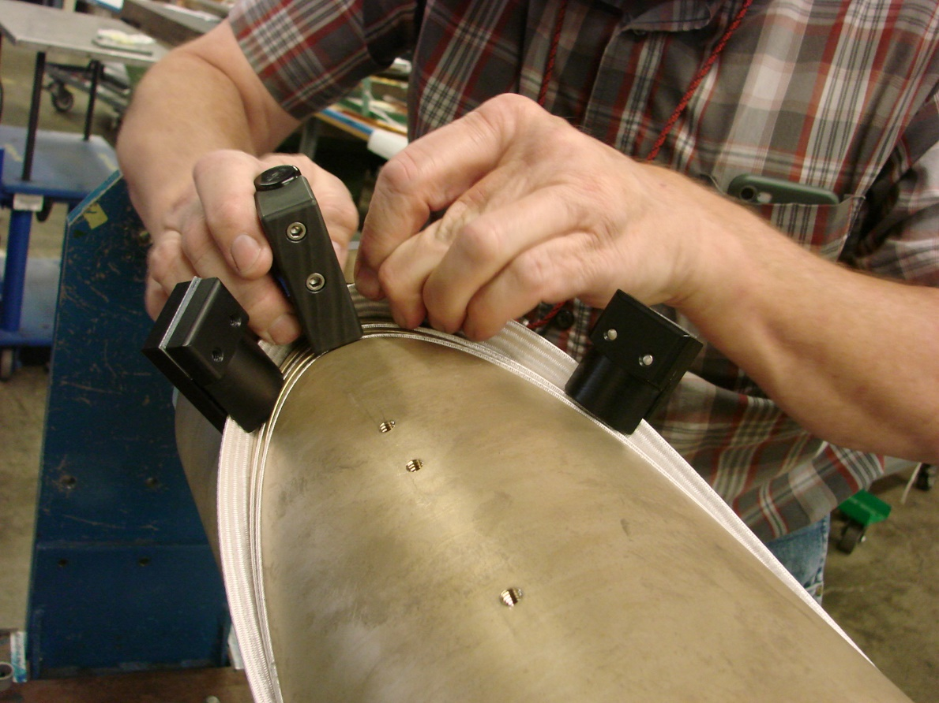
Winding process and determination of final groove dimension is in progress
Winding of 51 strand LD1 cable into deep grooves is challenging, but feasible
Clamps to prevent popped strands

Slide 9
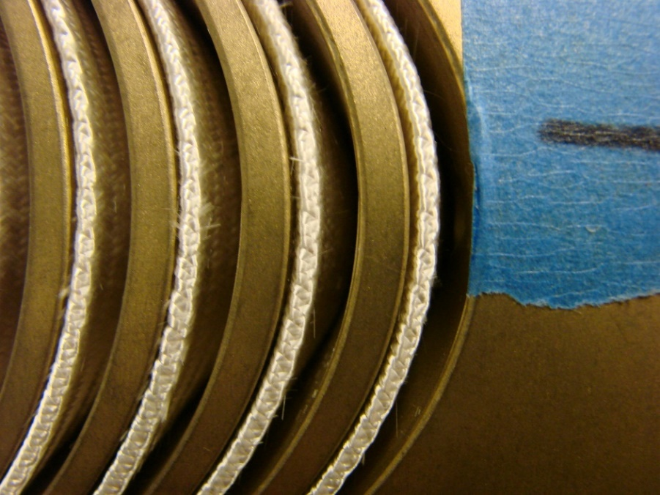
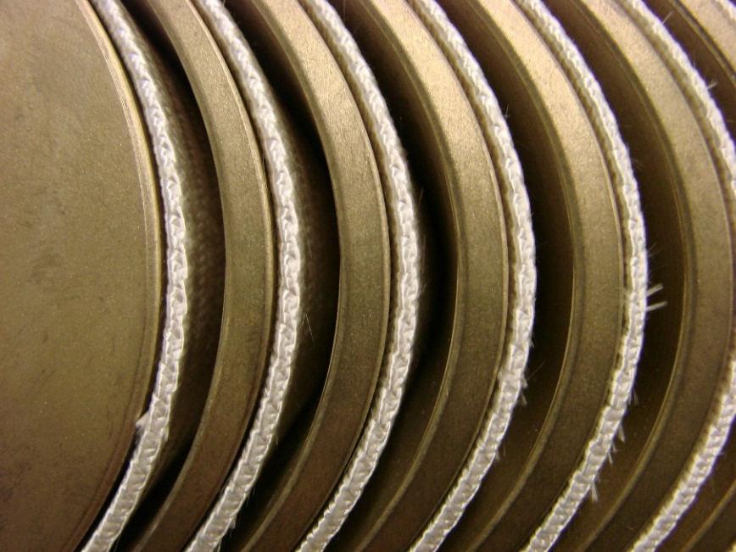
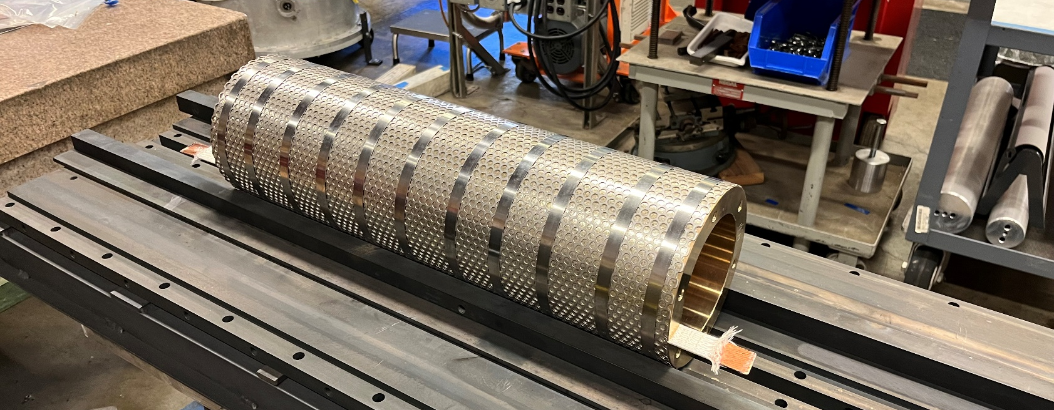
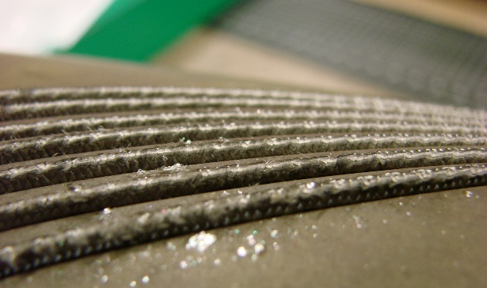
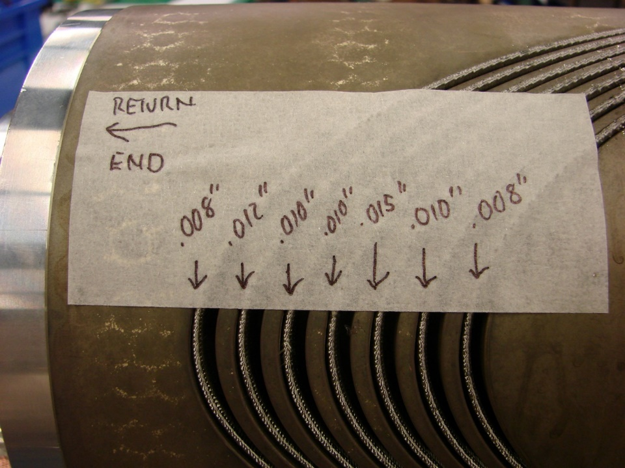
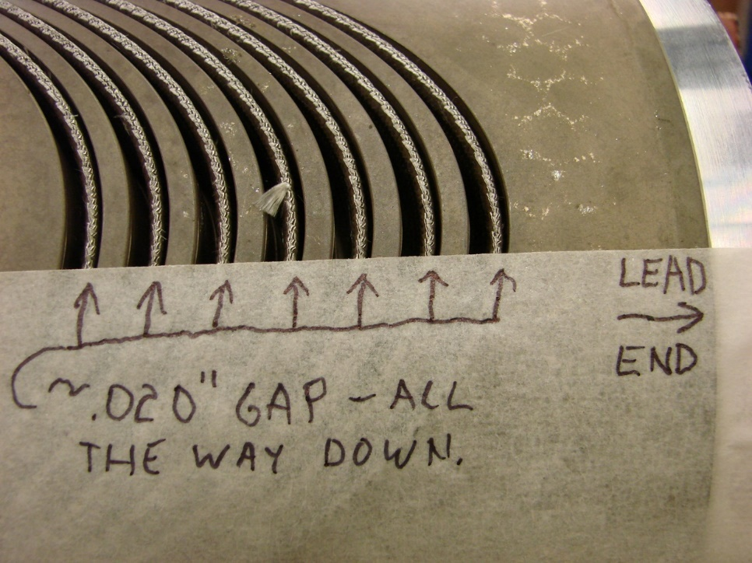
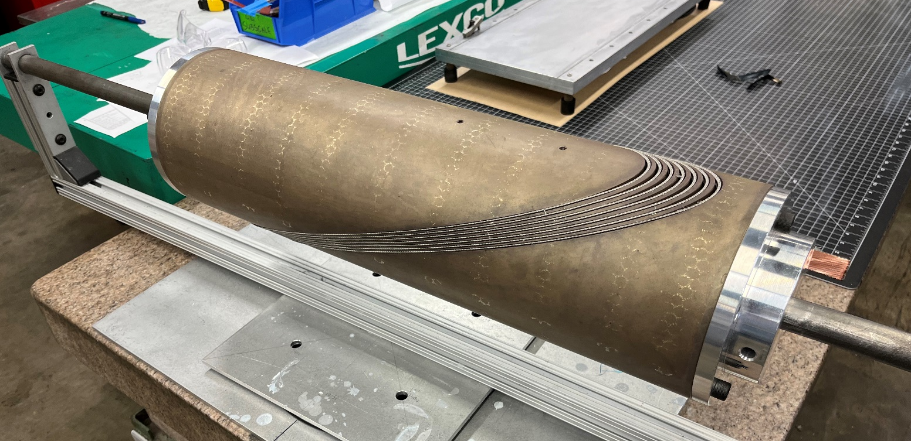
Winding process and determination of final groove dimension is in progress
Reaction gives first feedback on channel depth and reaction gaps
before reaction
after reaction

Slide 10
Summary and Next Steps
Conclusion
updated structural cross-section compatible with LBNL cryostat is meeting stress criteria in 2D
both mandrel manufacturing and coil winding for the LD1 cable are difficult, but appear feasible
Next Steps
3D mechanical modeling
work towards finalizing groove dimension and winding process (re-winding / testing with 7-turn mandrel)
7-turn mandrel with final groove dimensions (wind, reacted, pot, cut , inspect)
machining full length (1.5 m) mandrel

