Slide 1
From Nb₃Sn USL* to ESE** Relation and Spreadsheet
Ian Pong (ipong@lbl.gov)
Jack Ekin (jackekin1@gmail.com)
*USL: Unified Scaling Law (Ekin 1980 Cryogenics)
**ESE: Extrapolative Scaling Expression (Ekin 2016 SuST)

Slide 2
Outline
Introduction: superconducting surface (a.k.a. critical surface)
Scaling parameterization
A graphical presentation
A mathematical presentation
From USL to ESE
Addressing Temperature and Strain Dependence Issues
Addressing Transport vs. Magnetization Issues
ESE Spreadsheet usage – Live Demo (dedicated group)

Slide 3
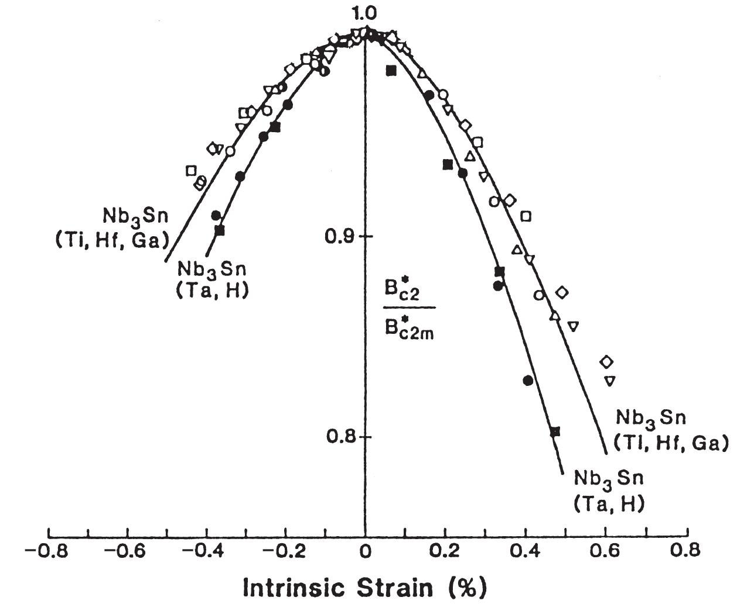
Introduction
The customary plot of J-H-T surface:
For practical purposes Nb-Ti is considered insensitive to strain
Nb₃Sn, by contrast, is highly strain sensitive:
I_{C} (B, T, ε) = B⁻¹ C g(ε) h(t) f(b)
Requires 4D plot
Or multiple 2D and 3D plots
Figure by courtesy of Lyn Evans
Figure from SMH ed. 1

Slide 4
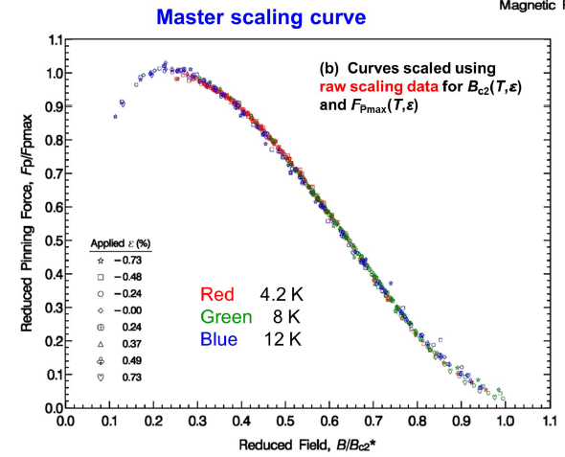
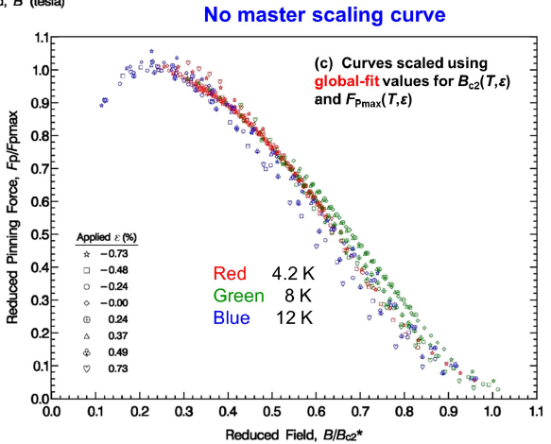
Pinning force curve and its scalability
The pinning curves at different temperatures and strains coalesce into one master scaling curve, and this is what gives the extrapolation capability
Global fitting is more expedient than fundamental scaling, but it greatly diminishes extrapolation capability.
Red: 4.2 K
Green: 8.0 K
Blue: 12.0 K
Thousands of I_{C} can be predicted from just a few I_{C}(B) measurements!
Key thing about scaling laws
is scalability
When something scales
it can be extrapolated
Supercond. Sci. Technol. 29 (2016) 123002

Slide 5
Determining B_{C2}* and K from I_{C}(B) Data
p = 0.5
For Nb₃Sn
q = 2
f (b) = b^{p} (1-b)^{q}
$$\frac{I_{C}^{\frac{1}{q}}}{B^{\frac{p−1}{q}}}×\frac{B_{C2}^{\frac{p}{q}+1}}{K^{\frac{1}{q}}}=$$
$$\frac{I_{C}^{\frac{1}{q}}}{K^{\frac{1}{q}}}×\frac{B_{C2}^{\frac{p}{q}+1}}{B^{\frac{p−1}{q}}}=$$
$$\frac{I_{C}^{\frac{1}{q}}}{K^{\frac{1}{q}}}×\frac{B_{C2}^{\frac{p}{q}}}{B^{\frac{p−1}{q}}}=$$
$$−\frac{K^{\frac{1}{q}}}{B_{C2}^{\frac{p}{q}+1}}B+\frac{K^{\frac{1}{q}}}{B_{C2}^{\frac{p}{q}}}$$
$$\frac{I_{C}}{K}×\frac{B_{C2}^{p}}{B^{p−1}}=$$
$$K{\left(\frac{B}{B_{C2}}\right)}^{p}{\left(1−\frac{B}{B_{C2}}\right)}^{q}$$
$$K{\left(\frac{B}{B_{C2}}\right)}^{p}{\left(1−\frac{B}{B_{C2}}\right)}^{q}$$
$$\frac{I_{C}}{K}×B×\frac{B_{C2}^{p}}{B^{p}}=$$
$$I_{C}^{\frac{1}{q}}×B^{\frac{1−p}{q}}=$$
$$\frac{I_{C}}{K}×B=$$
$$I_{C}×B=$$
$$I_{C}×B=$$
$$−B$$
$${+B}_{C2}$$
$$−B+B_{C2}$$
$$B_{C2}−B$$
$$f\left(b\right)=b^{p}{(1−b)}^{q}$$
$I^{0.5}×B^{0.25}$ [A^{0.5} T^{0.25}]
$$\frac{df}{db}=0⟹b=0.2$$
$$y= m x + c$$
$${⟹F}_{P max}\left(0.2\right)=0.286 K$$
$$B [T]$$
B_{C2}* -- effective upper critical field (determined from I_{C} using trimmed data)
Note: Trimming required due to natural measurement limits and flux creep effects at high T and B.
Formally:
$$f\left(b\right)≡\frac{F_{P}}{F_{P max}}=\frac{b^{p}{\left(1−b\right)}^{q}}{f_{max}\left(b\right)}$$

Slide 6
Temperature Dependence of the F_{P} Curve
T = 0 K
Nb₃Sn F_{P} curve is temperature and strain dependent
T = 4.2 K
T = 10 K
T = 16 K
If we plot the pinning force F against the actual field B instead, the curves at increasing temperatures will have a decreasing B_{C2}, but the shape of the curve remains the same.
B_{C2} [T]
4.2
10
16
Now, if we plot the temperature on the third axis, we can see the B_{C2} dependence on T more clearly.
T [K]

Slide 7
B_{C2}* (T)
b_{C2}
b_{C2} (t) = 1 – t ^{v}
This is one of two ways to determine T_{C}* -- the “effective flux-pinning critical temperature”
t
B_{C2} [T]
If we plot reduced field against reduced temperature, we can see a power law relationship.
T [K]

Slide 8
B_{C2}* (ε)
The strain function
b_{C2} (ε) = $\frac{B_{C2}^{∗}\left(ε\right)}{B_{C2}^{∗}\left(0\right)}$
B_{C2}* (ε) [T]
Note: in reality there is irreversibility

Slide 9
B_{C2}* (ε)
B_{C2}* (ε, T)
The strain function
b_{C2} (ε) = $\frac{B_{C2}^{∗}\left(ε, T\right)}{B_{C2}^{∗}\left(0, T\right)}$
B_{C2}* (ε, 0) [T]

Slide 10
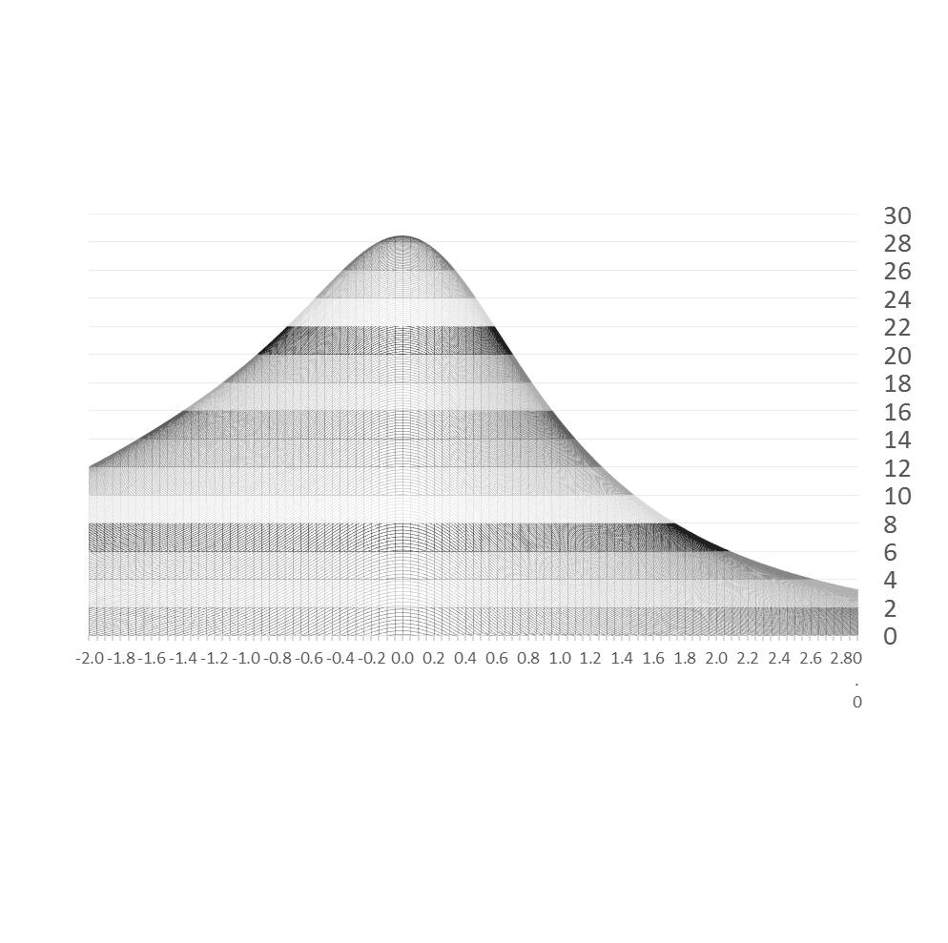
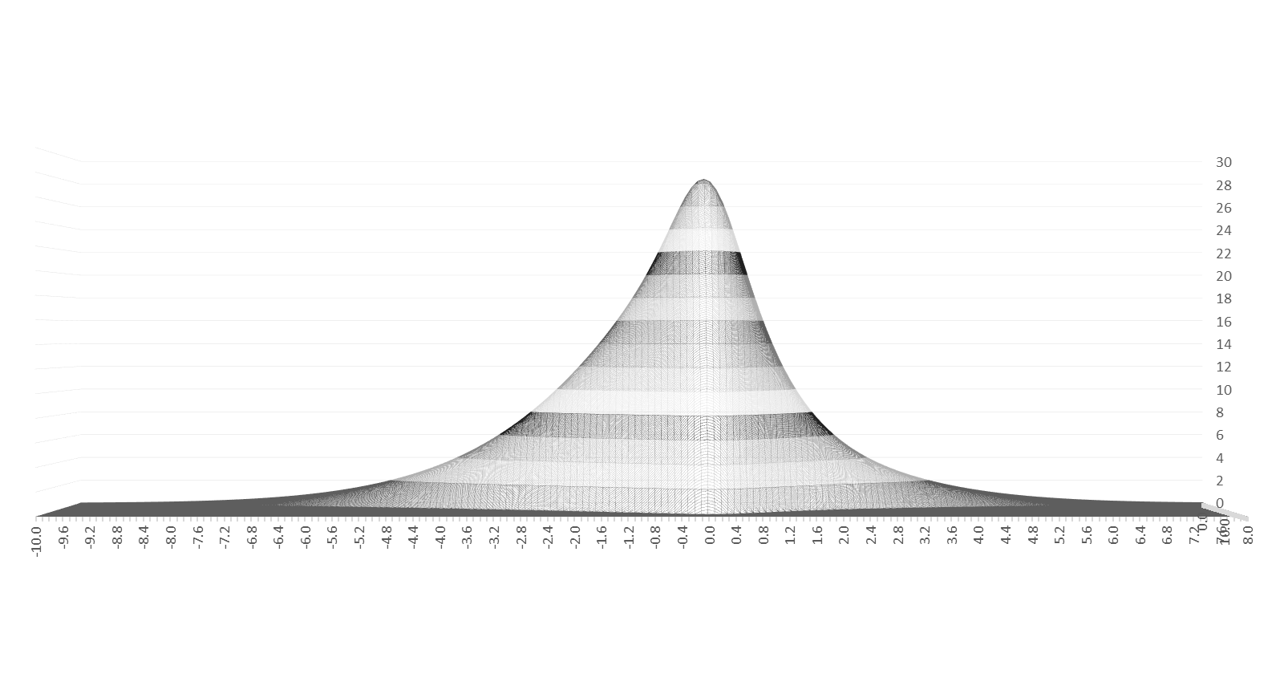
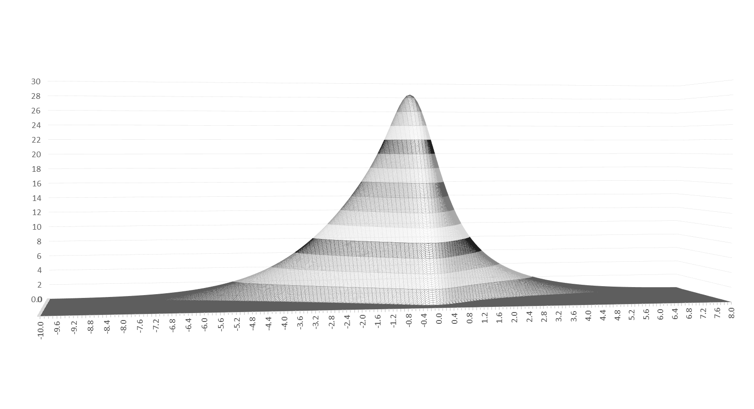
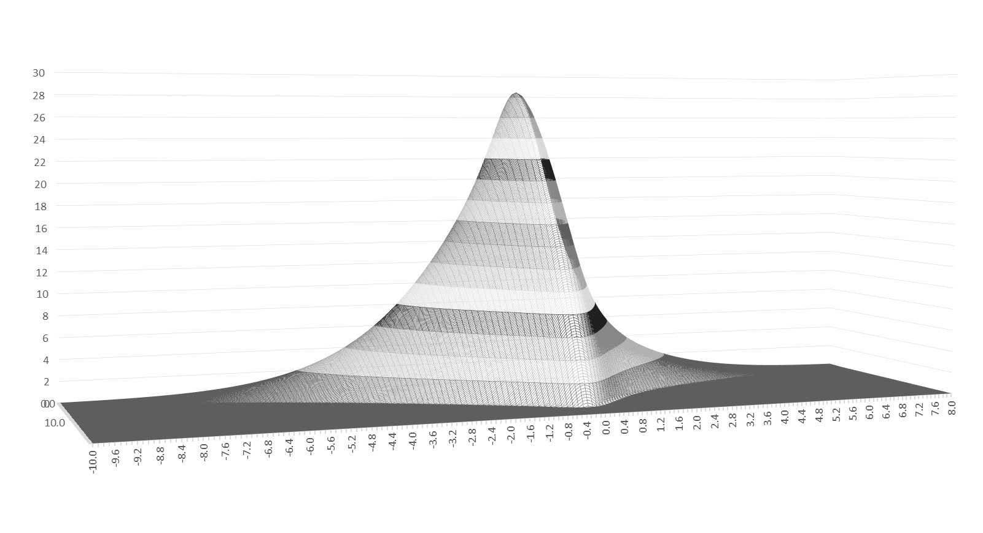
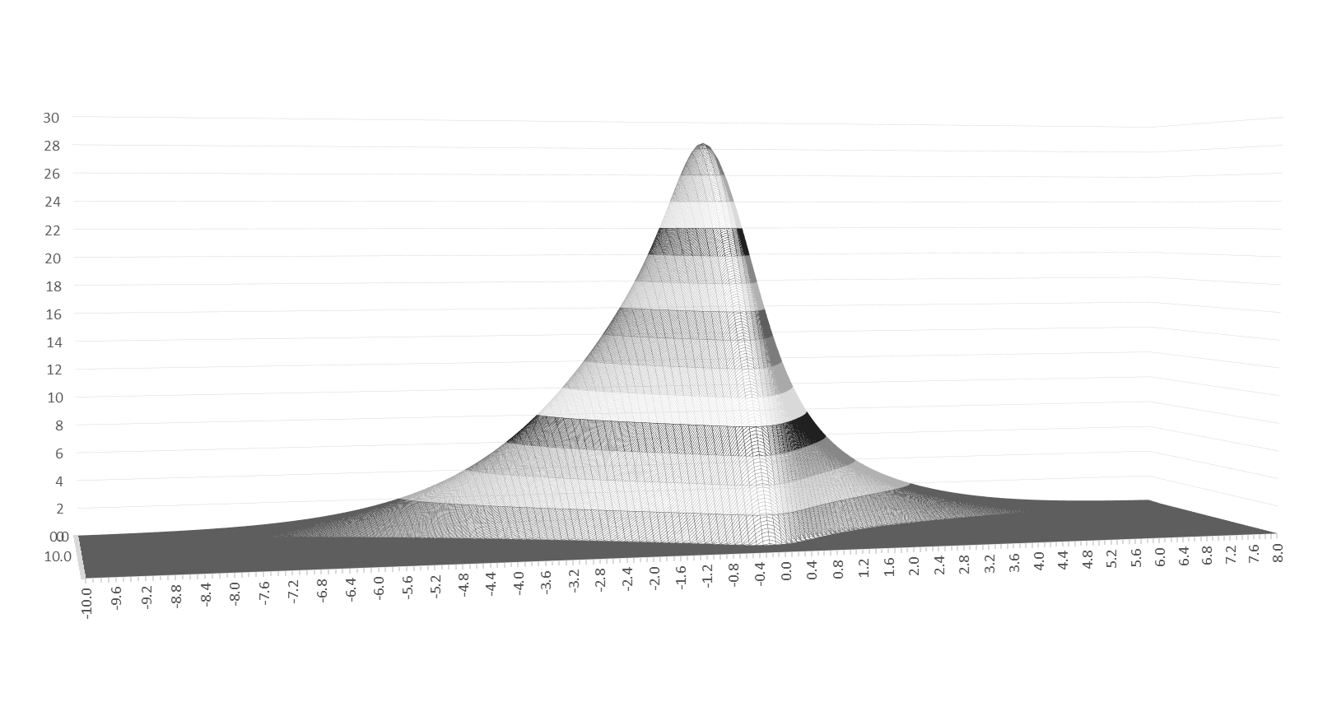
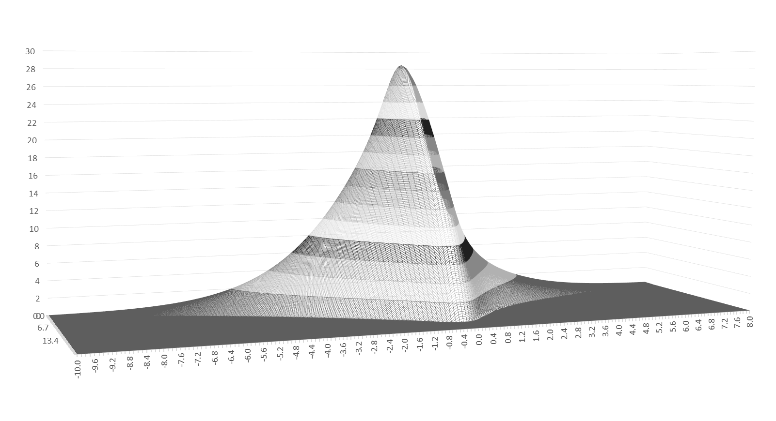
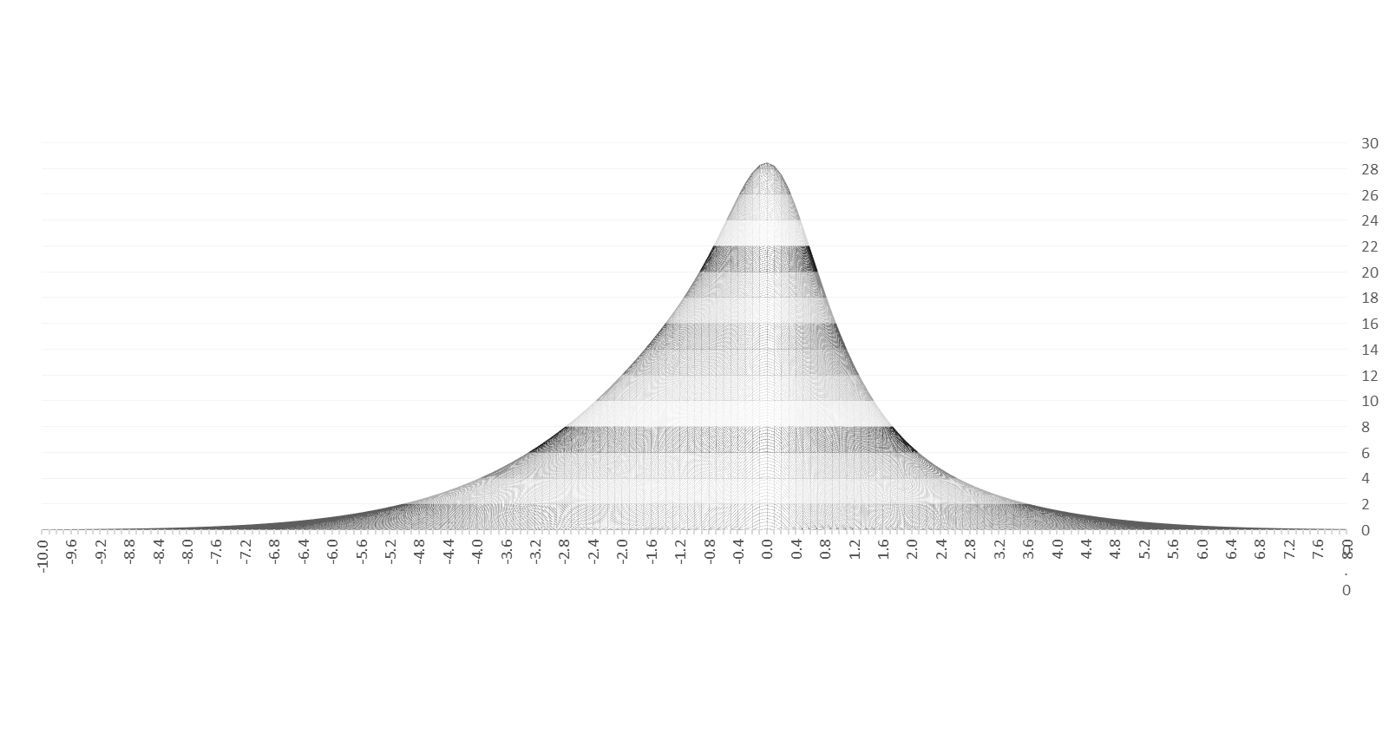
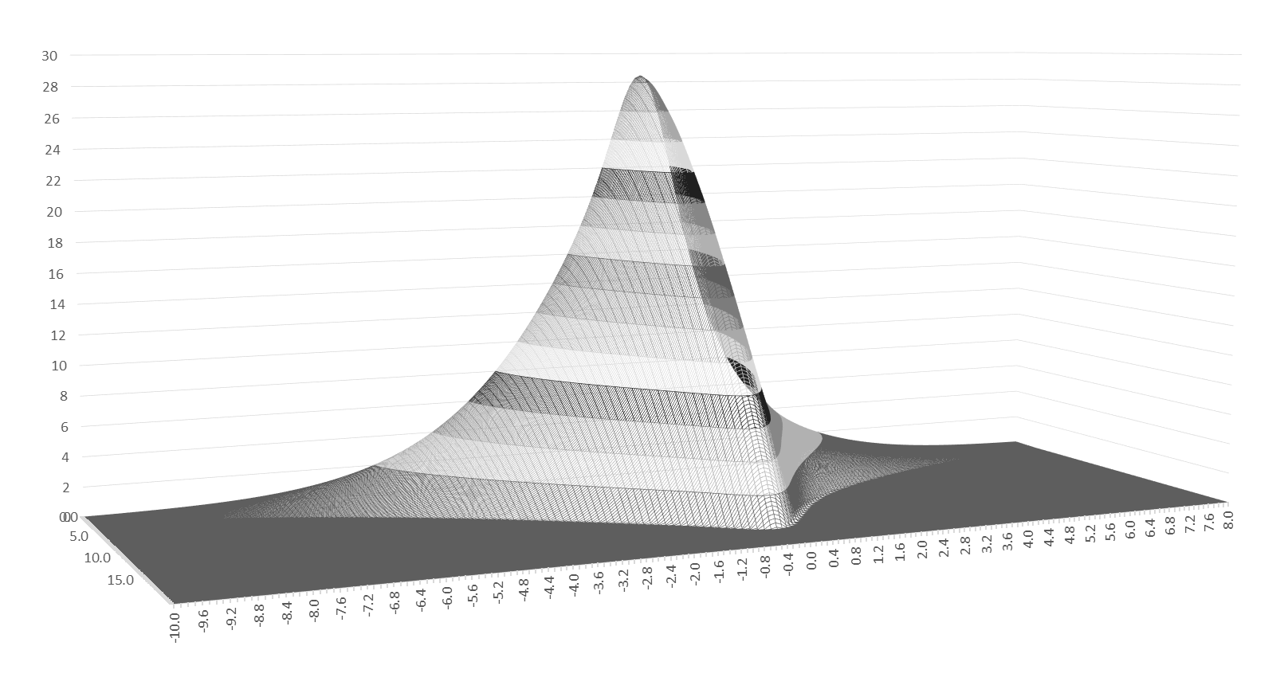
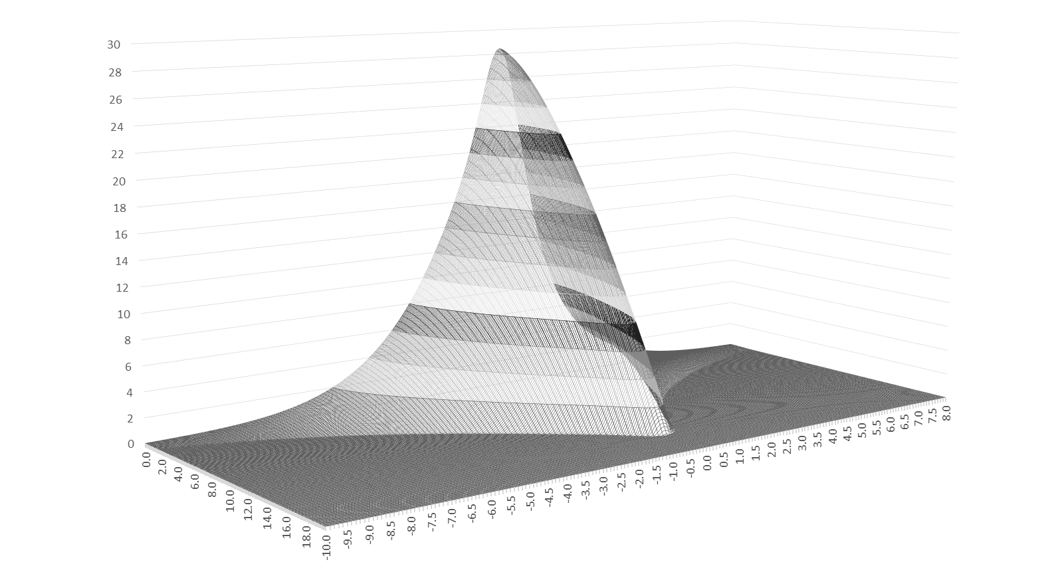
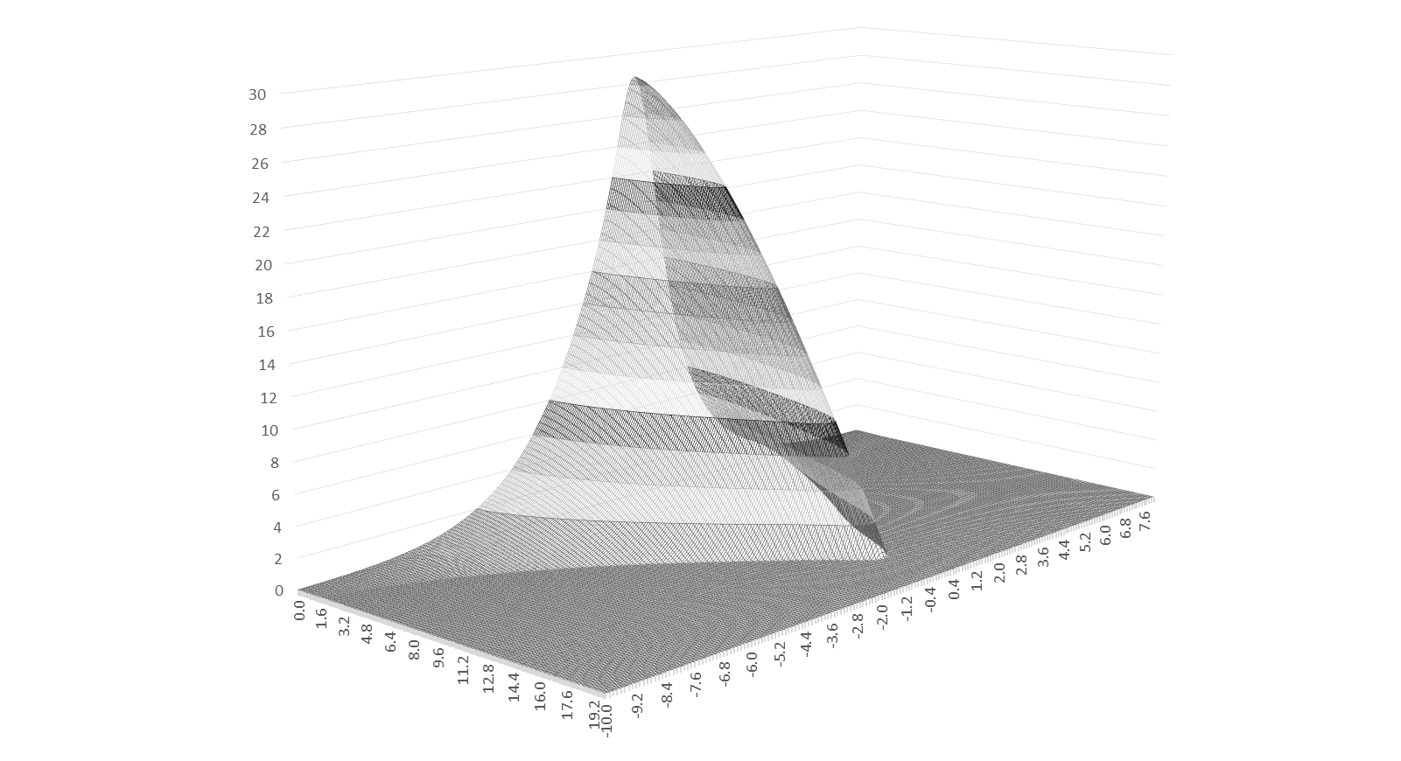
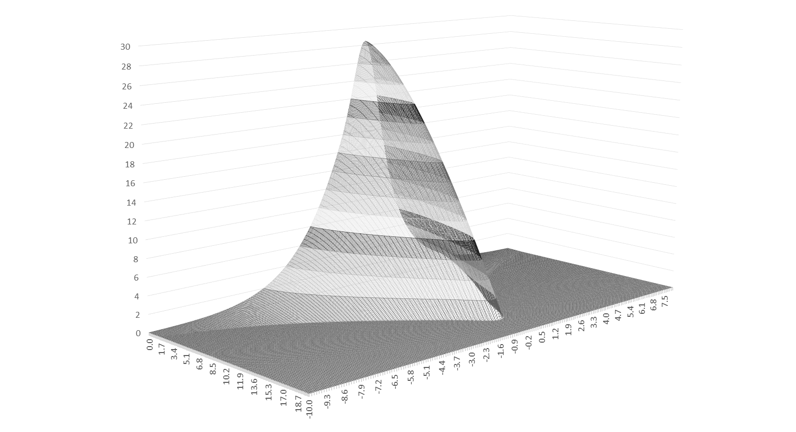
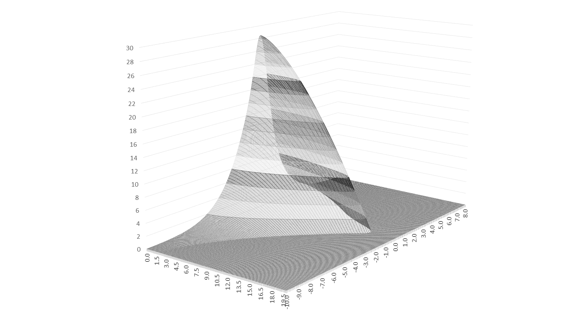
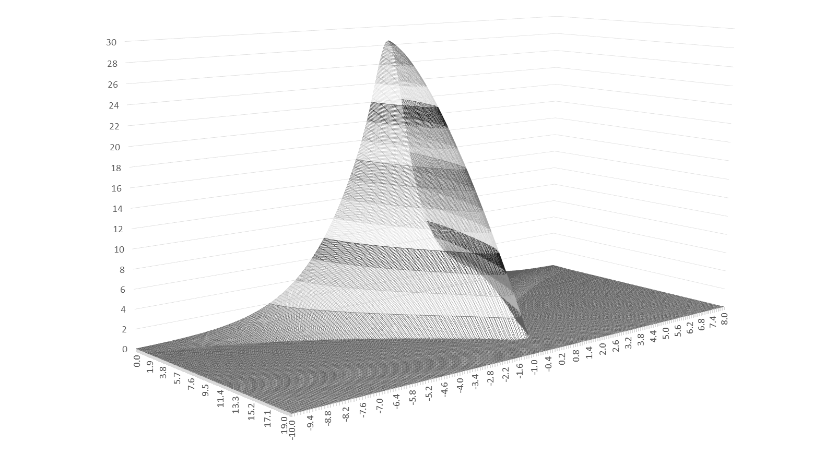
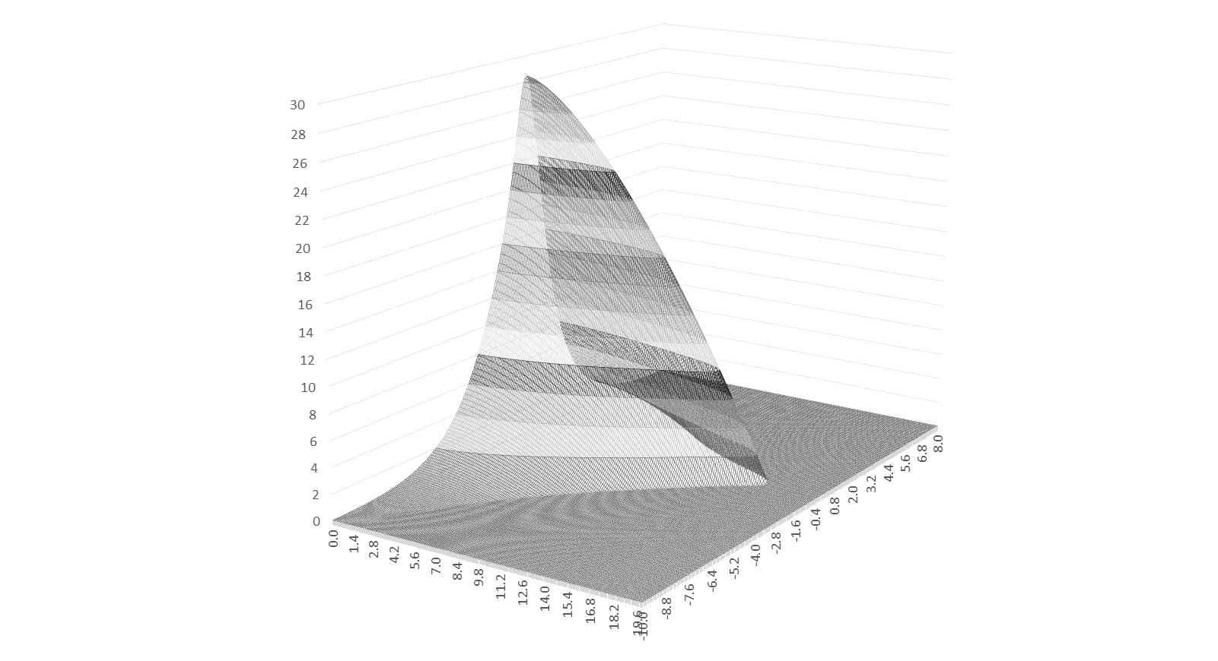
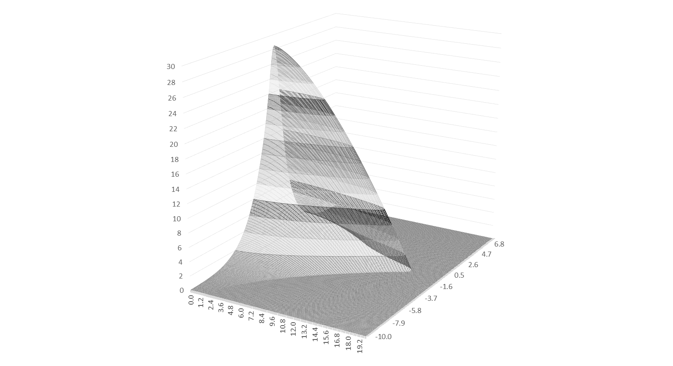
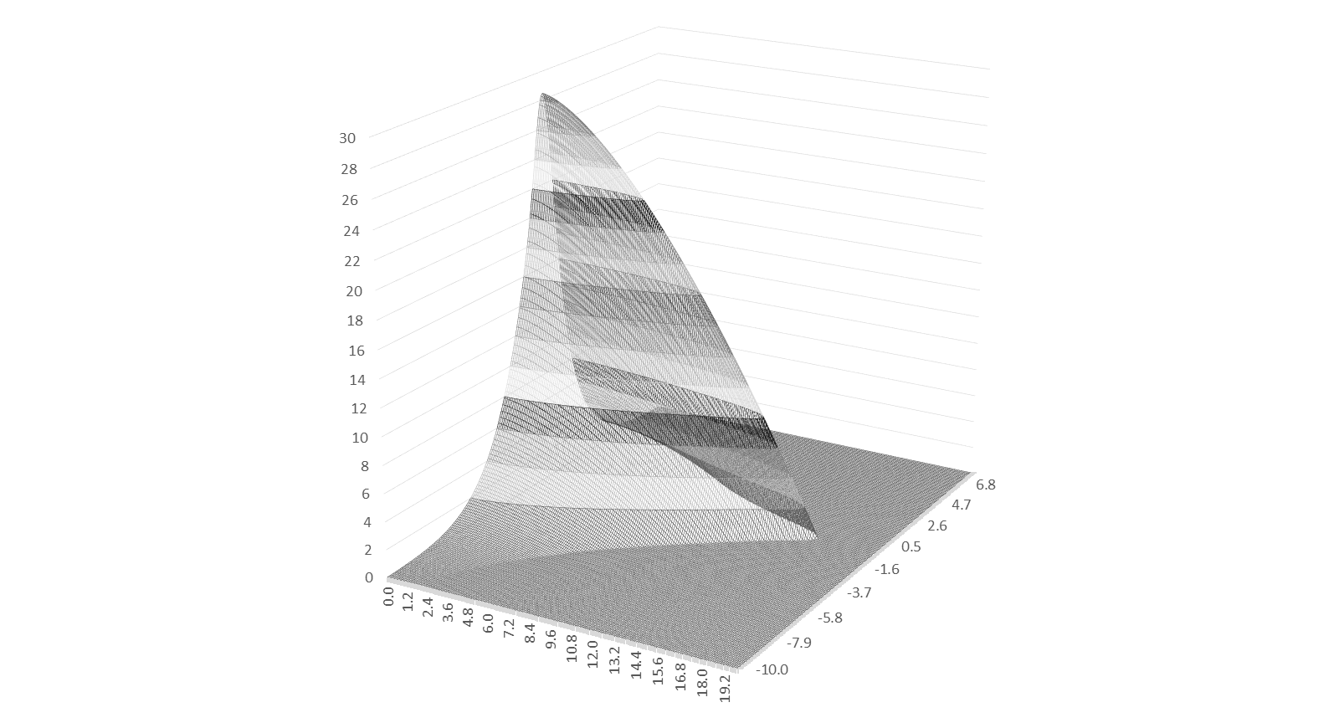
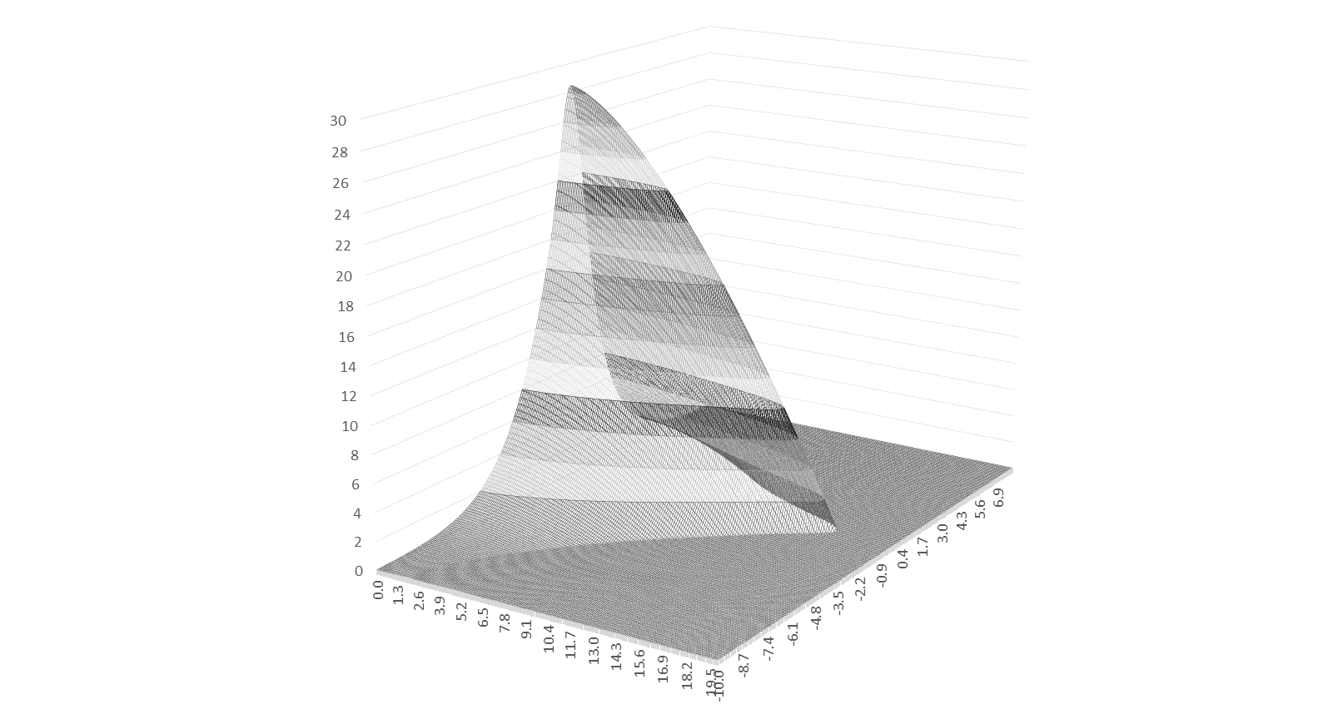
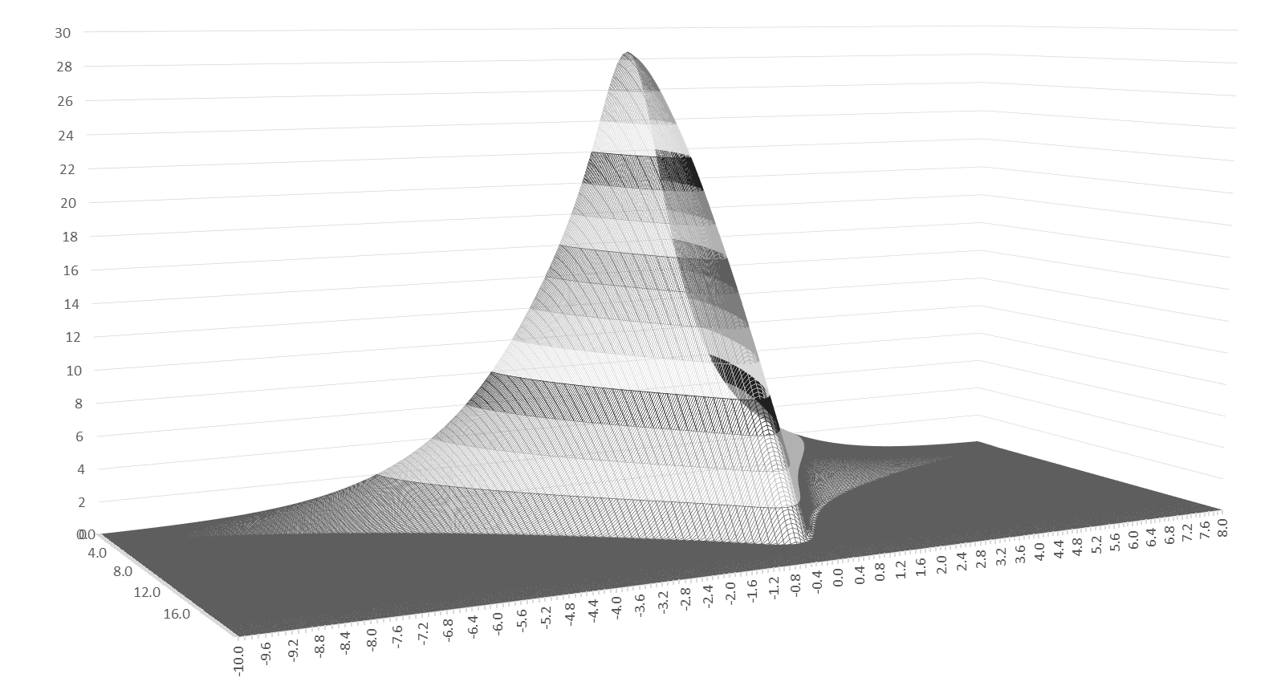
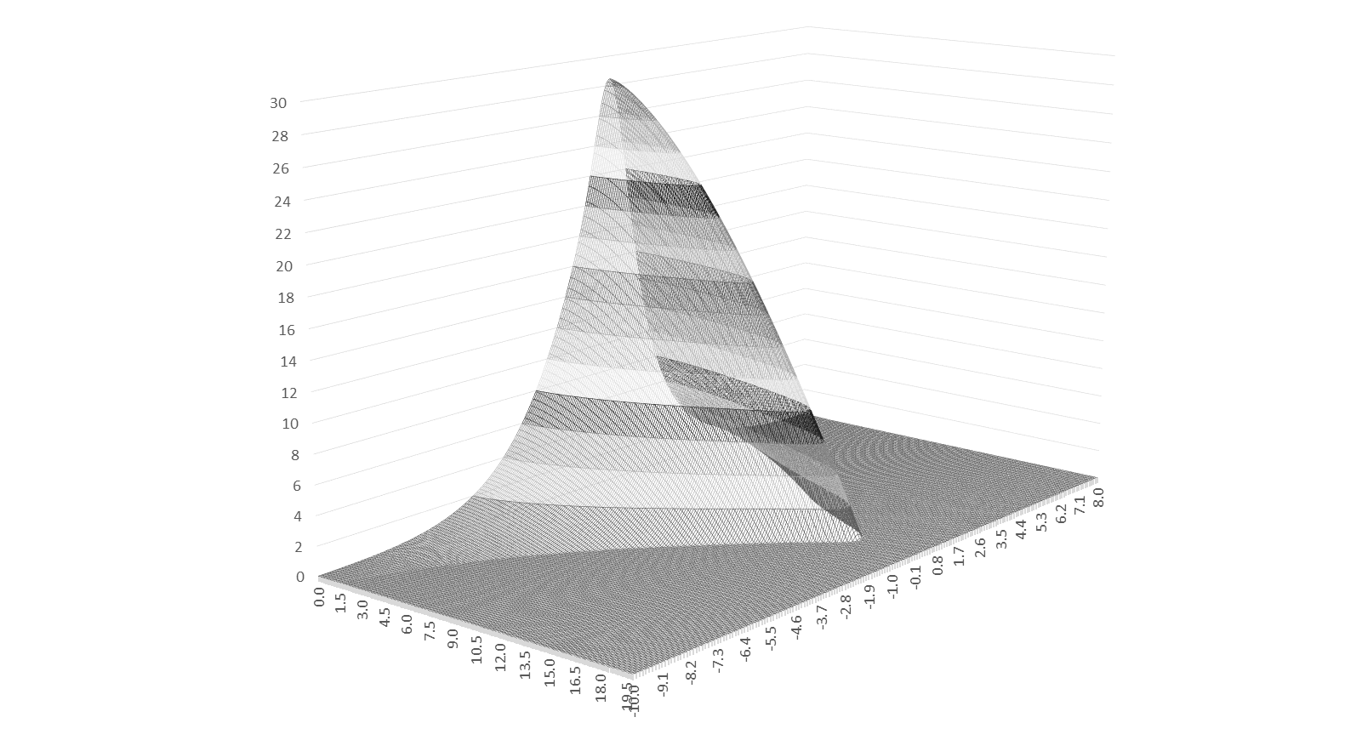
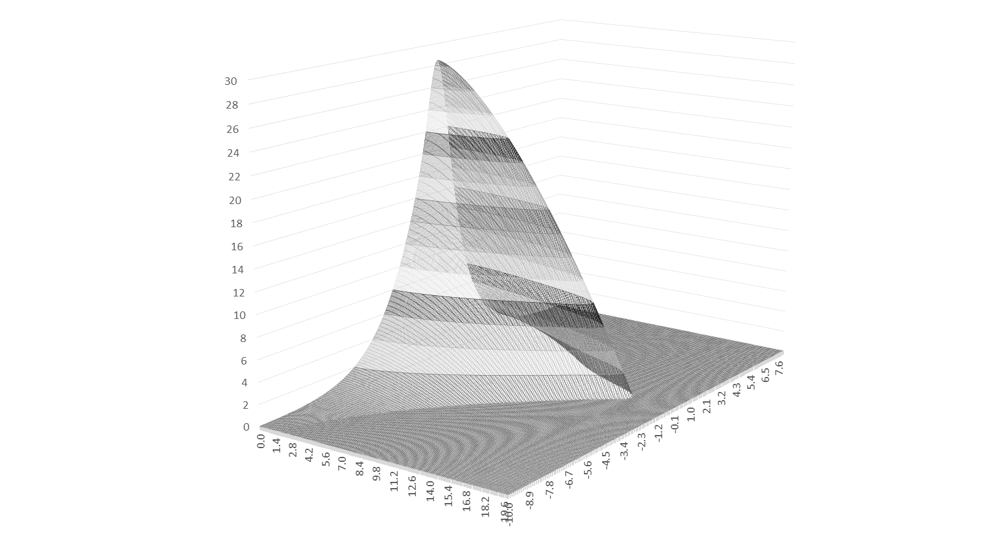
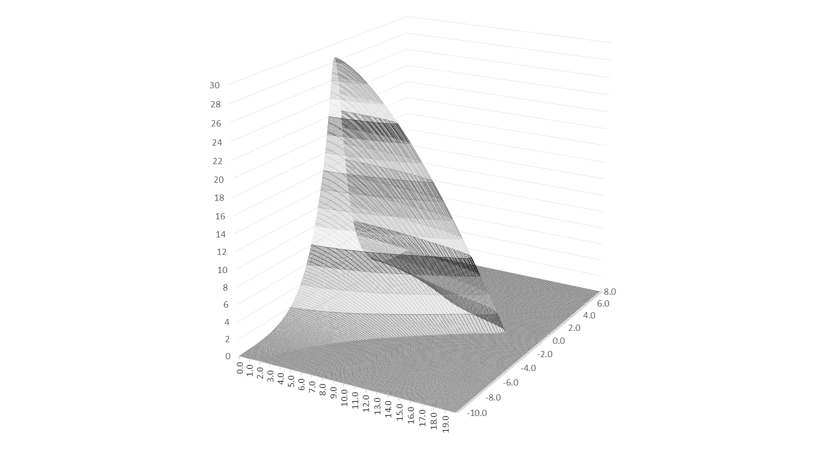

Slide 11
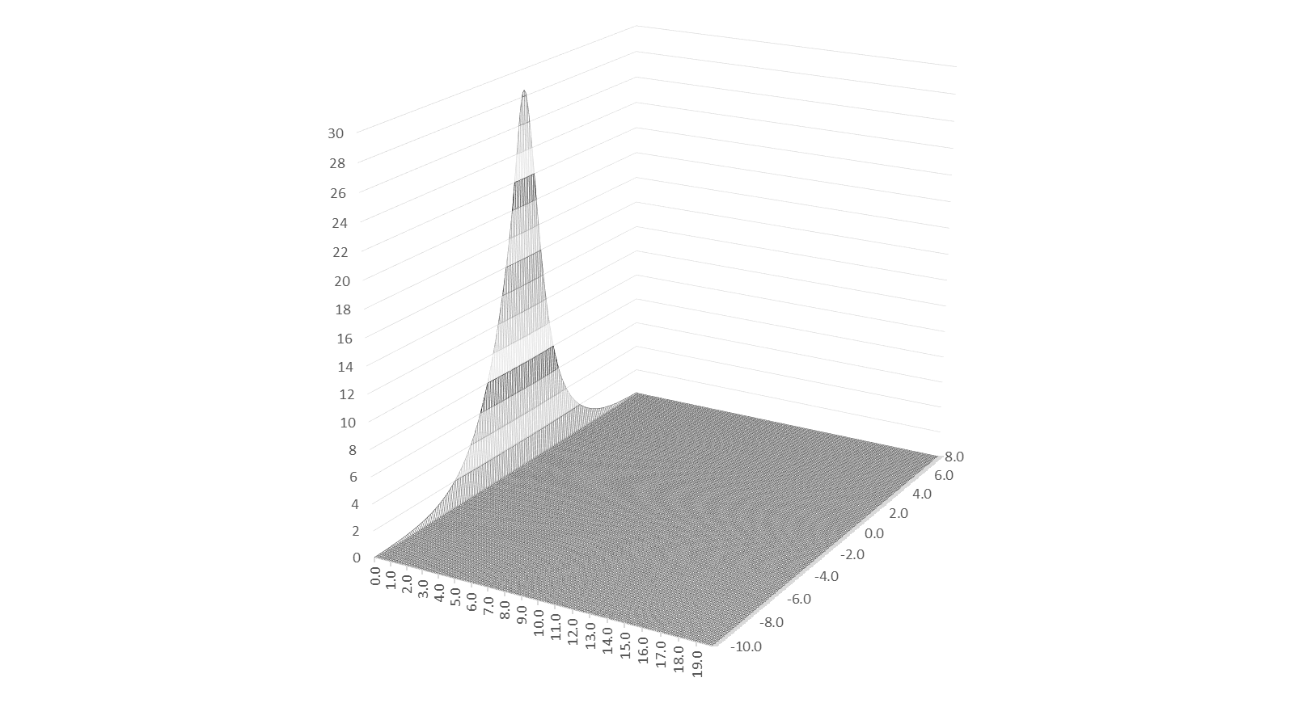
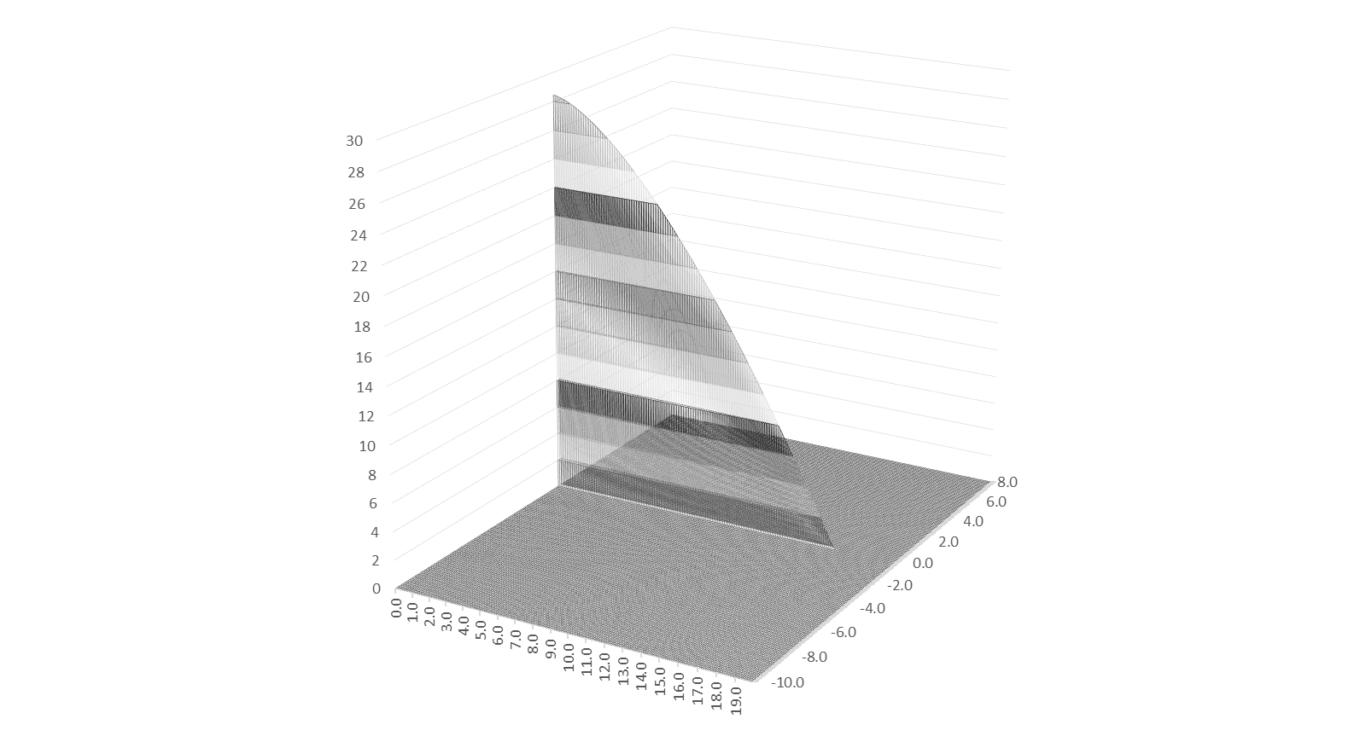
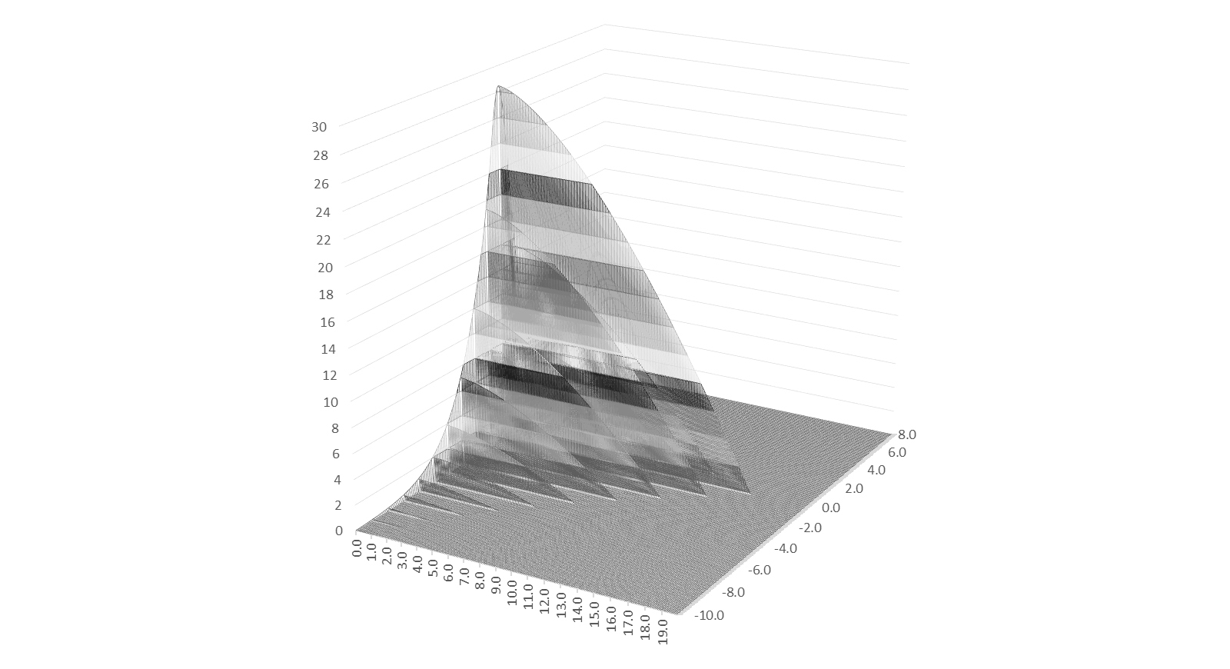
$$b_{C2}\left(ε\right)=\frac{B_{C2}^{∗}\left(ε\right)}{B_{C2}^{∗}\left(0\right)}$$
$$B_{C2}^{∗}\left(0,0\right)$$
$$B_{C2}^{∗}\left(ε,T\right)=B_{C2}^{∗}\left(0,0\right)×b_{C2}\left(ε\right)×b_{C2}\left(t\right)$$
$$b_{C2}\left(t\right)=1−t^{v}$$
$$\frac{B_{C2}^{∗}\left(T\right)}{B_{C2}^{∗}\left(0\right)}=1−{\left(\frac{T}{T_{C}}\right)}^{v}$$
$$\frac{T_{C}^{∗}\left(ε\right)}{T_{C}^{∗}\left(0\right)}={\left[\frac{B_{C2}^{∗}\left(ε,0\right)}{B_{C2}^{∗}\left(0,0\right)}\right]}^{\frac{1}{w}}$$
B_{C2}* (ε, T) [T]
ε₀ [%]
T_{C} (ε) [K]

Slide 12
Temperature dependence of K
$$F_{max}=0.286×K$$
T = 0 K
T = 4.2 K
T = 10 K
T = 16 K
B_{C2} [T]
4.2
This is the other way to determine T_{C}*
10
16
T [K]

Slide 13
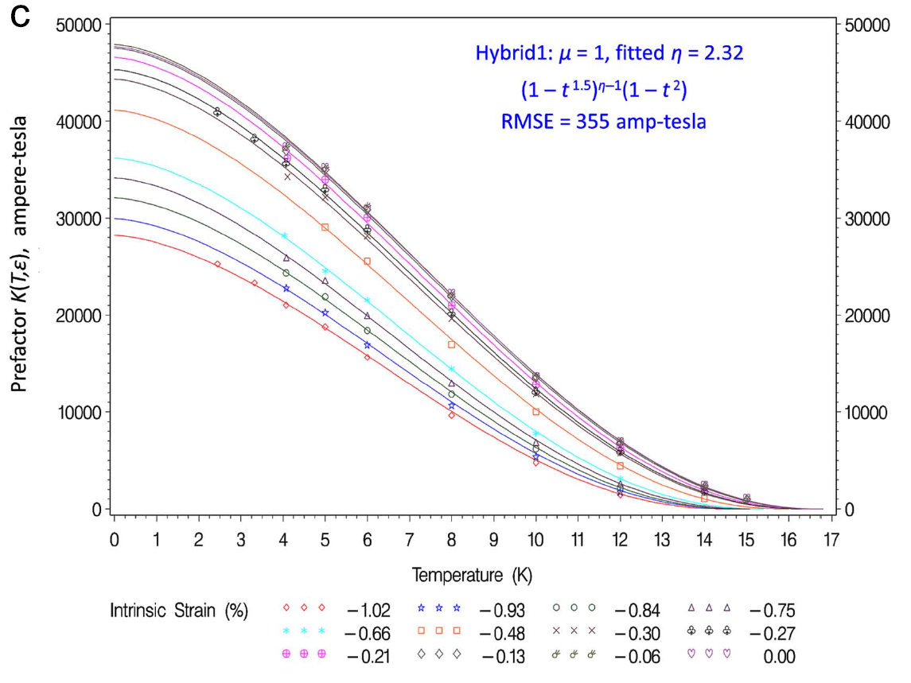
K (t)

Slide 14
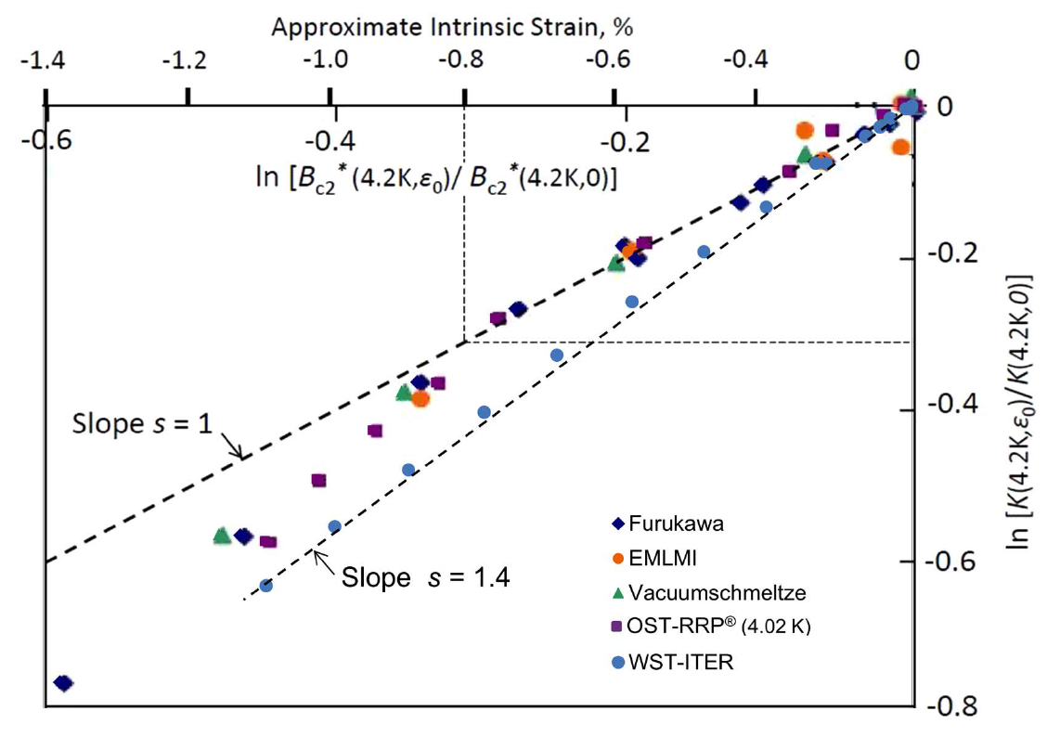
K (ε)

Slide 15
K (t)

Slide 16
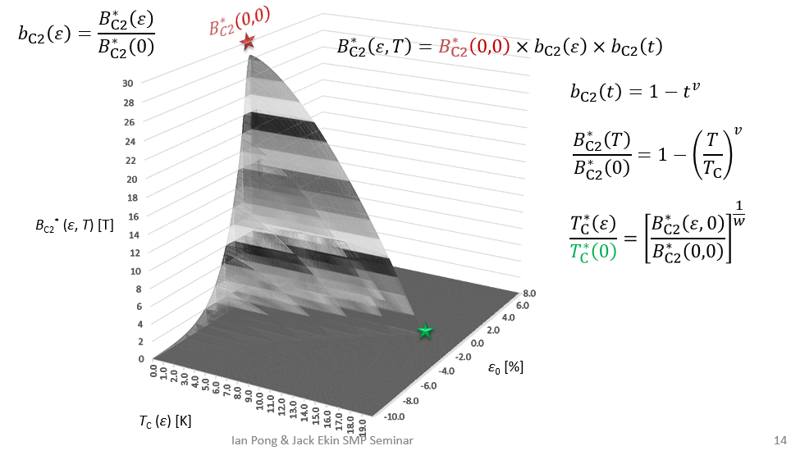
Mathematically…
$F_{P}\left(B,T,ε\right)=I_{C}\left(B,T,ε\right)B=K\left(t,ε\right)f\left(b\right)$
$T_{C}^{∗}\left(ε\right)=T_{C}^{∗}\left(0\right){×\left[b_{C2}\left(ε\right)\right]}^{\frac{1}{w}}$
$B_{C2}^{∗}\left(t,ε\right)=B_{C2}^{∗}\left(0, 0\right)×b_{C2}\left(ε\right)×b_{C2}\left(t\right)$
$K\left(t,ε\right)=K\left(0, 0\right)×g\left(ε\right)×h\left(t\right)$
where $K\left(0, 0\right)≡C$
$I_{C}\left(B,T,ε\right)B=C g\left(ε\right) h\left(t\right) f\left(b\right)$
$$I_{C}\left(B,T,ε\right)B=C g\left(ε\right) h\left(t\right) f\left(b\right)$$

Slide 17
Mathematically…
$I_{C}\left(B,T,ε\right)B=C g\left(ε\right) h\left(t\right) f\left(b\right)$
$g\left(ε\right)={\left[b_{C2}\left(ε\right)\right]}^{s}$
$h\left(t\right)={\left(1−t^{v}\right)}^{η−μ}{\left(1−t^{2}\right)}^{μ}$
$f\left(b\right)=b^{p}{\left(1−b\right)}^{q}$
Scaling parameters:
T_{C}*(0), s, η, and the various strain parameters modeling b_{C2}(ε);
C, B_{C2}*(0, 0);
w, v, u;
p, q
“Core Scaling Parameters”
ESE
USL
“Individual Wire Scaling Parameters”
$$I_{C}\left(B,T,ε\right)B=C g\left(ε\right) h\left(t\right) f\left(b\right)$$
“Scaling Constants” – have a consistent value within a family of Nb₃Sn conductors
“p = 0.5, q = 2 for strong (g.b.) pinning Nb₃Sn. Fitting accurately over technological B-T range

Slide 18
USL to ESE
USL:
F_{P} measured at different T and ε are shape invariant
All data coalesce into a single master unified-scaling curve
Significance: extrapolation capability from this master curve
ESE:
Derivation of ESE is an extensive but single study of many Nb₃Sn conductors
Application of ESE is just a fit, even allowing combined data from different measurement apparatuses

Slide 19
Outline – to be continued…
Introduction: superconducting surface (a.k.a. critical surface)
Scaling parameterization
A graphical presentation
A mathematical presentation
From USL to ESE
Addressing Temperature and Strain Dependence Issues
Addressing Transport vs. Magnetization Issues
ESE Spreadsheet usage – Live Demo

