Slide 1
Thermal-mechanical property of cable/insulation/epoxy composite in 15T diople
Pei Li, Steve Krave
10/18/2017
MDP meeting

Slide 2
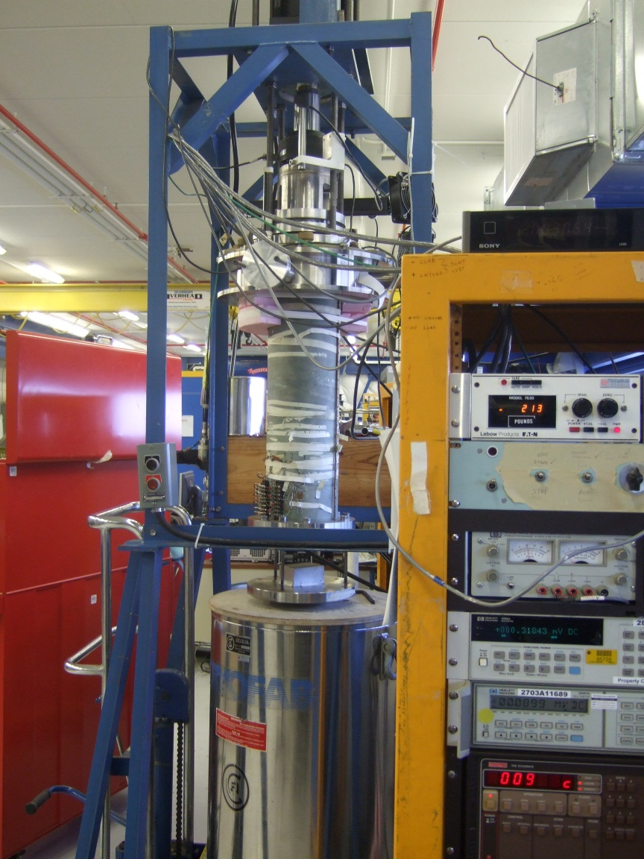
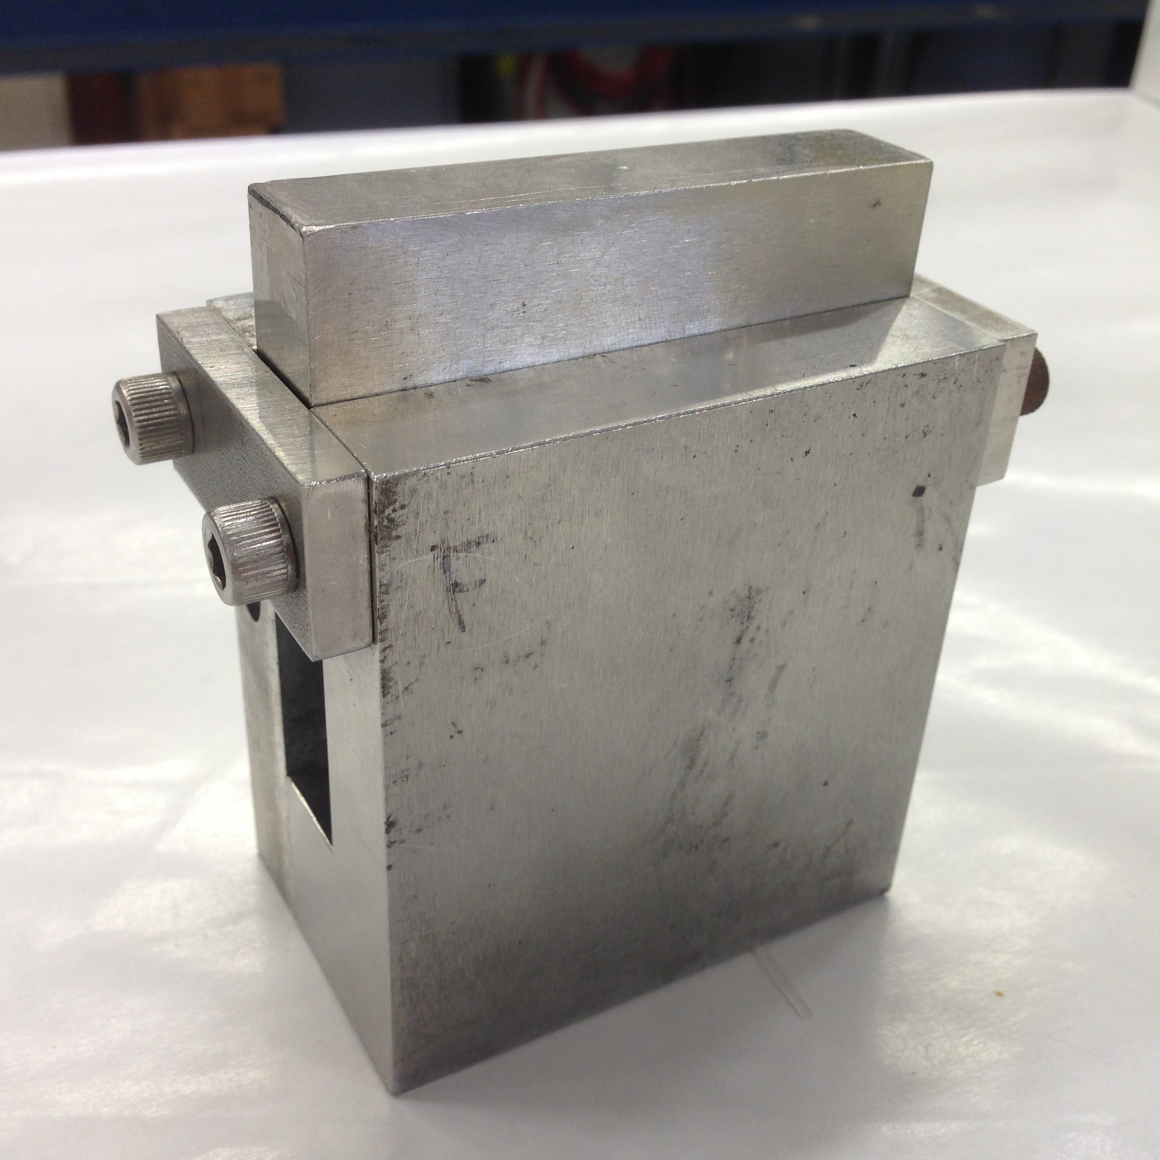
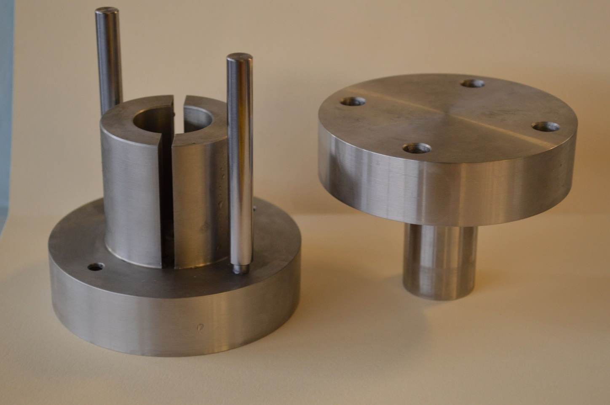
Experimental setup and sample description
Strand | 0.7 mm 108/127 RRP
Cable | 40 strands, with core, used in 15T dipole outer coils
Insulation | 3 mil E-glass tape, wrapping, 40-50% overlap/ceramic binder(CTD-1202x), brushed on, 2.1g/6.5 inch of 10-stack
Impregnation | CTD-101K
Cable reaction procedure | Full HT with final step 640 °C/48hr
Cable 10-stack cross section | 15.6mm x 17.2mm, length 12.7-25.4mm
Strain gage | WK13-125AD-350w
Tests | # of samples
Azimuthal | 1
Radial | 2
Axial | 1
Thermal contraction | 3

Slide 3
Verification with Al 6061
E=71.2GPa, comparing with commonly reported value of ~ 70GPa
3 loading-unloading cycles plotted. Loading and unloading curves overlap, no hysteresis.

Slide 4
10 stack, azimuthal loading, room temperature
Initial loading, maximum load =1500 psi
cyclical loading with increasing maximum load
2nd and 3rd loading
1st loading
unloading
Obvious work-hardening along azimuthal direction, starting form low load.
E =16.6-16.9 GPa (initial part of the trace)

Slide 5
Azimuthal modulus in monolithic loading
Azimuthal modulus in loading-unloading cycles after maximum load of 20000 psi (140 Mpa) was first reached

Slide 6
10 stack, radial loading, room temperature
Initial loading, maximum load =1500 psi
cyclical loading with increasing maximum load
Work-hardening is less significant along radial direction.
E =49.2-55.7 Gpa,
Simple rule of mixture predicts ~98GPa

Slide 7
Hysteresis behavior in 10-stack samples
Comparing with Al, 10-stack samples shows clear hysteresis behavior in loading-unloading cycles.

Slide 8
Thermal contraction
sample | Thermal contraction, 293-77K (%), after correction of thermal effect of gage, three samples average
Al-6061 | -0.369 (calculated=-0.385)
10 stack, azimuthal | -0.422(±0.0005)
10 stack, radial | -0.191(±0.0035)
10 stack, axial | -0.215(±0.0006)

Slide 9
Source/ direction | 15T out-layer (this work) | Chichili (2000, Nb3Sn/S-glass/binder) | Bossert (2014, LARP cable/S-glass/binder) | Swenson (1997, rectangular strand, layer-winding, 60% Cu, 4mil E-glass used as inter-layer insulation) | Imbasciati (2002, Nb3Sn cable,7mil E-glass,) | calculated (rule of mixture)
Az (%) | -0.422 | -0.322 | -0.32 | -0.3 (along broad side of rectangular) | -0.37 | -0.272
Radial(%) | -0.191 | -0.229 | -0.22 | -0.3 (along short side of rectangular) | -0.29 | -0.272
Axial(%) | -0.215 | -0.229 | -0.19 | -0.25 | N/A | -0.295

Slide 10
Issues with inter-layer bonding between insulation and cable
Loading, post failure
unloading
failure
Loading, normal
Sample delaminated under radial compression at 7000psi (50MPa).
As seen in the loading-unloading curve, the outmost layer is under tensile. Barreling.
Delamination also observed in radial laoding

Slide 11
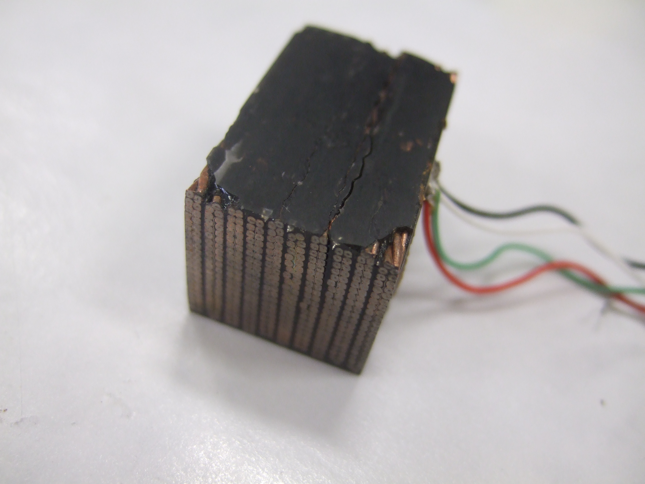
Thermal cycles can also lead to delamination.
Similar to the case of compressive loading, the delamination often occurs at the broad interface between cable and insulation/epoxy
Sample after 5 cycles between 300K and 77K

Slide 12
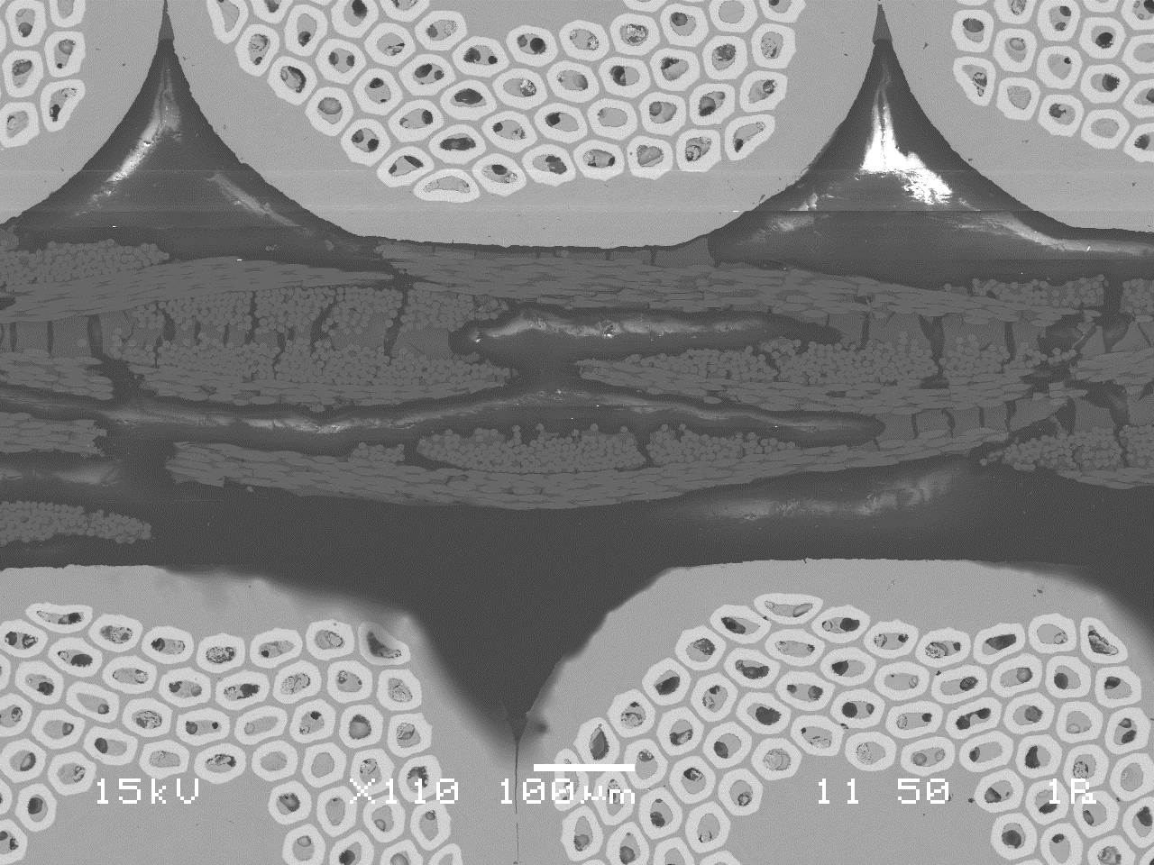
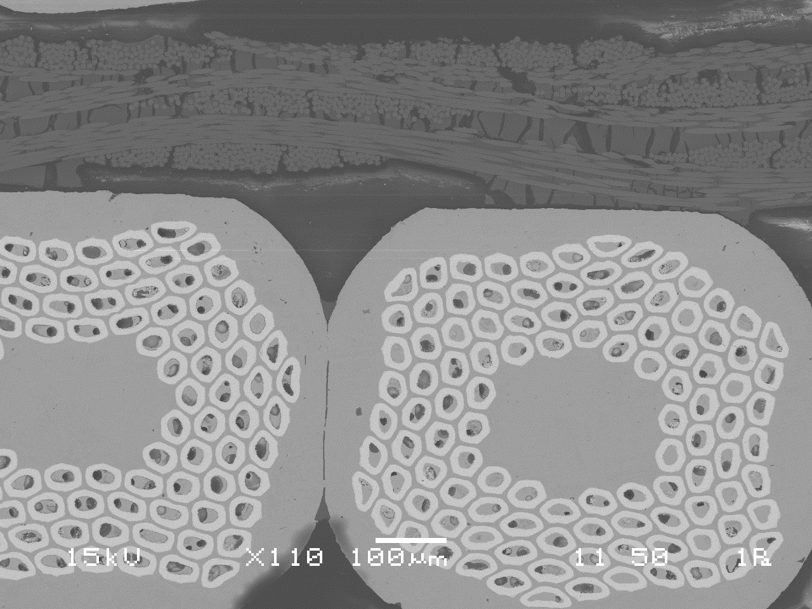
Microstructure of insulation
Large chunk of solid materials (circled) trapped between fiber layers. Probably dried binders. Need confirmation with elemental analysis.
Possible reason: because of tape wrapping, the inter-fiber space is non-uniform, leading to local accumulation of binder

Slide 13
A similar cable stack using S-glass sleeves and similar amount of binder

Slide 14
Summary
Thermal mechanical properties of cable/insulation/epoxy composite studied with strain gage method
Under uniaxial loading, samples were compressed up to 140 Mpa (azimuthal) and 50MPa (radial)
Easy sample delamination was observed, especially under radial and axial compression. Improved testing method is needed to evaluate mechanical property in high stress range.
The delamination may be related to the local accumulation of binder

