Slide 1
Integrated Project Team Meeting 7:
Introduction
Soren Prestemon
Director, US Magnet Development Program
Director, Berkeley Center for Magnet Technology
Lawrence Berkeley National Laboratory

Slide 2
Summary of funding received to-date
FNAL
LBNL
Thank you for continued strong and timely support!

Slide 3
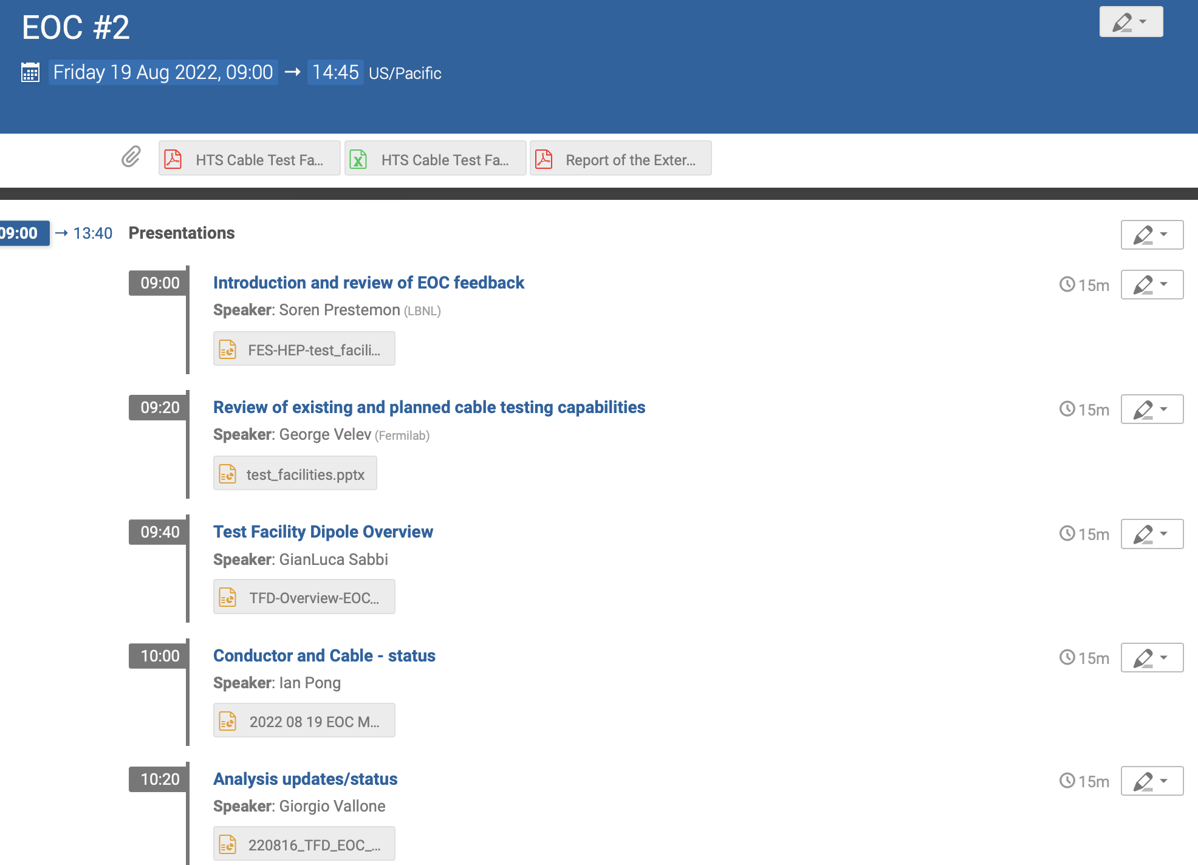
Oversight from EOC
External Oversight Committee
    Met with the External Oversight Committee August 19th, 2022 (https://conferences.lbl.gov/event/1036/)
    Feedback covered on the IPT6 meeting slides (https://conferences.lbl.gov/event/1043/)

Slide 4
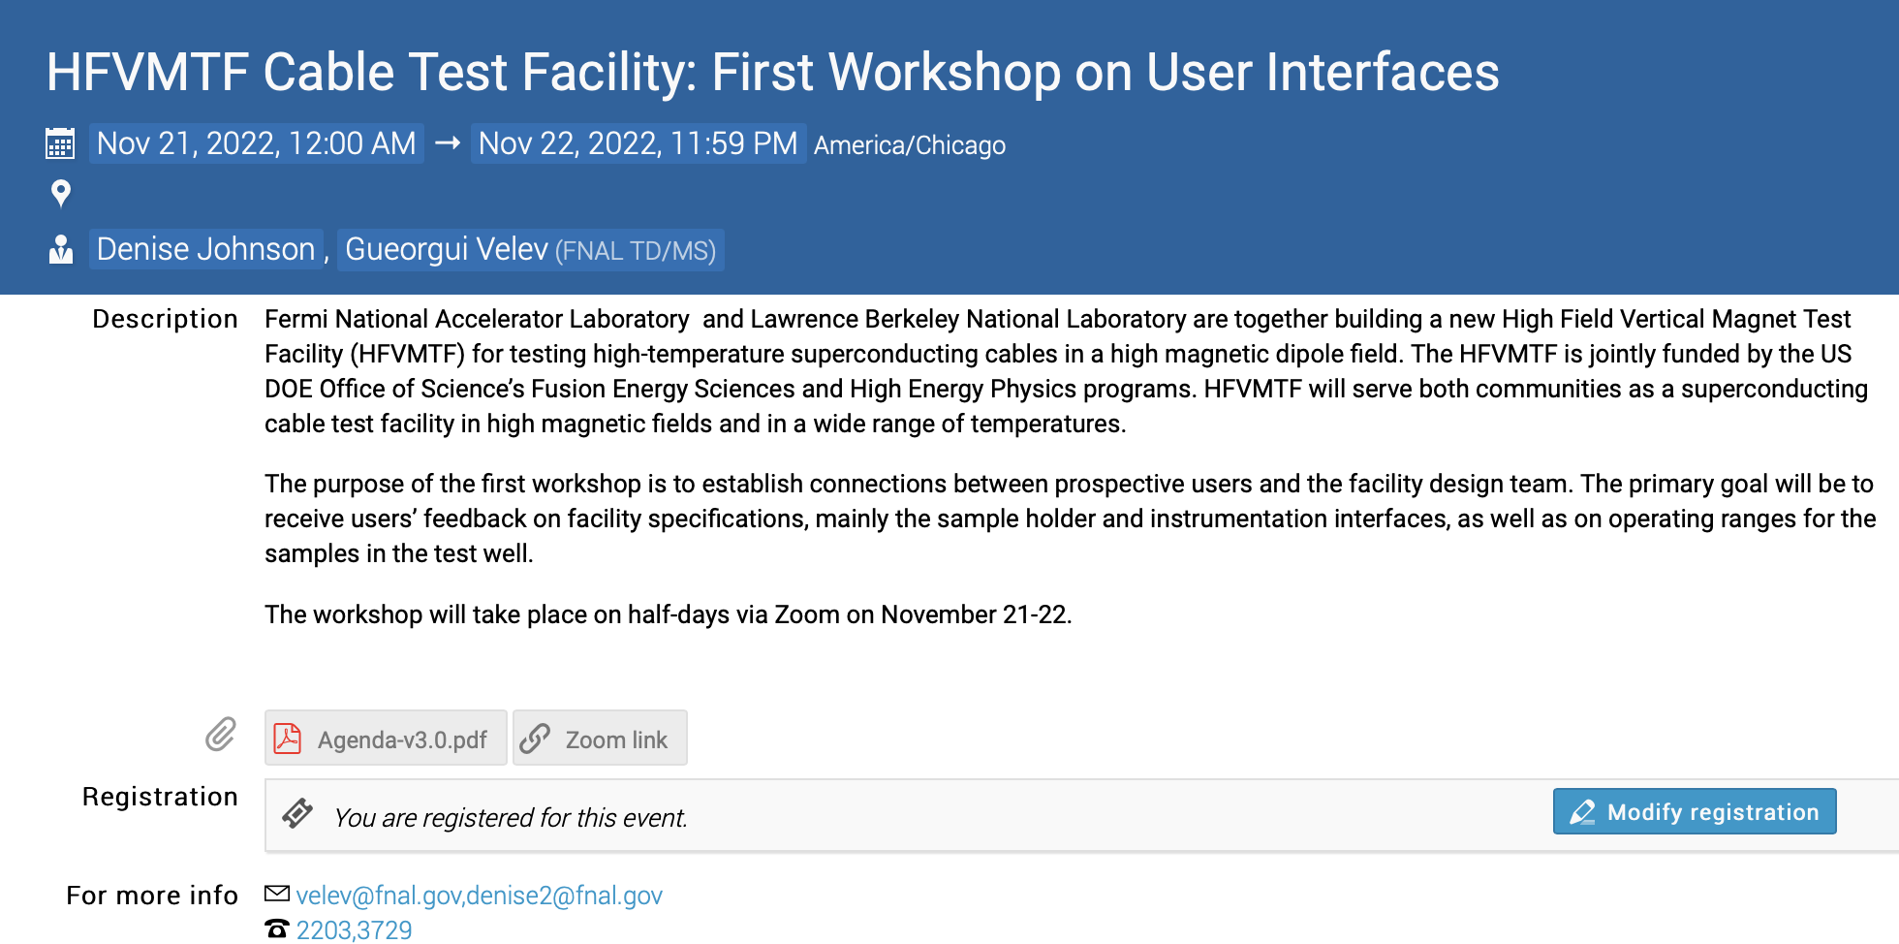
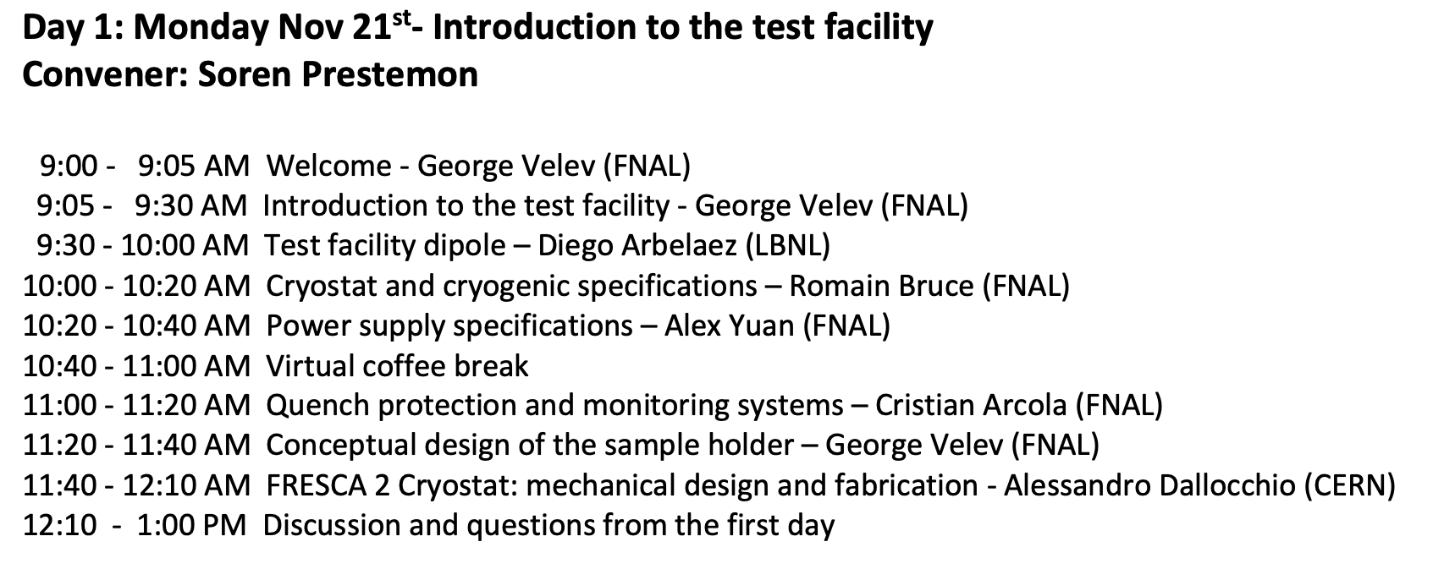
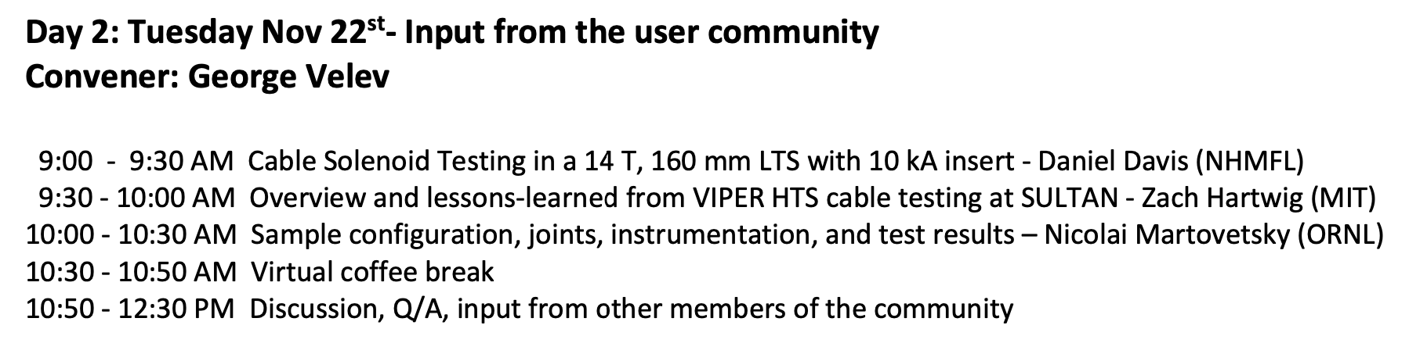
Feedback from potential users
    George Velev to the lead on organizing a first “User” workshop
  HFVMTF Cable Test Facility: First Workshop on User Interfaces
    Held Nov. 21-22, 2022 (virtual) (https://indico.fnal.gov/event/57027/)
    Feedback will be covered by George in last presentation today

Slide 5
Plans for next reviews / community outreach
Design Review for the Test Facility Dipole
Followed closely by a Cost and Schedule review for the Dipole
Then:
  Next IPT - suggest a regular schedule, e.g. every 3 months going forward
  Next EOC meeting
Targeting mid February

Slide 6
Background

Slide 7
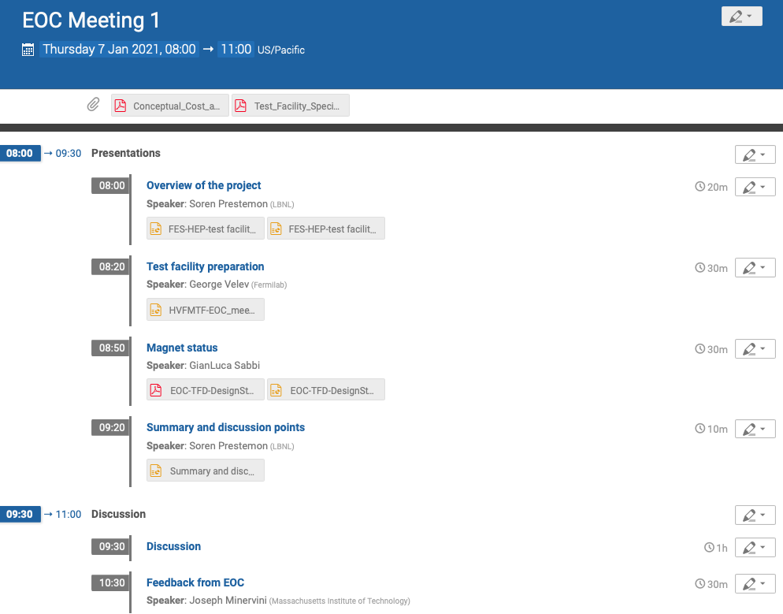
External Oversight Committee
  Joe Minervini (Chair) Steve Gourlay (Co-chair / Backup) Luca Bottura
  Luisa Chiesa Danko van der Laan Ruben Carcagno
  Nicolai Martovetsky
Role of the Oversight Committee (OC):
  Represent user interests in facility plans
  Provide guidance and oversight for the overall facility development
  Provide feedback on performance goals, overall design, and its implementation
  Provide advice to the project management in terms of:
                - Responsiveness to community needs
    - Coordination and integration of efforts magnet/facility
    - Balance of project risk and cost & schedule
  Provide guidance on:
    - Facility operational structure and user needs
    - Collaboration and coordination with other laboratories
  Provide feedback to sponsors on project team performance

