Slide 1
HTS Cable Test Facility - Status
G. Velev

Slide 2
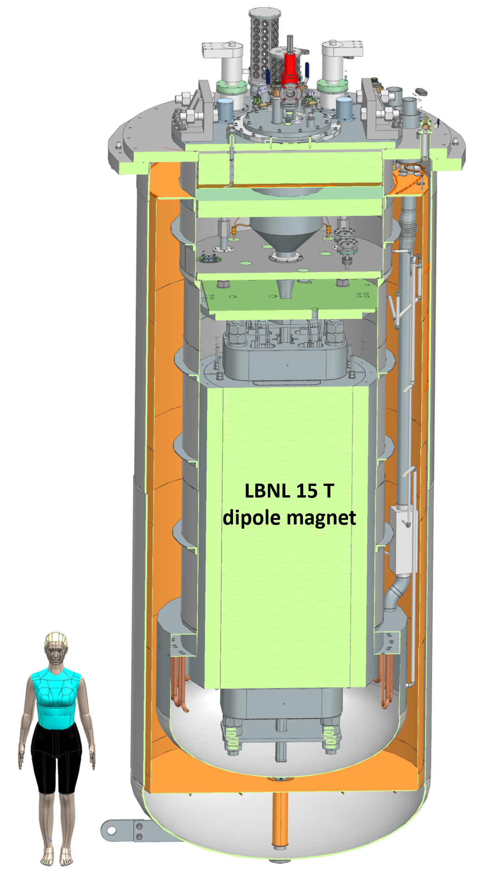
Outline
Short Overview
STEP 1: Test Pit construction and cryostat (GPP at Fermiab)
STEP 2: Quench Protection and Monitoring systems (QP/QM), Power Supplies, and test insert (cable holder)
STEP 3: Test Facility integration
Funding status
Schedule
Summary

Slide 3
Overview of the Test Facility
The test facility is constructed in Industrial Building 1, APS-TD, Fermilab. The proposed place is selected based on the proximity to the needed base infrastructure, including cryogenic, power, water and cranes.
Minimum operating temperature of the facility is 1.9K for the magnet providing the background field and with min 4.5 K for the test samples, variable to ~50 K.
The test pit cryostat should accommodate a dipole (cold mass) with maximum dimensions of 1.3 m and length of 3 m
The maximum energy in the test field dipole should be < 20 MJ
The maximum weight of the dipole cold mass should not exceed 20 ton
The test facility should be efficient and safe, minimizing the time for experiment preparation and no helium losses.
Operational lifetime of the facility at least 20 years.

Slide 4
Fermilab team
Fermilab team is fully assembled to L2
To execute the tasks, we rely on the personnel of the Magnet Technology Division and Cryo Technology Division (Magnet and Cry Sectors in APS-TD)
We are in strong competition with two 413b projects at CD3 level – Mu2e, and US LHC-AUP
COVID and other factors delayed the projects.
Now, we are navigating in environment where resources are in high demand
Project Director
G. Velev
Project Manager
V. Nikolic
Mechanical
V. Nikolic
Cryostat
R.Bruce
QP/QM system
C.Arcola
Power Supplies
X. Yuan
Integration
G. Velev (interim)
Magnet and Cryo
Division Personnel

Slide 5
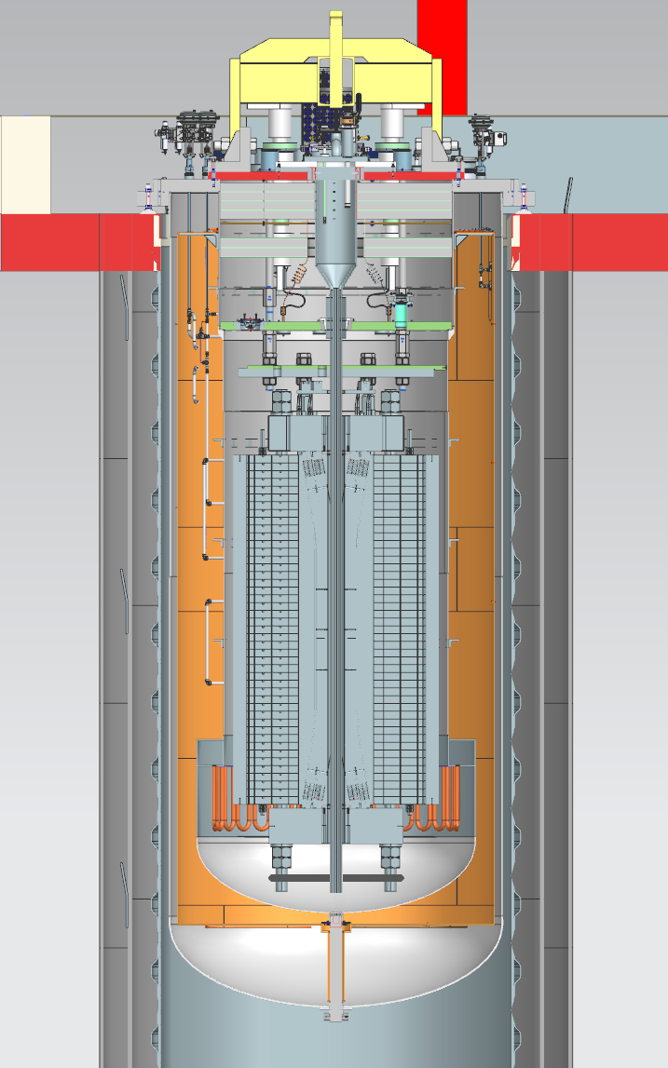
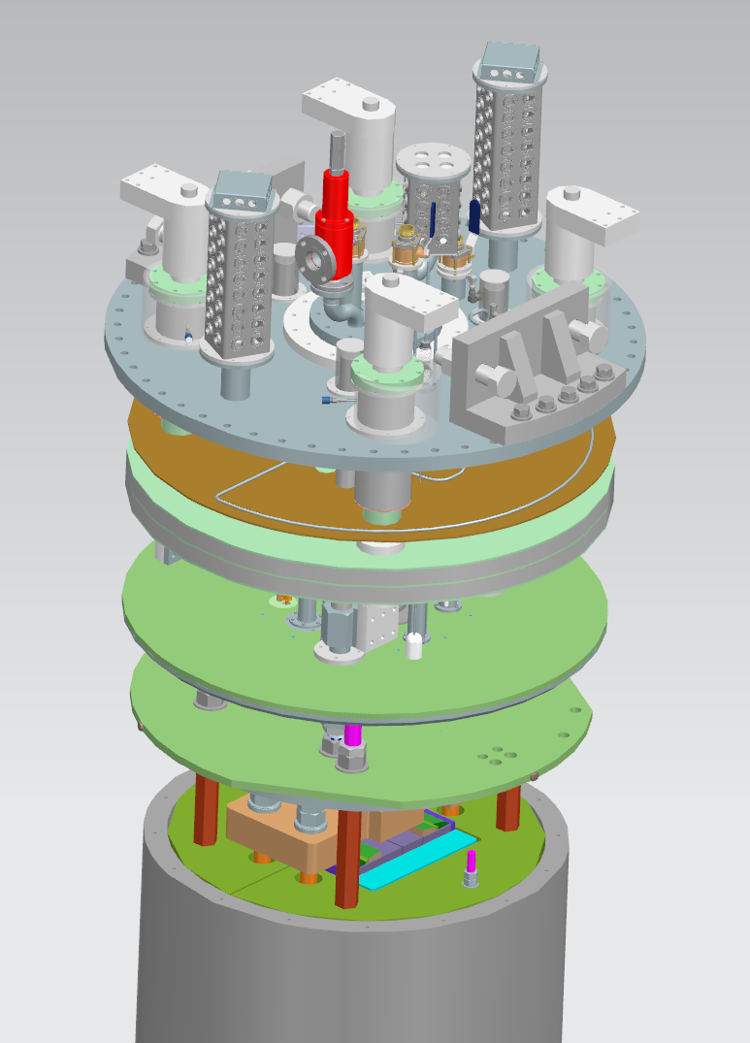
Test Pit and Cryostat – Status/Plans
This part of the project includes only the civil (pit) construction, the magnet cryostat and top&lambda plates
The pit is done - still dry even during strong Midwest rains
Cryostat vendor was selected
Meeting with the vendor every week
Preliminary design review is done
Final design review is expected in early February
Expected delivery June 2023 – probable delay of several months
Top and lambda plate design is in progress - the goal is to deliver the top and lambda plate in May for cryostat commissioning
Top
Lambda

Slide 6
Quench Protection and Quench Monitoring (QP/QM)
Benefiting from the projects mostly Mu2e Production/Operational grade QM/QC
Primary Custom Digital Quench Detection System (DQD)
Redundant Custom Analog Quench Detection System (AQD)
Quench management system, based on National Instruments C-RIO (Tier III ). Provides quench configuration, control and monitoring, and quench data management.
It is 85% finalized. Some modifications are needed to include some test capabilities for the samples.
Critical components are ordered and 50% received
Branch #1

Slide 7
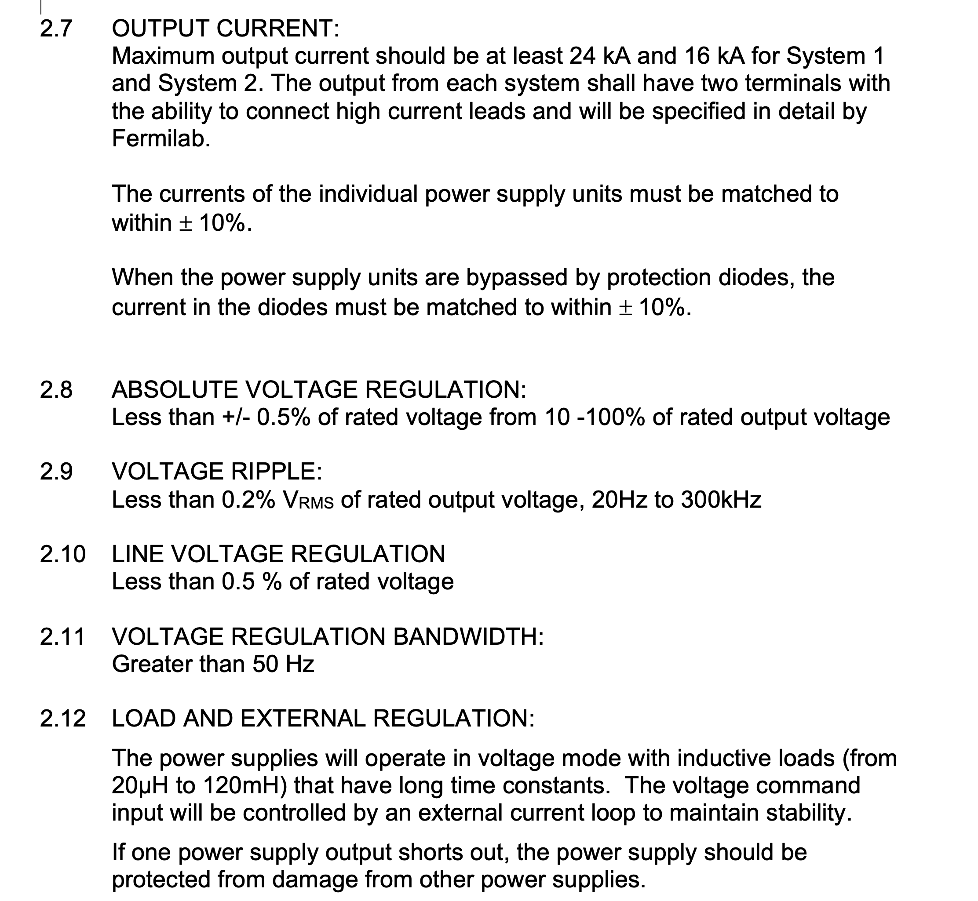
Power Supplies
Power Supply cost is $/per watt
We are procuring two sets of PSs:
Min 20 V @24 kA to power the main field magnet (LTS in case of hybrid magnet tests)
Min 20 V @16 kA to power the sample (HTS in case of hybrid magnet tests).
Specifications are finalized
We are asking for modular system built on switch-mode power supply modules, interchangeable
Procurement process started - 10 months ago
After 3 iterations, changing specs to get encourage US companies to meet the requirements we concluded
We select European company (OCEM), no US company met our specs
The cost for 2 sets is: A1- $1.66M, A2 -$1.06M and the winner E1 -$1.1M + overhead (FNAL charge) ~$100k
We have $963k for this bit, or $237k short
Caveat: the contract is not signed; quote expires at the end of January – seems we will miss the final date. We are asking for extension, but this may increase the cost.

Slide 8
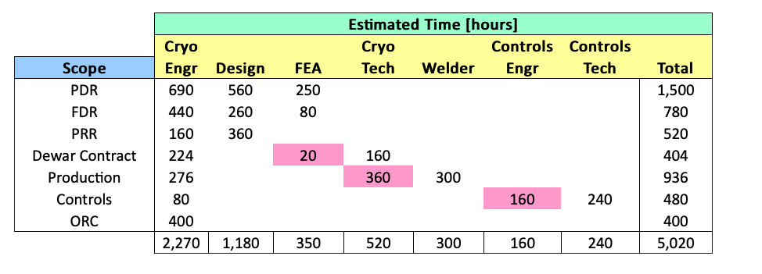
Integration
Documentation for the integration of the pit was started – based on the AUP stand 4 experience, progress is slow
Cryo and cryo-control engineers left - the process stopped and was restarted this summer
A discussion with the cryo sector for optimization of the project resources (mu2e, AUP, PIP II) is in progress. Need to show funding to get engineering support
2022
2220 h

Slide 9
Funding Status
This project has very low or no contingency ( proposal $700-$800k; 10% were used in GPP estimation and some other task)
 | Funds Planned/Recived/Pending |  |  |  | Jan 2022
Cost Estimate (k$) | Step 1 | Step 2 | Step 3 | TPC | Comments
k$ | $2,018.0 | $1,612.5 | $1011.0 | $4,641.5 | Total Cost
Year received | FES | HEP | FY total | Steps
FY19 received (GPP-test pit) | $1,299.0 | $250.0 | $1,549.0 | Step 1 | Received in August 2019, $500k is for the civil construction and $1000k for cryostat
FY20 Received (QP/QM) | $0.0 | $650.0 | $650.0 | Step 2 | Received in May 2020, for QP/QM electronics
FY21 Received (Power Supplies) | $0.0 | $962.5 | $962.5 | Step 2 | Received in April 2021, for PSs and supporting electronics
FY22 Cryostat additional funds | $234.5 | $234.5 | $469 | Step 1 | Top and Lambda plate additional funds. Cryostat additional funds.
FY23 (Integration) - not received | $563.5 | $0.0 | $563.5 | Step 3 | Needed for Integration (not received)
FY23 Pit Integration with Power, Cryo and controls | $223.8 | $223.8 | $447.5 | Step 3 | Needed for Integration (not received)
Total | $2,320.8 | $2,320.8 | $4,641.5

Slide 10
Funding Status – cont.
 | Funds Planned/Recived/Pending |  |  |  | Jan 2022
Cost Estimate (k$) | Step 1 | Step 2 | Step 3 | TPC | Comments
k$ | $2,018.0 | $1,612.5 | $1011.0 | $4,641.5 | Total Cost
The power supply is expected to be more expensive with ~ $237k (if there is no increase of the bid). This amount is not included in the table
We have funding from QP system to add to PS, but the QP should be compensated
We propose that ~ $700-800k should be established at this point.
Caveat: the anticryostat/sample holder is not included in this estimation.
We are still estimating what is the effect of the users' proposals.

Slide 11
Schedule
Two major known-unknowns
PS delivery – Dec 2023?
QP/QM system chip delivery – we started to receive the components end, 55%
Best estimation of the test facility components received - end 2023

Slide 12
Schedule Update –QP/PS/Integration
The QP/QM schedule is updated
It incorporates that the system is designed and article (version) 3 is tested
Indirectly it was affected from the COVID projects delays.
It incorporates the COVID component delay (electronics)
Final integration schedule is 8 months which is reasonable
The goal is in summer 2024 to test the a MDP magnet in the pit as final integration

Slide 13
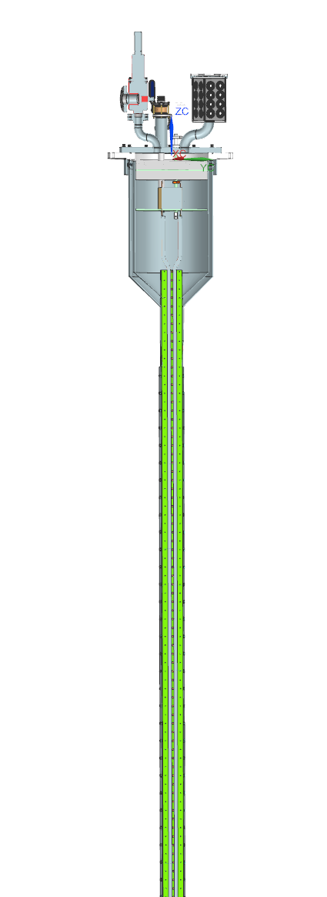
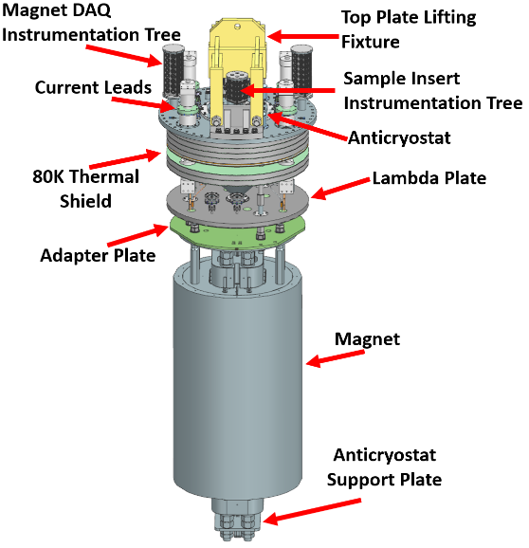
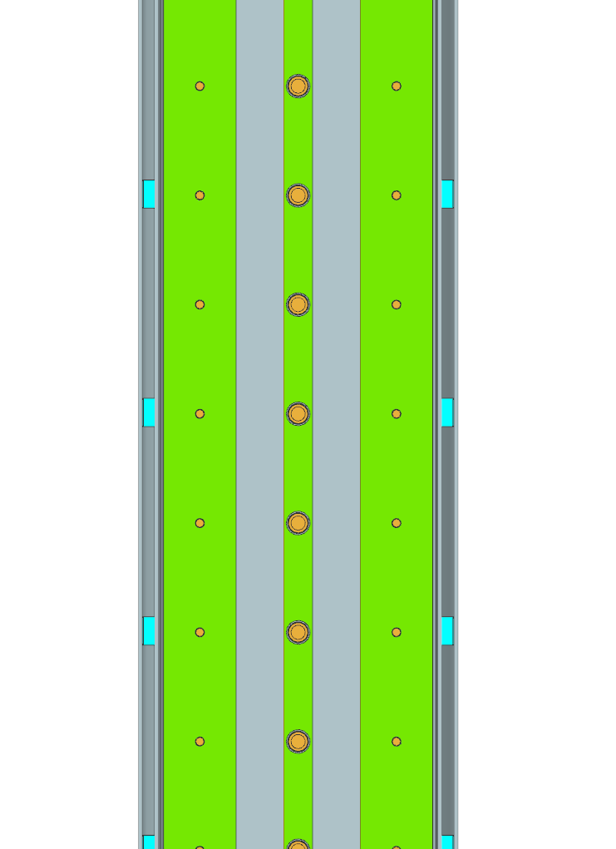
Recommendation from EOC
We had questions connected mostly with SC test sample cryostat and test sample well for FES
Assuming EDIPO type sample cryostat, is this what we need?
What are sample dimensions? Constant?
Any limitations on temperature gradient within the sample during testing?
Are there any requirements for warmup/cooldown?
SC transformer, what design we should use? Primary and secondary coil turns? Is 100kA what we need?
Nov. 21-22, we had virtual meeting with users' community - ~ 33 potential users were registered, more connected
Indico event: https://indico.fnal.gov/event/57027/
It was very productive: a lot of recommendations, some of them difficult to implement (next talk)

Slide 14
Summary
The HFVMTF test pit construction is done
Procurement is finalized. The final cryostat design is in progress with the company – cryostat is expected not early than July 2023
The QP/QM system is a close copy of the mu2e/AUP production systems
Small modifications are needed
Main electronic parts are ordered in the fall of 2021 – we started to receive the components
Power supplies second bids are received. Expecting to have a contact in February. Some cost increase is observed.
Integration of the stand needs additional cryo effort – expect to get resources after first AUP cryomodule test, Spring 2023
Workshop with potential user community was held in November – recommendations are in
As today, the current estimation of the stand completion is Summer 2024.

Slide 15
Backup Slides

Slide 16
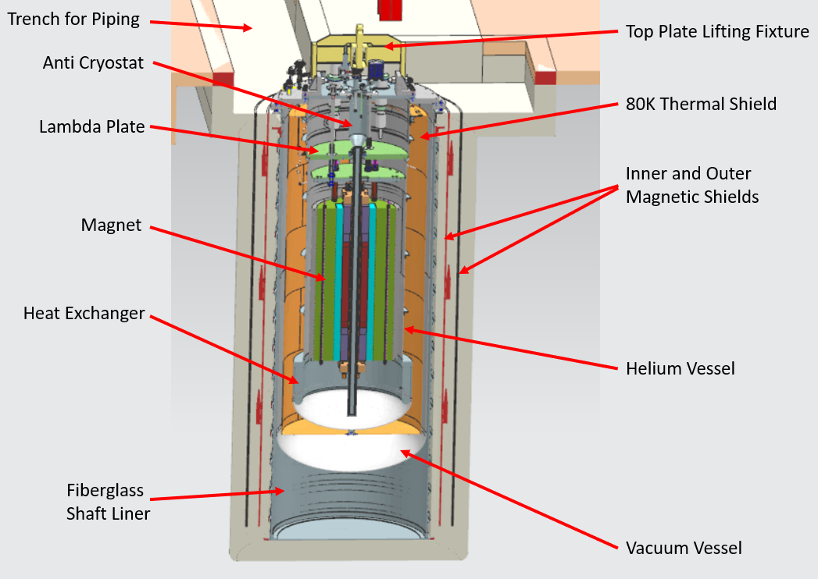
Civil Construction Design
Current VMTF
HFVMTF

Slide 17
QP/QM Current Design
Branch 1
Branch 2

Slide 18
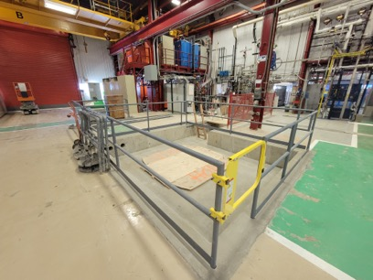
Current status - pit is done
There were some scary moments
~ 5 m the walls started to collapse
Concern that building column support was possibly compromised
Additional concrete was injected
Column survey before an after construction was showing no significant change of the tilt or position of the column
Several change request were executed
6 m deep pit for the cryostat
HFVMTF pit

Slide 19
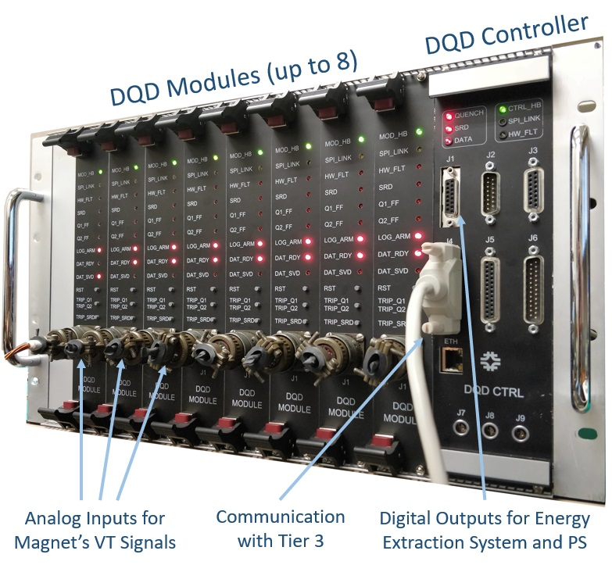
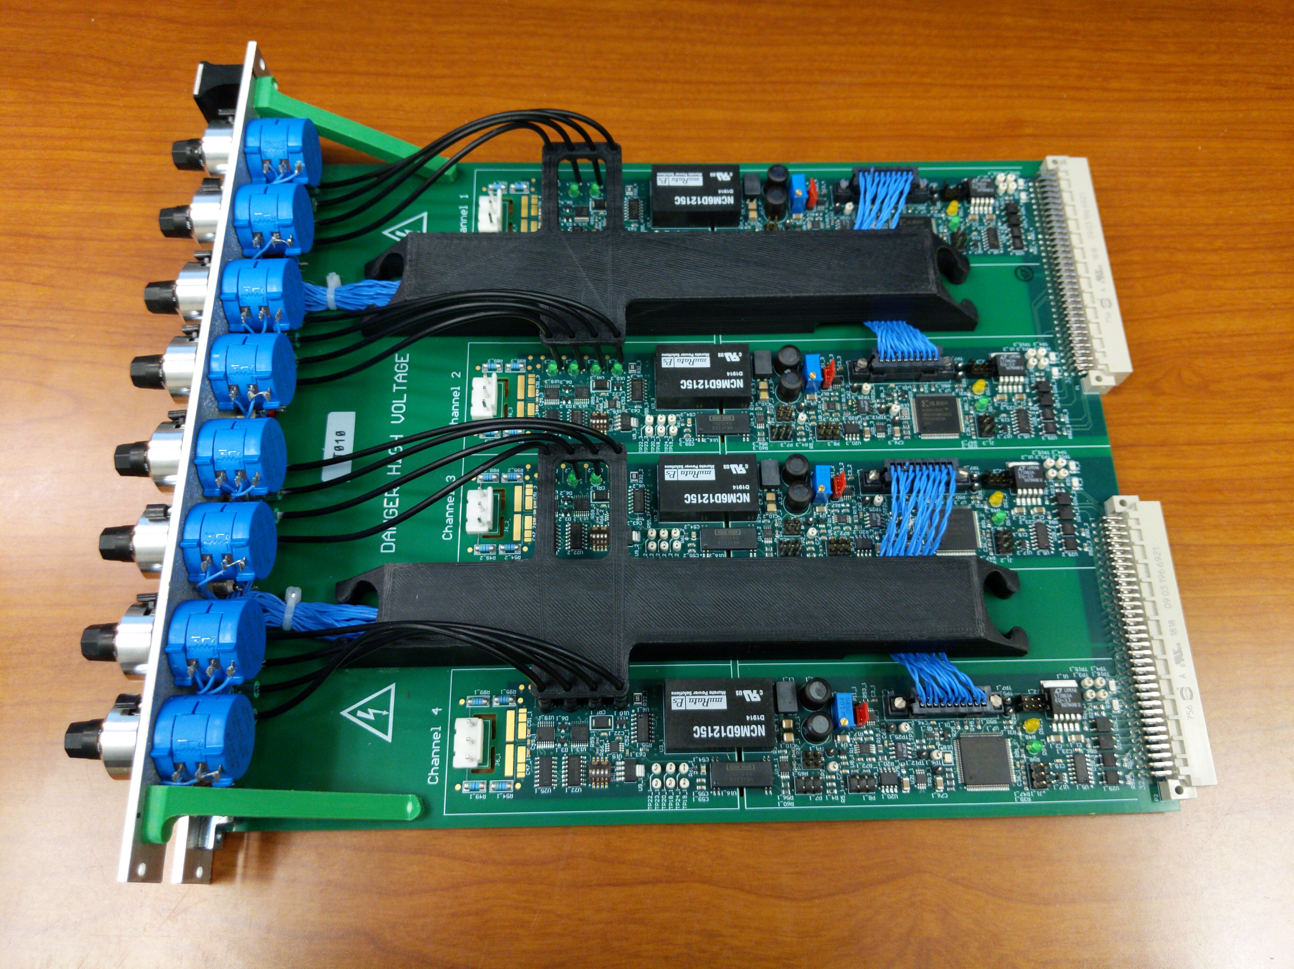
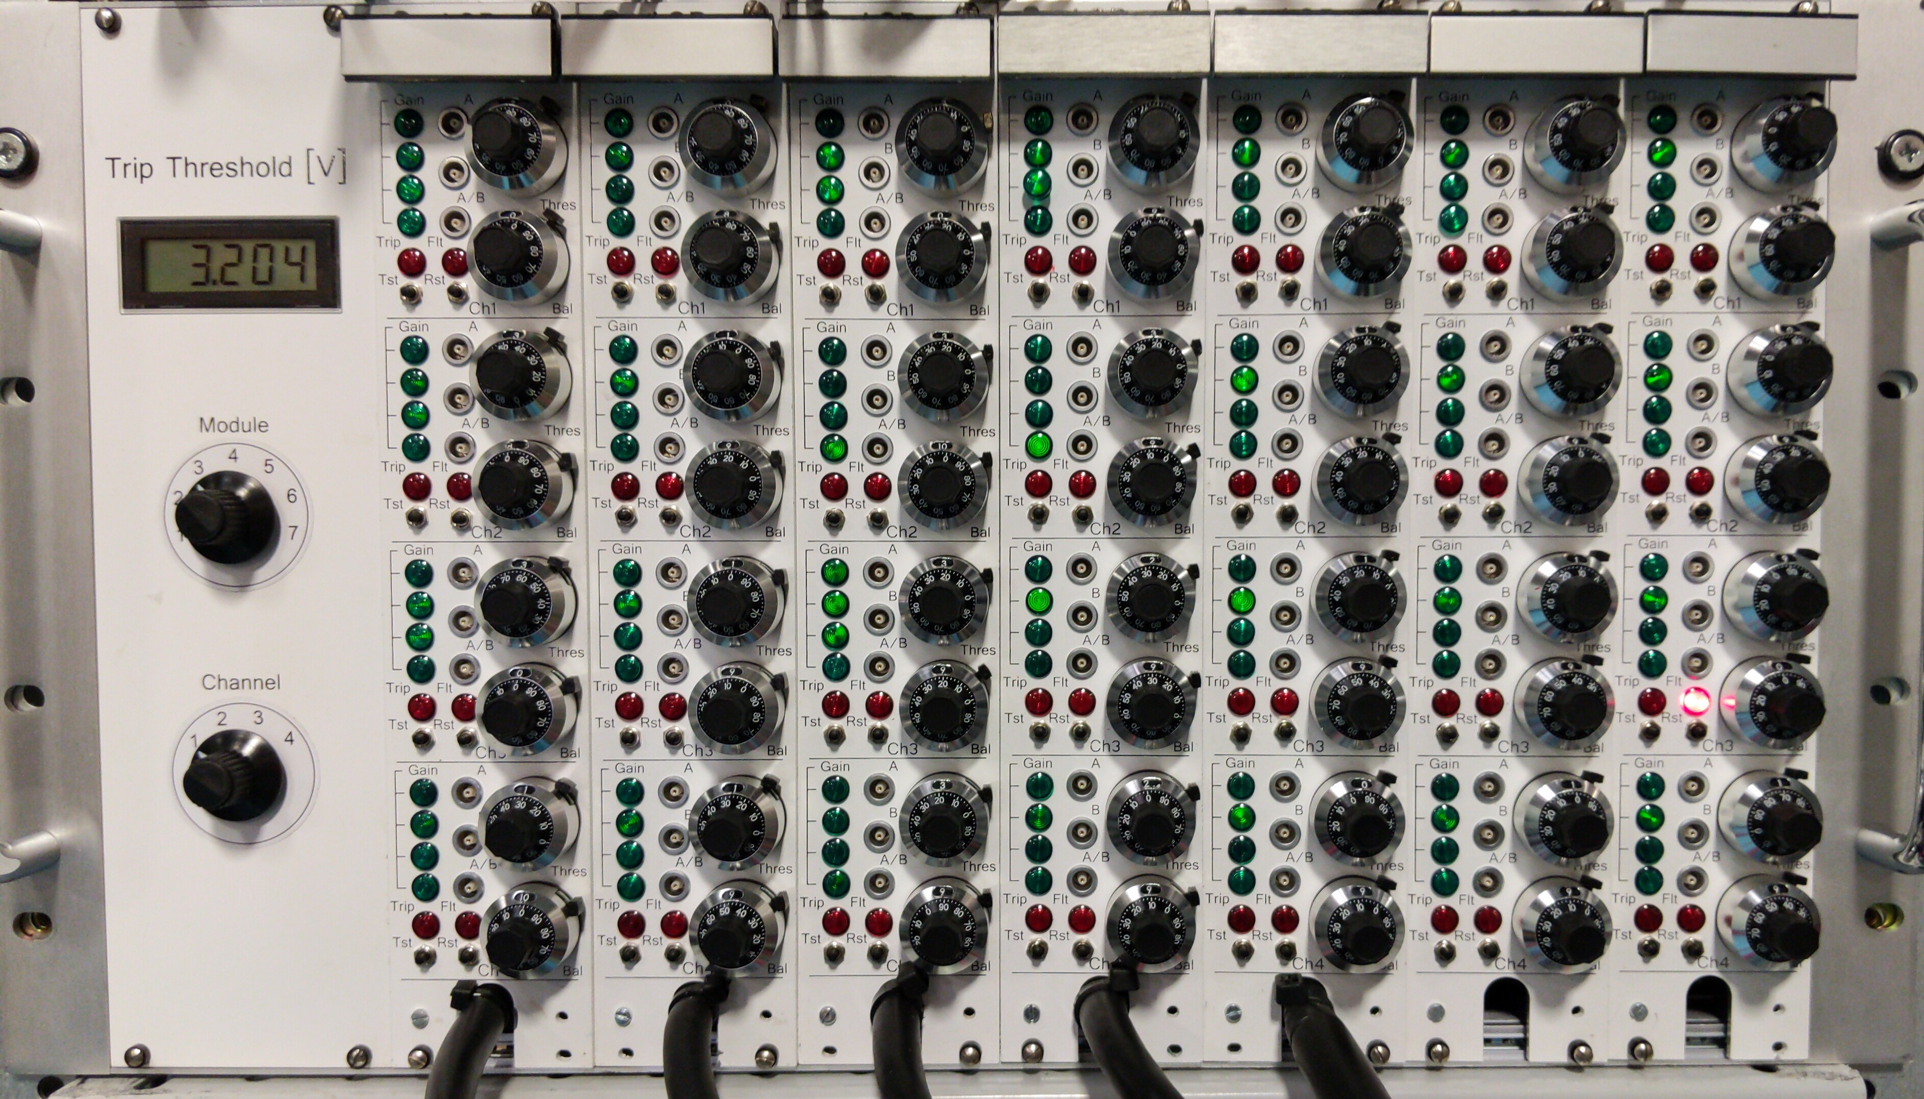
Quench Protection and Quench Monitoring (QP/QM)
Benefiting from the projects, LHC-AUP and mostly Mu2e
Production/Operational grade QM/QC - design is done
AQD system

Slide 20
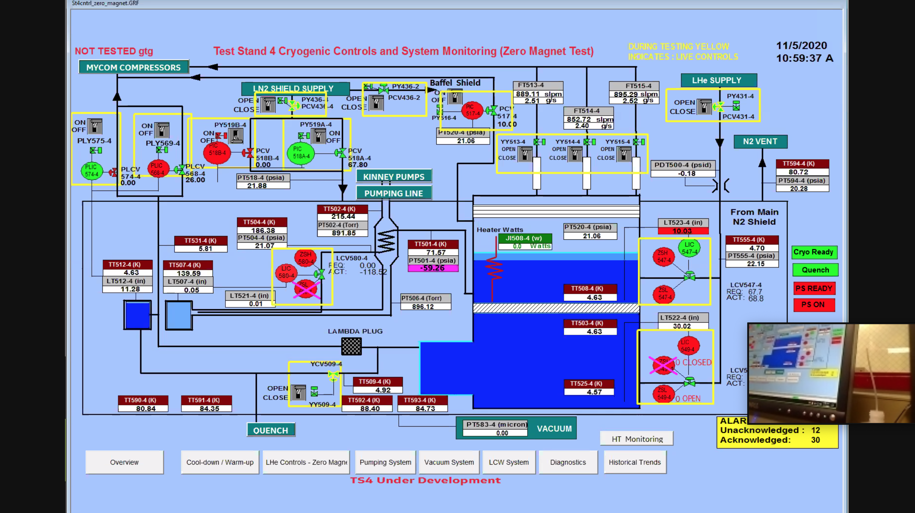
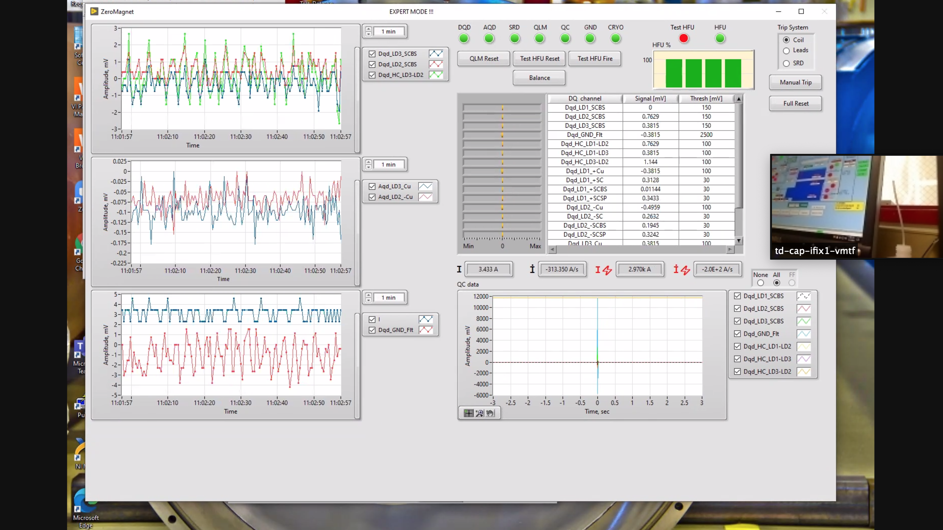
Mu2e 1st Article Quench Protection Hi-Lumi ZMT Cold Test
ZOOM Power Test side note:
The test was carried out in the control room, which has a limited capacity due to COVID-19
Zoom meetings were set up so all the subject matter experts could participate
The relevant test GUIs were shared with audio – worked great!
Darryl Orris

Slide 21
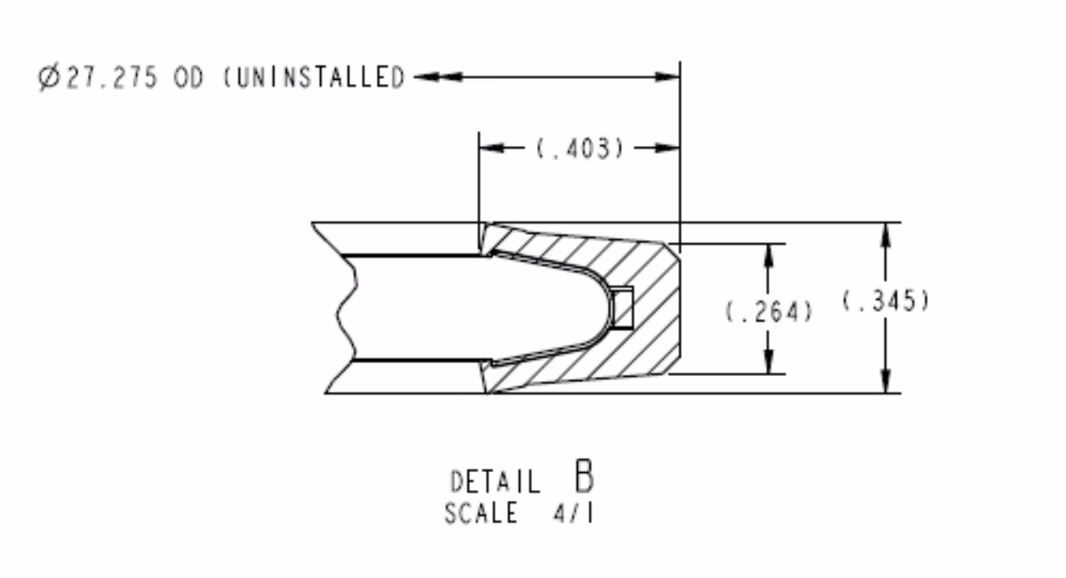
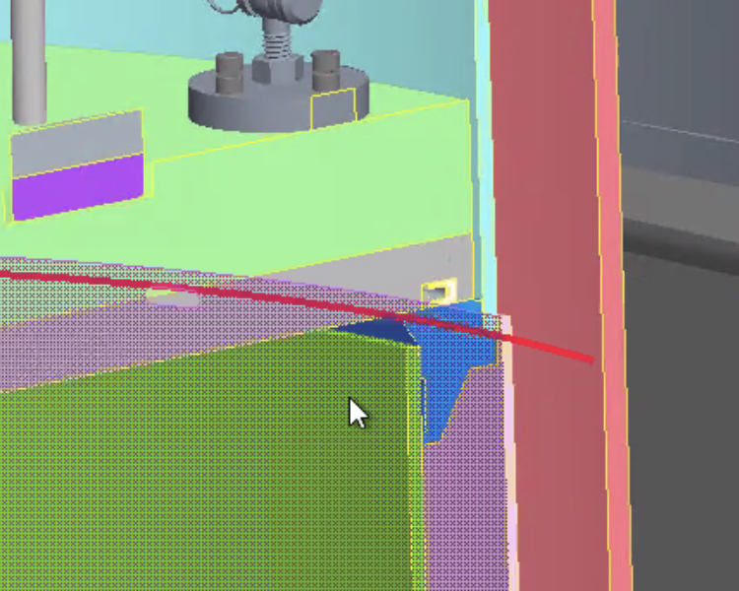
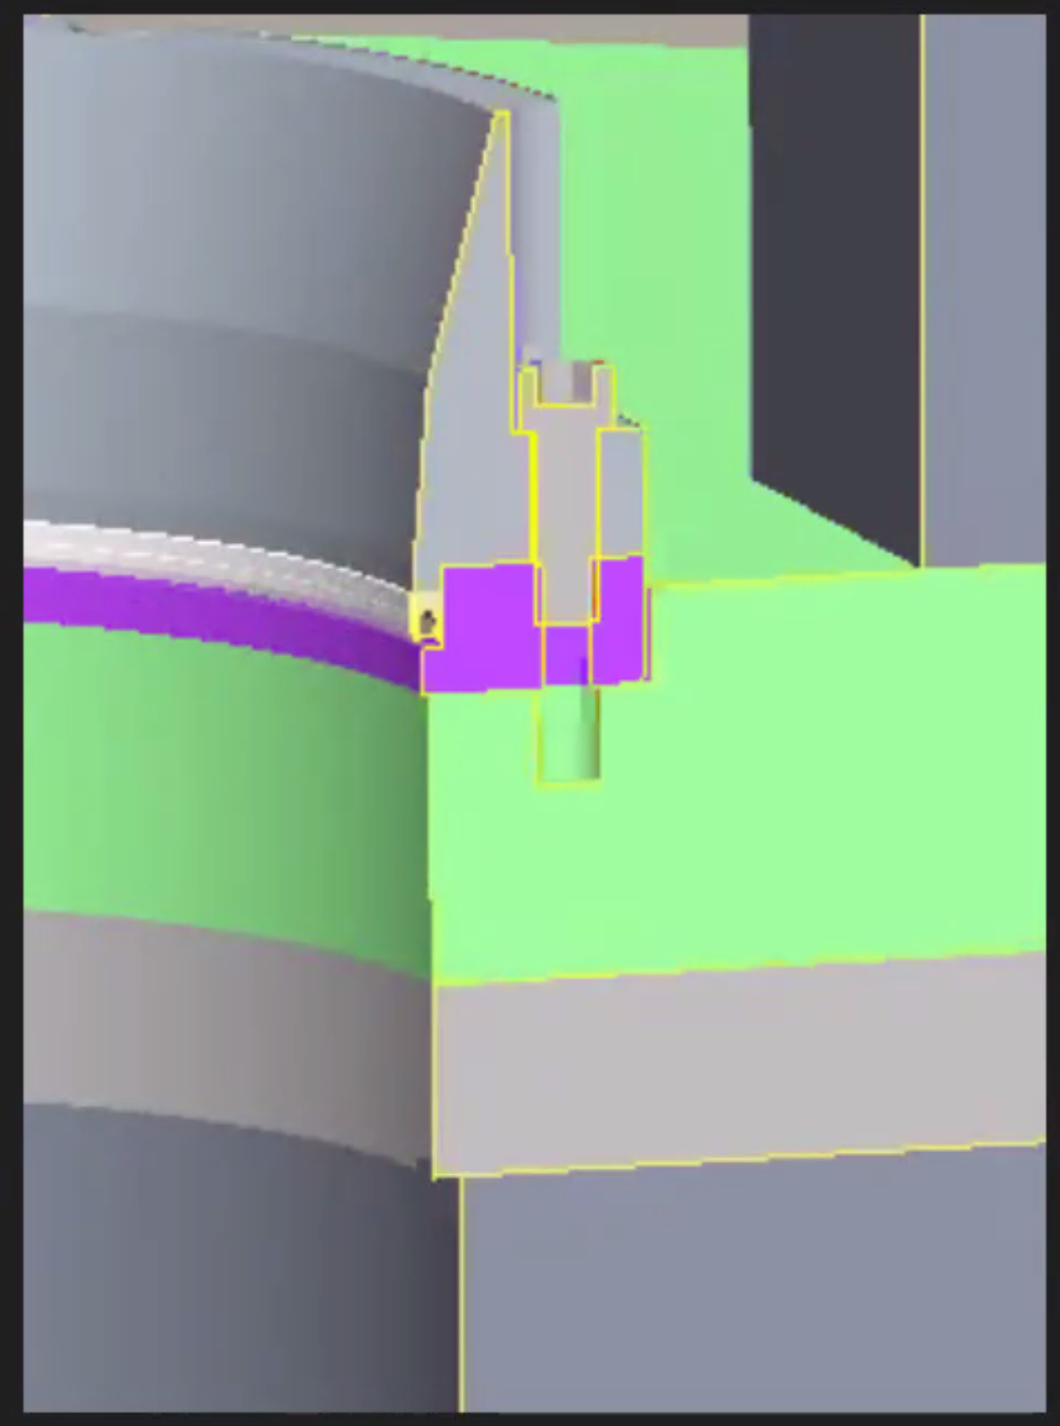
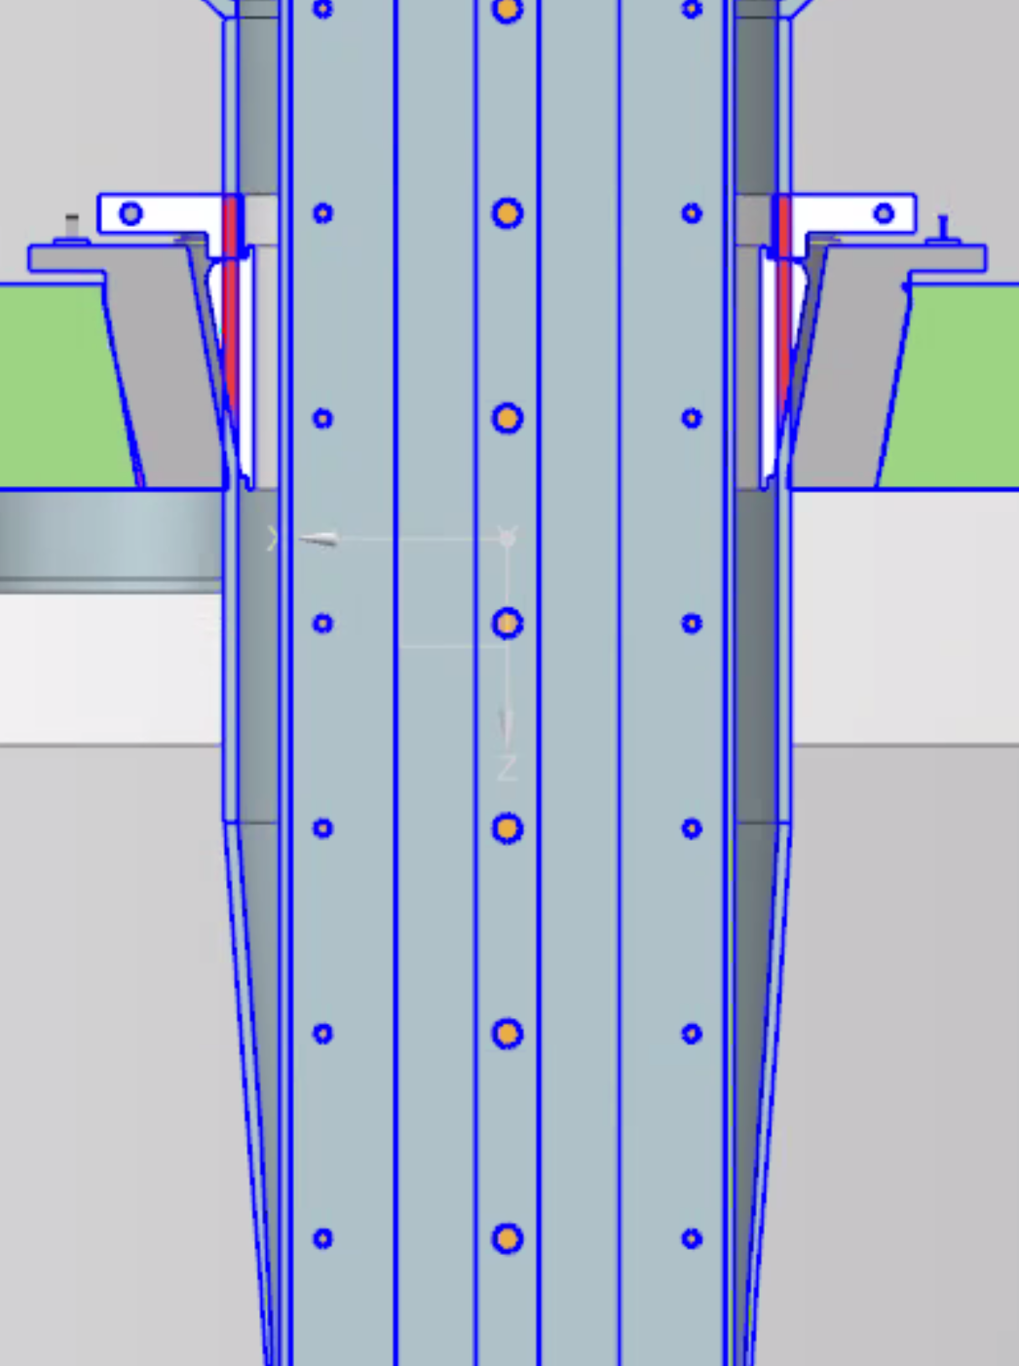
Lambda plate seal
We entertained 3 different options for lambda plate sealing - decided on the BNL seal following one of the EOC recommendations
After several meetings with BNL and evaluating our options, we decided to used BNL Lambda plate seal
For the anti-cryostat seal, we are still looking at two options BNL and Fermilab

Slide 22
Funding Status
This project has very low or no contingency (10% were used in GPP estimation and some other task)
 | Funds Planned/Recived/Pending
Cost Estimate (k$) | Step 1 | Step 2 | Step 3 | TPC | Comments
k$ | $1,549.0 | $1,612.5 | $563.5 | $3,725.0 | Total Cost
Year received | FES | HEP | FY total | Steps
FY19 received (GPP-test pit) | $1,299.0 | $250.0 | $1,549.0 | Step 1 | Received in August 2019, $500k is for the civil construction and $1000k for cryostat
FY20 Received (QP/QM) | $0.0 | $650.0 | $650.0 | Step 2 | Received in May 2020, for QP/QM electronics
FY21 Received (Power Supplies) | $0.0 | $962.5 | $962.5 | Step 2 | Received in April 2021, for PSs and supporting electronics
FY22 (Integration) | $563.5 | $0.0 | $563.5 | Step 3 | Needed for Integration (not received)
Total | $1,862.5 | $1,862.5 | $3,725.0

