Slide 1
Identification of Nanoprecipitates in TEM Images of APC Nb₃Sn Using Object Detection NN models Alice Moros CERN EN-MME-MM (alice.moros@cern.ch)
ML methods for Superconducting Materials, 25/01/2023

Slide 2
Outline
Context of Study
Manual Labeling leading to Smart Labeling through the use of Bounding Boxes
Model Training for Object Detection (OD): Initial Tests
Future Steps

Slide 3
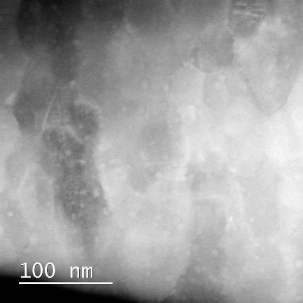
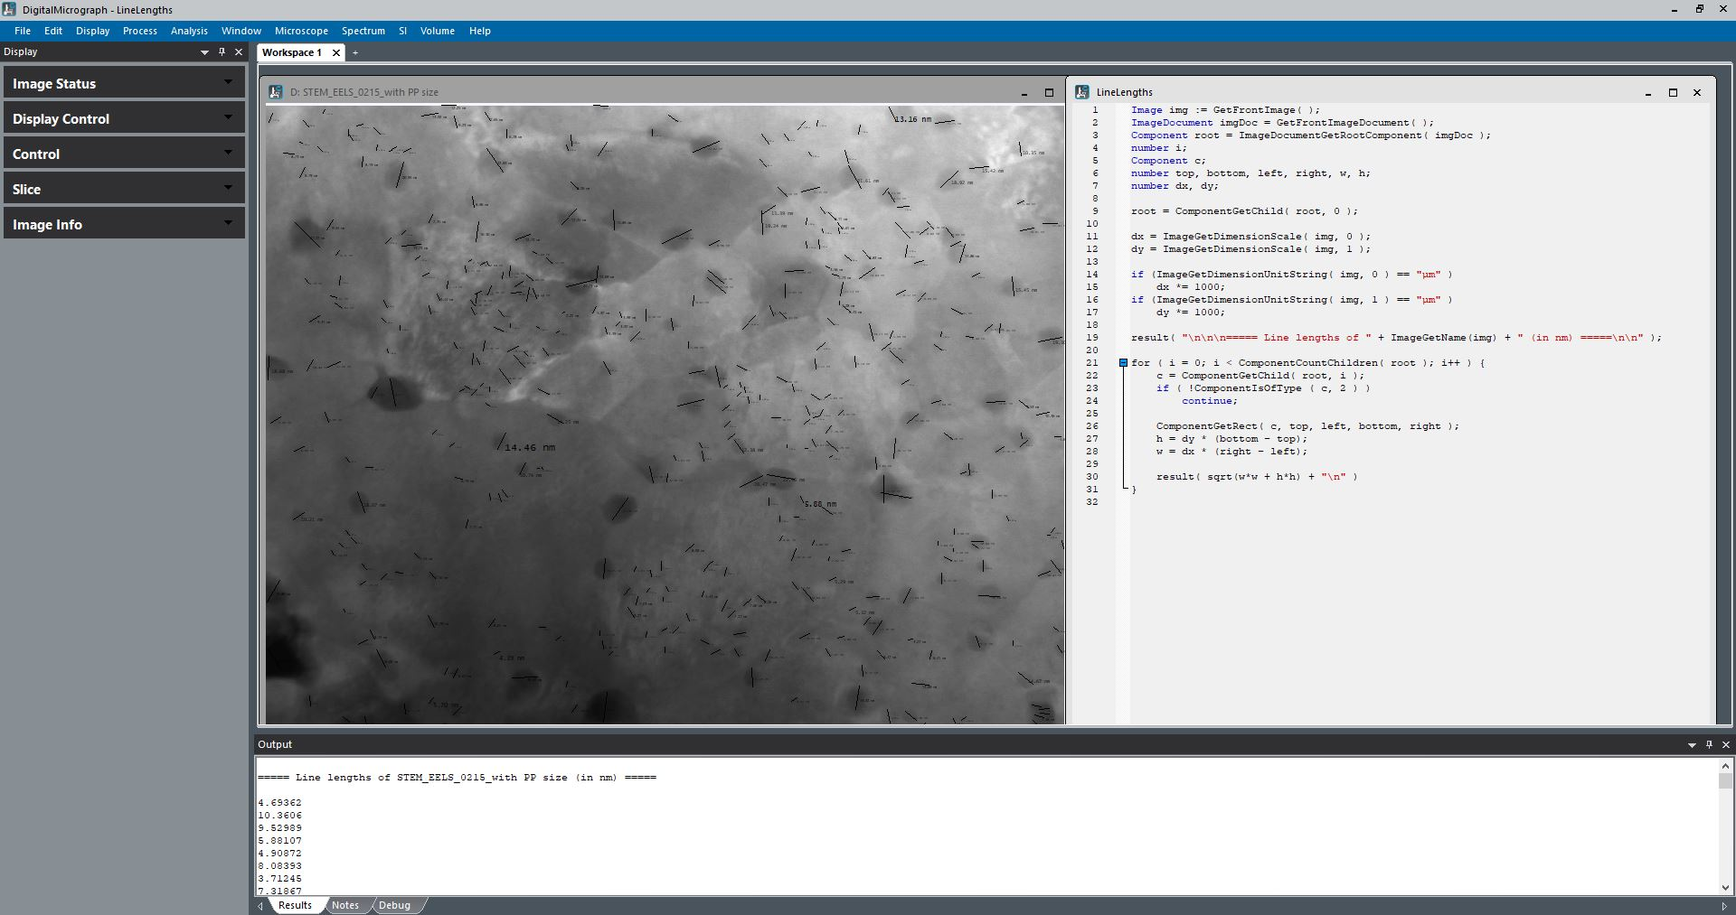
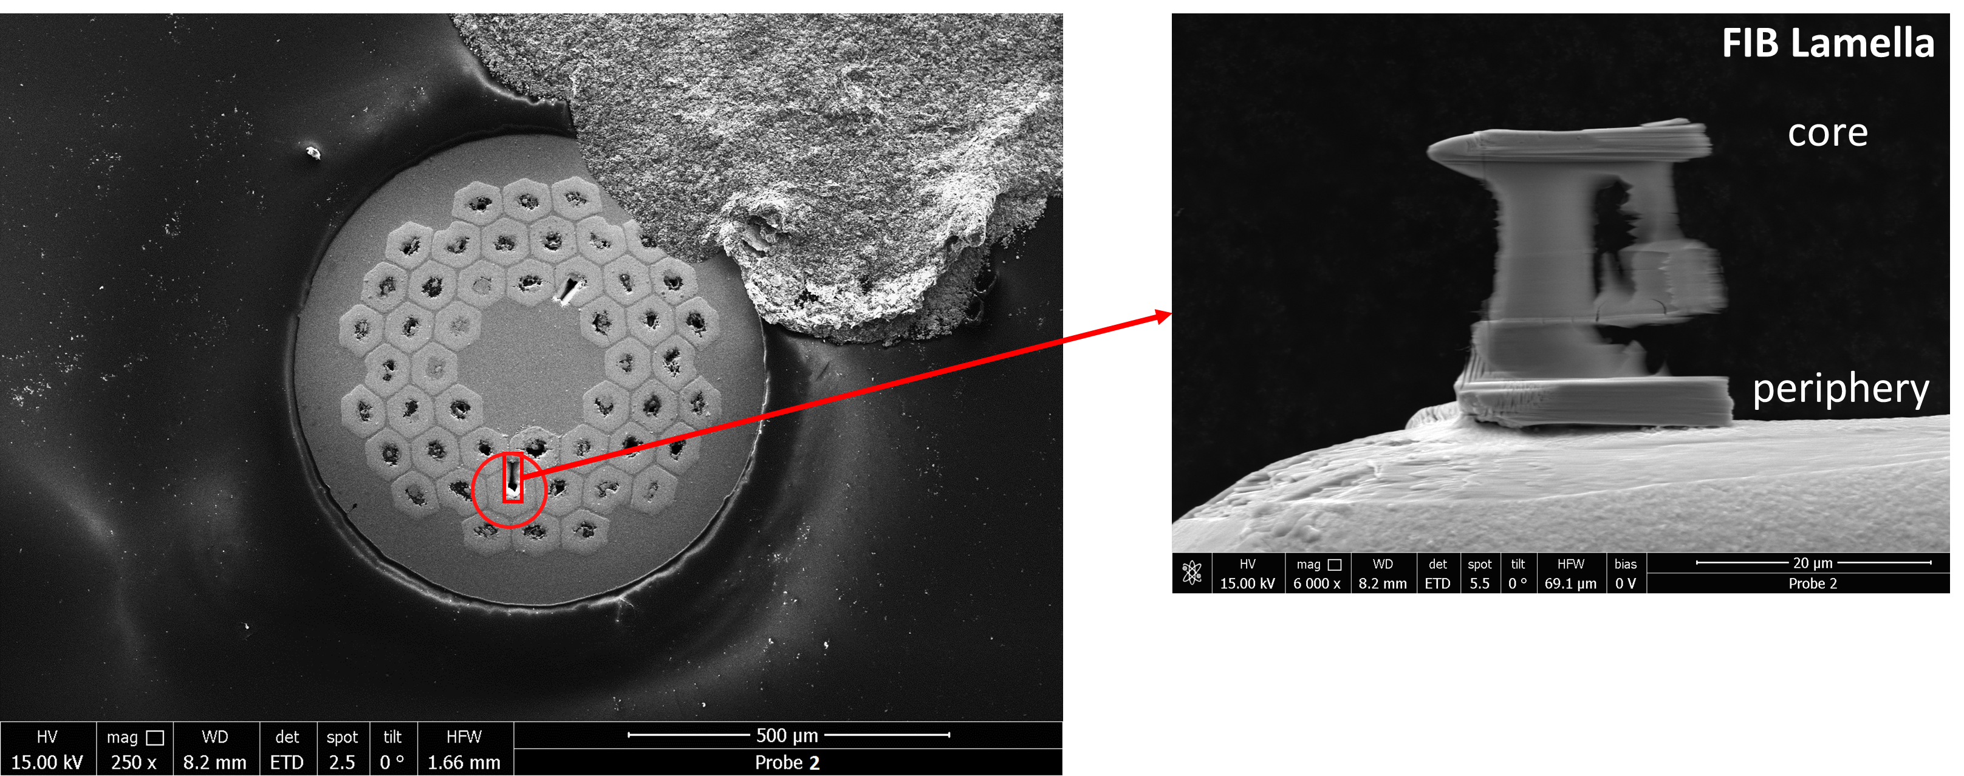
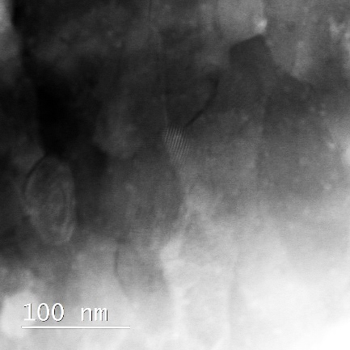
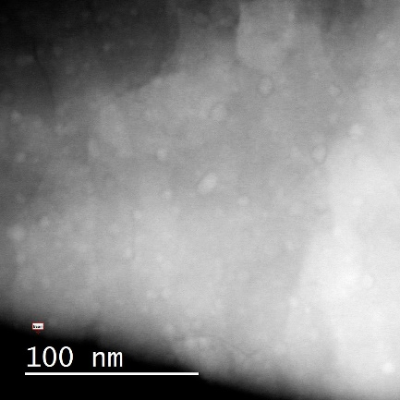
Context of Study
APC Nb₃Sn wires reacted with different HTs.
Microstructural characterization combining FIB and TEM to understand the correlations between the size and density of ZrO₂ and HfO₂ nanoprecipitates (PP) and HT.
PP sizes evaluated manually
Wire cross-section post polishing
FIB Lamella for TEM imaging
200-900 PP within an area of approx. 0.40 µm²
Digital Micrograph 3 (DM3) by Gatan to analyze PP size manually (VERY TIME CONSUMING)
+
Origin software to plot relative frequency vs size and determine the average PP size per sample
3 areas per lamella selected
through TEM/STEM imaging

Slide 4
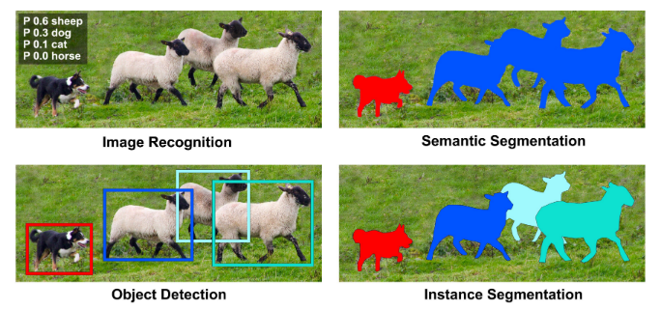
Bounding Boxes for OD
,
Bounding boxes for smart labeling.
Bounding boxes for object detection through NN models.

Slide 5
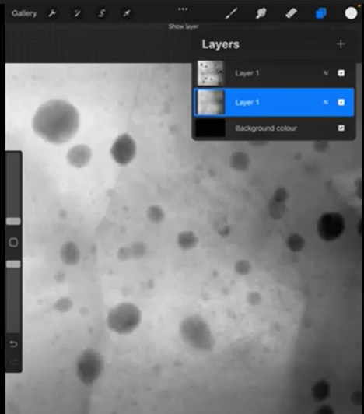
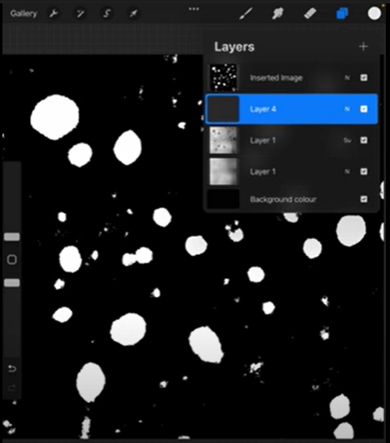
Bounding Boxes for OD - Smart Labeling
Manual labeling through iPad Procreate software + iPad pen for samples with ZrO₂ only (contrast reasons):
Completely manual work
Background subtraction method + manual work
IPad pen easier than PC mouse.
Still time consuming but worth it: manual labeling used as a basis for smart labeling.
~ 80 images labeled manually

Slide 6
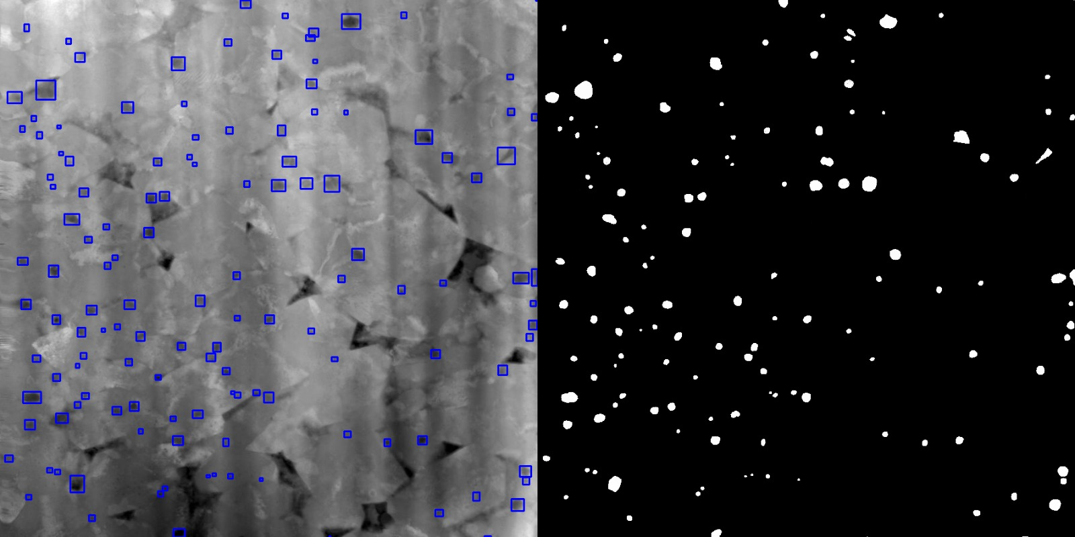
Bounding Boxes for OD - Smart Labeling
White PP of 72 manually labeled images were turned into boxes (Python code), then overlapped with the original TEM images.

Slide 7
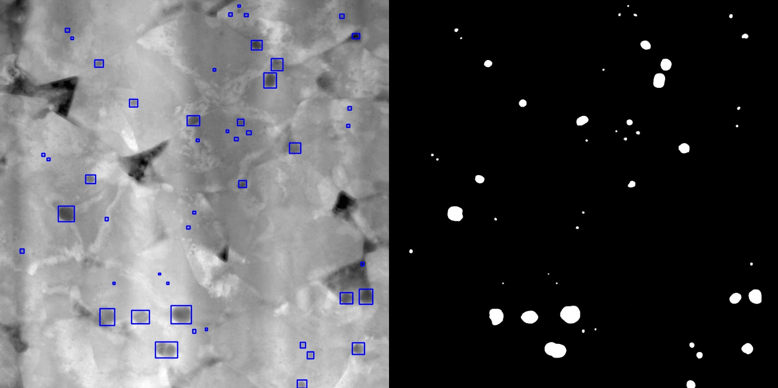
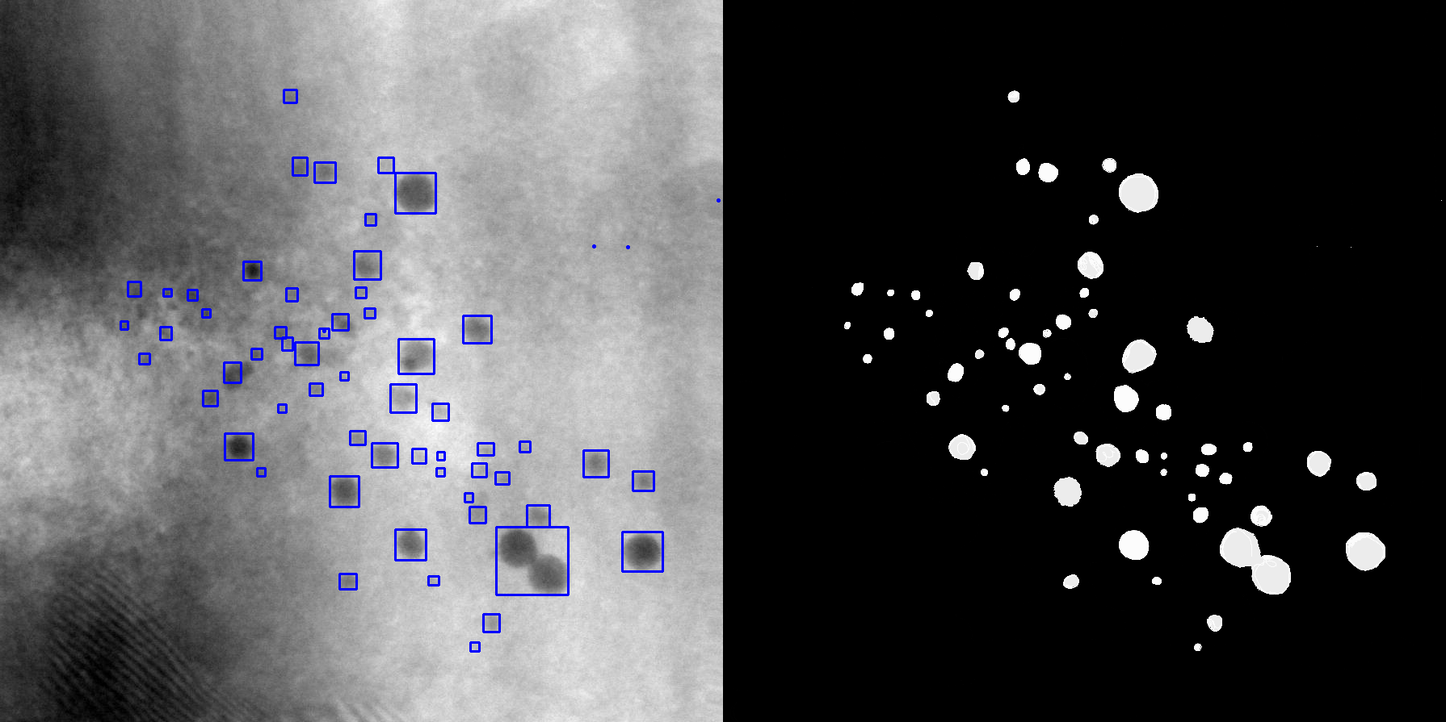
Bounding Boxes for OD - Smart Labeling
White PP of 72 manually labeled images were turned into boxes (Python code), then overlapped with the original TEM images.
Not labeled
Not distinguished (objects too close)
Larger amount of data + improved manual labeling would help!

Slide 8
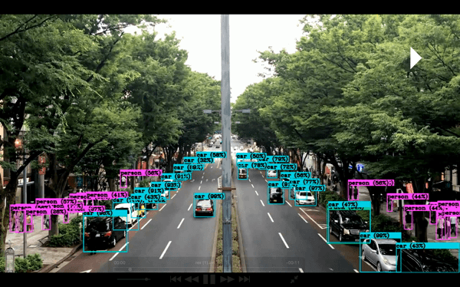
Bounding Boxes for OD - OD NN Model
YOLO (You Only Look Once) is a popular OD algorithm. It uses a single convolutional neural network (CNN) architecture to predict the bounding boxes and class probabilities of objects in an image.
Model training through YOLO v5.
Model training
STEP 1: display images with labels for the system to learn how to recognize particles (56 images).
Input -> TEM image - Output -> labeled image with bounding boxes STEP 2 (optional): set aside some images with labels, give them to the system without labels after the learning process, and compare the results (16 images). STEP 3: your system is now “ready”, you can use it on images where you do not have labels.

Slide 9
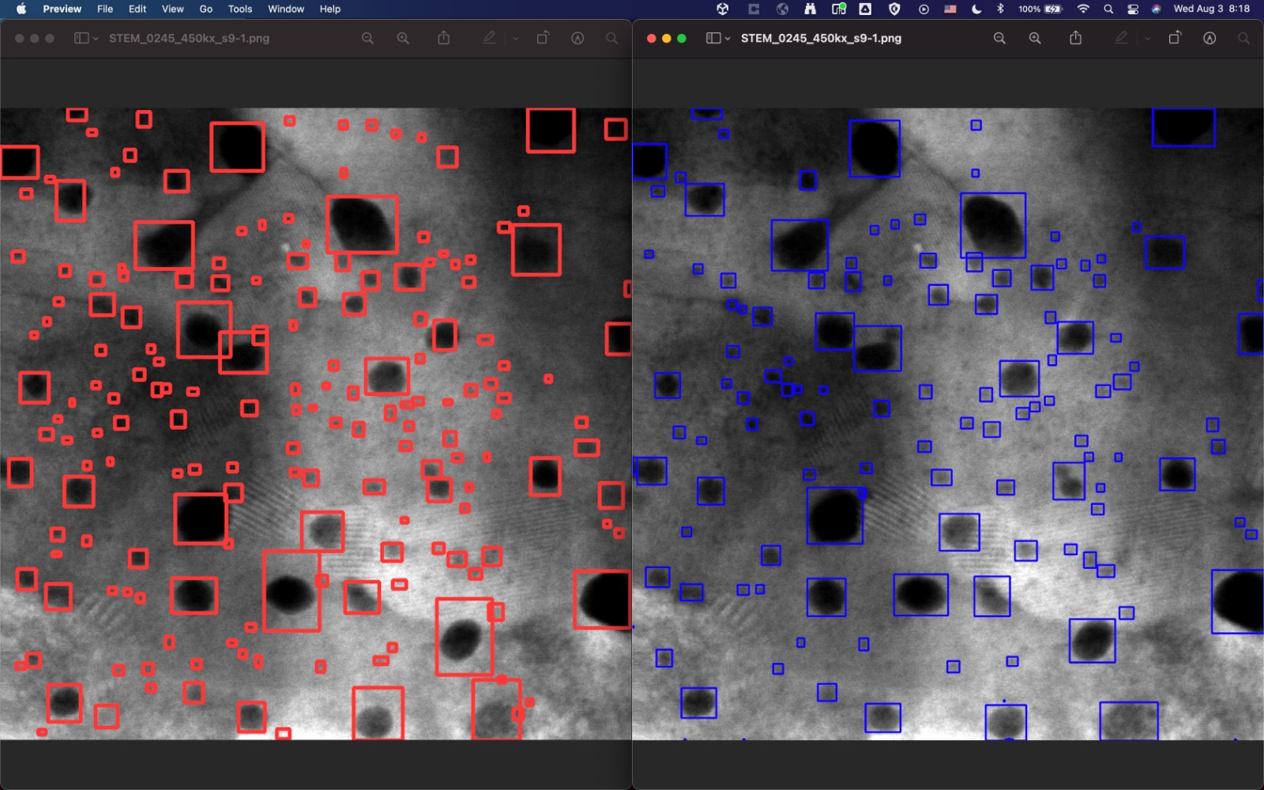
Bounding Boxes for OD - OD NN Model
STEP 2: set aside some images with labels, give them to the system without labels after the learning process, and compare the results (16 images).
Model outcome
Labeled image
Separation of close objects
Bounding box size too big in some cases

Slide 10
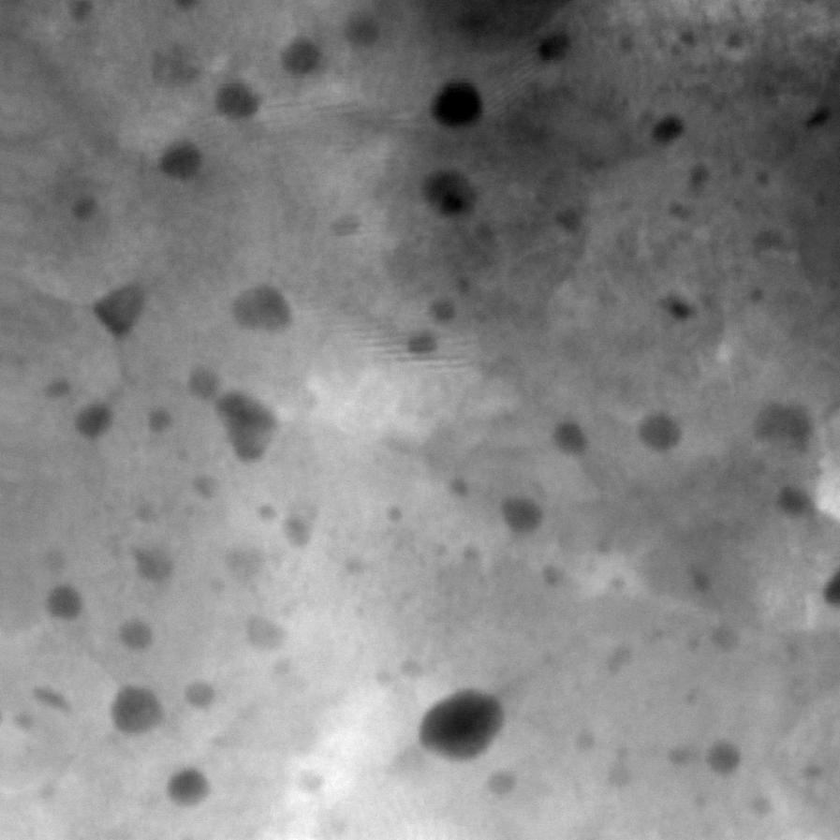
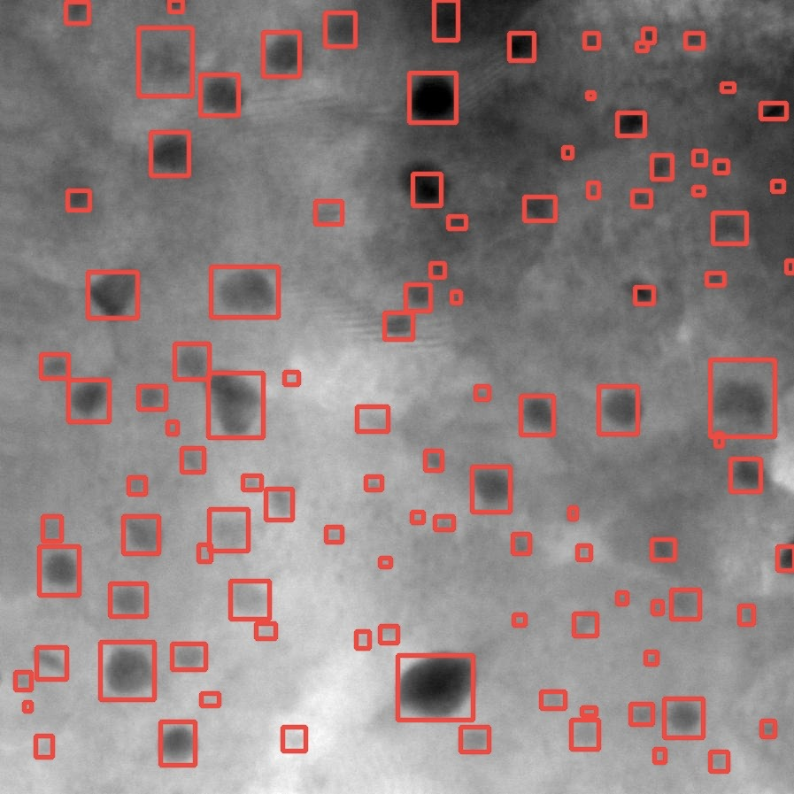
Bounding Boxes for OD - OD NN Model
STEP 3: your system is now “ready”, you can use it on images where you do not have labels.→ just started

Slide 11
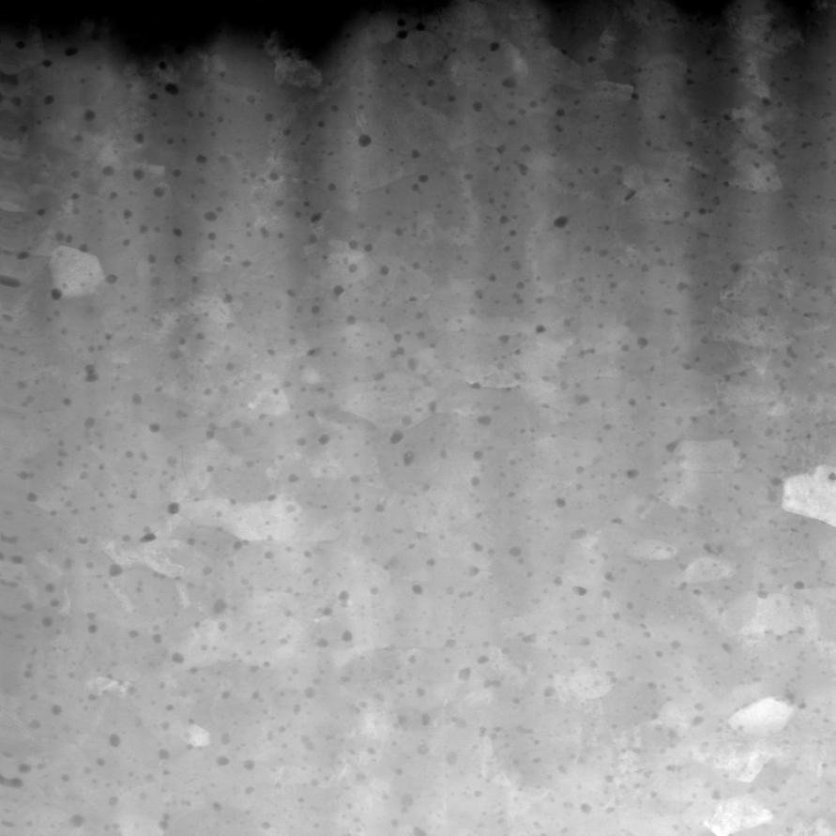
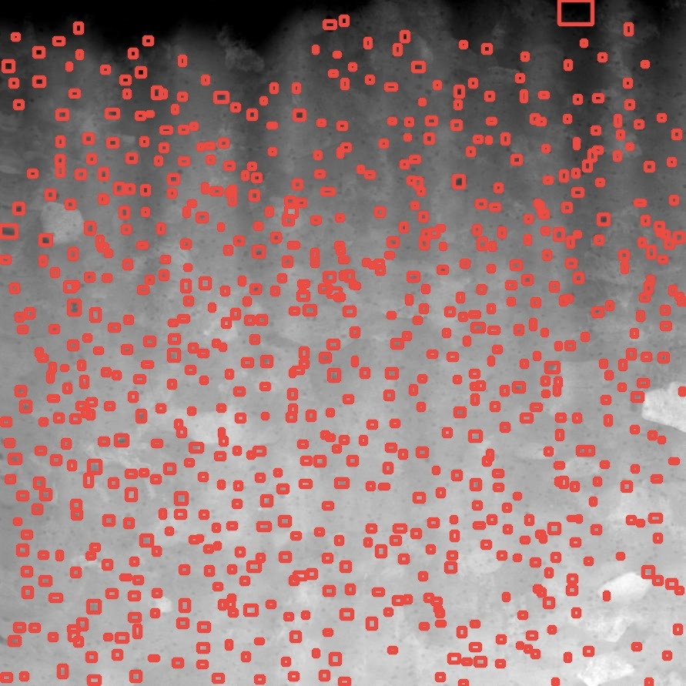
Bounding Boxes for OD - OD NN Model
STEP 3: your system is now “ready”, you can use it on images where you do not have labels.→ just started
The side of the bounding boxes can be approximated to the diameter of the nanoparticles for future statistical analysis.

Slide 12
Future Steps
Try to improve our model:
Artificial increase of nr. images for training: augmentation
25 new images received (courtesy of Stephan Pfeiffer, CERN) for labeling + training.
Improve labeling process with Procreate for new and (some) old images: e.g., trying to define the boundaries of nanoprecipitates close to each other, where possible (see example images below).
New data?
Not distinguished (objects too close)

Slide 13
Thank you for your attention!

Slide 14
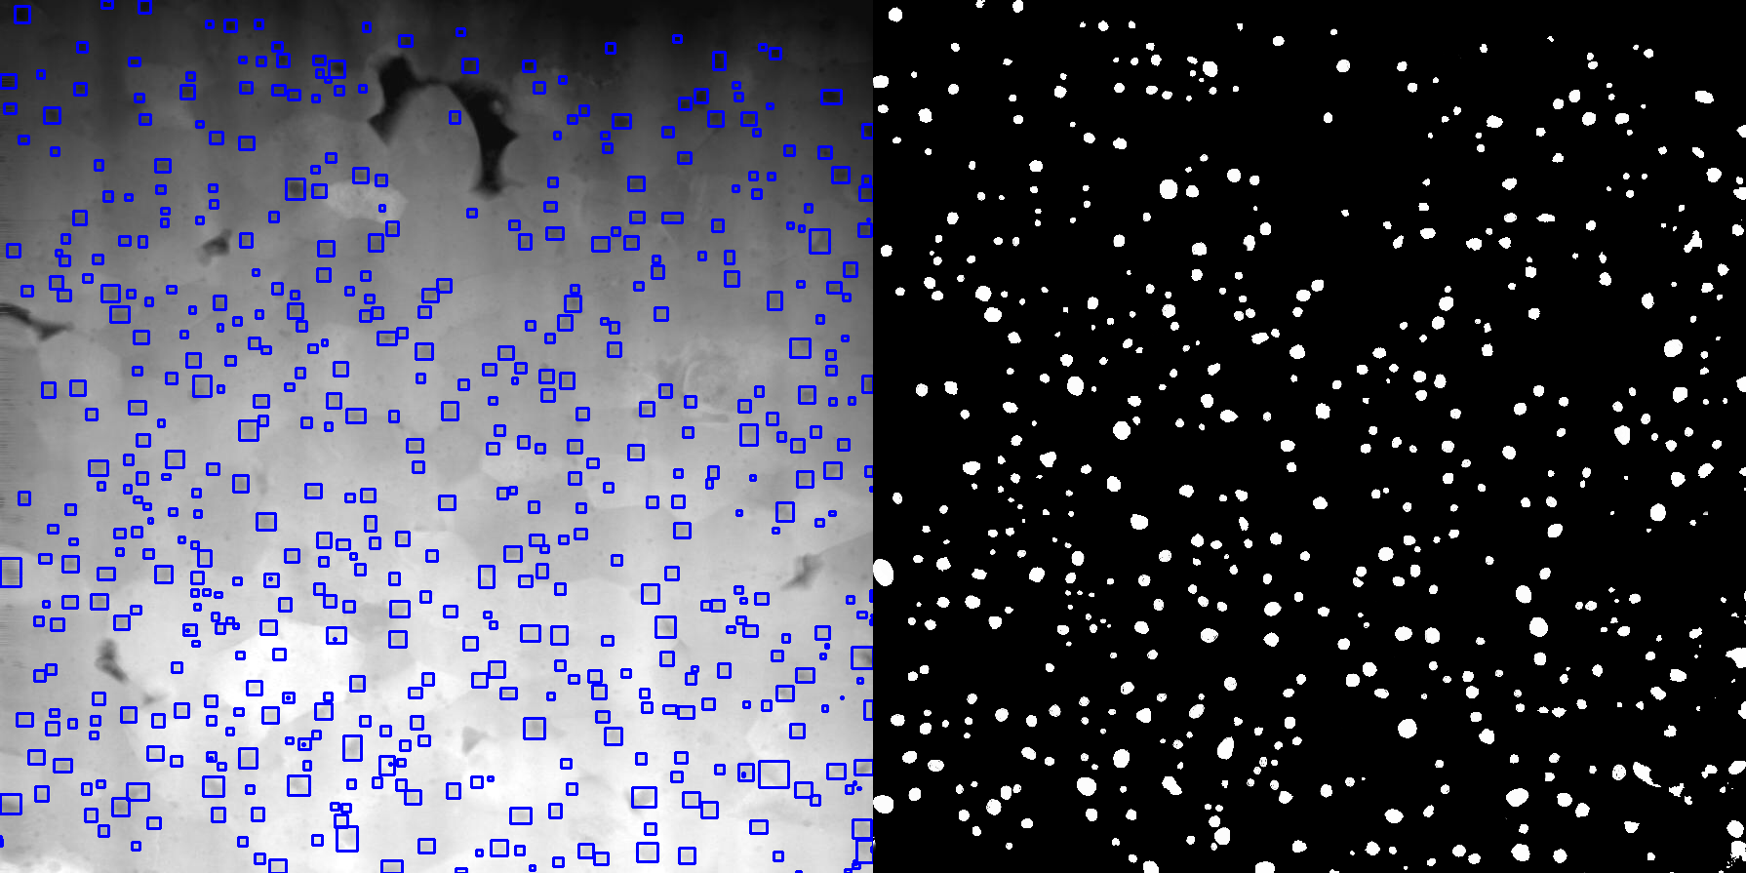
Bounding Boxes for OD - Smart Labeling
White PP of 72 manually labeled images were turned into boxes (Python code), then overlapped with the original TEM images.

