Slide 1
Subscale CCT Plans
D. Arbelaez, L. Brouwer, S. Caspi, D. Dietderich, S. Gourlay, R. Hafalia, T. Lipton, M. Martchevskii, S. Myers, J. Swanson, S. Prestemon
US Magnet Development Program
Lawrence Berkeley National Laboratory

Slide 2
Motivation
CCT4 exhibited a large number of training quenches
Subscale models can lead to faster turnaround for dedicated training experiments
Epoxy (or other matrix) influence on training
Structural influences
Interface conditions
Allows for testing of novel instrumentation
Subscale models are complementary to overall CCT program
CCT subscale – provides feedback for large bore magnets
CCT5 – Drawings are currently being finalized for mandrels and interface technology is being developed
CCT6 – Conceptual design phase

Slide 3
Design Goals
Similar Lorentz force density as CCT4
Similar stress as CCT4
Small and easy to test for quick turn around (epoxy etc.)
Test in small cryostat with 10 kA power supply
Plan to use existing conductor (RRP 132/169) that has been characterized for critical current and stability (previously used for undulator project)

Slide 4
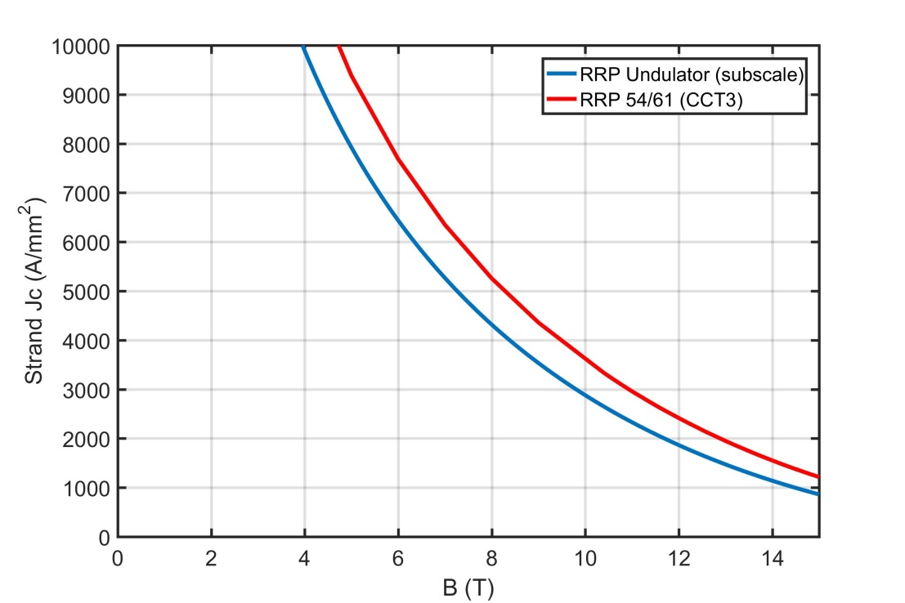
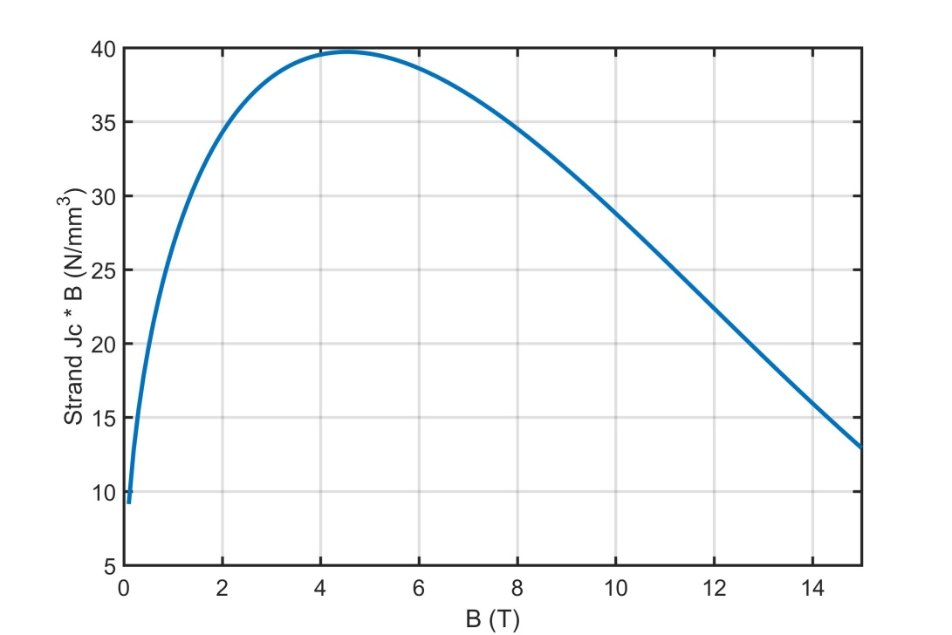
RRP 132/169 Conductor
RRP Nb3Sn
0.6 mm diameter strand
50% ncf
2880 A/mm^2 at 10 T
Lorentz force density peaks at 4.5 T

Slide 5
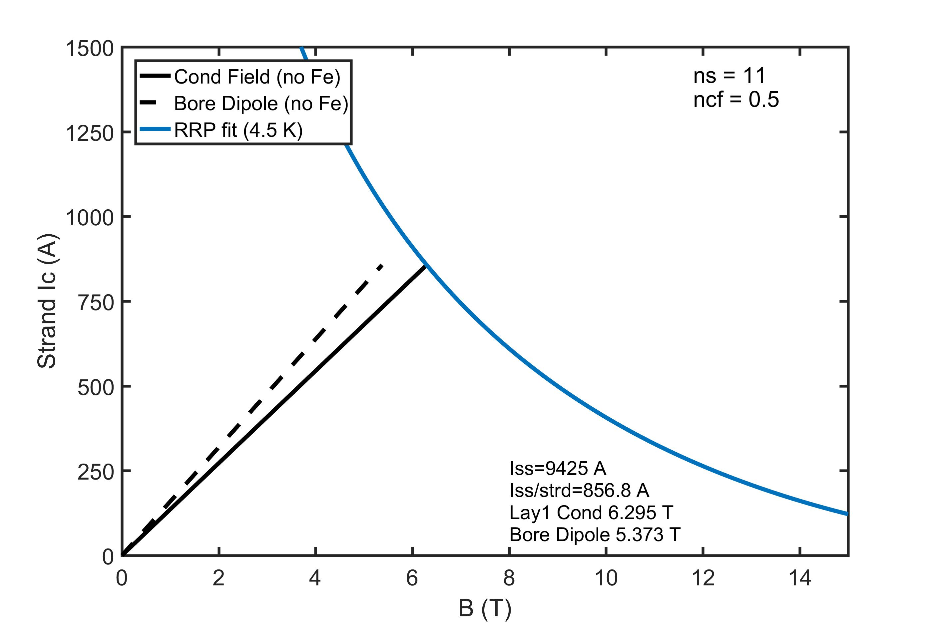
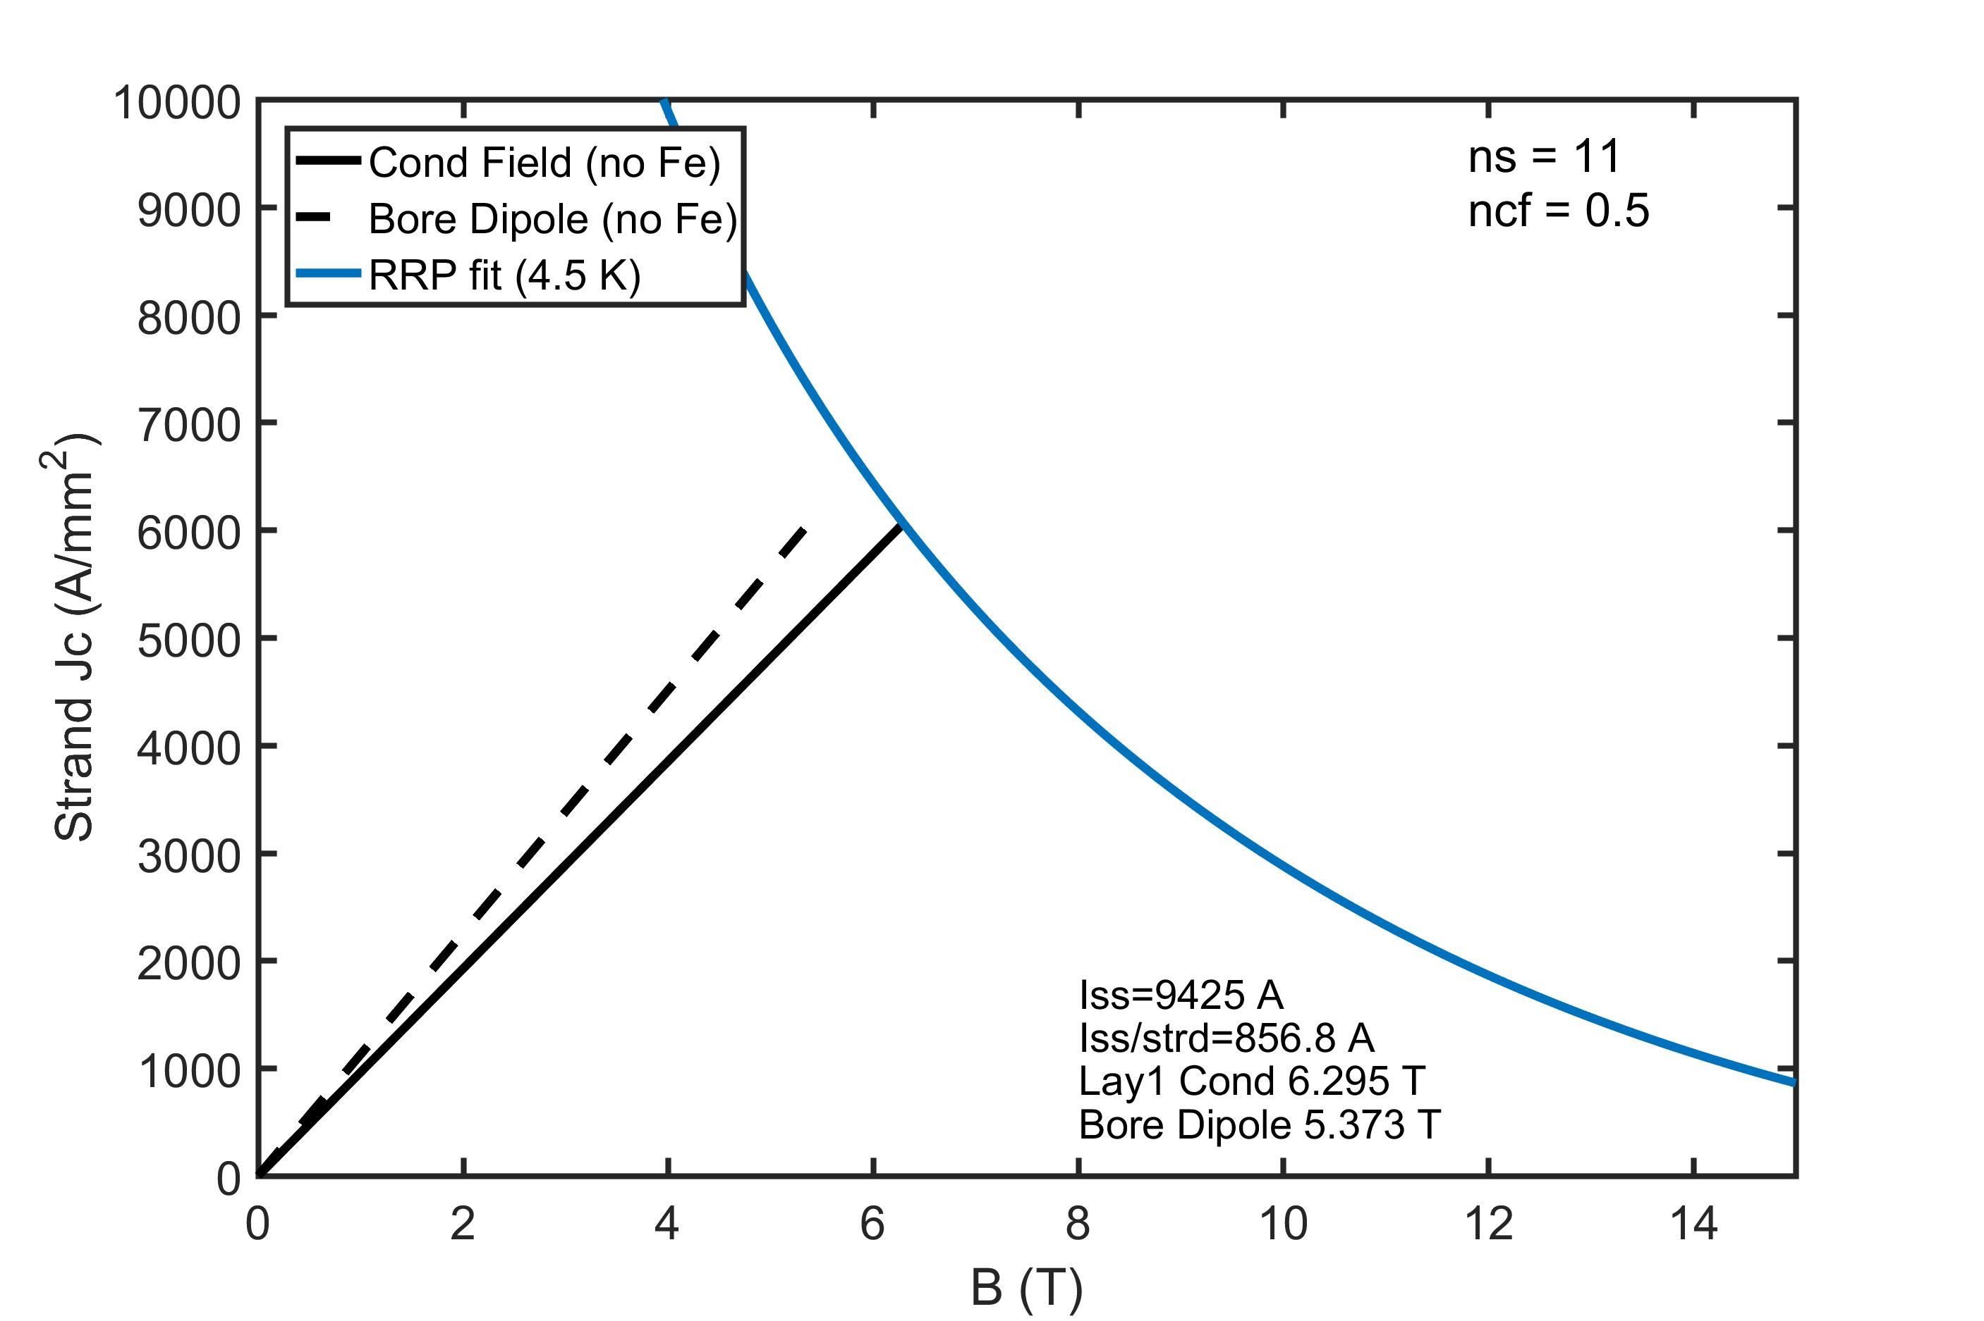
Choice of a 11 strand cable
A two layer 11 strand design
matches the Lorentz force density of CCT4
keeps the power supply current under 10 kA
keeps the current per wire < 1000 A for stability
4.9 x 1.7 mm channel (4.0 x 1.1 mm cable)
Short-sample bore field of 5.37 T, and conductor field of 6.30 T @ 857 A / wire (9.4 kA)

Slide 6
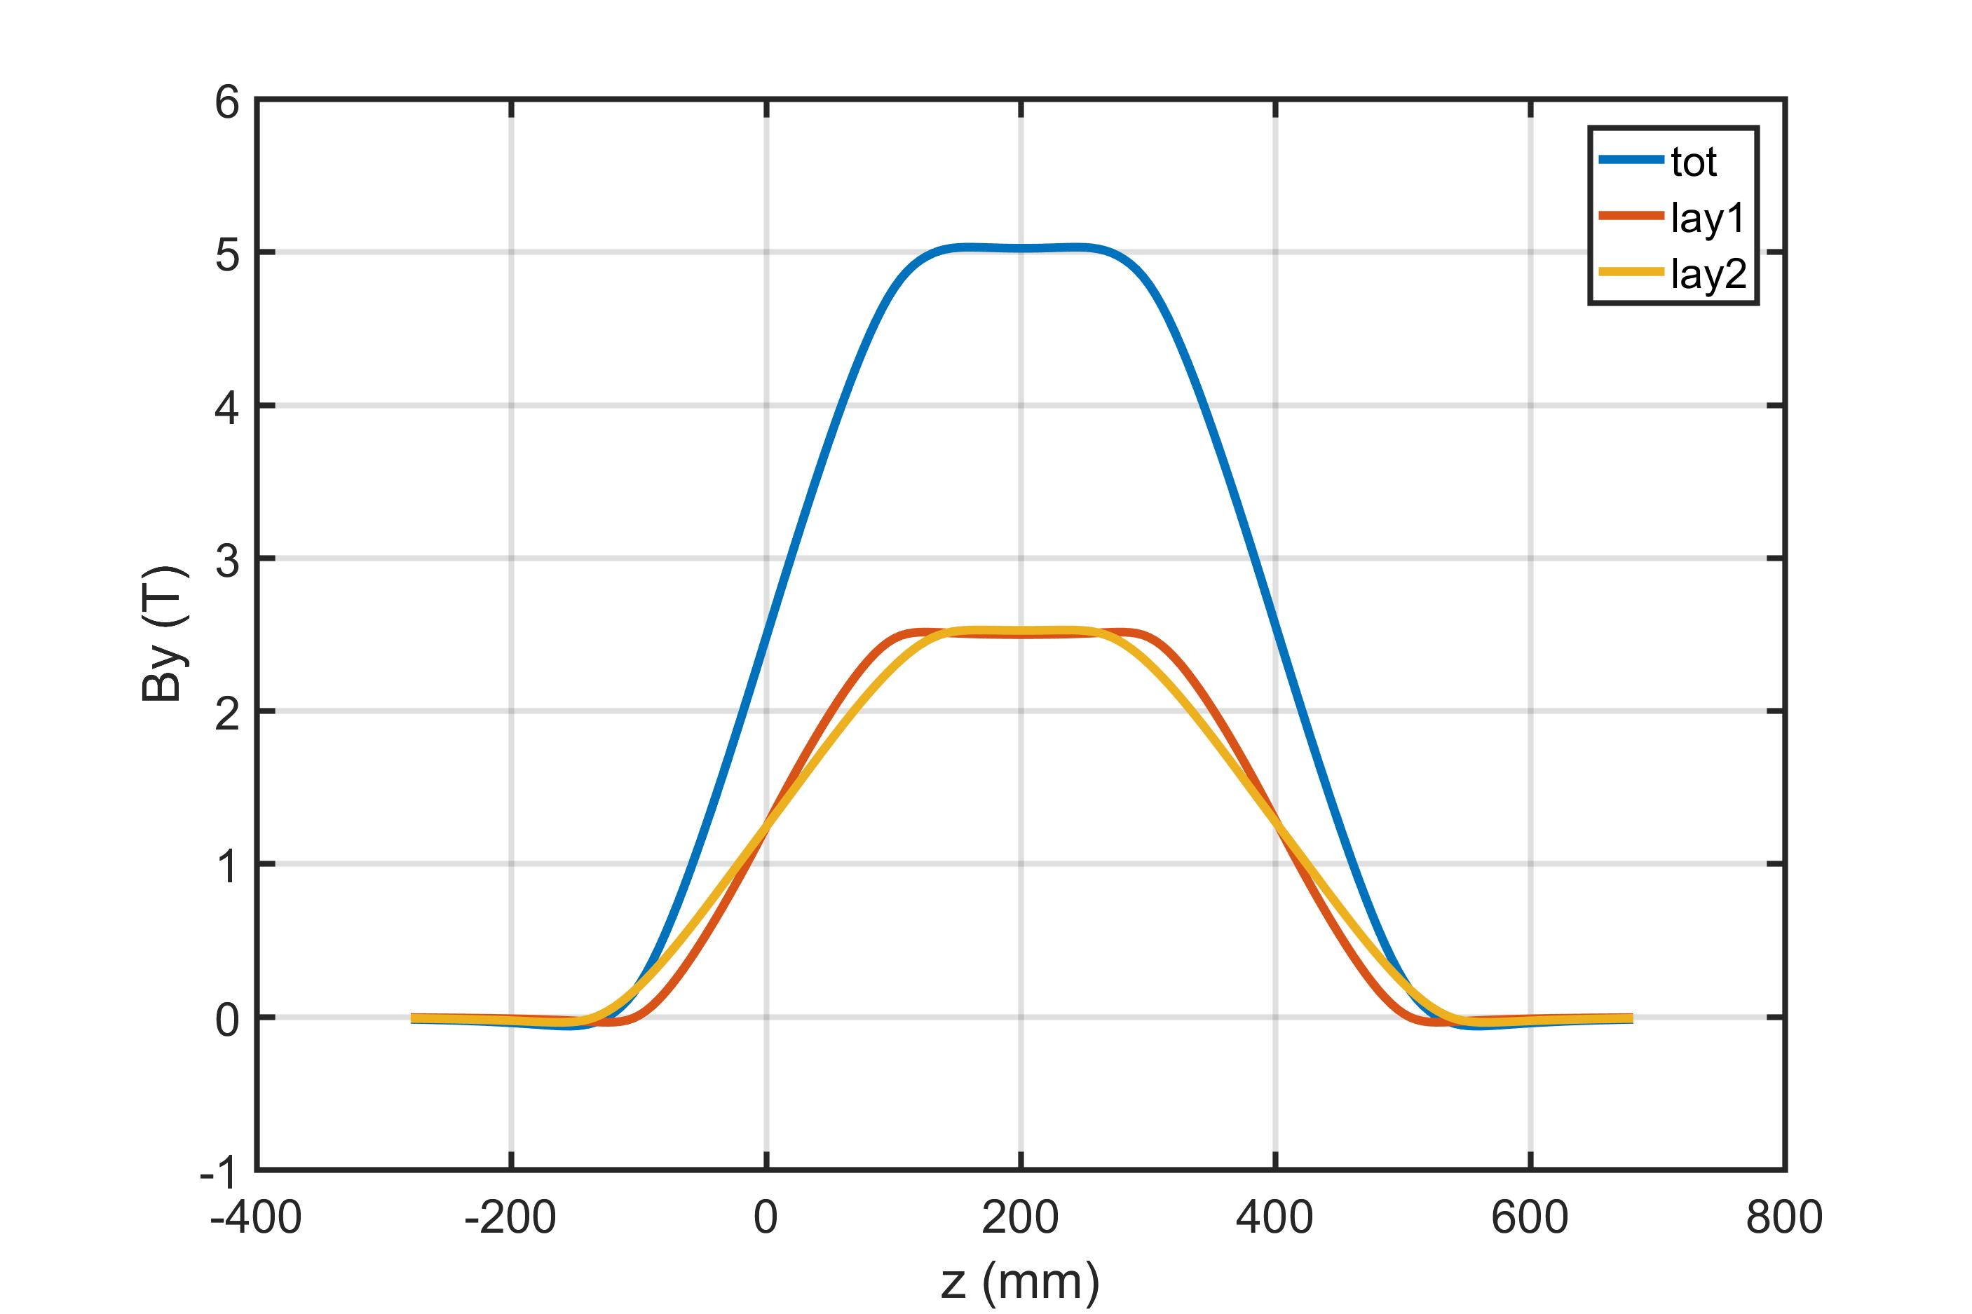
Fields along the length
85 mm straight-section

Slide 7
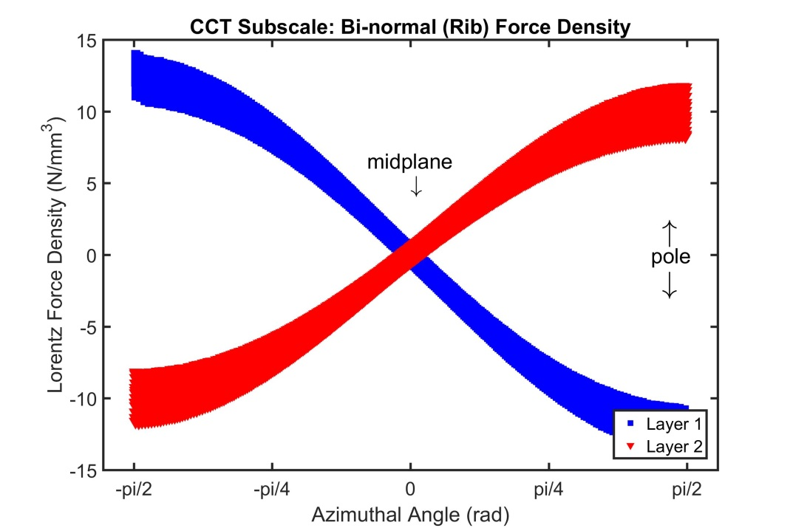
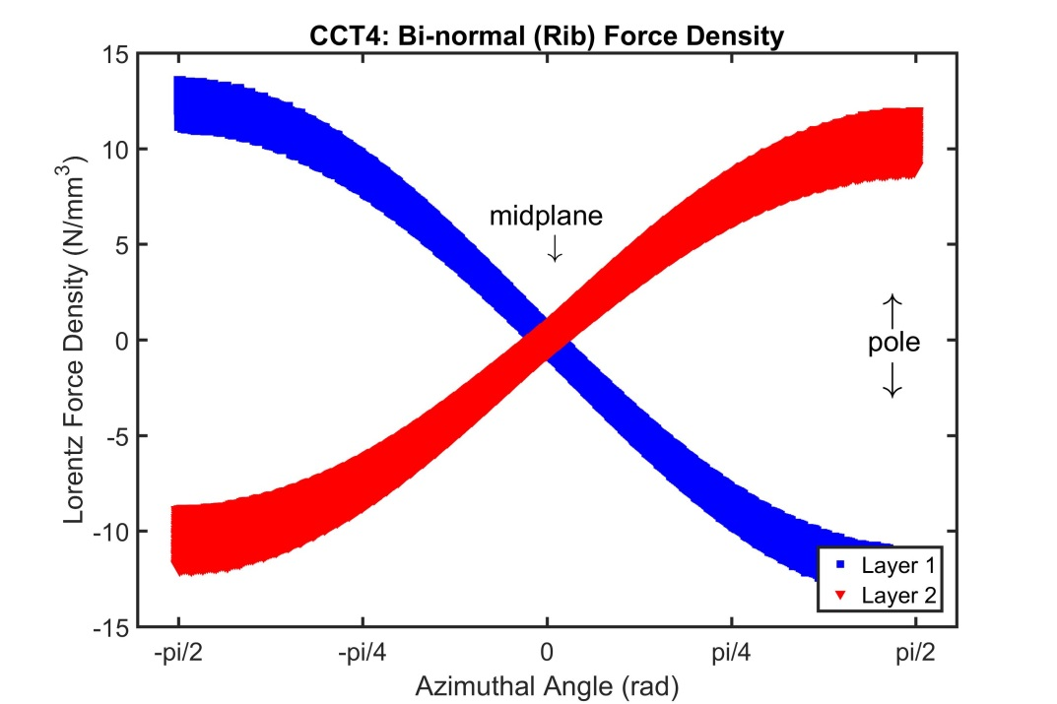
Lorentz Force Density Compared to CCT4
Comparison of the Lorentz force vs angle (from tosca)

Slide 8
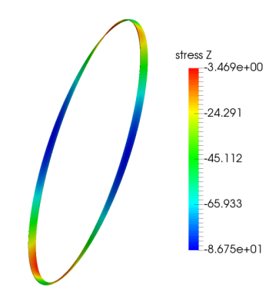
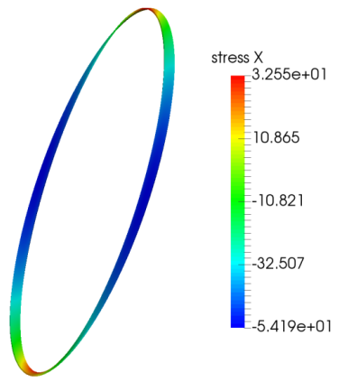
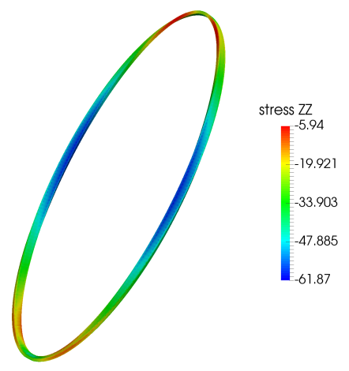
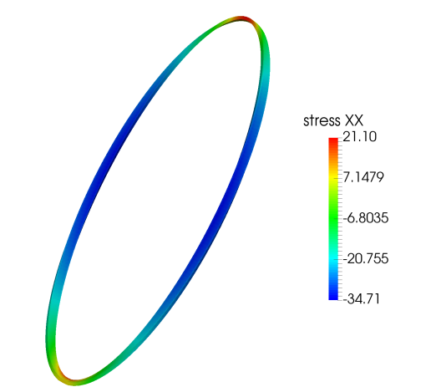
Normal Stress Distribution Compared to CCT4
Normal stress is close when compared to CCT4 (strongly dependent on choice of spar thickness)
* Comparison at short sample (CCT4 started training slightly above 50% of short sample)
Normal Stress along cable
Normal Stress transverse to cable
33 MPa
-3 MPa
CCT4
-54 MPa
-87 MPa
-6 MPa
21 MPa
CCT Subscale (2mm spar)
-35 MPa
-62 MPa

Slide 9
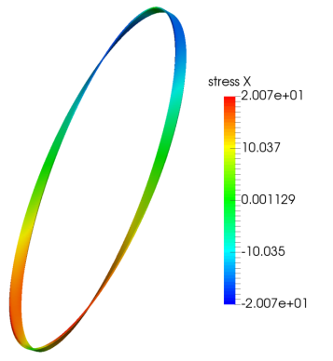
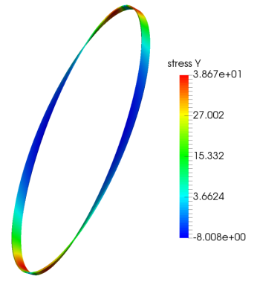
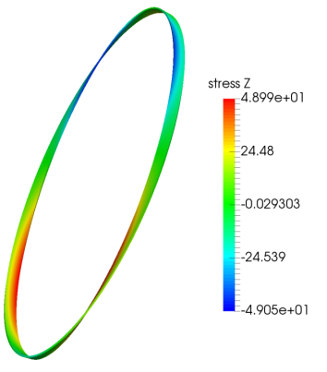
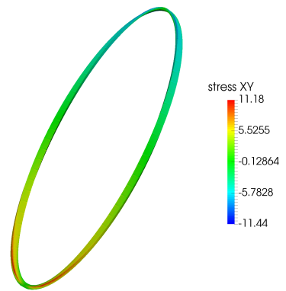
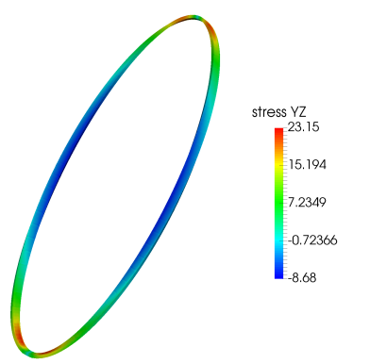
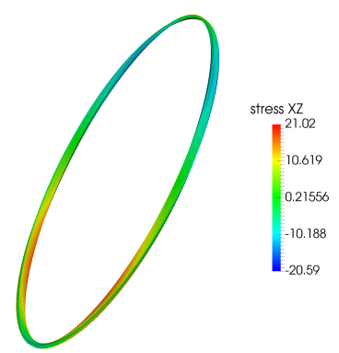
Normal Stress Distribution Compared to CCT4
Shear stress is approximately one-half when compared to CCT4 (not strongly dependent on overall deformation)
tangent-radial
radial-binormal
tangent-binormal shear stress
38 MPa
49 MPa
20 MPa
CCT4
-8 MPa
-49 MPa
-20 MPa
11 MPa
23 MPa
21 MPa
CCT Subscale (2mm spar)
-11 MPa
-9 MPa
-21 MPa

Slide 10
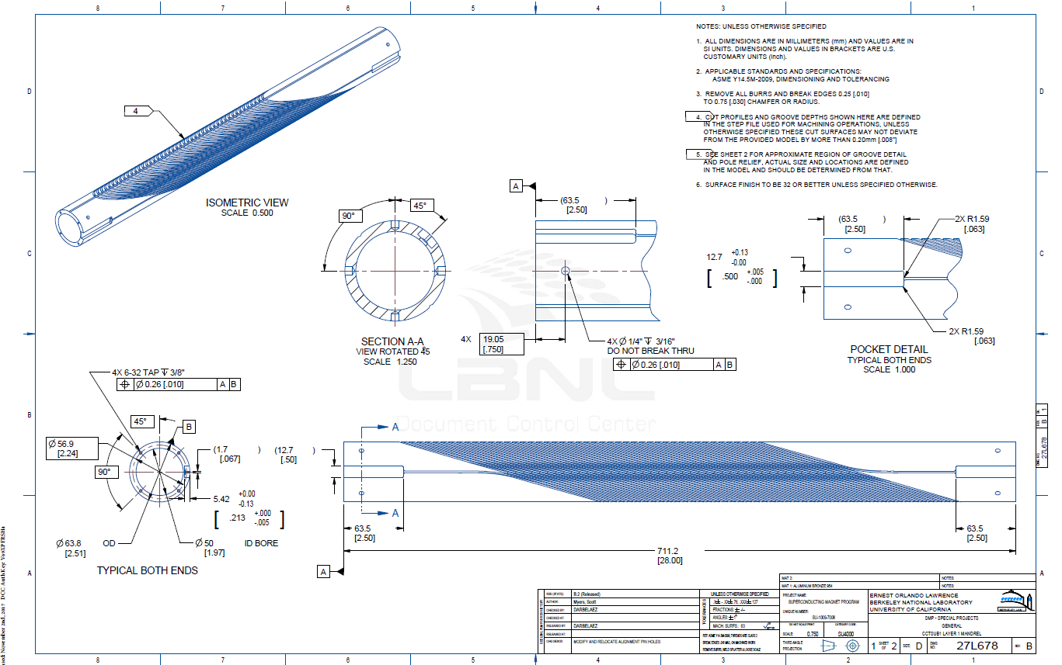
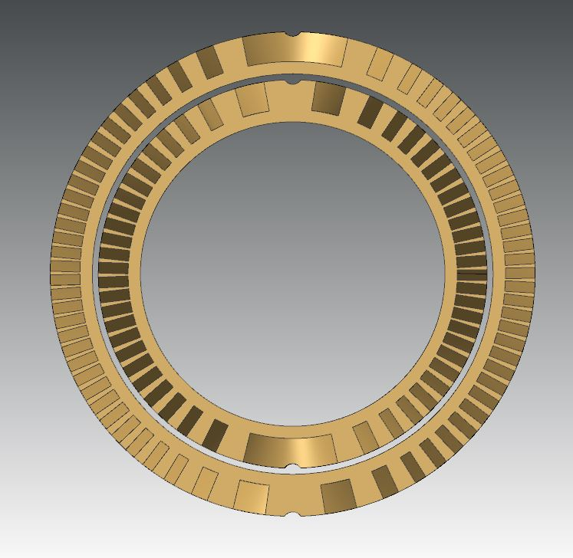
Current Status
Mandrel drawings are ready
Cable parameters have been defined
Minimal tooling is needed
End plugs for potting tooling
Splice tooling

Slide 11
Possible Training Studies
Baseline Test
Same as CCT4
layer 1 and layer 2 impregnated together inside of Al shell
CTD101K epoxy
Wax Impregnation Test
Layer 1 and layer 2 impregnated together inside of Al shell
Wax impregnation
Individual Layer impregnation
Impregnate inner layer with CTD 101K
Impregnate inner layer with FSU mix 61
Test effect of surface roughness and/or surface preparation in grooves
Multiple subscale magnets (2 to 3) can be wound can be fabricated and tested together in order to carry out the testing more efficiently

