Slide 1
TFD requirements, status and review charge
Soren Prestemon
Director, Berkeley Center for Magnet Technology
Lawrence Berkeley National Laboratory

Slide 2
Define responsibilities / management for maximum efficiency and minimal risk
LBNL serve as lead for the magnet design / fabrication and test
FNAL serve as the host for the facility

Slide 3
Facility parameters/specifications for FES and HEP needs
(From Conceptual Cost and Schedule document)
The test facility will be constructed in Industrial Building 1, APS-TD, Fermilab. The proposed place is selected based on the proximity to the needed base infrastructure for such a test stand, including cryogenic, power, water and crane.
Minimum operating temperature of the facility is 1.9K for the magnet providing the background field and 4.2-4.3 K *(under discussion) for the test samples.
The test pit cryostat should accommodate a dipole (coldmass) with maximum diameter of 1.3 m and length of 3.0 m.
The maximum weight of the dipole cold mass should not exceed 22 (Standard) tons, limited by the crane capacity.
The test facility should be efficient and safe, minimizing the time for experiment preparation and no helium losses after quenches.
Operational lifetime of the facility at least 20 years.

Slide 4
Magnet parameters/specifications for FES and HEP needs
(From Conceptual Cost and Schedule document)
Background dipole field > 15T.
Homogeneous field region>500-600mm, preferably>1000mm.
Cryostat to accommodate sufficient sample length to keep sample joint in low field.
Well dimension 90x140, and preferably100x150.
  It would be preferable to make the well compatible with FRESCA2 samples [note EDIPO was actually 94x144]
Field quality in the transverse plane
  target is to keep all harmonics below 20 units at 35 mm radius and 15 T field.

Slide 5
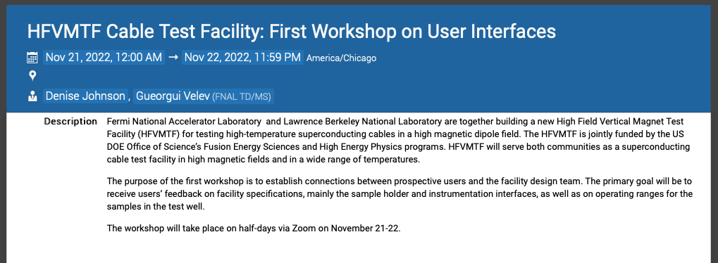
Project oversight, reviews, and user input
Test Facility Dipole CDR (Thursday, 11 June 2020)
TFD Wire Specification Review (Thursday 28 Oct 2021)
  Wire for the project has been procured
External Oversight Committee:
  First meeting January 2021
  Second meeting August 2022
Integrated Project team meetings
  Seven to-date
  PIs &PMs meet with HEP & FES Programs
HFVMTF Cable Test Facility: First Workshop on User Interfaces
  Held Nov 21-22, 2022
External Oversight Committee
  Joe Minervini (Chair)
  Steve Gourlay (Co-chair / Backup)
  Luca Bottura
  Luisa Chiesa
  Danko van der Laan
  Ruben Carcagno
  Nicolai Martovetsky

Slide 6
Project approach strives to minimize risk while maximizing performance
Leverage DOE-OHEP-developed high field magnet technology
  Build off of HD-series magnets – HD1 (16T, no bore), HD2/3 (~13.8T)
  Leverage early design and development efforts for a large bore magnet – LD1
Build on the design and successful test of FRESCA-II (14.6T, 100mm bore)
  Also leverage significant coil fabrication experience from the Saclay and CERN teams
Leverage efforts of the HEPDipo team and other relevant magnet experience
  Leverage latest RRP conductors
  Strong connections with CERN; build collaboration
Leverage facilities and expertise at the DOE-OHEP laboratories
  LBNL/FNAL/BNL have strong design and analysis teams
    LBNL with expertise and history in block-magnet designs
  US has only cabling machine capable of fabricating the requisite large cables (LBNL)
  Winding / reaction / potting tooling exists at LBNL that are not used by HL-LHC AUP
    BNL and FNAL have additional capabilities should the need arise
Define the project team so as to leverage expertise and facilities without impacting HL-LHC AUP and MDP progress towards goals

Slide 7
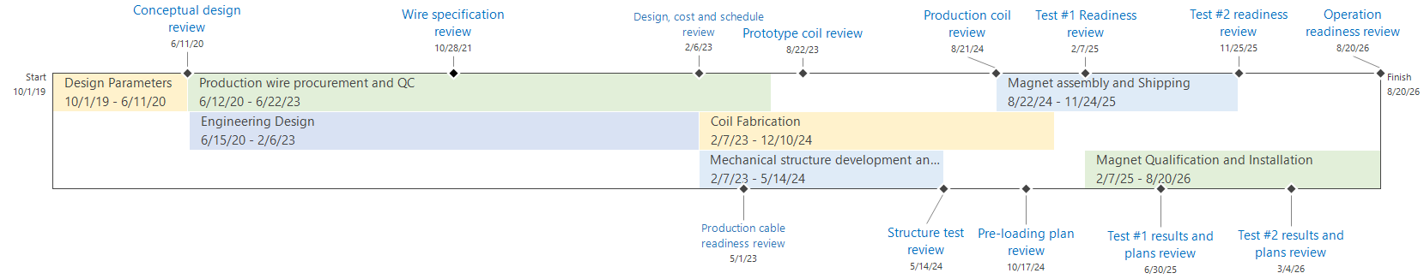
Approaching final magnet design
- and then fabrication!
This is a large “one-off” magnet project - very challenging requirements
  Conductor procured
  Review design status (this review!)
  Review Cost and Schedule (likely in March)
  Then… => begin transitioning from design to fabrication phase!

Slide 8
Charge to the Review Committee
Are the magnet requirements properly defined and documented? Have interfaces with the final facility been properly documented?
Are the plans for cable design finalization appropriate for this stage of the project? Have associated risks been identified? Does the plan provide adequate risk mitigation?
Is the design team using appropriate design and analysis tools?
Is the design at the proper level of maturity for this stage in the design? Is the project managing the design process to meet performance requirements while minimizing project risk?
Have critical design features and fabrication tooling been identified and solutions properly advanced, in particular for the coil? Is the team benefiting from all relevant experience from past projects and the broader community?
Have design and fabrication risks been properly identified, and are they being tracked and mitigated at a reasonable level?

Slide 9
Summary
The planned facility is an important investment from DOE-FES&HEP
This is the second review specific to the magnet design
We are leveraging significant work by the HEPDipo collaboration
Also leveraging the experience from the FRESCA-II team
We believe the design is technically sound, and generally ready to proceed to final design
We are eager to hear constructive feedback from
the review committee!

