Slide 1
Preliminary Scoping of a Bi-2212 Insert Inside CCT6
Lucas Brouwer + Paolo Ferracin
February 21st, 2023

Slide 2
Assumptions
Fix CCT6 geometry based on current design
Select cable size for a 2 layer CCT insert with
0.8 mm strand diameter
50 mm clear bore
5 mm spars
1 mm assembly gap
no extra space from OD of insert to CCT6 (only 1 mm assembly gap)
Use short-sample curves from Paolo for Nb₃Sn and Bi2212 at 1.9 K

Slide 3
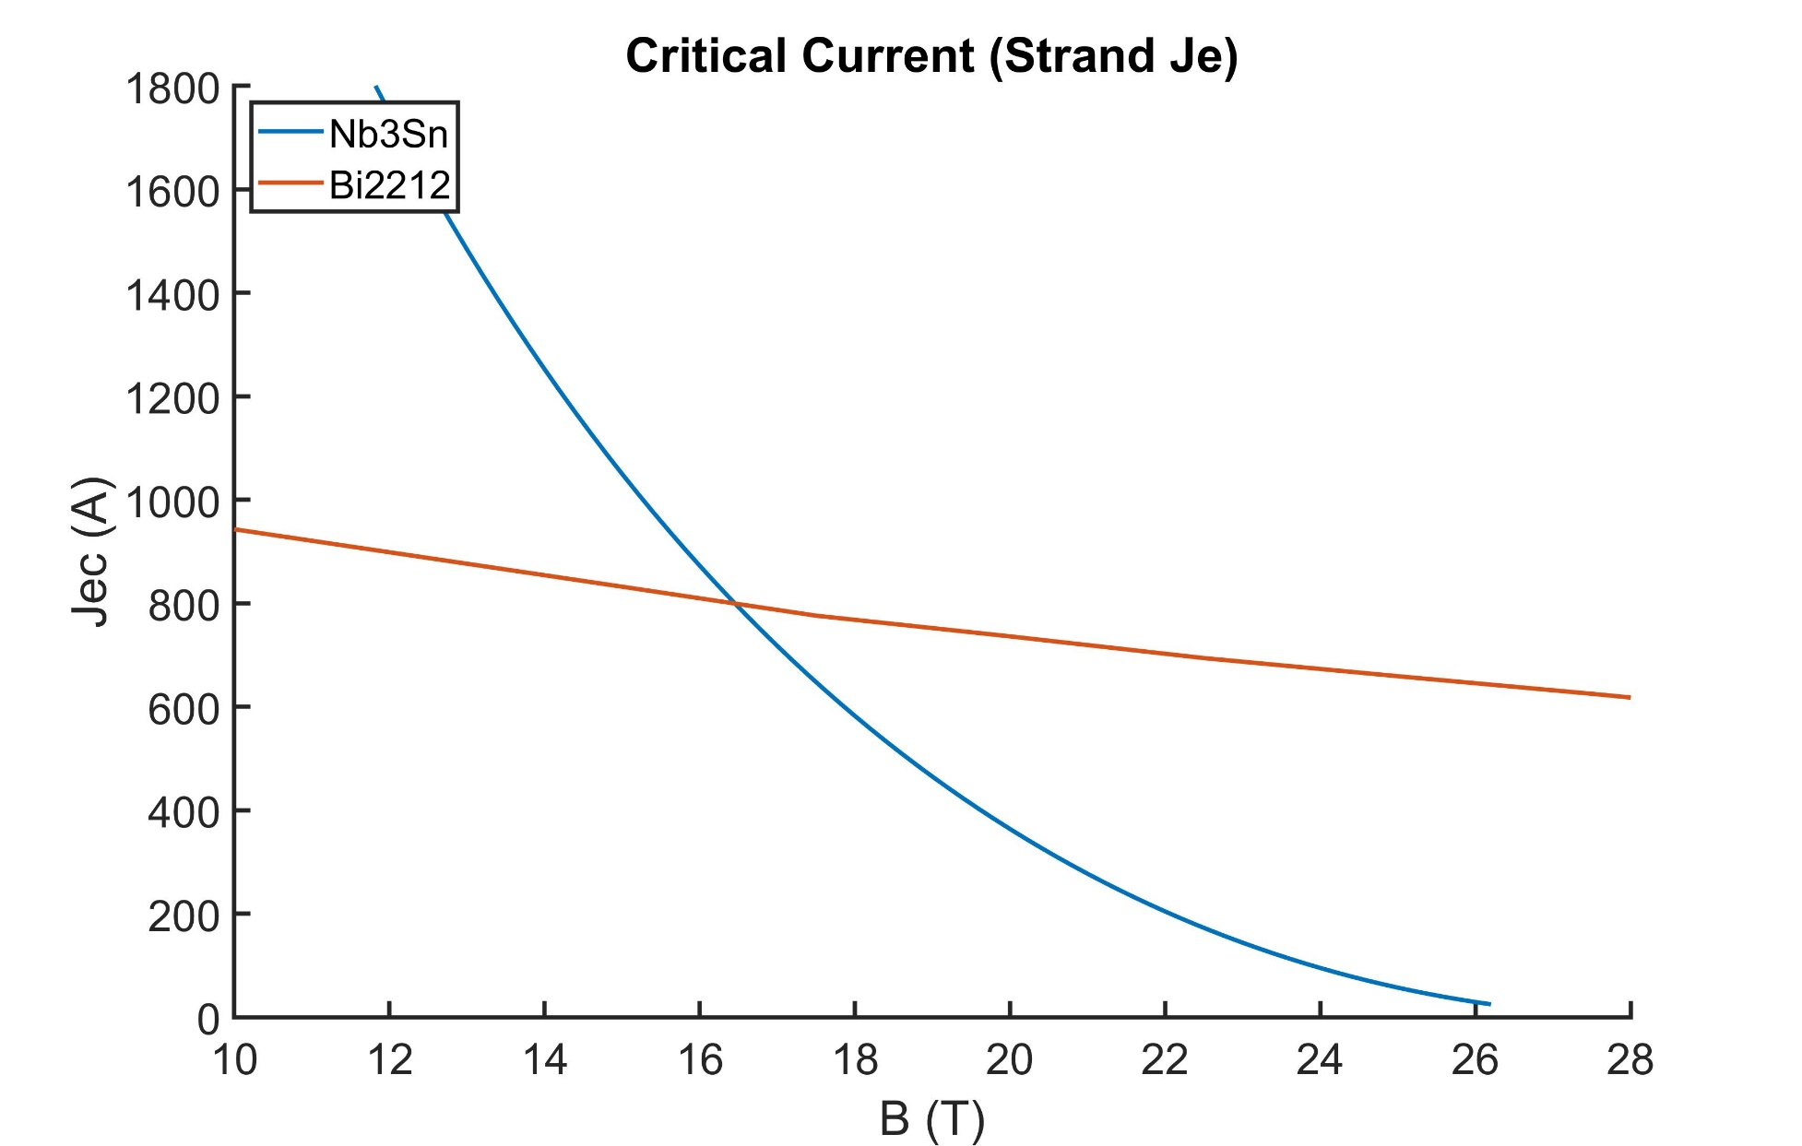
Short Sample Curves from Paolo (Je of strand)

Slide 4
Resulting Cross Section
CCT6 (Nb₃Sn)
Bi-2212 Channel
11.5 x 2mm (scales to 26, 0.8 mm strands)
Bi2212 Insert

Slide 5
Magnetic Study
Assumes independent powering of the insert/CCT6 – no more load “lines”, now a loading “area”
Assumes a ring of iron 15 inch thick outside CCT6
Solve a grid of operating currents in 500 A steps
0 < IHTS < 14 kA
0 < ICCT6 < 18 kA
For each solution extract: field in bore, field at HTS windings, and field at CCT6 windings
Without assuming any increase in field at the conductor (due to 3D effects), compare this field to short-sample, this may slightly overestimate the short-sample

Slide 6
All sampled designs shown w.r.t short-sample
Note the sampled area of the HTS is much broader. This is because the outsert can vary the field on the insert a lot more than the insert can vary the field on the outsert.

Slide 7
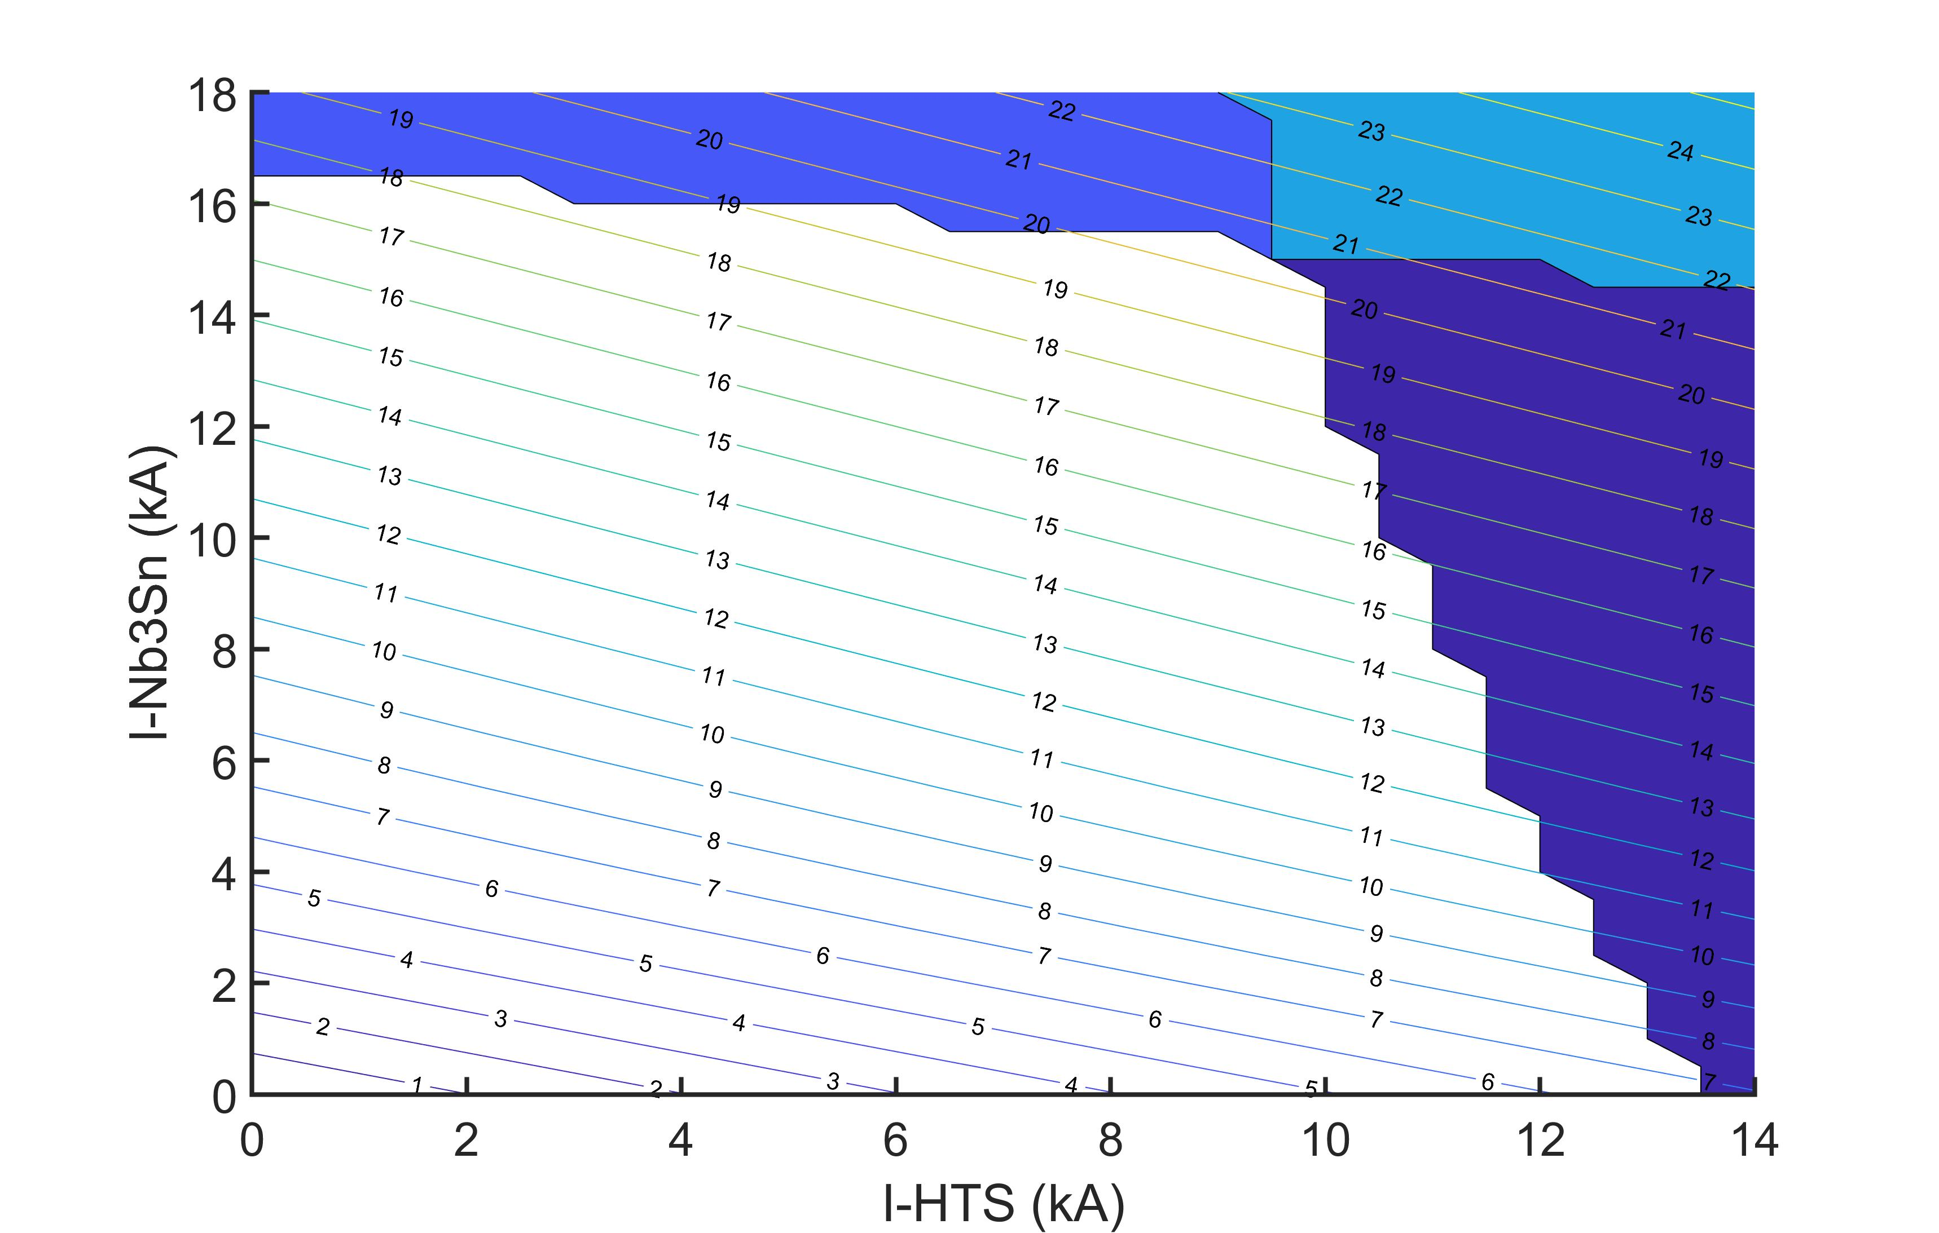
Load line of CCT6 stand-alone (see next slide)
Excluded by short-sample of Nb3Sn
Excluded by short-sample of both
Contours are achievable bore field
Excluded by short-sample of HTS
Peak bore field of ~20 T is with 9.5 kA insert, 15 kA outsert
Load line for powered in series (see next slide)
Load line of HTS stand-alone (see next slide)

Slide 8
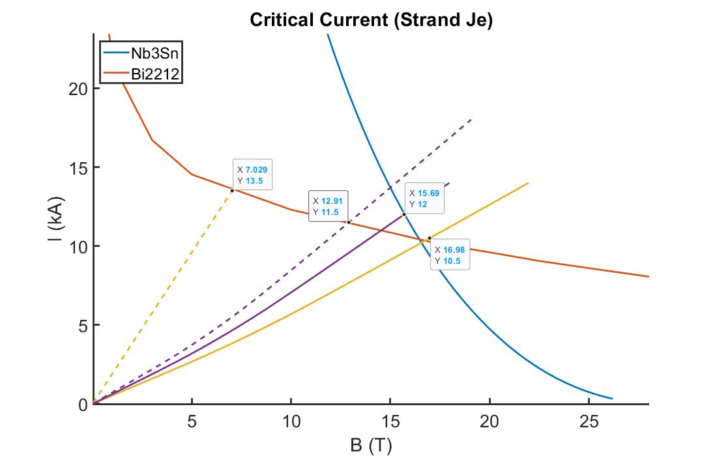
HTS, self-field
Nb3Sn, series
Nb3Sn, self-field
HTS, series [SERIES IS LIMITED BY HTS]

Slide 9
Short-Sample Summary at 1.9 K
Config. | I-HTS (kA) | B-HTS (T) | I-Nb3Sn (kA) | B-NbSn (T) | Bbore (T)
Standalone HTS | 13.5 | 7.0 | -- | 3.2 | 6.7
Standalone Nb3Sn | 12.9 | -- | 11.5 | 12.9 | 12.8
Series Powered (HTS limit) | 10.5 | 17.0 | 10.5 | 14.0 | 16.7
Independent, peak bore | 9.5 | 20.7 | 15 | 18.0 | 20.4

