Slide 1
WOMEN’S HISTORY MONTH
Mark Bandstra
Heather Crawford
Tom Gallant
Reiner Kruecken
Hannah Parrilla
Ernst Sichtermann

Slide 2
Brief History of Women’s History Month
Every year, March is designated Women’s History Month by Presidential proclamation. The month is set aside to honor women’s contributions in American history.
Women’s History Month began as a local celebration in Santa Rosa, California. The Education Task Force of the Sonoma County (California) Commission on the Status of Women planned and executed a “Women’s History Week” celebration in 1978. The organizers selected the week of March 8 to correspond with International Women’s Day. The movement spread across the country as other communities initiated their own Women’s History Week celebrations the following year.
In 1980, a consortium of women’s groups and historians—led by the National Women’s History Project (now the National Women’s History Alliance)—successfully lobbied for national recognition. In February 1980, President Jimmy Carter issued the first Presidential Proclamation declaring the Week of March 8th 1980 as National Women’s History Week.
Let’s spend a moment to recognize the contributions of all women, past and present, in the division.

Slide 3
Events
The Women’s Support and Empowerment Council (WSEC) has a list of various events to celebrate Women’s history:
2nd Annual Women's History Month Jeopardy Game and Celebration!
March 10th, 12-1PM
Dr. Heather Whiteman, UC Berkeley: "The Power of People Data: How we use data about, on and for people to bring about a more inclusive world of work"
March 14th, 11AM-12PM
Cradle to Commerce: Funding Opportunities for Lab Entrepreneurs
March 21st, 12-1PM
Women’s Interlaboratory Network Special Interlab Panel "No Woman Left Behind: Bridging the Gap"
March 30th, 9-10AM
Trans Day of Visibility Special Speaker Event: Dr. Clara Barker, Oxford University
March 31st, 12-1PM
UC Berkeley DEIBJ - Additional events and articles
Zoom backgrounds for download!
Co-sponsored by NSD IDEA Council

Slide 4
Current Outreach and Service Opportunities
K-12 STEM Outreach Opportunities
Support the The Berkeley Lab Director’s Apprenticeship Program (BLDAP)
Help with SAGE Camp taking place in June
Help facilitate SeA Spring Break Camp
Judges needed for Contra Costa County Science Fair (3/10)
Present at a reverse science fair (4/18)
Assemble STEM kits for Scientific Adventures for Girls
Staff the booths at the BERC or APS career fairs (3/08 - 3/09)
Community Service Opportunities
Volunteer with the Food Bank of Contra Costa and Solano (FBCCS), the UC Berkeley food pantry, or the Alameda County Community Food Bank
Sign up to help a local family with Rebuilding Together East Bay North (3/18)
Volunteer with Meals on Wheels to pack or deliver food to Berkeley’s homebound seniors
Sign up to volunteer for these opportunities and more at https://service.lbl.gov/need/

Slide 5
IDEA Resources
URM Job Posting funding
Luminary Cards
IDEA SPOT Award Program
LeanIn cards “50 ways to fight bias”
Idea.lbl.gov
Employee Resource Groups
Physical Sciences Workplace Life Committee
Consider joining the Council!
All-volunteer effort
Looking for people from all roles and areas of NSD
Share your ideas for topics or other feedback:
NSD-IDEA-Council@lbl.gov

Slide 6
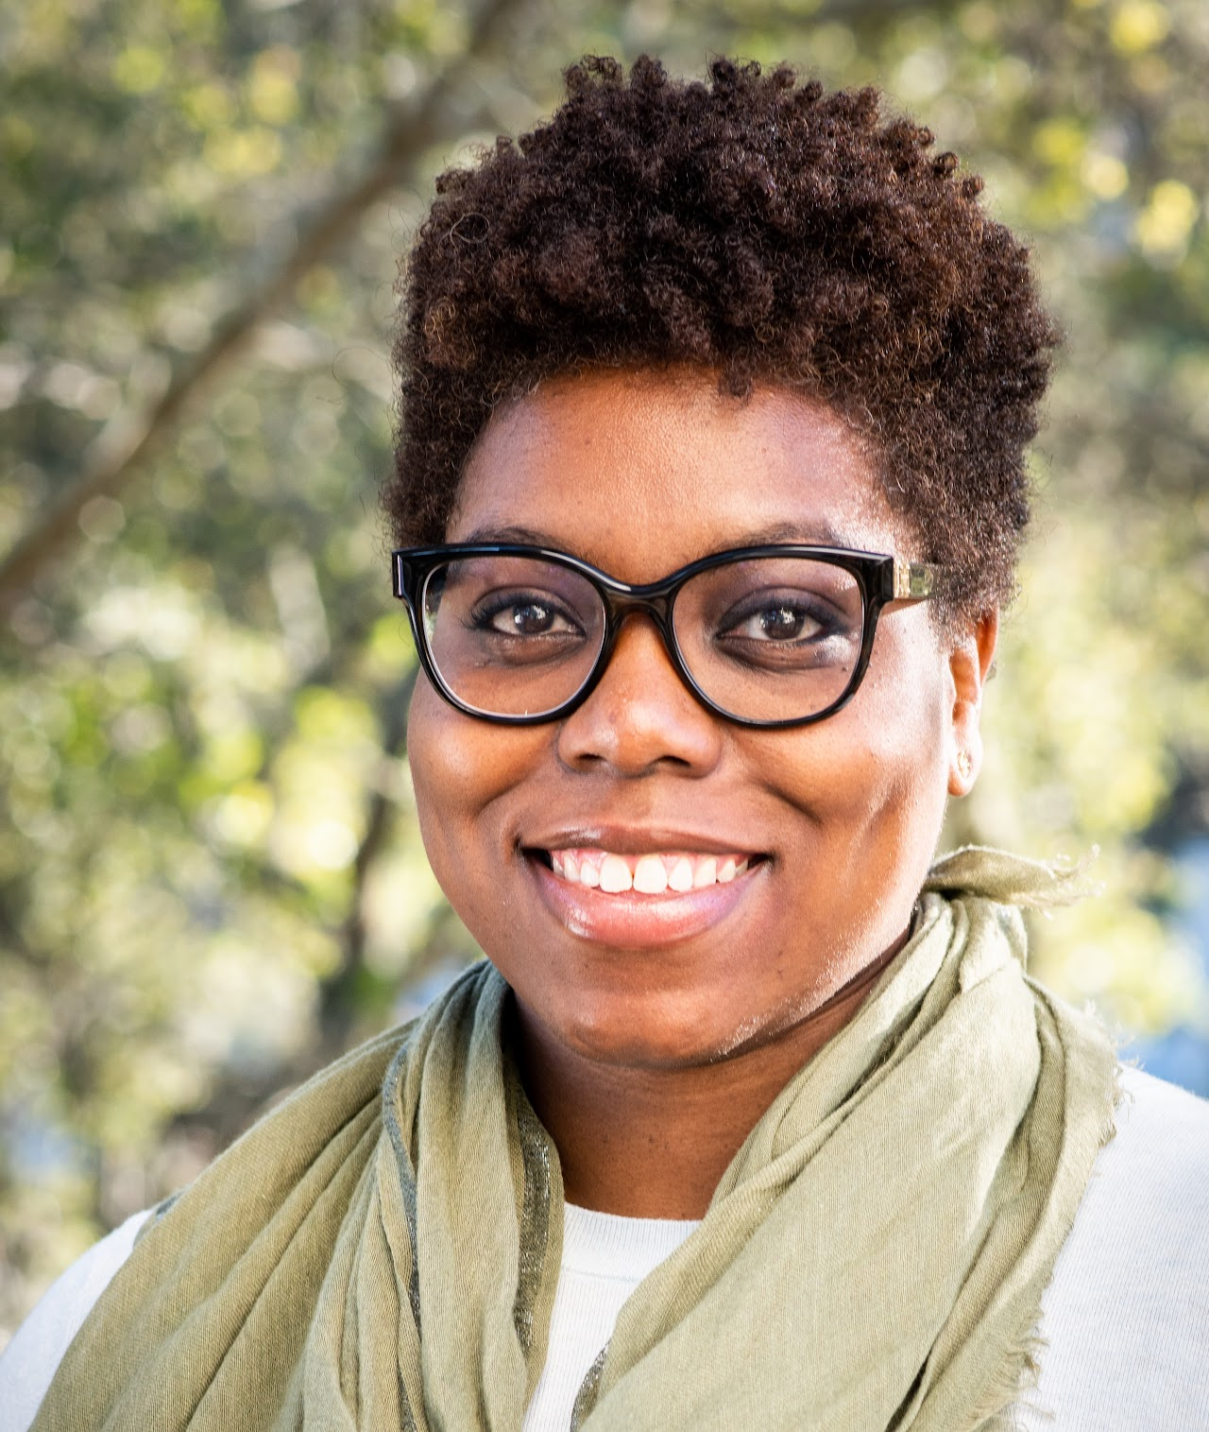
Faith Dukes
She joined LBNL in 2019 and is currently the
Director of K-12 STEM Education Programs
Faith started combining her passions for science and education as an instructor with Science from Scientists while working on her PhD thesis on waste remediation using photocatalytic semiconductors. She went on to develop educational programs as the Education Coordinator at the Massachusetts Institute of Technology Museum before transitioning to Washington, DC as an American Association for the Advancement of Science, Science Technology Policy Fellow. During her time as a Fellow, she served at the National Science Foundation in the Education and Human Resources Directorate.
Faith can be reached at fmdukes@lbl.gov

