Slide 1
18th of April, 2023
Development of Advanced Image Analysis using Machine Learning for Superconducting Wire and Cable Characterization
Algirdas Baskys
abaskys@lbl.gov
Lawrence Berkeley National Laboratory

Slide 2
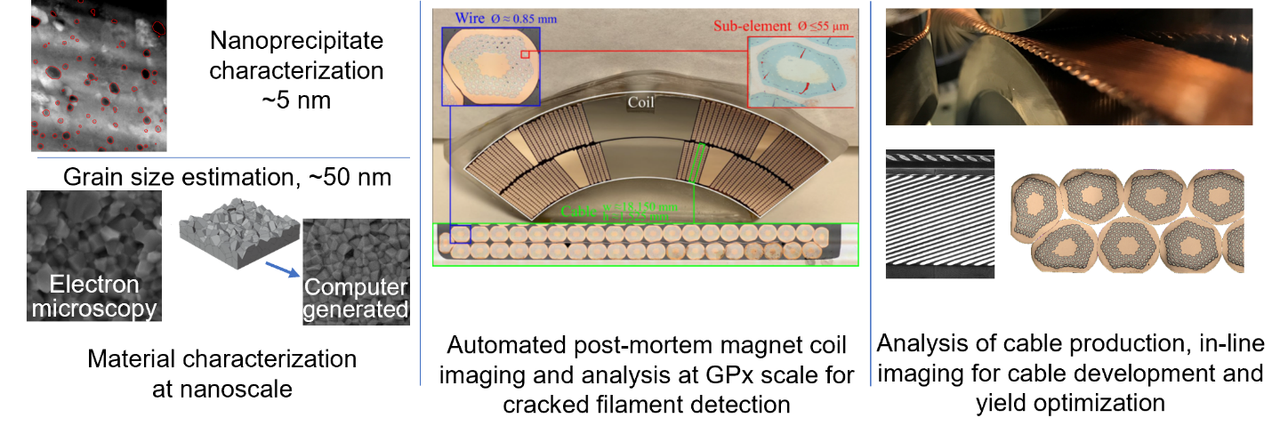
ECRP topic
Development of Advanced Image Analysis using Machine Learning for Superconducting Wire and Cable Characterization
The objective of the proposed work is develop advanced image analysis techniques utilizing ML for conductor characterization at the level of the individual wire, cable, and coil length scales and spanning the nanometer to kilometer range. Such characterization aims to correlate the phase, microstructure, and morphological information to the relevant materials’ properties.

Slide 3
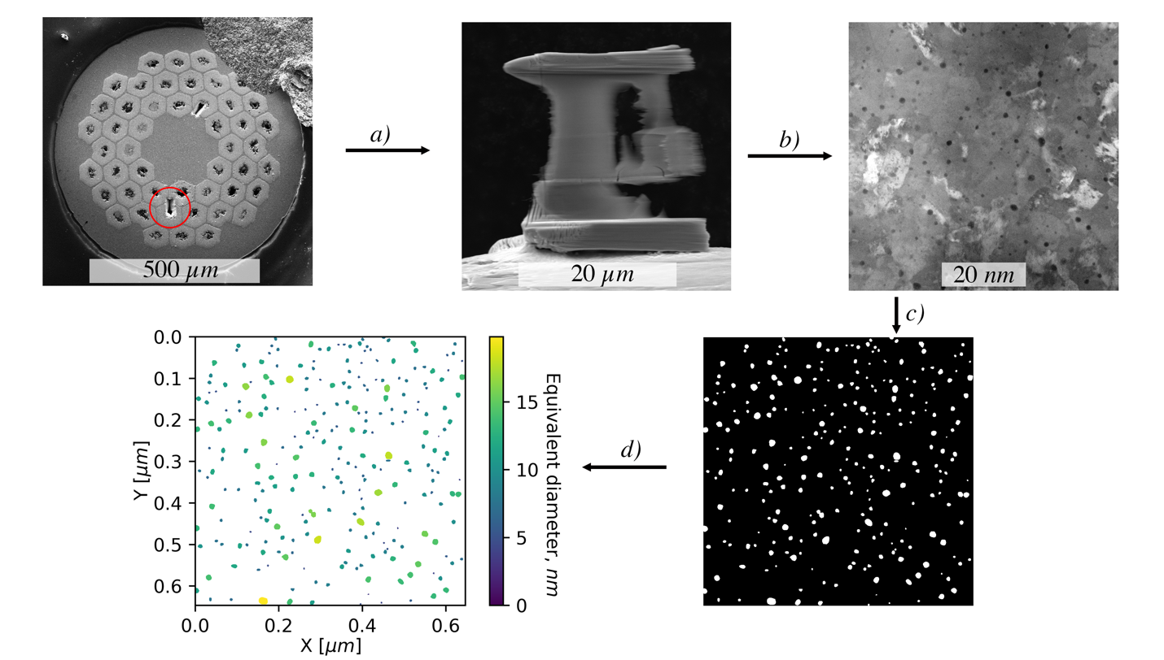
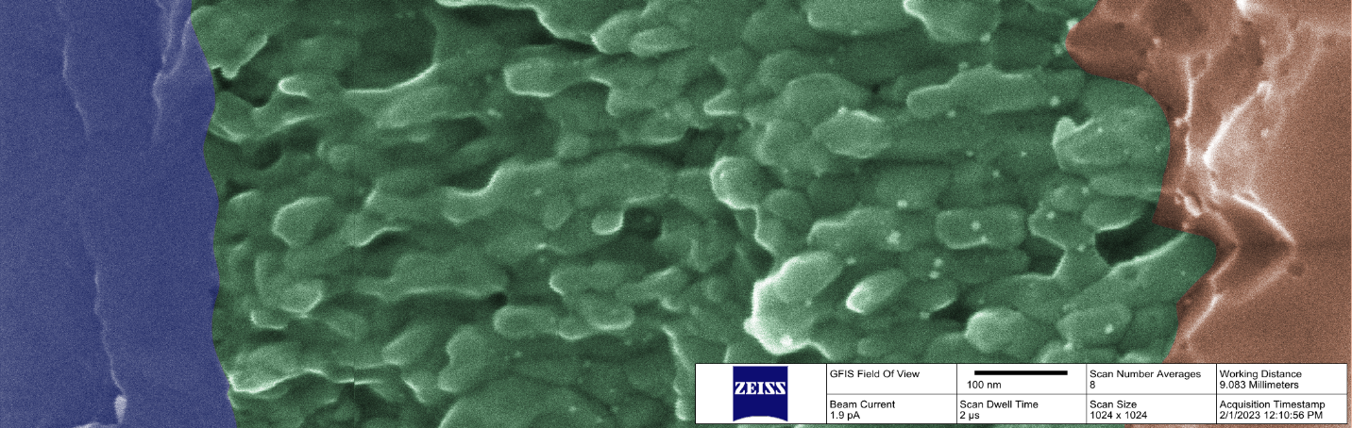
Conductor Scale
Grain size analysis
Analysis of the flux pinning landscape in APC Nb₃SN
How it is affected by heat-treatment
Correlation with electrical properties
Analysis can be extended to other materials:
E.g. analysis of foreign phases and agglomerates in Bi-2212 powder
Nanoprecipitate characterization
Pinning landscape characterization across the subelement/wire

Slide 4
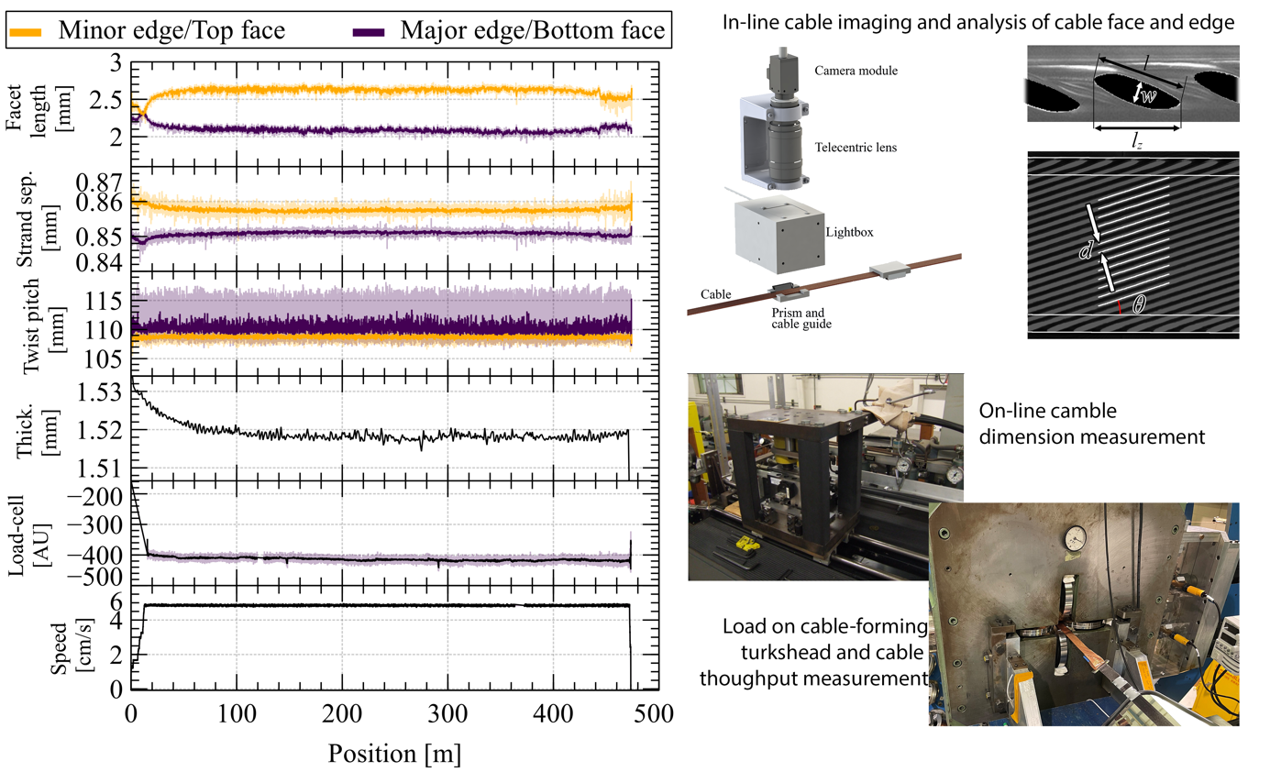
Cable scale
During Rutherford cable ~50k images are collected along with many other signals
Each production parameter can affect several aspects of the produced cable
Cable dimensions
Facet sizes
Cabling degradation I_{c}, RRR
Cable mechanical stability
ML can could be useful to disentangle the dependencies and feed those relationships back to the cable production

Slide 5
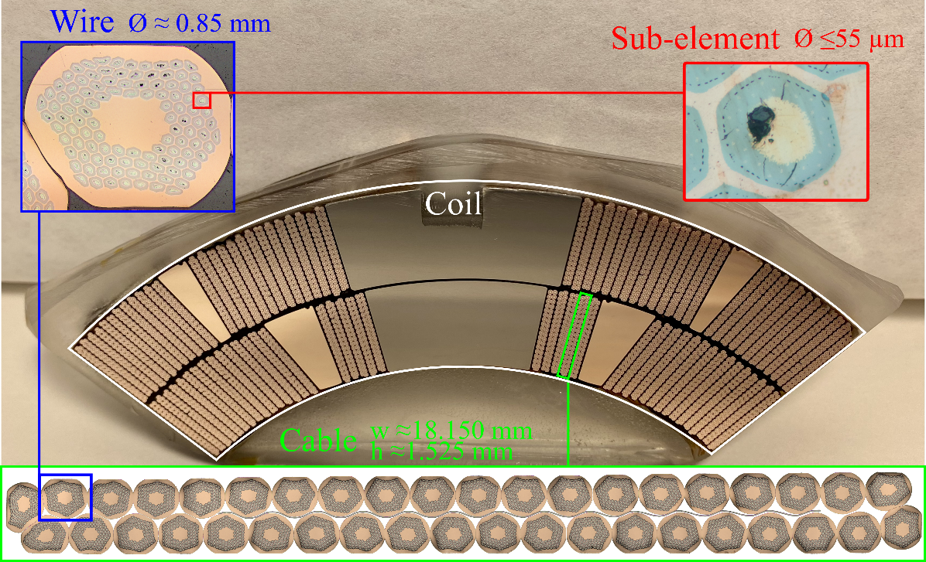
Coil scale
Post-mortem Nb₃Sn coil cross-section or 10-stack analysis:
Cracked subelement detection and characterization
Relating to stress states that caused the cracking
The high analysis throughput would enable studies of crack propagation due to cyclic loading

Slide 6
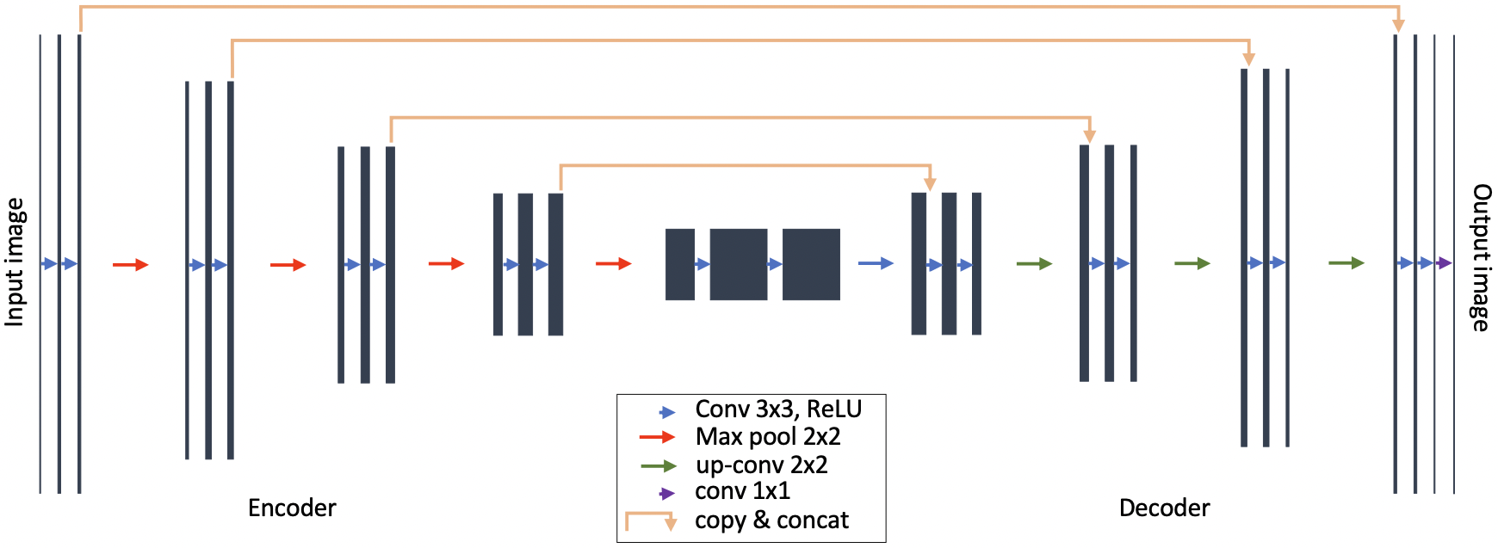
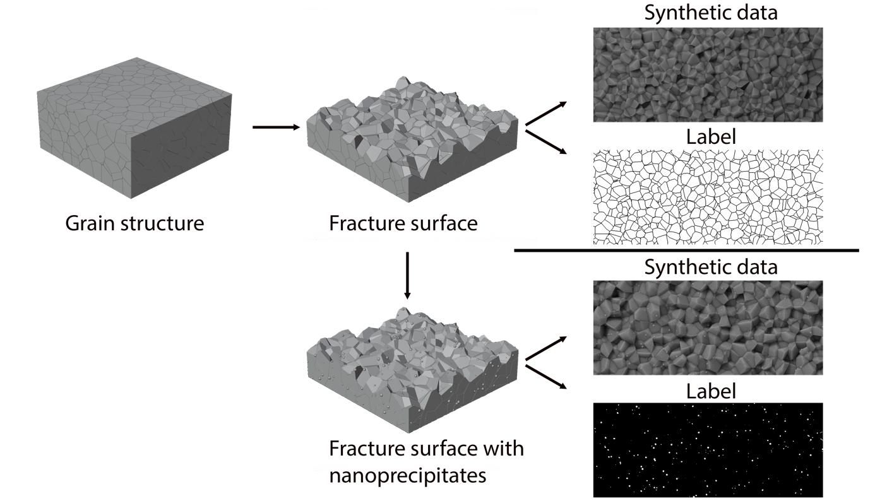
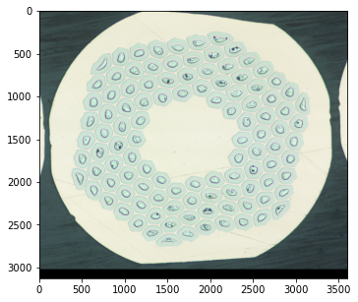
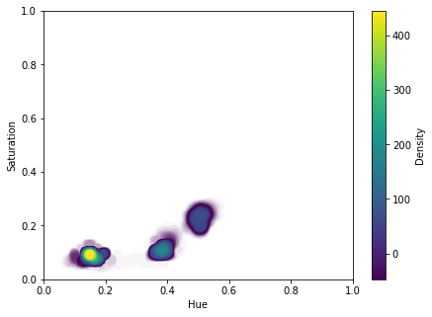
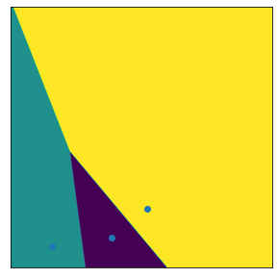
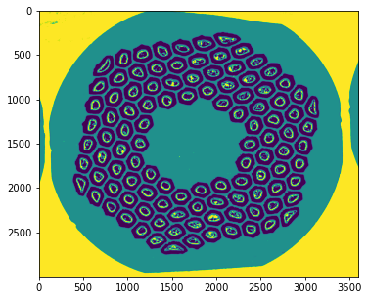
ML methods
Unsupervised methods
Supervised methods
Clustering methods
Semantic segmentation via convolutional neural networks
Training of NN via synthetically generated data to reduce need of labeled data
Clustering by color, brightness, morphology

