Slide 1
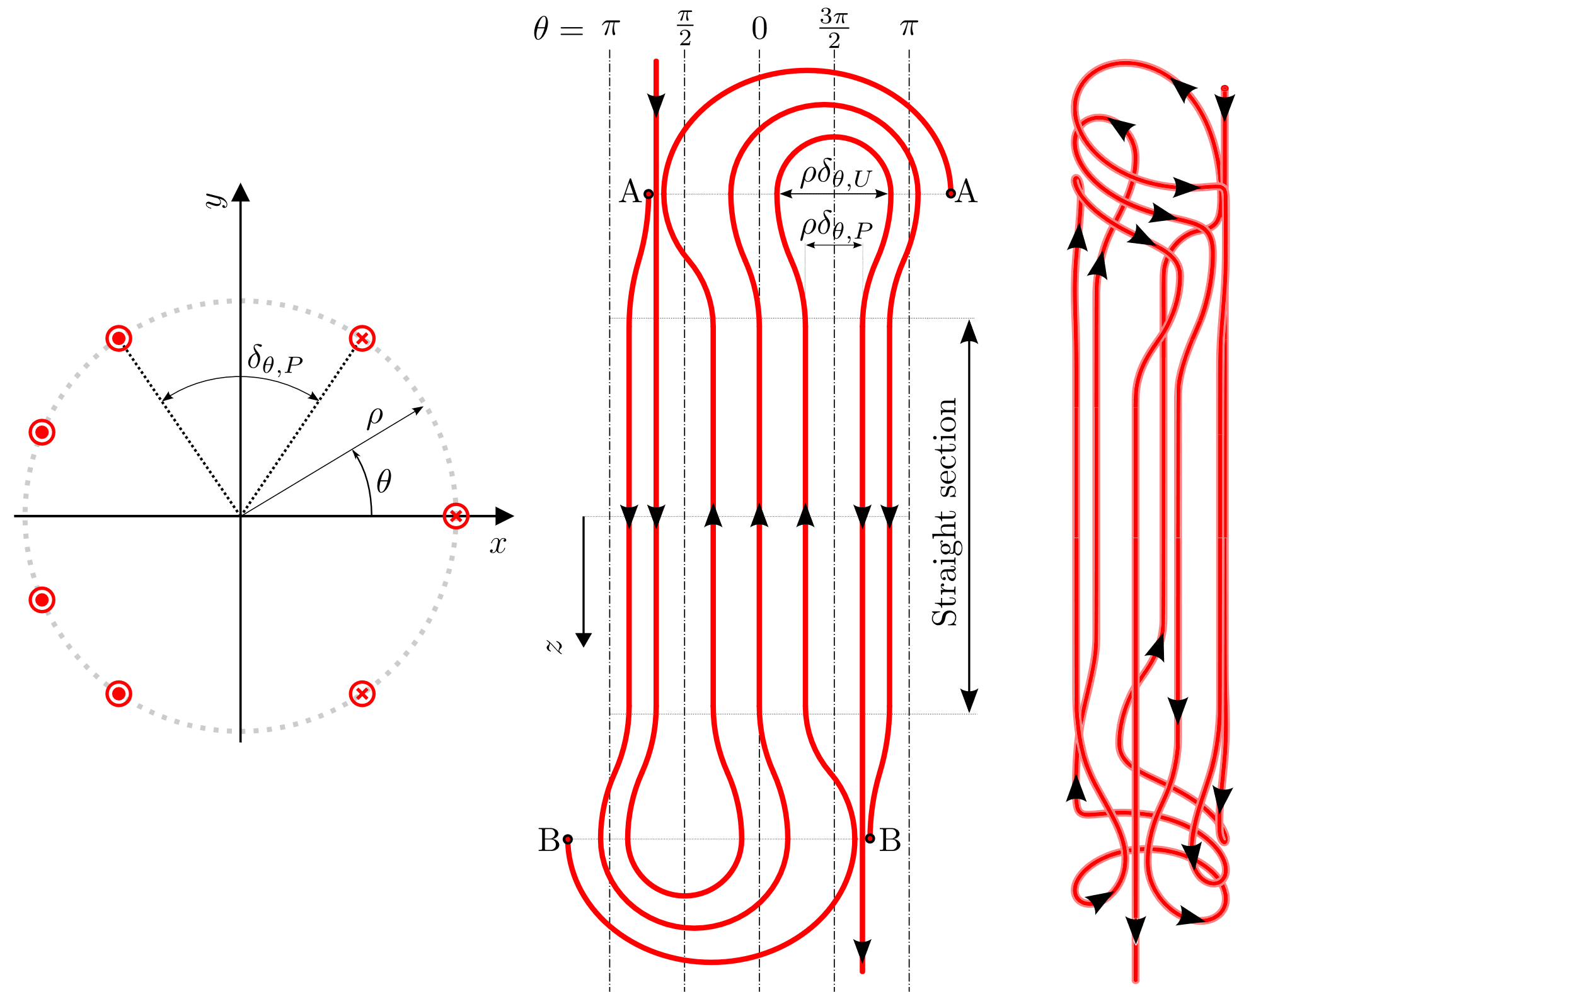
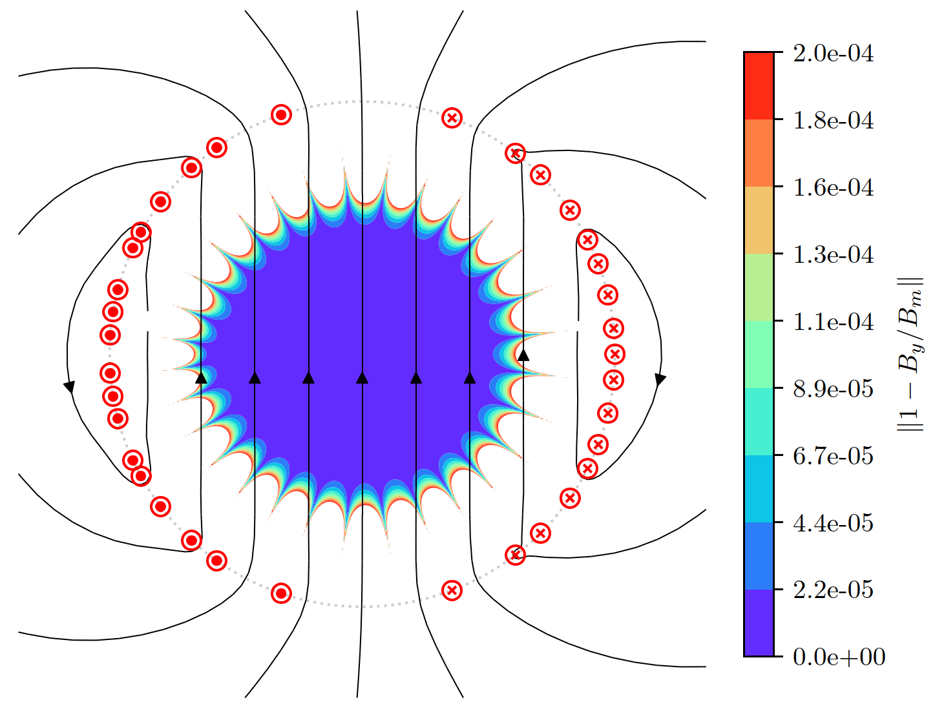
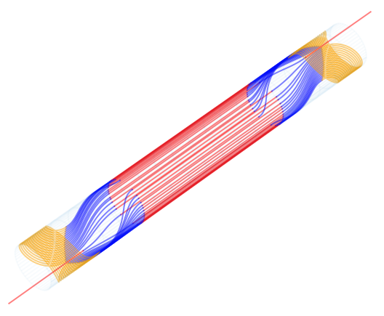
A Novel Design for High-Field Superconducting Magnets
Uni-layer magnets
A novel concept for superconducting magnets generating a magnetic field perpendicular to the aperture by:
single layer (no internal layer jump needed) (through asymmetric current distribution maintaining high-quality field in the aperture)
high bending radius in the continuous conductor
Significance and Impact
The specific characteristics of the uni-layer design are especially advantageous for strain-sensitive and prone to winding degradation high-temperature superconductors, in very high field accelerator magnet applications, in which, high efficiency in the use of conductor, and a small aperture are required. In this regard, the new design enables the effective use of HTS due to the higher bending radius required for winding, and in particular of REBCO and derived wires such as CORC.
Published in Supercond. Sci. Technol. 2023, 36
a
b
c
d
a: Fundamental idea of asymmetric uni-layer magnets. b: Demonstration of high field quality in asymmetric conditions. c: Potential 3D winding configuration. d: Simplification of former manufacturing.
J. L. Rudeiros Fernandez et al.

Slide 2
A Novel Design for High-Field Superconducting Magnets
The main objective of this proposal is to demonstrate the potential of UL magnets for particle accelerators and other applications, through the design, fabrication and test of UL dipole subscale magnet demonstrator using REBCO based superconductors.
 | Year 1 |  |  |  | Year 2 |  |  |  | Year 3 |  |  |  | Year 4 |  |  |  | Year 5
Project timeline
Phase 1 – Magnetic and mechanical conceptual development
1.1 Development of a generalized optimization code for UL magnets
1.2 Definition of the baseline of the UL magnet demonstrator
1.3 Conductor procurement
Phase 2 - Engineering design and prototyping
2.1 Development of the engineering design for UL magnets
2.2 Validation of the engineering through prototyping
2.3 Test of small prototype
Phase 3 - Fabrication and testing of the UL magnet demonstrator
3.1 Fabrication of the UL magnet
3.2 Test and validation of UL magnet
J. L. Rudeiros Fernandez et al.

