Slide 1
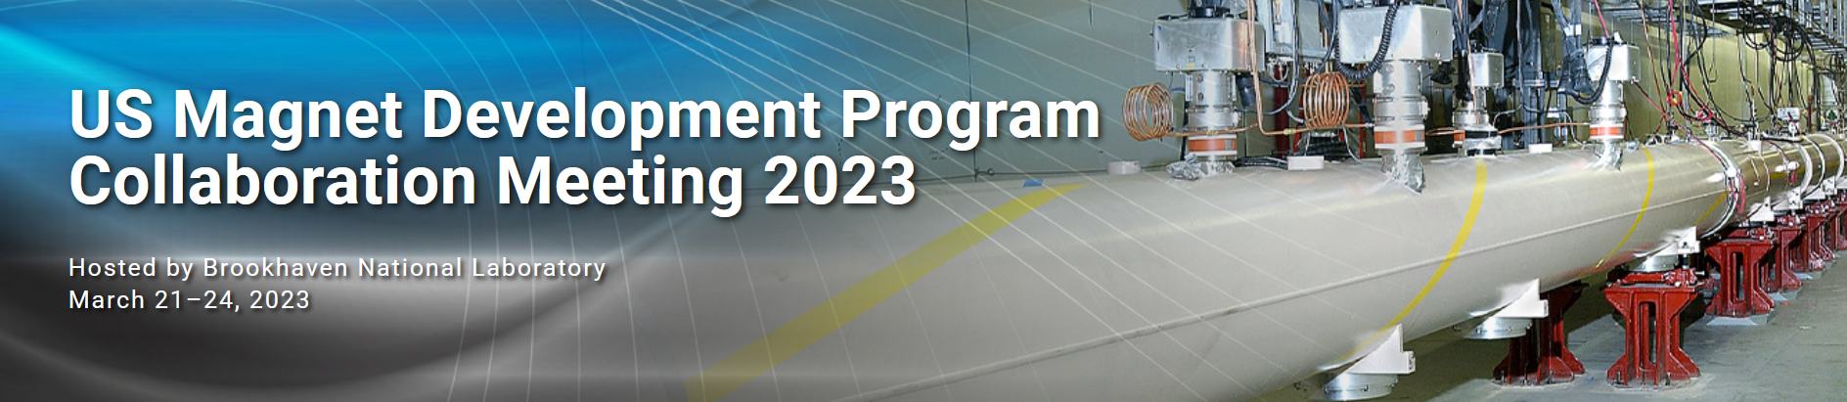
20 T Common Coil Mechanical FEA
M. Anerella
for
John Cozzolino, Chris Runyan
and
Ramesh Gupta

Slide 2
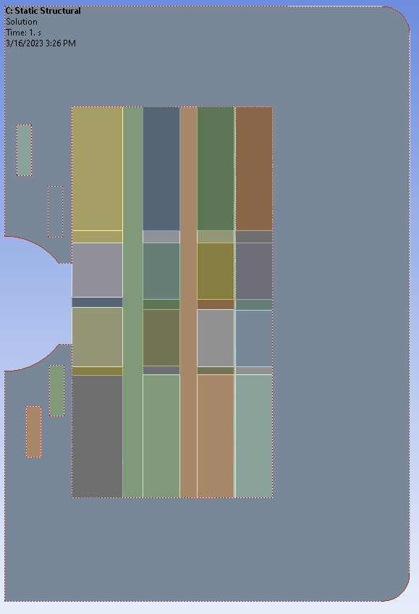
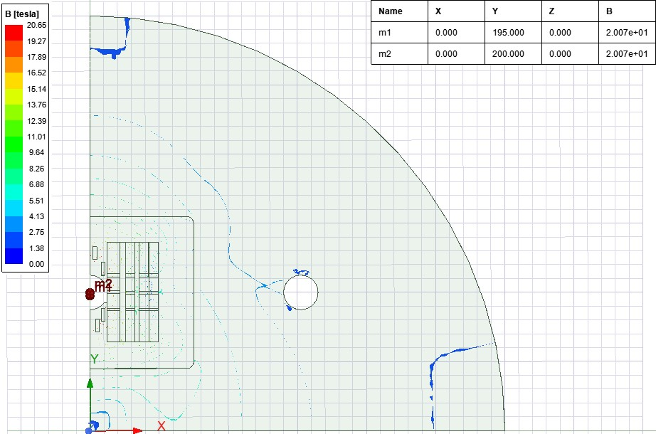
Model from previous review:
7.65mm
6.50mm
Initial Finite Element Model
Structure consists of a solid stainless-steel collar.
Inner and outer coil vertical spacing of 7.65 and 6.50 mm respectively between coils
50mm
Clear aperture

Slide 3
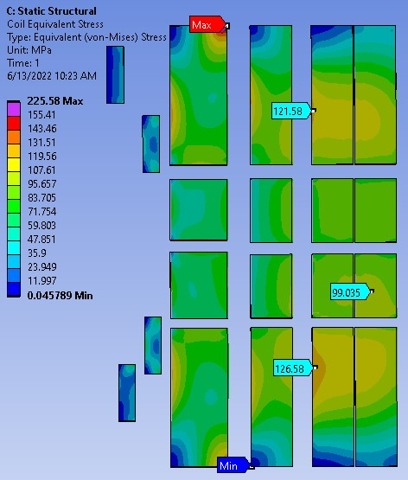
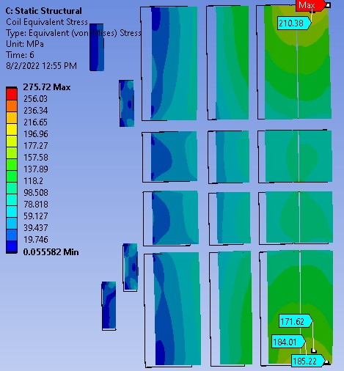
Results from previous review:
225MPa in HTS
LTS OK
210MPa in LTS
HTS OK
Coil Equivalent Stress – Fixed Vertical Separators
Solid stainless steel one-piece collar
Stainless steel horizontal stress supports
Coil Equivalent Stress – Sliding Vertical Separators
Solid stainless steel one-piece collar
Stainless steel horizontal stress supports

Slide 4
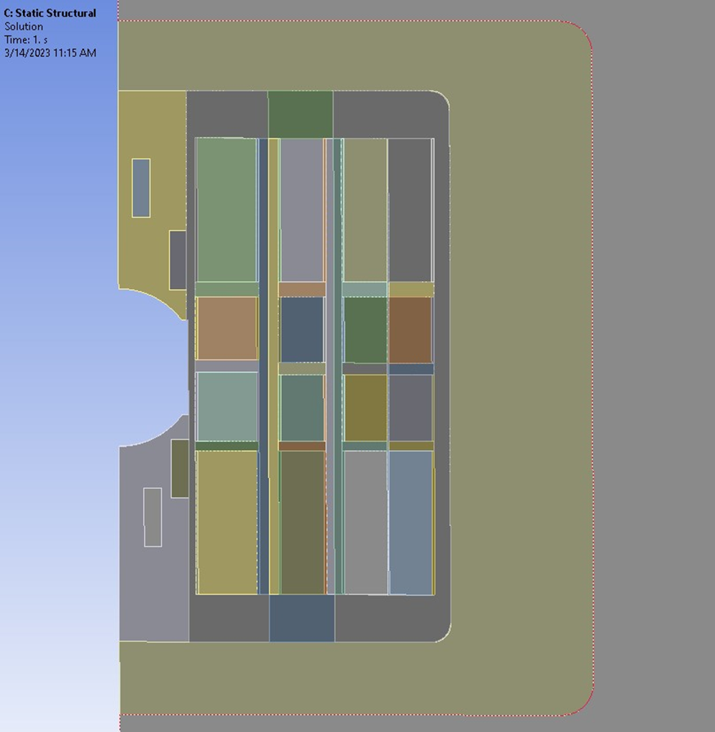
Goal of follow-on work: produce acceptable stresses in HTS & LTS together
7.65mm
6.50mm
Initial Method: Revised Structural FE Model
Uses original Maxwell model shown above because coil positions have not changed.
Structure divided into:
  individual collars inside an outer collar.
  0.76 mm “spacers” on both sides of coils (within original 7.65mm and 6.50mm vertical separations)
  Provides option of experimenting with different softer materials to minimize peak stresses – when not implemented, 0.76mm spacers are reverted to SST and bonded to original spacers

Slide 5
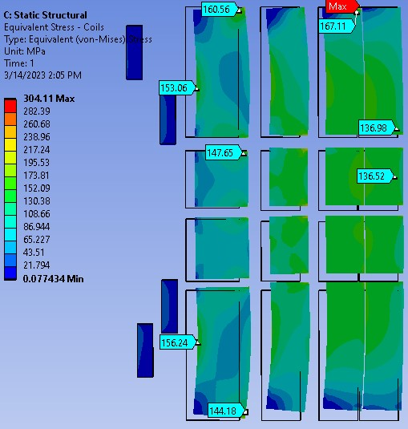
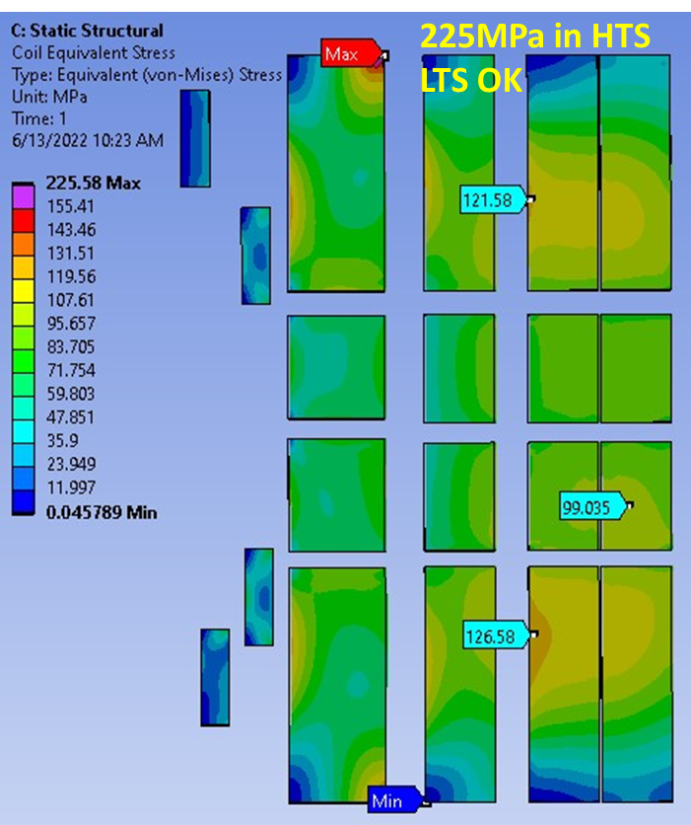
Results of initial revised model: improvement, but not yet acceptable
Was 225MPa in HTS
Now 160MPa in HTS
LTS still OK but 304MPa in corner?
old
Coil Equivalent Stress – Fixed Vertical Separators
SST structure is split into individual collars
Frictionless contact between adjacent collars
0.76 mm Kapton padding on right side of all coils.

Slide 6
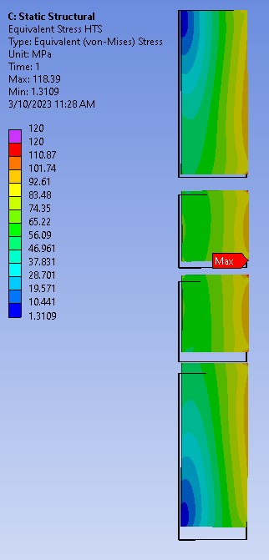
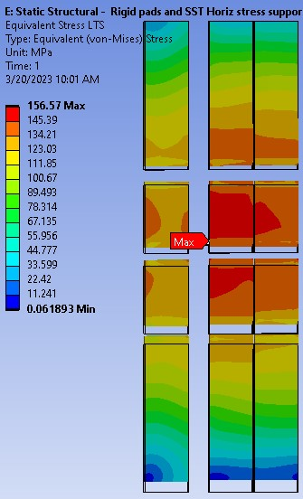
Test – determine effect of eliminating all bending within structure
Coil Equivalent Stress – Fixed Vertical Separators
Rigid spacers & collars are fully bonded together
Inner & outer coil vertical spacing is 7.65 and 6.50 mm respectively.
No Kapton padding
HTS & LTS stresses are acceptable; need to reduce bending

Slide 7
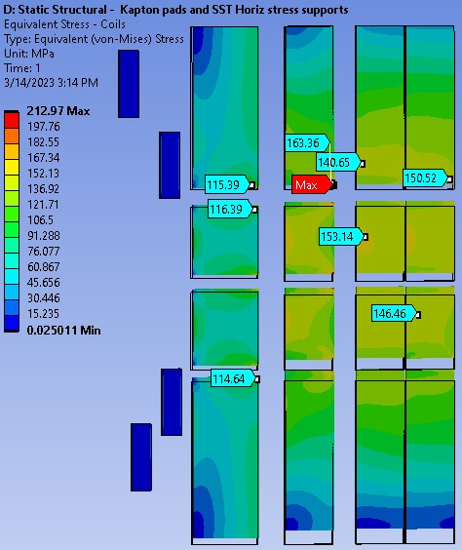
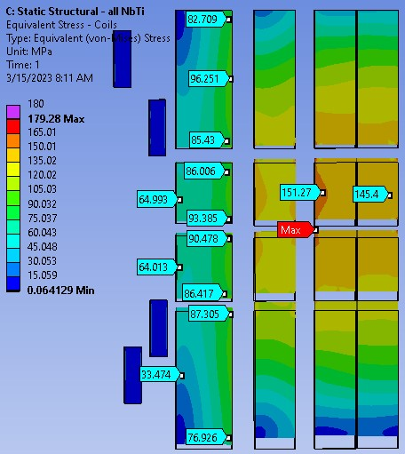
Test – determine added effect of zero bending plus soft material
Coil Equivalent Stress – Fixed Vertical Separators
Rigid spacers & collars are fully bonded together
Inner & outer coil vertical spacing is 7.65 and 6.50 mm respectively.
0.76 mm Kapton padding on right side of all coils.
HTS stresses are ok, LTS 212MPa peak
Pads and horizontal stress supports all set to the modulus of Nb₃Sn.
HTS and LTS stresses are acceptable

Slide 8
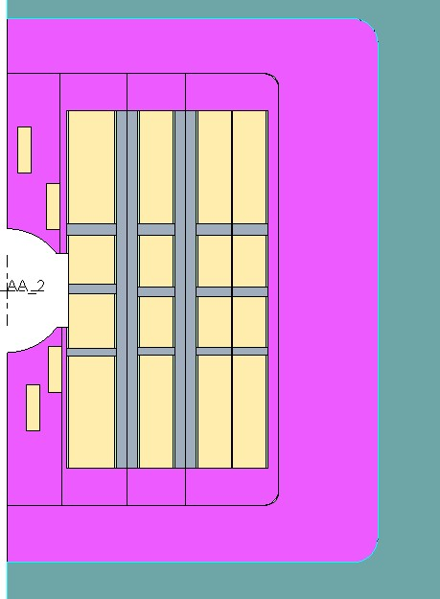
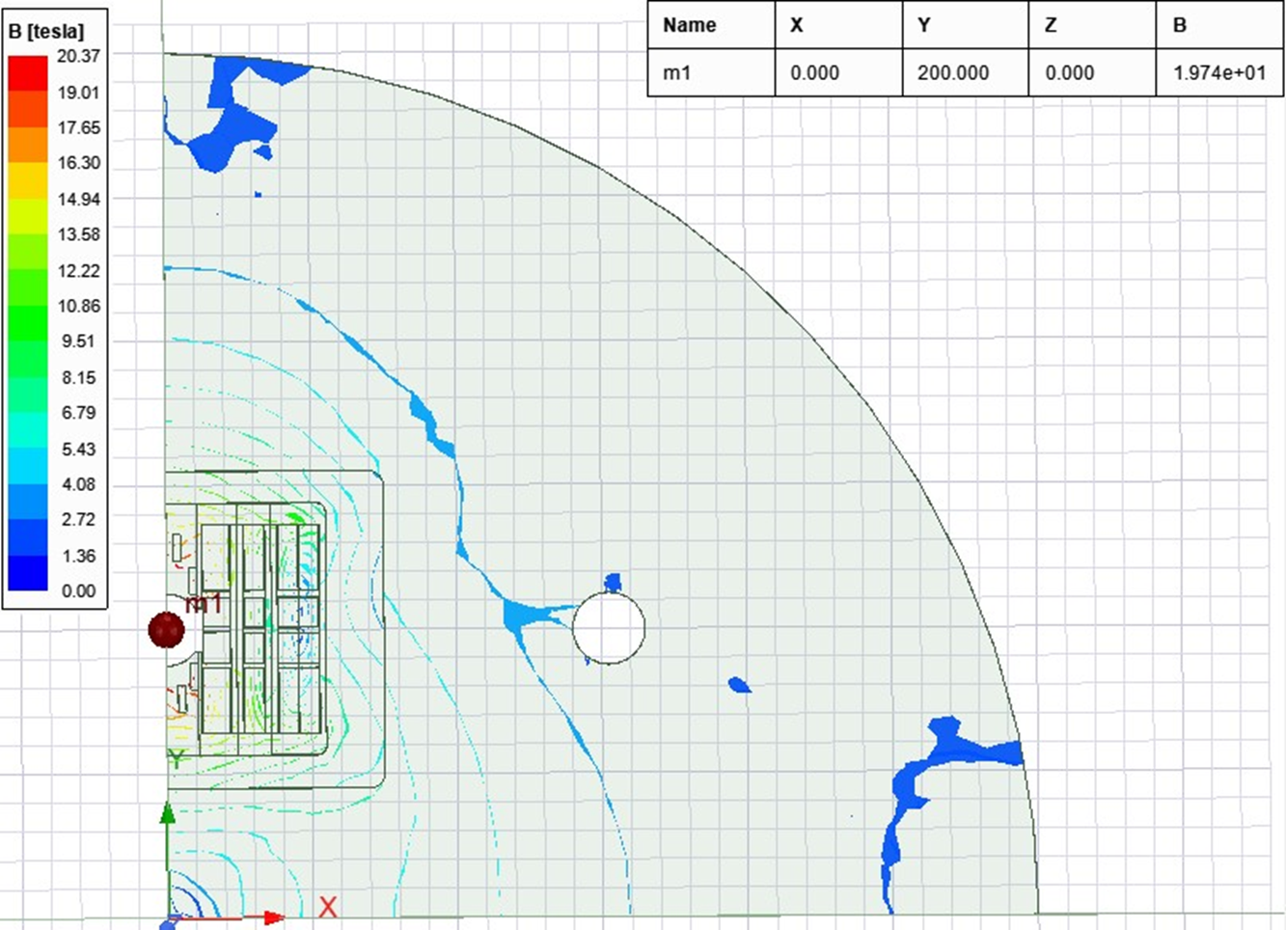
Real model solution
Second Revised Structural FE Model:
Coil inner and outer vertical spacing increased both to 10 mm to reduce bending
50 mm aperture.
Uses revised Maxwell model shown below because coil positions have changed.
0.76 mm thick “spacers” on both sides of coils (within 10mm)
  Provides option of selectively adding different soft materials.
Collars, spacers – modulus restored to SST unless noted
10mm
10mm
Revised Maxwell magnetic model
Reflects inner and outer coil vertical spacing of 10 mm.
Dipole central flux density dropped slightly to just under 20 T.

Slide 9
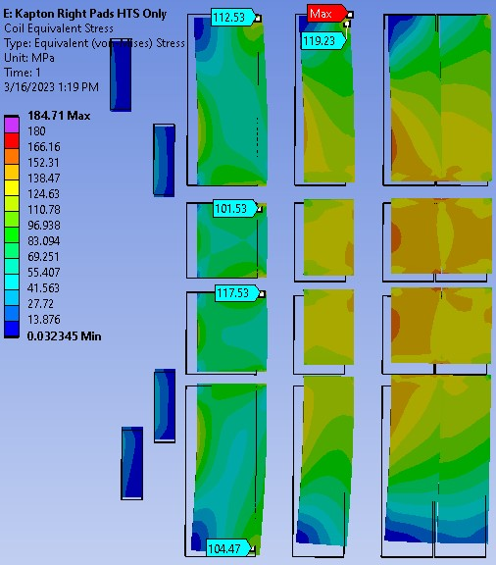
Real model solution (cont’d)
Coil Equivalent Stress – Fixed Vertical Separators
Stainless steel collars are fully bonded together.
Right pads are Kapton on HTS only. All others are stainless steel
Horizontal stress supports are stainless steel.
  112MPa max in HTS
  ~180MPa max* in LTS
  * 184MPa in corner, to be corrected via mesh refinement…

