Slide 1
Nb₃Sn Magnets:
15 T Cos-Theta Dipole Status
MDP meeting, December 6, 2017
Alexander Zlobin
US Magnet Development Program
Fermi National Accelerator Laboratory

Slide 2
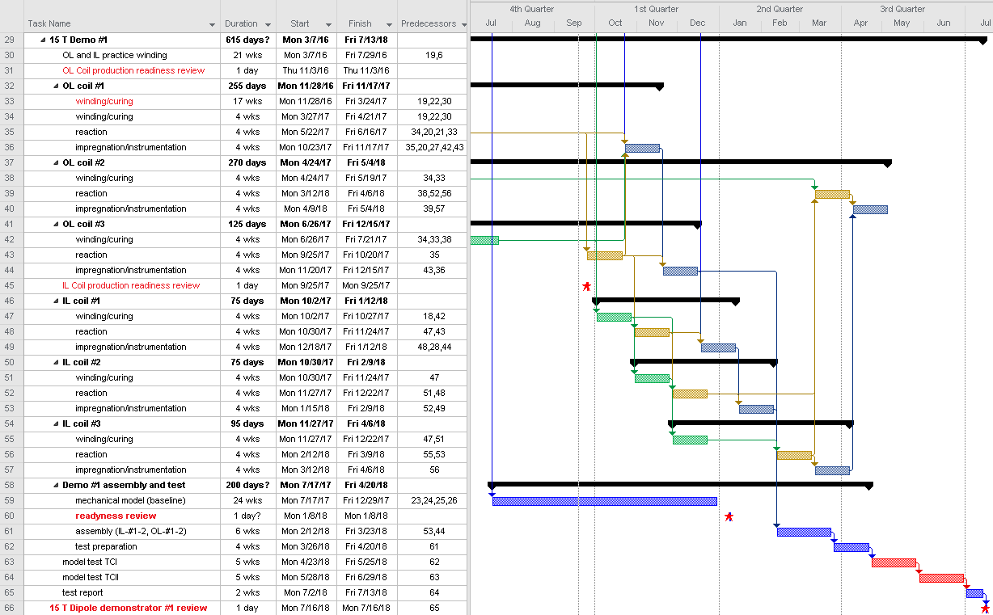
15 T dipole: Magnet Fabrication and test plan and schedule (Oct)

Slide 3
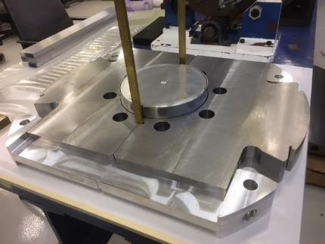
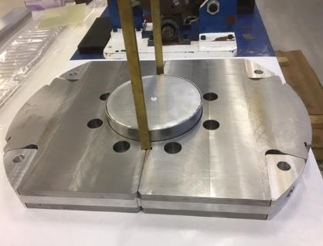
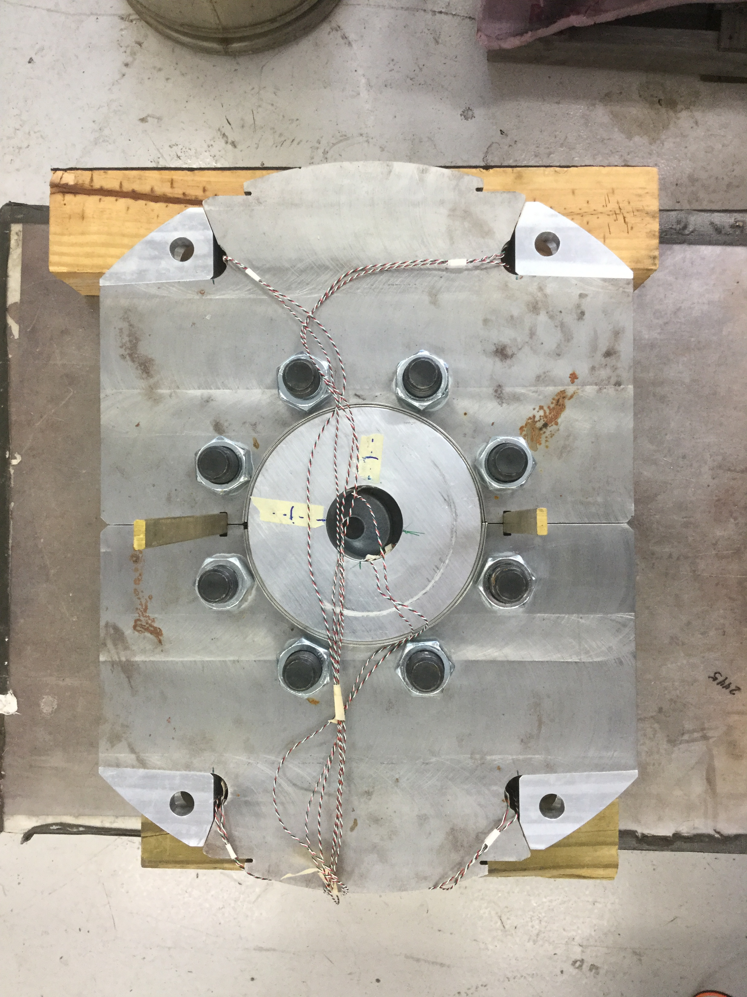
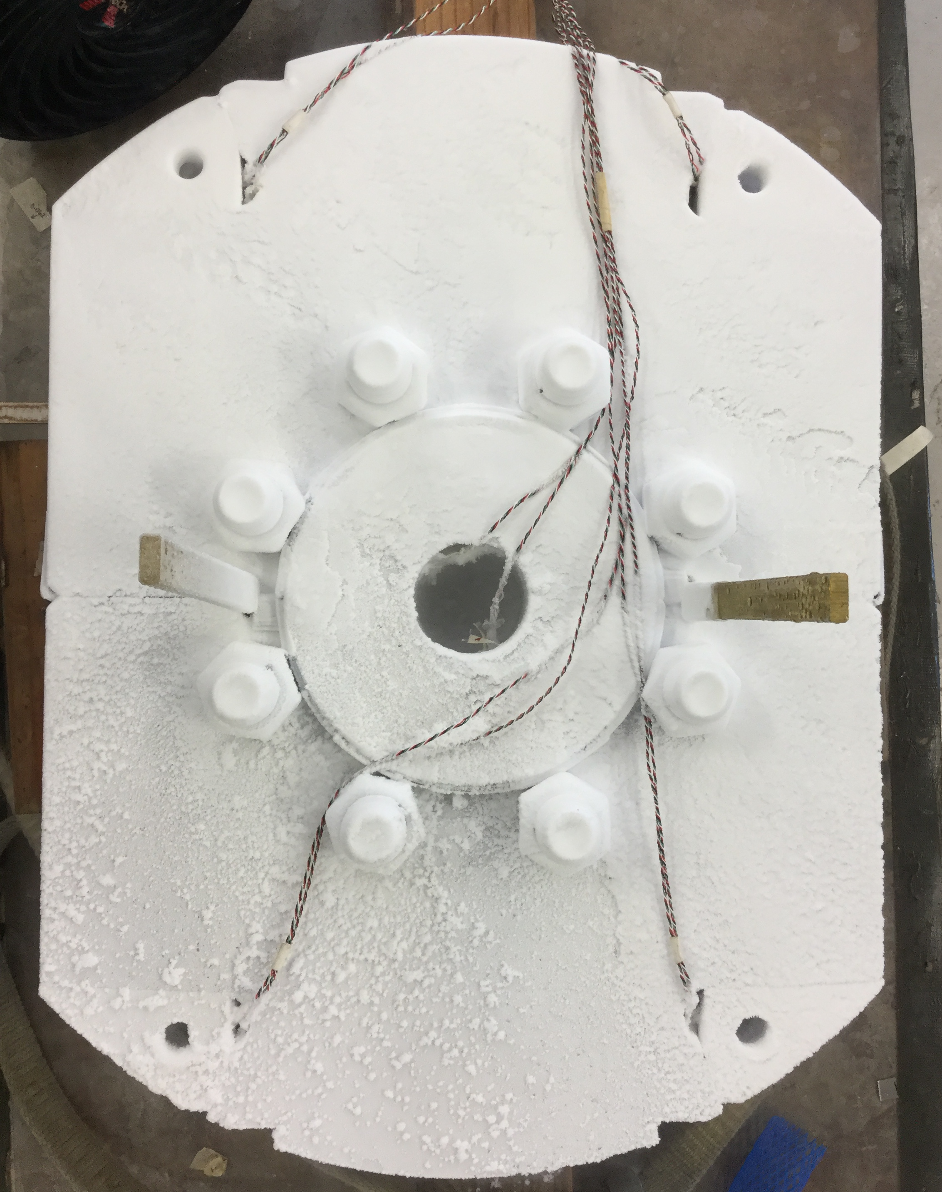
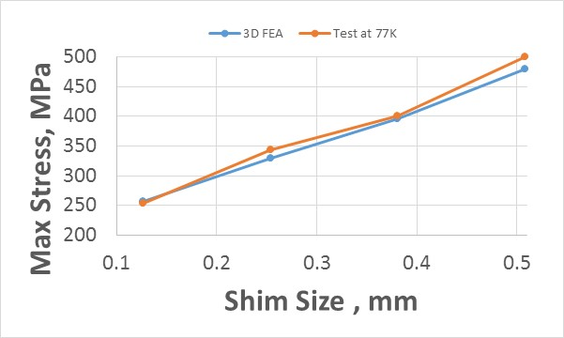
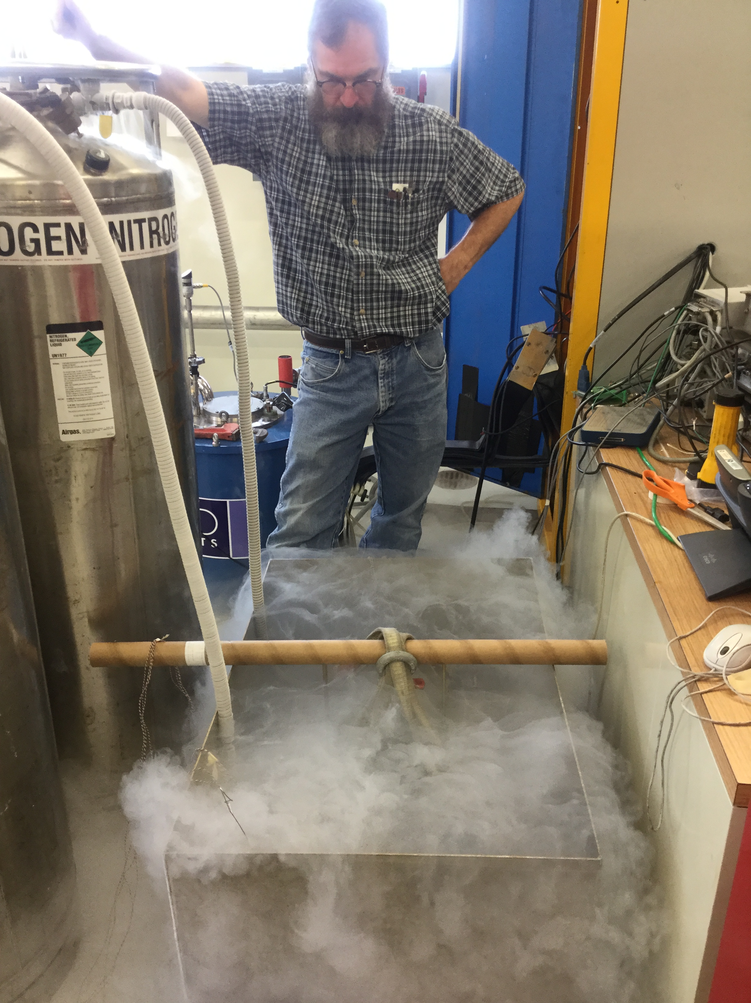
15 T dipole: Short Mechanical Model
Models:
5 cm long
1 m long
MM components:
iron laminations
Al I-clamps
coil-yoke shim
instrumented “dummy” Al coils (short and full-size)
Goals:
To test all main components of the mechanical structure and tooling
Develop a coil assembly plan and pre-stress targets
Check instrumentation
FEA validation

Slide 4
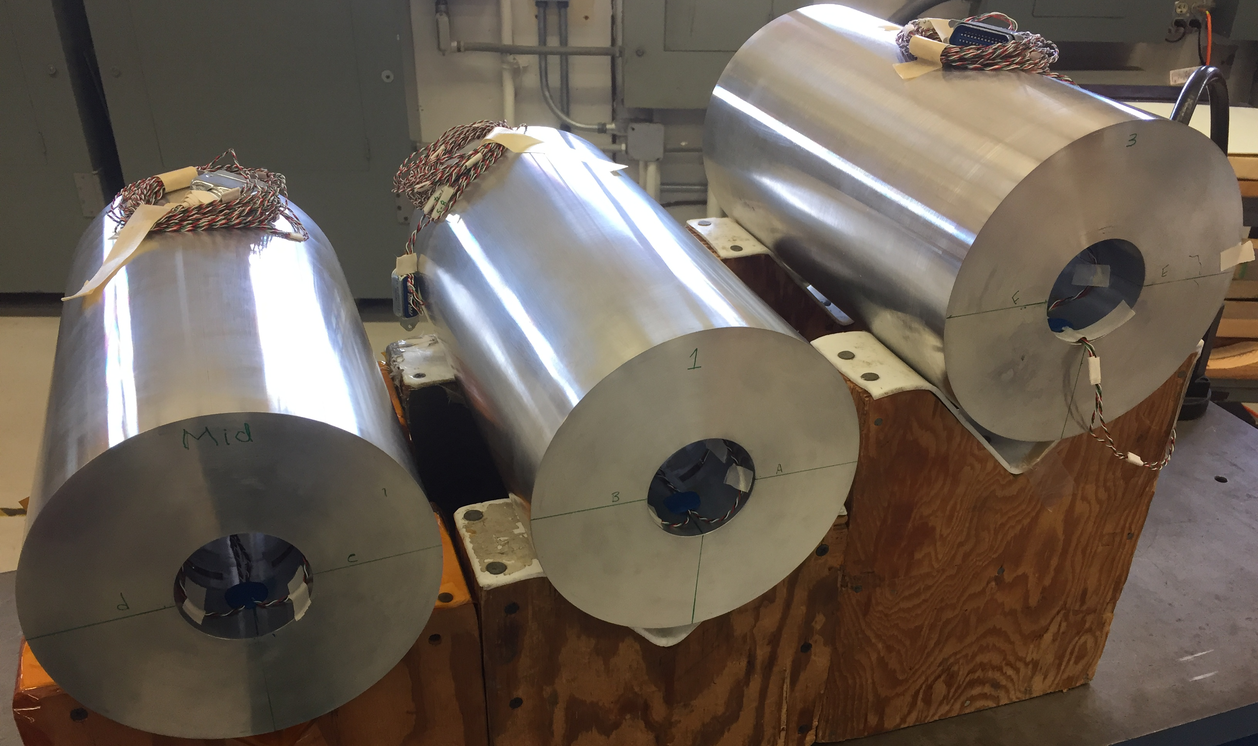
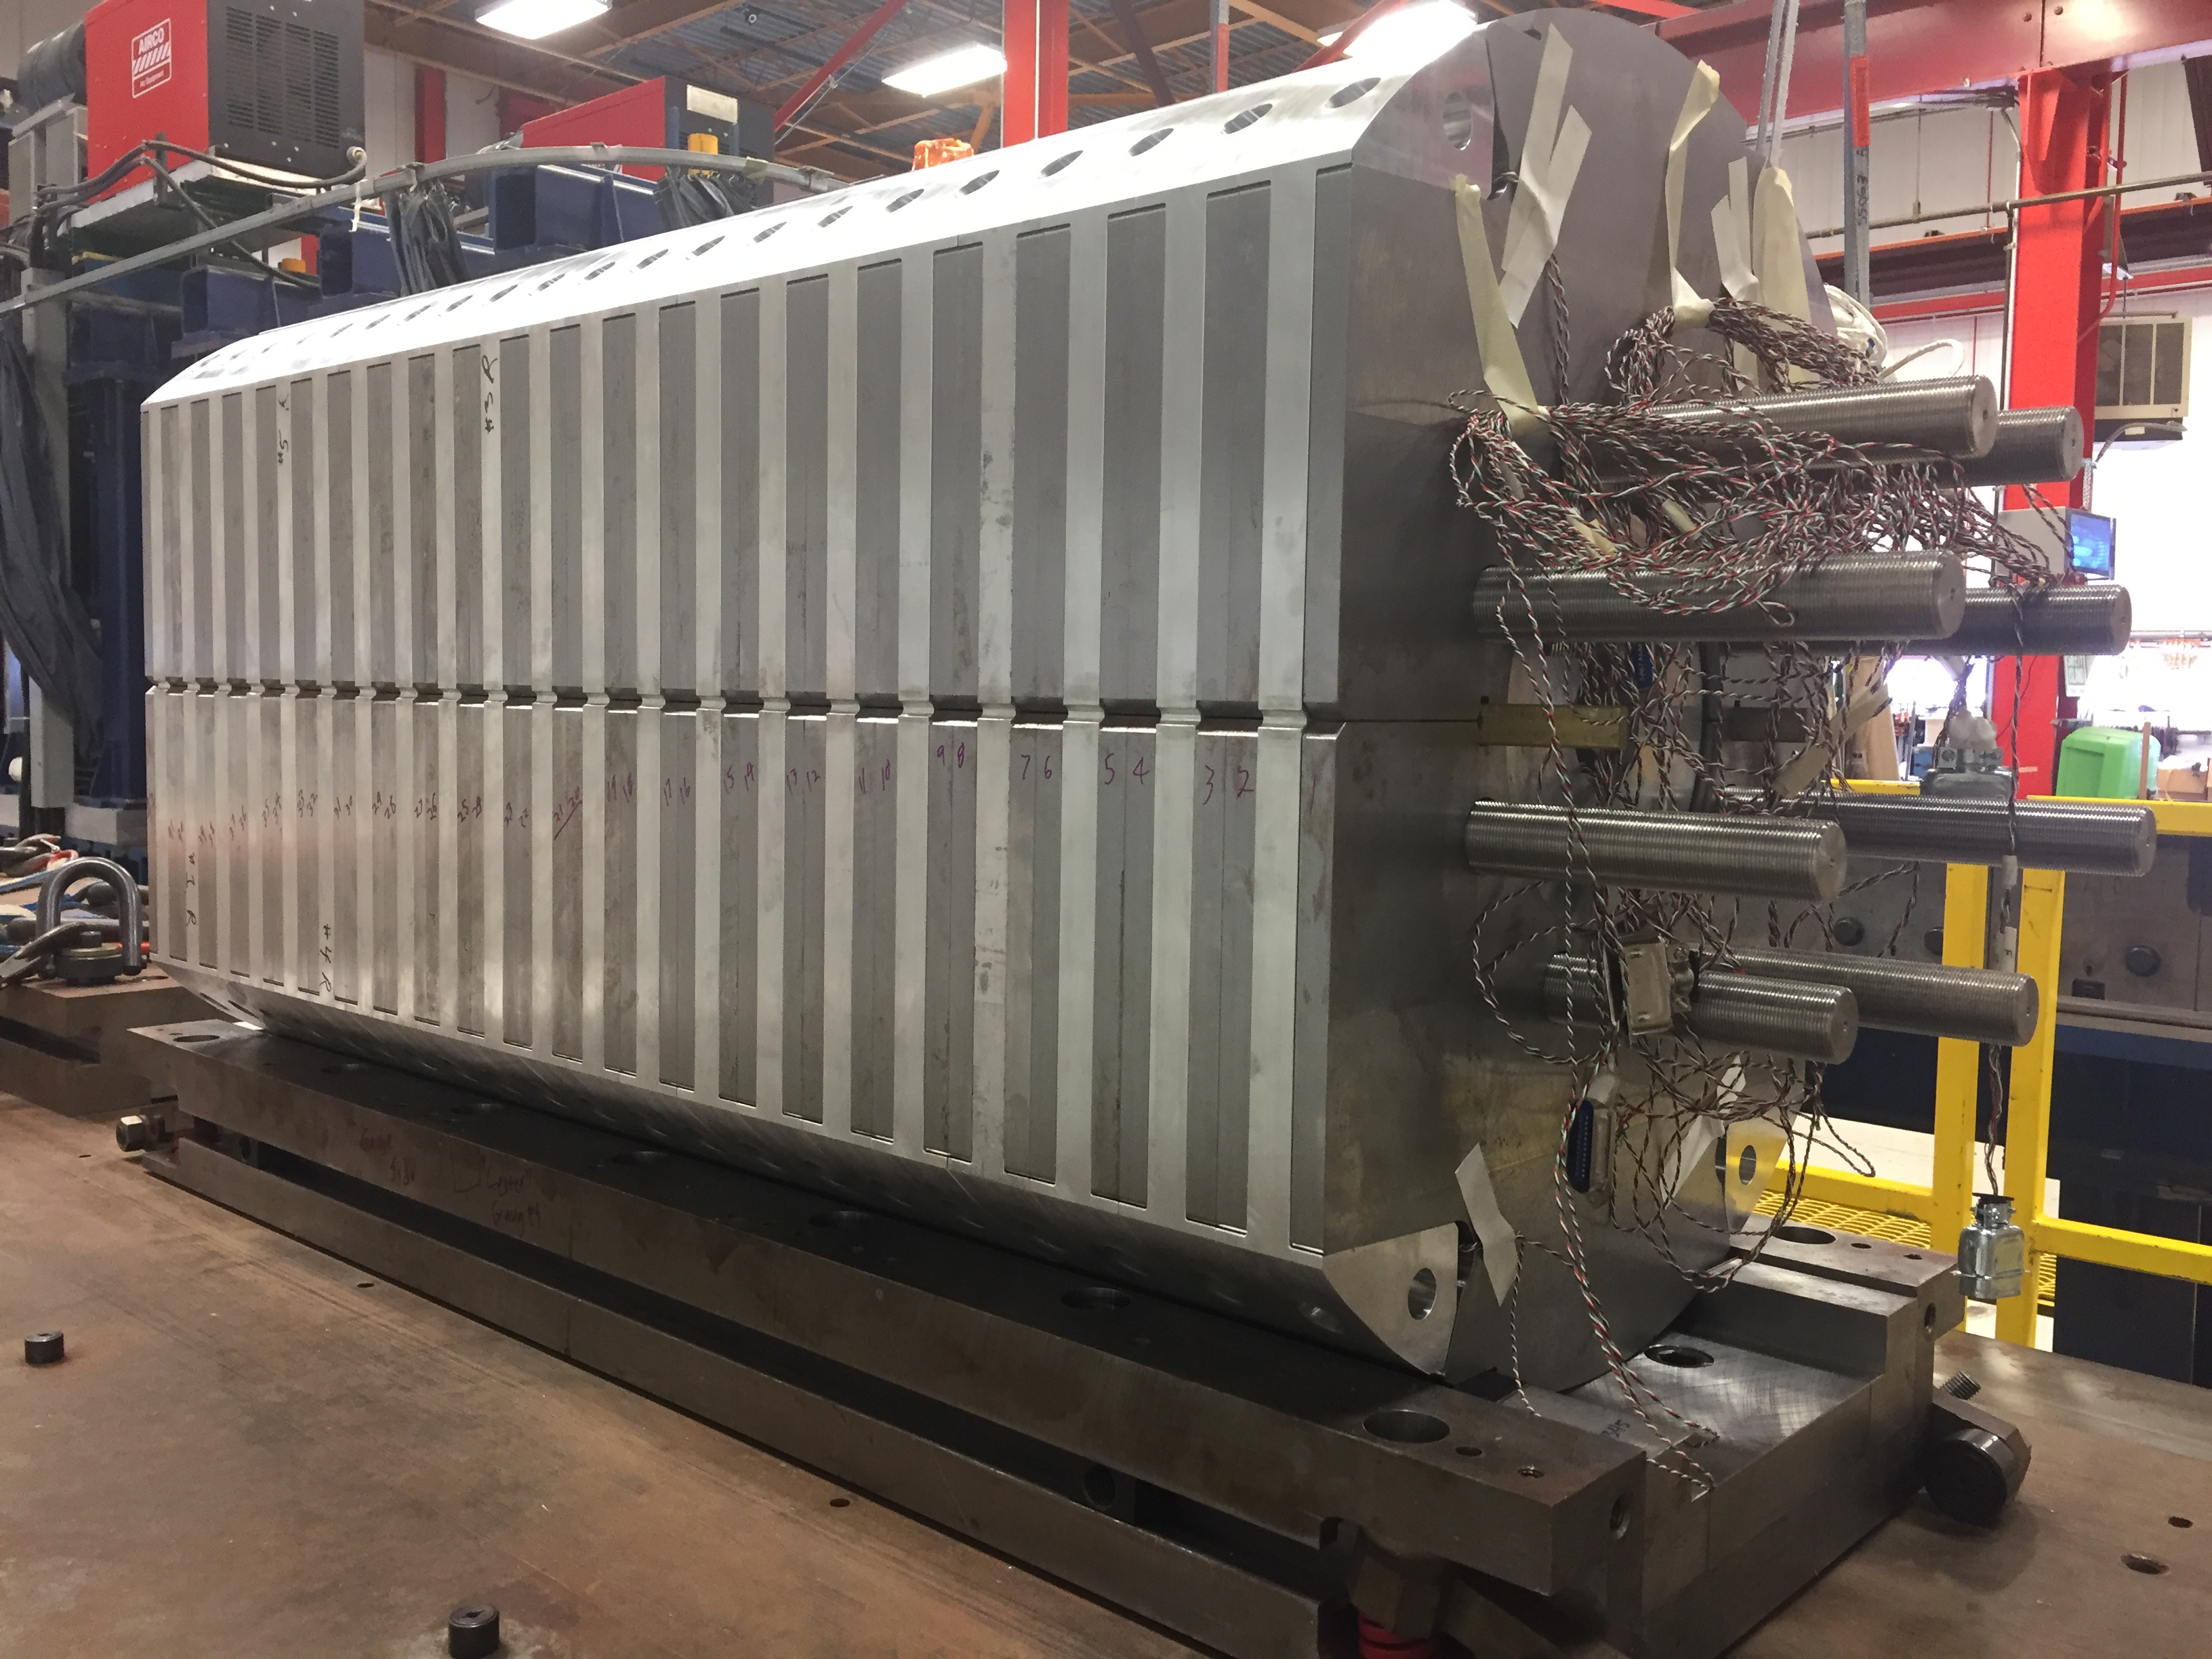
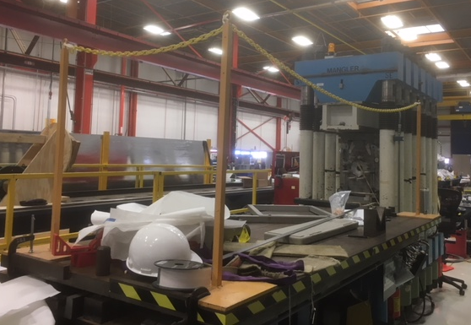
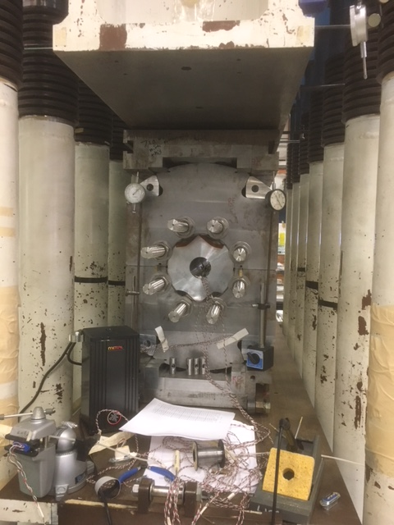
15 T dipole: Long Mechanical Model
Cylindric dummy coil instrumentation complete
Model assembly with two shims
On hold – waiting for safety rails

Slide 5
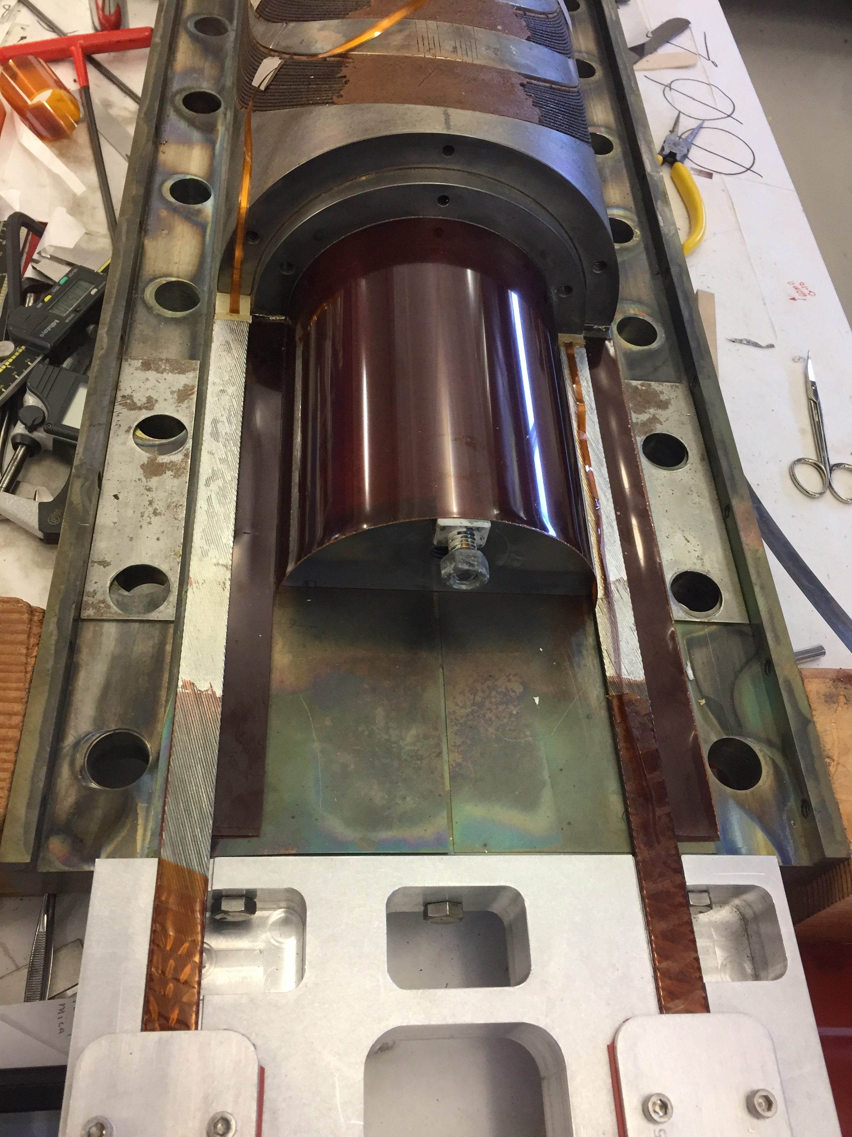
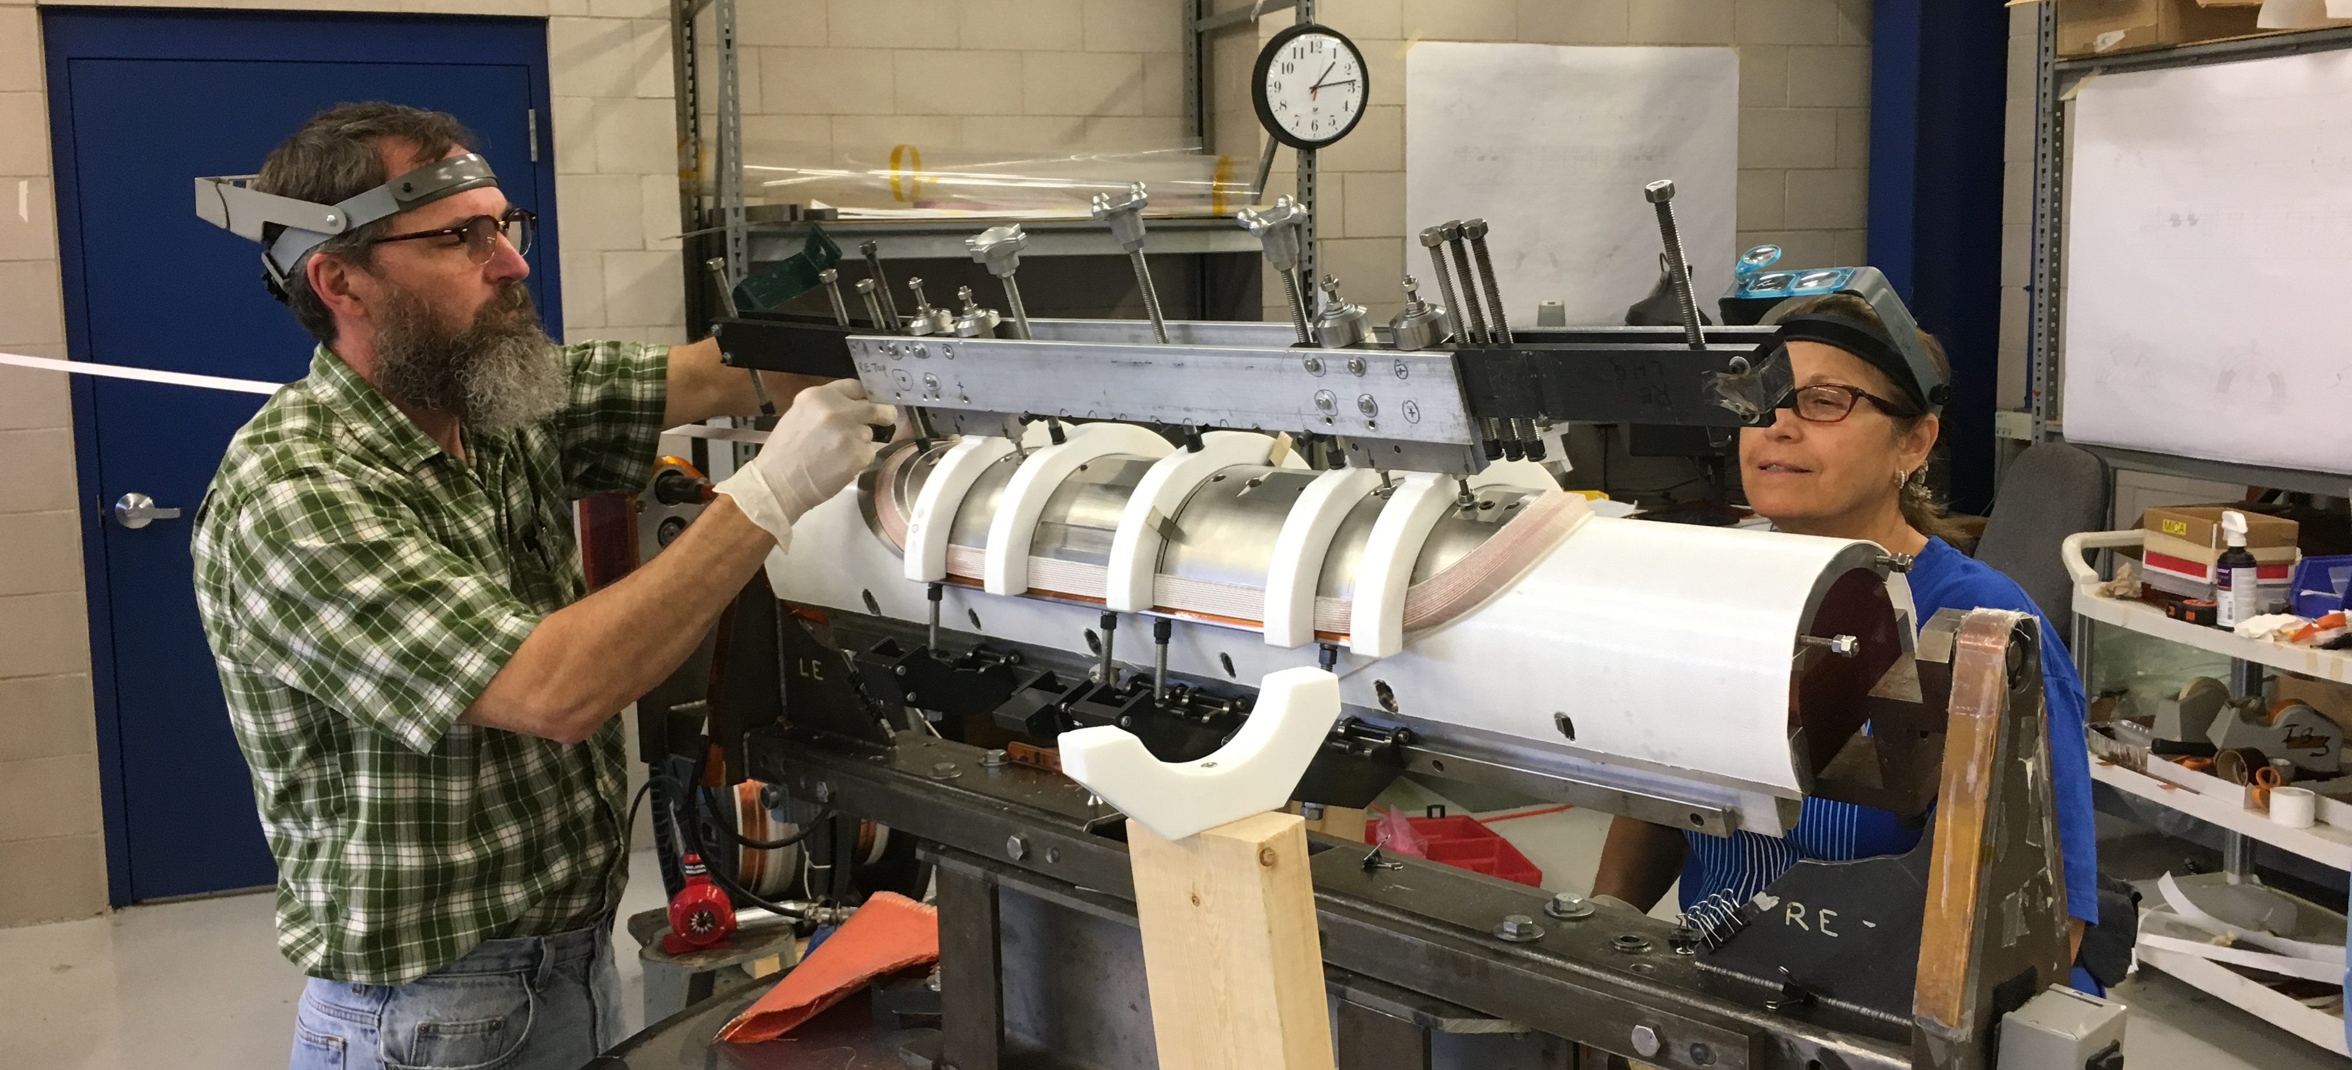
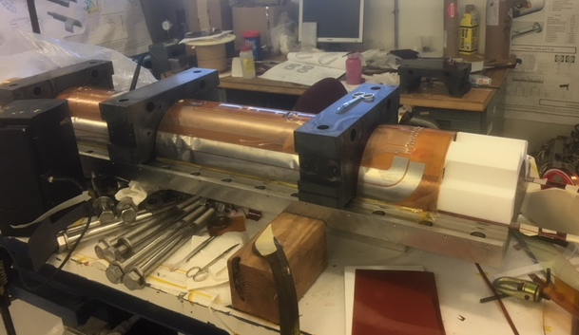
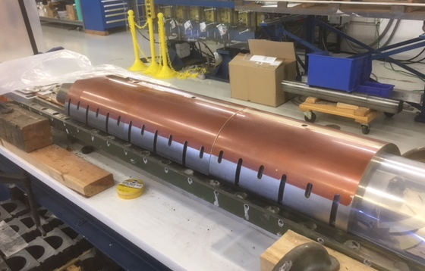
15 T dipole: Coil Fabrication Status - L3/4 coils
Coil #1
Coil reaction is complete
Leads splicing done
Preparation for coil impregnation is in progress
Coil #2
Coil winding and curing is complete
Short in the transition cable has been found and fixed
Will be used as a spare coil
Coil #3
wound and cured
Reacted, waiting for impr. tooling

Slide 6
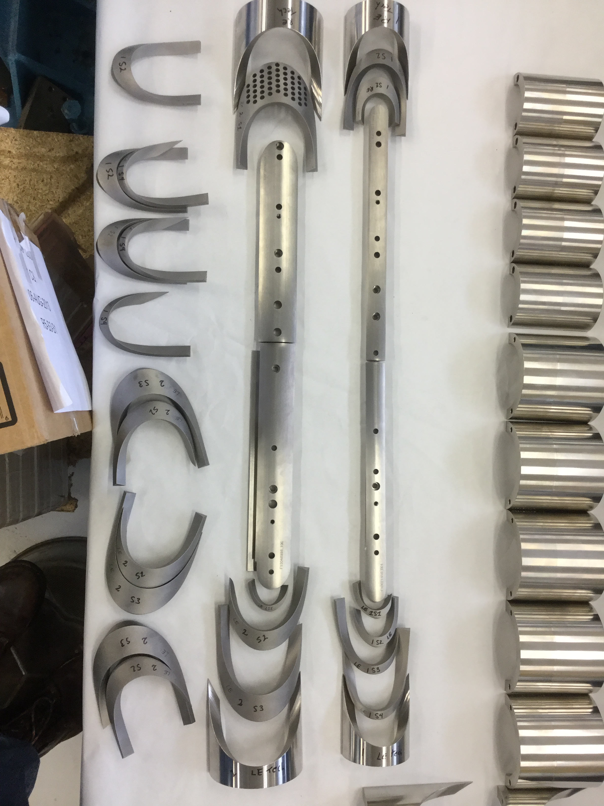
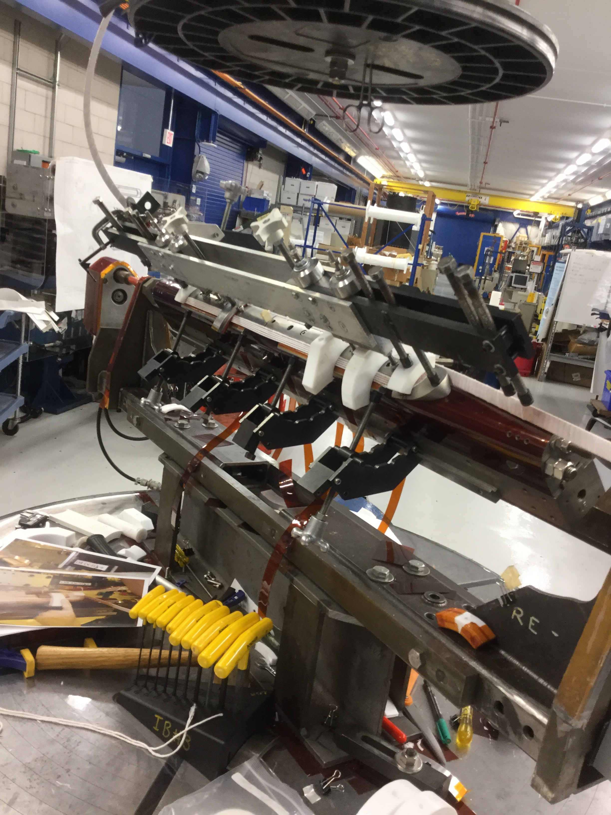
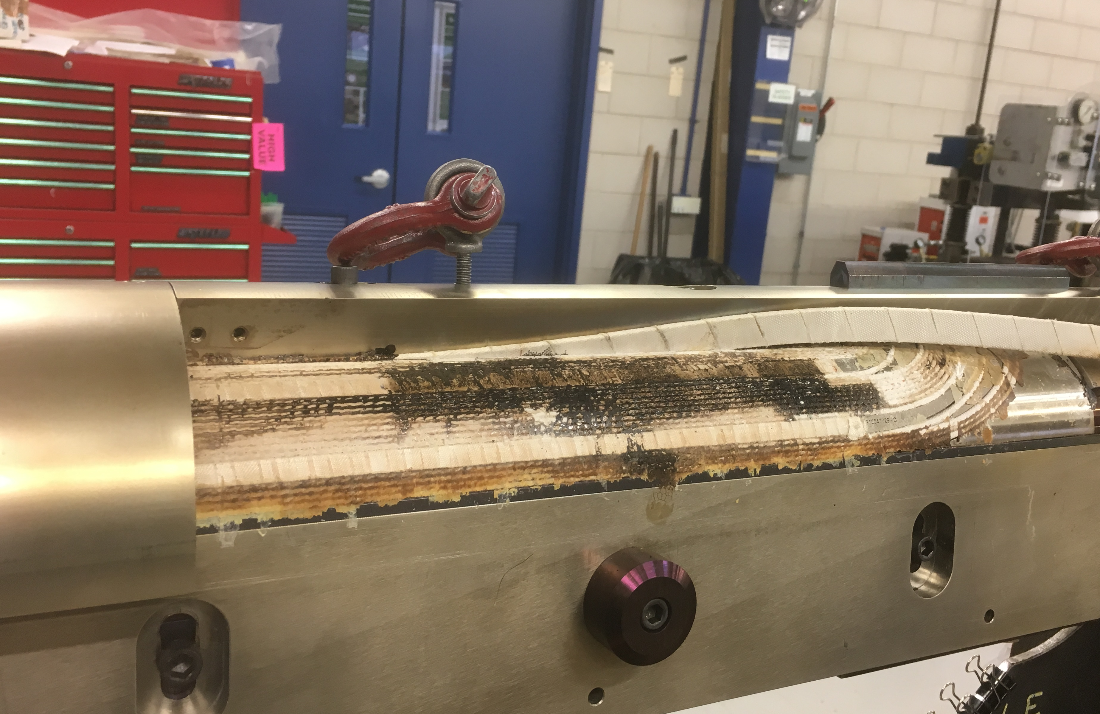
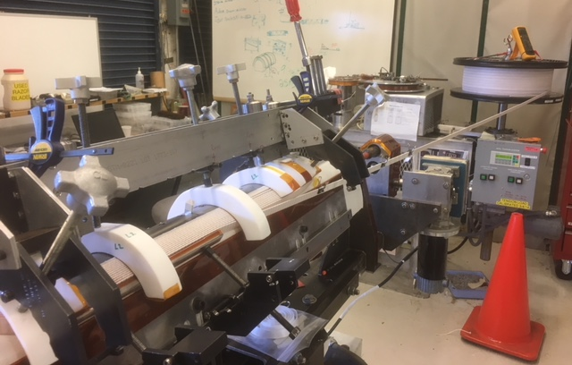
15 T dipole: Coil Fabrication Status - L1/2 coils
L1/2 coil winding starts in October 2017
Production readiness review – September 20, 2017
Coil #1
Inner-layer wound and cured – damaged during curing
New inner-layer wound and cured
Outer-layer winding in progress

Slide 7
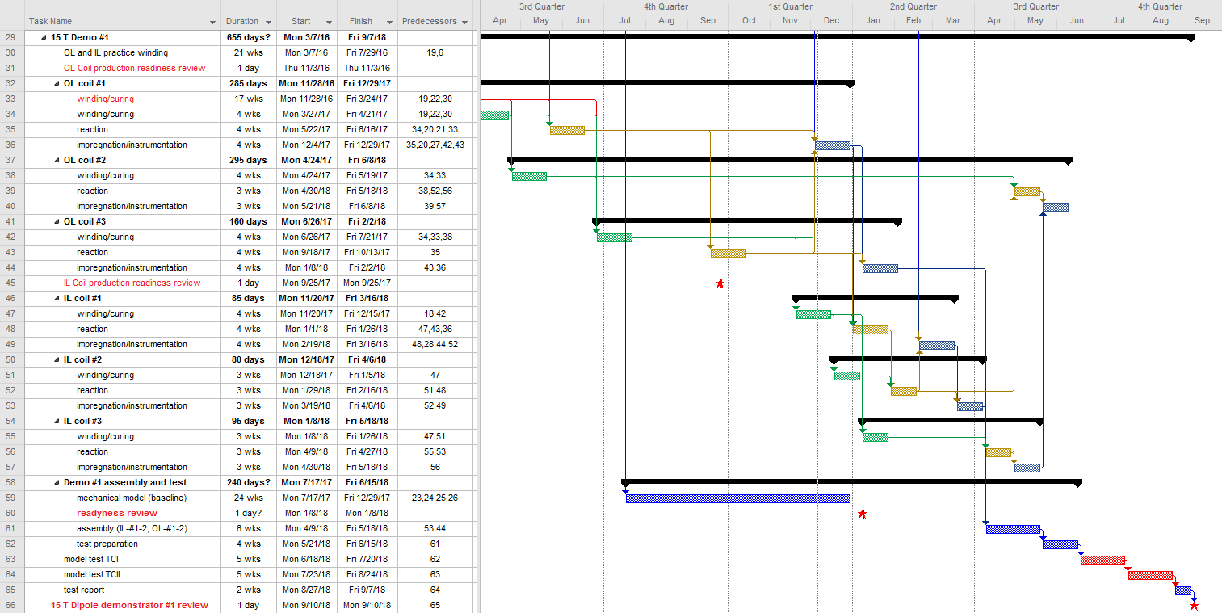
15 T dipole: Magnet Fabrication and test schedule update (Dec)
6 weeks delay
Moving to IB3 and re-winding L1
Curing press upgrades and recommissioning

