Slide 1
Modeling of electron-cloud-driven two-stream instability

Slide 2
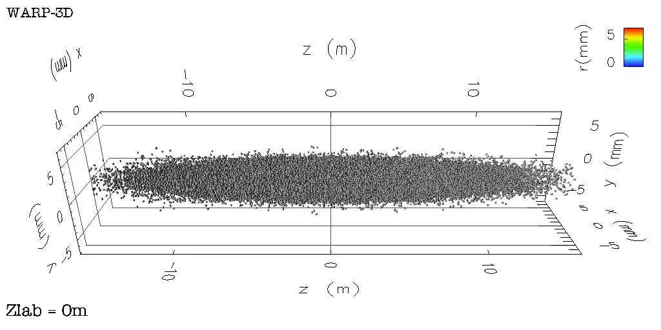
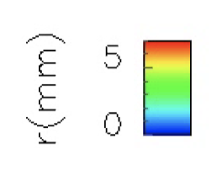
Relativistic proton beam crossing electron cloud
n_{e}(m⁻³)
Proton beam
(γ=500, σ_{z}=13 cm)
10¹⁵
0
z (km)
0
1
2
3
4
5
6
7
8
9
Notes:
The basics of the new observation lies in a direct consequence of the space and time dilation/contraction via Lorentz tranformation. For two objects crossing each other at relativistic velocities, the range of space and time scale is not a Lorentz invariant. For some reason, this direct and simple consequence of Lorentz transformation does not seem to be well known. However, its implications are potentially significant, especially for numerical simulation from first principles, for which the cost is generally proportional to the space and time scale range. For systems where the components cross with large relative gamma, the difference in numerical cost can be huge (orders of magnitude) depending on the choice of frame of calculation.

Slide 3
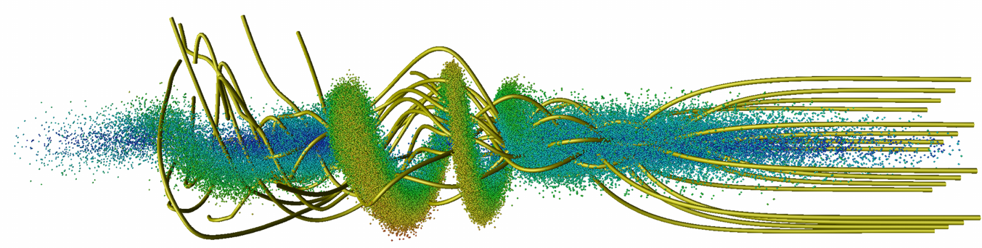
Modeling of two-stream instability is expensive
Need to follow:
short (σ_{z}=13 cm) and stiff (γ=500) proton beam for kilometer
mobile background electrons reacting in fraction of beam length
➔ many small time steps
electron
streamlines
beam
  Two solutions:
  separate treatment of slow (beam) and fast (electrons) components ➔ quasistatic approximation
  solve in a Lorentz boosted frame which matches beam & electrons time scales
Notes:
The basics of the new observation lies in a direct consequence of the space and time dilation/contraction via Lorentz tranformation. For two objects crossing each other at relativistic velocities, the range of space and time scale is not a Lorentz invariant. For some reason, this direct and simple consequence of Lorentz transformation does not seem to be well known. However, its implications are potentially significant, especially for numerical simulation from first principles, for which the cost is generally proportional to the space and time scale range. For systems where the components cross with large relative gamma, the difference in numerical cost can be huge (orders of magnitude) depending on the choice of frame of calculation.

Slide 4
Quasistatic approximation approach
2-D slab of electrons (fast time scale)
3-D beam
(long time scale)
s
lattice
s_{n}
quad
drift
bend
drift
2-D slab of electrons is stepped backward (with small time steps) through the beam field and its self-field (solving 2-D Poisson at each step),
2-D electron fields are stacked in a 3-D array and added to beam self-field,
3-D field is used to kick the 3-D beam,
3-D beam is pushed to next station with large time steps,
Solve Poisson for 3-D beam self-field.
repeat

Slide 5

Optimal Lorentz boosted frame approach
Lorentz
transformation
Lab frame
Boosted frame
Beam
Beam
Accelerator
Accel.
Many time steps needed to follow short stiff high-energy beam into long accelerator filled with fast reacting electron clouds.
Much less time steps needed to follow long low-energy beam into shorter accelerator filled with stiffer electron clouds.
Number of time steps divided by (1+β)γ²
With high γ, orders of magnitude speedups are possible.

Slide 6
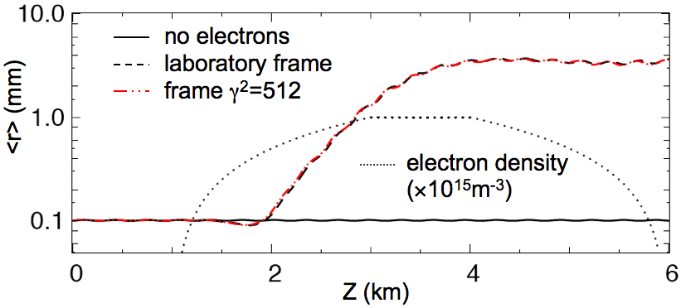
Application to modeling of two-stream instability
Calculation of e-cloud induced instability of a proton bunch
  Proton beam: γ=500, σ_{z}=13 cm
  L=6 km, continuous focusing
electron
streamlines
beam
proton bunch radius vs. z
CPU time (on 8 cores in 2006):
  lab frame: >2 weeks
  frame with γ²=512: <30 min
Speedup x1000
Notes:
The basics of the new observation lies in a direct consequence of the space and time dilation/contraction via Lorentz tranformation. For two objects crossing each other at relativistic velocities, the range of space and time scale is not a Lorentz invariant. For some reason, this direct and simple consequence of Lorentz transformation does not seem to be well known. However, its implications are potentially significant, especially for numerical simulation from first principles, for which the cost is generally proportional to the space and time scale range. For systems where the components cross with large relative gamma, the difference in numerical cost can be huge (orders of magnitude) depending on the choice of frame of calculation.

Slide 7
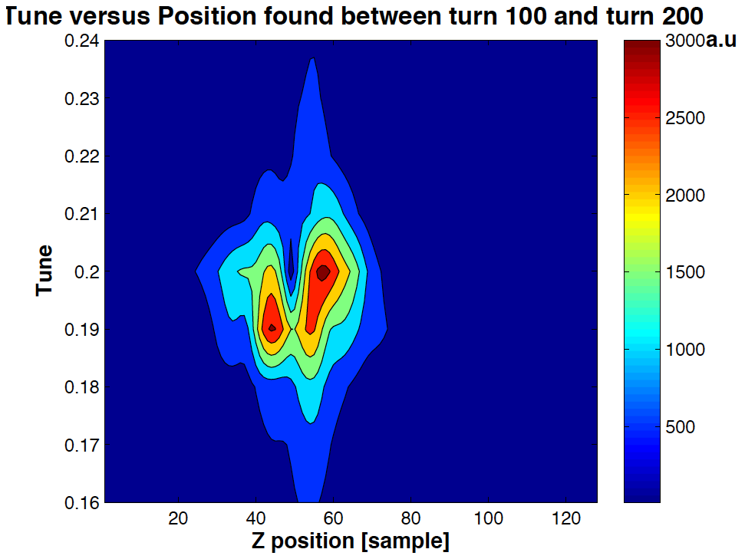
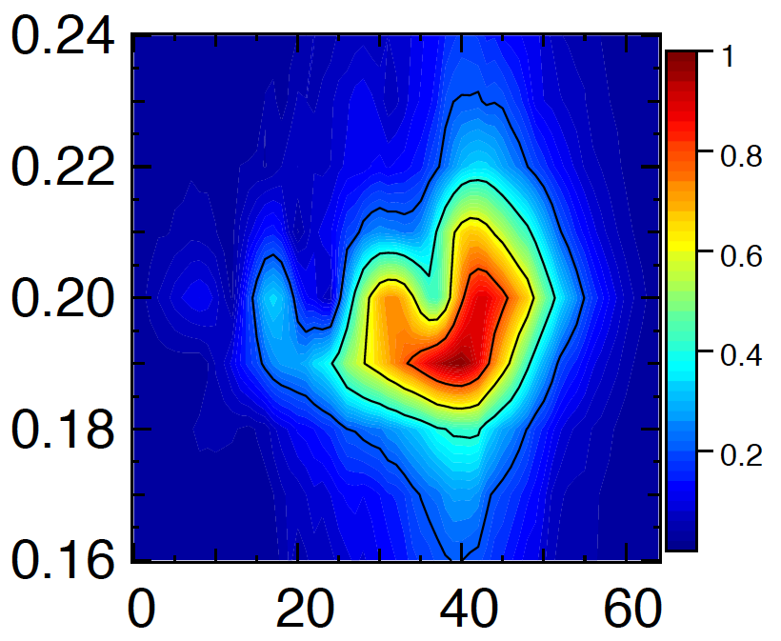
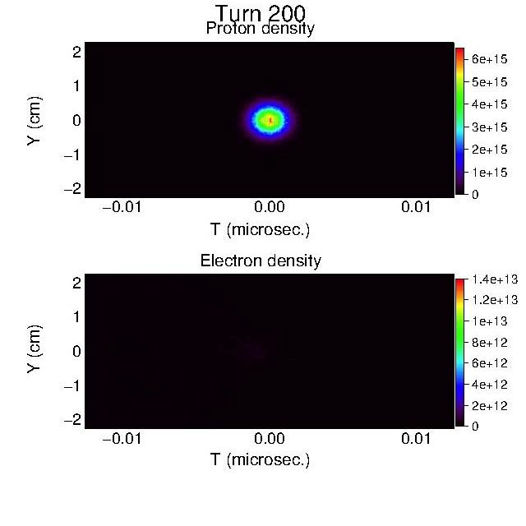

Warp+Posinst used to study e-cloud buildup and effect on 3 batches of 72 bunches in CERN SPS (>10k cores, 1 MPI group/bunch)
Warp-Posinst²
Experiment¹
Bunch 29, Turn 100-200
Bunch 119, Turn 100-200
Fractional tune
Fractional tune
Bunch-by-bunch snapshosts
Turn 200
x10¹⁵
Turn 1000
x10¹⁵
2
1
0
-1
-2
p+ density
6
4
2
0
2
1
0
-1
-2
p+ density
6
4
2
0
Y (cm)
Y (cm)
head
tail
head
tail
T (μs)
T (μs)
e- density
x10¹³
e- density
x10¹³
2
1
0
-1
-2
1
0
2
1
0
-1
-2
1
0
Bunch slice
Bunch slice
1
1
Y (cm)
Y (cm)
²J.-L. Vay, et al, Ecloud10 Proc., (2010)
¹J. Fox, et al, IPAC10 Proc., p. 2806 (2011)
T (μs)
T (μs)
J.-L. Vay, et al, IPAC12 Proc., (2012) TUEPPB006

Slide 8
Modeling of plasma-based accelerators

Slide 9
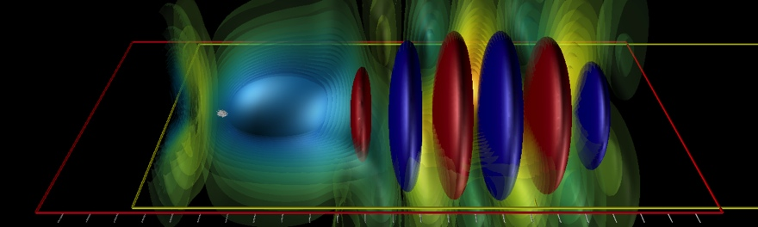
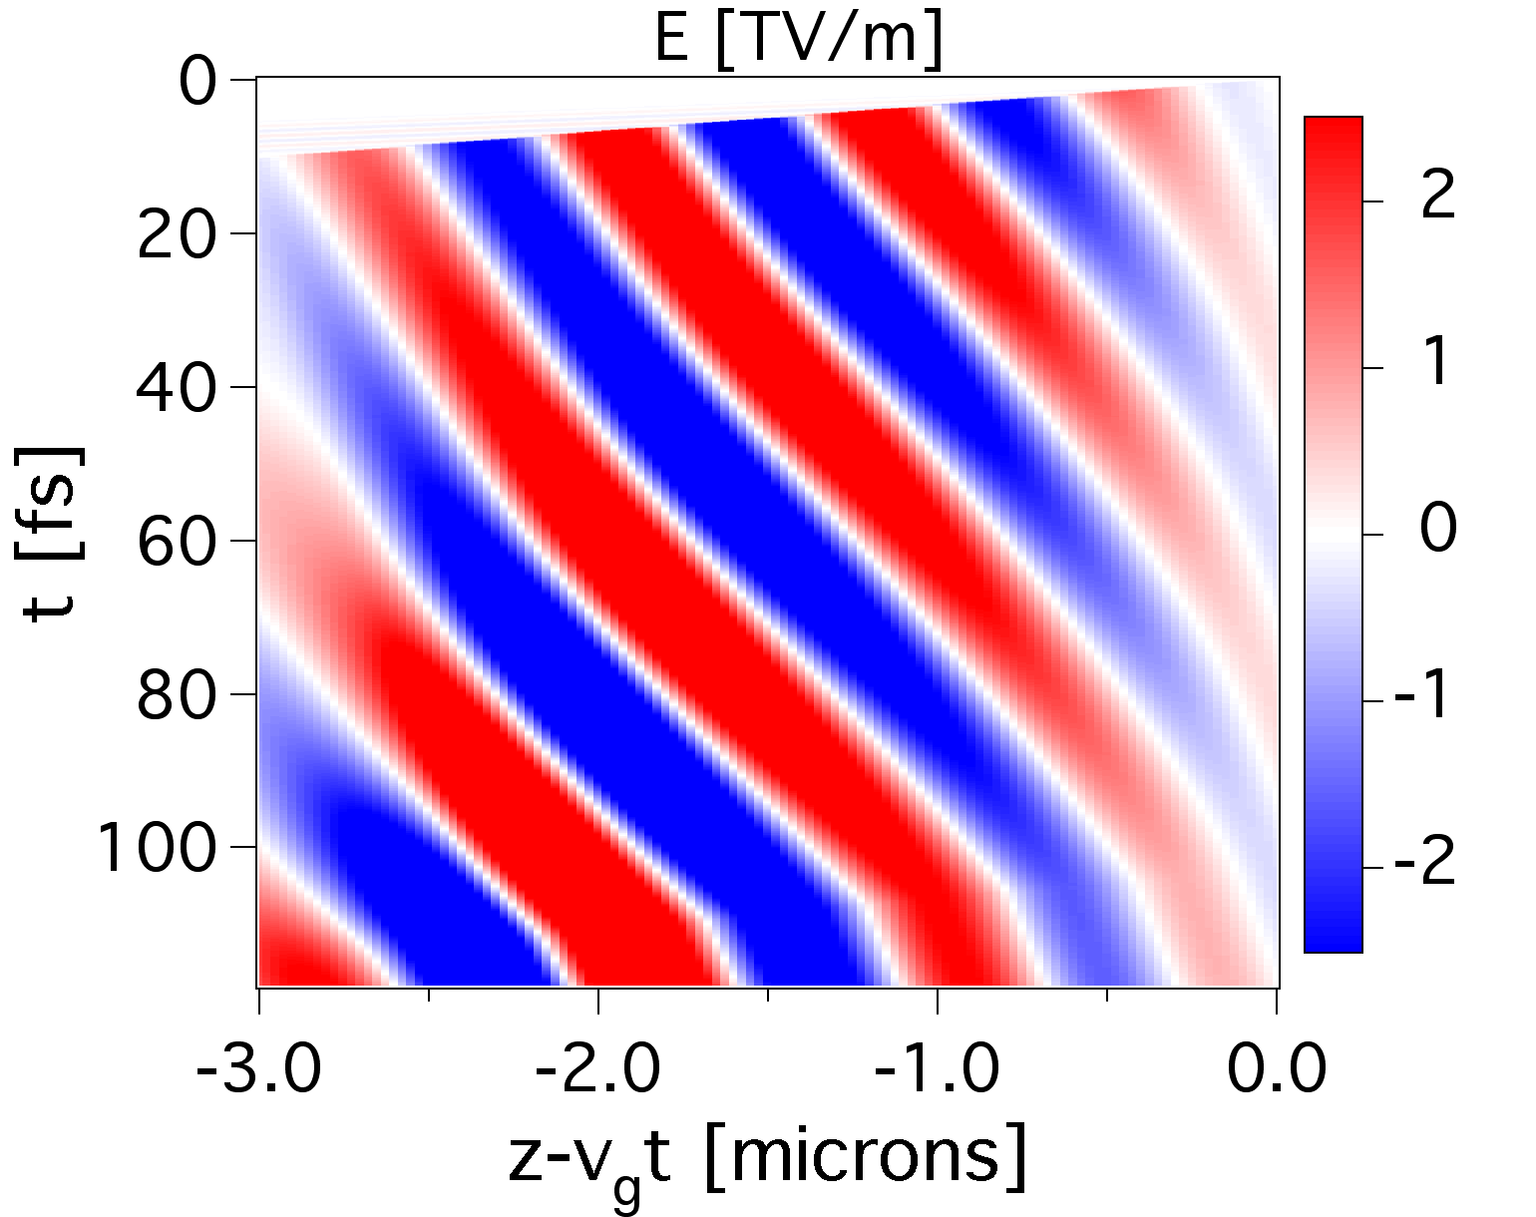
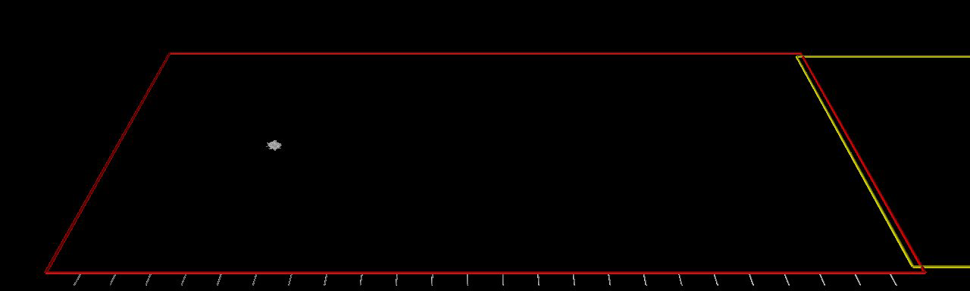
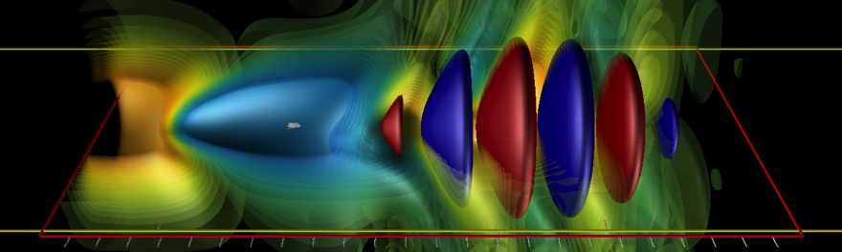
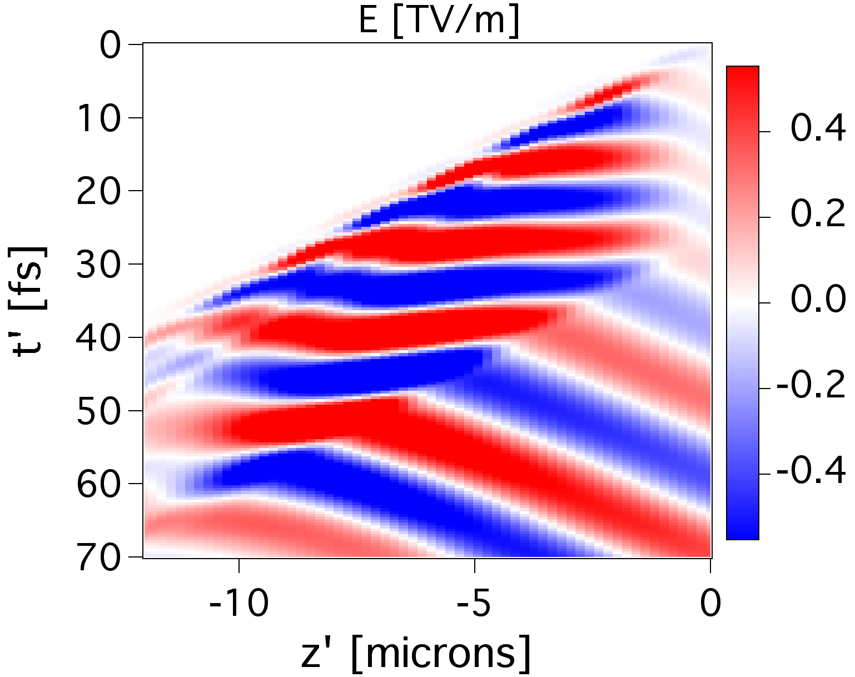
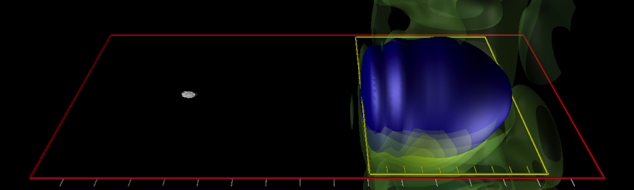
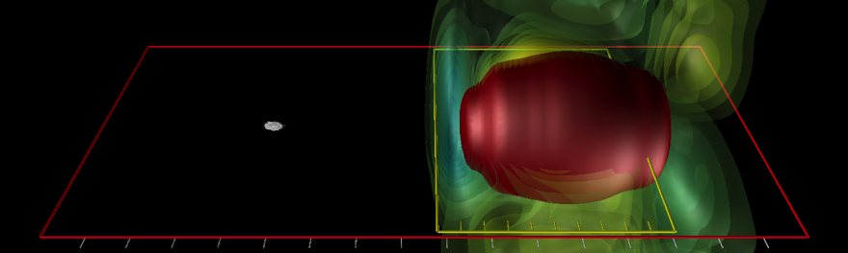
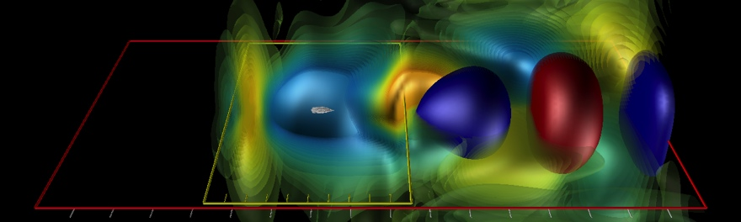
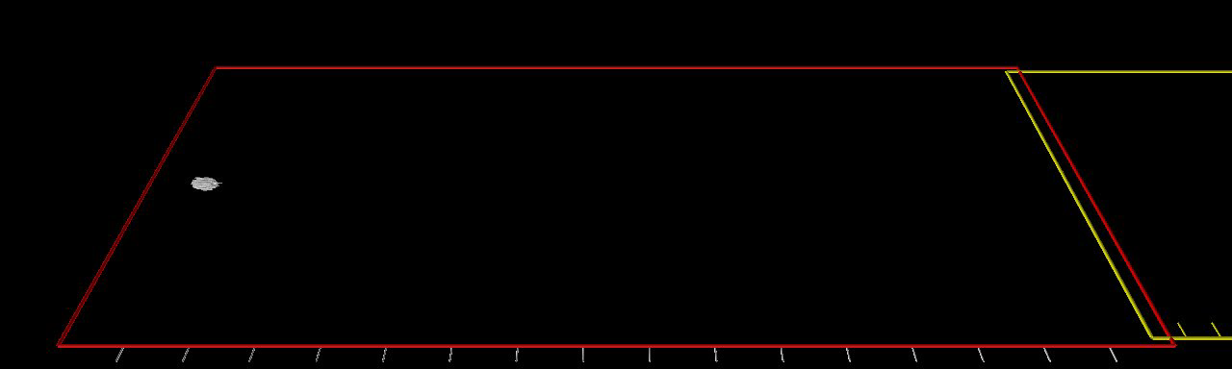
Laser field
Time
Hyperbolic rotation from Lorentz Transformation converts laser…
…spatial oscillations into
time beating
Lab frame
Laser field
Time
Wake frame

Slide 10
Verified with high precision that converge to same solution for all γ
Wake
on
axis
early
late
energy
momentum
spread
X_{R.M.S.}
e- beam
Warp-3D – a₀=1, n₀=10¹⁹cm⁻³ (~100 MeV) scaled to 10¹⁷cm⁻³ (~10 GeV).

Slide 11
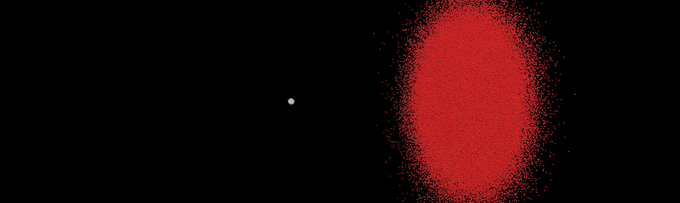
Can also model PWFA

Slide 12
More examples to be presented by others and during hands-on sessions…

