Slide 1
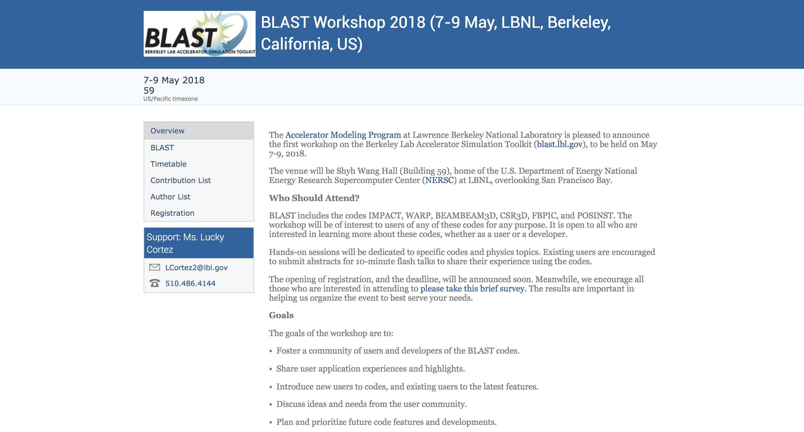


Particle-In-Cell method basics and stability
J.-L. Vay
May 7-9, 2018
Lawrence Berkeley National Laboratory
Berkeley, CA
USA
1st
workshop

Slide 2
Outline
Intro
Pushing particles
Field solve
Interpolation between particles and fields
Summary

Slide 3
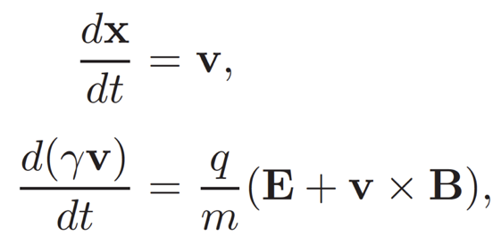
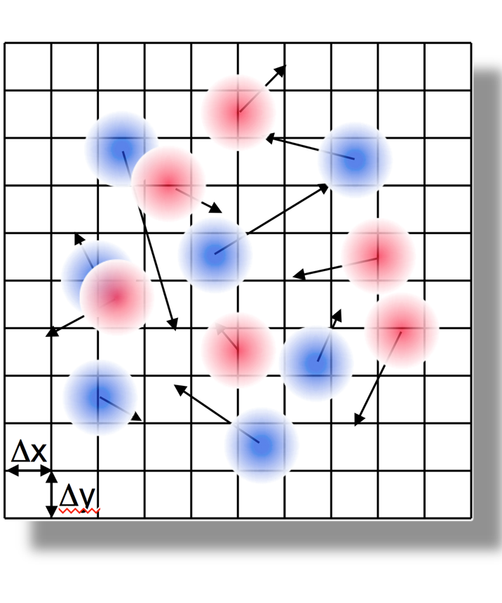
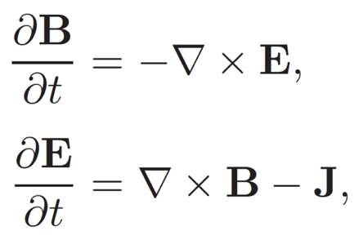
Particle-In-Cell method
Lagrangian macro-particles
Push particles
Newton-Lorentz
Gather forces
Δt
Deposit charge/current
Field solve
Eulerian fields on grids
(usually Cartesian)
Poisson/Maxwell
+ discretization of field and particles equations

Slide 4
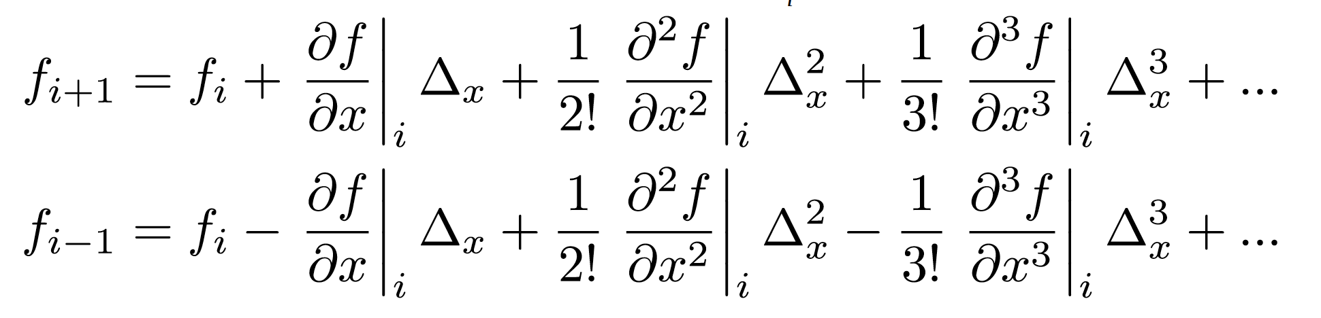
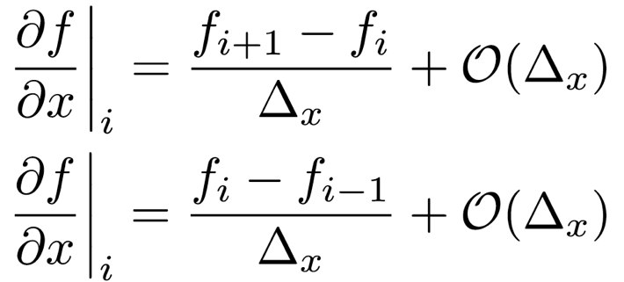
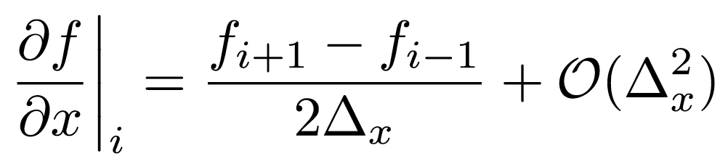
Discretization of differential operations
Δx
Assuming a uniform grid of cell size Δx,
and writing Taylor expansion of function f on grid, one cell forward and backward:
gives non-centered first-order finite-difference (FD) approximations of 1st order derivatives.
i-2
i-1
i
i+1
i+2
i+3
x
forward
backward
Subtracting forward and backward FD gives 2nd order centered expression:

Slide 5
Outline
Intro
Pushing particles
Field solve
Interpolation between particles and fields
Summary

Slide 6
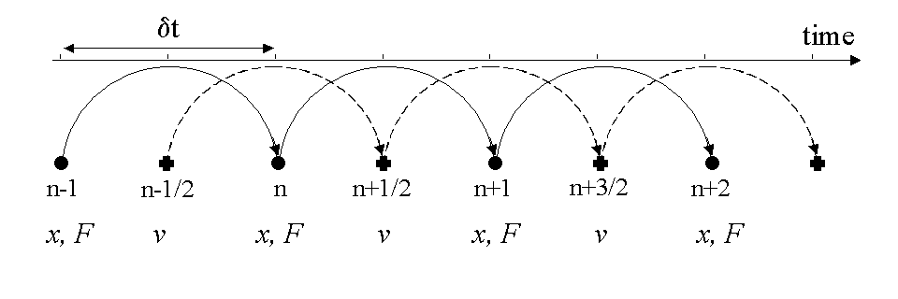
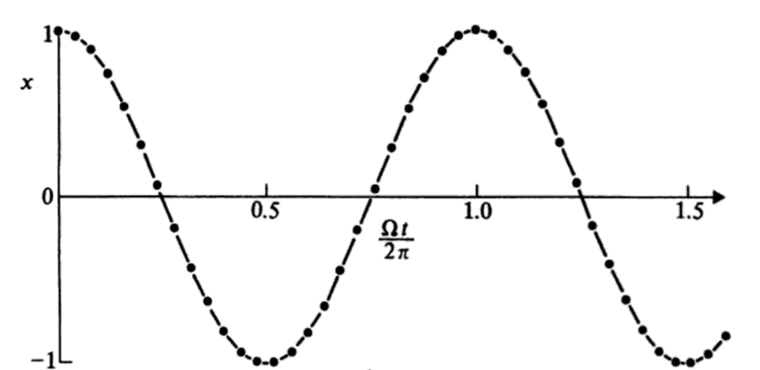
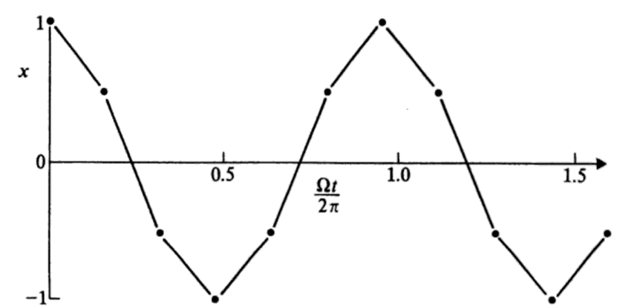
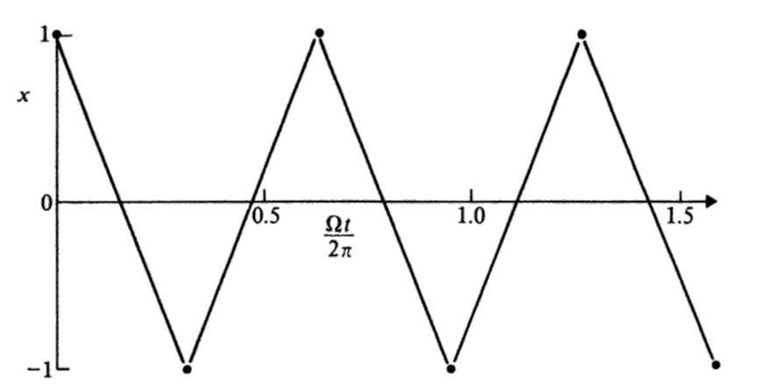
Application to particle pusher: leapfrog
Accuracy: error proportional to Δt²
Example: harmonic oscillator

Slide 7
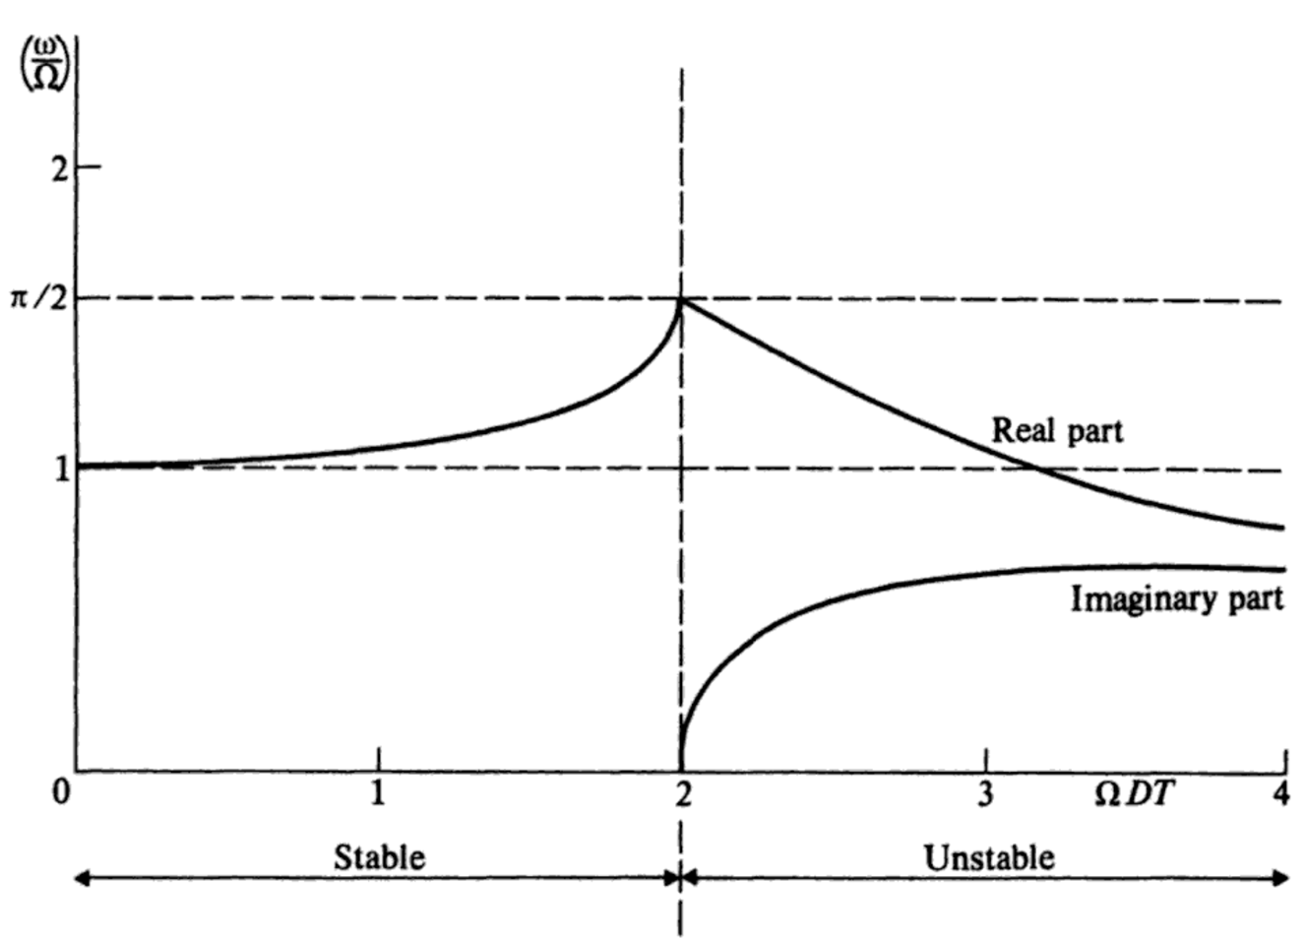
Stability analysis
Stability FD pusher: harmonic oscillator
➔ Unstable if
Hockney & Eastwood, “Computer simulation using particles”

Slide 8
Energy considerations
Ω²x²
Energy H.O.:
Δt=2.02/Ω
FD:
if
Δt=2/Ω
Δt=1/Ω
x
Now assuming random force δF giving random velocity δv kick (due to field interpolations, etc):
Energy change 1 step:
Average energy change: ➔
e.g. energy grows with time unphysically.
This is known as “numerical heating” and is a very common limitation.
=
0

Slide 9
Outline
Intro
Pushing particles
Field solve
Interpolation between particles and fields
Summary

Slide 10
Electrostatic field solve (2-D example)
Δx
j+1
Φ
Φ
Φ
Δy
j
Φ
Φ
Φ
j-1
Φ
Φ
Φ
i-1
i
i+1
or
E_{x},E_{y}
E_{x},E_{y}
E_{x},E_{y}
E_{x}
E_{x}
Fields on “centered” or ”nodal” grid
E_{y}
E_{y}
E_{y}
Fields on “staggered” or ”Yee” grid
E_{x},E_{y}
E_{x},E_{y}
E_{x},E_{y}
E_{x}
E_{x}
E_{y}
E_{y}
E_{y}
E_{x},E_{y}
E_{x},E_{y}
E_{x},E_{y}
E_{x}
E_{x}

Slide 11
Electrostatic field solve – with conductors
Δx
j+1
Φ
Φ
Φ
Δy
δx
j
Φ
Φ
Φ
δy
j-1
Φ
Φ
i-1
i
i+1
Because of non-centered FD, expression is locally of order , but solver still globally ~ .

Slide 12
Electrostatic field solve – relaxation to solution
Δx
Diffusion equation relaxes to
j+1
Φ
Φ
Φ
Δy
j
Φ
Φ
Φ
j-1
Φ
Φ
Φ
More generally
There exists many ways to interpret procedure and adapt to speedup convergence varying coefficients, ordering of updates, etc.

Slide 13
Electrostatic field solve – multigrid method
Main limitation of relaxation method comes from locality of procedure.
Multigrid method enables much faster convergence by enabling multi-resolution solve.
Procedure:
Partial relaxation on fine grid
  Restrict residue to coarser grid
  Partial relaxation on coarser grid
    Repeat recursively up to coarsest grid
  Interpolate correction to finer grid
  Partial relaxation on coarser grid
    Repeat recursively up to finest grid
Repeat all until convergence
Courtesy: https://devblogs.nvidia.com/high-performance-geometric-multi-grid-gpu-acceleration

Slide 14
Outline
Intro
Pushing particles
Field solve
Interpolation between particles and fields
Summary

Slide 15
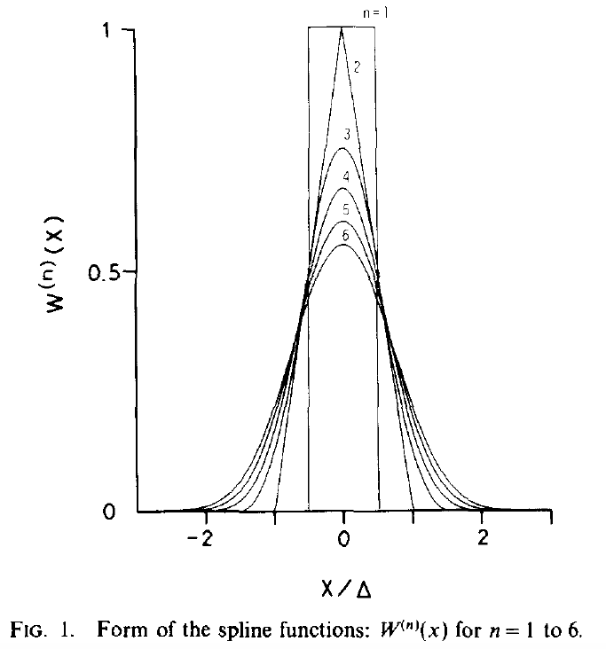
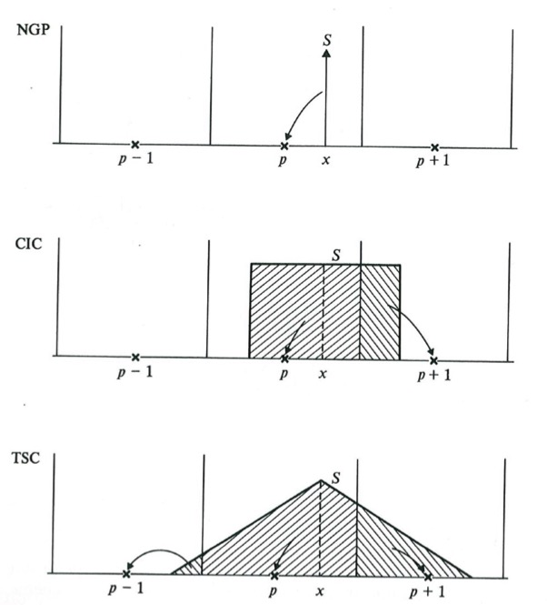
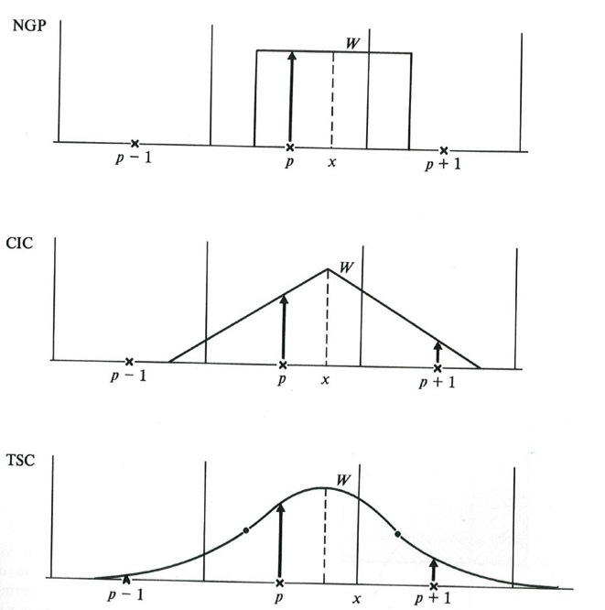
Splines are commonly used
order | Cloud shape
0 “NGP” | δ
1 “CIC” | Π
2 “TSC” | Π∗Π
3 “PQS” | Π∗Π∗Π
Assignment shape | Force
Π | Stepwise F
Π∗Π | Continuous piecewise F
Π∗Π∗Π | Continuous F+F’
Π∗Π∗Π∗Π | Continuous F+F’+F’’
Spline of order n is n times convolution of Π
Cloud shape interpretation
Assignment function shape interpretation
n⟶∞ ➔ W⟶Gaussian
# points = (order+1)^{dimension}
CIC is most common
Courtesy: Hockney & Eastwood, “Computer Simulations using Particles”, IOP

Slide 16
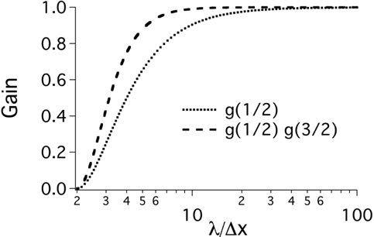
Digital filtering also commonly used
Bilinear filter + compensation routinely used
100% absorption at Nyquist freq.
1/4
1/2
1/4
Bilinear (B)
Bilinear (B) + compensation (C)
Bilinear
filter
Wider band filtering obtain via:
Wider (more points) filter.
Multiple passes of bilinear or wider filter.
Multiple passes of bilinear or wider filter with stride.

Slide 17
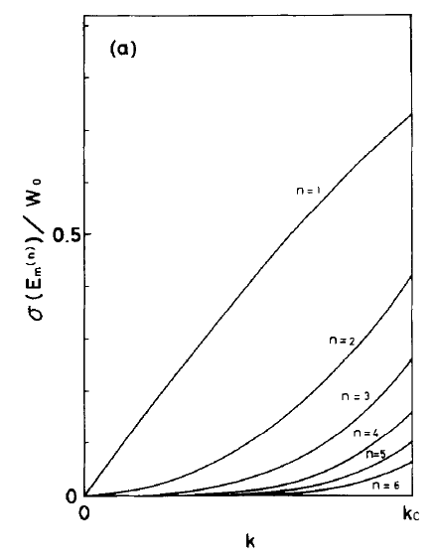
Best to combine splines & filtering to reduce aliasing errors
no filter
with Gaussian filter
CIC
Aliasing
Aliasing error
TSC
PQS
Spline efficient at low k.
Filter efficient at high k.
Courtesy: H. Abe, J. Comput. Phys. 63, 247 (1985)

Slide 18
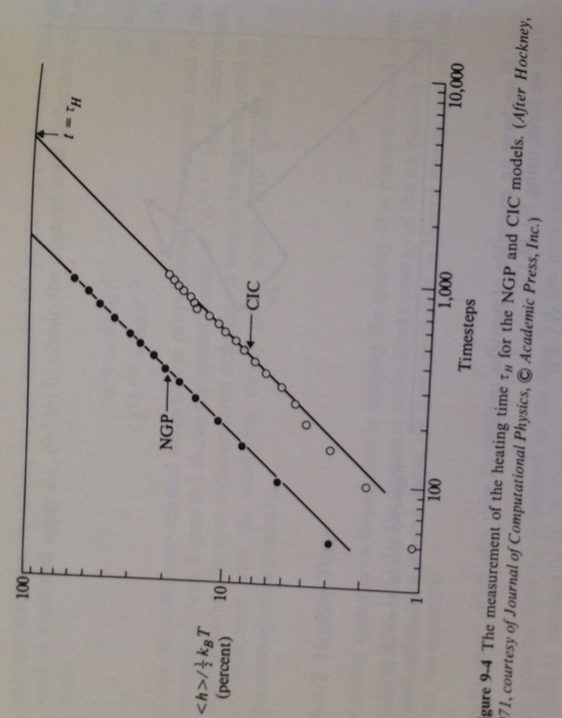
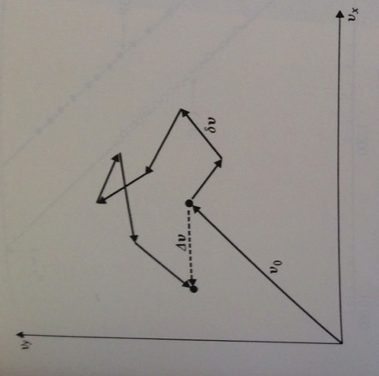
Numerical heating is greatly reduced with higher-order splines
Numerical heating
Random aliasing errors in velocity space*
Courtesy: Hockney & Eastwood, “Computer Simulations using Particles”, IOP

Slide 19
Most common options for field interpolations
“Energy-Conserving”
“Momentum-Conserving”
interpolates from staggered grid
one order down in // direction
first interpolate at grid nodes
same order in all directions
E_{x}
E_{x}
E_{x,y}
E_{x}
E_{x,y}
E_{x}
E_{x,y}
E_{y}
E_{y}
E_{y}
E_{y}
E_{y}
E_{y}
E_{x}
E_{x}
E_{x,y}
E_{x}
E_{x,y}
E_{x}
E_{x,y}
E_{y}
E_{x}
E_{y}
E_{y}
E_{y}
E_{y}
E_{y}
E_{x}
E_{x}
E_{x,y}
E_{x}
E_{x,y}
E_{x}
E_{x,y}
E_{x}
E_{x}
E_{x,y}
E_{x,y}
E_{x,y}
E_{y}
E_{y}
E_{y}
E_{x}
E_{x}
E_{x,y}
E_{x,y}
E_{x,y}
E_{y}
E_{y}
E_{y}
E_{y}
E_{x}
E_{x}
E_{x,y}
E_{x,y}
E_{x,y}

Slide 20
Example: test uniform warm plasma
1 pass bilinear filter
2 passes bilinear filter
Momentum cons.
Energy cons.
CIC
Energy (a.u.)
TSC
Energy (a.u.)
CIC
PQS
PQS
TSC
CIC
CIC
TSC
PQS
TSC
PQS
Time step
Time step

Slide 21
Summary
Discretization of equations enables rapid solve at a price
Leapfrog integrators have limit time step (Courant condition)
Random force kicks ➔ numerical heating
Energy/momentum conservation depends on data layout
Filtering + splines needed to control aliases errors

