Slide 1
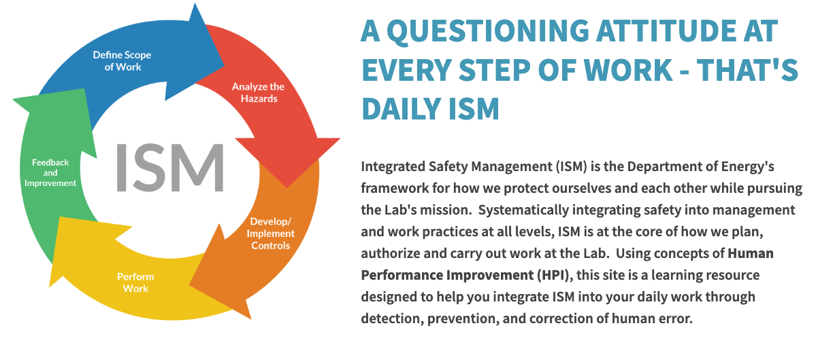
Integrated Safety Management @ LBNL ism.lbl.gov

Slide 2
ISM Guiding Principle
Line Management Responsibility for Safety
Clear roles and responsibilities
Competence Commensurate with Responsibilities
Balanced Priorities
Identification of standards and requirements
Hazard Controls are tailored to the work performed
Operations authorizations

Slide 3
Line Management Responsibility for Safety
Line management is directly responsible for the protection of workers, the public and the environment.
This is achieved when line management is directly involved in planning the work, supervising the work, and overseeing the work.
In short, management needs to model safe work behaviors and communicate safe work expectations to set up staff for success.
Clear roles and responsibilities
There are clear and unambiguous lines of authority and responsibility for ensuring safety.
These are established and maintained at all levels and for each job.
In short, everyone should know who is leading the work (Person in charge) and their respective roles and responsibilities for the work at hand.
Competence Commensurate with Responsibilities
Workers have the experience, knowledge, skills and abilities necessary to perform their work safely and effectively.
When line management assigns staff to a particular job or task, it is because they understand the skills and qualifications needed to perform work, and have confidence that the person they assign is qualified to do the work safely and effectively.
In short, management does not assign work to staff who do not yet have the experience, skills and abilities needed to fulfill that task responsibly.
Balanced Priorities
Resources are allocated to address safety, programmatic and operational needs.
Protecting workers, the public, and the environment is prioritized whenever planning work.
In short, safety and environmental protections are resourced appropriately at all phases of a project.
Identification of standards and requirements
Before starting work, the hazards are evaluated and there is agreement on the safety standards and requirements needed to plan and perform the work so that staff and the environment are protected.
Hazard Controls are tailored to the work performed
Engineered and work controls should be tailored to the work being performed.
Selecting and implementing appropriate controls is an iterative process, reviewed whenever the work conditions change.
In short, since research at the Lab can involve unique and one-of-a-kind experiments this can create complex and dynamic conditions and hazards which in turn require safety and process controls that are specific to the work conditions.
Operations authorizations
The conditions and requirements to be satisfied for operations to be initiated and conducted shall be clearly established and agreed upon.

