Slide 1
Magnetic Optimization of a 6 T Helmholtz Coil for an Electron Beam Ion Trap (EBIT)
SMP Technical Meeting
J. L. Rudeiros Fernández

Slide 2
Table of contents
Introduction to Helmholtz coils
Initial design
Magnetic optimization
Next steps
J. L. Rudeiros Fernandez et al.

Slide 3
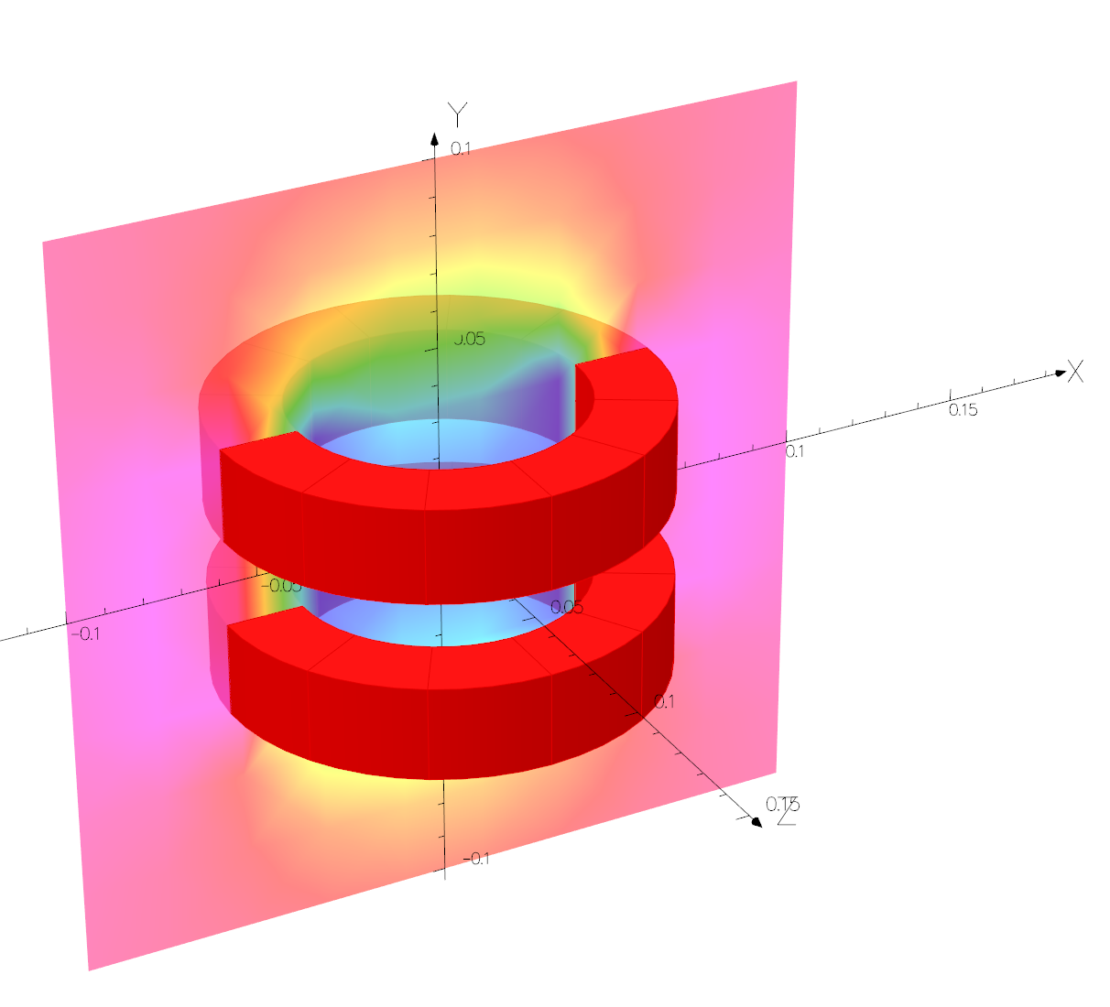
1. Introduction to Helmholtz coils
$$y$$
R
R
$$x$$
$$B_{y}\left(y\right)=\frac{μ_{0}I_{t}}{2R}\left({\left(1+{\left(\frac{y}{R}−\frac{1}{2}\right)}^{2}\right)}^{−\frac{3}{2}}+{\left(1{\left(\frac{y}{R}+\frac{1}{2}\right)}^{2}\right)}^{−\frac{3}{2}}\right)$$
J. L. Rudeiros Fernandez et al.

Slide 4
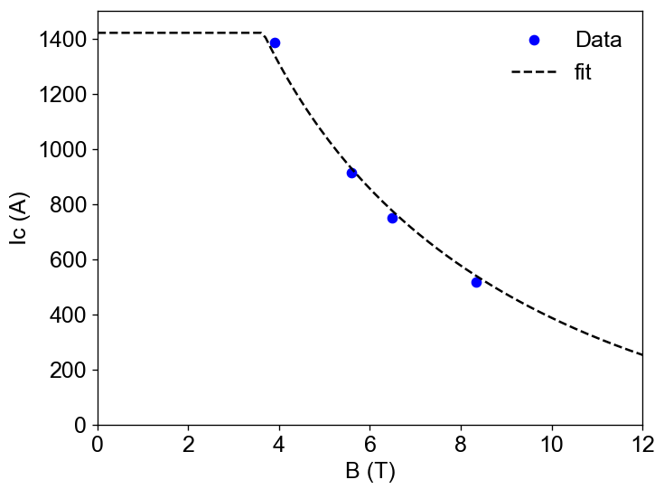
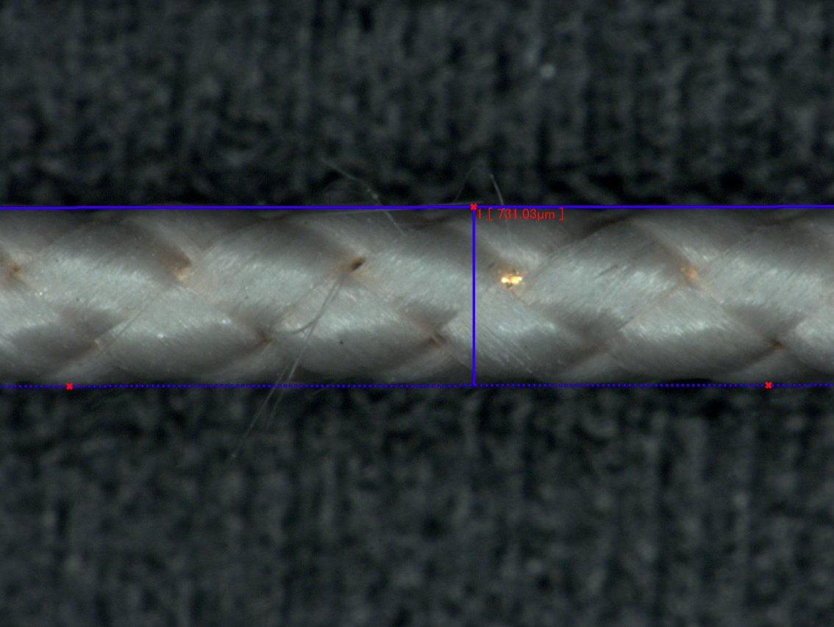
2. Initial design
Central target field: 6 T at 4.2 K
Conductor and winding assumptions:
Nb₃Sn strand 0.6 mm diameter.
Glass fiber insulation of thickness 50 um.
Hexagonal packing winding.
J. L. Rudeiros Fernandez et al.

Slide 5
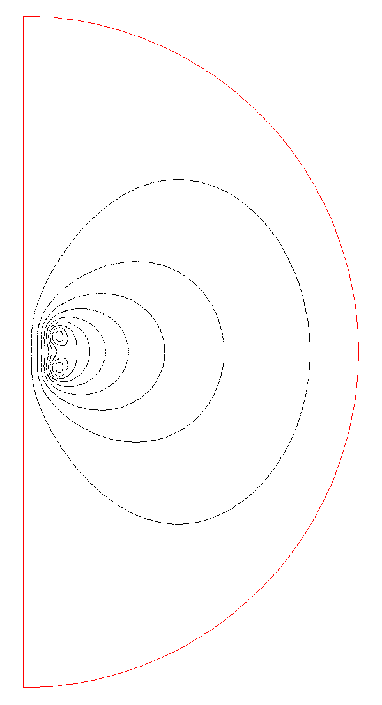
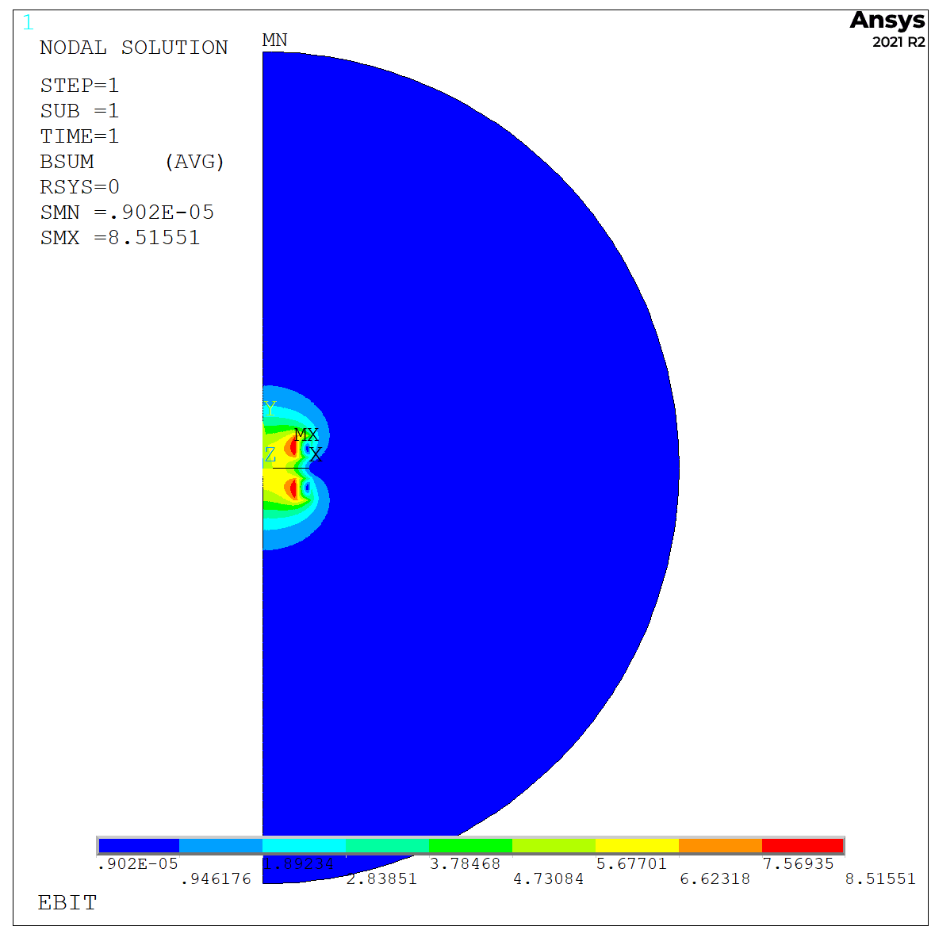
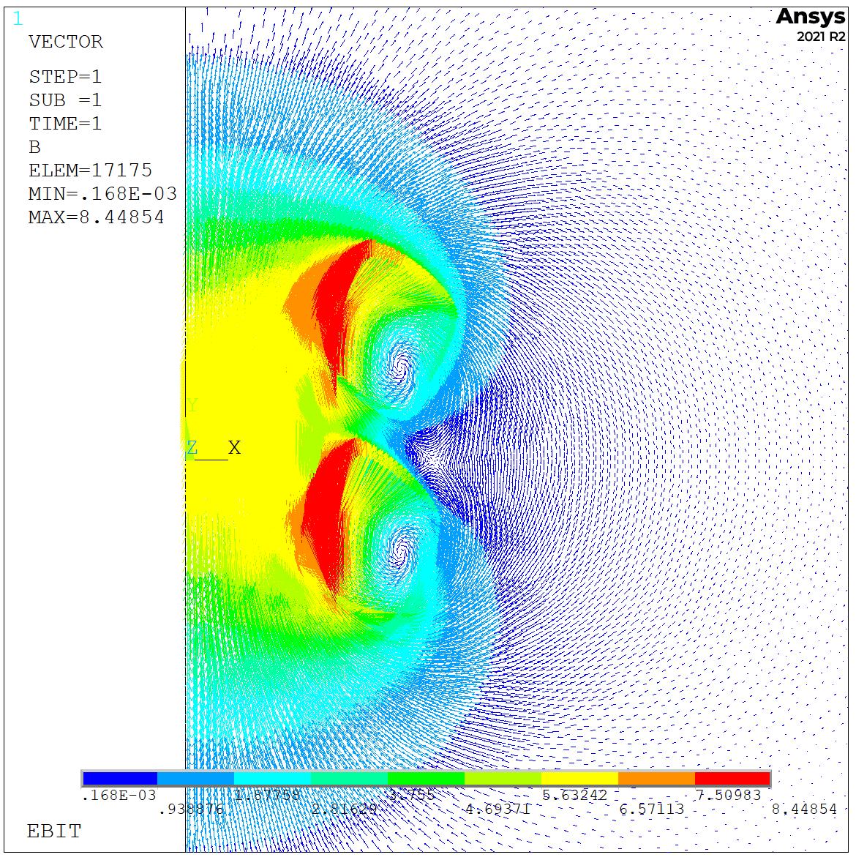
2. Initial design
Central target field: 6 T at 4.2 K
J. L. Rudeiros Fernandez et al.

Slide 6
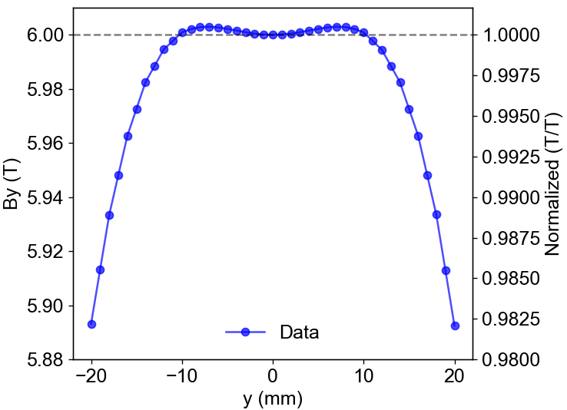
2. Initial design
Central target field: 6 T at 4.2 K
Field uniformity (objective of 0.02 % along 20 mm in the axis at 100 um)
Central field uniformity
J. L. Rudeiros Fernandez et al.

Slide 7
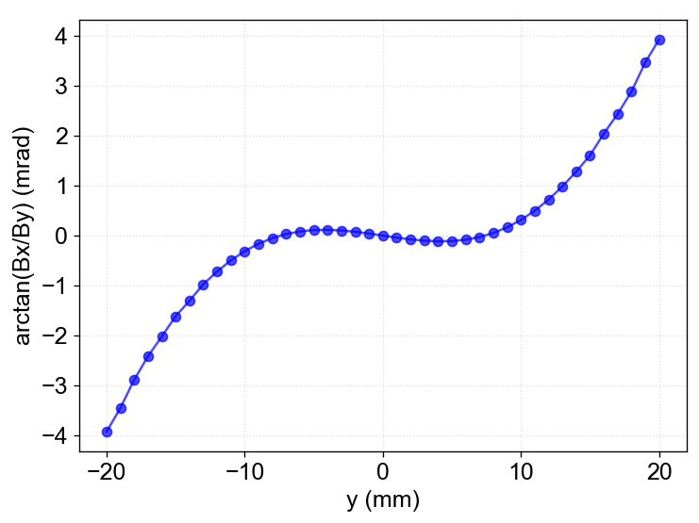
2. Initial design
Central target field: 6 T at 4.2 K
Field angular deviation @ 2 mm from center
J. L. Rudeiros Fernandez et al.

Slide 8
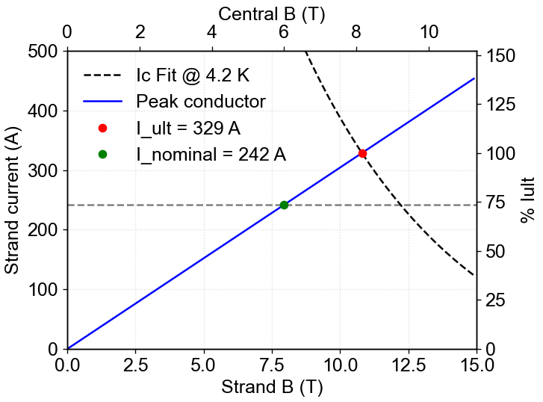
2. Initial design
Central target field: 6 T at 4.2 K
Operational margin
J. L. Rudeiros Fernandez et al.

Slide 9
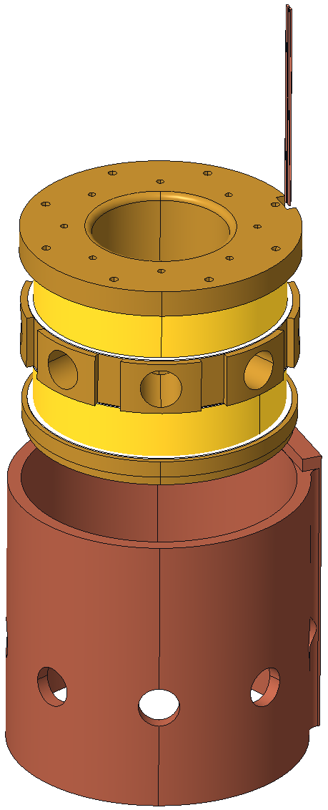
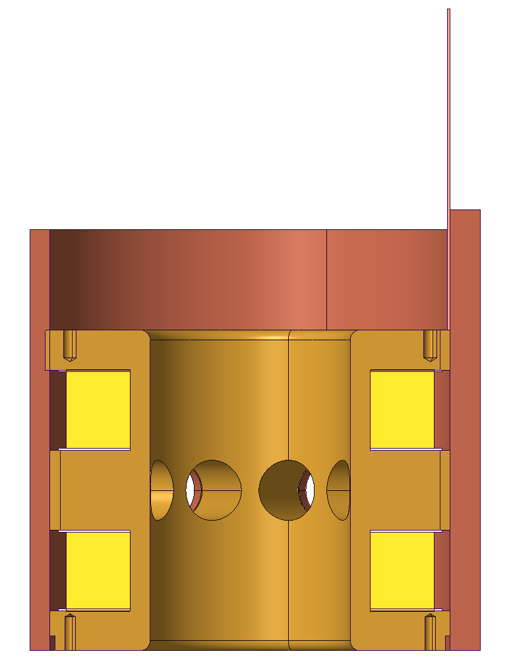
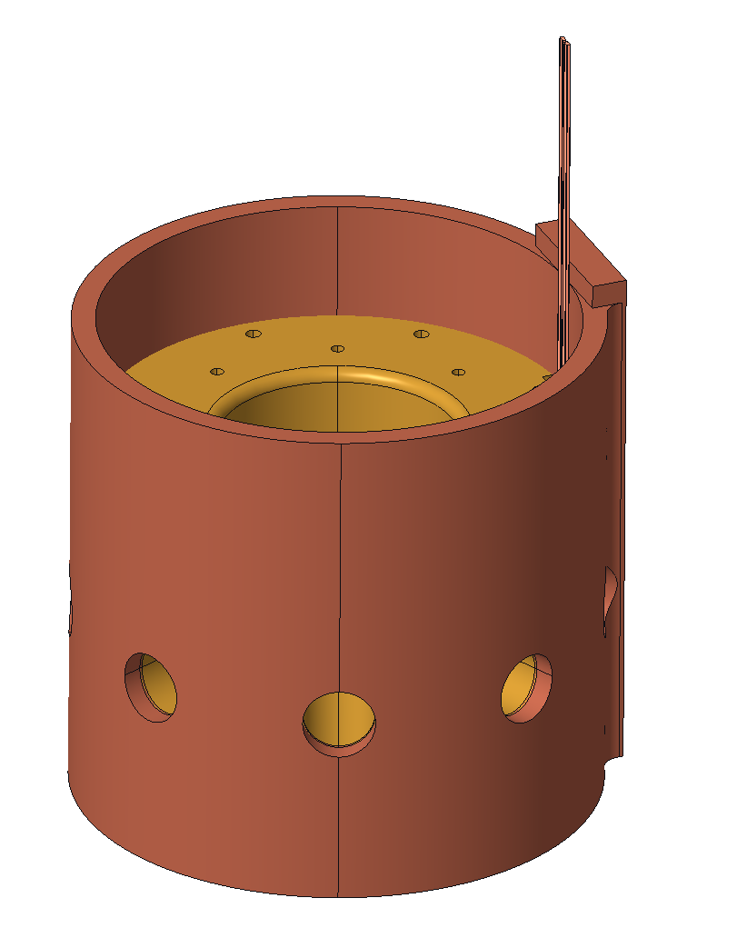
2. Initial design
Central target field: 6 T at 4.2 K
Diameter: 5.5 in = 139.7 mm
2.5 in = 63.5 mm
5.25 in = 133.35 mm
4 in = 101.6 mm
J. L. Rudeiros Fernandez et al.

Slide 10
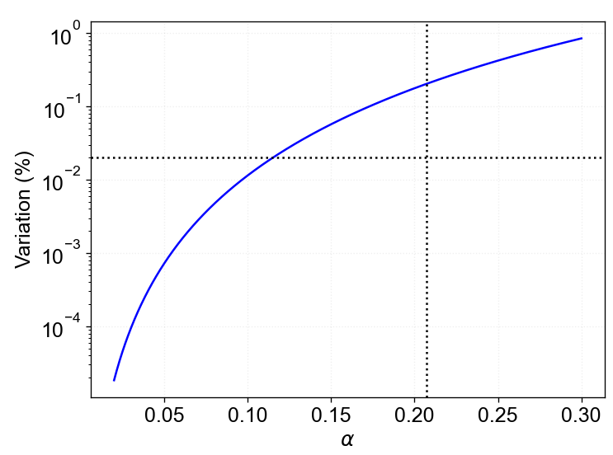
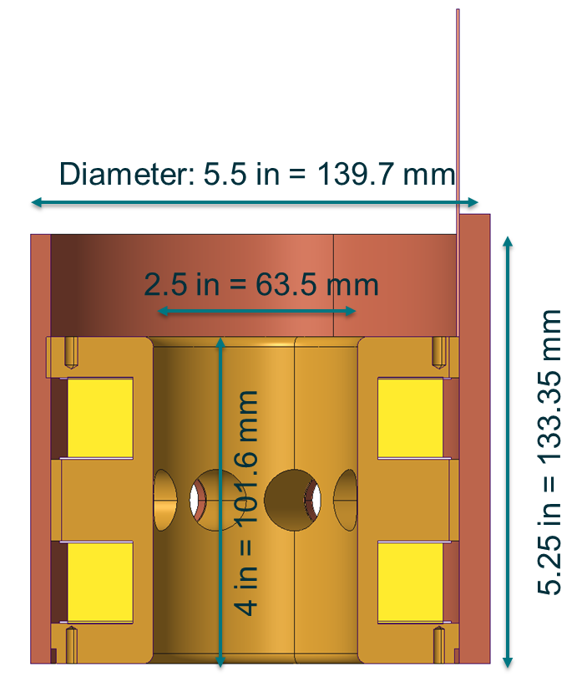
3. Magnetic optimization
Field uniformity (objective of 0.02 % along 20 mm in the axis at 100 um)
$Variation \left(\%\right)= 100\left(1−\frac{5\sqrt{5}}{2}\left({\left(4+{\left(1+2α\right)}^{2}\right)}^{−\frac{3}{2}}+{\left(4+{\left(1−2α\right)}^{2}\right)}^{−\frac{3}{2}}\right)\right)$ where $α=\frac{y}{R}$
$$α=\frac{y}{R}=\frac{10}{48}\sim 0.2$$
$$y$$
$α=\frac{y}{R}$
$$2R$$
J. L. Rudeiros Fernandez et al.

Slide 11
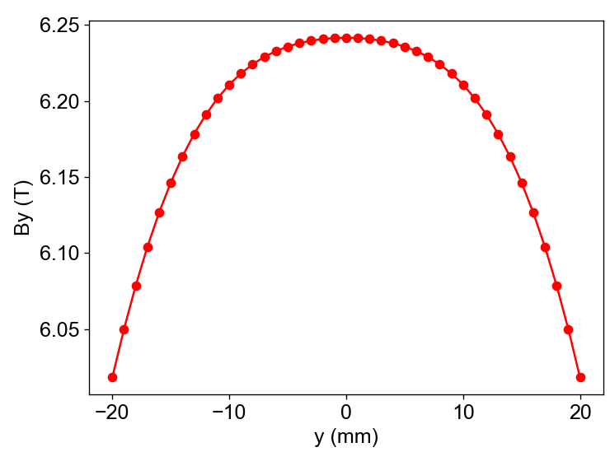
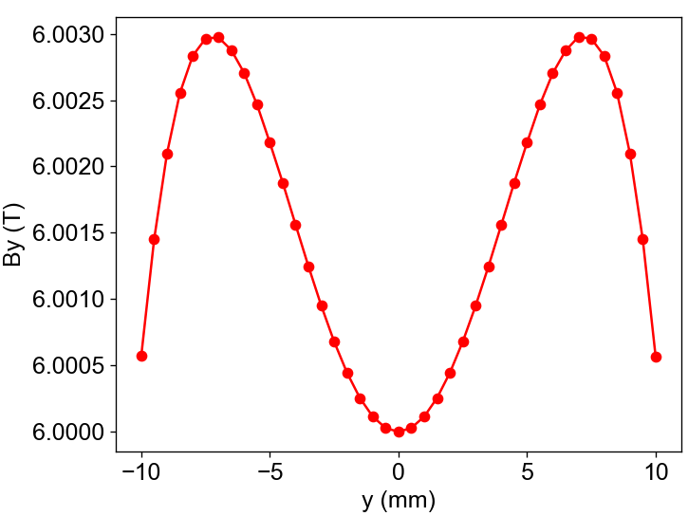
3. Magnetic optimization
Central field uniformity
J. L. Rudeiros Fernandez et al.

Slide 12
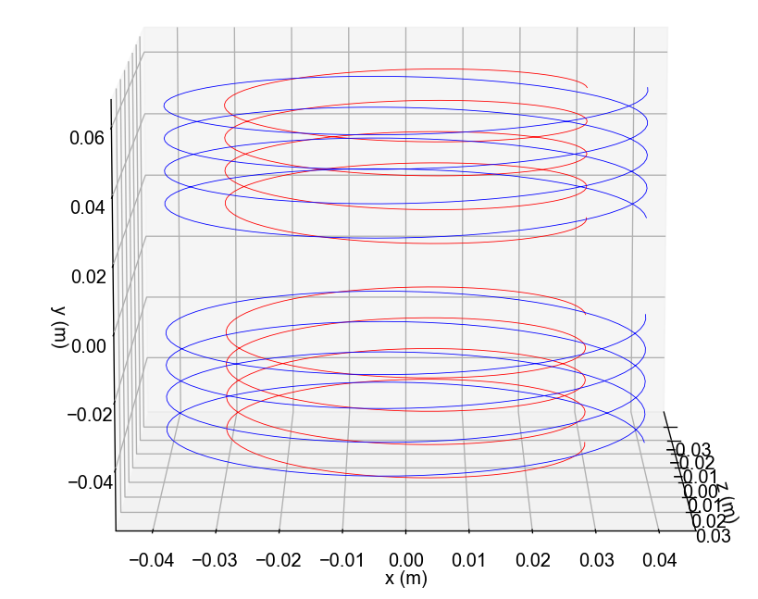
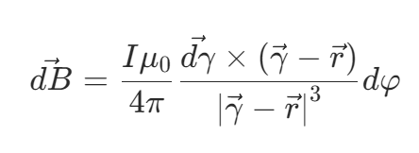
3. Magnetic optimization
Coil 1
Coil 2
J. L. Rudeiros Fernandez et al.

Slide 13
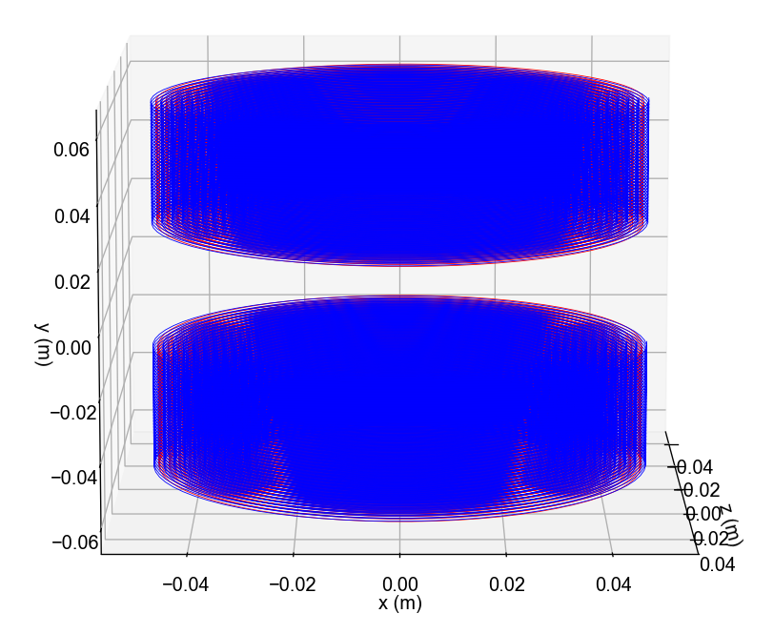
3. Magnetic optimization
Coil 1
Coil 2
J. L. Rudeiros Fernandez et al.

Slide 14
3. Magnetic optimization
Magnet system requirements
Parameter | Value
Electromagnetic
Considered superconductor materials | NbTi, Nb3Sn
Central target field | 6 T
Nominal operational temperature | 4.2 K
Nominal operational electromagnetic margin | Not defined
Power supply limitation/ Current on the strand | ALARA
Protection system/ requirements | Not defined
Max inductance | Not defined
Field quality requirements
Volumetric definition of region of interest | Central cylinder: 20 mm length x 100 µm diameter
Maximum field variation along the axis | 0.02%
Angular deviations of field lines in the boundary of region of interest | ≤ 0.3 mrad
Thermo-mechanical
Impregnation resin radiation resistance requirement | Not defined
Cryogenic system (final configuration) | Cryocooler
Available cooling power (final configuration) | 1.5 W
Bobbin material | Not defined
Geometrical | Not well defined
Max stress in conductor | Not defined
Structural safety margin | Not defined
J. L. Rudeiros Fernandez et al.

Slide 15
3. Magnetic optimization
Python program
Analytical model
Optimization based on a genetic algorithm
Boundary conditions
Objective
Field uniformity of 0.02 % along 20 mm in the axis
Maximization of the operational margin.
Winding constraints
J. L. Rudeiros Fernandez et al.

Slide 16
3. Magnetic optimization
x_dim
$$y$$
inner_radius
y_dim
$$x$$
Central_separation
Initial results
ID | y_dim (m) | x_dim (m) | Load line % | Central variation (%) | By_mean (T) | Central separation (m) | inner_radius (m) | outer_diameter (m) | Current (A) | Conductor material | Equivalent current density (A/m2)
Original design | 0.025 | 0.020 | 80 | 0.046 | 6 | 0.026 | 0.076 | 0.116 | 291 | nb3sn | 668044077.1
1 | 0.043 | 0.066 | 45 | 0.020 | 5 | 0.020 | 0.066 | 0.198 | 55 | nb3sn | 126021625.3
2 | 0.040 | 0.051 | 55 | 0.020 | 6 | 0.022 | 0.071 | 0.173 | 85 | nb3sn | 194302915.7
3 | 0.042 | 0.037 | 58 | 0.021 | 6 | 0.022 | 0.079 | 0.153 | 114 | nb3sn | 262445211.2
4 | 0.029 | 0.025 | 70 | 0.031 | 6 | 0.026 | 0.078 | 0.128 | 213 | nb3sn | 489793634.1
5 | 0.063 | 0.079 | 54 | 0.017 | 6 | 0.020 | 0.081 | 0.239 | 47 | nbti | 108206960.3
6 | 0.040 | 0.040 | 71 | 0.020 | 6 | 0.022 | 0.076 | 0.155 | 109 | nbti | 250219453.6
7 | 0.053 | 0.053 | 61 | 0.020 | 6 | 0.020 | 0.079 | 0.185 | 72 | nbti | 164530068.9
8 | 0.050 | 0.051 | 62 | 0.020 | 6 | 0.020 | 0.077 | 0.180 | 75 | nbti | 172834064.3
9 | 0.048 | 0.046 | 64 | 0.018 | 6 | 0.020 | 0.077 | 0.170 | 84 | nbti | 192813462.8
10 | 0.046 | 0.036 | 71 | 0.020 | 6 | 0.020 | 0.080 | 0.151 | 108 | nbti | 249019823.2
11 | 0.038 | 0.046 | 71 | 0.021 | 6 | 0.026 | 0.079 | 0.171 | 104 | nbti | 237991829.7
12 | 0.036 | 0.042 | 74 | 0.021 | 6 | 0.026 | 0.079 | 0.163 | 114 | nbti | 262737075.3
13 | 0.036 | 0.042 | 75 | 0.020 | 6 | 0.026 | 0.078 | 0.163 | 117 | nbti | 269290746.1
14 | 0.039 | 0.040 | 74 | 0.021 | 6 | 0.024 | 0.079 | 0.158 | 115 | nbti | 264352596.4
15 | 0.037 | 0.040 | 75 | 0.020 | 6 | 0.024 | 0.078 | 0.157 | 119 | nbti | 273254690.1
J. L. Rudeiros Fernandez et al.

Slide 17
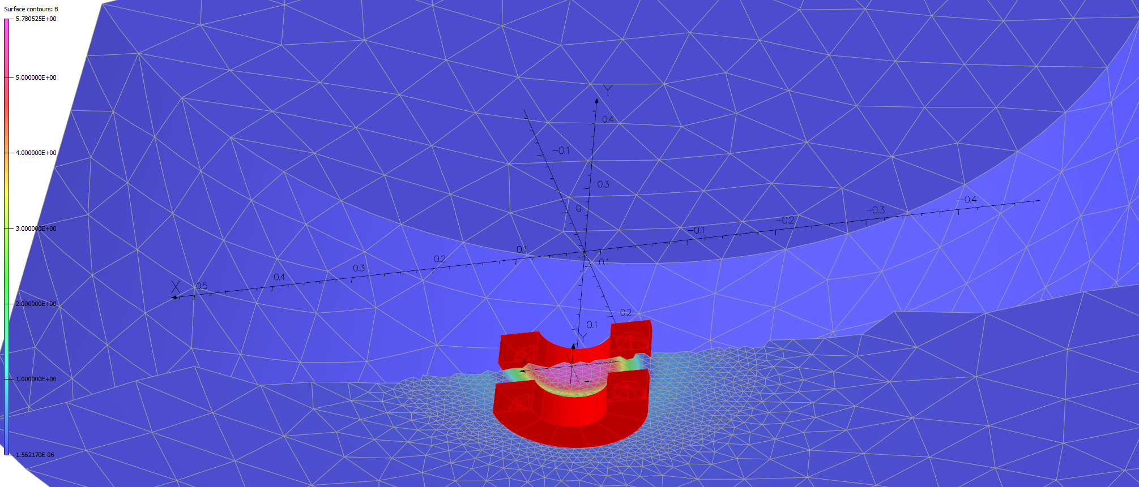
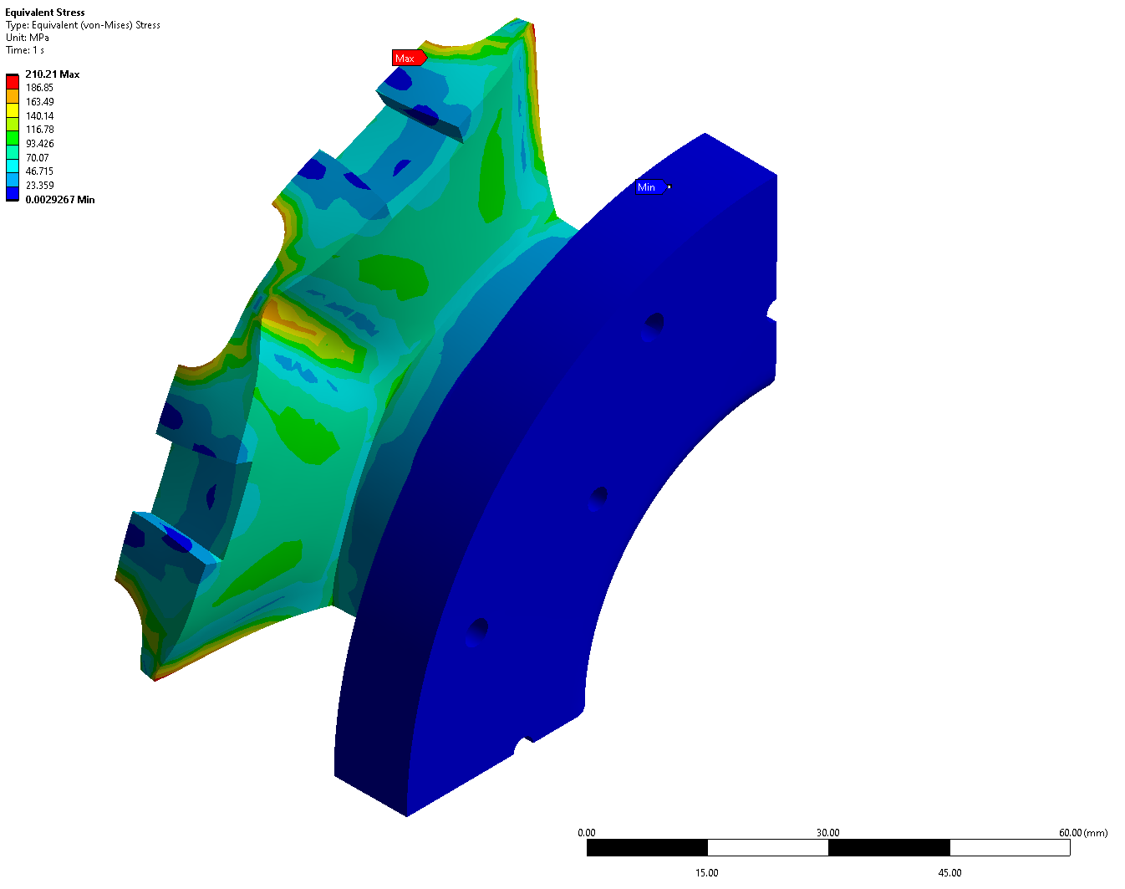
4. Next steps
Fix the preliminary design based on the solutions found through the genetic algorithm. Prepare a general specification document for review, and start the procurement of the conductor.
Magnet protection.
Mechanical analysis and Engineering design.
Prototyping.
Coil manufacturing.
Testing.
J. L. Rudeiros Fernandez et al.

Slide 18
Thanks!
J. L. Rudeiros Fernandez et al.

