Slide 1

Ten Stack Status and Next Steps
Steve Krave, Pei Li
US Magnet Development Program
Fermi National Accelerator Laboratory

Slide 2
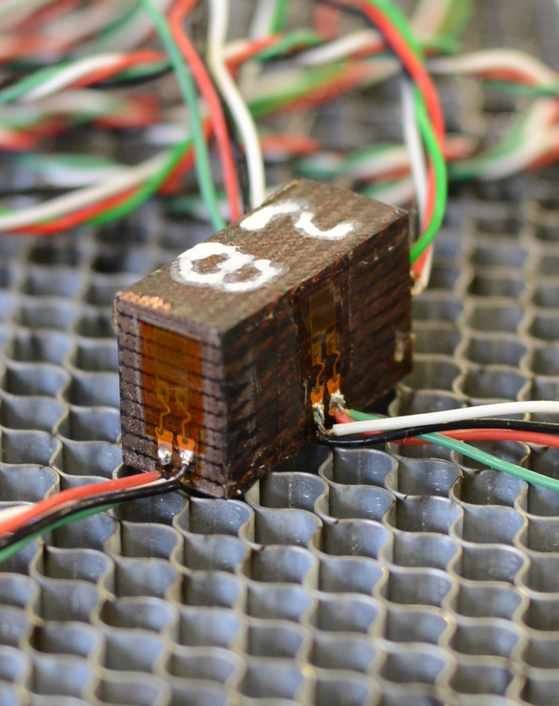
Why Ten Stacks
Ten stacks serve as a way to work to characterize coil mechanical properties with less work and well defined
  Coil Modulus measurements in 3 directions
  Thermal contraction measurements
  Some qualitative observations?

Slide 3
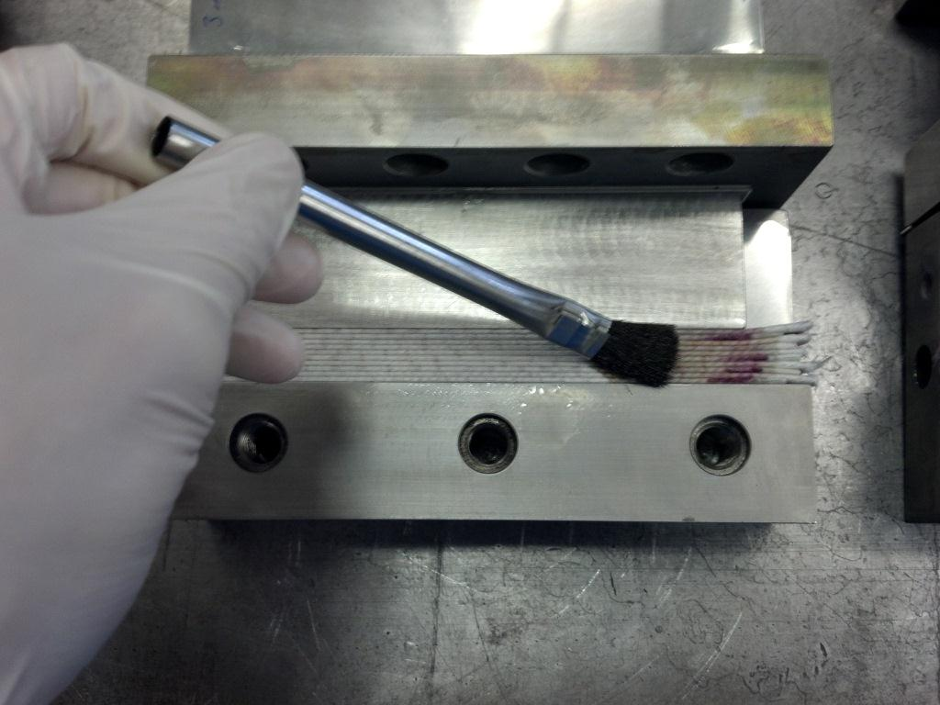
General Fabrication Procedure
Cut and fuse cable
  Each 10 stack requires 20 welds, and often rework and touchup
Insulate Cable
  Wrap with tape or slide on sleeve
  Braided on sleeve doesn’t really work
Wind (or stack) cables alternating thick/thin
Cure at nominal curing cavity equivalent
React at nominal reaction cavity equivalent
Impregnate at nominal cavity

Slide 4
Where we were last year: Experiment plan
Sample | Modulus | Poisson ratio | Loading procedure | Temperature | Number of gages
1 | E1 | v21, v31 | Low strain loading, and then cyclic loading after large monotonic loading | 300K, 77K 4.2K (?) | At least 3
2 | E2 | v12, v32
3 | E3 | v13, v23
4 | thermal contraction |  | No loading | 300-77K, 300-4.2K (?) | At least 3
Axial=1
Azimuthal=2
Radial =3
For loading test, each loading direction requires at least one 1 inch sample for each temperature (300, 77 and 4.2K). Thermal contraction requires one piece.
If 4.2K is to be included: 10 sample pieces; if not, 7 sample pieces. 2 10-stacks needed in either case.
For each cable insulation variety, 2 10 stack samples (6 inch long) is needed.
At least 3 gages per sample
Current plan is to build one set of stacks for each L1-2 and 3-4 cable:
  E-Glass
  S-Glass

Slide 5
Where are now
Sample | Modulus | Poisson ratio | Loading procedure | Temperature | Number of gages
1 | E1 | v21, v31 | Low strain loading, and then cyclic loading after large monotonic loading | 300K, 77K 4.2K (?) | At least 3
2 | E2 | v12, v32
3 | E3 | v13, v23
4 | thermal contraction |  | No loading | 300-77K, 300-4.2K (?) | At least 3
Axial=1
Azimuthal=2
Radial =3
E- Glass samples fabricated and tested on 15T outer cable (11 Tesla cable)
  Samples tested warm and for thermal contraction
  See ICMC 2017: Study of Thermomechanical Properties of The Epoxy Impregnated Cable Composite for a 15 T Nb3Sn Dipole Demonstrator
S-Glass proved more difficult to procure than anticipated
  We have it now…

Slide 6
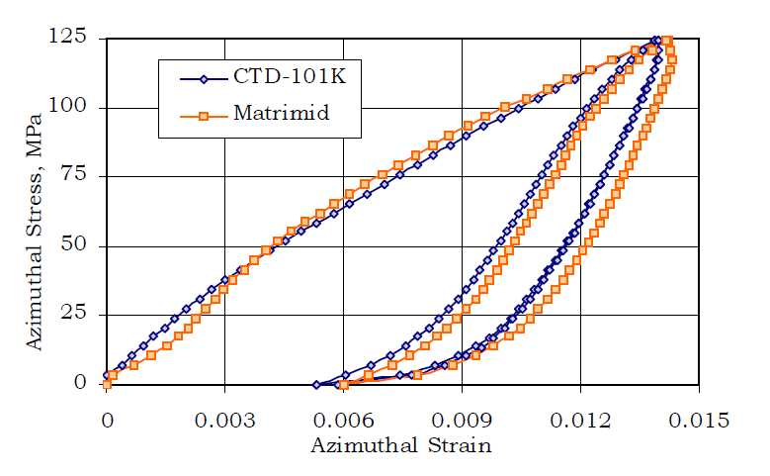
Comparison between rounds of testing
Results from recent testing. Ultimate pressure of ~137 MPa
Results from Deepak. Ultimate pressure of 125 MPa
Side by side of Deepak data with recent data. Additional ~12MPa added ~ 0.5% Strain.
  Subtract this offset and results are in much better agreement, but recent measured modulus is still low, maybe delamination?

Slide 7
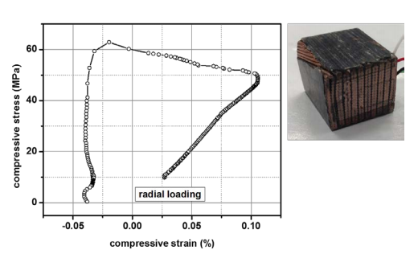
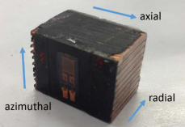
General Observations
Samples were rather fragile.
  Section of stacks needed to be done very carefully to avoid delamination
Radial loading was prone to delamination
  Lack of continuous stand in sample to reinforce over short 25mm samplelength
Axial loading was not worth attempting

Slide 8
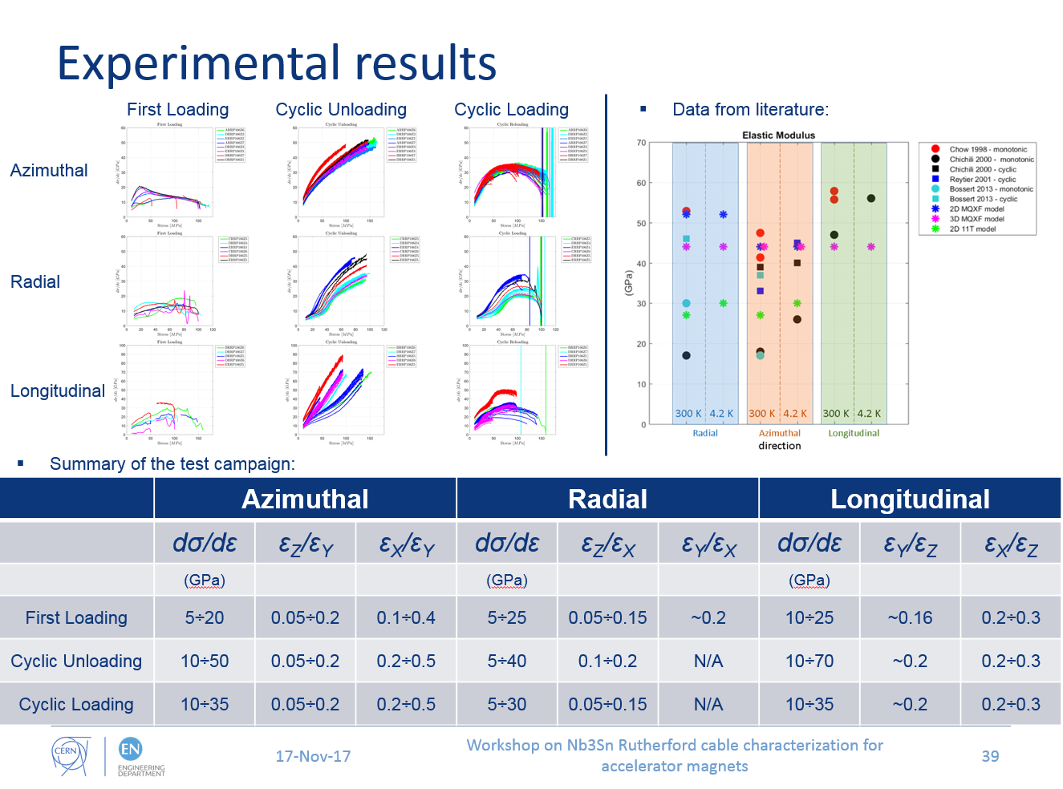
Some of CERN’s recent results (MQXF Cable)

Slide 9
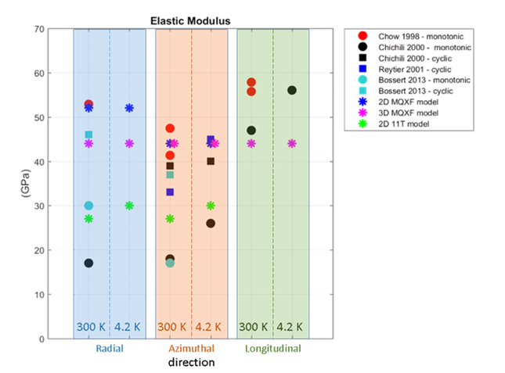
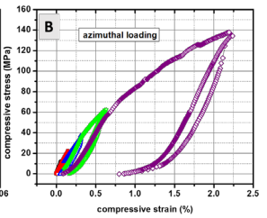
Adding recent FNAL results…
Our radial measurement goes to held together for ~55 MPa
CERN Data (MQXF) – Cyclic (has core)
Recent FNAL Data
Azimuthal measurement up to ~140MPa

Slide 10
Keep in mind older results using same procedure
TQ Reacted cable, 5 mil S-2 Sleeve
Note, not enough samples to reduce noise, but mechanical properties do not vary much with different resins with similar neat resin properties
Sample length was a much larger fraction of twist pitch
Somewhere I should have similar measurements with CE Resins…
Potting Material | Stack Type (Pressing direction) | Parameter | Initial Pressing | Subsequent Pressings
CTD101K | Azimuthal | Young’s Modulus Az | 17 | 37
 |  | Poissons ratio radial | .34 | .37
 |  | Poisson’s ratio axial | .12 | .20
 | Radial | Young’s Modulus Rad | 30 | 33/46*
Matrimid 5292 | Azimuthal | Young’s Modulus Az | 12 | 31
 |  | Poissons ratio radial | .27 | .39
 |  | Poisson’s ratio axial | .11 | .14
 | Radial | Young’s Modulus Rad | 22 | 21/51*

Slide 11
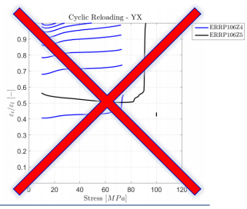
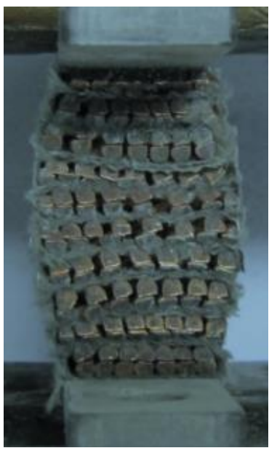
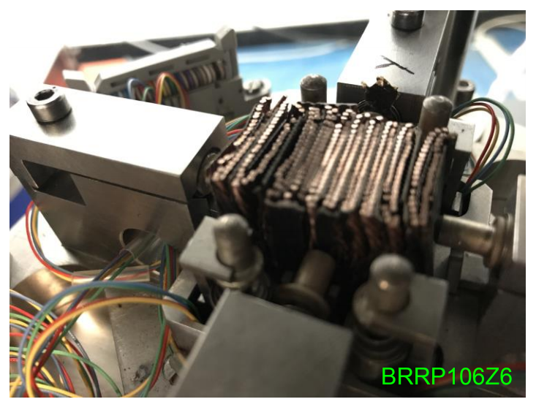
Not the only ones with delamination
From Maria Durante – Mechanical characterizaiton setup at CEA
From Workshop on Nb3Sn Rutherford cable characterization for accelerator magnets

Slide 12
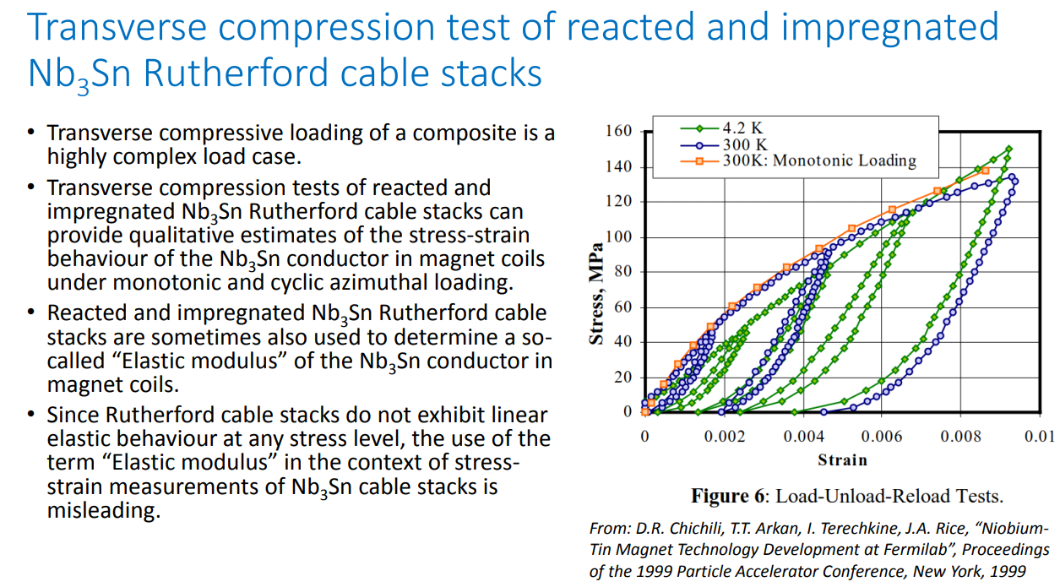
Two slides from C. Scheuerlein Uncertainties in the measurement of the mechanical properties of Nb3Sn coil constituents and cable stacks

Slide 13
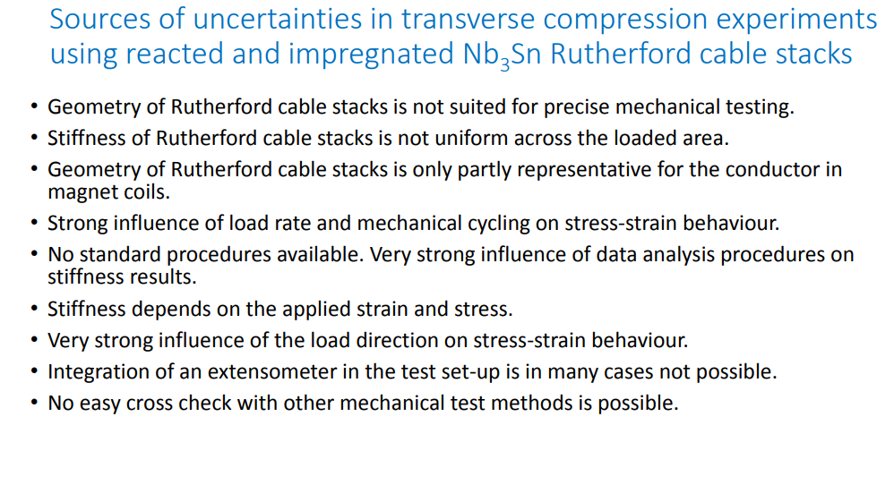
from C. Scheuerlein Uncertainties in the measurement of the mechanical properties of Nb3Sn coil constituents and cable stacks

Slide 14
Potential reasons for differences between recent results and past results
Core
  Epoxy doesn’t like to stick to stainless steel
  it is also rather squishy
E-Glass Tape
  E-glass does not maintain any structural integrity after reaction>no tensile fibers exist to carry load.
  Epoxy does not solve this problem
  Several attempts were made to fabricate E-glass stacks when Matrimid study was in progress using multiple resins with all samples essentially destroyed in fabrication
Short sample length relative to cable twist pitch
  No continuous strands between cable edges
Poor bonding of insulation/epoxy to cable
  Maybe from E-glass or oxidation of copper?
Binder-Tape interaction?

Slide 15
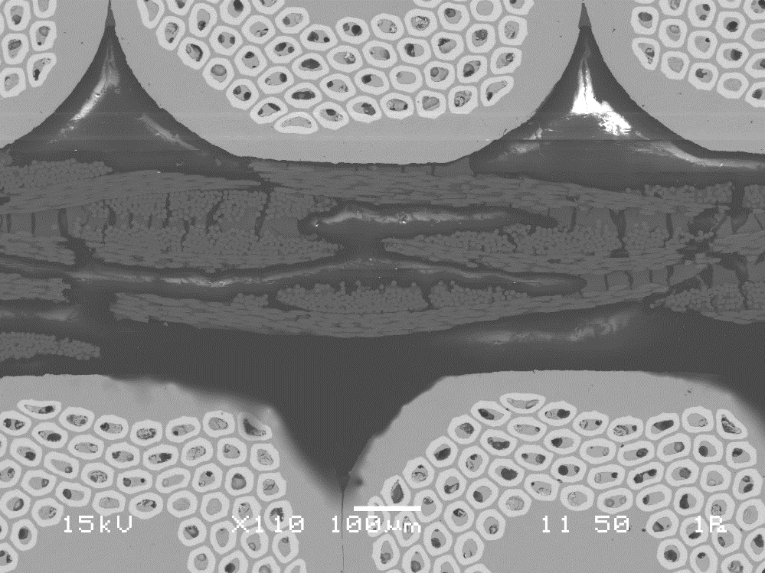
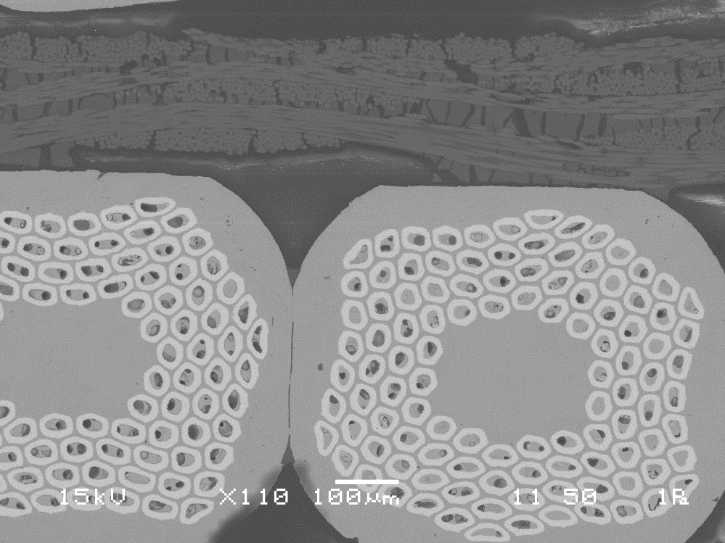
Microstructure of insulation
Large chunk of solid materials (circled) trapped between fiber layers. Probably dried binders. Need confirmation with elemental analysis.
Possible reason: because of tape wrapping, the inter-fiber space is non-uniform, leading to local accumulation of binder

Slide 16
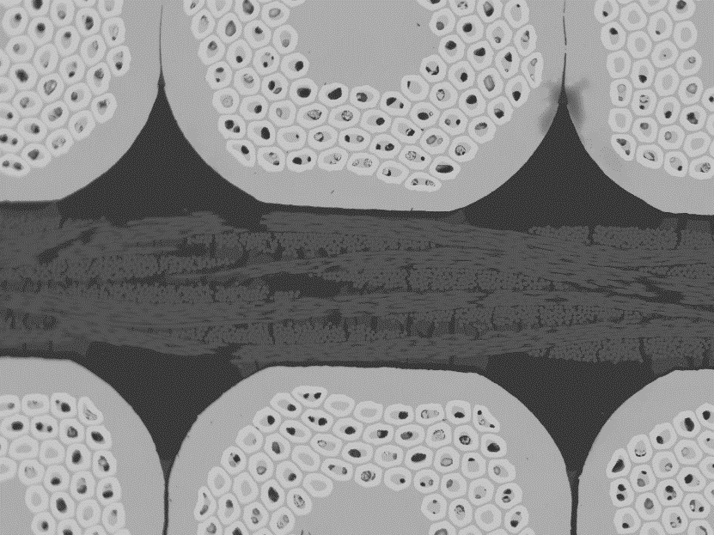
E-glass wrapping
100μm
epoxy
Fibre glass
binder
100μm

Slide 17
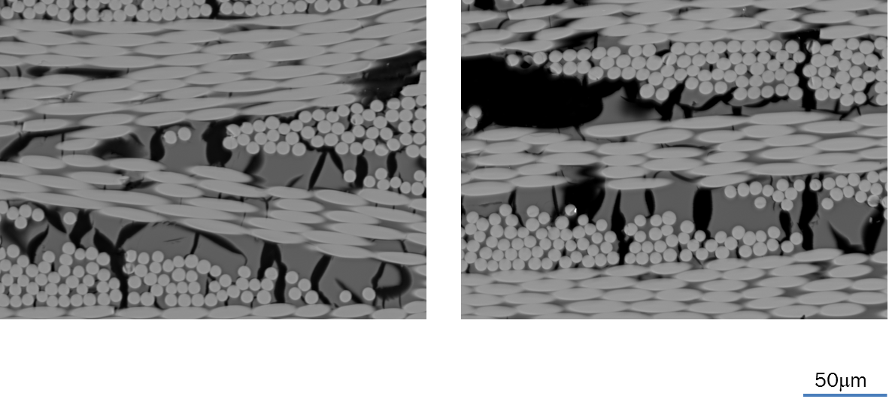
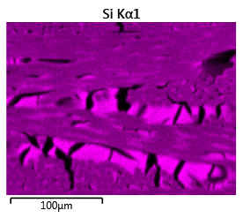
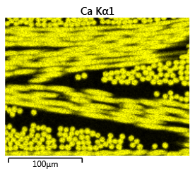
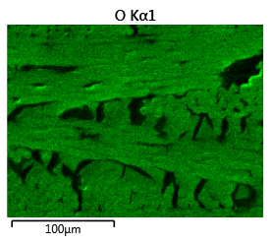
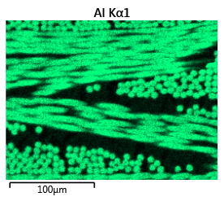
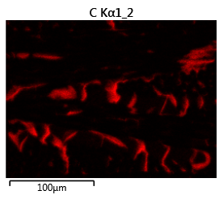
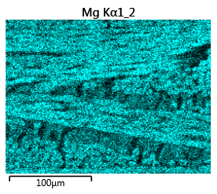
Elemental composition mapping
High Ca content is a signature of E-glass

Slide 18
S-Glass
100μm
50μm

Slide 19
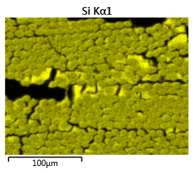
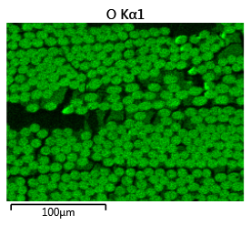
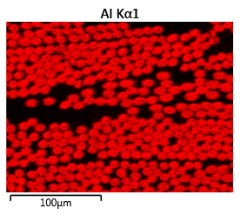
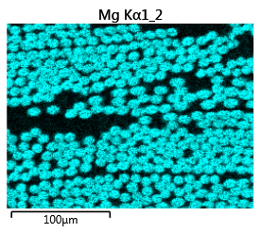
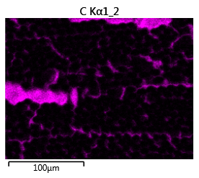
Elemental composition mapping

Slide 20
Thermal contraction
Thermal Contraction is measured relative to a reference material of known near zero contraction by strain gage
  Fused Quartz
These measurements are in close agreement (~10%) with previous measurements on TQ Cable Stacks
Sample | Thermal contraction, 293-77K (%), after correction of thermal effect of gage, three samples average
Al-6061 | -0.369 (calculated=-0.385)
10 stack, azimuthal | -0.422(±0.0005)
10 stack, radial | -0.191(±0.0035)
10 stack, axial | -0.215(±0.0006)

Slide 21
Moving Forward
Ongoing work
  3 mil S-Glass tape is on hand, heat cleaned, and ready to apply applied to cable.
  Proceed with fabrication of more stacks to compare S-glass to E-Glass. Use 15T Outer cable.
Potential Improvements to test program
  Increase sample length to one or more twist pitches to improve behavior.
    Current max length is 6”.
    Longer stack will reduce maximum loading
  Build set of same stacks with 11T cable w/o core to see what core effect is.
  Consider using traditional testing standards if possible to better characterize behavior.
    Cryogenic fracture toughness may be more useful then all of the rest of the measurements to qualify resins.
Potential SBIR to work on characterizing filled resins for our uses

Slide 22
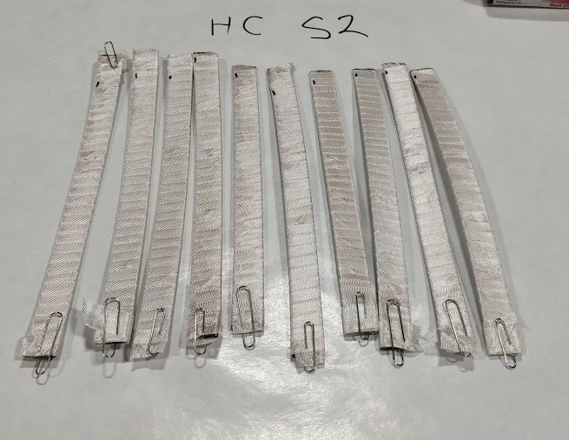
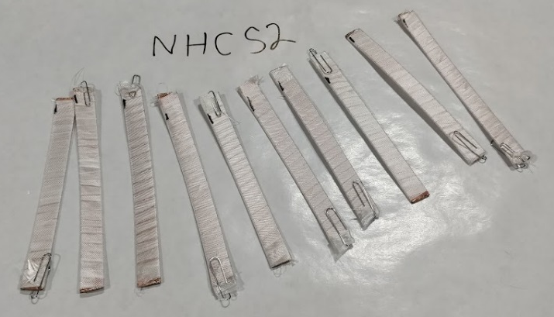
Stack fabrication using 15T outer cable is in progress to validate S2 improvement from E-Glass
  As received
  Heat Cleaned

Slide 23
Test Matrix
Keep in mind, even though samples are small, each one is basically a small magnet in terms of process.
This is a very inefficient way to obtain measurements.
To complete stacks for rest of matrix is about 54 days or 1 year at ~0.25 FTE excluding testing…

Slide 24
Time for additional sample sets
Fabrication of each stack takes about 18 days at 100% FTE
  When reaction is included as well as regular down time, each takes over a month. We can react 2 samples at once, maybe more if we make new tooling..
  We can impregnate 2 samples at once
Testing takes about
  half a day per object for thermal contraction
  1-2 days per sample for mechanical measurement
    1 day prep, 1 day measure

Slide 25
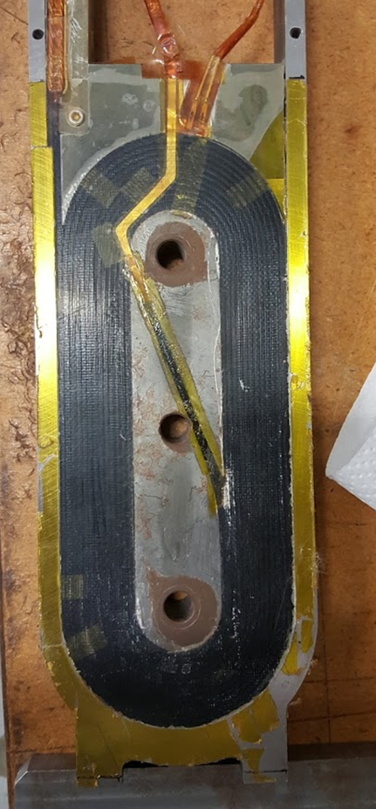
Alternative route to similar geometry?
Small Racetracks
  We can likely build non-functional ten stack racetracks much faster than by individual pieces
  Investigating feasibility of water-jetting all parts and making entire structure consumable
    Wind, cure, react, and impregnate without changing(or needing to clean?!) tooling
  No cable discontinuities through cross section
    Can insulate cable on machine
    No loss of tension on cable core
  Geometry much more like real coil
    Better way to qualify difficult resins or techniques

