Slide 1
REBCO program: status, issues and next steps
Xiaorong Wang
Lawrence Berkeley National Laboratory
MDP Collaboration Meeting, Jacksonville, FL, 2/8/2018
Notes:
Add date on each slide
30 slides

Slide 2
Acknowledgments
U.S. Magnet Development Program, a collaboration between ASC/NHMFL/FSU, FNAL and LBNL, supported by DOE Office of Science, Office of High Energy Physics
Danko van der Laan and Jeremy Weiss at Advanced Conductor Technologies LLC and DOE HEP SBIR programs
Team at LBNL: Lucas Brouwer, Shlomo Caspi, William Ghiorso, Hugh Higley, Andy Lin, Thomas Lipton, Soren Prestemon, Tengming Shen, Jordan Taylor, Marcos Turqueti, Kai Zhang

Slide 3
MDP-REBCO program aims to address the following driving questions
Can we build practical accelerator magnets with REBCO?
What performance parameters in REBCO are most critical for high field accelerator magnets?
What are the near and long-term goals for REBCO conductor development?
Our approach:
Build, test and understand magnets
Provide input to conductor development based on magnet performance and our understanding
What are the drivers and required operation margin for REBCO magnets?
What are the limitations on means to safely protect REBCO magnets?
Notes:
- Where are we now? What did we learn? What are the issues? What’s the plan?

Slide 4
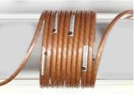
Our main vehicle is CCT + CORC® wires
CCT design
Low conductor stresses
Excellent geometric field quality
Field
current
[D. Meyer and R. Flasck, Nuclear Instruments and Methods, vol. 80, no. 2, pp. 339–341, 1970; AV Gavrilin et al., IEEE TAS, 13(2), 2002; S. Caspi et al., IEEE TAS, 4001804, 2014]
CORC® wires (< 3.7 mm diameter)
Isotropic for magnetics and mechanics
Flexible (~ 50 mm minimum bending diameter)
[J. D. Weiss et al., SuST, 014002, 2017 and references therein]
Compliments to efforts in EU and Japan
Notes:
Update the message.

Slide 5
A year ago, we started testing the first 3-turn magnet (C0a) and planned to make and test the first 40-turn magnet (C1)

Slide 6
We promised, we delivered
C0a
C0b
C0c
C1
Winding, test integration
Winding, terminal, magnet performance
Significantly pushed forward the REBCO front within a year using 3-turn and 40-turn magnets – we are well positioned for more significant next steps
Capable technical team
Effective collaboration with industry (ACT)

Slide 7
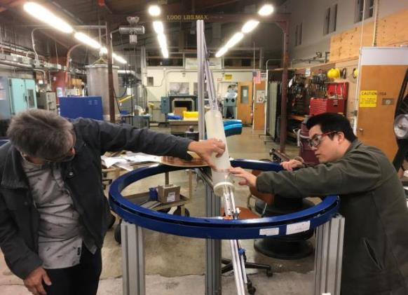
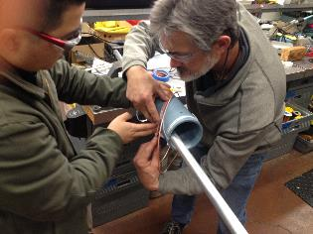
We learned how to wind coils without significant degradation
Hugh Higley (left) and Andy Lin (right) winding a 40-turn mockup coil

Slide 8
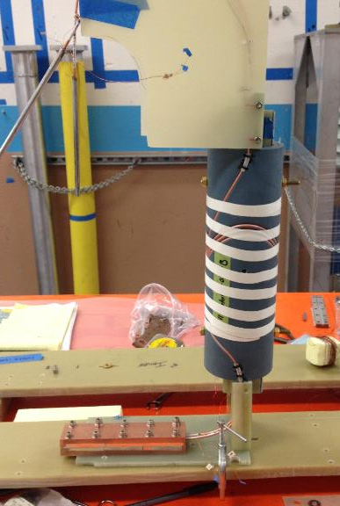
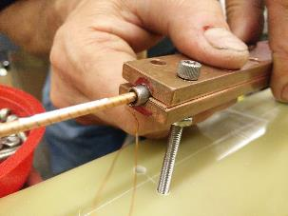
We learned how to make convenient joints between wires with acceptable performance
Indium foil pressure contact
Praying-hand joint

Slide 9
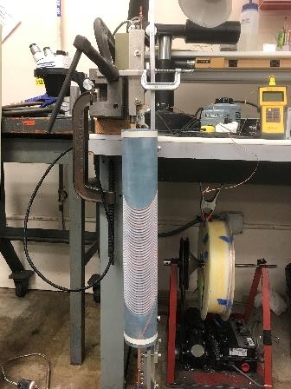
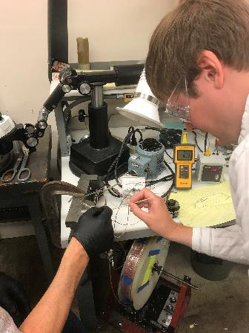
ACT taught us how to make wire terminals which is crucial and not trivial
Minimal voids after soldering benefits current transfer
Install terminals after winding
J. Weiss and D. van der Laan onsite to install terminals

Slide 10
We now know what it takes to make the cut

Slide 11
Successfully wound two 40-turn coils for magnet C1, each coil used ~ 15 m long CORC® wires
Inner layer
Outer layer
Co-wound instrumentation wires to reduce inductive noise in voltage-based quench detection

Slide 12
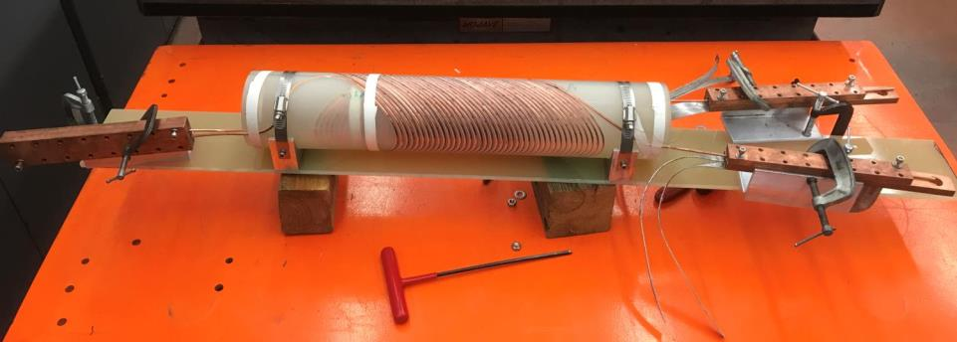
We developed effective magnet assembly plan based on mockup coils
Return-end joint
Non-magnetic clamp
Lead-end joint
Strongback to anchor the coils and joints
C1 mockup
NbTi cable leads

Slide 13
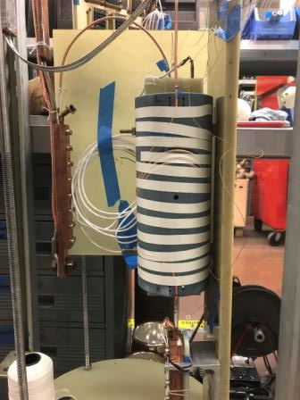
We learned how to integrate magnets to Test Facility and tested up to 12 kA
C0b, 29-tape wire, 3.7 mm diameter, 30 mm bending radius
NbTi cable
CORC® wire
Hall probe assembly
Acoustic sensors for quench detection experiments (developed by M. Marchevsky at LBNL)
“Acoustic thermometry for detecting quenches in superconducting coils and conductor stacks “, Marchevsky et al., APL, 2017, doi:10.1063/1.4973466
Notes:
- Integrate to the test facillity

Slide 14
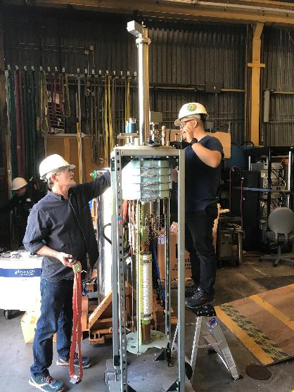
C1 magnet successfully attached to the header after careful planning and practice
Used dummy magnet assembly to arrange all the details

Slide 15
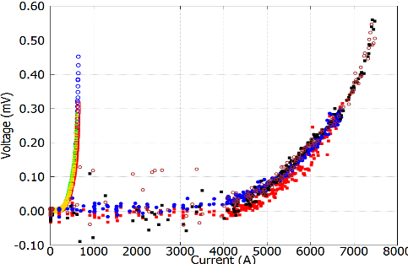
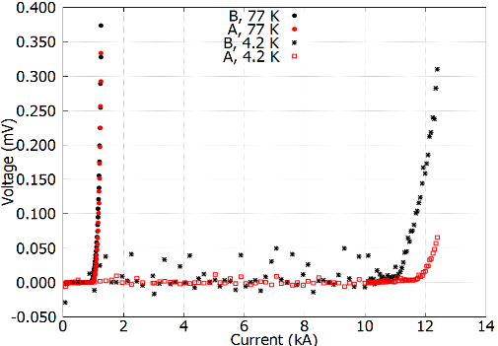
Successful tests suggest that CORC® CCT is a viable concept
C0a reached a peak J_{e} of 997 A/mm² at 4.2 K
C0b reached a peak J_{e} of 1198 A/mm² at 4.2 K
77 K
4.2 K
77 K
4.2 K
C0b
C0a

Slide 16
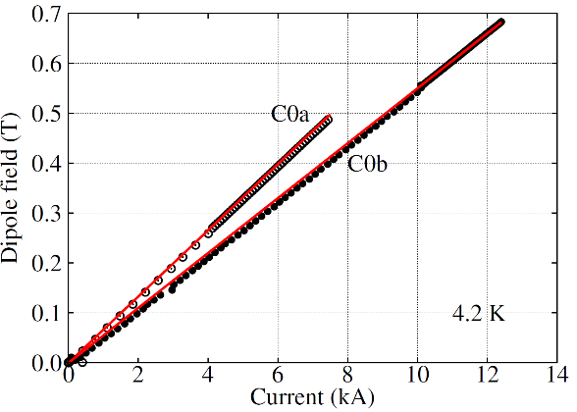
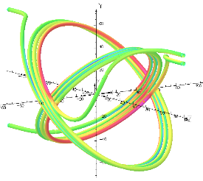
Measured dipole fields are consistent with calculation
Hall probe assembly
Calculation considers the coil ends

Slide 17
Joint resistance is good enough for near-term magnet development and test
97 nΩ
8 nΩ
Soldering the wires can further reduce the joint resistance

Slide 18
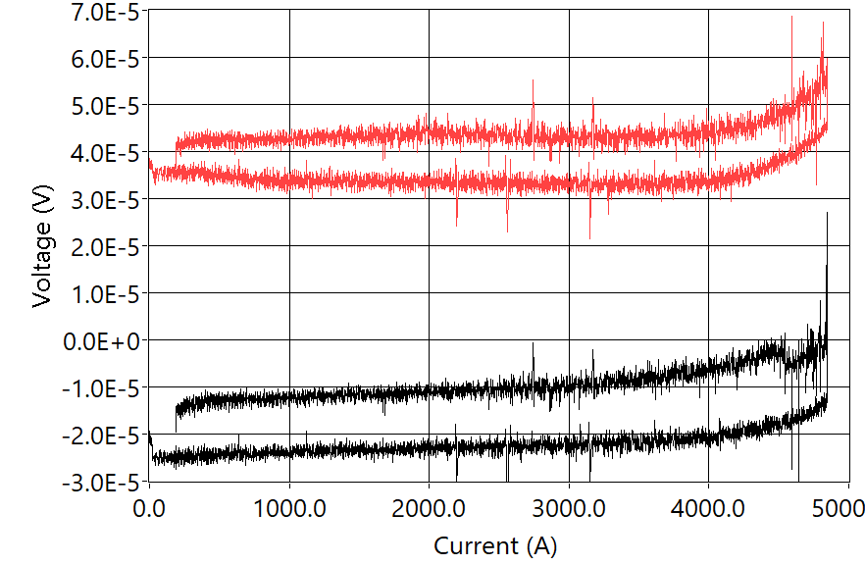
C1 started transition around 3.5 kA in the inner layer, 76% expected short-sample limit
4.2 K
Outer layer
Inner layer

Slide 19
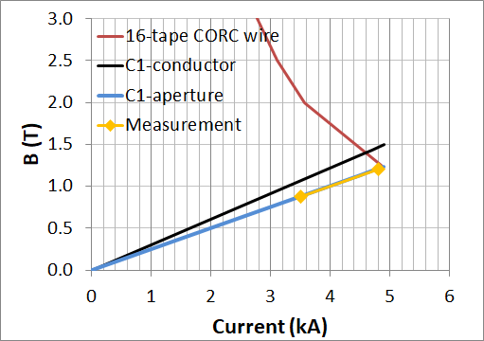
C1 reached 1.2 T at 4.2 K, 104% of the expected performance. Reproducible after thermal cycles
J_{e} = 640 A/mm²

Slide 20
A two-pronged approach to generate 5 T in 16 T background field: improve magnet design and wire performance
C1 wire J_{e} decreases by a factor of 5 from 600 A/mm² at 1.4 T to 114 A/mm² at 20 T → generate 0.2 T in 16 T
Improve magnet efficiency: triple the dipole transfer function
C1 design has a transfer function of only 0.25 T/kA
Increasing number of coil layers
Reducing wire bending radii
Increase the wire J_{e} by improving tape J_{e} and reducing wire diameter

Slide 21
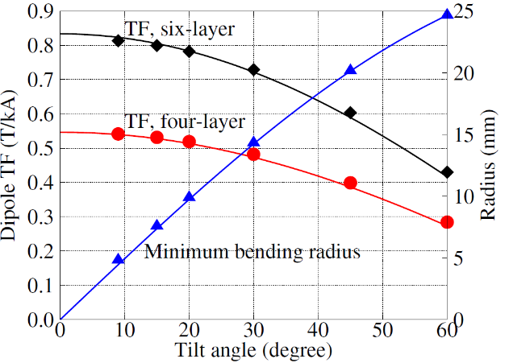
A target wire performance to generate 5 T in 16 T background field
Goal
Today
OD for 6-layer design: 121 mm
Minimum J_{e} at 3.7 mm wire diameter : 540 A/mm² at 21 T, 4.2 K, 15 mm bend radius
Today: 220 A/mm² at 21 T, 4.2 K, 30 mm bend radius
Notes:
Emphasize the point of 3.7 mm wire diameter
Two specific design, 4 layer and 6 layer, ID 50 mm, OD 97 and 121 mm.

Slide 22
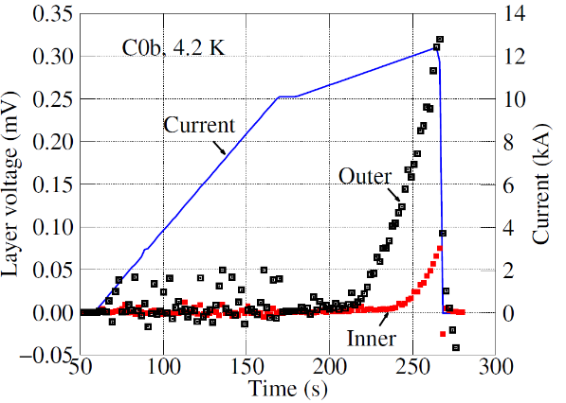
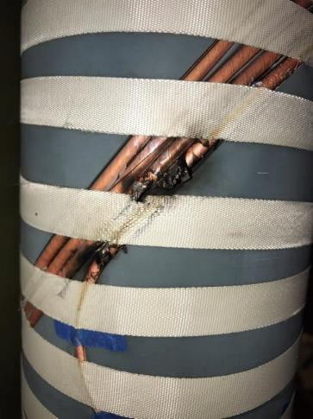
Understand current sharing inside wires and prevent conductor over-heating
50 s!
Mr. and Mrs. Voltage Tap still work
Understand current sharing and develop new detection strategy

Slide 23
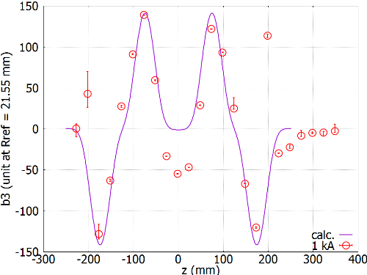
Field profile at 1 kA generally follows the expectation
Measurement at the magnet center with a 100 mm long rotating coil developed by Joe DiMarco at FNAL
Deviation from the calculation at the magnet center is due to the persistent-current effects at 1 kA

Slide 24
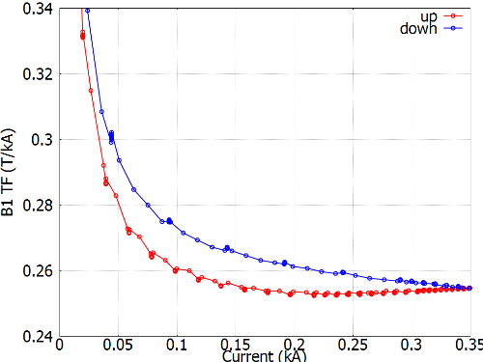
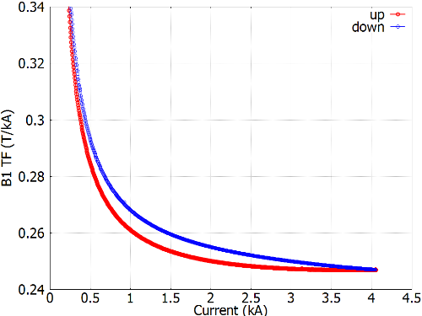
Stronger self-field hysteresis at 77 K than at 4.2 K
Measurement at the magnet center with a 100 mm long rotating coil developed by Joe DiMarco at FNAL
To be understood from the temperature dependence of the tape magnetization
77 K
4.2 K
Notes:
Maximum hysteresis between up and down ramps is about 4% of the nominal transfer function at 77 K and 2% at 4.2 K

Slide 25
Negligible ramp-rate dependence indicates possible large inter-tape contact resistance (R_{c}) between tapes inside the wire
Possible R_{c} range is 1 – 10 μΩ, under investigation
Need to establish the desired resistance level that can meet the competing needs of current sharing and low dynamic field errors

Slide 26
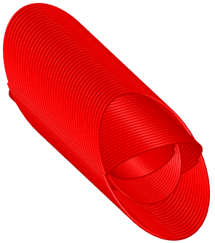
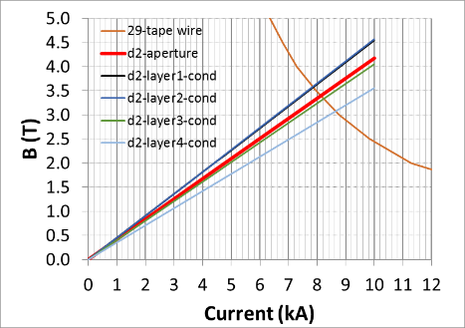
FY18 goal: make and test C2
4-layer design to generate 3 T dipole field at 4.2 K
Use C0b 29-tape wire as the baseline conductor
Wire OD 3.65 mm, minimum bending radius 30 mm
Magnet ID 70 mm, OD 125 mm
Notes:
- Change the magnet graph to 3D

Slide 27
With 0.5 FTE technician, we can make and test C2 in FY18
November 2017
Order the wire (done)
January 2018
Complete the magnetic design (done)
Determine the cryostat to use
Explore the fabrication of metal mandrel
March 2018
ACT makes and delivers the wires
Develop a wet winding process
Complete the mechanical analysis and determine if we need metal mandrels
Complete the CAD design

Slide 28
With 0.5 FTE technician, we can make and test C2 in FY18
May 2018
Finish fabricating the mandrels
Wind and test subscale coils to verify the procedures
July 2018
Wind and test individual layers
Assemble C2 with 4 layers
Test C2 at 77 K and 4.2 K, self-field
September 2018
Complete test after thermal cycles
Plan for the next magnet

Slide 29
We need more hands and a cryostat to make it happen
We need staff support
C0 and C1 used 0.25 FTE technician
C2 is more challenging and needs 0.5 FTE
Other high-priority projects take away the available FTE
A vertical cryostat (15” ID, 75” depth) within 4 months
C2 will not fit into the existing 15” cryostat (60” depth)
Reduce magnet length by reducing 25% of turns
Commercially available ($30 k), 3 month lead time
Notes:
We are not moving fast enough to encounter and address more issues
We need more wires to make magnets

Slide 30
Order wires in FY18 for FY19’s magnets
10 m more wire for C2
The current order has little margin
Order wires in FY18 to develop the next magnet in FY19
150 – 200 m
Exact wire length to be determined in the next few months
Complete more detailed magnet design (goal is 5 T)
Improved wire performance from the ongoing HEP Phase II SBIR program

Slide 31
We are addressing the driving questions
Can we build practical accelerator magnets with REBCO?
Yes, we are demonstrating it with CORC® CCT concept
What performance parameters in REBCO are most critical for high field accelerator magnets?
What are the near and long-term goals for REBCO conductor development?
The goal for next 12-24 months is to increase or maintain the same J_{e} and reduce bending radius to 15 mm
What are the drivers and required operation margin for REBCO magnets?
What are the limitations on means to safely protect REBCO magnets?
Need to build and test more magnets to answer
Continue to develop diagnostics to detect local hot zones
Need the infrastructure to test in background field
Notes:
- Where are we now? What did we learn? What are the issues? What’s the plan?

Slide 32
We made significant progress and can do better with enough resource this year
It’s been an exciting year!
Made the first CORC® CCT dipole magnets (1.1 T at 4.2 K). Learned a lot and know what to do next
The CCT concept using CORC® is viable – no showstoppers foreseen
Kudos to ACT and the dedicated team – we can generate 5 T in FY19
But it is painfully slow. We are not moving fast enough to encounter and address technology issues
With 0.5 FTE technical support and wires, this year we can be much more effective – to demonstrate and define what’s possible with REBCO
Notes:
I am not afraid of mistakes. I am afraid that we have no steam to make mistakes.

Slide 33
A 5-year technology-limited roadmap to demonstrate REBCO magnets
2017 | 2019 | 2021 | 2023
Develop cable & magnet technology
Provide feedback on conductor R&D
10 T dipole
FES magnet
1 T insert
5 T insert
7 T insert
CCT4
10-15 T Nb₃Sn outserts
Develop 20 T hybrid dipole
Qualify & develop FES cables
2017: 1 T dipole insert
2019: 5 T dipole insert, 2 – 3 T in 10 – 15 T background field
2020: 7 T insert for 20 T hybrid dipole.
2023: demo coil for tokamak and/or stellarator
10 T all-REBCO dipole

