Slide 1


Status of the FCC Study and of the 16 T dipole development program
Davide Tommasini on behalf of:
D.Arbelaez¹¹, B.Auchmann¹, H.Bajas¹, M.Bajko¹, A.Ballarino¹, E.Barzi¹⁰, G.Bellomo², M. Benedikt¹, S.Izquierdo Bermudez¹, B.Bordini¹, L.Bottura¹, L.Brower¹¹, M.Buzio¹, B.Caiffi⁵, S.Caspi¹¹, M.Dhalle³, M.Durante⁴, G. de Rijk¹, P.Fabbricatore⁵, S.Farinon⁵, P.Ferracin¹, P.Gao³, S.Gourlay¹¹, M.Juchno¹¹, V.Kashikhin¹⁰, F.Lackner¹, C.Lorin⁴, M.Marchevsky¹¹, V.Marinozzi², T.Martinez ⁶, J.Munilla⁶, I.Novitski¹⁰, T.Ogitsu⁷, R.Ortwein¹, J.Perez¹, C.Petrone¹, S.Prestemon¹¹, M.Prioli¹, J.M.Rifflet⁴, E.Rochepault¹, S.Russenschuck¹, T.Salmi⁸, F.Savary¹, D.Schoerling¹, M.Segreti⁴, C.Senatore⁹, M.Sorbi², A.Stenvall⁸, E.Todesco¹, F.Toral⁶, A.P.Verweij¹, S.Wessel³, F.Wolf¹, A.V.Zlobin¹⁰
1.CERN, 1211 Geneva, Switzerland; 2.INFN, 20133 Milano, Italy; 3.Twente University, 7500 Twente, Netherlands; 4.CEA, 91400 Saclay, France; 5.INFN, 16146 Genova, Italy; 6.CIEMAT, 28040 Madrid, Spain; 7.KEK, 305-0801 Tsukuba, Japan; 8.Tampere University, 33100 Tampere, Finland; 9.University of Geneva, 1211 Geneva, Switzerland; 10.FNAL, Batavia IL 60510, USA; 11.LBNL, Berkeley, CA 94720, USA

Slide 2
Outline
Status of the FCC Study
Status of 16 T programs
The ERMC and RMM R&D magnets
Conclusion

Slide 3


Slide 4

FCC Collaboration & Industry Relations
113
Institutes
32
Countries
International collaboration (CERN as host lab) to study:
100 TeV pp-collider (FCC-hh)
~100 km tunnel infrastructure in Geneva area, site specific
e⁺e⁻ collider (FCC-ee), as potential first step
HE-LHC with FCC-hh technology
p-e (FCC-he) option, e⁻ from ERL
EC
H2020
100 TeV pp in 100 km ⇒ ~16 T

Slide 5
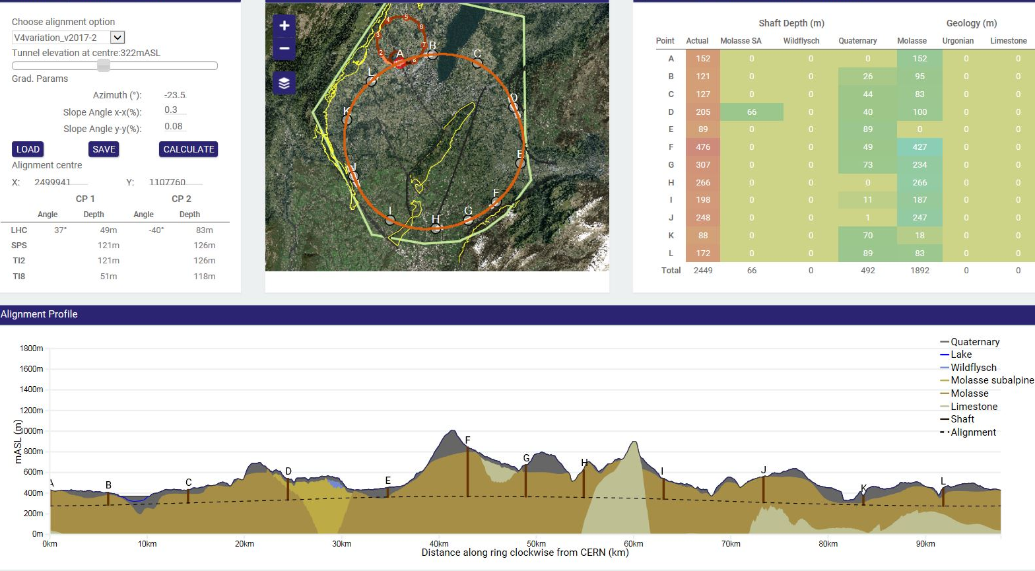
FCC Tunnel
100 TeV pp in 100 km ⇒ ~16 T

Slide 6

FCC-hh layout
Two high-luminosity experiments (A & G)
Two other experiments combined with injection (L & B)
Two collimation insertions
  Betatron cleaning (J)
  Momentum cleaning (F)
Extraction insertion (D)
Clean insertion with RF (H)
Compatible with LHC or SPS as injector
Circumference 97.8 km

Slide 7
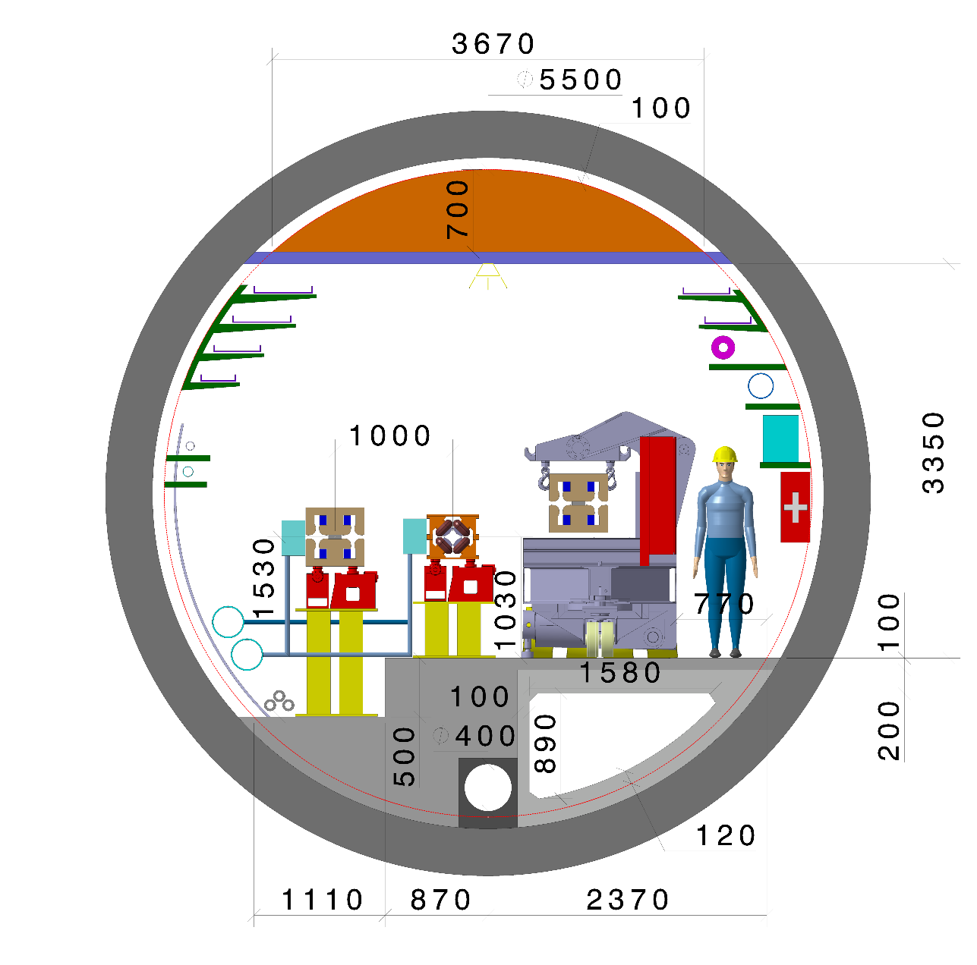
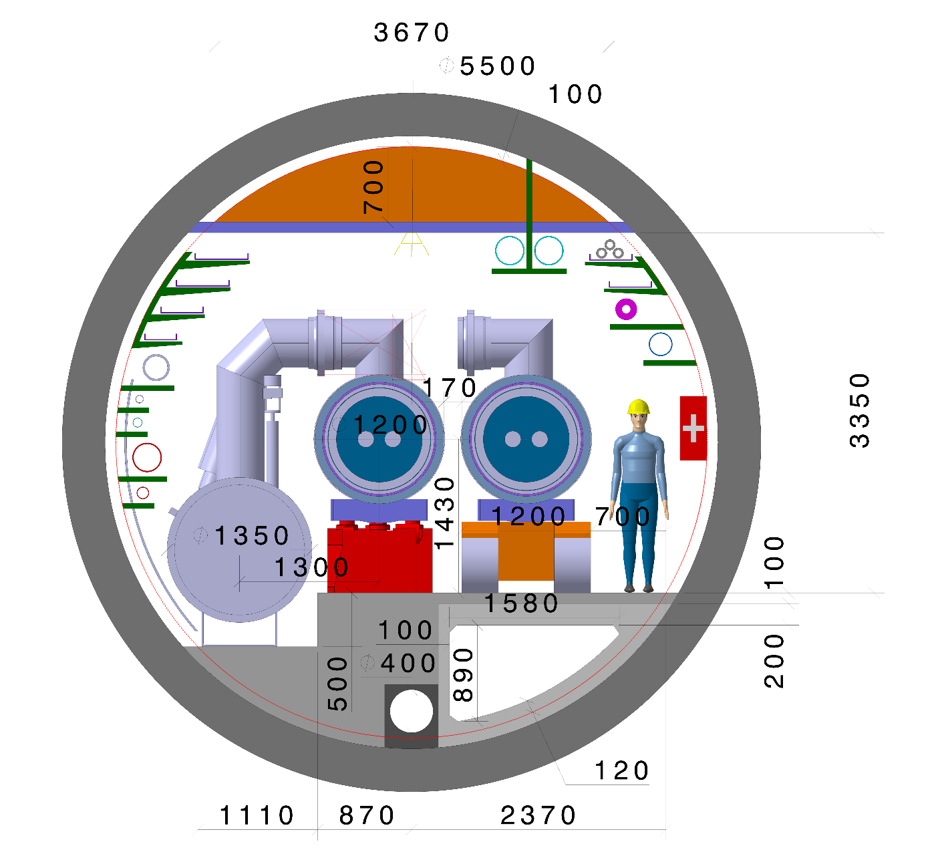
Tunnel integration
5.5 m diameter
FCC-ee
FCC-hh

Slide 8
Technical schedule
20
22
24
26
28
30
32
34
36
38
40
42
Technical Design Phase
Strategy Update 2026 – assumed project decision
Dipole short models
Dipole long models
16 T magnets
SC Magnets
16 T dipole indust. prototypes
16 T dipoles preseries
16 T series production
Civil Engineering FCC-hh ring
FCC-hh
FCC-hh
CE TL to LHC
LHC Modification
Installation + test FCC-hh
CE FCC-ee ring + injector
FCC-ee
FCC-ee
Injector
Installation + test FCC-ee
schedule constrained by 16 T magnets & CE
→ earliest possible physics starting dates
FCC-hh: 2043
FCC-ee: 2039
HE-LHC: 2040 (with HL-LHC stop LS5 / 2034)
LHC Removal
HE-LHC
HE-LHC
Installation HE-LHC

Slide 9
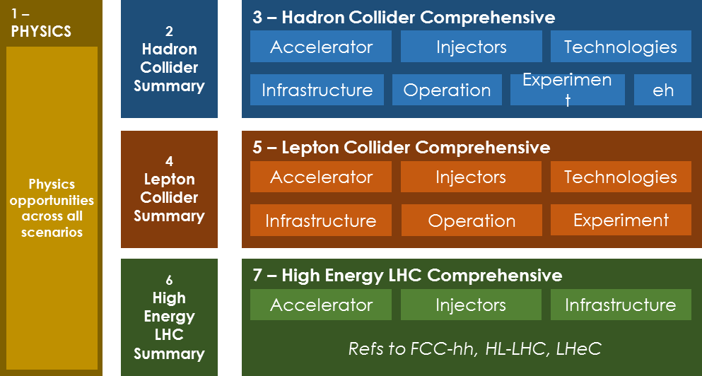
Conceptual Design Report
CDR summary volumes will be available by end 2018, as input for European Strategy Update 2019/20

Slide 10
Magnets
A Future Circular Collider (FCC), or an energy upgrade of the LHC (HE-LHC), would require bending magnets operating at up to 16 T.
This is about twice the magnetic field amplitude produced by the Nb-Ti magnets of the LHC, and about 5 T higher than the field produced by the Nb3Sn magnets for the High Luminosity LHC.
Can, these magnets, be feasible in «accelerator quality»*?
If yes, at which cost?
* margin, construction including alignmnent, field quality, protection in a circuit

Slide 11
Overview of activities 2018-2023
FCC Conceptual Design Report (to be delivered by end 2018)
Feed the CDR with one reference option, including cost model, plus a description of alternative options.
Conductor
Procurement of up to 1.5 t of conductor/year to feed models and demonstrators
Increase of J_{c} up to FCC target (1500 A/mm² @ 4.2 K, 16 T)
Electro-mechanical characterization of the conductor.
R&D Magnets
Design, Manufacture & Test of ERMC and RMM Magnets.
Identify and implement required technological R&D (wound conductor, splices, impregnation …)
Model magnets
Design, Manufacture & Test of Model Magnets

Slide 12

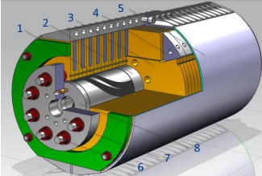

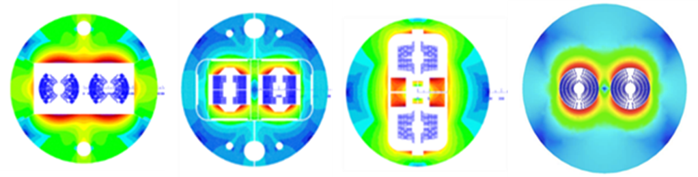

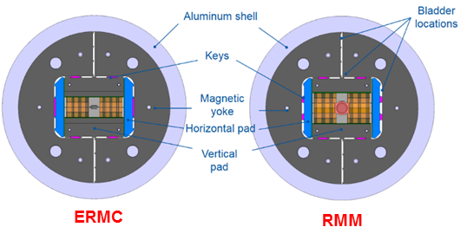
Present 16 T Development Programs
    US Magnet Development Program (ASC/NHMFL, FNAL, LBNL)
      initially focused to a 14-15 T cosine-theta magnet (2017-2018)
      also exploring a canted cosine-theta option (insert to the outer layers of the 14-15 T magnet?)
    EuroCirCol WP5 (CEA, CERN, CIEMAT, Geneva UNIV, KEK, INFN, Tampere UNIV, Twente UNIV)
        feed the FCC CDR with design and cost model of 16 T magnets
cosinetheta block-coils common-coils canted cosinetheta
    FCC 16 T Magnet Development, supporting:
      conductor development & procurement
      R&D magnets (ERMC and RMM) and associated development
      model magnets, agreements CERN with CEA, CIEMAT, INFN

Slide 13
EuroCirCol
Feed the FCC CDR with design and cost model of 16 T magnets
Daniel’s talk

Slide 14
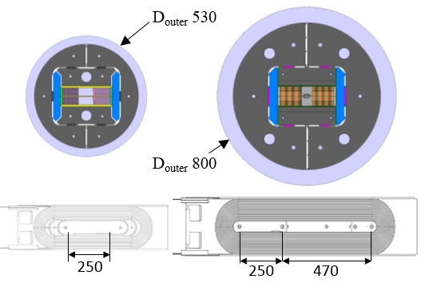
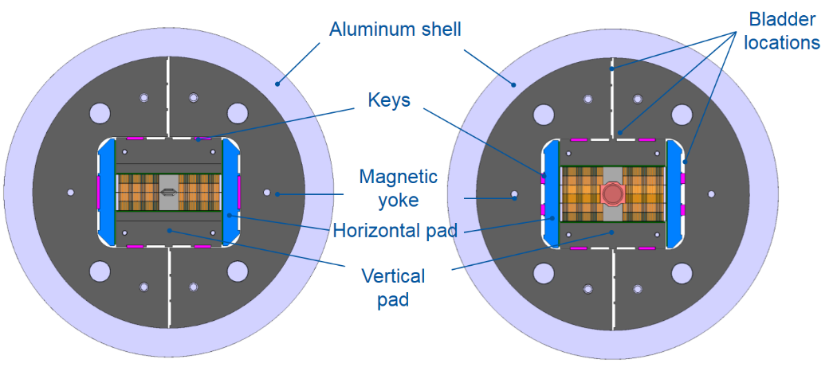
16 T Magnet Development: R&D Magnets
ERMC (Enhanced Racetrack Model Coil) and RMM (racetrack Model Magnet), non-graded and graded versions
530
800
RMC
ERMC/RMM
RMC
ERMC
RMM
a real straight section
a structure for fields up to 18-19 T
key & bladders for ease of multiple assembly
ERMC coils compatible with use in the RMM
RMM equipped with harmonic field probes
demonstrate the field level with margin and limited/no training
measure and characterize field quality static and dynamic
management of transitions (layer jump, ends …)
study/optimize coil manufacture
explore different loading configurations/strategies
splice studies in real magnet configuration

Slide 15
16 T Magnet Development: Model Magnets
EuroCirCol shows that more than one design option may work
Each of the options has stronger and weaker points than the others
Furthermore, each of the options can be imagined in different variants
We have now an opportunity to build up a varied experience on Nb3Sn magnets beyond the HILUMI specifications thanks to new initiatives:
Model magnet at CEA signed, start winding (block coils)
Model magnet at CIEMAT under discussion
Model magnet at INFN under finalization

Slide 16
16 T Magnet Development: other initiatives
CERN-PSI for Nb3Sn splice R&D signed, under way (talk at the FCC week)
CERN-ETHZ for R&D on impregnation resins under signature
CERN-Univ. Patras (Gr) for compact mechanical structures under signature
CERN-Univ. Tampere (Fl) for industrialization of large production signed

Slide 17
16 T Magnet Development: Conductor
Initial effort is to achieve J_{c} = 1500 A/mm² at 4.2 K, 16 T
Until 2023, the 16 T development program requires up to 1.5 tons/year
Interesting results from collaborations (Korea, Japan, Russia) will be presented at the LTSW next week
Personally, I believe that Nb₃Sn has an enormous potential which is not yet exploited and may open new horizons for performance and cost reduction.
Substrate and experience of US labs on Nb₃Sn still remains ahead of the field but risks to be severely weakened if not properly cultivated.

Slide 18
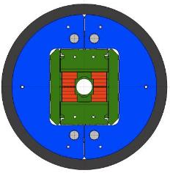
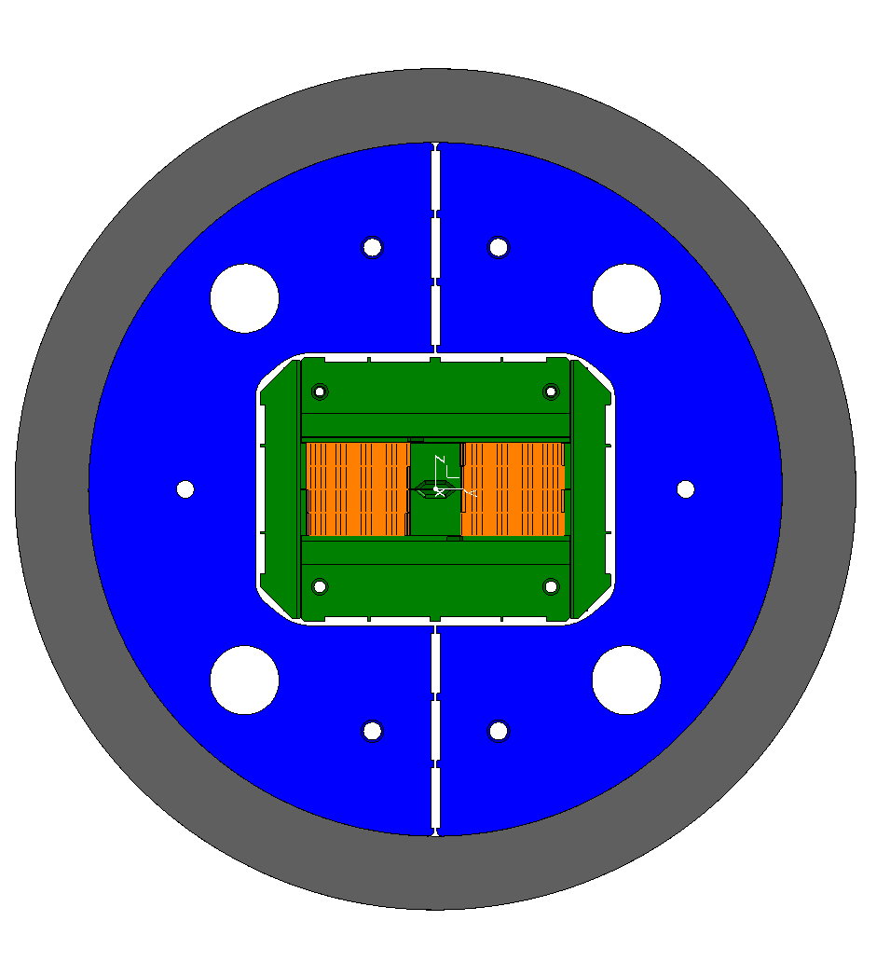
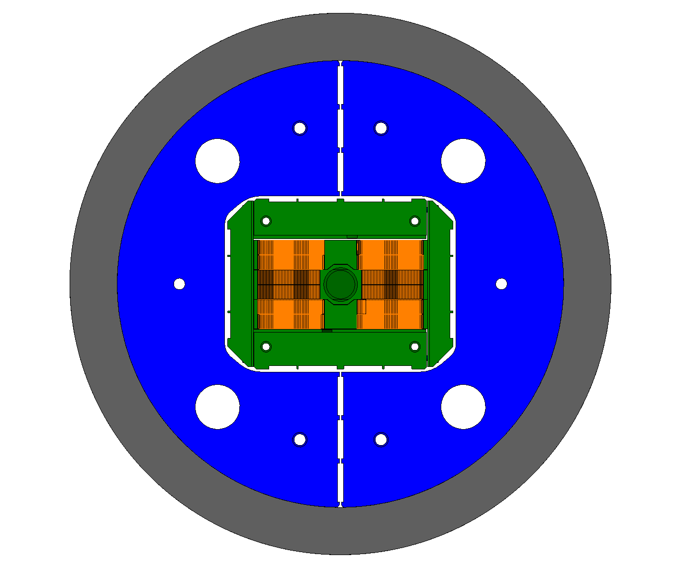
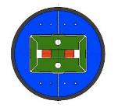
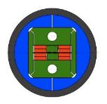
Nb3Sn HFM development @ CERN
SMC
RMC
ERMC
RMM
FRESCA2
OD = 530 mm
L = 500 mm
No Ap.
B_{op}= n.a.
B_{ult} = 14 T
OD = 570 mm
L = 820 mm
No Ap.
B_{op}= n.a.
B_{ult} = 16 T
OD = 800 mm
L = 1.2-1.4 m
No Ap.
B_{op}= 16 T
B_{ult} = 18 T
OD = 800 mm
L = 1.2-1.4 m
50 mm closed Ap.
B_{op}= 16 T
B_{ult} = 18 T
OD = 1.03 m
L = 1.6 m
100 mm Ap.
B_{op}= 13 T
B_{ult} = 15 T
Hi-Lumi R&D
FCC R&D
S. Izquierdo Bermudez

Slide 19
ERMC-RMM : Non-Graded Design
Start winding next week ☺

Slide 20
Magnet parameters
 | Units | ERMC | RMM
Nominal current (I_{nom}) | kA | 13.1 | 11.4
Overall current density | A/mm² | 282 | 245
Bore field | T | 15.7 | 16.0
Peak field at I_{nom} | T | 16.0 | 16.2
Stored energy at I_{nom} | MJ/m | 1.5 | 2.1
Differential inductance at I_{nom} | mH/m | 16.6 | 31.1
Short sample field at 4.2 K | T | 17.3 | 17.7
Short sample field at 1.9 K | T | 18.9 | 19.4
Short sample current at 4.2 K | kA | 14.4 | 12.7
Short sample current at 1.9 K | kA | 15.9 | 14.1
(1-I/I_{ss}) at 1.9 K | % | 18 | 19
(1-B/B_{ss}) at 1.9 K | % | 15 | 16
S. Izquierdo Bermudez

Slide 21
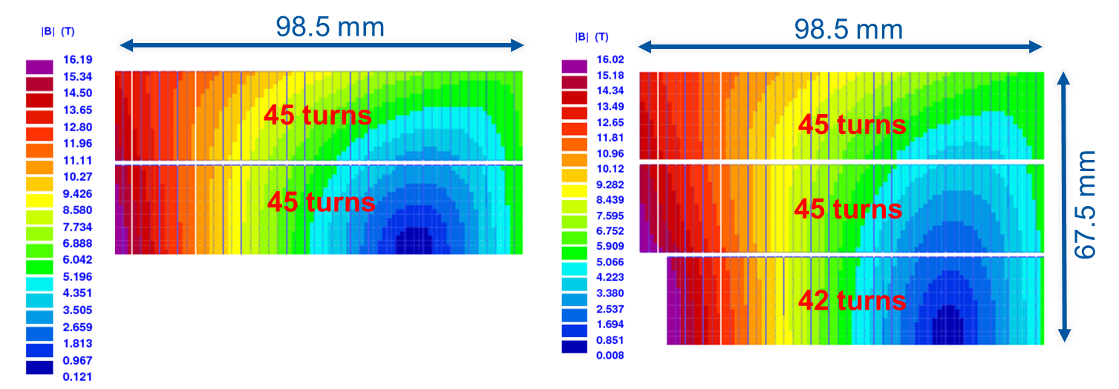
Magnetic design (2D)
S. Izquierdo Bermudez
ERMC
Two double-layers with 45 turns each wounded around a magnetic pole
B_{p}/B_{o} = 1.097
RMM (ERMC double layers +)
Middle double layer with 42 turns each wound around a titanium closed cavity
Coil aperture radius = 31 mm
Closed aperture radius = 25 mm
B_{p}/B_{o} = 1.097

Slide 22
Strand
B. Bordini
1 mm diameter wire, cu/sc =1
Wire received in 2016:
  4 billets RRP 120/127
    62-64 µm
  5 billets RRP 150/169
    54-55 µm
Enough wire to produce 5 coils (1 magnet + 1 spare coil per type)

Slide 23
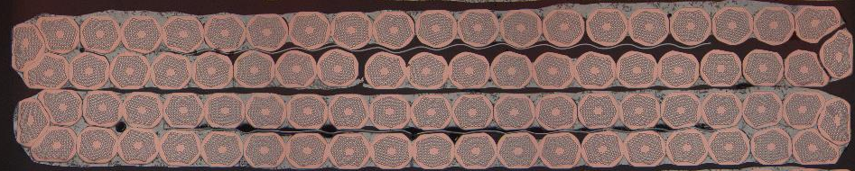
Cable
J. Fleiter & A. Bonasia
 | Before Heat Treatment | After Heat Treatment
Cable bare width, mm | 20.900 | 21.109
Cable bare thickness, mm | 1.820 | 1.875
40-strand cable
  Bare width x thickness:
  20.9 x 1.82 mm
  SS core 14 mm wide and 25 μm thick
Assumed growth during HT : 3% (thickness), 1% (width)
Assumed 5 % degradation on the critical current density due to cabling.
3 cable unit lengths (220 m x 3) produced in April 2017.
2 additional cable lengths to be produced (for RMM)

Slide 24
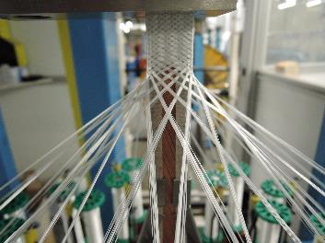
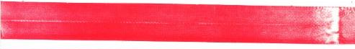
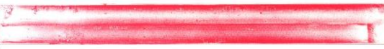
Cable insulation
J. Mazet
Baseline: 0.150 ^{+0.00/-0.02 mm} Mica-Glass Insulation
Insulation tests preformed to define the best parameters:
  S2 glass 636 11 TEX yarn
  14 yarns (ply) per bobbin
  32 bobbins
  Speed (angle) set to guarantee full coverage and appropriate thickness
ATTENTION !!!
https://indico.cern.ch/event/641886/
SMC11T-1
(no mica)
Upper layer
Lower layer
SMC11T-3
(mica)
Upper layer
Lower layer

Slide 25
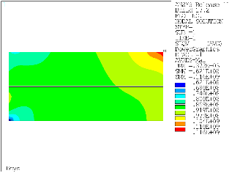
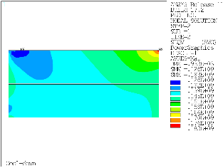
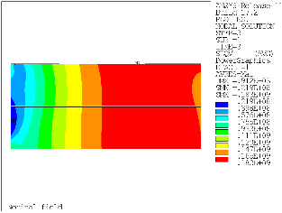
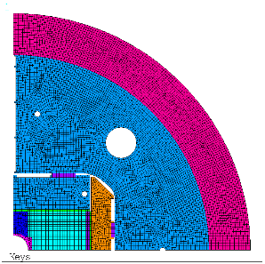
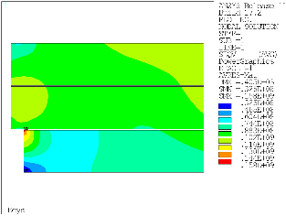
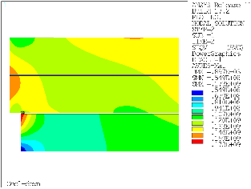
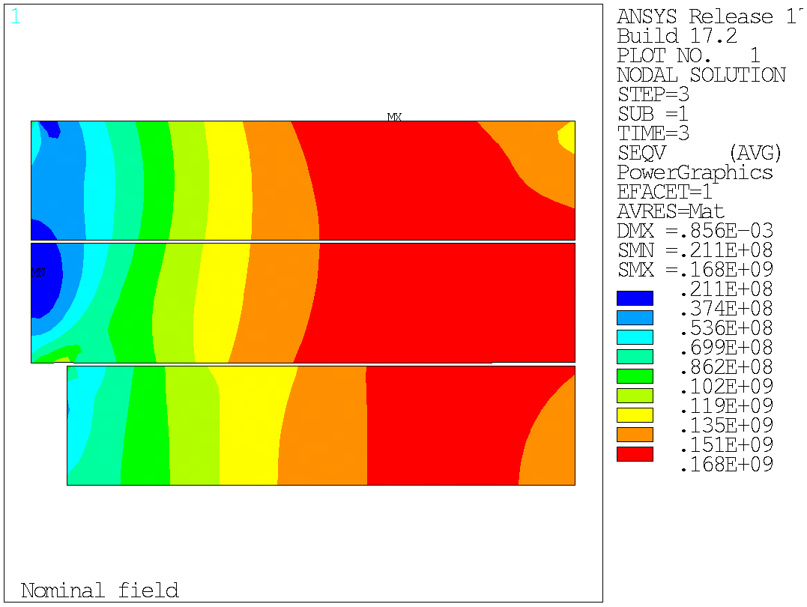
Mechanical design
Assembly
Cool-down
Powering
ERMC
183 MPa
183 MPa
RMM
168 MPa
173 MPa

Slide 26
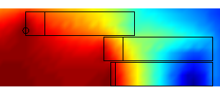
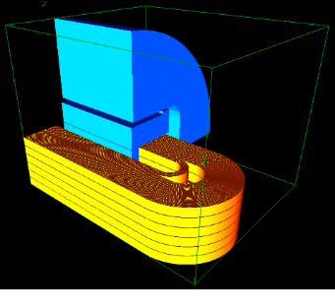
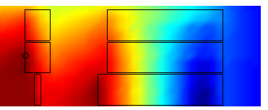
3D magnetic optimization
OBJECTIVE: Decrease the peak field in the end regions
Optimized solution 1
No end-spacer → simpler manufacturing
Shifted layer → minimum peak field
Unbalanced electromagnetic forces in the top layer
ΔBpeak = 1.1T
362 kN @ 18 T
168 kN @ 18 T
158 kN @ 18 T
Selected option
Optimized solution 2
Requires coil end spacers
The peak field in the coil ends is only 0.5 T lower than in the straight section
Balanced electromagnetic forces
ΔBpeak = 0.5 T
223 kN @ 18 T
239 kN @ 18 T
208 kN @ 18 T

Slide 27
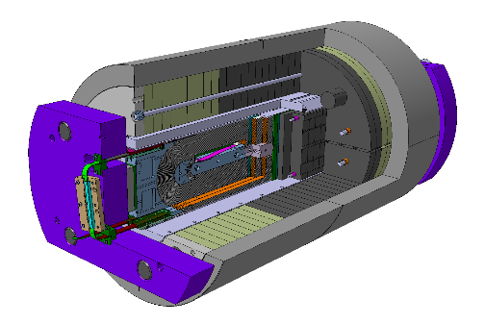
Axial support
Mechanical structure capable to load the magnet up to 18 T (3 MN longitudinal force RMM @ 18 T) , with enough margin to perform an experimental exploration of the different parameters relevant to magnet performance.
To allow a further exploration of the assembly parameters:
  Two different sets of shells have been procured:
    One shell, full length
    Two shells, central split
  Aluminum rods and stainless steel rods are under procurement.

Slide 28
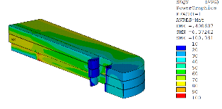
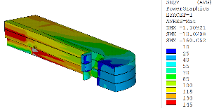
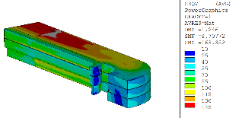
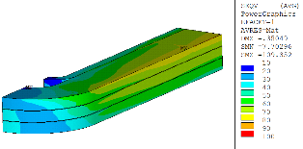
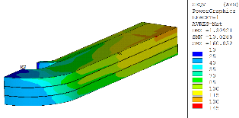
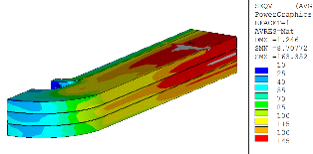
3D Mechanical analysis
Von Mises Stress [MPa]:
→ Peak stress in the straight section
→ <150 at Pre-load, <200 Cool-Down/Operation
101 MPa
160 MPa
163 MPa
Assembly
Cool-down
18 T
Equivalent (Von Mises) Stress [MPa]

Slide 29
ERMC-RMM : Graded Design

Slide 30
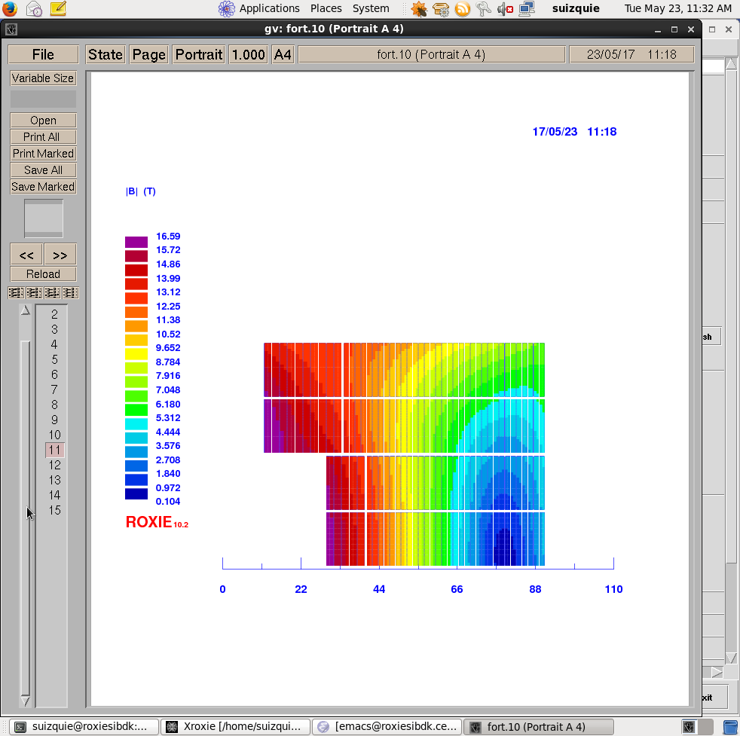
Magnetic design
Strong synergy with the EuroCirCol Block design option, slightly more conservative in some aspects:
  16 T bore field, with 14 % margin, using “available” critical current density (RMM critical current density, assuming 5 % cabling degradation)
  20 % margin in the low field region, as the impact on coil size is relatively small.
  Inner support thickness of 4 mm. In a later stage, coil with 2 mm inner support can be produced to study the impact of the inner support on the performance.
  Minimum available copper to superconductor ration 1 instead of 0.8
Parameter | Unit | Non Graded | Graded
 |  |  | HF | LF
strand diameter | mm | 1 | 1 | 0.7
Cu/SC | -- | 1 | 1 | 1.15
# of strands/cable | -- | 40 | 28 | 40
# turns/quadrant | -- | 132 | 30 | 132
coil width | mm | 86 | 69
I_{nom} | A | 11546 | 8695
J_{overall} | A/mm² | 248 | 264 | 357
Ratio LF/JF | -- | n.a. | 1.35
B₀ at I_{nom} | T | 16.0 | 16.0
B_{p} at I_{nom} | T | 16.1 | 16.6 | 13.6
1-B_{p}(I_{nom})/B_{ss}(1.9 K) | % | 18.5 | 14 | 23
F_{x}/h at I_{nom} | MPa | 141 | 145
F_{y}/w at I_{nom} | MPa | -49 | -55

Slide 31
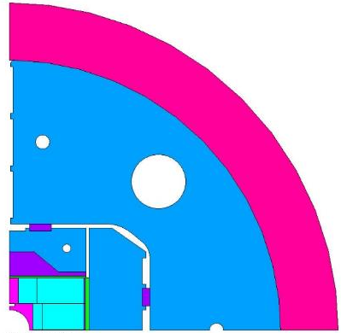
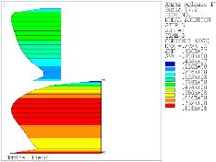
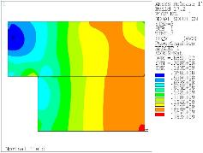
Mechanical design
Fulfills EuroCirCol Criteria.
  Max. Coil stress = 150 MPa at RT
  Max. Coil stress = 200 MPa at 1.9 K

Slide 32
Conclusion
Accelerator magnets in Nb₃Sn technology are becoming reality in HILUMI.
Still, the distance between 11 T and 16 T is large.
I believe that the conductor can be greatly improved in both performance and cost. Recent results on artificial pinning and introduction of Gd oxides are impressive. Perhaps the US MDP should reconsider the situation of Nb₃Sn.
The commitment of the US MDP in developing a new generation of Nb₃Sn models would be extremely useful for the 16 T Program for the FCC or for a HE-LHC. It will not only widen the opportunities of success with new ideas and models, but also contribute to maintain, after the HL-LHC, an effective channel of sharing of knowledge between laboratories.

Slide 33
Thank you for your attention

