Slide 1


Overview of EuroCirCol dipole designs, the efforts towards HE-LHC dipoles and other magnets for FCC-hh
Daniel Schoerling
9th of February 2018
On behalf of EuroCirCol WP5 and the FCC-hh Magnet Development Program
D.Arbelaez¹¹, B.Auchmann¹, H.Bajas¹, M.Bajko¹, A.Ballarino¹, E.Barzi¹⁰, G.Bellomo², M. Benedikt¹, S. Izquierdo Bermudez¹, B.Bordini¹, L.Bottura¹, L.Brower¹¹, M.Buzio¹, B.Caiffi⁵, S.Caspi¹¹, M.Dhalle³, M.Durante⁴, G. de Rijk¹, P.Fabbricatore⁵, S.Farinon⁵, P.Ferracin¹, P.Gao³, S.Gourlay¹¹, M.Juchno¹¹, V.Kashikhin¹⁰, F.Lackner¹, C.Lorin⁴, M.Marchevsky¹¹, V.Marinozzi², T.Martinez ⁶, J.Munilla⁶, I.Novitski¹⁰, T.Ogitsu⁷, R.Ortwein¹, J.Perez¹, C.Petrone¹, S.Prestemon¹¹, M.Prioli¹, J.M.Rifflet⁴, E.Rochepault¹, S.Russenschuck¹, T.Salmi⁸, F.Savary¹, D.Schoerling¹, M.Segreti⁴, C.Senatore⁹, M.Sorbi², A.Stenvall⁸, E.Todesco¹, F.Toral⁶, A.P.Verweij¹, S.Wessel³, F.Wolf¹, A.V.Zlobin¹⁰
1.CERN, 1211 Geneva, Switzerland; 2.INFN, 20133 Milano, Italy; 3.Twente University, 7500 Twente, Netherlands; 4.CEA, 91400 Saclay, France; 5.INFN, 16146 Genova, Italy; 6.CIEMAT, 28040 Madrid, Spain; 7.KEK, 305-0801 Tsukuba, Japan; 8.Tampere University, 33100 Tampere, Finland; 9.University of Geneva, 1211 Geneva, Switzerland; 10.FNAL, Batavia IL 60510, USA; 11.LBNL, Berkeley, CA 94720, USA

Slide 2
Outlook
16 T magnet design options for HE-LHC and FCC-hh – an overview
FCC-hh and HE-LHC the same design?
The different design options: cos-θ, block and common-coil
Quench protection (temperature, voltage, structural)
Irreversible degradation under transverse pressure
Heat load
The dipole field quality
The cost model
Other magnets
Conclusion

Slide 3



16 T Development Programs
EuroCirCol WP5:
Feed the FCC CDR with design and cost model of 16 T magnets
WP 5
FCC 16 T Magnet Development, supporting:
conductor development & procurement
R&D magnets and associated development
model magnets
Input for FCC and HE-LHC 16 T magnets
US Magnet Development Program:
initially focused to a 14-15 T cosine-theta magnet (2017-2018)
also exploring a canted cosine-theta option, in a first step possibly as an insert to the outer layers of the 14-15 T magnet above

Slide 4
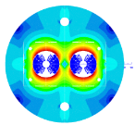
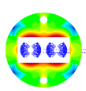
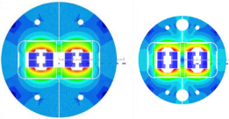
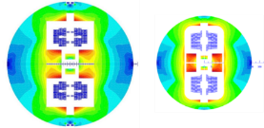
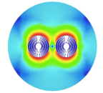
Magnet Design Options
800 mm 600 mm
Magnet length 14.3 m
Free physical aperture 50 mm
Inter-beam distance 204 mm
Field amplitude 16 T
Margin on the load-line @ 1.9K 14 %
Total time margin 40 ms
Critical current density @ 1.9 K, 16T 2300 A/mm²
Conductor fit (J_{c}/B) EuroCirCol fit
Degradation due to cabling 3%
Minimum Cu/nonCu 0.8
Maximum strand diameter 1.2 mm
Maximum stress on conductor at warm 150 MPa
Maximum stress on conductor at cold 200 MPa
Maximum hot spot temp. (@ 105% I_{nom}) 350 K
Maximum number of strands in a cable 40 - 60
Maximum voltage to ground (magnet) 1.2 kV
Maximum TOTAL voltage to ground 2.5 kV
Conductor cost (performance based) 5 Euro/kAm
Cosine-theta (baseline)
Block-type coils
Common-coils
2015 2017
CCT (PSI with LBNL and CERN)

Slide 5
Magnet comparison (HE-LHC versus FCC-hh)
Number of magnets:
  HE-LHC: 1232 dipoles, ~16 T (15.59 T), Aperture 50 mm, Inter-beam distance 204 mm
  FCC-hh: 4664 dipoles, ~16 T (15.71 T), Aperture 50 mm, Inter-beam distance 204 mm
Size restriction of cryostat:
  HE-LHC: existing LEP/LHC tunnel: 1200-1250 mm maximum cryostat outer diameter → compact magnets with fringe field
  FCC-hh: new tunnel; a reduction of 0.5 m is possible, if HE-LHC compact magnets are used
Sagitta s = R (1-cos(π/n)):
  HE-LHC (n = 1232 magnets, R = 2.8 km): s = 9.1 mm → curved magnets
  FCC-hh (n = 4664 magnets, R = 10.6 km): s = 2.4 mm → straight magnets
Injection energies and magnetic fields (field quality and heat load):
Injector | GeV | HE-LHC, B_{inj} (T)
SPS | 450 | 0.54
sclSPS | 900 | 1.07
scSPS | 1300 | 1.54
Injector | TeV | FCC-hh, B_{inj} (T)
LHC | 3.3 | 1.05
scSPS | 1.3 | 0.42

Slide 6
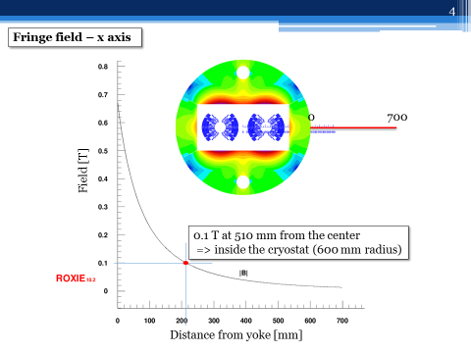
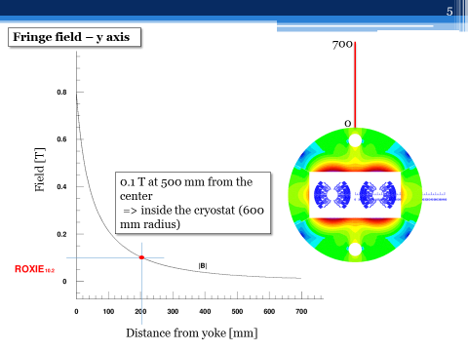
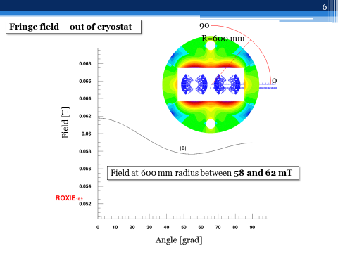
Fringe Field
Fringe field outside the cryostat is <0.2 T, reducing the fringe field would imply:
  Much larger yoke (~80 t mass instead of ~55 t)
  Ferromagnetic cryostat (thick cryostat required, forces between magnet and cryostat)
  Compensation coils (needs to be connected in series with main magnet)
No showstoppers (electronics, vacuum pumps, etc.) have been found which would not allow to have a fringe field in the order of 0.2 T in the tunnel → Decision: allow fringe field, forces between cryostat and CM to be investigated.
See EuroCirCol WP5 meeting, Nr. 23

Slide 7
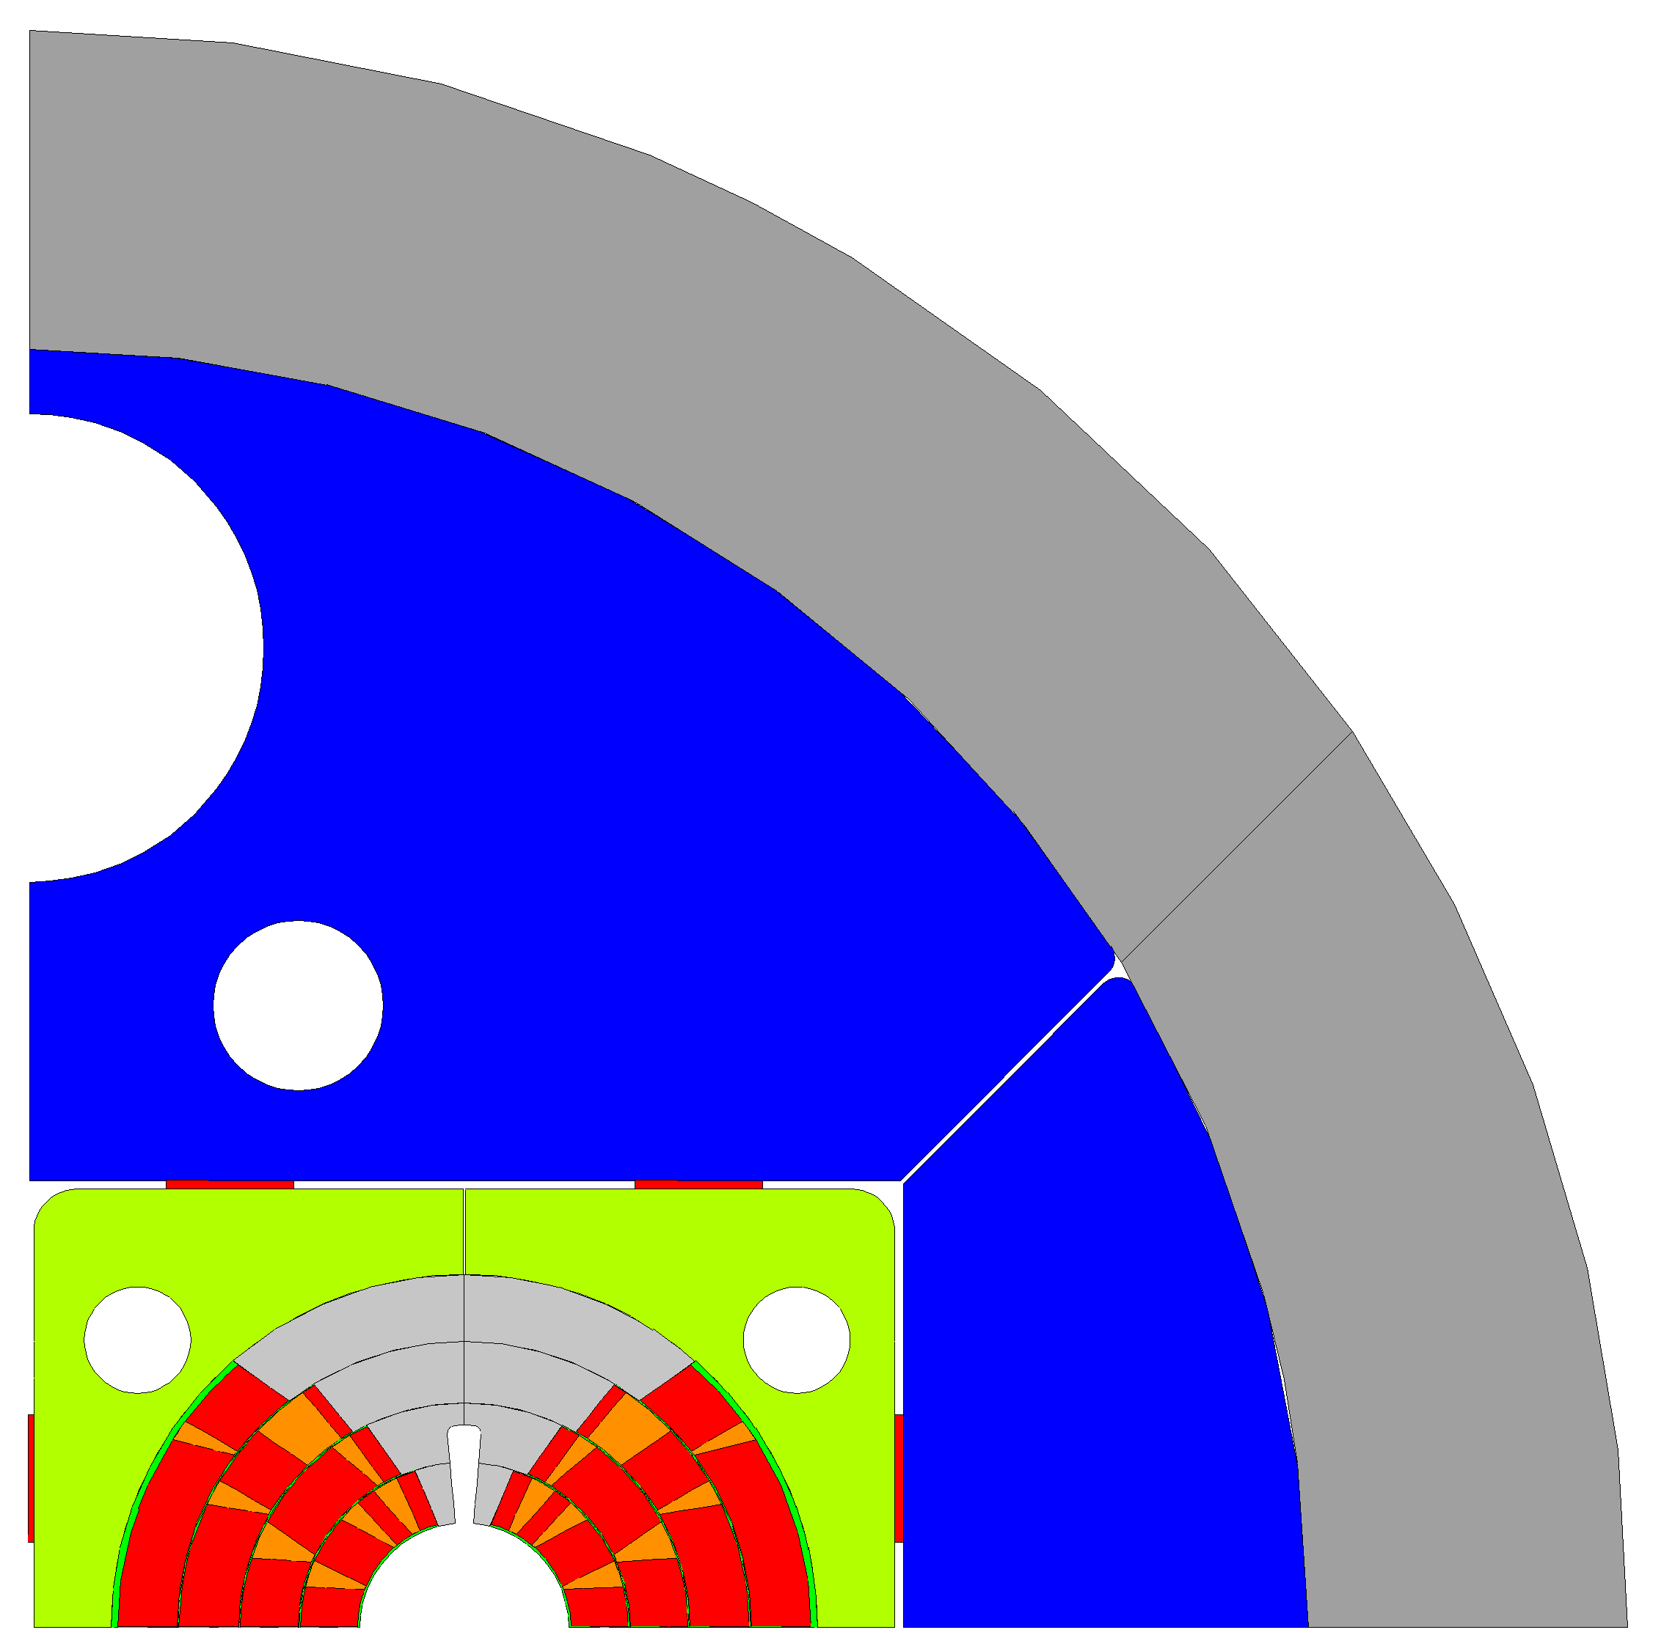
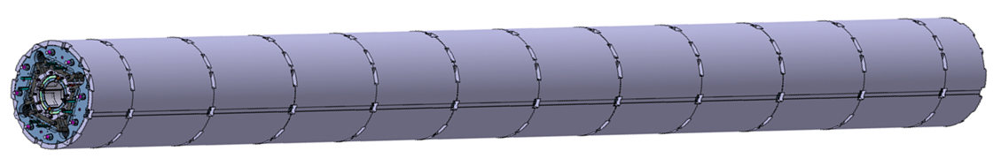
Curved compact dipole magnets
LHC dipole magnets were produced straight and then curved in a press before welding the outer shell
The current baseline foresees a bladder and key structure with approximately 0.8 m long aluminum shells
Making the segments shorter ‘Aluminum collar shell’ may allow bending the structure without concentrating the stress at few positions (assumptions: limit maximum strain on coil below 0.1%, equally distributing the strain along the coil would yield ~0.01% in HE-LHC)
Using Invar (FeNi36) as yoke material may allow to replace the Al shell (sufficient pre-stress and compensating the lower magnetic saturation may not allow for smaller overall size, studies are on-going)
Collaring and using yoke materials with larger stress limit may allow to further reduce the overall size (explorative studies will start soon)
Stainless steel shell
Aluminum shell
Iron yoke
Steel pad
Titanium pole
Copper wedges
Conductor
∅ 600 mm
∅ 700 mm
∅ 740 mm
MQXFB

Slide 8
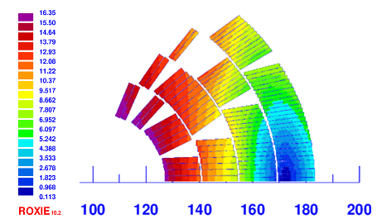
Design of the cos-theta
Wedge: 0.86 mm
 | HF Cable (inner) | LF Cable (outer)
Strand number | 22 | 38
Strand diameter | 1.1 mm | 0.7 mm
Bare width | 13.2 mm | 14 mm
Bare inner thickness | 1.892 mm | 1.204 mm
Bare outer thickness | 2.007 mm | 1.3261 mm
Insulation | 0.15 mm | 0.15 mm
Keystone angle | 0.5° | 0.5°
Cu/NCu | 0.82 | 2.1
Operating point on LL (1.9 K) | 86 % | 86 %
B_{peak}: 16.33 T
 | Parameter
Operating current | 11390 A
Inductance (2 ap) | 39.6 mH/m
Stored energy (2 ap) | 2600 kJ/m
Number of turns/aperture | 200
Total conductor mass | 7575 t
Courtesy INFN

Slide 9
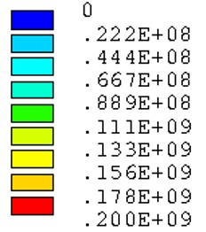
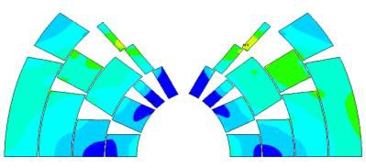
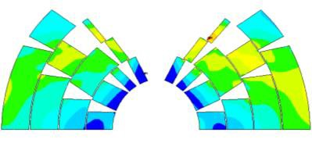
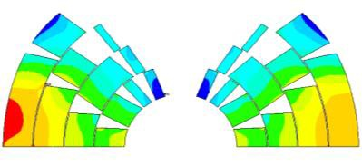
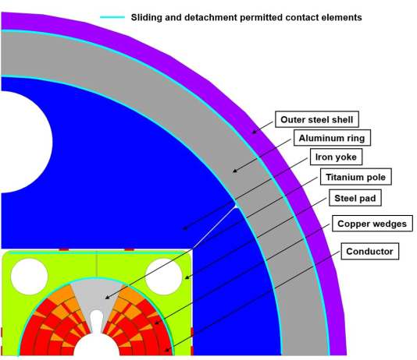
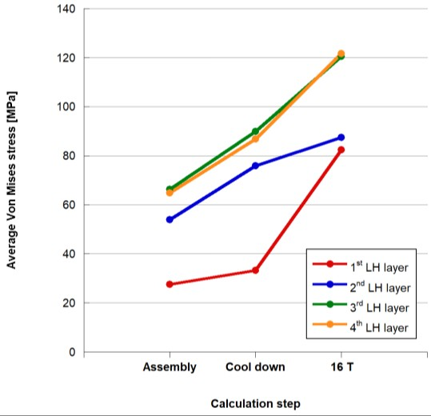
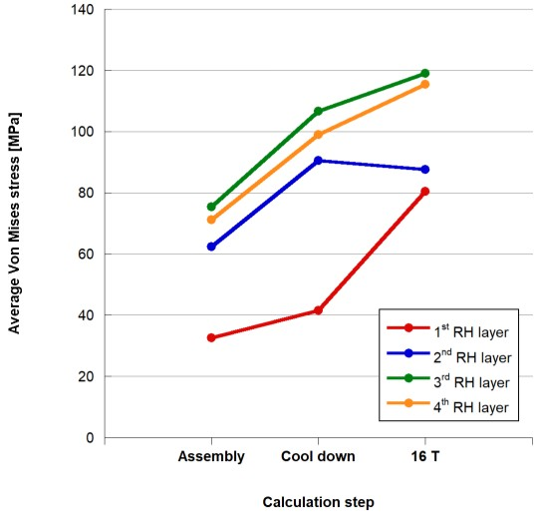
Design of the cos-theta
SS is pre-stressed to 150 MPa during assembly (reduces to ~20 MPa after cool-down and energization)
ASSEMBLY
COOL DOWN
16 T
VM stress [Pa]
σ_{VM,max} = 145 MPa
LEFT
σ_{VM,max} = 192 MPa
σ_{VM,max} = 199 MPa
RIGHT
Courtesy INFN

Slide 10
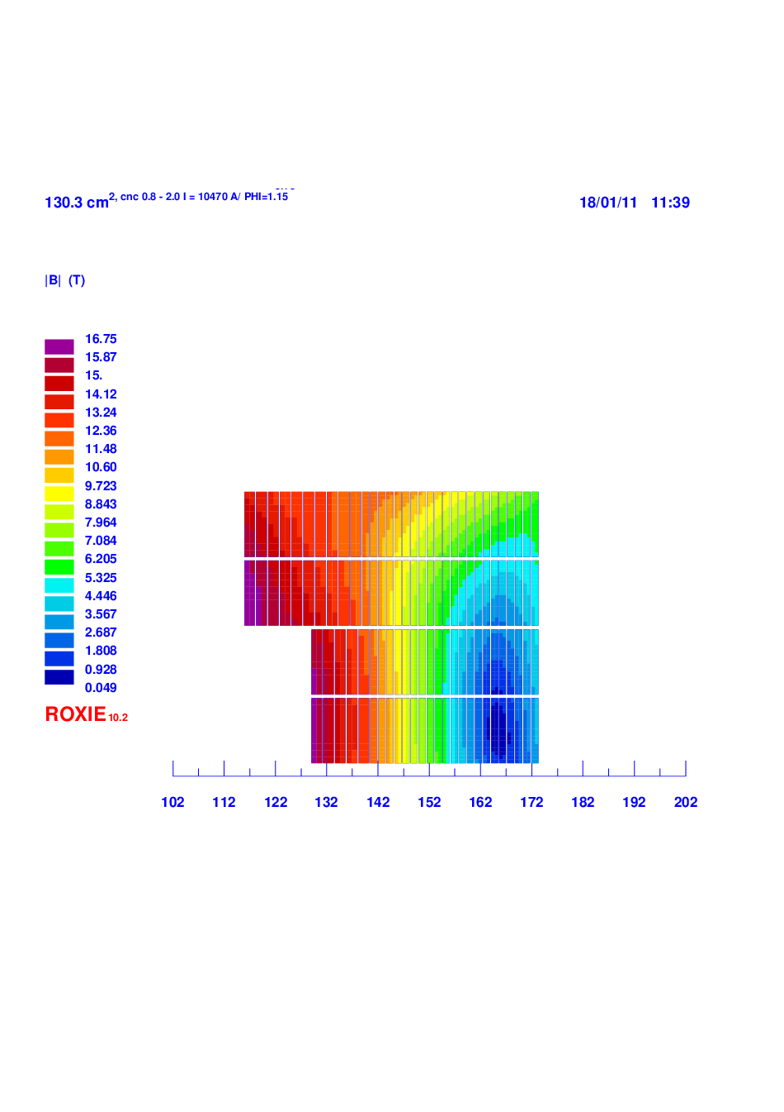
Design of the block
 | HF Cable (inner) | LF Cable (outer)
Strand number | 21 | 34
Strand diameter | 1.1 mm | 0.7 mm
Bare width | 12.47 mm | 12.47 mm
Bare inner thickness | 1.904 mm | 1.230 mm
Insulation | 0.15 mm | 0.15 mm
Cu/NCu | 0.8 | 2.0
Operating point on LL (1.9 K) | 86 % | 86 %
 | Parameter
Operating current | 10090 A
Inductance (2 ap) | 49.1 mH/m
Stored energy (2 ap) | 2611 kJ/m
Number of turns/aperture | 232
Total conductor mass | 7860 t
Courtesy CEA

Slide 11
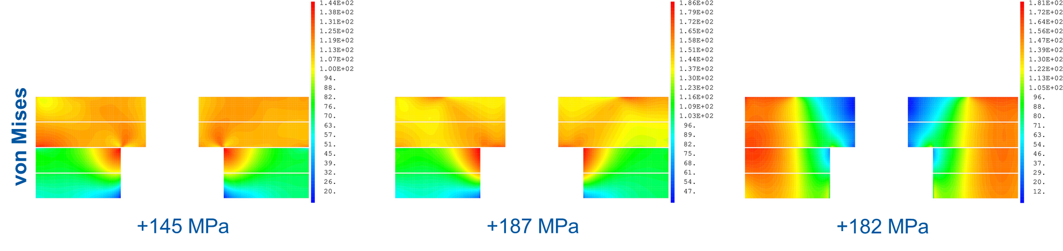
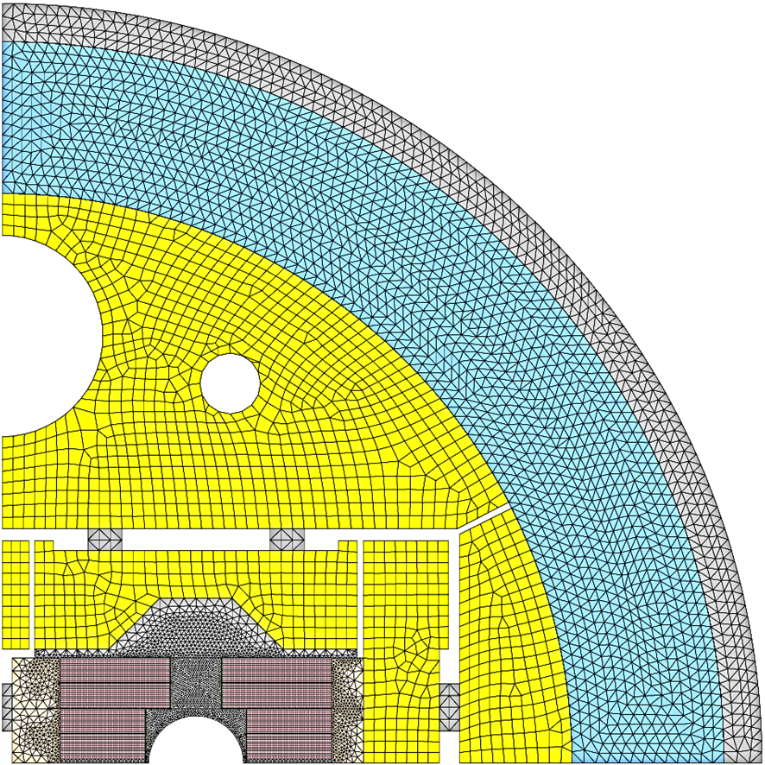
Design of the block
ASSEMBLY
COOL DOWN
16 T
Inter-beam distance now also 204 mm
Internal splice development ongoing with PSI
 | σ_{X} max | σ Von Mises max
Keys | -165 | 145
Cool-down | -204 | 187
Energization 16 T | -194 | 182
Courtesy CEA

Slide 12
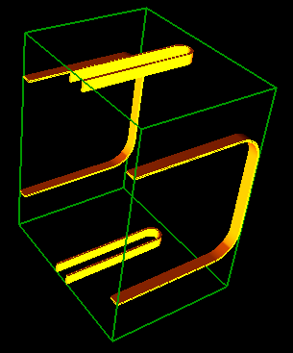
Design of the common-coil
A design with a larger current (16 kA) has been proposed to reduce voltages during quenches
Two main coils are used for this design and flat (or only slightly) flared ancillary coils
EM design optimization is still ongoing
 | Parameter
Operating current | 16100 A
Inductance (2 ap) | 23 mH/m
Stored energy (2 ap) | 2930 kJ/m
Number of turns/aperture | 75 (HF)+72 (LF) + 16 (PC)
Total conductor mass | 8951 t
Courtesy CIEMAT

Slide 13
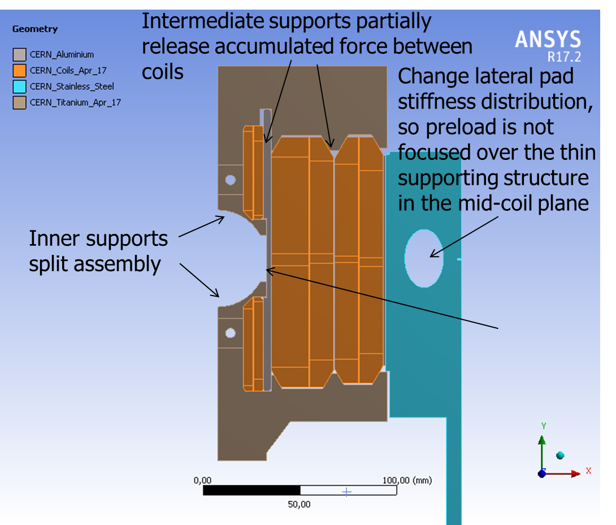
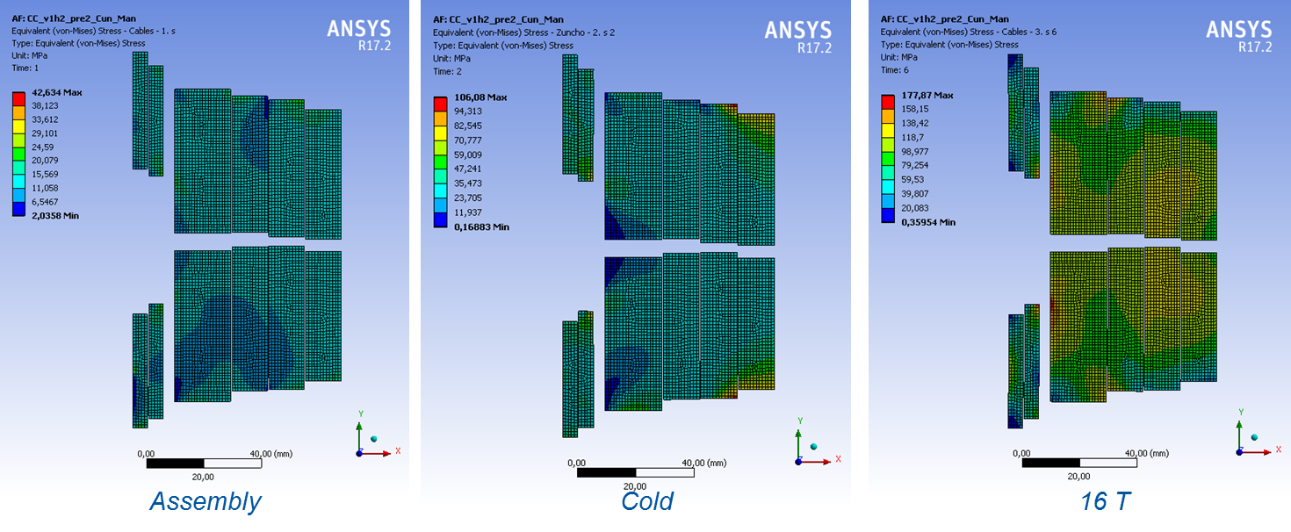
Design of the common-coil
To reach to a magnet design fulfilling all specifications further optimization is required, probably with an update of the EM design. The main challenge is to deal with the horizontal force (approx. double compared to the block coil), so the mechanics are extremely challenging
 | HF cable | LF cable
Coils | IL HF, Pole coils | OL HF, LF
Strand number | 28 | 18
Strand diameter | 1.2 mm | 1.2 mm
Bare width | 18 mm | 12 mm
Bare thickness | 2.2 mm | 2.2 mm
Insulation | 0.15 mm | 0.15 mm
Cu/NCu | 0.8 | 2.5
OP on LL (1.9 K) | 84.7%/86% | 84.8%/80.4%
Open support
OPEN SUPPORT (16T)
Displ. X COILS (mm) | 0,58 / 0,40
Displ. Y COILS (mm) | 0,03 / -0,23
σ_{VM} Support (MPa) | 527
Closed support
CLOSED SUPPORT (16T)
Displ. X COILS (mm) | 0,275 / 0,11
Displ. Y COILS (mm) | 0,52 / -0,25
σ_{VM} Support (MPa) | 1059
43 MPa 106 MPa 178 MPa
Courtesy CIEMAT

Slide 14
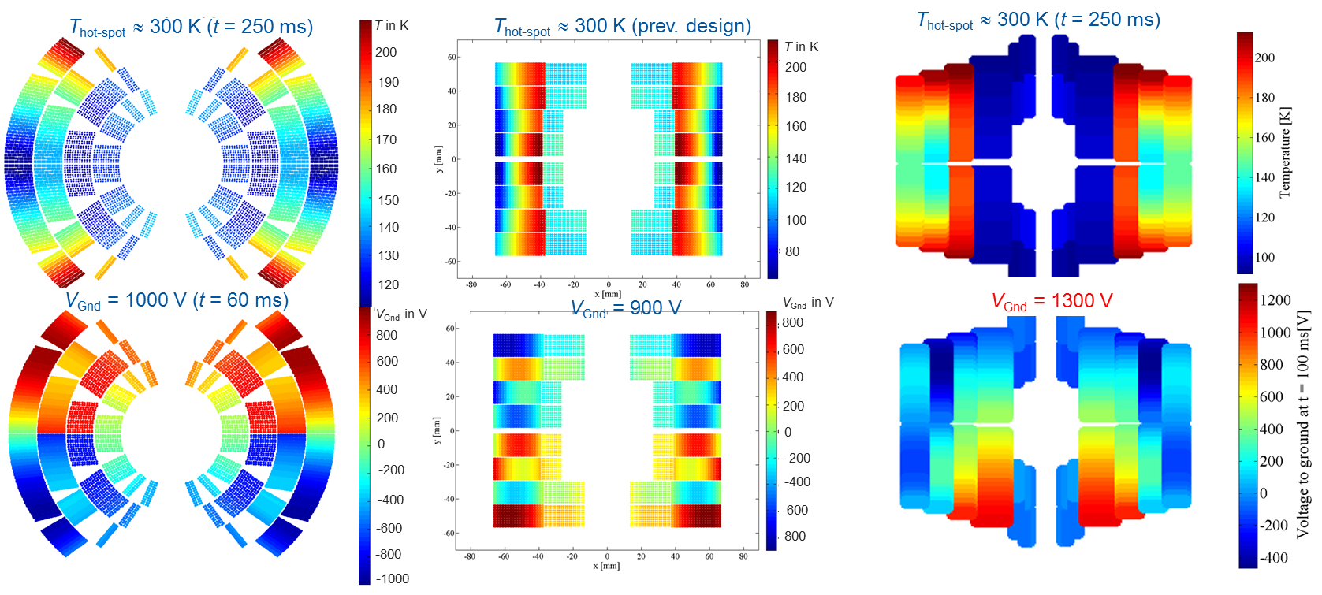
Quench protection
All designs are evaluated with the same software tools and under the same assumption (max hot-spot temperature 350 K and maximum voltage to ground (magnet) of 1.2 kV at 105%I_{nom} for single aperture (except CC), 21 ms delay for quench detection, validation, and switches
CLIQ has been selected as baseline protection design
Courtesy Tiina Salmi and Marco Prioli

Slide 15
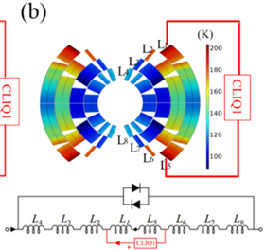
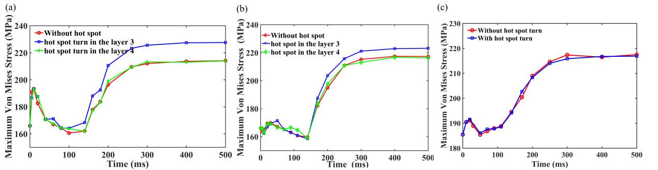
Quench structural analysis
Study performed for single aperture and slightly different cross-section at nominal current 100%I_{nom}
CLIQ activation with initial quench T_{hot-spot} ≈ 300 K (t = 250 ms)
Around 10-20 MPa increase compared to after cool-down, and 50 MPa larger
223 MPa
J. Zhao et al., Mechanical behavior during a quench in CLIQ protected 16 T dipole magnets designed for the Future Circular Collider, submitted to SUST

Slide 16
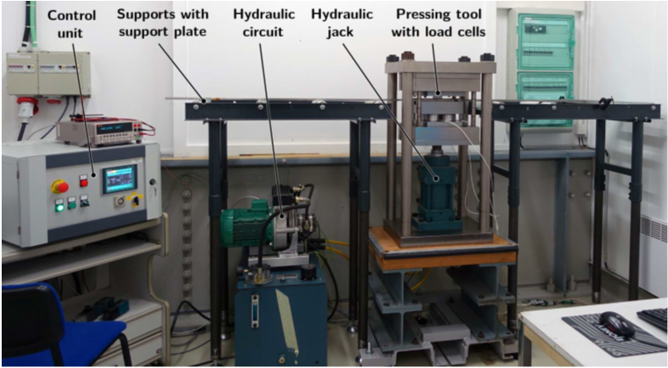
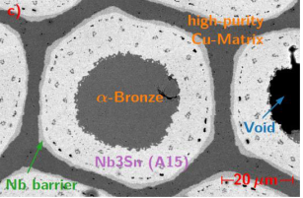
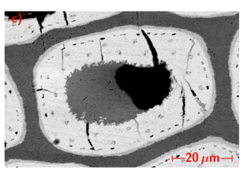
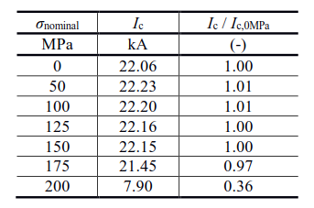
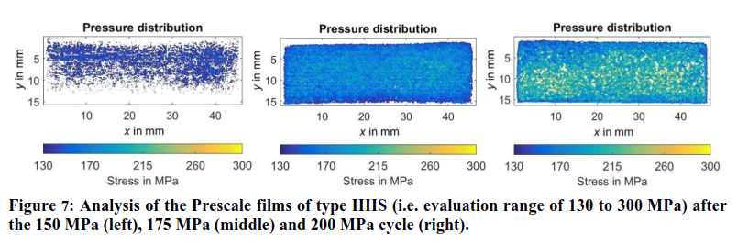
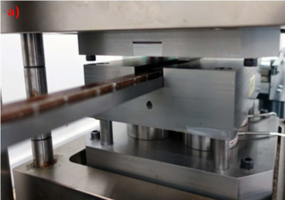
Work on transvers pressure (FCC)
Application of pressure at room temperature
Measurement of samples 11 T cable (RRP 144/169) at Fresca in a background field ranging from 7 T to 9.6 T
Simulation shows large stress enhancement in filaments, a more stiff epoxy may improve this value
Sample without (left) and after (right) loading with 200 MPa
P. Ebermann et al., Irreversible degradation of Nb3Sn Rutherford cables due to transverse compressive stress at room temperature, submitted to SUST
F. Wolf et al., Characterization of the Stress Distribution on Nb₃Sn Rutherford Cables Under Transverse Compression, IEEE Trans. Appl. Supercond., 28(3), April 2018

Slide 17
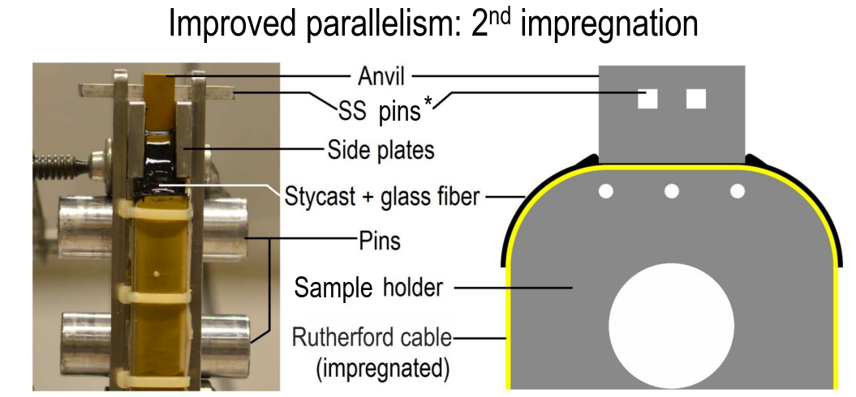
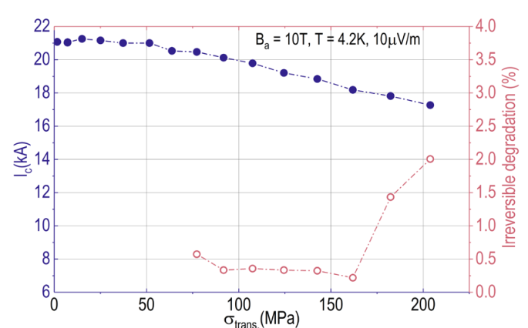

Work in progress on transvers pressure (EuroCirCol)
Application of stress at cold (University of Twente) and during cool down (Fresca) give similar results (18 str cable, RRP 132/169)
Irreversible degradation starts at around 170 MPa
Courtesy UoTwente

Slide 18
Heat load to the cryogenic system
The allowed energy loss produced during a full magnet cycle depends on:
  The heat capacity of the system to keep the temperature below the lambda point (2.17 K)
  The available cooling power. We allow a maximum time of 2 h to re-cool the magnet system to 1.9 K
A study performed for the FCC showed that a reasonable sized cryogenic system can cope with 5 kJ/m respecting the above conditions
The energy loss is mainly due to magnetization losses:
  with 50 μm filaments: 17 kJ/m
  with 20 μm filaments: 7 kJ/m
  with APC, 20 μm filaments: ~5 kJ/m
Courtesy L. Tavian and S.I. Bermudez

Slide 19
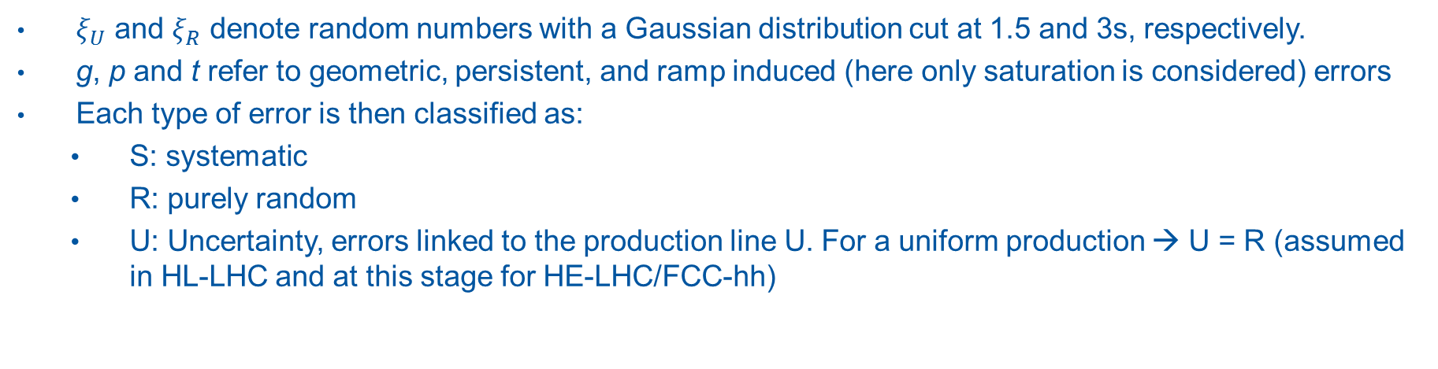
Field quality versus injection energy
We follow the LHC criteria for field error naming conventions (EDMS 90250), results are given for aperture 2.
Each harmonic is written as [1]:
$$b_{n}=\left[b_{n_{g}S}+b_{n_{p}S}+b_{n_{t}S}\right]+\frac{ξ_{U}}{1.5}\sqrt{b_{n_{g}U}^{2}+b_{n_{p}U}^{2}+b_{n_{t}U}^{2}}+ ξ_{R}\sqrt{b_{n_{g}R}^{2}+b_{n_{p}R}^{2}+b_{n_{t}R}^{2}}$$
$ξ_{U}$ and $ξ_{R}$ denote random numbers with a Gaussian distribution cut at 1.5 and 3s, respectively.
g, p and t refer to geometric, persistent, and ramp induced (here only saturation is considered) errors
Each type of error is then classified as:
  S: systematic
  R: purely random
  U: Uncertainty, errors linked to the production line U. For a uniform production → U = R (assumed in HL-LHC and at this stage for HE-LHC/FCC-hh)
[1] S. Fartoukh and O. Brüning, “Field Quality Specification for the LHC Main Dipole Magnets”, LHC Project Report 501.

Slide 20
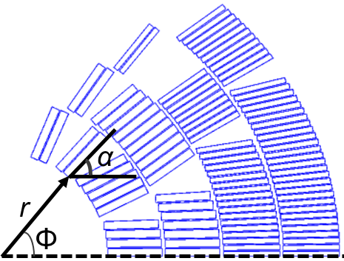
Calculation method & assumptions
Systematic field errors
g : Geometric and saturation can be accurately calculated using for example ROXIE (~10⁻⁶)
p : Persistent current induced multipoles. Calculation is performed using a semi-analytical hysteresis model for the superconductor, which is implemented in ROXIE [1]; successfully verified for LHC magnets and HL-LHC magnets (for Nb₃Sn with empirical reduction of strand magnetization at low field due to flux jumps [2]). The amplitude of the field error depends on:
  Strand magnetization (D_{eff} = 20 μm, J_{c} (1.9 K, 16 T)= 2300 A/mm², and Cu/NonCu) → not considering artificial pinning
  Coil geometry
  Hysteresis, for nominal cycle on reset current (I = 100 A)
t : transient effects, neglected as ramp rates are relatively small and a high-resistive core in the cable is foreseen
Random and uncertainty field errors
Geometric errors, average displacement of zero and a RMS of d/√3 (d = 0.05 mm):
  Radial displacement. r_{min} = r – d and r_{max} = r + d.
  Angular displacement. Δφ = d / (r + w_{cable}/2). φ_{min}= φ – Δφ and φ_{max}= φ + Δφ.
  Coil block rotation. Δα = 2d / w_{cable}. α_{min}= α – Δα and α_{max}= α + Δα.
  →Odd (allowed) multipoles are doubled (good agreement to measurements)
Persistent current: J_{c} ± 5% with respect to the nominal performance (entire coil)
[1] C. Vollinger, Superconductor magnetization modelling for the numerical calculation of field errors in accelerator magnets. PhD thesis, 2002, https://cds.cern.ch/record/633599/files/thesis-2003-022.pdf
[2] S. Izquierdo Bermudez et al., Persistent Current Magnetization effects in High-Field Superconducting Accelerator magnets, IEEE 2016.

Slide 21
Field quality table for 3.3 TeV (LHC injection, 1.1 T)
Systematic:
Injection = Geometric + Persistent
High Field/Collision = Geometric + Saturation
b₂ reduction would be beneficial
b₃ correction requires spool pieces to be aligned with ~0.1 mm or ~5 times smaller b₃ for an alignment of 0.5 mm
Beam acceleration
Beam acceleration
Courtesy S. Izquierdo Bermudez

Slide 22
Field quality table for 1.3 TeV (scSPS injection, 0.4 T)
Systematic:
Injection = Geometric + Persistent
High Field/Collision = Geometric + Saturation
Beam acceleration
Beam acceleration
Courtesy S. Izquierdo Bermudez

Slide 23
Target cost for HE-LHC/FCC dipoles
Scaling the HE-LHC dipole magnet cost from LHC, taking the higher complexity and double number of coil layers into account (double the cost +20%) and magnet assembly (+20%), would yield a target cost for coil fabrication and assembly of about 600 kEUR/magnet, and for parts of about 420 kEUR/magnet (30% above LHC)
According to the present cost model the target cost for a 16 T magnet for HE-LHC built according to the cos-θ design would be:
    Conductor cost: 670 kEUR/magnet
    Assembly cost: 600 kEUR/magnet
    Parts cost: 420 kEUR/magnet
    Total cost: 1690 kEUR/magnet
The calculation of the target conductor cost has been performed by assuming that the cost is insensitive to the Cu-amount in the strand. This cost is highly uncertain at this moment.
1232 dipole magnets are required for HE-LHC or 4578 dipole magnets for FCC-hh. Assuming the same percentage of spare magnets as for LHC (around 3.6%), yielding a total target cost of 2.2 and 8.0 GEUR for the dipole magnet system of HE-LHC and FCC-hh.
Work ongoing with CIEMAT, CEA and UoTampere

Slide 24
Other magnets : Overview
Magnets to be shown with electromagnetic design in the CDR
Main design criteria: stay in the shadow of the dipole for all arc magnets, be a bit more aggressive for the insertions.
In case Nb₃Sn is used, the same specifications set by the EuroCirCol WP5 collaboration are used.
Magnet strength limits have been explored using scaling laws and simplified models
Currently the designs are being established and will be shown at the FCC week 2018:
  Quadrupoles for the insertions: FNAL
  D1: KEK
  D2: INFN
  MQ: CEA
  All other arc magnets: CERN
Arc magnets (aperture 50 mm)
 | Number | Strength | Length
Main quadrupole (MQ) | 744 | 360 T/m | 7 m
Lattice sextupole (MS) | 718 | 7000 T/m² | 1.2 m
Lattice octupoles (MO) | - | 200000 T/m³ | -
Dipole correctors (MCB) | 750 | 4 T | 0.32 m
Trim quadrupoles (MQT) | 110 | 220 T/m | 0.32 m
Skew quadrupoles (MQS) | 110 | 220 T/m | 0.32 m
MCS | 9156 | 2900 T/m² | 0.11 m
Quadrupoles for the insertions
 | Number | Strength | Length | Aperture
Q1 high lumi | 4/IP | 130 T/m | 14.3 m | 164 mm
Q2 high lumi | 8/IP | 105 T/m | 12.5 m | 210 mm
Q3 high lumi | 4/IP | 105 T/m | 14.3 m | 210 mm
Q1 low lumi | 4/IP | 270 T/m | 10.0 m | 64 mm
Q2 low lumi | 4/IP | 270 T/m | 15.0 m | 64 mm
Q3 low lumi | 4/IP | 270 T/m | 10.0 m | 64 mm
D1 and D2
 | Number | Strength | Length | Aperture
D1 low lumi | 4/IP | 12 T | 10.2 m | 100 mm
D2 low lumi | 4/IP | 10 T | 12.2 m | 6 mm

Slide 25
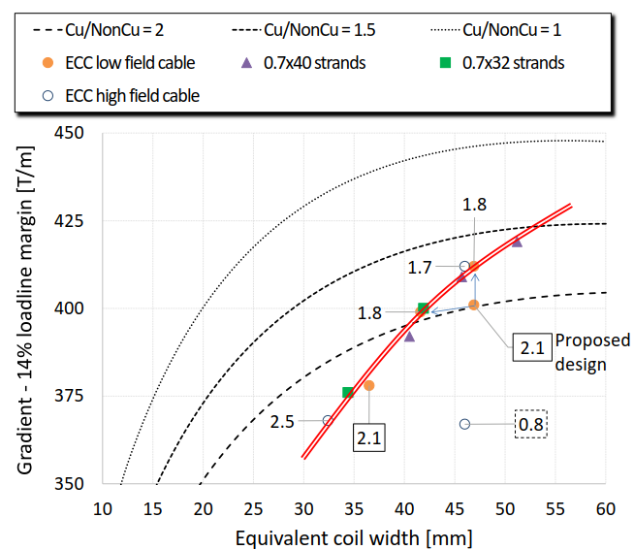
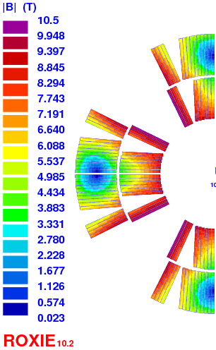
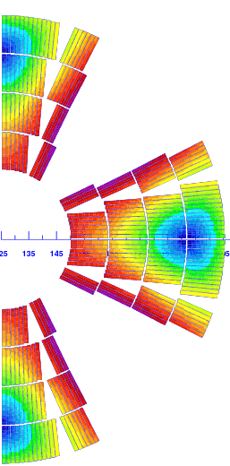
FCC MQ
MQ (designed by CEA) was started as 400 T/m quadrupole [1] and a four layer design. After discussions a 2-layer design is proposed with ~20% LL.
Challenges of this design: cable with large aspect ratio (51 strands, 0.7 mm), nominal current ~20 kA
350 K hot spot temperature limit
MQ | Nb₃Sn (14%) | Nb₃Sn (20%), 2-layer | Nb-Ti (20%)
Gradient | 400 T/m | 360 T/m | 250 T/m
Δ Dipole field | -0.1 T | 0 | +0.6 T
[1] C. Lorin et al., Design of a Nb₃Sn 400 T/m quadrupole for the Future Circular Collider, IEEE Transaction on Applied Superconductivity, DOI: 10.1109/TASC.2018.2797945

Slide 26


Triplets
The design criteria is too prove the highest ‘realistically’ achievable strength in the CDR
Addendum with FNAL under discussion!
Filling factor of the coil $κ$: 0.25
Margin on the load: 20%
EuroCirCol J_{c} fit
85% of maximum gradient
Aperture: 100 mm
$$G_{c}=\frac{1}{2}κsγ_{0}\ln\left(1+\frac{w}{r}\right) \left(\sqrt{\frac{4b}{κrsλγ_{0}\ln\left(1+\frac{w}{r}\right)}+1}−1\right)$$
Triplets
 | Number | Strength | Length | Aperture
Q1 high lumi | 4/IP | 130 T/m | 14.3 m | 164 mm
Q2 high lumi | 8/IP | 105 T/m | 12.5 m | 210 mm
Q3 high lumi | 4/IP | 105 T/m | 14.3 m | 210 mm
Q1 low lumi | 4/IP | 270 T/m | 10.0 m | 64 mm
Q2 low lumi | 4/IP | 270 T/m | 15.0 m | 64 mm
Q3 low lumi | 4/IP | 270 T/m | 10.0 m | 64 mm

Slide 27
Conclusion
We are ready for the FCC CDR, a first executive summary (8 pages for magnets) is currently being compiled and will be finalized until April 2018
During the FCC week in Amsterdam (9-13 April 2018) the chosen design parameters will be discussed globally and finalized. After the FCC week the detailed volumes for FCC-hh and HE-LHC will be compiled
The concerns about irreversible degradation in a compact magnet suggests to explore more creative design variants for having more margins during assembly and operation
Better characterization and exploration of impregnation systems and their test in a simplified test-setup simulating the conditions experienced in coils seems critical
APC seems a great opportunity to make best use of the SC material
The field quality (or its correction!) in particular at low injection energies is mandatory in particular for HE-LHC with injection from SPS at ~0.5 T
HE-LHC has triggered a development towards compact magnets, which is both beneficial for FCC-hh and HE-LHC
The effort of EuroCirCol will be continued and we plan 3 short model 16 T magnets built by the respective institutes with CERN contributions.

