Slide 1

PSI Pogram and Strategy
B. Auchmann (CERN/PSI), L. Brouwer (LBNL), S. Caspi (LBNL), R. Felder (PSI), J. Gao (PSI),
G. Montenero (PSI), S. Sanfilippo (PSI), S. Sidorov (PSI)
09.02.2018, 2nd UD-MDP Collaboration Meeting.
Work supported by the Swiss State Secretariat for Education, Research and Innovation SERI.

Slide 2
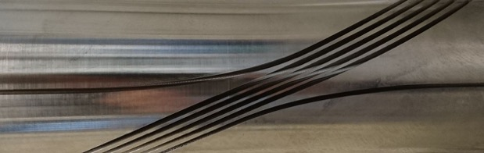
Overview
CCT for FCC
  Electromagnetic design
  Mechanical design
The PSI CCT model program
  Roadmap
  Status CD1
  Status Infrastructure

Slide 3
Overview
CCT for FCC
  Electromagnetic design
  Mechanical design
The PSI CCT model program
  Roadmap
  Status CD1
  Status Infrastructure

Slide 4
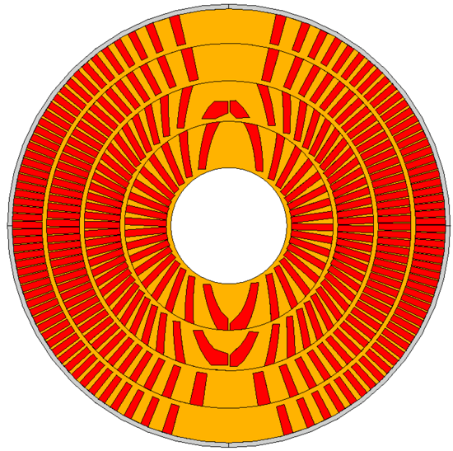
CCT Design for FCC
Keys to an efficient CCT design:
  Thin spars
  Wide cable, large strands
  Thin ribs.
  Increase J_{e}.

Slide 5
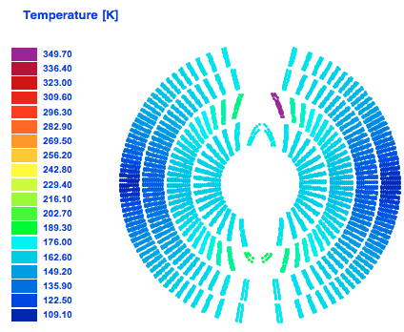
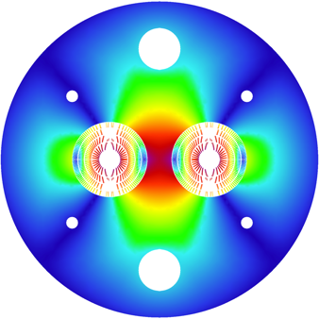
PSI’s CCT Design for FCC
Homogeneous coil temperature after quench.
Current: 18055 A
FCC-wide conductor use:
    Total: 9.77 kt (+30% wrt. cosine theta/block)
    NonCu: 3.75 kt
    Cu: 6.02 kt
Total inductance: 19.2 mH/m
Total energy: 3.2 MJ/m
Layer # | n_{S} | cuNc | loadline marg. [%] | current marg. [%] | T_{peak} [K] | V_{grnd} [V] | J_{cu} [A/mm²]
1 | 29 | 0.8 | 14.2 | 111 | 292 | 1133 | 1237
2 | 25 | 1.1 | 14.4 | 95 | 342 | 1264 | 1217
3 | 22 | 1.95 | 14.4 | 74 | 310 | 1156 | 1096
4 | 20 | 2.6 | 15.7 | 70 | 338 | 1144 | 1103
Geometric/nl. iron
harmonics:
b2 <= 6 units
b3,4,5, .. <= 1 unit

Slide 6
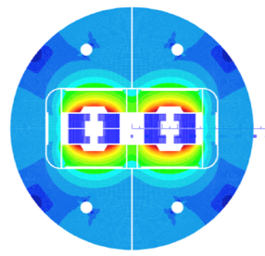
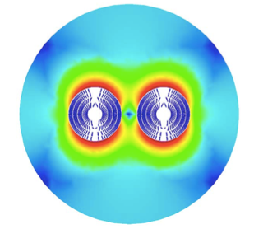


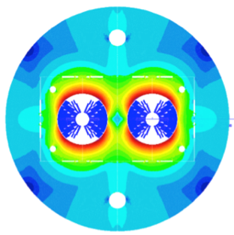
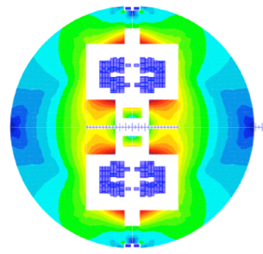


CCT joined the fold in Nov. 2016
Block coil
Canted Cosine Theta
Cos-theta
Common coils

Slide 7
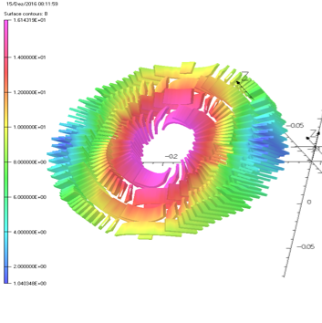
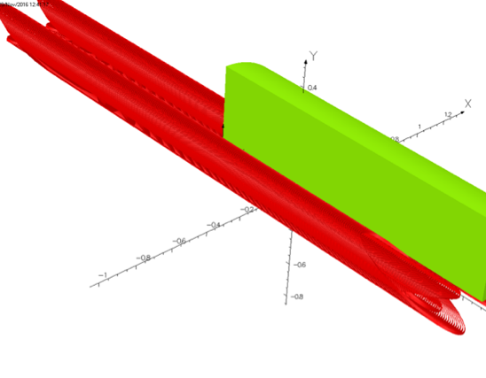
3-D Magnetic Design
3-D modeling results:
Yoke cut-back not needed (20 mT peak-field enhancement in ends).
Magnetic length with yoke equal to that of bare coil.
Physical length minus magn. length = 53 cm; equal to 11 T magnet.
Peak field minus main field at 16-T bore field: 0.14 T excluding self field.
  comparable or lower than cos-theta due to continuous current distribution.
Courtesy M. Negrazus

Slide 8

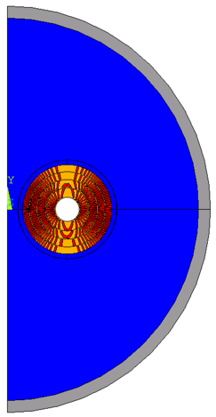
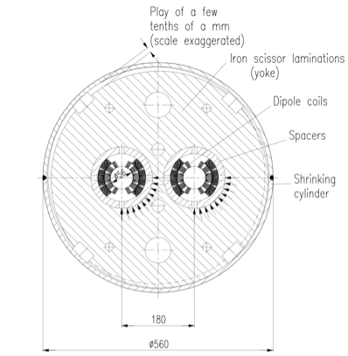
Mechanical Structure
CCT does not require azimuthal prestress.
Radial prestress on the midplane provided by “scissor” laminations

Slide 9
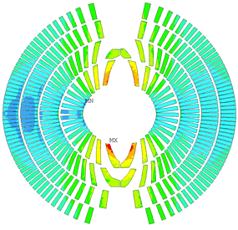
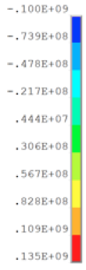
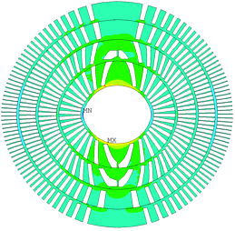
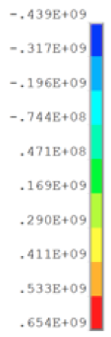
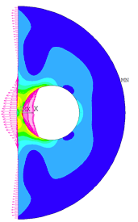

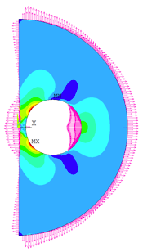

2D Mechanical Design

Slide 10
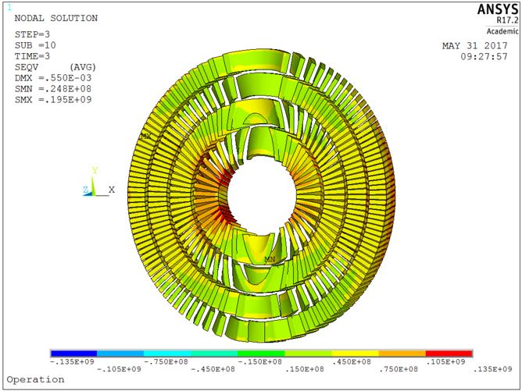
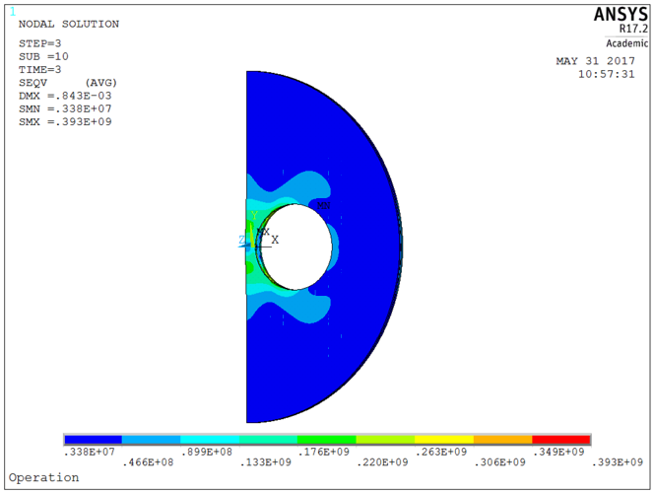
3-D Periodic Simulation
Generalized plane stress condition applied (following D. Arbelaez, L. Brouwer, LBNL)
Initial 3-D results confirm 2D, but show distinct imprint of scissors lams
→ increase protective shell thickness, change its material to iron
→ decrease lamination thickness.
135 MPa on conductor
Courtesy G. Rolando

Slide 11
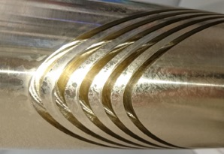
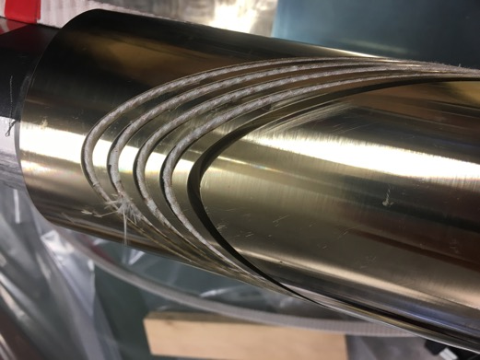
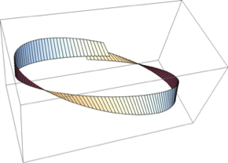
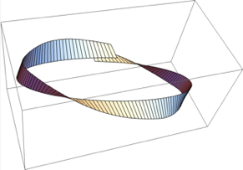
Machinability and Windability
Successful machining of 16-mm-deep 2-mm-wide 15-degree-inclined channels.
FNAL gave some meters of cable
for winding test.
Intermediary result: winding is
possible, but tooling development
necessary for increased reliability.
Courtesy Heinz Baumgartner AG

Slide 12
Overview
CCT for FCC
  Electromagnetic design
  Mechanical design
The PSI CCT model program
  Roadmap
  Status CD1
  Status Infrastructure

Slide 13
Overview
CCT for FCC
  Electromagnetic design
  Mechanical design
The PSI CCT model program
  Roadmap
  Status CD1
  Status Infrastructure

Slide 14
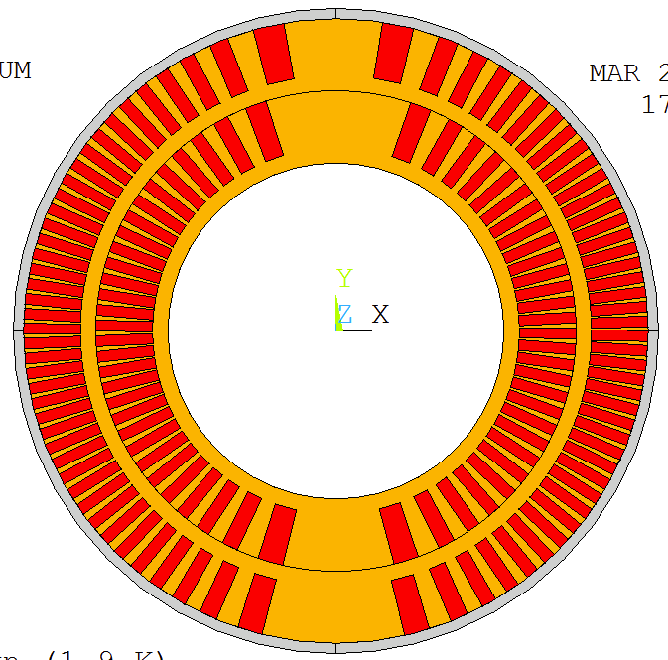
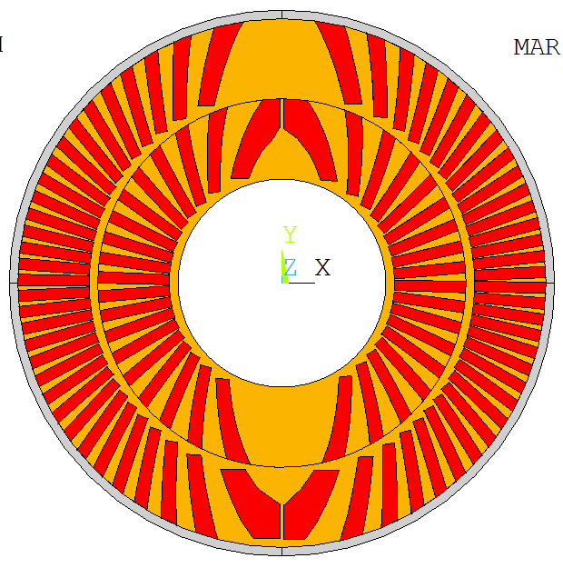
PSI Goals towards FCC Requirements
Joint funding from CHART (Swiss Accelerator Research and Technology) and the FCC design study from mid 2016 until the end of 2019.
Goal: Demonstrate key technological features of an efficient 16-T CCT in two-layer technology model magnets.
Thin spars
Exterior Bladder and Key structure
Fast quench detection and CLIQ protection.
Wide Rutherford cable.
Inclined channels.
CD1
CD2

Slide 15
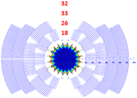
CD1 & CD2 Details
PSI builds one mechanical structure for
  CD1, 2018:
    LBNL CCT cable (0.85 mm diam, RRP 108/127, 21 strand),
    10.6 mm channel depth, 3 mm spar, 0.5 mm assembly gap
    Layer-2 OD = 122 mm, ID = 65.6 mm (clear bore).
    CD1 introduces CCT technology to PSI.
  CD2, 2019:
    15-T IL cable, (1 mm diam, RRP 150/169, 28 strand)
    16 mm inclined channel,
    Layer-2 OD = 122 mm, ID = 48 mm (clear bore).
    CD2 fits into MDP 15-T outer layers 3&4 (ID = 124.46 mm).
CD2 could also become layers 1&2 to an all-CCT
4-layer magnet in collaboration with LBNL.
Caveat: CD2 according to above specs only if
CD1 is reasonably successful. Else CD2 will be
an improved CD1.
Use LBNL coil-manufacturing
experience with this cable!
Use FNAL wire and cable
resembling FCC IL requirements!
Demonstrate CCT ILs
functioning in high-field (>15 T)

Slide 16
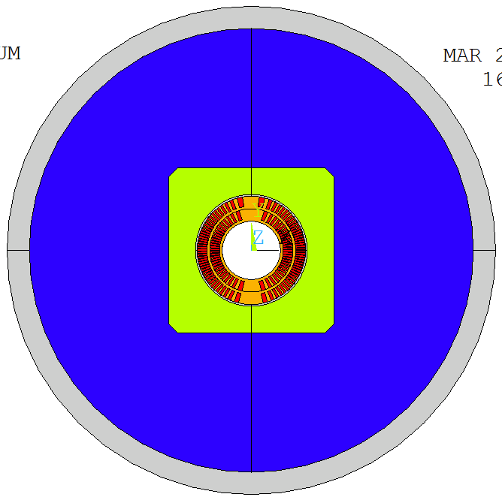
Mechanical Structure
Bladder and Key technology chosen for tuneability and relative simplicity.
  Closed and pre-loaded pad gap for maximum-rigidity cage around coils.
  Steel pads to better match coil differential contraction.
  Designed with S. Caspi, LBNL.
Closed pad gap
Bladder locations
Vertical and horizontal keys
Al shell 25 mm
Protective Al shell 5 mm
Vertically split Al-bronze pad
Vertically split yoke, OR 250 mm
Al-bronze former
Open yoke gap
International conceptual design review of CD1 on June 26 at CERN (http://indico.cern.ch/e/cd1cdr).
Notes:
show loading concept via reaction forces

Slide 17
Overview
CCT for FCC
  Electromagnetic design
  Mechanical design
The PSI CCT model program
  Roadmap
  Status CD1
  Status Infrastructure

Slide 18
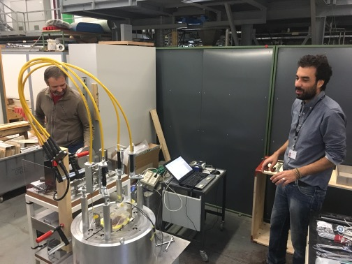
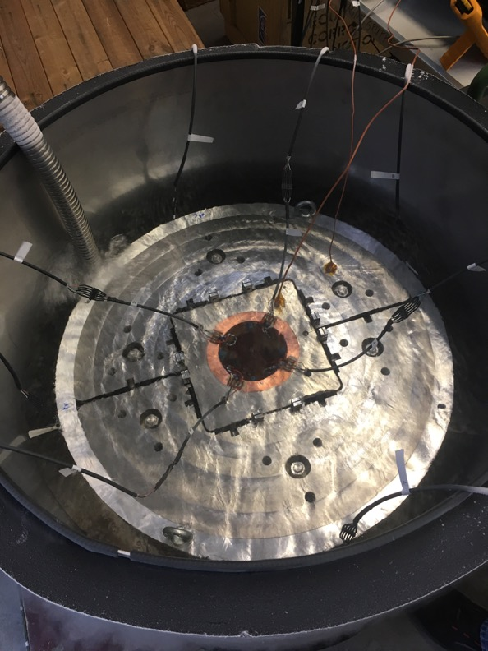
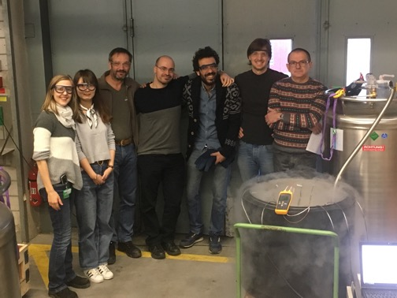
Short Mechanical Model

Slide 19
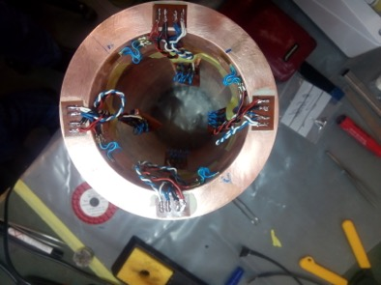
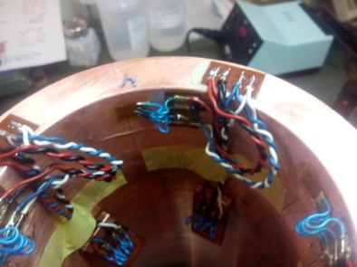
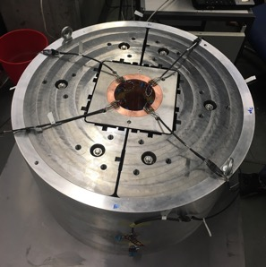
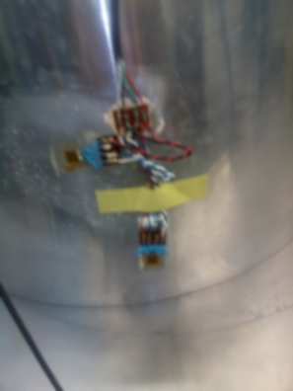
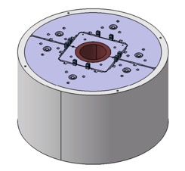
Short Mechanical Model - Instrumentation
Al.S SG@ 270°
HBM setup (like CERN, LBNL)
4 full-bridge SGs on dummy and shell, resp.
Solved bonding issues using Araldite adhesive
Better cable routing and strain management on SGs using intermediate pads
Cu D. SG@ 180°
Cu D. SG@ 270°
Cu D. SG@ 90°
Cu D. SG@ 0°
Al.S SG@ 180°
Al.S SG@ 0°
Al.S SG@ 90°

Slide 20
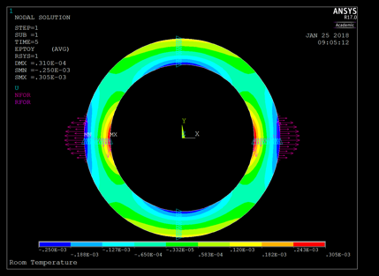
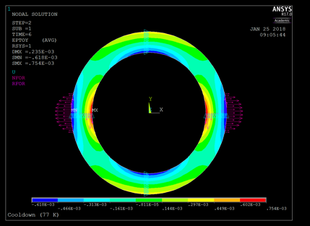
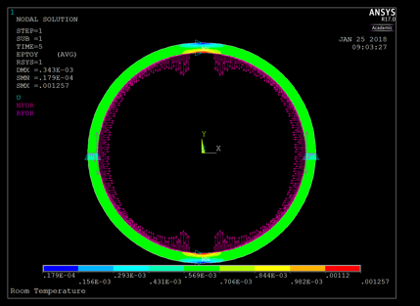
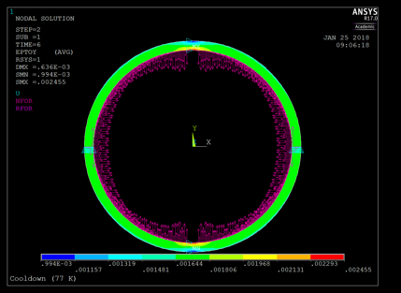
Short-Model SG Data vs. 2D Simulation
-
-
-250 µm/m
-618 µm/m
305 µm/m
754 µm/m
RT Dummy
Cryo Dummy
-17.9 µm/m
-994 µm/m
569 µm/m
1644 µm/m
RT Shell
Cryo Shell
Asymmetry observed during key insertion and in SG data:
  Improve tolerances, discussion of results with structure manufacturer.
  Set up proper reception QA at PSI.
  Procure hydraulic 8x manifold with valves.

Slide 21
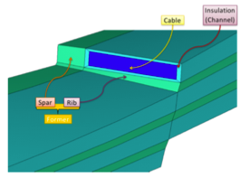
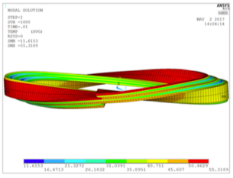
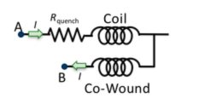
PhD Thesis Jiani Gao: CCT Protection
Goal:
  Design an efficient detection & protection system for a four-layer FCC CCT.
  Make a credible argument for shorter protection delays wrt. LHC experience.
Simulation
  2-D and 3-D models of propagation
  and protection.
  ANSYS UDEs by Lucas.
Detection
  Co-wound Cu wire (in insulation).
  Co-wound SC wire for current-based detection.
  Optical fiber (Federico Scufgi, Justin-Schwartz Group)
  on top of channel post-reaction.
    Mostly for diagnostics; evaluate potential for detection.
Protection
  CLIQ
x
x
x
x
x
x
x
x
x
x
x
x
x
x
x
x
x
x
x
x
x
x
x
x
x
x
x
x
x

Slide 22
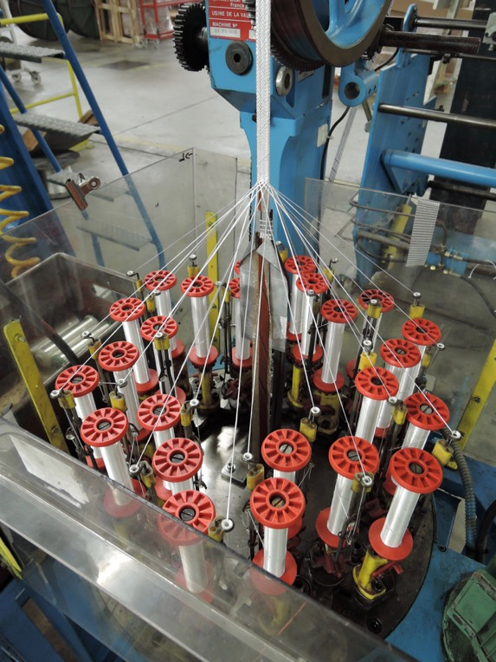
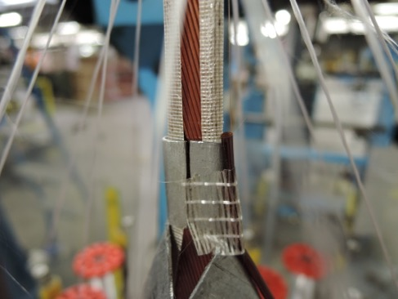
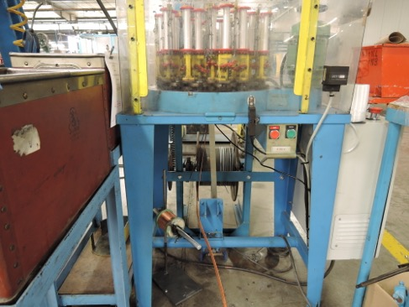
Insulation Trial
Cu wire
x
x
x
x
x
x
x
x
x
x
x
x
x
x
x
x
x
x
x
x
x
x
x
x
x
x
x
x
x
Mica spool
Cu wire
spool
Cable
Development by Jacky Mazet (CERN)

Slide 23


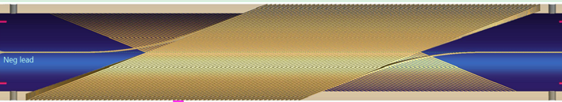
Instrumentation Plan
J. Gao
Power source connection
IL
Optical fiber leads
Heater
OL
Coil leads
AE
AE
Ti - Ti
Ti - Sn
Sn - Ti
Ti - Sn
Sn - Ti
Ti - Cu
Vo. Meas.
Voltage taps
CLIQ leads
Power
Energy extraction
Coil lead x 2
CLIQ lead x 1
Optical fiber lead x 2
Co-wound Cu wire output x 1
Voltage tap x 4 for 2 splice boxes
AE x 1
OL: Voltage tap x 3
CLIQ lead x 1
Optical fiber lead x 2
Voltage tap x 4 for 2 splice boxes
OL: Voltage tap x 1
Heater source connection x2
(Courtesy L. Brouwer)
AE x 1
IL: Voltage tap x 2
Discussions on integration with the LBNL test station ongoing with Maxim and Marcos.
Need to find a way to test with CLIQ.

Slide 24
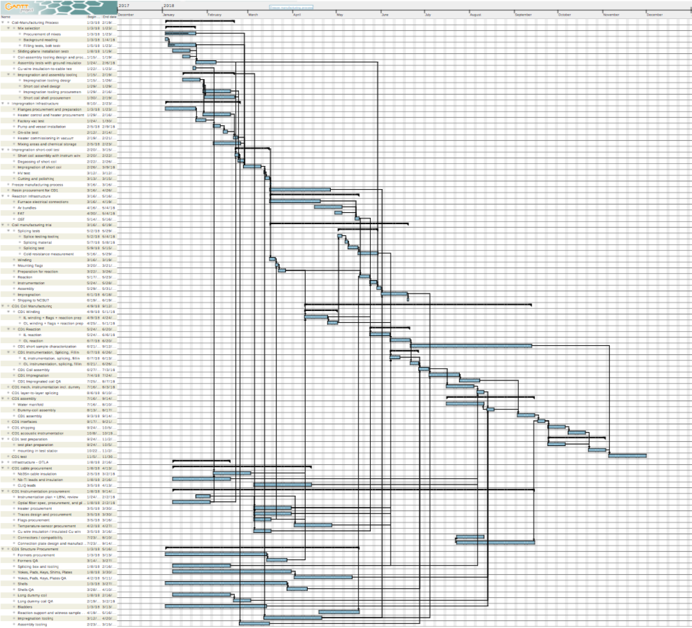
CD1 Schedule v2
Manufacturing-process development – Q1/19
Fabrication infrastructure commissioned – Q2/19
Magnet shipped to Berkeley for test – Q3/19
Magnet test – Q4/19

Slide 25
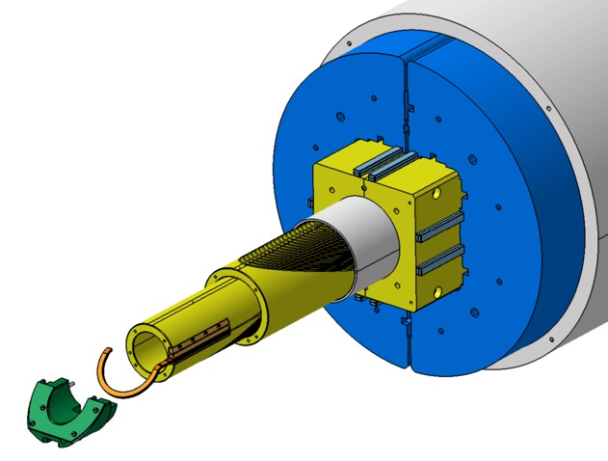
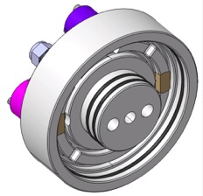

Technical Design and Procurement
Cable received from LBNL mid ‘17
Cable insulation: in February ‘18 by CERN
Coil formers: delivery April ’18
Outer shell and protective shell: April ‘18
Yokes, pads, keys: in procurement
Bladders: March ‘18
Layer-to-layer splice box in procurement
Splicing tooling received
Impregnation tooling: design finalized
to be ordered in house
Heater setup and controls ordered
Capacitive level gauge to be devised
Courtesy S. Sidorov

Slide 26
Overview
CCT for FCC
  Electromagnetic design
  Mechanical design
The PSI CCT model program
  Roadmap
  Status CD1
  Status Infrastructure

Slide 27

New Lab Space
Coil winding, instrumentation, assembly
Assembly and RT mag. meas.
Reaction
Storage
Impregnation, mixing
Workplace

Slide 28

Procurement of Reaction Furnace
Order placed, expected commissioning: May ‘18.

Slide 29






Impregnation Trials
So far: CTD 101-K (left) and Mix 61 (right)

Slide 30



Bolt Tests
Bolt suspended in cup
  CTD 101-K: loud banging noise during shock-freezing in LN2; large part expulsed by ~15 cm during warm-up at RT.
  CTD 101-G: hair-like fissures, increasing in number and size with repeated thermal shocks.
  Mix 61: no sign of cracking after three thermal shocks.

Slide 31


Vacuum Equipment and ETH Collaboration
Vacuum vessel Factory-Acceptance-Test passed.
Vacuum pump tested.
First vacuum impregnation of 5-turn former
in March ‘18.
Starting in March ‘18 a post doc will be working
with CERN, PSI, and ETH Zurich to
  Characterize existing epoxies (thermal,
  rheological, mechanical, electrical, radiation).
  Develop new epoxy systems, building on
  ETHZ competence.
  Characterize resin performance in
  impregnated Rutherford cable.
  Also:
    Study possibilities of super-critical CO₂
    cleaning of reacted coils/formers.
    Study improved former/resin adhesion.

Slide 32

Conclusion
The CCT option was established as a valid contender in the FCC design study.
The PSI program has been designed to be complementary to and closely coordinated with the LBNL program, pushing towards specific features needed in an FCC magnet.
2018 will be decisive for PSI’s infrastructure and technology import.
PSI benefits from generous support by LBNL, integrating deeply with their program, as well as from regular exchanges and training with CERN staff who share freely and are most helpful – THANK YOU!

Slide 33
END

Slide 34
Lessons from CCT4 Test:
the magnet was not performance limited - it only had subpar training.
three issues must be addressed to improve (and eventually eliminate)
the training:
  epoxy cracking (strong evidence in acoustic data),
    alternatives to CTD-101-K will be tested.
    alternative filling-schemes will be tested.
  epoxy de-lamination from the metal former,
    chemical etching to increase surface roughness will be tested.
  friction due to intra-layer movement (strong evidence in acoustic data),
    a slip-plane will be introduced.

Slide 35


Protection Studies
Co-wound copper secondary windings significantly accelerate the current decay.
Relevant only if detection and active-protection can be made more efficient.
Cowound wire and/or interrogated optical fibers have potential to bring detection time to the order several milliseconds.
CLIQ on CCTs promises to be effective.
Numerical studies under way.
About to join LBNL (L. Brouwer) effort to create user-defined ANSYS “quench elements” for consistent and efficient CLIQ modeling in ANSYS.
courtesy: L. Brouwer

Slide 36




Manufacturability and Cost
Deep channels, aspect-ratio ~10.
Inclined channels → 5-axis machining on long rotating cyl., machining tests under way.
Selective Laser Melting (3-D printing) not successful.
Collaboration with IWS Fraunhofer on
fabrication of thin-lamination formers.
  Laser cutting, spot welding + diffusion welding.
  Goal: improve scalability and cost.
Notes:
add more on former manufactuiring, insulation, impregnation challenge

